Slide 1
BRR status and future
P.Konik, M.Marko, L. Rosta
Budapest Neutron Centre
Centre for Energy Research – Budapest, Hungary

Slide 2
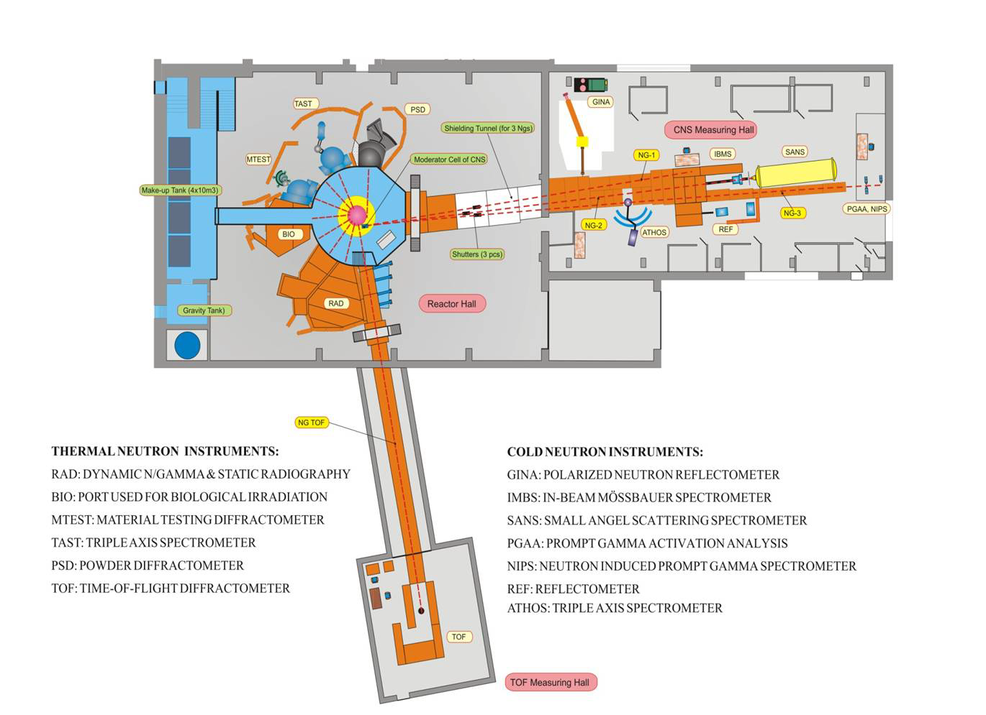
Licence prolonged till 2030
Neat relocation

Slide 3
Reasons behind reconstruction
The existing system was built 25 years ago
Today we have
Better cold sources
Better manufacturing and installation of the guides
Better guide designs

Slide 4
BrightnESS studies
X2 gain in brilliance is achievable for small moderator

Slide 5
Brilliance and flux trade-off
High-brilliance cold moderators:
Gain in flux on sample for brilliance-hungry instruments requiring highly collimated beams and small samples (reflectometer, SANS, …)
Not so advantageous for flux-hungry instruments with relaxed Q-resolution and larger samples (NSE, fundamental physics,…)
Moderators
Desirable
divergence
Brightness
Neutron guide
3cm
10cm
Under-illumination for
flux-hungry instruments
One needs to determine the moderator size providing highest brilliance, full sample illumination and minimal background (over-illumination) at the sample

Slide 6
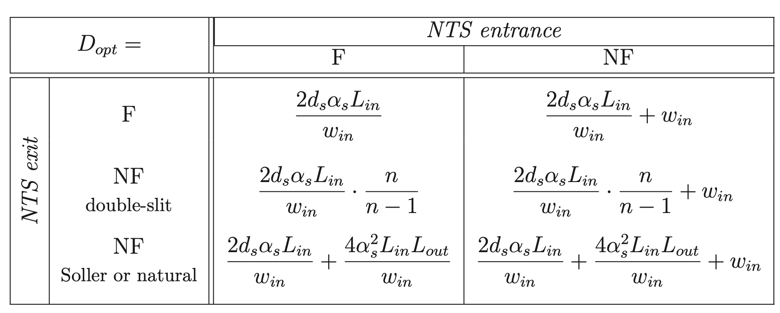
Curves of optimal and full sample illumination
If 3 conditions are fulfilled simultaneously:
Guide natural divergence equals the instrument resolution
Guide exit provides perfect sample illumination
Moderator provides just enough neutrons
+ we assume ideal transport V_{in}=V_{out} (Liouville theorem)
=> we can calculate D_{opt}
Realistic curves
Hypothetical curves
in
COFSI is defined by only 4 parameters
(sample size, resolution, distances)
Konik, P., & Ioffe, A. (2023). A new method to find out the optimal neutron moderator size based on neutron scattering instrument parameters. NIM:A, 1056, 168643.

Slide 7
NEAT requires at least 50x80 mm2 moderator
Such a large moderator prevents from huge gains

Slide 8
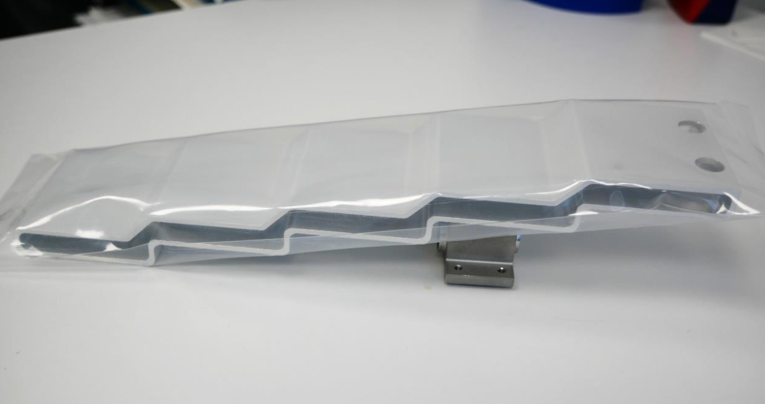
Staircase moderator assembly
Prototype produced by J. Bessler’s team in FZJ
Ioffe, A., Konik, P., & Batkov, K. (2023). High-brightness and high-flux cold neutron source utilizing high-aspect ratio rectangular para-hydrogen moderators. arXiv preprint arXiv:2311.15389.

Slide 9
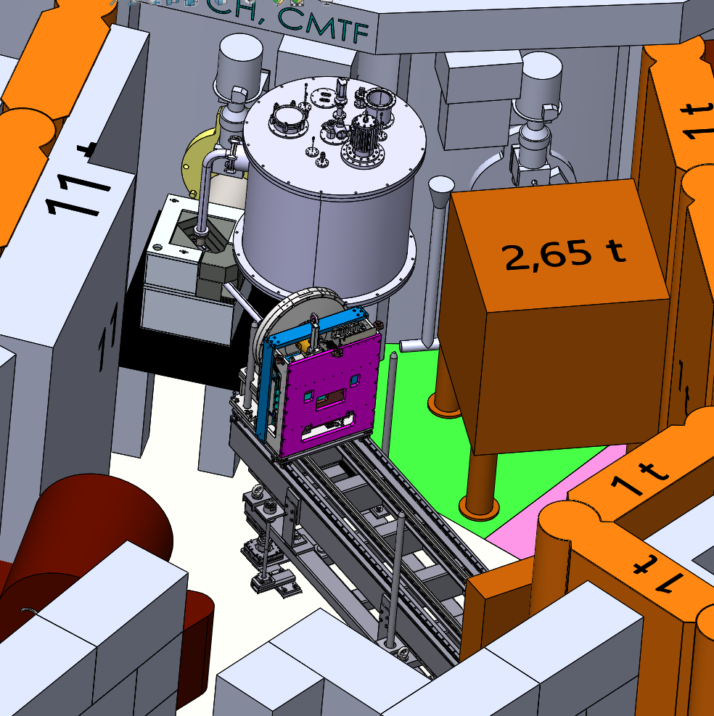
CMTF at BRR
1
4
The Cold Moderator Test Facility
channel #4 (1)
the beam take-off collimator (2),
out-of-pile neutron reflector (3),
cold moderator cryostat (4),
cold neutron beam optical guide (5)
the pin-hole camera device (6) for TOF spectral measurements.
2
3
5
6

Slide 10
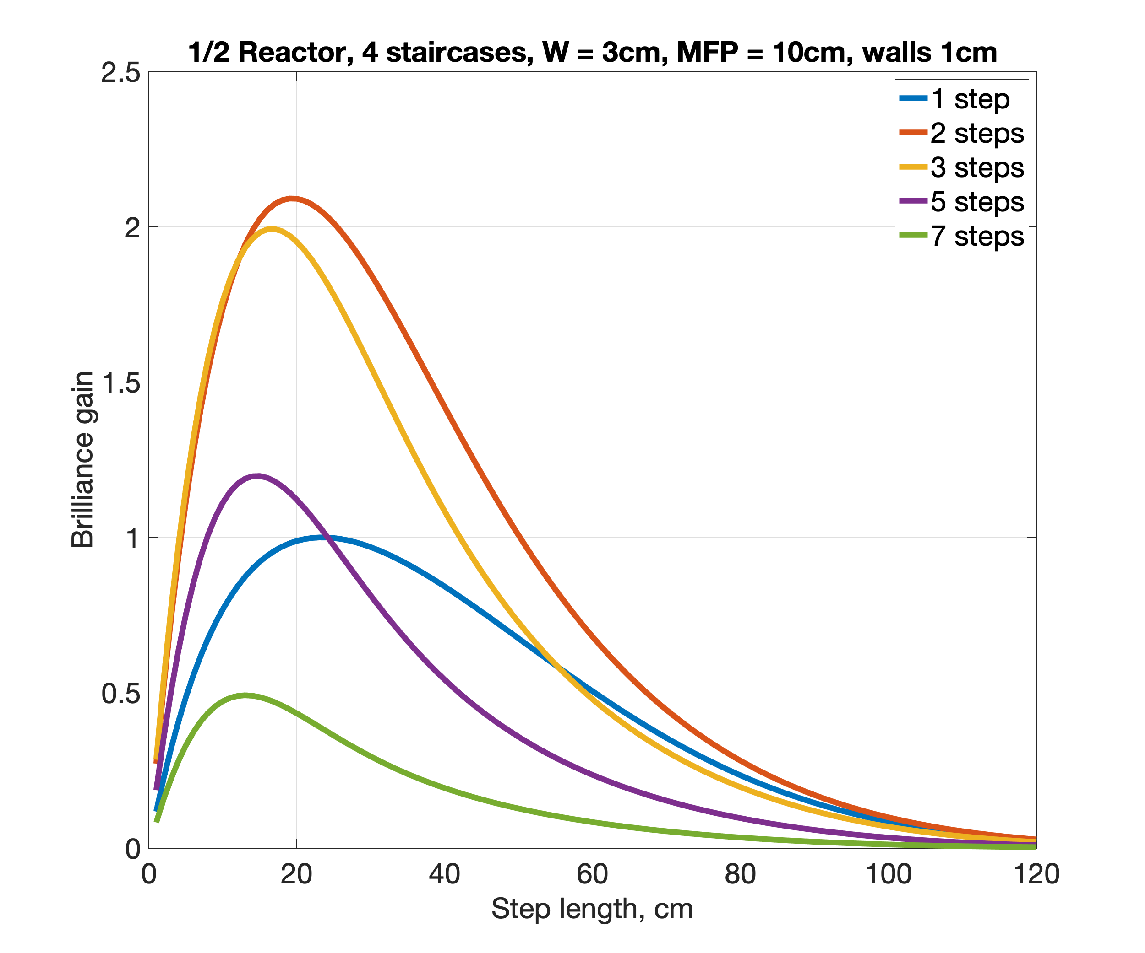
Preliminary gain estimations
MCNP simulations should start this week
In collaboration with K.Batkov

Slide 11
Conclusion
Significant gains can be expected:
x1.5 from pH2
x2 from staircase
at least x2 from realignment and better mirrors
additional gains for reflectometers
reduced background
Future steps:
Choose the moderator geometry
Fix in-pile design and guide hall plan
Optimize individual branches

