Slide 1
Update from MLZ
LENS/ELENA neutron moderator workshop
Andreas Frei

Slide 2
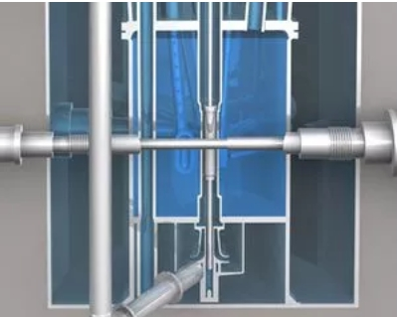
Central channel
19.01.2022: Reportable Incident, report category “N”, INES = 0.
Leakage of central channel JEC10 at the main compensator.
Central channel
Fuel Element
UCN beam tube SR6
D₂O moderator vessel

Slide 3
Status
Fabrication of new channel has started.
But production of new compensators is extremely difficult:
  Old welding procedures were not successful
  Alternatives like EB-welding, friction-welding, 3D-print, etc. would have to be qualified (new nuclear specifications…)
  Manufacturer has to qualified
  Compensators and channel have to be produced
  All components have to be installed
Hopefully new central channel is produced until Q3/Q4-2024.
Old central channel must be removed, new channel has to be installed.
No neutrons in 2024.

Slide 4
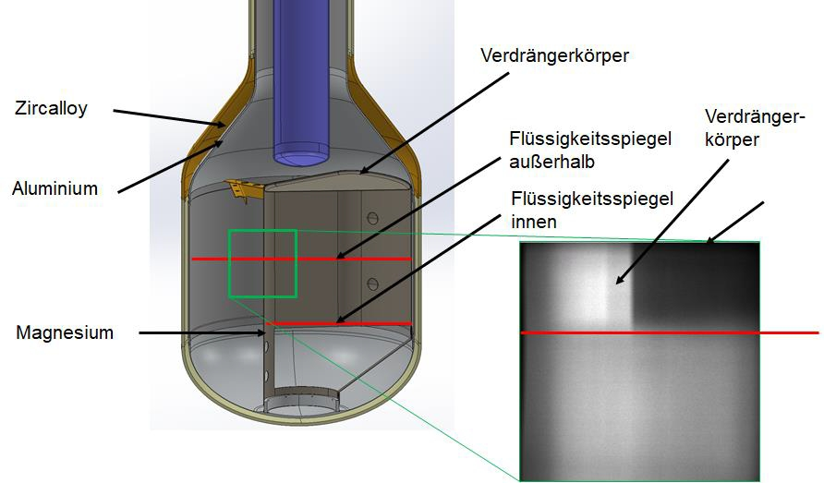
The Cold Source
31.03.2021: Restart of reactor for cycle 48.
During the power increase phase 1MW → 5MW the pressure of the D₂ system of the cold source increased to 190kPa at 2MW reactor power.
According to regulations the reactor was shut down immediately (“RESA”).
A Cd plate was fallen down to at least 6cm below the middle line of the cold source.
New cold source is currently produced, optimistic target time is Q3/2027.
Afterwards approx. 6 months for installation and commissioning.

Slide 5
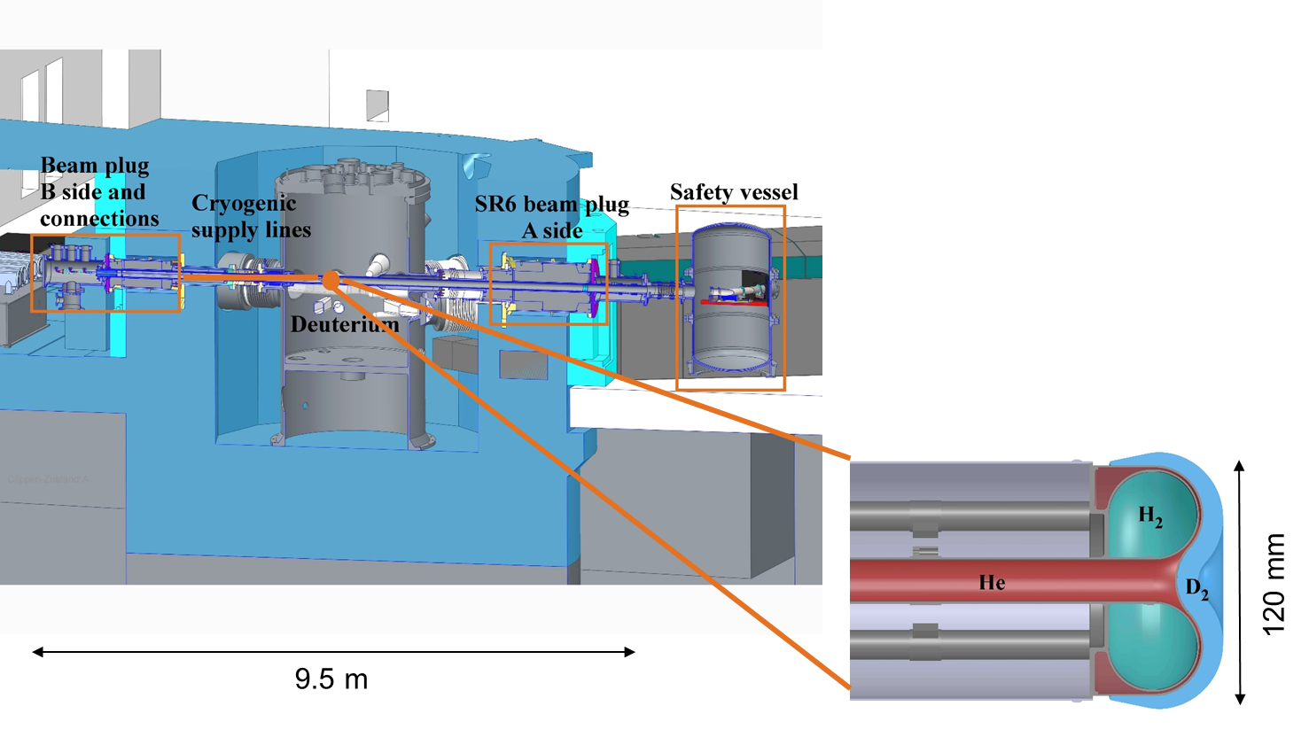
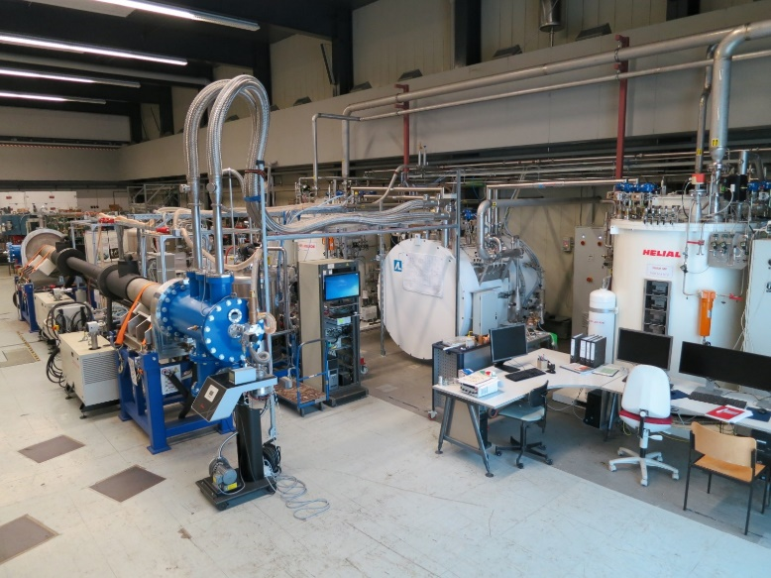
How to get UCN at FRM II
Licensing procedure §7 AtG
Surveillance procedure§19 AtG
Essential changes of FRM II
Non-Essential changes of FRM II
Operation of UCN with D₂ and H₂
assembly and installation of all components
Non-nuclear test mandatory
Technical Data
Converter temperature min. | 5 K
Pre-moderator volume (sH₂) max. | 250 cm³
Converter volume (sD₂) max. | 250 cm³
Cooling power @ 5K max. | 1 kW
UCN flux density @ SR6a exit (100 neV – 230 neV) | 6·10⁵ s⁻¹cm⁻²
UCN beam aperture (circular guide) | 100 cm²
UCN flux @ SR6a exit (100 neV – 230 neV) | 6·10⁷ s⁻¹

Slide 6
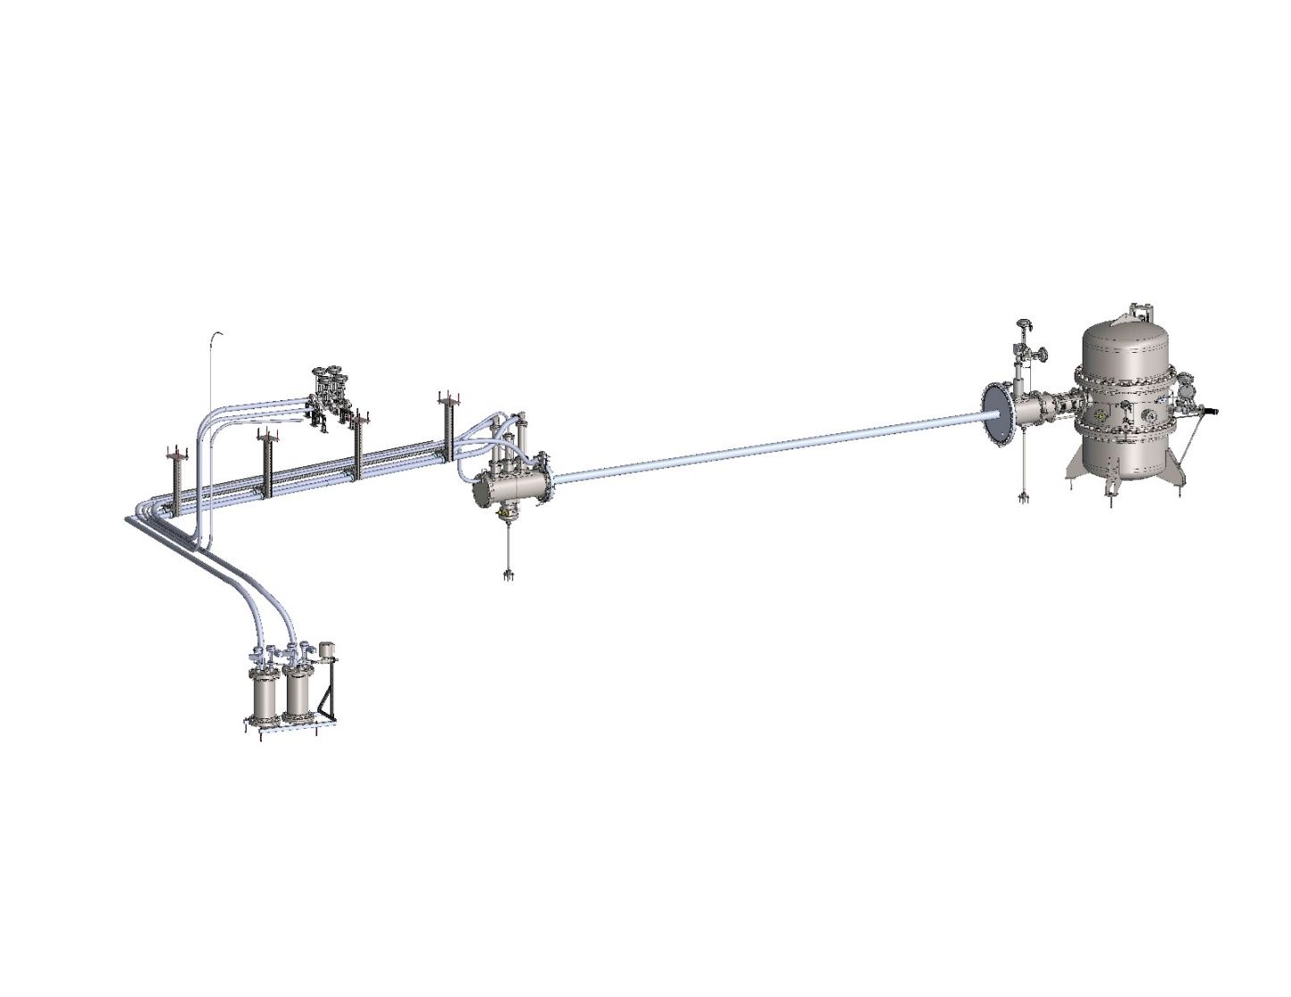
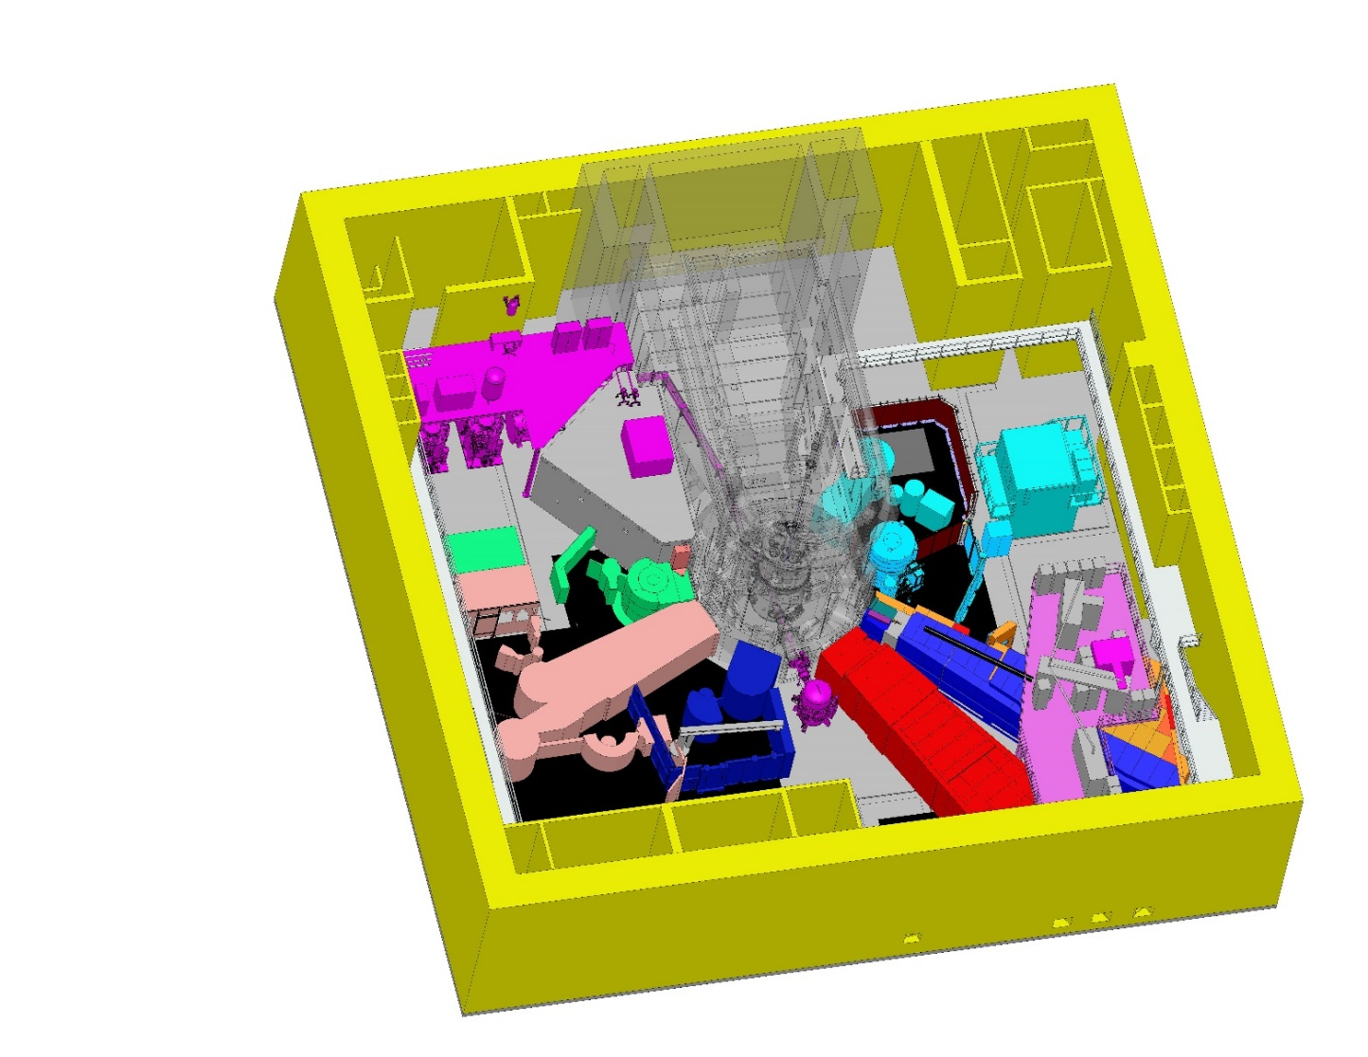
UCN source – Inpile parts
FRM II experiment hall
Inpile parts, end caps, security vessel, cryogenic connections

Slide 7
Current Status
Licensing procedure
Surveillance procedure
Done:
  Security report
  System description
  Explanation report
  Proof of concept report
  Environment review (not necessary)
  New nuclear specifications
Covered by FRM II & test phase:
  Security measures
  Expert knowledge program
  Damage compensation
To Do:
  Radioactive waste report
  Testing manual
Nr. of modification amendments: ~ 30
Completely finished: 11
  Nuclear specifications, preparation of necessary infrastructure
Currently worked on: 12
  Manufacturing of all parts, installation of infrastructure
  Target: Finished until end of 2025
To Do, not started: 7
  Installation, integration and commissioning
  Starting 2026

Slide 8
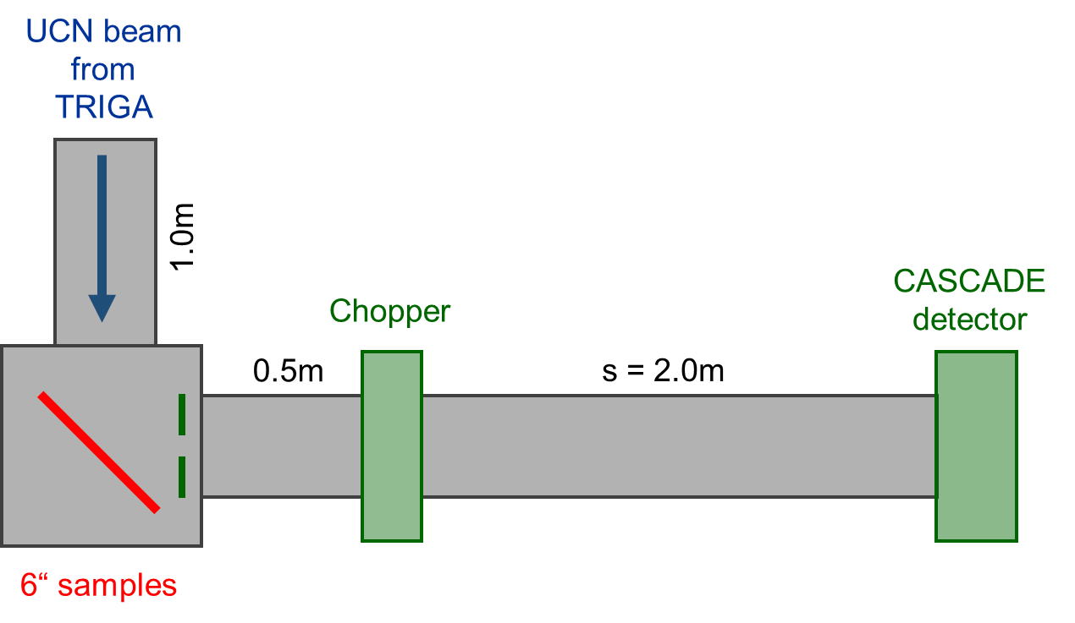



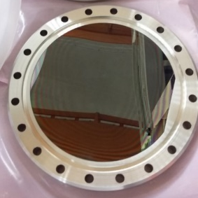

UNCD as UCN reflector
Time-of-flight (TOF) set-up with
90º reflection geometry
UNCD characteristics:
  10 nm large diamond grains embedded in C:H matrix
  Total H concentration down to 1%
  Density up to 3.3 g/cm³
  Fermi potential up to 290 neV
  Radiation hardness
  Low nuclear activation
200nm
UNCD-coated Si wafer inserted in CF150 flange
0nm
Surface is fine grained and smooth: RMS = 21 nm
Main influence on roughness: surface corrugation with distances between the “maxima” around 500-750 nm

Slide 9
Summary
No neutrons at FRM II in 2024.
Probably no cold neutrons at FRM II until 2028.
Ways to speed up production of new cold source are invesitgated.
FRM II UCN source:
  All necessary nuclear specifications have been approved.
  Start production of all inpile parts in 2024.
  All inpile parts at site until end of 2025.
  Afterwards excange of SR6b beam plug, installation of inpile parts, and nuclear commissioning.

