Slide 2
Scientific Information Management Systems
SIMS
PRESENTED BY Fredrik Bolmsten

Slide 3
Group
Staff & Scope
Fredrik Bolmsten – Group lead
Max Novelli - Data curation scientist
Jay Quan - Software engineer
Yoganandan Pandiyan - Software engineer
Janos Babik – Software engineer
Martin Trajanovski - Service agreement
User Office:
Proposal system
Scheduling software
Statistics
Data Curation:
Metadata catalogue
Electronic logbook
Scientific data management
Miscellaneous:
E-learning platform
Publication system
AI-Platforms
Additional responsibility as LM of ECDC DK group

Slide 4
ECDC
Line Management
NSS/Lund site
ECDC
Line manager - Matt Clarke(Interim)
Matt Clarke
Jonas Petersson
Anders Pettersson – Work Package Manager
Torsten Bögershausen
Stephanos Athanasopoulos (replacement)
DMSC/Lyngby site
DMSC line manager Fredrik Bolmsten
Morten Jagd Christensen
Afonso Mukai
George ONeill
Tibor Bukovics
Daniel Cacabelos (replacement)
Scope remains in NSS – personnel in DMSC matrixed 100% to ECDC
Long term – find a Technical and Work package Leader (in Lund, replace Tobias)
Short term – Anders Petersson assigned as Work Package Manager

Slide 5
The User Journey
Users notify ESS of team
User training
Experiment safety review
Travel and accommodation
Ship samples
Physical Access
Dosimetry
Feedback
Experiment report
Data curation
Expenses review
Publications
KPIs
Submit proposals
Technical review
Excellence review
Result notification
Registration
Proposal
Scheduling
Planning
Performing & Analysing
Wrap-up & Harvesting
Register
Personal Data
Digital Access
Experiments
Sample environments
Local contacts
User lab facilities
Experiment notification
Data directories in place
Automatic data processing
Manual data processing
Permissions for files
Done
To be done for HC
Not started

Slide 6
Status & Progress
User Office
Added support for multiple instruments/labs
Maturing software, STFC to run complete review flow
ELI to sign MoU and start contributing in the coming months
MAX IV pilot project completed with postive results
Data Curation/SciCat
New backend launched and being rolled out at sites
Engaging with Instrument Scientist for tranche 1 instruments
Leveraging library resources at ESS additional data curation effort
Significant effort has been spent on the relocation to DTU
Handover from Tobias
Bottleneck continues to be readiness of other stakeholders
Limited progress with Safety, ESH, RP, Training…

Slide 7
A User Journey Project
Training – Lars Aprin, Monika Hartl
Remote
On-site
Lab
User Logistics – Jörgen Larsson, Linda Björk
Shipping samples to and from ESS
Travel to and from ESS
Accommodation
Catering and amenities
Account – Ari Benderly, Rikard Krisle
Identification assurance
Life cycle
Deletion/disable
Join/leave flows
GDPR
Site access – Ulrika Agnvik, Linda Björk
Reception
Labs
Cards
Dosimetry
Signage/Maps
Remote access
Agreement with ESS Instrument Scientist
Sample preparation and delivery to ESS
Sample return from ESS
Data curation and provision to remote users
There is a need for a project manager to ensure that all parties are aware of their scope and work in a unified way in order to ensure that a well thought out user experience exists ahead of SOUP.
Ideally this can be commissioned by visiting scientists as we move from hot commissioning to SOUP.
One of the main reasons for this is the lack of research infrastructure experience in many parts of the organization, this leads to faulty assumptions and scope being orphaned.

Slide 8
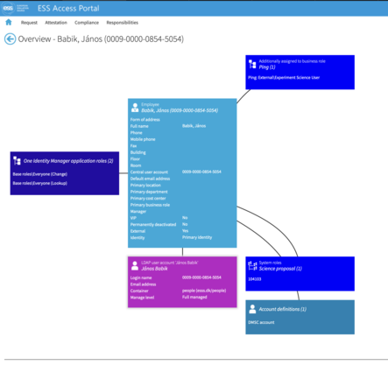
Pressing issues
Security & Identity Assurance
It is unclear to the SIMS group how to meet the security requirements expressed by our chief security officer.
What is acceptabel risk? Who decides? And how can we move forward today?
Do we need to go above standard operating procedure? World leading in everything?
Creation of users in the DMSC ldap

Slide 9
AI@ESS
Jumping on the hype train
One of the most common questions asked has been:
“How are you working with artificial intelligence?”
Important to recognize where AI/ML is applicable and where it is not. Start with small proof of concept projects before larger investment.

Slide 10
Use case
Support licensing at ESS
We have hundreds of policy documents in CHESS. These documents go through a review process and are used for licensing.
In a review process by the Swedish Radiation Agency it was noted that the roles & titles used were not coherent across the documents.
ESS has created an approved list of roles & titles to be used in documents. The task is to programmatically check documents for adherence to the list of approved roles & titles.

Slide 11
Information Extraction with LLM
Extract job roles and job titles from a document
Goal: Help with the CIDL document reviewing process to detect new roles and job titles in documents.
Convert the document into smaller chunks.
In each chunks run the question
“Identify all roles and titles in the given context. Output must be an array of strings!”
Check raw answers
Answers must be unique, and each answer must be contained within the context.
Verification
Recursively check all values using the LLM engine again, asking: ”Is ‘Operator’ a valid role based on the context? Yes or No.”
Post-validation (CIDL)
Use a whitelist/blacklist to decide if the value is an enabled role/title.

Slide 12
Image title

Slide 13
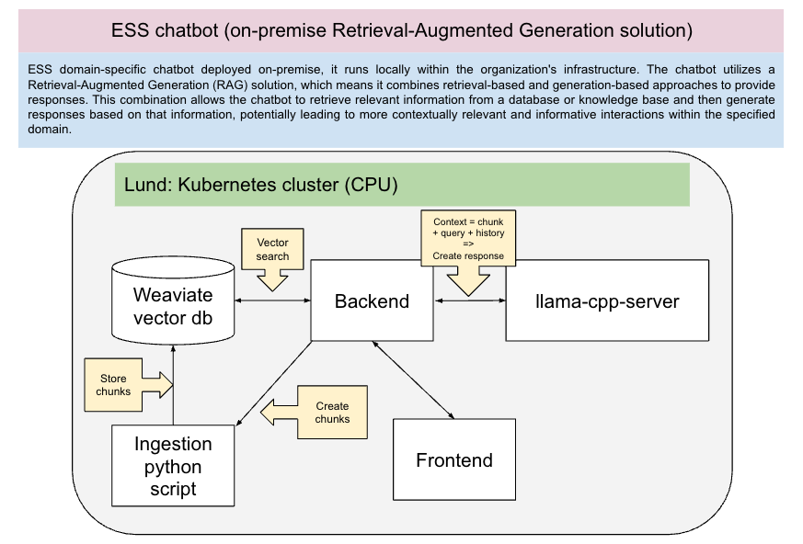
AI Projects

Slide 14
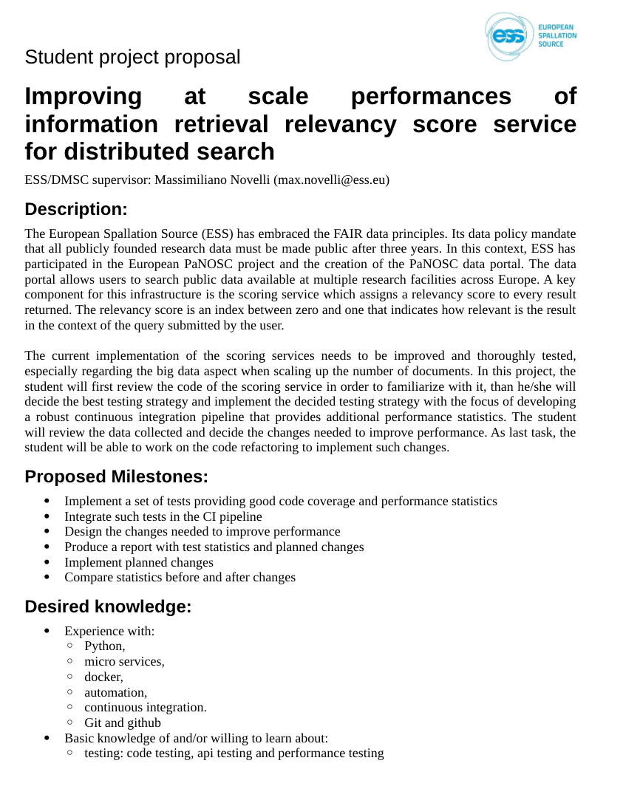
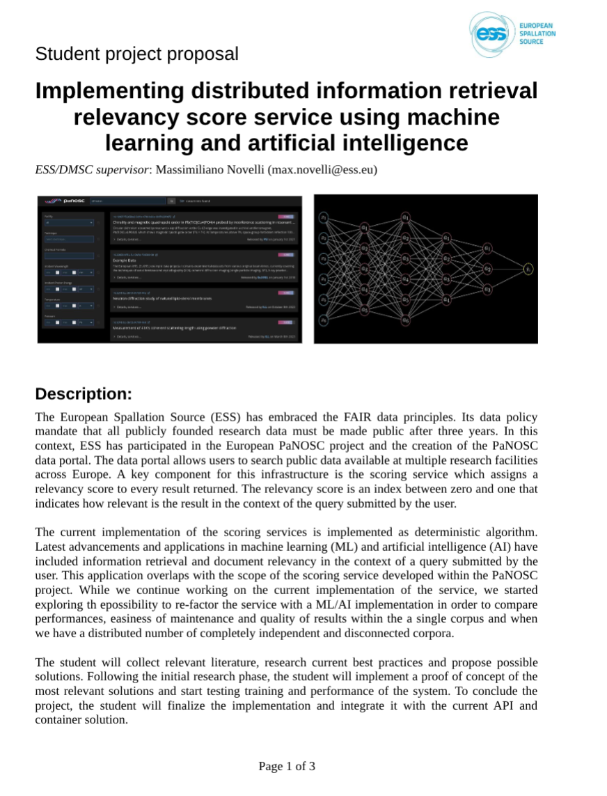
DTU Opportunities

Slide 15
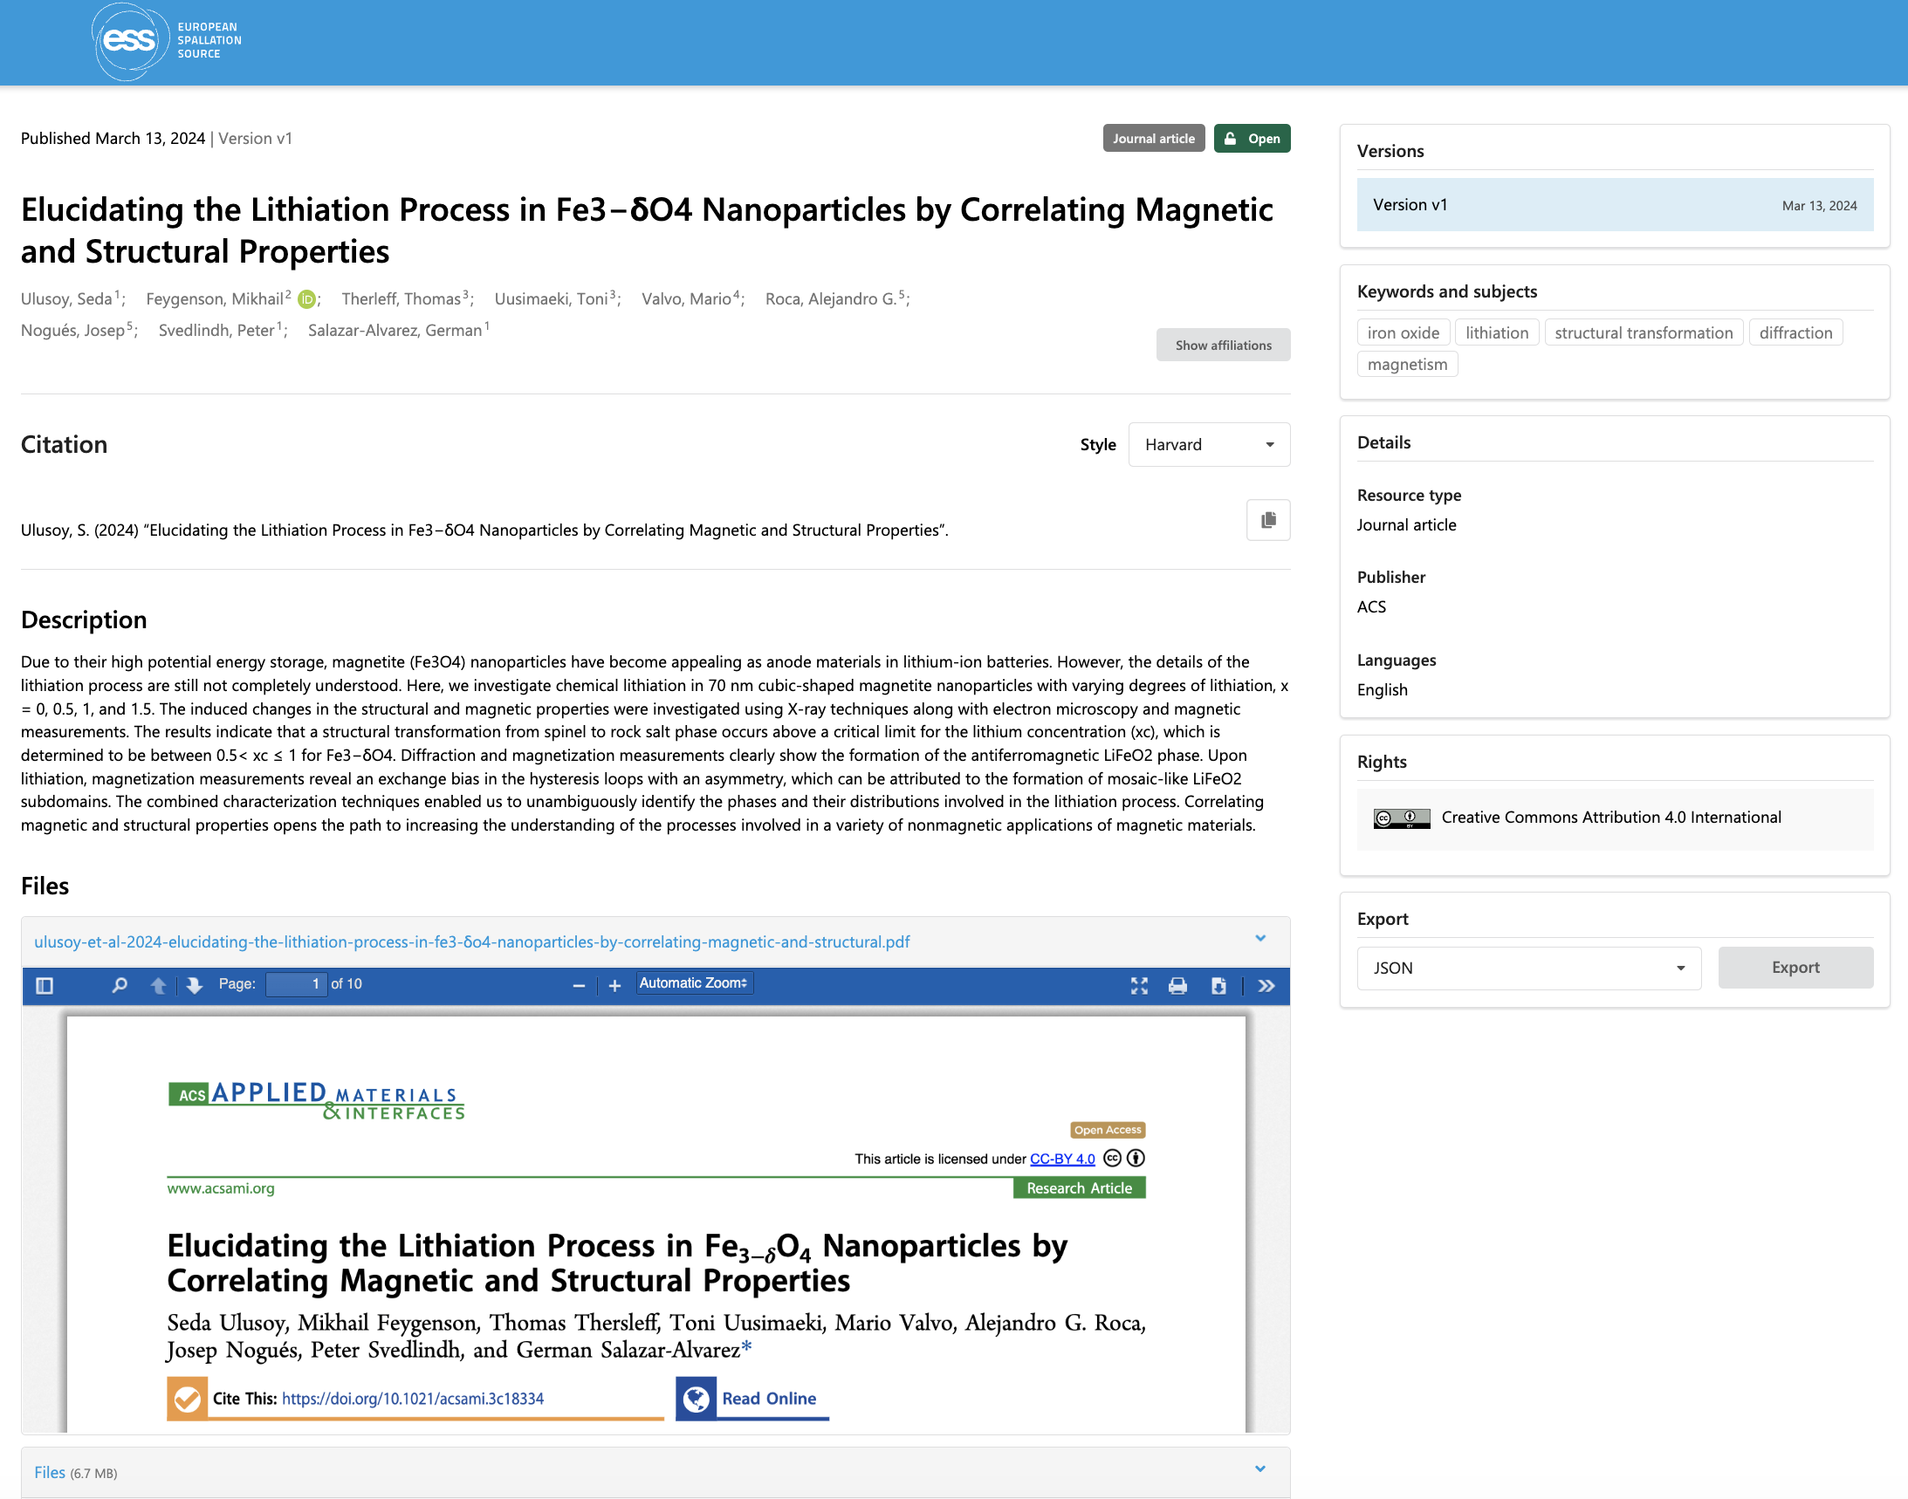
Publication
ESS Publications Portal, a public access knowledge hub containing all scientific output from ESS-affiliated researchers
Created by leveraging the same framework use by Zenodo, Invenio RDM. Minimal changes done to core codebase.
https://publications.ess.eu/

Slide 16
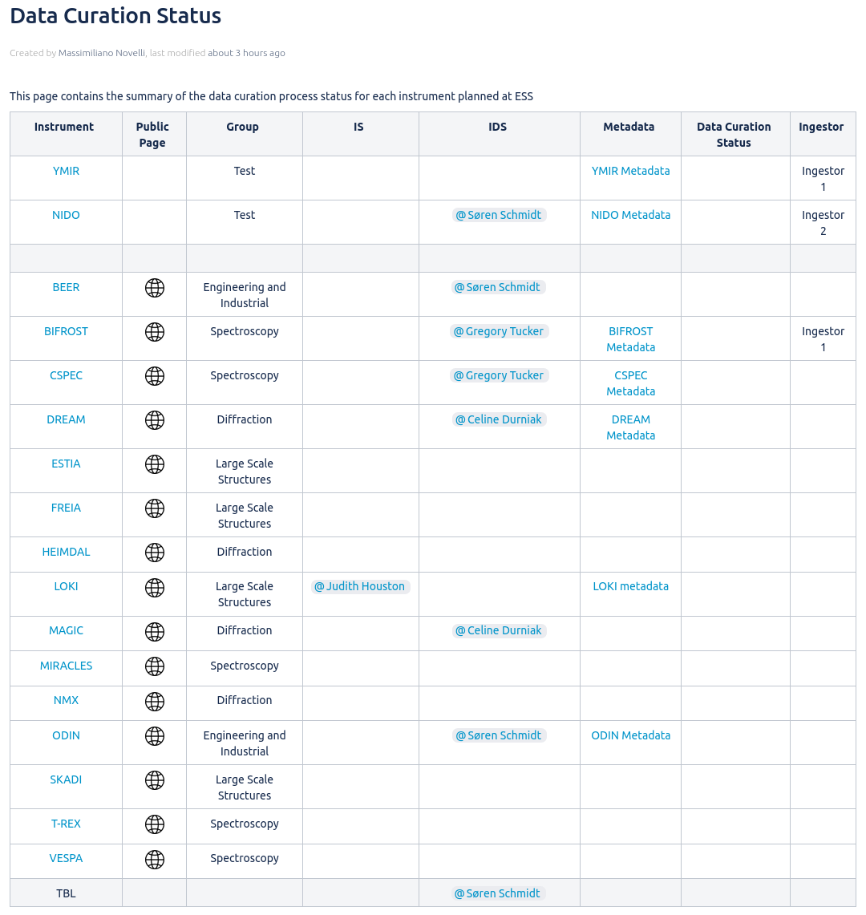
Data Curation
On-Going activities:
Engaging with Instrument Scientist and Instrument Data Scientist of tranche-1 instruments
Cross groups collaboration to define and manage metadata expectation
Metadata configuration: format, management and sources
Proposal folders creation: naming and permissions
Dataset ingestor code review
Future milestones:
Document individual instrument metadata
Instrument metadata acceptance from stakeholder
Finalize metadata configuration implementation
Dataset ingestor code refactoring

Slide 17
Projected labour resources
SSO - 2027
1 Group leader
Manage and coordinate work
4 Software developers (+1 from current)
Upkeep of the metadata catalogue and the entire user office stack. Support for user authorization and new developments to cater the science directorate.
2 Data Curation Officers (+1 from current)
The data curation officers primary task will be to work closely with the instrument scientist, the controls group and scientific users in order to capture as complete set of metadata as possible. In addition it is foreseen to be a high level of integration with the data reduction group to enable automatic processing and data pipelines.
From SSO Report:
Are the resources (labor and non-labor) that have been identified for the defined scope reasonably estimated?
The SIMS team at 7 FTEs seems significantly understaffed for its full range of activities – not just the user journey but also defining and implementing metadata ontologies for FAIR data. The benchmarking for this work tried to compensate for the very early career team at ISIS however the panel think that this was too discounted.
17

Slide 18
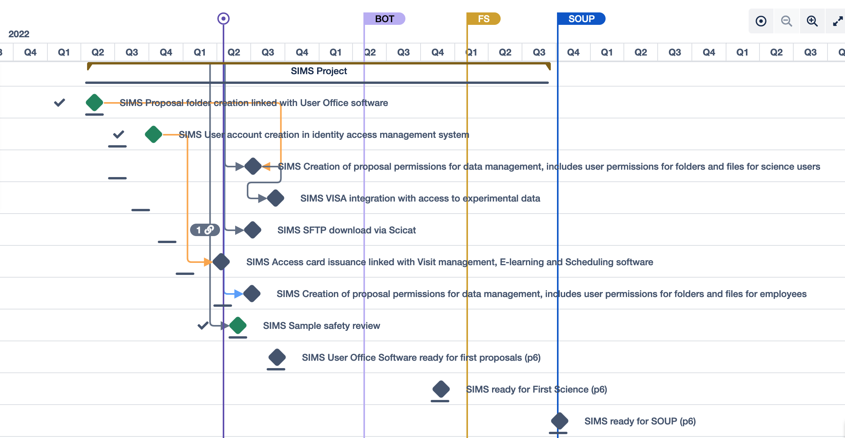
Project plan

Slide 19
STAP Recommendations
The STAP recommends that the SWAP team tries to avoid taking on more tasks that are outside their scope but recognises that this is not always easy to do in practice.
One example is that the team run a Kubernetes cluster, which is a standard computing capability that should be provided as a service for the SWAP team to use and not administer themselves.

Slide 20
SWOT
Group is overall happy and working well together.
Large scope with small team means that single points of failure will continue being a issue
Strengths
Weaknesses
Loss of connection with main site
Increased collaboration with other facilities for software development.
New grant opportunities consolidate software
Threats
Opportunities

Slide 21
Questions?

