Slide 1
Intro to DMSC STAP
April 17, 2024

Slide 2
Charge
We would like feedback and advice on the following topics:
How are we doing? What can we do better?
Can we mitigate risks by making use of staff at other facilities? (only Greg & Andrew (& Fredrik) have worked at other facilities)
Steady-State-Operations review report
ECDC and data format. An update on latest progress will be given?
Opportunities at new location and how to balance ‘academic research’ with moving ESS forward
What is your thoughts about your role? And how should we do this next time?
Any burning questions from yesterday?

Slide 3
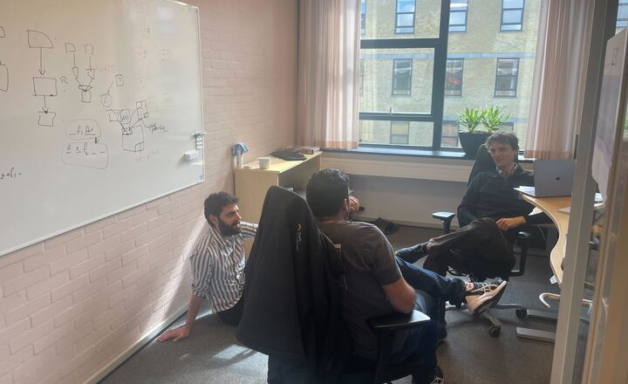
New location and interface to DK stakeholders
Offices well received, the food and commute less so
Have quarterly meetings with ministry and university management
Continue to have university workshops
Local DTU ‘ESS’ persons actively invite us for events
Started to (slightly) push for university affiliations for IDSes
We see an increase in student projects

Slide 4
ECDC
The group has been through a longer phase of uncertainty
Organisation
Matt is Acting Line Manager for ECDC-SE
Fredrik is Line Manager for ECDC-DK
Morten & Matt are technical leads
Anders P is WP leader
Moved ECDC staff who lives in Sweden to Swedish contracts (Matt & Jonas)
  Data format
  Mutual understanding about data format is improving:
  chexus: interface testing
  Opportunity to add File Reader to end-to-end test at YMIR
  Should FileWriter be moved to scipp (where there also is NeXUS experience)? A similar setup is used at ESRF.

Slide 5
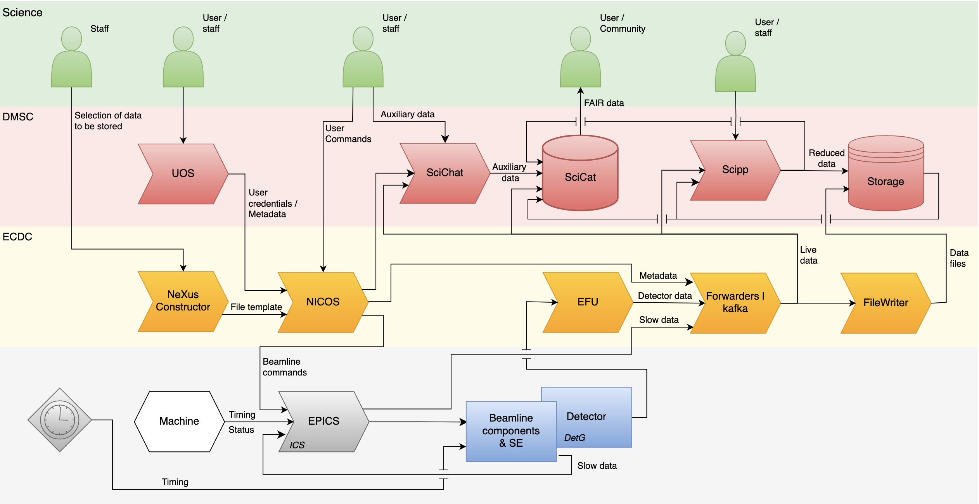
ECDC interfaces

Slide 6
Staffing (presented for SSO review)
Now
SSO 2028
Administration
Admin (4)
Admin (4)
Mng, Admin, and staff support
Data Systems & Technologies
DST (5/8)
DST (12)
Storage and computing infrastructure, Less staff will be needed in 2028
DST
Scientific Information Management Systems
SIMS (5)
SIMS (7)
User office, data catalogue, data curation. Likely too small!
Data Reduction, Analysis, and Modelling
DRAM (14)
DRAM (21)
Data reduction, modelling, and simulations software.
Support to instrument teams with instrument simulations
Instrument Data Scientists
IDS (5/6)
IDS (16)
1 FTE / instrument
Hands-on support for analysis and modelling. Research activities. University collaborations.

Slide 7
Staffing (presented for SSO review)
Now
SSO 2028
Administration
Admin (4)
Admin (4)
Mng, Admin, and staff support
Data Systems & Technologies
DST (5/8)
DST (12)
Storage and computing infrastructure, Less staff will be needed in 2028
DST
Scientific Information Management Systems
SIMS (5)
SIMS (7)
Data Reduction, Analysis, and Modelling
DRAM (14)
DRAM (21)
Scientific roles
Instrument Data Scientists
IDS (5/6)
IDS (16)

Slide 8
Two overlapping scientists groups
Scope
Data reduction
Data analysis
Materials modelling
Instrument simulations
Data science
Requirements, feedback
Data Reduction, Analysis, Modelling Group
Instrument Data Scientists Group
User support
Research collaboration with universities and other research institutes
Software development
From presentation for council
Software solutions

Slide 9
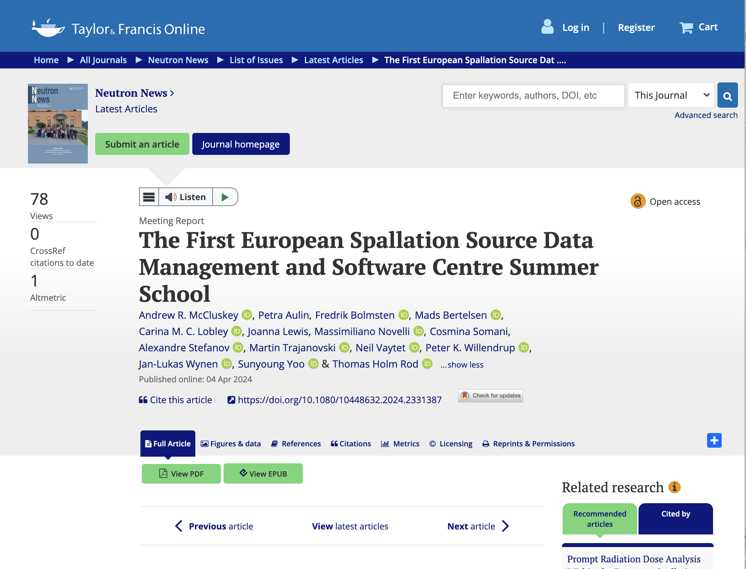
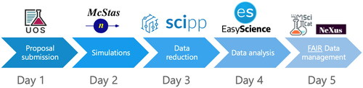
Summer school
Planning a new one for this year
Planning new summer school this year
Lead-organizer: Mads
Strong support from Science Director

