Slide 1
Instrument Data Scientists for
SANS: LOKI & SKADI
Reflectometry: ESTIA & FREIA
PRESENTED BY thomas holm rod

Slide 2
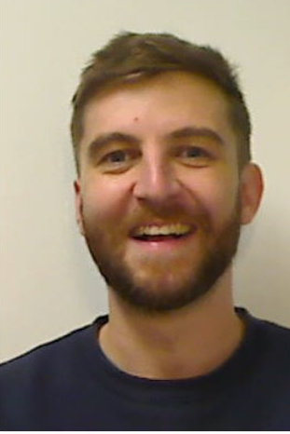
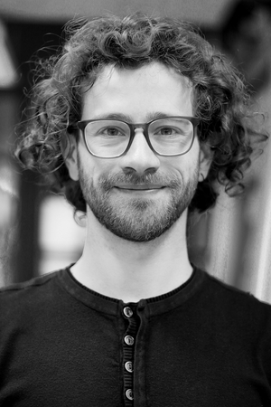
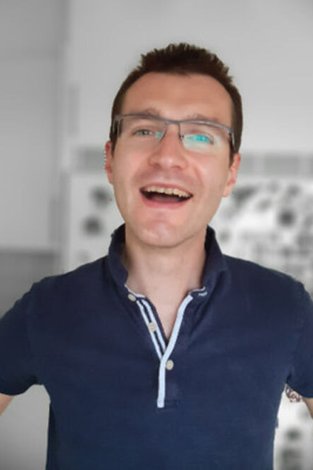
SANS and LOKI instruments
Where are the Instrument Data Scientists?
Nicoló Paracini (ILL)
Tranche 1
LOKI
But AMOR in December
ESTIA
Tranche 2
Last day: August 11, 2023
First day: August 12, 2024
ESTIA
SKADI
FREIA
?
Tranche 3
FREIA
+42 applications
Last day: March 31st, 2024

Slide 3
Progress for SANS & Reflectometry
Currently no Instrument Data Scientist
Successes / achievements
Basic data reduction for SANS ready for H.C.
Demonstrated in December that we can do data reduction
Funding for post doc to work on ShapeSpyer
---
Found replacement for Drew
Data reduction for reflect is well advanced
Failures / setbacks
Wojtek resigned
Test in December showed that there were still issues with data format and beam centering (fixed by now)
---
Loss of Drew resulted in one year without IDS for reflectometry
Opportunities / accelerating measures
Threats / risks
54 candidates applied to replace WP
‘easy’ for new IDS to take over due to good documentation
Good collaboration opportunities with SciLifeLab
---
Has recruited AM part time as consultant
Another consultant works on easyRefl
ESTIA has moved to Tranche 2 making it possible to replan
Loss of Wojtek is likely to cause delays
Recruitment of new IDS for SANS may get really close to BOT
Detector position calibration script still unresolved?
---
ESTIA may go back to Tranche 1

Slide 4
Data pipeline status
Instrument or scattering technique
Not started
In progress
Completed
DAQ
Can setup and control experiment
Can store instrument geometry in NeXUS
Data analysis
Can analyze data at expected rate with correct resolution function (live)
Data archiving
Can store analyzed data to SciCat
Can receive reduced data from SciCat
Data reduction
Basic analysis – SasView 6 is expected soon
Can perform detector calibration required for file writer
Meta data
Can plot reduced data I(q) Can view instrument geometry Can reduce data at expected rate (real time) | TOF resolutions

Slide 5






SANS data processing pipeline
Current status for LOKI and SKADI
Experiment control
Stream events & meta data
Data reduction & visualization
Data analysis
Data management
LOKI | Baseline version Use case at Ymir NURF setup | Full chain tested Detector calibration scripts Meta data | Basic workflow Pipelining Direct beam TOF Resolution | Basic functionality TOF Resolution New release | Basic functionality Automation and integration Meta data
SKADI | Planning with ECDC | Planning with ECDC +DG | Will benefit from LOKI and DREAM (polarization) | Magnetic SANS workflows
Completed
Work in Progress
+ User office software, DST requirement (storage, VISA)

Slide 6
Milestones
From now to Hot Comissioning
M1 = LoKI detector test data reduced and analyzed – Approval by LoKI instrument team – December 15th 2023 - Done!
M2 = TOF resolution treatment available from data analysis and reduction software – approval by SANS instrument teams and SasView and scipp developers - March 2024 - Delayed!
M3 = Coverage for reduction workflows for LoKI. Reduction workflows available on ess documentation webpages - Approval by SANS instrument scientists – March 2024 – Done!
M4 = Delivery of complete data pipeline at the LOKI instrument – June 2024 - Approval by SANS instrument scientists – In progress
M5 = Interface testing for full DMSC software stack for LoKI available on dmsc-nightly - June 2024 – approval by DMSC stakeholders – In progress

Slide 7
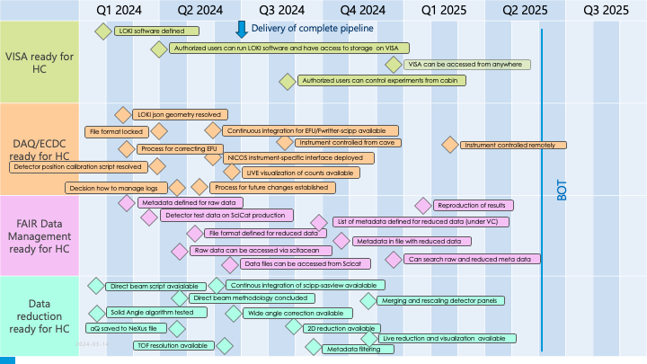
Plans & schedule
Granular milestones

Slide 8
Concluding remarks
Resignment of Drew and Wojtek is a setback for the project, but so far not critical
  … LOKI and ESTIA still well advanced
One year passed from Drew’s last day to Nico’s first day
    … however, pool of candidates for Wojtek’s replacement looks promising
  For the next STAP:
  Full data pipeline (incl. live reduction and analysis) on production infrastructure
  New IDS for SANS
  Like to see some IDS affiliated with universities

