Slide 1

Monolithic mesophase polymer membrane templated from ternary hexagonal lyotropic liquid crystal system
PhD Candidate: Guang WANG
Supervisors: Lingxue Kong (Deakin University)
Chris Garvey (ANSTO)
Maria Forsyth (Deakin University)

Slide 2
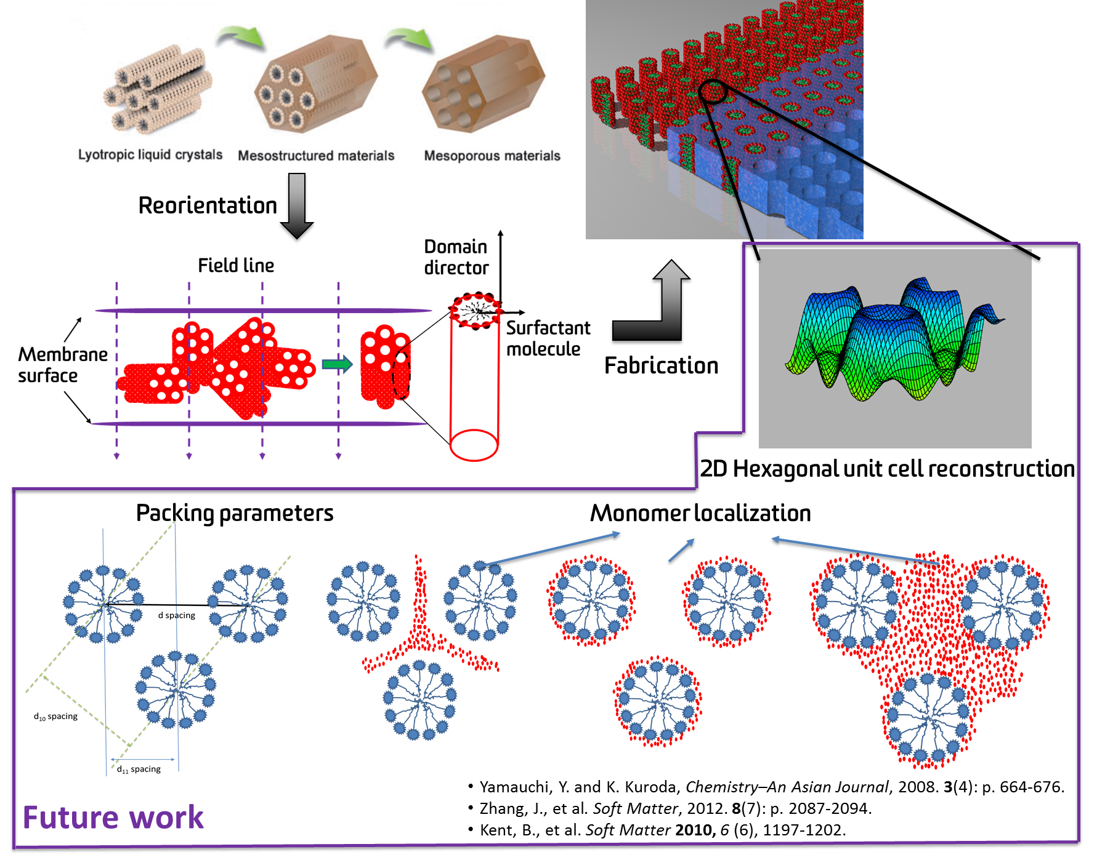
Background of my PhD project

Slide 3
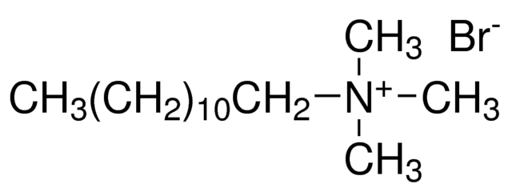
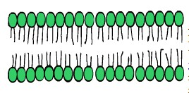
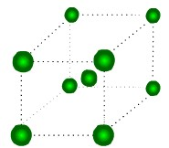
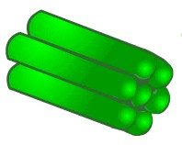
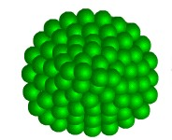
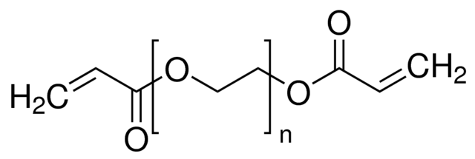
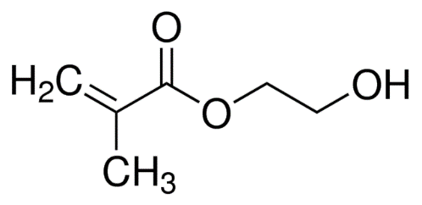
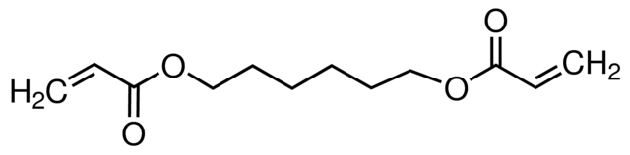
Chemicals
Structure directing agent: Dodecyltrimethylammonium bromide (DTAB)
Water
Ratio of DTAB
Monomers:
http://plc.cwru.edu/tutorial/enhanced/files/llc/phase/phase.htm
Poly(ethylene glycol) diacrylate (PEGDA)
2-Hydroxyethyl methacrylate (HEMA)
1,6-Hexanediol diacrylate (HDDA)

Slide 4



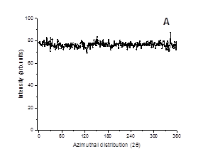
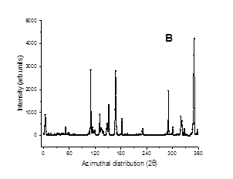
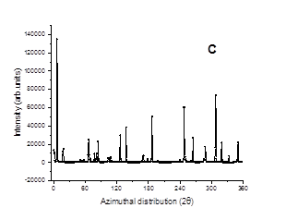
Alignment experiment under electric field
Transition temperature
Equilibration
Heating up
Cooling down
B
A
Room temperature
C
12 h

Slide 5
Hexagonal LLCs without monomer-Complex viscosity and DSC
σ= 10 Pa, ω=10 rad/s
Binary system of DTAB and water stable to temperature

Slide 6
Effect of monomers on hexagonal lyotropic liquid crystal mesophase (LLCs)-Polarized light microscopy (PLM)
30℃
60℃
70℃
80℃
Increasing
80℃
55℃
50℃
30℃
Decreasing
PLM images of ternary system of DTAB, Water and PEGDA

Slide 7


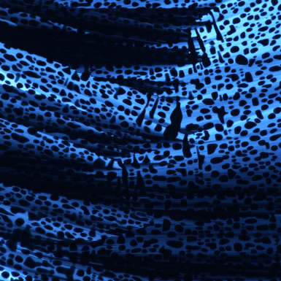


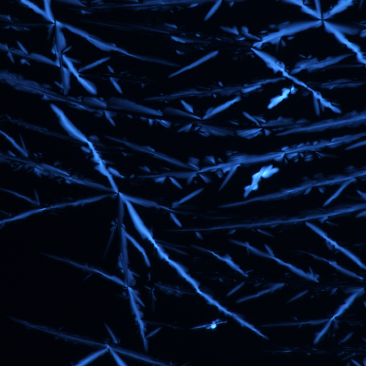
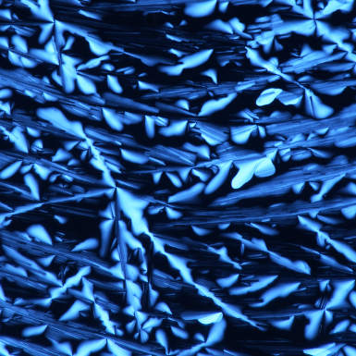
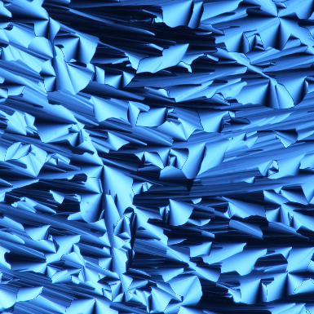
Effect of monomers on hexagonal (LLCs)-PLM
25℃
30℃
35℃
40℃
Increasing
42℃
38℃
35℃
30℃
Decreasing
PLM images of ternary system of DTAB, Water and hydrophilic HEMA

Slide 8
Effect of monomers on hexagonal LLCs-Complex Viscosity
σ= 10 Pa, ω=10 rad/s

Slide 9
Effect of monomers on hexagonal LLCs-DSC

Slide 10

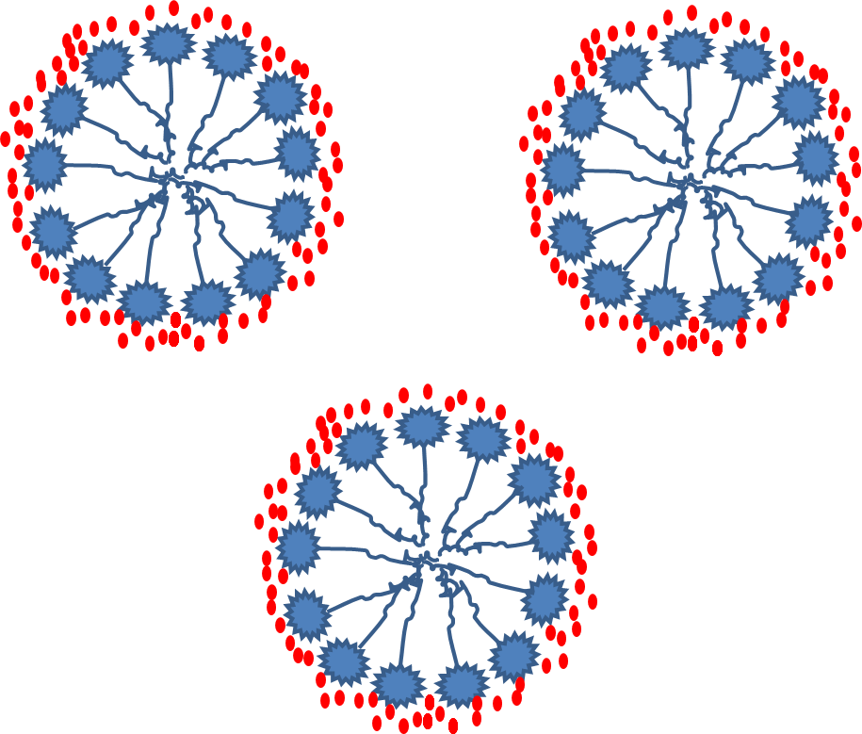

Conclusions
Phase transition temperature (T_{t}) from hexagonal to isotropic micellar phase observed after adding monomers and T_{t} varies depend on the monomer and its ratio
T_{t} Decreased from about 70℃ to about 42 ℃ when PEGDA replaced with HEMA gradually
The transition is reversible
?
Where Monomer sits
Structure retention
Membrane fabrication
Membrane properties

Slide 11
SLD calculation and contrast variation
Contrast variation
D₂O ratio | 0 | 8% | 100%
Tail-deuterated DTAB (D₂₅-DTAB) | 0 | 5.3% | 100%
Fully-deuterated DTAB (D₃₄-DTAB) | 0 | 3.2% | 100%
21% for PEGDA
22% for HEMA

Slide 12
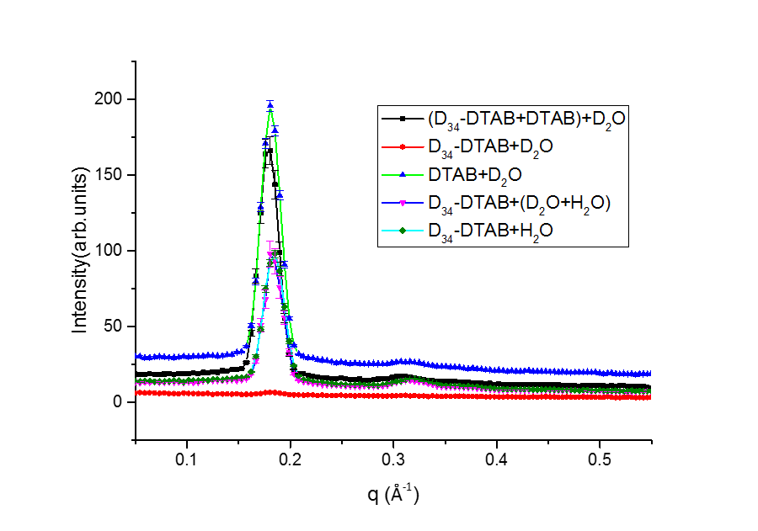
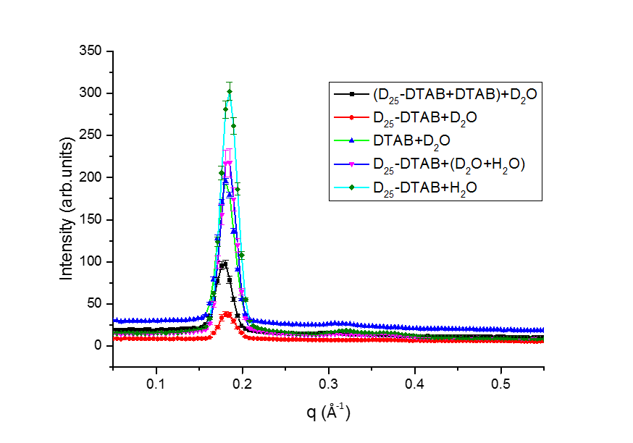
1D SANS pattern after contrast variation

Slide 13
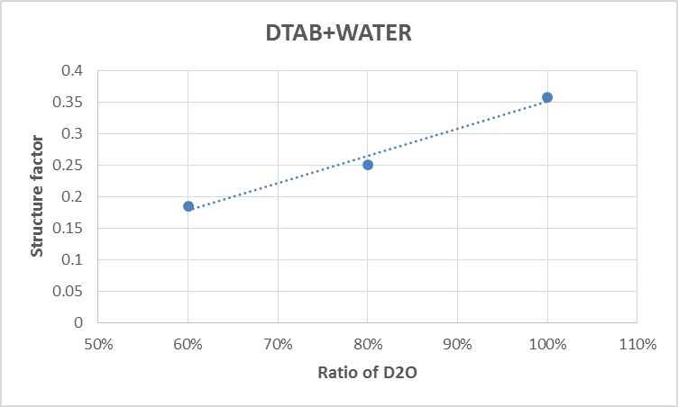
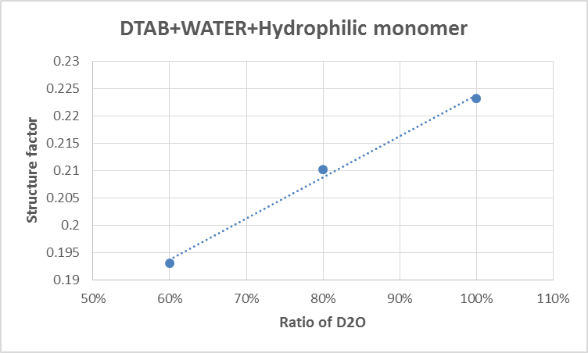
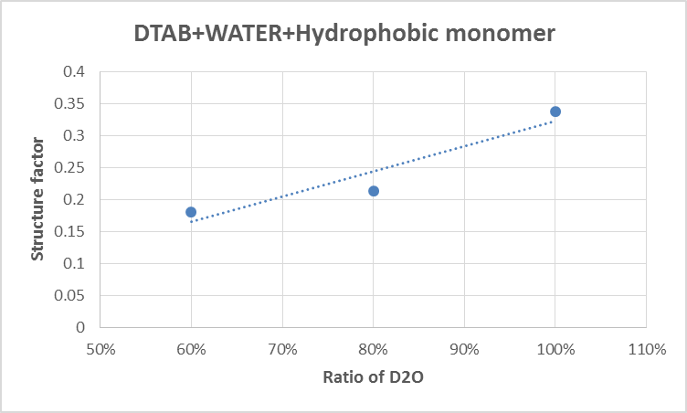
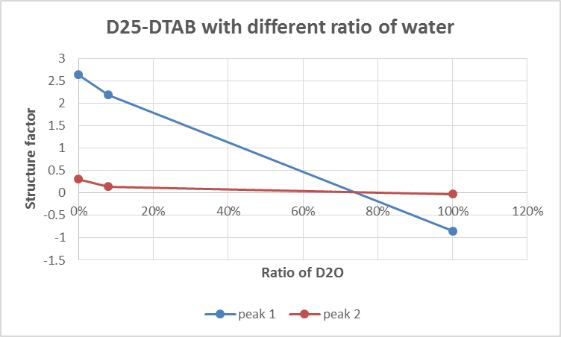
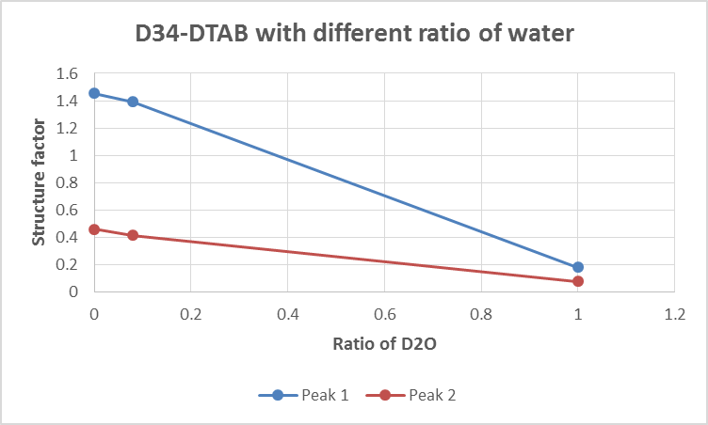
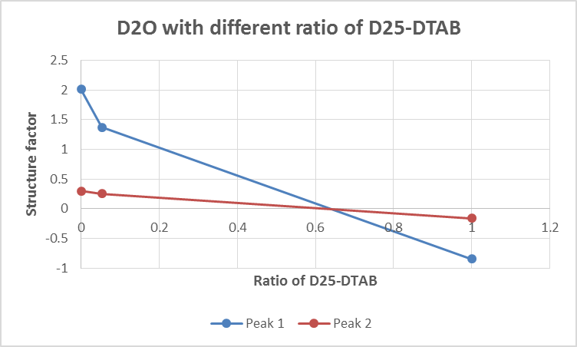
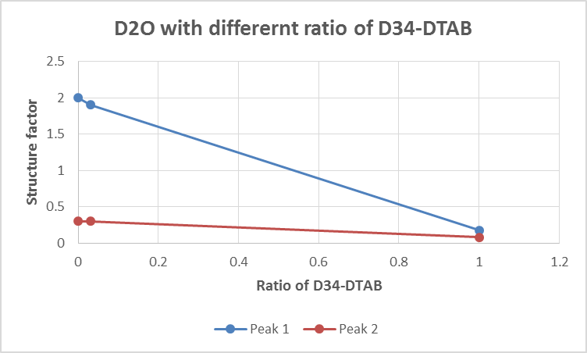
Structure factor calculation vs contrast variation

Slide 14
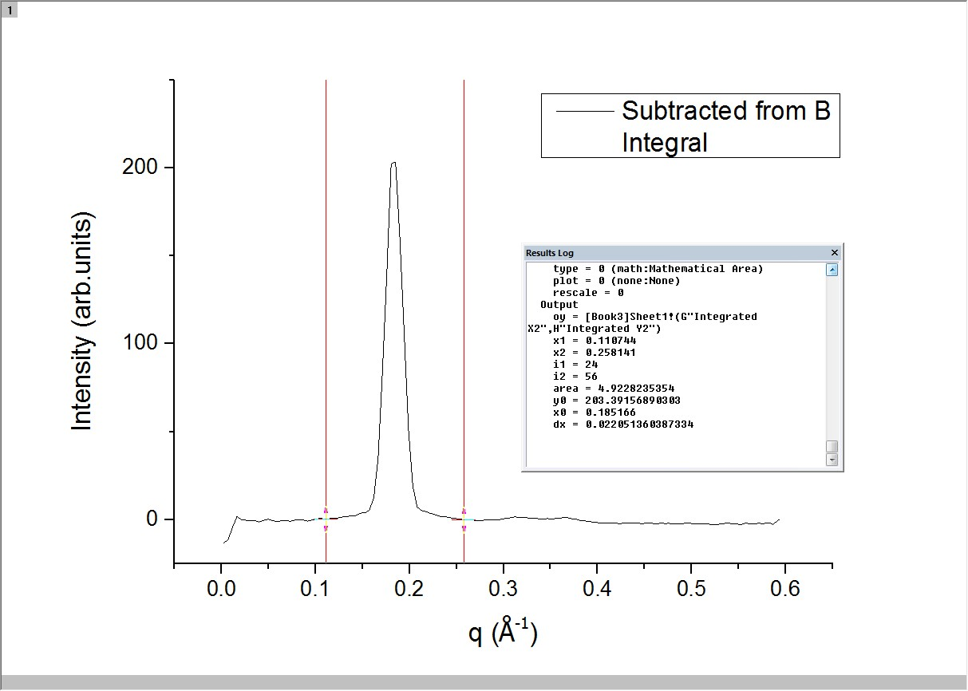
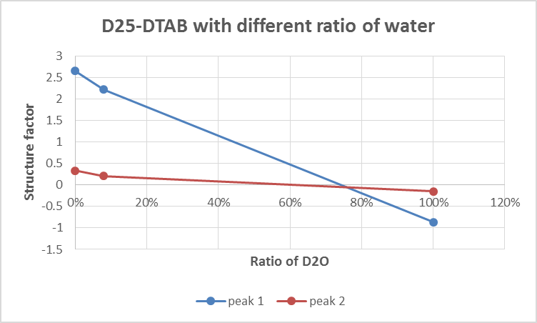
Gauss fitting and integral peaks
D₂₅-DTAB+ (H₂O+D₂O)
Wide Bragg peaks
Inaccurate peak structure
factor calculation
Δλ/λ
10%

Slide 15
Future works:
V1 membrane diffractometer in Germany ( in September )
Longer collimation system to obtain more uniform wavelength
BILBY in Australia (Proposal submitted)
Wavelength resolution within range between 4% and 30%

Slide 16
Hexagonal Phase
Two dimensional Fourier series
where:
Harper, P. E., D. A. Mannock, et al. (2001). "X-ray diffraction structures of some phosphatidylethanolamine lamellar and inverted hexagonal phases." Biophysical Journal 81: 2693-2706.

Slide 17
Thanks for your attention
Suggestions appreciated

