Slide 1
Challenges in mapping structural uniformity & texture of the cubic phases in butterfly and beetle wing scales with synchrotron pin hole ultra small angle (x-ray) scattering
Christopher J Garvey, Bodo D Wilts, Ben Kent, Stephen Mudie, Vasyl Garamus, Pawel Kwasniewski, Adil M Mughal & Gerd Schroeder-Turk

Slide 2
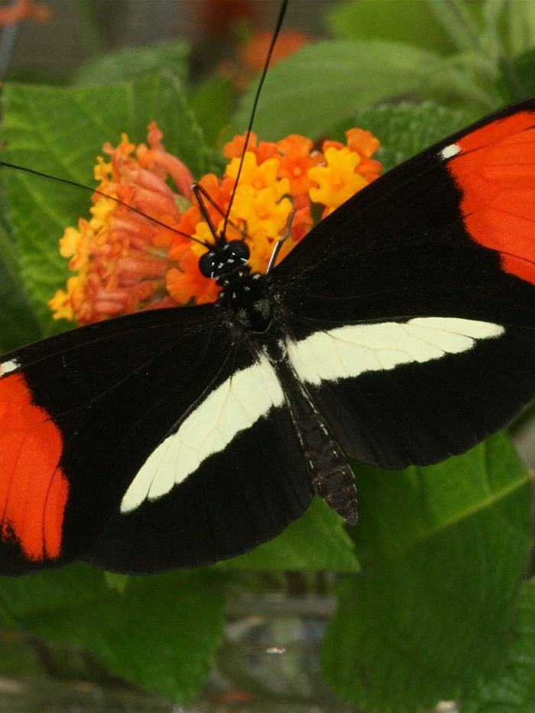
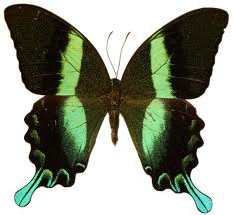
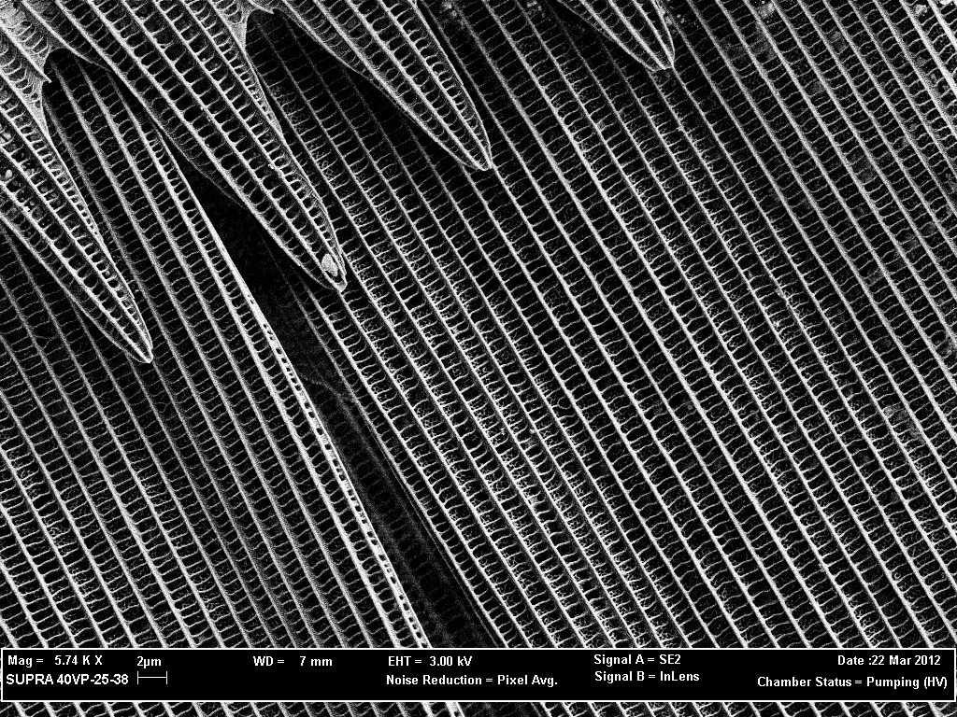
Background
Structural colours made from pigments and photonic crystals
  Social and mating signaling
  Warning to predators
  Nanostructures
Photonic crystals
  Security devices
  Biomimetic technology
Notes:
Butterfly wings consist of pretty colours
Used for various purposes
Structural colours
Complex 3d structures
Highly organised cubic structures on length scales that provide useful optical properties

Slide 3
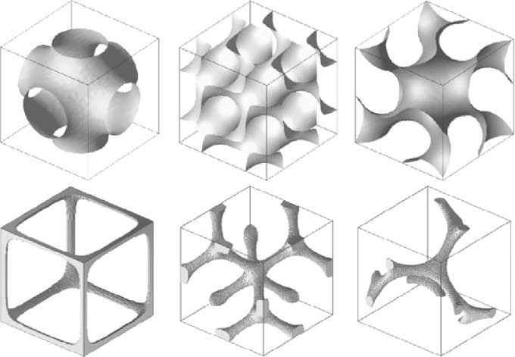
Structure of butterfly scales
Most studies have used SEM/TEM, tilt-series electron tomography
    Simple cubic
    Face centred cubic
    FCC arrangement of
    air spheres in chitin
Difficult to obtain 3D from SEM
and TEM data
Michielsen and Stavenga
  Qualitative pattern matching
K. Michielsen and D. G. Stavenga, Journal of the Royal Society Interface, 2008, 5, 85-94.

Slide 4
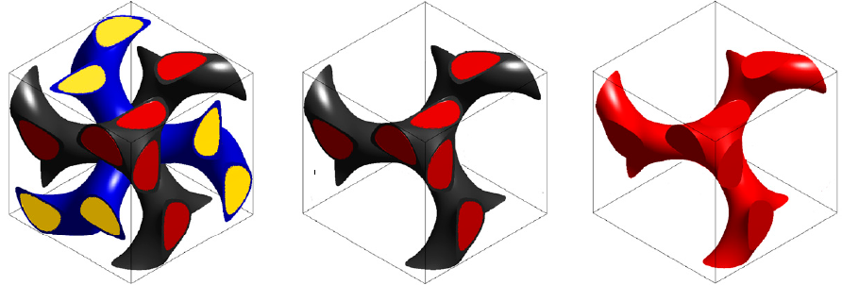
Cubic Structure Formation
Single gyroid, I4₁32
Lipid membranes and smooth endoplasmic reticulum form a double gyroid structure (Ia3d) – template (??)
Chitin is deposited and polymerised in extra-cellular space
V. Saranathan et. al., Proc. Natl. Acad. Sci. U. S. A., 2010, 107, 11676-11681.

Slide 5
Aims
(BIG) Wing as photonic (templated) Crystals.
(specific) Variation of:
  unit cell parameters
  grain size
within the wing of an individual,
between individual of a given species
different species.

Slide 6
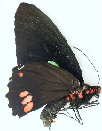


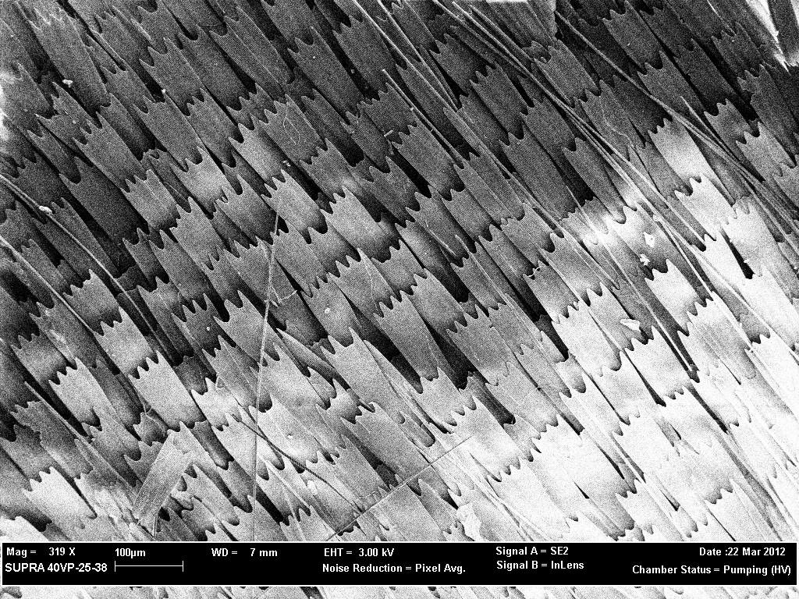
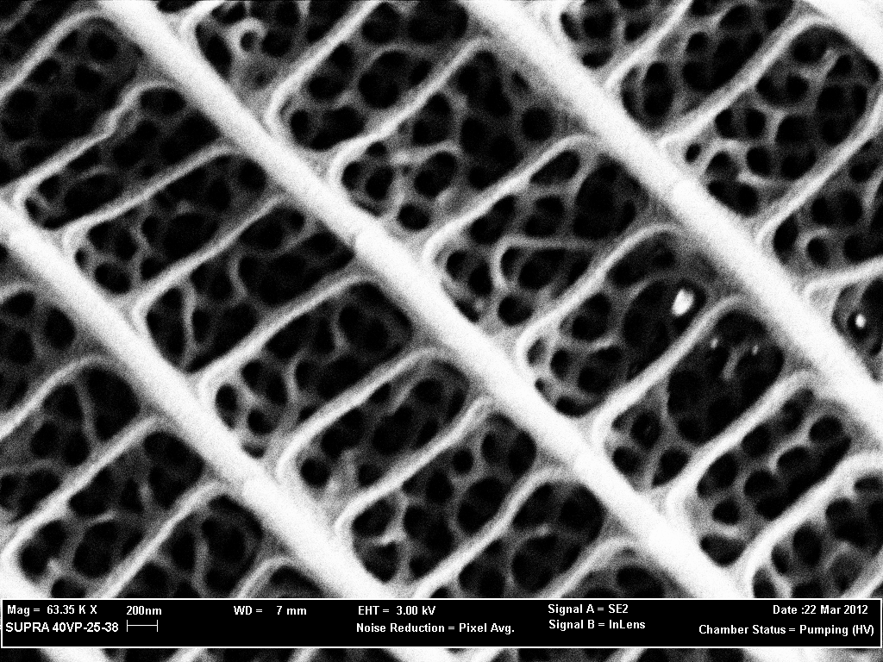
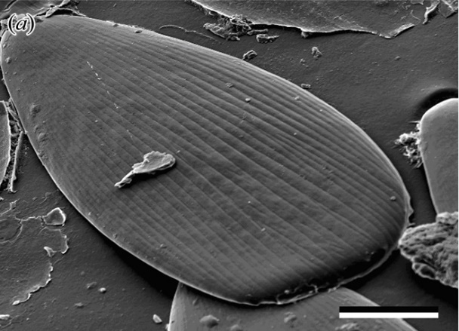
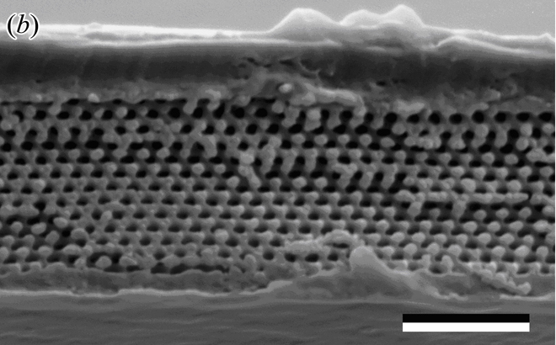
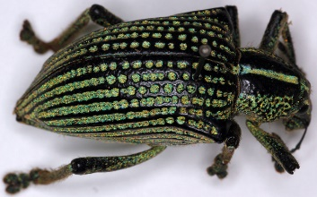
Synchrotron Pin-hole SAXS
Parides Sesostris
Southern Cattleheart
Callophrys Rubi
Green Hairstreak
Callophrys Gryneus
Juniper Hairstreak
Average 3D structure within the volume illuminated with an x-ray beam.
Very large unit cell size ( very small q-values)
Pushing the limits of modern synchrotron SAXS at low q & Δq (pixel size):
100 μm
200 nm

Slide 7
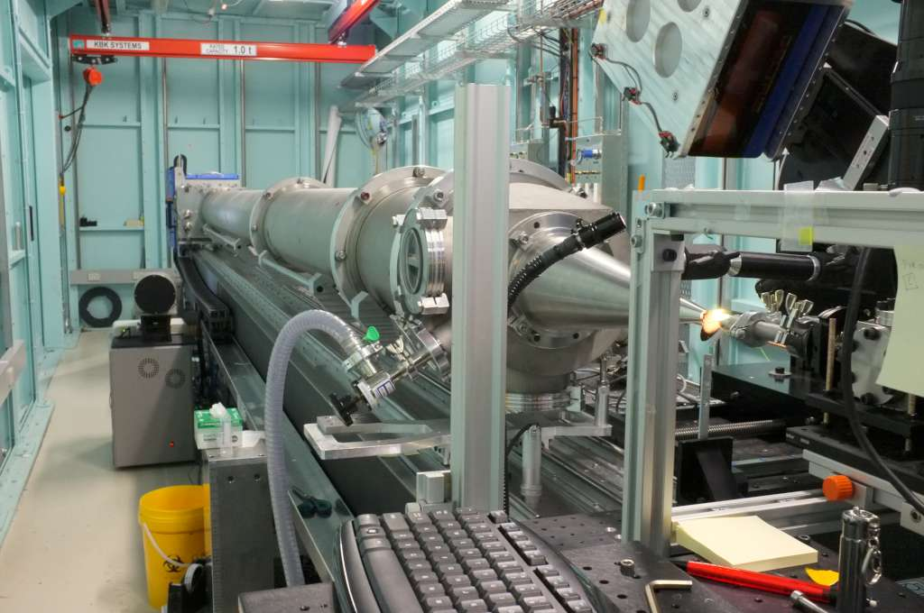
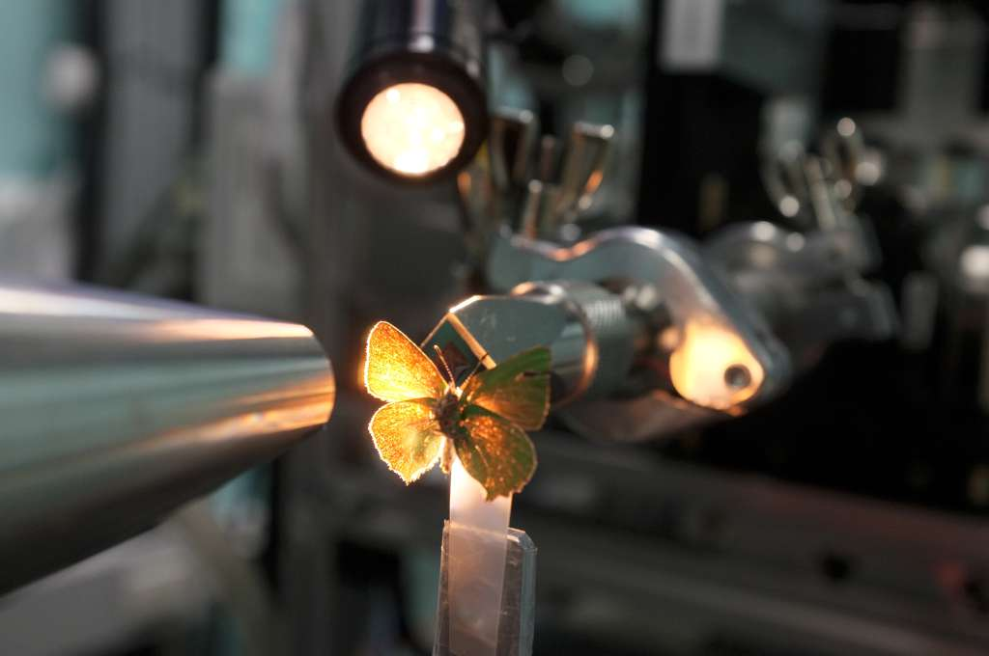
SAXS/WAXS Beamline – Australian Synchrotron
Optimise the Δq-resolution and q_{min}
  7.2 m camera length.
  8.4 keV x-rays (1.476 Å).
  q_{min} = 0.008 Å⁻¹
  spot size of 250 x 100 μm (multiple scales).
  Pixel size on the Pilatus 1M detector is 172 x 172 μm.

Slide 8
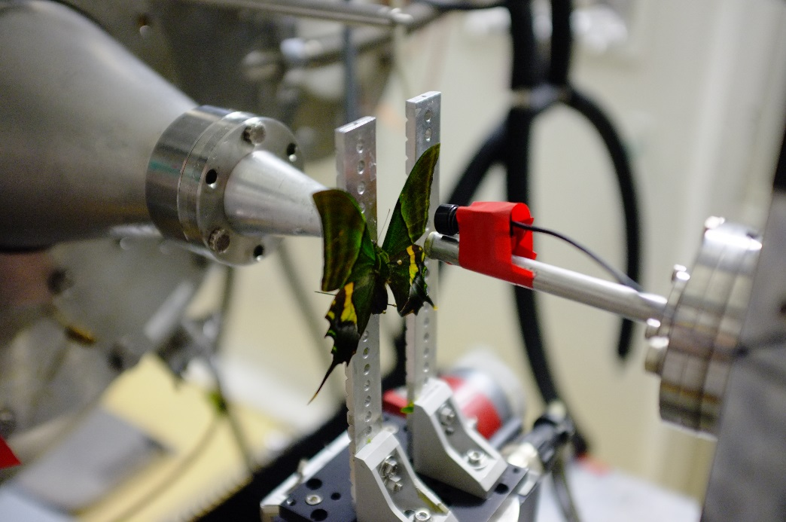
ID02 - ESRF
10 m camera length (now 30 m).
q_{min} = 1 x 10⁻⁴ Å
a spot size of 20 x 50 μm (single scales)
FreLon Kodak detector (pixel size 80 x 80 μm).

Slide 9
Method & Analysis
Position resolved SAXS (grid) on wings.
Identification of phase.
Automatic (radial average) fitting of unit cell size and peak width (grain size).
  mapping onto image of wing.

Slide 10
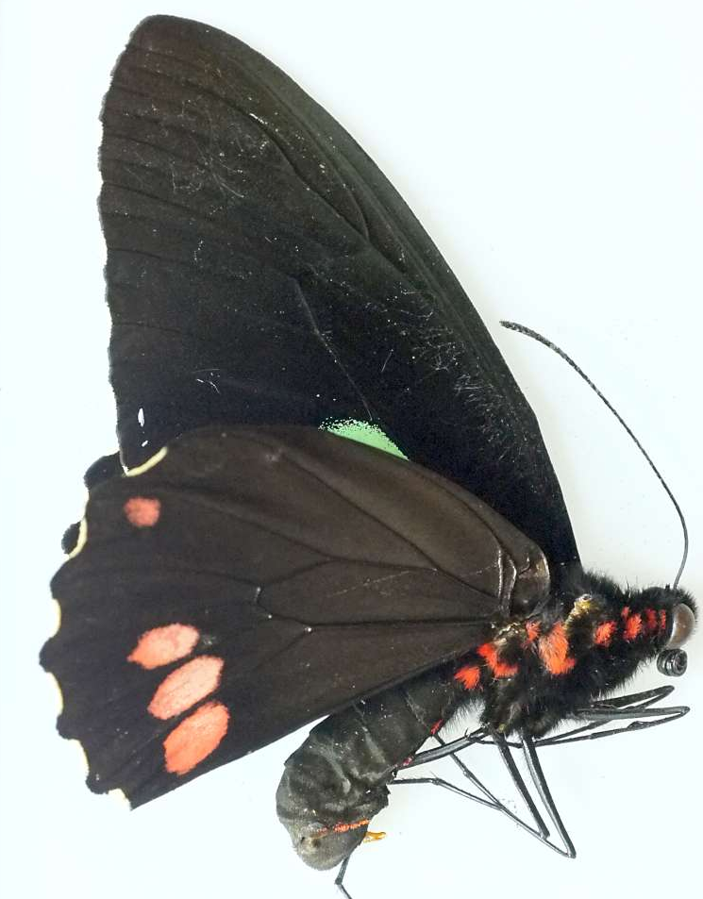
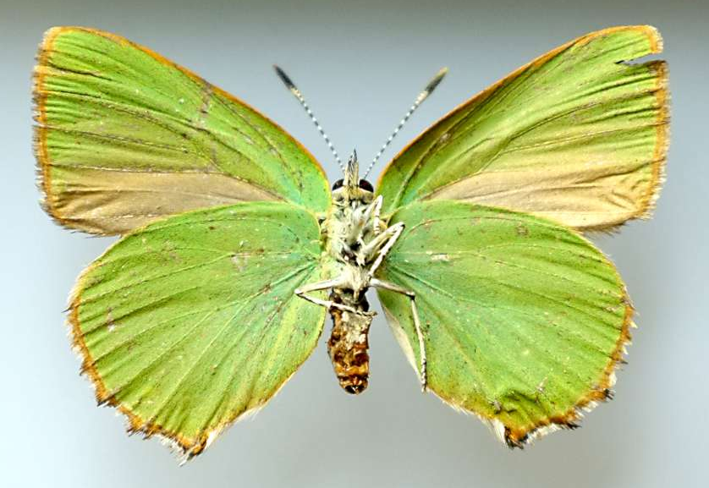
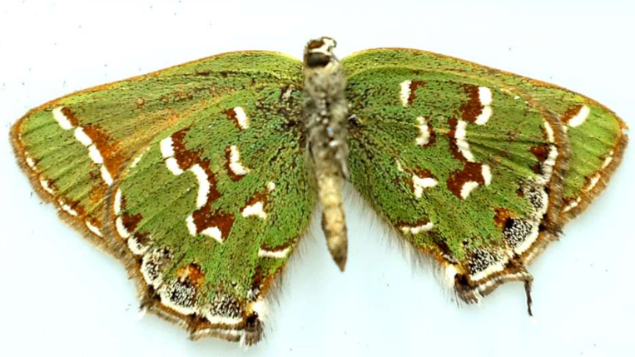
Structurally Green
Butterflies
Parides Sesostris
Southern Cattleheart
Callophrys Rubi
Green Hairstreak
Callophrys Gryneus
Juniper Hairstreak
Found in most of Europe, North Africa, Russia, Asia Minor, Siberia, Amurland, Baluchistan and Chitral.
North America
This species is native to the Americas. It is widespread from Mexico until Brazil and Peru.

Slide 11
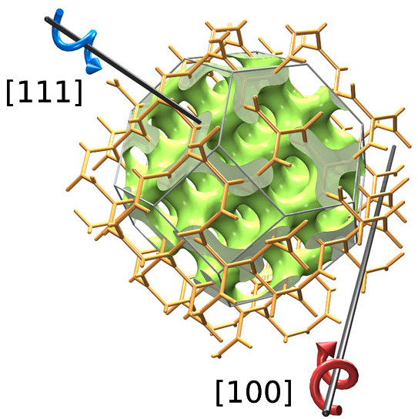
Butterfly wings "Single-Gyroid" I4(-1)32
All patterns powders (many grains with a scale).
Large unit cell (~350 nm).
Nature of template? (d-spacing is very large!)

Slide 12
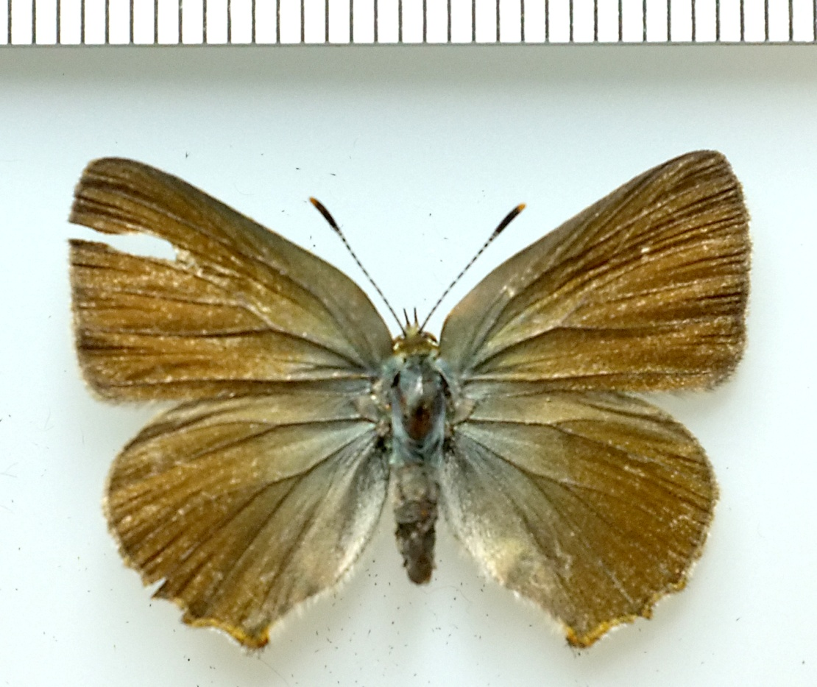
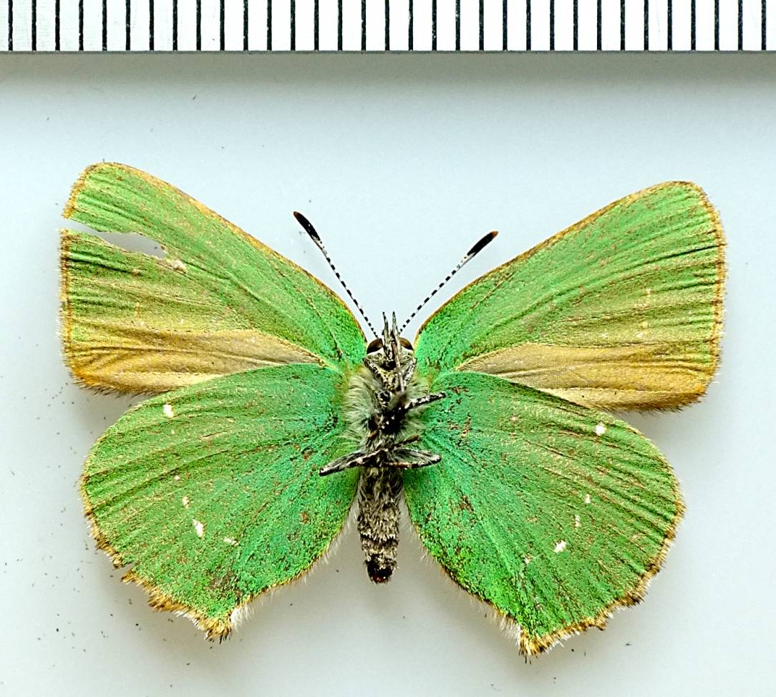
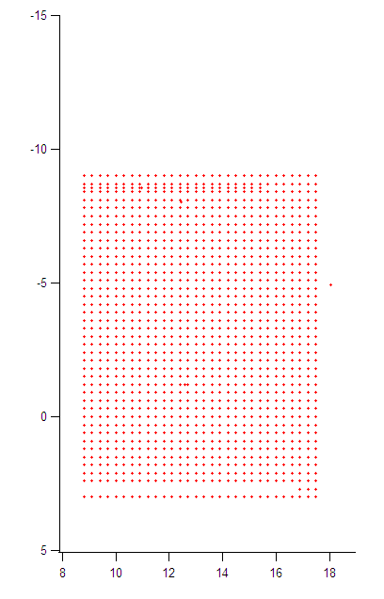
Rubi 2
Large scan
1230 points
300 x 300 um grid
3.41 hrs
x-rays into page
x-rays out of page

Slide 13
Rubi 2
Large scan
1230 points
300 x 300 um grid
3.41 hrs
x-rays out of page
x-rays out of page
Basis length
width

Slide 14
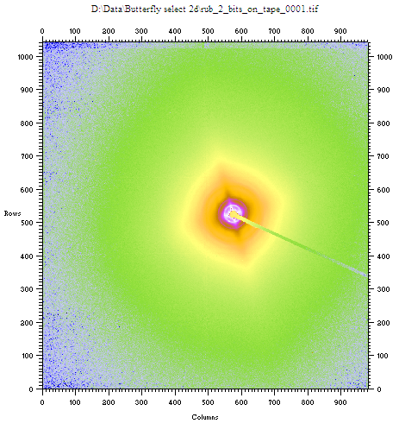
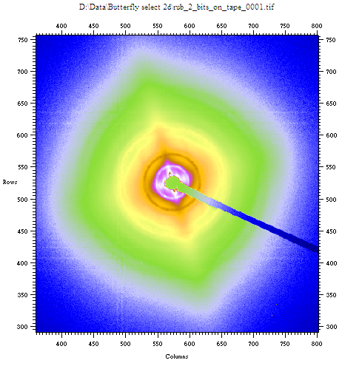
Superposition of isotropic scattering pattern and fibre pattern

Slide 15
x-rays out of page
x-rays out of page
Basis length < 346 nm
Basis length > 346 nm

Slide 16
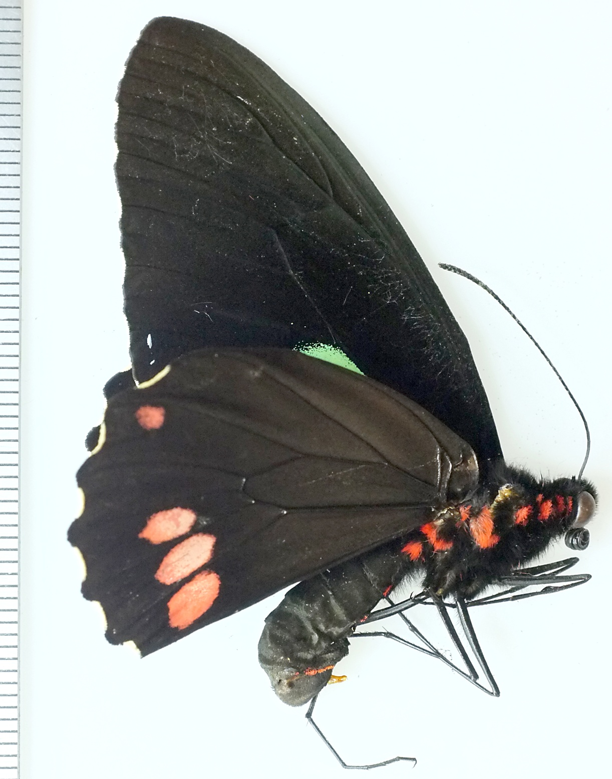
Pari 1
Parides Sesostris

Slide 17
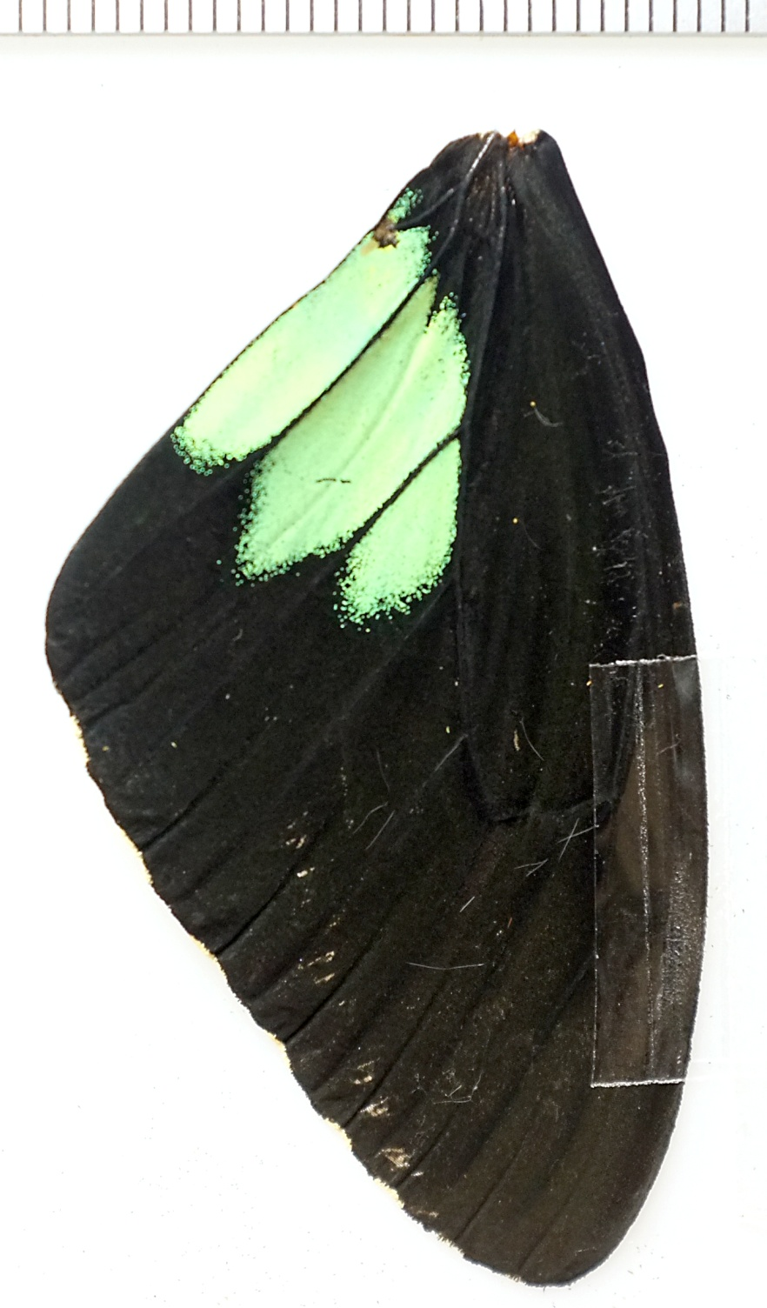
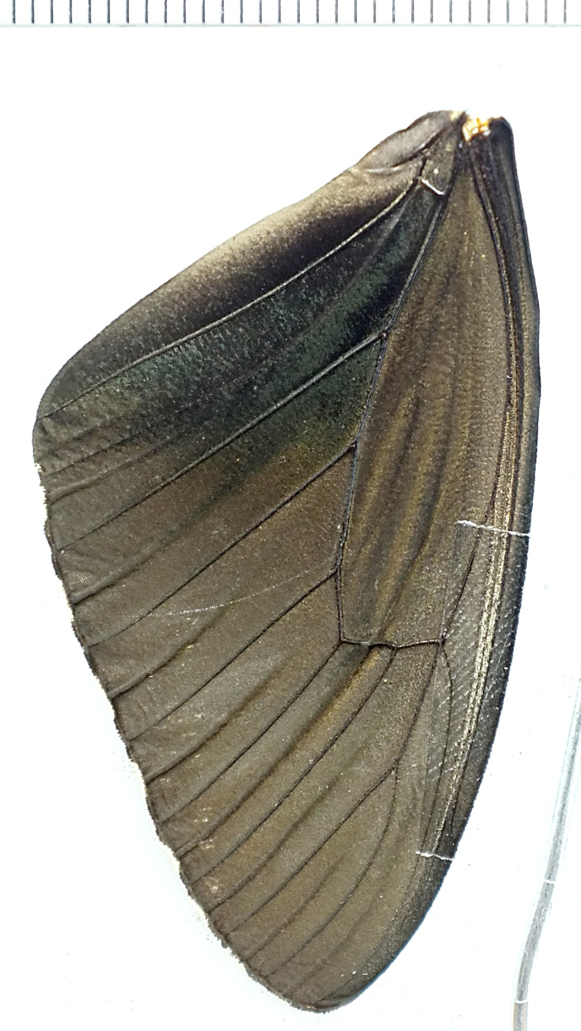
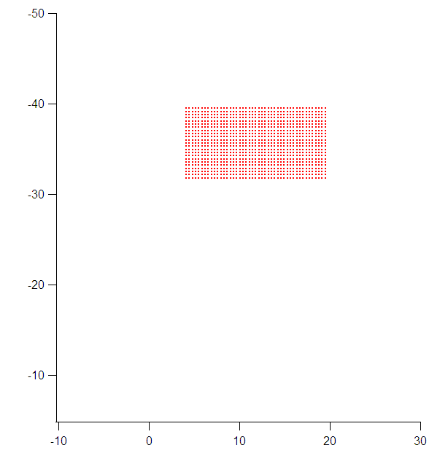
Pari_1_scan
1035 points
step size 0.35 mm
15.4 x 7x7 mm grid

Slide 18
Pari_1_scan
1035 points
step size 0.35 mm
15.4 x 7x7 mm grid

Slide 19
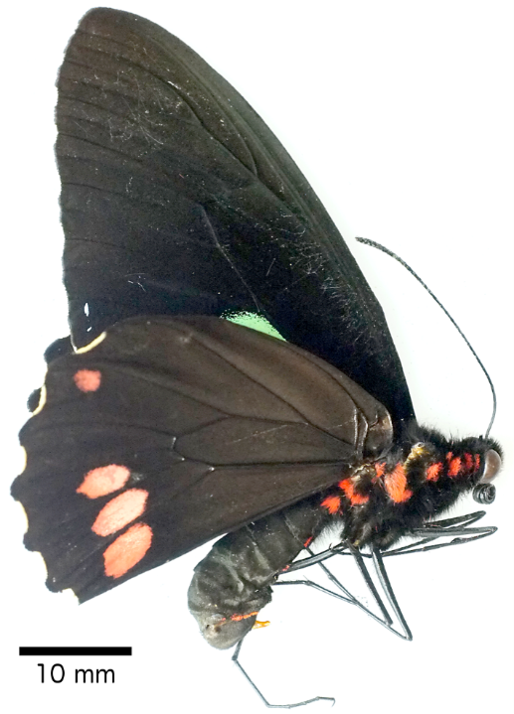
Parides Sesostris - Mappping

Slide 20
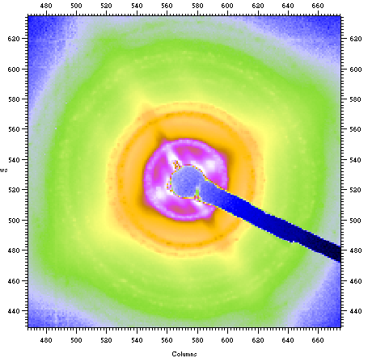
Butterfly - summary
SAXS patterns superposition of isotropic (scales) and anisotropic pattern (wings ribs).
All butterflies had single gyroid phase.
Unit cell characteristic of species.
Some variation within species.
Peak width (grain size?) characteristic of species.

Slide 21
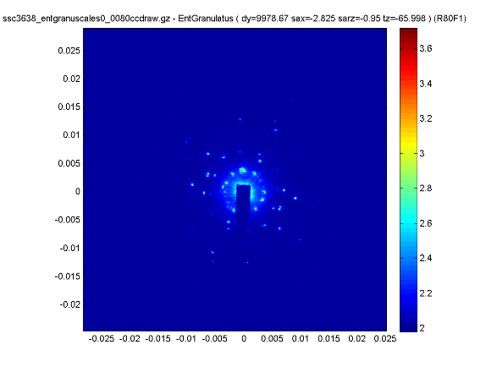
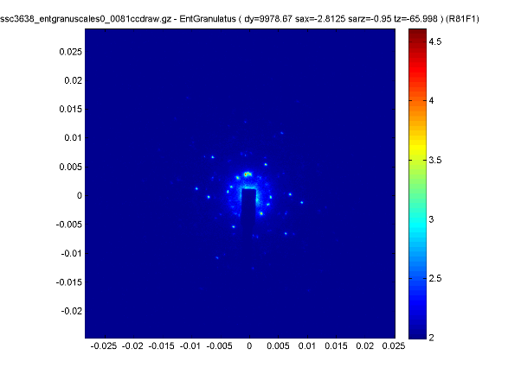
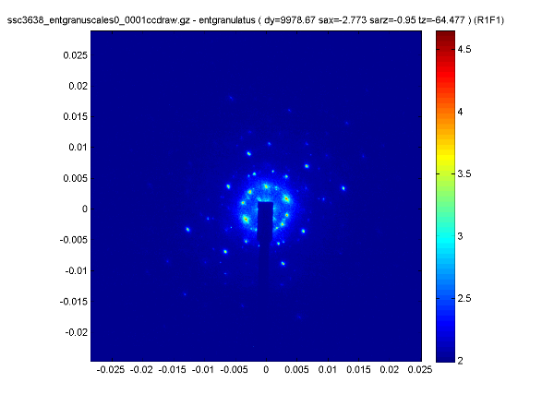
Diamond weevil (Entimus imperialis)
Diamond phase.
Large crystallites (~beam size).

Slide 22
Further synchrotron work (Vasyl Harumus GKSS)
Butterfly wing scales are certainly isotropic in some crystallographic directions.
Weevil scale is close to single crystal.
Very small spot size ~ micron size, pin-hole with axis of rotation and beam co-localised.

Slide 23
Challenges?
q_{min}.
q-resolution (Δq).
Large amounts of data/spatial heterogeneity
    Mapping average grain size.
    D-spacing.
    Orientational parameter

Slide 24
Small Angle Scattering (SAS) Vs Small Angle Crystallography (SAC)
SAS
SAC
Large continuous q-range.
Δq less important (q-dependant!!!!).
Small q-range (small number of higher order reflections).
Anisotropic.
Δq more important. Can be optimised with:
  λ.
  Detector.
  SDD.

