Slide 2
Workflow, JIRA & task management office
March19th, 2024
PRESENTED BY Xavier roy

Slide 3
Agenda
1 Today status
2 The path to serenity
3 TMO
4 Ok, But… What in real life

Slide 4
Today status
Today status
The path to serenity
TMO
Ok, But… What in real life
We are a service provider with an hollistic approach
Engineering excellence
(Usable, reliable and sustainable solution)
We know what is important
and urgent for the good of ESS

Slide 5
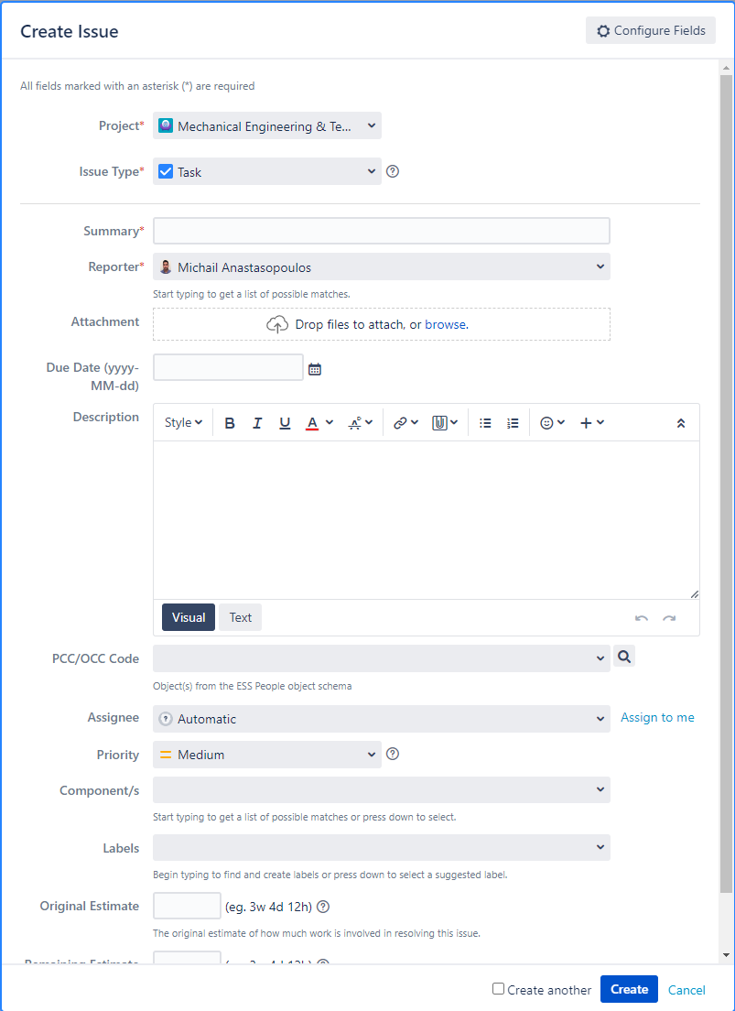
Today status
Today status
The path to serenity
TMO
Ok, But… What in real life
How to get the request
Create engineering support ticket in JIRA (collaboration tool
Per ticket procedure
MET team leader receives and evaluates the request from JIRA
  Complexity,
  Expectations
  Availability of the resource
Task is assigned appropriately

Slide 6
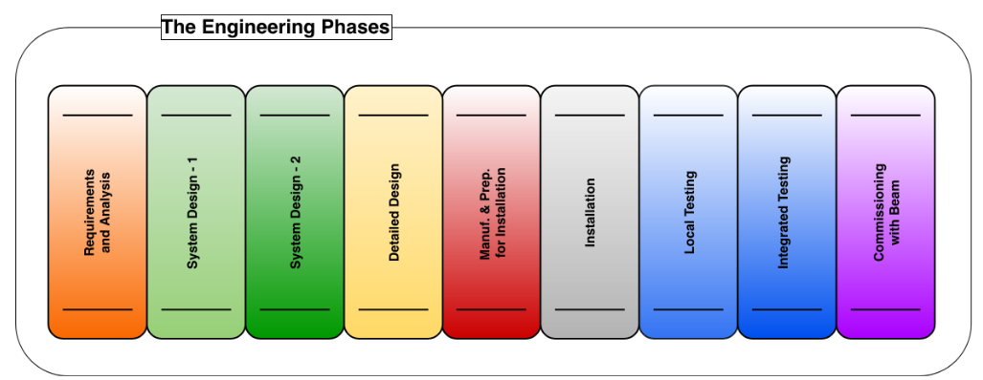
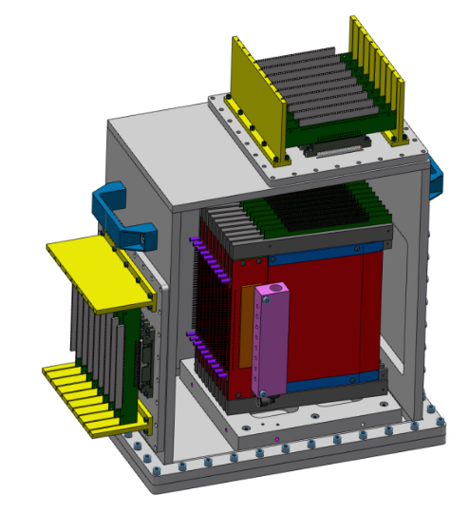
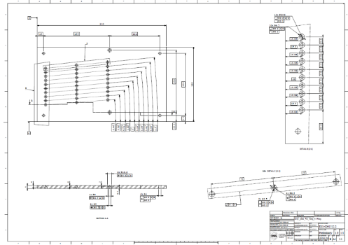
Today status
Today status
The path to serenity
TMO
Ok, But… What in real life
Workflow => Engineering data book
Mr Plus zone
Concept
First design and/or concept are being developed
Detail design and associated procurement/manufacturing department documentation

Slide 7
Today status
Today status
The path to serenity
TMO
Ok, But… What in real life
Complexity 1/2
SRF
NSS
Vaccum
Manufacturing
Dpt
H09
Installation
Mecanical
Enginering
dpt
FM
Automation
Electrician
Functionnal leaders
ESS
Quality
Piping
And many more bubles

Slide 8
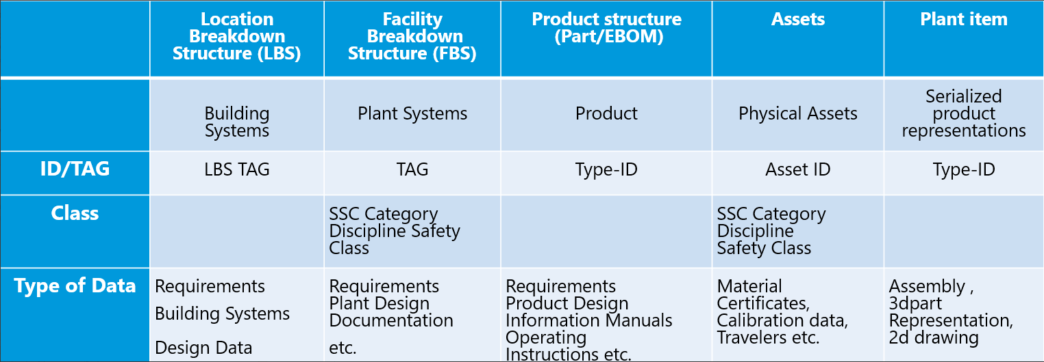
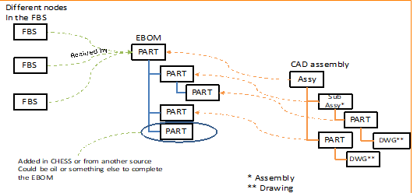
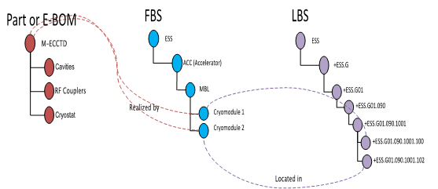
Today status
Today status
The path to serenity
TMO
Ok, But… What in real life
Complexity 2/2 (circularity of the information)

Slide 9

Today status
The path to serenity
TMO
Ok, But… What in real life
The path to serenity
Cost, Lead time and quality
Serenity
Mentoring
Quality
JIRA Request
Side request
Continuous improvement
Centralized
ESS state of art

Slide 10
The path to serenity
Today status
The path to serenity
TMO
Ok, But… What in real life
Requester
ESS rules
Quality
Task management office
Designer
Designer
Requester
Manager
Ess rules
quality

Slide 11
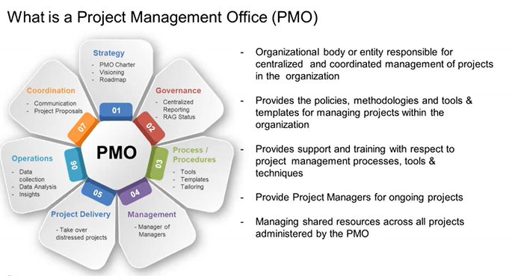
The path to serenity
Today status
The path to serenity
TMO
Ok, But… What in real life
TMO – Task Management Office
To handle a large amount of order, industry use PMO

Slide 12
TMO
Today status
The path to serenity
TMO
Ok, But… What in real life
Key Feature
Priority vision
Clear roadmap,
Mentoring
Harmonisation of the culture and practice
Accelerated tool kit
Clear view of priority
Transformation Framework
Governance
Focus on starting good
Template available quick
Change request management
Metrics
Continuous improvment
Risk moderation
1
Objectives
6
2
Report
Process
TMO
Culture
People
Collaboration
5
3
Community of practice - Mentoring
Application Lifecycle Management (JIRA)
Resource management
Change request management
Team
Technical
Cross functionnal
Commitment to engagement
Self management
4
Engineering excellence
Tools mastering
Engineering practice

Slide 13
TMO
Today status
The path to serenity
TMO
Ok, But… What in real life
Role
Dispatch meeting once a week – Ressource management
Mentoring (FBS-LBS
Reporting of the activity
Make sure the priority are followed
Make sure the process is followed (not by the book but by the necessity)
Central point for communicate to the external service
Change request management
Manage urgencies

Slide 14
TMO
Today status
The path to serenity
TMO
Ok, But… What in real life
Benefits
Having a clear view of the load
Improve customer vision and communication
Have a proper scope (less scope screep)
Quality involve at the right moment

Slide 15
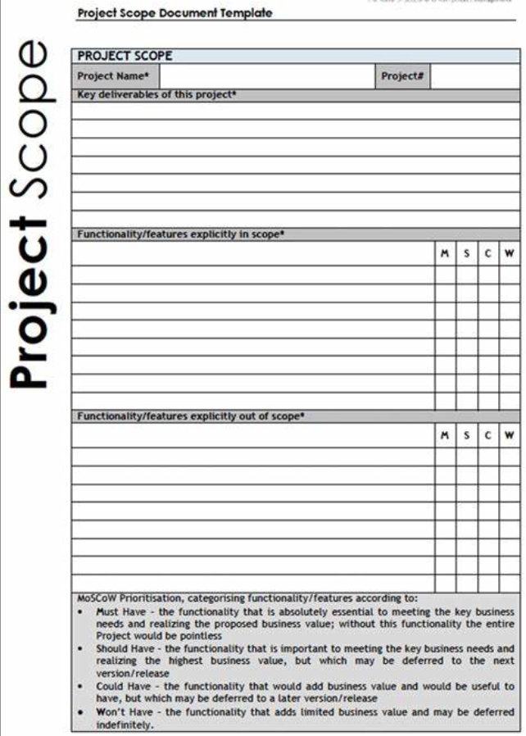

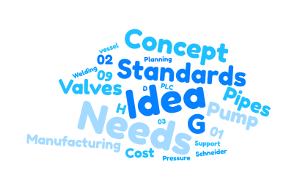

Ok, But… What in real life
Today status
The path to serenity
TMO
Ok, But… What in real life
Main missions to come
Deal with the request
Somewhere in ESS

Slide 16
Ok, But… What in real life
Today status
The path to serenity
TMO
Ok, But… What in real life
The process
Need
Open a Jira ticket with a specification
First analyse of the scope
Weekly meeting
Appoint a designer
Define a time line
Communication with customer
Starting point to align the vision
Raise the main issue
Stakeholder list
Follow up internally
Follow up – Cost and planning
Change request analysis

Slide 17
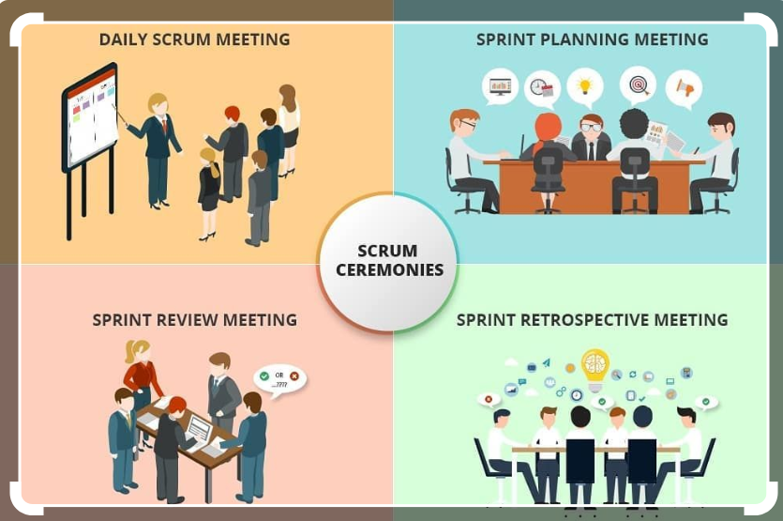
Ok, But… What in real life
Today status
The path to serenity
TMO
Ok, But… What in real life
All in one meeting

Slide 18
Finish presentation

