Slide 2
Collaboration in CATIA V6
Large assemblies, revisions control, and integration
PRESENTED BY Dawid Patrzalek

Slide 3
Handling large assemblies

Slide 4
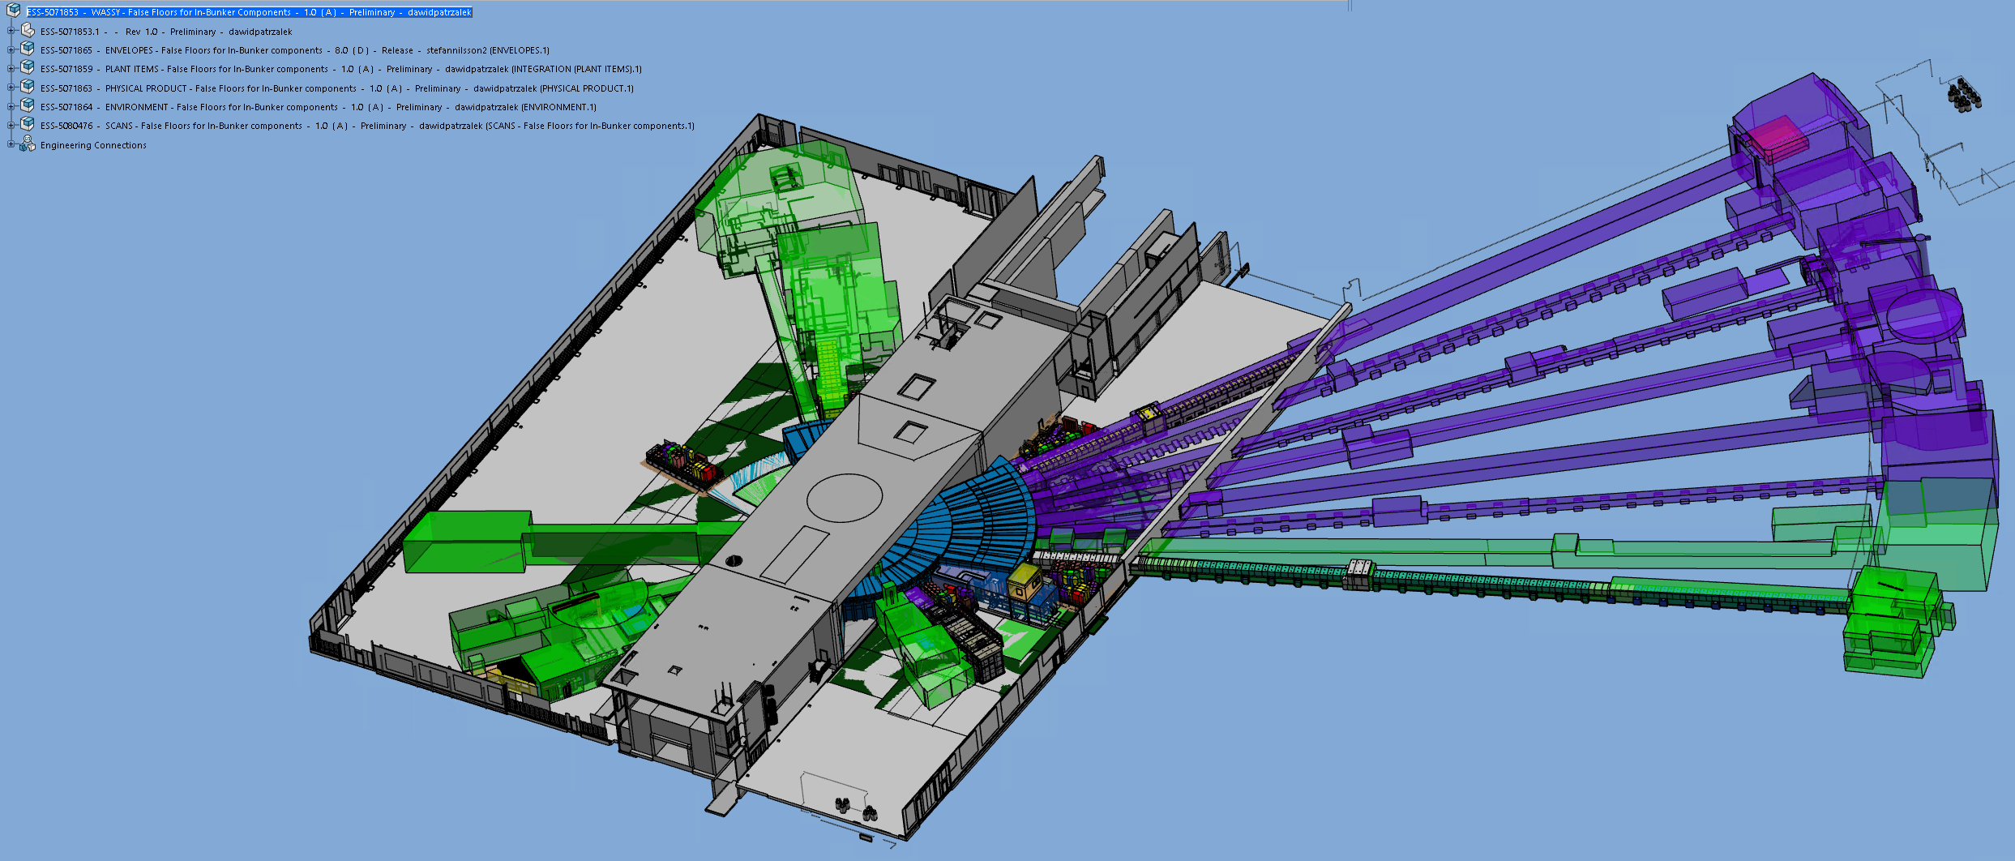
Handling large assemblies
Introduction
CATIA V6 is capable of handling large assemblies, however:
  Opening a large assemblies is time consuming
  If an assembly is too big, user experience becomes difficult
  In most cases there is no need to open whole large assemblies at once

Slide 5
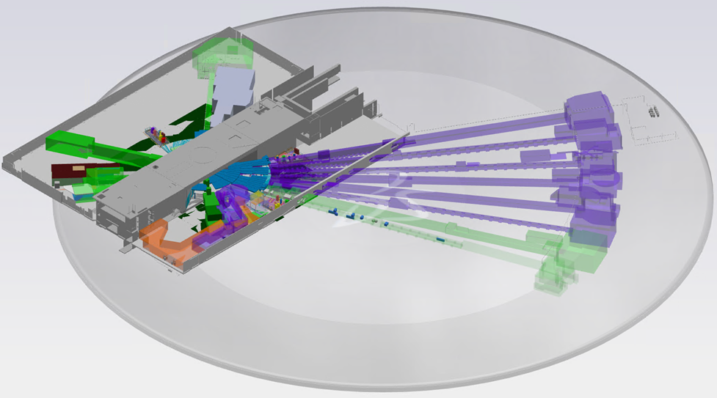
Handling large assemblies
Silver vs. blue layer
V6 has two layers which can be used to explore, filter, and open models.
Silver layer (explore mode):
  Overview models only
  Lightweight and fast
Blue layer (physical product mode):
  Full details and productivity available
  Heavy and slow if overloaded
Took 1 minute to explore
Took 12 minutes to open

Slide 6
Handling large assemblies
Filtering models
Silver layer can be used to inject filtered models into the blue layer:
  Use the tree structure to explore models in the silver layer
  Open chosen model
  Once opened, models will become available in the blue layer.
  Tree structure from the silver layer is preserved allowing to inject more models from the silver layer later.

Slide 7
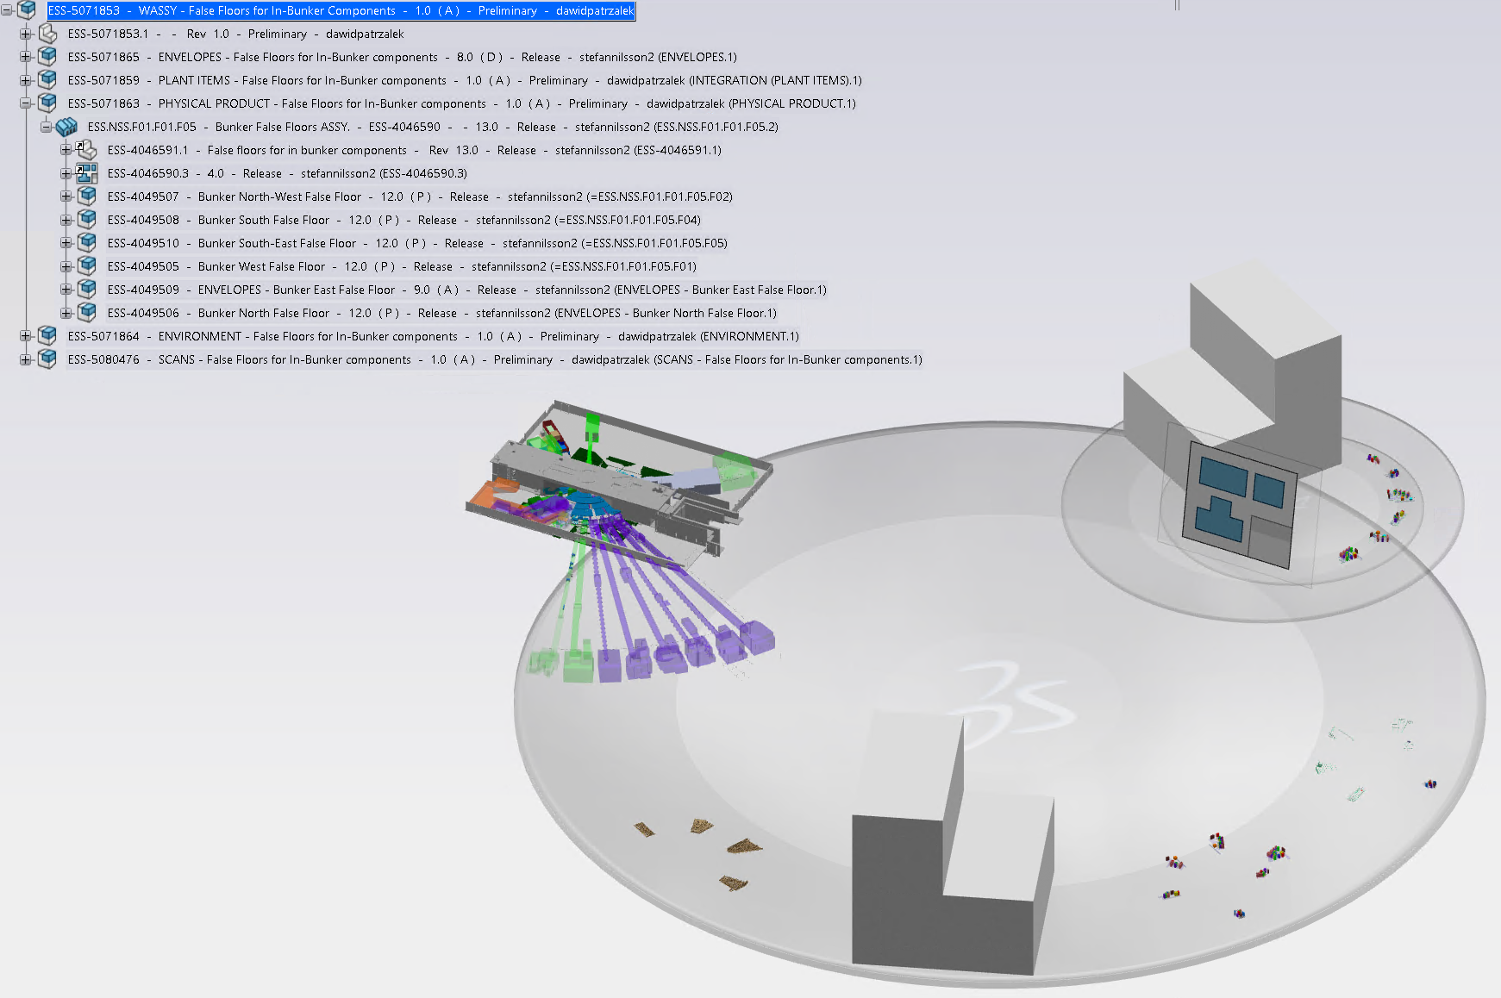
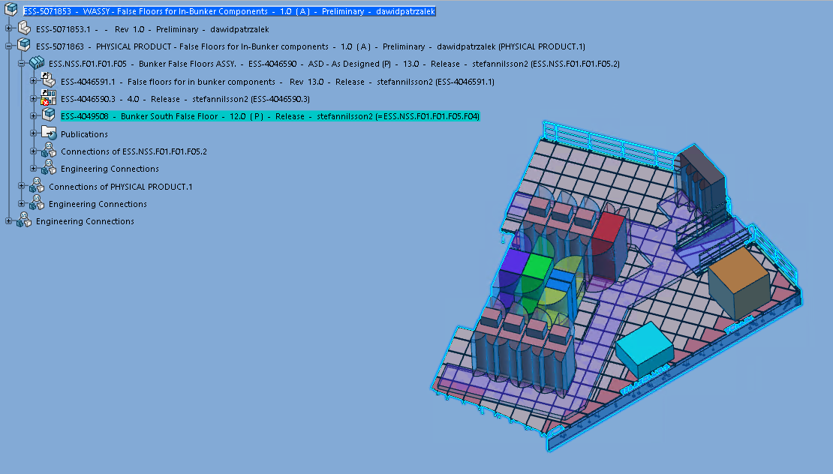
Handling large assemblies
Injecting models

Slide 8
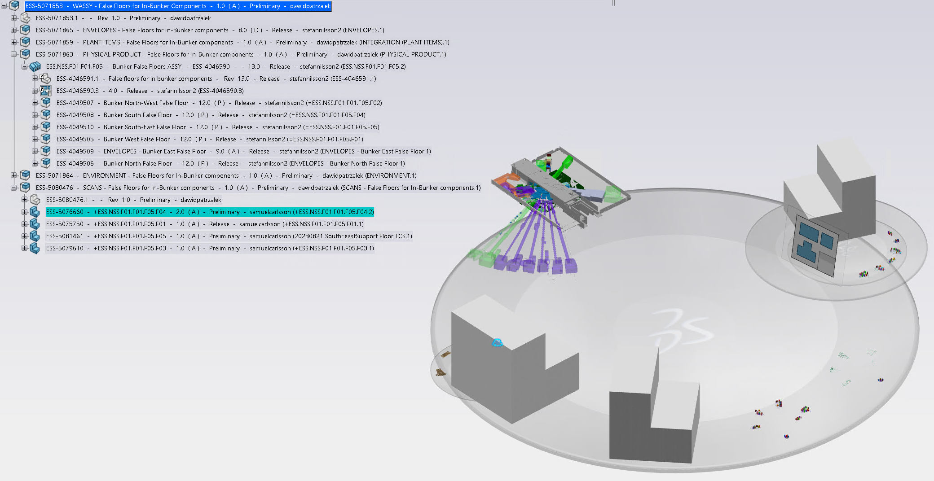
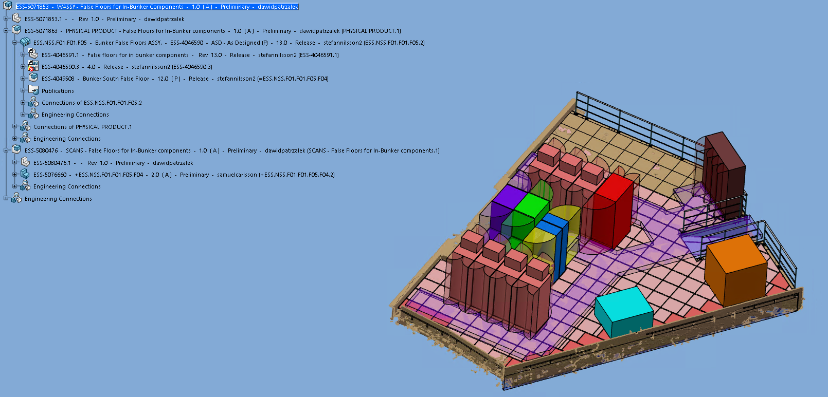
Handling large assemblies
Injecting even more models
Coming back to the silver layer and opening another model from previously explored models will inject it into the blue layer.
Tree structure is still preserved and updated with new models. Such methodology can be carried on and on.
If the blue layer becomes too heavy, unwanted models can be also unloaded from the blue layer.

Slide 9
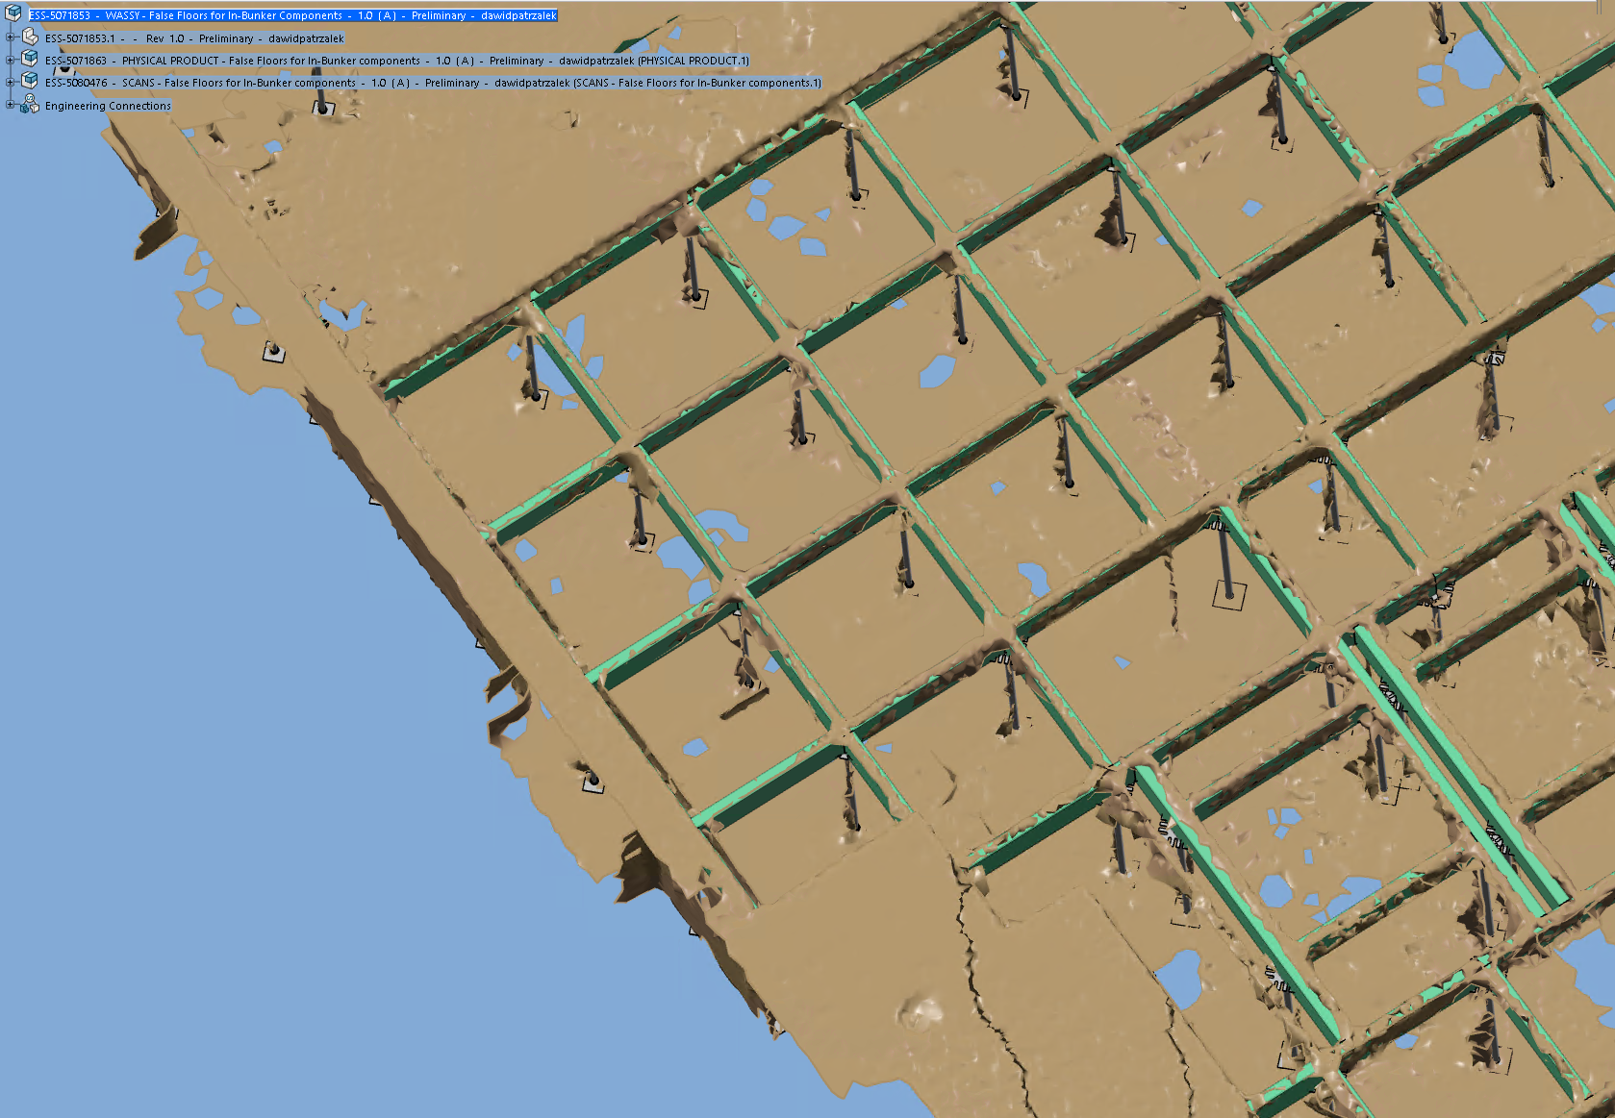
Handling large assemblies
Outcome of large assemblies handling
On-site scan
Thanks to the silver layer filtering:
  Only two needed models were opened
  Blue layer is much more responsive compared to the whole assembly opening
  Opening necessary models took 3 min vs. 12 min of whole assembly opening
  All productivity functions are available (add/delete/replace models, save, etc.)
  Off-topic:
  3D scan used to create as-built model.
3D model

Slide 10
Revisions control

Slide 11
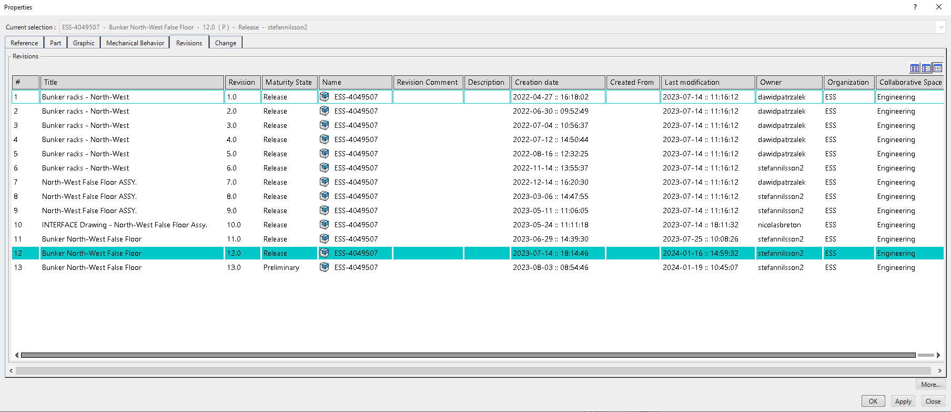
Revisions control
Introduction
PLM allows for flexible revisions control and collaboration between users:

Slide 12
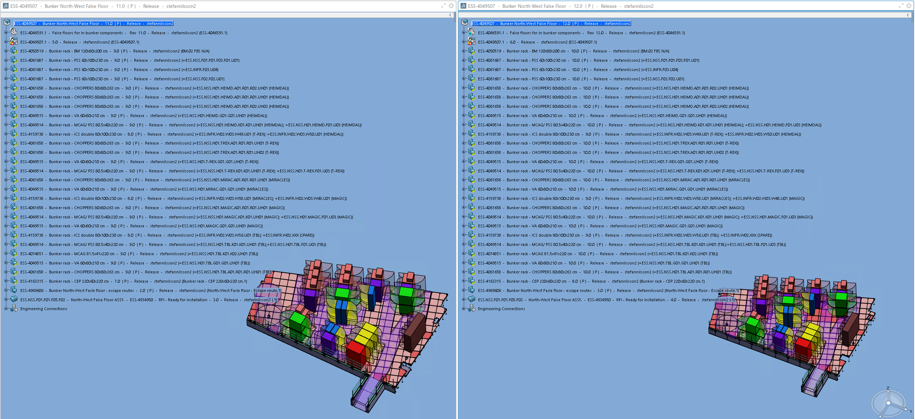
Revisions control
Handling various revisions
Different revisions of the same model can be opened at the same time:

Slide 13
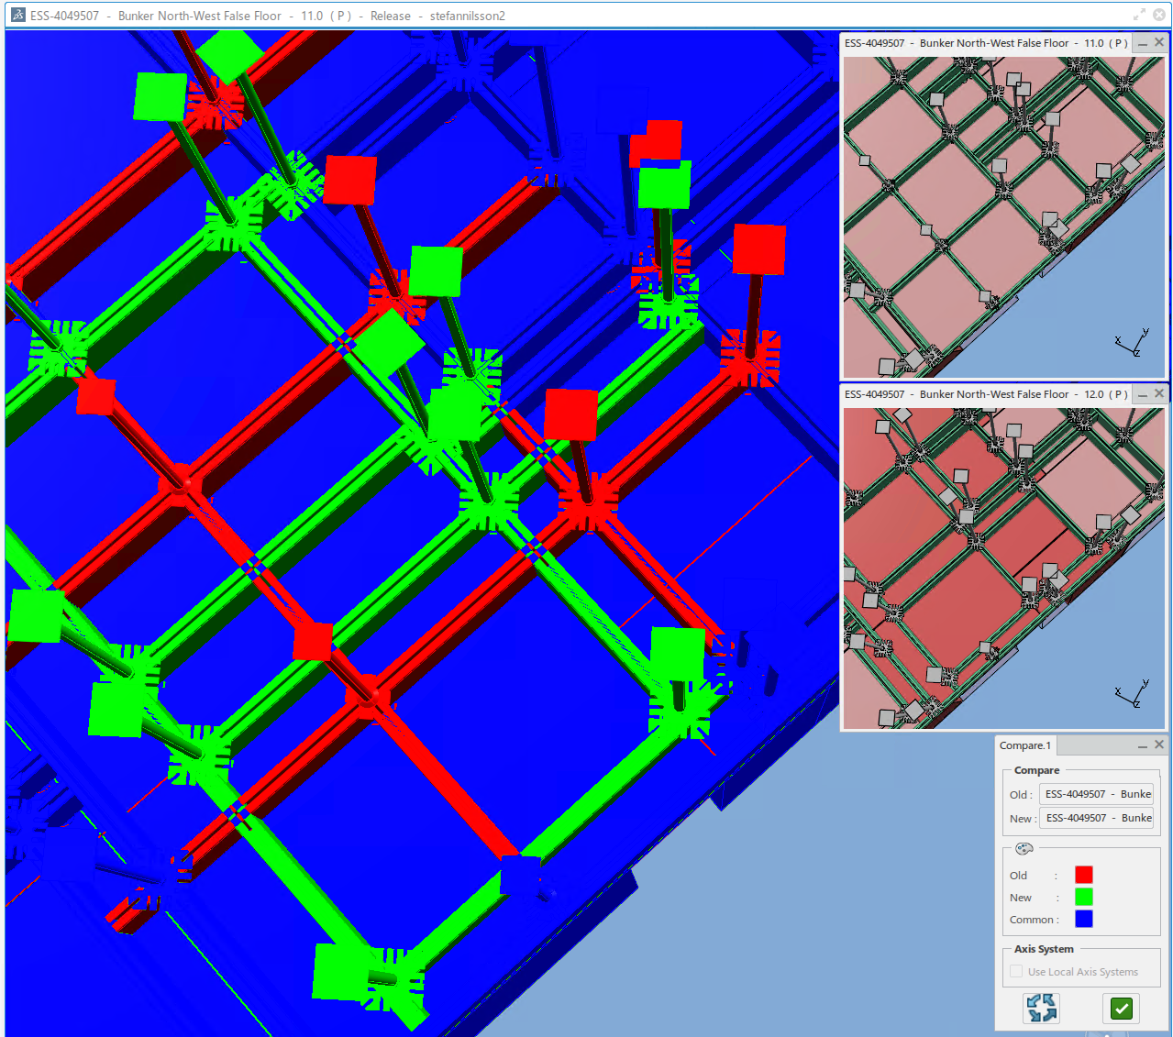
Revisions control
Design review
And e.g. compared to each other:

Slide 14
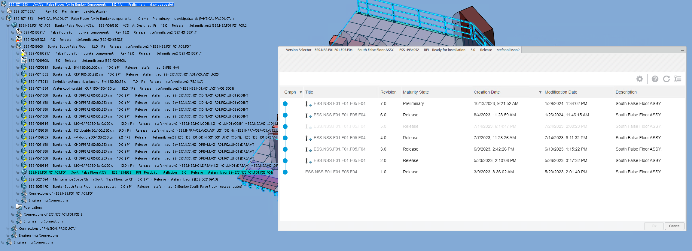
Revisions control
Introduction
  Users can replace models with their newer/older revisions
  On-live refresh models which are being edited by other users
Currently used model…
… can be replaced by working revision and refreshed on-live to fetch the newest changes.

Slide 15
Integration

Slide 16
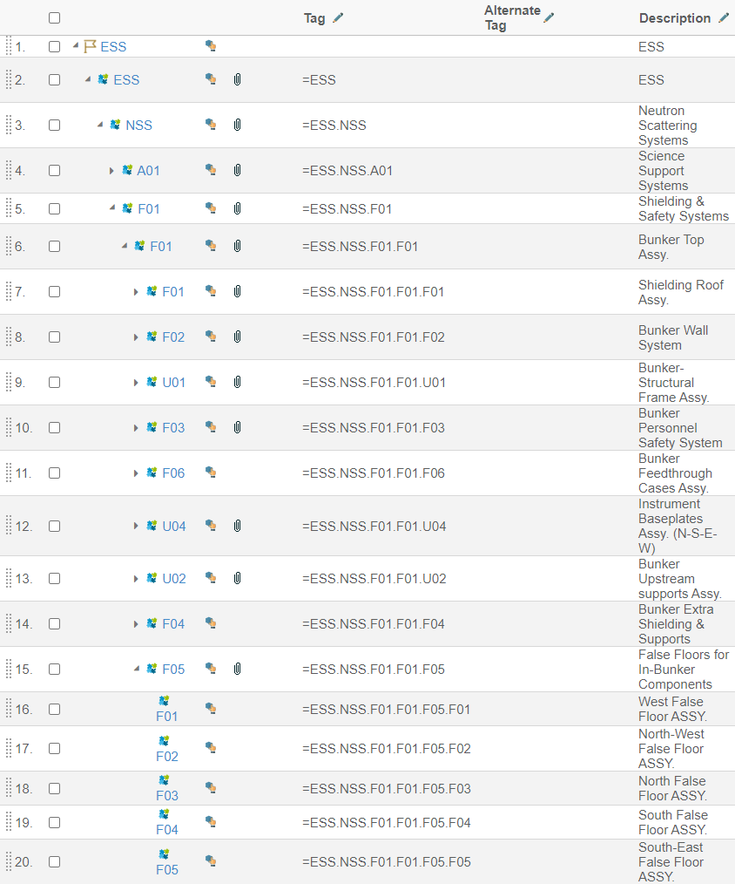
Integration
FBS structure
Unique FBS tags
Single point of truth at ESS
  The very top 3D model of the whole ESS facility is available in CATIA, the ESS Plant Layout (EPL)
  Integration of sub-projects into the EPL is handled by ESS Spatial Integration Team and EPL is used as a single point of truth of the facility
  Projects have their own specific destination in the EPL, which is regulated by Facility Breakdown Structure (FBS)
  Various documents can be attached to FBS tags and accessed through a regular internet browser
  FBS also allows assets traceability
Project related documentation

