Slide 2
ESS CAD PLM
Preparation meeting 2024-01-25
PRESENTED BY ARDHENDU NANDA

Slide 3
Topics
ESS
Order of topics addressed:
Evolution of PLM
Breakdown structures
Spatial Integration
Large Assembly management

Slide 4
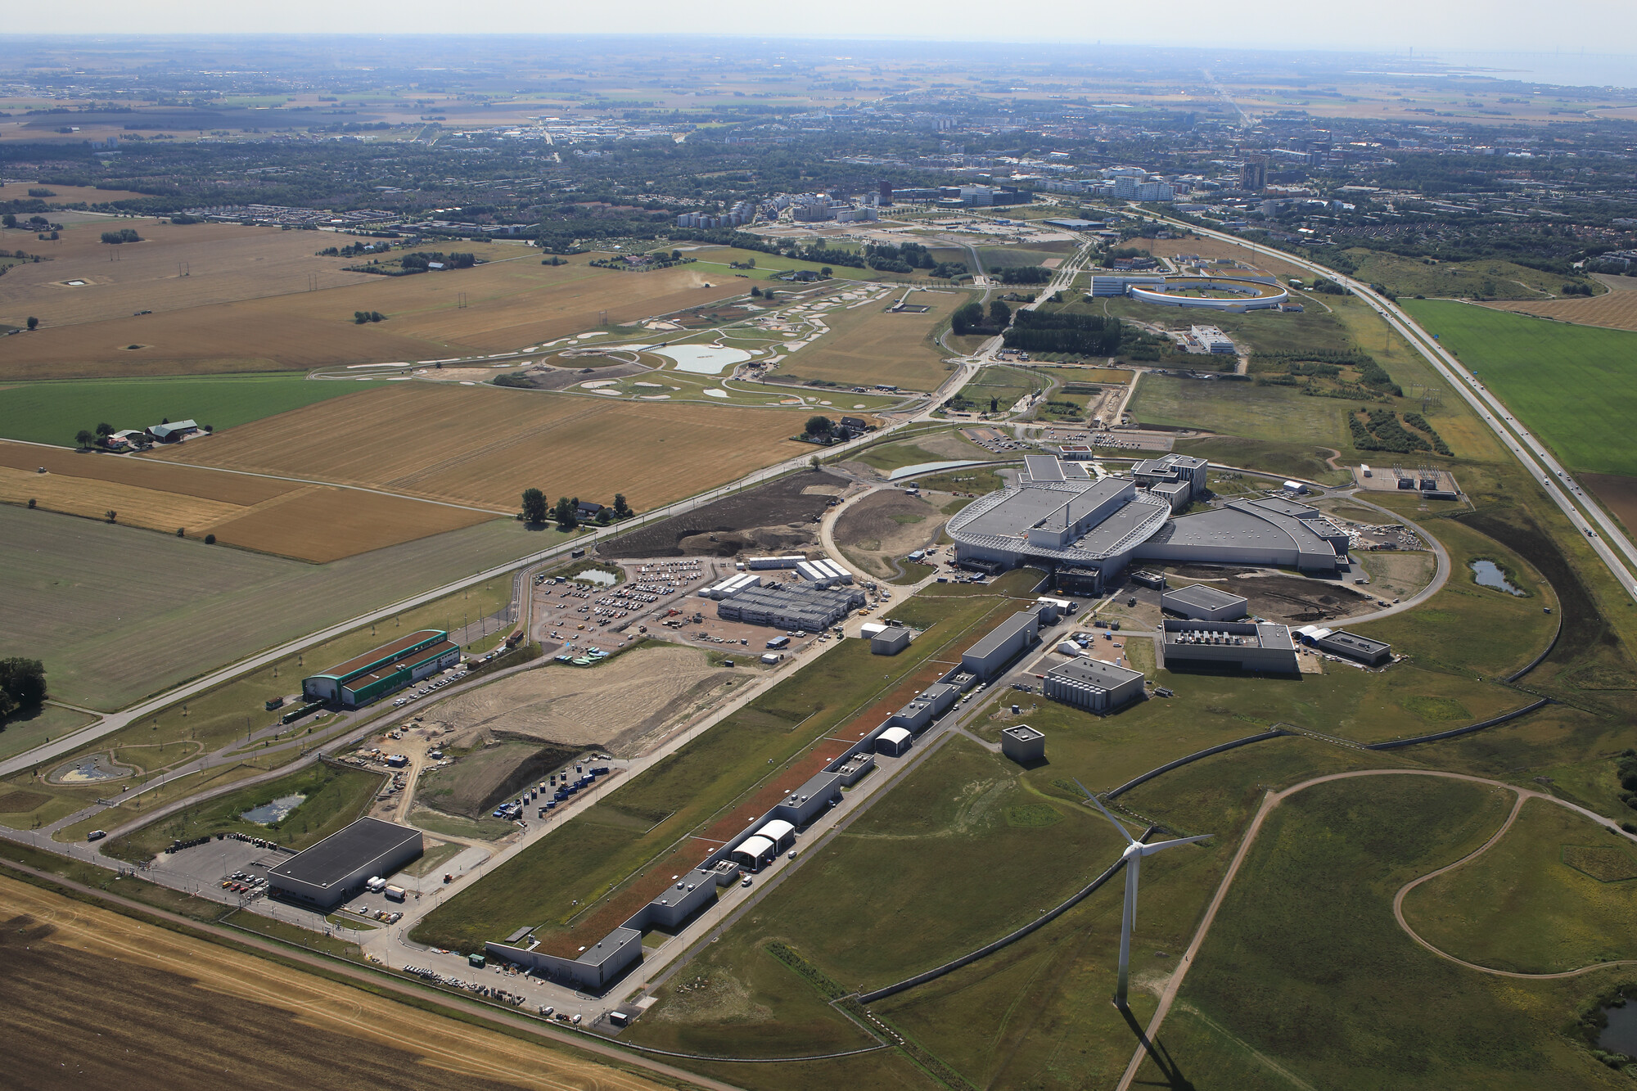
Timeline
2009
Decision to site ESS in Lund
2014
Start of construction
2024
Today
2003
Concept design of ESS presented
2012
ESS design update phase complete
2019
Start of initial operations phase
2027
First science
4

Slide 5
Technical evolution of TIM
Pilot and decision for:
Facility Breakdown Structure
Tagging
Reference Data Library
User experience improvement
EAM definition
Mass approval
Access for In-Kind & Contractors
Stamping – drawings & pdf
CATIA methods
Large Assembly Management
AIB 2.0
Labeling in EAM
EAM-ERP integration
CHESS-EAM integrations
Decision for CATIA V6 and ENOVIA
EAM-CHESS Document integration
Document hierarchy referencing
2012
2014
2015
2016
2017
2018
2019
2020
2021
Implementation of:
Facility Breakdown Structure
Location Breakdown Structure
Change Management FBS and LBS
Tagging and naming
Reference Data Management
Labelling
EAM deployed
Facility Breakdown Structure 2.0
New change process FBS and LBS
New change process EBOM
User Experience improvement
FBS-ICS (cable database) Integration
Authoring tools integrations
External delivery upload
Facility Configuration Management 1.0
Improvements document management
Confirmation after review of CATIA V6 and ENOVIA

Slide 6
Technical evolution of PLM
Upgrade to 2014x
Development of LESS (Light Weight files) with Technia
VR room set up design reviews
Decision for CATIA V6 and ENOVIA
Upgrade to 2020x
2012
2014
2015
2016
2017
2018
2019
2020
2021
2022
Evaluation of plant and process tool, Acceptance of Aveva E3D and Aveva Diagrams
Upgrade to 2016x
Facility Configuration Management 1.0
Improvements document management
Confirmation after review of CATIA V6 and ENOVIA

Slide 7
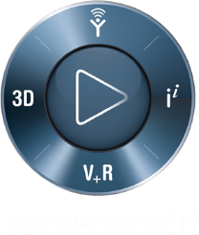
Overview engineering systems relations
EPL Viewer
EAM
…
Electrical design
SHARE DRIVE
Info
CHESS
FM/CF Document Selection
CATIA Native CAD
FM/CF
-REVIT, TEKLA, E3D, …
Plant design
SHARE DRIVE
Model Exchange
Cable DB
IKC
‘any’ CAD format
Analysis
Legend:
Manual connection
Auto or integration
Two arrows =Two way connection

Slide 8
Design data to Part management
CATIA
CAD BOM generates EBOM from Catia to CHESS
+ Simple action
+ Quick
+ Titles / Description is propagated
- Can generate “to many” EBOM parts
- Tricky to update/make changes, easy to get it wrong and need support
- Not OOTB behaviour, high costs in maintenance
Mechanical design
EAM
CAD design is managed and revised in the external tool, no EBOM in CHESS all PLM parts generated by Jira request
+ Simplifies integration
+ Only needed EBOM parts generated
+ Good control on parts
- Manual work – quality risks
- Time consuming
- Workflow is not integrated
…
PLM
Info
Electrical design
FBS/LBS
Chess sends:
Decsription
Long description
Manufacurer
Manufacturer Part no. (External ID in CHESS)
Connection to existing positions
EAM responsible Supplier information
Purchasing information
Warehouse information
CAD design is managed and revised in the external tool EBOM generation is manual/batch, revision is manual
+ Simplifies integration
+ No EBOM parts generated
+ Good control on parts, low risk of extra parts added
- Manual work – quality risks
- Time consuming
- Workflow is not integrated
Plant design

Slide 9
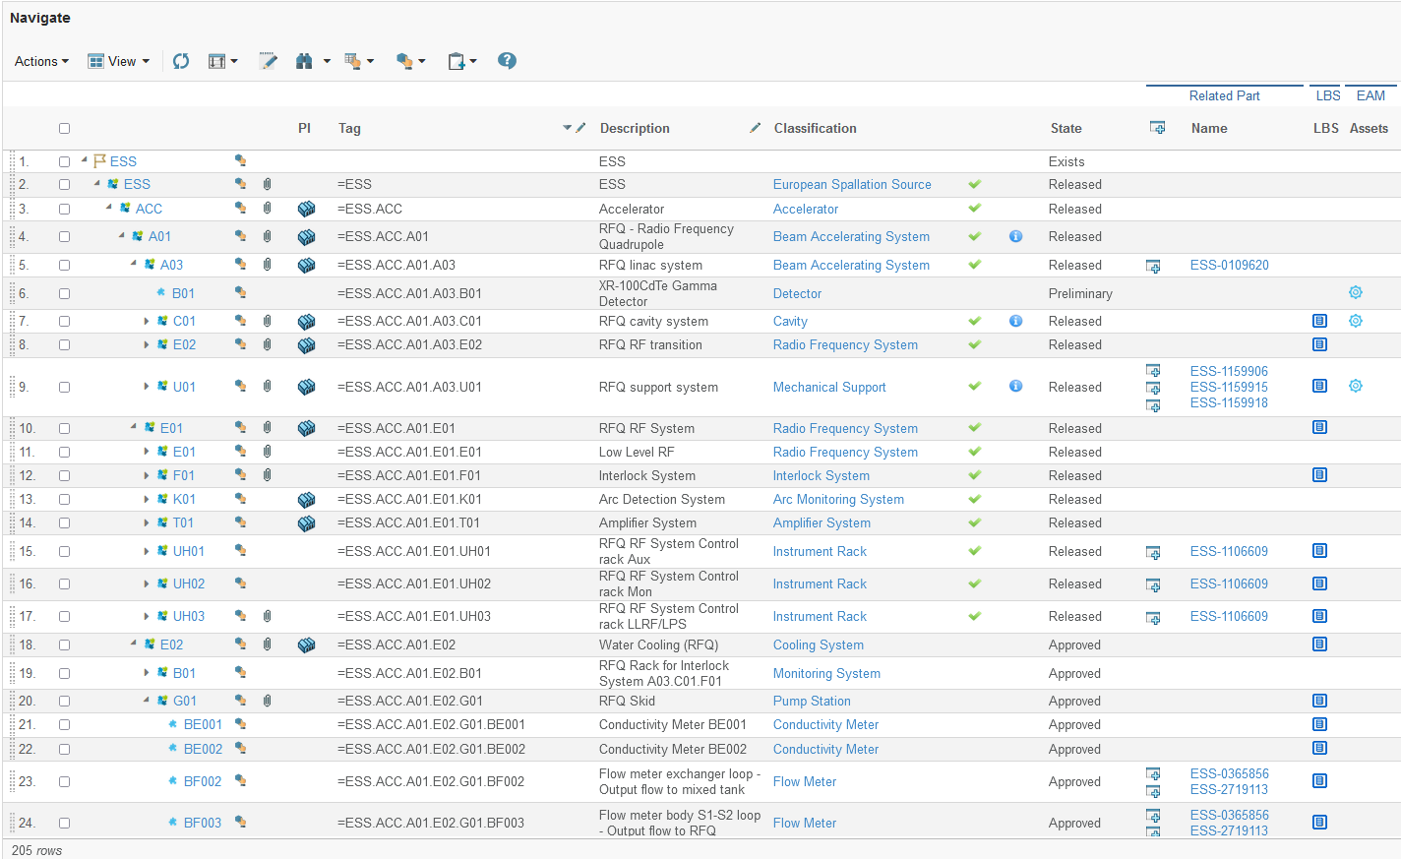
Single entry to all Facility information
Structural information
Access to all tag documents
Access to detailed tag information

Slide 10
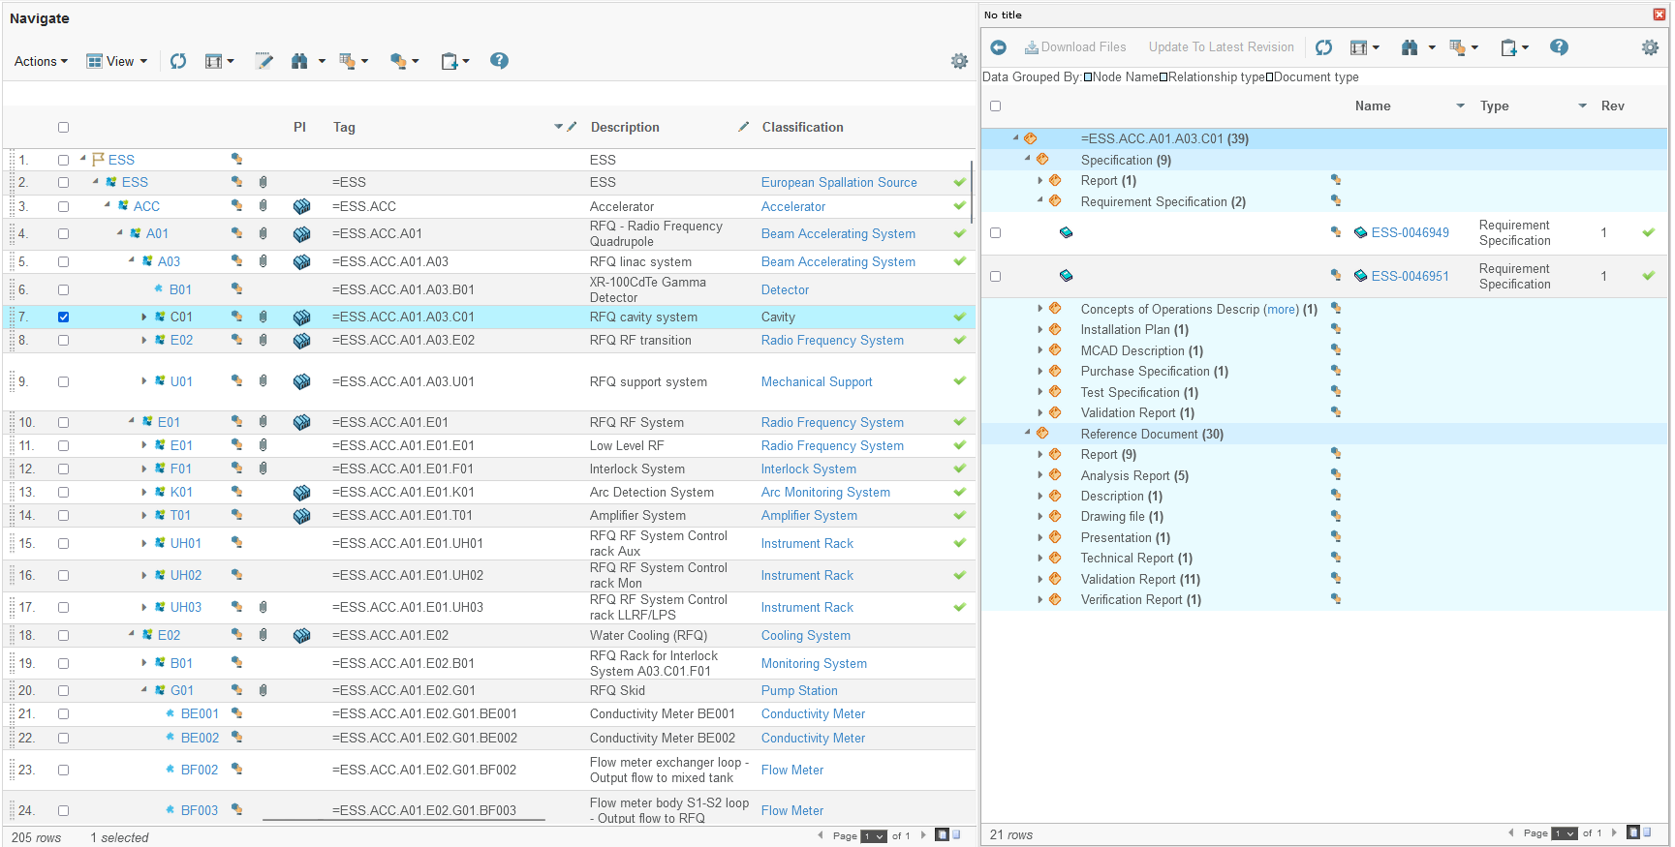
Single entry to all Facility information
Access to all tag documents

Slide 11
Single entry to all Facility information
Access to runtime 3D master model, the EPL

Slide 12
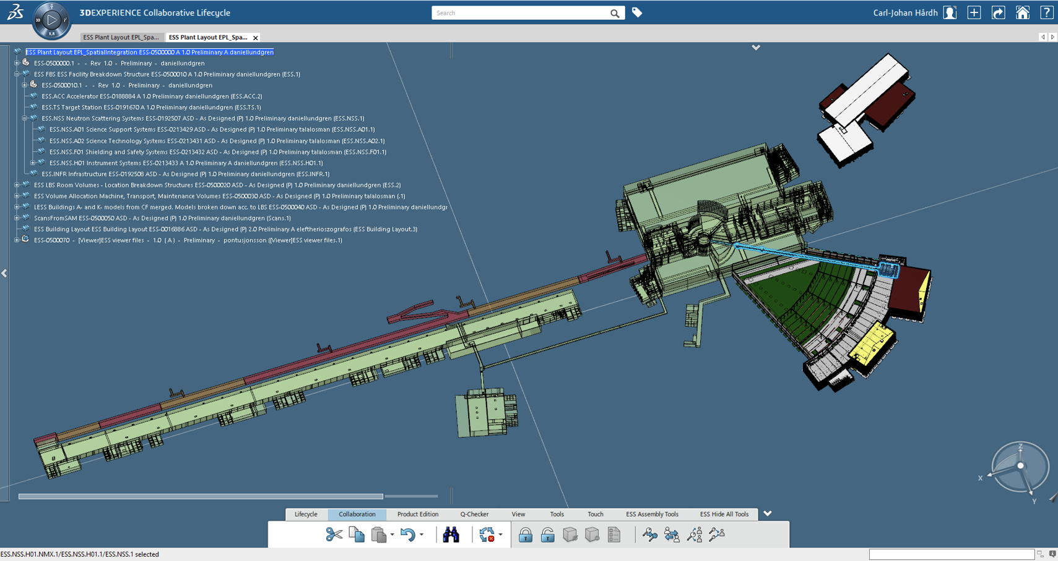
ESS Plant Layout - Spatial Integration
All space allocations refer to tags – EPL viewed from multiple disciplines

Slide 13
Single entry to all Facility information
Tag description
Reference Data class
Status
Full tag
Entry point to the tags installed asset
Entry point to the tags location
Parts that can be used for realization of the tag

Slide 14
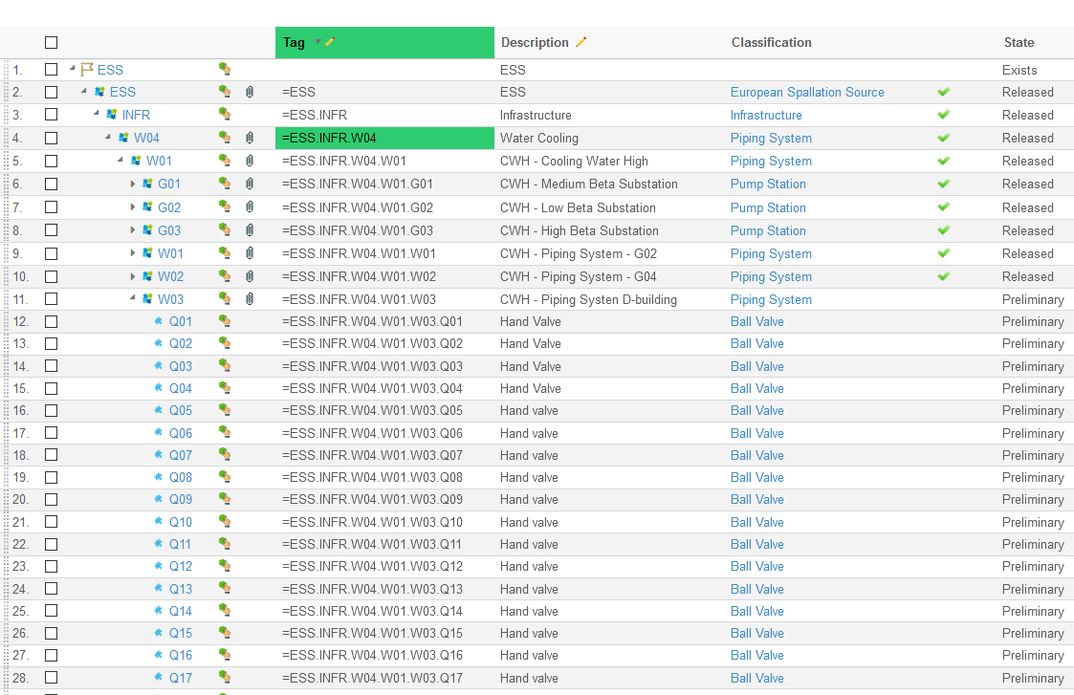
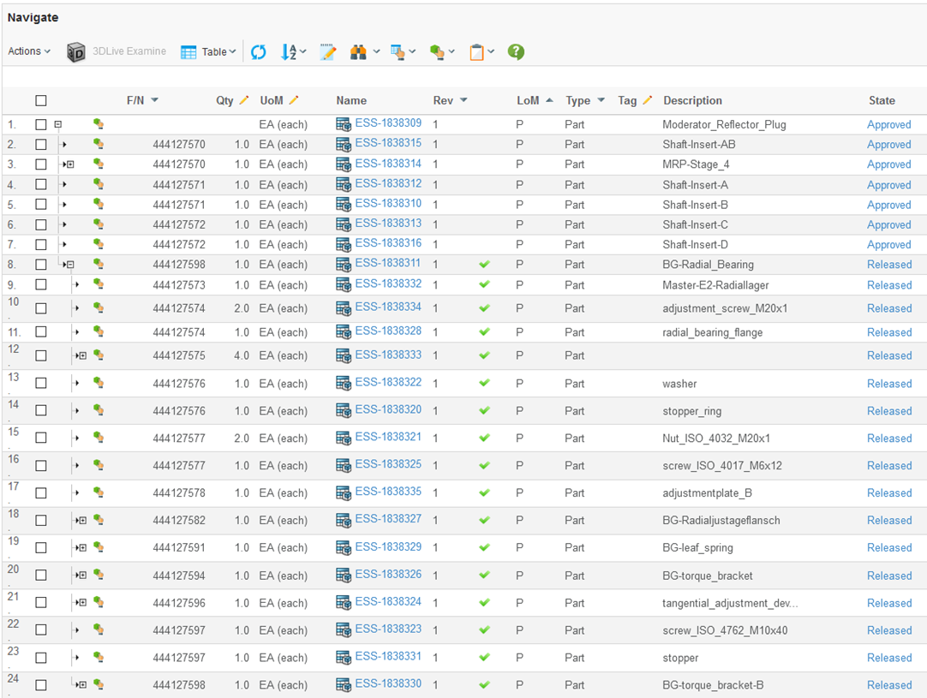
FBS vs product design (EBOM)
The FBS structure is released in a top down fashion
Discipline centric data for a tag including specifying documentation must be released prior to the tag’s release
The Engineering Bill Of Material is released in a bottom up fashion

Slide 15
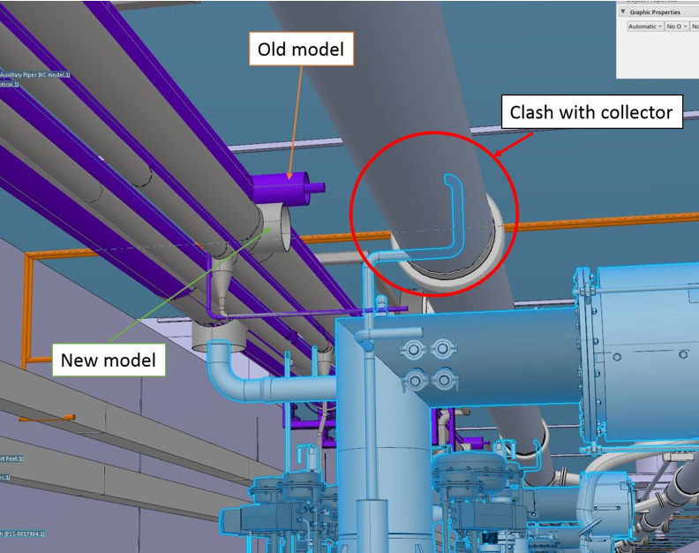
ESS Plant Layout - Spatial Integration
Clash analysis of revised design models

Slide 16
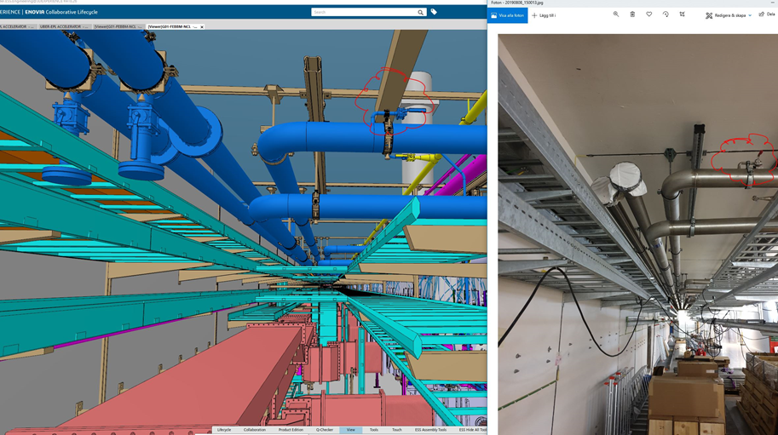
ESS Plant Layout - Spatial Integration
Allows for As-Designed multi discipline view with As-Built comparison

Slide 17
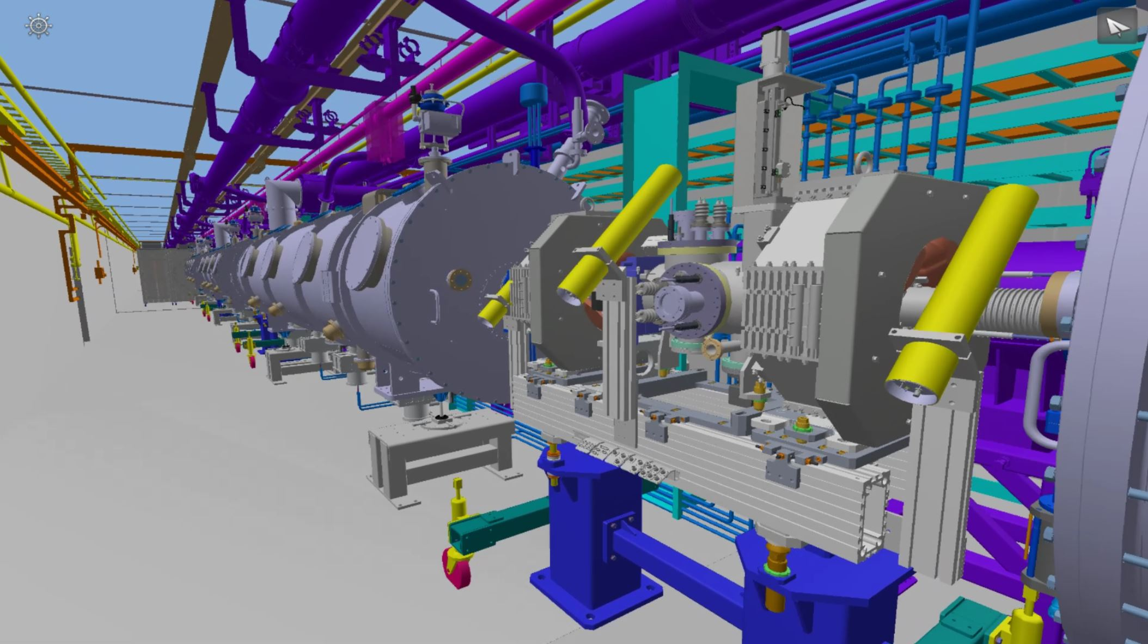
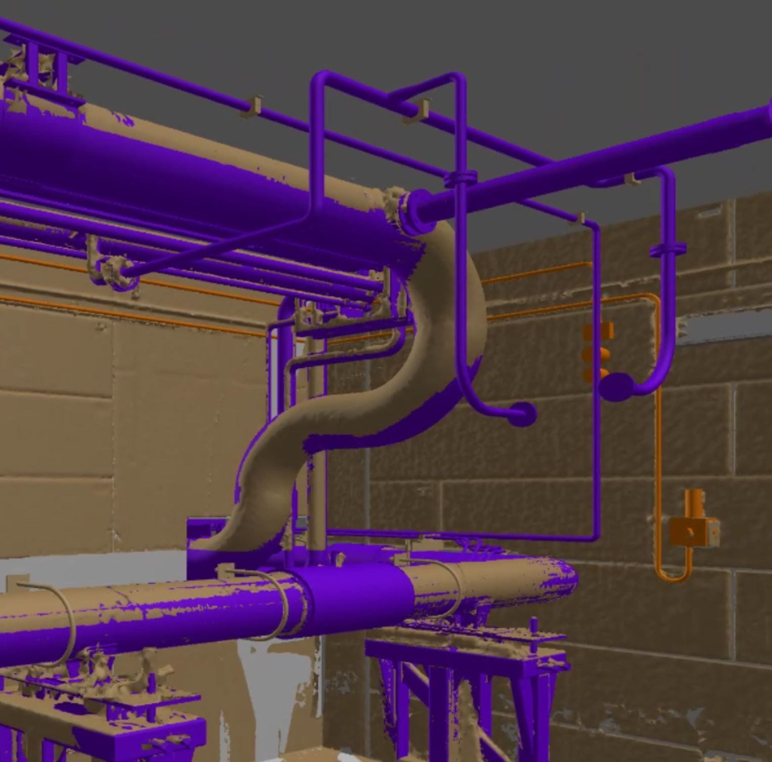
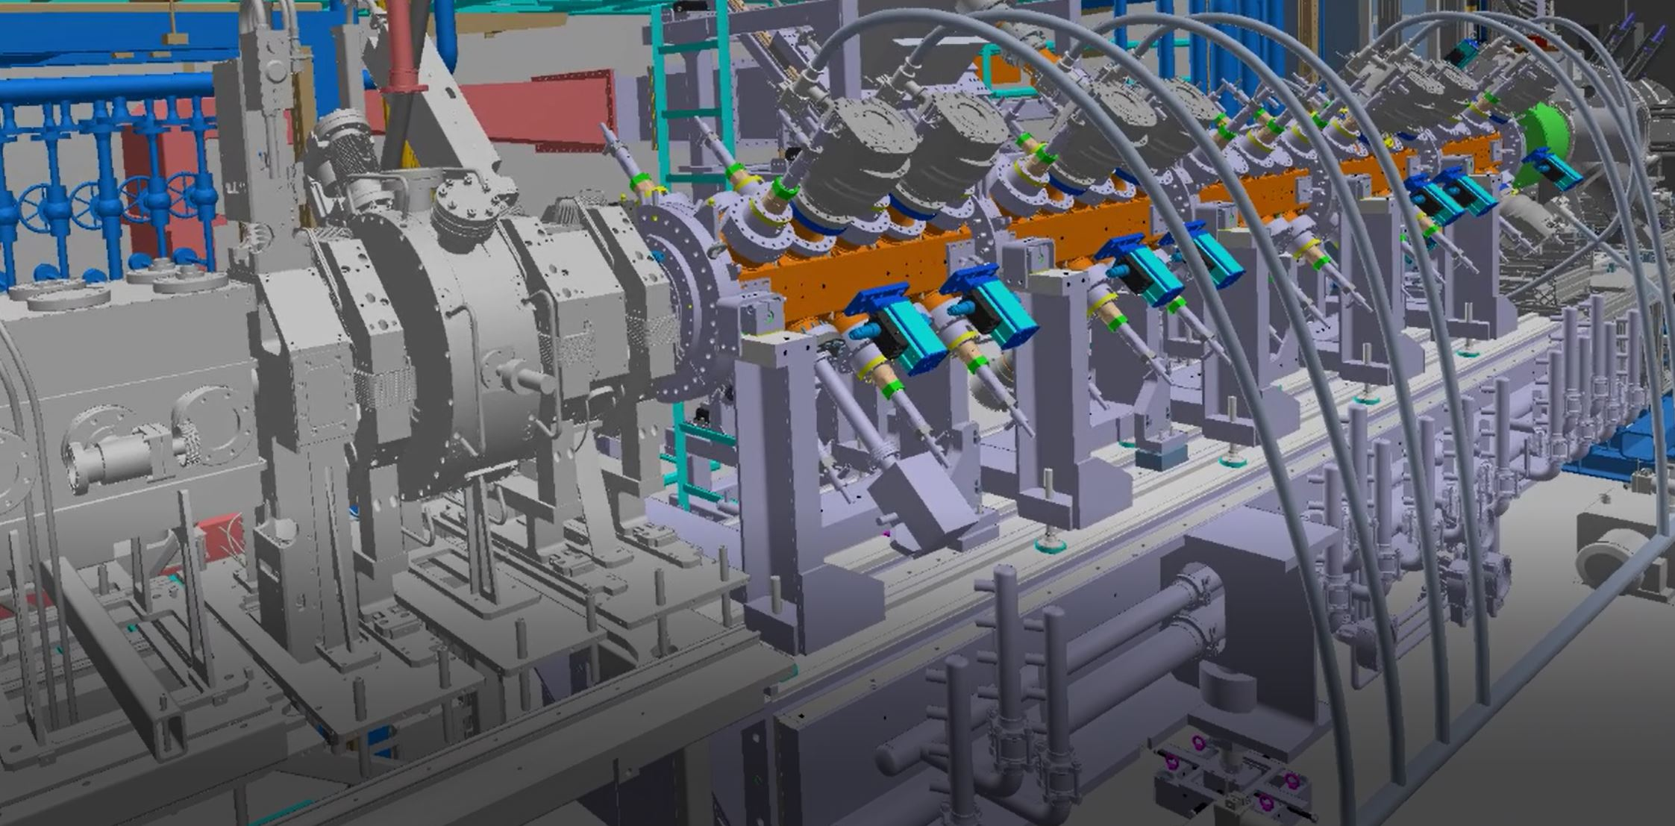
ESS Plant Layout - Spatial Integration
As-Designed multi discipline with As-Built comparison

Slide 18
Large Assembly Management
ESS 3DEXPERIENCE 2020x
ARDHENDU NANDA

Slide 19
Infrastructure & Hardware (1)
Create & work with LAM data in CATIA… (8)
CATIA Preferences (2)
Usage of 3DIndex & 3D Thumbnails (3)
ESS - LAM
Open the data (7)
LAM method:
Simplified representations & Envelopes (4)
Build the CATIA working session from Explore layer (6)
Search the data in db (search methods) (5)

Slide 20
ESS LAM Methods
Search the data in db (search methods)
Usage of 3DIndex & 3D Thumbnails
Build the CATIA working session from Explore layer
Usage of Simplified representations & Envelopes
Product structure & LAM
Open the data
Create & work with LAM 3D data in CATIA
Drawing Management & LAM
System setup
Infrastructure & Hardware
CATIA Preferences
3DIndex & 3D Thumbnails setup
System setup:
Simplified reps

Slide 21
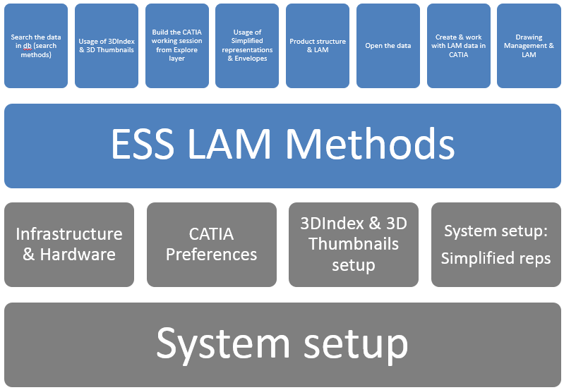
Infrastructure & Hardware
Platform architecture & infrastructure
DB
Performance investigation & tuning (DS or TechniaTranscat)
LAN
Desktop clients (RAM)
RAM: 16 GB is to less!? Increase for all users 32GB?)?
No more memory footprint in 2016x! Instead shared memory between Explore & Authoring layer...

Slide 22
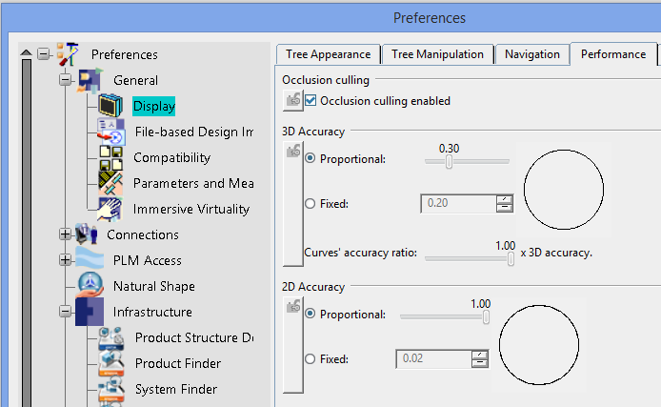
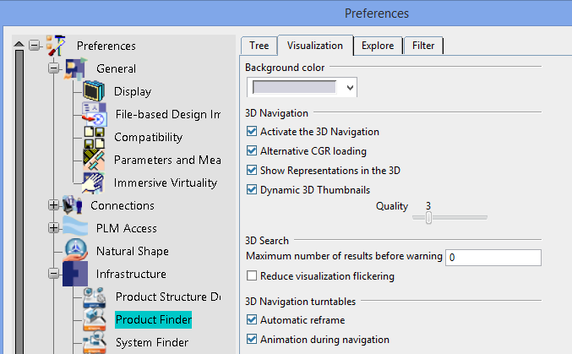
CATIA Preferences
Performance: 2D/3D Accuracy → Affects CGR and 3D Thumbnail file sizes in database...
3D Thumbnail is computed from the saved CGR in database (~ 1/3 of a GCR)
All CATIA users should use the same values
Impact on users having different 3D Accuracy/Sag values → The users will have the cost of re-computing the visualization each time…
Lock 3D Accuracy as admin!
For plant companies (such as ESS), for everyday work, if dealing with many Parts → Give priority to performance and use a high sag value between 0,2-0,3 (DS)
Infrastructure/Product Finder: 3D Navigation, Alternative CGR loading, Dynamic 3D Thumbnails etc.
“Quality slider” (1-10) – filtering Dynamic 3D Thumbnails…
Turn off “everything” for better performance during tree-navigation when no 3D needs to be visualized
Drafting: Exact, Approximate, (CGR) mode... Only generate 3D shapes larger than..?
Other Preferences: Ex. "Occlusion culling" (2D/3D), "Dynamic tessellation " (UVR)...?

Slide 23
CATIA Preferences
"Delay view update"?
Uncheck "Exact preview for view generation"

Slide 24
CATIA Preferences
Remove unnecessary Dress-up…

Slide 25
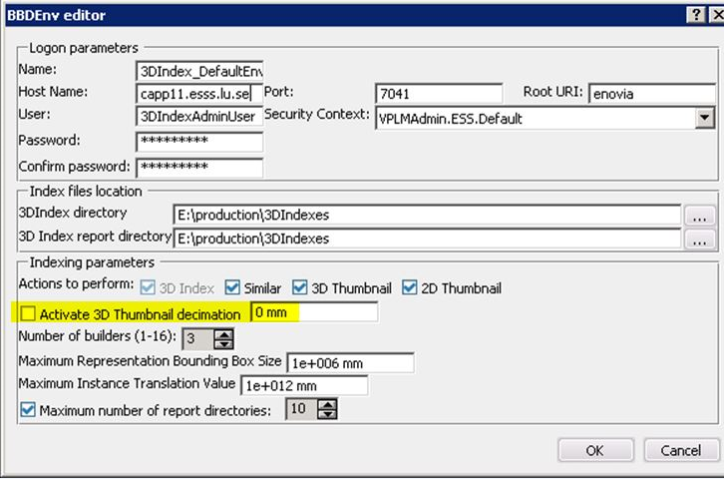
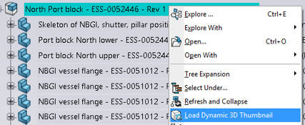
3DIndex & 3D Thumbnails setup
3DIndex Admin server settings
"Activate 3D Thumbnail decimation“, to reduce the number
of triangles of the 3D Thumbnail
Max rep bounding box size
Max instance translation value
To modify the limit of translation of instance and the maximum bounding box size of representation to index objects with a big dimension...
The 3D Indexing Server generates 3DIndex files of all geometry in database to allow:
3D Search from CATIA client
To build Dynamic 3D Thumbnails (Products & Sub-Products)
It also builds 2D and 3D Thumbnails of terminal nodes (3DParts)
"Load Dynamic 3D Thumbnail" can be used "on demand" on selected nodes. If "Dynamic 3D Thumbnails" option is turned off (see CATIA Preferences)!
Generate static 2D & 3D Thumbnails in batch mode (PLMThumbnailBuilder)?
Available from
2014x

Slide 26
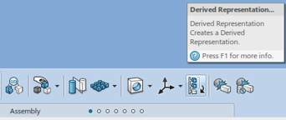
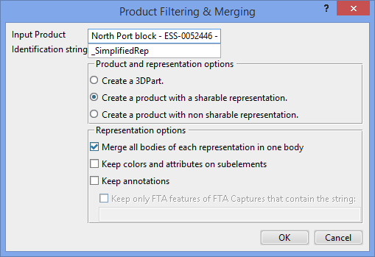
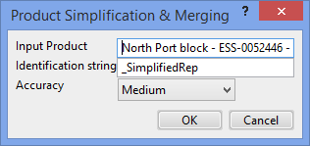
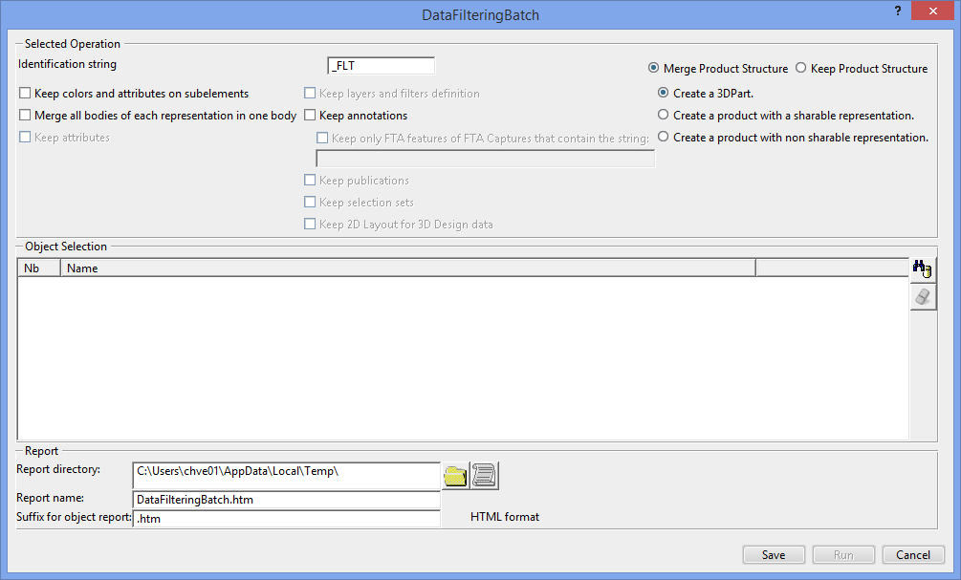
System setup:
Simplified reps/Envelopes
System setup supporting ESS LAM Methods: “Simplified representations & Envelopes”
Different requirements and needs for different Roles at ESS (TBD)!? Ex.:
Faster opening of multiple large assemblies from the EPL
Lighter models to be used as reference when designing
Drawings... -Create & Review, Interface and Layout drawings that includes multiple large assemblies
OOTB functionality/tools that can be used…?
Derived representations...
CATIA Engineering IP Control: Product Filtering, Product Filtering & Merging & Product Simplification & Merging (CGR based on 3DIndex)
Others (Wrapping, Distiller, Volume Computation (VOO) etc.)???
CATIA Experience Models Preparation app?
Native data/3D solid geometry or CGR´s?
Automation...?
Use the Batch utility (DataFilteringBatch)? → It only creates new data (no update/link functionality)..?
Usage of Security context (Collab. Spaces) to control the access...?
Volume Computation
New in 2016x

Slide 27
Search the data (search methods)
Usage of Favorites, take a "picture" of the session and save it in database
In CATIA
In Explore layer/Product Finder
For search results
Personal Favorites
Favorites can also be shared with other users
Search using EXALEAD indexed data (6WTags)
Search using Advanced search
More…?

Slide 28
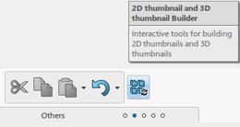
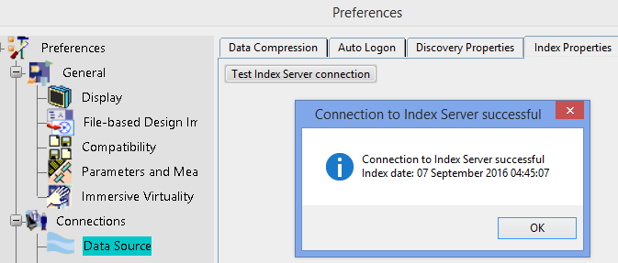
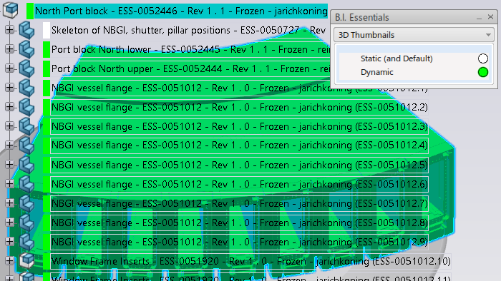
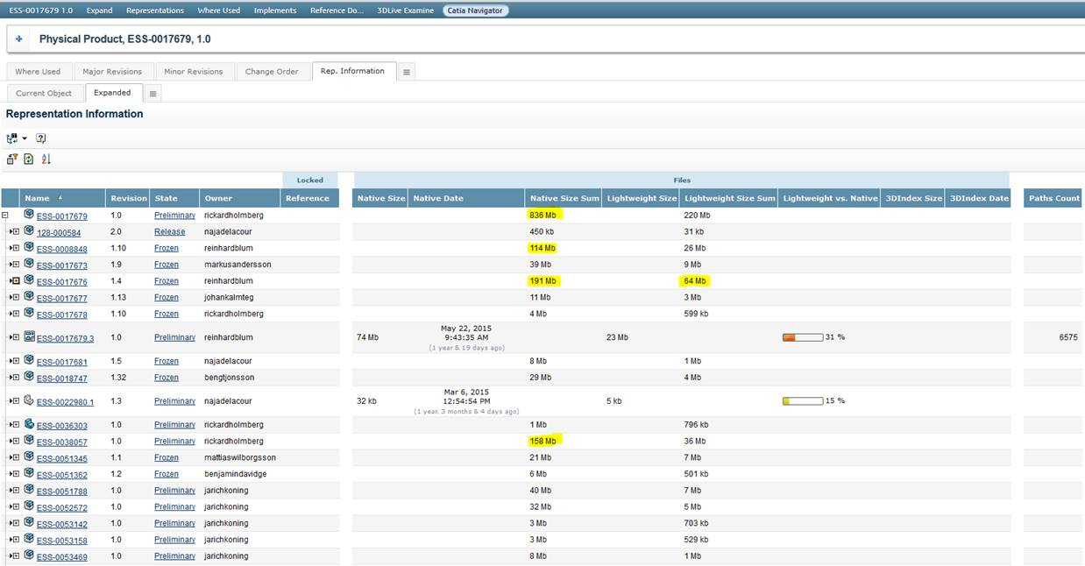
Usage of 3DIndex & 3D Thumbnails
#1: Explore layer + 3DIndex & 3D Thumbnails = LAM functionality OOTB!
The 3D Indexing Server generates 3DIndex files of all geometry in database to allow:
3D Search from CATIA client
To build Dynamic 3D Thumbnails (Products & Sub-Products)
It also builds 2D and 3D Thumbnails of terminal nodes (3DParts)
"Load Dynamic 3D Thumbnail" can be used "on demand" on selected nodes. If "Dynamic 3D Thumbnails" preference is turned off!
Static 2D & 3D Thumbnails can be created manually using "Thumbnails builder" on intermediate nodes (Products/Sub-Products)
Check 3DIndex & 3DThumbnail status (user side):
Preferences/Connections/Index properties → Index date and time
B.I: Essentials - 3D Thumbnails
The “2D/3D Thumbnail builder” command will also give the last Root Indexing Date and time
Lightweight file sizes can be analysed in CHESS
Note: Partial 3D indexation is done every 5 min in Prod

Slide 29
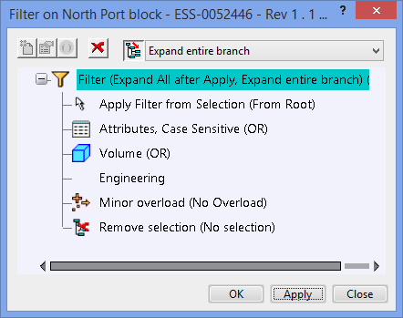
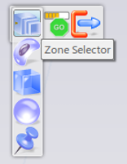
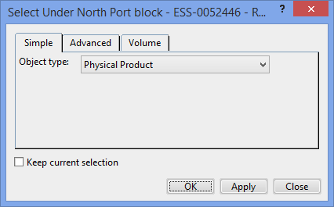
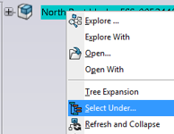
Build the CATIA working session from Explore layer
How to build (and save) the relevant CATIA working session from Explore layer: Build and load a working session with just the data needed!
Explore layer + 3DIndex: 3D Thumbnails automatically created
Enables - Volume Filters, Zones, 3D Search
"Product configurations" using existing Filters in database...
Zones method: 3D Search with a Zone query, select predefined zones and load every parts within it. Combination (OR) of several zones is possible.
Volume search: 3D Search with a Proximity query, select a 3DPart and every others in a specified clearance area.
Filter the product structure based on Attributes…
Use "Select Under“ functionality!? → Investigate!
To stop selection on a specific level…?
Choose the nodes to open or not to open (ex. Remove)...
In Explore layer, choose to see dynamic (real time) 3D Thumbnails (based on 3DIndex) or have a faster view with Static 3D Thumbnails.
Usage of Favorites, take a "picture" of the session and save it in database.
With “Store Filter”, every criteria filtering the tree will be memorized and replayed when opening the filter. Also, the filter object is sharable

Slide 30
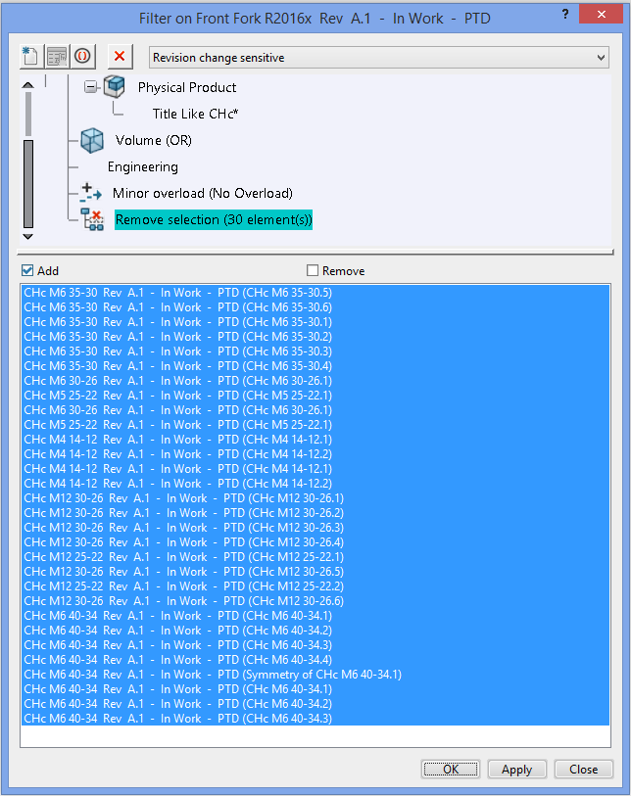
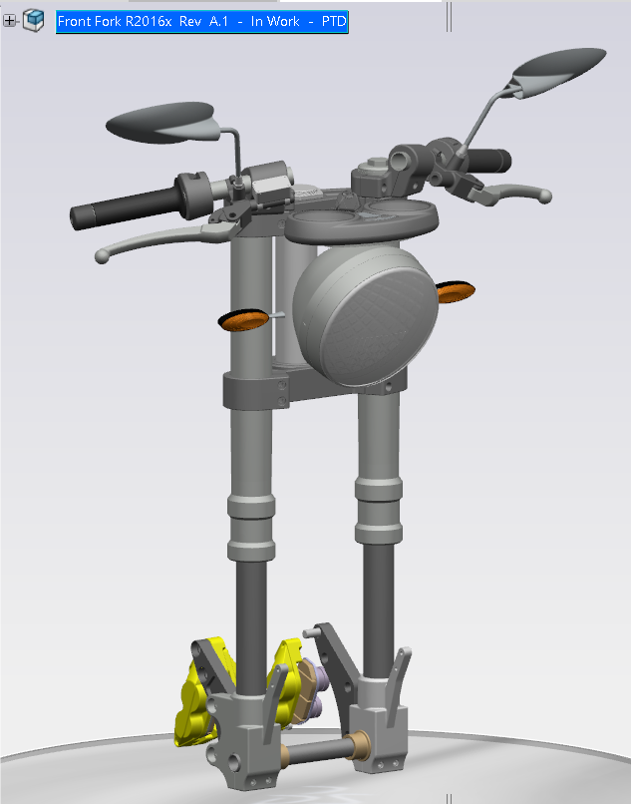
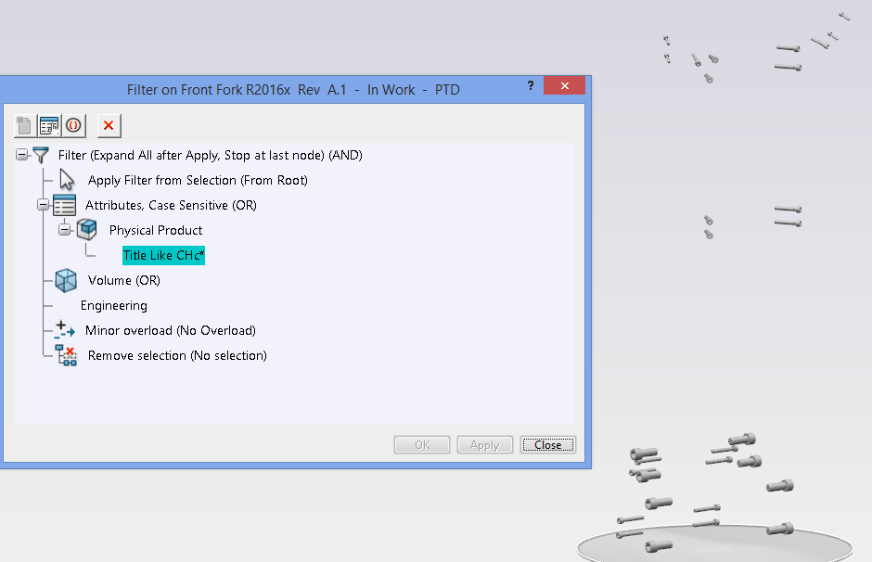
Build the CATIA working session from Explore layer
Filter the product structure based on Attributes…
Ex. Remove smaller geometry…???

Slide 31
Usage of Simplified representations & Envelopes
Pre-req.: System setup for ESS LAM Methods: “Simplified representations & Envelopes” – Automation..?
Methods: "How to work with Simplified representations & Envelopes at ESS
Creating Simplified representations/Envelopes… Multiple reps.?
Link(s) to native data?
Maintain/update structures (parallel structures?)
Filtering/Open structure(s) etc.)?
Drawing management...?
Different requirements and needs for different Roles at ESS (TBD)!? Ex.:
Faster opening of multiple large assemblies from the EPL
Lighter models to be used as reference when designing
Drawings... -Create & Review, Interface and Layout drawings that includes multiple large assemblies
OOTB functionality/tools that can be used…? Filter/”Select under” using attributes..?
Derived representations...
CATIA Engineering IP Control: Product Filtering, Product Filtering & Merging & Product Simplification & Merging (CGR based on 3DIndex)
Volume Computation (VOO)..?
Volume Computation
New in 2016x

Slide 32
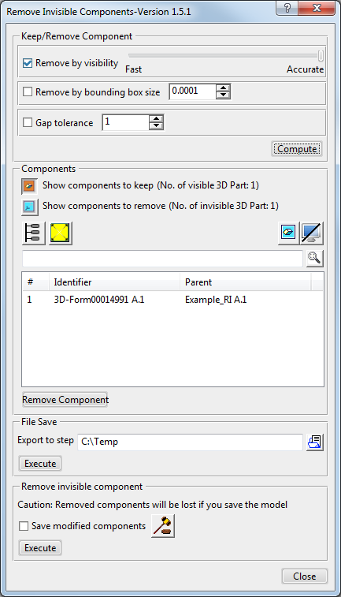
Remove Invisible is available in 3DEXPERIENCE apps for editing physical products and 3Dshapes, for example in Product Structure Design, Assembly Design or Part Design
Remove by visibility
Select the Remove by visibility option to mark components that are not visible from the outside to be removed.
The application calculates the visibility from various viewpoints. Use the slider control to adjust the accuracy.
• For faster processing with a coarse grid, move the slider further towards the left.
• For a more precise calculation, which increases processing time, move the slider further towards the right.
When you place the mouse pointer above the slider, the resolution of the plane behind the model and the number of viewing directions is shown in a tooltip.

Slide 33
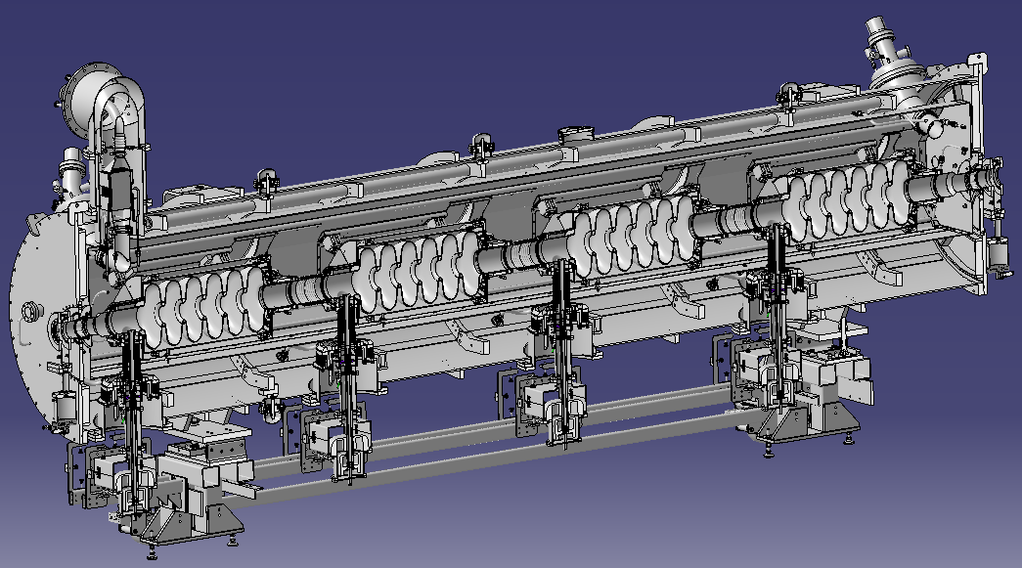
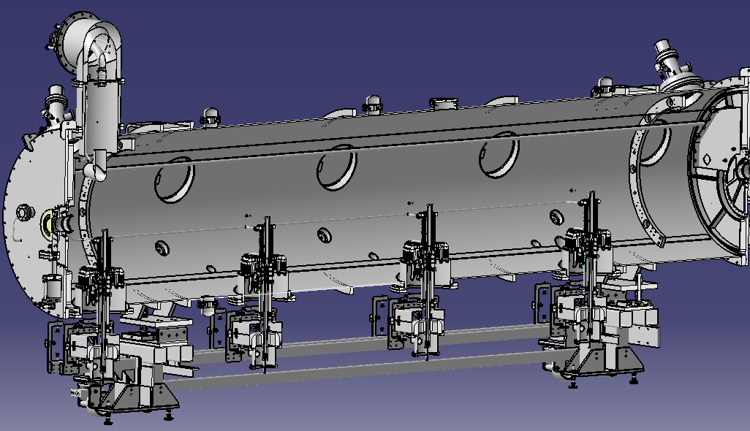
ESS example Cryomodule Assy – RemoveInvisible with gaps ignored
Some inner elements are visible through holes
3 239 Components have been detected as invisible
Calculation time on common laptop ~35s

Slide 34
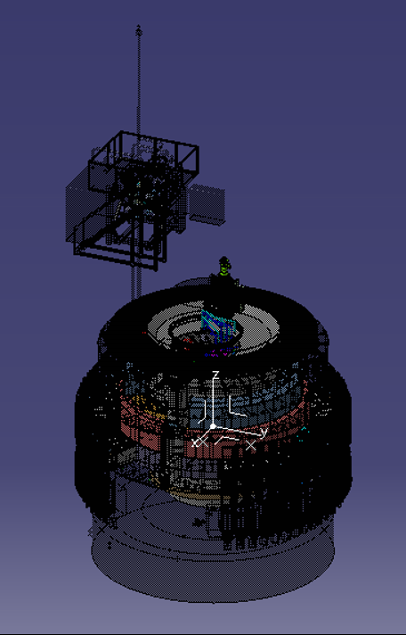
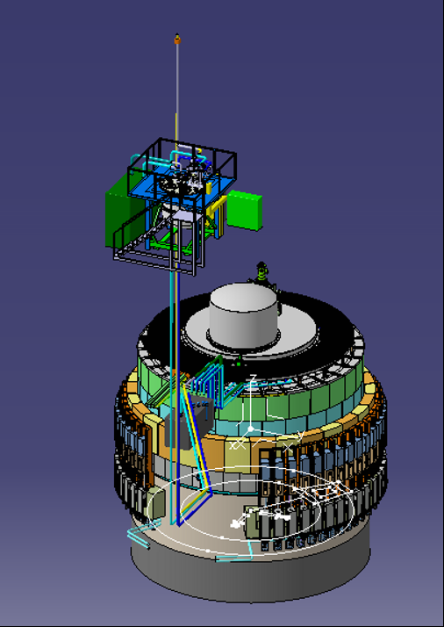
ESS example TOP Monolith Assembly
35 941 components have been detected as invisible
~3 min of calculation
Visualization with visible components in transparent mode

