Slide 2
Data Systems and Technologies
VISA as user facing service for scientific computing
PRESENTED BY Jesper rude selknæs

Slide 3
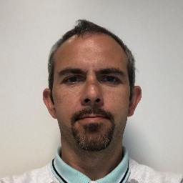
The DST team
Jesper Rude Selknæs
Alexandre Stefanov
Farshid Farjad
Brian Lindgren Jensen
Tilde Bonnevier Walstedt Starting August 15th 2024
Kareem Galal
Sigurdur Magnusson Studentworker 10h per week
Theodor Nørby-Lassen Studentworker 10h per week

Slide 4
DMSC
Computational infrastructure for the scientific user program
Goal:
Provide computational infrastructure that supports the user-journey of the scientific user from Idea to Publication
Pre-Experiment:
Simulations, modelling, virtual experiments
On-Experiment:
Experiment control
Data acquisition / Live data / analysis
Post-Experiment:
Data (re-)reduction and analysis
Simulation/modelling
User-experience needs to be:
Efficient
Consistent
User-friendly
Powerful
In a way that supports:
Collaboration
FAIR principles
Remote operations
Notes:
To support this user-journey, we need to provide a user-experience that is: Efficient, Consistent, User-friendly, Powerful and that supports Collaboration and FAIR principles

Slide 5
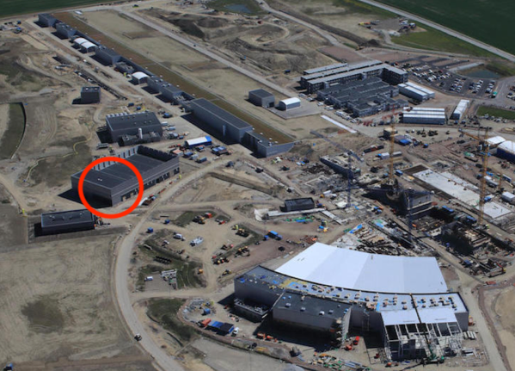
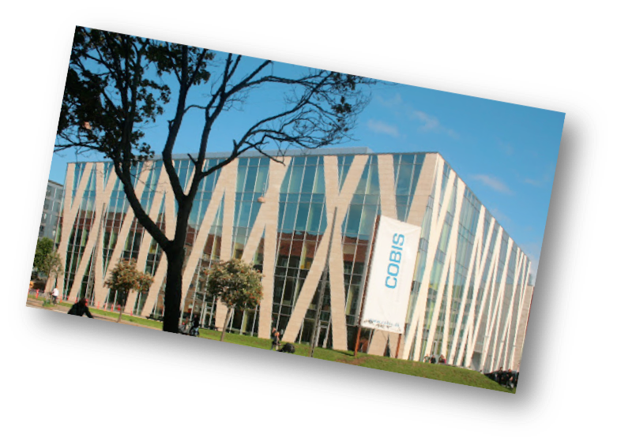
The ESS data pipeline
From detectors to publication
Site server room
Beamlines
Detector readout and EPICS Bridge
DAQ
Online Data reduction and analysis
Online storage - raw
Online storage - derived
Service Failover
External Archive
Raw data (read-only)
Derived data (read/write)
Copenhagen server room
Data Portal
Offline environment

Slide 6
DMSC data center consists of
Hardware
The Datacenter consists of:
A HPC cluster consisting of 95 nodes and 2656 cores+ 2x A100 GPU cards.
Storage systems:
ZFS based home directories – 80TB total
ZFS based storage for project data – 320TB total.
Lenovo based GPFS SpectrumScale 2 x 850TB
A 120TB ZFS based backup system at I2 (DeIC) in Lyngby DK. To be sunset in 2022.
A 3 host 1.1TB RAM virtualization system. Including 2 x 10TB SAS based storage systems
10 nodes (32 to 96 cores each) for virtualization being deployed on OpenStack in both sites.
Mac OSX servers (1 MacPro server and 10 Mac Minis)
1GBE, 10GBE and 100GBE Ethernet
QDR and HDR InfiniBand for cluster- and storage interconnect. QDR to be sunset.
Total of 46 servers in Lund for event formation, KAFKA cluster and filewriters.
10GBE MPLS based site-to-site link connecting COBIS and H01

Slide 7
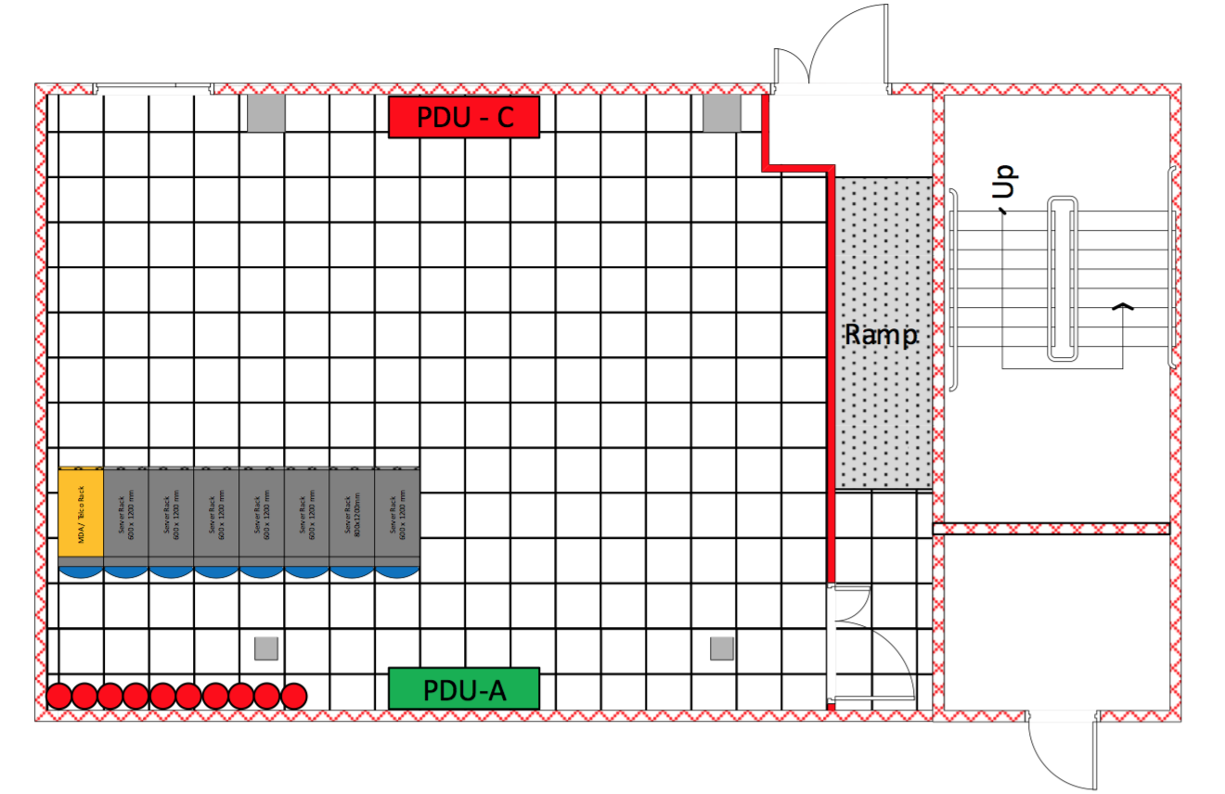
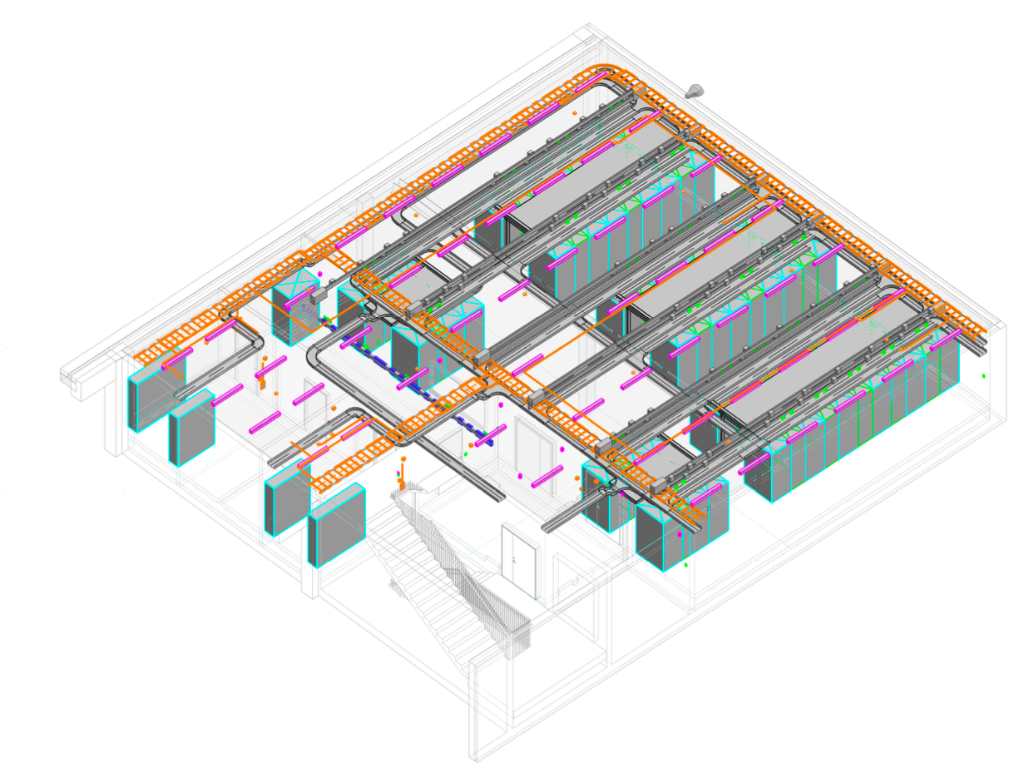
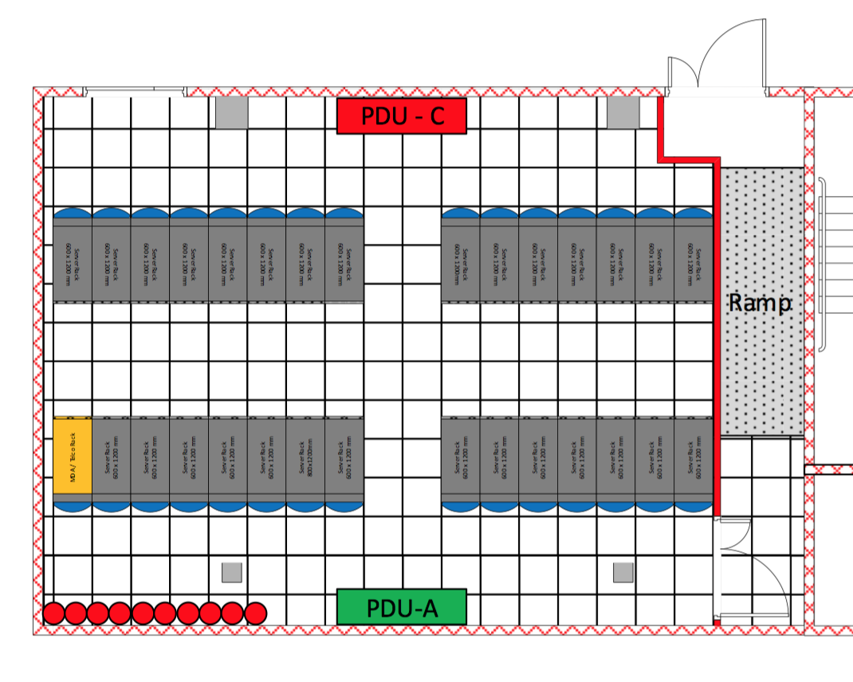
Future data centres
Copenhagen - available Q4, 2019
CUB (H01) – available Q4, 2019
2019
?
2030

Slide 8
VISA
Virtual Infrastructure for Scientific Analysis
- developed at ILL – funded by PANOSC
On-demand desktop and JupyterLab environment for experiment users
Available for users both before, during and after the experiment
Sessions can be shared with collaborators (and local contacts / support)
Compute resources are allocated based on experiment and instrument
https://visa.readthedocs.io/

Slide 9
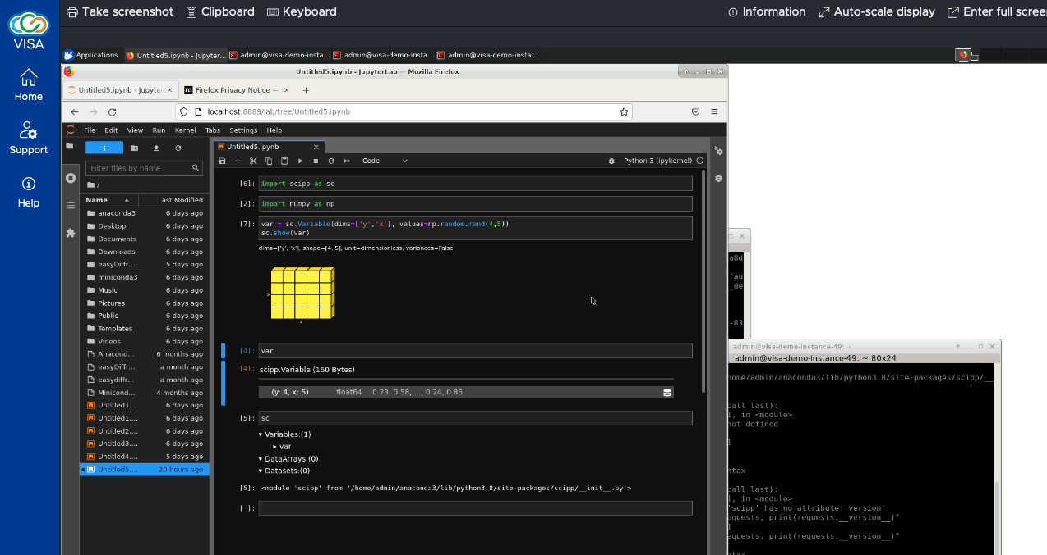
VISA at ESS
Integration
Persistent storage/config across sessions, instances and proposal cycles (though any given instance will have a limited lifetime, a new can just be started with the same settings)
Computing cluster integration – to enable easy computing offload from e.g. JupyterLab/DASK to the DMSC HPC cluster

Slide 10
VISA at ESS
Scientific Applications
Apptainer (formerly singularity project)
- docker-like containers without (most) of the security issues of docker. Provides a self-contained environment that can run independently of the host system and environment.
Scientific applications (apps) in VISA will be made available through apptainer containers
Containers allow for each app to have its own environment (which mitigates conflicts between different apps and versions)
Live updates to apps (incl. hot-fixes in a support-situation) without the user needing to restart their instance

Slide 11
VISA at ESS
Scientific applications
Reproducibility will be ensured as old versions of apps will still be available (and working) for users – also when redoing an analysis after many years – supporting FAIR data use
Flexibility - as users can build and bring their own containers with applications, or download a container with the software used for a given proposal cycle to use on their own compute resources
Planned features:
SciCat integration
FAIR data use (third party)
Windows support
Backend:
Openstack
Authentication through Keycloak
Authorization from UserOffice

Slide 12
VISA at ESS
Current features
Software available
McStas
Ncrystal
Fullprof
GSAS-II
EasyDiffraction
Sasview
MAUD
NICOS
ShellX
Standard LINUX software
PowCod
Vesta
Mantid
Qaulix
Spinvert
RMCProfile
Features
OS Support
Ubuntu 22.04
CentOS 7 and 8
AlmaLinux 8 and 9
One Windows application using Apptainer is in place
Shared storage can be mounted
Integration with User Office is in progress
Integration with the HPC backend is in progress
More user friendly remote access is in progress

Slide 13
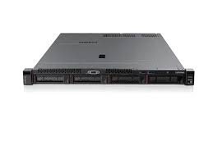
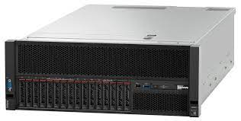
VISA at DMSC
Prototype
VISA demo box
Vagrant deployment
OpenStack controller
VM control
HTTPS access
SSH SOCKS proxy
Internet
SSH bastion
Remote desktop traffic
Access to data
OpenStack compute nodes
SpectrumScale storage system

Slide 14
Virtualization capacities at DMSC
OpenStack – catering for large SMB machines
Hardware installed:
Copenhagen: 4 nodes of 96 cores and 1TB memory. Two nodes comes with 1 x Tesla M10 GPU card. 2 nodes of 96 cores and 1TB memory including Nvidia A100 card 4 nodes of 32 cores and 1TB memory.
ESS H01: 4 nodes of 96 core and 1TB memory. One node comes with 1 x Tesla M10 GPU card. One node with Nvidia A100 card
Status of OpenStack:
A 3 node production setup in place in CPH and to be expanded per need.
An interim setup in H01 for testing by other DMSC groups. Production system under installation.

Slide 15
VISA and HPC
How to get startet
Contact DST:
Catch one of us live
Write to support@esss.dk

Slide 16
Finish presentation

