Slide 2
Scientific Information Management Systems
SIMS
PRESENTED BY Fredrik Bolmsten

Slide 3
Group
Staff & Scope
User Office:
Proposal system
Scheduling software
Statistics
Data Curation:
Metadata catalogue
Electronic logbook
Scientific data management
Miscellaneous:
E-learning platform
Publication system
AI-Platforms
Fredrik Bolmsten
Max Novelli
Jay Quan
Yoganandan Pandiyan
Janos Babik

Slide 4
The User Journey
Users notify ESS of team
User training
Experiment safety review
Travel and accommodation
Ship samples
Physical Access
Dosimetry
Feedback
Experiment report
Data curation
Expenses review
Publications
KPIs
Submit proposals
Technical review
Excellence review
Result notification
Registration
Proposal
Scheduling
Planning
Performing & Analysing
Wrap-up & Harvesting
Register
Personal Data
Digital Access
Physical Access
Experiments
Sample environments
Local contacts
User lab facilities
Experiment notification
Data directories in place
Automatic data processing
Manual data processing
Permissions for files
Done
To be done for HC
Not started

Slide 5
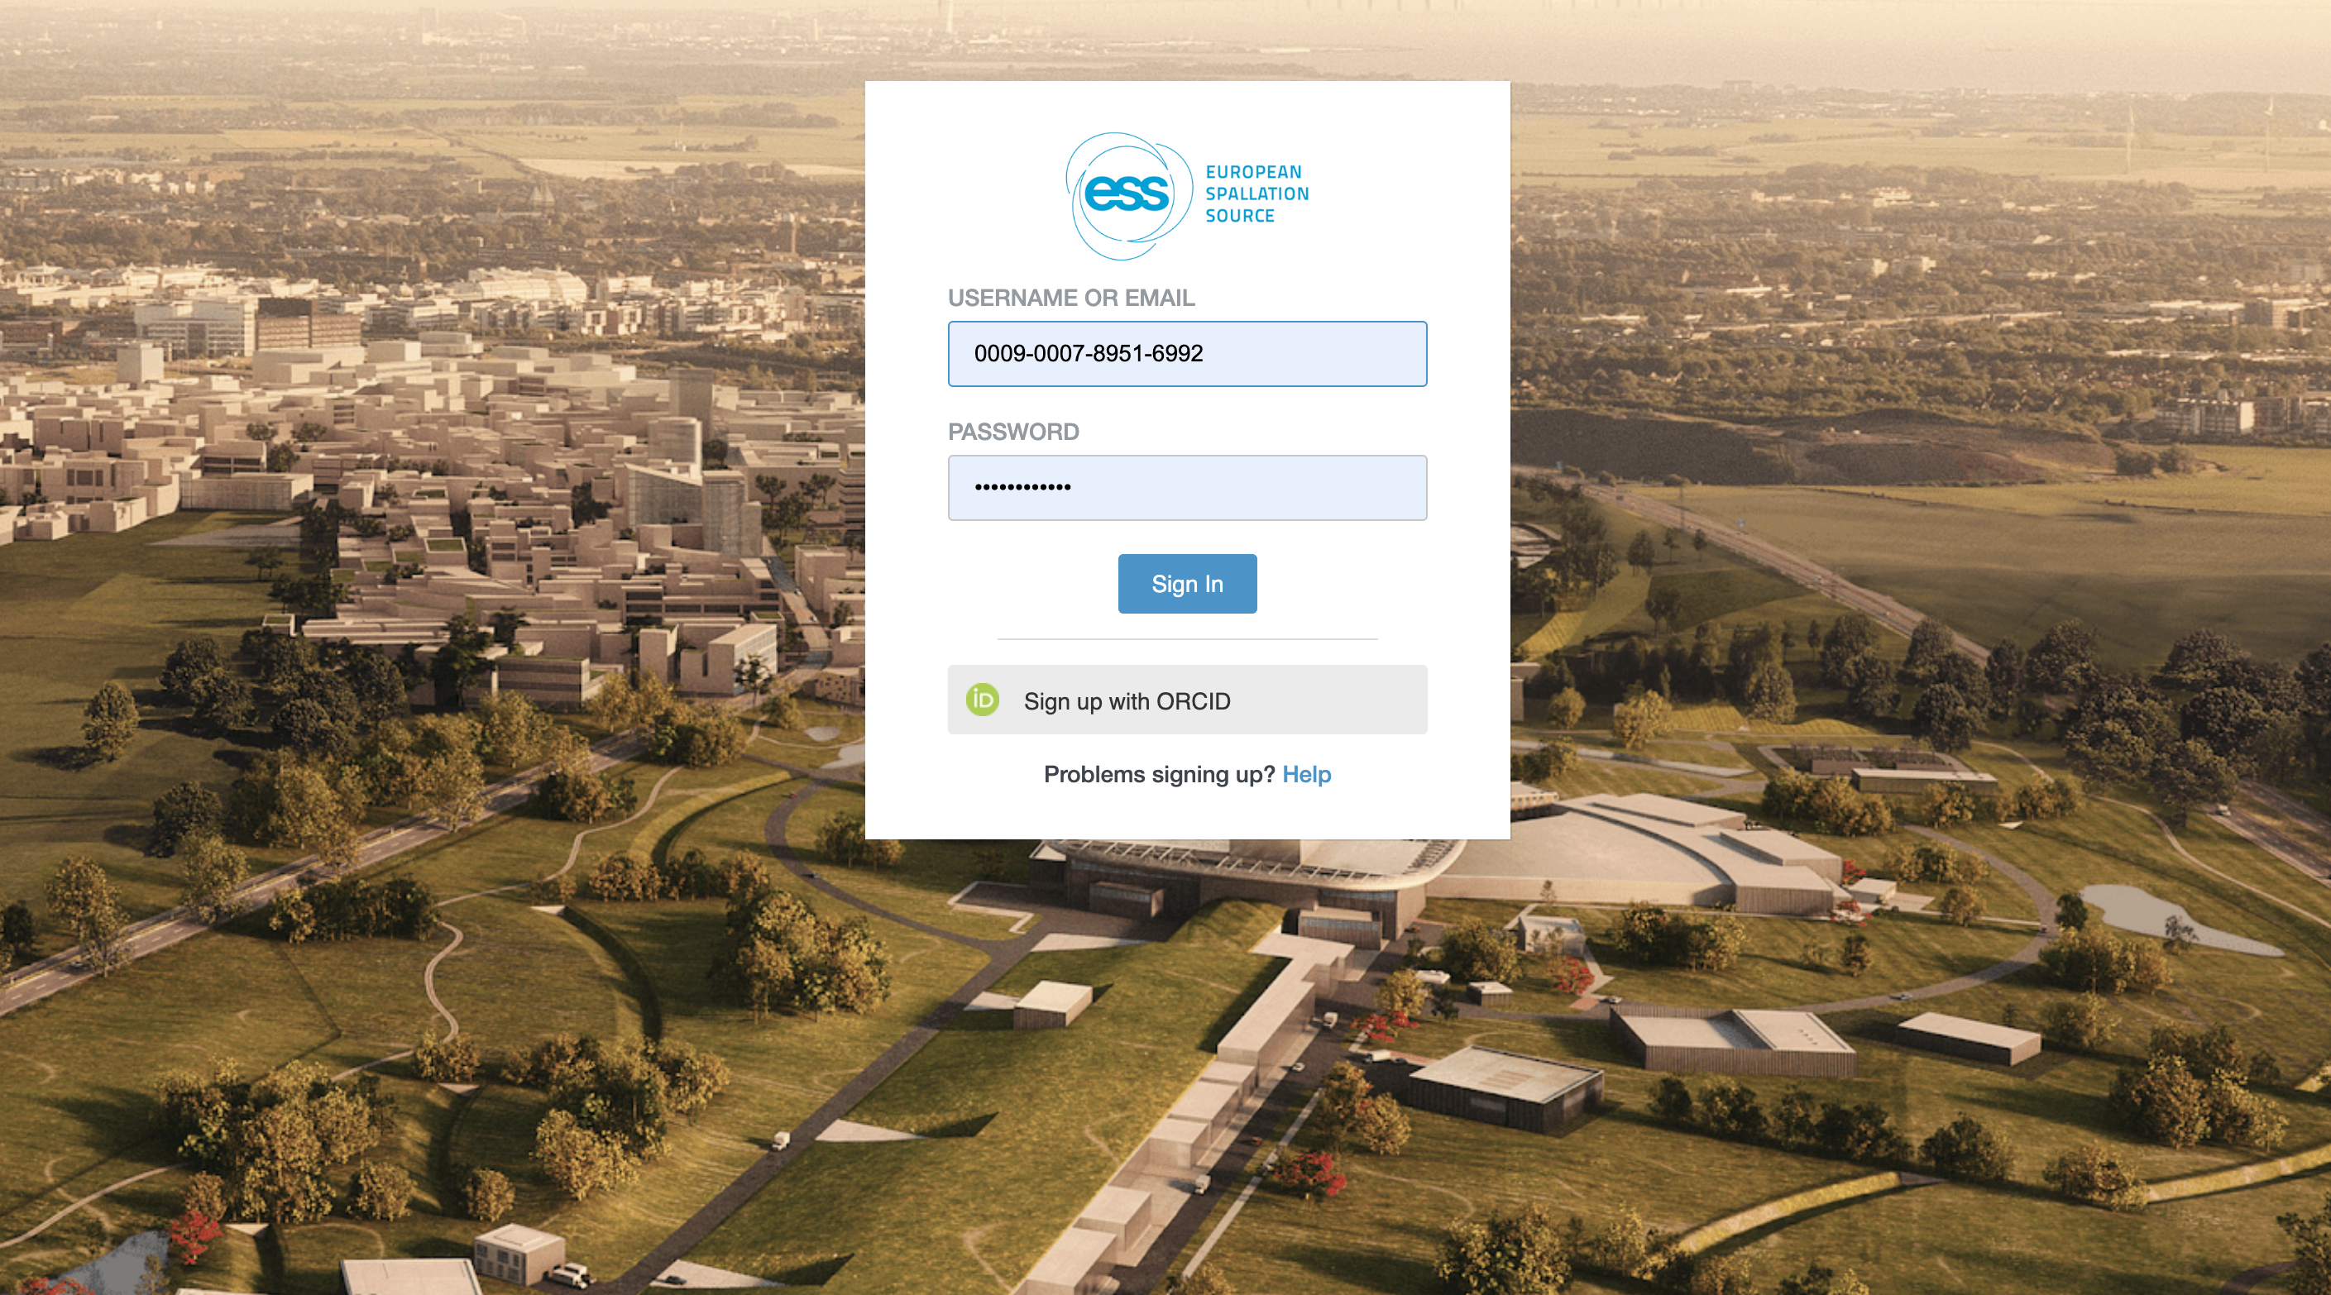
Account creation

Slide 6
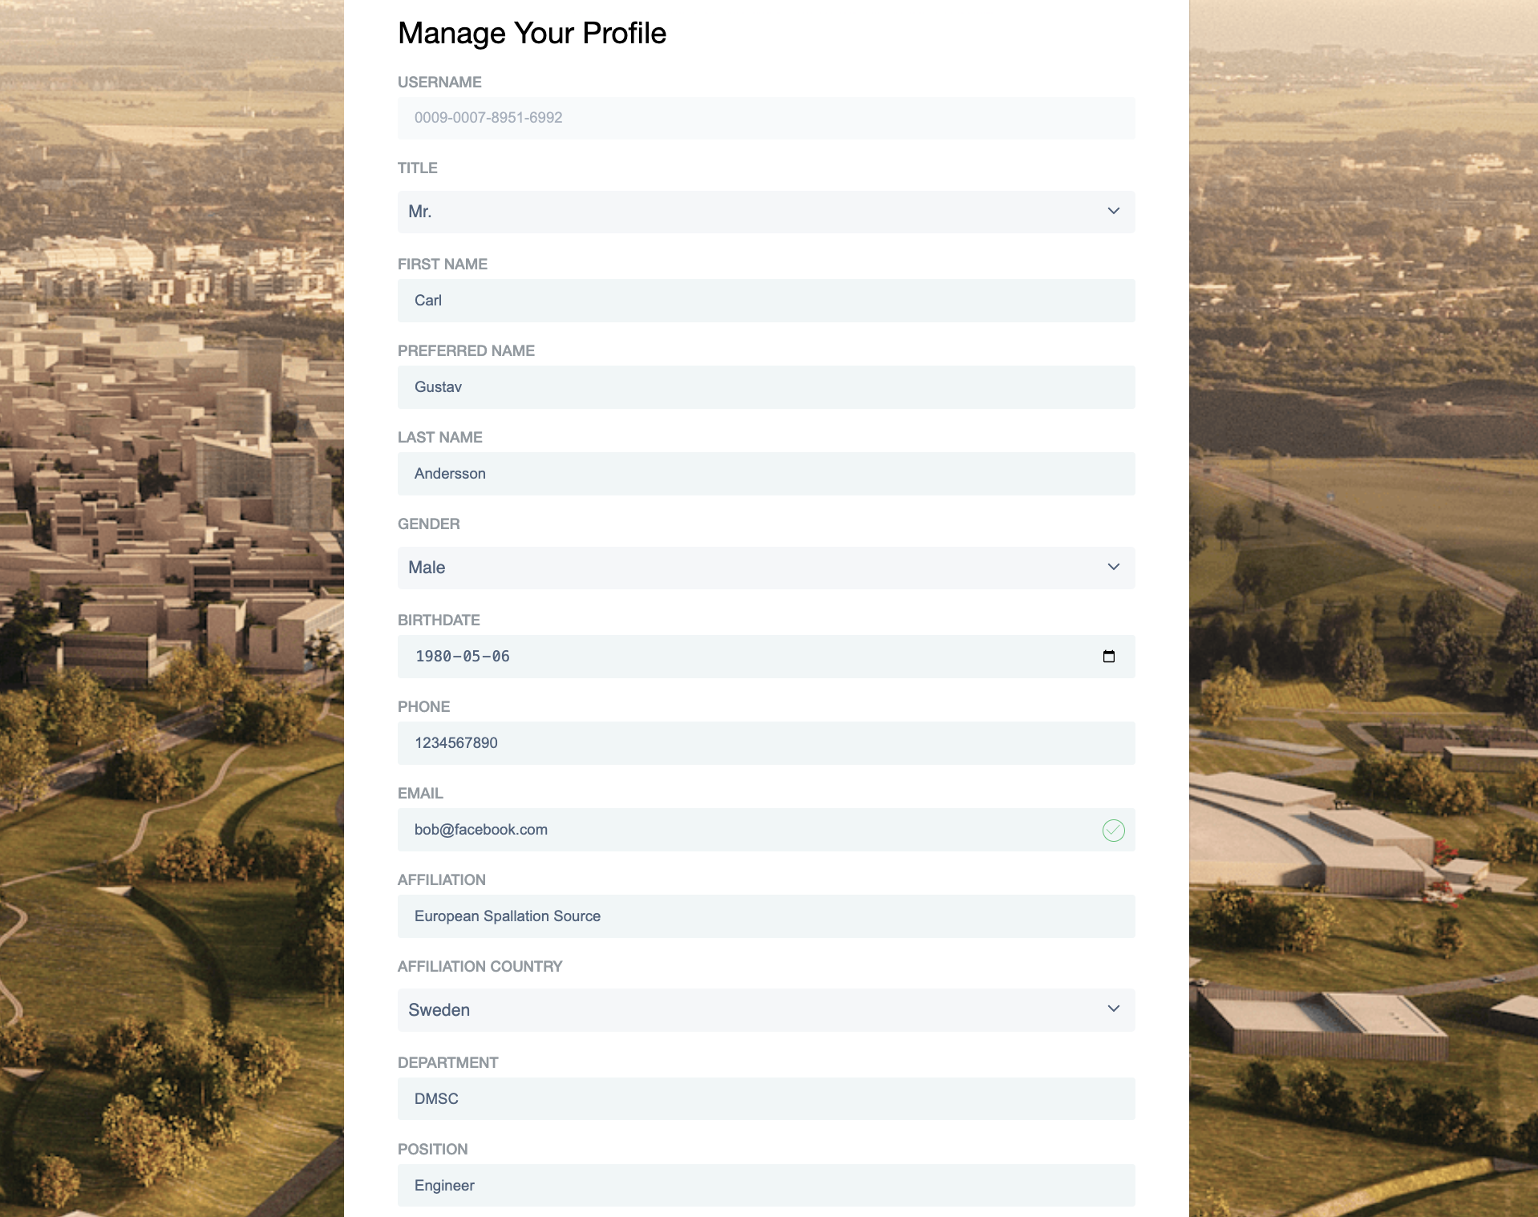

Slide 7
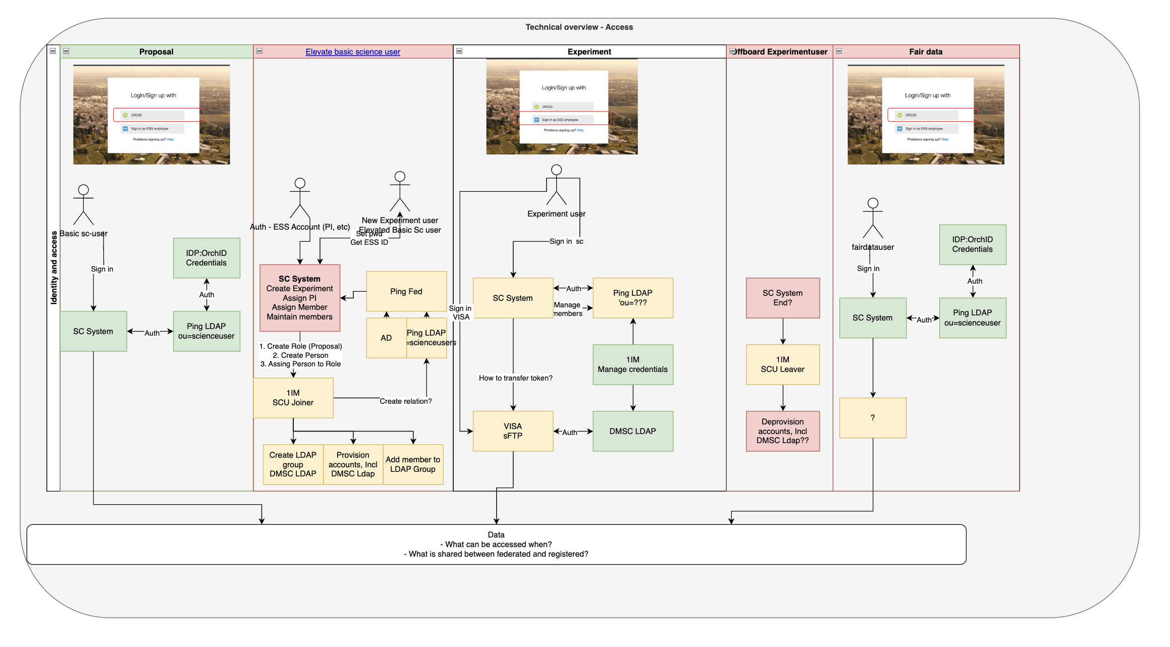
Account life cycle

Slide 8
Folder creation
https://confluence.esss.lu.se/display/ECDC/Proposal+Folder+and+File+Structure

Slide 9
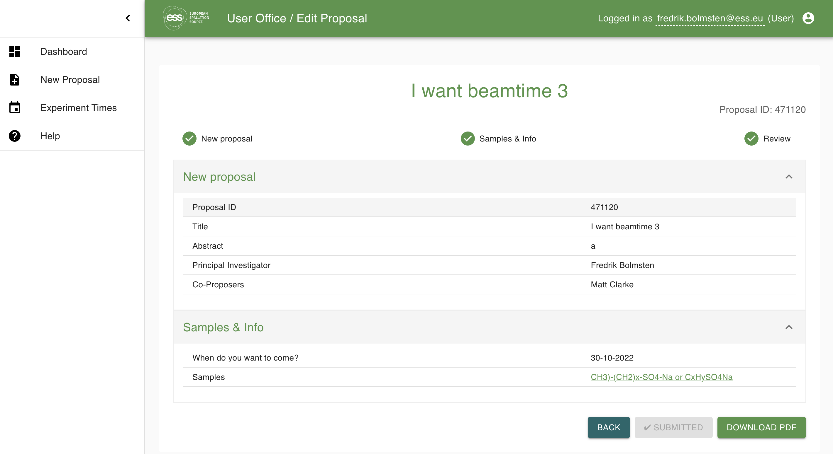
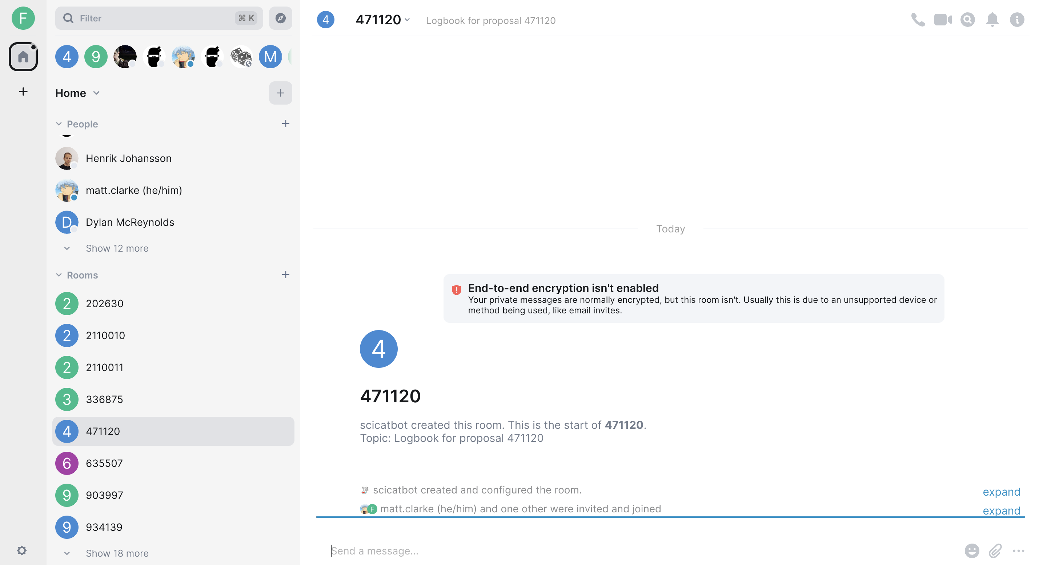
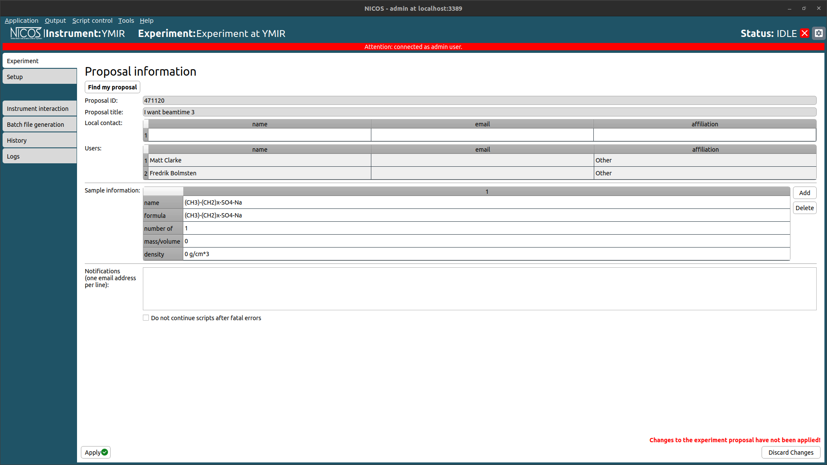
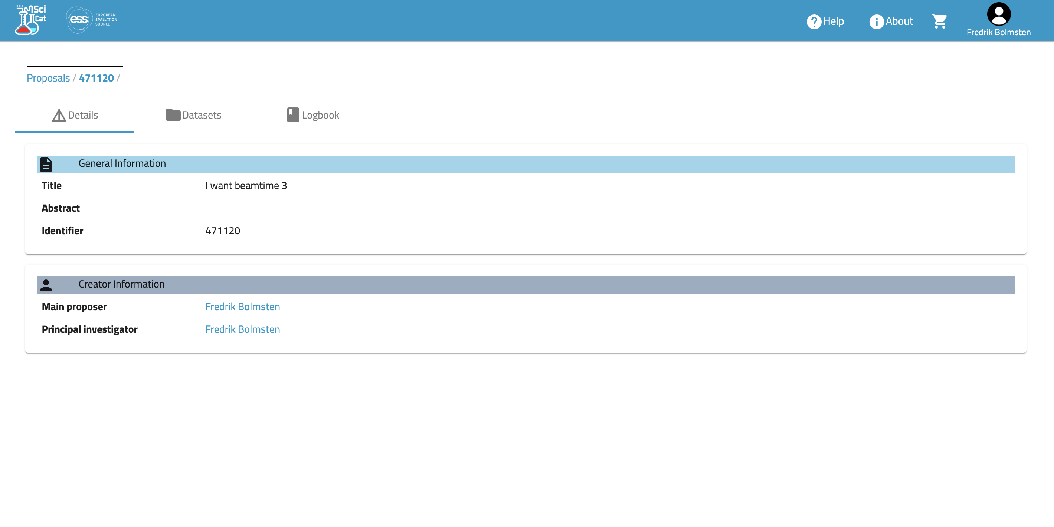
YMIR
Testing it all
Account creation
Proposal creation
Technical Review
Scientific Review
Scheduling
Folder creation
SciChat room creation
SciCat dataset creation
Simulating NiCOS to SciChat messages
Jupyterhub to SciCat dataset creation
Download

Slide 10
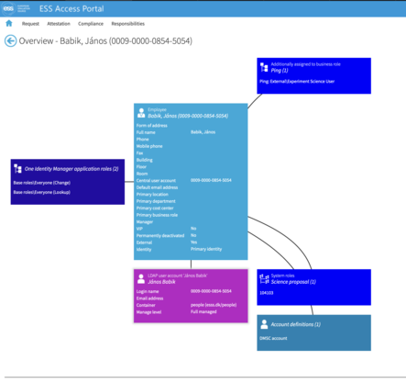
Concerns
Security & Identity Assurance
It is unclear how to meet the security requirements.
What is acceptabel risk? Who decides? And how can we move forward today?
Do we need to go above standard operating procedure (i.e. what other facilities does)? World leading in everything?
Creation of users in the DMSC ldap

Slide 11
Questions?

Slide 12
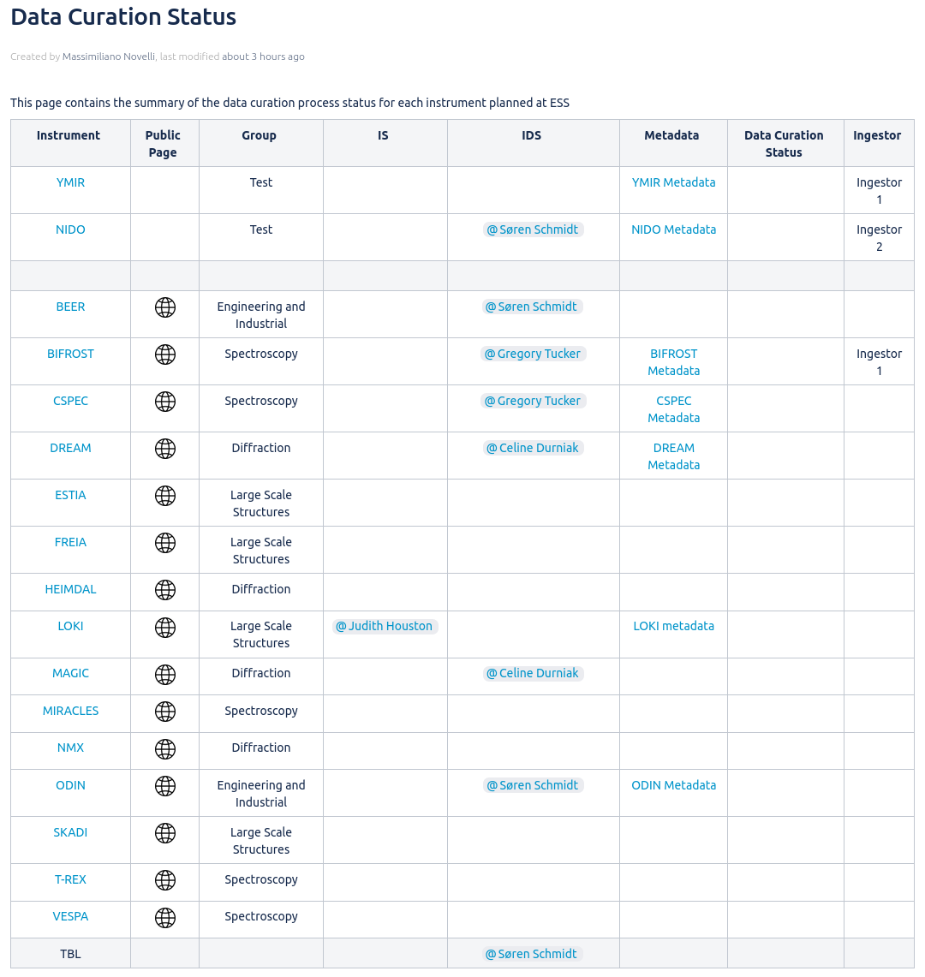
Data Curation
On-Going activities:
Engaging with Instrument Scientist and Instrument Data Scientist of tranche-1 instruments
Cross groups collaboration to define and manage metadata expectation
Metadata configuration: format, management and sources
Proposal folders creation: naming and permissions
Dataset ingestor code review
Future milestones:
Document individual instrument metadata
Instrument metadata acceptance from stakeholder
Finalize metadata configuration implementation
Dataset ingestor code refactoring

Slide 13
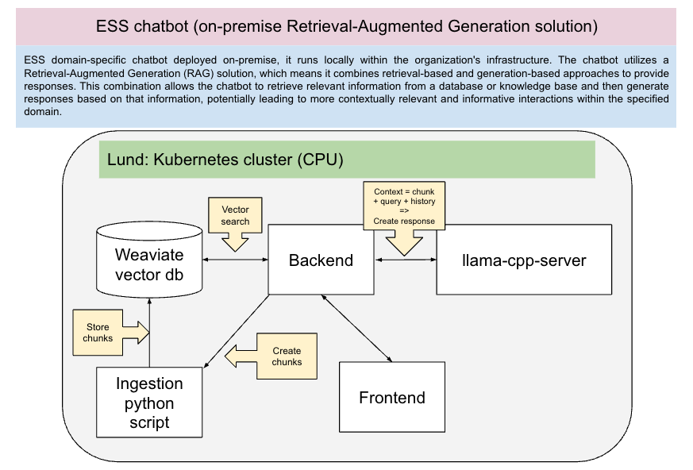
AI Projects

