Slide 1
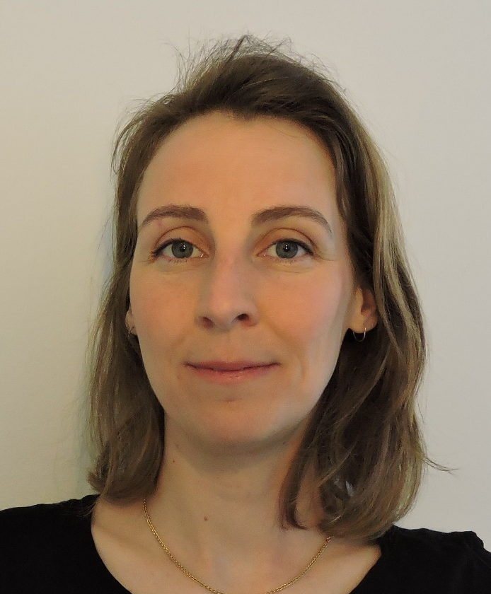
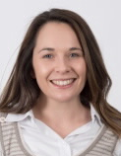
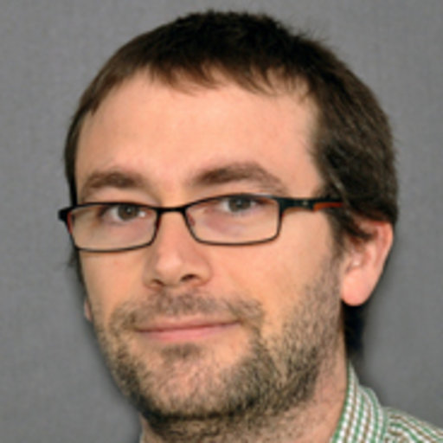
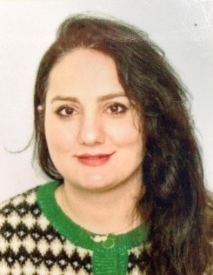
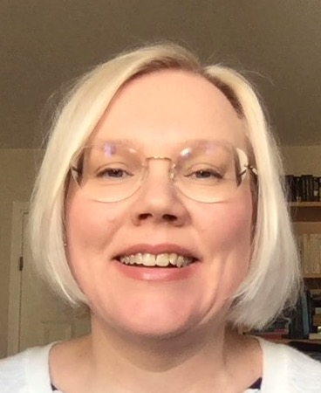
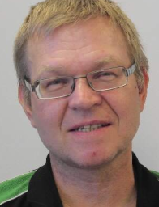
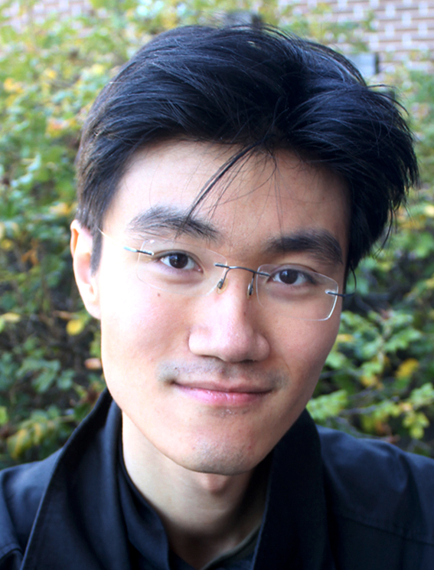



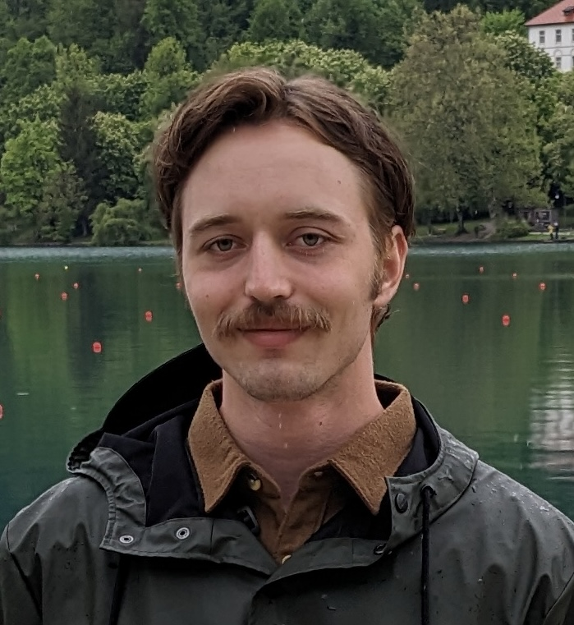
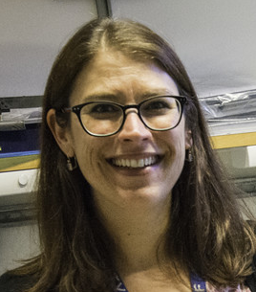
Chemistry and Life Science Support (CLS)
SSD Division
PRESENTED BY Monika Hartl

Slide 2
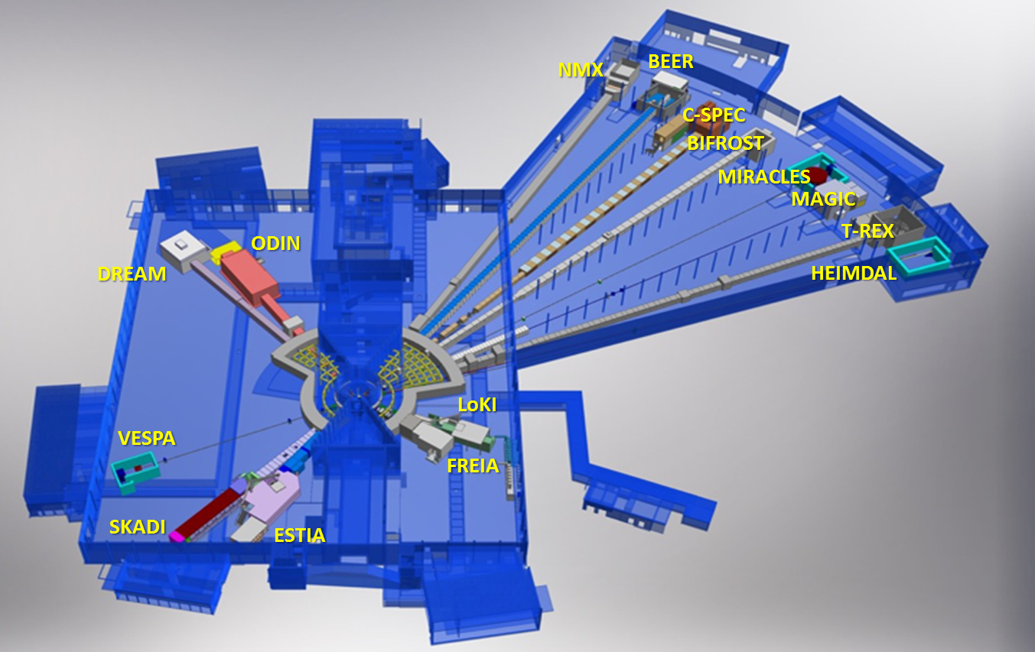

Where are we?
Locations
RML (radioactive materials lab)
Chemistry and Life Science Support :
1120 m², 25 rooms
4 buildings
Offices:
D08, E04
and
E03
D08
E04
D04
Installation started

Slide 3
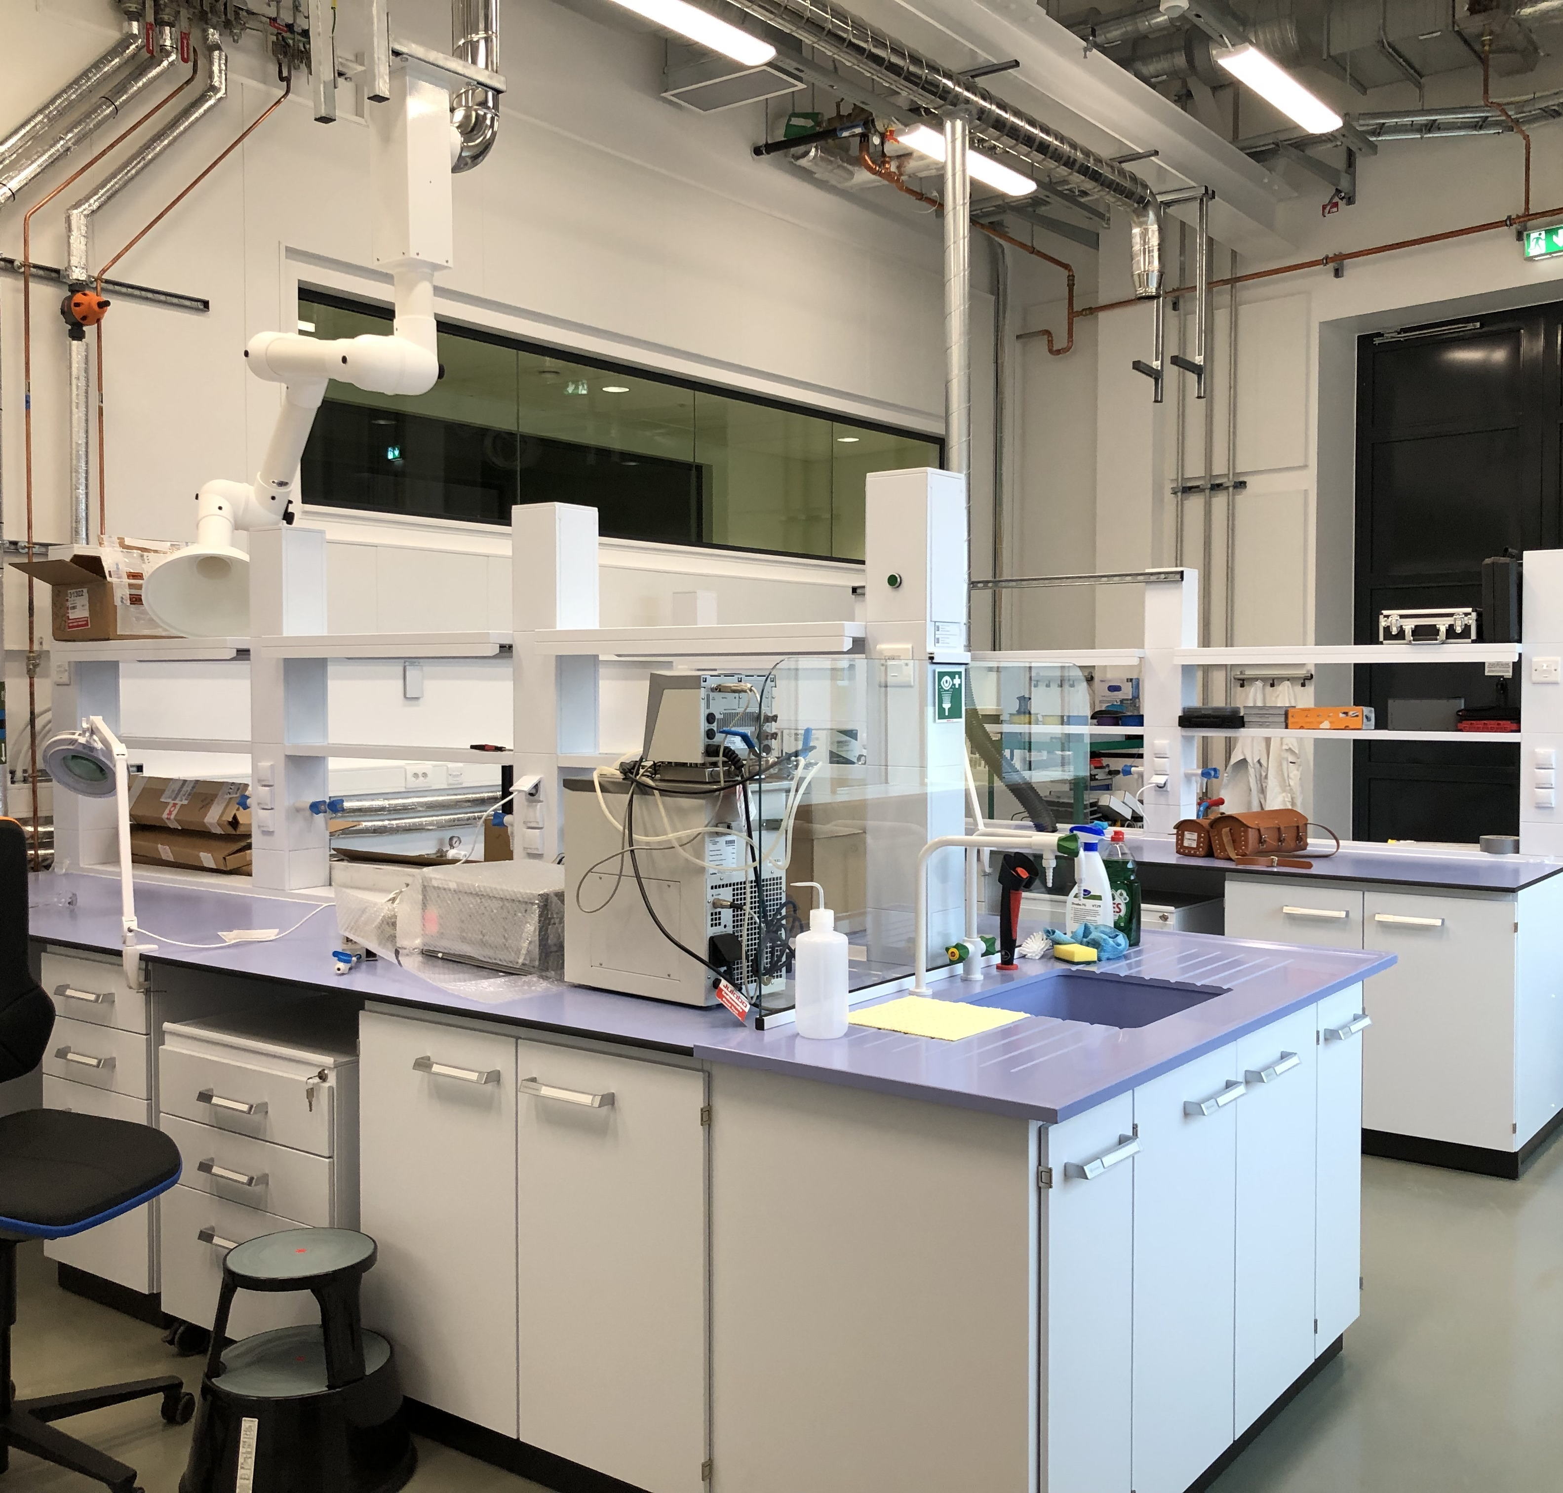
What do we do?
- Deuteration of samples (all areas)
- User Laboratories (not materials engineering, high pressure -> MSPS)
- Sample Environment for chemistry (gas handling, optical, electrochemistry,…) and soft matter (liquids, rheology, humidity,…)
  Also heavily involved in:
  ESS proposal system (user office)
  Sample Management (OHS, RP ->SSM)
  conventional/ rad. safety (inventory, portal monitors, installation,…)
  D04, D08, E04 building area management (office support, FM, Logistics, Access forum,…)

Slide 4




CLS – DEMAX
Supply of deuterated samples and protein crystallization.
Deuteration and macromolecular crystallization (extended team)
Bio deuteration
Protein Crystallography
Chemical Deuteration
Hanna
Wacklin-
Knecht
0.2 FTE
Lipids
Anna
Leung
Jia-Fei
Poon
Small organic molecules,
Lipids (e.g. POPC, SOPC, POPE)
Surfactants (e.g. sugar-based)
Novel molecules
Deuterated biomass from algae, yeast, E. coli, …
Recombinant soluble proteins, DNA
Yeast-derived lipids
Zoë
Fisher
0.7 FTE
LP3
High- and low-throughput screening,
fine screening in large volumes
r.t. crystal mounting & data collection, X-ray testing at MAX lab

Slide 5
CLS – DEMAX Access
How to get in contact?
Level 110
Chem. Lab (VESPA, ESTIA, SKADI)
Laboratory space in D04, first floor
Office space: D08, 2nd floor
(chemical deuteration)
NEED HELP with deuteration?
rolling access:
https://europeanspallationsource.se/node/247917
Contact: zoe.fisher@ess.eu OR demax@ess.eu

Slide 6
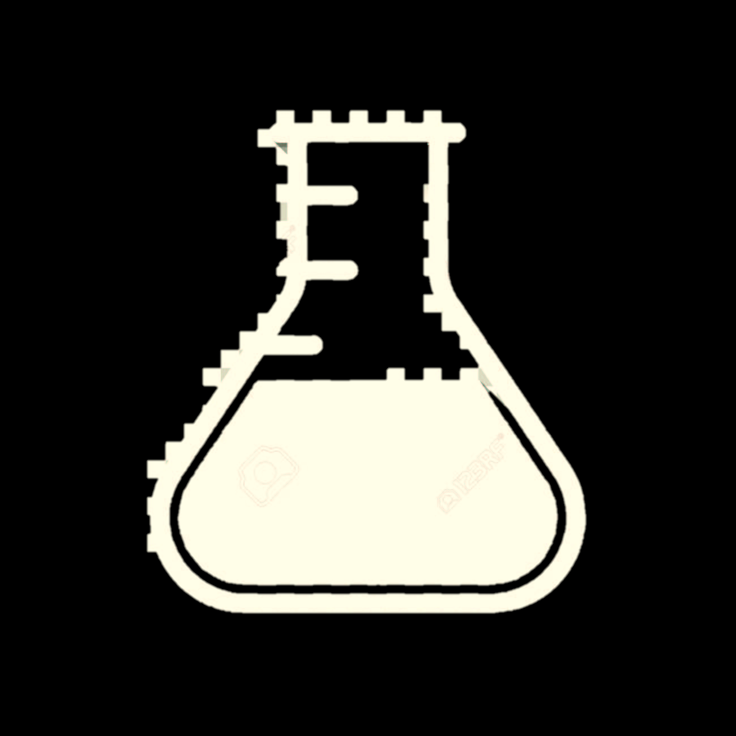


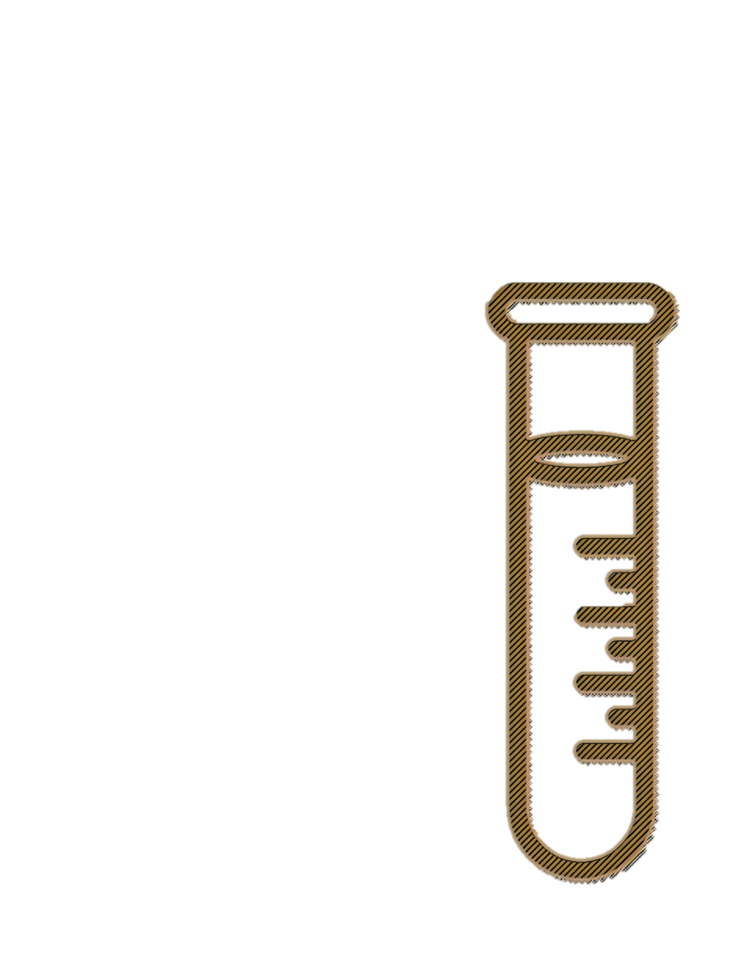

CLS-SULF
Handling, modifying & characterizing samples before, during, and after beamtime.
Sample Handling and User Laboratory Facility (extended team)
Installation of labs & workshops
User laboratories
ESS project support
Complete user lab installation and workshops in D08 for SAD
Provide area coordination
Operate and maintain sample handling and user lab facility
Scientific&technical support
Ghazaleh
Roostaei
Katrin
Michel
Melissa
Sharp
Nick
Weisend
Neutron Optics
Support ESS project with material analysis (accelerator, target, science)
Support with radiation chemistry
Beam characterization for instruments (γ-spec /foil)
Material characterization
Neutron Guide degradation/simulation
Damian
Martin Rodriguez
Monika
Hartl
Notes:
The first two slides will give you an overview of the SULF team and the budget. The SULF team consists of 4 full time employees since Harald joined SULF in January of 22.

Slide 7
CLS-SULF: E04 Level 100/110 (fully operational)
Area coordinator: Katrin
Level 100
Life science Lab
(NMX, CSPEC,
MIRACLES)
Detector lab
X-ray diffraction
Physical Characterization
Spectroscopy room
Cold
room (later)
Level 110
Motion Control lab
storage
Cutting/ polishing
SULF Offices
Basic Chemistry lab (BIFROST, TREX, MAGIC, BEER,)
SEM
storage

Slide 8
Access to user labs
Currently E04
- Sign up for “Working with Chemicals” training on the ESS learning lounge
- Read: ESS-2511912 “Rules and routines for working at the ESS user laboratories in E03, E04, D04 and D08”
- Send email to Katrin.Michel@ess.eu or Monika.hartl@ess.eu to ask for lab induction (usually done 1x/week or whenever there is enough demand)
Note:
- access to the more delicate instruments after training and depending on expertise.
- lab users are expected to clean up after themselves and help out.
- lab users are expected to notify us in case of damaged equipment and missing consumables

Slide 9
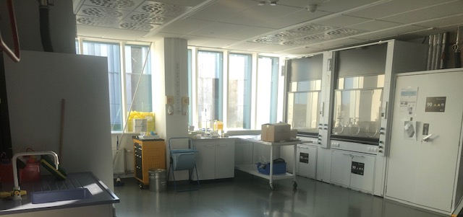
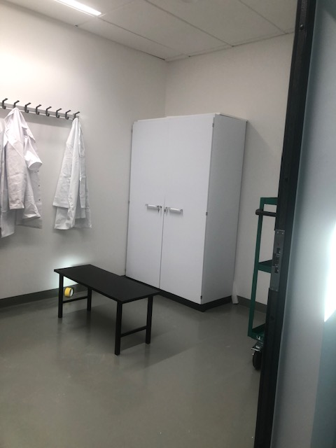
Cold Commissioning finished: RML in D08
“Hot” commissioning of radioactive materials lab in fall 2024
RML
Exp. halls
Changing
area
Radiation monitor
Required training:
- Lab training plus
- Read ESS-0273808 – “Rules and routines for laboratory work in the Radiological Materials Laboratory”
- lab induction done on demand – email Monika.hartl@ess.eu
Test cases:
  H&F Monitor need (already at ESS)
  Filling of catalyst into vessel for target cooling water loop (May 2024) DONE
  Need good reason to use lab!

Slide 10

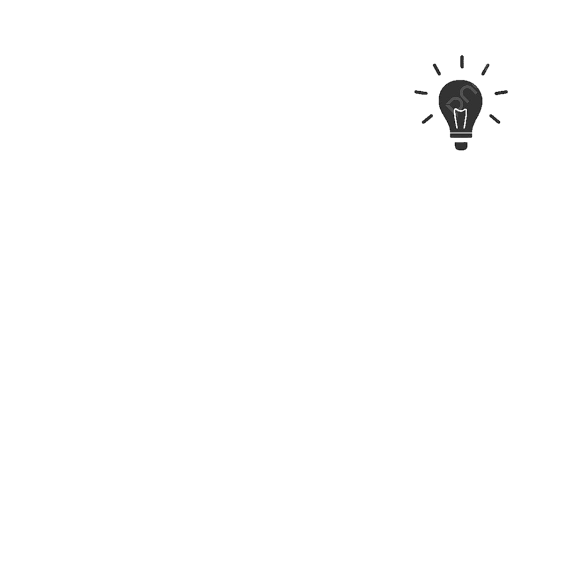
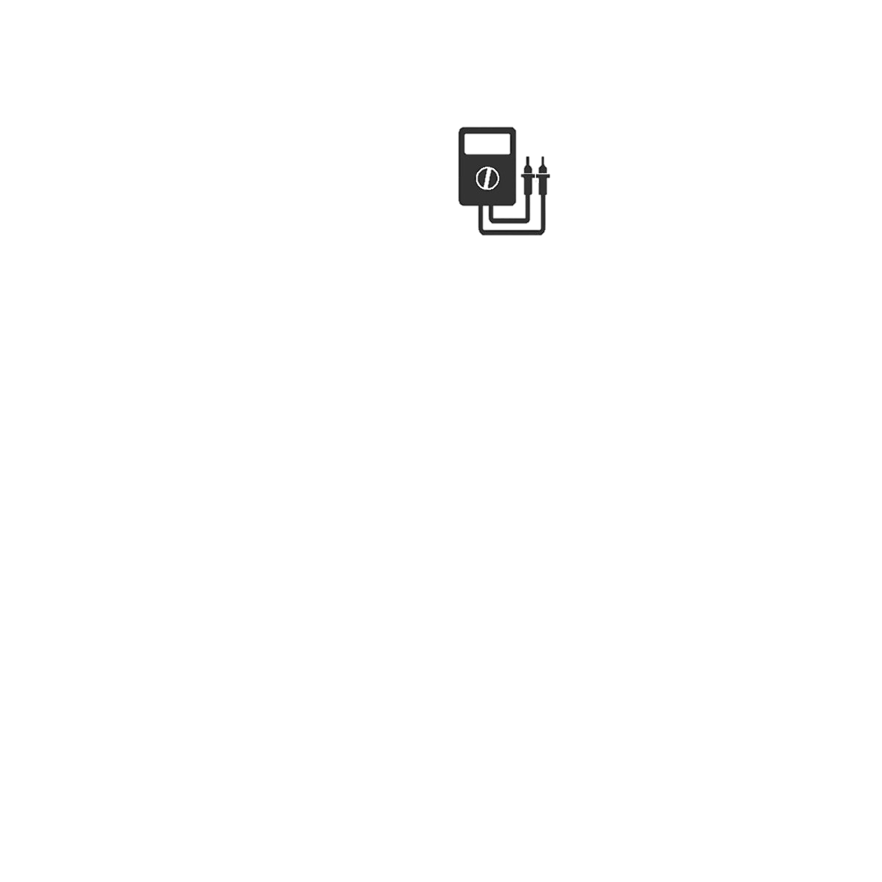
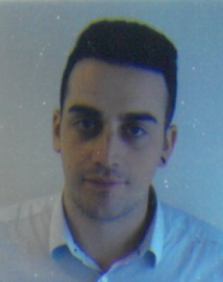
CLS - SCSE
Design, setup, maintain & operate sample environment equipment.
Soft Matter and Chemistry Sample Environment
Soft condensed matter & life science, fluids
Chemistry, electrochemistry, spectroscopy, reaction cells, gases,
Alice Corani
Harald
Schneider
Humidity
Gas flow / gas adsorption
Reaction Cells
In-situ experiments (e.g. spectroscopy)
Liquids (liquid/solid; liquid/liquid)
Liquid flow
Thermalized liquid
Shear/Rheology
Luca Sagliano (50%)
Mech. Engineer (central)
Notes:
Small description about Inkind

Slide 11
CLS-SCSE Access
Access mainly through collaboration!
Workshop in D04, ground floor
Level 100
NEED access to D04 workshop?
Write email to alice.Corani@ess.eu or monika.hartl@ess.eu with the following content:
(1) What have you planned on doing? How much space do you need?
(2) Start date and end date
(3) Risk assessment as necessary
Note: we are happy to host you, but there is limited space and workshop should not be used as storage area for equipment that is not being worked on actively.
Safety: we need to know who is working on what and when. We are responsible and we have to assure it is safe for everyone.
Life science Lab (LOKI/ ESTIA, VESPA, SKADI)
Sample Env.
(57 m²)
spectroscopy
Cold room
appliances

Slide 12
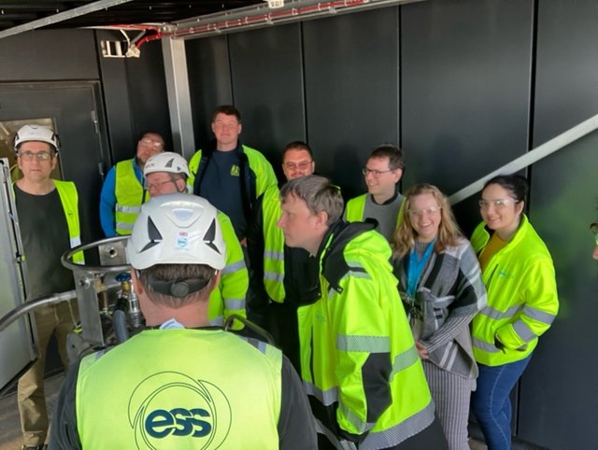
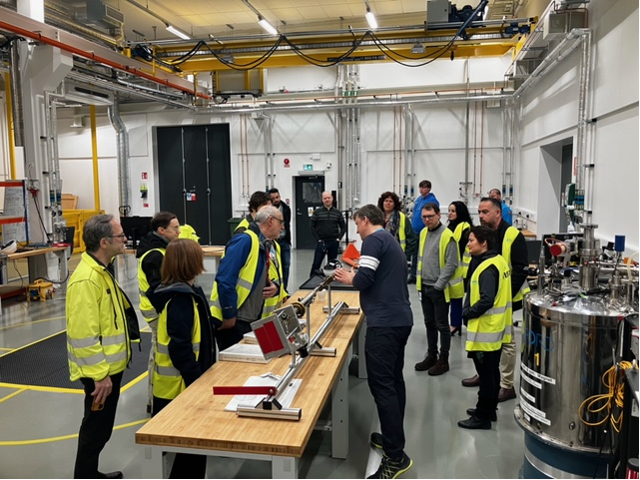
MSPS + CLS = SSD
CLS STAP visiting MSPS workshop
Joint CLS/MSPS l-N2 training

Slide 13










Thank you
What we need from the instruments:
- include us in your planning for science
- make use of our expertise
- get informed what we have and what we plan
(outside of STAP meetings – come over to E04/D04/D08!)

