Slide 1
Call for instruments 16-22
PRESENTED BY sindra petersson Årsköld

Slide 2
ESS is expected to, and committed to, delivering 22 instruments for science.
Why open the call for instruments 16-22 now?
Build instruments while we have the skilled staff on site.
Pressure from some countries and communities.
There are scientific gaps in the suite of 15.
Get as much science as possible out of the ESS source as early as possible.
ESFRI report (2003)
ESS Technical Design Report (2013)
ESS Statutes (2016)

Slide 3
This call will be different from the calls for instrument proposals 2013-2015.
Very different starting point
Filling gaps rather than starting with a blank sheet.
Community buy-in no longer an issue.
More mature organization, up and running.
Lessons learned
+ Strong community engagement
- Instruments fully in-kind turned out to be challenging
+ Scientifically ambitious proposals
- Not fully realistic proposals
ESS is expected to, and committed to, delivering 22 instruments for science.

Slide 4
The aim of expanding the instrument suite:
How do we best achieve that?
- Community engagement
- Smooth implementation at ESS
- Appropriate timing
To fill gaps in scientific capabilities and capacity.
Which science is missing?

Slide 5
Boundary conditions
OVERARCHING AIM:
To fill gaps in scientific capabilities and capacity.
FUNDING
Now: run process, make selection, establish time-frame. Funding not specified at this point in time.
Will make the case to fund this inside the steady-state budget – clear plan required for this.
ROOM AND RESOURCES
No additional instrument halls to be built now.
Process should not distract from delivery of the first 15. Recruitments may be possible.
TIMING
SAC April 19th: supportive of plan, not sure about timing.
Present plan to Council for information, early June
Open call by summer
Keep open 12-18 months
When it's time to construct: build 2+2+3, staggered by 2 years.
COMMUNITY ENGAGEMENT
Engage the community in identifying scientific gaps
Open call but with well-defined boundaries set by us
Avoid model with whole instruments being in-kind
Enable collaborative in-kind contributions inside the instrument projects
Peer-review the proposals

Slide 6
OVERARCHING AIM:
To fill gaps in scientific capabilities and capacity.
Related bits and pieces
Benchmarking and rescoping of the first 15 instruments
The capability gap analysis from 2018
Proposals from the first call
Identifying first science experiments; workshops with community planned
The instrument science cases may be updated.

Slide 7
Planned process outline
OVERARCHING AIM:
To fill gaps in scientific capabilities and capacity.
1. An open preproposal call with specific information is opened this summer and kept open until the end of the year. The call will ask for short (5 pages), scientifically driven proposals, no simulations. The applicant will be asked for a strong science case, a gap analysis in terms of both capability and capacity, and some initial comments on technical feasibility.
2. The SAC, STAPs and expert committees will review these proposals, as will ESS. The concepts will be considered in relation to rescoping current instruments. A selection is made of which proposals to move ahead with, and these teams will be invited to develop a full proposal, in collaboration with ESS.
3. Building the selected instruments will reside with ESS. Collaborative in-kind contributions inside the instrument projects can be considered, primarily in the form of staff (recruited by and working at ESS) or sample environment equipment, developed in close collaboration with the instrument team.

Slide 8
Call for instruments 16-22
Comments, questions?
PRESENTED BY sindra petersson Årsköld

Slide 9
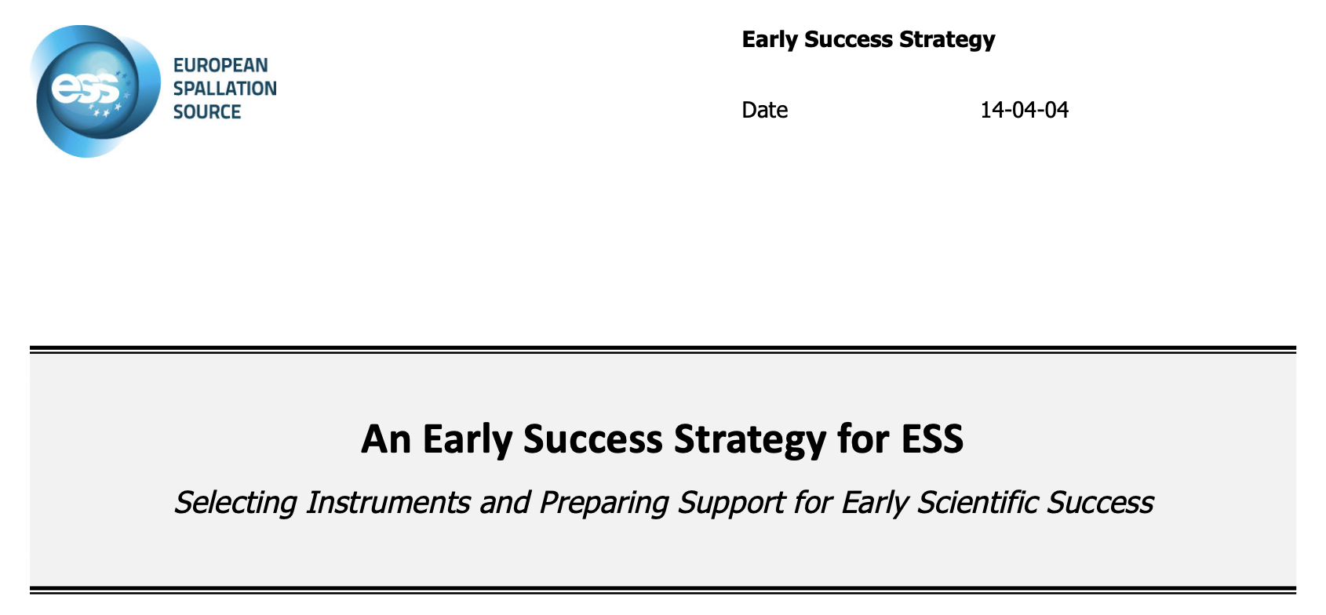
2014

Slide 10
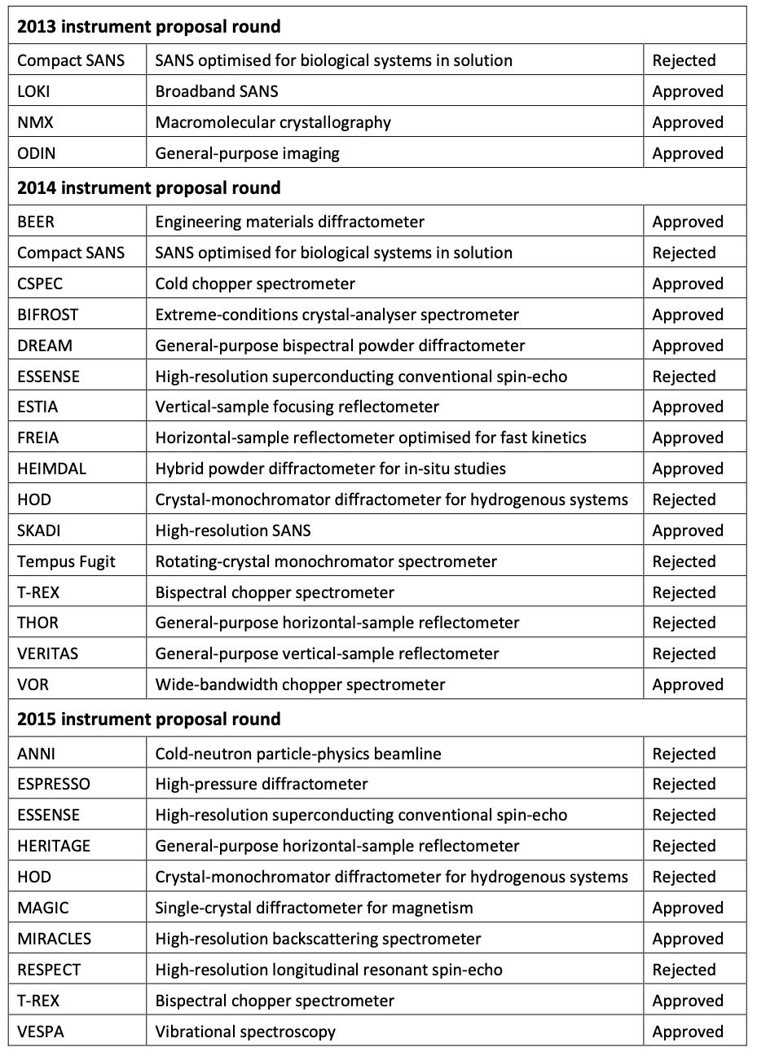
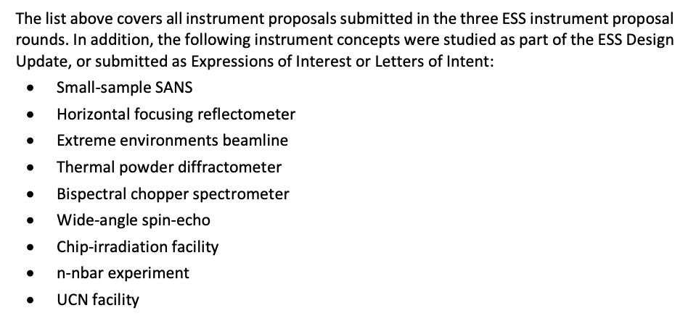
Proposals 2013-2015

