Slide 2
Material Science and Physics Support Group
Update
PRESENTED BY caroline curfs
With support FROM Richard Ammer, Niklas Ekström, Andreas Hagelberg, Alexander Holmes, Damian Paliwoda, Yulia Pedersen, Luca Sagliano, Lauritz Saxtrup and Oleksiy Zadorozhko

Slide 3
Agenda
1 Scope and Team
2 Updates
3 Labs and Workshops

Slide 4
1
Scope and Team

Slide 5
Scope
    Provide services for materials engineering, quantum materials and physics
    Provide and maintain sample environment systems in the fields of:
      Low and ultra low temperatures
      High temperature
      Electrical and magnetic fields
      High pressure
      Mechanical processing
    Provide mechanical integration for all SES (including CLS projects)
    Provide control integration for complex SES (including CLS projects)
    Coordinate the He management

Slide 6
Team
Current
2 technicians : Lauritz and Richard
2 control engineers : Niklas and Andreas
4 sample environment engineers: Alex, Oleksiy, Damian and Caroline
0.5 mechanical design engineer: Luca
1 technical writer : Yulia
Planned recruitment:
on going : Sample environment engineer for HT
End of 2024: 2 technicians
2025: 1 technician
2027: 1 technician

Slide 7
3
Updates

Slide 8
MSPS Sample Environment Systems
Systems to be delivered before 12.2027
  8 magnets from 2.5 T to 15 T
  Low temperature : 6 cryofurnaces and 10 cryostats (7 wet and 3 dry) including 1 for PE presses and 1 for electro-chemistry
  Ultra low temperature: 3 dilution fridges and 1 He3 insert
  High temperature: 3 ILL-type furnaces (2 Niobium, 1 Vanadium), 1 induction furnace, 1 lamp furnace and 1 hot air blower
  High pressure: 10 high pressure cells (5 gas, 4 liquid and 1 clamp), 5 compressors (4 automatic and 1 manual), 5 Paris Edinburgh presses with gas loader
  Mechanical processing : 2 stress rigs (uniaxial and torsion/rotation), 1 thermo-mechanical instrument (dilatometer)
  Provided by instruments : 1 He3 insert, 1 cryofurnace with sample changer and 4 cryostats

Slide 9
Status of SES by end of 2023
Magnets | 2.5 T WBM | 8 T magnet | 15 T magnet | Spectro magnet | 15T magnet | 6.5T magnet
Cryo Instr. & IK | Flow cryostat ESTIA | Wet cryostat BIFROST | Cryofurnace CSPEC | Sample changer CSPEC | He3 insert CSPEC | HP cryostat
Cryo pool | Sample rot sticks | Dry Cryo DIFF EC | Cryofurnace DIFF 2nd hand | Dil. Fridge 2nd hand | Dil. Fridge | Dry cryo spectro
 | Dry Cryo Heimdal
High Pressure | Clamps | Gas cells | PE | Gas loading for PE
Mechanical processing | Rig 60 kN | Tortion/rot. rig | Dilatometer
High temperature | ILL-type furnace | Induction furnace | Cryostream/gas blower
Preparation CFT
Design
CFT
Construction
Procurement
Tests
Control and mechanical
integration
Specifications

Slide 10
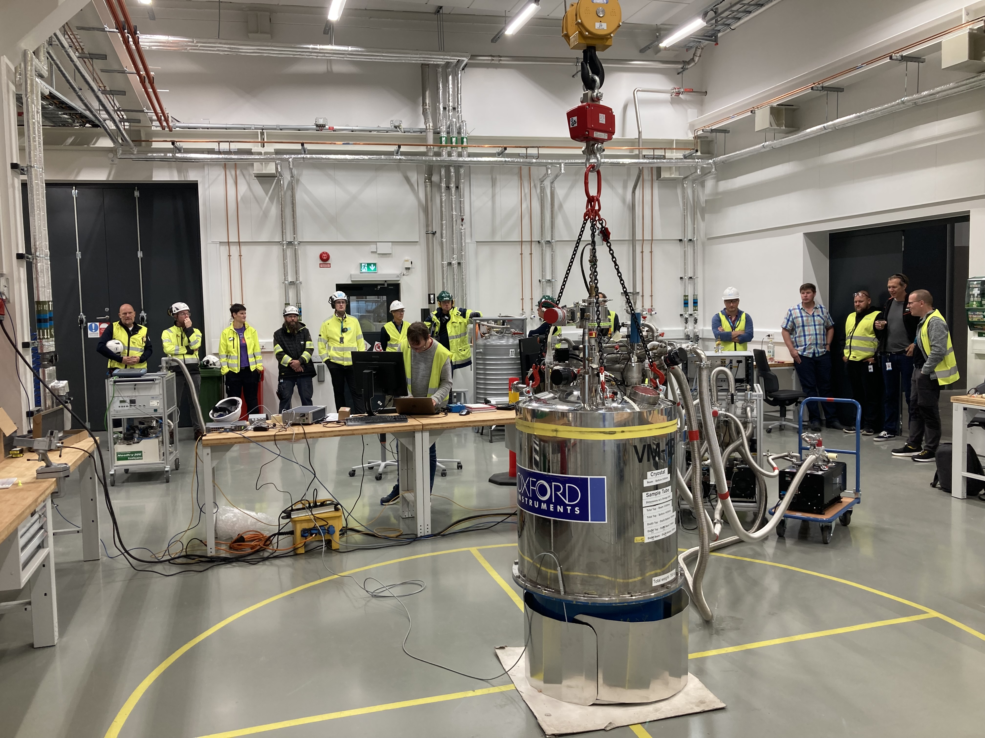
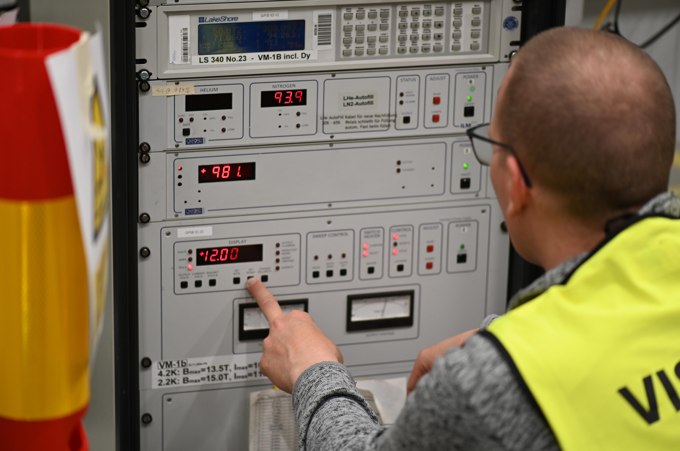
Update
Magnets
15T for BIFROST
  2nd hand from HZB
  Done: Tested up to 15T with new electronic rack
  Next step: Control (via Octopy) and mechanical integration
6.5T for ESTIA
  2nd hand from HZB
  Tested up to 6.5 T with new electronic racks
  Next step: Control (via Octopy) and mechanical integration
15T for POOL
  2nd hand from HZB
  Leak tested at room temperature
  Next step: test at field and integration
2.1T WBM for ESTIA
  HTS 110 compatible with flow cryostat and polarisation
  In production
  Planned to arrive at ESS Q4/24
8T magnet for Diffraction
  Large aperture magnet
  In production
  Planned to arrive at ESS Q4/24-Q1/25
Magnet for Spectroscopy
  Design study on going for a 14T
  Next step: Call for tender
Future magnets
  Meeting with instruments 01.24
  List of priority set :
    > 10T horizontal split pair for SKADI
    1-2 T electromagnet for LOKI, SKADI and ESTIA
    10T wide opening for Diffraction
    10T wide opening for Spectrometer
    7T full polarisation for SKADI and ESTIA
Alexander.holmes@ess.eu

Slide 11
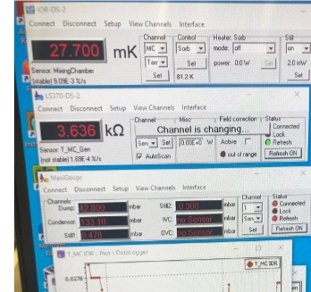
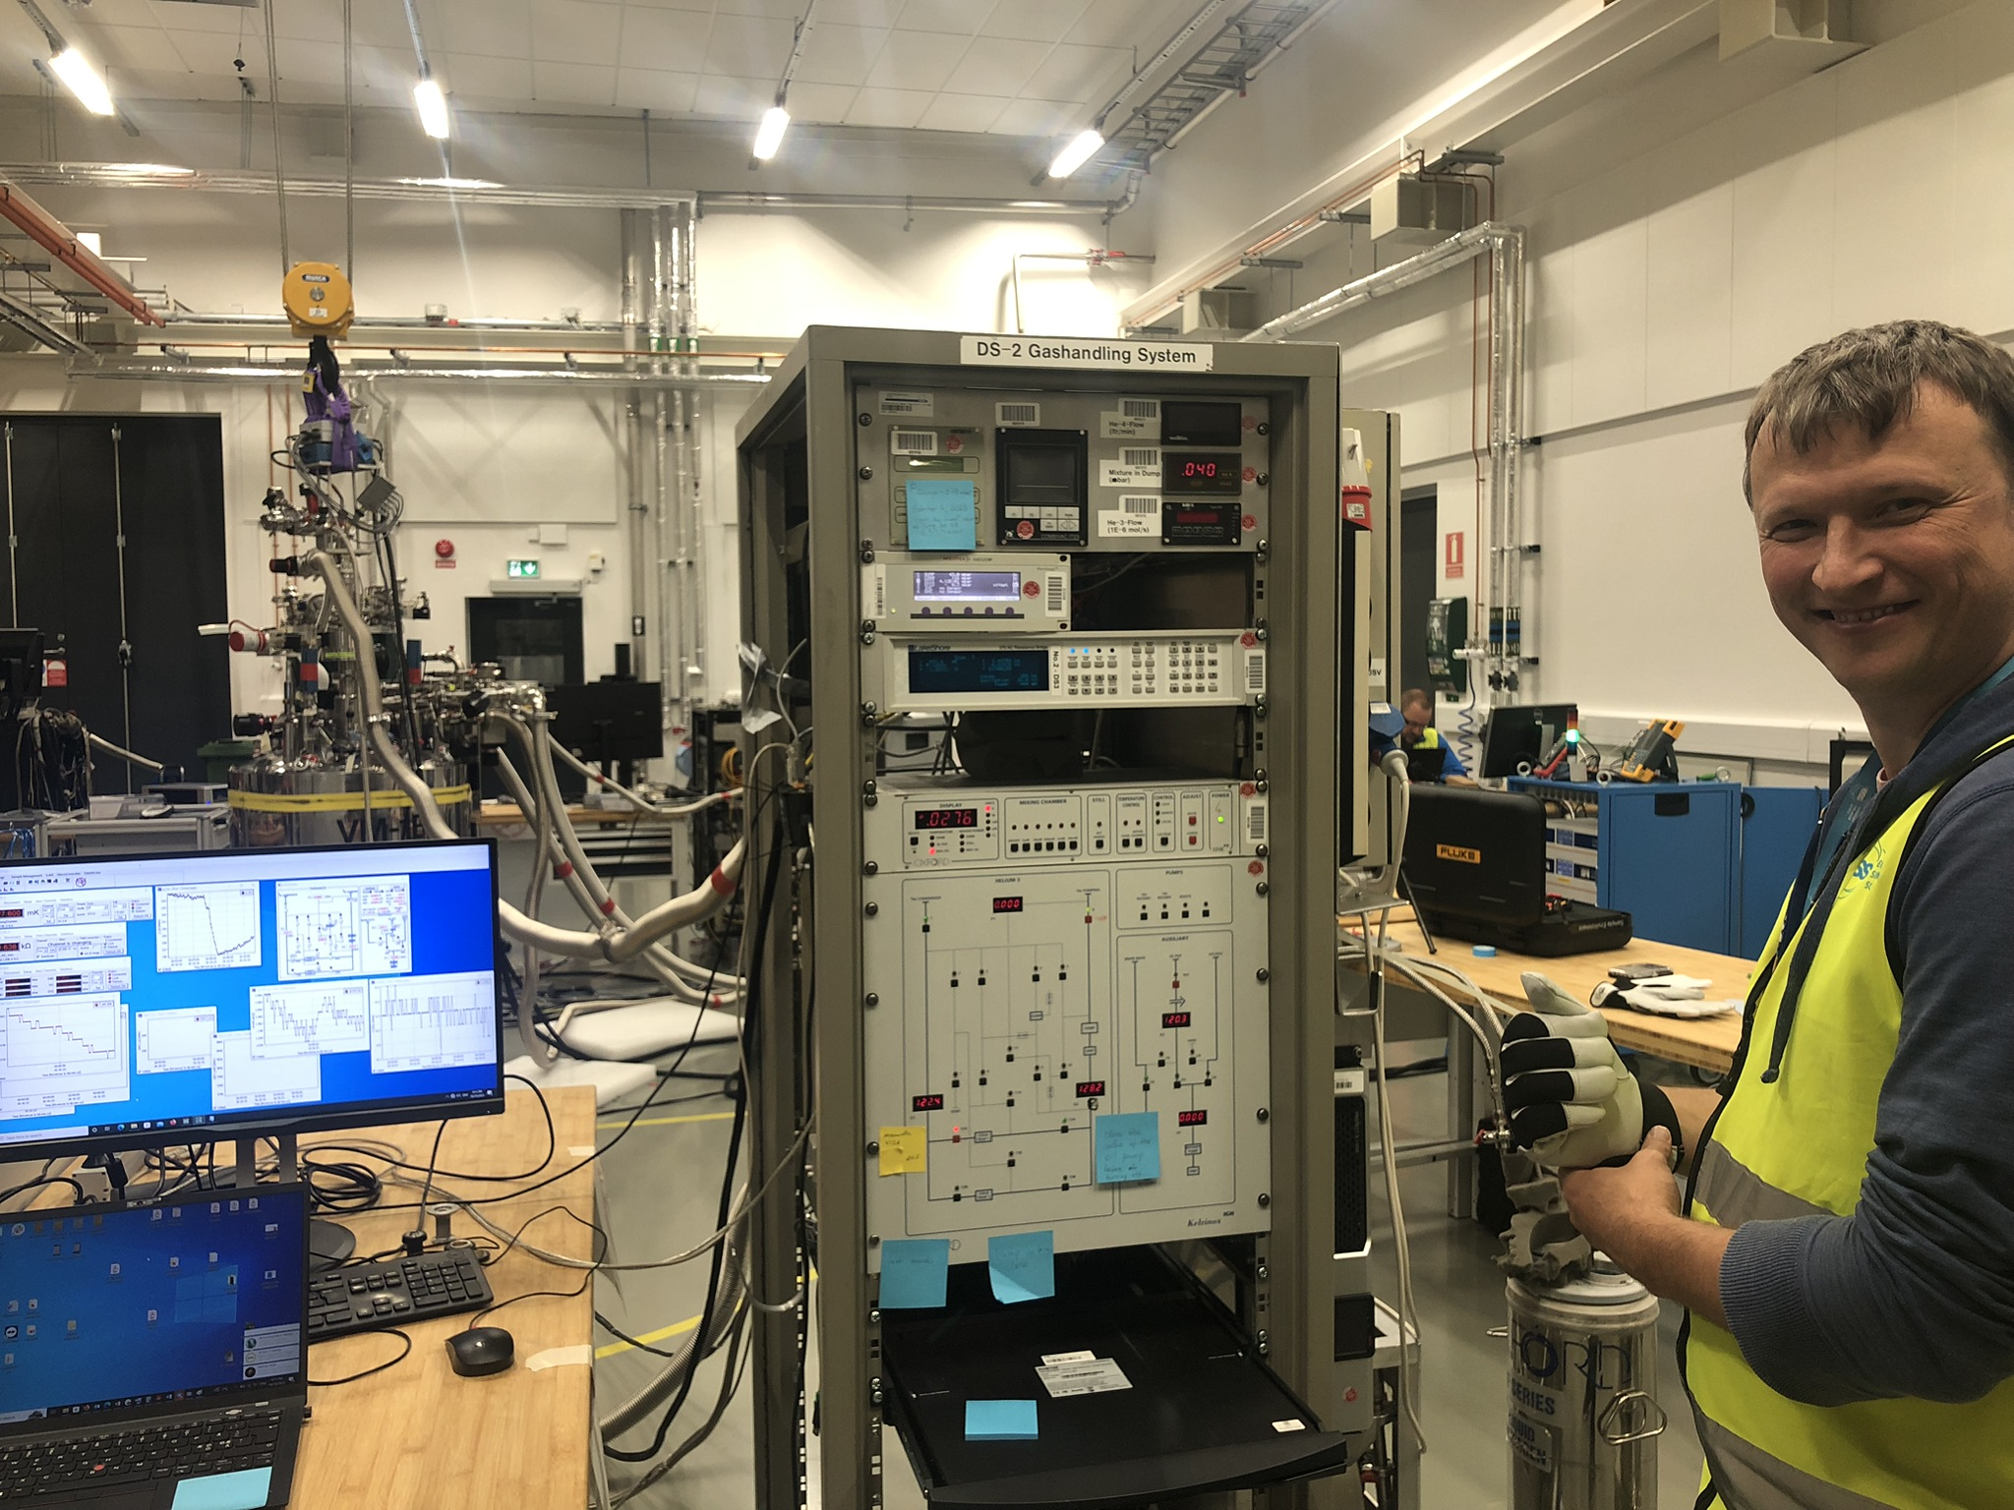
Update
LT and ULT
Pools cryostats and cryofurnaces
  8 cryostats and 2 cryofurnaces
  Specified for each tecgnique or/and instrument
  Tender and purchase specifications sent to procurement
Cryostat for Electro-chemistry
  Dry cryostat dedicated to diffraction
  In Production
  Delivery planned Q4/24
Cryostat for High-Pressure (IK)
  Custom-made wet cryostat built by ILL
  In construction
  Planned to be ready in 25
Dilution fridges
  2nd hand from HZB
    Refurbished and successfully tested down to 27 mK
    Next step : control integration
  IK with LLB suitable with 8T magnet
    Answers for CFT received – Decision on going
  Pool
    Tender and specifications in writing
Oleksiy.Zadorozhko@ess.eu

Slide 12
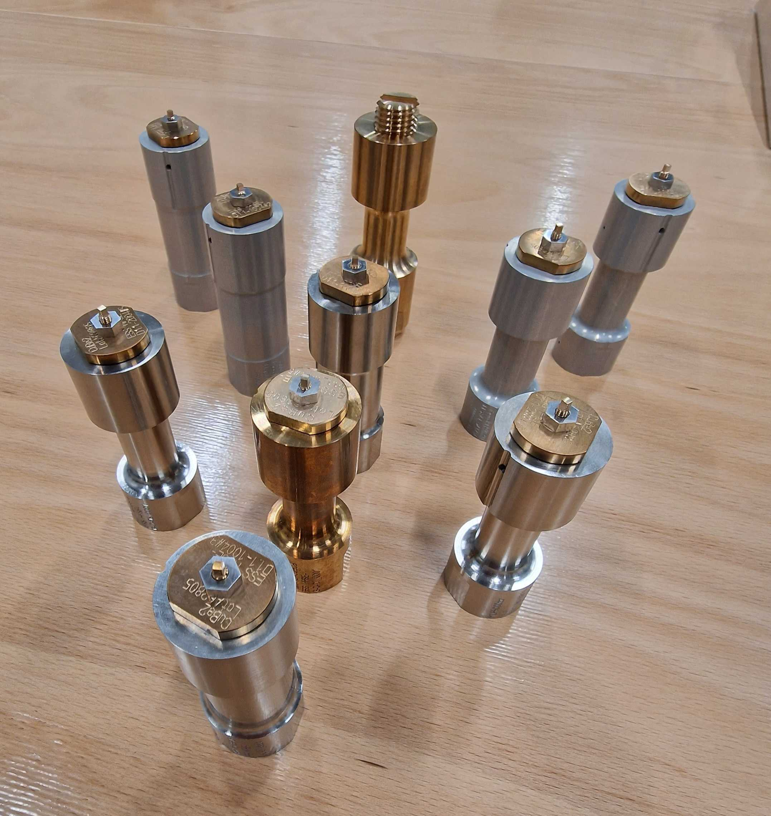
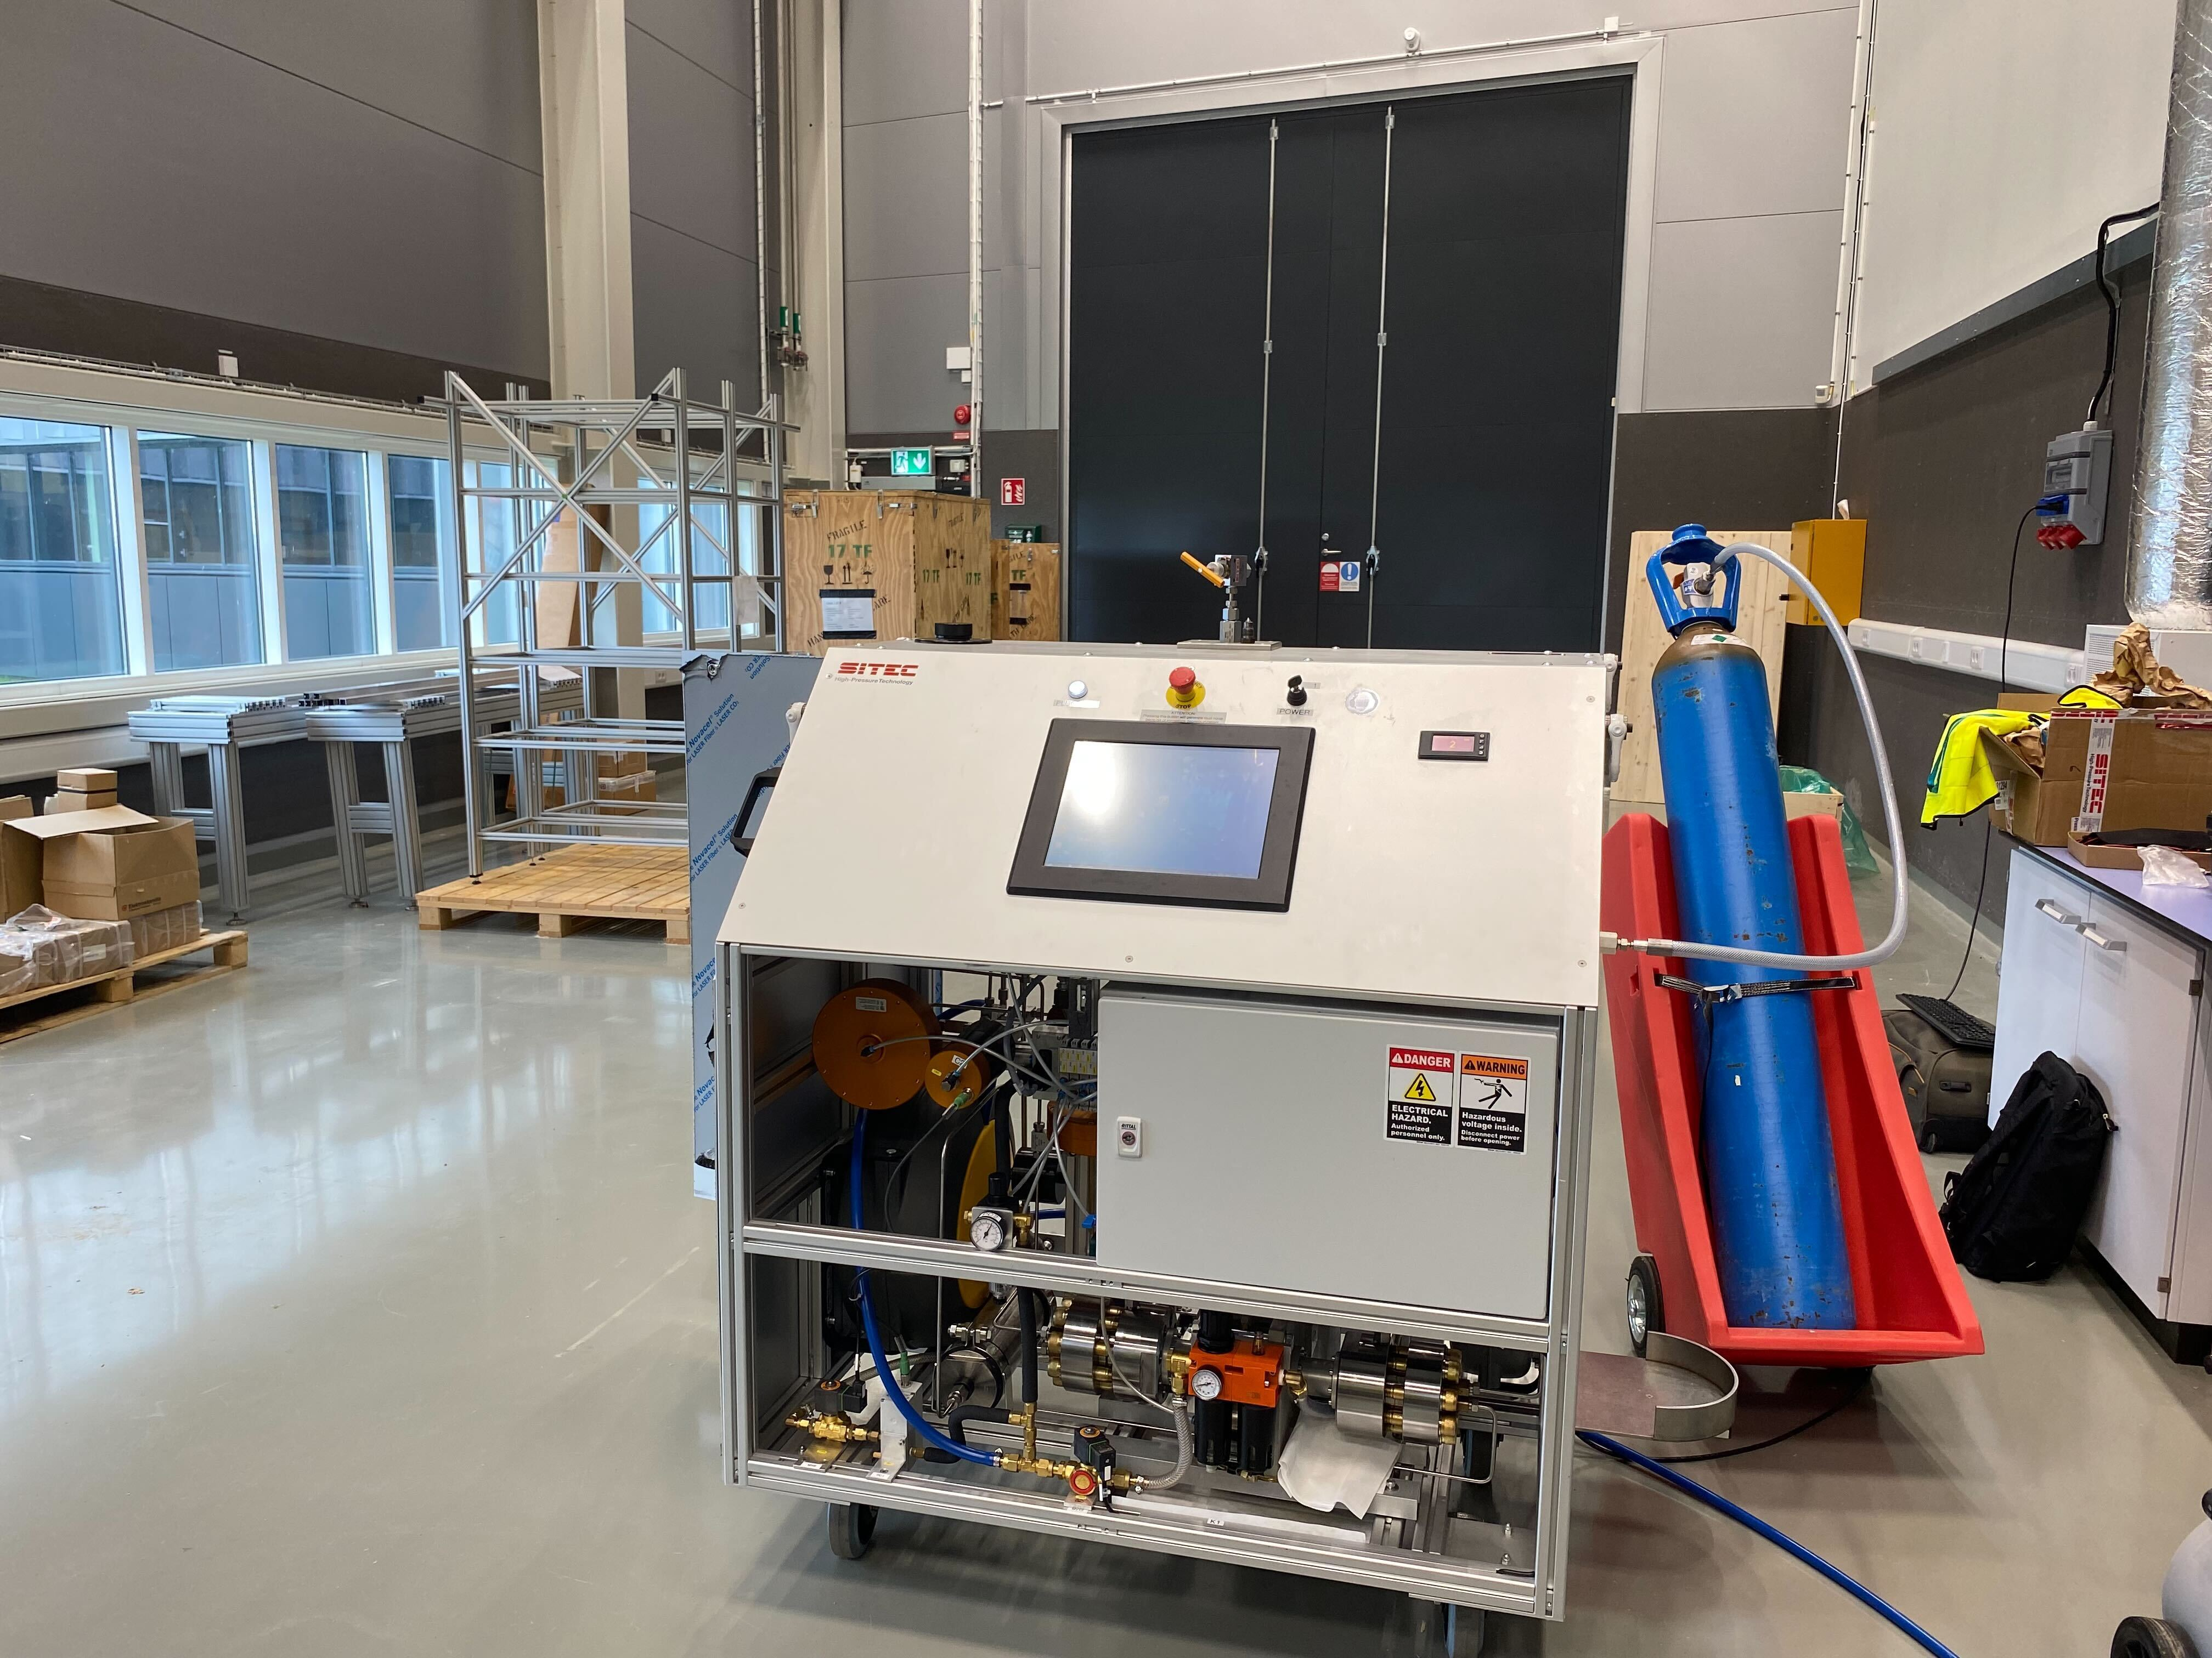
Update
High-Pressure
Gas. Liquid and clamp cells
  Received at ESS and some tested without beam
  Training to manufacture more done
10kBar compressor for gas cells
  Received at ESS
  Problems of quality: modification and repairs on going
Other compressors
  Vinci pump and PACE 5000 control integrated
PE presses and gas loader
  2 PE presses at ESS, tested
  1 PE press + gas loader to arrive at ESS April 24
DAC
  Project DAC for Lab Xray started
  PRL ready
  RAMAN system in specifications phase
Future HP
  SANS cells : discussion with scientists and other facilities on going
Damian.Paliwoda@ess.eu

Slide 13
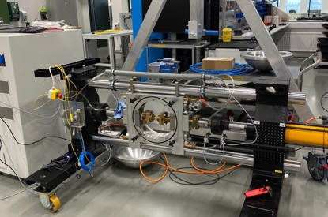
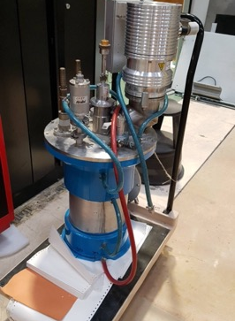
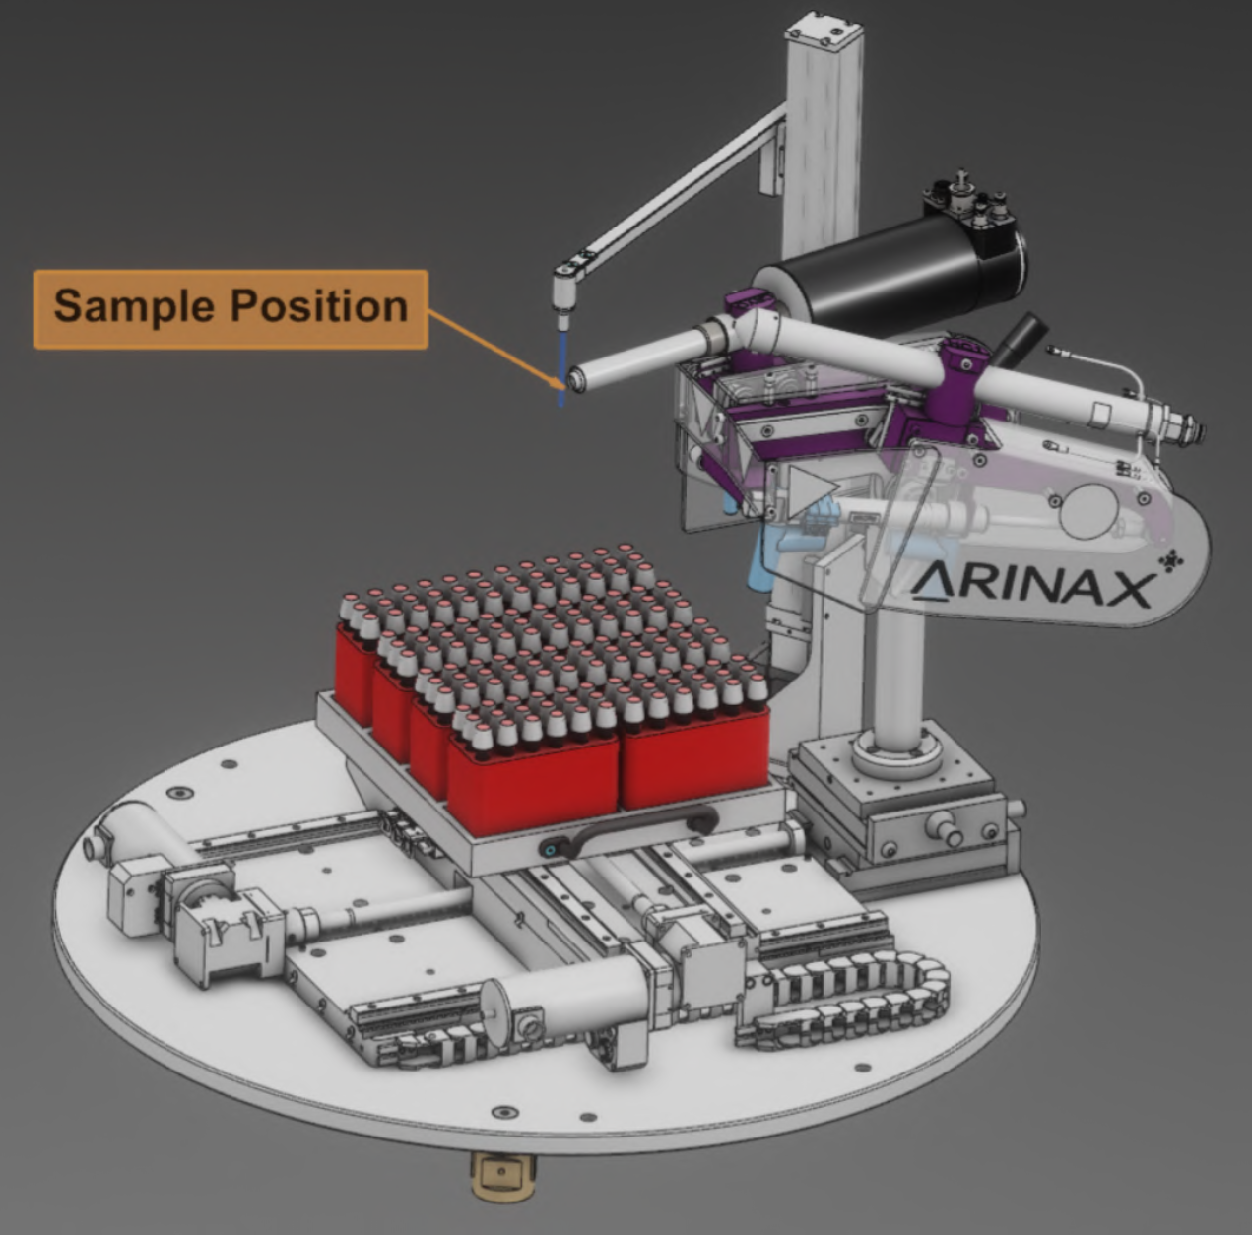
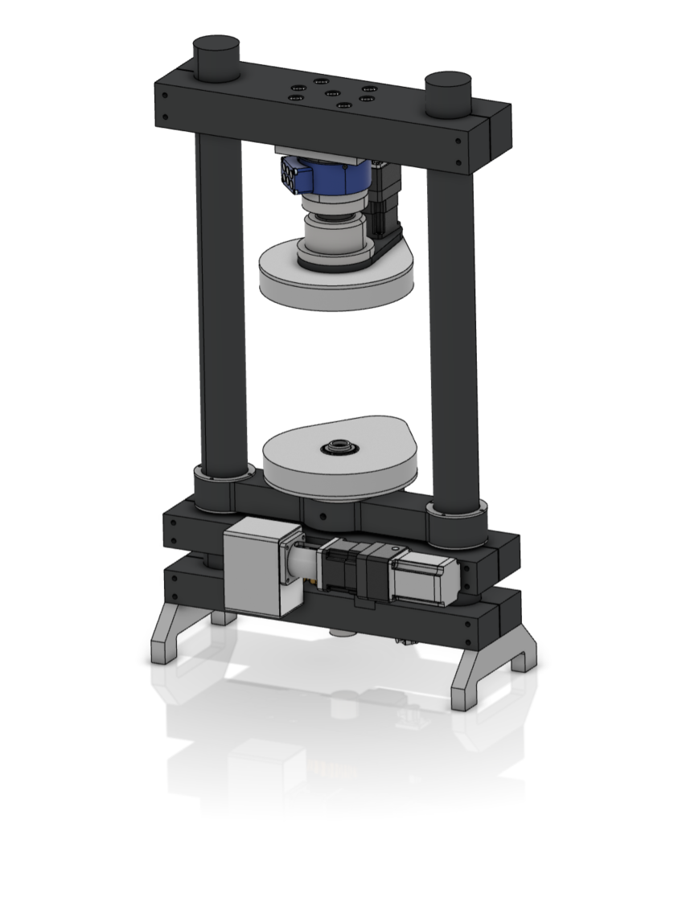
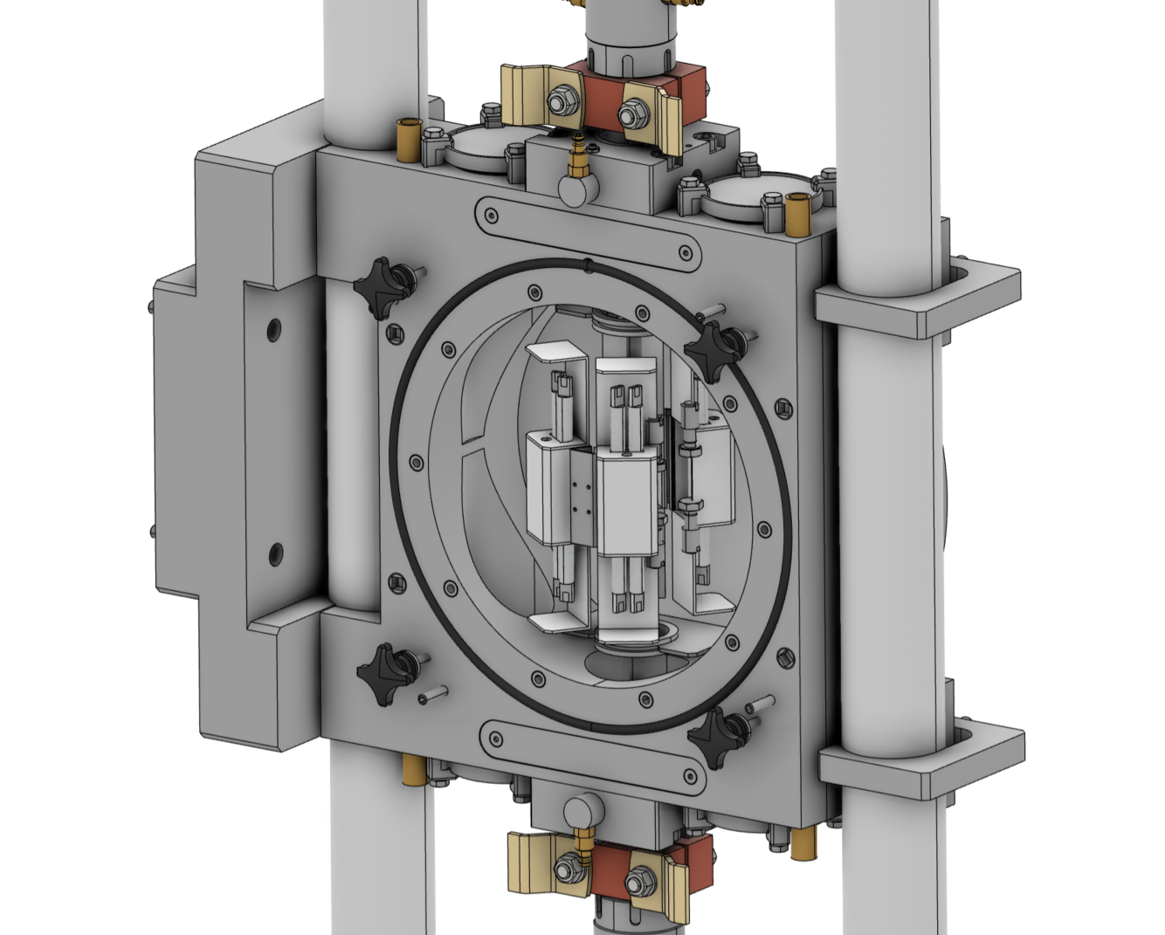
Update
High Temperature and Mechanical processing
ILL-Type furnaces
  2 Niobium 1650 C and 1800 C (2nd hand)
    Transfer from LLB delayed
    Refurbishement will be needed
  1 Vanadium 1100 C
    Specifications on going
Hot Air Blower/Cryostream
  From 100 K to 800 C
  Sample changer
  Design nearly completed
  Off-the-shelf parts ordered – some received
  Planned to be available Q4/24-Q1/25
UHT furnace
  Lamp furnace up to 1800 C
  Vacuum or inert atmosphere
  Adapted to the NPI
  Design on going with ISIS
NPI stress rig
  60 kN unixial deformation rig
  Conductive heating (800 A / 15 V)
  At ESS
  Software update on going
  Collaboration with Alfa Laval for use case started
Tortion/rotation rig
  Design on going
  Construction planned 25
Dilatometer
  Specifications on going
Caroline.Curfs@ess.eu
13

Slide 14
MSPS priorities for HC and CC
Instrument | Instrument | Cold Commissioning |  | Hot Commissioning
 |  | SES | Timeline | SES | Timeline
TRANCHE 1 | DREAM | Hot Air Blower/Cryostream | 10.24 – 03.25 | ILL-Type furnace | 07.25-03.26
 | BIFROST | 15T magnet / Wet cryostat | 11.24-04.25
 | ODIN |  |  | Tortion/rotation rig | 07.25-03.26
TRANCHE 2 | ESTIA | 2.5 T WBM/Flow cryostat | 07.25-12.25
 | SKADI |  |  | Electromagnet | 10.26-06.27
 | BEER | 60kN stress rig | 07.26-12.26 | Dilatometer | 01.27-09.27
 | MAGIC | 8T magnet / Wet cryostat | 04.26-09.26
TRANCHE 3 | HEIMDAL | ILL-Type furnace/Dry cryostat | 10.26-03.27
 | T-REX | Wet cryostat | 07.26-12.26 | He3 insert | 01.27-09.27
 | MIRACLES | Dry cryofurnace | 07.26-12.26 | Wet cryostat | 01.27-09.27
 | CSPEC | Rotation stick | 10.26-03.27 | Spectro magnet | 04.27-12.27
 | VESPA | Dry cryostat | 04.27-09.27

Slide 15
5
Labs and workshops

Slide 16
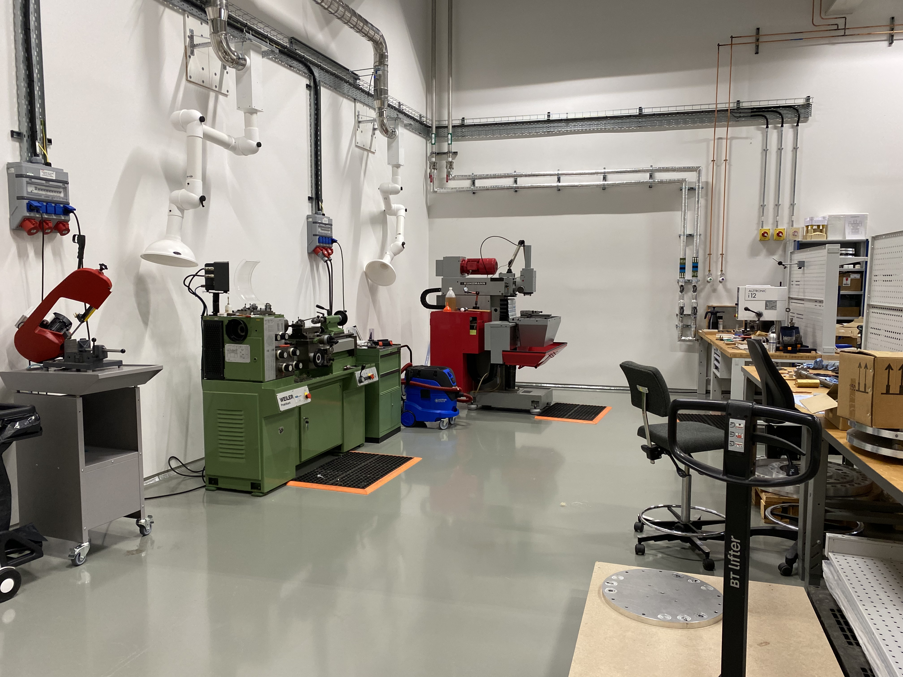
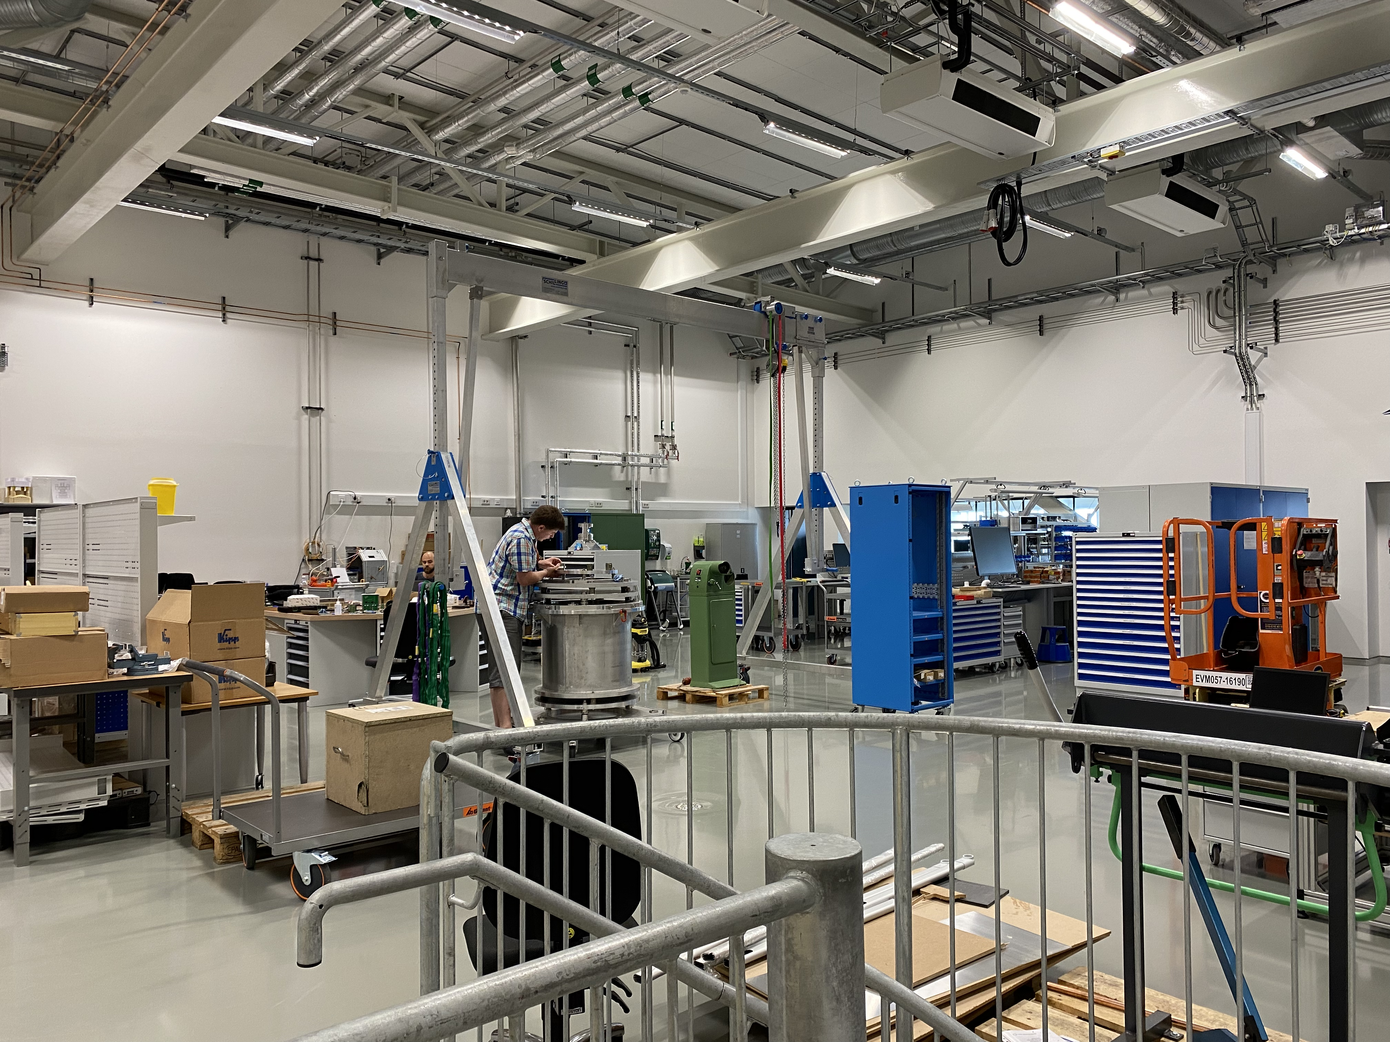
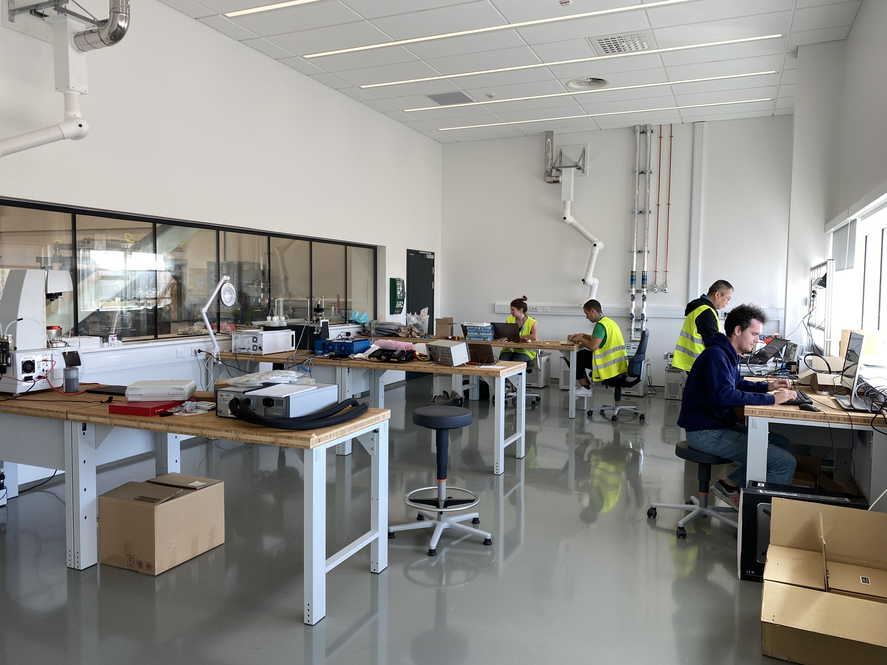
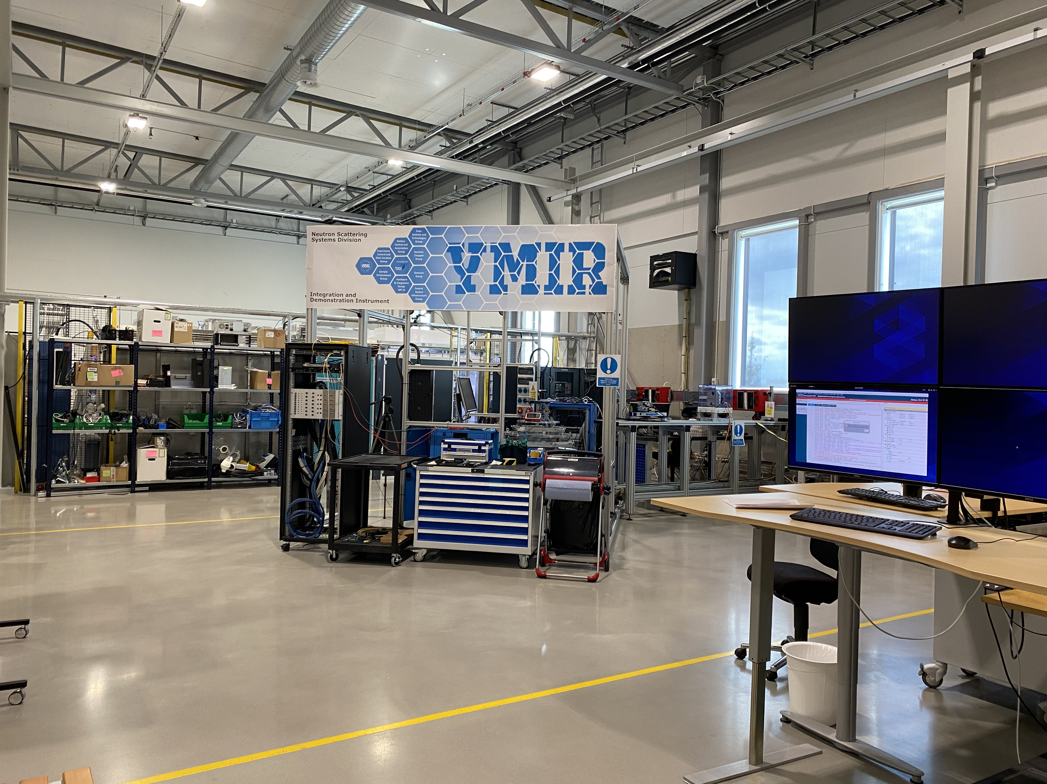
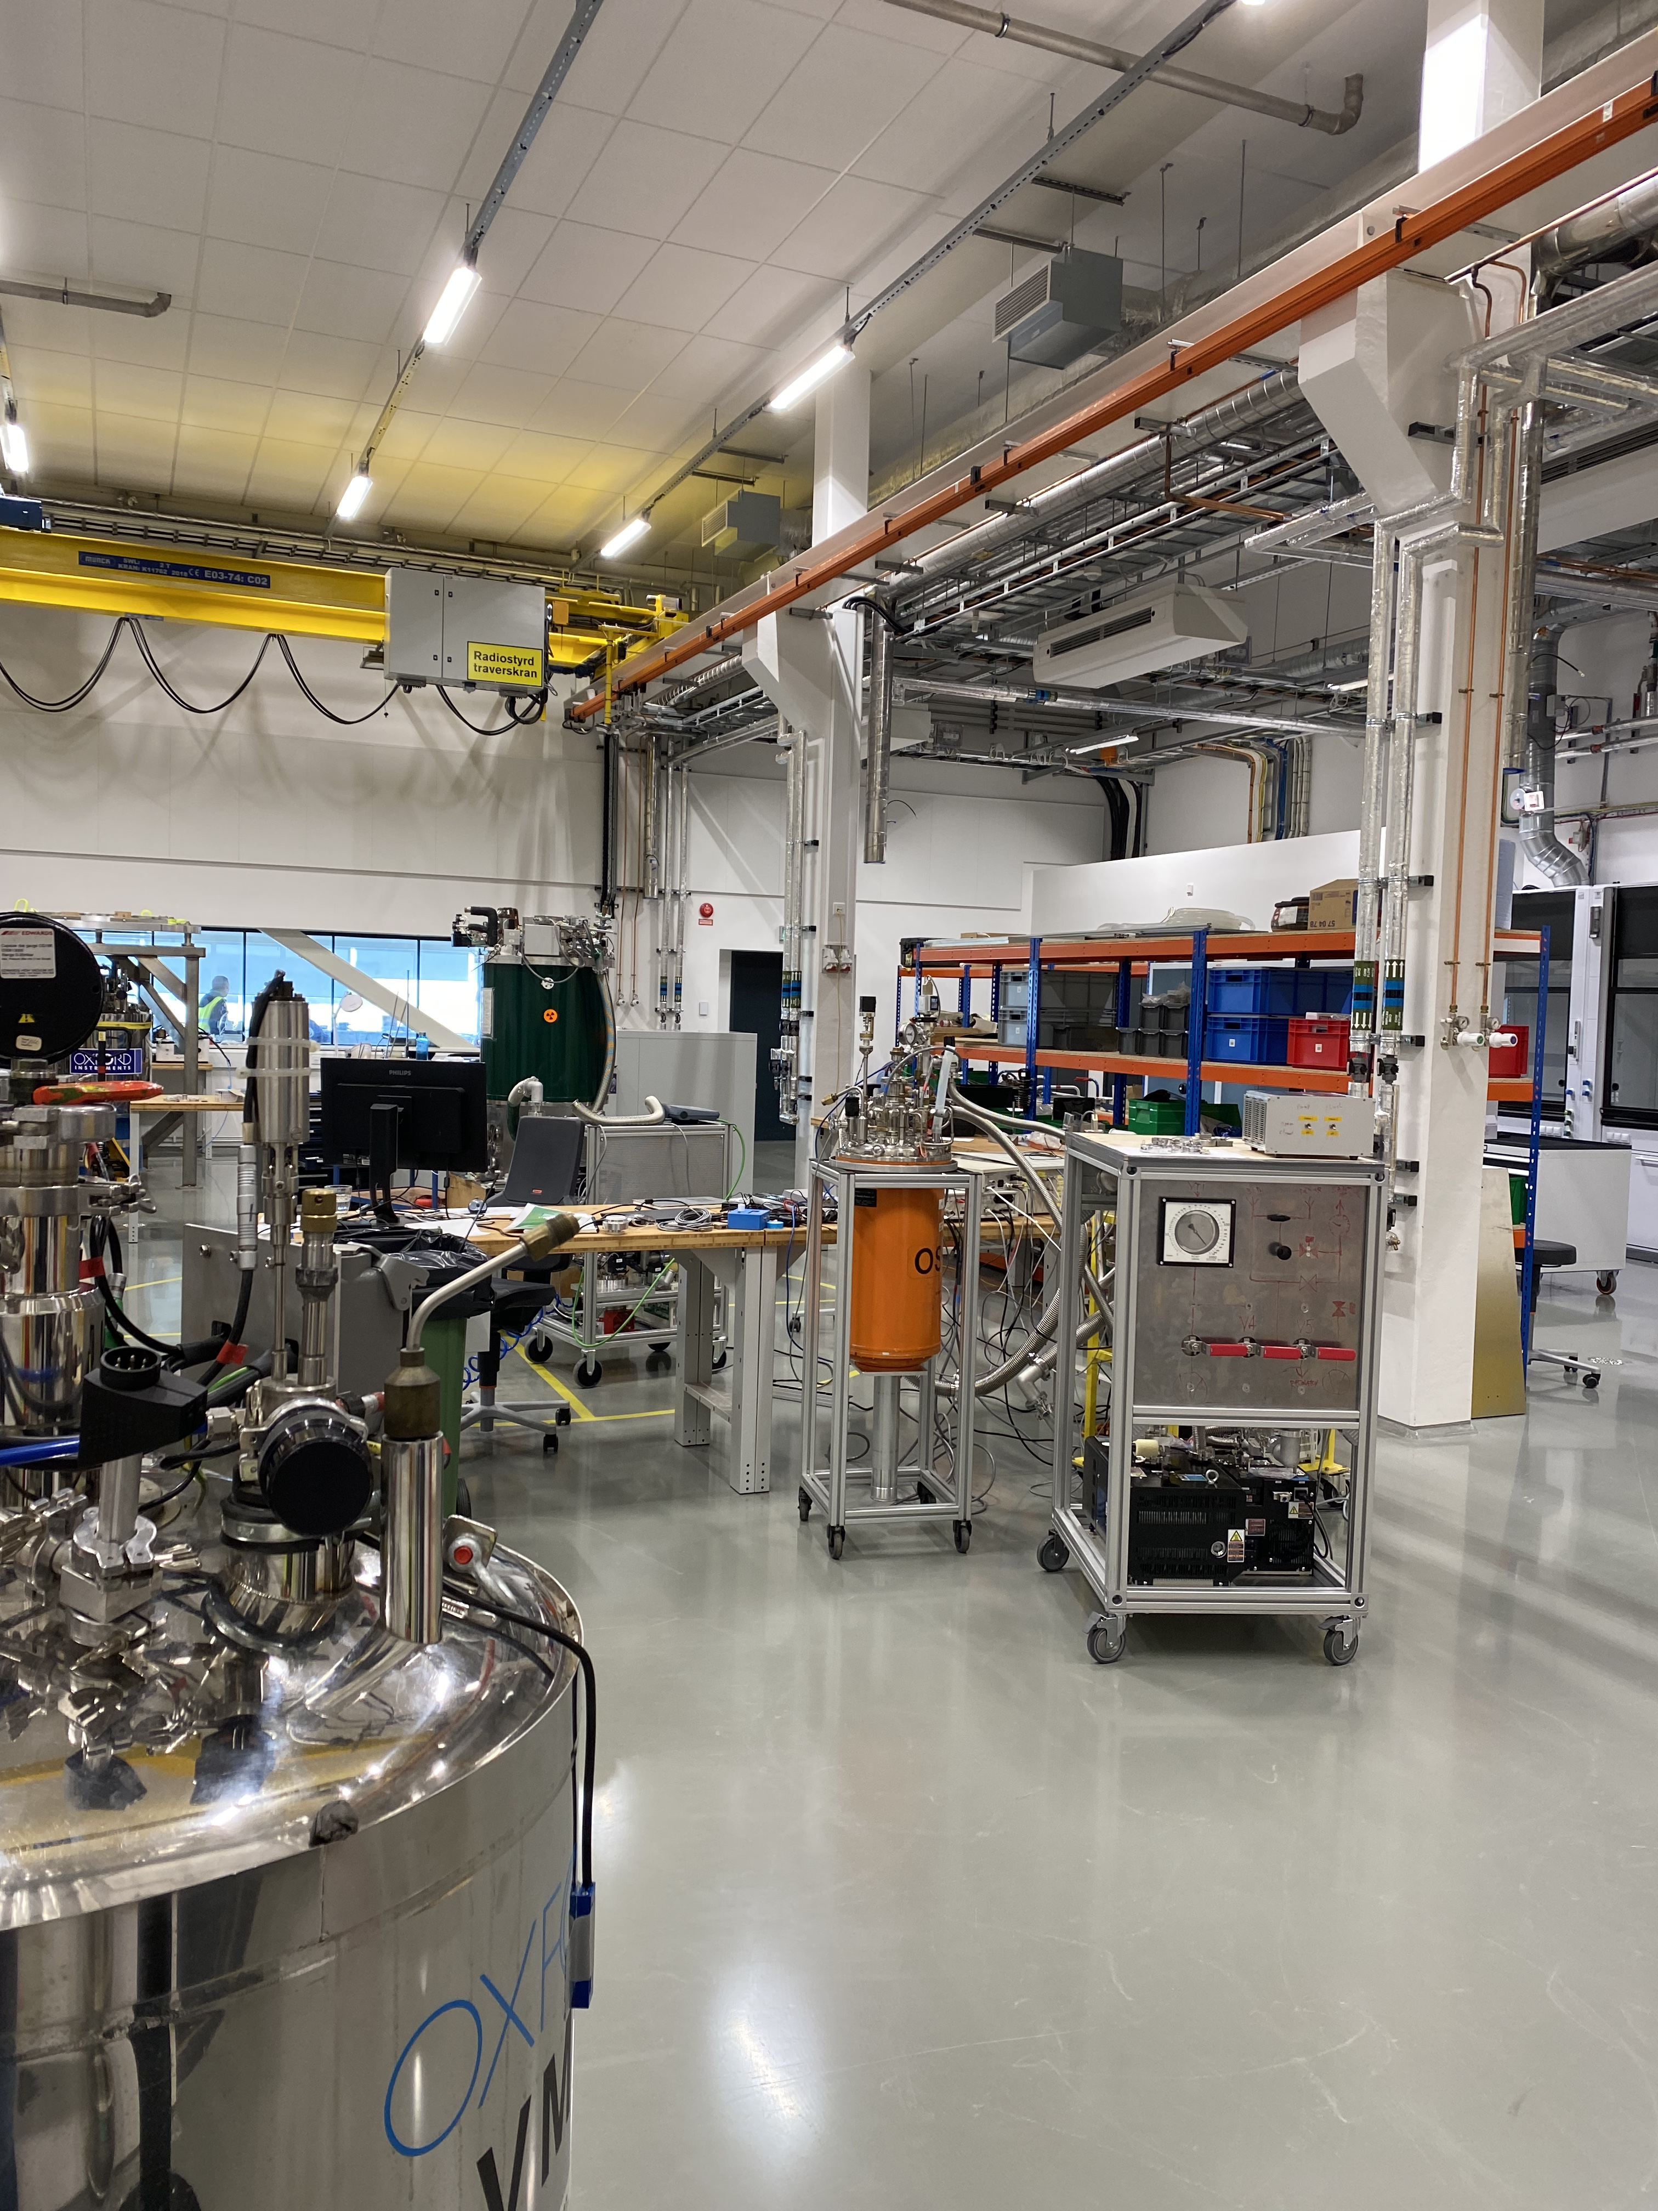
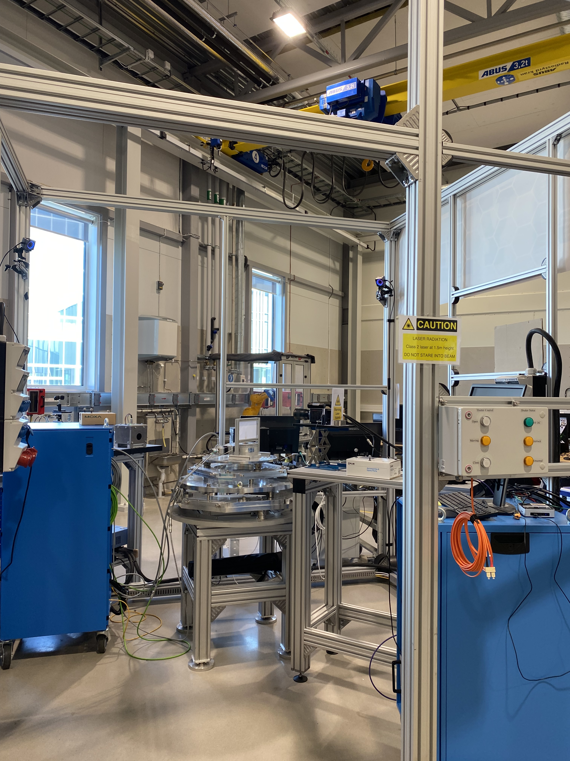
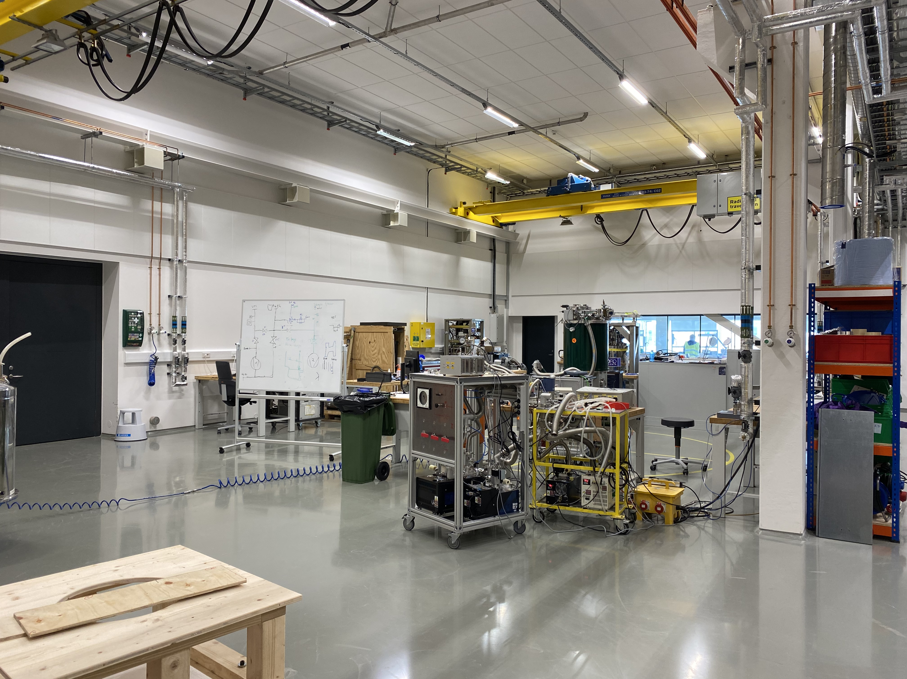
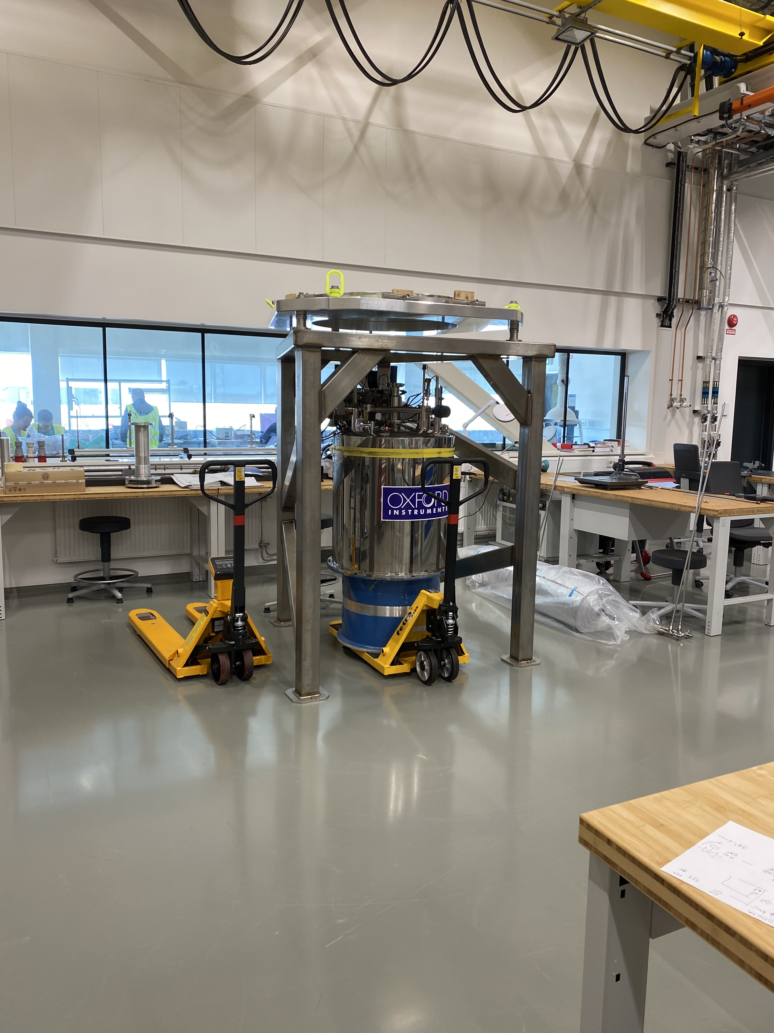
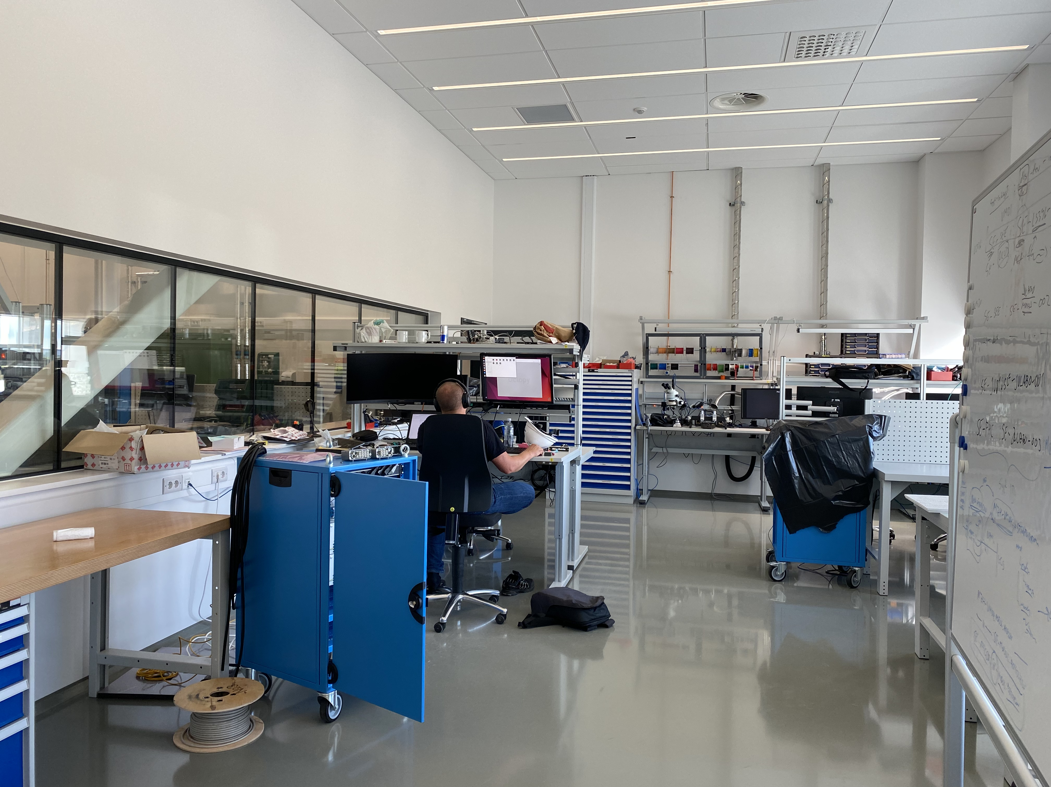
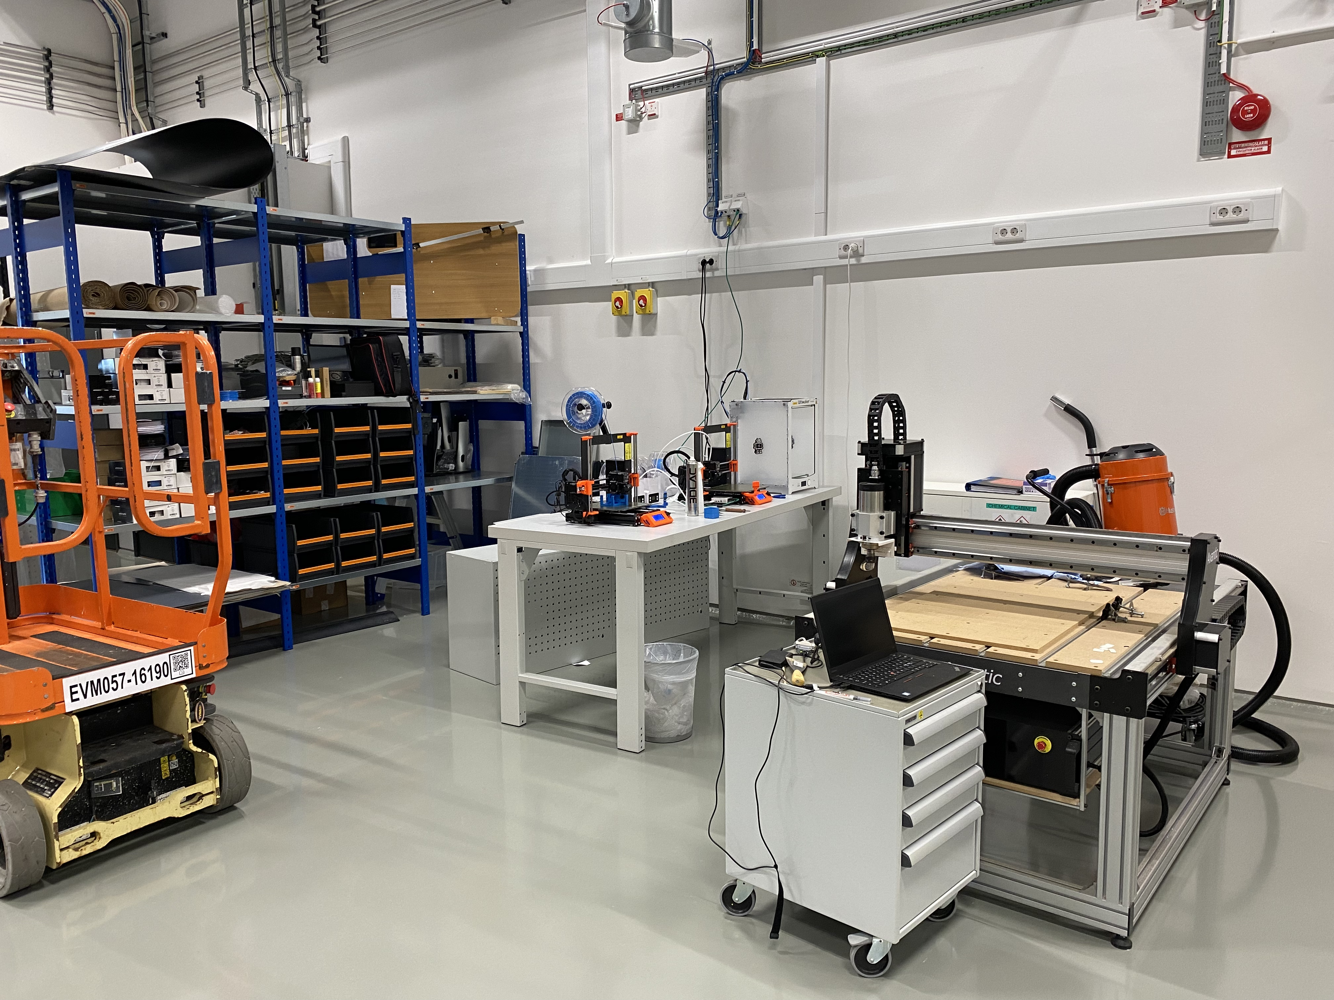
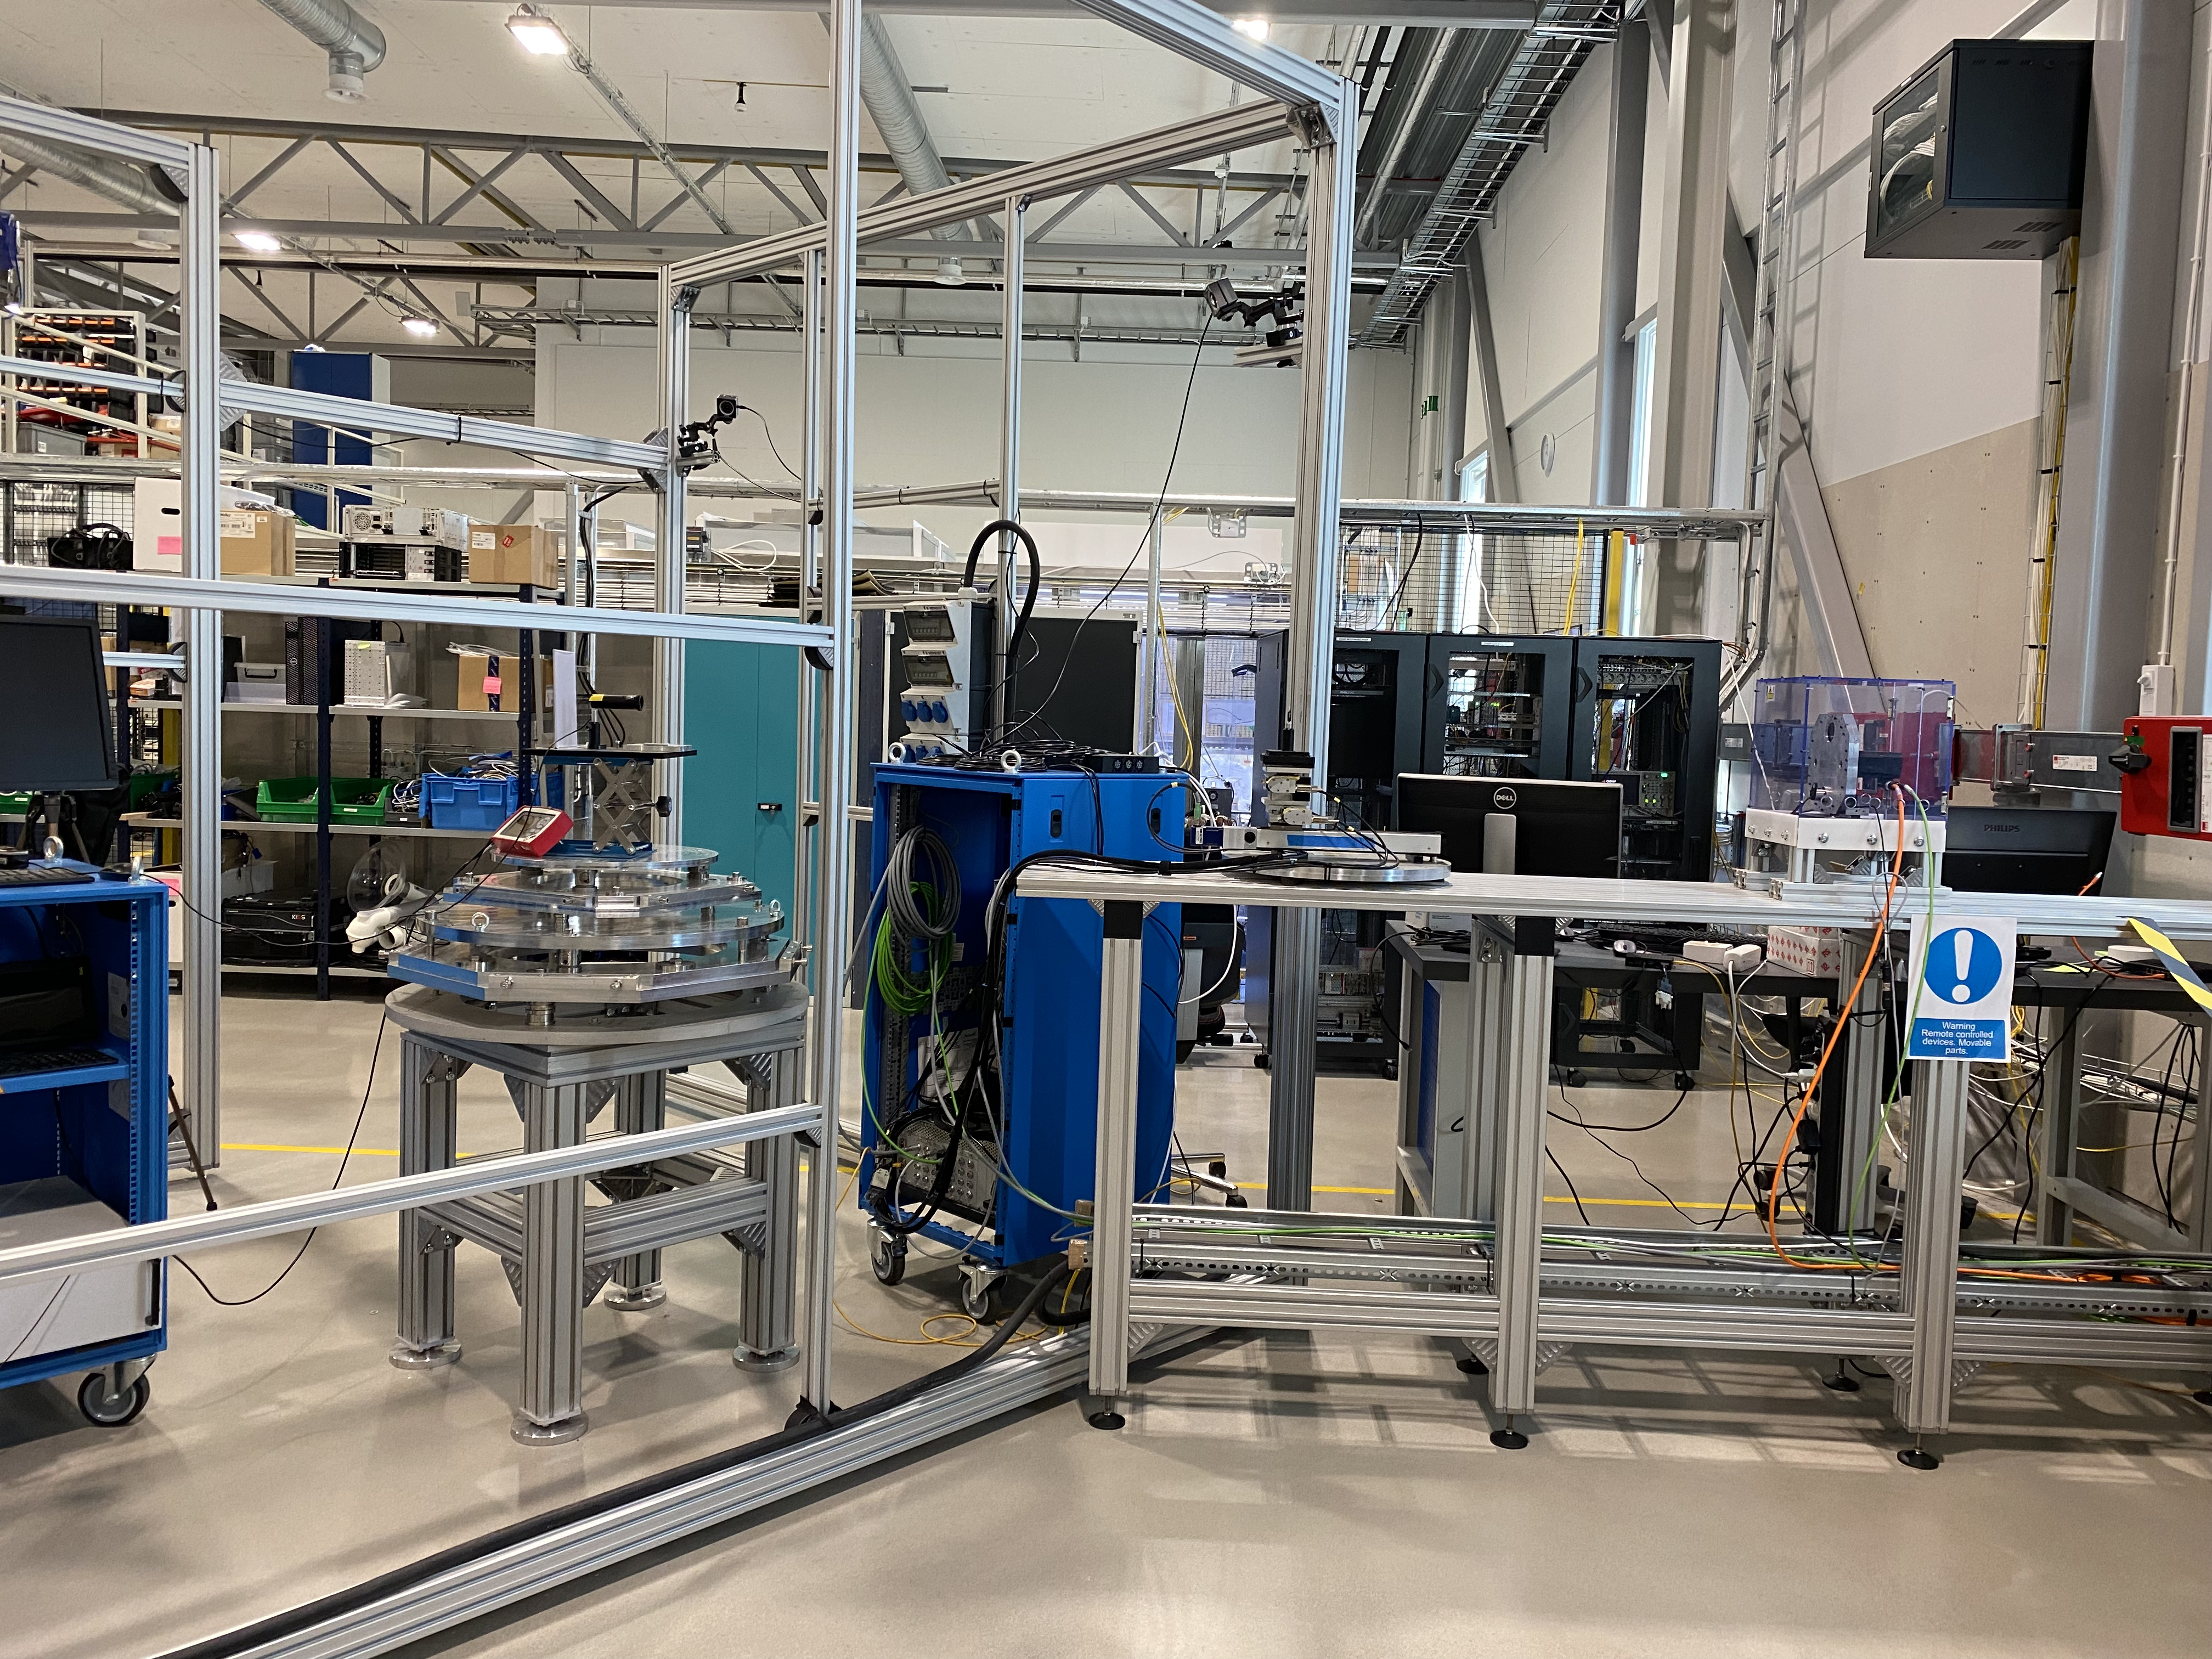
Main workshops used
B02 and E03
B02: Used by ECDC for testing of control integration
E03: Main MSPS operational workshop

Slide 17
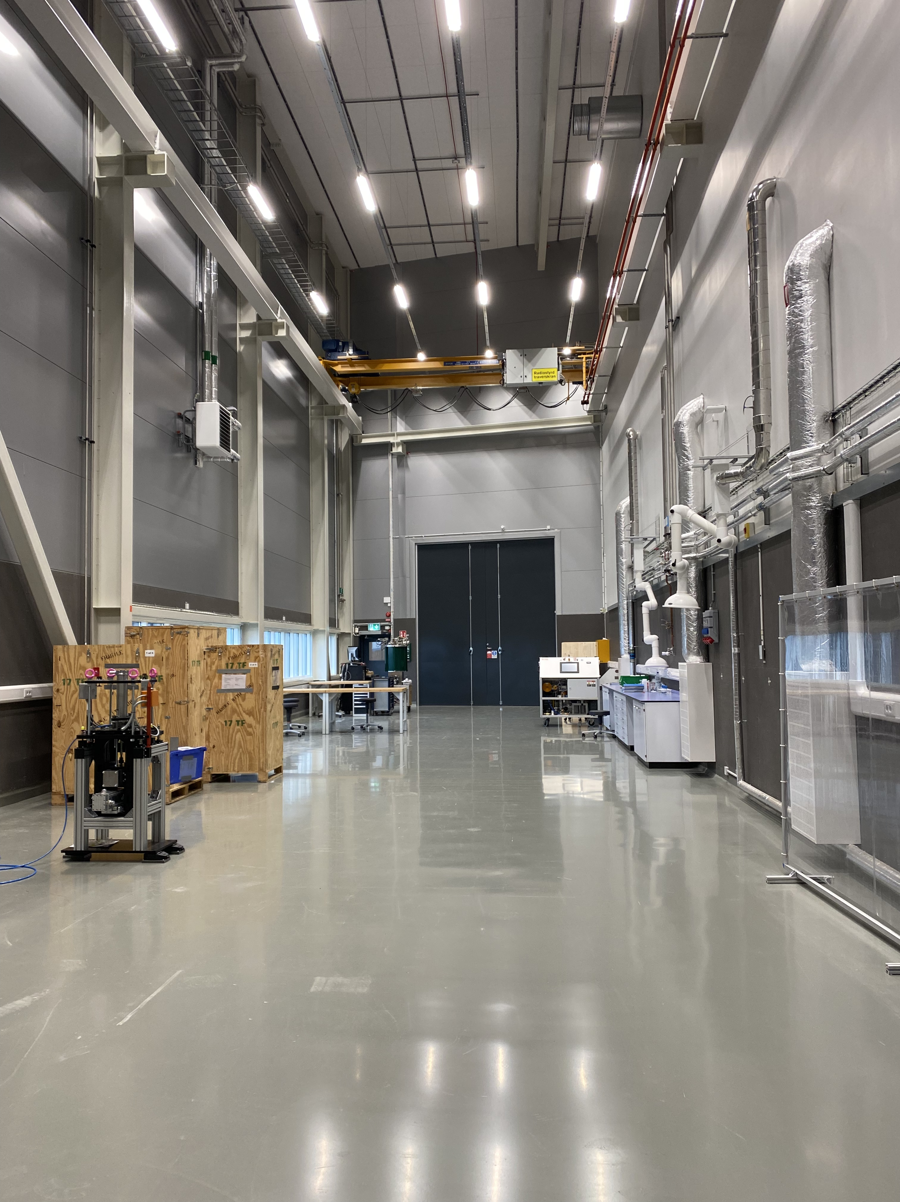
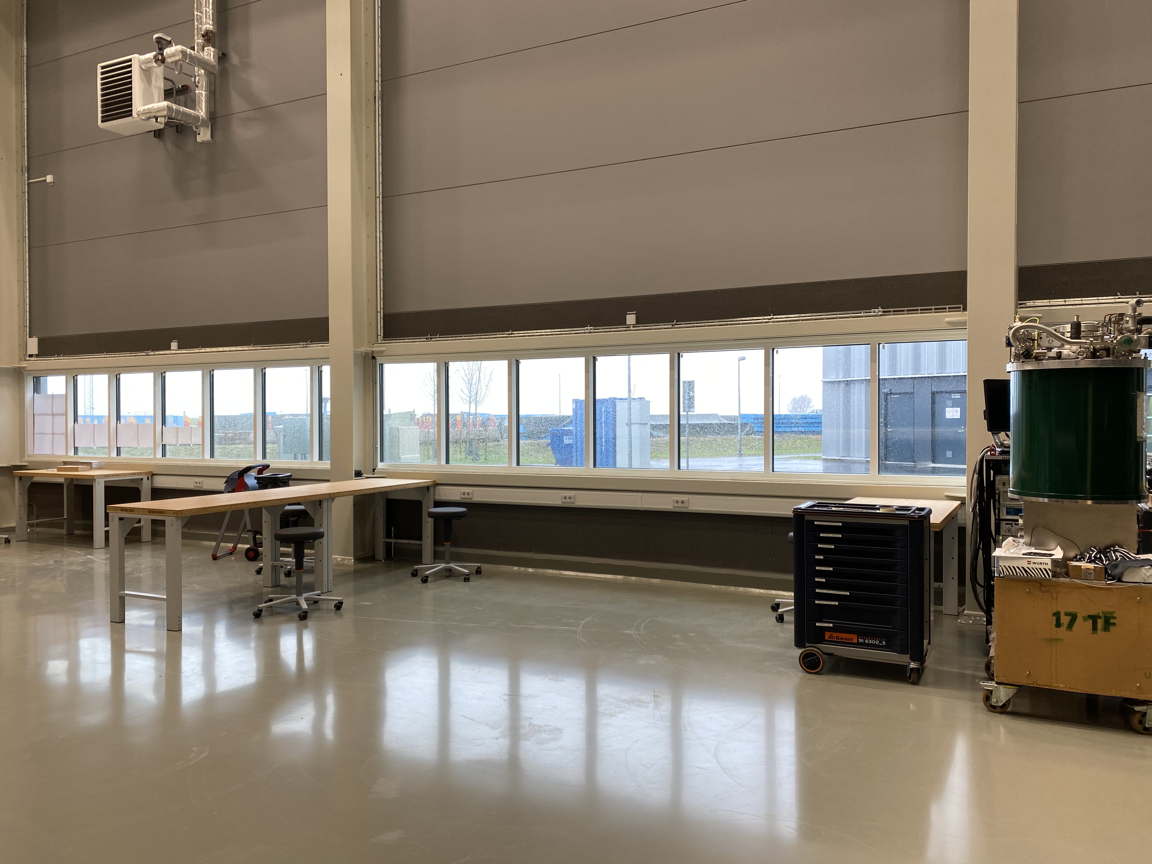
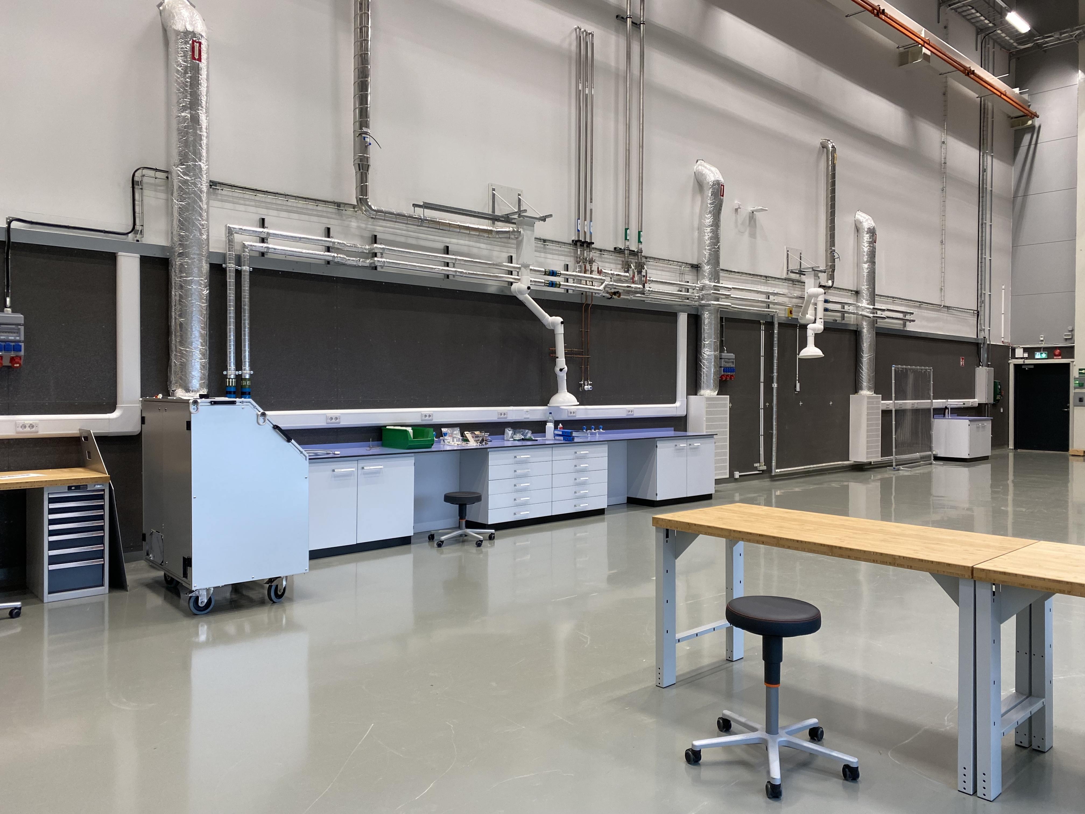
Labs & workshops to install
E03 SLIME lab
Installation started
Planned to support BEER and ODIN users for mechanical engineering
  Deformation rigs
  Furnaces
  Equipment for sample preparation

Slide 18
Labs & workshops to install
D08
Ready to move in by end of 24
First floor
Sample environment
Maintenance and storage of cryos, magnets, furnaces for ODIN, DREAM, ESTIA,…
High Pressure
PE presses, Liquid, gas and clamp cells
Compressors
High pressure
DAC
RAMAN
Ground floor

Slide 19
Thanks to
Richard Ammer, Niklas Ekström, Andreas Hagelberg, Alexander Holmes, Damian Paliwoda, Yulia Pedersen, Luca Sagliano, Lauritz Saxtrup and Oleksiy Zadorozhko and you for your attention

