Slide 1

Update on ESS
GIOVANNA FRAGNETO, SCIENCE Director
2027-2028
User program
2014
Construction starts on green field site
2025
Beam on target
2009
Decision to site ESS in Lund
2019
Start of initial operations phase
2012
ESS design update phase complete
2003
European design of ESS completed

Slide 2














A coalition of 13 European countries
Host countries
Non host member countries
Sweden, Denmark
Czech Republic, Estonia, France, Germany, Hungary, Italy, Norway, Poland, Spain, Switzerland, United Kingdom
Construction
47.5%
Construction
52.5%
(70% is in-kind)
Operations
15%
Operations
85%
When in operation:
2-3000 users per year
Open 24-7 (200 d/y)
~600 members of staff
~220-240M€ operation budget

Slide 3
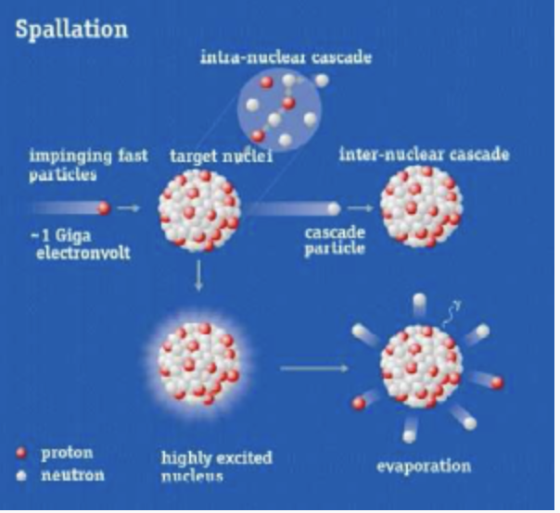
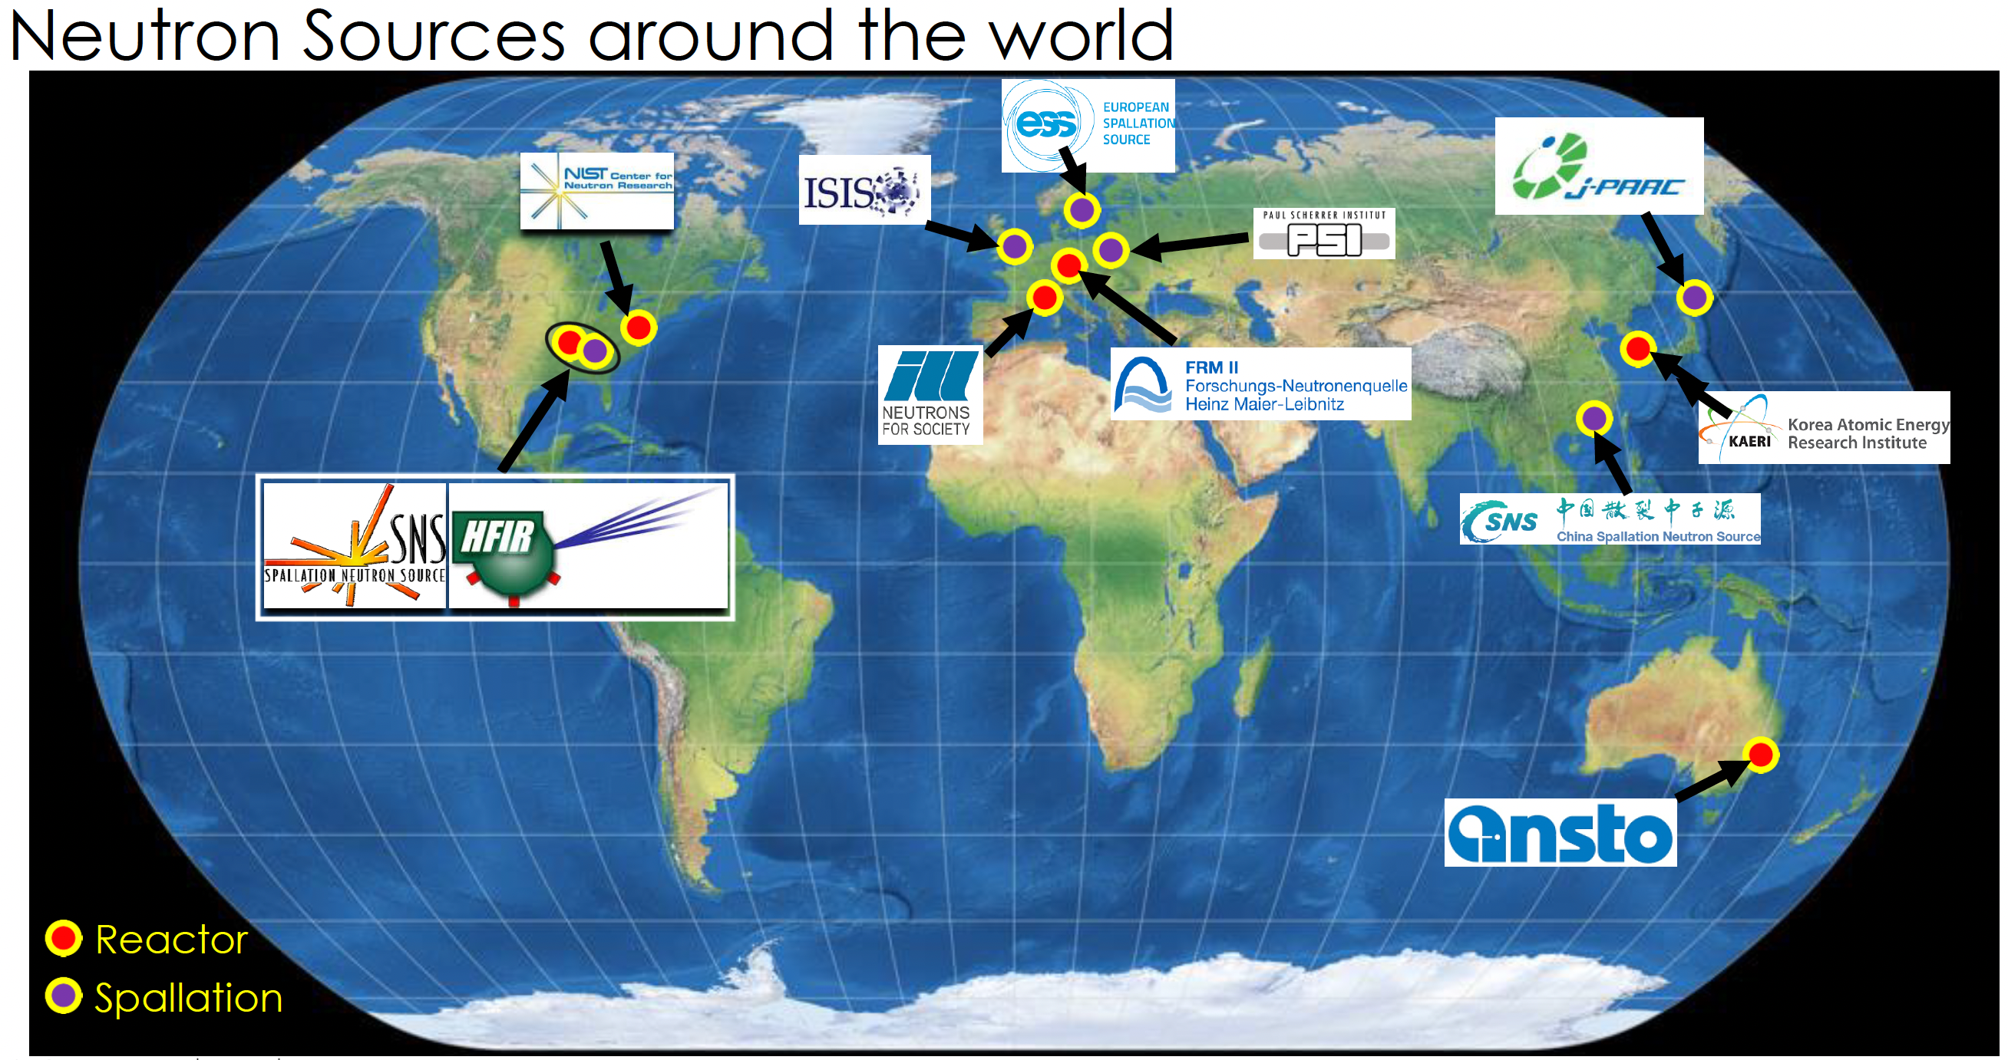
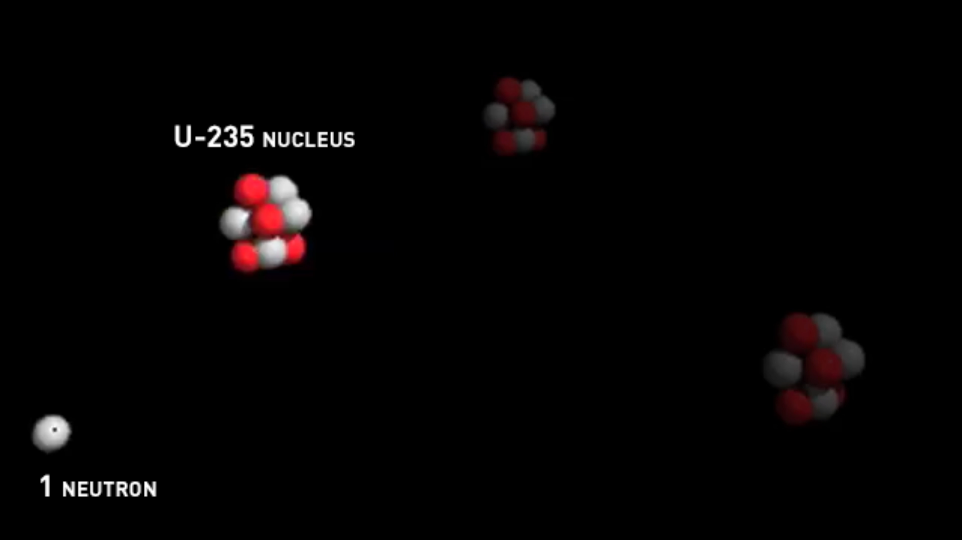
Neutrons
Subatomic particles found in atomic nuclei
Discovered in 1932 by Chadwick
Mass slightly higher than that of protons (~1.67×10⁻²⁷ kg)
Uncharged
Lifetime ~15 mins
Wave-particle duality (v = 2.2 km/s at RT)
Wavelength similar to atomic distances (λ = 0.18 nm at RT)
Energies similar to motion of molecules (~ 0.025 eV)
Possess a spin
Fission Spallation

Slide 4
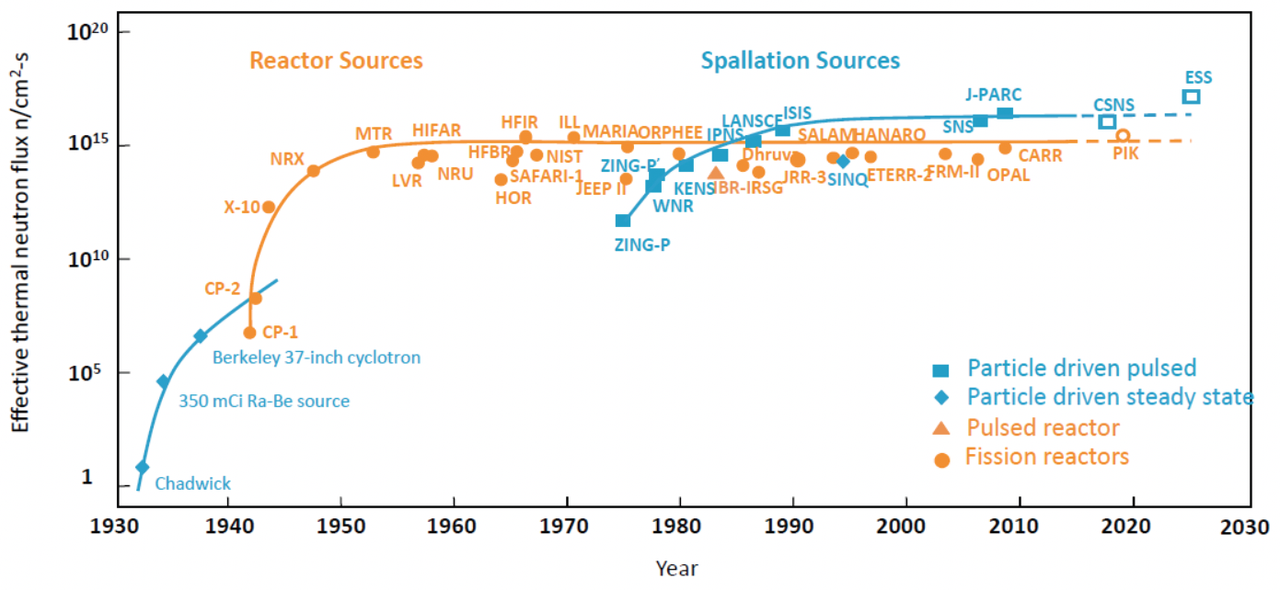
The global neutron source landscape
Where will ESS be?
SNS PPU
ESS peak flux 20 to 50 times higher than ILL

Slide 5
ESS in the global neutron source landscape
  Continuous Sources
  Pulsed Sources
  Fission reactors :
  ILL (France) – 58 MW thermal, 50-day fuel cycle, 4 cycles / year
  HFIR (USA) – 83 MW thermal, 23-day fuel cycle, 6-7 cycles / year
  Short-pulse driven by rapid-cycling synchrotron accelerators (RCS), all beam structures less than 1 microsecond
  J-PARC MLF (Japan) – 25 Hz, 3 GeV RCS up to 1 MW proton beam power – Hg target
  ISIS (RAL/UK) – 50 Hz, 0,8 GeV RCS up to 200 kW proton beam power providing muons and spallation neutrons divided between TS-1 (40 Hz) and TS-2 (10 Hz) – W target
  CSNS (China) – 25 Hz, 1,6 GeV RCS up to 100 kw proton beam power – W target
  Long-pulse driven by linear accelerator pulse length 2,86 milliseconds
  ESS (SE/DK) – 14 Hz, 0,8 – 2 GeV, 2-5 MW proton beam power
  Cyclotron accelerator-based:
  SINQ (PSI/Switzerland) – 1,4 MW proton beam power producing muons and spallation neutrons
ESS bridges the space between continuous and short-pulsed sources and opens up new techniques and opportunities
  Short-pulse driven by linear accelerators and accumulator rings, all beam structures less than 1 microsecond
  SNS (USA) – 60 Hz, 1,05 GeV 1,7 MW proton beam power - Hg target
  LANSCE (USA) – 20 Hz, 0,8 GeV 80 kW proton beam power – W target

Slide 6
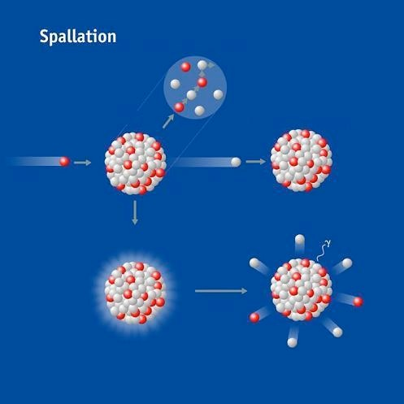
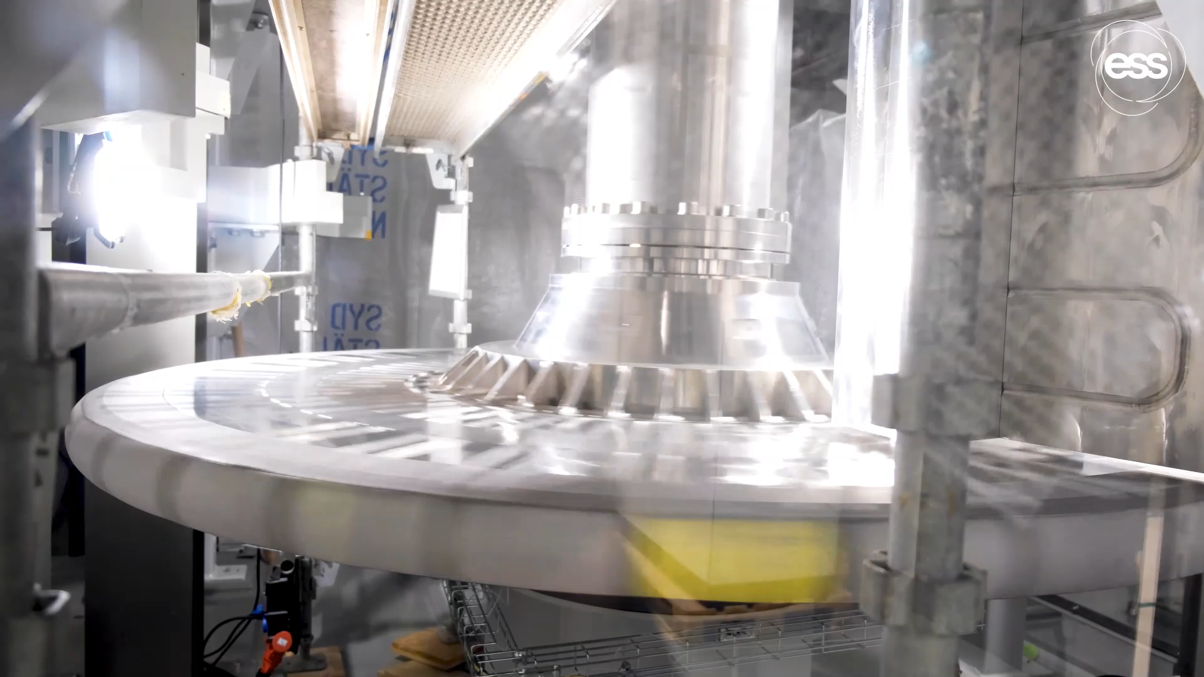
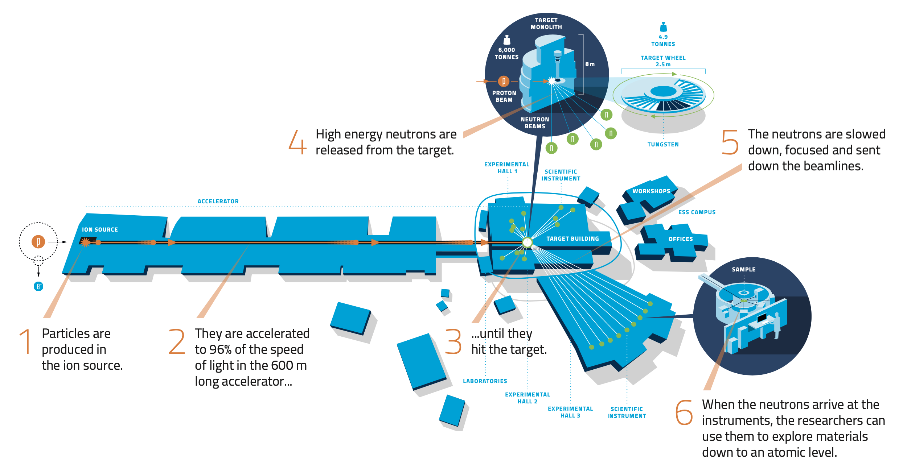
How it works
The technology

Slide 7
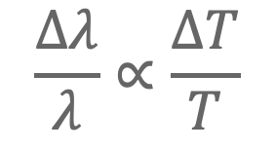
Long-pulse Performance and Flexibility
ESS 5MW
2018 design
Possibilities of pulse shaping
λ = 5 Å
10
×10¹³
Brightness (n/cm²/s/sr/Å)
ESS-TDR 5MW
updated engineering model
$$\frac{Δλ}{λ}∝\frac{ΔT}{T}$$
5
ESS 2MW
JPARC
1 MW
SNS
2 MW
Average flux = ILL
Peak flux 20 to 50 times higher
ISIS TS1
128 kW
ISIS TS2
32 kW
ILL 57 MW
0
time (ms)
1
2
3
4

Slide 8
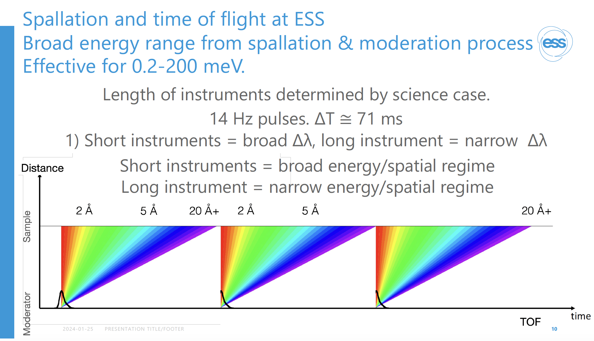

Slide 9
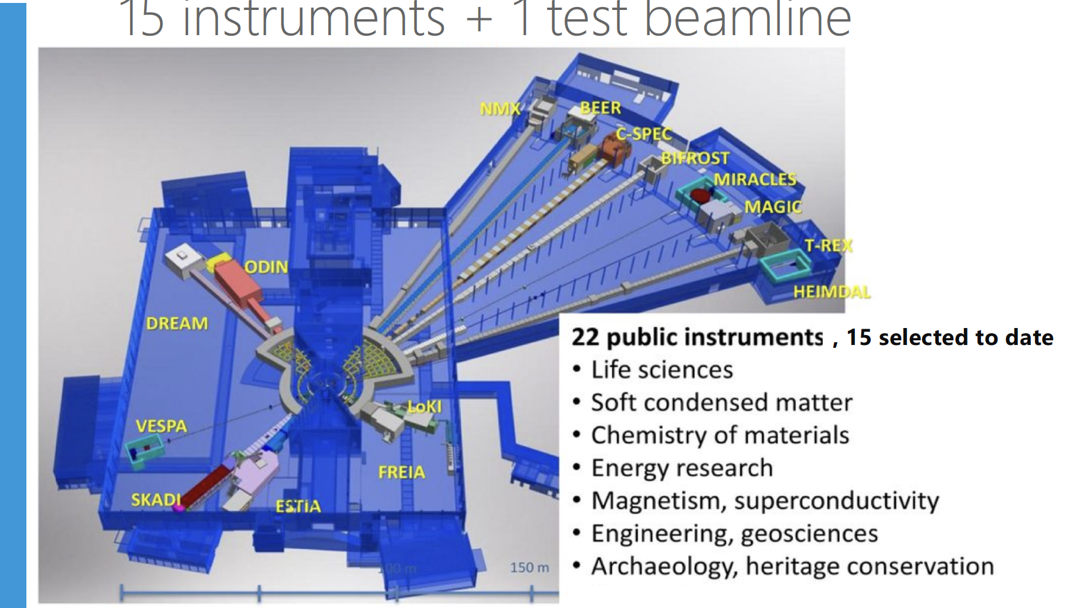
Diffractometers (DREAM, MAGiC, HEIMDAL, BEER) - Imaging (ODIN)
SANS (LoKI, SKADI) - Reflectometers (Estia, FREIA) - Macromolecular Crystallography (NMX)
Spectrometers (CSPEC, T-REX, BIFROST, MIRACLES, VESPA)
In-kind model for instrument design and construction

Slide 10
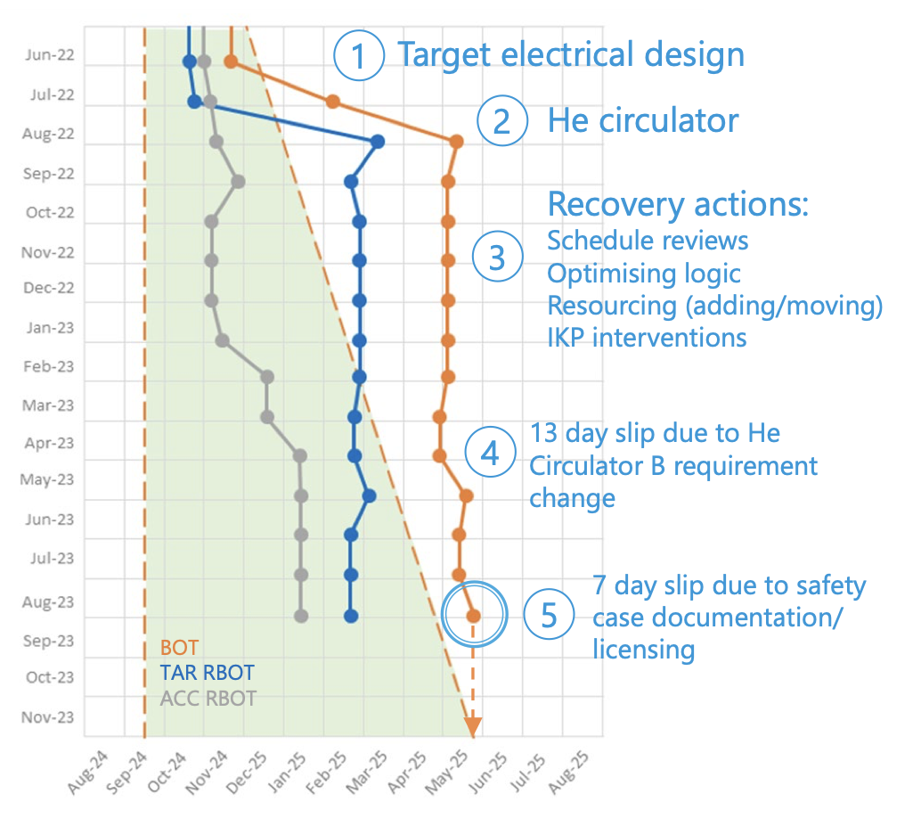
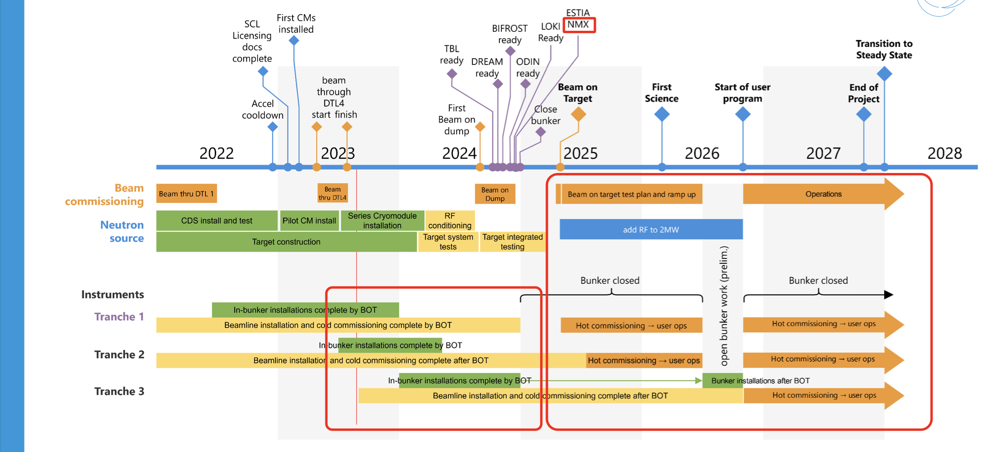
Project Timeline

Slide 11
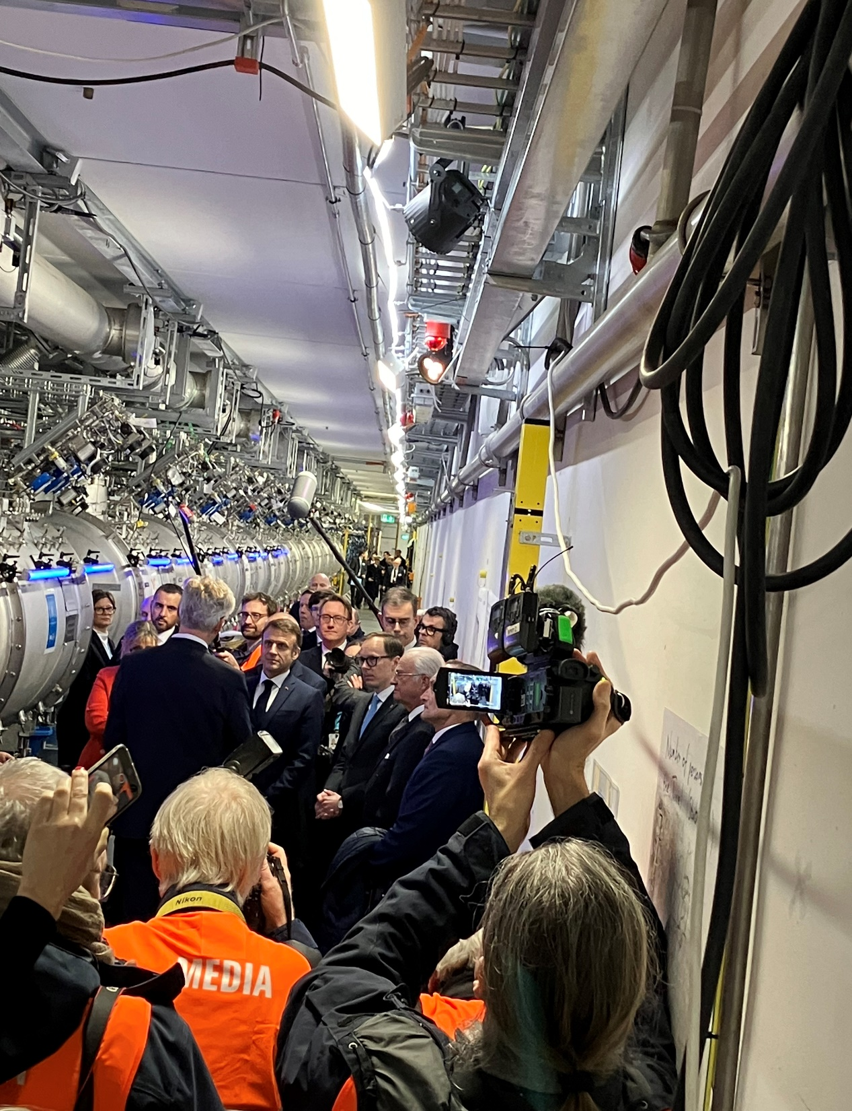
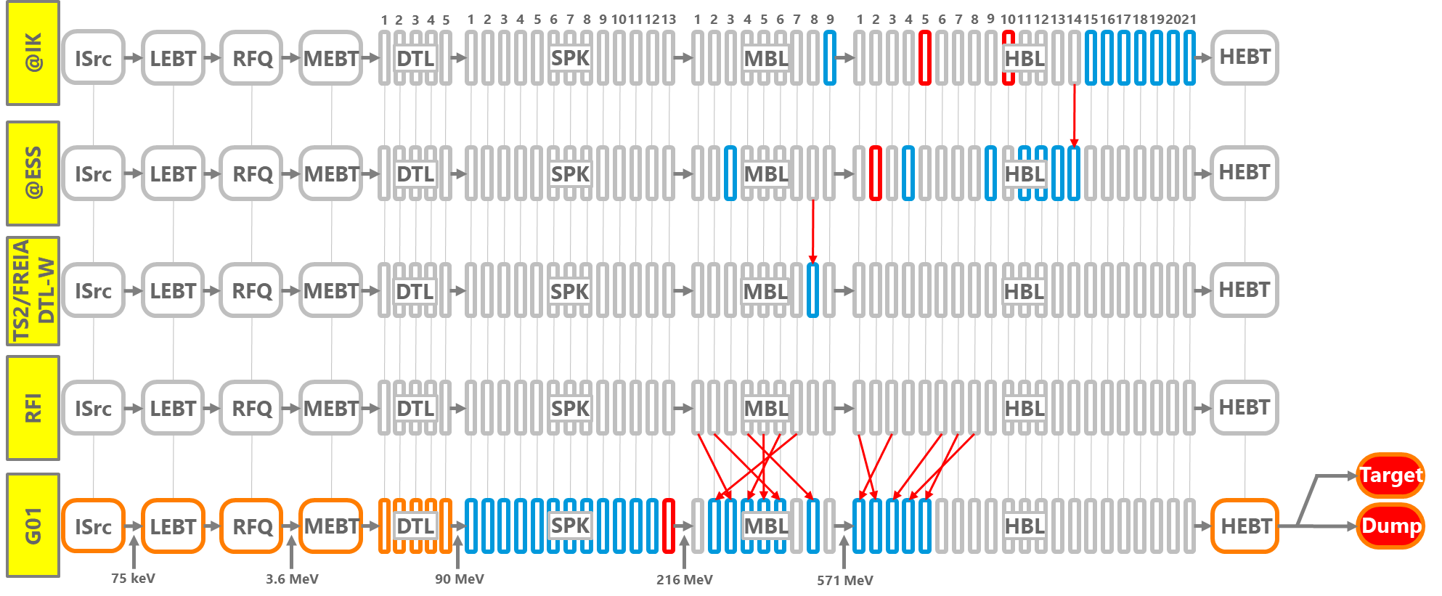
Accelerator
Installations progressing
  Almost a full compliment of CMs ready for BOD/BOT
  Gallery support systems are in good shape. All RF racks needed for BoT have been energized, now being soak tested.
  A2T region nearing completion
Week 5: The French state visit to the Accelerator tunnel celebrating the recent achievements leading up to beam operations at the end of 2024
Installed and tested
Installed

Slide 12
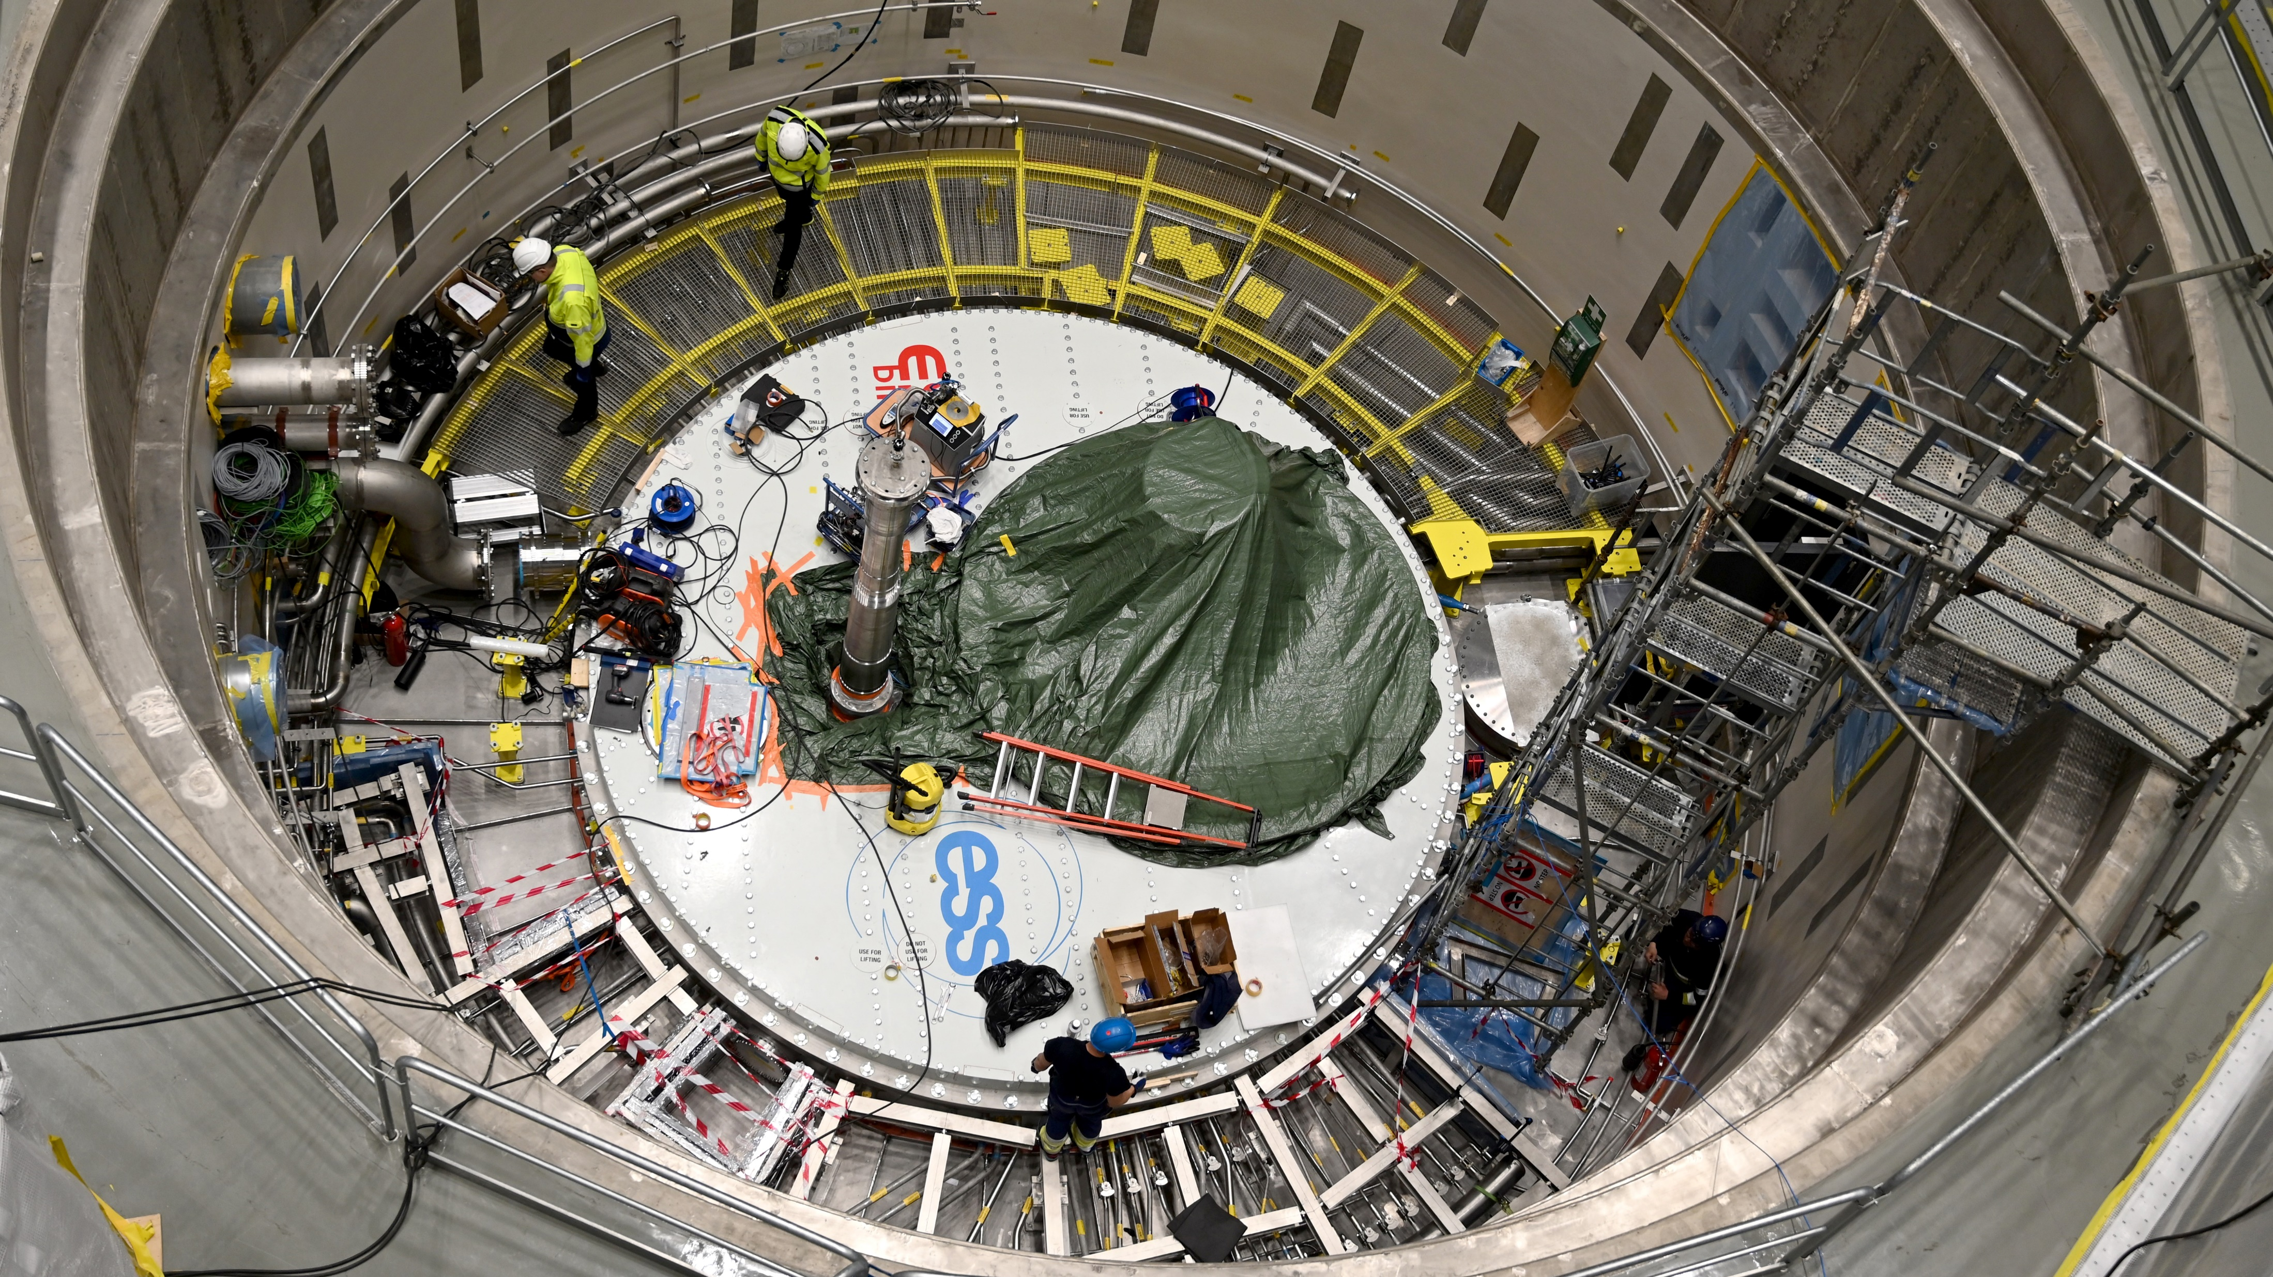
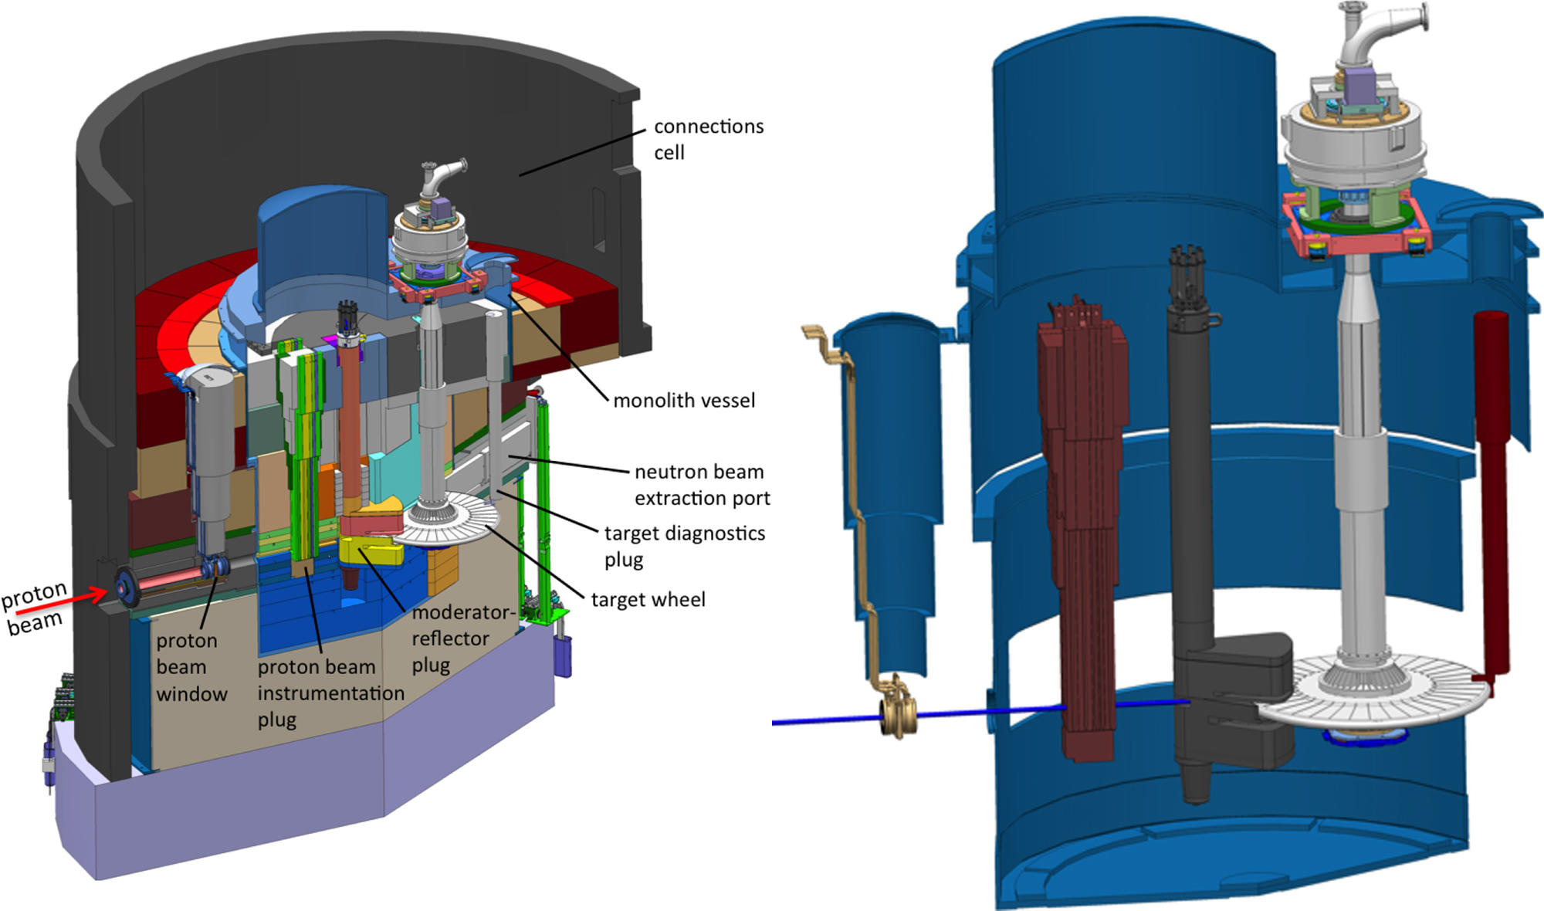
Target
  The connection cell and monolith area has been a hive of activity.
  Next step is to install the target wheel drive unit and continue with electrical/mechanical connections in the connection cell
  Installation is rapidly turning to testing and commissioning leading up to TAR RBOT
Monolith systems

Slide 13
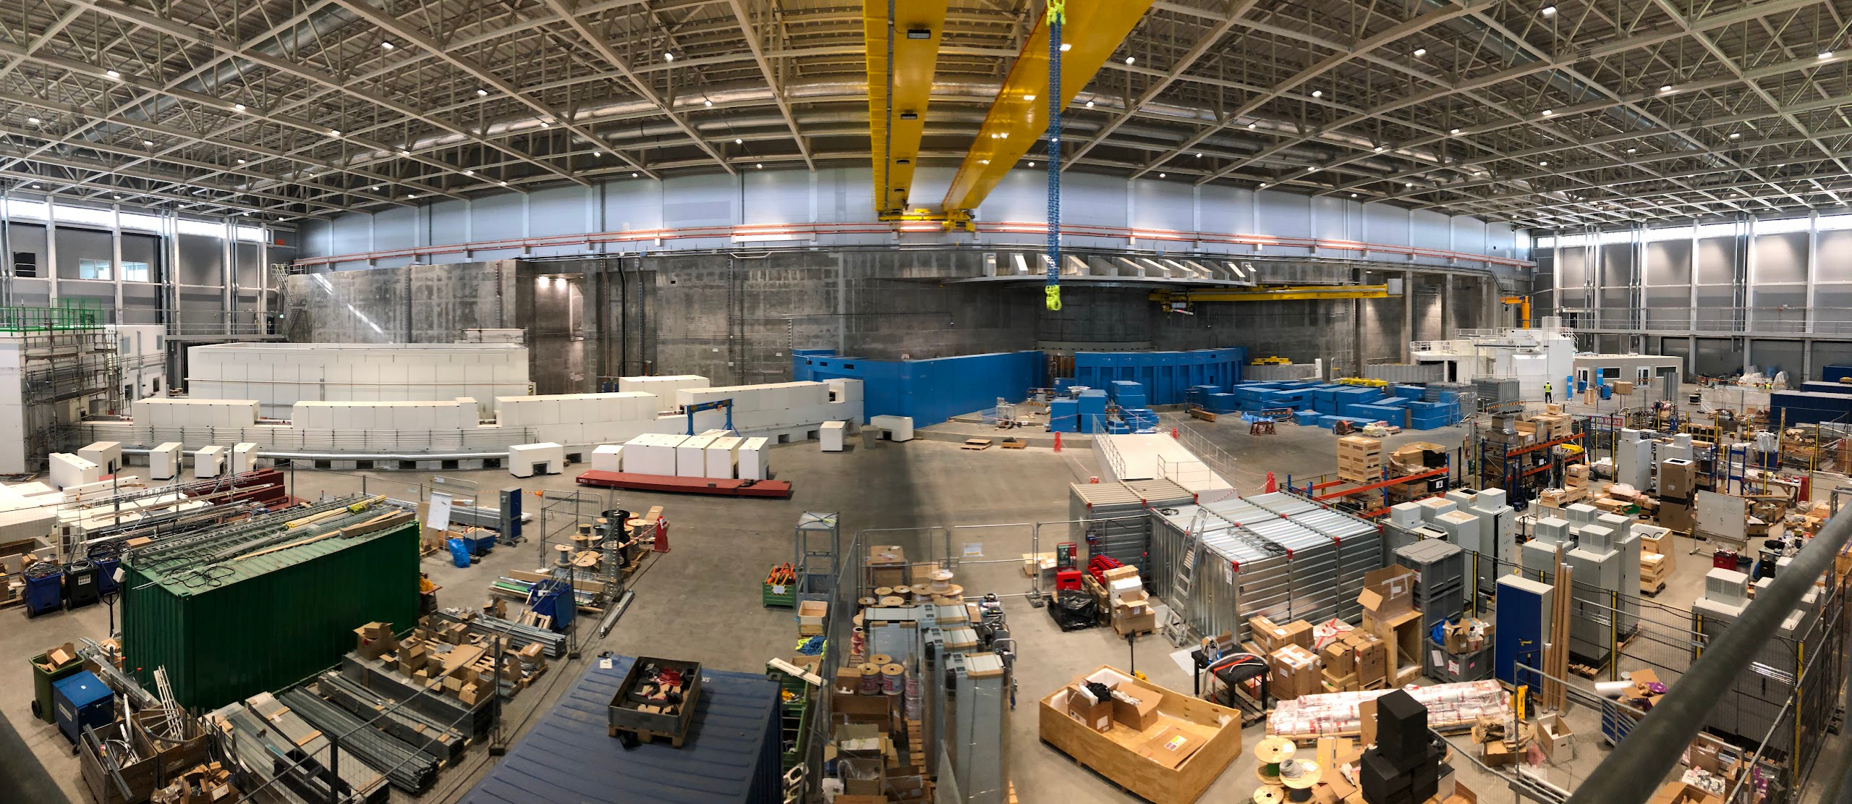
Neutron Instruments
D01 side
DREAM
ESTIA & SKADI
ODIN
VESPA

Slide 14
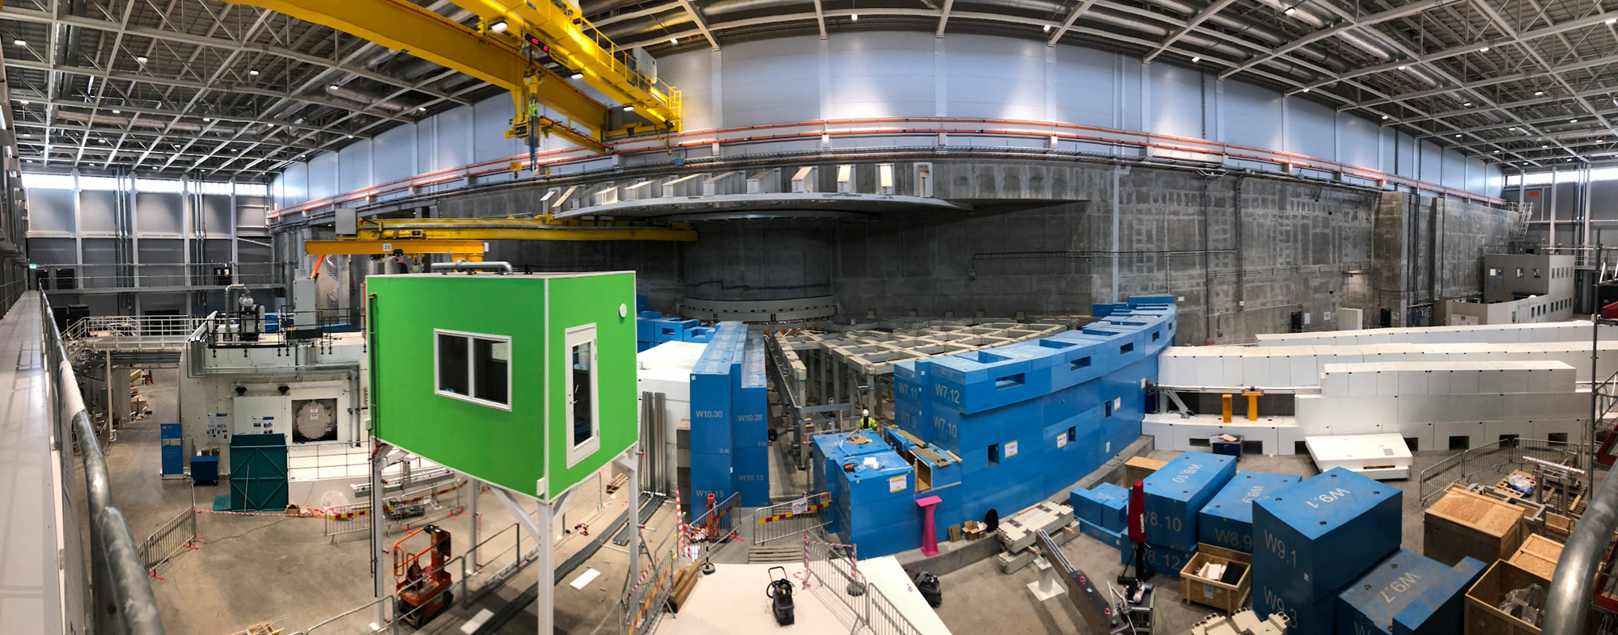
Neutron Instruments
D03 side
LOKI & FREIA
TBL
NMX, BEER, CSPEC, BIFROST, MIRACLES, MAGIC, T-REX, HEIMDAL (towards long hall)

Slide 15
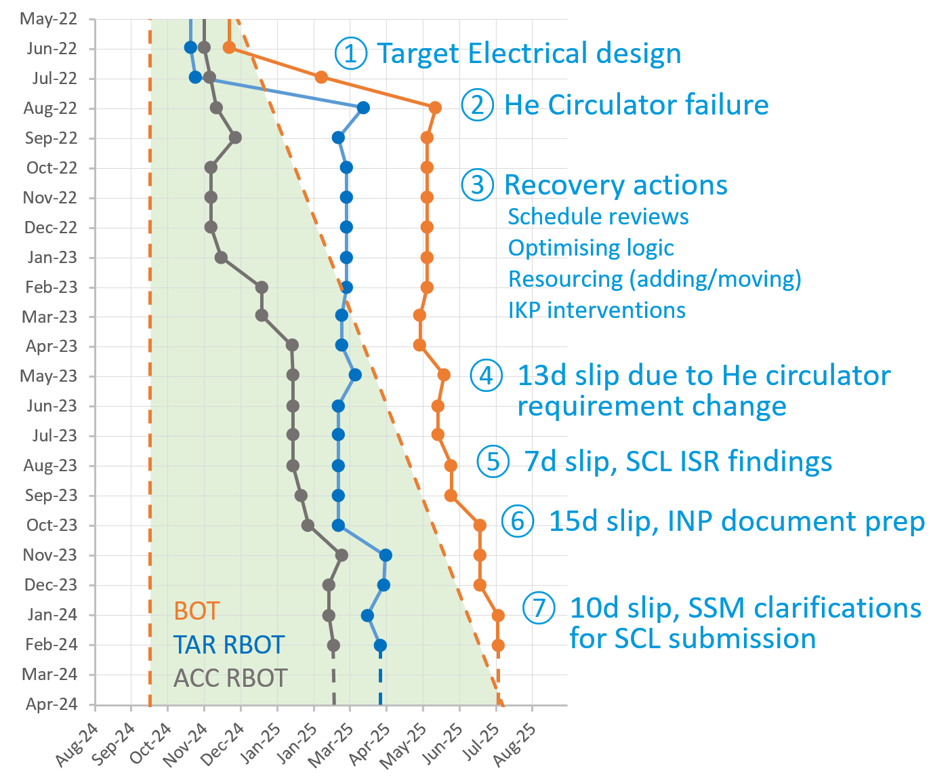
2024
A crucial year for the project
  Finish installation of CMs, RF, BI, Magnets
  Conditioning of CMs and DTLs
  Shielding and fire sealing
  Backup compressor, H20 upgrade
  MPS, PSS for BoD
  Cryo cooldown with 27 CMs
  SAR4/SRR4
  Beam on Dump ~Nov
  A2T region
  2024
  2025
  Last deliveries of Target components (e.g. He circ. A&B)
  Target installation -> testing & commissioning
  INP ref doc complete, receive SCL permit, submit INP permit
  DMSC systems ready for Tranche 1
  LOKI, ODIN, DREAM, BIFROST, TBL TG5/SAR
  Integrated
  testing
  Post-BoT activities
  Beam on Target
  ~Jul

Slide 16
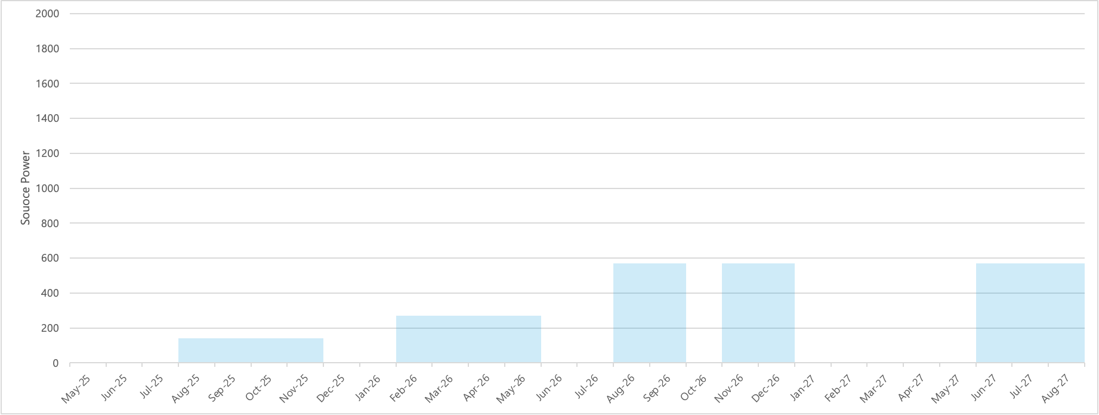


ESS Ramp up
Accelerator commissioning & TBL
18 months after BOT
Assuming BOT July 2025
Hot commissioning
First users
Shutdown
Users
2000
1800
Typical beam
6 mA
5μS
1 Hz
> 570 MeV
90 days
Typical beam
6 mA
2860μS
14 Hz
> 570 MeV
140 kW
120 days
Typical beam
12 mA
2860μS
14 Hz
> 570 MeV
270 kW
120 days
Typical beam
25 mA
2860μS
14 Hz
> 570 MeV
570 kW
40 days
Typical beam
25 mA
2860μS
14 Hz
> 570 MeV
570 kW
40 days
Typical beam
25 mA
2860μS
14 Hz
~870 MeV
800 kW
90 days
1600
1400
1200
Source Power (KW)
1000
40 days for HC
40 days for HC
40 days for HC
20 days for UP
40 days for UP
800
600
400
200
0
July 2025
Oct 2025
Jan 2026
Apr 2026
July 2026
Oct 2026
Jan 2027
Apr 2027
July 2027
Oct 2027
$$\frac{\text{570 }\text{kW} \text{at}\text{ 570 }\text{MeV}}{\text{2000 }\text{kW} \text{at}\text{ 870 }\text{MeV}}\text{→}\text{10 \% }\text{flux}$$
$$\frac{\text{800 }\text{kW} \text{at}\text{ 870 }\text{MeV}}{\text{2000 }\text{kW} \text{at}\text{ 870 }\text{MeV}}\text{→}\text{40 \% }\text{flux}$$
See ESS-0420218 “Early operations of ESS and prerequisites for first scientific results” for more details

Slide 17
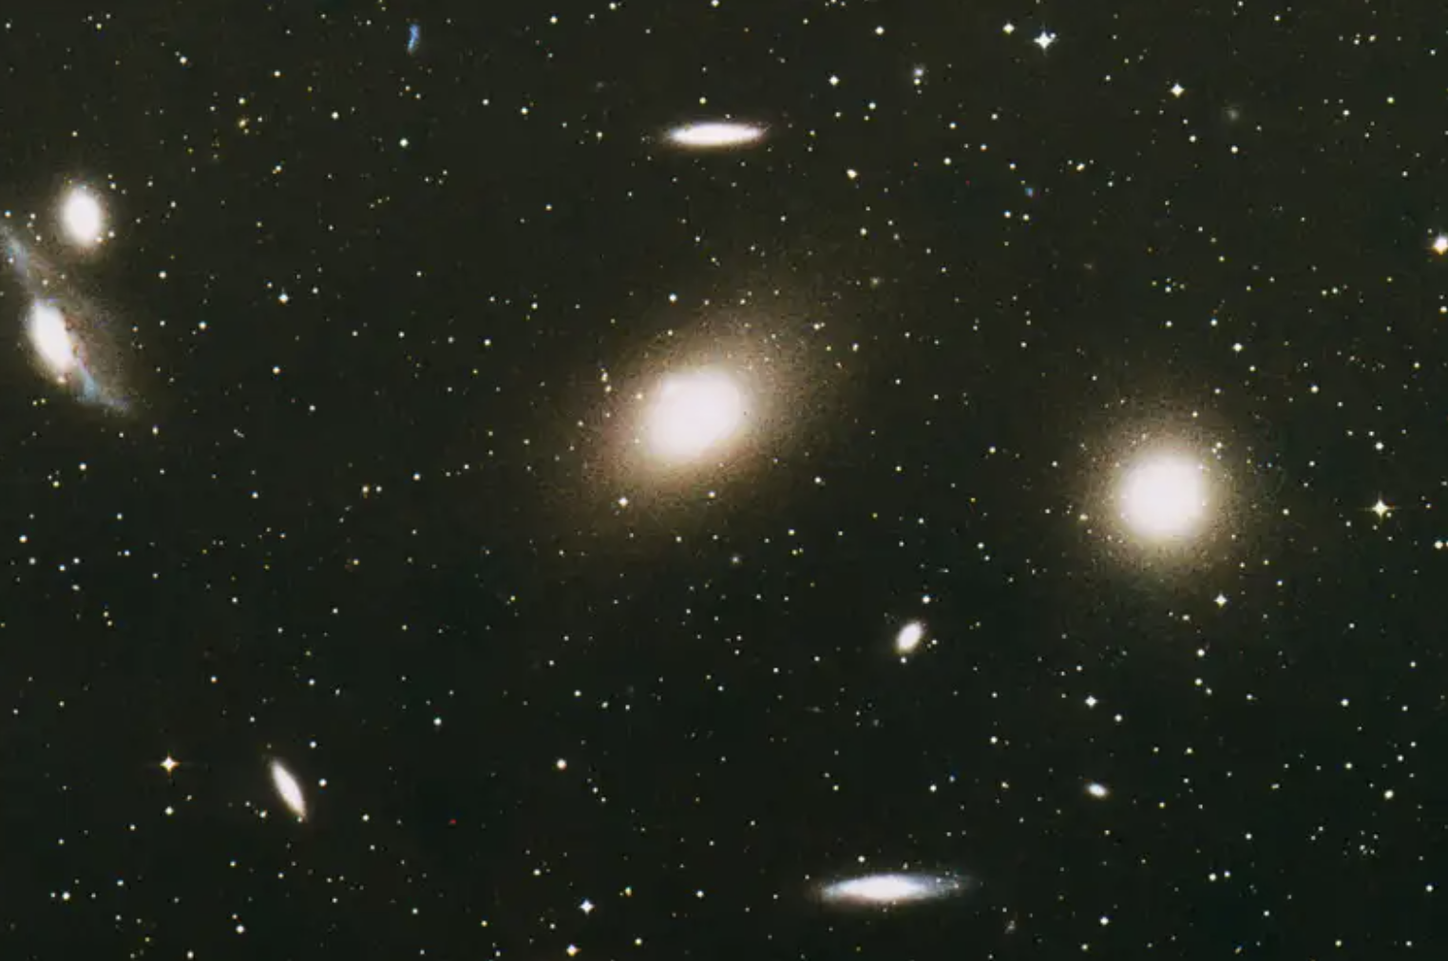
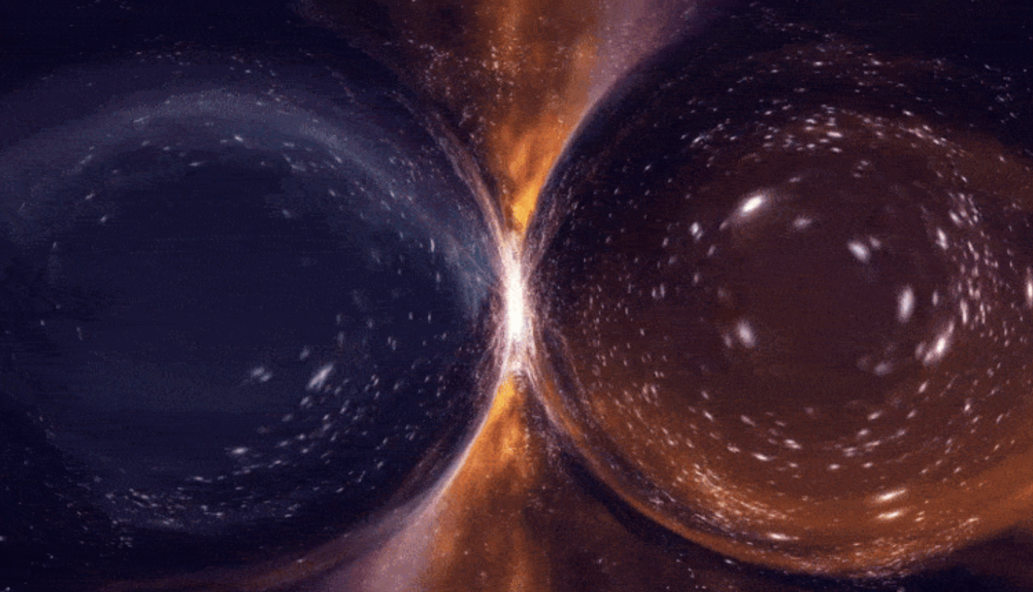
The ESS Particle Physics Program
The ESS particle physics program is included in the ESS mandate and identified as one of the high - priority gaps in The ESS Instrument Suite – A Capability Gap Analysis
The ESS will have the unprecedented capability to access and unlock some of the greatest challenges of the universe
Particle physics communities around the ESS are developing a broad fundamental physics program, that will be evaluated in few years, with a time span of at least two decades
This includes mainly
  Physics with neutrons
  Physics with neutrinos
Call for expression of interest for next instruments will be discussed at SAC this week and Council at the beginning of May – opened by summer

Slide 18
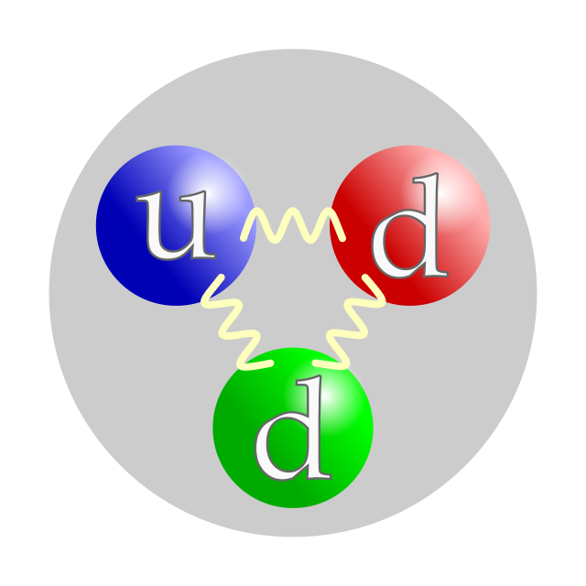
Particle physics possibilities with neutrons
Standard Model of particle physics (SM)
Precision experiments
Beyond SM
New interactions
Fundamental Particle Physics Beamline
HIBEAM beamline: search for neutron oscillations, Axion-like particles , and other searchers
ANNI beamline:
Neutron beta decay
and other searchers
Search for Neutron antineutron oscillation (NNBAR)
Matter –Antimatter asymmetry of the Universe
Ultra Cold Neutron
Electric Dipole moment of the neutron (EDM)
Gravity resonance spectroscopy
Neutron beta decay

Slide 19
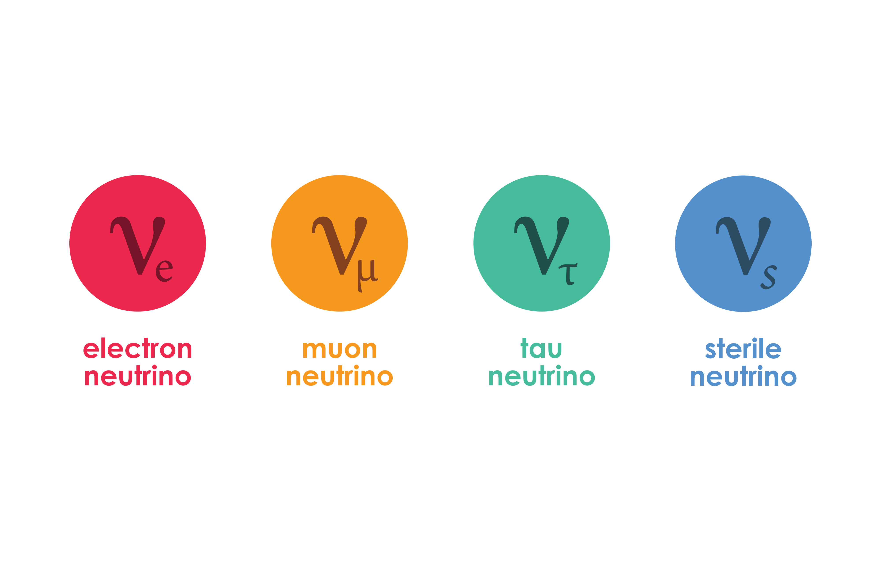
Fundamental physics possibilities with neutrinos
Standard Model of particle physics (SM)
Precision experiments
Beyond SM
New interactions
ESSν
Coherent Elastic Neutrino-Nucleus Scattering at the ESS
High-statistics, precision CEνNS measurements
ESSnuSB
Discover and measure neutrino CPV

Slide 20
Charge for Fundamental and Particle Physics STAP Meeting
For today meeting, we request the following from the STAP:
Evaluate the proposal of the vESS collaboration, focusing on:
  Maturity and relevance of the science case for the vESS collaboration in accordance with the ESS schedule and ramp-up conditions.
  Clarity of identified needs for ESS support, including availability and accessibility of proposed room locations and infrastructure required for installation.
  Assessment of whether the vESS collaboration has the necessary funding to operate the experiment in the coming years.
Provide detailed feedback on the scientific merit, feasibility, and potential impact of the proposed vESS collaboration.
Consideration should be given to:
Novelty and innovation of the proposed research approach.
Technical feasibility of the experimental methods.
Potential contributions to advancing fundamental understanding in particle physics and related fields.
Alignment with ESS strategic priorities and broader scientific objectives.
Prepare a comprehensive report addressing the above questions and any related topics deemed relevant by the STAP. This report will be presented at the upcoming meeting of the ESS Scientific Advisory Committee (SAC) scheduled for April 18th and 19th.

Slide 21
Call for next instruments
The guiding principle is, Which science is missing?
We open a preproposal call this summer and keep it open until the end of the year. We’ll be asking for short (5 pages), scientifically driven proposals, no simulations. The applicant will be asked for a strong science case, a gap analysis in terms of both capability and capacity, and some initial comments on technical feasibility. Open to everyone.
The STAPs, SAC and selected committees will review these proposals, as will we. The concepts will be considered in relation to rescoping current instruments. A selection is made on which proposals to move ahead with, and these teams will be invited to develop a full proposal, in collaboration with us.
Even though they have been invited to move forward, we can still turn a proposal down.
Building the selected instruments will reside with us. Collaborative in-kind contributions inside the instrument projects can be considered, primarily in the form of staff (recruited by us and working at ESS) or sample environment equipment, developed in close collaboration with the instrument team. We will not have entire instruments in-kind, nor will we accept large instrument components to be delivered in-kind.

Slide 22
Considerations:
We don’t have funding for these instruments at this time, but are aiming at securing funding from the SSO budget. We move ahead with the selection process on the assumption that funding will be made available.
We do not intend for this process to distract from our current work of finalizing the project. Recruitments may be on the table.
We won’t be expanding the instrument halls, so all proposals have to fit into the currently available space.
If you have comments/advice pertinent to the specific area of fundamental and particle physics we will be happy to discuss them

Slide 23













The ESS Project
Host Countries
Sweden and Denmark
Member Countries

