Slide 2
MSPS - Materials Science and Physics Support Group
General update
Organisation
Labs & workshops
PRESENTED BY caroline curfs

Slide 3
MSPS specific charges
Steady State Operation (SSO):
  MSPS plan: ESS management will optimize the developed SSO model following advice from the reviewers. In this context we would like the STAP to comment on the completeness of the tasks presented (did we forget tasks which will require resources?)
  The SSO review panel suggested to provide a full service to the users including the full installation of the sample environment equipment on the instruments and the refill of dewars, cryostats and magnets. Those services would be in addition to the more complex tasks (e.g. dilution fridge) which were originally foreseen. STAP is invited to comment on this service approach and advice on a possible implementation method. What are the advantages and drawbacks of this type of full service model? What tasks would be better performed by the instrument staff?
  The SSO review panel suggested to increase the number of technicians. What would be an appropriate number for each planned task?
The need for Paris-Edinburgh press high pressure high temperature synthesis / operation has been expressed by the potential high pressure user community. At the moment this will need additional resources for developing high temperature equipment. What is the advice of the STAP members regarding such development?

Slide 4
Agenda
1 Organisation
3 Projects plan
4 Labs and Workshops
5 Conclusions

Slide 5
1
Organisation

Slide 6
Changes since spring 23
  Group name : MSPS for Materials Science & Physics Support
  MSPS directly under Science Directorate
  Polarisation moved to NSS project division in Technical directorate
  2 new MSPS team members :
    Oleksiy Zadorozhko for Low and Ultra low temperature
    Damian Paliwoda for high-pressure
  New mechanical designer shared with CLS: Luca Sagliano
  New Technical writer : Yulia Pedersen
  Anders Petersson from ECDC moved to other responsibilities
  Jaroslaw Fydrych moved to other responsibilities

Slide 7
Scope
    Provide services for materials engineering, quantum materials and physics
    Provide and maintain sample environment systems in the fields of:
      Low and ultra low temperatures
      High temperature
      Electrical and magnetic fields
      High pressure
      Mechanical processing
    Provide mechanical integration for all SES (including CLS projects)
    Provide control integration for complex SES (including CLS projects)
    Coordinate the He management

Slide 8
Team
Current
2 technicians : Lauritz and Richard
2 control engineers : Niklas and Andreas
4 sample environment engineers: Alex, Oleksiy, Damian and Caroline
0.5 mechanical design engineer: Luca
1 technical writer : Yulia
Planned recruitment:
on going : Sample environment engineer for HT
End of 2024: 2 technicians
2025: 1 technician
2027: 1 technician
What profiles do we need?

Slide 9
3
Projects plan

Slide 10
MSPS Sample Environment Systems
Systems to be delivered before 12.2027
  8 magnets from 2.5 T to 15 T
  Low temperature : 6 cryofurnaces and 10 cryostats (7 wet and 3 dry) including 1 for PE presses and 1 for electro-chemistry
  Ultra low temperature: 3 dilution fridges and 1 He3 insert
  High temperature: 2 ILL-type furnaces, 1 induction furnace, 1 lamp furnace and 1 hot air blower
  High pressure: 10 high pressure cells (5 gas, 4 liquid and 1 clamp), 5 compressors (4 automatic and 1 manual), 5 Paris Edinburgh presses with gas loader
  Mechanical processing : 2 stress rigs (uniaxial and torsion/rotation), 1 thermo-mechanical instrument (dilatometer)
  Provided by instruments : 1 He3 insert, 1 cryofurnace with sample changer and 4 cryostats

Slide 11
Status of SES by end of 2022
Reality
Magnets | 2.5 T WBM | 8 T magnet | 15 T magnet | Spectro magnet
Cryo Instr. & IK | Flow cryostat ESTIA | Wet cryostat BIFROST | Cryofurnace CSPEC | Sample changer CSPEC | He3 insert CSPEC | HP cryostat
Cryo pool | Sample rot sticks | Dry Cryo DIFF EC
High Pressure | Clamps | Gas cells | PE | Gas loading for PE
Mechanical processing | Rig 60 kN | Tortion/rot. rig | Dilatometer
High temperature | ILL-type furnace
Soft matter | SANS SC therm. | SANS SC tumbler | Stopped flow cells | Rheometer
Surface interfaces | Solid/liquid cells
In situ | Laser P&P
Physical chemistry | Electrochem. cell | Gas handling | Humidity
Preparation CFT
Design
CFT
Construction
Procurement
Tests
Control and mechanical
integration
Specifications

Slide 12
Status of SES by end of 2023
Expected
Magnets | 2.5 T WBM | 8 T magnet | 15 T magnet | Spectro magnet | 15T magnet | 6.5T magnet
Cryo Instr. & IK | Flow cryostat ESTIA | Wet cryostat BIFROST | Cryofurnace CSPEC | Sample changer CSPEC | He3 insert CSPEC | HP cryostat
Cryo pool | Sample rot sticks | Dry Cryo DIFF EC | Cryofurnace DIFF 2nd hand | Dil. Fridge 2nd hand | Dil. Fridge | Dry cryo spectro
 | Dry Cryo Heimdal
High Pressure | Clamps | Gas cells | PE | Gas loading for PE
Mechanical processing | Rig 60 kN | Tortion/rot. rig | Dilatometer
High temperature | ILL-type furnace | Induction furnace | Cryostream/gas blower
Preparation CFT
Design
CFT
Construction
Procurement
Tests
Control and mechanical
integration
Specifications

Slide 13
Status of SES by end of 2023
Reality
Magnets | 2.5 T WBM | 8 T magnet | 15 T magnet | Spectro magnet | 15T magnet | 6.5T magnet
Cryo Instr. & IK | Flow cryostat ESTIA | Wet cryostat BIFROST | Cryofurnace CSPEC | Sample changer CSPEC | He3 insert CSPEC | HP cryostat
Cryo pool | Sample rot sticks | Dry Cryo DIFF EC | Cryofurnace DIFF 2nd hand | Dil. Fridge 2nd hand | Dil. Fridge | Dry cryo spectro
 | Dry Cryo Heimdal
High Pressure | Clamps | Gas cells | PE | Gas loading for PE
Mechanical processing | Rig 60 kN | Tortion/rot. rig | Dilatometer
High temperature | ILL-type furnace | Induction furnace | Cryostream/gas blower
Preparation CFT
Design
CFT
Construction
Procurement
Tests
Control and mechanical
integration
Specifications

Slide 14
Status of SES by end of 2024
Expected
Magnets | 2.5 T WBM | 8 T magnet | 15 T magnet | Spectro magnet | 15T magnet | 6.5T magnet
 | High Field SANS magnet
Cryo Instr. & IK | Flow cryostat ESTIA | Wet cryostat BIFROST | Cryofurnace CSPEC | Sample changer CSPEC | He3 insert CSPEC | HP cryostat
 | Dil. Fridge
Cryo pool | Sample rot sticks | Dry Cryo DIFF EC | Cryofurnace DIFF 2nd hand | Dil. Fridge 2nd hand | Dil. Fridge | Dry cryo spectro
 | Dry Cryo Heimdal | He3 insert | Wet cryo MIRACLES | Wet Cryo TREX | Dry Cryo SANS | Cryofurnace TREX
High Pressure | Clamps | Gas cells | PE | Gas loading for PE | DAC/RAMAN
Mechanical processing | Rig 60 kN | Tortion/rot. rig | Dilatometer
High temperature | ILL-type furnace | Induction furnace | Cryostream/gas blower | UHT furnace
Preparation CFT
Design
CFT
Construction
Procurement
Tests
Control and mechanical
integration
Specifications

Slide 15
MSPS priorities for HC and CC
Instrument | Instrument | Cold Commissioning |  | Hot Commissioning
 |  | SES | Timeline | SES | Timeline
TRANCHE 1 | DREAM | Hot Air Blower/Cryostream | 10.24 – 03.25 | ILL-Type furnace | 07.25-03.26
 | BIFROST | 15T magnet / Wet cryostat | 11.24-04.25 |  | 07.25-03.26
 | ODIN |  |  | Tortion/rotation rig | 07.25-03.26
TRANCHE 2 | ESTIA | 2.5 T WBM/Flow cryostat | 07.25-12.25
 | SKADI |  |  | Electromagnet | 10.26-06.27
 | BEER | 60kN stress rig | 07.26-12.26 | Dilatometer | 01.27-09.27
 | MAGIC | 8T magnet / Wet cryostat | 04.26-09.26
TRANCHE 3 | HEIMDAL | ILL-Type furnace/Dry cryostat | 10.26-03.27
 | T-REX | Wet cryostat | 07.26-12.26 | He3 insert | 01.27-09.27
 | MIRACLES | Dry cryofurnace | 07.26-12.26 | Wet cryostat | 01.27-09.27
 | CSPEC | Rotation stick | 10.26-03.27 | Spectro magnet | 04.27-12.27
 | VESPA | Dry cryostat | 04.27-09.27

Slide 16
5
Labs and workshops

Slide 17
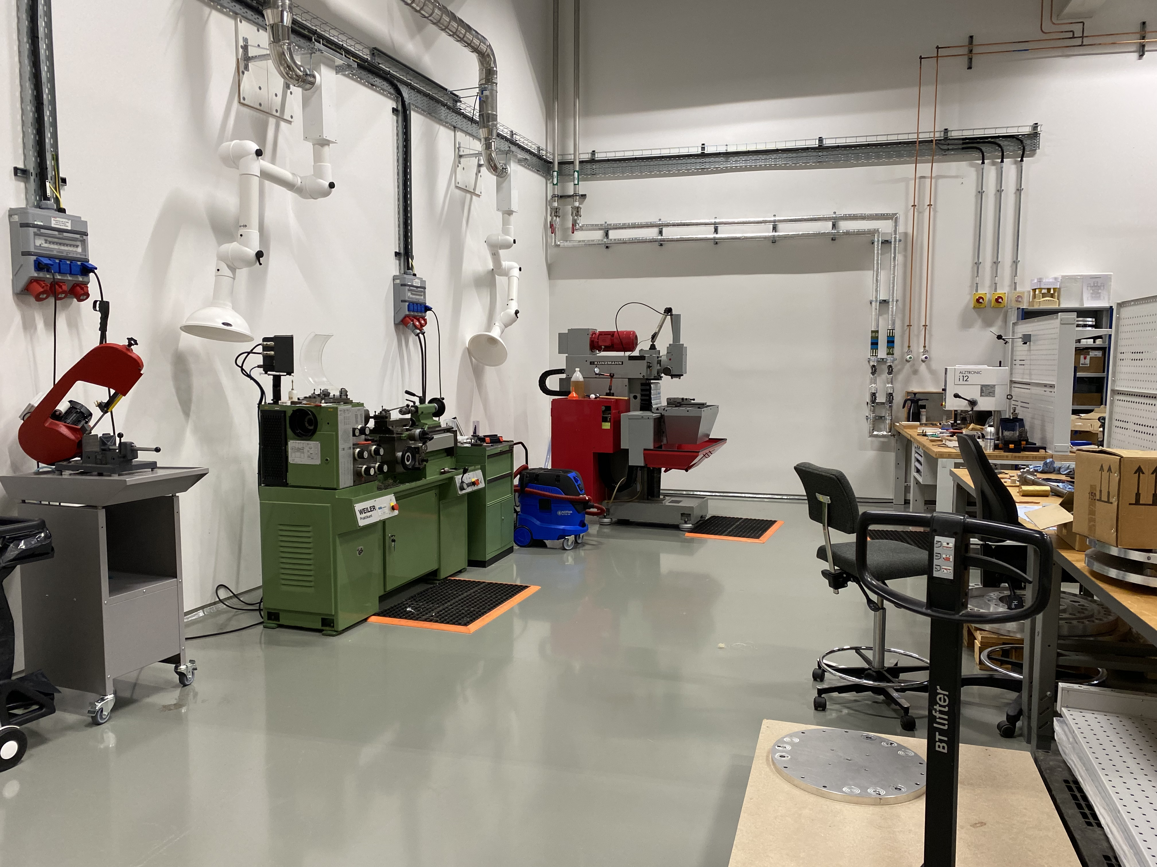
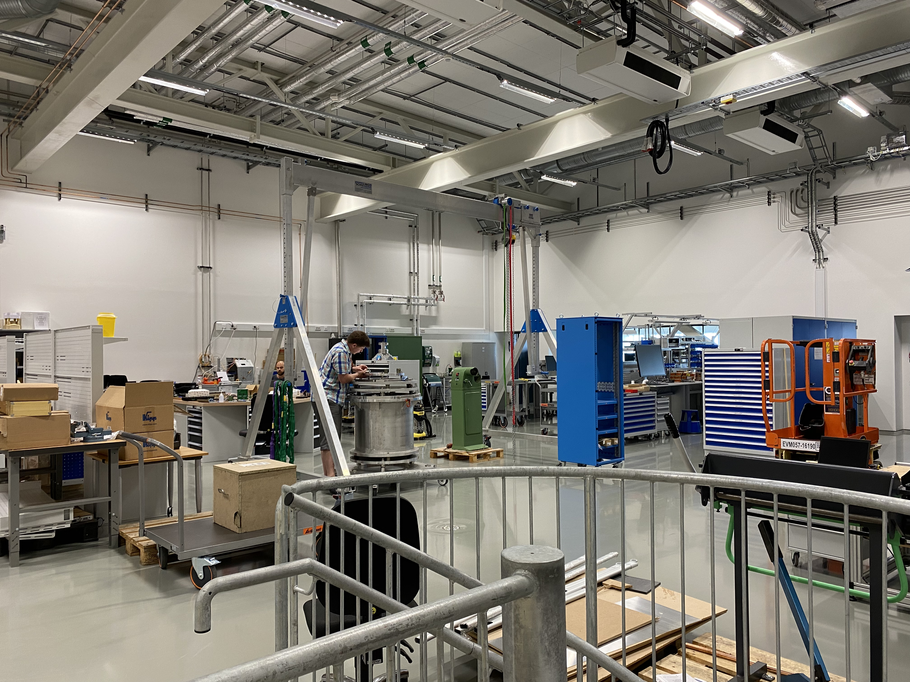
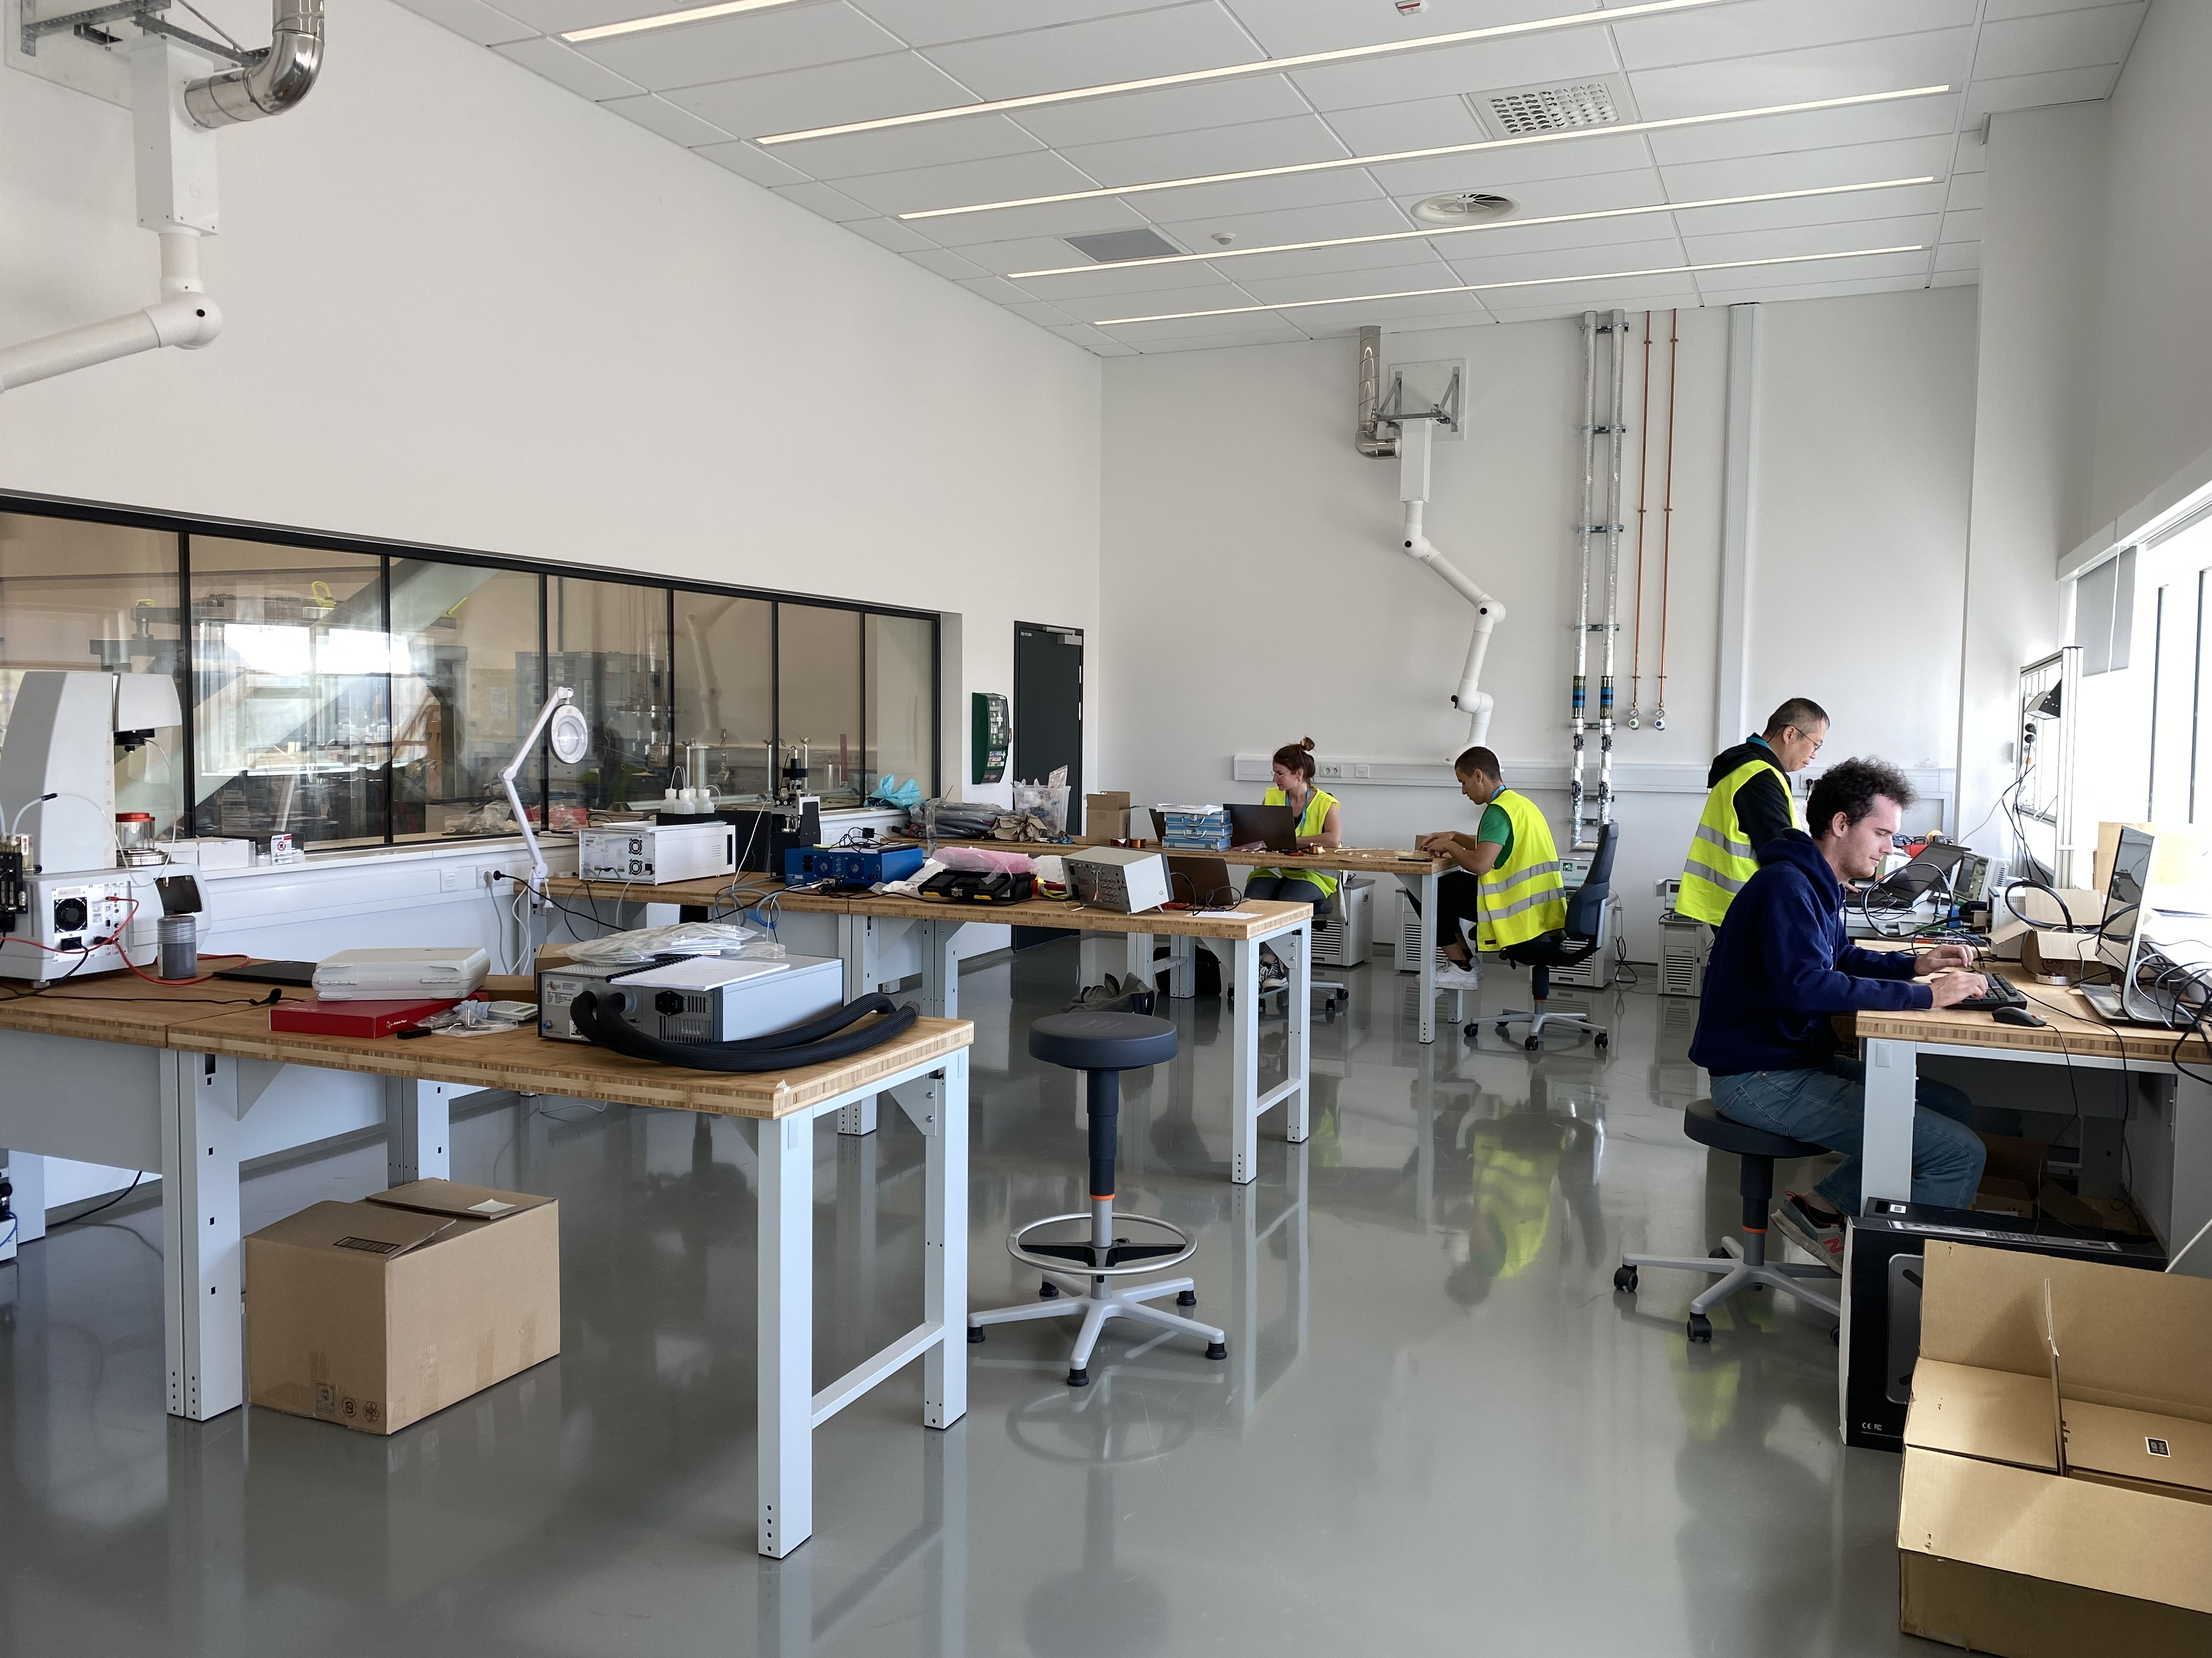
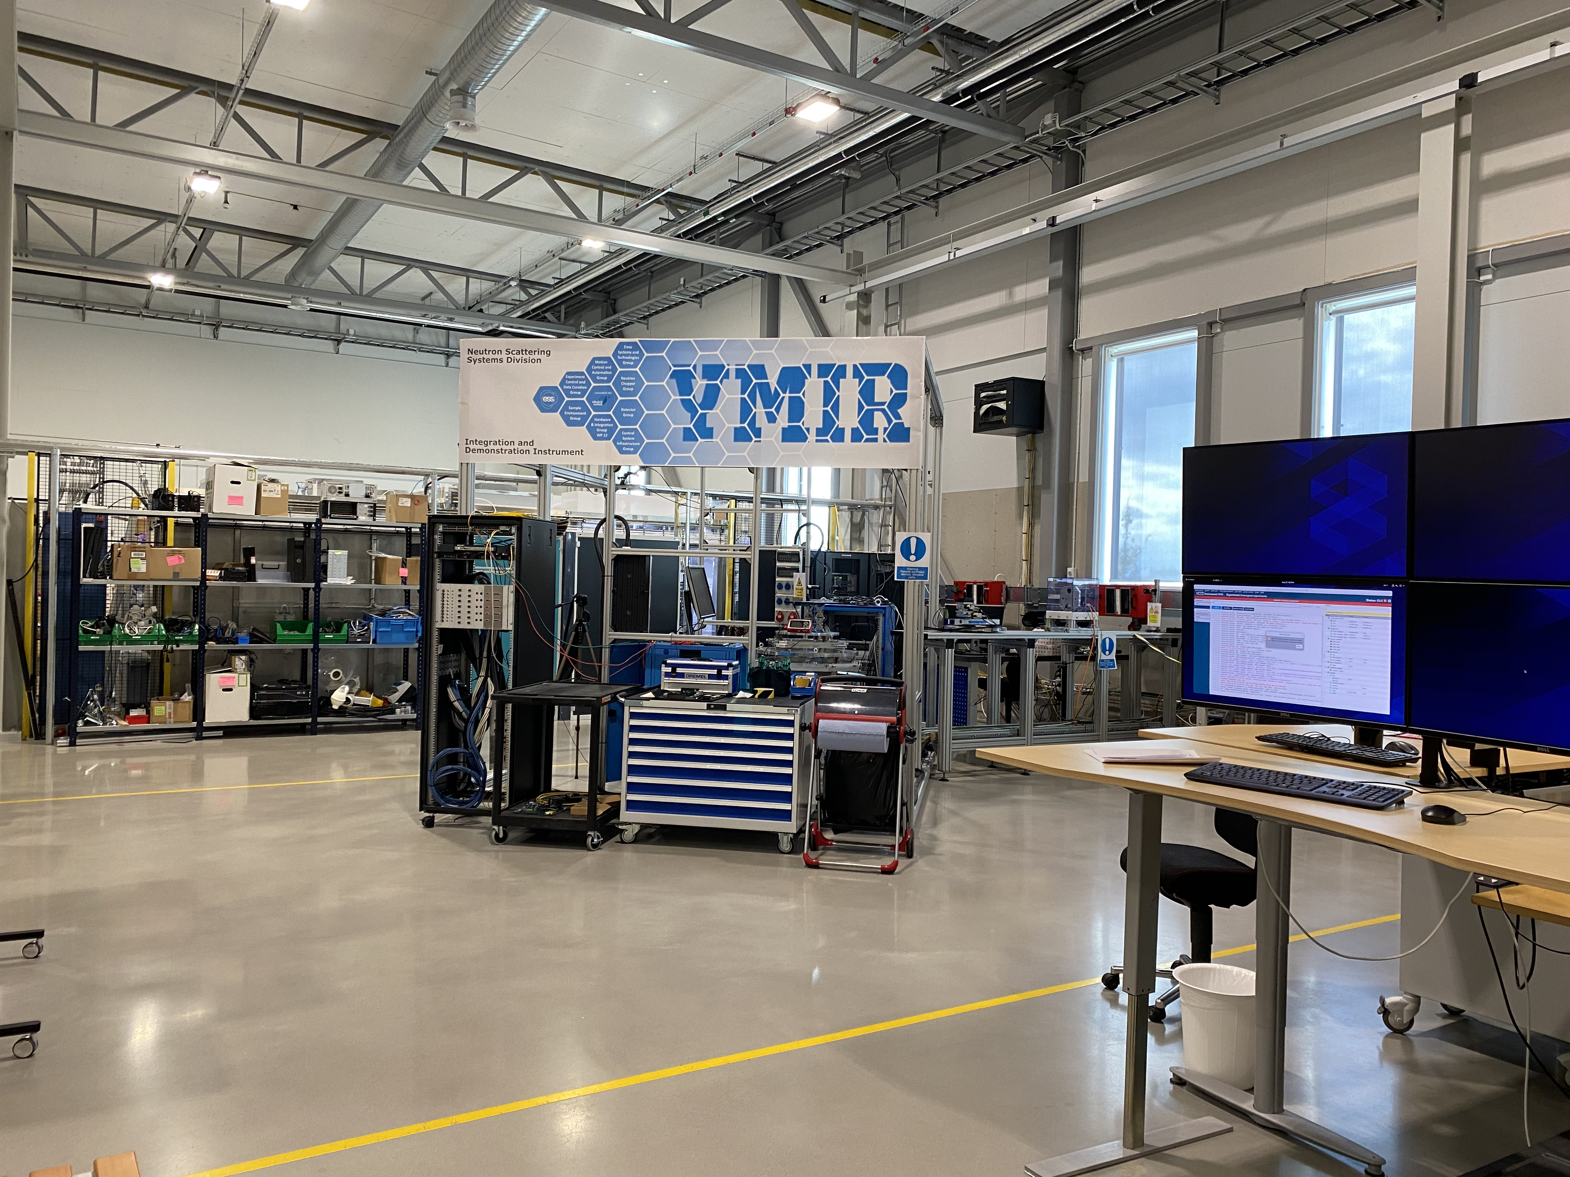
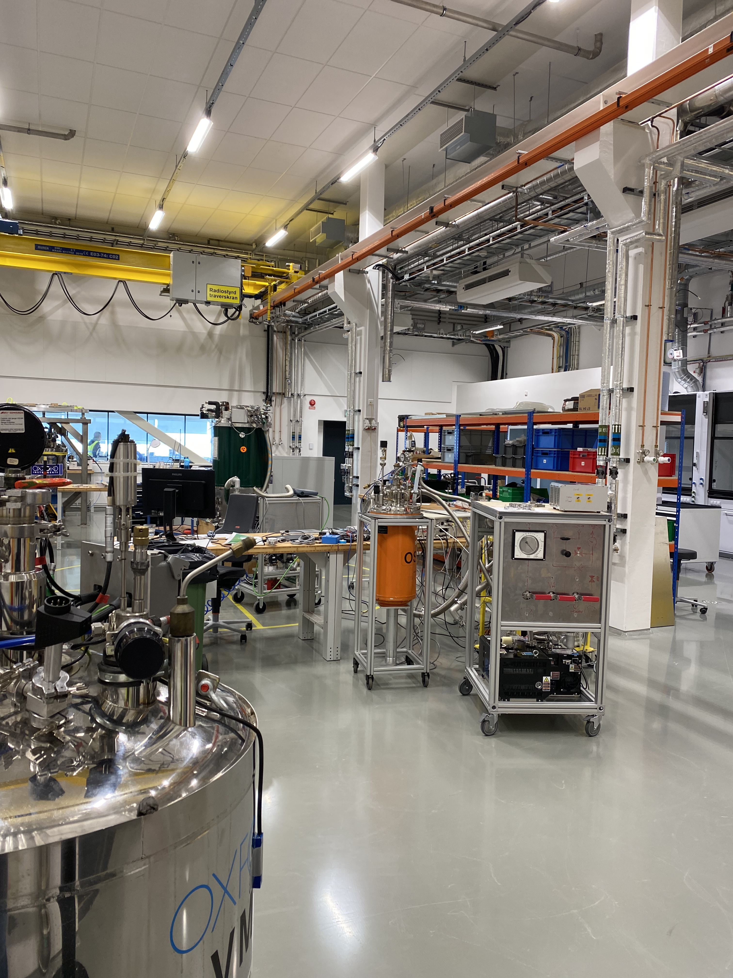
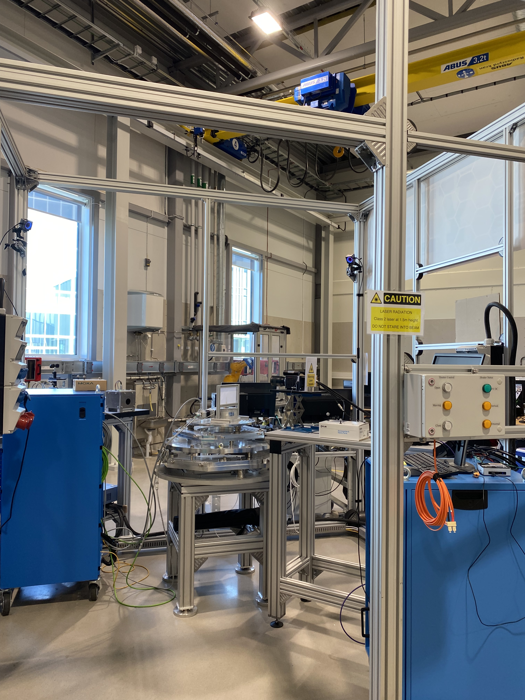
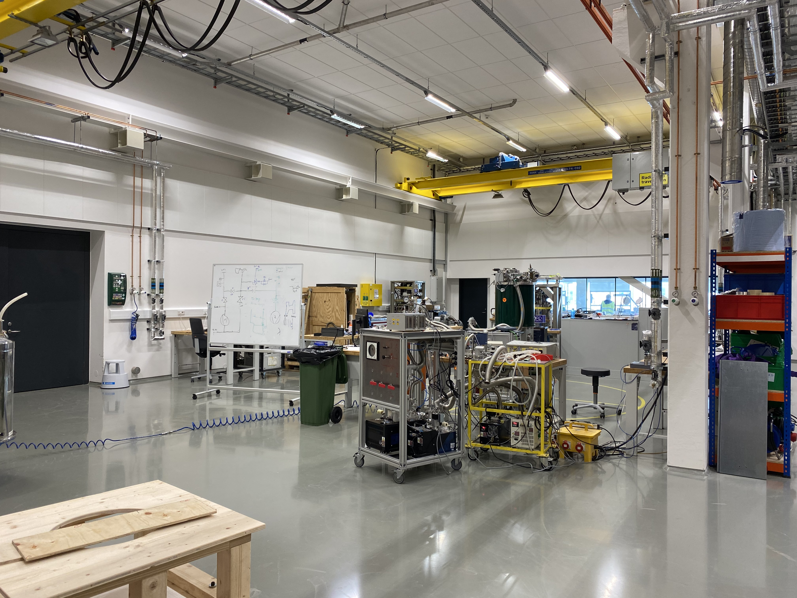
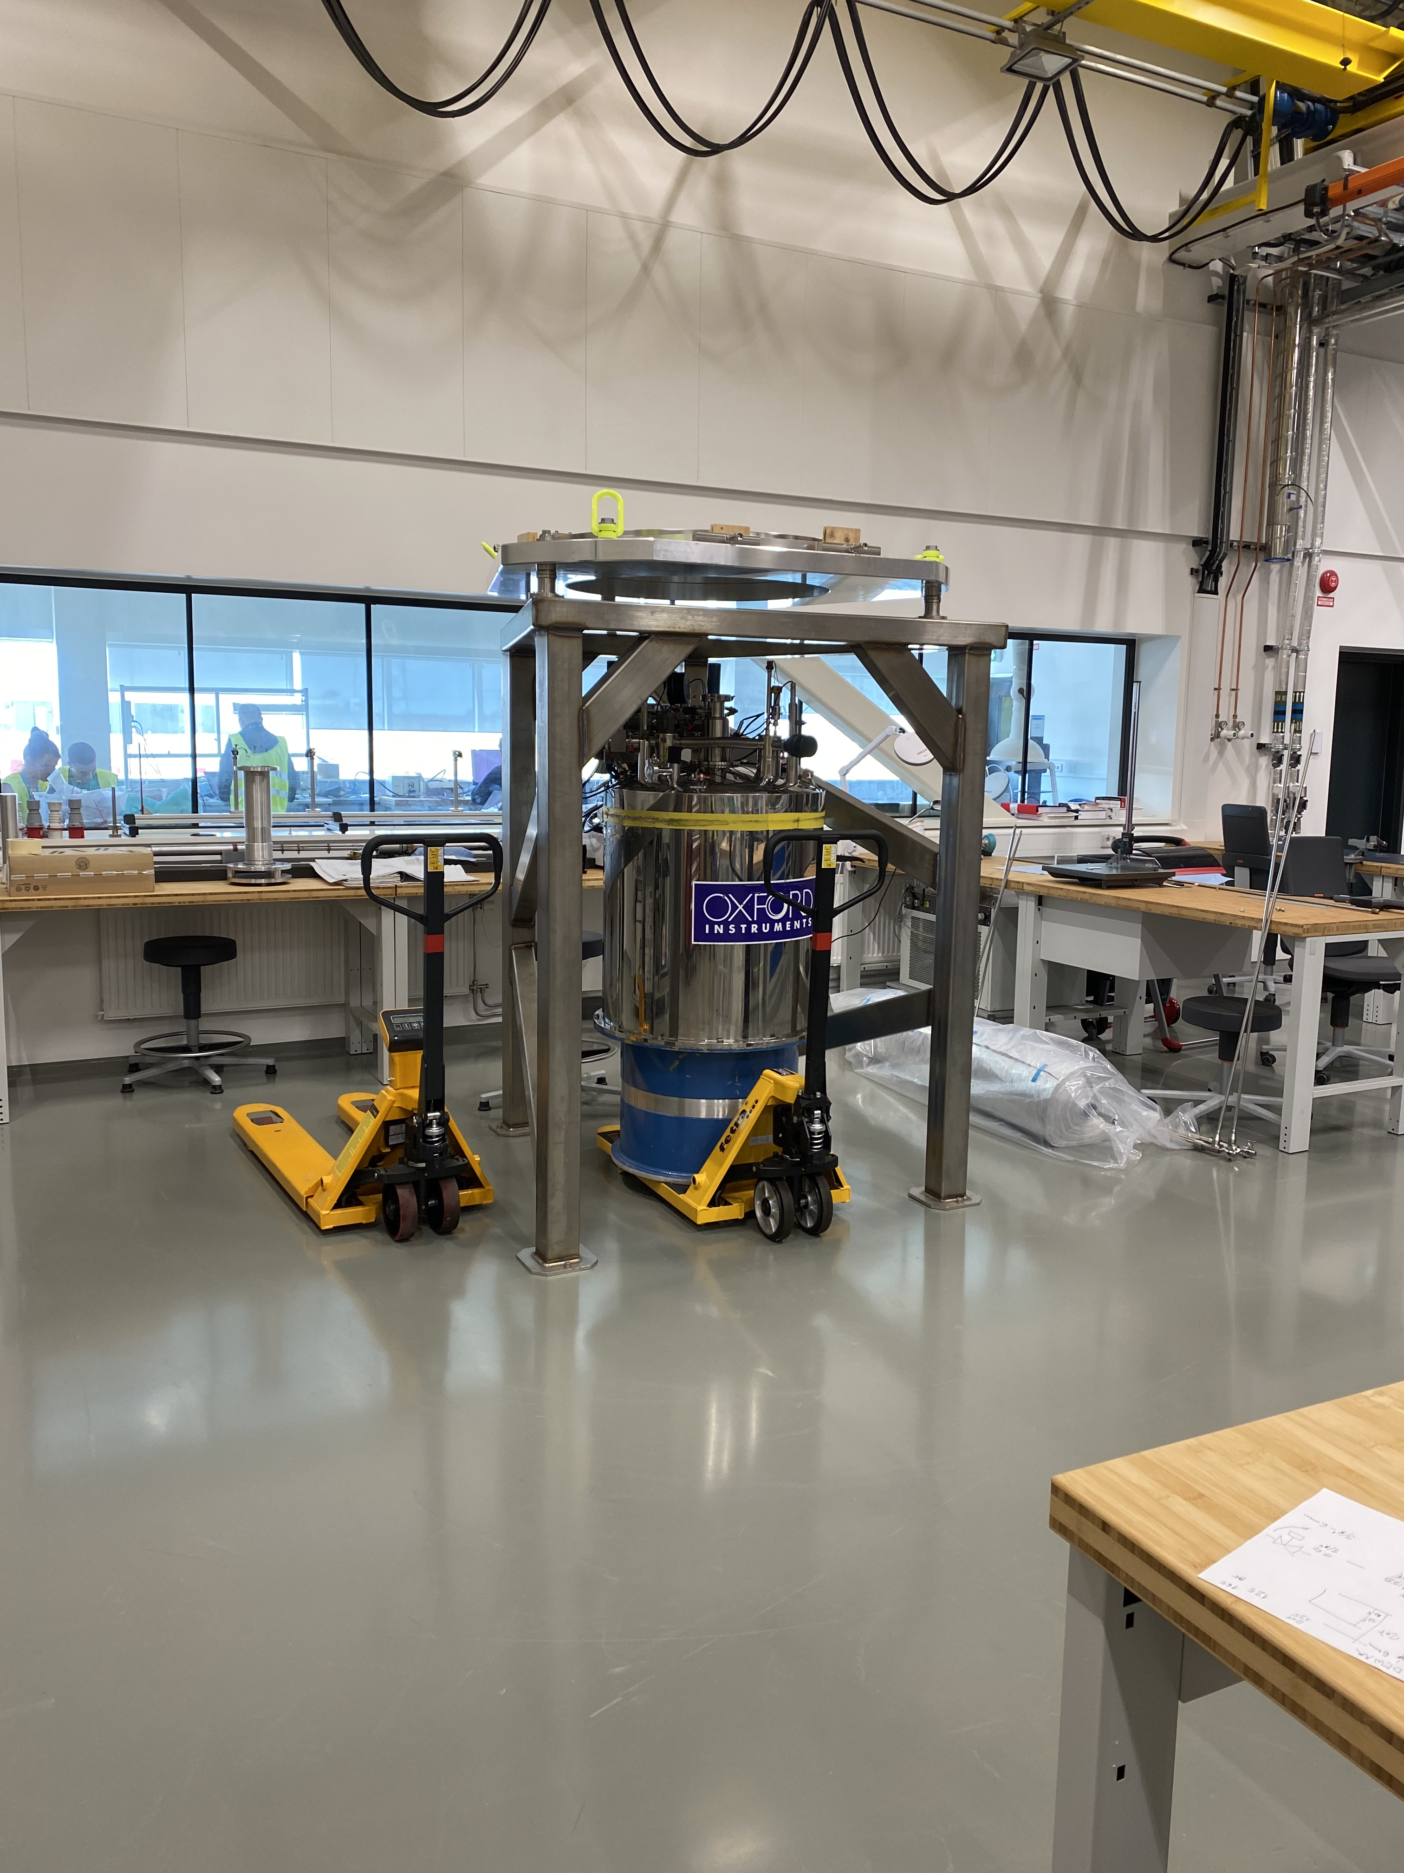
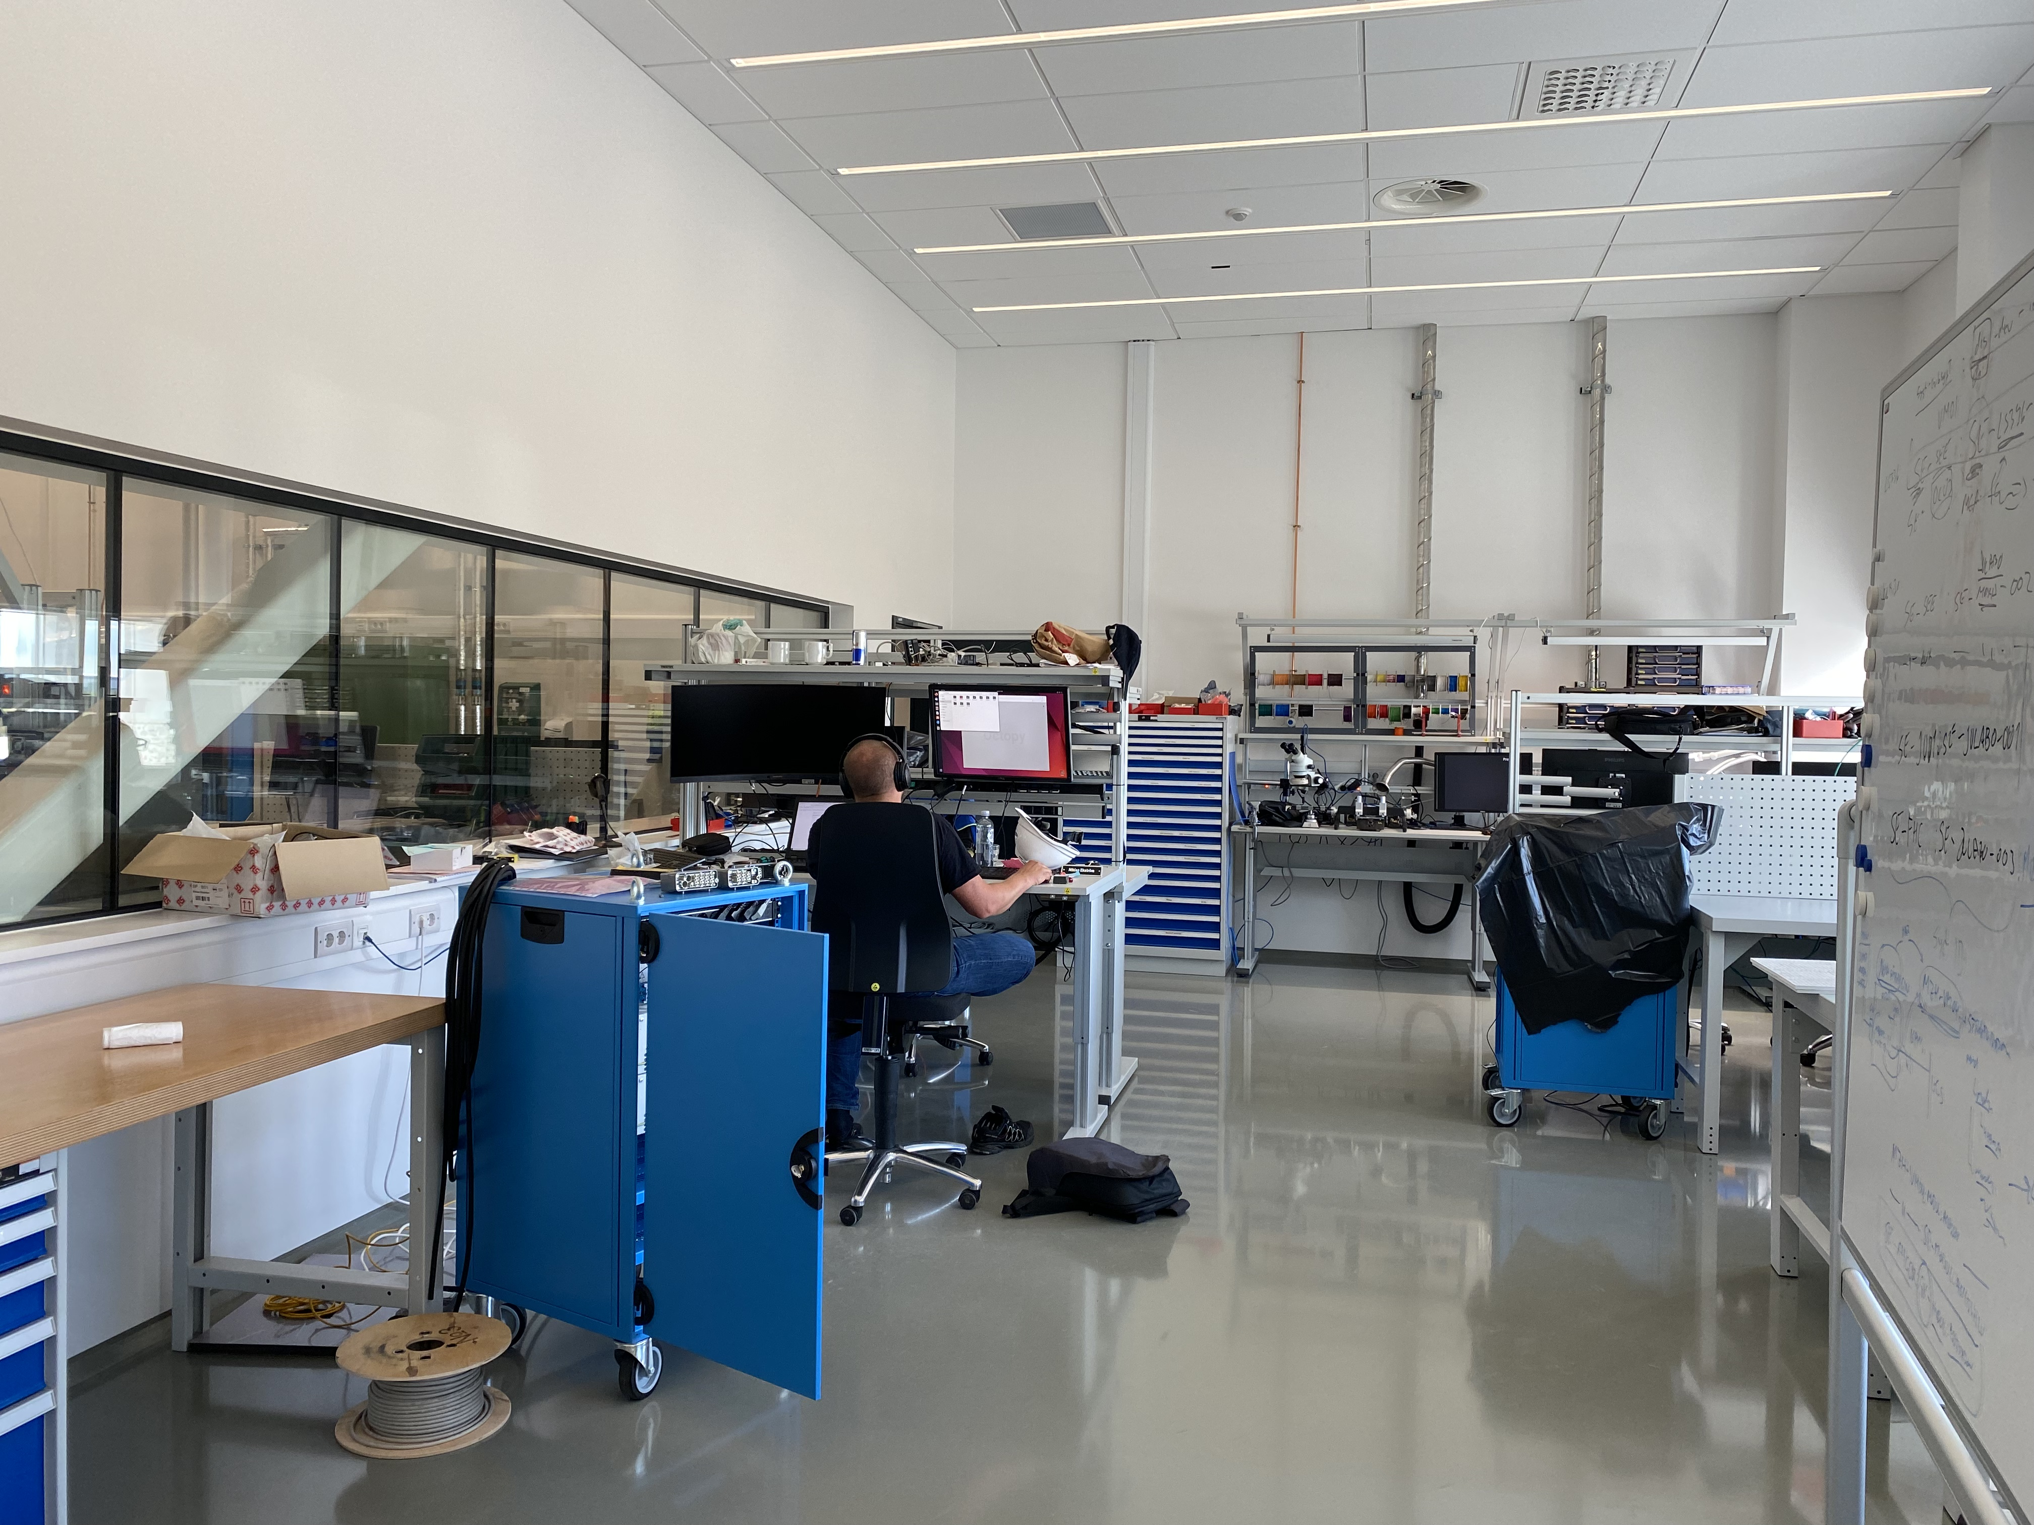
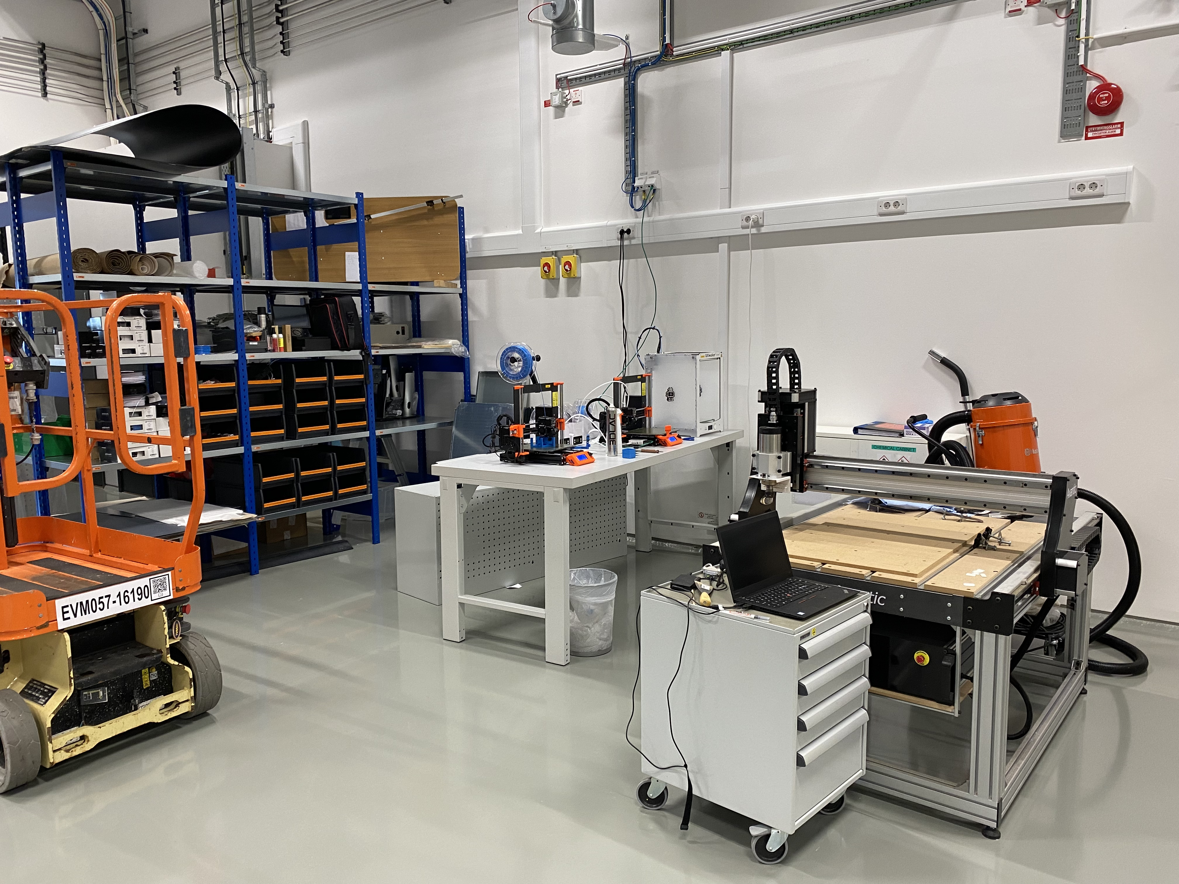
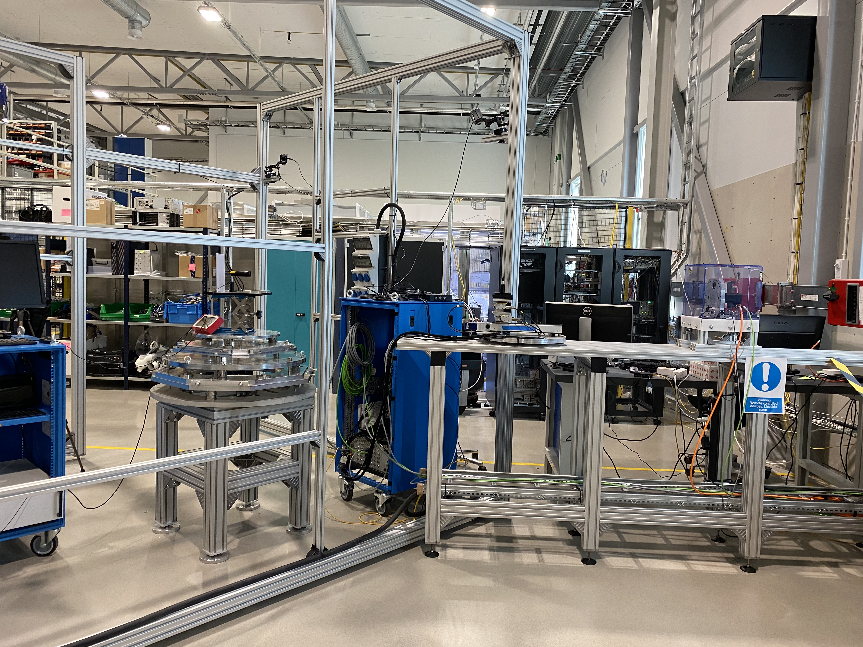
Main workshops used
B02 and E03
B02: Used by ECDC for testing of control integration
E03: Main MSPS operational workshop

Slide 18
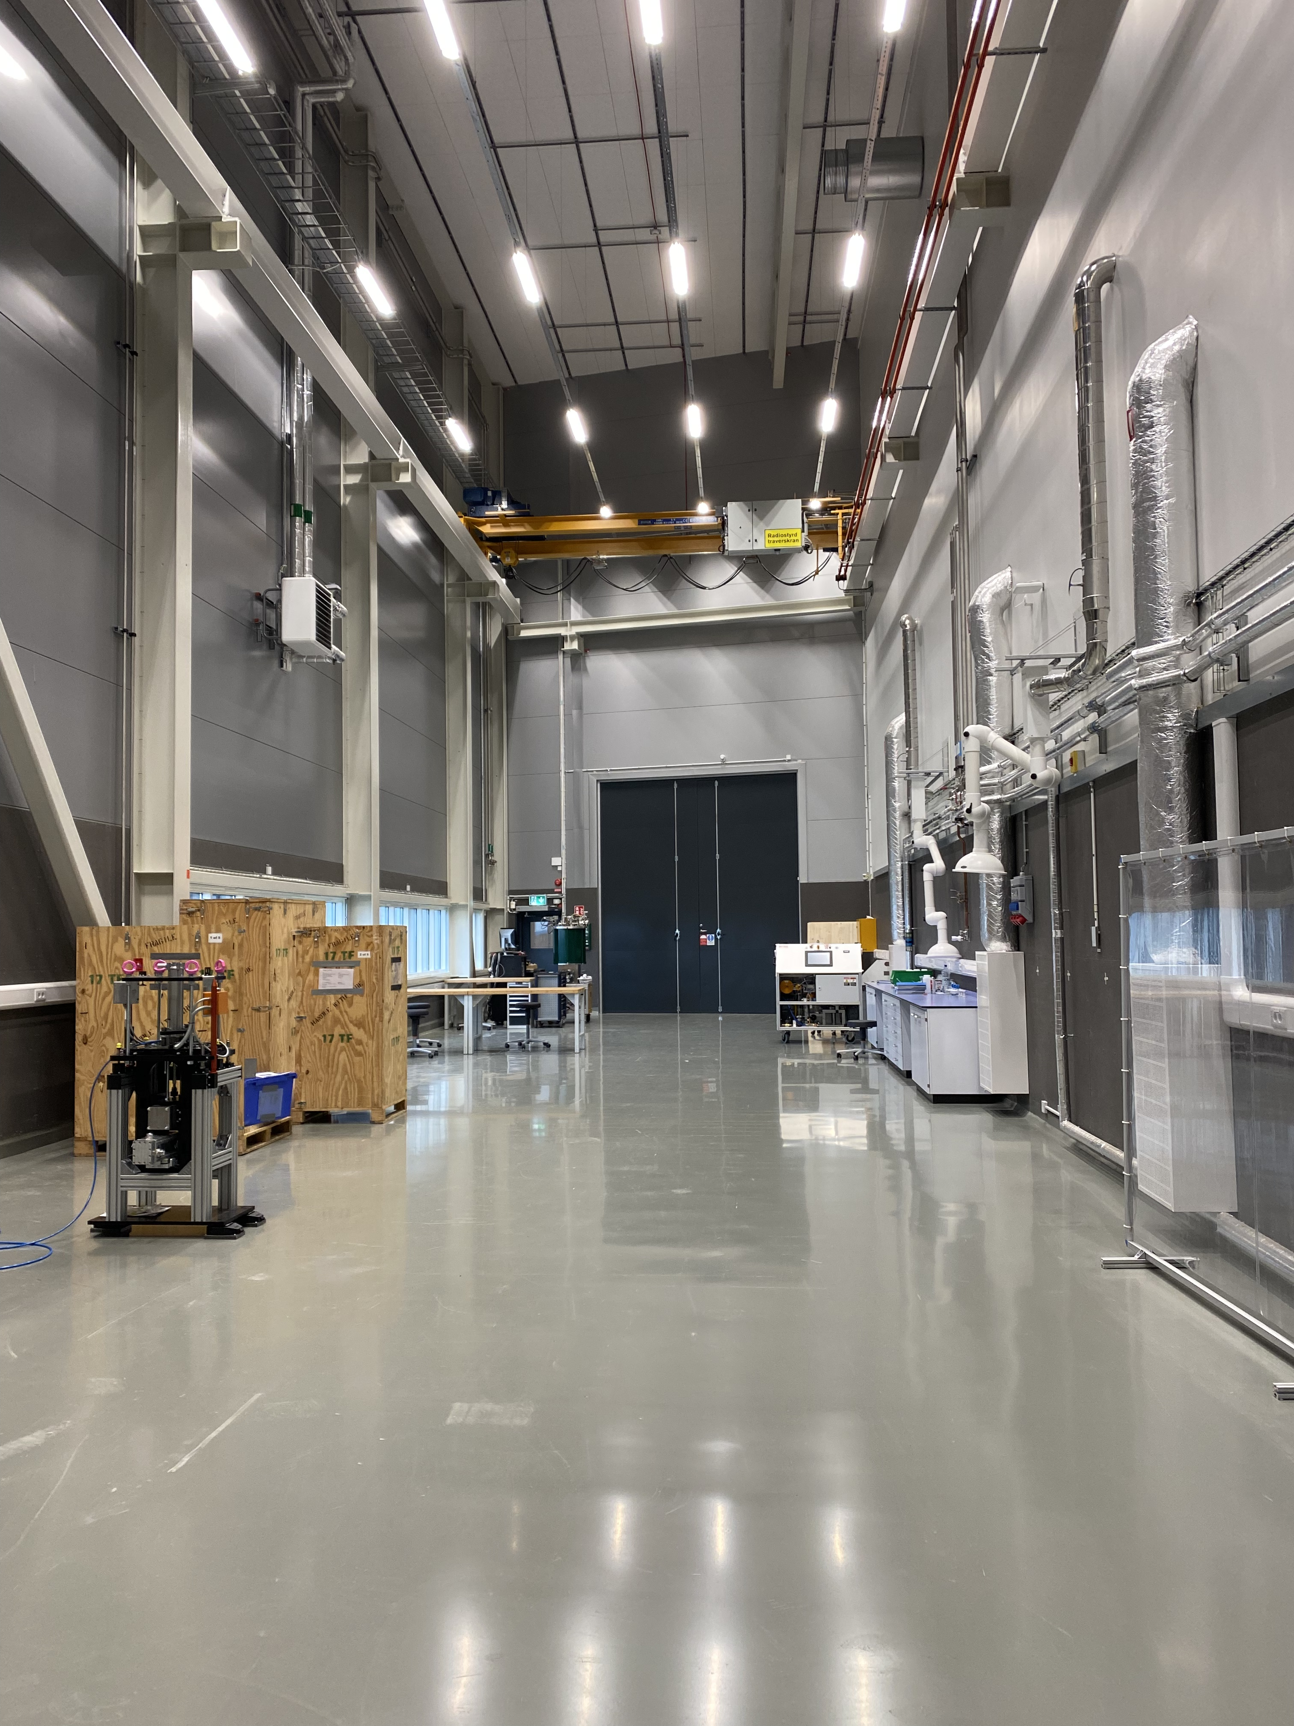
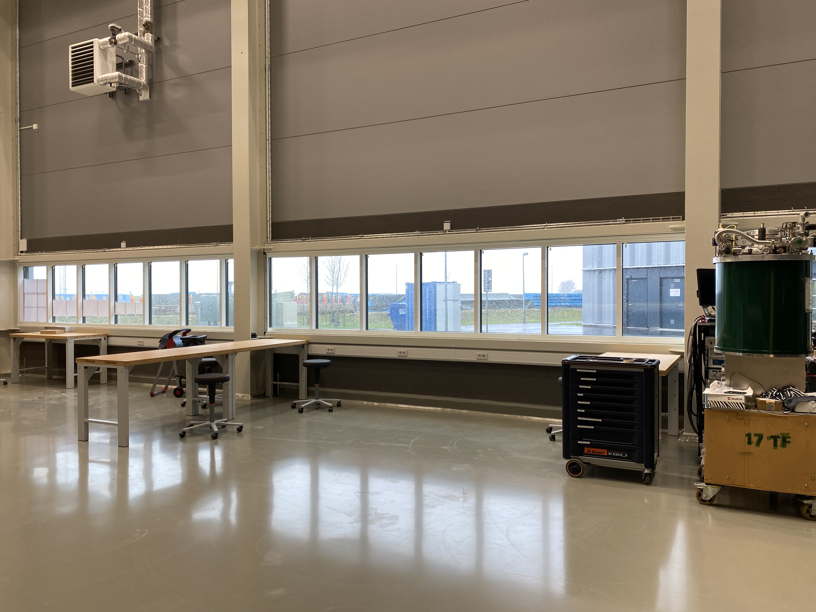
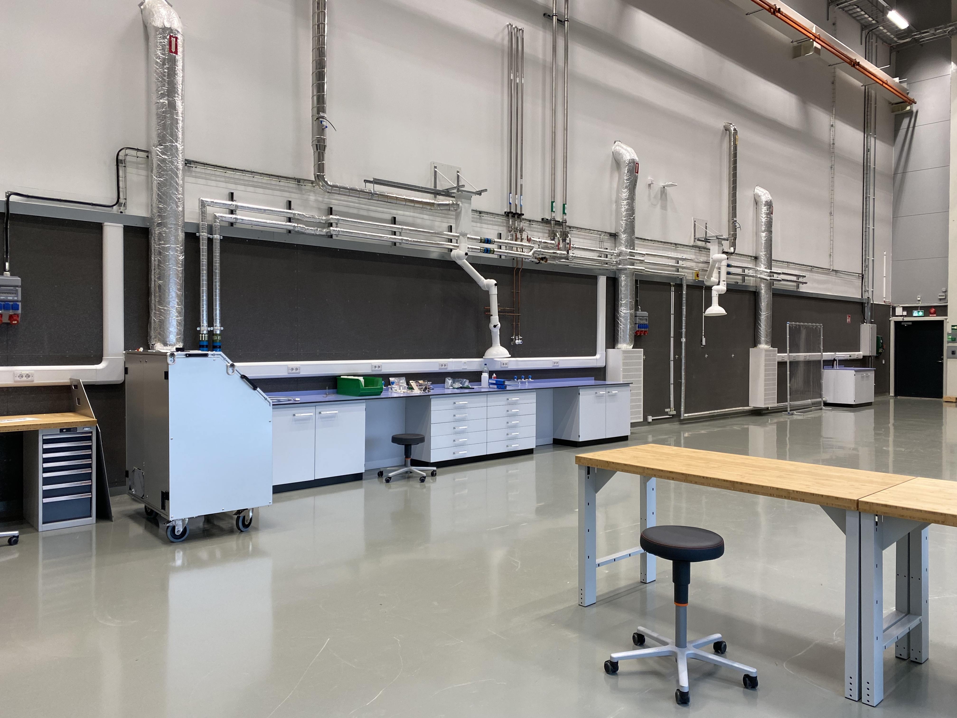
Labs & workshops to install
E03 SLIME lab
Installation started
Planned to support BEER and ODIN users for mechanical engineering
  Deformation rigs
  Furnaces
  Equipment for sample preparation e.g. cutting, polishing
Suggestion: Mechanical workshop and workbenches for instruments

Slide 19
Labs & workshops to install
D08
Ready to move in by end of 24
First floor
Sample environment
Maintenance and storage of cryos, magnets, furnaces for ODIN, DREAM, ESTIA,…
High Pressure
PE presses, Liquid, gas and clamp cells
Compressors
High pressure
DAC
RAMAN
Ground floor

Slide 20
Lab access rules
Current rules
B02 : Open access
E03 / Sample environment lab : Open door during working hours (bell), full access for defined tasks after TRA
E03 / SLIME lab : Limited badge access
Suggestions
E03 / SLIME lab: badge access for MSPS, IOE after training, BEER and ODIN scientists
D08 /Sample environment: Open door during working hours (bell), full access for defined tasks after TRA
D08 / High Pressure: Open door during working hours (bell), full access for defined tasks after TRA
D08 / DAC: Limited badge access

Slide 21
3
Training, conferences and collaborations

Slide 22
Training and conferences
At other large facilities for visits and training
June 23: Andreas, Lauritz and Caroline at MAX IV for magnet experiment with M. Feygenson (DREAM)
July 23: Damian at SNS for 1 week
Oct 23: Damian and Joel at the ISSE workshop
Jan 24 : Damian at ISIS for 1 week
Feb 24: Damian, Lauritz and Richard at LLB for 3 days
March 24: Luca, Oleksiy and Caroline at ISIS for 1 week
March 24 : Alex at J-Parc and JRR3 for 2 weeks via the SAKURA grant
Conferences
Past :
  Dec 23: CC to HiReS at ILL
  March 24 : NE and Anders at PSI – SECOP meeting
To come:
  ISSE meeting organised by MAX IV
  IUCr High Pressure workshop and LENS High Pressure meeting organised by Damian

Slide 23
Collaboration, grants
Running projects, grants
ReHeart : Hydrogen embrittlement under load with KTH
NEXT competence center to link industries, academics and large facilities run by KTH
Proposals
BOBINE: New generation of high field magnets
THEIA: Tribometry at large facilities

Slide 24
4
Conclusions

Slide 25
Conclusions
We are running late!
How can we accelerate the rhythm given the resources and the ESS way of working?
What do you suggest to be ready for operations?
How can we get the right competences quickly?

