Slide 2
Projects updates
High temperature and mechanical processing
PRESENTED BY Caroline curfs

Slide 3
Agenda
1 High Temperature
2 Mechanical processing

Slide 4
1
High Temperature

Slide 5
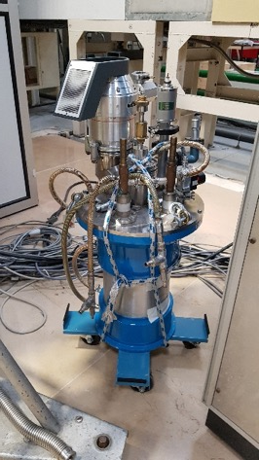
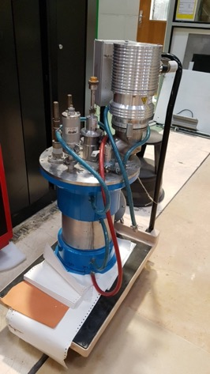
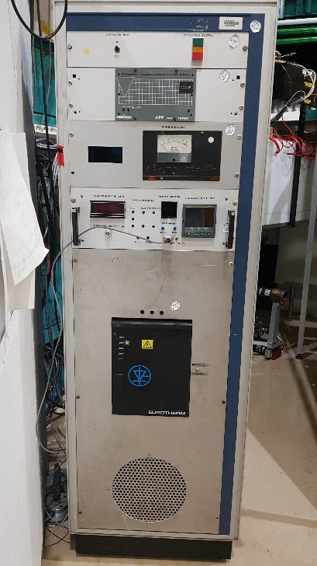
High Temperature
ILL-Type furnaces (vacuum)
2nd hand furnaces from LLB
1350 C : 1 Nb resistor with 5 Nb screens, dia. 45 mm, used on diffraction instrument
1800 C : 1 Nb resistor with 7 Nd screens, dia 35 mm, used on spectrometer
Planned to be ready by April 24
Transfer on standby due to problems with CNRS
New furnace
Only 1 manufacturer (?) : AS Scientific
Full vanadium for DREAM (T_{max} = 1100 C) – Specifications on going
Requested for DREAM Hot Commissioning (July 25 – March 26) / HEIMDAL Cold commissioning (October 26 – March 27)
Planned to be ready by April 24

Slide 6
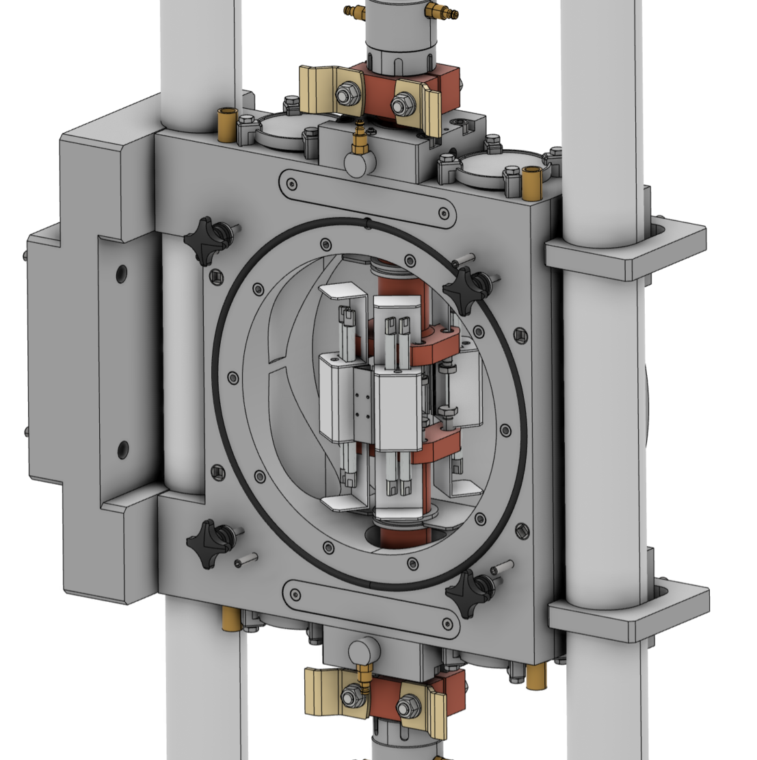
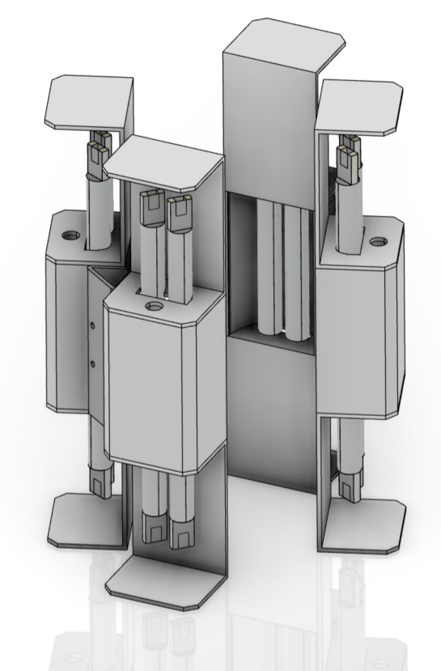
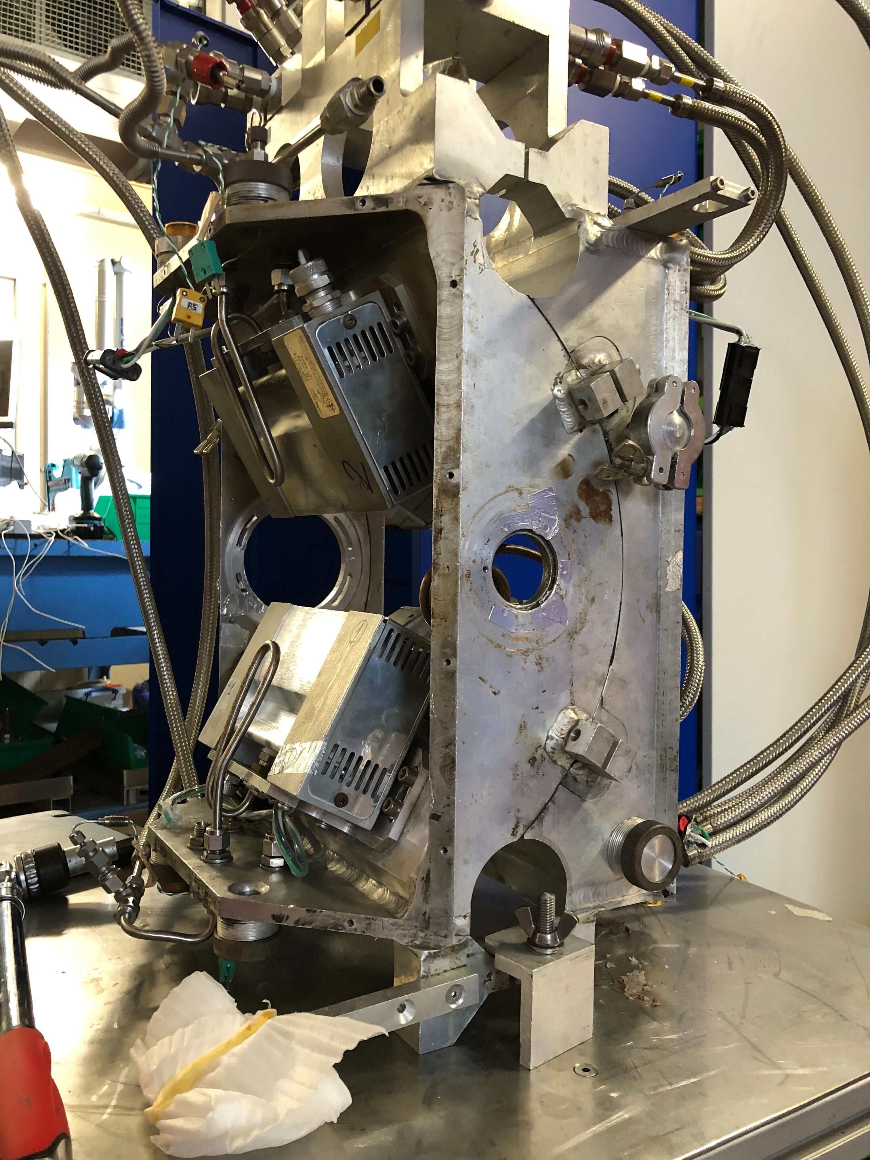
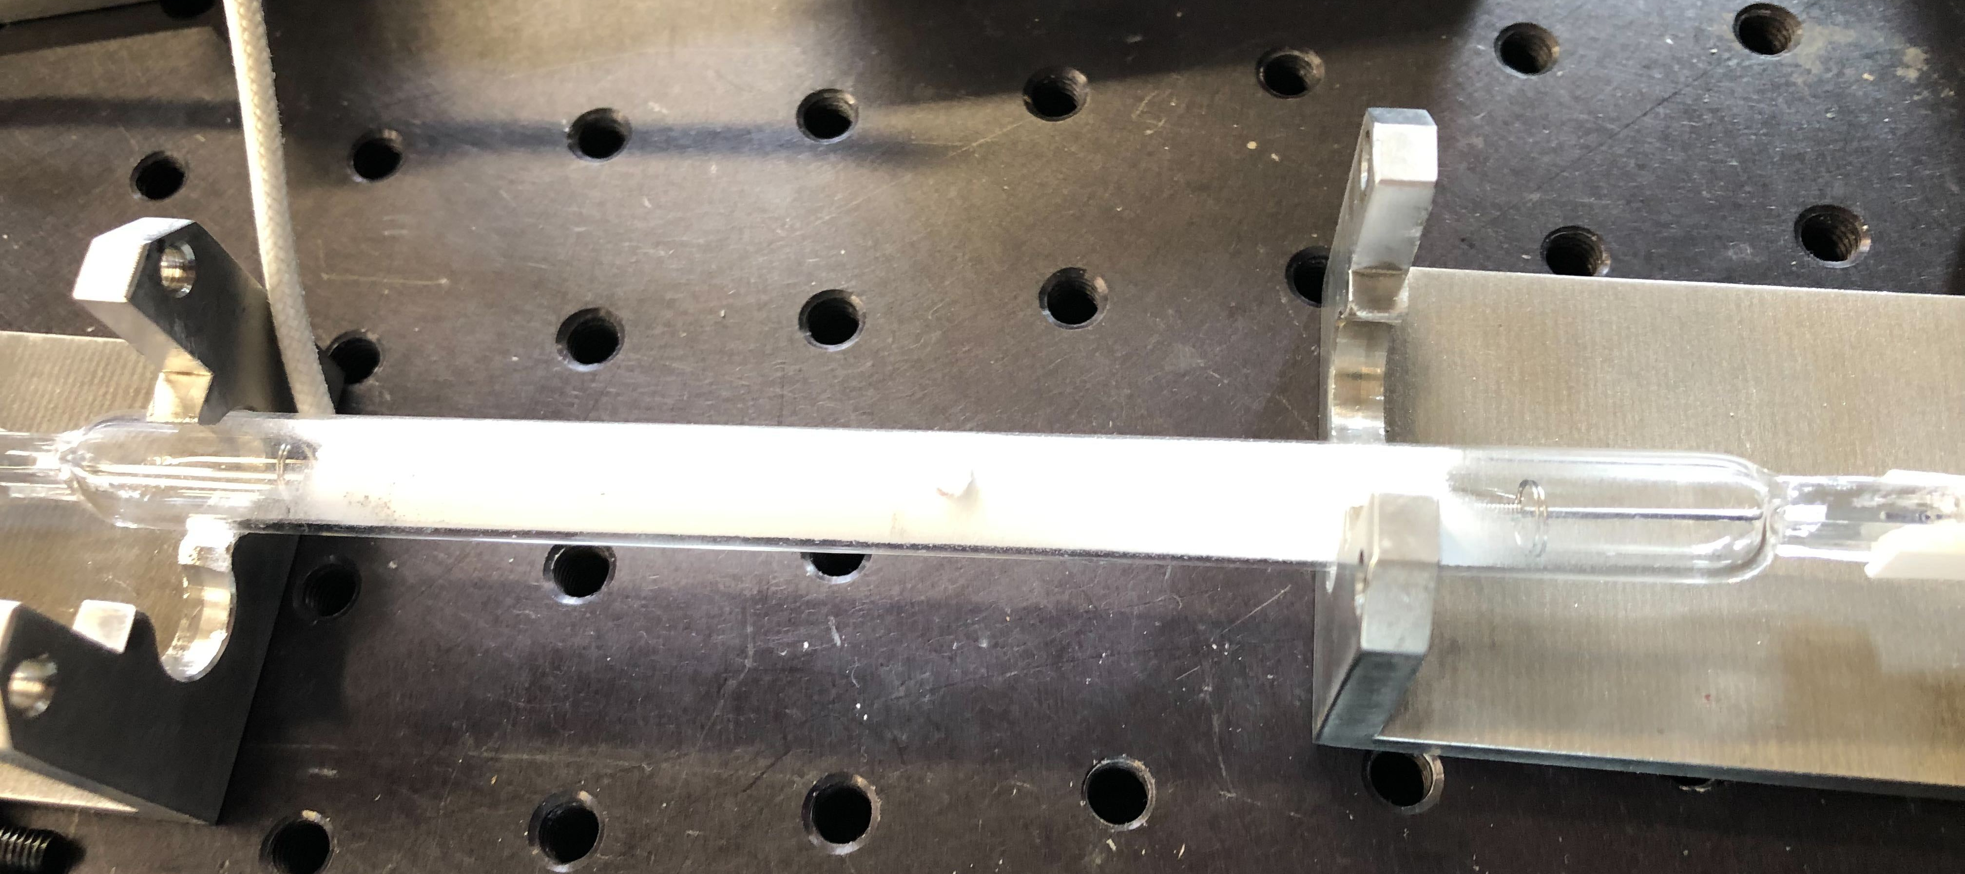
High-Temperature
UHT furnace
VR (Swedish Research Council) grant between Chalmers & ISIS
Started in 2017 (grant awarded)
Phase 1: design at ISIS by ISIS team based on already existing furnace
Phase 2: manufacturing by Chalmers Uni
Specifications:
Lamp furnace : max temperature 1800 C
Standalone or attached to 60 kN stress rig
Vacuum or inert gas chamber
Status:
Manufacturing moved to ESS – Budget available1.6 MSeK
Design by ISIS up to conceptual design – Mechanical design needed to enable manufacturing
Bulbs and reflectors currently at ISIS – test to be done

Slide 7
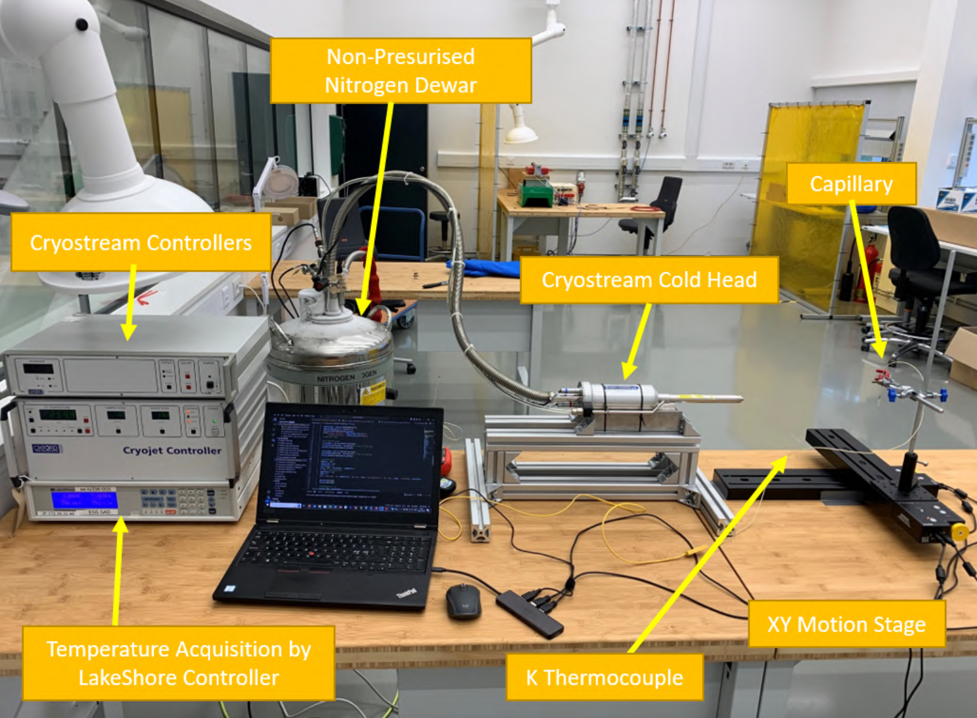
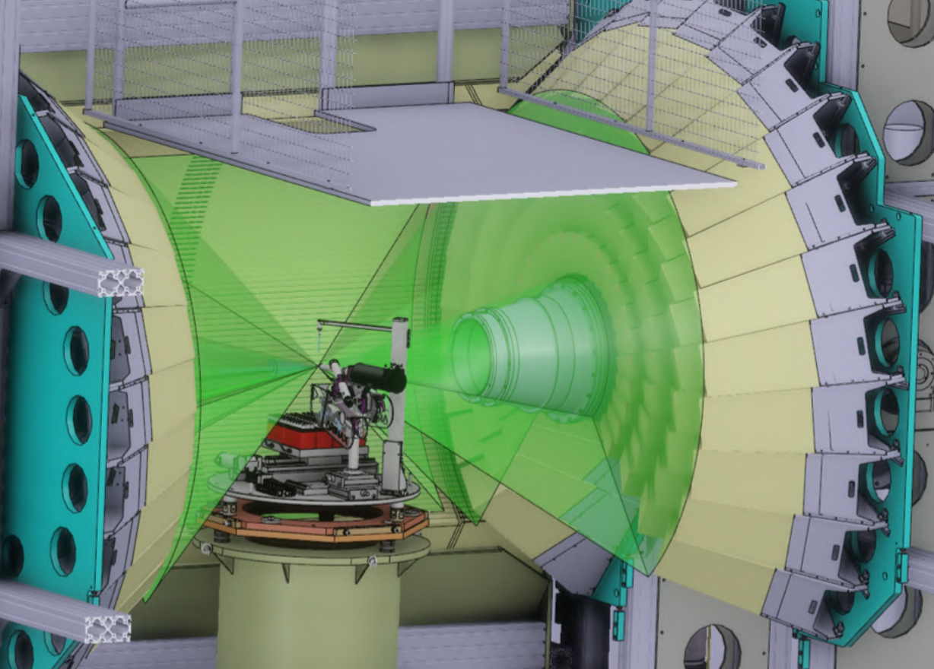
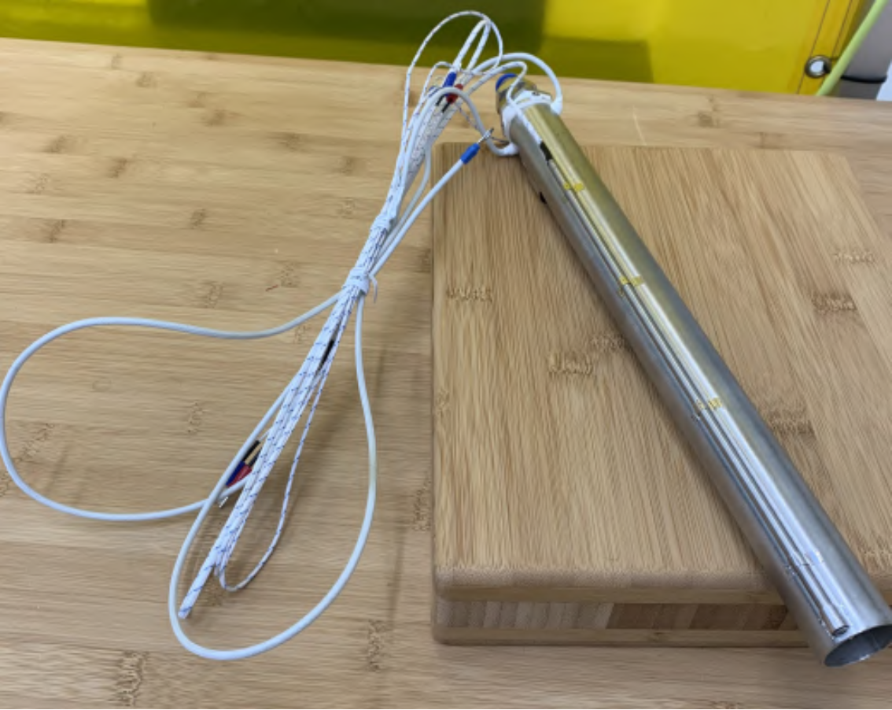
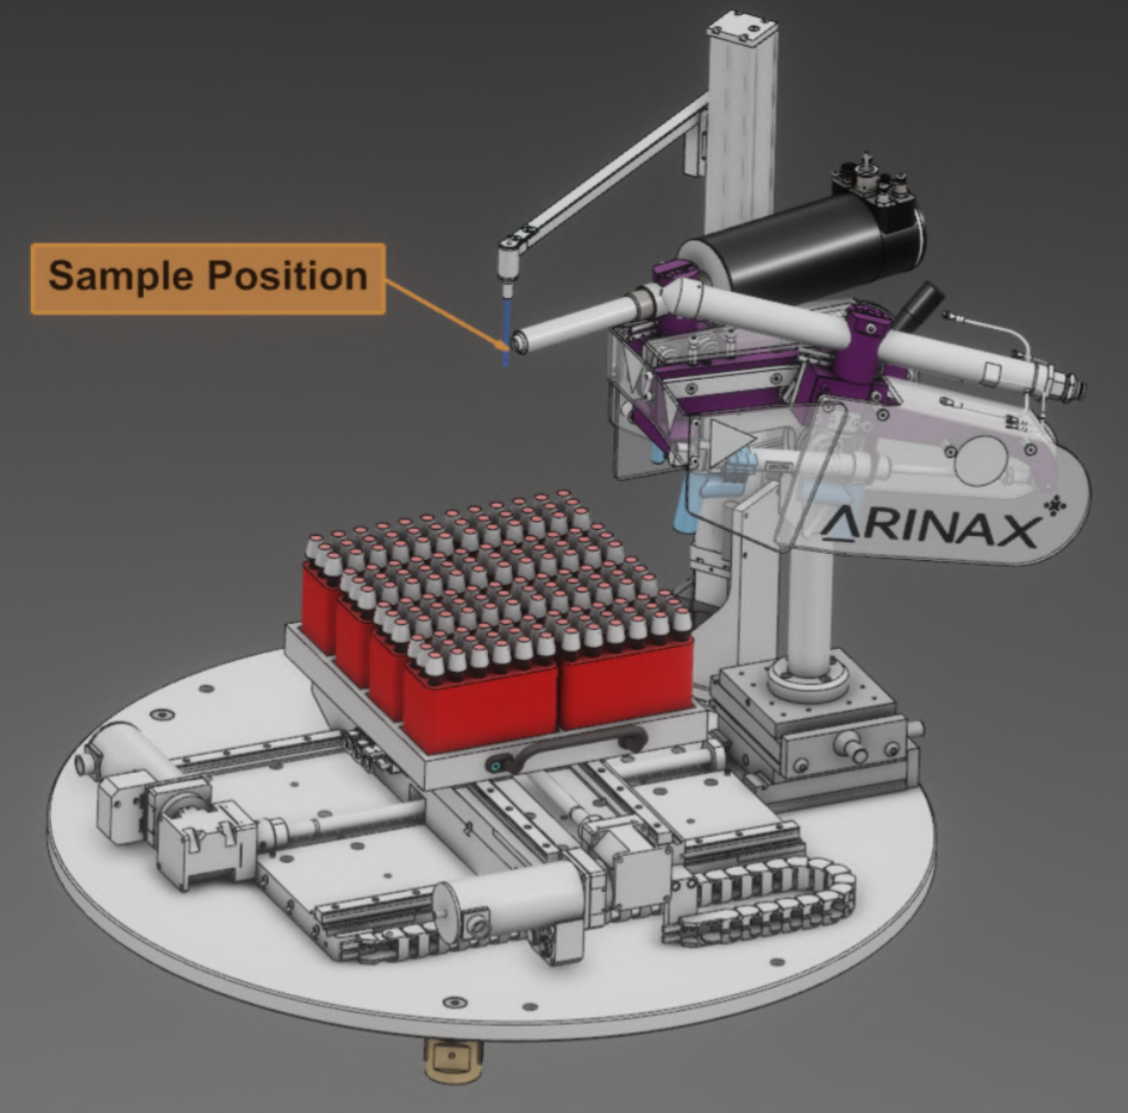
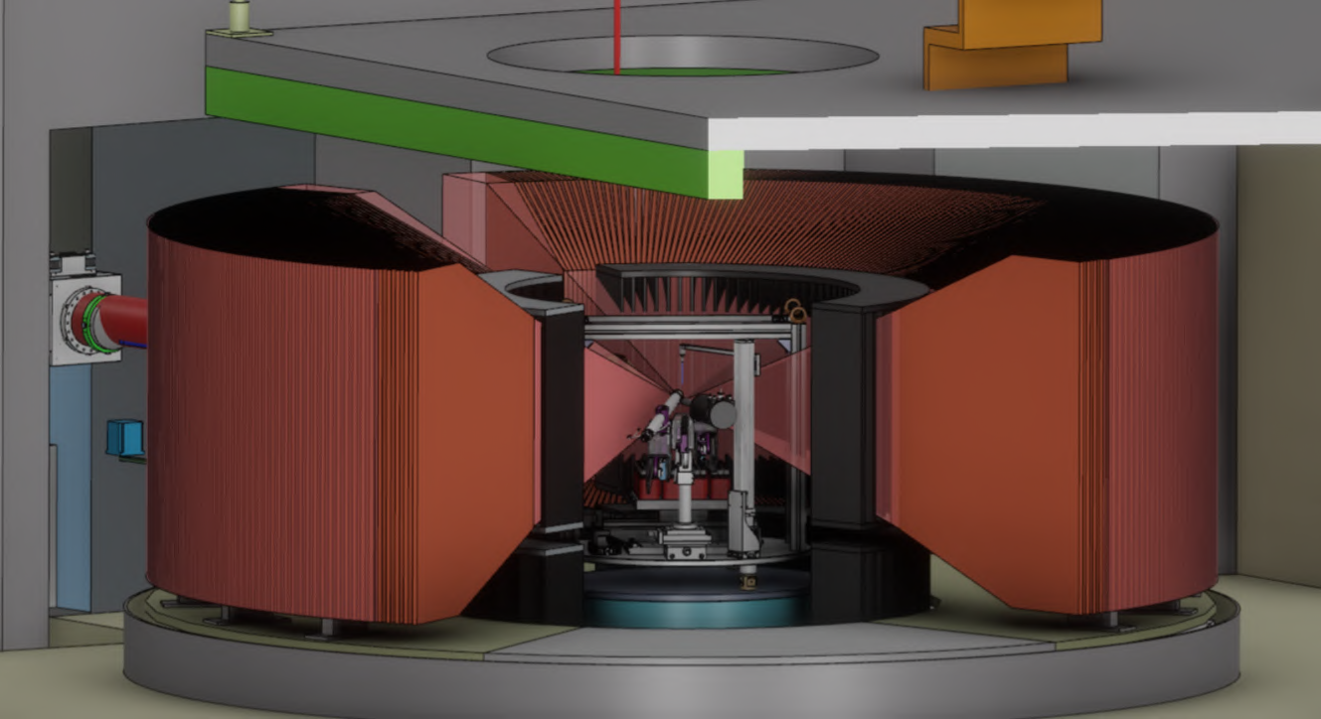
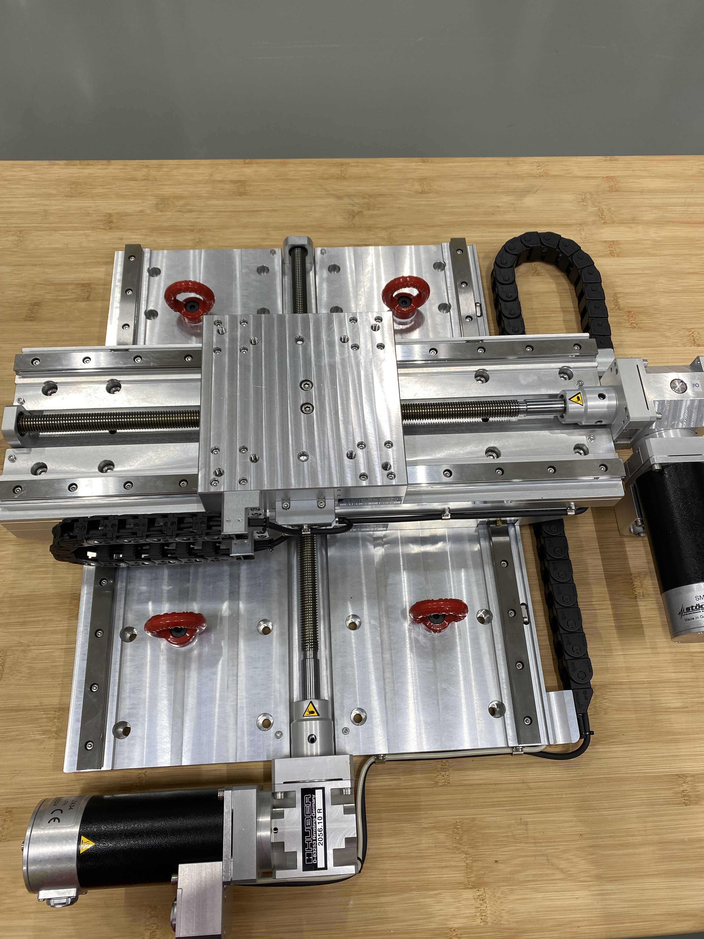
High-Temperature
Hot Air Blower/Cryostream
Project lead by Quentin Borlet (6 months Internship from UTC, France)
Specifications:
Quick and versatile
Min. 15 capillaries of different sizes
Suitable for DREAM and HEIMDAL
Temperature from 100 K to 800 C
Status:
HAB: on site, tested and integrated
Cryostream: 2nd hand to be tested
Mechanical part:
Off-the-shelf equipment procured
XY stage received
Arinax to arrive end of May
Z Translation + motor received
Plate and lifting support: more design needed before manufacturing
Gripping system tested
Control integration:
HAB done
Cryostream via Lakeshore done
Motors : Arinax done by manufacturer, other to be done by MCA

Slide 8
3
Mechanical processing

Slide 9
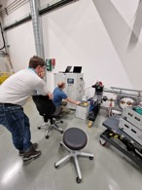
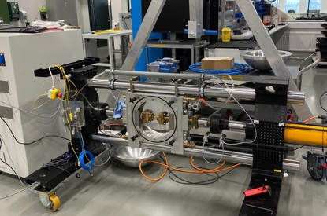
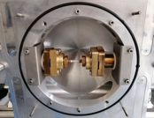
Mechanical processing
NPI Stress rig
Requested by BEER for cold commissioning 07.26-12.26
Specifications :
40kN (60kN/100 kN) uniaxial rig for tension and compression
Joule heating (15V and 800 A) and vacuum chamber
Can be installed horizontally or vertically
Status :
New control software received and installed – to be tested
New extensometer received – to be tested
Mechanical integration: not started
Control integration via MQTT
3D DVC/DIC system:
Cameras installed - computer ready
Software to be installed and tested: collaboration with J. Hektor from Malmö Uni.
Use case :
Collaboration with Alfa Laval

Slide 10
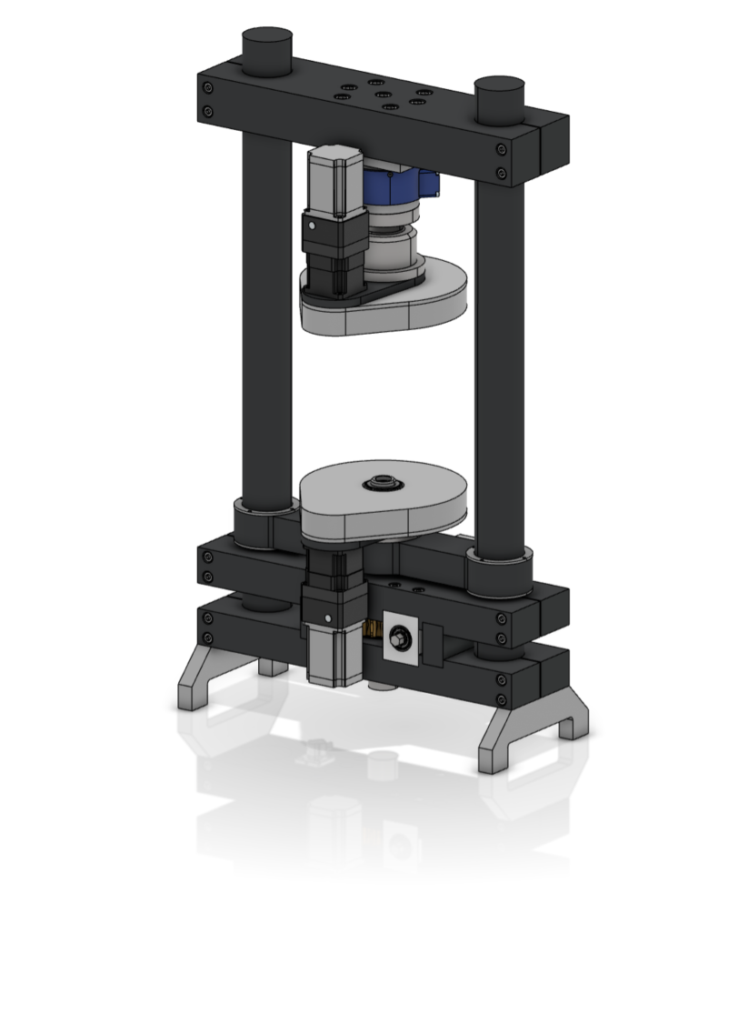
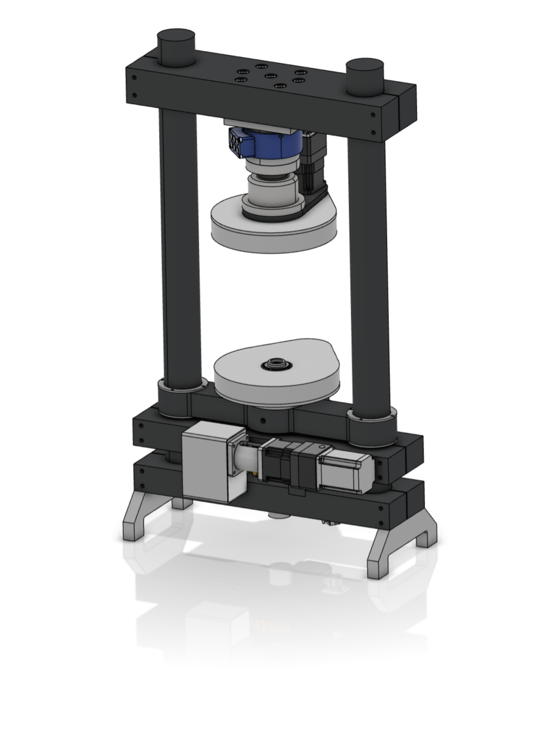
Mechanical processing
Torsion/rotation rig for tomography
Requested by ODIN for hot commissioning 07.25-03.26
Design nearly finished
List of off-the-shelf parts to be ordered soon
Construction planned to be finished by Q4/24
Control electronics planned to be Beckhoff
Dilatometer
Specifications still on going
Requested by BEER for hot commissioning 01.27-09.27

Slide 11
Thanks to Quentin Borlet, Luca Sagliano, Richard Ammer, Lauritz Saxtrup, Florence Porcher, Jonas Engqvist, Robin Woracek, Joe Kelleher and Ali Mortazavi

