Slide 2
Action plan – EAB 2021-2024
Draft 1.1
LARS BÖRJESSON

Slide 3
Areas of action
Information material ”medium”
Innovation Day – next step
EAB meeting with State Secretary
Alliance with IVA
High level visit SNS
Connect with universities in the US

Slide 4
1. Information material ”medium”
Prerequisite for high level meetings & Innovation Day
Need for better information material supporting our effort to engage with stakeholders in business life, politics and administration.
Questions of fate / homo sapiens “why”
Questions of fate / SE – the Western World “why”
Industrial relevance and benefit “why”
Vision for ESS and the surrounding eco-system
Basic technology “how”
ESS structure & governance “how”
The instruments and areas of science
WORK IN PROGRESS!
1A) Fact sheet + power point
1B) Industrial film produced
after Innovation Day
Notes:
Increasing computing capacity and speed for Data analytics

Slide 5
2. Innovation Day – next step
Develop the concept for the Nordics and other member states
Innovation Day debuts in Västerås on January 18th, 2022. Next step is to relay the host status to another Swedish industrial company for a follow up 2023. Industry specific meeting(s) can also be arranged together with partner organisations.
For the next Innovation Day in SE 2023 we suggest inviting some Norwegian and/or Danish companies. In 2024, we suggest involving industry from 4-5 member states.
Suggested EAB team supported by ESS?
3. Innovation Day SE+ INT?
January 2024
Host to be decided
2. Innovation Day SE +NO/DK?
January 2023
Host to be decided
1. Innovation Day in Västerås
Jan 18th, 2022
Host: ABB
+ Potential industry
specific Innovation Day
together with partner
Notes:
Increasing computing capacity and speed for Data analytics

Slide 6
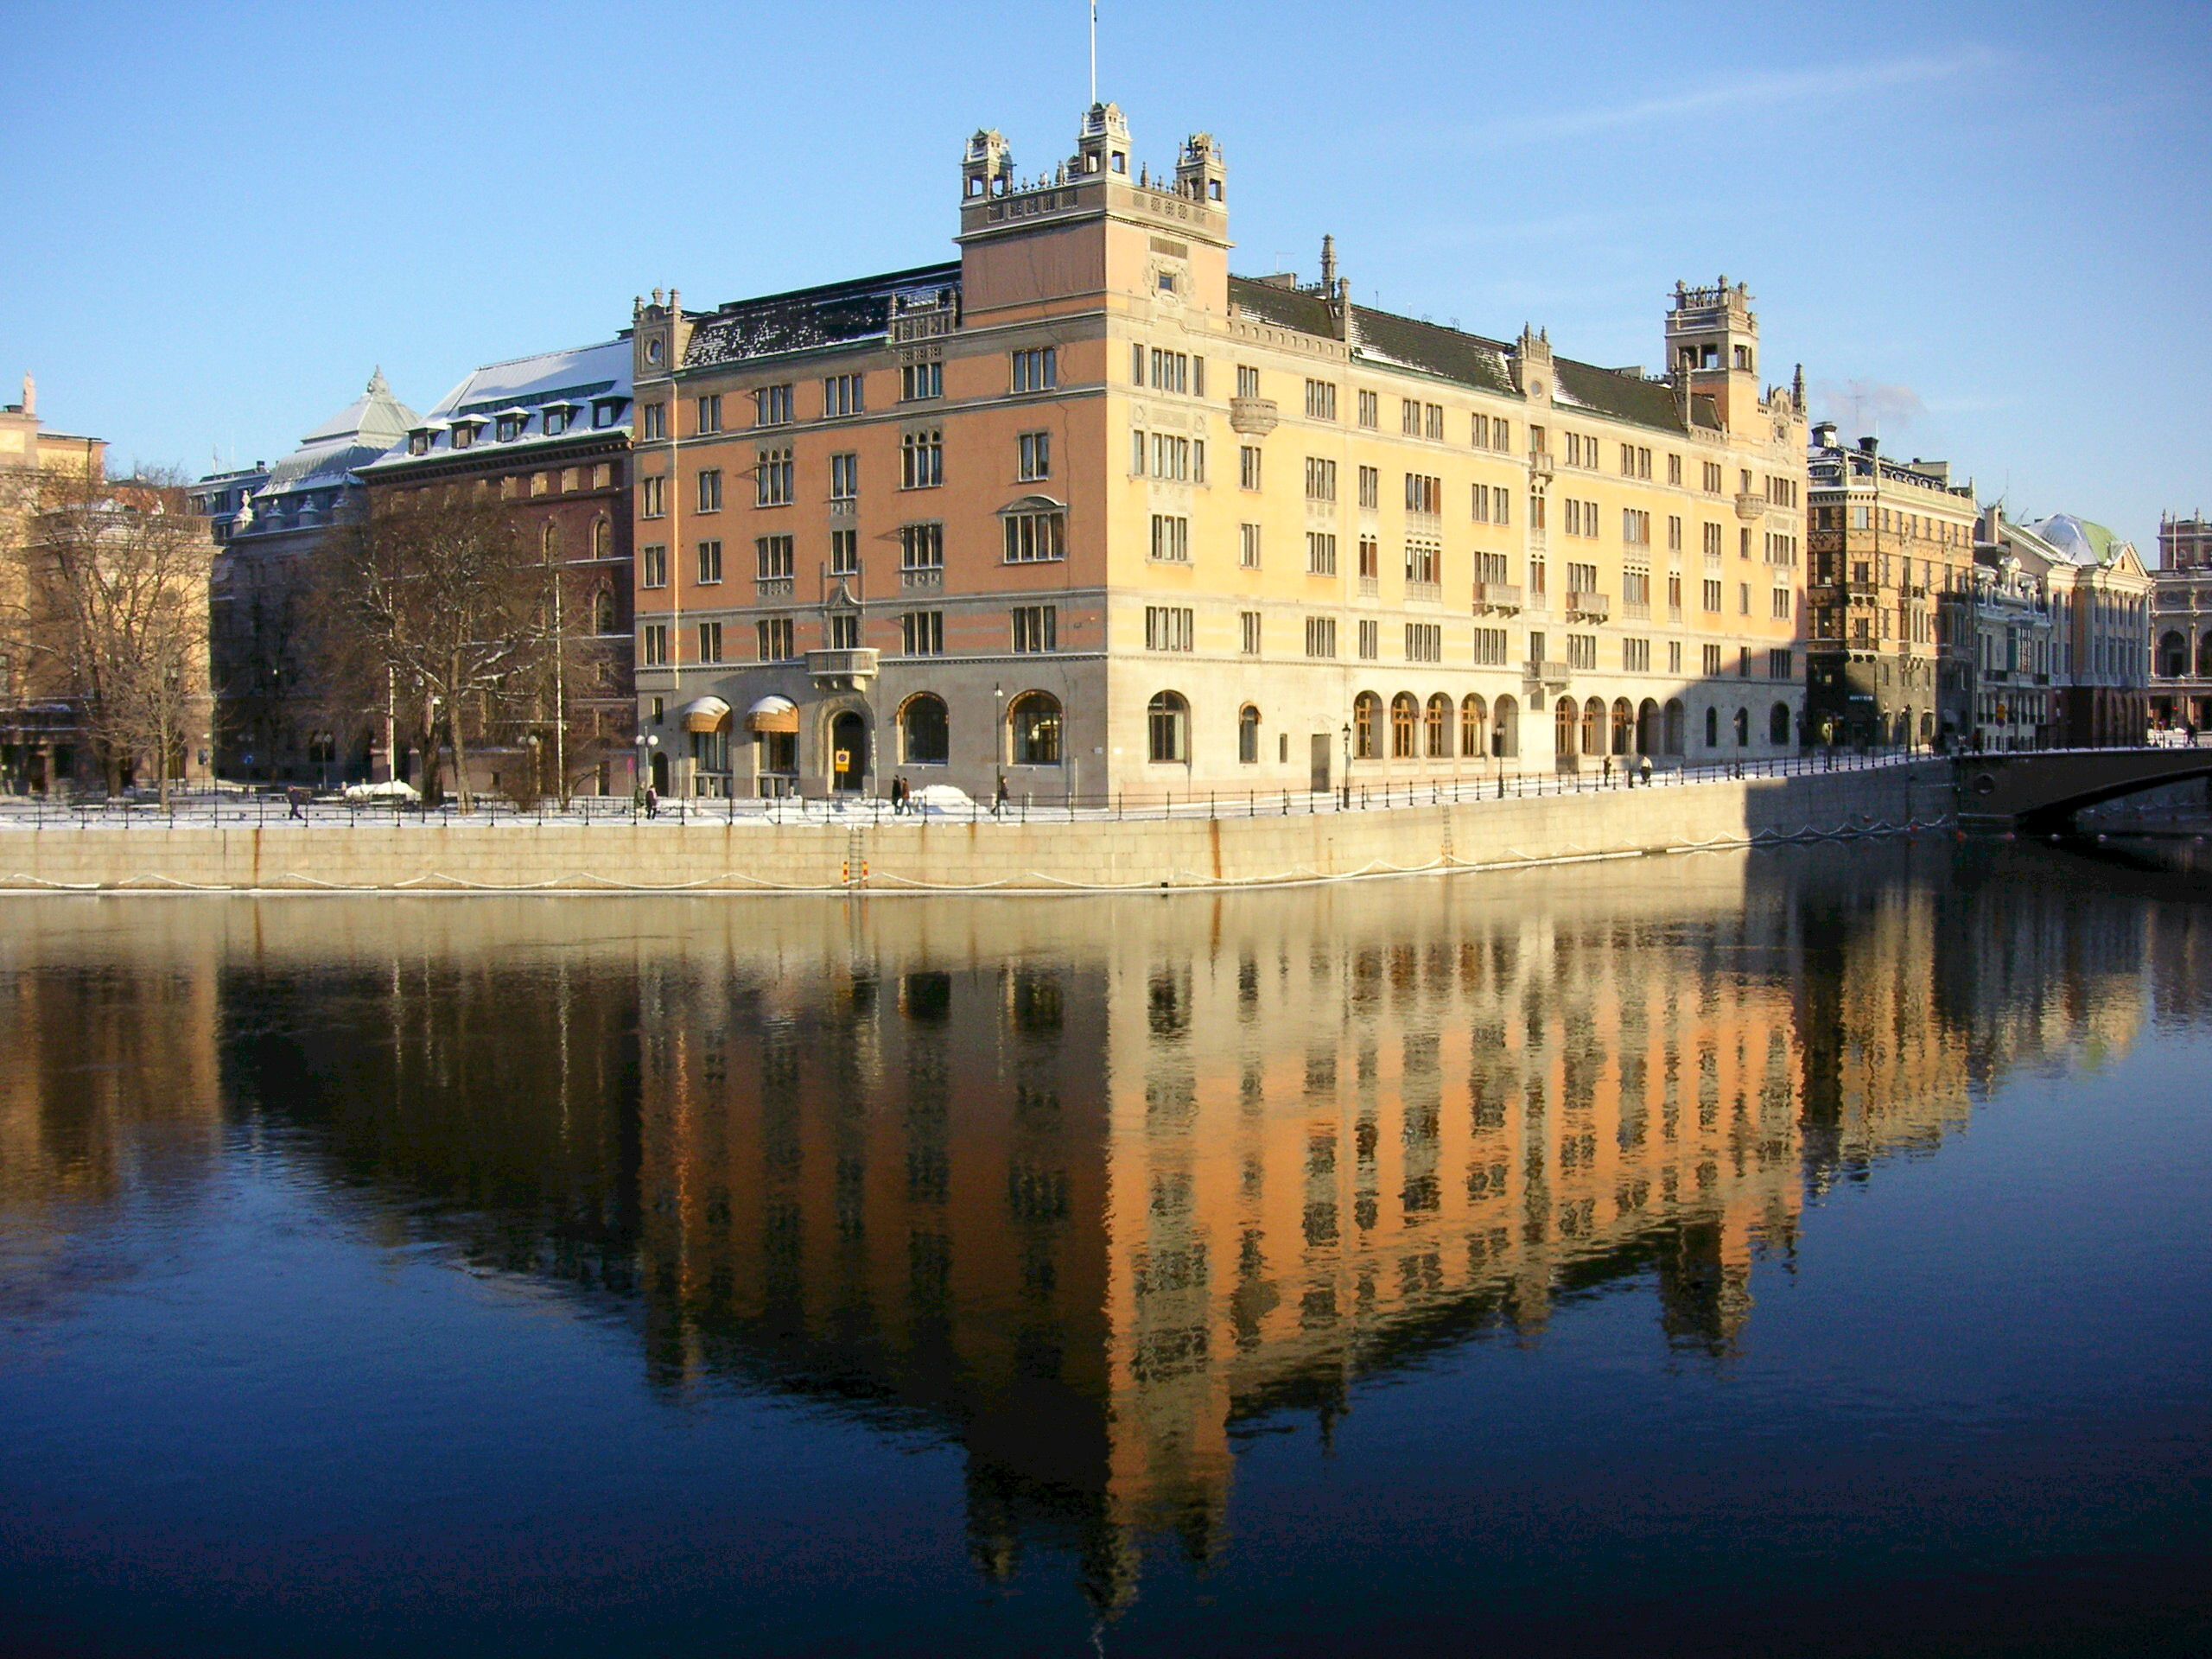
3. EAB meeting with State Secretary
High level dialogue
EAB delegates to partner with LB in order to describe the potential industrial usability of ESS and stress the importance of continued funding.
Suggested EAB team supported by ESS?
Notes:
Increasing computing capacity and speed for Data analytics

Slide 7
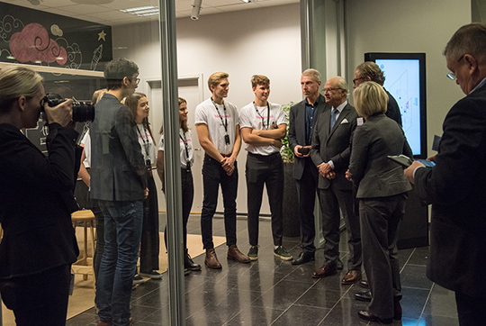
4. Alliance with IVA
Long term relationship – initiate future seminars
EAB task force to build stronger relations with IVA in order to make ESS a topic for further seminars, study tours and cooperation.
List with five potential topics for seminars to be compiled together with information material.
EAB team supported by ESS (decided on August 18th):
Lena Olving
Bert Nordberg
Maria Strömme
Notes:
Increasing computing capacity and speed for Data analytics

Slide 8
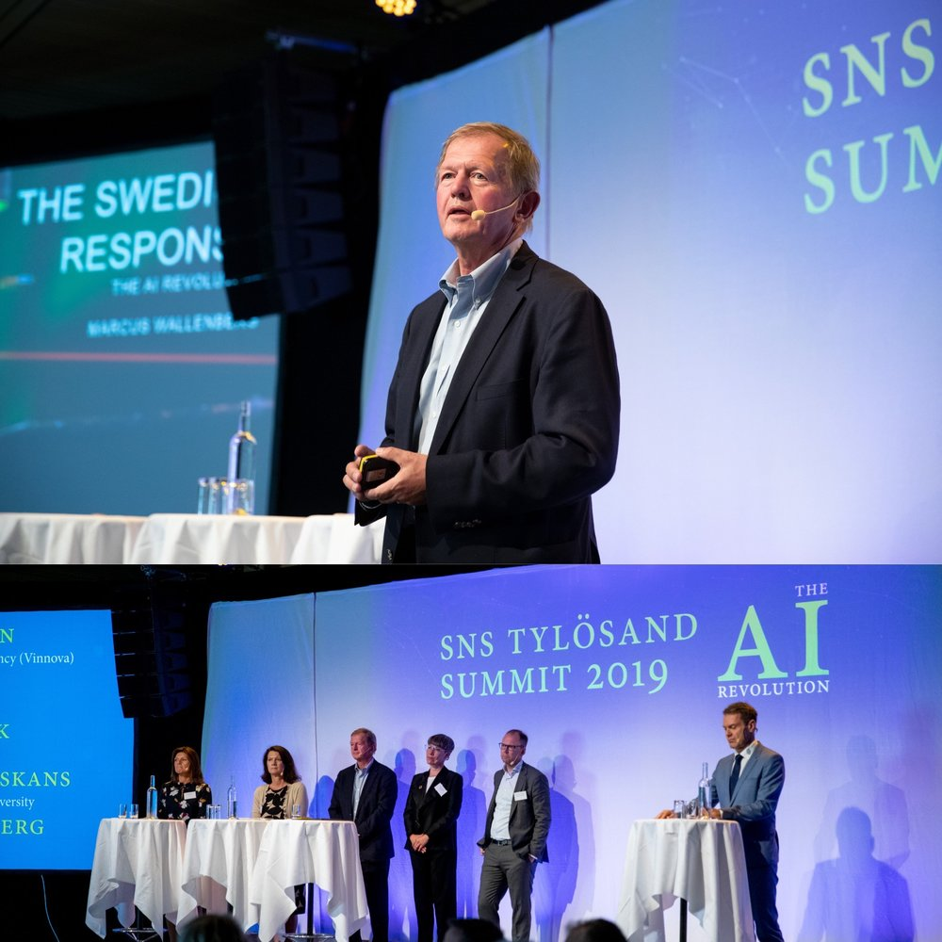
5. High Level visit for SNS?
Connect EAB meeting with SNS visit after Tylösand Summit 2022
SNS Tylösand gather high level industrialists. EAB can invite some of the leading participants to visit ESS the day after the summit in August 2022.
Suggested EAB team supported by ESS?
Notes:
Increasing computing capacity and speed for Data analytics

Slide 9
6. Connect with universities in the US
Effort to build cross Atlantic networks
EAB can assist ESS to establish networks with leading universities in the US and form a strategy for the cross Atlantic scientific and industrial link.
Suggested EAB team supported by ESS?
Notes:
Increasing computing capacity and speed for Data analytics

Slide 10
Rough Time Plan 2021-2024
1. Info material
2. Meeting…
3. Innovation Day
4. IVA
5. SNS
6. US Universities
Q4/21
Q1/22 | Q2/22 | Q3/22 | Q4/22 | Q1/23 | Q2/23 | Q3/23 | Q4/23 | Q1/24 | Q2/24 | Q3/24 | Q4/24
SE |  |  |  | SE+ NO/DK? |  |  |  | SE + INT?

