Slide 1
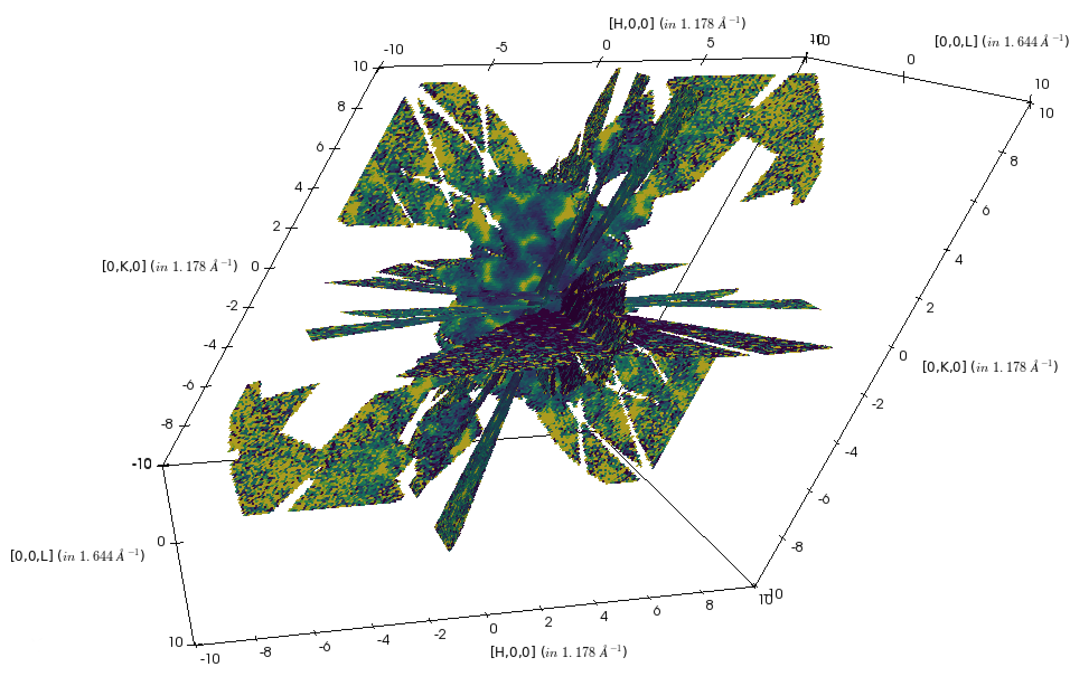
Advanced Visualization Capabilities for Neutron Scattering Data
Steven Hahn
Neutron Data Analysis and Visualization Division

Slide 2
Outline
ParaView client/server
  Helpful hints
  VSI (custom application)
Examples from
  Neutron tomography
  Neutron diffraction
  Neutron spectroscopy

Slide 3

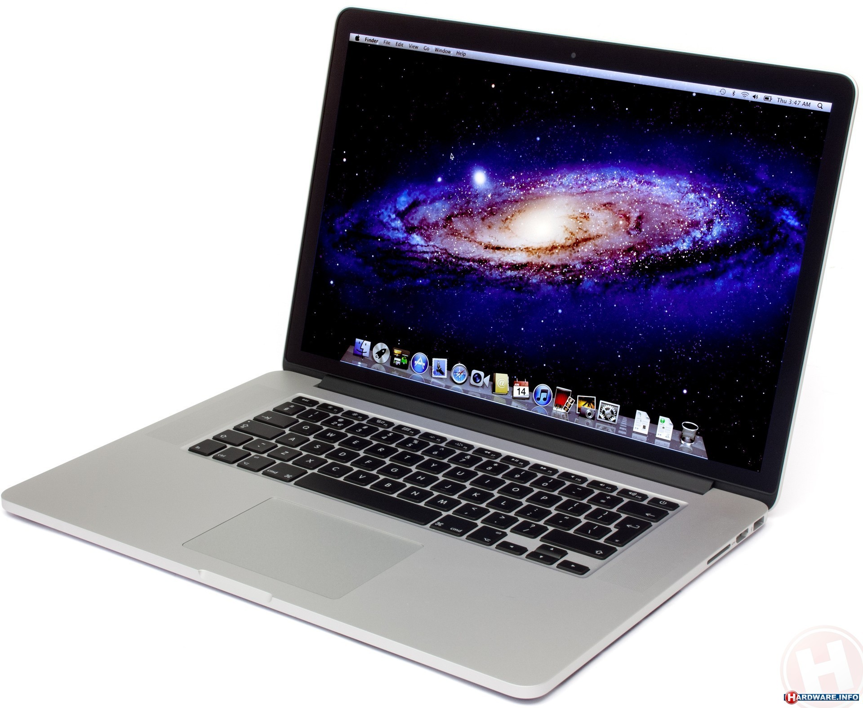
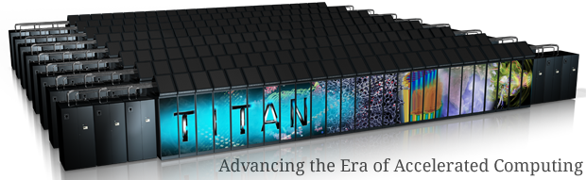
ParaView
Open source, multiplatform data analysis and visualization application.
Capable of rendering massive data sets
  Remove client/server configuration
  Multiple data types
Customizable
  Plugins
  Custom applications
Notes:
Visualization Simple Interface

Slide 4
Tips
Prefer building from source or binaries on www.paraview.org
Utilize hardware-accelerated OpenGL rendering
  Avoid `ssh –X`
  Use VirtualGL with VNC, Thinlinc, NX
  Try building with EGL enabled
Python trace of GUI interactions
Profile tasks routinely performed by your users
  Check for hot spots
  Execution time on CPU vs GPU?
Notes:
System package manager

Slide 5
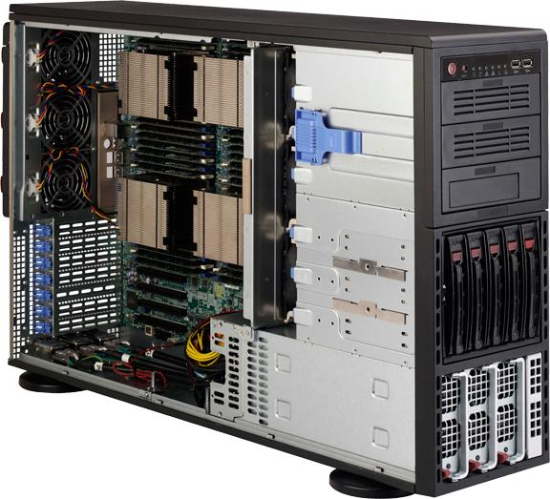
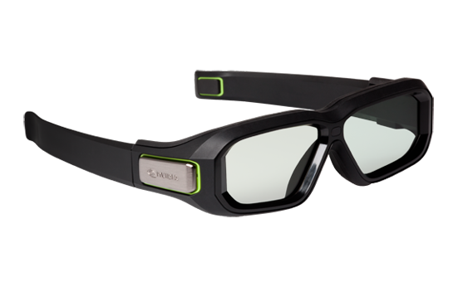
Visualization resources at the SNS
3D Visualization station (Building 8600, 5th floor)
  2 x 6 Core Intel Xeon E5-2643 v2 @ 3.5GHz
  64 GB Ram
  NVidia Quadro K6000 graphics
  Stereoscopic 3D glasses
  Oculus DK2
Remote visualization server
  4 x 8 Core Intel Xeon E5-4650 @ 2.70GHz
  512 GB RAM
  Nvidia Quadro K4000 & Dual NVidia K20c
Distributed HPC resources

Slide 6
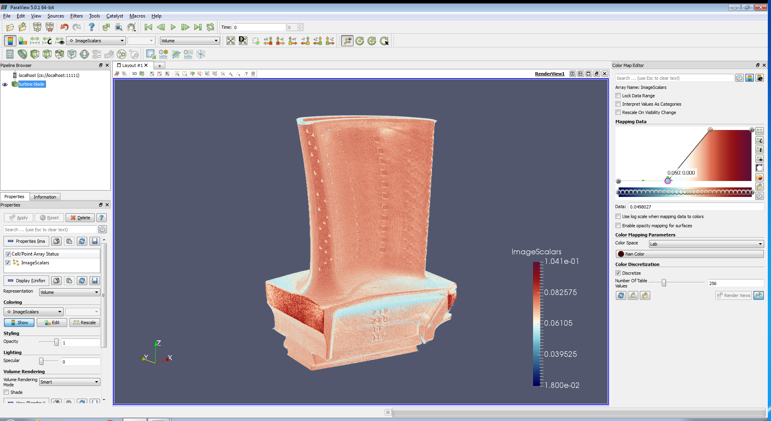
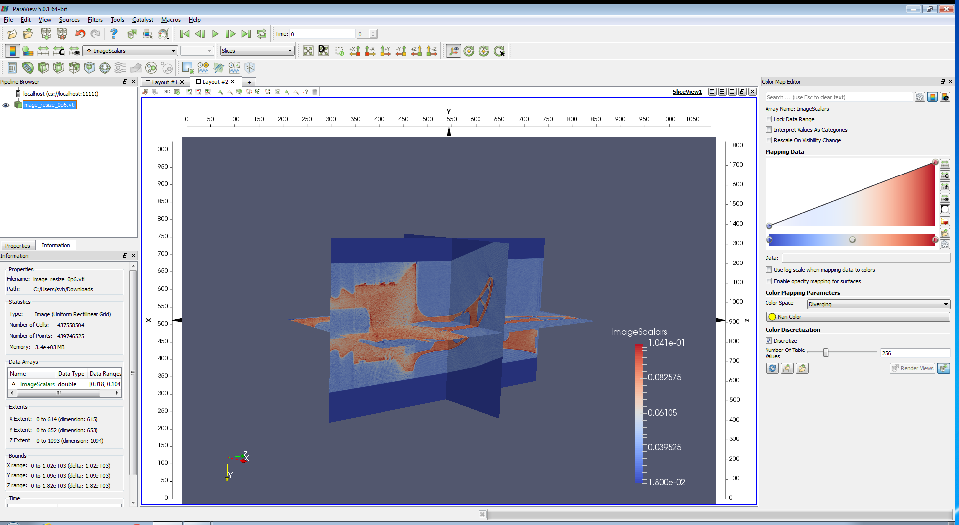
Neutron Imaging
Simple loading a stack of tiff files from reconstruction.
  Ideal data format for VTK
Challenge mixing domain-specific terminology and techniques with a more general-purpose tool.
Demonstrated capabilities with data to 30 GB
Scaling to meet current and future visualization needs
Notes:
Investigating hardware requirements to interactively view and manipulate 3D volume renderings of multiple ~30 GB vtkImageData files.

Slide 7
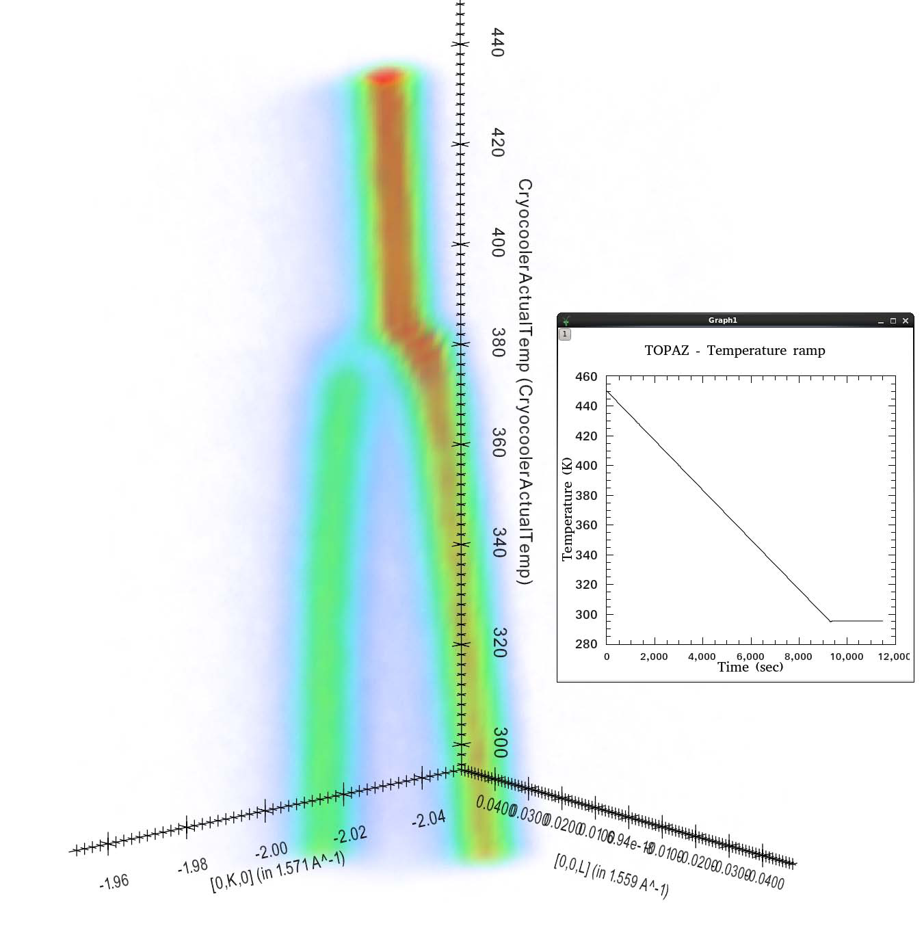
Unique visualization requirements
>3 dimensions
  Inelastic scattering,
  Temperature, pressure, magnetic field
nonorthogonal axes
Cell blanking
Notes:
Honeycomb lattice && tuning fork (higher dimensions: temperature)
remove blanking subbullet and cut off second row of images

Slide 8
Visualization
Multiple reduced data sets
  1-100 GB each.
Formats
  Sparse: adaptive box structure
  Dense array
Visualization Simple Interface
  ParaView custom application bundled with Mantid

Slide 9
Reducing memory consumption
vtkUnstructuredGrid
  Explicit geometry, 8 points/Hexahedron
  Generates a second copy in memory
  2.15 GiB
vtkStructuredGrid
  Explicit points, implicit geometry
  Signal array can be reused
  1.45 GiB
Position can be obtained from the index.
  New zero copy interface in VTK 7
Notes:
Hexagonal ( 300GB of ram for visualization and slicing)
Can I say more with images, less with text?
Paraview memory inspector

Slide 10
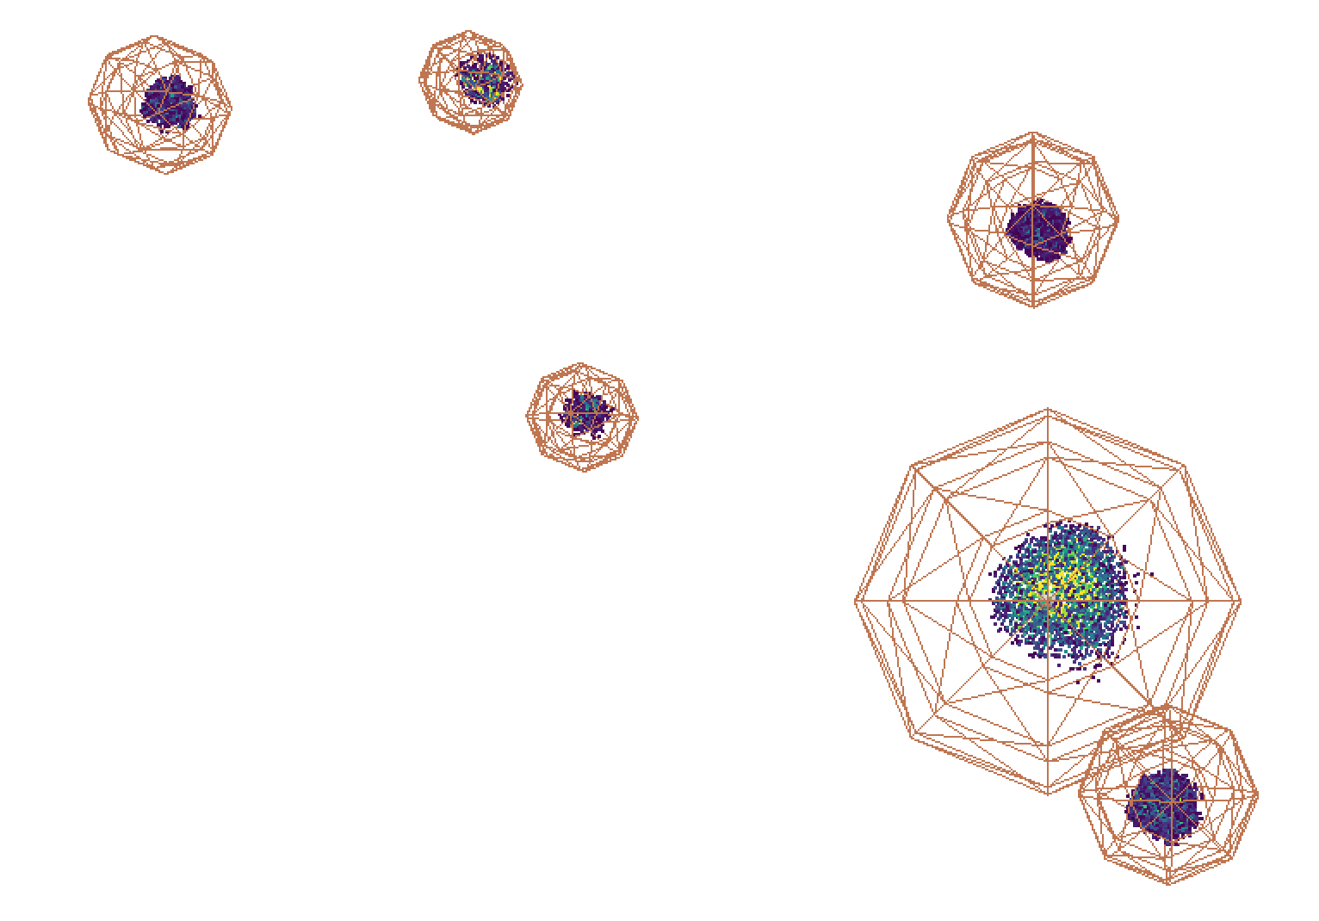
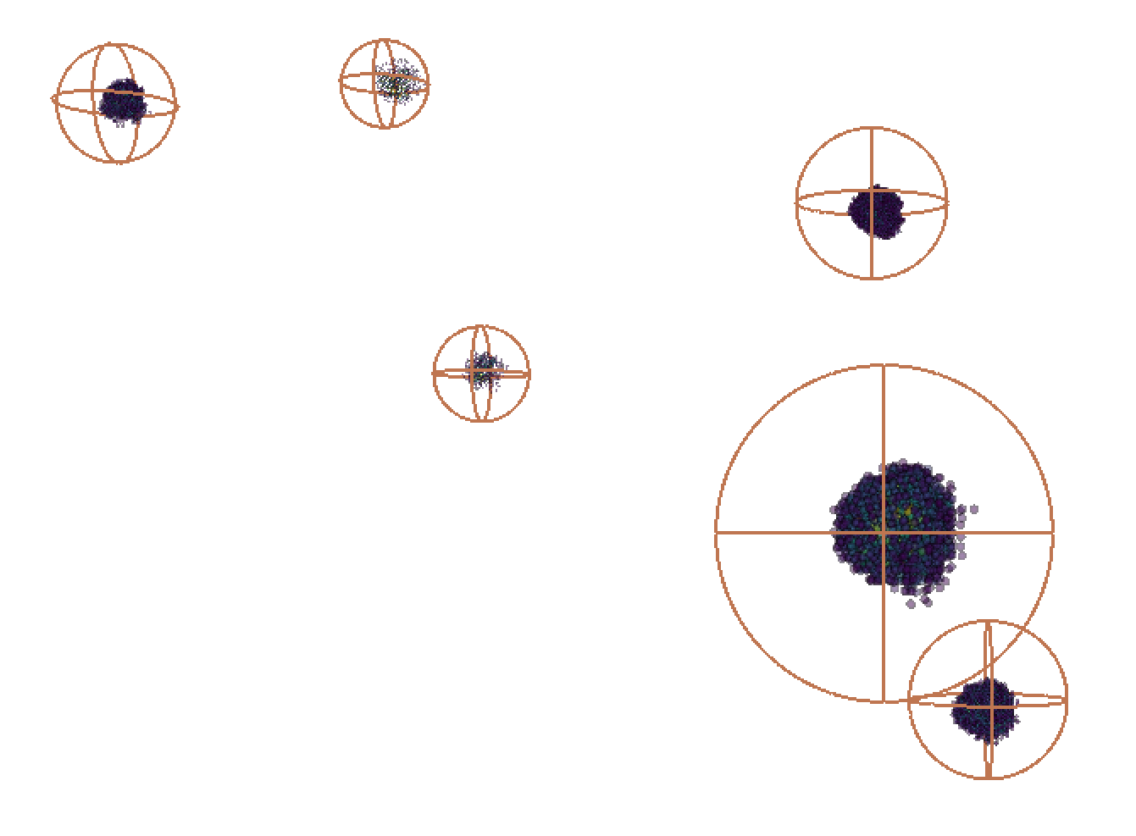
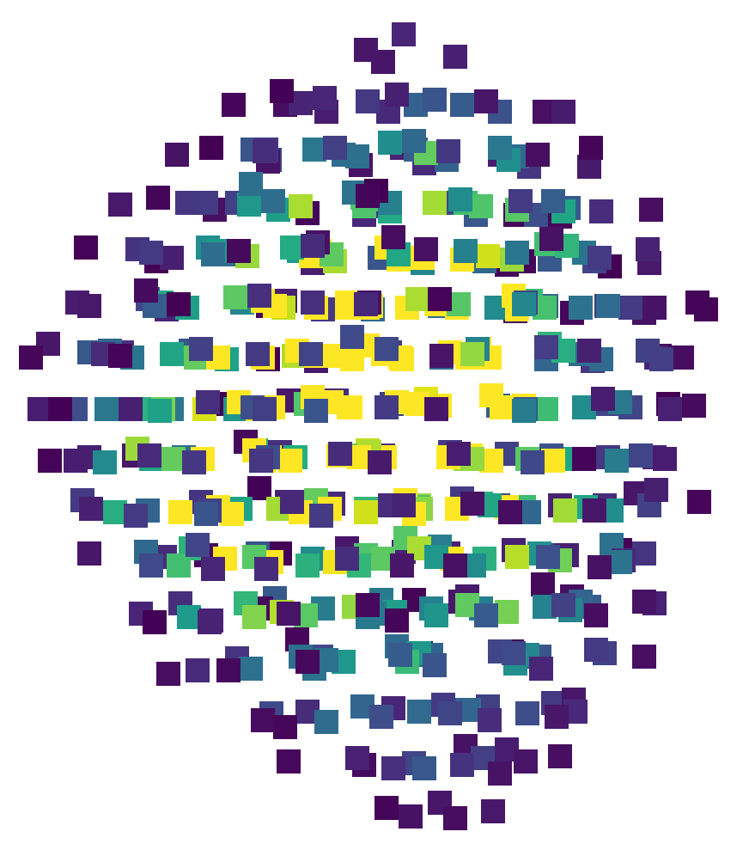
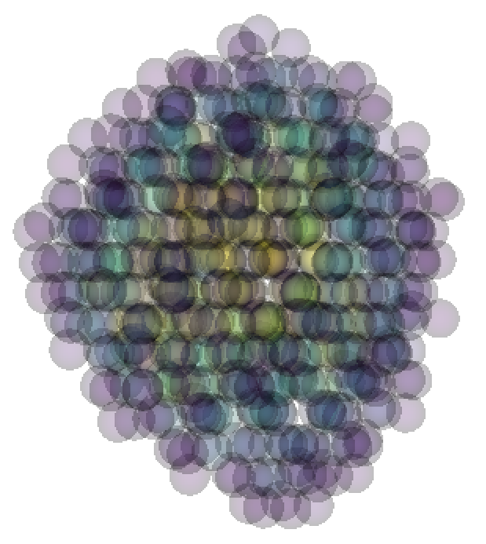
Improved Splatter Plot and Peaks View
Peaks shown by the principle axes of the ellipsoidal integration volume.
Default changed to larger translucent spheres using the Point Gaussian Representation (new in ParaView 5.0)
New defaults improve the perceived quality of figures.
Before
After
Notes:
Prior to Mantid 3.7, points are shown as opaque cubes
Compared to previous wire mesh, these changes make it easier to see inside the ellipsoid and verify that the integration volume is correct.
Translucency makes it easier to see intensity at center of Bragg peak.

Slide 11
Publication-quality Figures
Automatic slicing along non-orthogonal axes
High-quality, customizable axis labels
  Insert symbols and equations with LaTeX commands
Viridis colormap from matplotlib is now available
Coming in Mantid 3.9
  Auto-select axis color upon background color change
  anti-aliasing

Slide 12
Save as a VTK data file
SaveMDWorkspaceToVTK saves a Mantid MDWorkspace in a VTK data format which can be read by a wide variety of 3D visualization software
Simpler alternative to third-party plugins
Utilize remote, parallel rendering
Notes:
Alternative to Mantid’s ParaView plugins

Slide 13
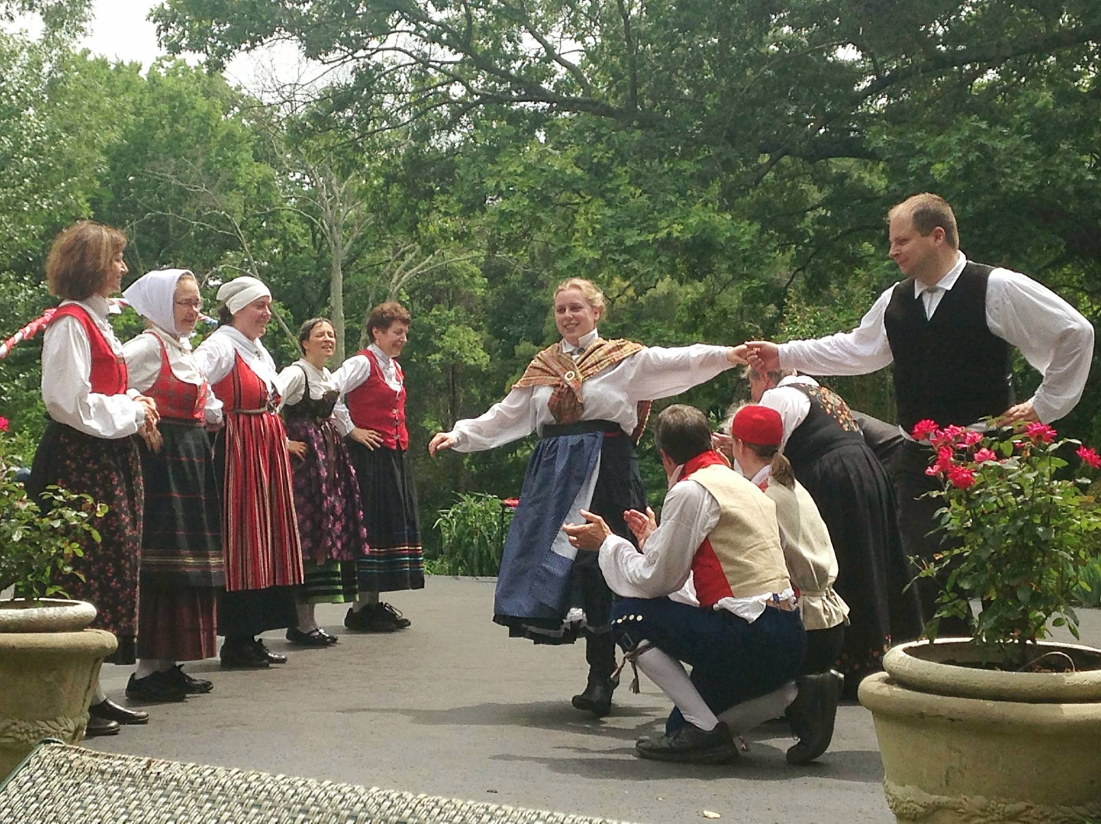
Questions?

Slide 14
Questions?

