Slide 1
Safety systems at the SAFARI-1 Neutron Diffraction Facility
D Marais, JC Raaths,
PR van Heerden, AM Venter
Radiation Science, Research and Development Division, The South African Nuclear Energy Corporation (Necsa) SOC Limited

Slide 2
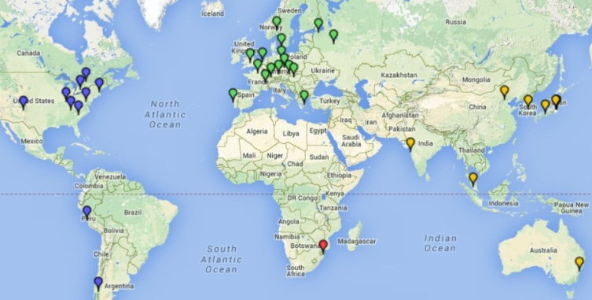

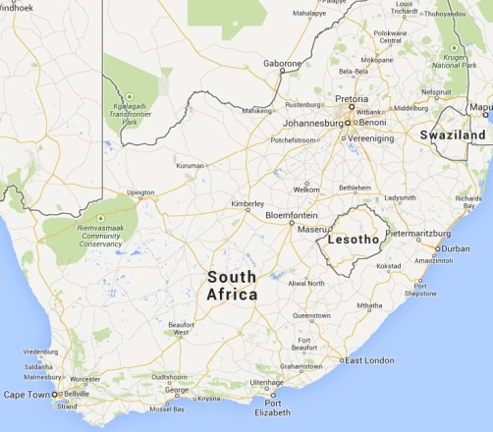
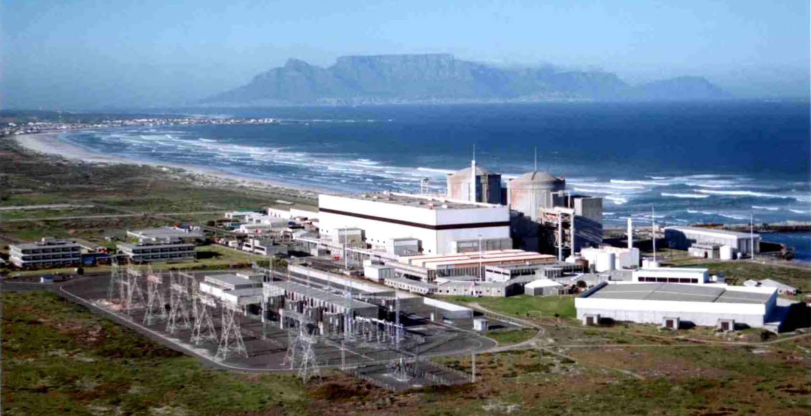
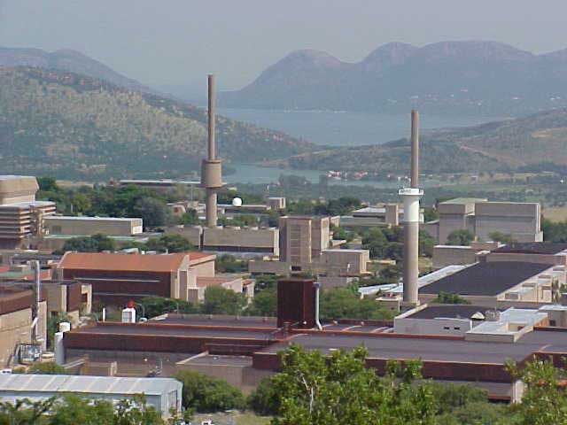
Where we are

Slide 3
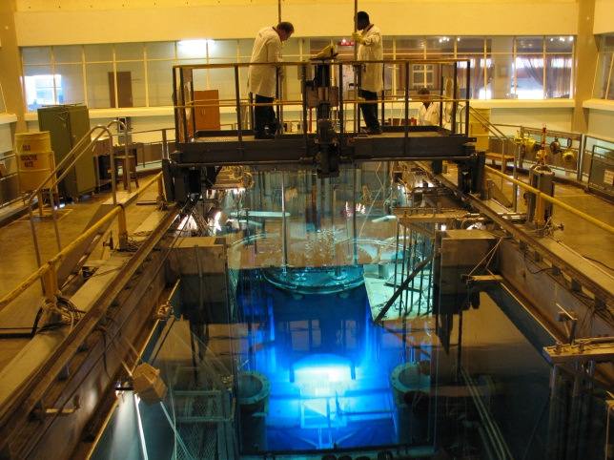
SAFARI-1 Research reactor
South African Fundamental Atomic Research Installation
  20 MW Tank-in-pool
  Commissioned in 1965
  Flux 4x10¹⁴ n.cm⁻².s⁻¹
  Medical isotopes
  Irradiation services
  Neutron activation analysis
  Neutron beam line facilities
  ~300 days availability p/a

Slide 4
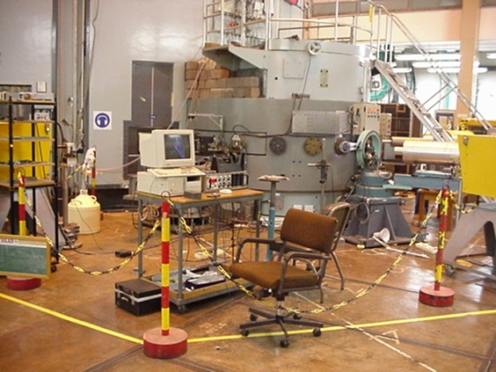
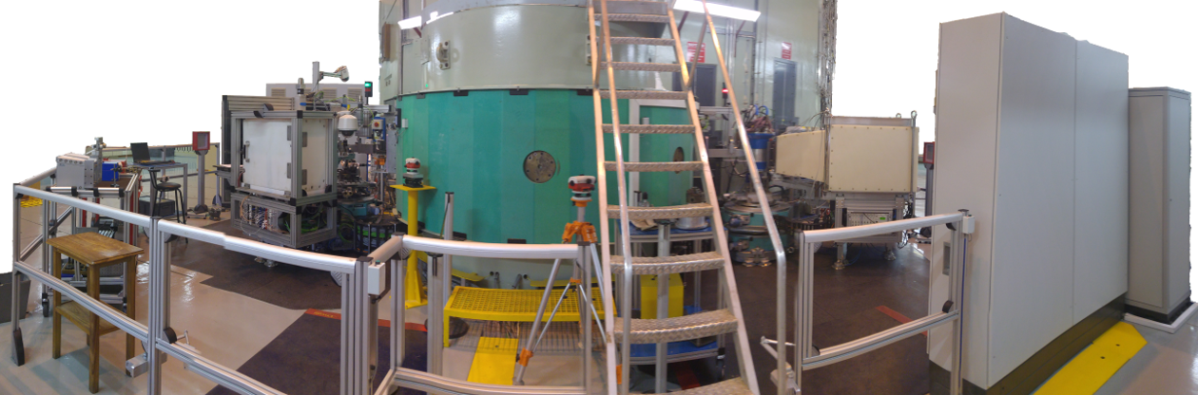
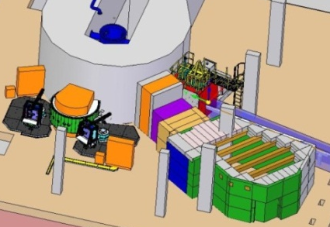
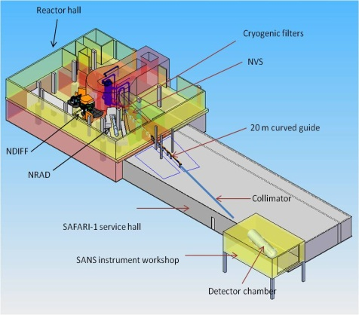
Beam-line facilities
  Past
  Strain scanner
  Powder diffractometer
  Single crystal
  Present
  Strain scanner
  Powder diffractometer
  Future
  Neutron radiography
  Small angle scattering

Slide 5
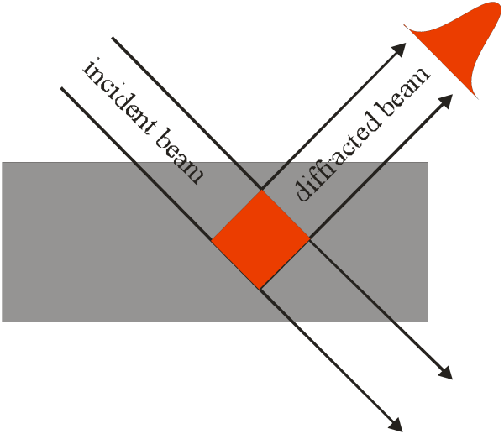
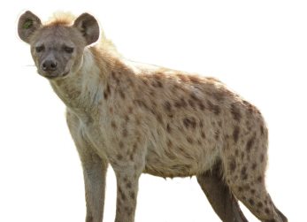




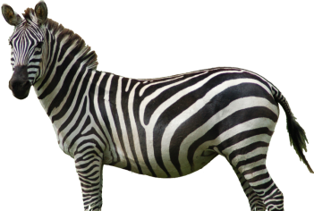
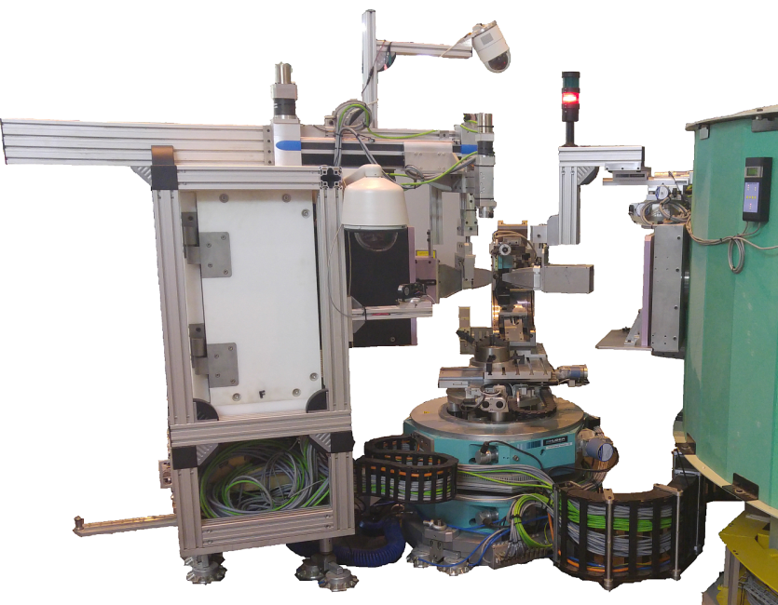
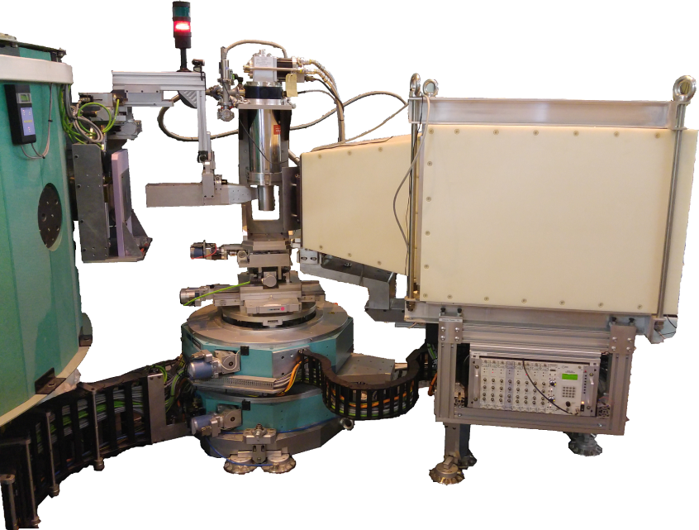
Neutron diffraction instruments
  MPISI - Materials Probe for Internal Strain Investigations
  PITSI - Powder Instrument for Transition in Structure Investigations
  Spotted hyena in Zulu
  Zebra in Sesotho
Notes:
PITSI – Sesotho & Tswana
MPISI – Zulu & Xhosa

Slide 6
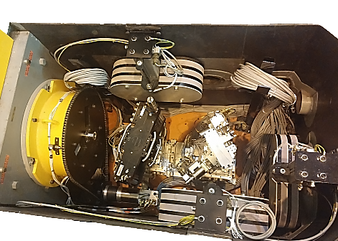
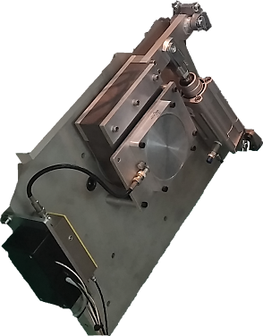
Beam shutters
Primary shutter
  Resembles a large drum
  Chain linked electric motor and resolver
Secondary shutter
  Pneumatic system
  On power loss, gravity moves shutter to closed position (passive safety)
Materials
  Borated polyethylene, borated aluminium, low carbon mild steel, lead
PITSI inner secondary shutter
Primary shutter
MPISI inner secondary shutter
Outer secondary shutter
Neutron beam monitor

Slide 7
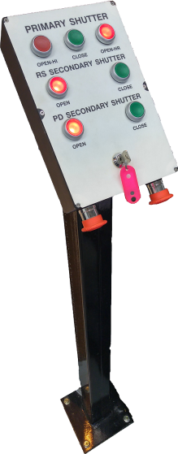
Beam shutters
Shutter control
  Shared console in NDIFF computer room
  Lockout key
  Logic trees implemented on GALIL DMC 2280 motor controller with GALIL command language
  Secondary shutter closable from instrument control software (SICS)
  Emergency button on motion control cabinet reachable from within instrument area

Slide 8
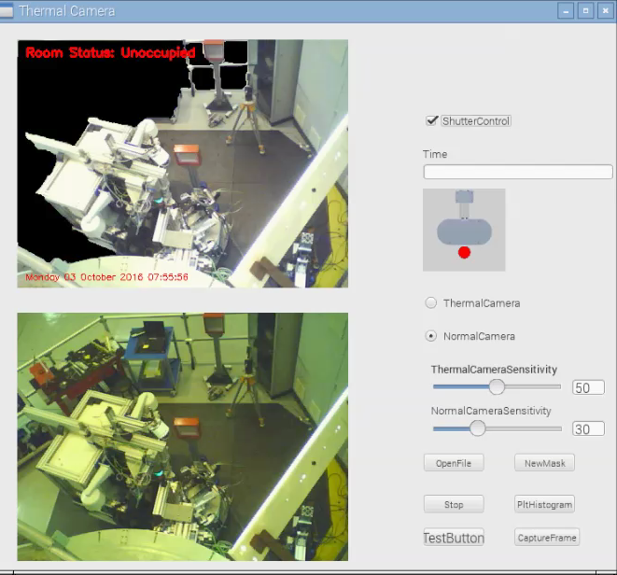
Beam shutters
Continuous monitoring system prototype
  Eliminates need for ‘search procedure’
  Real-time monitoring of area: cannot open shutter and will close it if a person is detected
  Low cost system: USB webcam, Raspberry Pi 3, existing Python scripts for motion detection
  Reduce false positives using thermal USB camera: thermal intensity in stead of motion

Slide 9
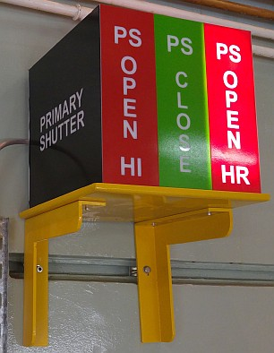
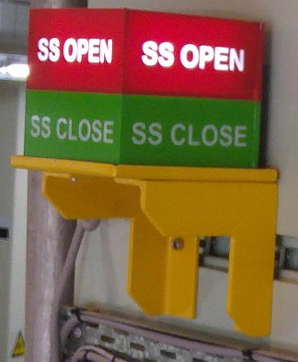
Visual displays
Facility and instrument shutter indicators
  Indicates shutter positions read from limit switches, GALIL implementation
  Primary shutter status visible from SAFARI-1 control and NDIFF computer room
  Secondary shutter status visible from NDIFF computer room & beam stop positions

Slide 10
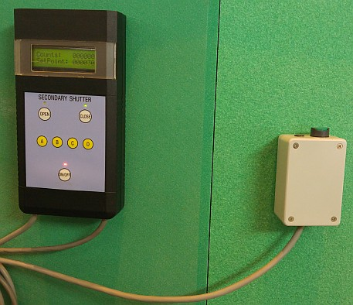
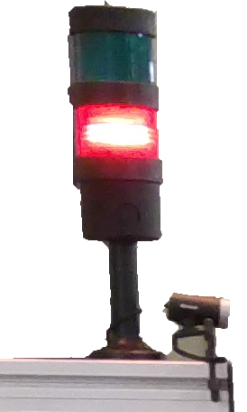
Visual displays
Instrument safety indicators
  Controlled by an “interlock box” containing C programmed Microchip dsPIC30F6012 microcontroller
  Reads counts from beam monitor
  Will only switch to ‘safe’ if neutron count rate is below a threshold value and the secondary shutter is closed
Gate interlock system
  Gate is magnetically locked when secondary shutter is open or beam is detected

Slide 11
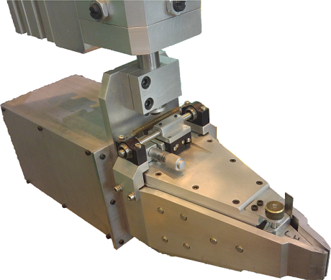
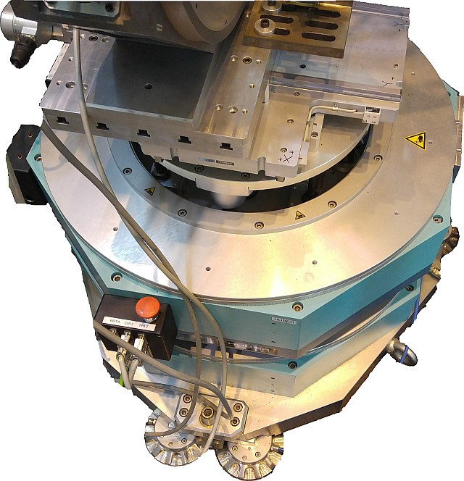
Motion interruption
Motor limit switches
  Restricts motor movement to design specifications
  Stops all movement if aperture is bumped
Emergency stop buttons
  On sample table
  Shutter control console inside NDIFF computer room
  Instrument control software GUI (Gumtree)

Slide 12
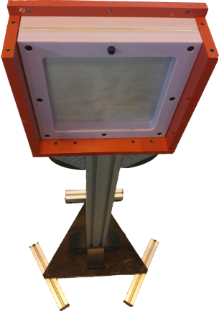
Beam stops
Open workspace in reactor hall, confine beam to instrument area
25 mm thick borated polyethylene (5wt% boron) sheet
5 mm thick sheet of 95% ¹⁰B enriched borated aluminium 1100 Alloy (4.5wt% boron)
16 mm mild steel sheet on the back side
Position | Dose rate [µSv/h]
 | Neutrons | Gammas
Beam port | 470 | 318
Front of beam stop | 333 | 277
Behind beam stop | 2.3 | 10.9
Mild steel
Borated Polyethylene
Borated Aluminium 1100

Slide 13
Conclusion
User and personnel safety is of utmost importance
Continuously improving the safety system
Software is important not only for data acquisition, reduction and visualization, but also for SAFETY!

Slide 14
Acknowledgements
Nick Hauser and team
ANSTO/PSI for the use of SICS and Gumtree
National Research Foundation of South Africa
IAEA
Necsa SOC Limited

Slide 15
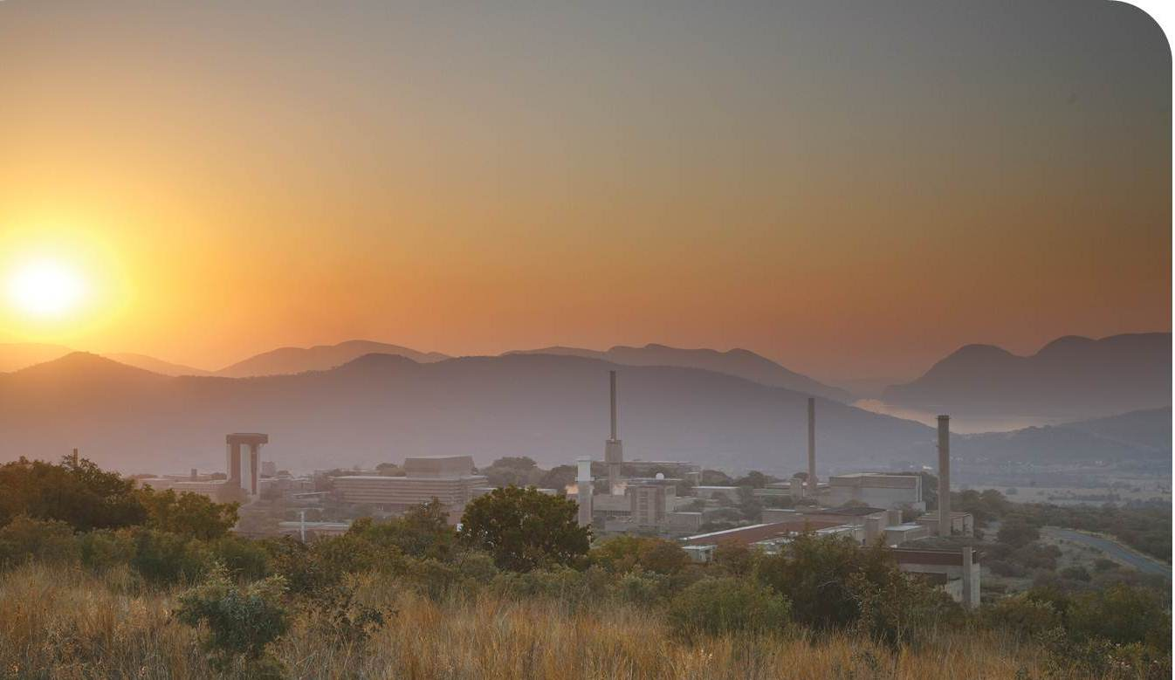
Questions

