Slide 1
Programs and techniques based on ROOT package for acquisition and sorting of the list mode data of the neutron detectors
Elena Litvinenko¹,
Andrey Bogdzel¹, Andrey Churakov¹, Feodosiy Levchanovsky¹,
Lutz Rossa², Olaf-Peter Sauer², Thomas Wilpert²
¹FLNP JINR Dubna
²HZB Berlin
litvin@nf.jinr.ru

Slide 2
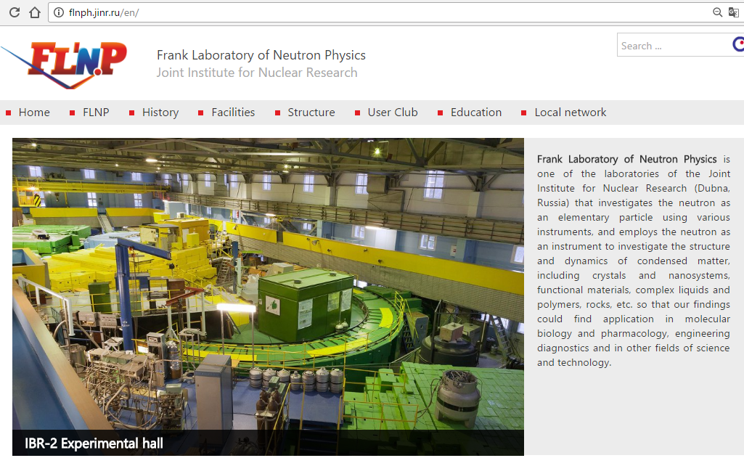
FLNP JINR flnph.jinr.ru

Slide 3
Outline
Software requirements from the detector group
About list mode data acquisition
Delay line detector signals
What is DeLiDAQ-1
DeLiDAQ-1 list mode options
DeLiDAQ-1 data structure and format
Why ROOT
ROOT file with list mode data
ELLADA program
CaDeLin program

Slide 4
The software requirements from the detector group in FLNP
detailed diagnostic tools
autonomy (stand-alone operation, independence from the experiment control systems and local database management systems, etc.)
fast deployment
flexibility (flexible configurability of parameters, easy modifications, configurable visualization tools)
compact data formats
easy integration into the experiment control software (via communication components or via components which can be used autonomously)
extensibility

Slide 5
About list mode data acquisition
Listmode - a special measurement mode in which each event and its precise time of occurrence (timestamp) is recorded sequentially, with selected properties. List mode data can be used as a diagnostics tool to verify the performance of the detection system, but also to find time correlations between signals.
Acquisition of data in list mode is known since 1985. Before 2000 - the analog electronics (values from ADC stored together with a timestamp). After 2000 - the digitizers that collect the signals directly from the detector output (pre-amplifier or photo-multiplier) with rate ~10 MHz
In recent years – the digitizers with sampling rates up to 5 GS/s. Recent digitisers use DSPs and FPGAs equipped with algorithms for data reduction embedded in the digitiser's firmware.
Now -new international standard for the data format for list-mode digital data acquisition used in radiation detection and measurement is being developed (TC45 of IEC)

Slide 6
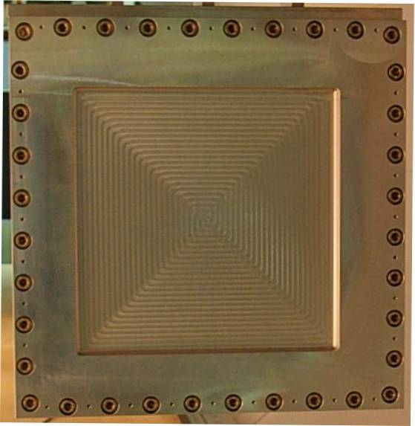
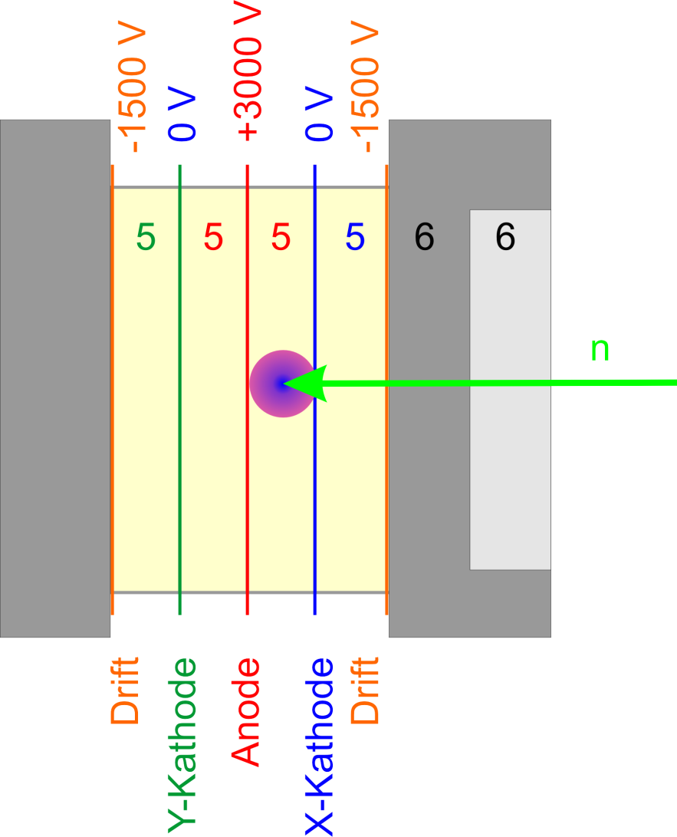
MWPC – ³He-2D Detector
Delay line detector signals
EMBL, DENEX (300x300 mm²)
~200 wires/plane

Slide 7
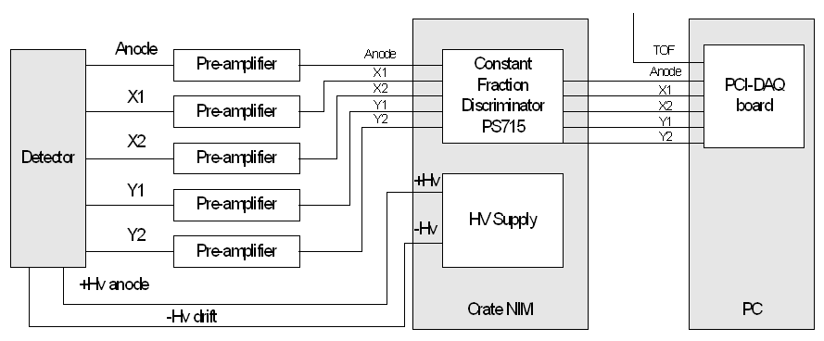
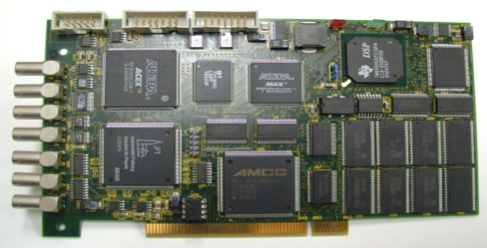
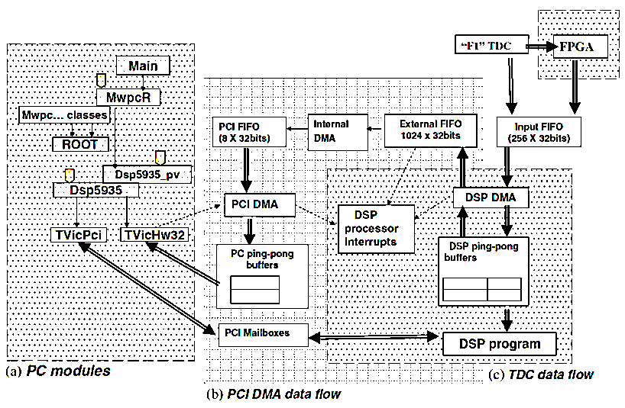
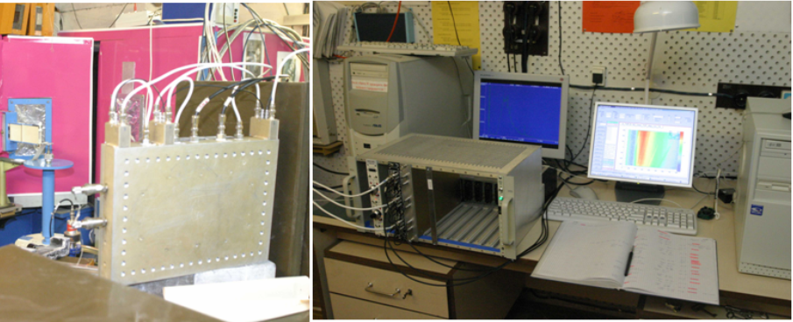
DeLiDAQ-1 systems at the FLNP (used since 2005)
Detector (2D PSD)=>Preamplifiers=>Discriminator => DeLiDAQ-1 <=> PCI <=> PC software
PC

Slide 9
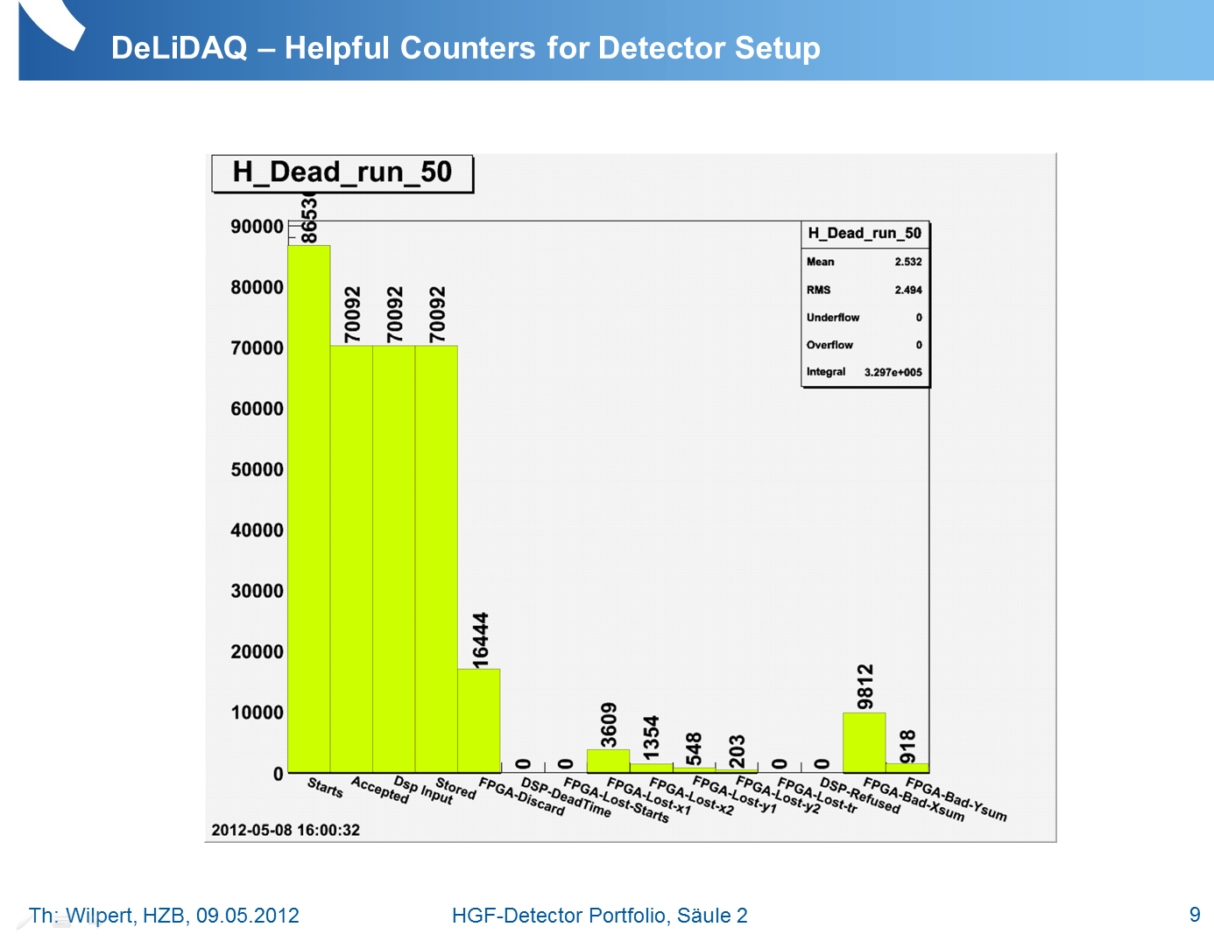

Slide 10
List mode: encoded event data (DeLiDAQ-1)
conventional raw list mode
conventional filtered list mode
packed list mode
0x00kmxxxx 0xkmiibbbb 0x00tttttt 0x0080xxxx 0x0081xxxx 0x0082xxxx 0x0083xxxx 0x0084xxxx
0x(8-F)xxx(0-7)xxx 0x(8-F)xxx(8-F)xxx

Slide 11
Example of DeLiDAQ-1 data file structure
DeLiDAQ-1 file (.root)
Meas_1
Board_Param_run1
H1D_X1+X2_run1
Meas_2
H_Dead_run2
H2D_X1-X2_Y1-Y2_run1
H3D_TOF_X1-X2_Y1-Y2_run1
ReadListMode_run3
FPGA_ListMode (tree)
Requested histograms
[One file]
[Folders]
[Histograms; Parameters; Trees]

Slide 12
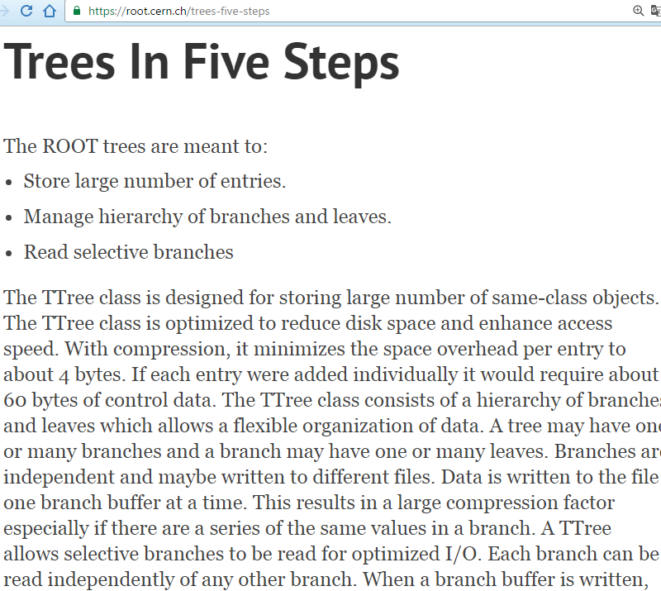
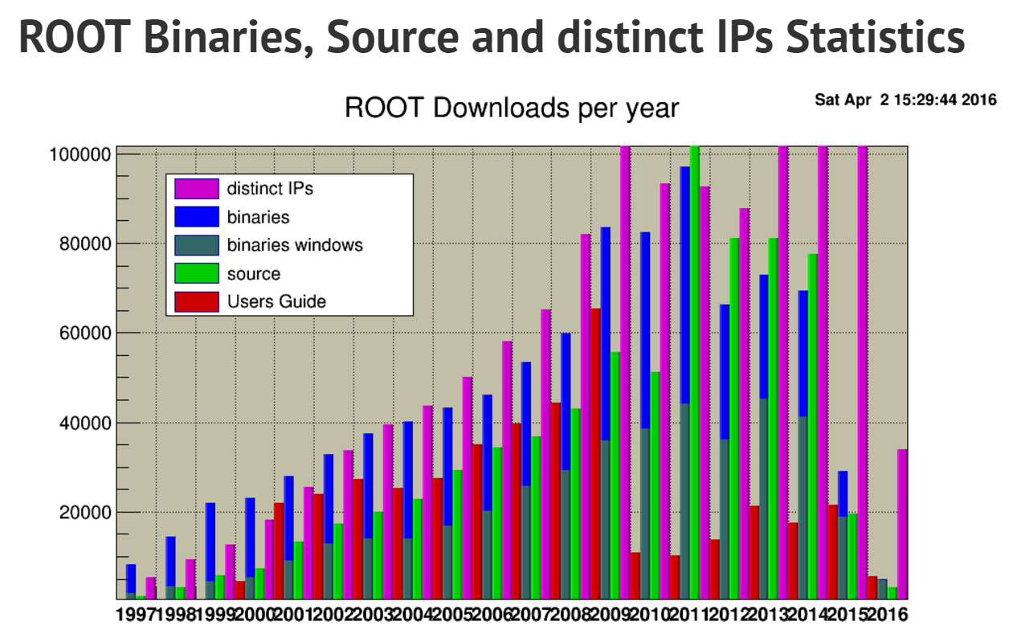
Why DeLiDAQ-1 saves data to ROOT files
Every day, thousands of physicists use ROOT applications to analyze petabytes of data or to perform simulations.

Slide 13
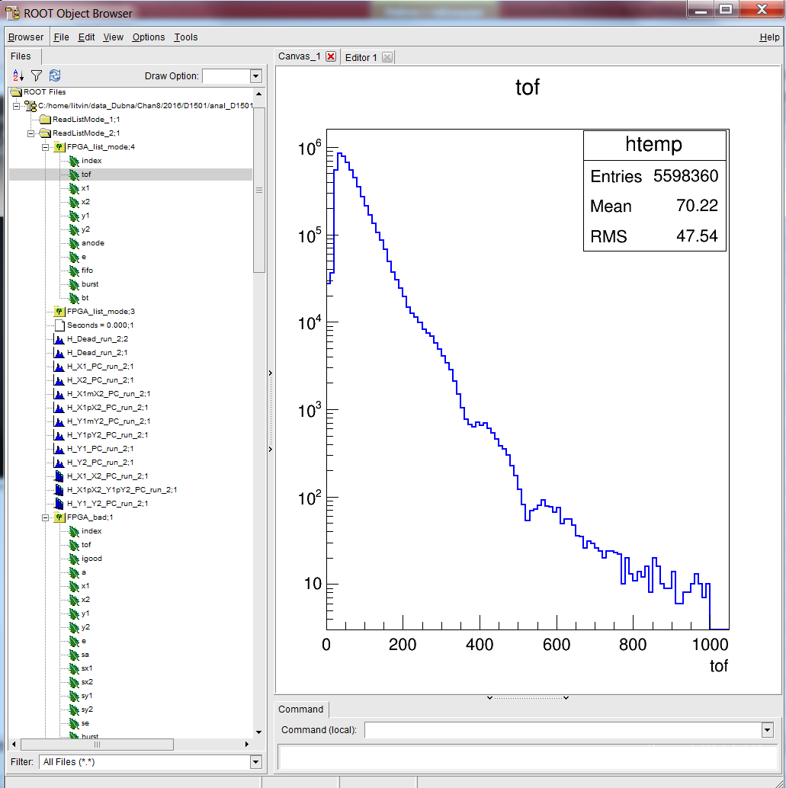
ROOT file with list mode data
The file sizes in bytes divided to the number of good events (i.e. number of bytes per good event in the file). Real world examples of the DeLiDAQ-1 list mode data from the detector.
Mode (all TOF): | Binary file: | ROOT tree file:
Raw (2D) | (Ideal value 32) 36; 55 | 21; 30
Filtered (2D) | 16 | 11
Packed (2D) | 4 | -
Raw (1D) | (Ideal value 24) 64 | 34
Filtered (1D) | 12 | 8

Slide 14
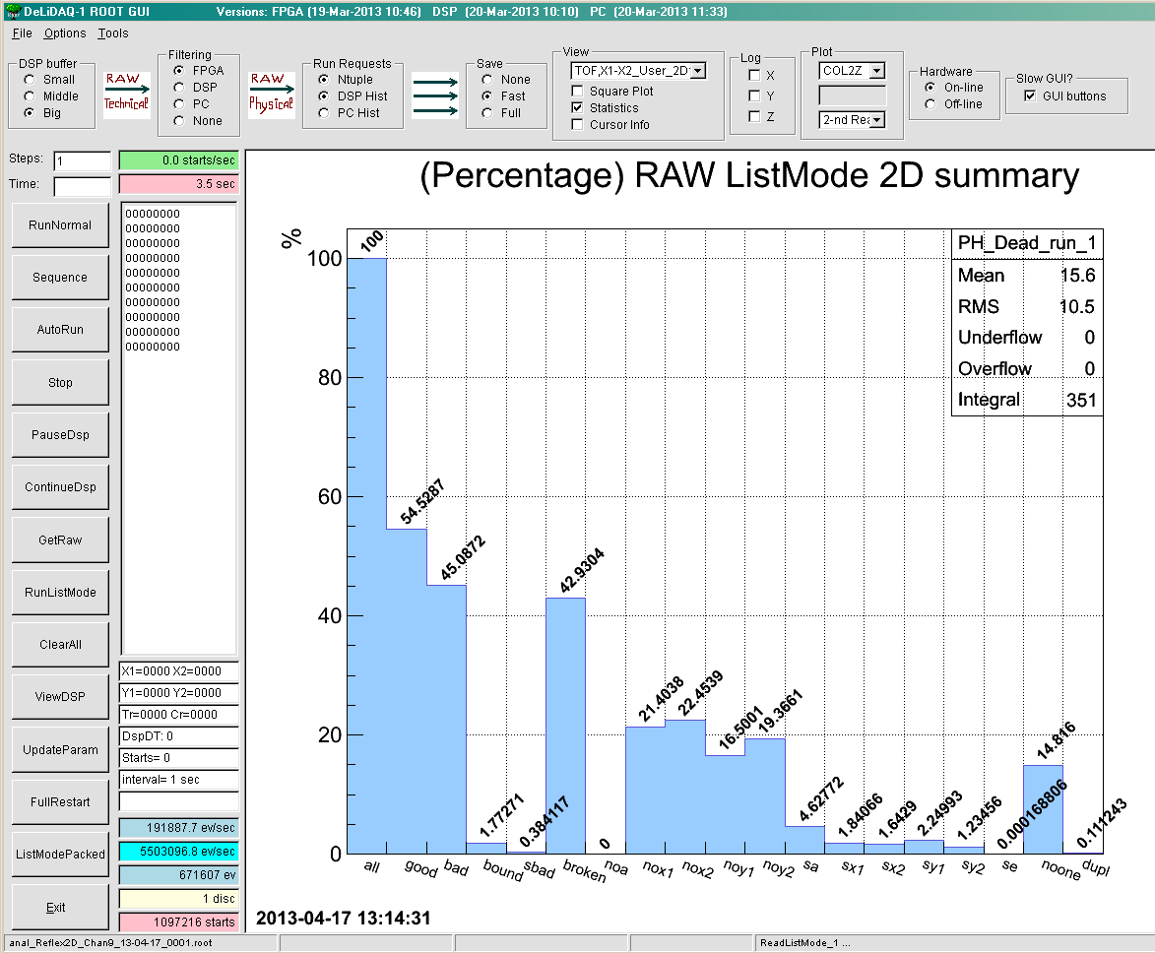
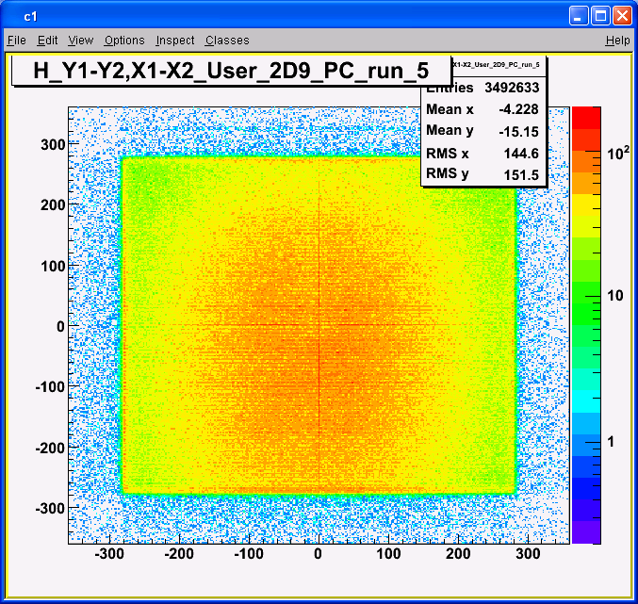
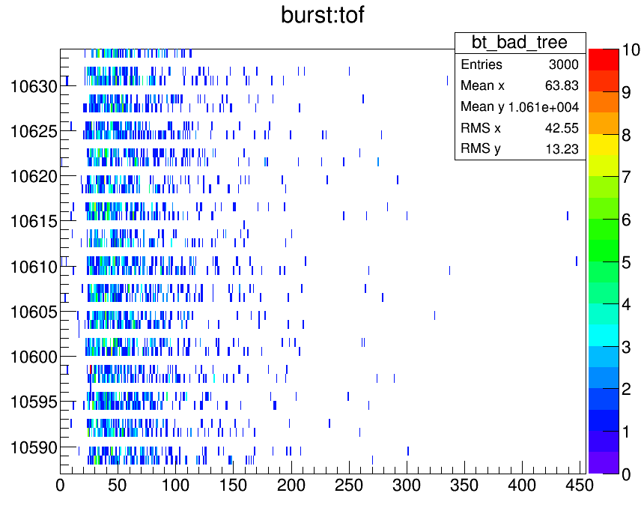
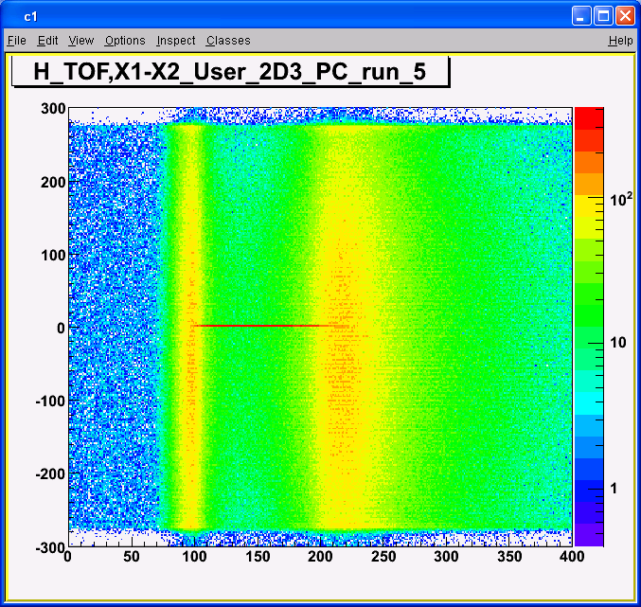
Revealing the problems (examples)

Slide 15
ELLADA program
Designed for express-analysis of the list mode data from the neutron spectrometer based on a proton telescope with electronic collimation of recoil protons, developed and created in the FLNP.
Raw input data, collected using the digitizer N6724, produced by Caen, and CAEN MC2 Analyser software (10 ns timestamp resolution).
ELLADA converts the raw binary data to root file with four independent ROOT trees (lmp,lm1,lm2,lm3)
At the next step ELLADA performs the building of the events:
lm0: t, e (timestamp, energy)
lm1: t, e
LM: t0,e0,t1,e1,t2,e2,t3,e3
lm2: t, e
lm3: t, e

Slide 16
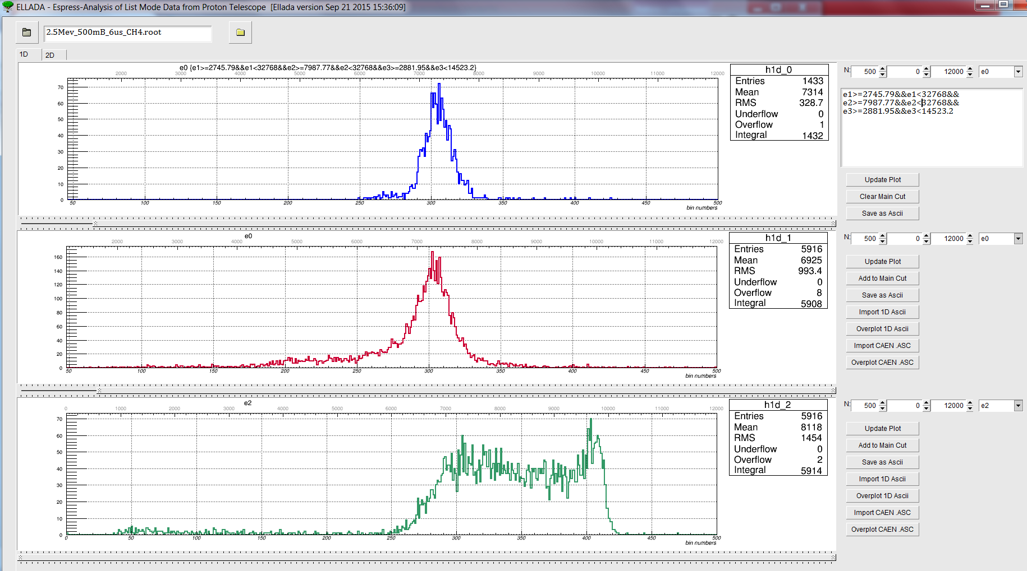
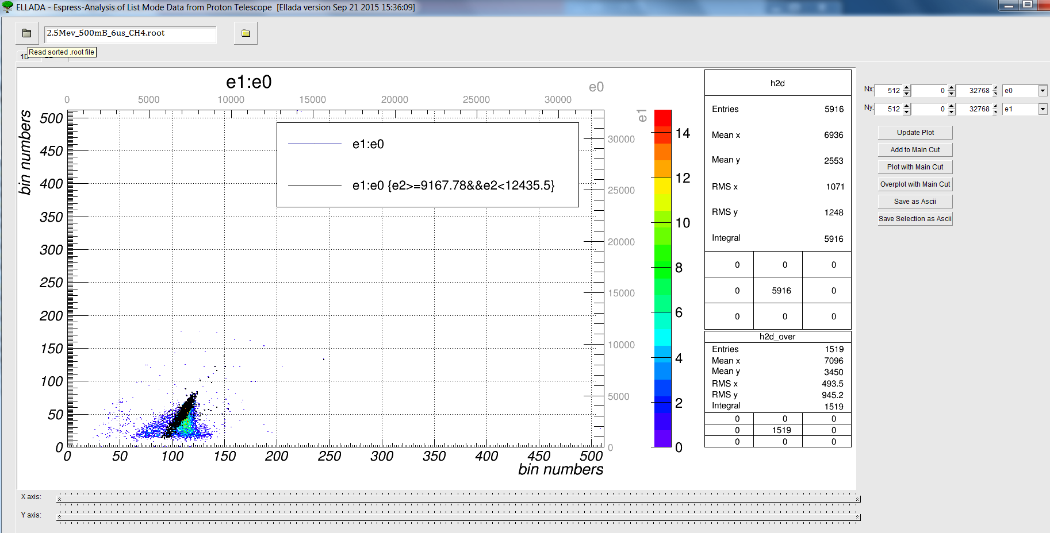
ELLADA interface

Slide 17
CaDeLin program
Designed for data acquisition and express-analysis of the list mode data from the delay line neutron detectors, developed and created in the FLNP.
Raw input data measurements using the digitizer N6730 (running DPP-PHA firmware ), produced by Caen (2 ns timestamp resolution).
The raw data are saved directly to root file with several (from 5 to 8) independent ROOT trees (lm0,lm1,lm2,lm3,…,lm7)
The data sorting (building of the events) is performed later
lm0: t, e, w, … (timestamp, energy, waveform,…)
lm1: t, e, w, …
LM: tof,x1,x2,y1,y2
….
lm5: t, e. w, …

Slide 18
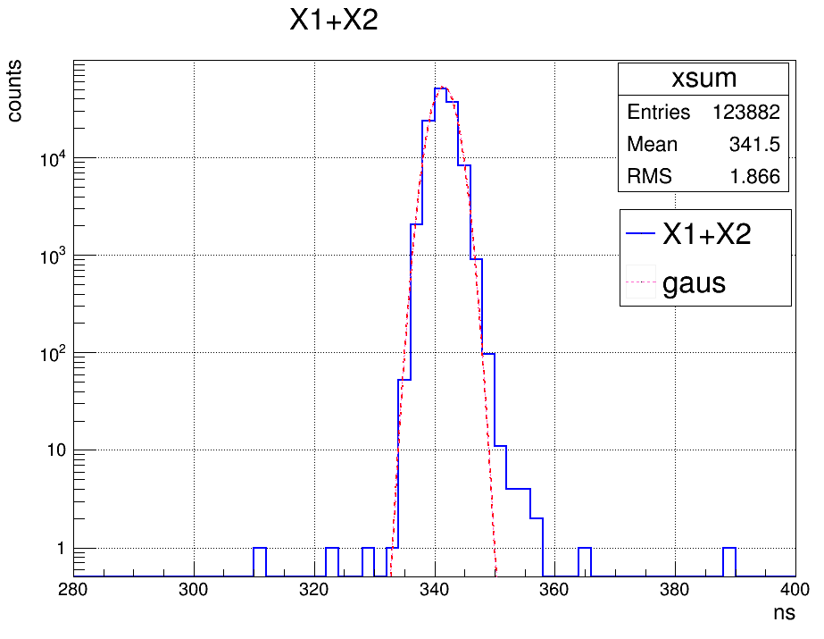
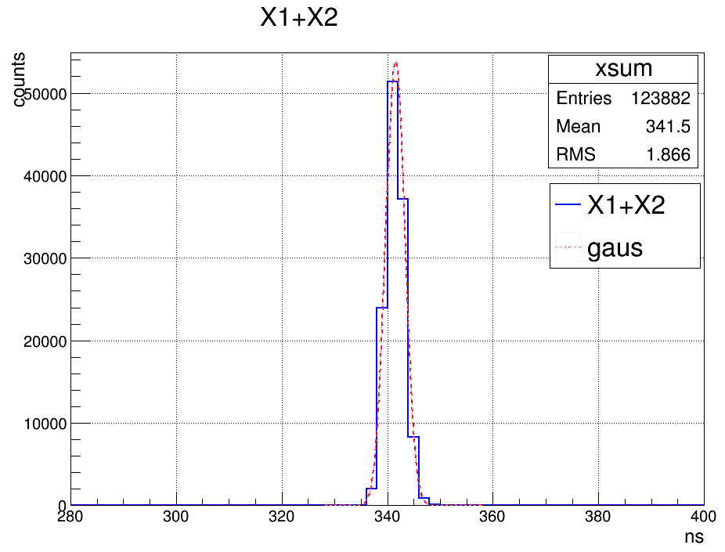
CaDeLin measurements with detector

Slide 19
References
[ROOT] Brun R, Rademakers F 1997 Nucl. Instrum. Meth. A 389(1) 81-6, See also http://root.cern.ch
[List Mode Standard developments] http://www.iec.ch/dyn/www/f?p=103:23:0::::FSP_ORG_ID,FSP_LANG_ID:1244,25
[DeLiDAQ-1 (the most recent publication)] Litvinenko E I, , Ryukhtin V, Bogdzel A A, Churakov A V, Farkas G, Hervoches Ch, Lukas P, Pilch J, Saroun J, Strunz P, Zhuravlev V V 2017 Upgrade of detectors of neutron instruments at Neutron Physics Laboratory in Řež Nucl. Instruments Methods Phys. Res. A 841 5–11 http://www.sciencedirect.com/science/article/pii/S0168900216310531 (free access to the article until 4-Dec-2016)
[Proton telescope] Milkov V M, Panteleev T T, Bogdzel A, Shvetsov V N, Kutuzov S, Borzakov S B and Sedyshev P V 2012 Physics of Particles and Nuclei Letters 9(6) 508-16
[Caen] http://www.caen.it
Paepen J, Peerani P, Schillebeeckx P, Tomanin A and Wynants R 2013 Use of a CAEN digitiser for nuclear safeguards and security applications with a scintillator detector JRC Sci. Tech. reports JRC87790. doi: 10.2787/87780

