Slide 1

Common STAP meeting
Detectors & Beam Monitors Update
FRANCESCO PISCITELLI on behalf of the detg

Slide 2
COMMON STAP
Overview
Changes to the DetG
Firmware and integration progress
Beam monitor update
Detector update
Closing remarks

Slide 3
COMMON STAP
Overview
Changes to the DetG
Firmware and integration progress
Beam monitor update
Detector update
Closing remarks

Slide 4
Changes to the DetG

Slide 5
Changes to the DetG

Slide 6
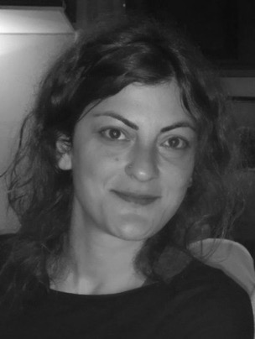
Changes to the DetG
Ourania Sidiropoulou
Transitioning away from BMs (backfill)
Responsible for: BIFROST, CSPEC, MIRACLES, VESPA
TBL He-3 scope remains with Irina Stefanescu

Slide 7
COMMON STAP
Overview
Changes to the DetG
Firmware and integration progress
Beam monitor update
Detector update
Closing remarks

Slide 8
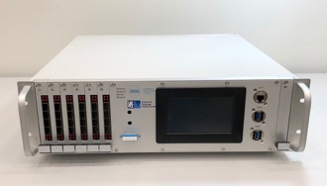
integration, integration, and more integration
  front-end electronics with the RMM
  RMM with the EFU
  IOC-RMM-FEN slow controls (ICS integration)
  LV and HV power supplies
  devices (LV and HV, slow controls) into subsystems (ICS integration)
a subset of this work has commenced, and a dashboard is in the works
DetG / WP12 / ECDC alignment will be the key
front-end
FEN
FEN
FEN
FEN
R1
R0
Readout Master Module (RMM)

Slide 9

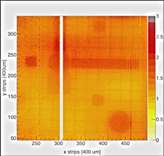
integration efforts
(Frontend
Electronics)
(Backend
Electronics)
clock
server
analog, copper
digital, copper
digital, optical
Readout
Master
Module, RMM
server
BM or
detector
FE
assisters
EPICS
EPICS
env
(clocked detector variables)
LV
EPICS
EPICS
HV
EPICS
gas
EPICS

Slide 10
integration efforts
(Frontend
Electronics)
(Backend
Electronics)
clock
server
analog, copper
digital, copper
digital, optical
Readout
Master
Module, RMM
server
BM or
detector
FE
assisters
EPICS
EPICS
env
(clocked detector variables)
LV
EPICS
EPICS
HV
EPICS

Slide 11
integration efforts
(Frontend
Electronics)
(Backend
Electronics)
front-end electronics with the RMM
clock
server
analog, copper
digital, copper
digital, optical
Readout
Master
Module, RMM
server
BM or
detector
FE
assisters
EPICS
EPICS
env
(clocked detector variables)
LV
EPICS
EPICS
HV
EPICS

Slide 12
RMM with the EFU
integration efforts
(Frontend
Electronics)
(Backend
Electronics)
front-end electronics with the RMM
clock
server
analog, copper
digital, copper
digital, optical
Readout
Master
Module, RMM
server
BM or
detector
FE
assisters
EPICS
EPICS
env
(clocked detector variables)
LV
EPICS
EPICS
HV
EPICS

Slide 13
RMM with the EFU
integration efforts
(Frontend
Electronics)
(Backend
Electronics)
front-end electronics with the RMM
clock
server
analog, copper
digital, copper
digital, optical
Readout
Master
Module, RMM
server
BM or
detector
FE
assisters
EPICS
EPICS
IOC-RMM-FEN slow controls
env
(clocked detector variables)
LV
EPICS
EPICS
HV
EPICS

Slide 14
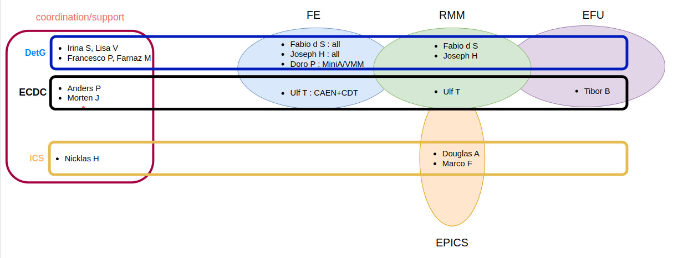
integration efforts
Ioannis K, Nicholai M

Slide 15
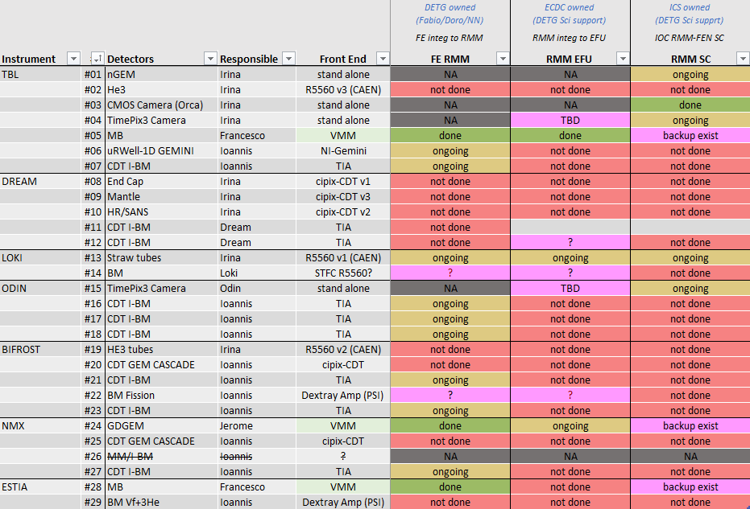
Integration efforts, as of Mar24
front-end electronics with the RMM
RMM with the EFU
IOC-RMM-FEN slow controls

Slide 16
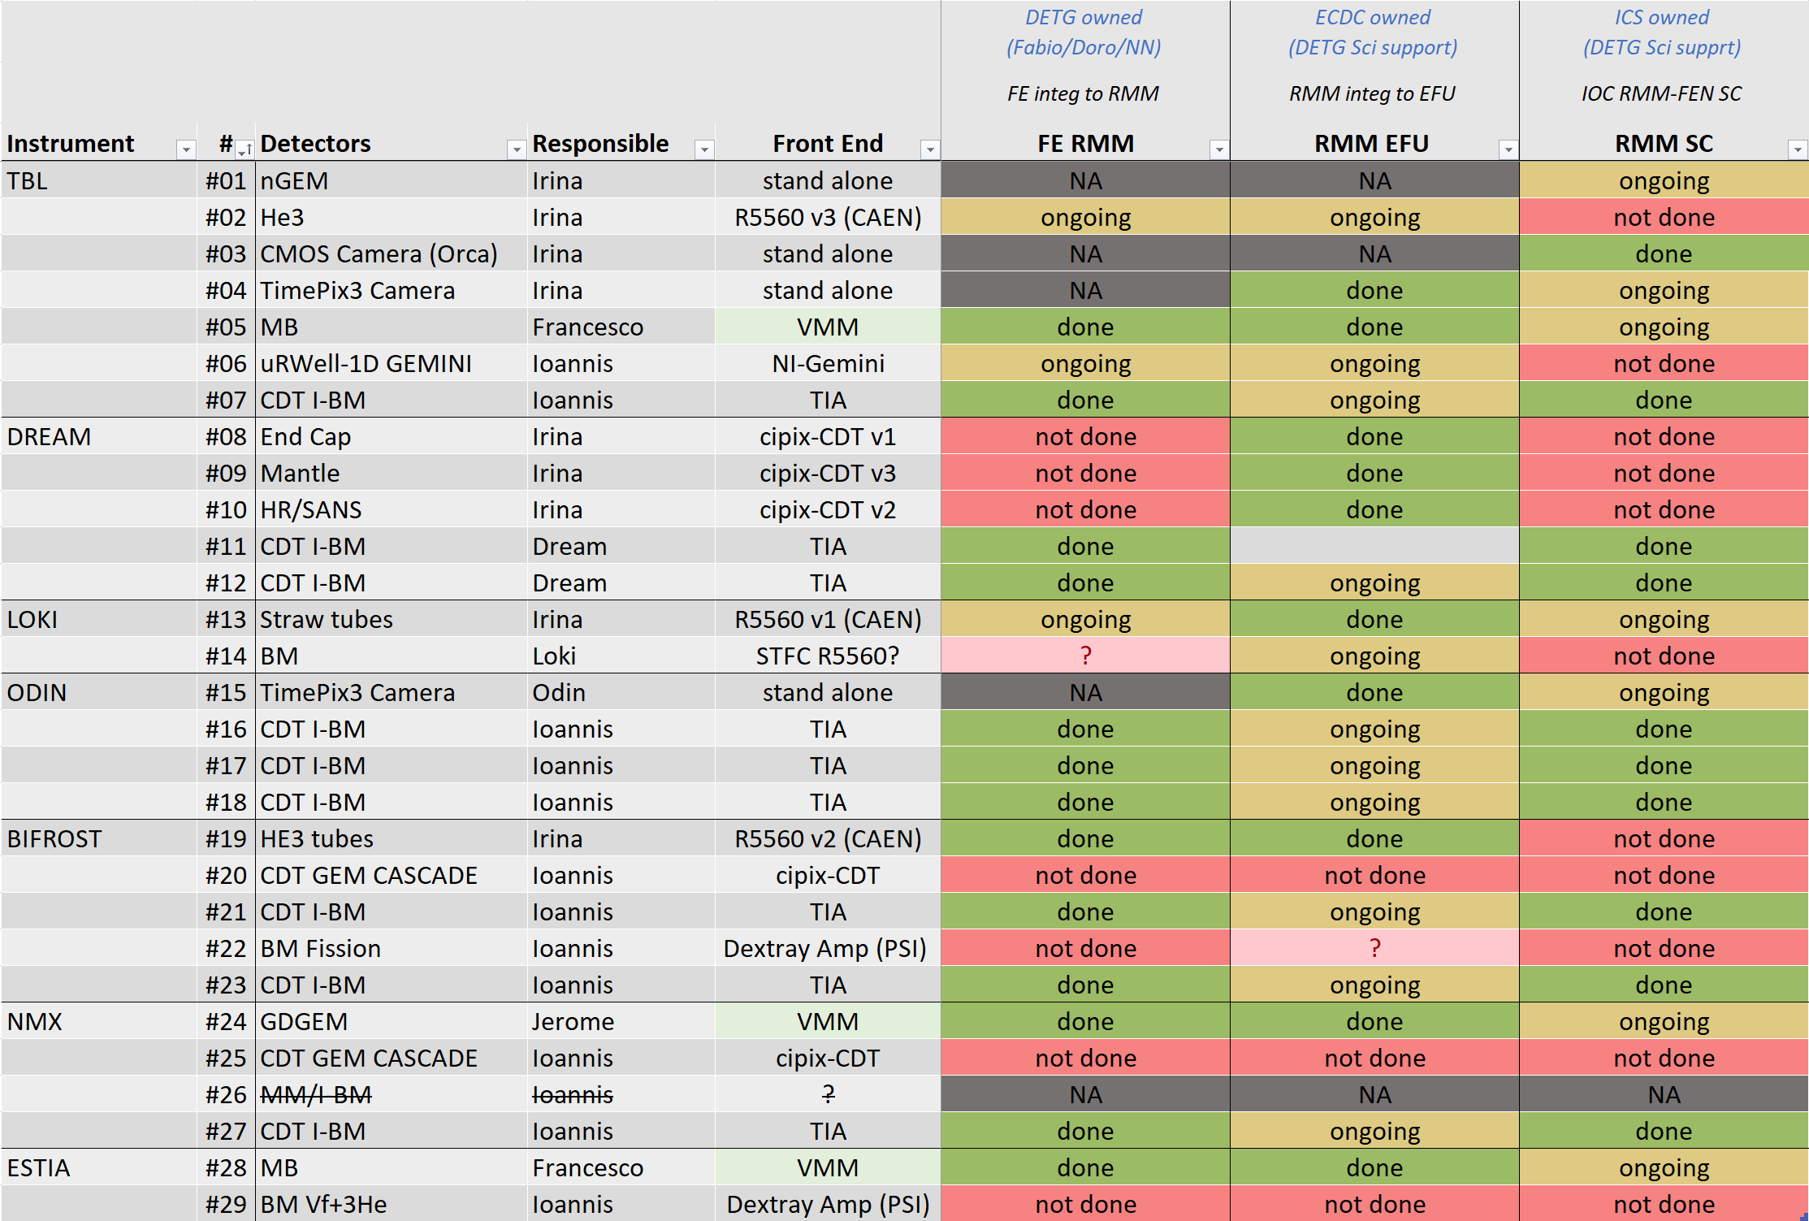
Integration efforts, as of Sep24
front-end electronics with the RMM
RMM with the EFU
IOC-RMM-FEN slow controls

Slide 17
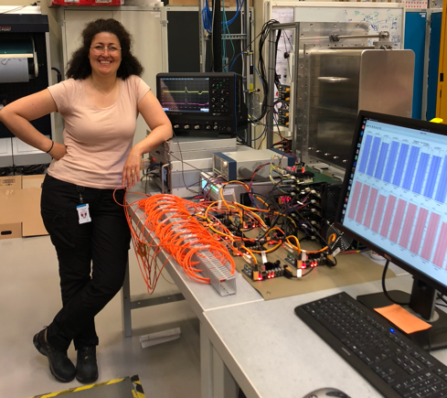
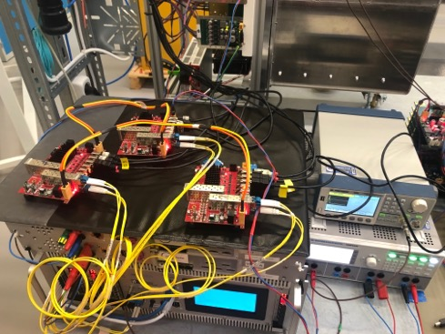
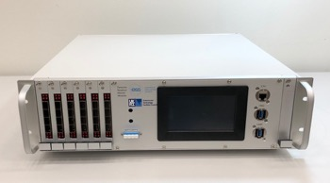
Firmware progress
RMM Firmware v1.1 (not released)
  Added standard networking features for DMSC neutron data Ethernet link
    ARP support to request the EFU MAC address
    Ping support for network diagnosis
  Support for all 12 rings of detector front end electronics
  Support for ICS development of C++ slow control API
Work in Progress
  Moving to Artefactory for release maintenance
  Scaling up testbeds at Utgård to add more front ends
  Ring issues: fibers and SFP connectors needed cleaning

Slide 18
COMMON STAP
Overview
Changes to the DetG
Firmware and integration progress
Beam monitor update
Detector update
Closing remarks

Slide 19
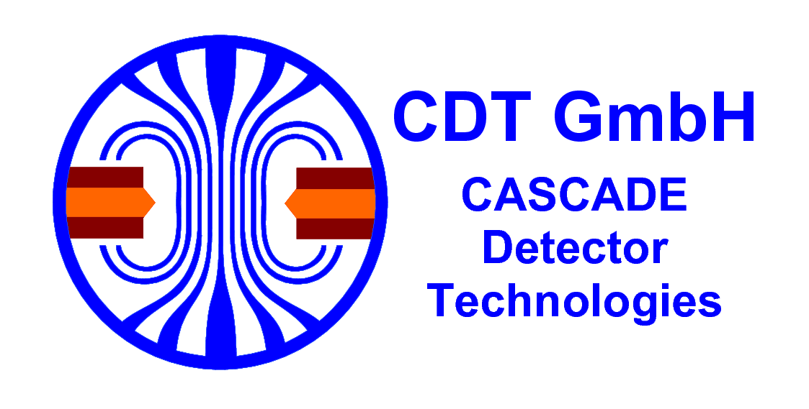

Beam monitors, I-BM, NFM, CASCADE GEM, 1D

Slide 20
Installing an I-BM
How difficult could [it] be?
[it] = install an I-BM
100s of hours of carefully coordinated efforts between 10s of individuals with specialized skillsets spanning several disciplines

Slide 21
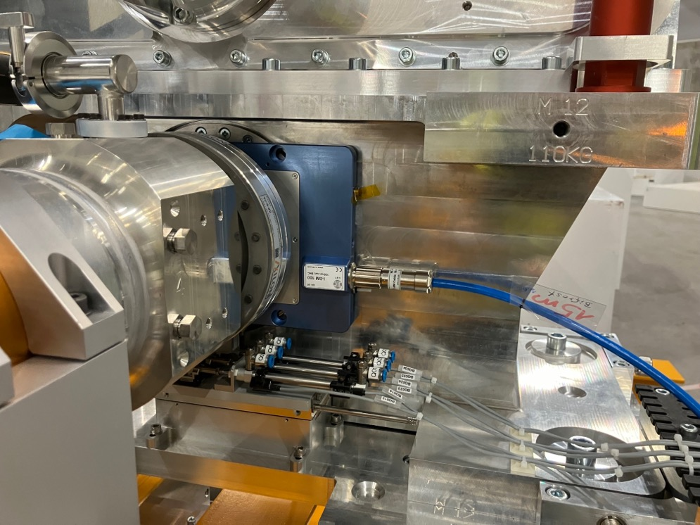
Installing an I-BM
And then it happens…

Slide 22
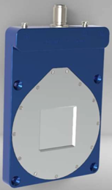
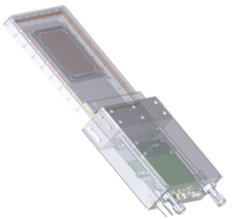
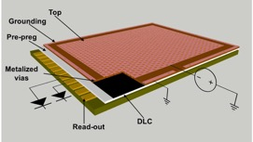
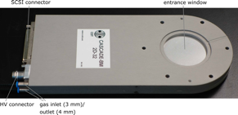
Beam monitors, I-BM, NFM, CASCADE GEM, 1D
Counter, commercial
DetG driven R&D
No in-bunker electronics
Current mode operation
n/γ discrimination
Large dynamic range
Low material budget
CDT I-BM
Counter, DetG with friends
High rate capabilities
Pulse and current mode operation
Adaptable design
Huge dynamic range (singles)
Low material budget
ESS NFM
MicroMegas
ESS 1D
profiler, commercial
High rate capabilities
Pulse mode operation
Current mode operation
Good 2D spatial resolution
CDT CASCADE GEM
profiler, DetG with friends
High rate capabilities
Pulse mode operation
Low material budget
Good 1D spatial resolution
2D GEM
uRWELL

Slide 23

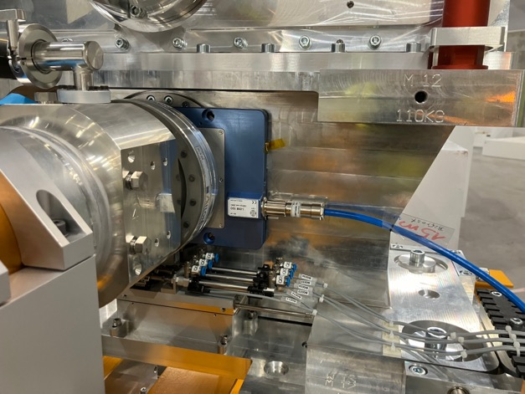

Beam monitors, testing
stress tests O(MGy) of CDT I-BM at IRASM
  vary electronics and mechanical components
  material degradation and failure
  electrode aging
  structural damage
  electrical properties loss
soak tests O(startup) of CDT I-BM at AMOR, PSI
  complete I-BM system including ESS DAQ to be installed to start operation from the next beam cycle
  validate long-term stability and radiation hardness

Slide 24
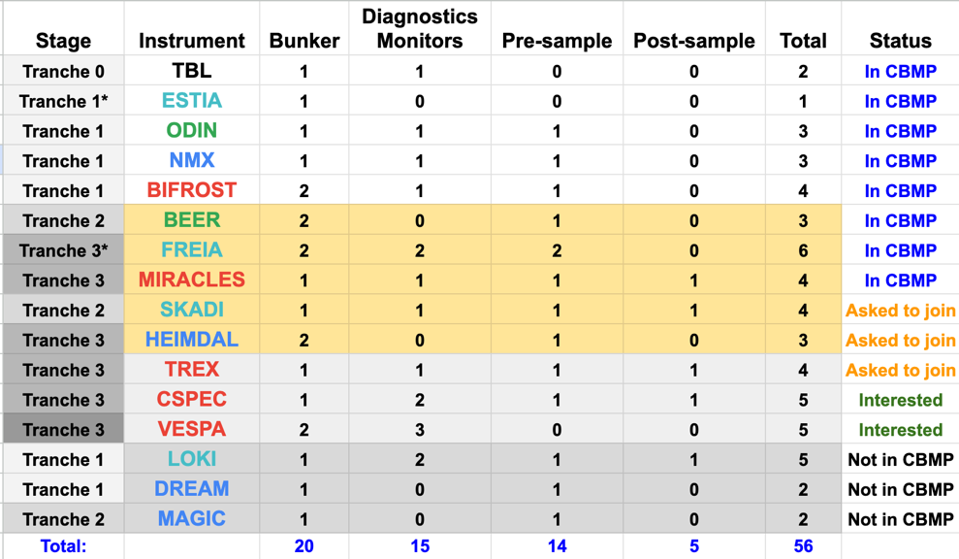
Beam monitors, status
Monitors have been tested, debugged and upgraded for ODIN, TBL, BIFROST, DREAM, MAGIC
T1 planning, procurement, and documentation is being finalized
  Moving towards installation and energization
The T2T3 design phase to start, with a focus on bunker BMs
  NMX, T2, ESS NFM, ESS 1D
Instruments that have not declared their intent to join the CBMP will continue to be included in all discussions until they see the light
2024-10-22
24

Slide 25
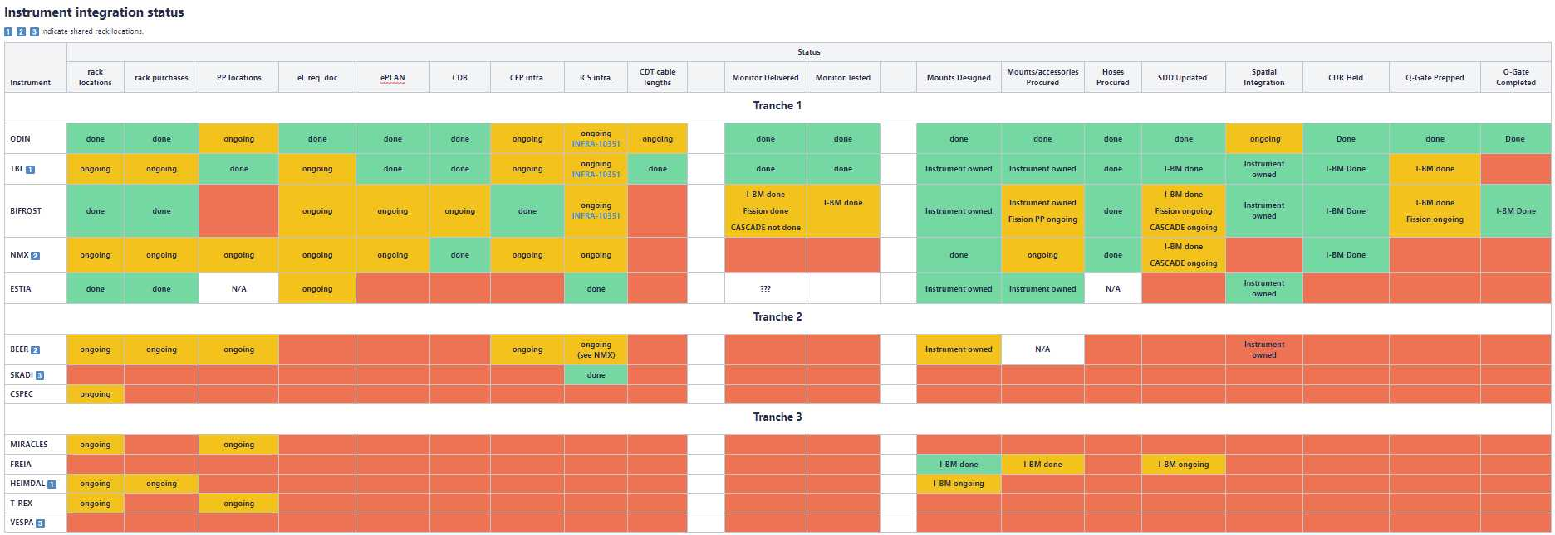
Beam monitors, status
Complete CBMP details at https://confluence.esss.lu.se/x/piKhEQ
2024-10-22
25

Slide 26
COMMON STAP
Overview
Changes to the DetG
Firmware and integration progress
Beam monitor update
Detector update
Closing remarks

Slide 27
Detector technology breakdown
B4C
Closed tubes; Jalousie; MultiBlade; MultiGrid; planes
LOKI; DREAM, MAGIC, HEIMDAL; TBL, ESTIA, FREIA; T-REX; BEER
He-3
Closed tubes; Multitube
TBL, BIFROST, MIRACLES, VESPA; CSPEC
GEM
nGEM; GdGEM
TBL; NMX
Cameras and scintillators
CMOS, TimePix3; SoNDe
TBL, ODIN; SKADI

Slide 28
Detector technology breakdown
B4C
Closed tubes; Jalousie; MultiBlade; MultiGrid; planes
LOKI; DREAM, MAGIC, HEIMDAL; TBL, ESTIA, FREIA; T-REX; BEER
He-3
Closed tubes; Multitube
TBL, BIFROST, MIRACLES, VESPA; CSPEC
GEM
nGEM; GdGEM
TBL; NMX
Cameras and scintillators
CMOS, TimePix3; SoNDe
TBL, ODIN; SKADI

Slide 29

B4C, Closed tubes, LOKI (T1)
InKind: sealed resistive wire tubes

Slide 30
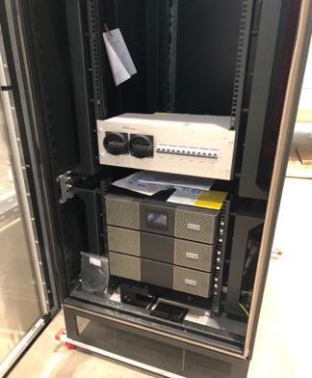
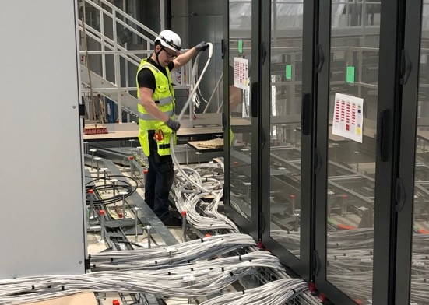
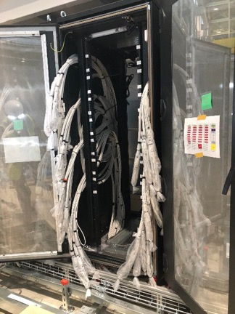
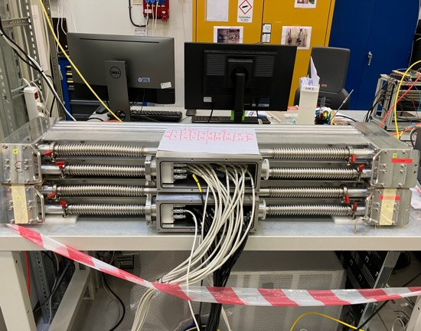
B4C, Closed tubes, LOKI (T1)
Installation of the UPS system in the detector Master rack complete
Cable installation well underway
Documentation for the energization of the detector Master rack under preparation
9-ring operation of the RMM with 3 CAEN 5560 digitizers under testing
Detector EPICS slow controls under testing

Slide 31
B4C, Jalousie, DREAM, MAGIC, HEIMDAL
InKind: MWPCs at shallow inclination angles

Slide 32
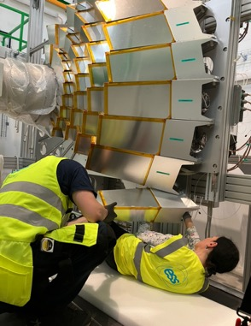
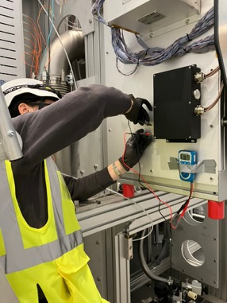
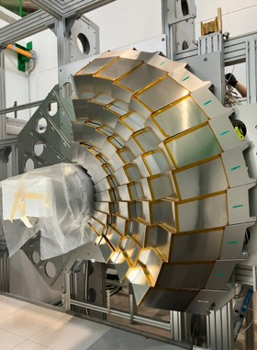
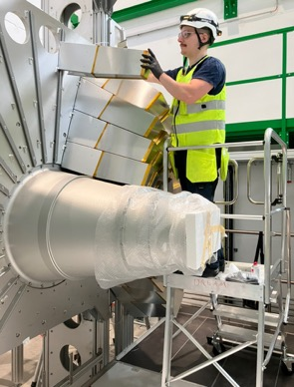
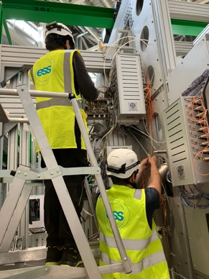
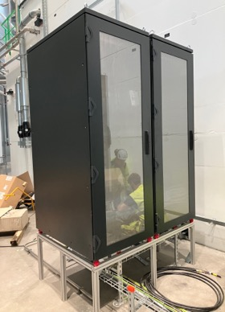
B4C, Jalousie, DREAM (T1)
EndCap and high-resolution modules installed
  In situ ground and connectivity tests performed
Detector racks installed in the final positions
  UPS installation in detector Master rack ongoing
Eplan for the detector racks completed
Detector cable installation to start soon

Slide 33
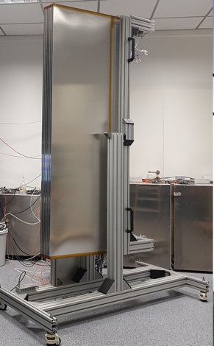
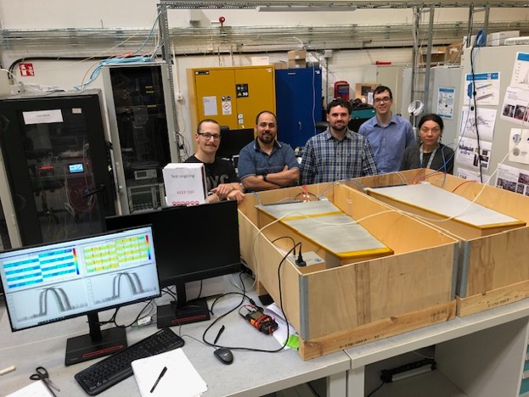
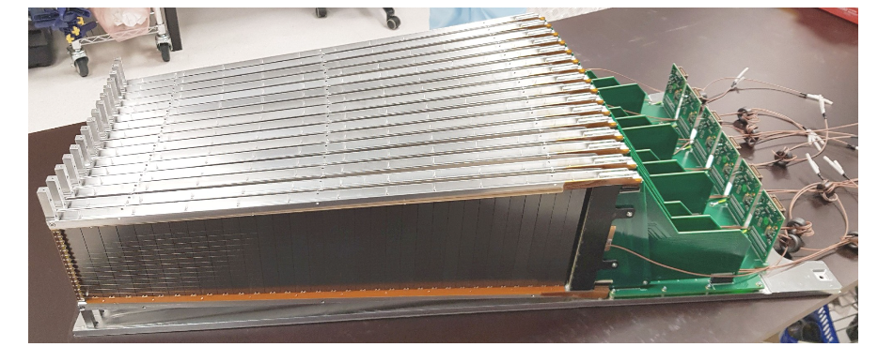
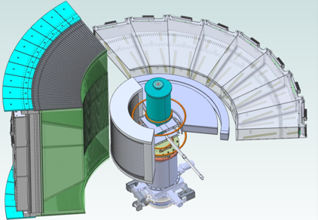
B4C, Jalousie, MAGIC (T2)
MAGIC-A detector modules are under construction at CDT
MAGIC-B detectors in hand, SIT approved
  16 segments: 16 anode wires, 16 cathode strips
  64 ch CIPix ASICs
A
B
A
B

Slide 34
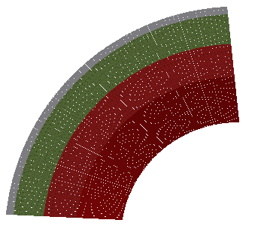
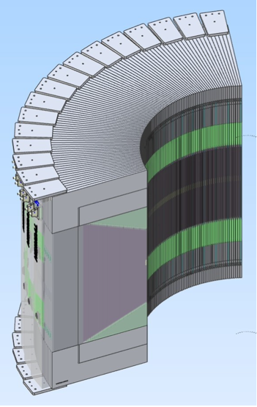
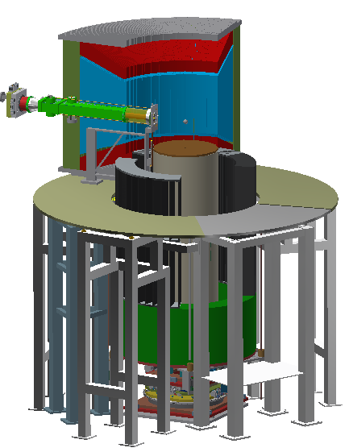
B4C, Jalousie, HEIMDAL (T3)
Detector design very similar to MAGIC-A
12 (day1) + 22 = 34 modules, 6.7 deg segments, 81.6° in 2θ and 44° in φ
Detector IDR held Jun24, sub-TG3 Nov24
Bi-weekly detector delivery meetings have commenced

Slide 35
B4C, Multi-Blade, TBL, (AMOR-PSI), ESTIA, FREIA
DetG: MWPCs at shallow inclination angles

Slide 36
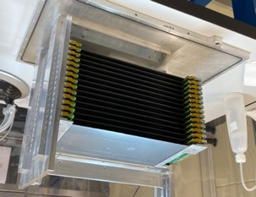
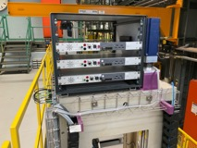
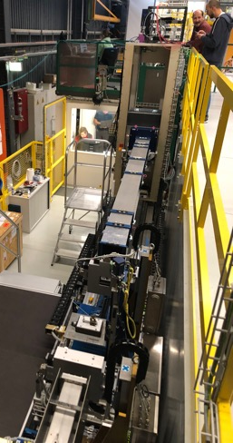
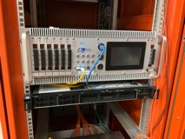
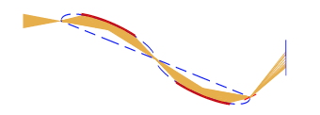
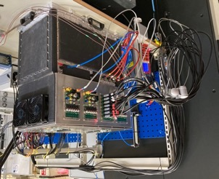
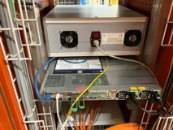
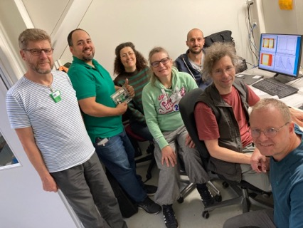
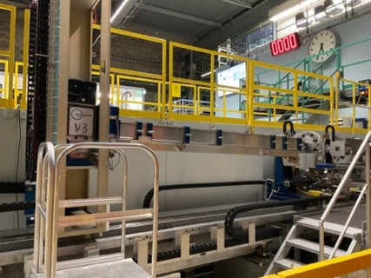
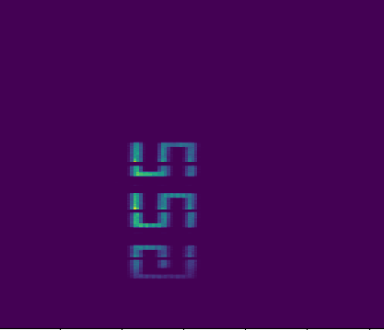
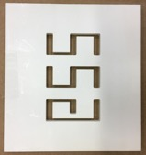
B4C, Multiblade, MB.AMOR
1:1 MB.TBL detector
complete VMM3a readout and entire ESS data chain including EFU, fully integrated
Science since Nov23
NiTi
ϑ
λ

Slide 37
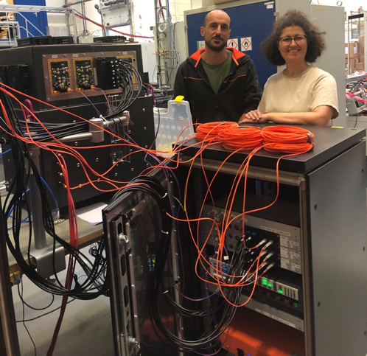
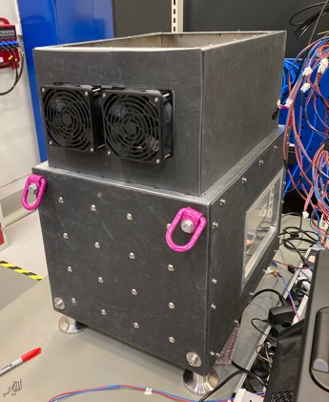
B4C, Multiblade, MB.TBL (T1)
1:1 MB.AMOR detector
E-plan completed
CDR completed
Q-gate underway
Detector and Assister Racks assembled
Detector commissioned with complete readout and data chains at PSI
Installation foreseen Nov 2024

Slide 38
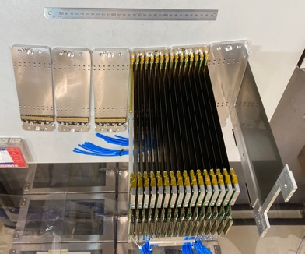
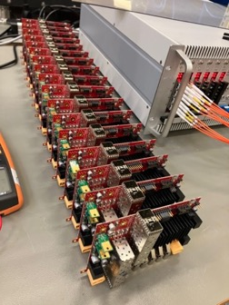




B4C, Multiblade, MB.ESTIA (T2)
The biggest DetG build to date
Taking us to our present build limit

Slide 39



B4C, Multiblade, MB.ESTIA (T2)
The biggest DetG build to date
Taking us to our present build limit

Slide 40






B4C, Multiblade, MB.FREIA (T3)
All blades produced and tested
Preliminary design complete
Detailed design Jan25

Slide 41
B4C, Multigrid, T-REX (T3)
DetG: Voxelated proportional chamber

Slide 42


B4C, Multigrid, T-REX (T3)
Exhaustive simulation suite (including electronics) completed
  internal shielding candidates identified
  clear pulse-position within voxel signal dependence identified
Electronics study nearing completion, input from simulations, resolution implications
Notes:
Convoluted neural network? CNN

Slide 43



B4C, Multigrid, T-REX (T3)
MERLIN
EMMA
EMMA
Sep 2024
Oct 2024
Nov 2024
Dec 2024
Internal shielding
Electronics
Prototyping and planning for comprehensive testing at EMMA in Dec24 is very mature
Strategic planning, resourcing, and budgeting efforts are converging
Preliminary
Preliminary
Preliminary
Preliminary

Slide 44

B4C, Planes, BEER (T3)
InKind: A stack of 12 planar MWPCs with a delay-line readout

Slide 45



B4C, Planes, BEER (T3)
detector has been realized
electrical design of the detector Master rack will start in the upcoming weeks
synched with the CEP design work for the electrical infrastructure
The HEREON detector team will ship a copy of the custom readout hardware to ESS to allow for integration work to begin

Slide 46
Detector technology breakdown
B4C
Closed tubes; Jalousie; MultiBlade; MultiGrid; planes
LOKI; DREAM, MAGIC, HEIMDAL; TBL, ESTIA, FREIA; T-REX; BEER
He-3
Closed tubes; Multitube
TBL, BIFROST, MIRACLES, VESPA; CSPEC
GEM
nGEM; GdGEM
TBL; NMX
Cameras and scintillators
CMOS, TimePix3; SoNDe
TBL, ODIN; SKADI

Slide 47



He-3, Closed tubes, TBL, BIFROST, MIRACLES, VESPA
InKind: sealed resistive wire tubes with various pressures

Slide 48

He-3, Closed tubes, TBL (T1)
Two 4-pack He-3 modules (1 bar and 10 bar) assembled and under commissioning at Utgård
module integration into the ESS data pipeline ongoing
E-plan for the detector racks completed
CDR underway, Q-gate to follow

Slide 49



He-3, Closed tubes, BIFROST (T1)
45 triplets of triplets of ½” by ~1’ 10 bar He-3 tubes
Triplets are electrically connected and readout via charge-sensitive preamps from ILL
Frontend based on the CAEN R5560 digitizer will be employed
First instrument for much of the documentation and Q efforts, respect

Slide 50


He-3, Closed tubes, MIRACLES (T3)
96 ½” by ~152 mm, 10 bar He-3 tubes
Complete CAEN electronics instrumentation chain with lots of overlap with earlier instruments

Slide 51

He-3, Multitube, CSPEC
InKind: resistive wire tubes supporting top-up

Slide 52


He-3, Multitube, CSPEC (T3)
12+1 modules
32 1” by 3500 mm tubes per module, 2.5 bar initially in 7 modules
Frontend electronics overlap with BIFROST (ILL preamps and CAEN R5560 digitizers)
HV overlaps with Multiblade and LOKI
module

Slide 53
Detector technology breakdown
B4C
Closed tubes; Jalousie; MultiBlade; MultiGrid; planes
LOKI; DREAM, MAGIC, HEIMDAL; TBL, ESTIA, FREIA; T-REX; BEER
He-3
Closed tubes; Multitube
TBL, BIFROST, MIRACLES, VESPA; CSPEC
GEM
nGEM; GdGEM
TBL; NMX
Cameras and scintillators
CMOS, TimePix3; SoNDe
TBL, ODIN; SKADI

Slide 54

GEMs, nGEM, GdGEM
InKind: nGEM using B4C neutron converter
DetG: GdGEM using Gd neutron converter

Slide 55

GEMs, nGEM, TBL (T1)
E-plan for the detector rack completed
Integration into the ESS data pipeline ongoing

Slide 56



Mini-assister card
GEMs, GdGEM, NMX (T1)
Jerome has relocated to Lund from CERN
Development continues at CERN
Main effort: chasing noise in the readout electronics to permit as low an operating threshold as possible
LV card
Cooling
hybrids
Box with robot mount

Slide 57
Detector technology breakdown
B4C
Closed tubes; Jalousie; MultiBlade; MultiGrid; planes
LOKI; DREAM, MAGIC, HEIMDAL; TBL, ESTIA, FREIA; T-REX; BEER
He-3
Closed tubes; Multitube
TBL, BIFROST, MIRACLES, VESPA; CSPEC
GEM
nGEM; GdGEM
TBL; NMX
Cameras and scintillators
CMOS, TimePix3; SoNDe
TBL, ODIN; SKADI

Slide 58




Cameras and scintillators, CMOS, TimePix3, SoNDe
LumaCAM
InKind: CMOS whitebeam camera with various scintillators
InKind: TimePix3 with various scintillators
InKind: SoNDe Li-glass sheets on MAPMTs

Slide 59


Cameras, CMOS, TBL (T1), ODIN (T1)
White-beam detectors
  Camera:
    Andor NEO (with drivers, boxes from PSI), Hamamatsu?
  Scintillators:
    Gd₂O₂S, ⁶LiF/ZnS(Ag)
    (>10 samples)
Control interface design, EPICs integration well underway
  ECDC/ICS efforts at YMIR
Detector rack and UPS system installed for ODIN

Slide 60
Cameras, TimePix3, TBL (T1), ODIN (T1)
Time-of-flight detector (TimePix3)
  TPX3CAM for early operations
  Scintillators:
    Gd₂O₂S, ⁶LiF/ZnS(Ag) (>10 samples)
Operational experience collected
  DetG participated in KT with TBL team at ISIS Nov23
  Benchmark data set obtained for ECDC software development efforts

Slide 61



Scintillators, SoNDe, SKADI (T2)
A SoNDe tile consists of
  Four 64 pixel Hamamatsu MAPMTs
  2 X 2 MAPMT configuration
  each MAPMT observes a single 1 mm GS20 wafer
SoNDe tiles are readout using concentrator boards
  IDEAS product, four FPGAs per board
SNS measurement program Aug24
  Employ a 1 X 5 tile configuration, 2 X 10 MAPMTs
  measure SANS images with the scattering center and scattering image recorded as one
  perform time synchronization tests
Results are eagerly awaited by DetG

Slide 62
COMMON STAP
Overview
Changes to the DetG
Firmware and integration progress
Beam monitor update
Detector update
Closing remarks

Slide 63
COMMON STAP
Closing remarks
1. What’s with all the logos?

Slide 64




COMMON STAP
Closing remarks
1. What’s with all the logos?
LumaCAM

Slide 65
COMMON STAP
Closing remarks
1. What’s with all the logos?
  DetG scope is challenging: large scale R&D projects combined with a vast integration space covering many technologies, suppliers, and partners with many different approaches

Slide 66
COMMON STAP
Closing remarks
1. What’s with all the logos?
  DetG scope is challenging: large scale R&D projects combined with a vast integration space covering many technologies, suppliers, and partners with many different approaches
2. Recent cause for optimism?

Slide 67
COMMON STAP
Closing remarks
1. What’s with all the logos?
  DetG scope is challenging: large scale R&D projects combined with a vast integration space covering many technologies, suppliers, and partners with many different approaches
2. Recent cause for optimism?
INTEGRATION

Slide 68
COMMON STAP
Closing remarks
1. What’s with all the logos?
  DetG scope is challenging: large scale R&D projects combined with a vast integration space covering many technologies, suppliers, and partners with many different approaches
2. Recent cause for optimism?
INTEGRATION

Slide 69
COMMON STAP
Closing remarks
1. What’s with all the logos?
  DetG scope is challenging: large scale R&D projects combined with a vast integration space covering many technologies, suppliers, and partners with many different approaches
2. Recent cause for optimism?
INTEGRATION
What are some of the biggest DetG detector events happening in the near future?

Slide 70



COMMON STAP
Closing remarks
1. What’s with all the logos?
  DetG scope is challenging: large scale R&D projects combined with a vast integration space covering many technologies, suppliers, and partners with many different approaches
2. Recent cause for optimism?
INTEGRATION
What are some of the biggest DetG detector events happening in the near future?
  T-REX activities!
GlaMM24, Nov24, Glasgow
MechDem into can, Sep24, Juelich
MG.EMMA, Dec24, ISIS

Slide 71


