Slide 1
Supporting the Users via the User Office
October 2024

Slide 2
The Research Coordination Office
User Office – Academic & Industrial
User Office Software Collaboration
Policies and Guidelines for ESS Access
Scientific Events
Postgraduate Education Programme
Promote ESS Scientific Activities
Proposal Consultancy
Programme & Grant Management
Stakeholder Relations
Access Scientific Content
Request Resources
View KPI’s

Slide 3
The User Journey
Users notify ESS of team
User training
Experiment safety review
Travel and accommodation
Ship samples
Physical Access
Dosimetry
Feedback
Experiment report
Data curation
Expenses review
Publications
KPIs
Submit proposals
Technical review
Excellence review
Result notification
Registration
Proposal
Scheduling
Planning
Performing & Analysing
Wrap-up & Harvesting
Register
Personal Data
Digital Access
Experiments
Sample environments
Local contacts
User lab facilities
Experiment notification
Data directories in place
Automatic data processing
Manual data processing

Slide 4
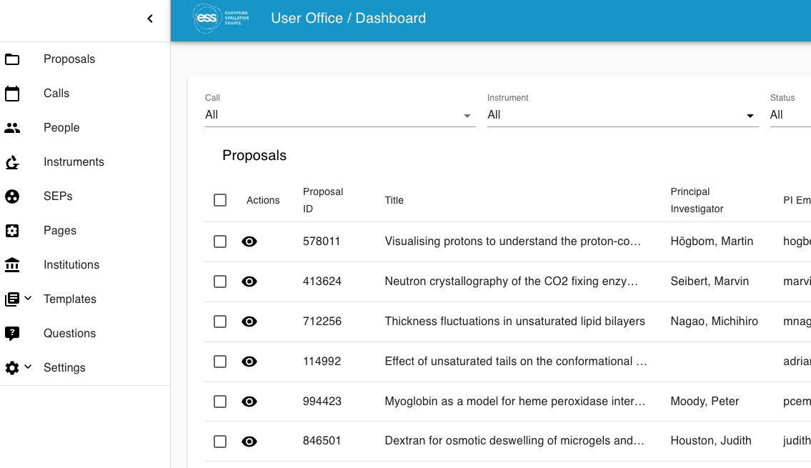
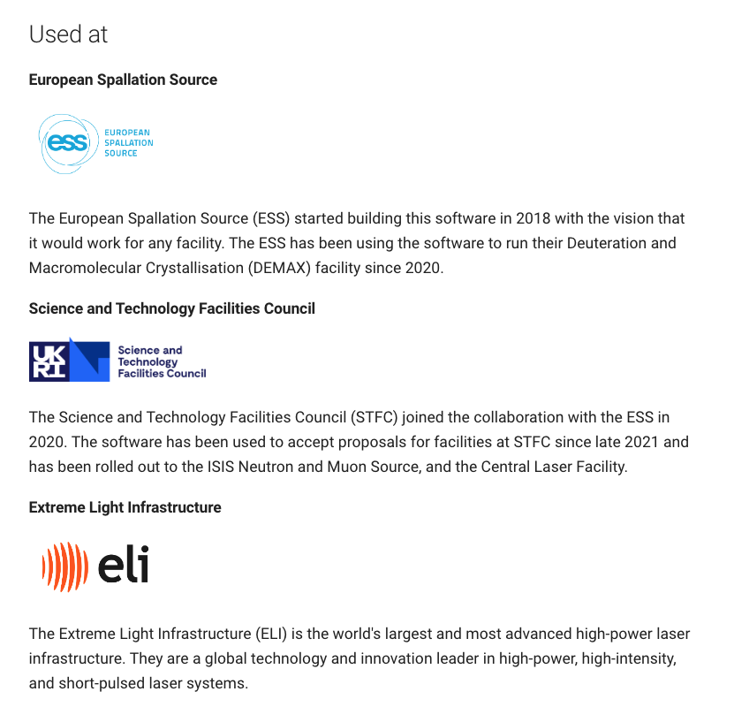
User Office Software

Slide 5
User Focused
Dynamic
Integrated
Virtually nothing is hard coded. Templating tools are simple to use by non-software developers giving flexibility to changes.
Providing a clean, simple to navigate and use system for participants in user access.
Providing an access point to all elements of the user journey from registration to data curation.

Slide 6
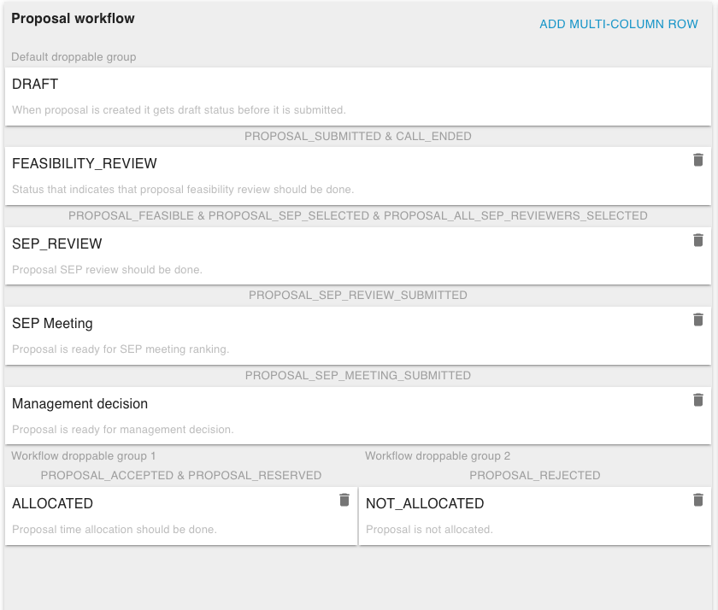
Proposal Management
Fully editable proposal questions template and proposal workflows give enormous flexibility
FAP_REVIEW
Peer reviews collected digitally in software
FAP_MEETING
Reviewers meet on site or digitally to rank proposals
ESS management makes the final selection of proposals
Workflows can branch to allow for multiple outcomes from the review

Slide 7
Scheduling
The data policy states that:
Basic proposal information (proposal title, abstract and sample composition) will become publically accessible once the experiment is scheduled.
Instruments
Sample Environments
Local Contacts
SIMS and RCO team testing
Instrument Scientists demo
Development on-going
Other Resources

Slide 8
Experiment Planning
User Logistics
Experiment Safety Review
User Training
Shipping
Samples
Sample
Tracking

Slide 9
Wrap up and Data Harvesting
Feedback Survey
Experiment Report
Data DOIs
Publication DOIs

Slide 10
Owning the Journey
Director General
Helmut Schober
Occupational Health Safety & Environment
Radiation Protection
Environment, Safety, Health & Security Division
Ola Dahlborg
Quality and Compliance Division
Mattias Skafar
Safety Training
Operations and Machine Directorate
Kevin Jones
Science Directorate
Giovanna Fragneto
Project Directorate
Andrew Kimber
Administration Directorate
Anders Ihr
IT Operations & Support
Instrument Divisions
Communications Group
Service Support
Scientific Support Division
Finance & Business Control Division
Accelerator Division
Data Management & Software Centre
Supply, Procurement & Logistics Division
Research Coordination Office

Slide 11
Finish presentation

