Slide 1
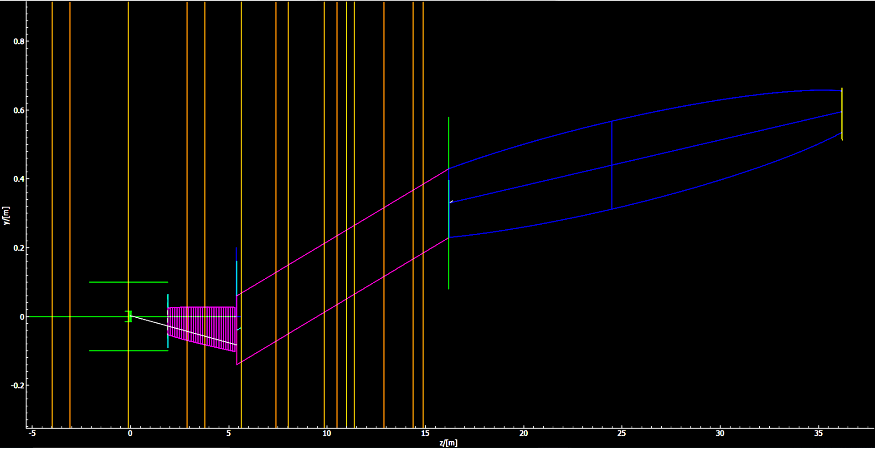
Beam geometry being evaluated
Elliptical guide
Straight guide
Monolith
Source

Slide 2
Straight guide m=3.25 omega=0.9, followed by elliptical guide with entrance and exit dimensions 0.2mx0.2m
DISCLAIMER: OPTIMISATION STILL ON GOING, VERY PRELIMINARY
M-value | 2.50 | 3.00 | 3.25 | 4.00
Rotation [deg] | 2.4 | 1.15 | 1.15
Percentage 8.85-8.95* [%] | 1.8 | 1.8 | 1.7
Percentage 8.8-9.0 [%] | 3.5 | 3.5 | 3.5
Flux @ 8.9 Å** [n/s/cm^2/Å] | 2.82e7 | 2.92e7 | 2.88e7
Normalised flux @ 8.9 Å [n/s/cm^2/Å/MW] | 5.64e6 | 5.84e6 | 5.76e6
Divergence | Slide 5 | Slide 4 | Slide 3
*Refers to how large a percentage of the total intensity is contributed by neutrons with wavelength 8.85 Å to 8.95 Å
** flux is calculated by taking the intensity at 8.9Å divided by the distance between bins and then by area 0.2m*0.2m

Slide 3
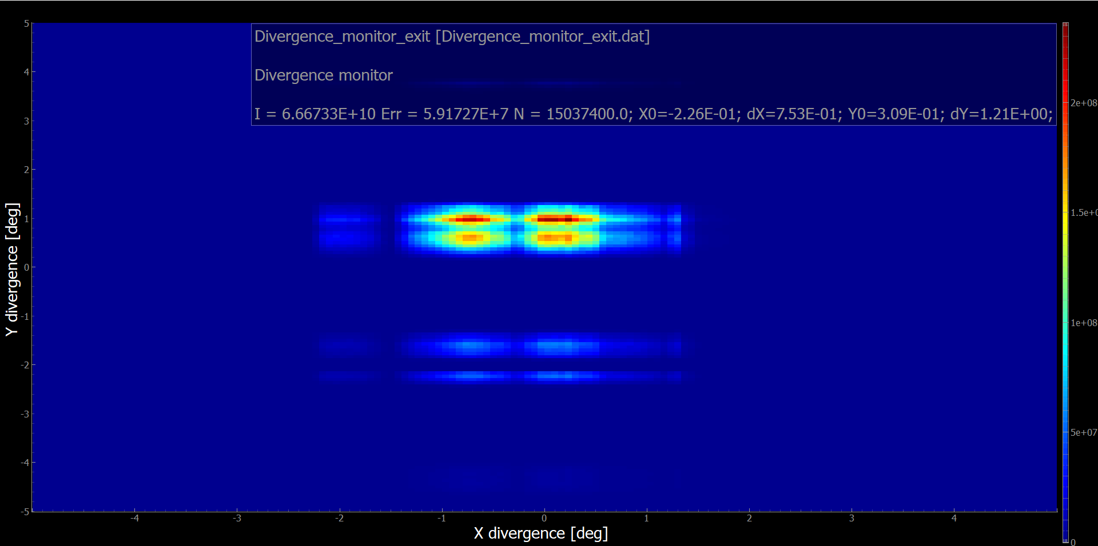
Rotation is 1.15 degrees

Slide 4
Rotation is 1.15 degrees

Slide 5
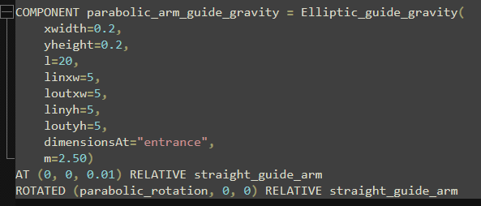
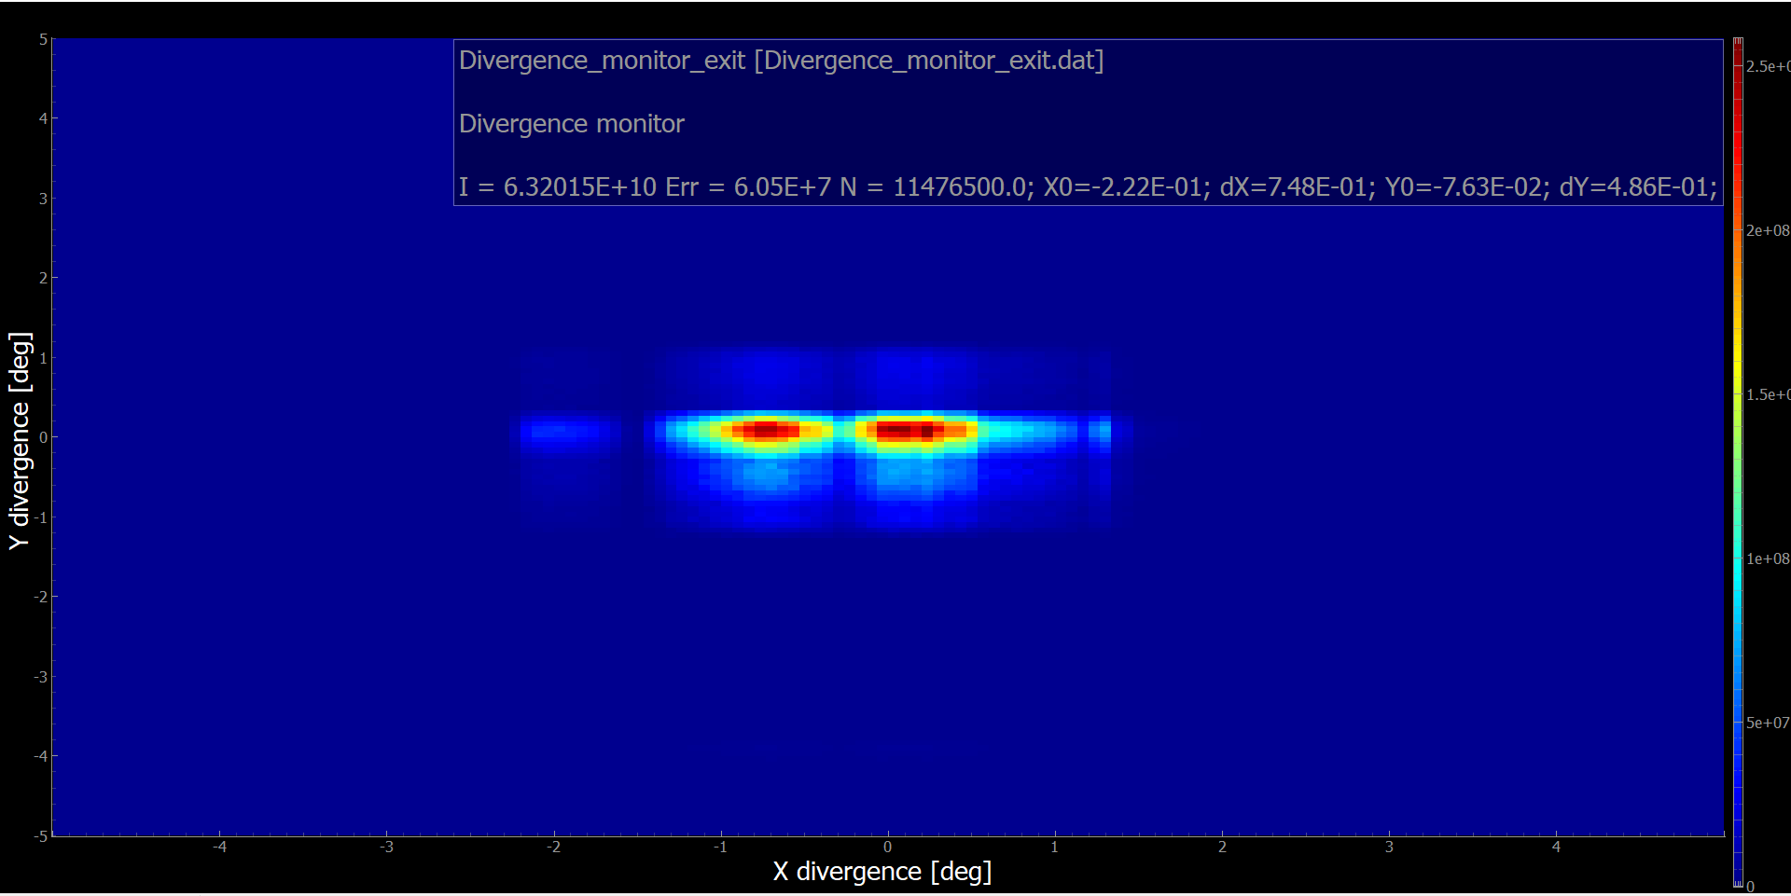
Rotation is 2.4 degrees

Slide 6
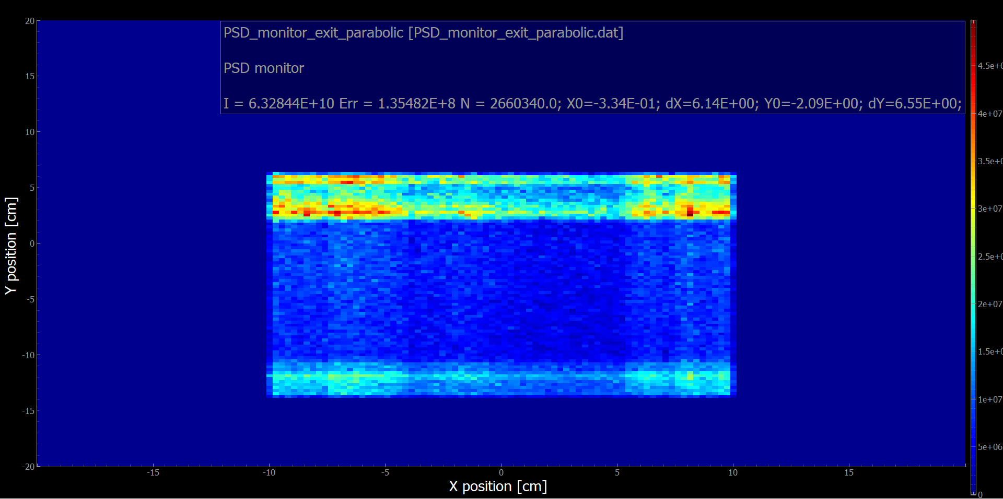
Red outline is the area the flux was calculated over
Black outline is the size of one target

