Slide 1
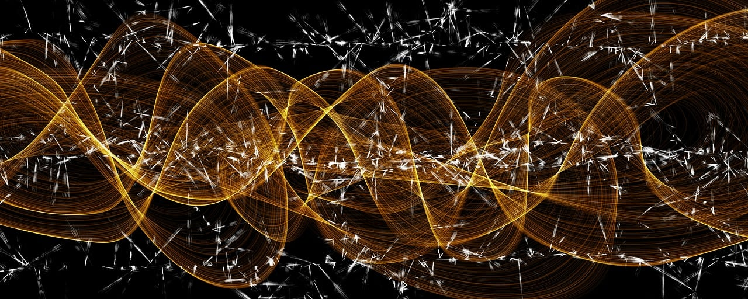
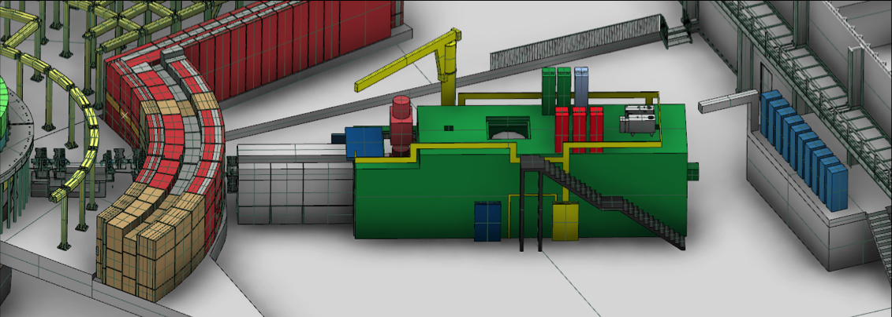
Advanced Readout Technology in LoKI SANS Instrument at European Spallation Source
Andrea Abba
Davide Raspino
Fabio dos Santos Alves
Erik Schooneveld
Nigel Rhodes
Joseph Hindmarsh
Morten Jagd Christensen
Steven Alcock
Harry Walton
Judith Houston
Francesco Caponio
Luca Pastori
Alberto Cusimano
Yuri Venturini

Slide 2
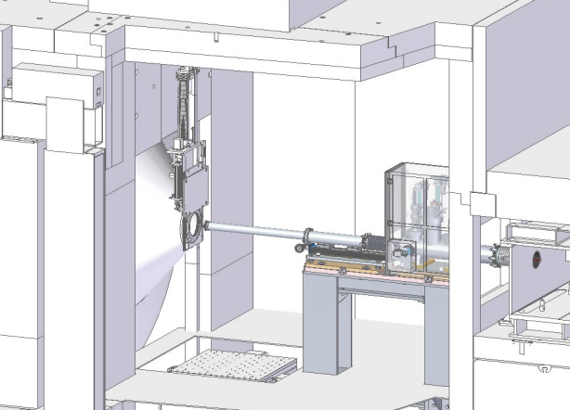
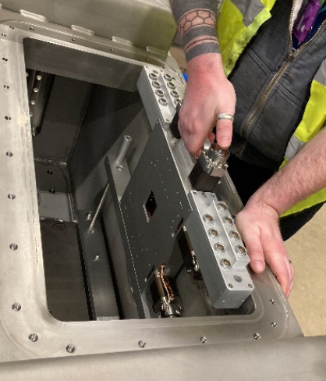
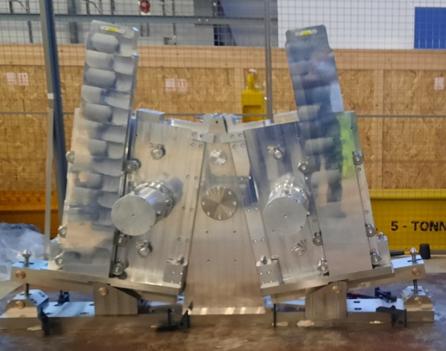
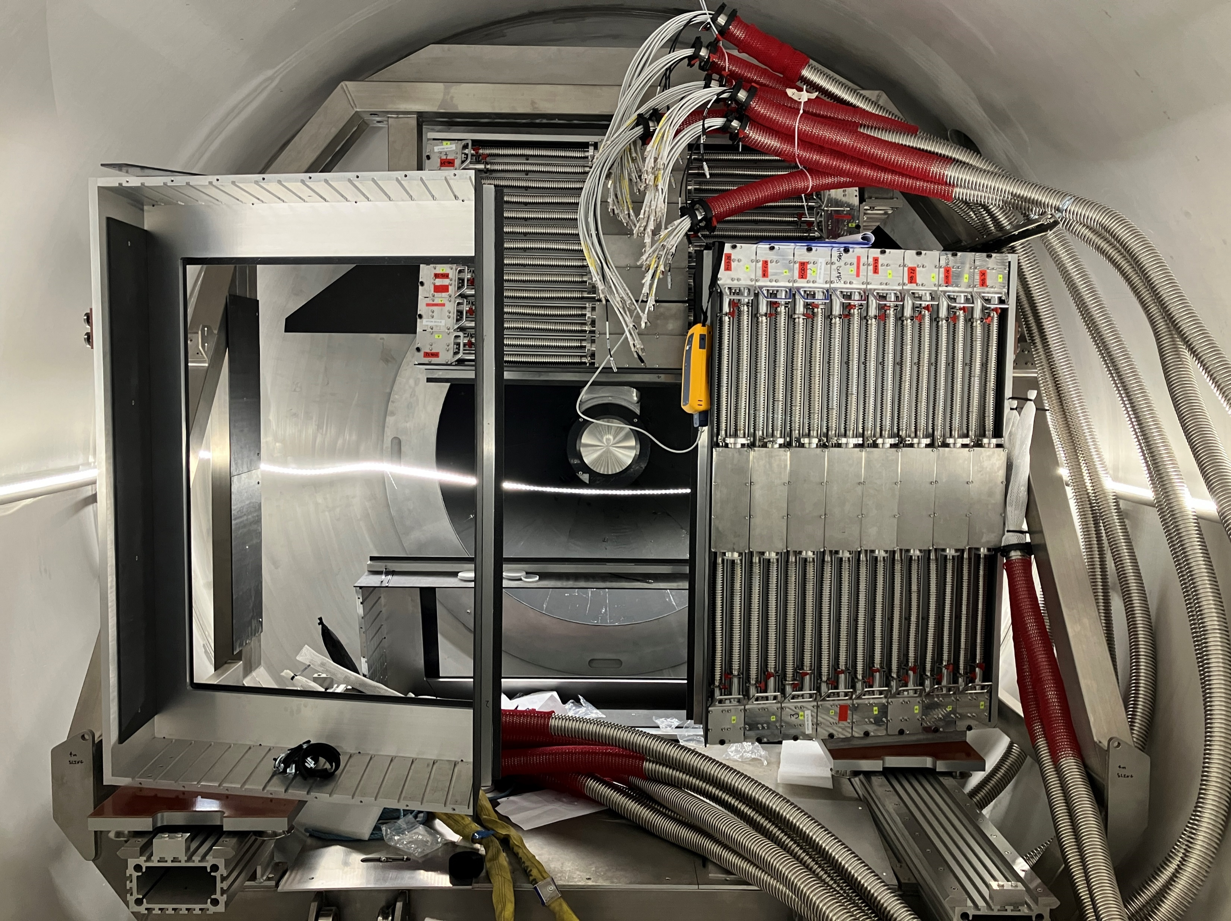
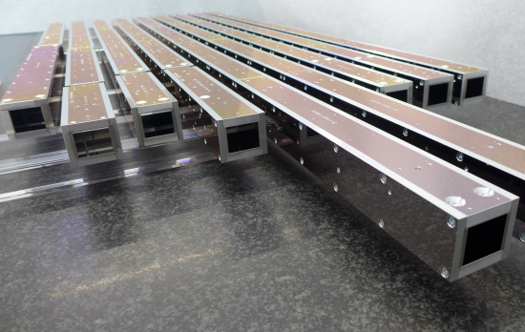
LoKI SANS @ ESS
Beam
Detector System
Sample environment
Collimator
Neutron Guide
Choppers

Slide 3
Loki Readout pipeline
instrument hardware
site infrastructure
DMSC
detectors
readout
event formation
'RM'
EFU
filewriter
storage
data
controls
Lund - CPH
slits
'EPICS'
EPICS
FW
choppers
...
samp. env
NICOS

Slide 4
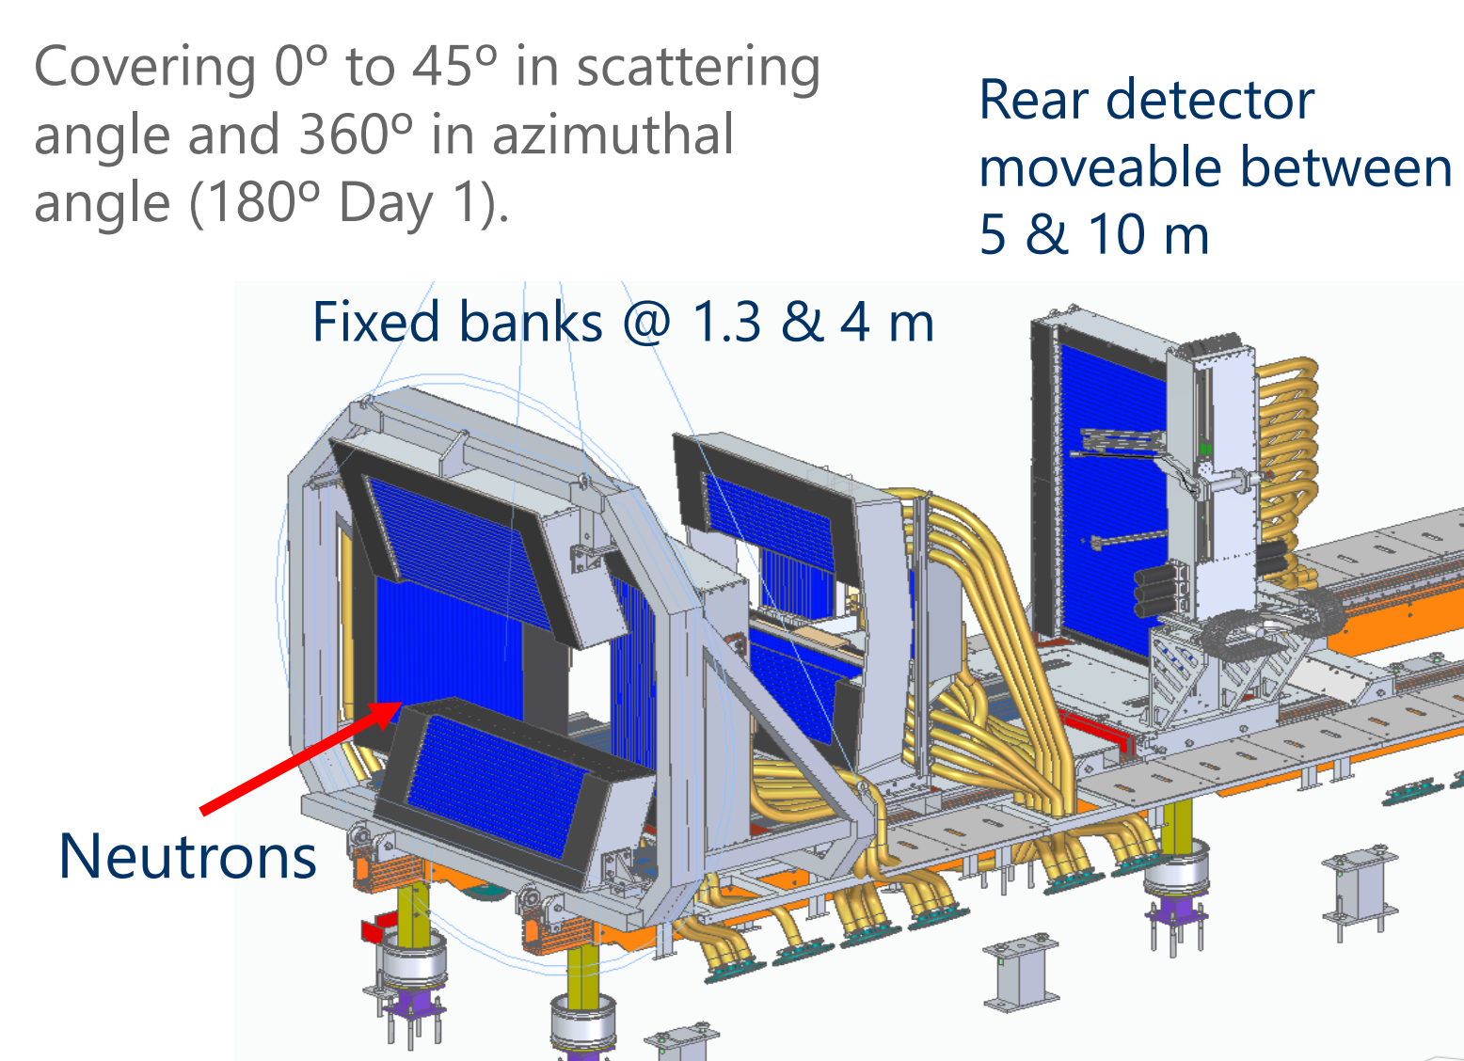
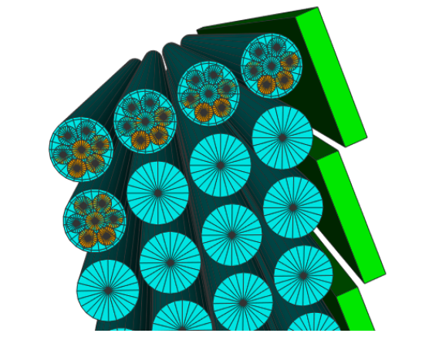
LoKI Detector
4 layers of Al tubes
each containing 7 boron-coated straw detectors
Produced by Proportional Technologies INC.

Slide 5
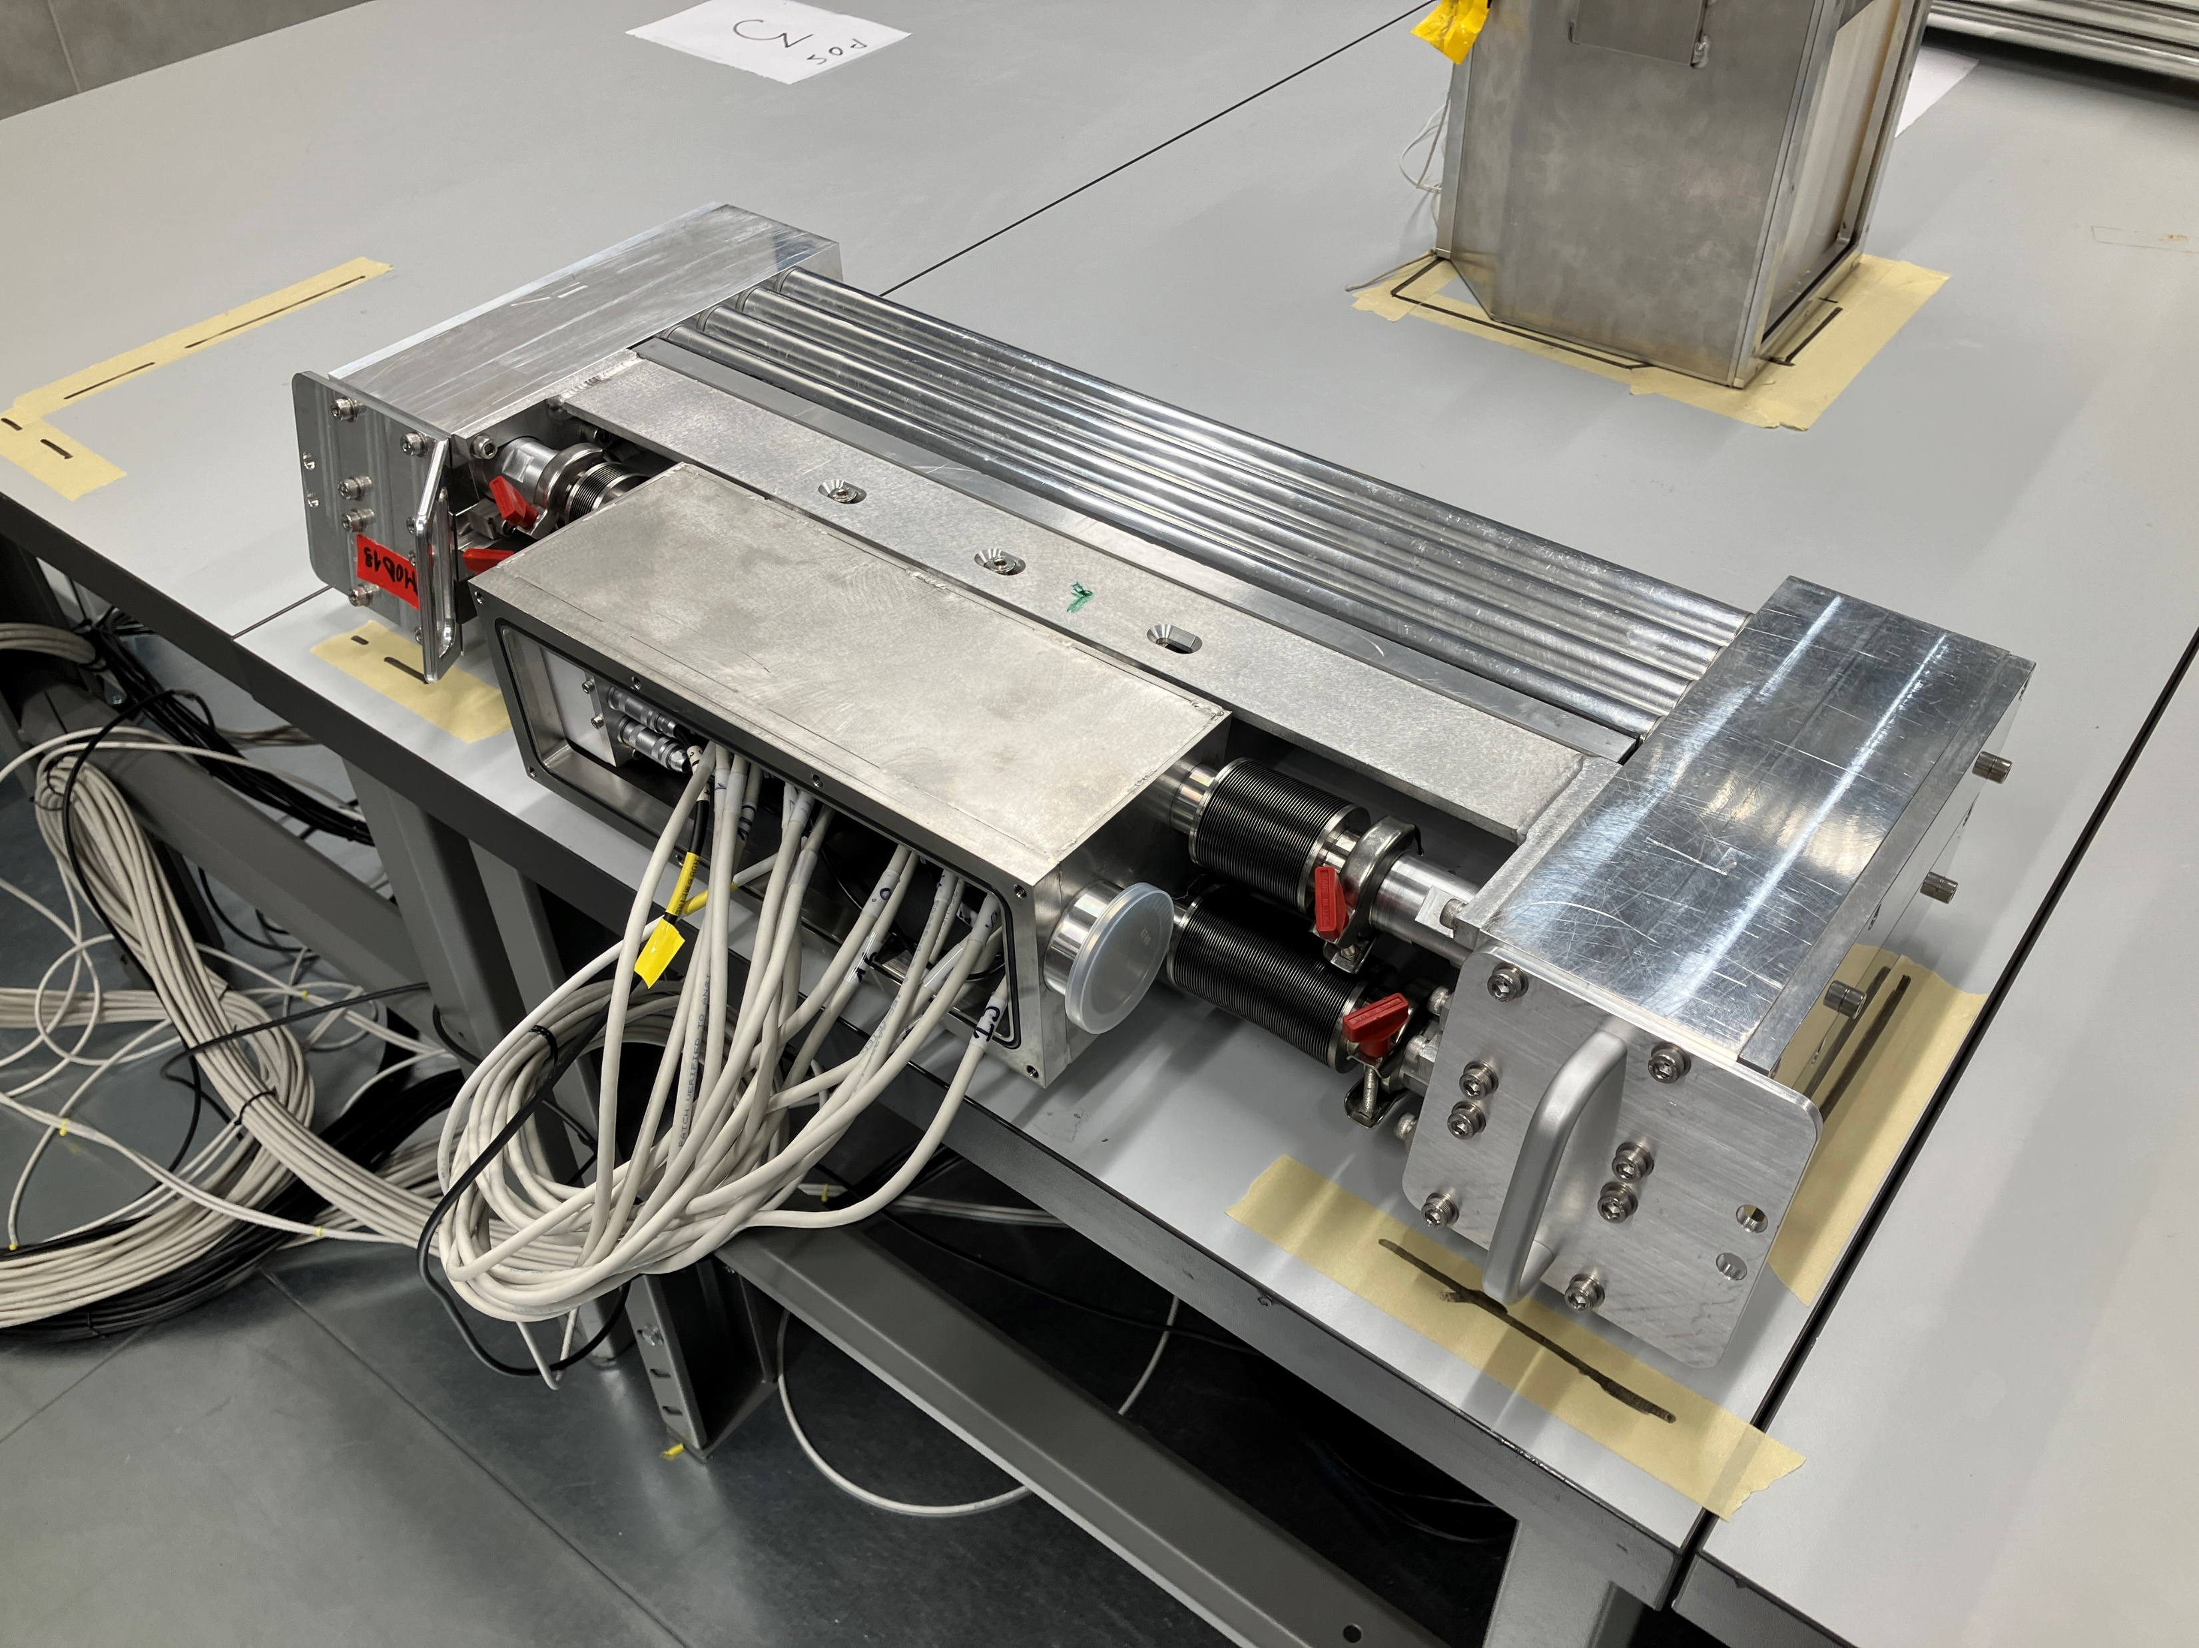
LoKI Detector
Loki detector testing at ESS
Efficiency: ~50%-60% at LoKI wavelength
Position Resolution: FWHM is ~6 mm up to 350 kHz
Rate capability: 15% rate lost at 2.3 MHz

Slide 6
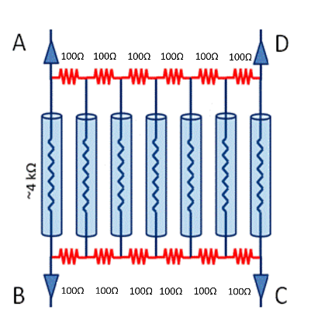
LoKI Straw Tube Readout
This is a resistive divider network connected to each end of the tubes.
As the wires are also resistive, we get charge division in 2 dimensions; one along the wire, the other which straw tube has detected a neutron.
We need only 2 preamp and digitiser channels on each end of the tube, instead of 7 channels (one for each straw tube).
We need in total 4 preamp channels per tube (7 straw tubes).
880 tubes x 7 straws x 256 pixels (binnig) = 1,576,960 pixels

Slide 7
LoKI Straw Tube Readout

Slide 8
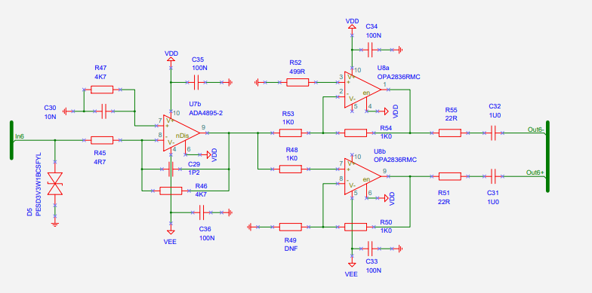
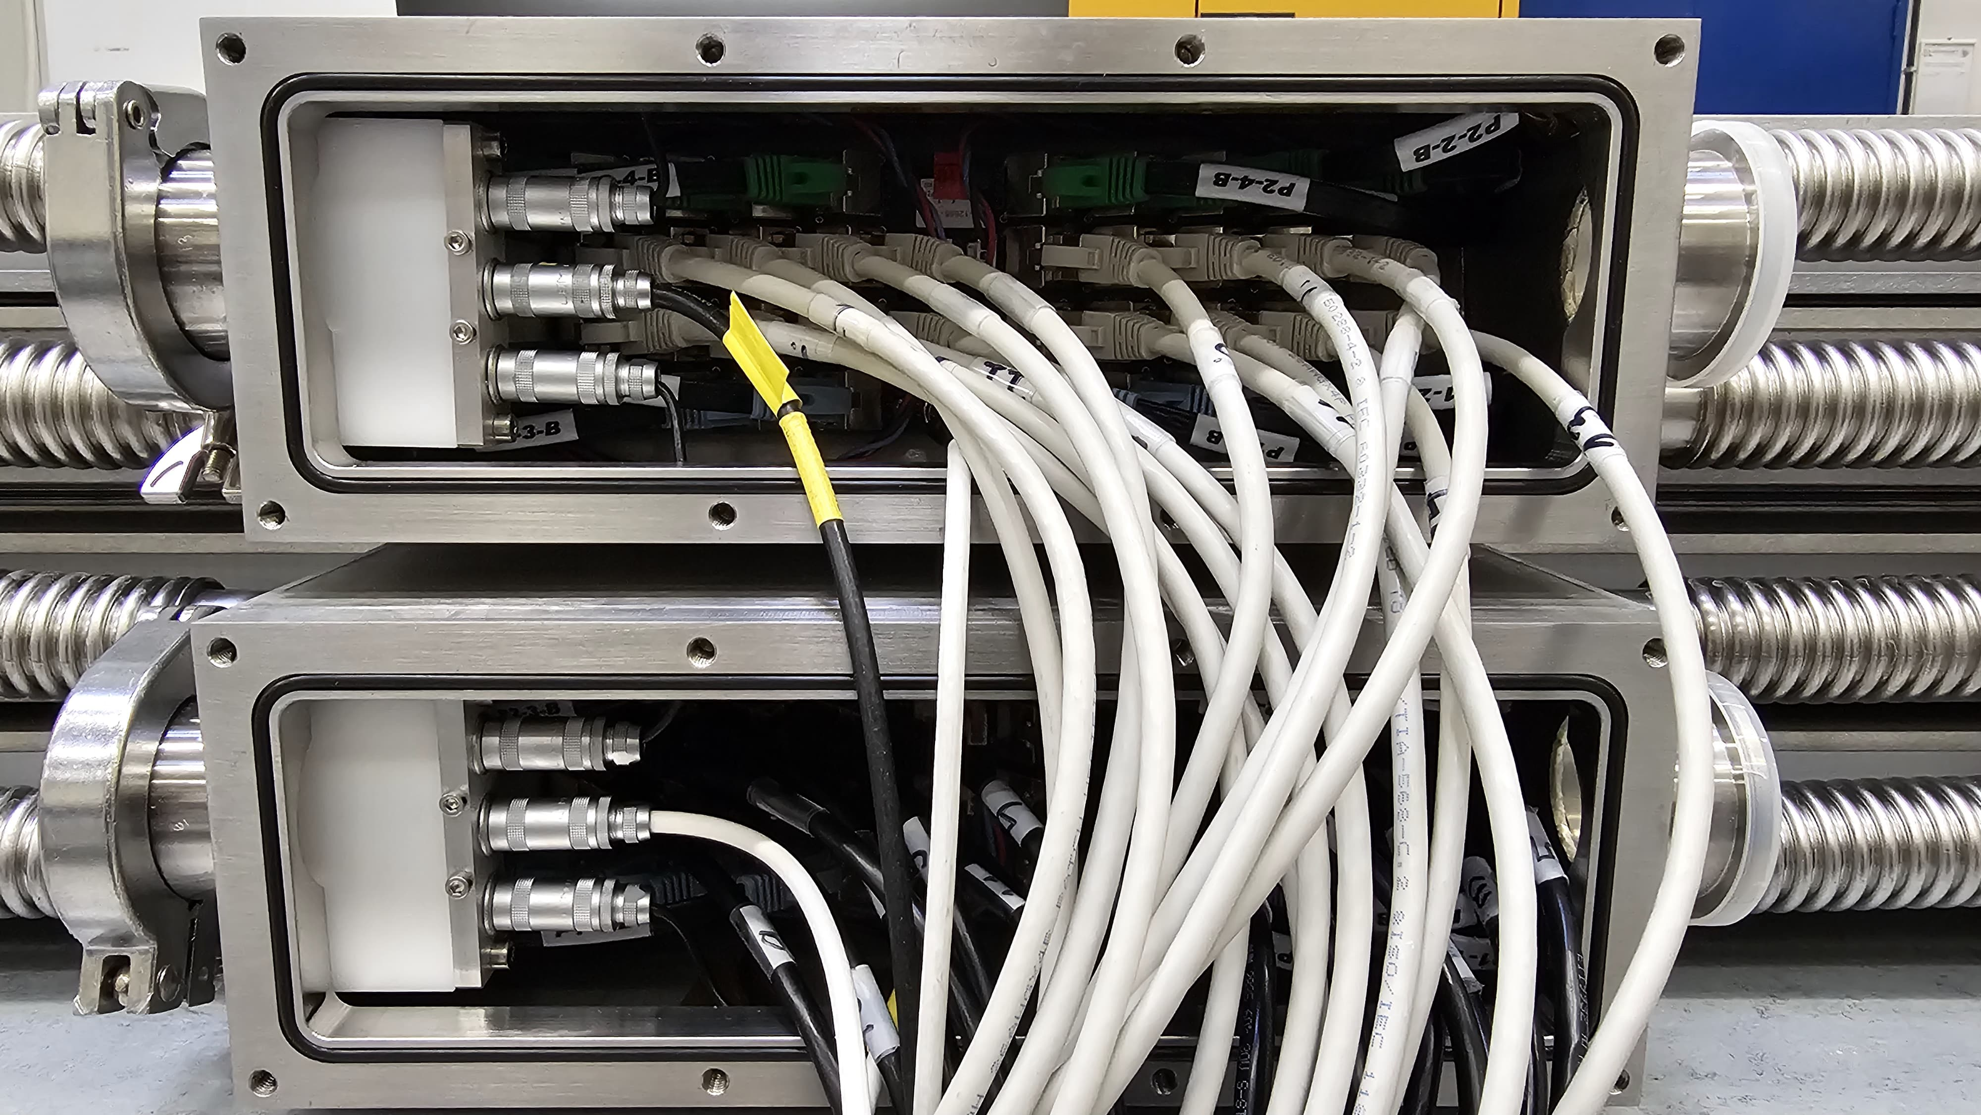
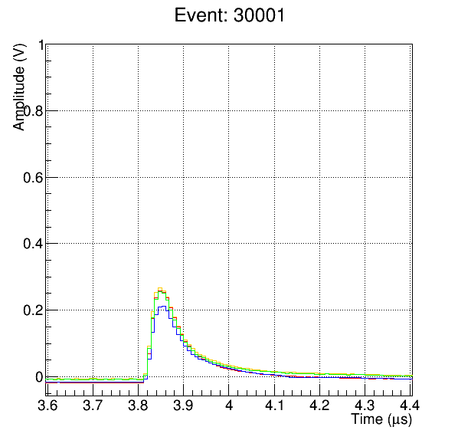
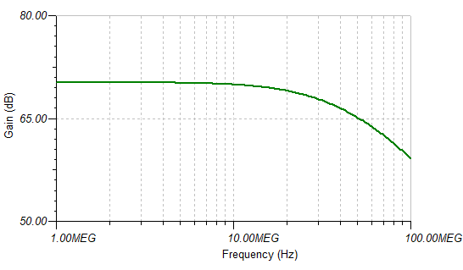
LoKI Preamplfier
-3dB frequency is 32MHz
Gain 6mV/uA (transimpedance)
power dissipation is 25mW/channel (5mA/channel).

Slide 9
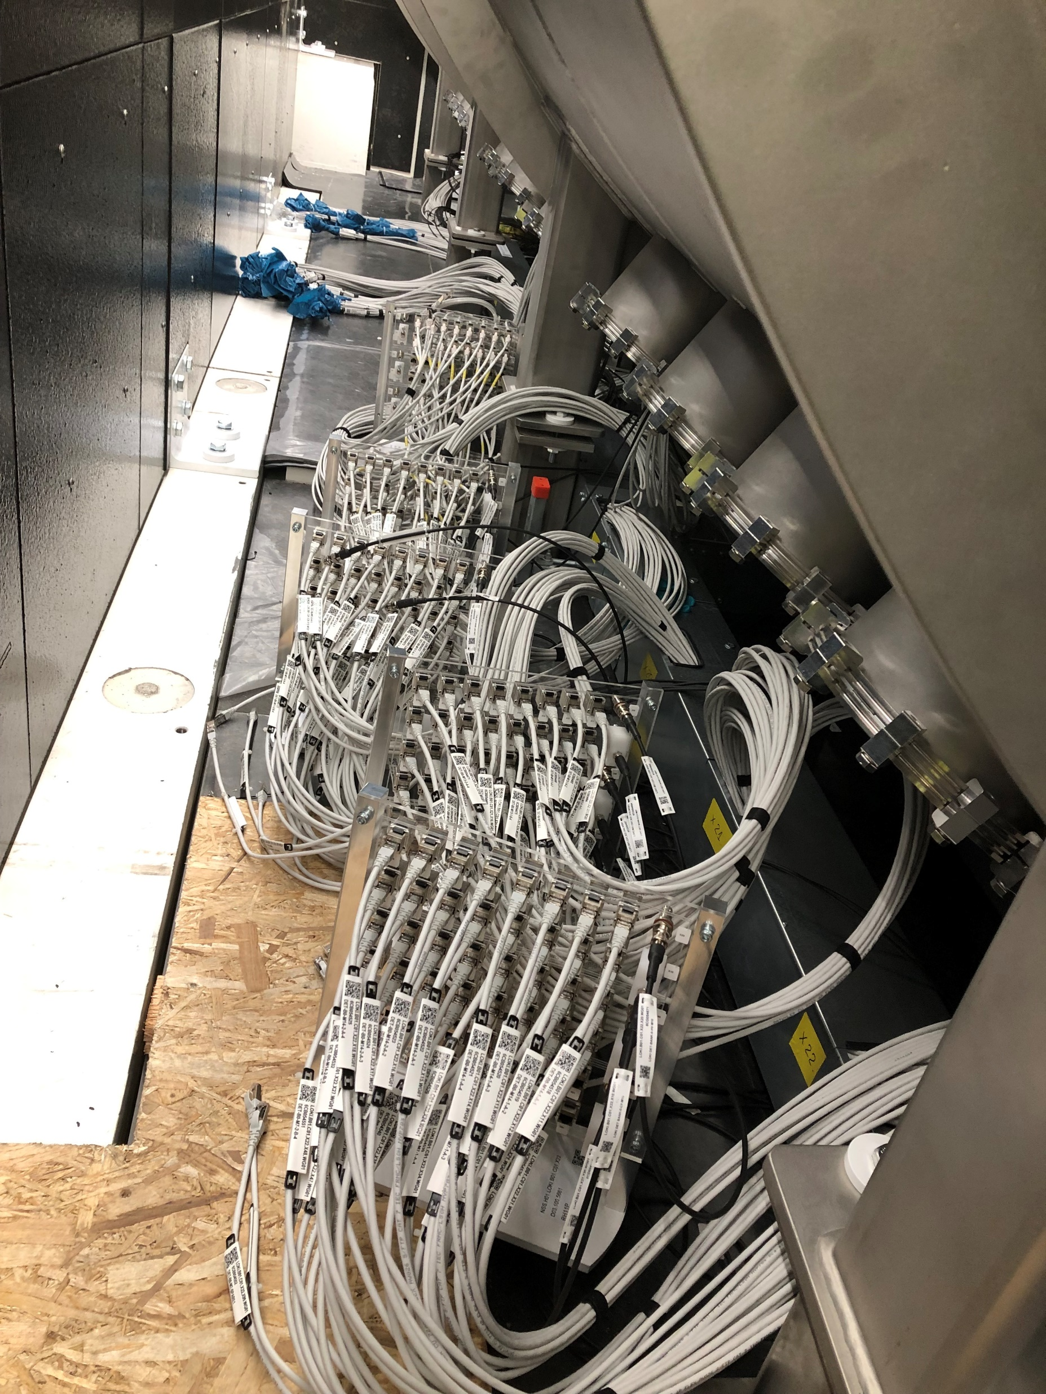
LoKI Detector Banks

Slide 10
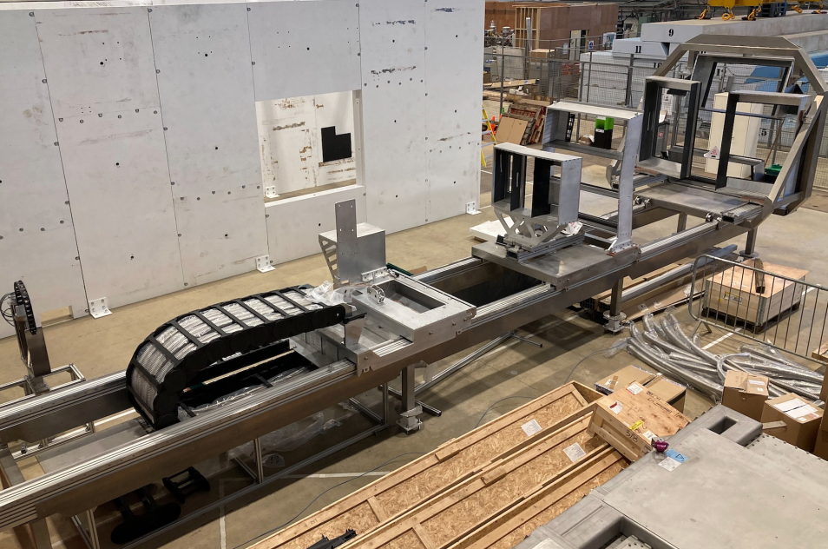
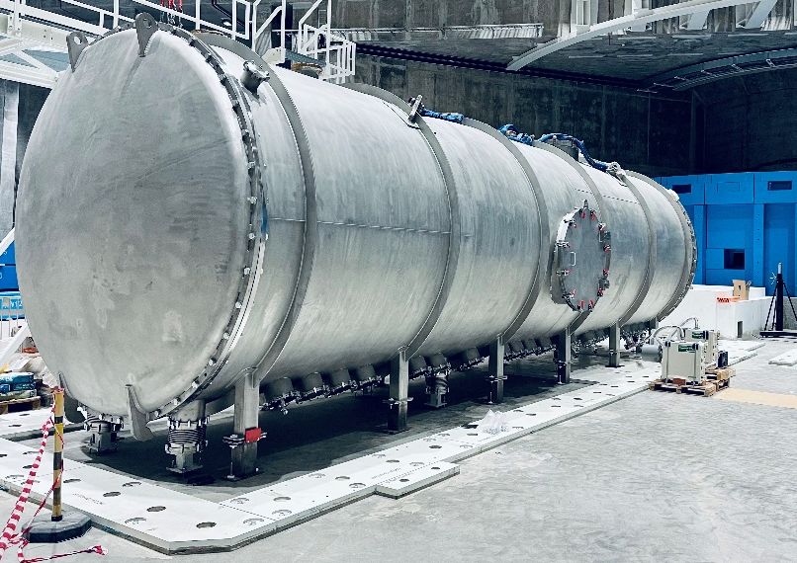
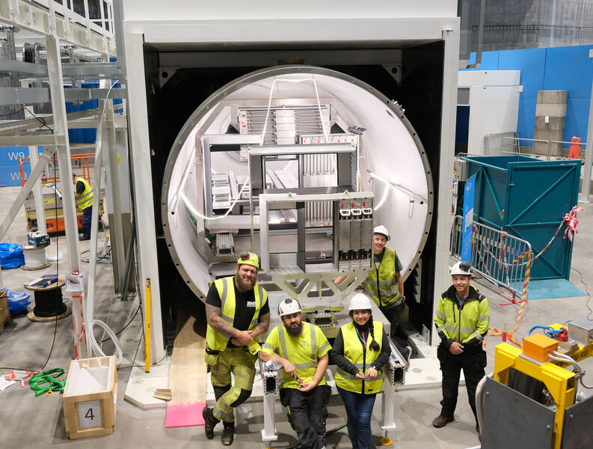
Loki Detector tank

Slide 11
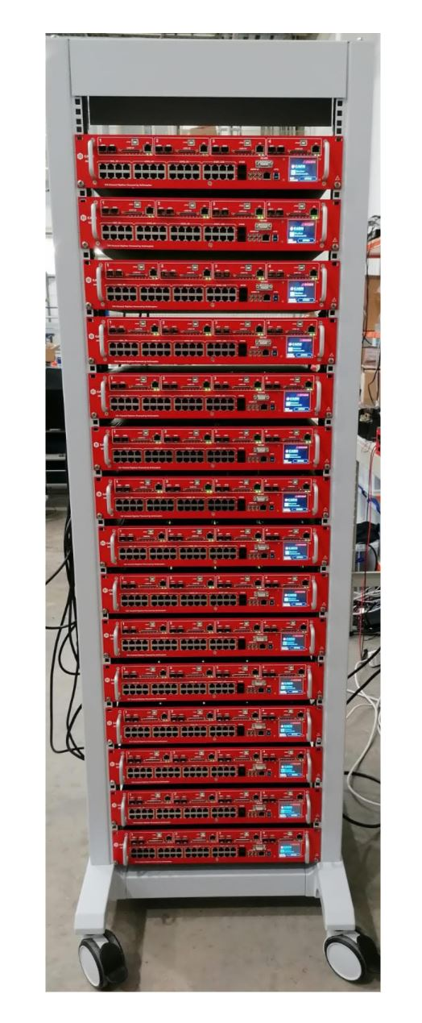
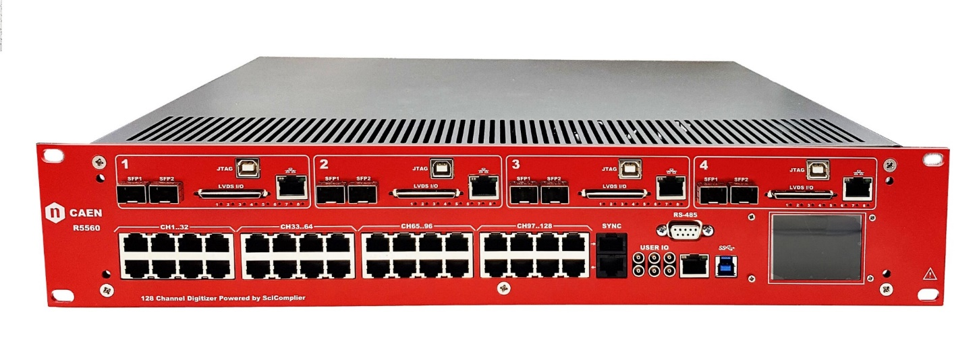
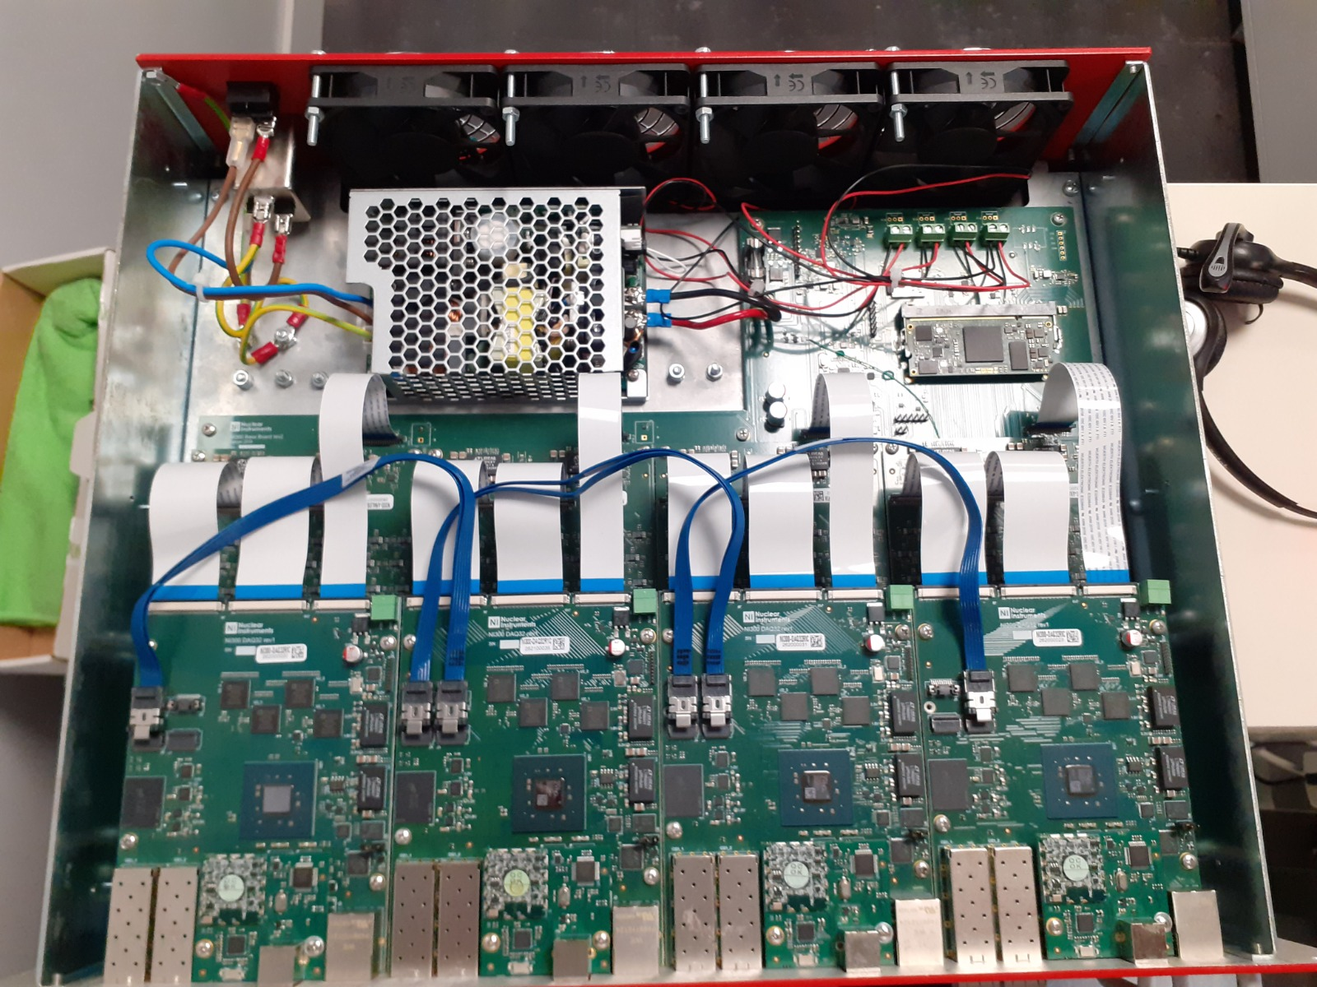
Loki ADC – R5560

Slide 12
Loki ADC – R5560
128 Analog Input Channels
R5560:
Differential Input on low cost RJ45 connector
125 MSPS, 14 bit simultaneous sampling ADC.
4 x 32 LVDS pair or 4x64 single ended I/O (256 I/O)
4x FPGA based on Xilinx Zynq SOC 7035 Xilinx Zynq for a total logic up to 1.4 million of LUT
Embedded Linux installed in SoC SoC
4x 1 Gbps Ethernet interface connected to Zynq PS for fast data readout
8x 10 Gbps optical link (80 Gbps) connected to Zynq PL for extreme fast data readout.
Clock recovery capability from optical Link
Programmable in SciCompiler

Slide 13
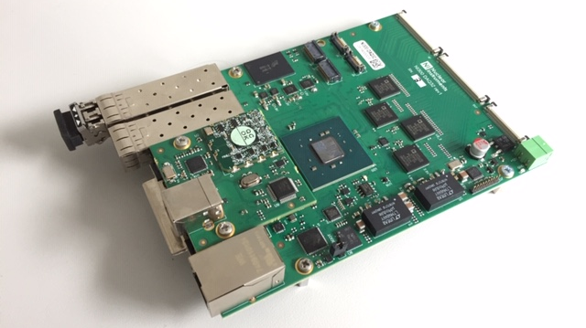
R5560 - DAQ
8xADC
8xADC
8xADC
8xADC
QSPI
8GB MMC
DDR 3 – 1 Gbyte PS
CLOCK PPLs
H
LNK
1
H
LNK
2
ZYNQ-7035
Open FPGA & Open SoC
4x8channels simultaneous sampling ADC 125 Msps 14 bit
4x10 Gbps link (2 SPF + 2 Internal) distributed on 2 FPGA bank
PLLs for clock recovery
Programmable arbitrary frequency clock generator plugin module
Open source FPGA framework for custom firmware integration & open source SoC software
SFP
1
SFP
2
4 x 10Gbps
Link
JTAG / DEBUG
64 DIGITAL IO
GBPS ETH

Slide 14
R5560 – Internal Interconnections
USB DEBUG
32 x LVDS
Gbps
Eth
SFP 1
SFP 2
USB DEBUG
32 x LVDS
Gbps
Eth
SFP 1
SFP 2
USB DEBUG
32 x LVDS
Gbps
Eth
SFP 1
SFP 2
USB DEBUG
32 x LVDS
Gbps
Eth
SFP 1
SFP 2
MODULE 1
32 Channel 128 MSPS
14 bit
MODULE 2
32 Channel 128 MSPS
14 bit
MODULE 3
32 Channel 128 MSPS
14 bit
MODULE 4
32 Channel 128 MSPS
14 bit
HORIZONTAL LINK
HORIZONTAL LINK
HORIZONTAL LINK
Analog Front End
Analog Front End
Analog Front End
Analog Front End
Inputs
Inputs
Inputs
Inputs

Slide 15
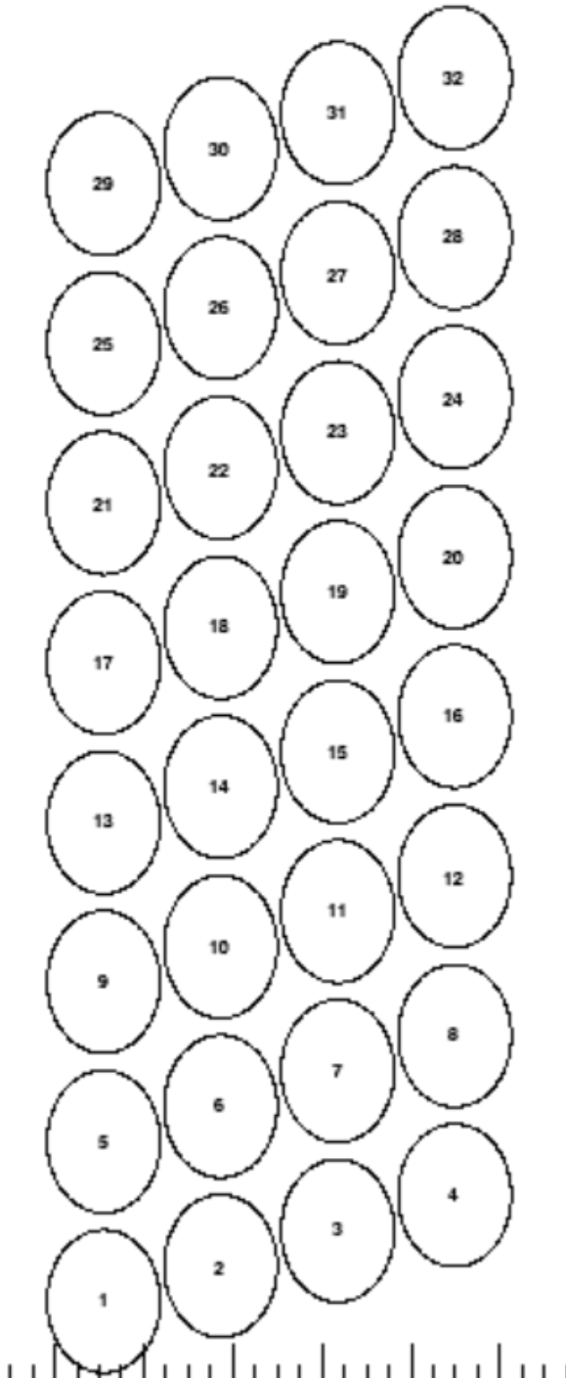
R5560 – LOKI READOUT BANKS AND RINGS
R0
R1
R2
R3
R4
R5
R6
R7
R8
R9
R10
R11
Readout Backend
BM

Slide 16
ESS READOUT INFRASTRUCTURE
To DMSC
COTS Switch
100G
Backend
Backend
Backend
ICS Ctrl
&
Timing
ICS
Ctrl
ctrl
data
x12
FE
FE
FE
Ring interface
Ring interface
ASIC/ADC
ASIC/ADC
ASIC/ADC
Ring Topology
P-to-P Topology
ctrl + data
failsafe ring
FE
FE
FE
FE
ASIC/ADC
Detector Readout for ESS Instruments
Scott Kolya, IKON-13, Sept.2017
x16
FE
FE
FE
FE
ASIC/ADC
ASIC/ADC
ASIC/ADC
ASIC/ADC
ASIC/ADC
ASIC/ADC
ASIC/ADC
ASIC/ADC

Slide 17
ESS TIMING DISTRIBUTION
Acquire accurate timestamp.
Collect digitized (timestamped) neutron data, and downstream it to the BE.
Separate FPGAs must be clocked synchronously for local timestamps to ‘tick’ equally.
Master embeds its clock as 8b10b bitstream. Each slave recovers and re-transmits the clock.
Backend
Backend
Master FE
Master FE
Recovered clock is sent through jitter-cleaner IC before forwarding
‘time now’
failsafe ring
FE
FE
FE
FE
ASIC/ADC
ASIC/ADC
ASIC/ADC
ASIC/ADC
FE
FE

Slide 18
R5560 – CLOCK RECOVERY AND DISTRIBUTION
125 MHz from BASEBOARD
H-LINK
RIGHT
H-LINK
LEFT
ADC
ADC
ADC
ADC
RX+TX
CLK
DISTR
CLK
DISTR
CLOCK PROPAGATION
TX+RX (4)
CLK OUT
TX+RX (3)
MUX_SEL
7035 + 7045
CLOCK PROPAGATION
CLK1
TX+RX (1)
TX
RX
RX
CLK2
SFP1
SFP2
CLK1
7030
CLK2
TX+RX (2)
156.25
CLK
DISTR
JITTER
CLEANER
ARBITRARY CLOCK MEZZANINE

Slide 19
R5560 – CLOCK RECOVERY AND DISTRIBUTION
125 MHz from BASEBOARD
ADC
ADC
ADC
ADC
CLK
DISTR
CLK
DISTR
CLK OUT
MUX_SEL
7045
CLOCK PROPAGATION
CLK1
TX+RX (1)
TX
RX
TX
RX
CLK2
SFP1
SFP2
CLK1
CLK2
156.25
CLK
DISTR
JITTER
CLEANER
ARBITRARY CLOCK MEZZANINE

Slide 20
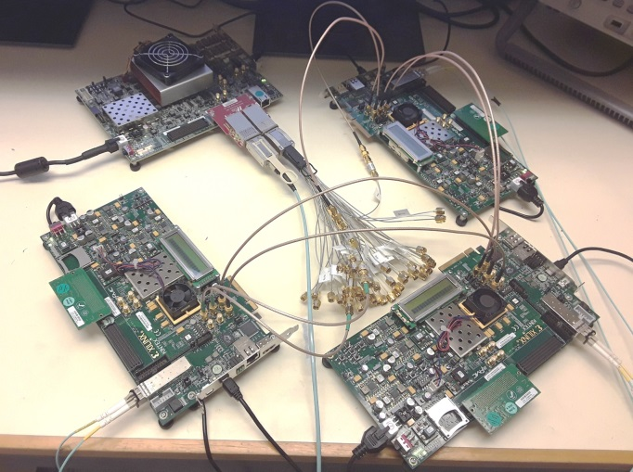
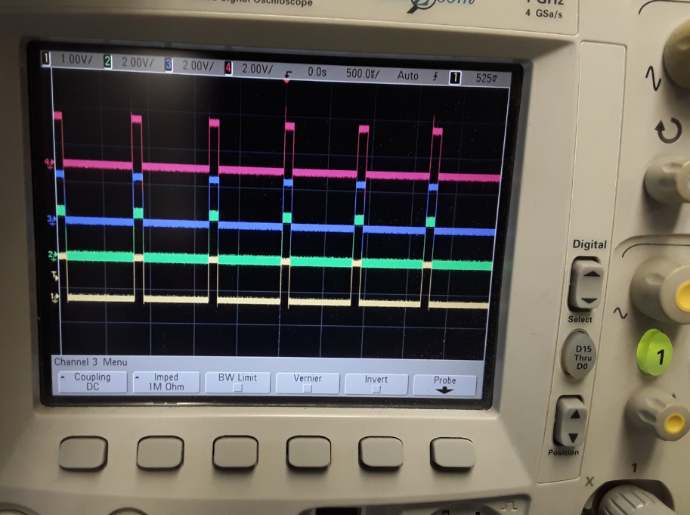
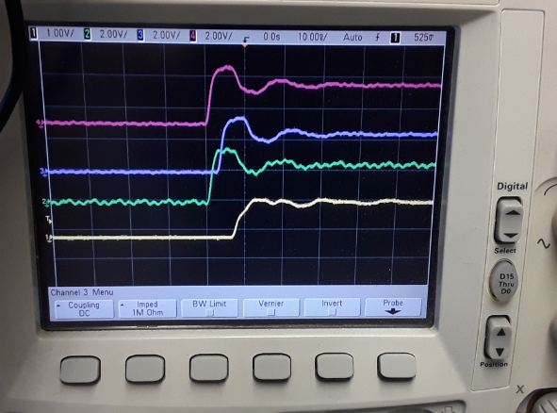
ESS TIMING DISTRIBUTION
Stable, Δt ~ 10ns, timestamp synchronisation.
50ns worst case with 16 devices in the chain
Backend
Master FE
Based on local timestamp, FE’s emit a pulse-per-millisec
FE
FE
FE
(Gahl et al. Hardware Aspects, Modularity and Integration of an Event Mode Data Acquisition and Instrument Control for the European Spallation Source (ESS), 2014, arXiv: 1507.01838v1)

Slide 21
R5560 – LOKI POSITION SENSING FIRMWARE
A and D signals on the same Ethernet cable: twisted pair 1 and 2 or 3 and 4
B and C signals on the same Ethernet cable: twisted pair 1 and 2 or 3 and 4
Amplitudes @ peak of Σ
A
D
2xIntegration
1xDifferentiation
A_{amp}
B_{amp}
C_{amp}
D_{amp}
B
C
2xIntegration
1xDifferentiation
Σ
Self trigger
Peak
Finder on the Σ

Slide 22
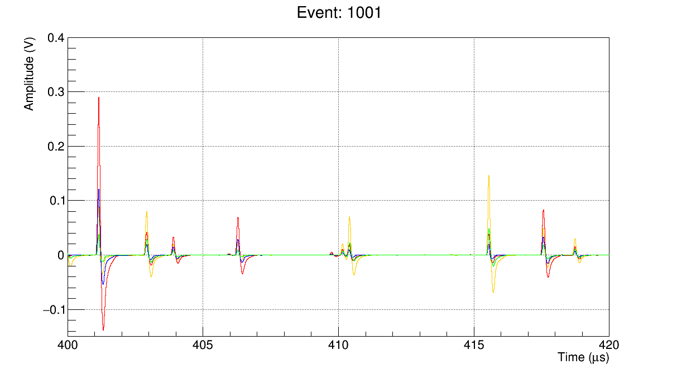
R5560 – LOKI POSITION SENSING FIRMWARE
SIGNAL
Raw signals
EMMA
1m long straws
HT=1100V
at y=0.3m from the centre
Rate ~400 kHz/1” tube
DERIVATIVE

Slide 23
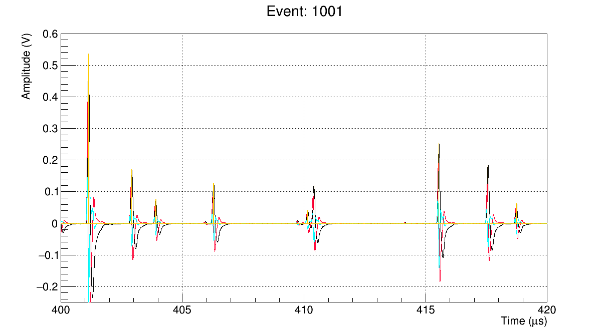
R5560 – LOKI POSITION SENSING FIRMWARE
A+B+C+D
Derivative
2nd Der.
Peak Found
A+B+C+D
Derivative
2nd Der.
Peak Found
1
3
2

Slide 24
R5560 – LOKI POSITION SENSING FIRMWARE
CHANNEL1
CHANNEL 2
2xIntegration
1xDifferentiation
AFTER INPUT PROCESSING
DELAYED TO CENTER THE PEAK
PEAK CAPTURED
TRIGGER SUM
TRIGGER DIFFERENTIATOR
TRIGGER SIGNAL
DATA PACKET TRANSMISSION

Slide 25
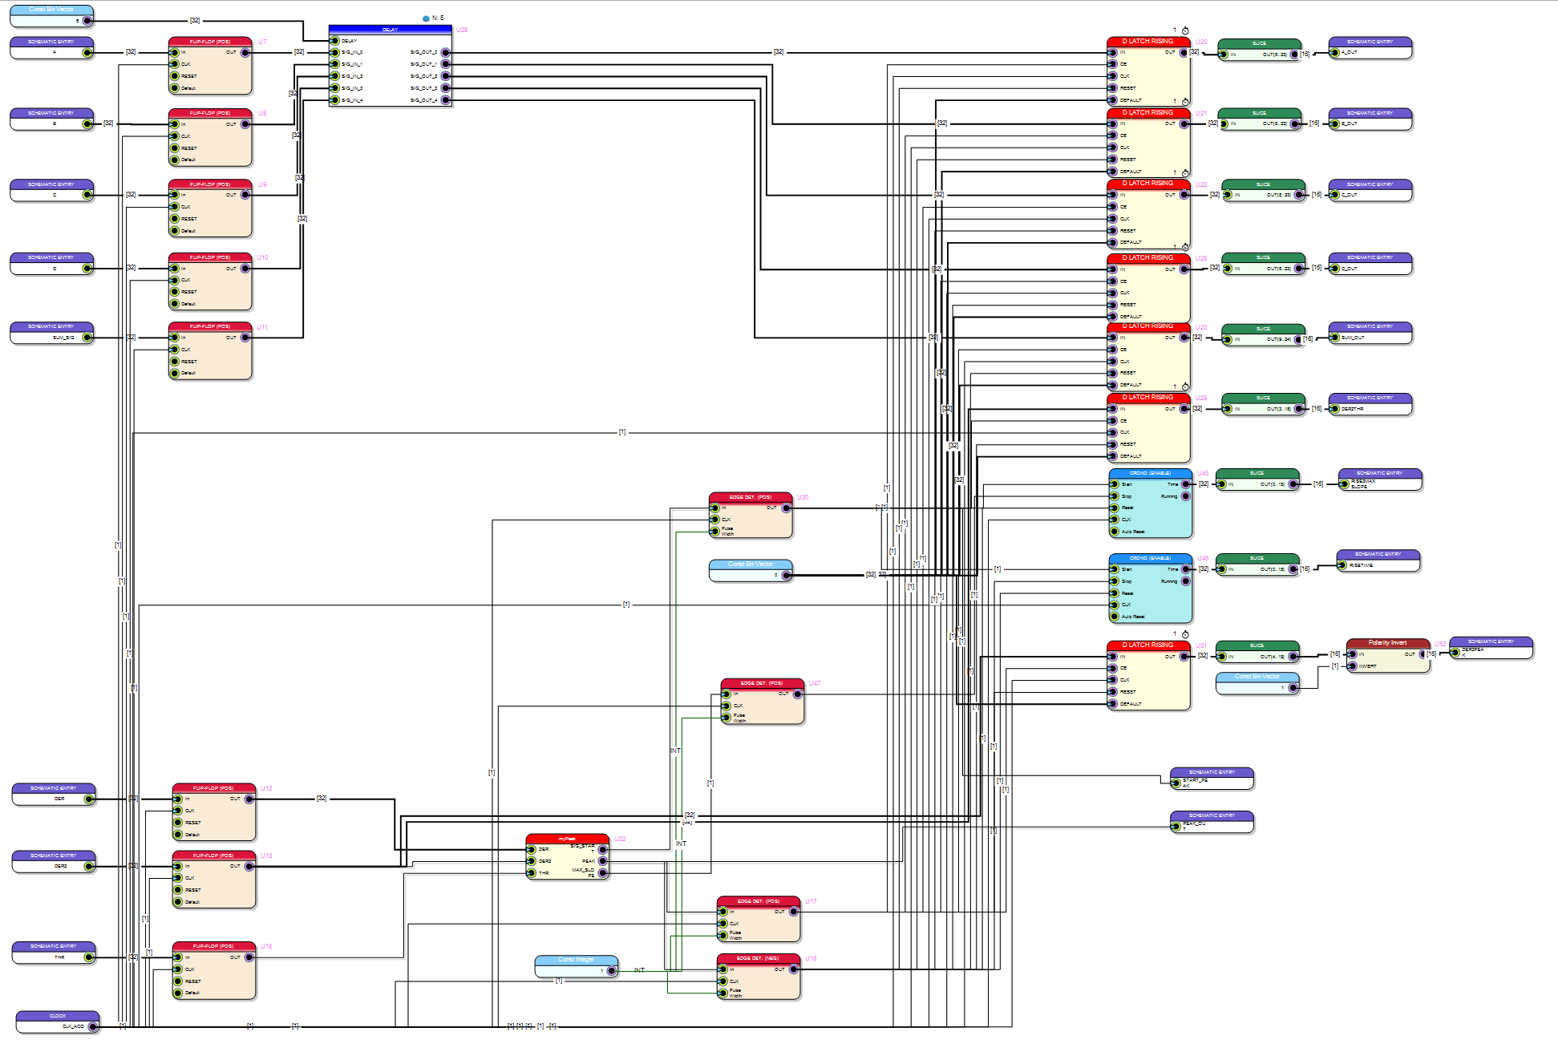
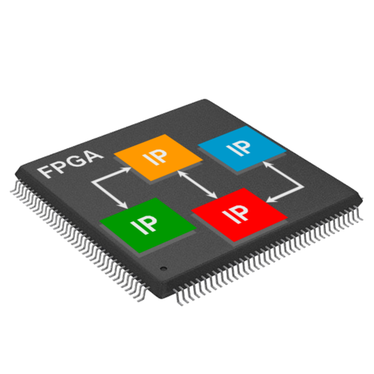
R5560 – LOKI POSITION SENSE FIRMWARE
LoKI Firmware fully designed by Dr. Davide Raspino @ ISIS, STFC

Slide 26
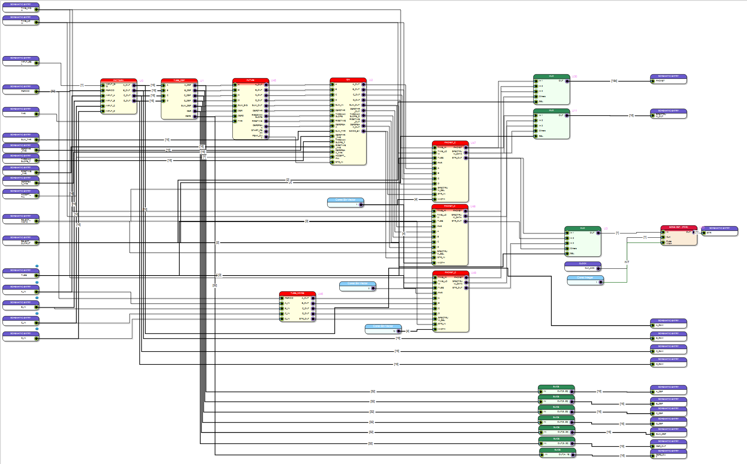
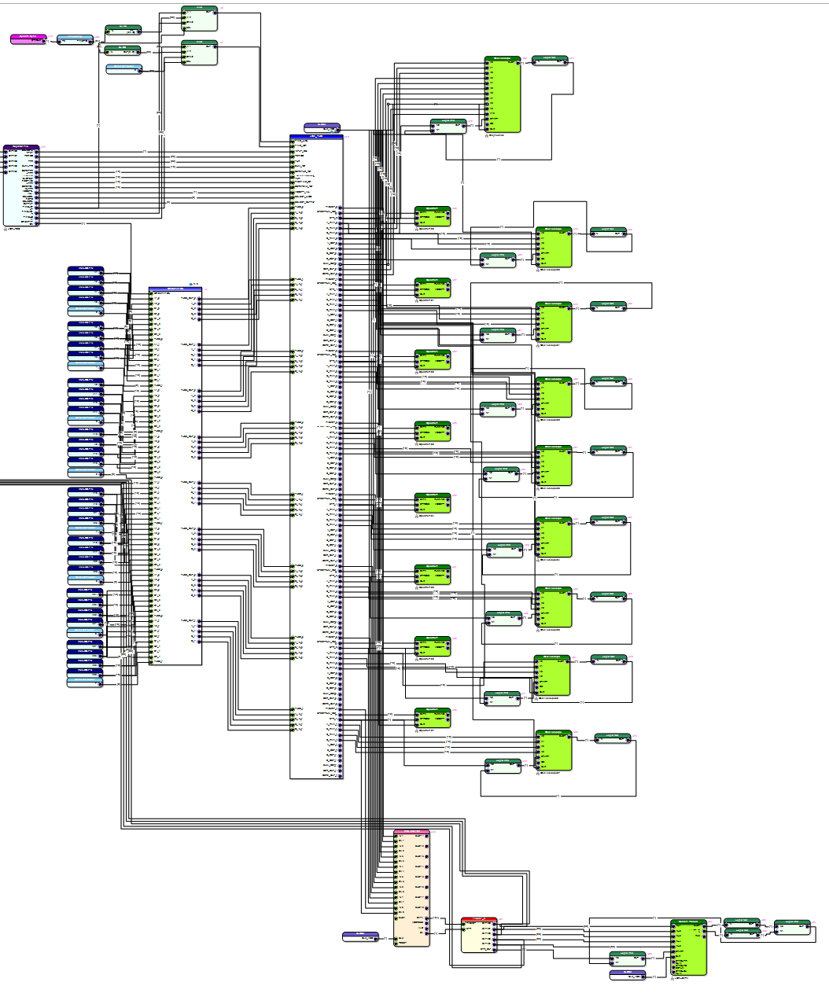
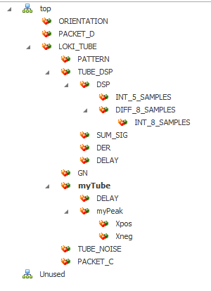
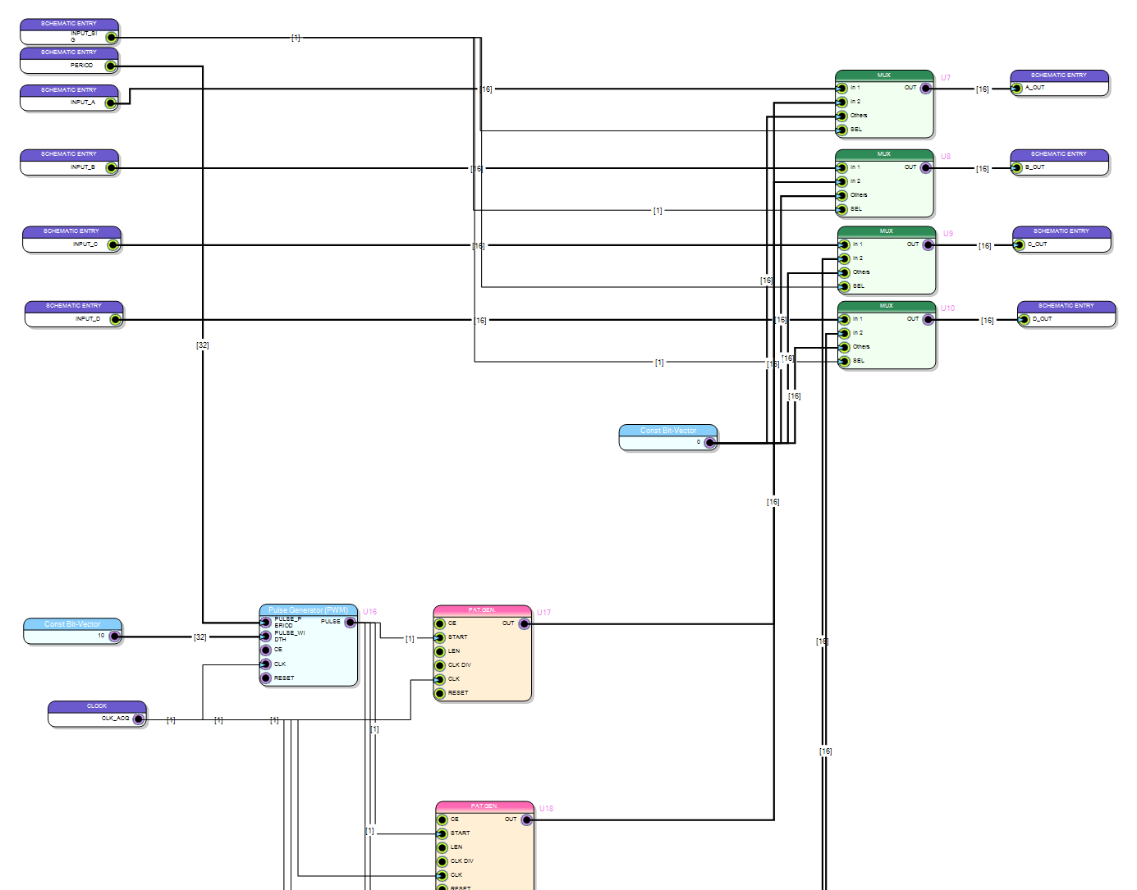
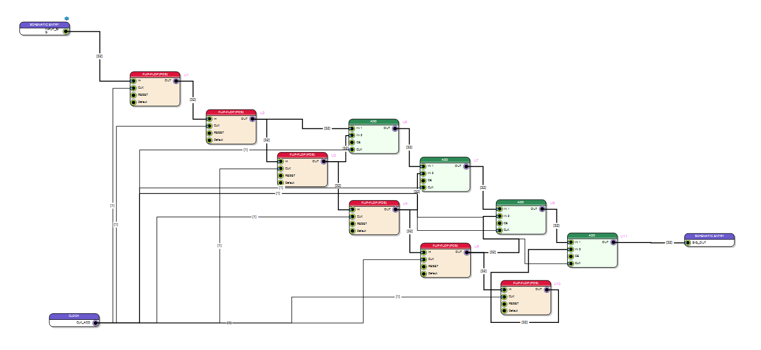
R5560 – LOKI POSITION SENSE FIRMWARE
LoKI Firmware fully designed by Dr. Davide Raspino @ ISIS, STFC

Slide 27
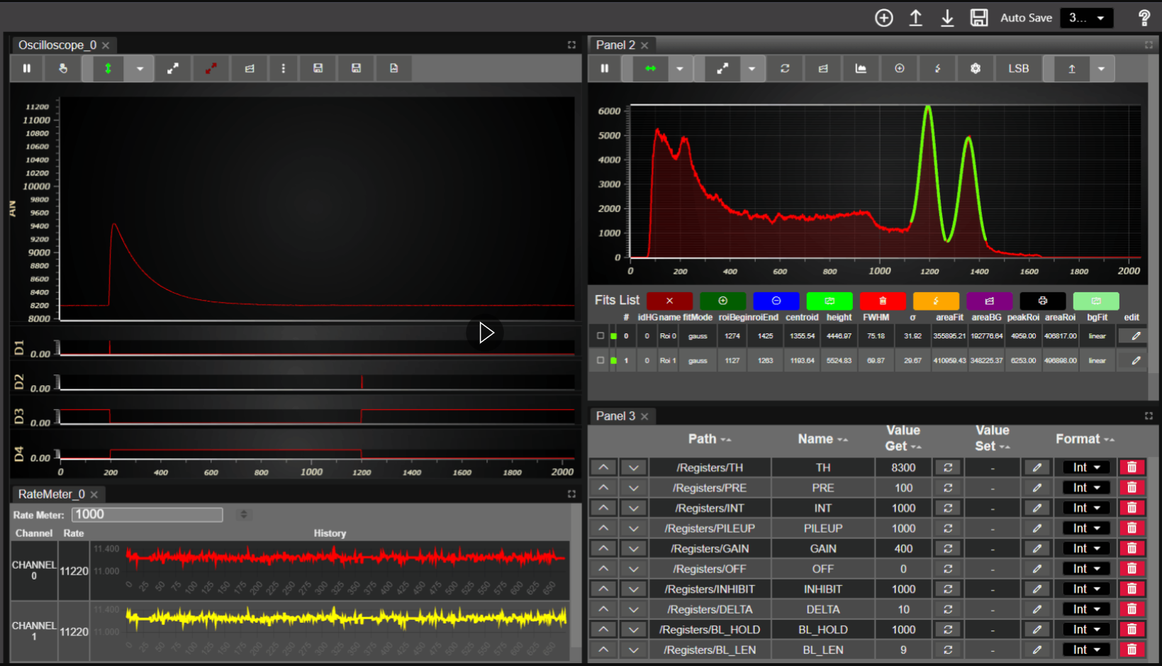
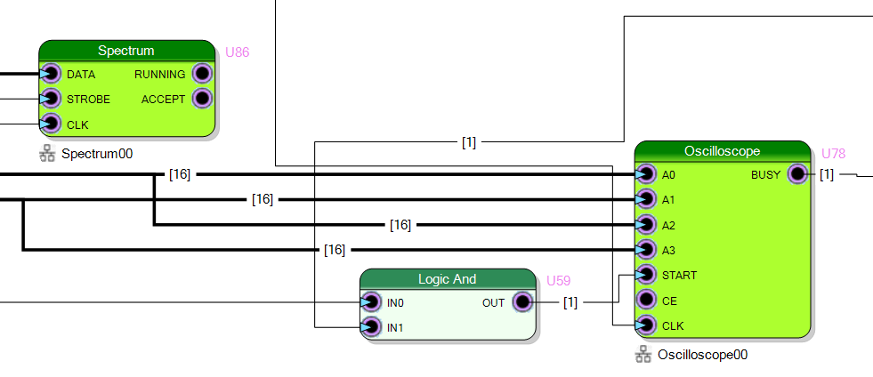
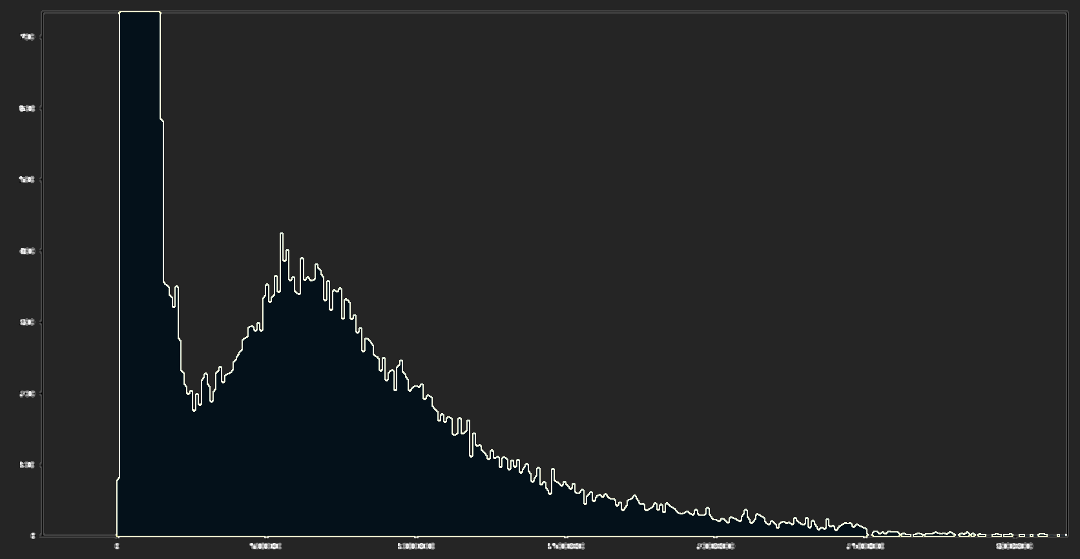
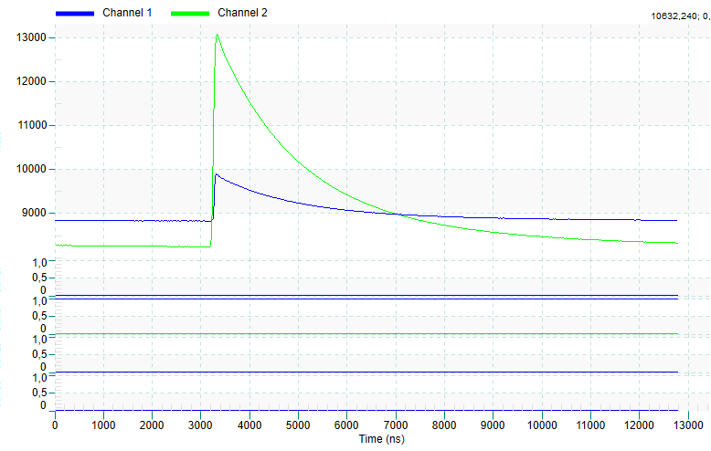
R5560 – LOKI MONITOR AND DEBUG
Real time oscilloscope, spectra and counts monitoring

Slide 28
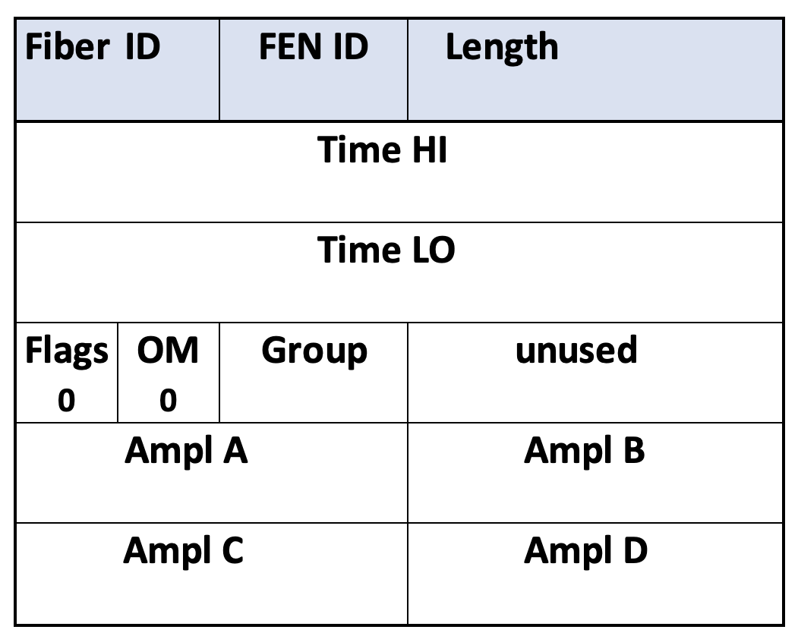
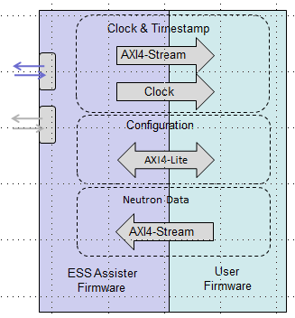
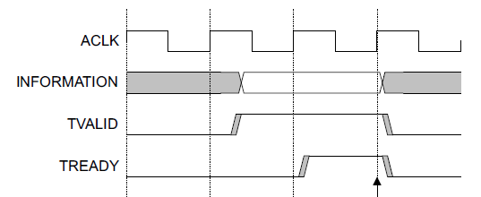
R5560 ESS INTERFACE – DATA READOUT
Neutron Data
FE Firmware
(Slave)
ACLK
Data to backend
TDATA[32]
User
(Master)
TVALID
TREADY
A ESS Customized version of SciCompiler Custom Packet is made available to all ESS experiments in order to allow direct data integration to the ESS FEA
LoKI, Miracle, Bifrost, Cspec, Vespa

Slide 29
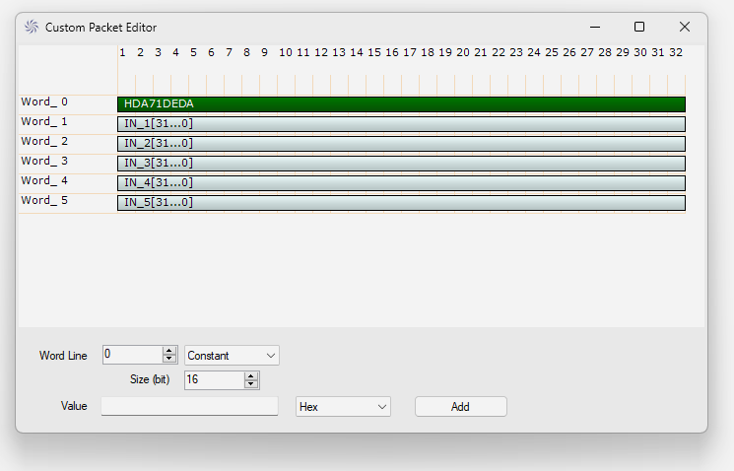
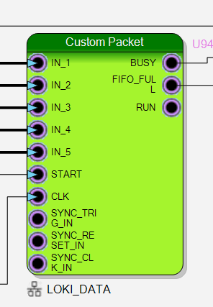
R5560 ESS INTERFACE – DATA READOUT
A ESS Customized version of SciCompiler Custom Packet is made available to all ESS experiments in order to allow direct data integration to the ESS FEA
Data Format and packet can be customized to integrate others experiments
BIFROST
DATA FORMAT

Slide 30
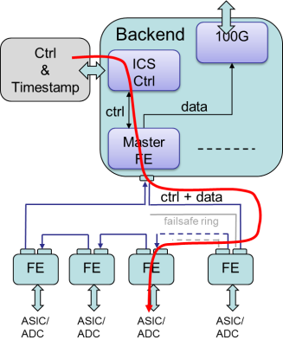
R5560 ESS INTERFACE - CONTROL
Ctrl
FEA Firmware
User Firmware
Backend
Front End
AXI
Interconnect
SciCompiler
Register File
INTEG
RATOR
W 0x41C0....
GAIN
Configuration
registers
0x50000000 –
0x5F420000
( Read returns )
Configuration
registers
0x41C10000 –
0x41C1FFFF
Axi-Lite
Timer 1

Slide 31
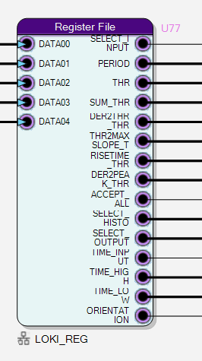
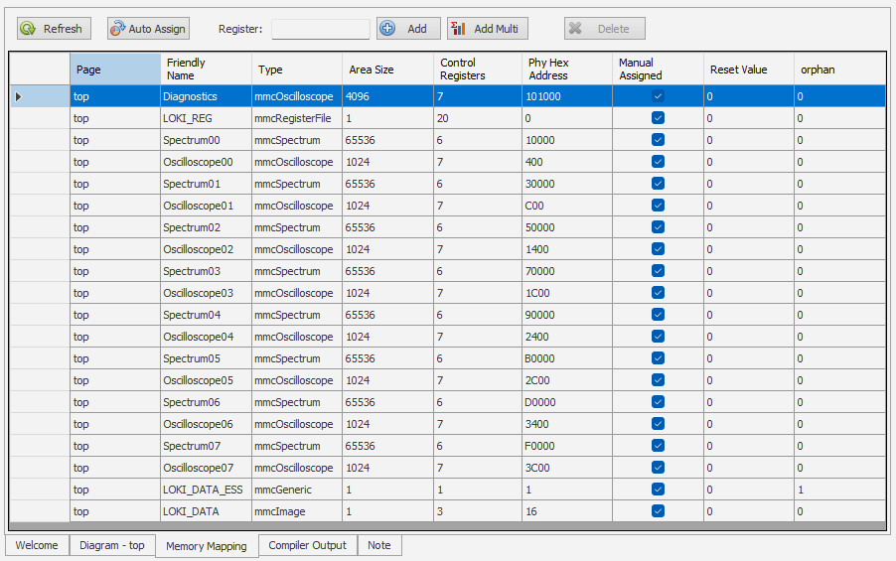
R5560 ESS INTERFACE - CONTROL
Every Memory Mapped Component placed in the SciCompiler design can be access using FEA slow control module

Slide 32
R5560 ESS INTERFACE - TIMESTAMP
FEA Firmware
User Firmware
PROCESSING
FIRMWARE
Timestamp Counter
SciCompiler
TimeStamp Module
TRIGGER
AXI-S TIMESTAMP
TIMESTAMP 56 BIT
DATA
PACKET
CREATOR
(ESS FORMAT)
AXI-S NEUTRON

Slide 33
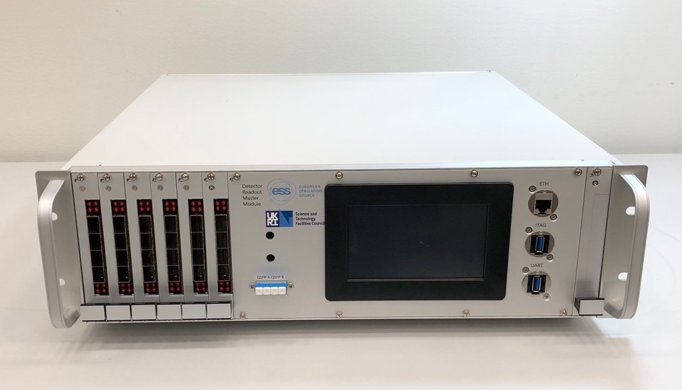
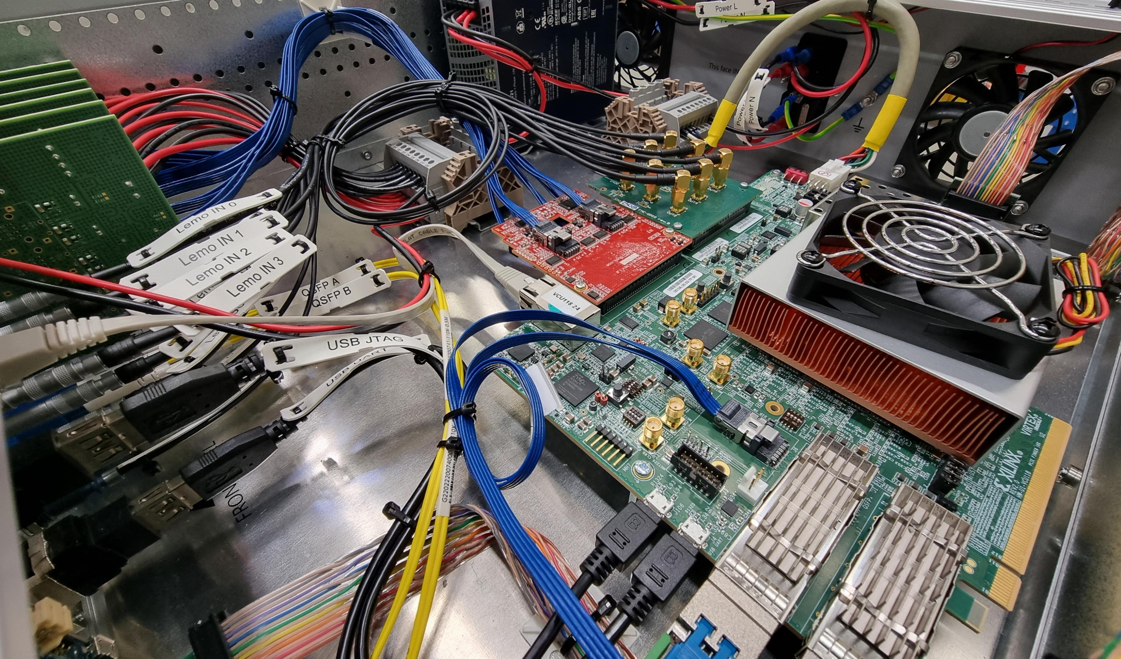
ESS MASTER MODULE
Main requirements:
Data acquisition system common across all ESS instruments.
Integrate ICS timing, ICS EPICS slow control and Data Egress downstream to DMSC.
Output bandwidth 2x100Gb/s.
Data rings to front-end: 12 bidirectional rings (24 fibers).
Ring connection done through daughter boards interfacing with fibre via SFP connectors.
The readout data is sent over Ethernet as UDP payload which can be as long as 8972 bytes long.
The connectivity between the Readout Master and the FENs is achieved through 8B/10B encoded MGT-driven (Multi-Gigabit Transceiver) optical fibres links arranged in a ring topology.
For the slow control interface, the Readout Master instantiates a lightweight UDP stack which communicates with the EPICS IOC (Input Output Controller) using a standard Gigabit Ethernet link.
Based around VCU118 FPGA (UltraScale+ Architecture) hardware from Xilinx.

Slide 34
R5560 READOUT RACK
All R5560 readout module for LOKI Experiment has been provided to ESS and installation in the facility is in progress
ESS Detector Group
Development Setup
One of the 5 Rack with R5560 front-end electronics installed at ESS for LOKI

Slide 35
LOKI TEST BEAM
First test beam at ISIS on EMMA
Successful beamtime at ISIS was the first true end-to-end test of the full DAQ chain:
Straw tubes
Amplifier
Readout Electronics and firmware
FEA firmware
Master Module
Provides confidence that the ESS Readout System can be used for configuration, time distribution, and data readout of a real Instrument.

Slide 36
LOKI TEST BEAM
Collected calibration data on the LoKI rear detector using the full ESS software stack on LARMOR (ISIS) SANS

Slide 37
LOKI TEST BEAM
LARMOR Test Beam Results
Sample measured:
Cd stripped mask
Silver behenate
SDS powder
empty beam
blocked beam
ISIS standard polymer
Silica particles
Vanadium
NeXus file displayed in scipp

Slide 38
LOKI TEST BEAM
LARMOR Test Beam Results
Sample measured:
Cd stripped mask
Silver behenate
SDS powder
empty beam
blocked beam
ISIS standard polymer
Silica particles
Vanadium
Notes:
Here are some pretty pictures of the processed data that we recorded. This is what the scientists had expected, so that are very happy with the performance of the detector system.

Slide 39
Conclusion
An innovative digitizer has been developed by the collaboration of ESS/ISIS with Nuclear Instruments and Caen
The new digitizer takes the advantage to be reconfigurable with Sci-Compiler and its firmware can be customized for several experiment in ESS/ISIS (LoKI, Miracle, Bifrost, Cspec, Vespa) and other facilities
The firmware can be easy maintained directly by the scientists involved in the development of the detectors
The ESS readout is integrated in Sci-Compiler and used by several detectors now in developing and future ones.
The Loki electronics readout has been commissioned and a scaled model of the full detector up to the data analyses has been validated, including all readout elements from analog frontend to ESS readout interfacing
Notes:
Here are some pretty pictures of the processed data that we recorded. This is what the scientists had expected, so that are very happy with the performance of the detector system.

