Slide 2
ESS Admin Update at 20th ESS Industry Liaison Offices Network
September 10, 2024
PRESENTED BY <Charlotte Hartelius klaar>

Slide 3
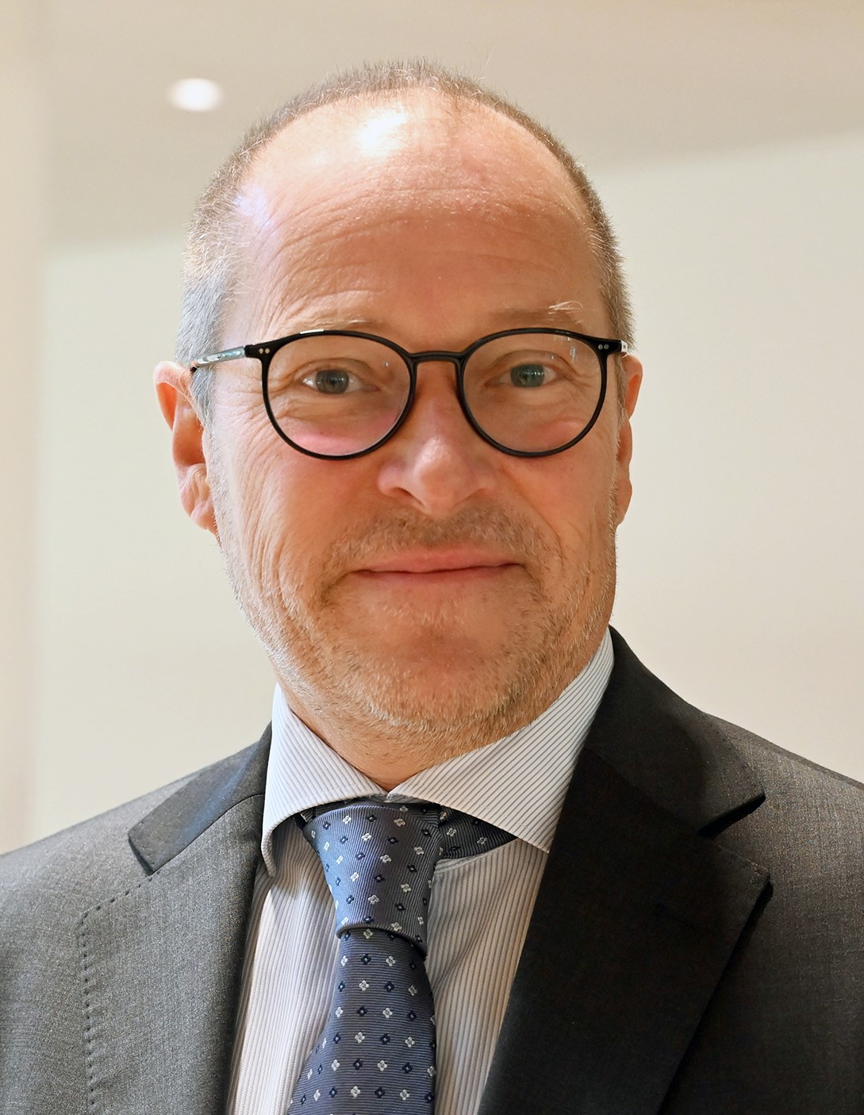
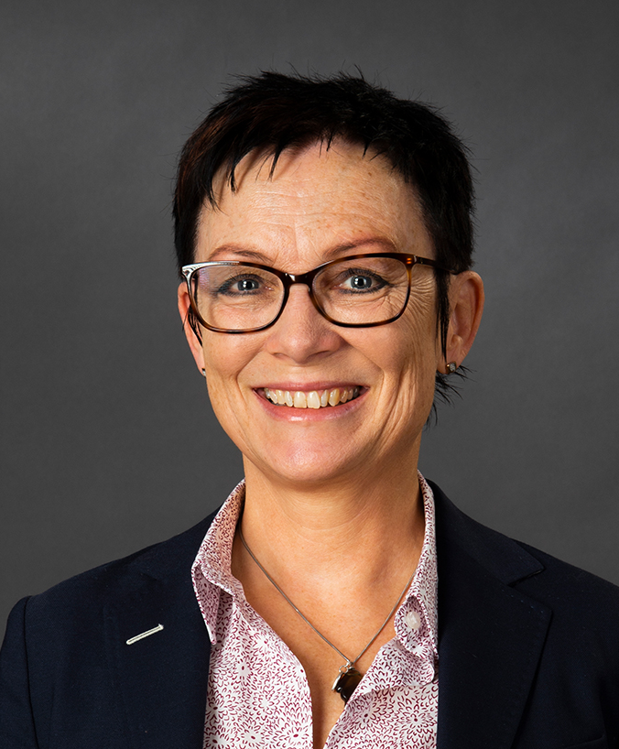
Introduction
Administration Directorate
One of four directorates at ESS
Led by our Director of Administration, Anders Ihr
Part of the Executive Board
Responsible for
Admin Management
Communications
Human Resources
Finance & Business Control
Supply, Procurement & Logistics
Anders Ihr M.Sc. Business and Economics Director of Administration
Charlotte Hartelius Klaar M.Sc. Eng. Physics Programme Manager

Slide 4
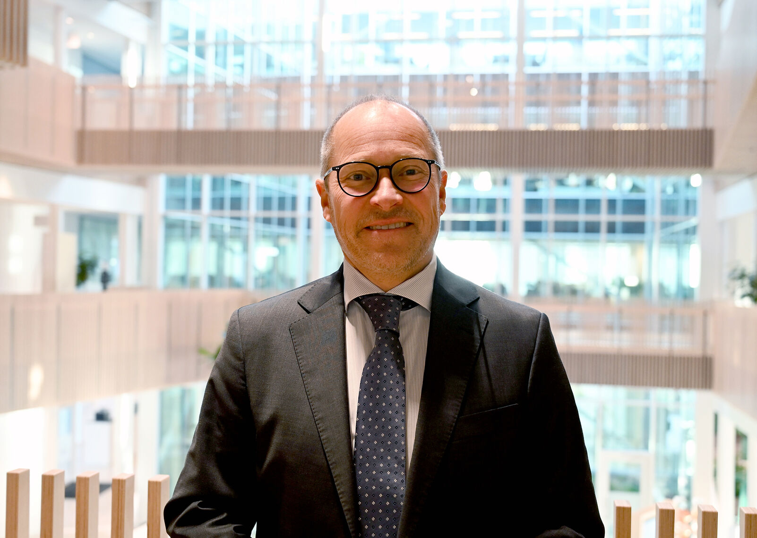
Administration Directorate
Director of Administration
Anders Ihr
Program Management
Charlotte Hartelius Klaar
Finance & Business Control Division
Florian Weissbach
Human Resources Division
Anna Hansson Kalaris
Communications Group
Marina Giampietro
PA
Eva Lagrelius
Supply, Procurement & Logistics
Mirko Menninga
Finance Group
Maja Jensen
Procurement Administration Group
Charlotte Rafsten
Warehouse & Logistics
FL: Jörgen Larsson
Dotted box = tasked based groups
FL = Functional Leader

Slide 5
Administration Directorate Supports in ESS’s Road to Science
2028
Start of steady state operations
2009
Decision to site ESS in Lund (SE), with Data Management & Software Centre in Copenhagen (DK)
2014
Start of construction
2025
First beam on target
Today
2003
Concept design of ESS presented
2013
ESS Technical Design Report completed
2022
Civil construction completed
2026
First scientific experiments
Notes:
SSO is coming closer
AD supports in this work
AD already at “SSO” to a large extent
Licensing from the Swedish Radiation Safety Authority is a vital part of the plan and one of AD’s focus areas

Slide 6
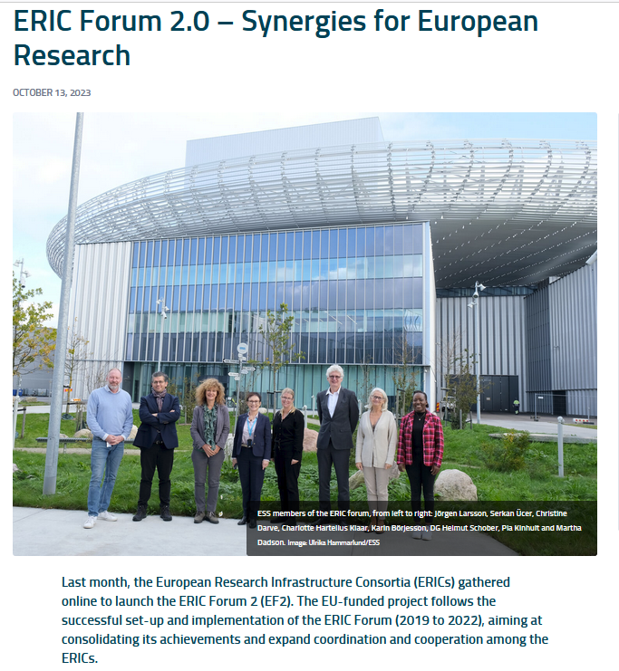
Administration Directorate
Administration Directorate – General
Responsible for maintaining day to day services in order to meet requirements and support the whole organisation.
The Programme Manager manages the strategic and cross-functional project portfolio of the Administration Directorate.
Current focus
Licensing
Crisis Management Exercise Matilda
Cost Control Project
ERIC Forum 2 Project
Notes:
Administration Directorate – General
The Administration Directorate is responsible for maintaining day to day services in order to meet requirements and support the whole organisation.
The Programme Manager manages the strategic and cross-functional project portfolio of the Administration Directorate

Slide 7
Administration Directorate
Communications
Supporting ESS's strategic ambitions and priorities through communications.
To share accurate information that, over time, contributes to ESS being regarded as a professional, admired, attractive and trusted research facility.
Current focus
ESS Content:
Streamline and simplify to deliver a robust narrative across all channels
ESS Public Website:
re-vamp structure and content to reflect current status of the project and engage key audiences (such as science community and future users)
ESS Stakeholder Engagement:
roll out strategic initiatives to strengthen engagement with key target groups (employees, students/educators, industry, public)
Notes:
Communications
The Communications group is tasked with supporting ESS's strategic ambitions and priorities through communications.

Slide 8
Administration Directorate
Finance & Business Control
Maintains and supports ESS’ fiscal responsibilities through accounting and financial compliance.
Provide financial oversight and business controlling services to ESS.
Accounting, VAT, re-imbursements, Member contributions, financing, cash flow, financial reporting, analyses, monitoring, business planning, and large insurances.
Current focus
Cash flow
Fixed assets
SSO financial mode, accounting framework, and annual budget template
Notes:
Finance & Business Control
The Finance & Business Control Division maintains and supports ESS’ fiscal responsibilities through accounting and financial compliance. We provide financial oversight and business controlling services to ESS. We cover accounting, VAT, re-imbursements, Member contributions, financing, cash flow, financial reporting, analyses, monitoring, business planning, and large insurances.
Our task is to share accurate information that, over time, contributes to ESS being regarded as a professional, admired, attractive and trusted research facility

Slide 9
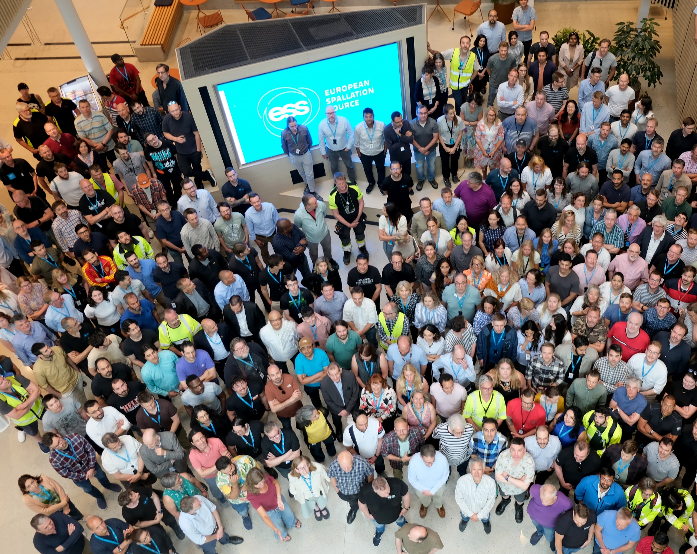
Administration Directorate
Human Resources
Leads the work to define, find, attract, recruit, relocate, develop, retain and exit employees
Contribute to making ESS an attractive and inspiring work place.
Current focus
Recruitment – high number of recruitments
HRM System – tender phase
24/7 and none standard working hours – planning and schedule
Notes:
Human Resources
The Human Resources Division leads the work to define, find, attract, recruit, relocate, develop, retain and exit employees and also contribute to making ESS an attractive and inspiring work place

Slide 10
Administration Directorate
Supply, Procurement & Logistics
To service ESS's strategic objectives by utilising efficiently a fully functioning procurement process in order to maximise stakeholder investment.
The Logistic group is responsible for all processes related to transportation and logistics at ESS.
Notes:
Supply, Procurement & Logistics
The Procurement, Supply and Logistic Division goal is to service ESS's strategic objectives by utilising efficiently a fully functioning procurement process in order to maximise stakeholder investment. The Logistic group is responsible for all processes related to transportation and logistics at ESS

Slide 11
Thank you!

