Slide 1





Status and Prospects for High Precision Neutron Beta-Decay Research
A. R. Young
North Carolina State University/Triangle Universities Nuclear Laboratory

Slide 2
Outline
Why Make High Precision Measurements of Neutron Beta Decay?
The Neutron Global Data Set
Experiments:
  Lifetime: development of the Neutron Lifetime Problem
  Lifetime: ongoing experiments with beams and stored UCN
  Angular correlations: beta asymmetry measurements
  Angular correlations: beta-neutrino correlation measurements
Prospects and Conclusions

Slide 3
Why Make High Precision Measurements of Neutron Beta Decay?

Slide 4
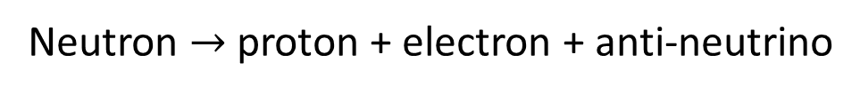

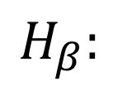

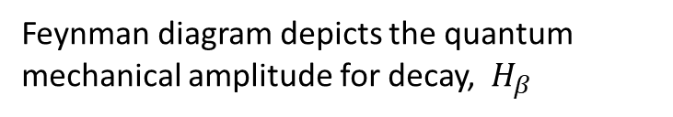
Neutron beta decay basics
Proton
$$H_{β}:$$
Feynman diagram depicts the quantum mechanical amplitude for decay, $H_{β}$
Total decay rate $∝ H_{β}^{2}$
Neutron
Neutron $→$ proton + electron + anti-neutrino
Interaction mediated by exchange of $W^{−}$ particle

Slide 5
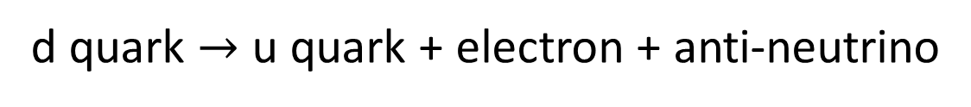
Neutron beta decay basics
Appeal:
Permits very precise characterization of the weak interaction and sensitive tests
for BSM physics!
Switch off the strong force binding quarks in the neutron
d quark $→$ u quark + electron + anti-neutrino
Extremely good approximation to model the W-exchange (W mass >> energy scale of decay) as occurring at a single pt using the current-current formulation introduced by Fermi

Slide 6
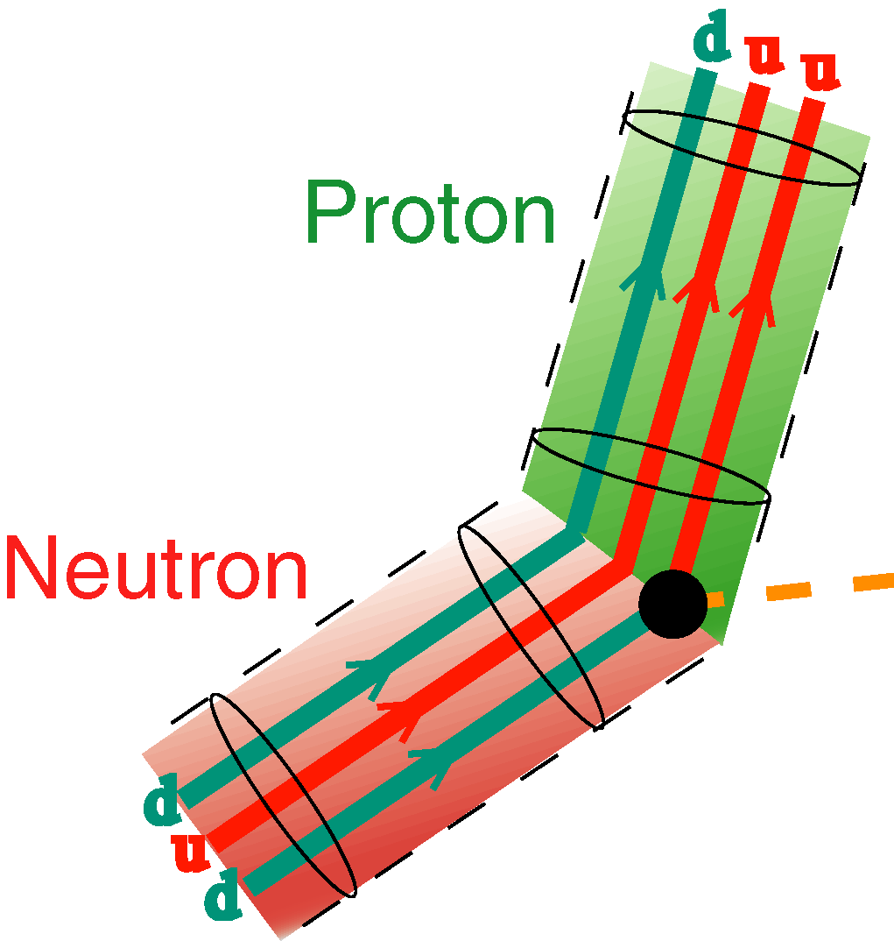





The Standard Model for β Decay
Three input parameters required:
Fermi constant:
W⁻ exchange“strength”
$$\frac{G_{F}}{\sqrt{2}}$$
$$\sqrt{2}$$
(Precisely calculable)
J
( quarks)
μ
$$=\overline{u}\left[γ_{μ}{−γ}_{μ}γ_{5}\right]V_{ud}d + h.c.$$
V-A helicity structure
CKM matrix: flavor mixing in SM
V
A
Axial-vector matrix element
$$\overline{u}\left[γ_{μ}\right]d ∝ g_{V}$$
$$\overline{u}\left[γ_{μ}γ_{5}\right]d ∝ g_{A}$$
Vector matrix element
specified by CVC

Slide 7
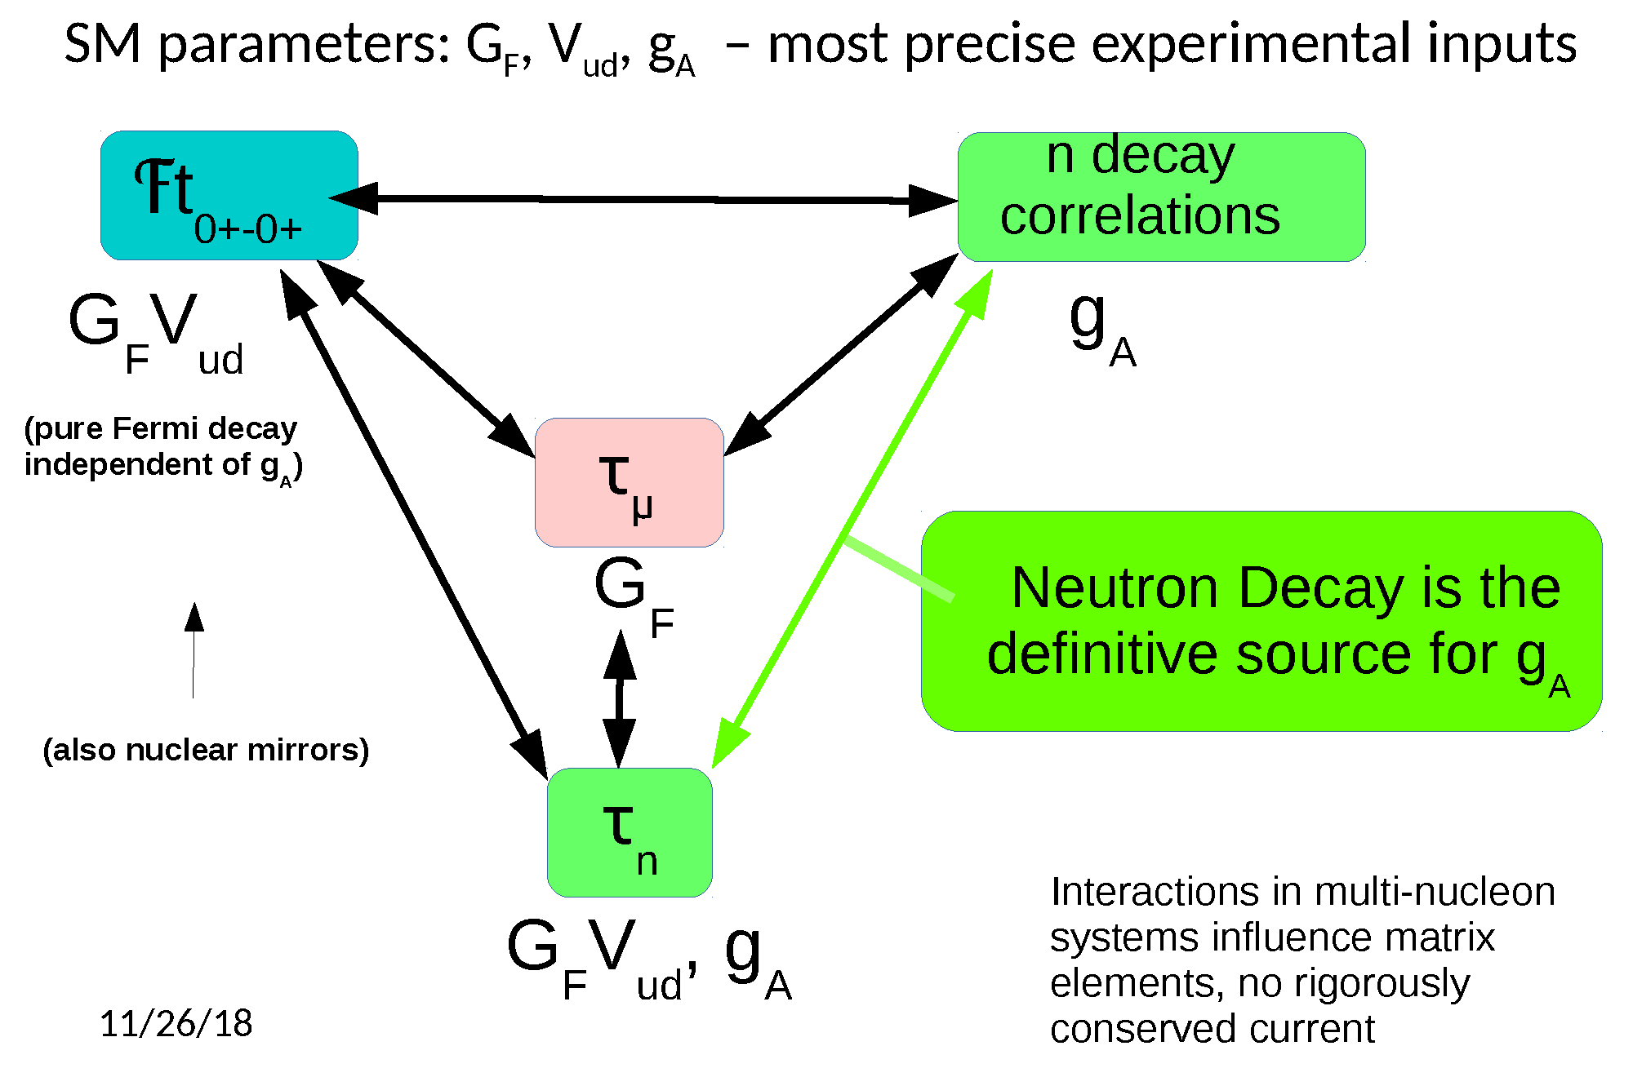
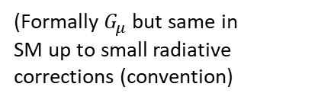
Muon Decay
~ppm precision
(Formally $G_{μ}$ but same in
SM up to small radiative corrections (convention)
M cover?

Slide 8
Most precise values of V_{ud}
M cover?

Slide 9
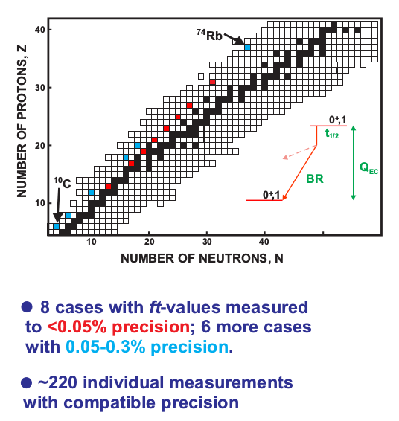

Super-allowed Nuclear Decays
Isobaric analog decays with initial and final spin,parity = 0⁺
$$0^{+}→0^{+}$$
Parent & product nuclear states almost identical
Spin selection rules ensure only G_{V} contributes
Hundreds of measurements lead to incredible experimental data precision < 10⁻⁴
But nuclear structure corrections very challenging!
Currently limiting precision at about 0.03%
(NS ~ 0.028%)
J. Hardy and I. Towner, PRC 91, 023501 (2015)
J. Hardy and I. Towner, PRC 102, 045501 (2020)
Gorchtein and Seng
M cover?

Slide 10
2 measurements required for neutron
M cover?

Slide 11
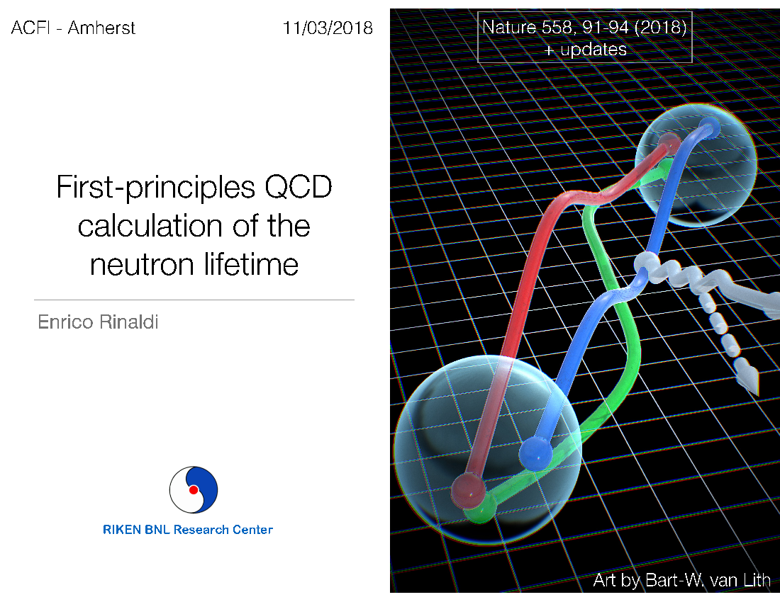
Neutron Data Impact
Neutron decay input important (with sub-1% precision) for
  Big bang nucleosynthesis (0.1% pred. of ⁴He/H !)
  Solar fusion rates
  Reactor neutrino anomaly
  High precision target for lattice nucleon couplings possible, e.g. at < 1% level in g_{A} for some approaches
Sustained lattice effort for $g_{A}$ by many collaborations, including
CalLat, PNDME, ETM, Mainz, PACS, RQCD
Pushing precision envelope for QCD

Slide 12
Neutron Data Impact
Neutron decay input important (with sub-1% precision) for
  Big bang nucleosynthesis (0.1% pred. of ⁴He/H !)
  Solar fusion rates
  Reactor neutrino anomaly
  High precision target for lattice nucleon couplings, .e.g. at < 1% level in g_{A}!
New Physics Constraints
  Input for CKM unitarity test: ~3σ discrepancy when using the most precise data for V_{ud} (from superallowed nuclear decays)
  Direct test for BSM Axial couplings (combine unitarity with lattice)
  Model independent constraints on exotic (S,T) interactions
  Variety of models (hadronic right-handed currents, leptoquarks, vectorlike quarks, charged Higgs…)

Slide 13
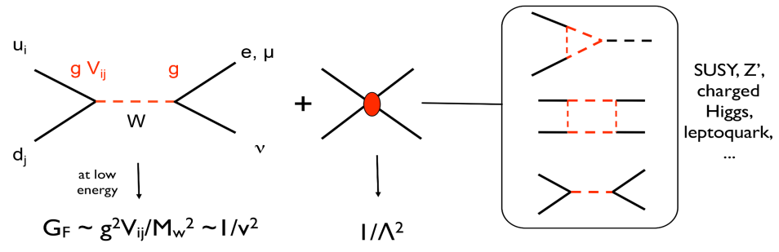
EFT Model Independent Analysis
At high energy, direct W production possible
Assume below prod scale for new physics
Cirigliano, 2013
V = 170 GeV
Contact interaction
Similar to G_{F} at low E
Build in appropriate helicity dependence
+
Permits “broad-band” comparison between sensitivity of high energy probes and beta decay
Examples: Unitarity constraint (need V_{ud}) Λ > 11 TeV for (V,A) from β decay
Λ > 7 TeV ultimately from LHC
Now!
M cover?

Slide 14
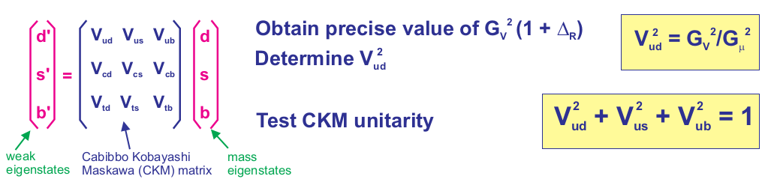


Unitarity Tests
In SM, u quark must couple to either d, s or b!
Sensitive to BSM V,A couplings!
High precision value for V_{ud} required! -- LHC can not provide! SM “backgrounds” too large
(precision limited to ~ %)
Current status: compare measured values of V_{us} with unitarity prediction
(should be consistent!)
?
$${\left|\text{V}\text{ub}\right|}^{2}≪1$$
$${\left|\text{V}\text{u}d\right|}^{2}+{\left|\text{V}\text{u}s\right|}^{2}=1$$
M cover?

Slide 15






The Cabbibo Anomaly: Unitarity Issues
decays involving strange quarks
PDG
V_{us}
$τ→$ inclusive
$τ→$ K$υ/τ→πν$
K$→πlυ$
K$→μυ/π→μν$
K$→μυ$
neutron
$β$neutron
V_{us} predicted from unitarity
Superallowed
Should all provide the same value!
[Cirigliano et al., JHEP04 (2022) 152]
M cover?

Slide 16

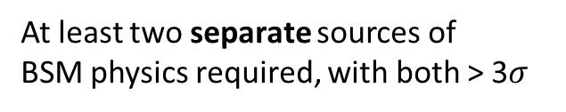
The Cabbibo Anomaly: Unitarity Issues
PDG
V_{us}
$τ→$ inclusive
$τ→$ K$υ/τ→πν$
K$→πlυ$
K$→μυ/π→μν$
K$→μυ$
$β$neutron
Superallowed
use $0^{+}→0^{+} currently$
<Vus >= 0.22431(85)
S = 2.5 from PDG 2024
[Cirigliano et al., JHEP04 (2022) 152]
1 operator at a time: [10^-3 units]
At least two separate sources of
BSM physics required, with both > 3$σ$
Lepton “non-universality” a possibility…
M cover?

Slide 17
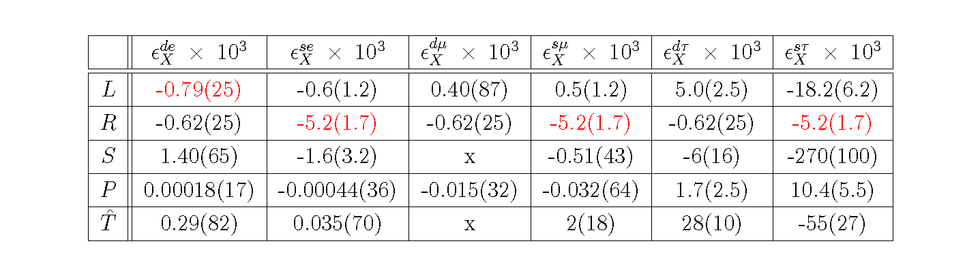
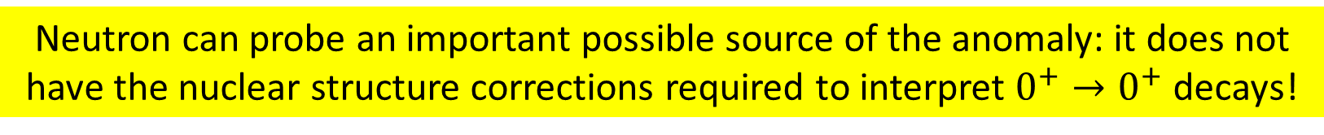
EFT analysis – check couplings one at a time to consistency with observed CAA
Based on Superallowed Decays
[Cirigliano et al., JHEP04 (2022) 152]
Cabbibo Anomaly!
Neutron can probe an important possible source of the anomaly: it does not have the nuclear structure corrections required to interpret $0^{+}→0^{+}$ decays!
In order for the neutron to compete with superallowed decays we require
Neutron uncertainty targets: lifetime – 0.3 s (current most precise, UCNtau with 0.3 s)
g_{A} ~ 0.03% (current most precise, PERKEO III with 0.044%)
More precise theory implies discovery level sensitivity possible for neutrons…

Slide 18
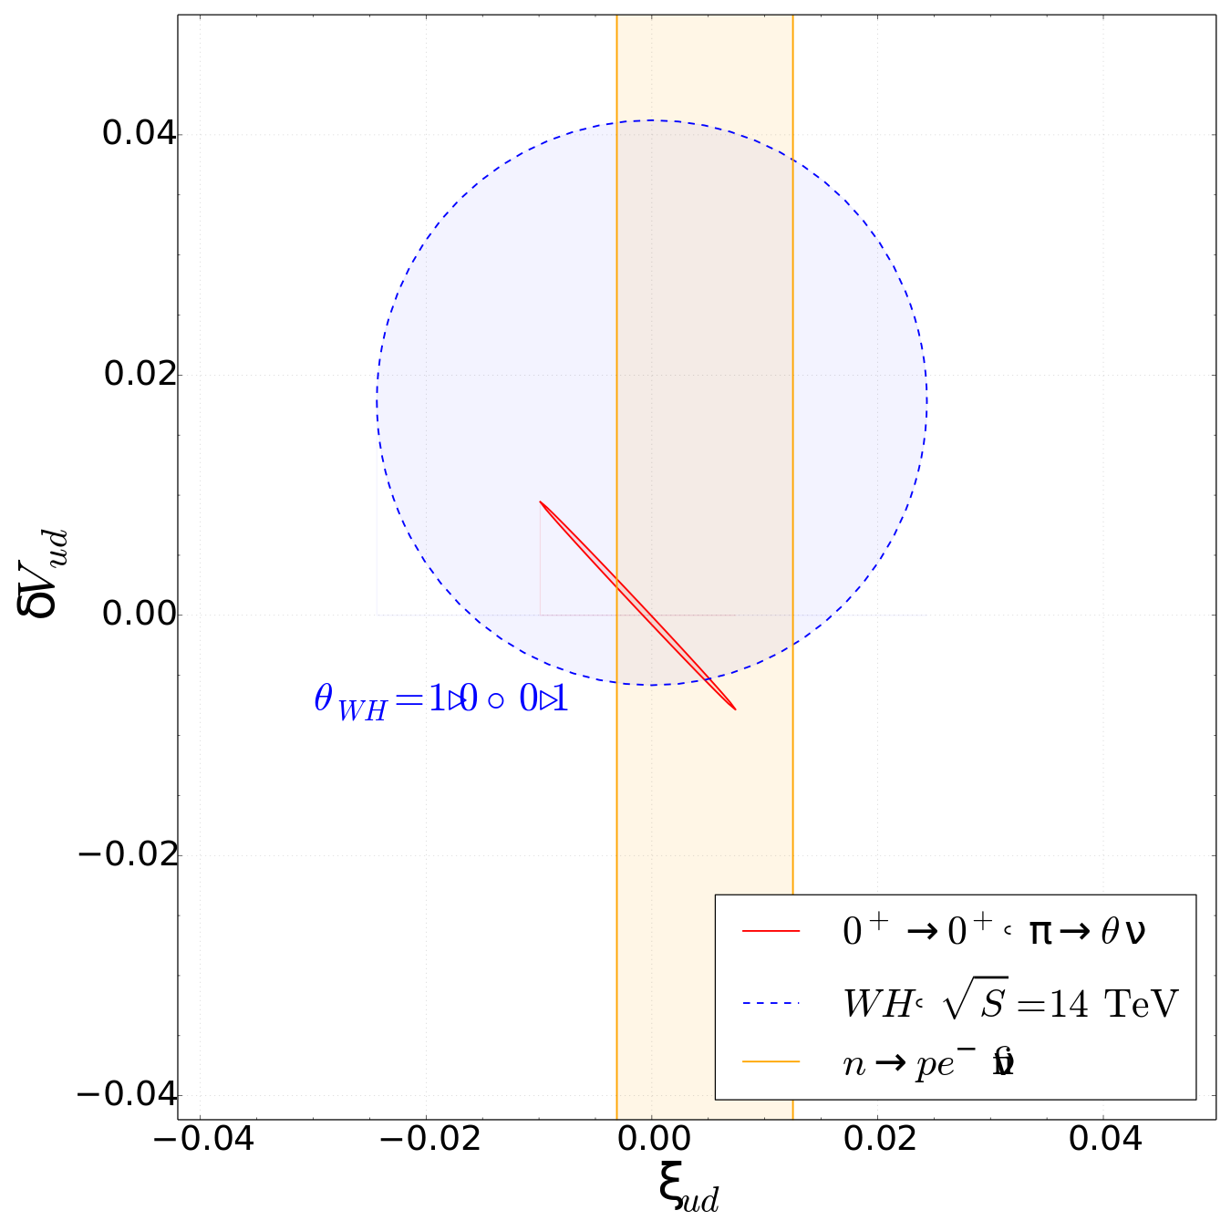
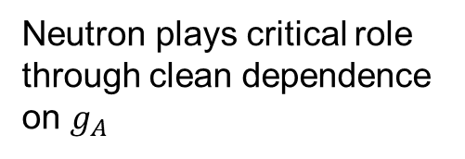
RHC Constraints with Unitarity and EFT
RHC change effective value of g_{A}!
Alioli et al., JHEP 05(2017) 086
Neutron plays critical role through clean dependence on $g_{A}$
A first: calculated SM value of g_{A} from lattice compared with value from n decay to constrain origin of BSM physics
1% precision for g_{A} from Cal-Lat group
μ_{WH}=1.0±0.1
Associated WH production at LHC: (includes contact term and SM-like term)
As before, CKM unitarity
provides stringent constraints!
ν
Note: for (S,T) interactions – helicity changing couplings suppressed relative to helicity conserving (V,A) ints → evades unitarity constraint
M cover?

Slide 19

Neutron Data Impact
Neutron decay input important (with sub-1% precision) for
  Big bang nucleosynthesis (0.1% pred. of ⁴He/H !)
  Solar fusion rates
  Reactor neutrino anomaly
  High precision target for lattice nucleon couplings, .e.g. at < 1% level in g_{A}!
New Physics Constraints
  Input for CKM unitarity test
  Direct test for BSM Axial couplings (combine unitarity with lattice)
  Model independent constraints on exotic (S,T) interactions
Beta Decay competitive with the LHC for couplings to left-handed (SM) neutrinos through Fierz interference terms b:
Integrated decay rate: $Γ=1+b\frac{m_{e}}{E_{e}}$
with $b∝\frac{1}{C_{V}^{2}+3C_{A}^{2}}\left[2C_{S}C_{V}+2C_{T}C_{A}\right]$
linear in exotic (S,T) couplings!
Bhattacharya et al., Phys. Rev. D 85, 054512
Tulin and Ramsey-Musolf, Phys. Rev. D 75, 075017 (2007)

Slide 20
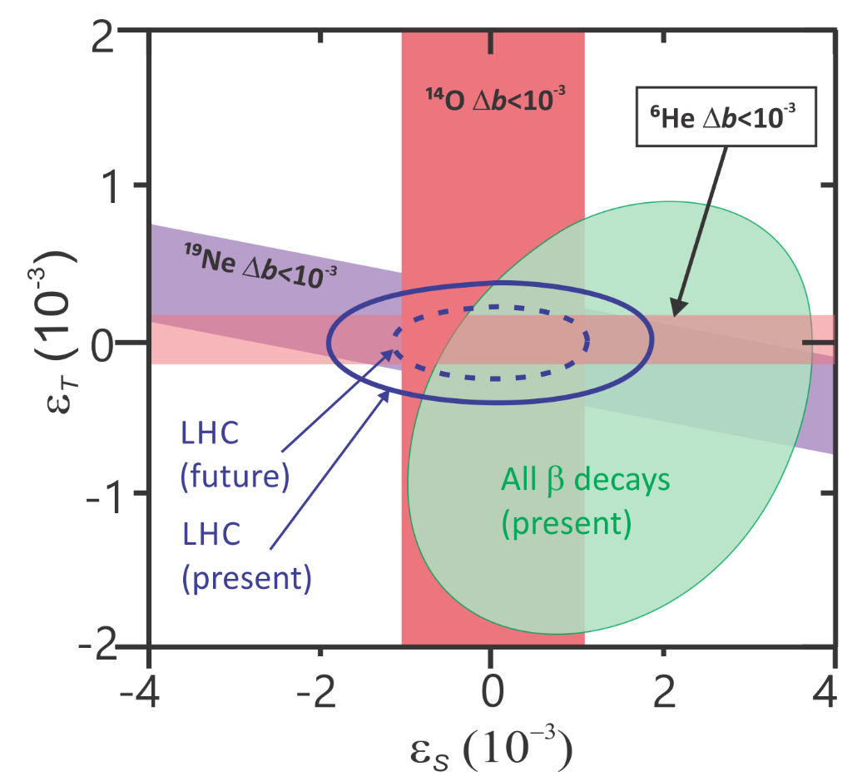



Limits on Exotic Couplings
Plot from A. Garcia
Because Fierz terms distort lifetime and angular correlation measurements, current global data set provides strong constraints!
$$b≲{10}^{−3}$$
Neutron and superallowed decay data play a huge role in these limits (left-handed neutrino couplings) but direct Fierz limits not competitive yet for neutron
$$C_{S}=C_{V}ε_{S}$$
BSM
$$C_{T}={4C}_{A}ε_{T}$$
(new physics)
Falkowski et al, JHEP04 (2021) 126
We will return to this point with “Prospects”

Slide 21

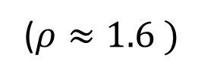
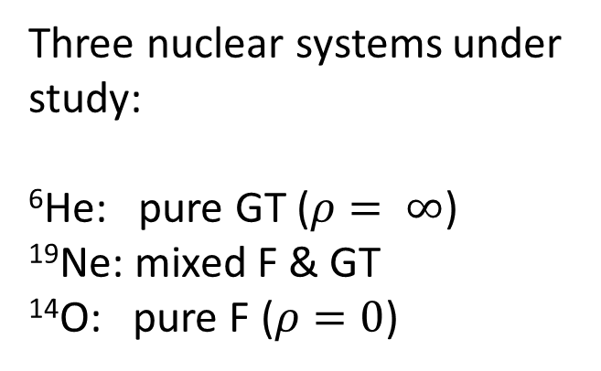
At present, most promising approach to improve involves measuring the beta spectrum using Cyclotron Resonance Emission Spectroscopy (CRES) using nuclei (first introduced for Project 8):
He6-CRES collaboration (spokesperson, A. Garcia):
Byron et al, PRL 131, 082502 (2023)
Three nuclear systems under study:
⁶He: pure GT ($ρ= ∞$)
¹⁹Ne: mixed F & GT
¹⁴O: pure F ($ρ=0$)
$$b≲{10}^{−3}$$
($ρ≈1.6 )$
$$C_{S}=C_{V}ε_{S}$$
BSM
$$C_{T}={4C}_{A}ε_{T}$$
Neutron: mixed F & GT ($ρ≈−2.2$)
(new physics)
Direct limits on Fierz Terms!
We will return to this point with “Prospects”

Slide 22
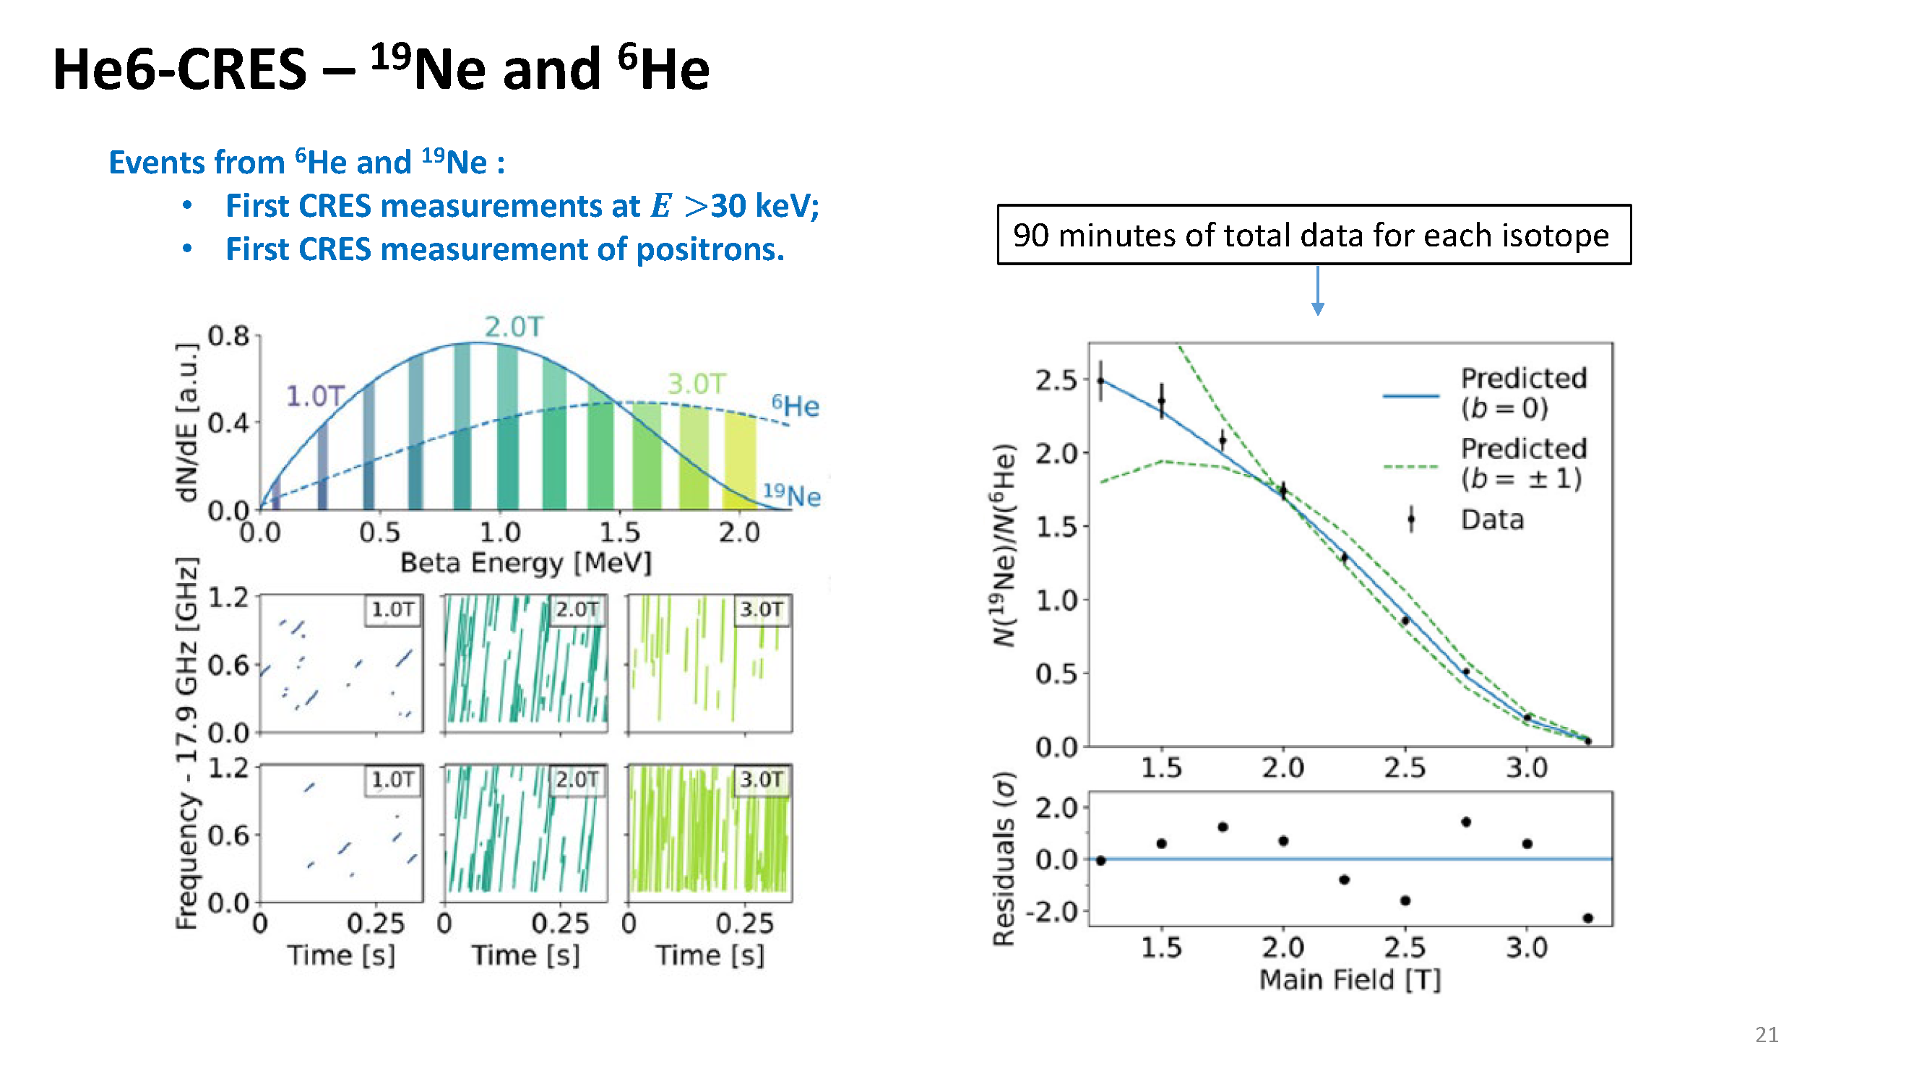
Ratio of Spectra
Well defined in SM, enhanced sensitivity to Fierz
Publication:
Byron et al, PRL 131, 082502 (2023)

Slide 23
Recent Theory Progress
2017: Dispersion analysis of hadronic loop contributions to the radiative corrections
2021: Self-consistent EFT analysis of all low energy beta decay data
2023: Rigorous EFT Treatment of Radiative and Recoil Order Corrections for N Decay
2023: Multi-component analysis of new physics scenarios with EFT
2024: Lattice Analysis of Hadronic Loop Contributions
2024: Rigorous EFT Treatment applied to superallowed decays
For neutron, theory good to 0.01% except hadronic contrib. to radiative corrections (0.02%)

Slide 24












Beta Decay Observables
I_{f}
ν_{e}
I_{i}
$$θ_{Ip}$$
proton
$$θ_{Ie}$$
I_{i}
Don’t observe final state spins
or neutrino
neutron
(BRAND is an exception to this)
neutron decay (at rest):
e⁻
Decay rate
Energy spectrum: p, e
Directional distribution
(angular correlations)
Many accessible observables
Use momentum consv:
Notes:
24

Slide 25
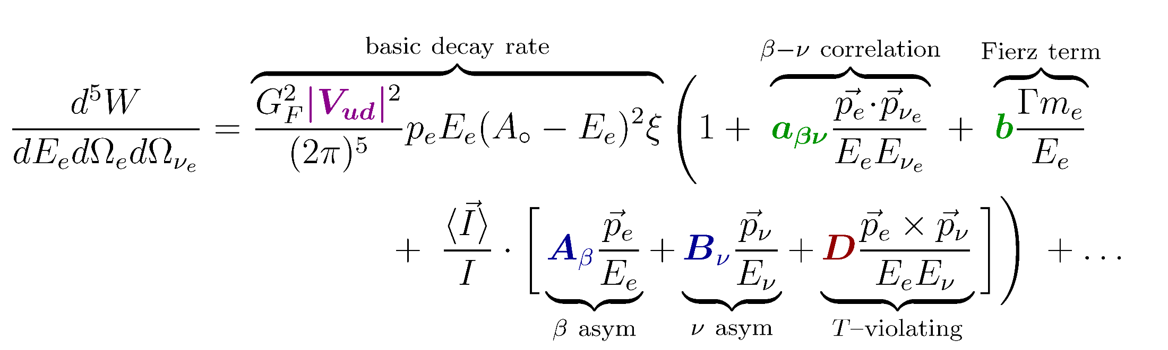
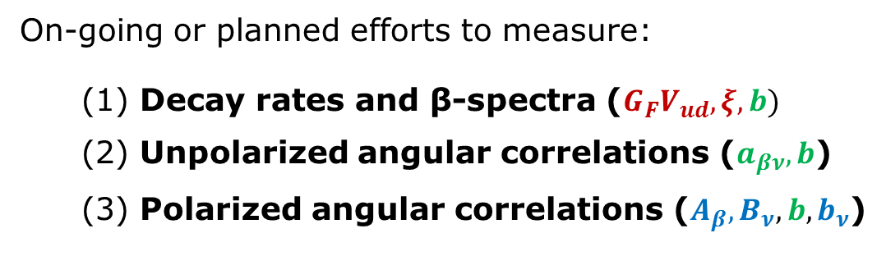
Beta Decay Parameters
Jackson, Treiman and Wyld (Phys. Rev. 106 and Nucl. Phys. 4, 1957)
Note: to specify both C_{V} and C_{A}, 2 meas. needed
Notes:
25

Slide 26
The Neutron Global Dataset
Reminder: we need a lifetime and angular correlations measurement
to fix SM predictions
Special thanks to D. Salvat, C.-Y Liu, F. Wietfeldt for slides

Slide 27
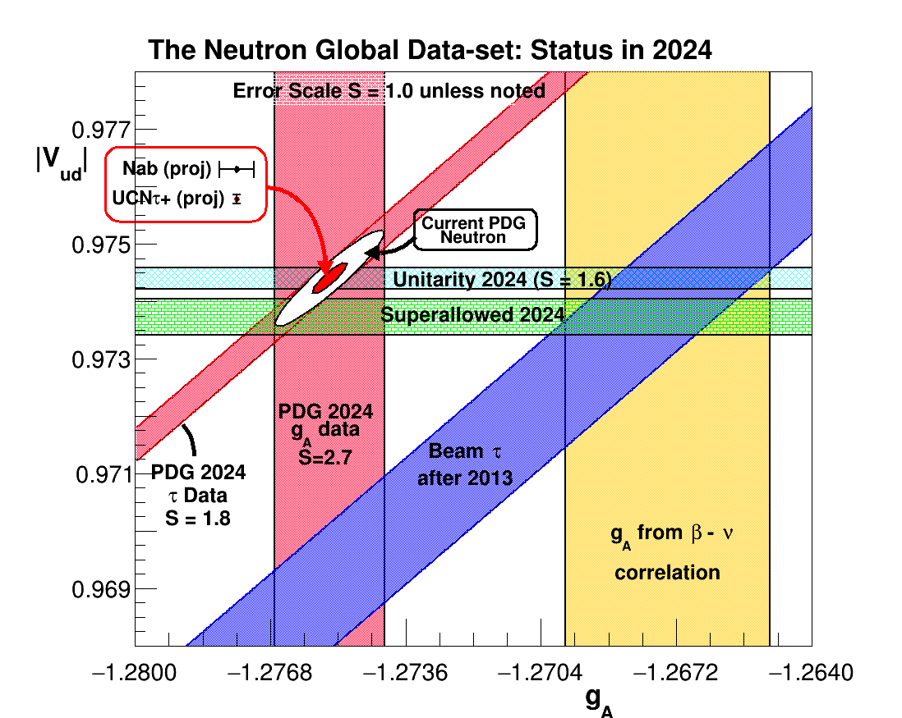


$${\left|\text{V}\text{u}d\right|}^{2}=1−{\left|\text{V}\text{u}s\right|}^{2}$$
PDG expands error for $V_{us}$

Slide 28
The Particle Data Group (PDG):
Average values agree with unitarity and superallowed decays
significant scale factors on uncertainties to account for scatter
Roughly factor of 3 larger uncertainty for neutron than superallowed…

Slide 29

Experimental challenges:
The lifetime puzzle:
Dominated by UCN storage expts
Most precise beam lifetime (BL1)
BL2 and BL3 ongoing!
$τ_{beam}−τ_{UCN}=9.6\left(2.1\right) s \sim 1\%$
⁴He abundance…

Slide 30
Neutron Lifetime Measurements
Special thanks to D. Salvat, C.-Y Liu, F. Wietfeldt for slides

Slide 31
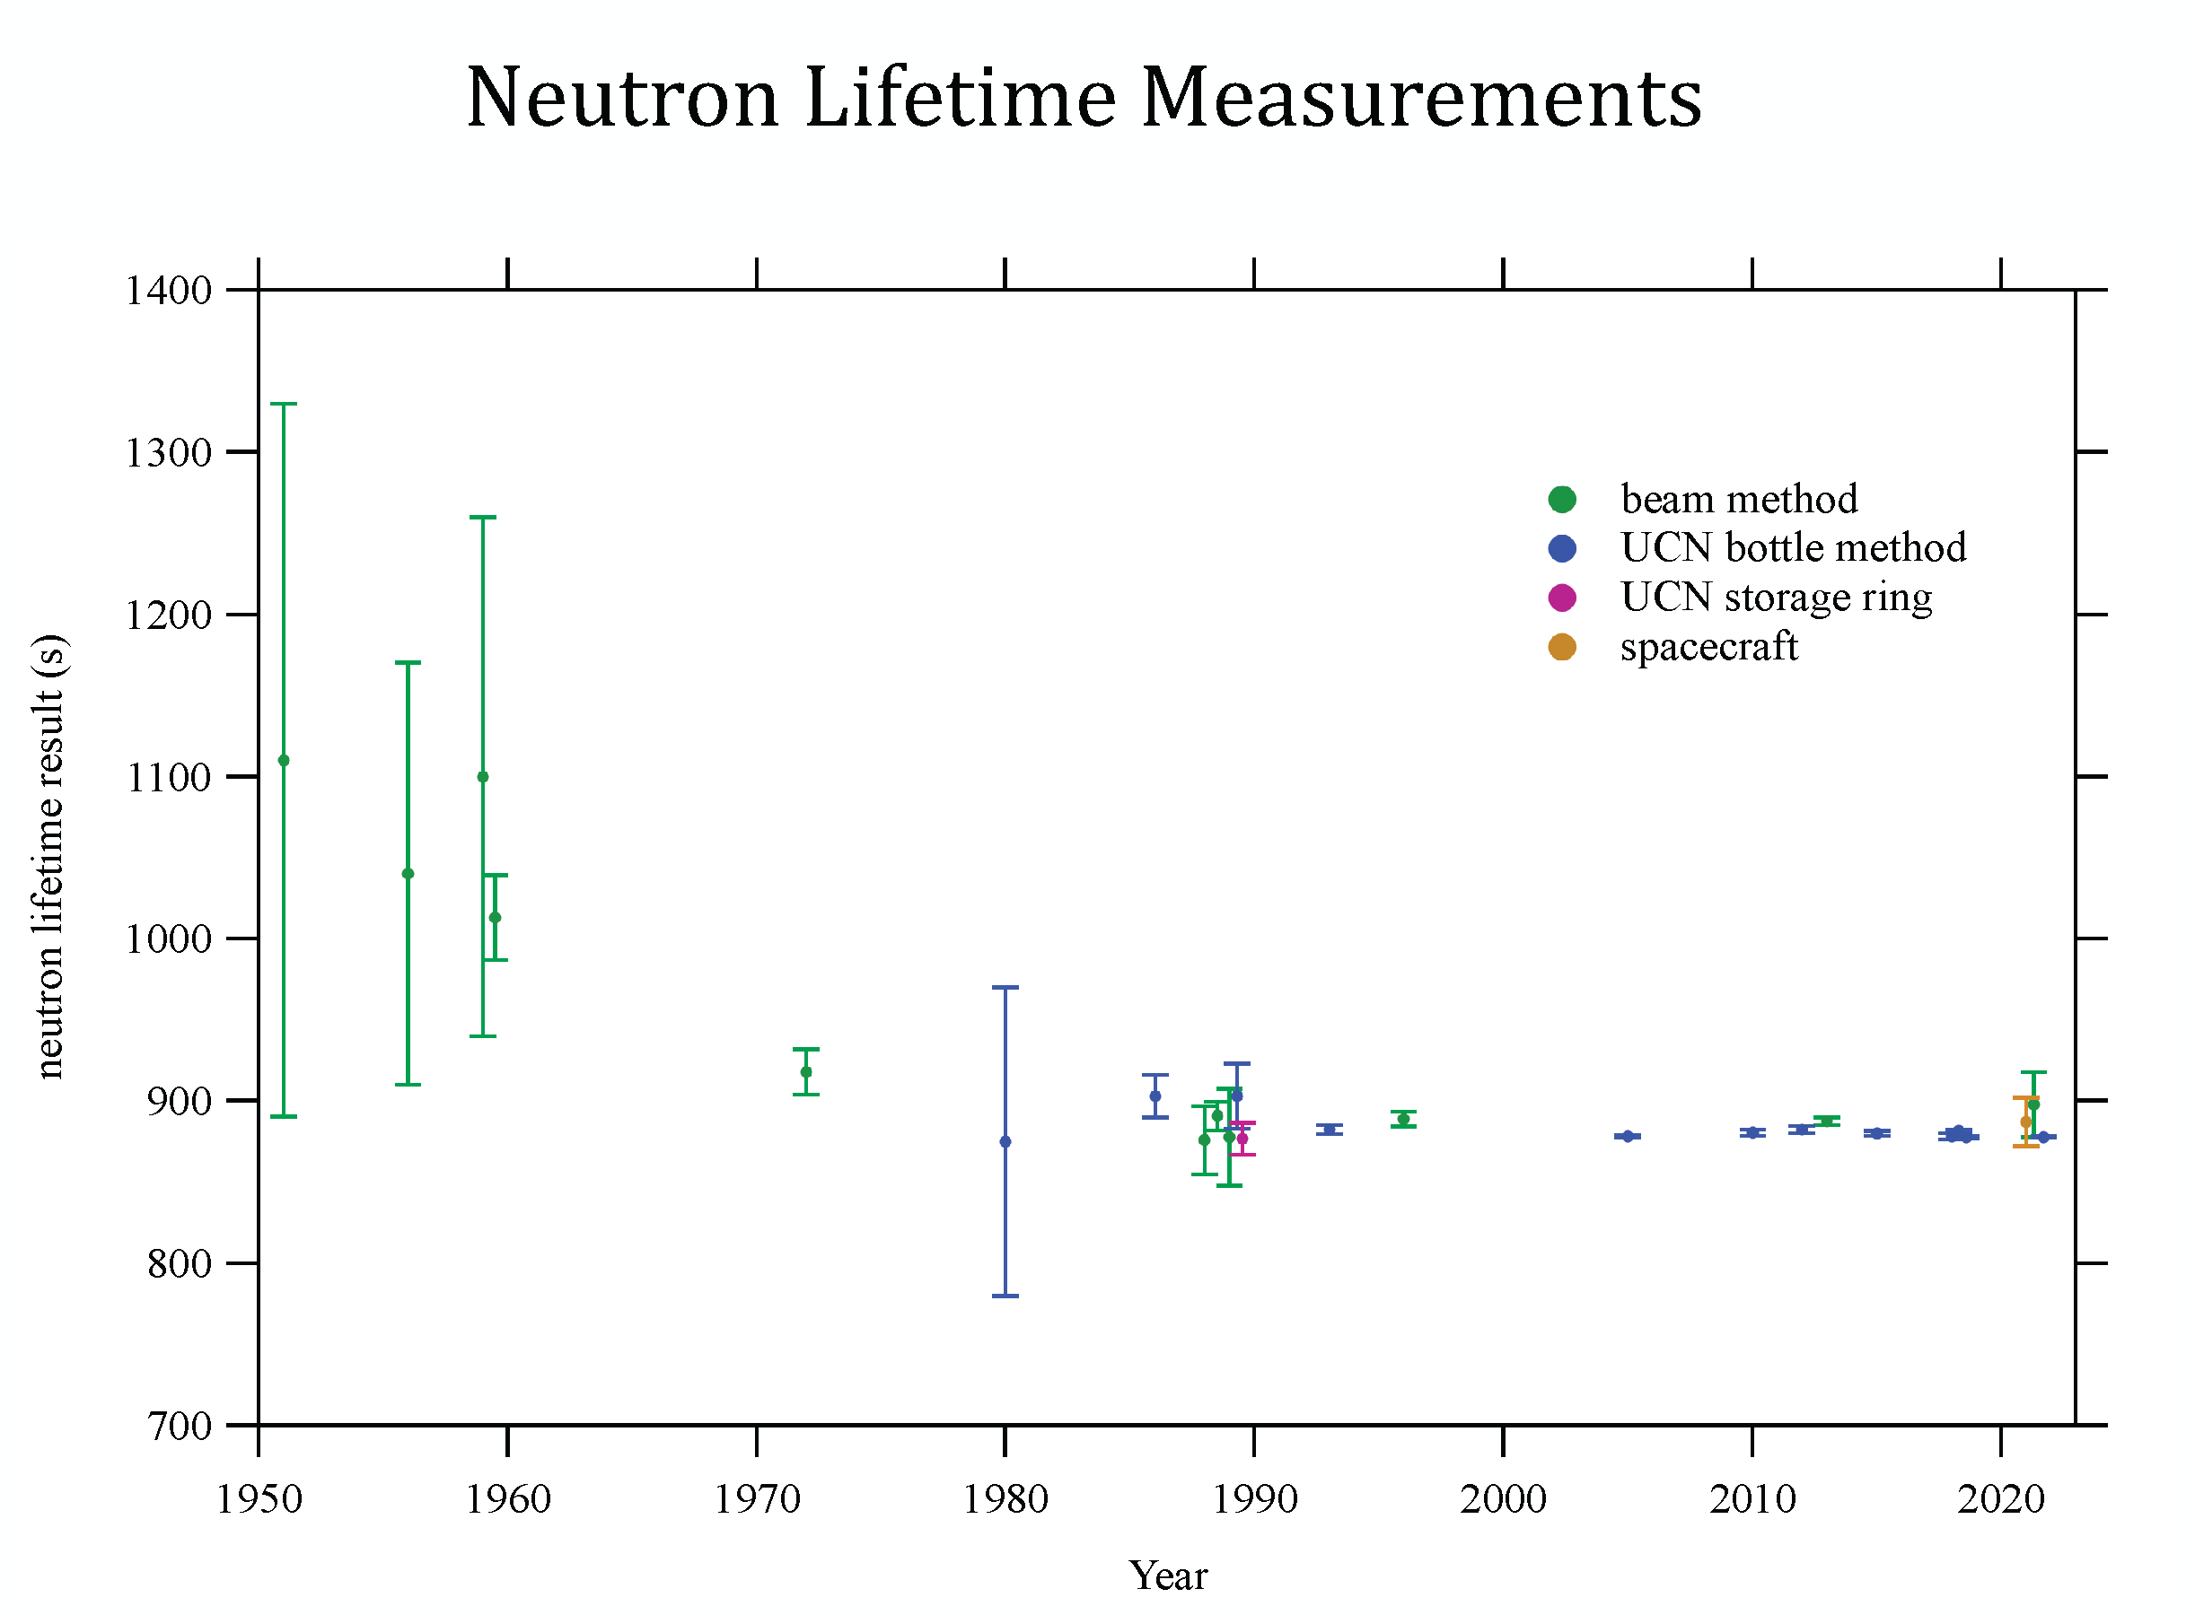
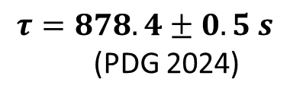
(quite a history!)
$$τ=878.4±0.5 s$$
(PDG 2024)
Challenging:
Neutral Particle
Absorbed by ~ all materials
Relatively long-lived
All beams before 1980…
From: Wietfeldt and Greene, Rev. Mod. Phys. 83, p. 1173 (2011)

Slide 32
Beams I
Special thanks to D. Salvat, C.-Y Liu, F. Wietfeldt for slides

Slide 33
First beam measurement
(Robson, Phys. Rev. 83, 349 (1951)
From: Wietfeldt and Greene, Rev. Mod. Phys. 83, p. 1173 (2011)

Slide 34
Lifetime measurements with cold neutron beams
State of the art as of 2005…
L
d
L
n
thin detector
Beam area A
Neutron
e⁻ and/or p
beam
N neutrons
d
Thin neutron detector e.g. ³He
Decay products detector
(1) Count protons
from neutron beta decay

Slide 35
Lifetime measurements with cold neutron beams
State of the art as of 2005…
L
d
L
n
thin detector
Beam area A
Neutron
e⁻ and/or p
beam
N neutrons
d
Thin neutron detector e.g. ³He
Decay products detector
(1) Count protons
from neutron beta decay
(2) Determine neutron
density in beam using
neutron detector

Slide 36
Lifetime measurements with cold neutron beams
State of the art as of 2005…
th th
L
d
L
n
thin detector
Beam area A
Neutron
e⁻ and/or p
beam
N neutrons
d
Thin neutron detector e.g. ³He
Need absolute proton
detection efficiency and
very well-defined volume
Need absolute neutron detection efficiency
Decay products detector
(1) Count protons
from neutron beta decay
(2) Determine neutron
density in trap using
neutron detector

Slide 37
Lifetime measurements with cold neutron beams
Assume (1) mono-energetic neutron beam (v ) with flux Φ and density ρ
n n n
(2) neutron detector cross section proportional to 1/v = σ v /v
th th
Beam area A
d
Neutron
e⁻ and/or p
beam
Decay products detector with efficiency ε
d
S
ε (Φ/v)AL
n d
1
S_{n}ε_{d} L_{d}
Detected signals, S
d
=
τ =
S
ε (Φ/v)AL σ v
d n th th
τ
S_{d}ε_{n}L_{n}σ_{th}v_{th}
n
So...with knowledge of absolute efficiencies, the length of the decay and neutron detection regions, and the neutron absorption cross-section, you can determine the neutron beta decay lifetime!

Slide 38
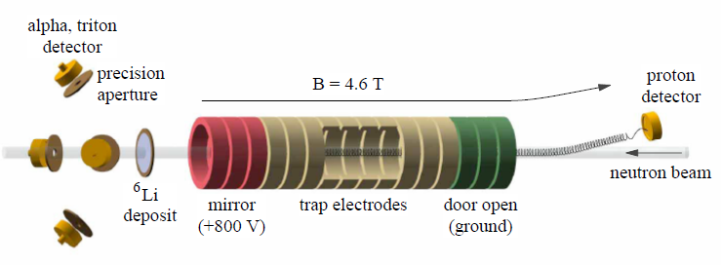
The most precise beam experiment is at the
National Institute of Standards and Technology (NIST)
Cold neutron beam, collimated to 2 mm
A quasi-penning trap electrostatically traps beta-decay protons. When the door electrodes are set to ground, the protons are guided by a B field to an external detector (surface barrier Si detector).
Neutron monitor measures the incident neutron flux by counting n+⁶Li→ ³He +
α
39

Slide 39
The most precise beam experiment is at the
National Institute of Standards and Technology (NIST)
Cold neutron beam, collimated to 2 mm
A quasi-penning trap electrostatically traps beta-decay protons. When the door electrodes are set to ground, the protons are guided by a B field to an external detector (surface barrier Si detector).
Neutron monitor measures the incident neutron flux by counting n+⁶Li→ ³He +
Hard part! Limiting uncert. due to neutron abs. cross section eliminated in 2013
α
BL1
39

Slide 40
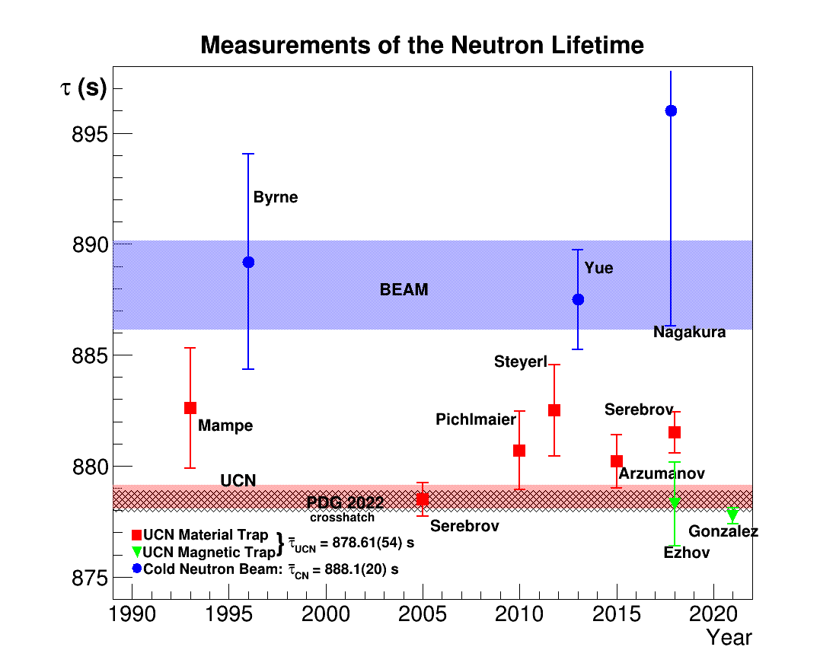
Nico
Conclusion:
Decay rate from beam experiment 1% slower!

Slide 41
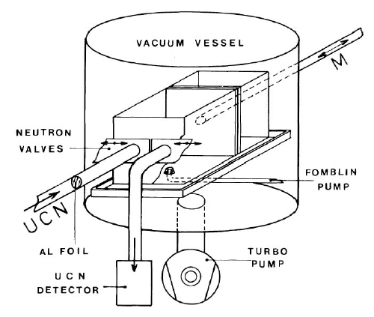

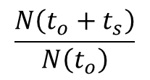
Lifetime measurements: two varieties
Beam lifetimes: count neutron beta decay products
Requires precisely known:
i) decay volume
ii) absolute neutron density
iii) decay product detection efficiency
Pre-2013: neutron density was dominant source of uncertainty
Neutron
e⁻ and/or p
beam
Decay products detector
UCN storage experiments: count neutrons which survive after well defined storage time t_{s}
Actually measures total loss rate from trap…
$$\frac{N\left(t_{o}+t_{s}\right)}{N\left(t_{o}\right)}$$
Pre-2018: losses due to collisions with material surfaces was dominant source of uncertainty
Notes:
41

Slide 42
Neutron Storage I
Special thanks to D. Salvat, C.-Y Liu, F. Wietfeldt for slides

Slide 43
Kosvintsev, JETP Lett. 31 236–40 (1980)
Early Beam Measurements
From: Wietfeldt and Greene, Rev. Mod. Phys. 83, p. 1173 (2011)

Slide 44
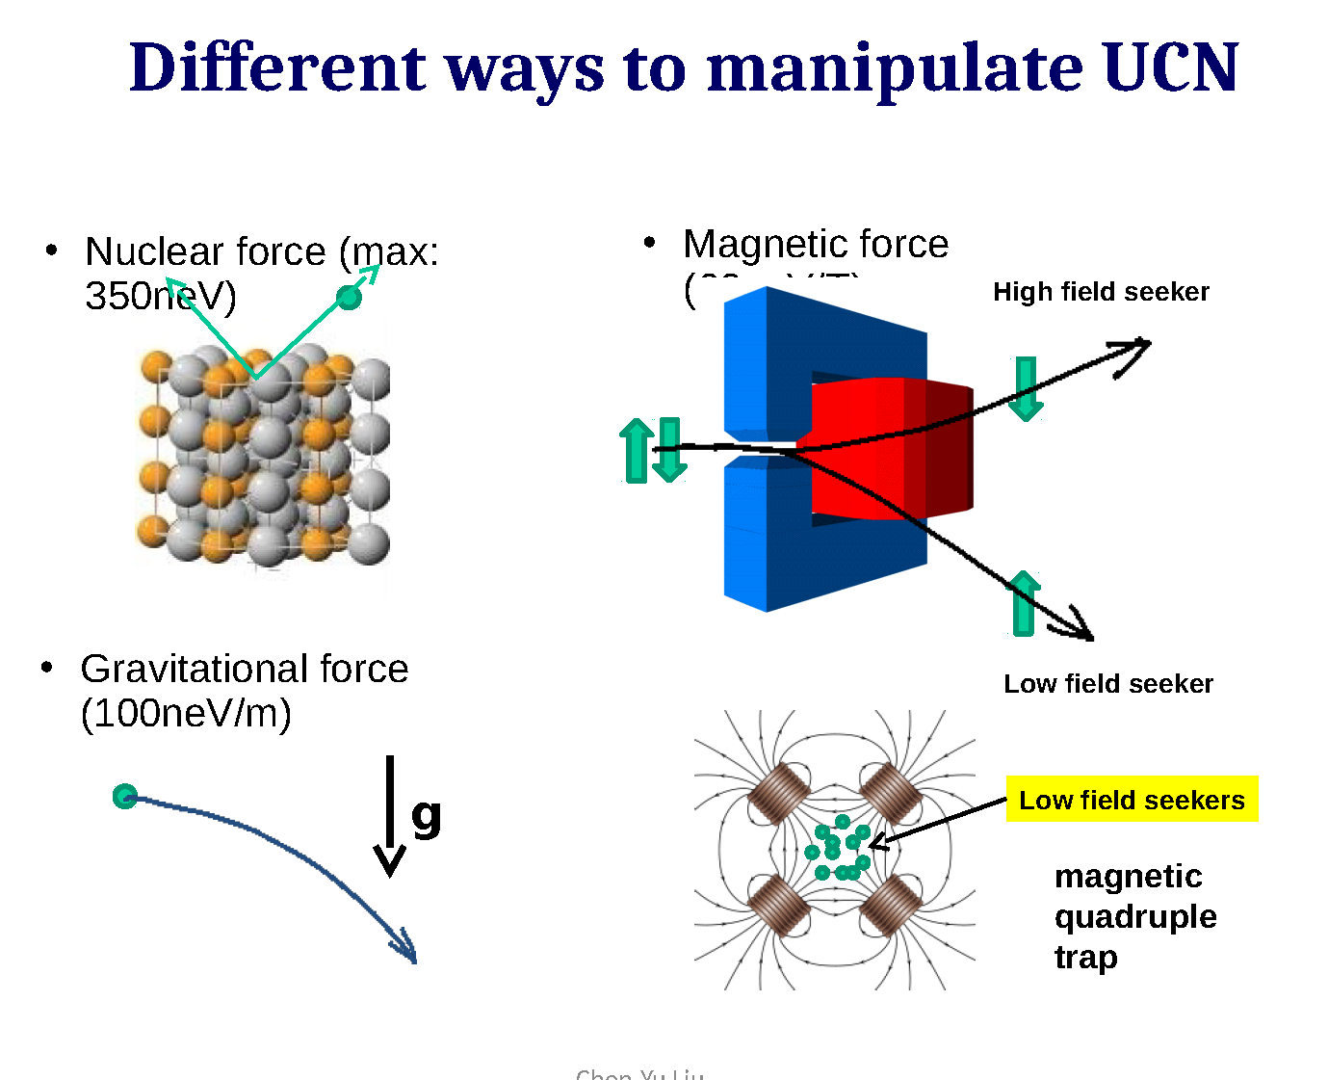
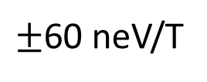
Ultracold Neutron (UCN) energies so low, they reflect from some material surfaces for any angle of incidence!
Store them in bottles!
$±$60 neV/T
Old idea: use repulsive magnetic forces to trap UCN!
Vladimirskii, Zhur. i. Teoret Fiz., 1960
C.-Y. Liu

Slide 45
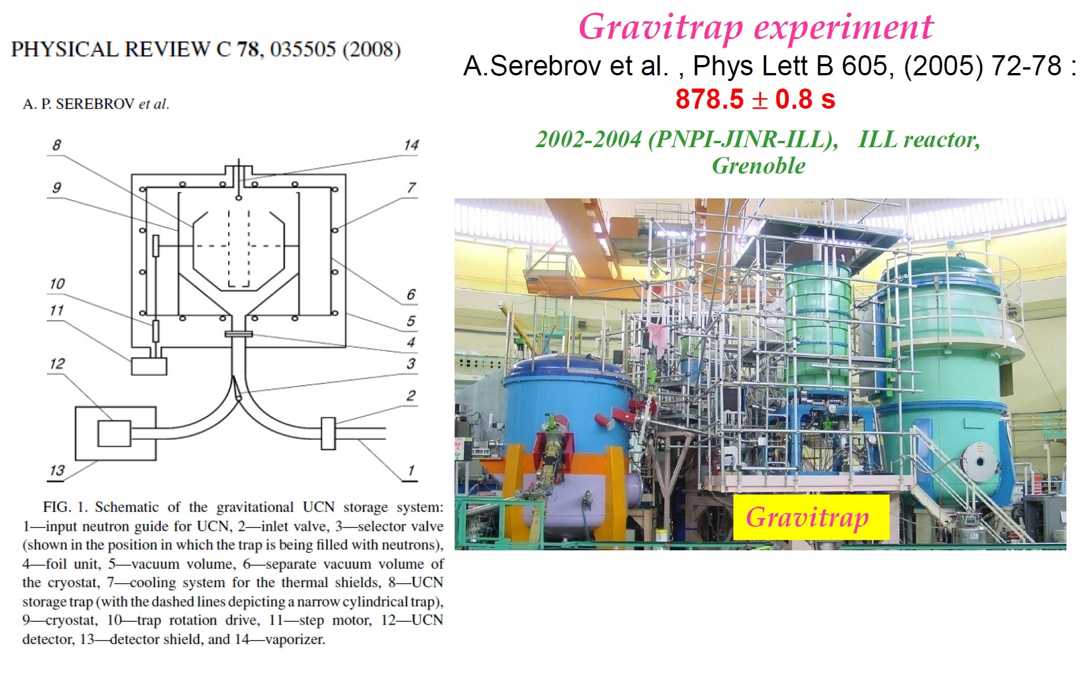

The Gravitrap Experiment
7 liters
51

Slide 46
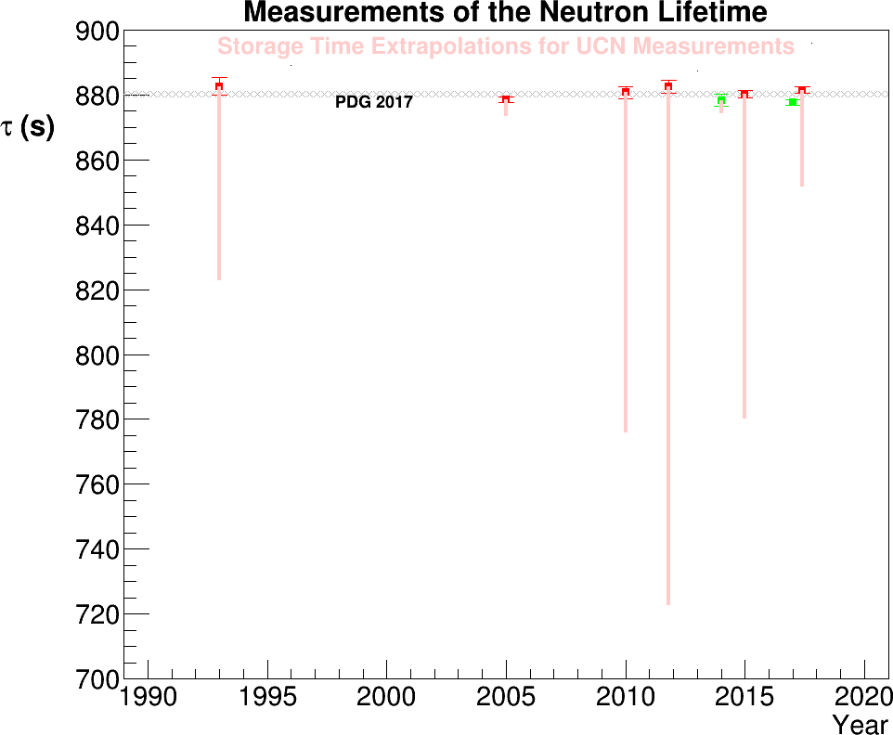
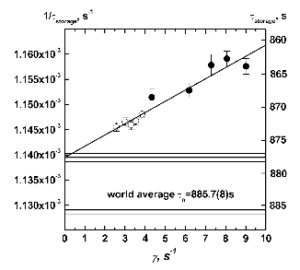
Serebrov’s experiment by far the best material storage experiment – low temperature fluorinated polymer coating requires only 8s extrapolation...
The big difference:
Corrections for UCN storage experiments in material traps due to losses are typically large!

Slide 47
Most recent results for groups or experiments
Nico
Conclusion:
Decay rate from beam experiment 1% slower!
Average for Storage

Slide 48
Lifetime measurements: two varieties
Neutron
Historically, shown reasonable agreement,
but since 2013:
e⁻ and/or p
beam
Cold neutron beams: τ = 888.0(2.0) s
Decay products detector
Differ by > 4σ
UCN storage experiments in material traps:
τ = 878.4(5) s
Notes:
48

Slide 49
The Path Forward (since 2013):
Explore possible indications of new (BSM) physics
  Decay to Dark Particles
  Neutron-mirror neutron (N-N’) oscillations
Confirm beam and storage measurement results
  Develop experiments with alternative measurement techniques
  Improve control of the sources of systematic uncertainty on existing techniques

Slide 50
Beams

Slide 51
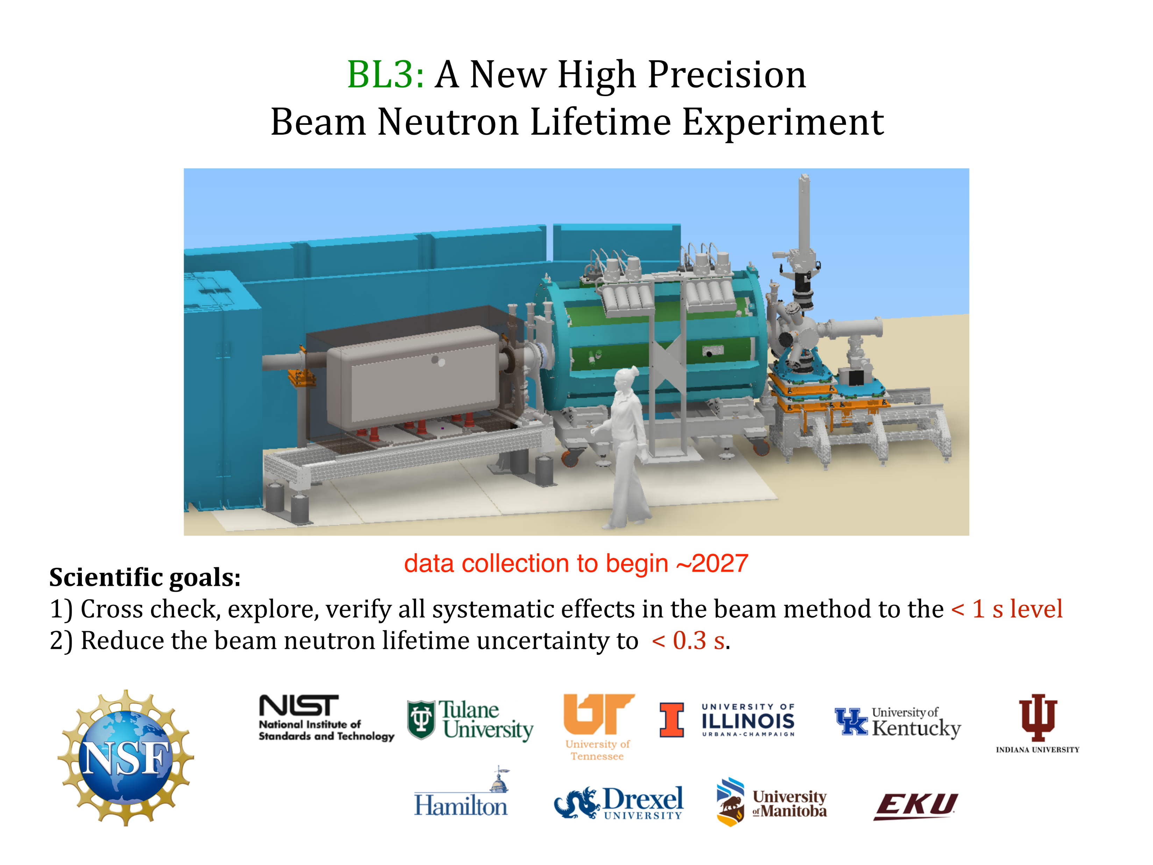
Spokesperson: F. Wietfeldt

Slide 52
This part of the project is called BL2, with final running planned in 2026

Slide 53




Principle of J-PARC experiment
Cold neutrons are injected into a TPC.
The neutron β-decay and the ³He(n,p)³H reaction are measured simultaneously.
Information from Kenji Mishima
Principle
Count events during time of bunch in the TPC
（Kossakowski,1989）
Neutron bunch
shorter than TPC
Neutron bunch
p
³He(n,p)t
e
ν
τ_{n}
v
ε_{e}
: lifetime of neutron
: velocity of neutron
: detection efficiency of electron
β-decay
ε_{n}
ρ
σ
: detection efficiency of ³He reaction
: density of ³He
: cross section of ³He reaction
³He(n,p)³H
σ₀=cross section@v₀, v₀=2200[m/s]
This method is free from the uncertainties due to external flux monitor, wall loss, depolarization, etc.
The goal is the experiment is accuracy of 1 sec.
Notes:
Principle of our experiment is following.
We use a Time Projection Chamber with doped 3He.
The electron from the neutron decay(上式) and the proton from the 3He(n,p)3H reaction(下式) can described by this fomula.
The ratio of counting rate of electrons and protons gives the neutron lifetime.
By using shorter neutron bunches and measuring only when the bunches are totally in the TPC,
we can obtain high efficiency(tau式).
Both of them are measured simultaneously in a same detector.
So systematic uncertainty of fiducial volume will be canceled.
-----
Comparing with UCN experiment, There are no systematic uncertainties due to wall interaction or depolarization.

Slide 54
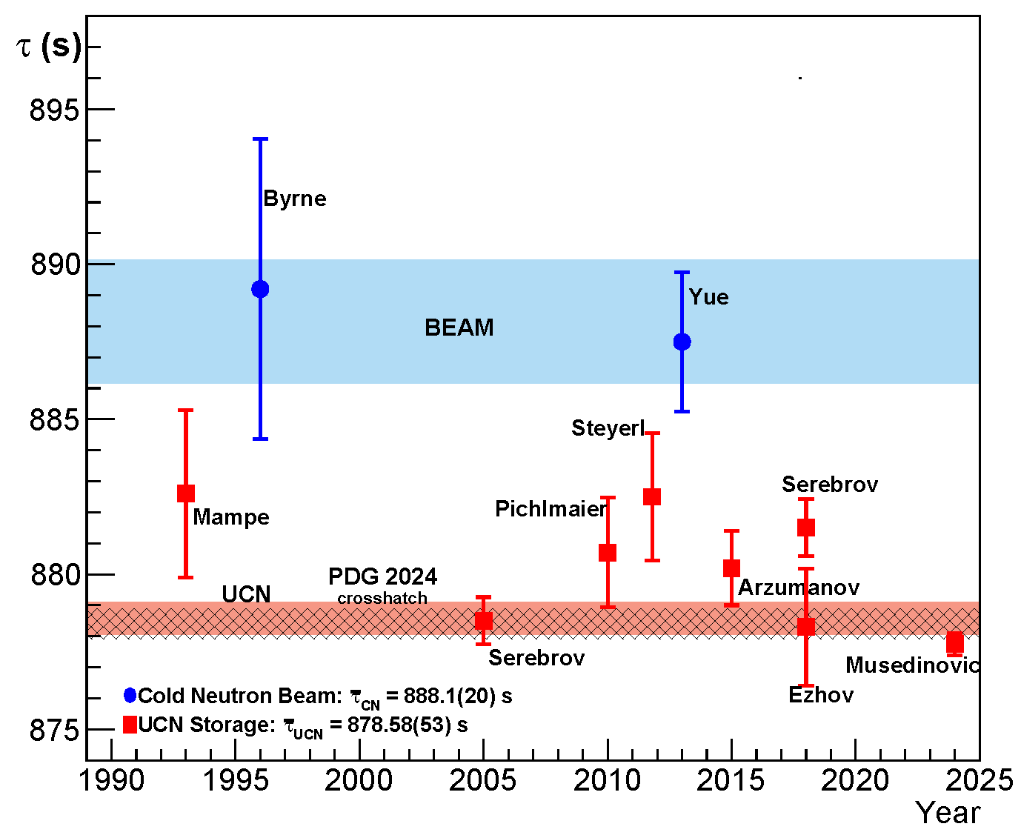
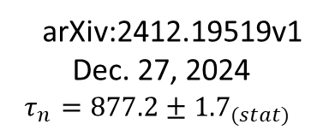


Most recent results for groups or experiments
JPARC Beam Experiment
arXiv:2412.19519v1
Dec. 27, 2024
$$τ_{n}=877.2±{1.7}_{(stat)}$$
$$\begin{matrix}+4.0 \\ −3.6\end{matrix}$$
$$\left(sys\right)$$
2.3σ tension with previous beam expts…
Fuwa

Slide 55
Neutron Storage (Magnetic Bottles)
UCN do not make contact with material walls, avoiding primary loss mechanism of material traps
Special thanks to D. Salvat, C.-Y Liu, D. Ries and for slides

Slide 56
Most recent results for groups or experiments
Magnetically Trapped UCN!
UCNτ and Ezhov published first high precision results in 2018
(UCNτ published two updates since then)

Slide 57
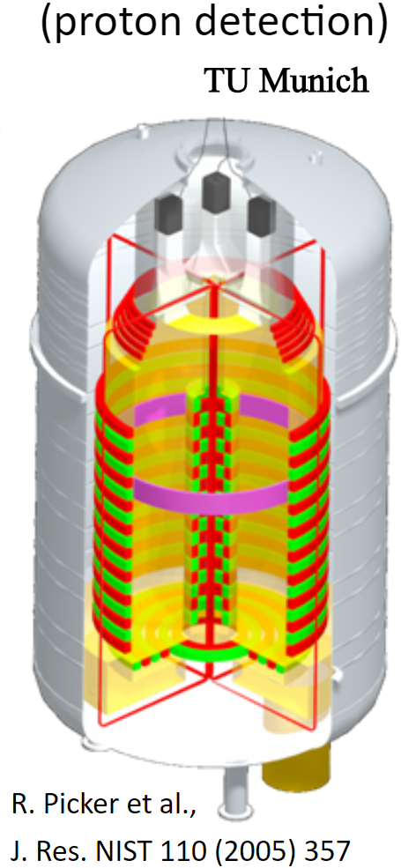
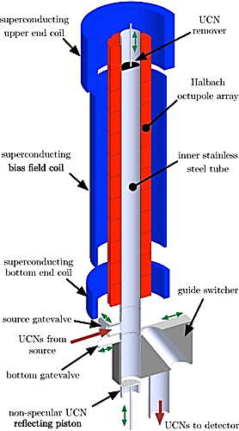
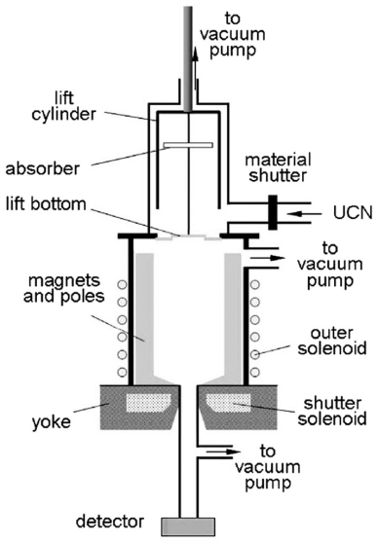
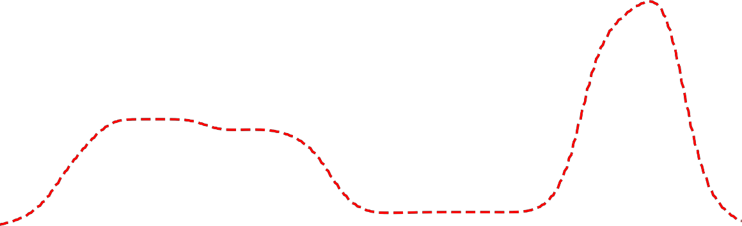





Magnetic Bottles: Many in Progress
HOPE
PENeLOPE
15 l
2 l
ρ_{UCN} = 10³ – 10⁴ cm⁻³ (FRM II)
Stat δτ_{n} ~ 0.1 s in 2-4 days
700 l
$τ$Spect
V. Ezhov et al., NIMA, 611, 167 (2009)
superconducting magnet
HFS LFS
AFP
Spin-Flip
τ_{n} = 878.3 ± 1.9 s
τ_{n} =(887±39)s
UCN-guide
Leung, et al, PRC 94, 045502 (2016)
Oktupole magnet
p-detector
Notes:
Other experiment try to use magnetic bottle to mitigate the problem of surface loss.
UCN loss in magnetic traps:
Depolarization (adiabatic, Majorana: zero field)
Marginally trapped neutrons
Magnetic Storage of Neutron and Proton Extraction
57

Slide 58
Magnetic Bottles: Many in Progress
HOPE
PENeLOPE
15 l
ρ_{UCN} = 10³ – 10⁴ cm⁻³ (FRM II)
Stat δτ_{n} ~ 0.1 s in 2-4 days
First demonstration of magnetically trapped UCN
2 l
700 l
V. Ezhov et al., J. Res. NIST 110 (2005) 345
Full analysis published in 2018
Earlier measurement with trapped Very Cold Neutrons in a magnetic storage ring
W. Paul et al., Zeitschrift fur Physik C43, 175 (1989)
$τ$Spect
V. Ezhov et al., NIMA, 611, 167 (2009)
superconducting magnet
HFS LFS
AFP
Spin-Flip
τ_{n} = 878.3 ± 1.9 s
τ_{n} =(887±39)s
UCN-guide
Leung, et al, PRC 94, 045502 (2016)
Oktupole magnet
p-detector
Notes:
Other experiment try to use magnetic bottle to mitigate the problem of surface loss.
UCN loss in magnetic traps:
Depolarization (adiabatic, Majorana: zero field)
Marginally trapped neutrons
Magnetic Storage of Neutron and Proton Extraction
58

Slide 59
UCN Lifetime Experiment at the ILL
Neutrons from the ILL turbine.
Trapped with permanent magnets and gravity.
Surviving neutrons counted.
Analysis unpublished
V. Ezhov et al., J. Res. NIST 110 (2005) 345
59
Notes:
UCN loss in magnetic traps:
Depolarization (adiabatic, Majorana: zero field)
Marginally trapped neutrons
59

Slide 60
Magnetic Bottles: Many in Progress
PENeLOPE
Spokesperson R. Picker
Moved from TU Munich to TRIUMf, installed at the TUCAN UCN source
Quench training will begin after appropriate He capture components (recovery balloon and piping) are installed
First UCN tests in 2027, earliest
Goal ~ 0.1 s
ρ_{UCN} = 10³ – 10⁴ cm⁻³ (FRM II)
Stat δτ_{n} ~ 0.1 s in 2-4 days
700 l
Information from M. Fertl and D. Ries
Moved from Mainz UCN source to PSI in 2023
Features a “double” spin-flipper loading mechanism which provides cooling
Currently operating, with statistics accumulated in late 2024 for about 1% uncertainty in lifetime!
Goal for this apparatus ~ 0.3 s (M. Fertl’s talk)
$τ$Spect
superconducting magnet
HFS LFS
AFP
Spin-Flip
UCN-guide
Oktupole magnet
p-detector
Notes:
Other experiment try to use magnetic bottle to mitigate the problem of surface loss.
UCN loss in magnetic traps:
Depolarization (adiabatic, Majorana: zero field)
Marginally trapped neutrons
Magnetic Storage of Neutron and Proton Extraction
60

Slide 61
2024: 𝜏SPECT experiment operating at PSI UCN source
J. Auler, et al., J. Phys. G: Nucl. Part. Phys. 51 115103, 2024

Slide 62

UCN$τ$
(current state of the art for magnetically trapped UCN)
spokespersons: A. T. Holley and S. Clayton

Slide 63
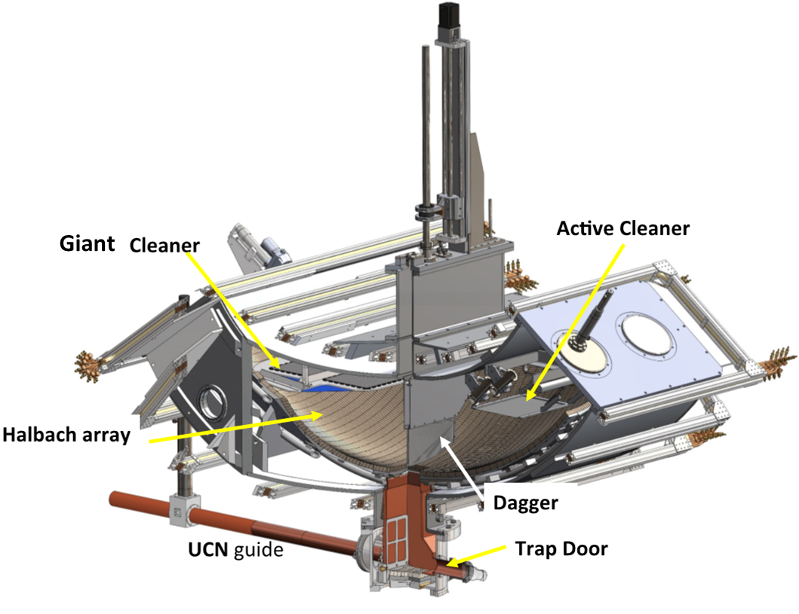
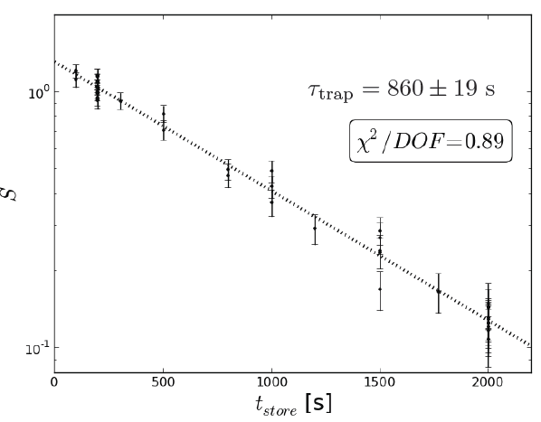

The UCN$τ$ Experiment
1st measurement
D. Salvat, PRC 89, 052501 (2014)
79

Slide 64
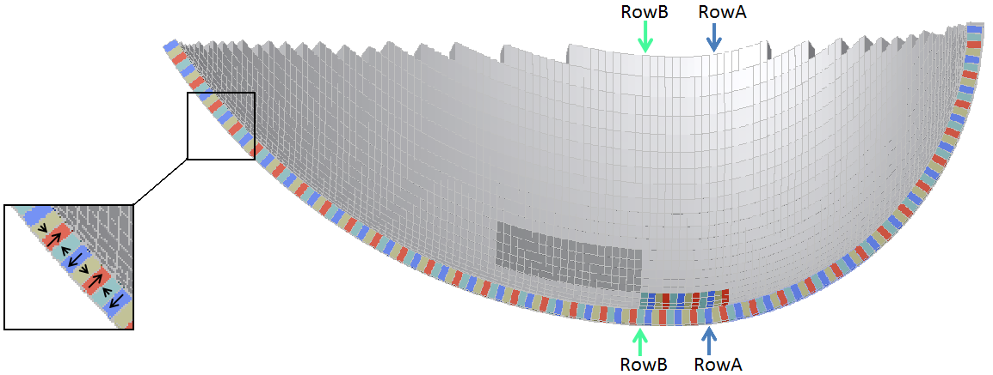
UCN𝜏
|B| always greater than 1 T at surface!
F_{m}
F_{g}
B_{rem}≈ 1 T
50 cm
(~50 neV)
Low field-seeking states repelled by large fields

Slide 65
UCN𝜏
|B| always greater than 1 T at surface!
F_{m}
F_{g}
B_{rem}≈ 1 T
50 cm
(~50 neV)
Low field-seeking states repelled by large fields
UCNτ Design Features
Magnetic barrier eliminates interaction with materials
Very large volume (~400 l UCN storage)
Asymmetrical construction to ensure rapid emptying/detection

Slide 66
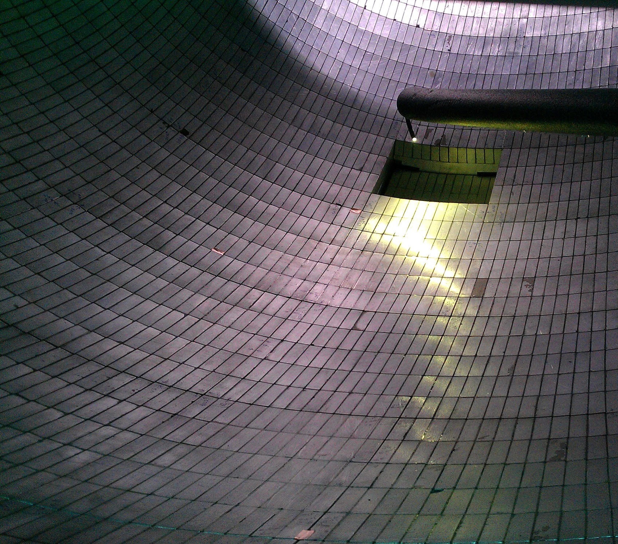
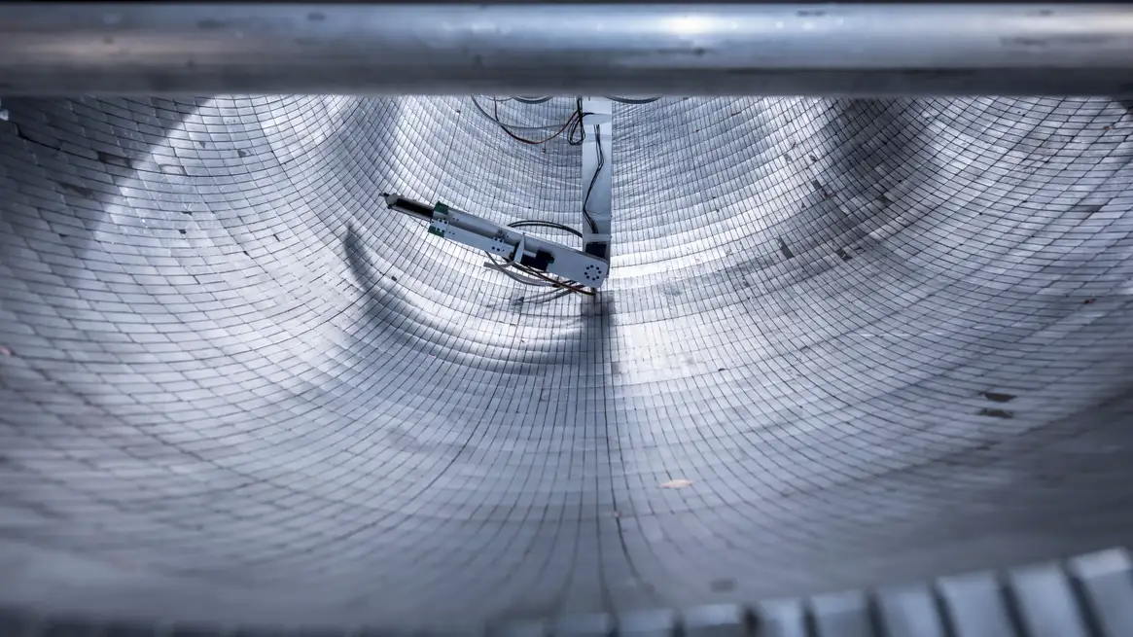
D. Salvat

Slide 67

The UCN$τ$ apparatus
1st measurement
D. Salvat, PRC 89, 052501 (2014)
Detector enters trap from top, permits studies of “quasi-bound” neutrons
In situ detector
79

Slide 68
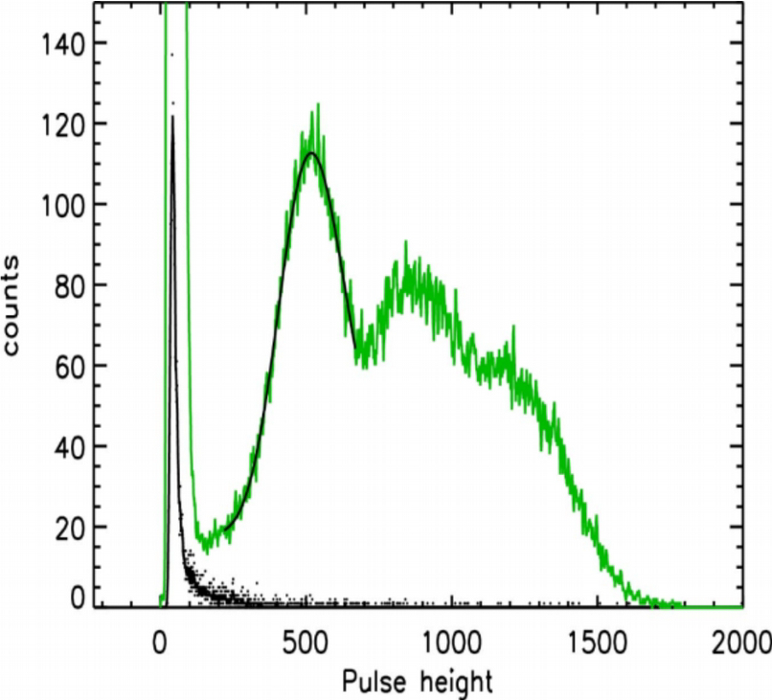
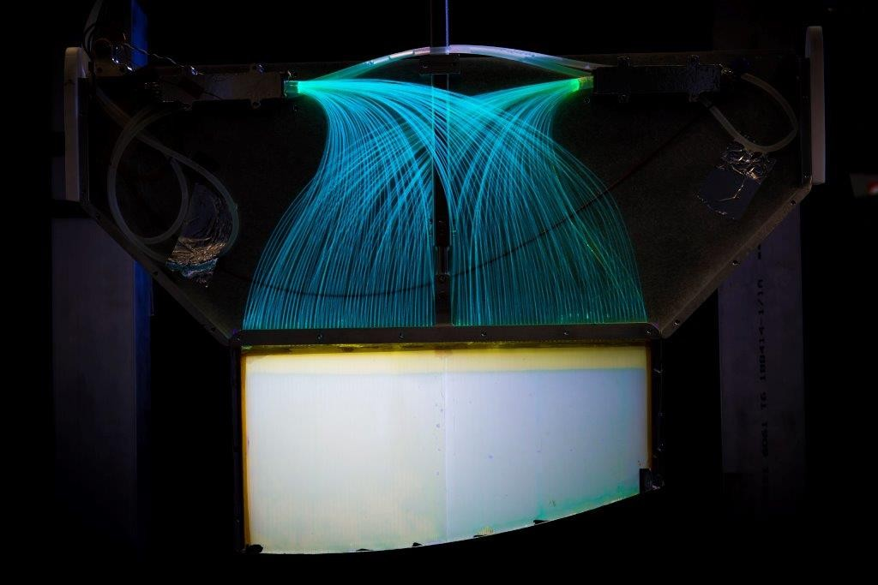
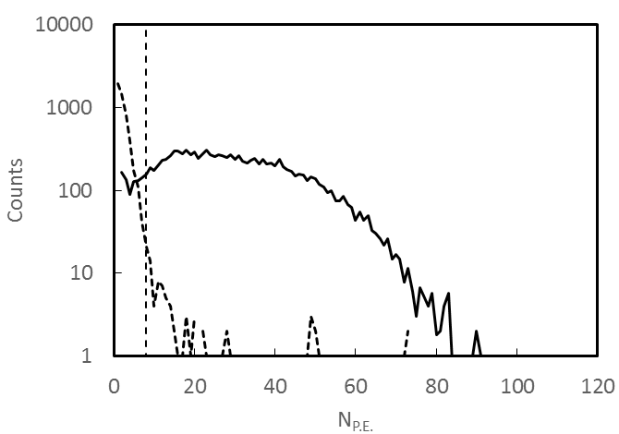


In situ “Dagger” Detector
20-200 nm B
Z. Wang et al., NIMA 798, 30 (2015).
n + ¹⁰B $→$ ⁷Li + $α$
~10μ ZnS
Light collecting fibers embedded in acrylic sheet
Light output huge compared
to backgrounds!
Typical thresholds for valid event > 10 photons
Recently increased to ~ 200 nm
Absorption near 100%

Slide 69



Pairs of short-long storage times
Run Cycle
Run Cycle
N: UCN counts
M: Monitor counts
(Detector lowered in “steps”)

Slide 70
Systematic Corrections (2020-2022 running)
 | 2020 |  | 2021 Fast |  | 2021 Slow |  | 2022 |  | Average
Effect | Correction | Uncertainty | Correction | Uncertainty | Correction | Uncertainty | Correction | Uncertainty | Correction | Uncertainty
Event definition | 0.00 | 0.20 | 0.00 | 0.16 | 0.00 | 0.17 | 0.00 | 0.14 | 0.00 | ±0.16
Dagger uniformity | 0.00 | 0.02 | 0.00 | 0.02 | 0.00 | 0.02 | -0.22 | 0.02 | 0.06 | ±0.02
Residual gas | 0.06 | 0.03 | 0.07 | 0.04 | 0.04 | 0.02 | 0.05 | 0.03 | 0.05 | ±0.03
Statistical bias | 0.51 | 0.01 | 0.50 | 0.01 | 0.55 | 0.01 | 0.31 | 0.01 | 0.47 | ±0.01
Depolarization | 0.00 | 0.07 | 0.00 | 0.07 | 0.00 | 0.07 | 0.00 | 0.07 | 0.00 | +0.07
Uncleaned | 0.00 | 0.01 | 0.00 | 0.01 | 0.00 | 0.01 | 0.00 | 0.01 | 0.00 | +0.01
Heating | 0.00 | 0.07 | 0.00 | 0.07 | 0.00 | 0.07 | 0.00 | 0.07 | 0.00 | +0.07
Δt_{ph} | -0.02 | 0.02 | -0.01 | 0.01 | -0.02 | 0.01 | -0.04 | 0.01 | -0.02 | ±0.01
Uncorrelated sum |  |  |  |  |  |  |  |  | 0.58 | +0.20-0.17
Summary: works like a charm!
statistically limited with loss correction < 0.07 s
$τ_{2024}=877.95±{0.37}_{stat}{+\left(+0.20/−0.17\right)}_{sys}$s

Slide 71

The 2020-2022 Dataset: Most Recent Results
arXiv:2409.05560
arXiv:2409.05560
arXiv:2409.05560
R. Musedinovic et al., ArXiv: 2409.-5560, September 2024
Dagger configuration for 2022 runs
Improved population monitoring using the “dump” detector and the Tau trap dagger detector during loading
Different configurations of the main “dagger” detector were used
  2020 runs and 2021 “fast” runs used 2 PMTs and had both sides uncovered
  2021 ”slow” runs used 2 PMTs and one side of the dagger was covered by aluminum
  2022 runs used 8 PMTS and had the dagger divided into 4 sections as shown
Reduced rates by up to factor of 4 and provided position sensitivity!

Slide 72



UCNτ 2025 and beyond
Global average of all UCN$τ$ results (still under review, but available on ArXiv):
Phase space evolution under study (Monte Carlo) – new measurements are needed to improve understanding!
Upgrade of UCNτ underway: UCNτ⁺
$τ_{UCNτ}=877.82±0.30$ s
Currently at precision required for CKM unitarity test
Together with $g_{A}$ of similar precision!

Slide 73


A neutron elevator: UCNτ+
New Loading Mechanisms to maximize statistics
Funded by LANL LDRD
Anticipate ~10× counts
Shooting for < 0.15 s sensitivity!

Slide 74

Simulation of a cylindrical trap geometry: UCN Loading
Modeling: thesis R. Musedinovic

Slide 75








UCNProbe is a new “beam” method experiment using UCN
Spokesperson Z. Tang
Goal is to measure $τ_{β}$ using UCN with a total error of 1-2 seconds with totally different systematic effects compared to past “beam” experiments.
Requires absolute measurements of two quantities to 0.1%
  Number of neutrons in the trap
  Number of neutrons that decayed (measurement of charged particles)
The collaboration is completing prototype detector this year
Plans to start commissioning run with UCN in 2025.
4 weeks real time of data taking for 0.14% statistics.
Funded by DOE early career award (2023-2027), previously funded by LANL LDRD-ER (2019-2022)
Notes:
The problem with the current neutron lifetime discrepancy is that the so called “beam method”, where the beta decay lifetime is measured, only uses one single measurement technique, and most of the statistics is due to just one experiment.
The goal of our experiment is to measure the beta decay lifetime to similar errors as the previous experiment using a completely different technique, where we are sensitive to completely different systematic effects. If our experiment confirms the existing discrepancy, then that would hint at the possibility for new physics, and if our results is the same as the bottle experiments, then that would point to systematic errors in the beam experiments.
Like any other “beam” experiments, to extract the beta decay lifetime, we need to measure the number of neutrons that are available for decay and the number of beta decays.

Slide 76
Angular Correlations
Thanks to B. Maerkisch for PERKEO III and Perc slides

Slide 77

Experimental challenges:
Dominated by $g_{A}$ from beta asymmetry
beta-neutrino asymmetry

Slide 78

Most Sensitive Results
for all groups
Recent measurements of A(E) for neutron agree, with most precise PERKEO III
Using only beta asym:
λ = −1.2757(5), S=1.2
Reminder: .0004 is unitarity target!

Slide 79



(P)
$$θ$$
P
$$A_{β}\left(0\right)=\frac{2\left|λ\right|−2λ^{2}}{\left(1+3λ^{2}\right)}≈−0.1$$
(leading order)
Recent work establishes precision level for $λ$ ~ ${10}^{−4}$

Slide 80

Many sources of error --
systematic uncertainties
provide limits in most cases!

Slide 81
PERKEO III
(current state of the art for angular correlation measurements)
spokesperson: B. Maerkisch

Slide 82


(The most sensitive angular correlation expt for neutrons)
(4$π$ solid angle collection – magnetic field guides betas to detectors)
Operated at ILL in pulsed beam mode…

Slide 83
(The most sensitive angular correlation expt for neutrons)
(4$π$ solid angle collection – magnetic field guides betas to detectors)
Operated at ILL in pulsed beam mode…

Slide 84

Electrons detected with plastic scintillator
(4$π$ solid angle collection)
Electrons detected with plastic scintillator
Guiding magnetic fields weaker near the detectors to create an “inverse pinch” to suppress backscatter

Slide 85
(Beam Polarization)
99.1%
99.99%
unc ~ 0.06%
³He spin analyzer in beam-stop position

Slide 86


Slide 87


Slide 88


Slide 89

Important Sources of Systematic Uncertainty
(similar issues, different techniques!)
Detector Effects
λ = −1.27641(56),
Δλ/λ = 4.4 × 10 −4
Polarization
Magnetic Mirror
Limited by statistics!
B. Markisch et al., Phys. Rev. Lett 122, 242501 (2019)

Slide 90











The next generation:
PERC (Proton Electron Radiation Channel) at MLZ / FRM II, Garching
And the next generation for this team (spectrometer now at the MLZ):
Perc
Goal for $β$-asymmetry: $\frac{Δλ}{λ}→\sim 1.3\text{× 10 −4}$
Priority Programme SPP1491 of the German Research Foundation (DFG)

Slide 91

PERC (Proton Electron Radiation channel) Facility at MLZ
Active volume – 8m !
Magnetic filter
Detector region
e,p-beam
stop
Secondary
spectrometer
(User)
B₀ = 0.5 – 1.5 T
B₁ = 3 – 6 T
B₂ up to 1 T
Mechanical
Chopper
Raw decay rate ~ ~30 kHz/m…
  (pulsed, polarised) cold neutron beam (6x6cm²)
  8m long non-depolarising neutron guide as active volume, B₀ ~ 1.5T
  Magnetic filter (B₁ = 3 - 6T) to enhance systematics ${B_{1}}/{B_{0}}=2…12$
    separates e/p from neutrons, contains neutron beam stop,
    limits max. angle of electrons / protons
  Source of electrons and protons to user-spectrometers:
  Observables: A, B, C, b, a
X. Wang, C. Ziener et al. (PERC Collaboration), EPJ Web Conf. 219, 04007 (2019)
D. Dubbers et al., Nucl. Instr. Meth. A 596, 238 (2008) and arXiv:0709.4440

Slide 92

PERC (Proton Electron Radiation channel) Facility at MLZ
Active volume – 8m !
Magnetic filter
Detector region
e,p-beam
stop
Secondary
spectrometer
(User)
B₀ = 0.5 – 1.5 T
B₁ = 3 – 6 T
B₂ up to 1 T
Mechanical
Chopper
Raw decay rate ~ ~30 kHz/m…
!
Groundwork has been laid!
Magnet commissioning in 2nd half of 2025
  (pulsed, polarised) cold neutron beam (6x6cm²) x50 of PERKEO III
  8m long non-depolarising neutron guide as active volume, B₀ ~ 1.5T
  Magnetic filter (B₁ = 3 - 6T) to enhance systematics ${B_{1}}/{B_{0}}=2…12$
    separates e/p from neutrons, contains neutron beam stop,
    limits max. angle of electrons / protons
  Source of electrons and protons to user-spectrometers:
  Observables: A, B, C, b, a
X. Wang, C. Ziener et al. (PERC Collaboration), EPJ Web Conf. 219, 04007 (2019)
D. Dubbers et al., Nucl. Instr. Meth. A 596, 238 (2008) and arXiv:0709.4440

Slide 93
The Beta-Neutrino Correlation
Thanks to F. Gonzalez for many Nab slides!

Slide 94

Angular Correlation Measurements:
Beta-neutrino angular correlation
a
The angular correlation between the emitted beta momentum and the neutrino momentum – no polarization required!
Similar sensitivity to λ as the beta asymmetry
Very important in the late 50’s to 70’s!

Slide 95
aSPECT
Most recent results for groups or experiments
Note: although not as precise, aSPECT (Beck et al.) of “a” is impacting scatter for λ – now 2.7

Slide 96






Nab
~0.04% target precision for $g_{A}$
Measure momentum of protons through time of flight, then use conservation of momentum and energy to relate to a_{βν}
$${\vec{p}}_{p}={\vec{p}}_{e}+{\vec{p}}_{ν}→p_{p}^{2}=p_{e}^{2}+2{\vec{p}}_{e}∙{\vec{p}}_{ν}+p_{ν}^{2}$$
&
$p_{ν}^{2}$ from consv. of E
Thin dead-layer, segmented Si detectors record electron “start” in either detector, proton “stop” in upper detector
$$p_{p}^{2}∝\frac{1}{{Δt}_{ep}^{2}}$$
p
Magnetic field “pinch”, long, low field TOF region optimize sensitivity to TOF

Slide 97

Advantages of Nab
Determines the axial coupling constant $λ=\frac{g_{A}}{g_{V}}$ with very different systematic error budget to the beta asymmetry measurements
Can help resolve the current tension between the aSPECT measurement and the beta asymmetry measurements
There is a “straightforward” upgrade path to measurement of polarized angular correlations which promises a factor of two higher precision
Running now!

Slide 98

Prospects
The current goals for the neutron beta decay community are primarily to produce a data set which can
provide internally consistent data which permits the extraction of $V_{ud}$ at a level comparable to the superallowed decays
This means:
Elucidating the current lifetime problem
Beams: BL2/BL3 should operate at NIST, with target 0.3 s, and running starting in 2027
J-PARC beam experiment provides an important cross-check, with goals near 1 sec precision, ongoing
UCNprobe plans to start data taking with direct measurement of beta-decay branching ratio, initial goal
0.14%, start running in 2025
UCN storage: UCN$τ$+ will start commissioning in 2025, with sensitivity goal below 0.15 s
TauSpect is currently running at PSI , with sensitivity goal at 0.3 s
PeNELOPE planned to start running in 2027 at TRIUMF, ultimate sensitivity goal of 0.1 s
(2) Angular correlations to determine $g_{A}$
β-asymmetry: Perc targeting 0.013% uncertainty, with magnet commissioning in 2026
UCNA+ under development, targeting < 0.05% with running after 2025 (date not established)
PNAb under development, targeting ~ 0.02% with running after 2025 (date not established)
$β−{\overline{ν}}_{e}$ correlation: Nab targeting ~0.04%, can also clarify issues suggested by aSPECT measurement, currently running
As a whole, these experiments should provide a robust characterization of the neutron decay at roughly the same level as
the superallowed decays, and set the stage for a thrust to theoretical limits during the period of ESS running

Slide 99

Prospects
Currently Running! New results soon!
The current goals for the neutron beta decay community are primarily to produce a data set which can
provide internally consistent data which permits the extraction of $V_{ud}$ at a level comparable to the superallowed decays
This means:
Elucidating the current lifetime problem
Beams: BL2/BL3 should operate at NIST, with target 0.3 s, and running starting in 2027
J-PARC beam experiment provides an important cross-check, with goals near 1 sec precision, ongoing
UCNprobe plans to start data taking with direct measurement of beta-decay branching ratio, initial goal
0.14%, start running in 2025
UCN storage: UCN$τ$+ will start commissioning in 2025, with sensitivity goal below 0.15 s
TauSpect is currently running at PSI , with sensitivity goal at 0.3 s for their current instrument
PeNELOPE planned to start running in 2027 at TRIUMF, sensitivity goal of 0.1 s
(2) Angular correlations to determine $g_{A}$
β-asymmetry: Perc targeting 0.013% uncertainty, with magnet commissioning in the second half of 2025
UCNA+ under development, targeting < 0.05% with running after 2025 (date not established)
PNAb under development, targeting ~ 0.02% with running after 2025 (date not established)
$β−{\overline{ν}}_{e}$ correlation: Nab targeting ~0.04%, can also clarify issues suggested by aSPECT measurement, currently running
As a whole, these experiments should provide a robust characterization of the neutron decay at roughly the same level as
the superallowed decays, and set the stage for a thrust to theoretical limits during the period of ESS running

Slide 100
New Initiatives for the ESS
The brightness and intensity of the ESS make it the logical choice for some experimental studies which are under development, for example:
BRAND: a survey instrument designed to measure (simultaneously) 11 angular correlations (5 of which have never been measured), with sensitivity to both T-invariant and T-violating interactions. See D. Rozpedzik’s talk tomorrow (“Measurements of neutron decay correlations with electron tracking and electron spin determination”)
Given the current development of CRES methods for full beta spectrum measurement, it may be possible to implement for neutron decay
Exotic decays may also impact the global beta decay data set, such as those discussed in B. Meirose’s talk (“Exotic neutron decays in free neutron experiments”)
New beam lifetime methods – see for example “Neutron Lifetime with Pulsed Cold Neutron inside Superfluid Helium,” by Weijun Yao
Bound state beta decay (thanks to Mike Snow and Pieter Mumm for bringing this up)

Slide 101
Conclusions
Motivation for high precision neutron decay measurements for BSM constraints is strong, especially from the current status of the Cabibbo Angle Anomaly (CAA). Theoretical work has been critical in characterizing the current situation.
The current set of experiments (under construction and ongoing) have the capability to address internal issues in the neutron beta decay data sets and achieve global values at the targets needed to confirm the observed violation of unitarity deduced from the superallowed data set.
Experiments and optimized beamlines at the ESS can be critical in pushing precisions to discovery-level for the neutron (~0.02% and below)
Note: a push to improve understanding of the theory corrections for the nuclear data set (perhaps through study of selected, low Z mirror decays, e.g. ASGARD)) improve the sensitivity in global fits such as that of Falkowski et al and interpretation of superallowed decays

