Slide 1
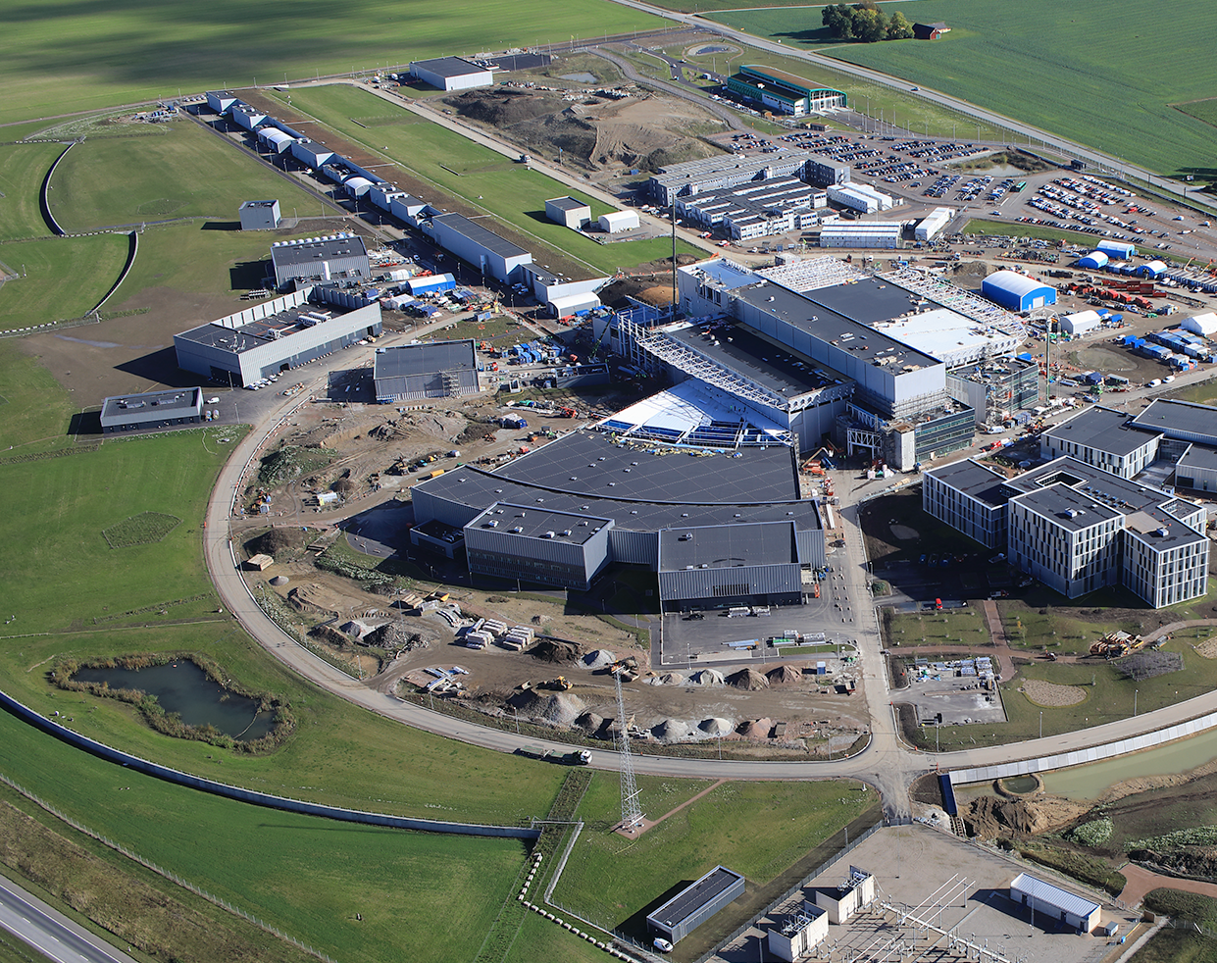
EDM Experiments: Status and Challenges
The Fundamental Nuclear and Particle Physics at the ESS workshop
Chen-Yu Liu
University of Illinois Urbana-Champaign
Jan. 15, 2025
Slide Slide contributions from Beck, Fujimoto, Degenkolb, Ito, Lauss, Piegsa
Notes:
Per Marcel’s request, I am giving an overview on EDM experiments. I want to thank the many colleagues who provided me with slides with a short notice. I also want to bring attention of three EDM talks by Doug Beck, Skyler Degenkolb and Florian Piegsa tomorrow (Thursday) afternoon.

Slide 2
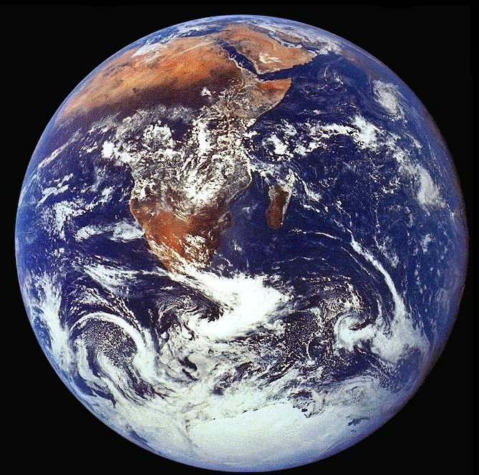
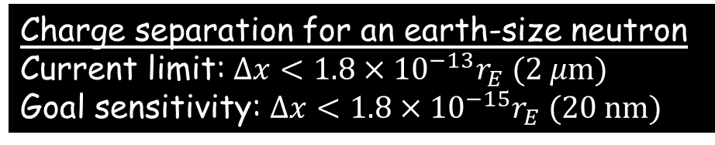
Electric Dipole Moment (EDM) of the Neutron
Purcell and Ramsey, Phys. Rev. 78, 807 (1950)
Neutron EDM (d_{E}) : Permanent,
net charge separation within
the neutron volume
x
-
+
spin
First experiment (1957):
d_{E} < 5 x 10⁻²⁰ e-cm
Current limit [1]:
Charge separation for an earth-size neutron
Current limit: $Δx<1.8×{10}^{−13}r_{E} (2 μ\text{m})$
Goal sensitivity: $Δx<1.8×{10}^{−15}r_{E} (\text{2}\text{0 }\text{nm})$
d_{E} < 1.8 x 10⁻²⁶ e-cm
[1] PRL 124 081823 (2020)
Slide credit: J. Long
Notes:
Neutron is a charge-neutral, composite particle, made of quarks and gluons.
The electric dipole moment of neutron quantifies the change separation within the neutron volume.
To illustrate how sensitive the experiments have achieved, if you could project a neutron up to the size of the earth, the experiment can see, in this earth-sized neutron, a charge separation of a micron that is the width of a single strain of the human hair; and for planned experiments, this distance sensitivity would be 100 times better.
-----------------------------------------------------------------------------------
If you have never heard about this effort before, you might wonder: why is it such a big deal to search for the electric dipole moment of the neutron? If our grandfathers and fathers have tried their best and found nothing, perhaps there is really nothing to see.
On the other hand, we vaguely recall in our chemistry class that the polar molecules have charge separation, derived from their molecular structure, leading to a large, easily measurable EDM. If so, why bother with neutrons?

Slide 3
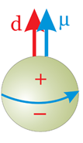
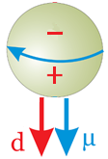

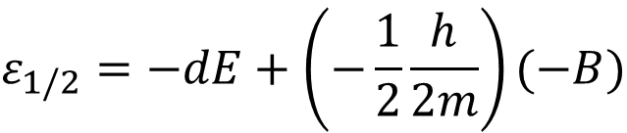
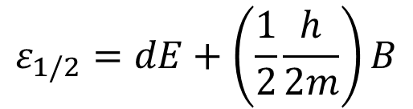
Electric Dipole Moment implies Time Reversal Symmetry Violation
Fundamental particles do not have degenerate ground states, so $\vec{d}=d\hat{J.}$
We start with the ground state of
E
B
E
B
T
$$\vec{d}=d\hat{J}$$
$$ε_{1/2}=dE+\left(\frac{1}{2}\frac{h}{2m}\right)B$$
$$ε_{1/2}=−dE+\left(−\frac{1}{2}\frac{h}{2m}\right)(−B)$$
T-odd
T-even
The ground state is not a T eigenstate!
The Hamiltonian violates T symmetry.
Notes:
A discovery of EDM would require the breaking of discreate symmetries of parity inversion and time reversal. To illustrate the time-reversal symmetry violation, let’s start with a ground state neutron like this:
The electric and the magnetic fields align the EDM and the spin.
Under time reversal, the spin reverses direction, so does the EDM. Also, the magnetic field reverses the direction, as the source current flows backwards, but not the electric field. As a result, we have a T-odd term in the Hamiltonian that changes the energy of the time-reversed ground state.
Therefore, the ground state is not a T eigenstate, and the Hamiltonian does not commute with Time reversal operation. The physics must violate the time-reversal symmetry, in order for the EDM and the spin to co-exist.

Slide 4
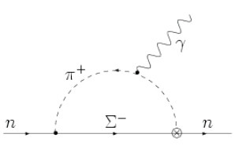
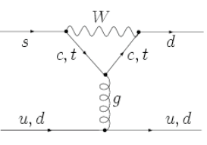
EDM is a sensitive probe to search for BSM CP-violating physics
nEDM: violates P and T (or CP through the CPT theorem)
In the Standard Model:
Suppressed 3-loop effect from the CKM phase in the Standard Model
d_{n} ~ 10⁻³² e-cm
(Khriplovich & Zhitnitsky 1986)
Large effect in more comprehensive theories:
In beyond the Standard Model (BSM) physics extensions:
d < 10⁻²⁶ e-cm → Λ_{cp} = 1 TeV
EDM violates P and T symmetries. Searches of electric dipole moments (EDM) give the best opportunity to establish new sources of CP violation.
Notes:
In the standard model, there is a source of CP violation, from the complex phase of the CKM matrix, which describes the weak coupling between quarks. This CP violating phase can give rise to T violation (through the CPT conservation theorem). To generate a neutron EDM, one will have a Feynman diagram like this one, with the exchange of a long-range meson and a vitual hyperon; one vertex is CP violating, which requires a loop of weak interaction on the quark level. Because it takes 3 loops to generate an EDM, the SM prediction of the neutron EDM is quite small, on the level of 1e-32 e-cm.
In beyond the SM extensions, there are many more particles with different CP violating phases; it is easy to generate EDM on a single loop level.

Slide 5
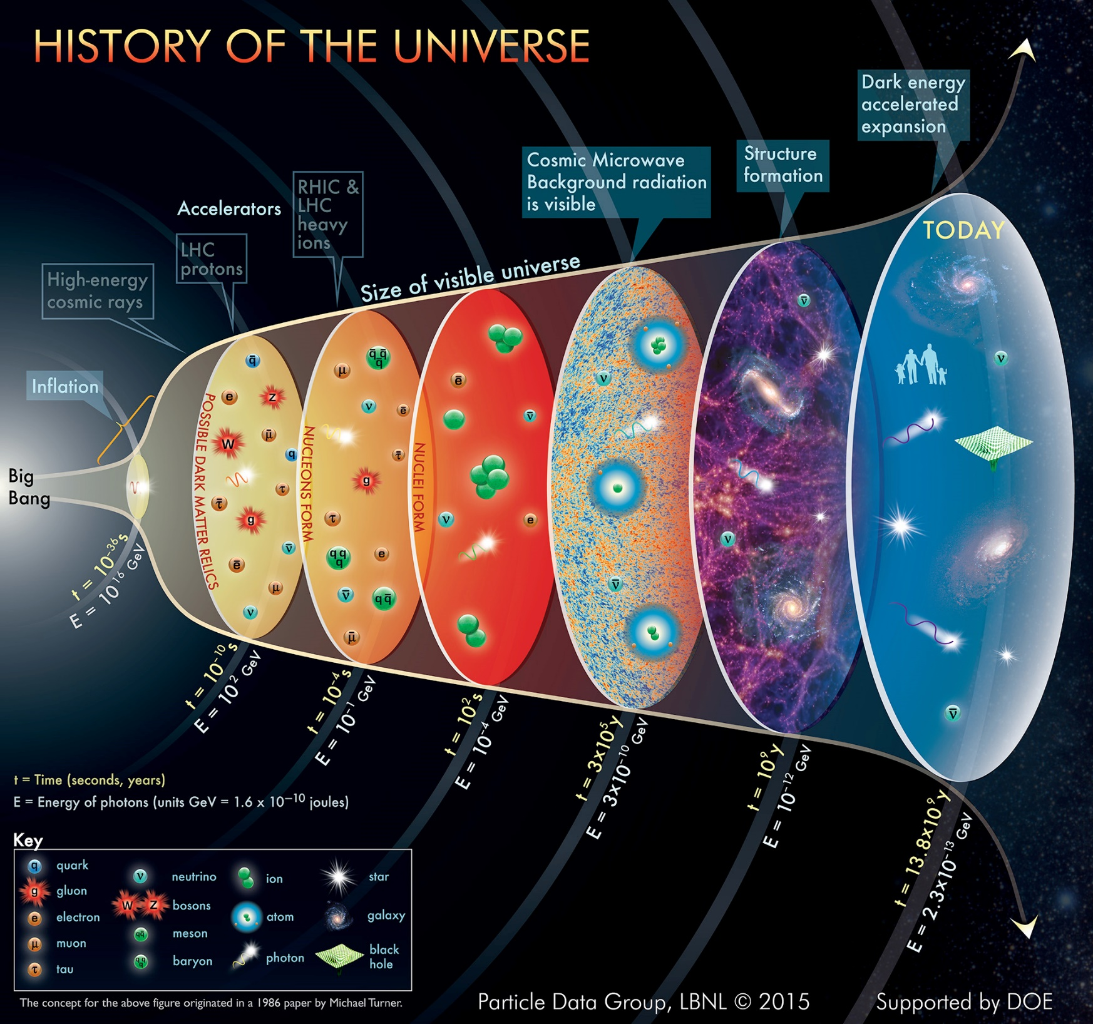

We are motivated to understand our ‘matter-dominated’ Universe
Plank CMB 2018 data: Astron. Astrophys. 2020, 641, A6
Baryogenesis: creation of baryons
Nucleosynthesis: creation of the light elements
Standard model
Baryogenesis: The Standard Model of Particle Physics fails to account for the observed baryon asymmetry in the Universe (BAU) and thus cannot explain “why we exist”.
Notes:
In physics, there are a few big questions, several of them are directly linked to origin of the universe, and the ultimate question of our existence.
We try to apply the micro physics in the
Many subfields try to apply their specialized techniques to answer these questions.
Using neutrons, we can try to answer:
Why does the universe have matter, but not pure empty space with nothingness? The early universe must have the baryogenesis, happened shortly after the inflation, to turn pure energy released from the explosion into matters (mostly quarks).
How were the elements made after the Big-Bang? It must have happened when the universe expands and cools enough to allow neucleons, which are bound states of quarks, to bind together in the process of nucleosynthesis.
All of these process is based on the established standard model of particle physics, which provides the basic building blocks of matter and dictates the interactions, via the exchange of the force mediators.
Three generations of quarks, and three generations of leptons.
However, we believe that it is not quite complete, because the theory does not predict the hierchy of the mass and the forces, it does not contain the dark matter, and said nothing about the dark energy. It also does not provide enough symmetry violation needed to generate matter in the existing universe.

Slide 6
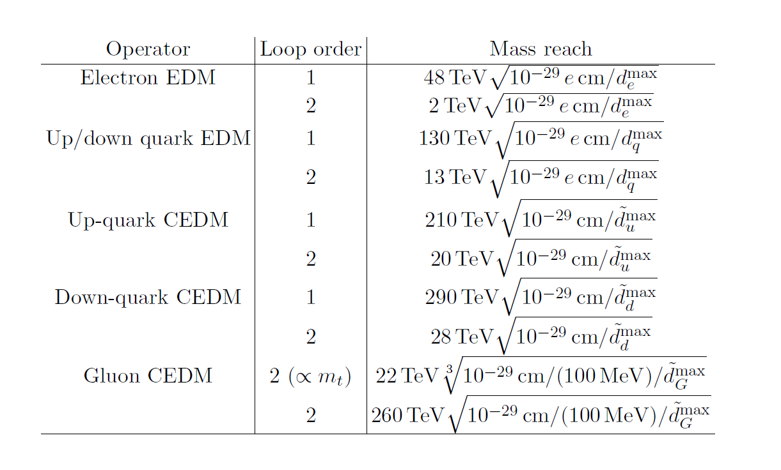
Significant Reach of Energy Scales with Improved EDM Sensitivity
From Snowmass EDM 2022
Notes:
We need new sources of CP violation to account for the BAU as observed. The same BSM physics with CP-symmetry breaking at high energy scales can generate non-zero EDM, albeit small, in low energy systems.
If we keep on improving the experimental sensitivities, various EDM searches are projected to be sensitive to CP-violating physics at energy scales comparable to and exceeding the reach of high-energy particle colliders, as summarized in a recent Snowmass report.

Slide 7

EDM Searches = The Quest for the Holy Grail

Slide 8
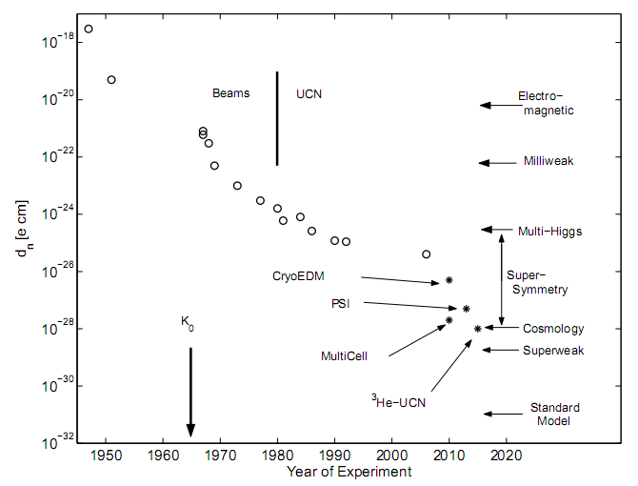
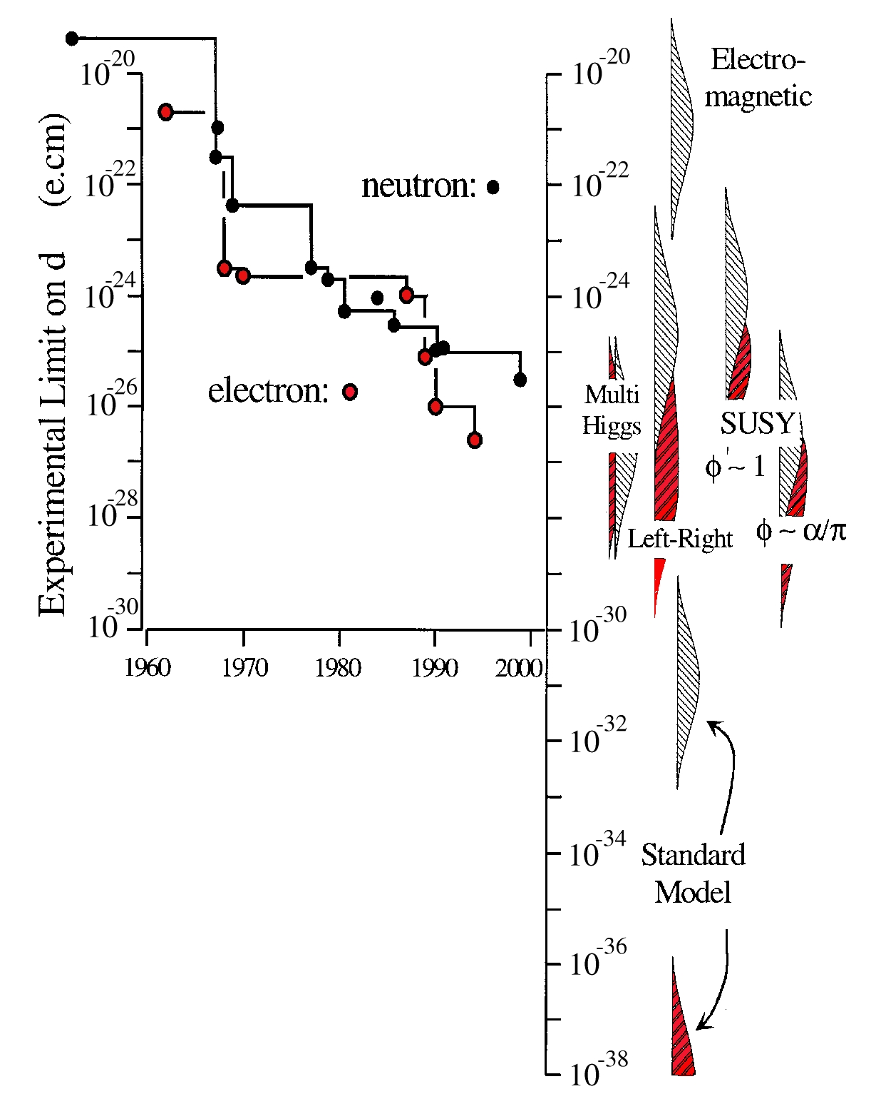

Λ_{CP} > 200 GeV
Λ_{CP} > 50 TeV
Notes:
This plot shows the history of the neutron EDM measurements.
Following the first measurement done by Ramsey’s group in 1950, the sensitivity improves roughly by an order of magnitude every decade.
The open circles are published results, and the stars are the anticipated results from ongoing efforts.
Despite all these activities, no one has found a non-zero EDM.
Seventy years ago, Purcell and Ramsey did their first measurement using thermal neutrons from the Graphite Reactor at Oak Ridge National Laboratory.
The efforts kept ongoing with a handful of persistent physicists, who were not afraid to measure zero. So far, no one has found a definitive EDM; The continual push of measurement technique improve the sensitivity for almost two orders of magnitude per decade. The current best limit is low 1e-26 e-cm.
Along the way, many theories which contains large sources of CP violation were either ruled out, or their parameter space were squeeze to some uncomfortably tight corners.
In many scenario of electroweak baryogenesis, which has CP violation large enough to explain the BAU, the theory give rise to EDM no smaller than 1e-28e-cm.
The standard model prediction of the neutron is close to the bottom of the plot.
From the current sensitivity to the SM prediction, there exists 6 orders of magnitude of uncharted land; it opens up an opportunity for theorists to build new physics, and for the experimentalist to slay the dragons.

Slide 9
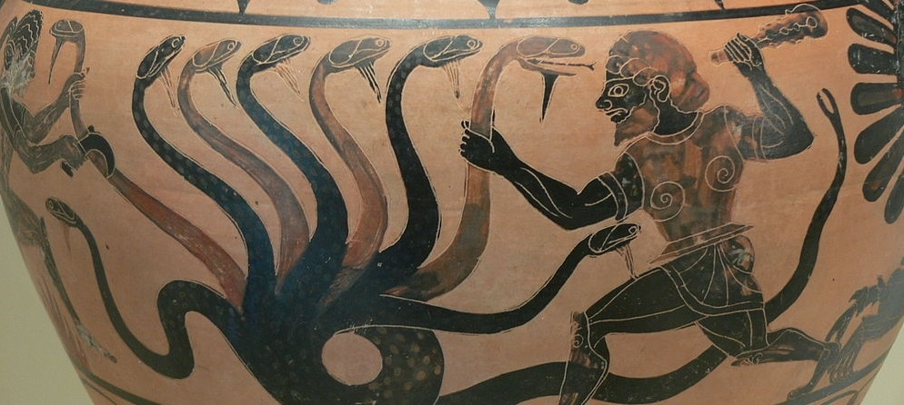
EDM is directly sensitive to BSM physics, free of SM backgrounds!
Different BSM theoretical models
EDM searches

Slide 10

EDMs test SuperSymmetry
Compatible with baryon asymmetry
Bhattacharya, VC, Gupta, Lin, Yoon
Phys. Rev. Lett. 115 (2015) 212002 [1506.04196]
Li, Profumo, Ramsey-Musolf 2009-10
Notes:
Here I give a few examples of how the EDM test some popular BSM theories.
On the right plot, the fact that the EDM of the neutron and electron have not been found exclude the low-mass range of the Higgsino (mu) and the Gauginos below 5 TeV, assuming a CP-violation phase on order 1.
On the left plot, CPV phases appearing in the gaugino-higgsino “mixing” contribute to both baryogenesis and the EDM. In this model of MSSM, successful baryogenesis implies a “guaranteed signal” for EDM, within the reach of planned experiments!
The horizontal axes give the bino (gaugino) soft mass parameter M1, the vertical axes give the relative phases of M1, and mu, and the soft Higgs mass parameter.

Slide 11
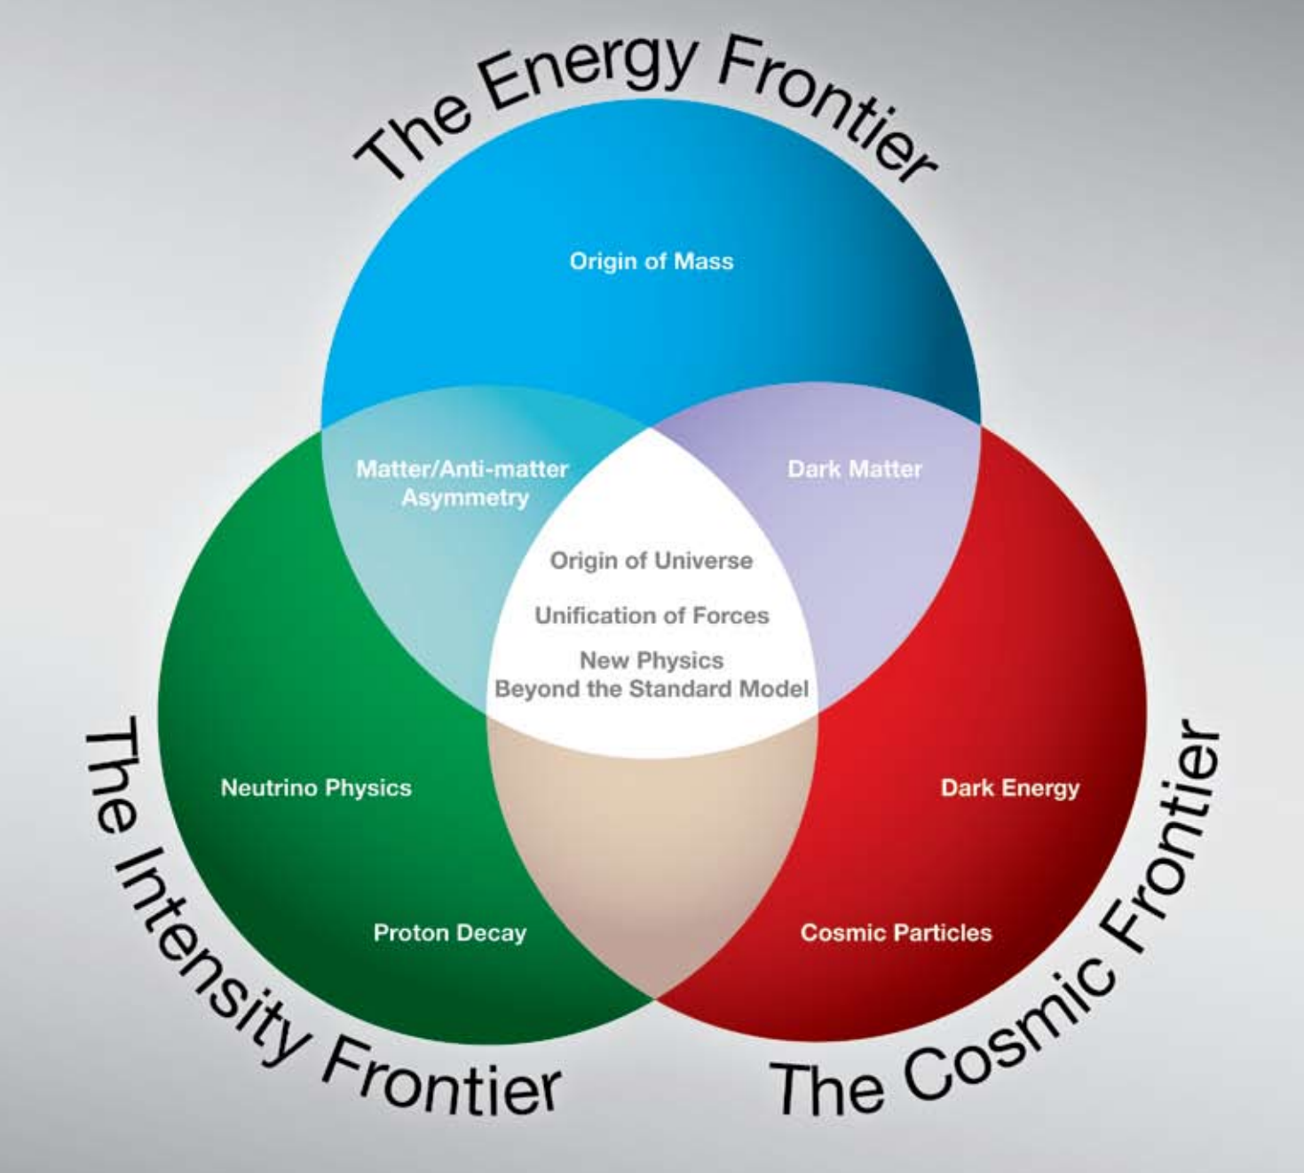
P5 Report (Particle Physics Project Priorization Panel)
High-energy colliders
Fundamental Neutron Physics
High current accelerators, high flux reactors
Telescopes, LIGO
Notes:
This venn diagram is from the recent P5 report that summarizes the fore-front research activities and important problems in the high-energy-physics community.
The research we do with neutrons is in the precision frontier. To get to high precision to see the small symmetry-violating effects, we need the large statistics.
Work is complementary to HEP prioritized programs. In particular, the questions we are trying to address about the origin of universe, new physics beyond the standard model is front and center on this venn diagram.
-------------------------------------------------------------------------------------------------
P5: Particle Physics Project Prioritization Panel. It is a subpanel of HEPAP, the High Energy Physics Advisory Panel. Through HEPAP, advises the DOE and NSF by making recommendations on projects, including priorities among projects.

Slide 12
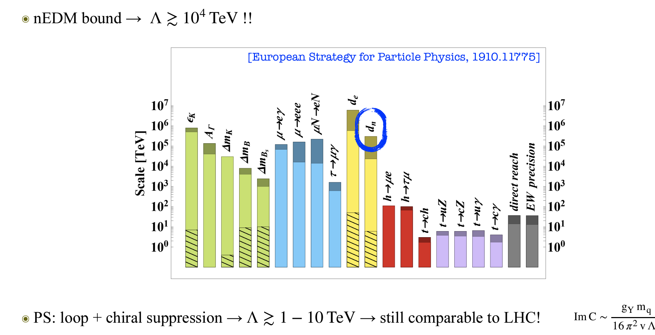
Significant Reach of Energy Scales with Improved EDM Sensitivity
From M. Gonzalez Alonso’s talk this morning

Slide 13
Connecting high-energy physics to low-energy measurements
Sources of CP-violation
Particle Physics Theory
Effective Field Theory
Lattice QCD Theory
Nuclear Theory
+
Nuclear Experiment
Atomic Theory
+
Atomic Experiment
Molecular Theory
+
Molecular Experiment
EDM Measurements
Multi-energy scale problem
Notes:
There is a well developed framework to connect the high-energy CP-breaking physics to low-energy EDM observables; it requires challenging theory work bridging over many different energy scales.
CP is broken in a high-energy scale. Take your favorite BSM physics, through loops in Feynman diagrams, it can be first turned into coefficients through effective field theory that give EDM of electron, neutron, and proton, or other CP-odd couplings in nuclear Lagrangian.
Through nuclear theory, EDM observables can then be calculated in light nuclide, in heavy nuclide, a Schiff moment exists which can be measured in diamagnetic atoms. Paramagnetic atoms, with unpaired electron, is directly sensitive to the edm of electron.

Slide 14
Many different sources of CP violation → multiple systems are needed to disentangle the various sources of CP
-Theory topical groups are formed to tackle the challenges of EDM calculations and perform ab initio calculation on nuclear Schiff moments.
Notes:
At the hadronic level, there are many different sources of CP violation that could manifest into EDM.
For example, the mercury EDM has sensitivity to neutron EDM, proton EDM, and the isoscalar coupling to pions.
Radium is mostly sensitive to CP-violating pion couplings.
Multiple systems are required to disentangle the sources.

Slide 15
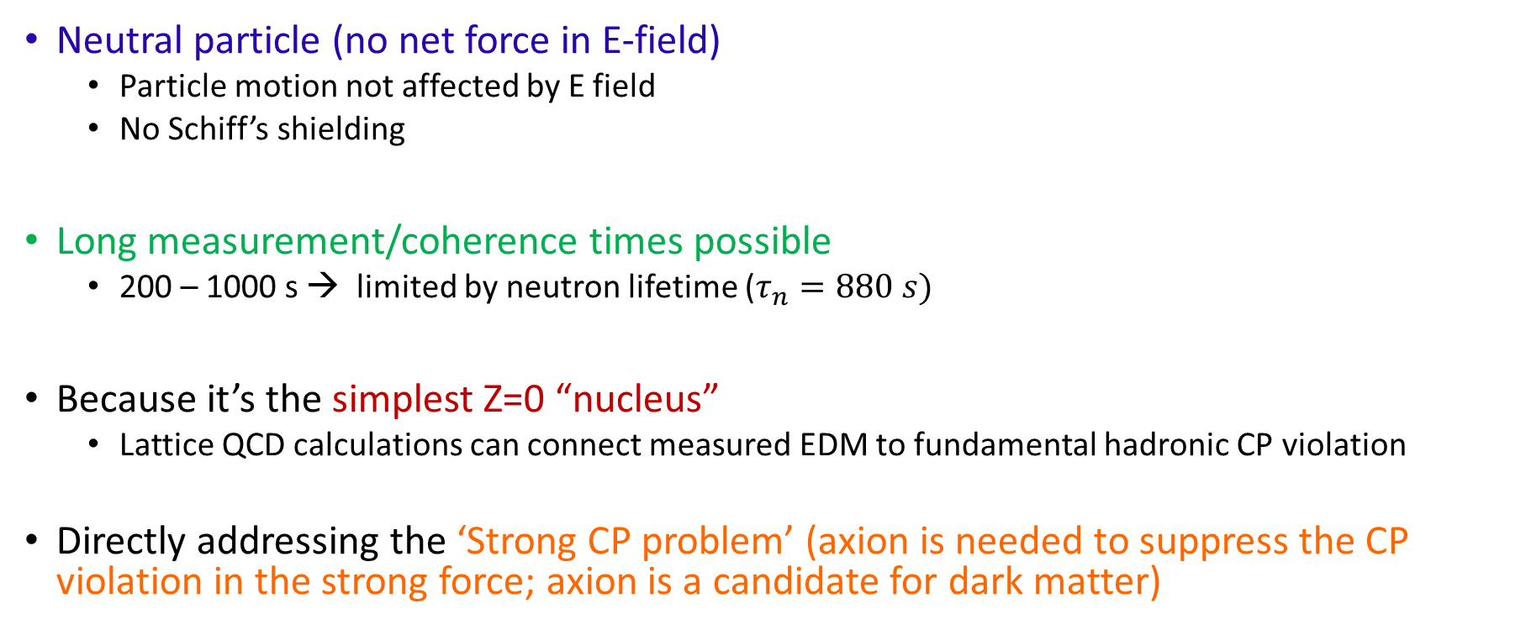
Why neutron EDM?
Neutral particle (no net force in E-field)
  Particle motion not affected by E field
  No Schiff’s shielding
Long measurement/coherence times possible
  200 – 1000 s → limited by neutron lifetime ($τ_{n}=880 s)$
Because it’s the simplest Z=0 “nucleus”
  Lattice QCD calculations can connect measured EDM to fundamental hadronic CP violation
Directly addressing the ‘Strong CP problem’ (axion is needed to suppress the CP violation in the strong force; axion is a candidate for dark matter)

Slide 16
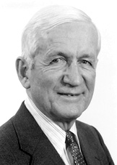

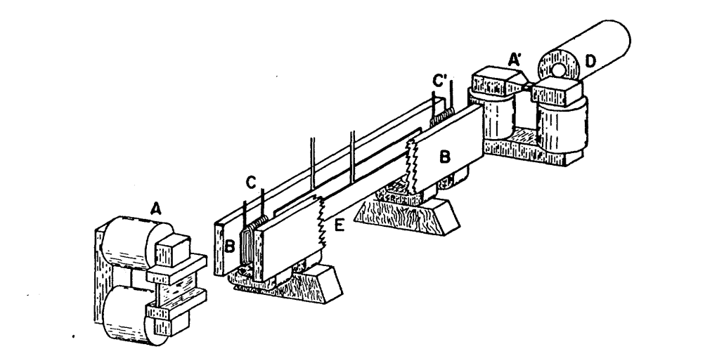
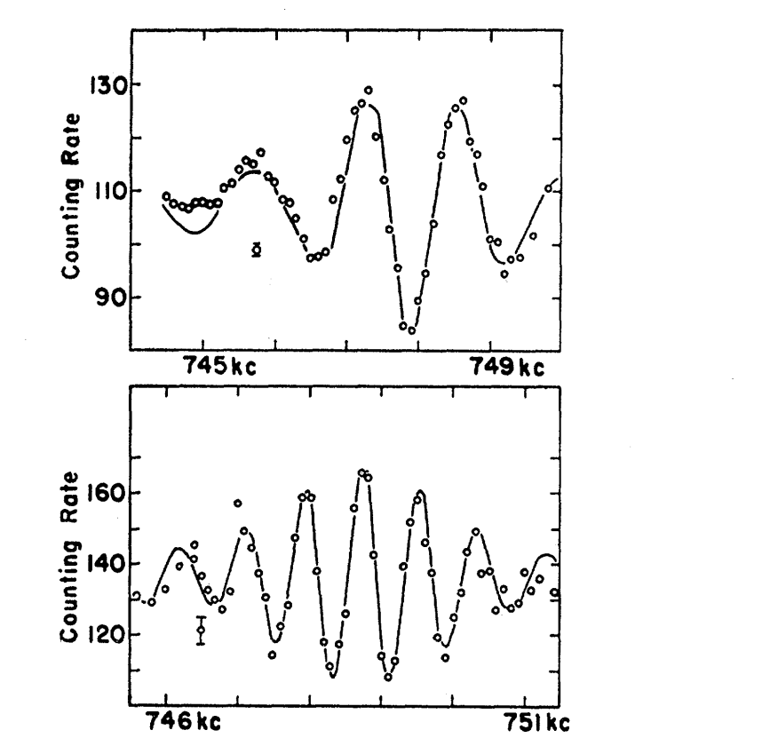

Ramsey’s method of Separated Oscillatory Fields
A particular arrangement that is more advantageous in many cases is one in which the oscillating field is confined to a small region at the beginning of the space in which the energy levels are being studies and to another small region at the end, there being no oscillating field in between.
-- N. Ramsey (1950)
1989
Smith, Purcell, Ramsey, Phys. Rev. 108, 120 (1957)
Oscillating Fields
n detector
Pi/2 coil
Pi/2 coil
Fast(er) neutrons
Spin polarizer
Spin analyzer
Slow neutrons
This separated oscillatory fields give
Narrow fringes
Not sensitive to the field uniformity.
Notes:
Nobel Prize in Physics in 1989 for the “for the invention of the separated oscillatory fields method and its use in the hydrogen maser and other atomic clocks”
In this experiment, a beam of neutrons are first polarized by a piece of magnetized iron foil. Its spin is rotated by 90 degree by a Pi/2 coil and then allowed to precess in a field region along the flight path. Upon exit, the spin is rotated by another 90 degrees before it is analyzed by a spin analyzer.
Ramsey noted that this particular arrangement of the oscillatory fields separated in space is more advantageous. It creates narrow fringes, and the number of fringes increase using slower neutrons.

Slide 17
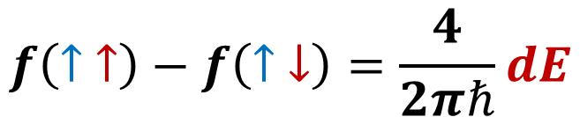
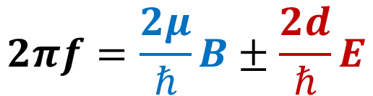
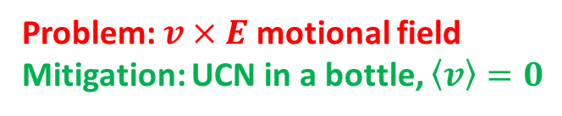
Store ultracold neutrons (UCN) in a bottle to measure the Electric Dipole Moment of free neutrons
Problem: $v×E$motional field
Mitigation: UCN in a bottle, $\left\langle v\right\rangle =0$
$$2πf=\frac{2μ}{ℏ}B±\frac{2d}{ℏ}E$$
$$f\left(↑ ↑\right)−f\left(↑ ↓\right)=\frac{4}{2πℏ}dE$$
Double-cell configuration:
In one load, the EDM is extracted by the frequency difference between the two cells.
→ Less sensitive to temporal drifts of the background B fields.
Notes:
The Electric Dipole Moment is the holy grail of precision measurements. There are many efforts to search for it, but so far no one found any.
We know the EDM has to be there, because it links to the same CP violating physics that was responsible for the big-bang baryogenesis, creating the matter-antimatter asymmetry of the universe as we see today.
Our effort to measure the EDM of neutrons uses the polarized neutrons stored in bottles, like this one. We watch how fast the neutron spin precesses under the influence of the magnetic field and the electric field. The spin precession velocity scales directly with the applied E field and the size of the electric dipole moment.

Slide 18
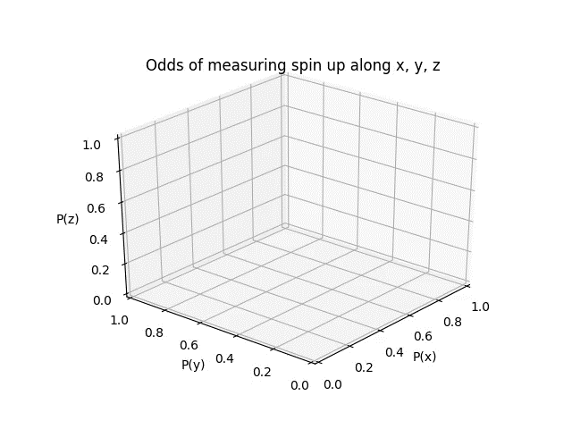

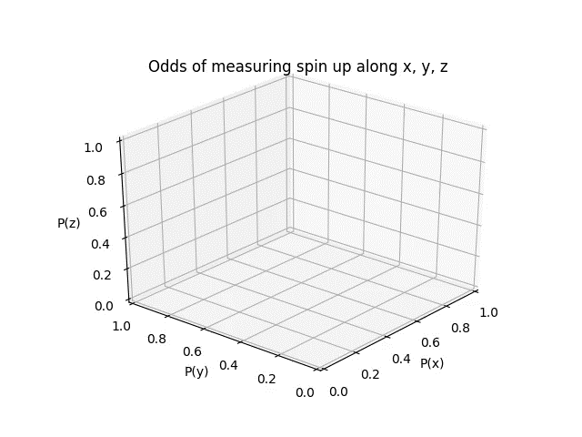
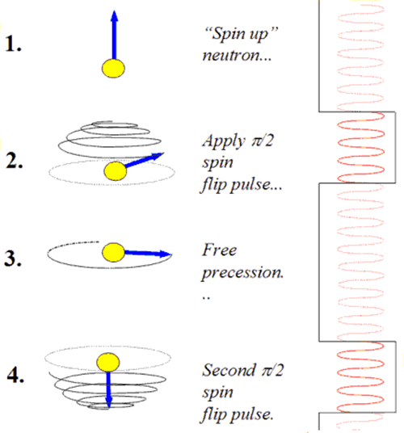
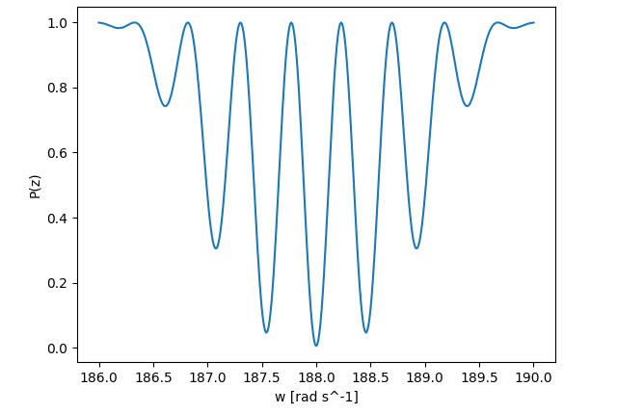
Ramsey’s method of separated oscillatory fields: Making a fringe by interfering the coherent neutron spin precession with an external RF clock
Off resonance
On resonance
Also off resonance
Each point on the fringe comes from one ramsey sequence. Experimentally, to make this fringe, all you need to do is to apply a ramsey sequence (for various RF frequencies) on a population of neutrons, and count the number of spin up neutrons at the end.
Slide credit: Doug Wong
Notes:
The frequency of spin precession is measured using the Ramsey’s method of separated oscillatory fields.
Here are simulations made by graduate student Douglas Wong to illustrate the physics of Ramsey fringes.
Using an oscillatory field, the neutron spin is first rotated by 90 degrees, and then the spin precesses freely under the influence of the magnetic and electric fields. The second pulse of oscillatory field continue to rotate and tilt the neutron spin downwards.
The frequency of the oscillatory field is scanned through the resonance to give this interferogram with nice narrow fringes. It is an elegant experimental technique to greatly increase the precision of the frequency measurement.

Slide 19
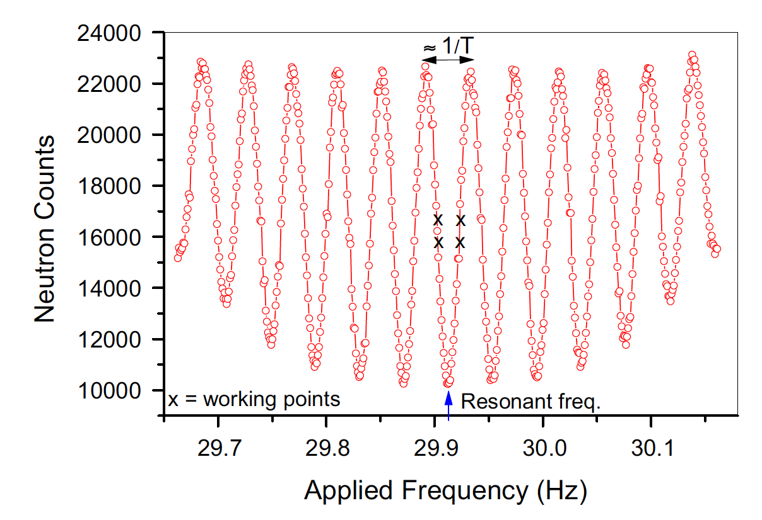
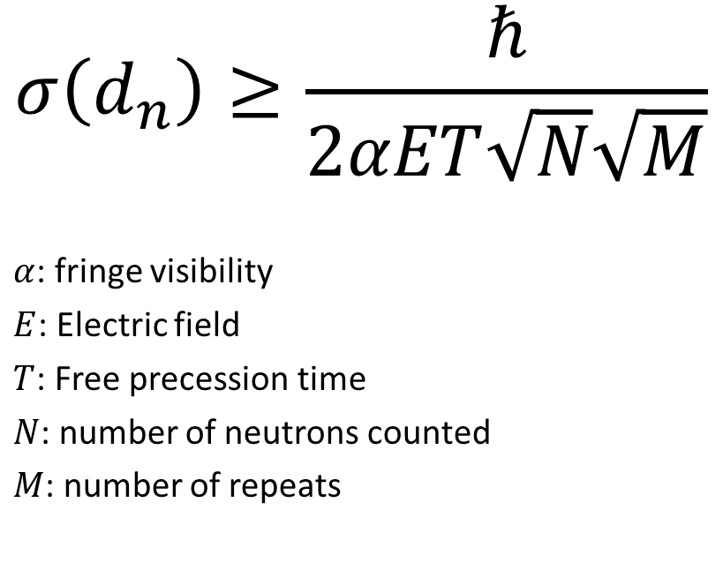
nEDM sensitivity:
$$σ\left(d_{n}\right)≥\frac{ℏ}{2αET\sqrt{N}\sqrt{M}}$$
$α$: fringe visibility
$E$: Electric field
$T$: Free precession time
$N$: number of neutrons counted
$M$: number of repeats
The principle is to measure frequency of spin precession, but in practice we are still counting neutrons.
Nmax
Nmin
For B ~ 10 mG, ν = 30 Hz
For E = 10 kV/cm and d_{n}= 3 x 10⁻²⁷ e·cm,
δν = 30 nHz
One part per billion precision!

Slide 20
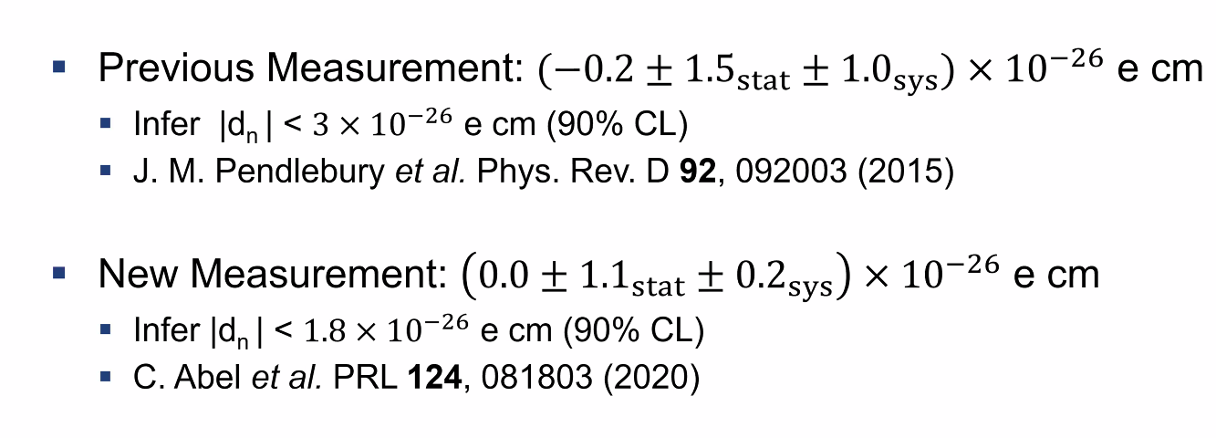
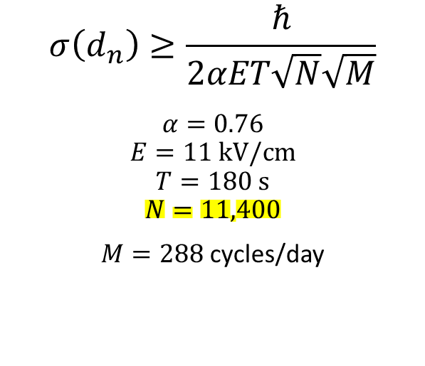
The best nEDM limit: PSI (2020)
$$σ\left(d_{n}\right)≥\frac{ℏ}{2αET\sqrt{N}\sqrt{M}}$$
$$α=0.76$$
$$E=11 kV/cm$$
$$T=180 s$$
$$N=11,400$$
$M=288$ cycles/day
2005-2015: improving OILL apparatus @ PSI
2015-2016: physics data taking
2017: field mapping

Slide 21
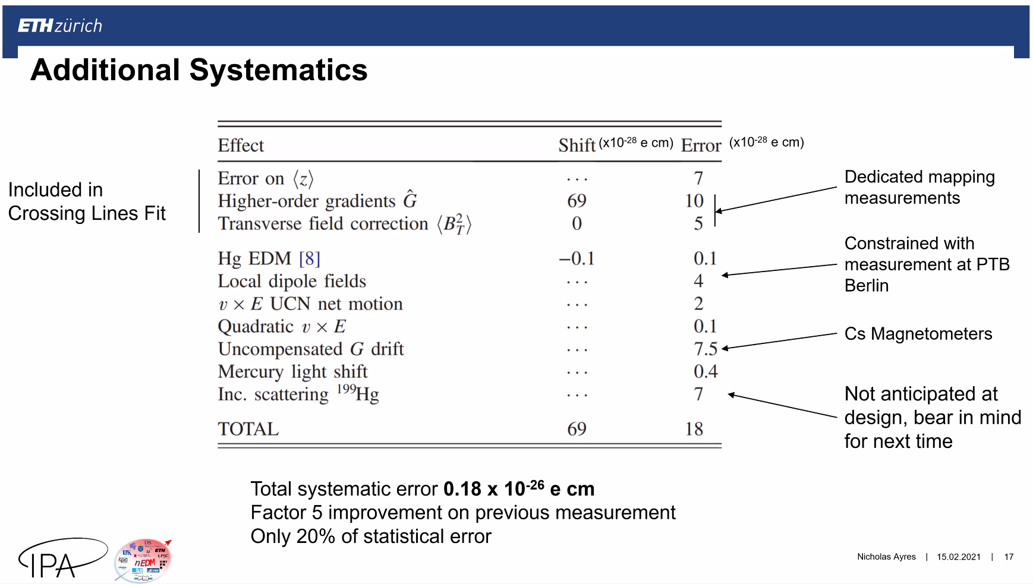
From N. Ayres, nEDM2022

Slide 22
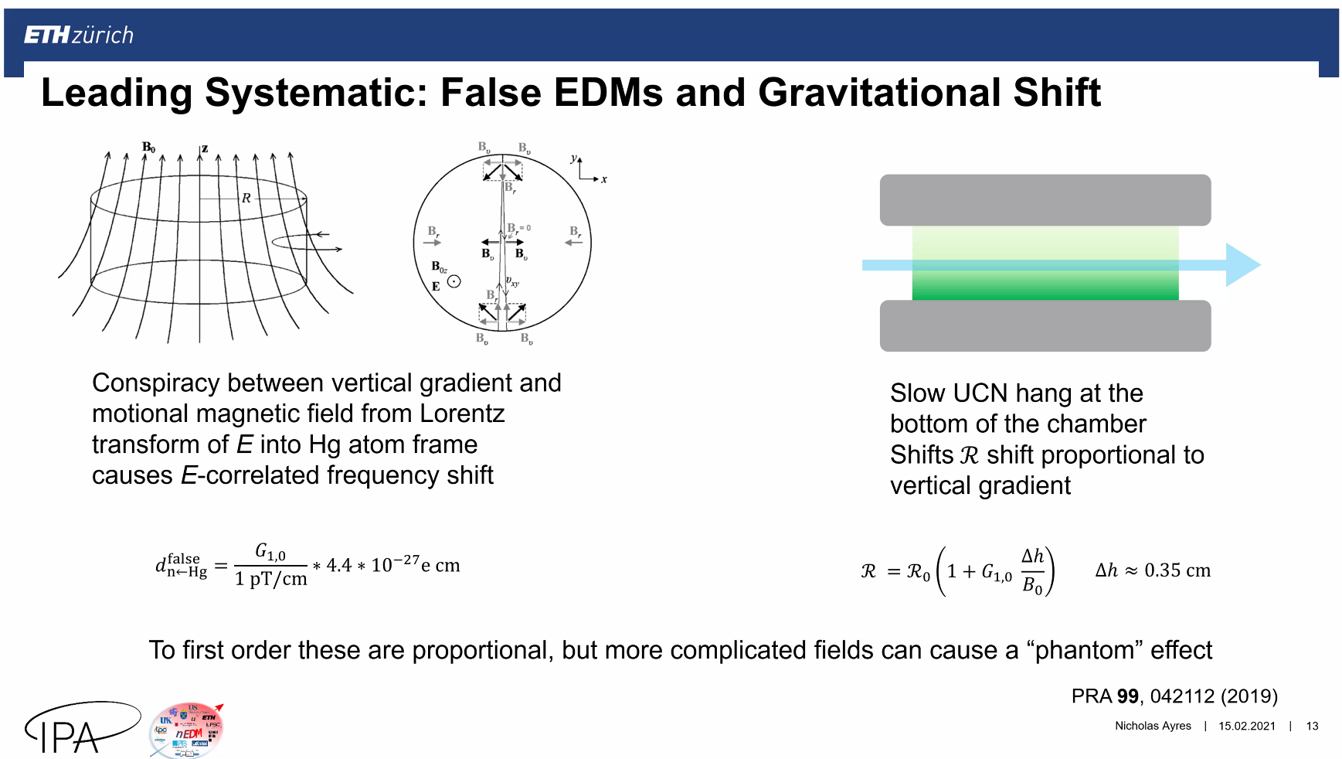
From N. Ayres, nEDM2022

Slide 23

Study the Systematic Effects below 1e-26 e-cm
Low-frequency field drift
  Cancelled by Hg signal
Leakage current
Geometric Phase Effects
  The field gradient coupled to the motion of UCN
Gravitational induced frequency shift
  Different velocity of UCN and Hg
Earth rotation
  Frequency shift in an accelerating frame.
Pseudo magnetic field
  Spin-dependent scattering between UCN & Hg
…….
Matryoshka dolls
Notes:
Even though there is no Standard Model background to contaminate EDM signals, the experiments background from Maxwell Equations that describes classical electromagnetic fields.

Slide 24
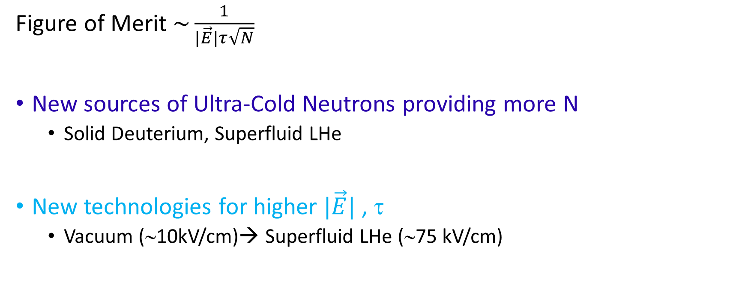
How to Improve Sensitivity
Figure of Merit $\sim \frac{1}{|\vec{E}|τ\sqrt{N}}$
New sources of Ultra-Cold Neutrons providing more N
  Solid Deuterium, Superfluid LHe
New technologies for higher $|\vec{E}|$ , τ
  Vacuum (∼10kV/cm)→ Superfluid LHe (∼75 kV/cm)

Slide 25

Neutron EDM Experiments Underway
PNPI
TRIUMF
ILL
FRMII
PSI
J-PARC
LANL
SNS
Notes:
The science reach of neutron EDM has encouraged many potential experiments …

Slide 26

Beyond 1e-26 e-cm…
$$σ\left(d_{n}\right)≥\frac{ℏ}{2αET\sqrt{N}\sqrt{M}}$$
Present 90% limit: 1.8 x 10⁻²⁶ e-cm
Abel et al., PRL. 2020; 124(8): 081803
Experiment | Facility | α | E (kV/cm) | T (s) | N | neutron density (1/c.c.) | Chamber D (cm) or volume | Coating | σ(d) per day (e-cm) | σ(d) (e-cm)
OILL | PSI-sD2 | 0.76 | 11 | 180 | 11,400 | 2 | 47 | DLC + dPS | 11e-26 | 1.5e-26
n2EDM | PSI-sD2 | 0.8 | 15 | 180 | 121,000 | 2 | 80 | DLC + dPS | 2.6e-26
LANL | LANL-sD2 | 0.8 | 12 | 180 | 80,000 | 15 | 47 | dPS | 4 e-26 | 3.4e-27 (1y)
TUCAN | TRIUMF-lHe |  |  |  | 600,000-2,000,000 | 200-400 | 30,000 c.c. | dPS |  | 1e-27 (400d)
PanEDM | ILL—lHe |  |  |  |  | 3.9 40 |  | dPE | 3.8e-26 (I) 7.9e-27 (II) | 3.8e-27 (100d) 7.9e-28 (100d)
PNPI | PIK—lHe |  | 12→ 27 |  |  | 200 |  |  | 1.5e-26 | 1e-27 (1y)
nEDMSF | ILL/ESS--lHe |  | 75 | 500 | 380,000 | 120 | 3,000 c.c. | dTPB-dPS |  | 3e-28 (3y)
BeamEDM | ILL/ESS |  | 40 | 4e-2 |  |  | FP=50m |  | 5e-26
→ 4.45e-26 (2024)

Slide 27

nEDM sensitivity is still limited by the UCN counting statistics → continuing efforts to make more intense UCN sources
$$σ\left(d_{n}\right)≥\frac{ℏ}{2αET\sqrt{N}\sqrt{M}}$$
Facility |  | Current | Power | UCN converter | Production volume (L) | UCN rate (1/s) | Storage (s) | Temperature (K) | Heat load in target (W) | Neutron density (1/c.c.)
PSI | 590 MeV p | 2.4 mA (1%) | 1.4 MW | sD2 | 30 |  |  | 5 |  | 2
LANL | 800 MeV p | 9 μA | 7.2 kW | sD2 | 2 |  | 40 | 5 |  | 15
TRIUMF | 480 MeV p | 40 μA | 20 kW | lHe | 27 | 1.4-1.6e+7 | 30 | 1.1 | 8.1+1.5 | 200-400
ILL | 9A n flux |  |  | lHe | 12 |  |  | 0.6 |  | 200
PNPI—PIK reactor | 9A n flux | 5e+8 (/cm^2-s-A) |  | lHe |  |  |  | 1.15 | 3.85 | 350
SNS | 9A n flux | 5e+8 /s |  | lHe | 3 | 0.31/c.c. |  | 0.5

Slide 28

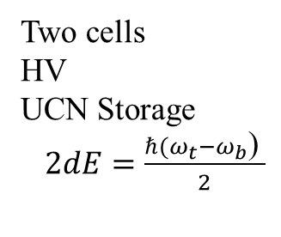

Magnetometry strategy
From source
To polarimetry
External Magnetometers
Two cells
HV
UCN Storage
$2dE=\frac{ℏ(ω_{t}−ω_{b}\text{) }}{2}$
TOP
$${\vec{E}}_{top}$$
HV
Central magnetometers
$${\vec{E}}_{bot}$$
BOTTOM
Vacuum chamber
Complex B₀ coil
MSR
A
External Magnetometers
Effect | Mitigation
B-field variations | Co-agnetometry, MSR, Two cells, external magnetometry
Leakage currents | Monitor, comagnetometry
vxE effects | UCN storage, Uniform fields (offline mapper, two cells, co-magnetometry, …)
Geometric phase | Gradient control, external magnetometry
Major Challenges

Slide 29
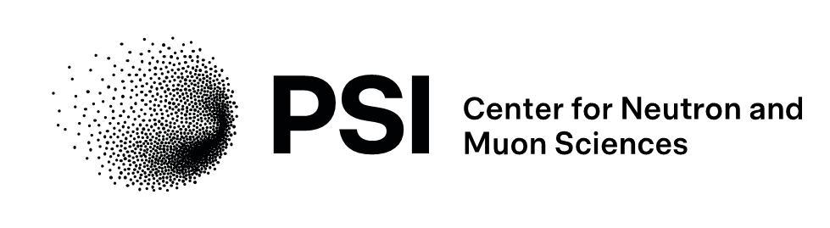


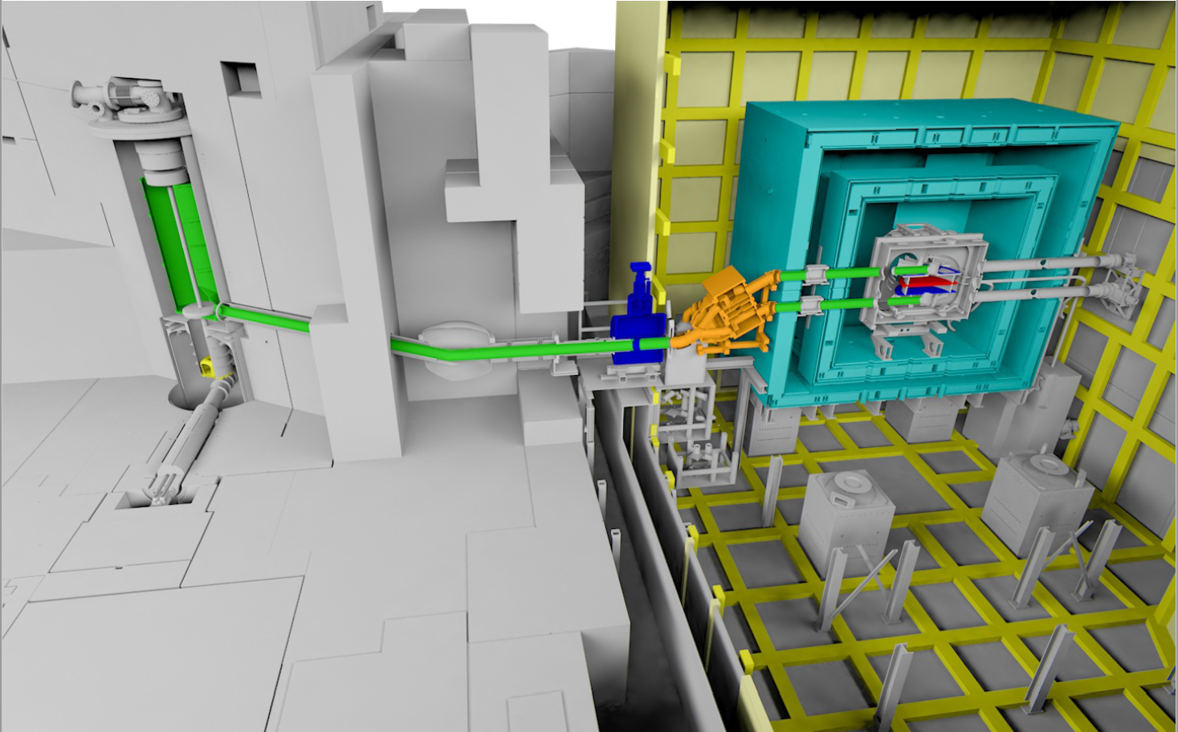
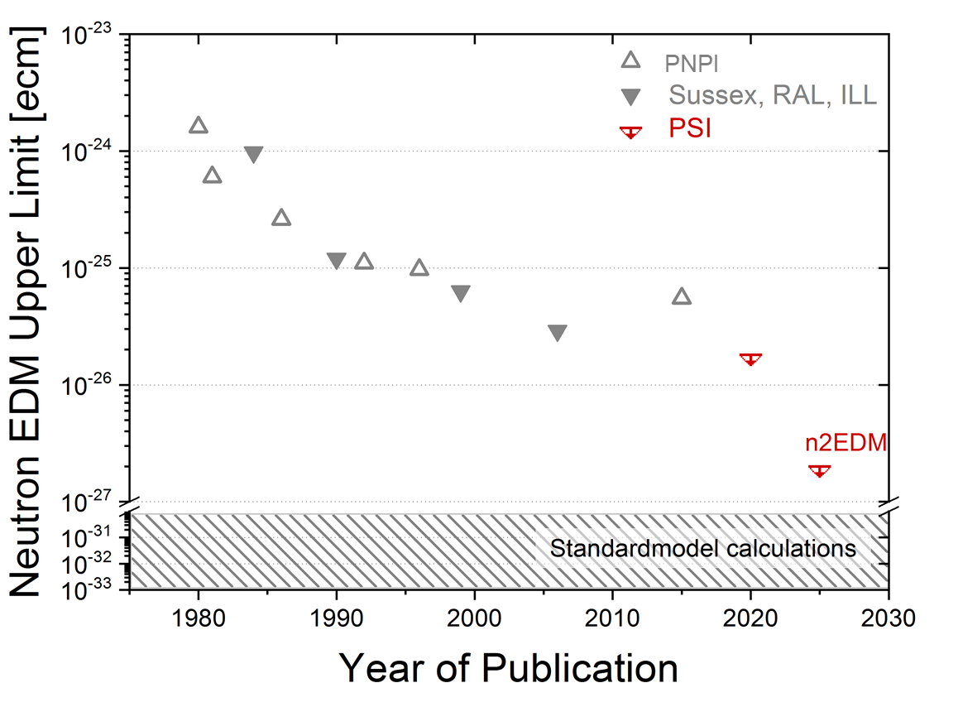
n2EDM - High sensitivity search for a permanent electric dipole moment d_{n} of the neutron
Measurement at the high intensity
ultracold neutron (UCN) source of the Paul Scherrer Institute (PSI), Switzerland.
History of nEDM limits
nEDM
current best limit
|d_{n}|< 1.8×10⁻²⁶ e⋅cm
by the nEDM collaboration at PSI.
C.Abel et al. Phys.Rev.Lett. 124 (2020) 081803
new apparatus n2EDM: factor 10 sensitivity improvement in the baseline setup
The design of the n2EDM experiment, N.J. Ayres et al., Euro.Phys.J. C 81 (2021) 512
- future n2EDMagic phase ~5×10⁻²⁸ e⋅cm sensitivity goal, at 10 μT field. 2028++
Bernhard Lauss/2025
B.Lauss

Slide 30
n2EDM - new apparatus
UCN Source
Active Magnetic Shielding
Magnetically Shielded
Room
UCN switch
distributing
to 2 chambers
B
UCN storage
chambers
vacuum tank
E
~9m guides
5T polarizing magnet
n2EDM apparatus
B.Lauss
Bernhard Lauss/2025

Slide 31
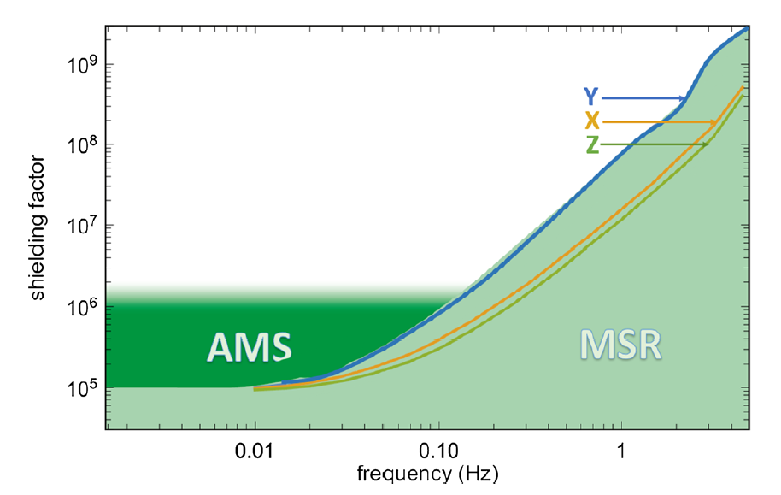
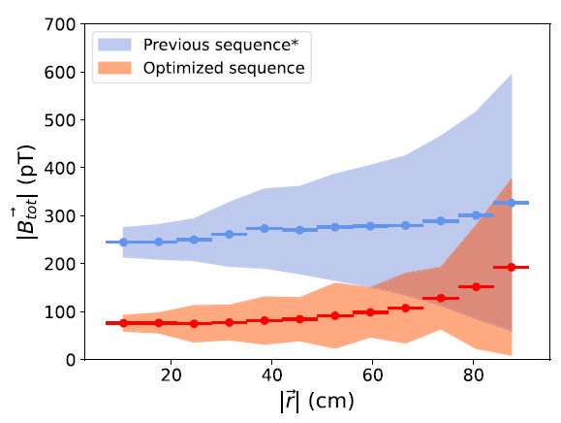
n2EDM
active and passive magnetic shielding
shielding factor versus frequency
MSR
Active
Magnetic
Shielding
coils
(55km wire)
5m
1μT coil
Magnetically
Shielded Room
6 layers mu-metal
1layer Al
optimized rest field <100 pT
Magnetic environment at or better than design values:
Design of the n2EDM experiment: EPJC 81 (2021) 512
Magnetically shielded room: Rev.Sci.Instr. 93 (2022) 095105
Active magnetic shielding: EPJC 83 (2023) 1061
Ultralow magnetic fields: EPJC 84 (2024) 18
UCN chamber dimension
Bernhard Lauss/2025

Slide 32
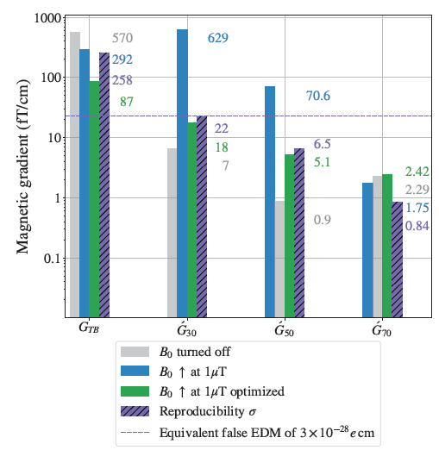
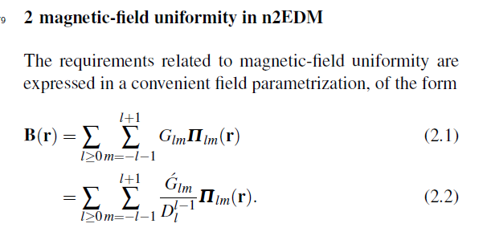
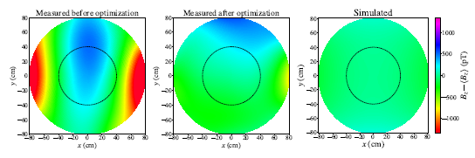
n2EDM
coil system for homogeneous 1μT vertical field
field description in spherical polynomic expansion
C,Abel et al, PhysRevA 99 (2019) 042112
central magnetic field mapped
Normalized gradients responsible for the false EDM extracted from the magnetic field maps. The 23 fT/cm limit (dotted line) imposed on the gradients corresponds to a false EDM of 3×10⁻²⁸ ecm. The G_{TB} gradient can be corrected with special coils.
Horizontal cut at z = 0 of the deviations of the vertical B0 magnetic field, in the positive coil polarity.
Highly homogeneous B-field arXiv:2410.07914
Bernhard Lauss/2025

Slide 33
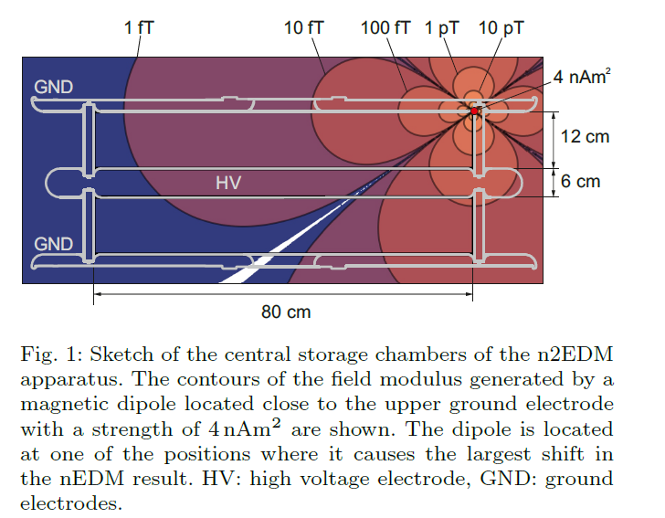
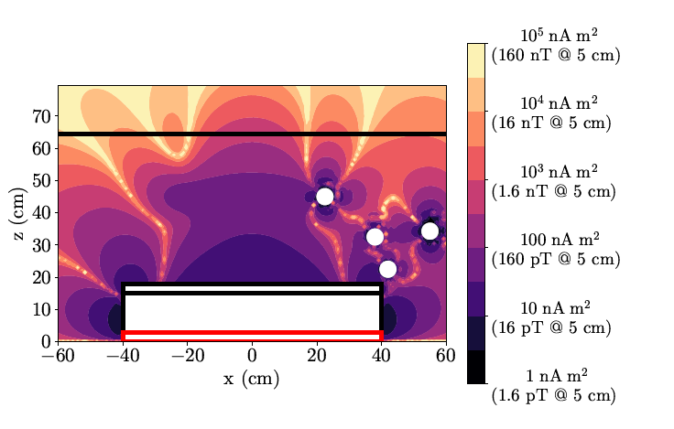
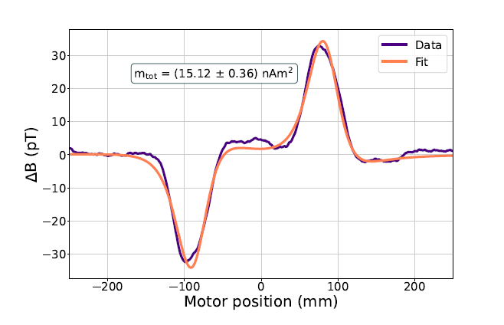
n2EDM
eliminating magnetic contaminations of components
It is crucial to check all parts which are in the central region of the apparatus = the innermost chamber of the MSR
for magnetic contaminants - searching for magnetic dipoles
--- there is no apriori non-magnetic material
e.g. same batch of screws can be good or bad
we check small parts in gradiometer at PSI to ~ 3pT noise level in 25mm distance and large parts (electrodes, insulator rings, vacuum tank sides)
at BMSR2- PTB Berlin
magnetic dipoles cause frequency shift
'allowed' magnetic dipoles to reach a
3x 10⁻²⁸ ecm systematic uncertainty contribution to false Hg EDM
e.g. PEEK part
PhD Thesis V.Kletzl 2025
=> immense work and time spent with scanning parts!
Design of the n2EDM experiment: EPJC 81 (2021) 512
Bernhard Lauss/2025
Notes:
It is crucial to have a co-magnetometer to control systematic effects due to local magnetic dipoles.

Slide 34
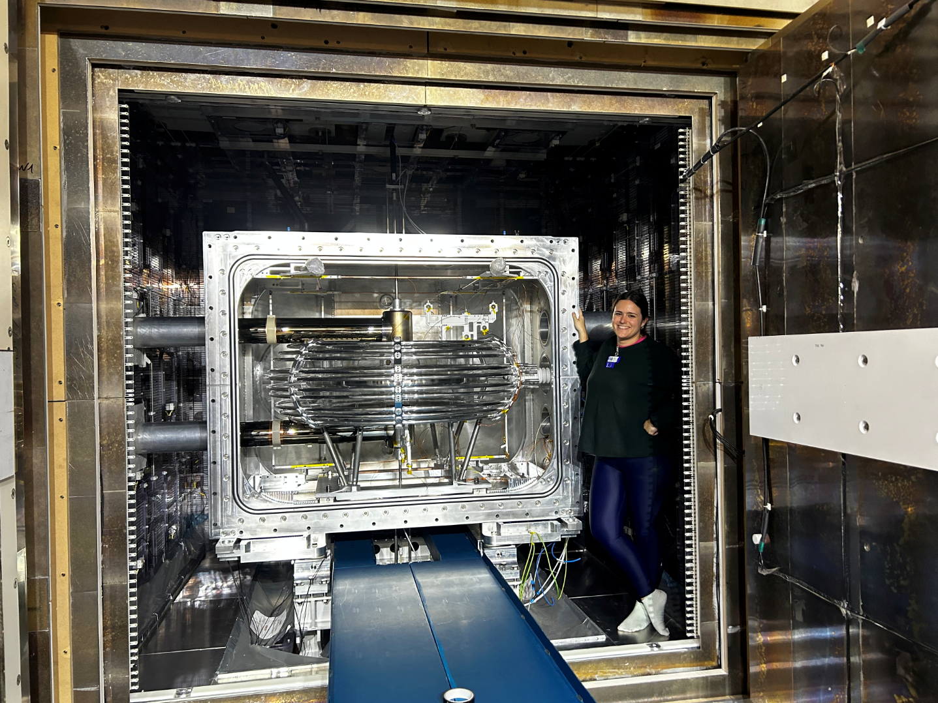
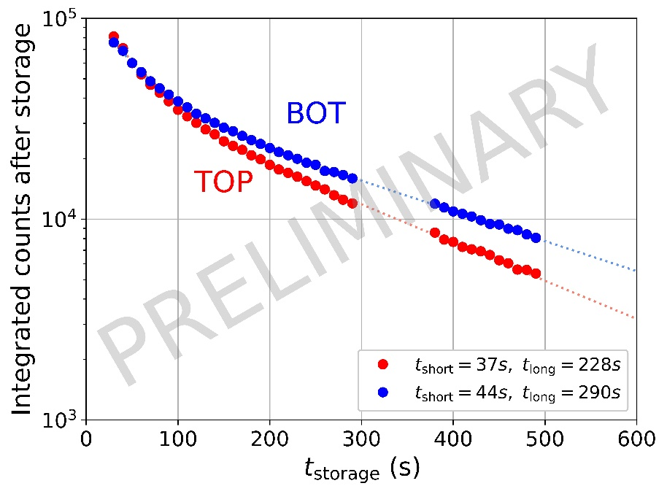
n2EDM
UCN chamber stack - 2x 60 liter volume
currently: DLC + Quartz
magnetically shielded room
shielding factor 10⁸ at 1 Hz
- regular measurements with full UCN system and Hg and Cs magnetometer in Dec. 2024
- operated at a statistical sensitivity of
4.45 x 10⁻²⁶ ecm per day
in Dec.2024
magn. field
B= 1 μT
electric field
E =15kV/cm
UCN storage in top and bottom chamber
top
bottom
UCN chambers
Bernhard Lauss/2025

Slide 35
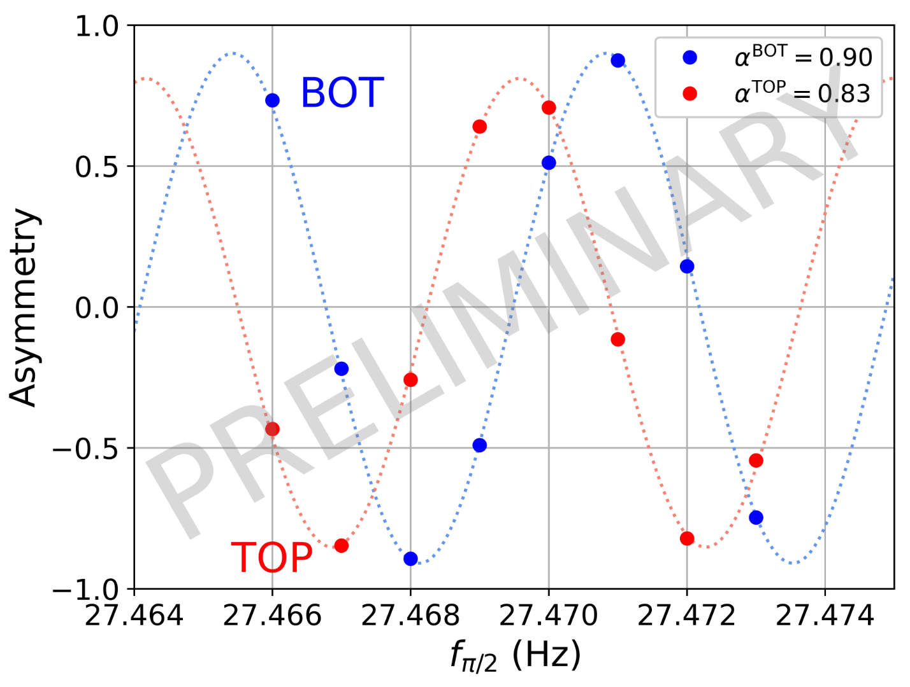
n2EDM
commissioning
Coincident Ramsey measurement in top and bottom UCN chambers already without B-field correction and highest asymmetry.
Bernhard Lauss/2025

Slide 36
n2EDM
Status January 2025
- magnetically shielded room (MSR) - ultralow remanent field in 25m³ - operating
- active magnetic shield (AMS) - operating
- internal magnetic field system at 1 μT and high homogeneity - operating
- UCN chambers and beamline - operating
- high voltage system operated at up to 180 kV - commissioning ongoing
- Hg comagnetometry - commissioning ongoing
- Cs magnetometers - commissioning ongoing, full array in preparation
- test nEDM measurement with all subsystems together done in Dec. 2024
- daily sensitivity of 4.45 x 10⁻²⁶ ecm (~54% of design sensitivity reached in continuous operation)
- new UCN chambers for summer 2025 to reach 100% design sensitivity in preparation/production
- first double chamber Ramsey curve measured
- many auxilliary measurements (gradient scans with UCN,Hg,Cs , R-curves etc done)
- full data blinding in preparation to be implemented
- magnetic scanning and cleaning of many parts ongoing
- plan to start nEDM measurements after PSI accelerator shutdown in summer 2025
n2EDMagic phase ~5×10⁻²⁸ e⋅cm sensitivity goal, at 10 μT field. 2028++
Bernhard Lauss/2025

Slide 37



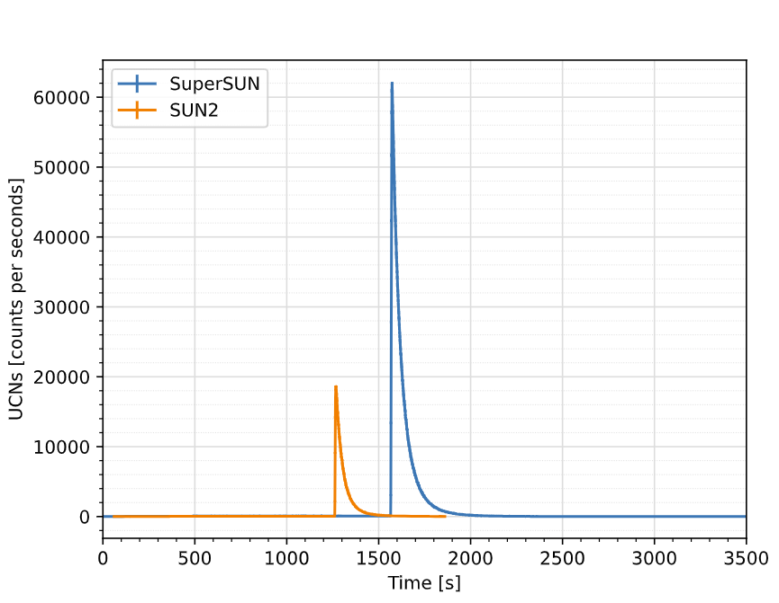






SuperSUN: High density UCN source
Phase I characterization
Measurement agrees with expectation (48 MW)
cf. EPJ Conf. 219, 02006 (2019)
Total UCN output: 3.8×10⁶ (integral of blue peak)
Source density: 270 UCN/cm³
Long storage times: 126,000 UCN remaining after 20min
Expected density in PanEDM: 3.9 UCN/cm³ (58 MW)
Source characterization, PanEDM commissioning ongoing
Phase II expectation
Peak field: 2.1 T
Source density: 1,670 UCN/cm³ (x5 gain)
Density in PanEDM: 40 UCN/cm³ (x10 gain)
Comparison to the prototype source SUN2
Zoom log
Photo credit:
Ecliptique – Laurent Thion.
Slide credit: Skyler Degenkolb

Slide 38



SuperSUN phase II:
polarized UCN and magnetic storage
Benefits in phase II
Increase storage potential for one spin state
Decrease loss rate for stored UCN
→ UCN already polarized within the source
Phase II expectations (gain over phase I)
Peak field: 2.1 T
Source density: 1,670 UCN/cm³ (x5 gain)
Density in PanEDM: 40 UCN/cm³ (x10 gain)
Status
Quench protection validated
Octupole trained up to 1 T
Preparing impregnation of the octupole, to reach nominal field
Slide credit: Skyler Degenkolb

Slide 39





The PanEDM Experiment
Still preliminary!
3.8×10⁶ UCN measured (fill-and-empty)
…relative to 0.88×10⁶ at SUN2
Under investigation: spectrum, storage in external volumes, etc…
Slide credit: Skyler Degenkolb

Slide 40


The PanEDM Experiment
Double chamber Ramsey interferometer at room temperature
¹⁹⁹Hg magnetometers with few-fT resolution (external in phase I)
Cs magnetometers (also at high voltage)
Magnetic shielding factor: 6×10⁶ at 1 mHz
Simultaneous spin detection for up/down
SuperSUN UCN source at ILL in 2 phases:
  Phase I: unpolarized UCN with 80 neV peak
  Phase II: polarized UCN, magnetic storage
Ongoing installation of parts, commissioning now in progress
  first UCN production: June 2023 (met expectation)
  ongoing source characterization: 2024-2025
  interface and UCN delivery to PanEDM: 2026-
EPJ Web of Conferences 219, 02006 (2019)
Slide credit: Skyler Degenkolb

Slide 41


TUCAN @ TRIUMF
Timeline:
  2024 UCN production with new TUCAN source
  2025 Readiness for nEDM data taking
Initial goal to demonstrate 10⁻²⁷ e-cm capability
TUCAN nEDM Experiment Overview
Polarizer
UCN Source
Precession Cell
Cryostat
Detectors
Magnetically Shielded Room
Slide credit: Derek Fujimoto

Slide 42






TUCAN nEDM Experiment Status
6-layer MSR Complete
Self-shielded B0 coil in fabrication
Array of 20 Cs magnetometers under final characterization
Half-precession cell prototype tested with UCN at J-PARC
Asynchronous spin analyzer reuses existing UCN detector
Slide credit: Derek Fujimoto

Slide 43

Recent Challenges
Budgetary: temporarily descoped to a minimally-complete EDM experiment (OC100) as a development platform.
MSR: shielding factor of original build was too low. Installed an additional 6th layer.
B0: needed redesign to accommodate the new MSR layer.
High Voltage: lack of suppliers may require polarity switcher to be designed in-house.
Detectors: lack of suppliers motivated the development of a different detector technology
(6Li glass → CH4+3He gas)
Slide credit: Derek Fujimoto

Slide 44



UCN “Pokotilovsky” source operating at the Los Alamos Neutron Science Center (LANSCE)
Source upgrade (2016):
Better moderator cooling
NiP guides
Optimized geometry
UCN density measured by Vanadium activation: 184 UCN/cc.
A. Saunders, et al. RSI 84, 013304 (2013); T. M. Ito et al. Phys. Rev. C 97, 012501(R) (2018)
Notes:
Flapper valve, proposed by Pokotilovsky.
The 52 V production rate, R , was measured to be
R = 1.82(18) °ø 103 s−1 with a gate valve detector rate of 318
UCN/s. If this is taken as the UCN flux into the area of the
foil, the UCN density can be calculated using kinetic theory
as: ρUCN = 4R
a ¯ v , where ¯ v = 390 cm/ s is the average neutron
velocity and a is the area of the foil. This gives a density of
44 (5) UCN/cm3 when normalized to the gate valve monitor
rate 586 s−1 , obtained when the source and beam are optimally
tuned.
There are

Slide 45
LANL nEDM Experiment overview
Selected features
Ramsey’s separated oscillatory field method at room temperature
Double precession chamber
Simultaneous spin analysis
MSR
  4 layer mu-metal + 1 layer RF shield
  Outer dimension: 3.5 m x 3.5 m x 3.5 m
  Inner dimension: 2.4 m x 2.4 m x 2.4 m
Magnetometry:
  199Hg comagnetometer
  199Hg external magnetometer inside the HV electrode
  Atomic external magnetometers
Demonstrated UCN density*
Goal: 3.4×10⁻²⁷ e-cm with one-year of accumulated running time.
Physics data taking starts in 2026
* Ito et al., PRC97, 012501 (R ) (2018), Wong et al., NIMA 1050, 168105 (2023).
Notes:
The LANL experiment has a setup similar to the PSI experiment, using room-temperature apparatus, but will take advantage of a strong UCN source available at LANSCE. The goal is to improve the PSI limit by an order of magnitude, reaching into 1e-27 e-cm.

Slide 46






Hardware updates
20 pT
Background
Coils

Slide 47



nEDM@SNS
Spallation Neutron Source at ORNL
Polarized ³He Source
Magnetic field coils and internal magnetic shields
Concept:
R. Golub & S. K. Lamoreaux, Phys. Rep. 237, 1 (1994)
HV electrode
Measurement cells
All unque to nEDM@SNS
Two-layer magnetic shield
High trapped neutron densities
Superfluid Helium moderator
LHe as HV insulator
> 70 kV/cm vs 10 kV/cm
Use of a ³He co-magnetometer and superconducting shield
Control of systematics
Variation of LHe temperature to study v x E systematics
Monitor of systematics
Precession frequency measurement via two techniques
Cross-check of non-zero signal
Unprecedented sensitivity reach
dn < 3 x 10^{–28} e-cm (in 3 calendar yrs)
M.W. Ahmed at al 2019 JINST 14 P11017
“Most ambitious nEDM experiment that is currently underway”
nEDM@SNS Review Committee
However, the project was cancelled in Nov. 2023.
Notes:
This experiment is taking place at the Spallation Neutron source at Oak Ridge.
The experiment uses superfluid helium as a UCN source, a HV insulator, and a neutron detector.
The leading systematic effects due to vxE systematics could be studied by adjusting the temperature of the liquid helium bath.
It calls for many innovative techniques.
It involves many challenging cryogenic engineering at the scale never attempted before.
A recent review committee make a remark that this is the “most ambitious nEDM experiment currently underway”

Slide 48

An unique experiment uses ³He as detector
R. Golub and S. K. Lamoreaux, Phys. Rep. 237 (1994) 1
UCN too dilute to detect with magnetometer (SQUID)
Inject small concentration (~ 10⁻¹¹) of polarized ³He
Look for reaction: n + ³He → t + p + 764 keV
TPB coating
t, p scintillate in ⁴He (a liquid noble-gas detector)
Pipe through light guides and detect with PMT
To measure spin precession:
1. n + ³He → t + p:
UCN
3He
σ (³He, n: ↑↓singlet) ~ 10⁷ b
σ (³He, n: ↑↑ triplet) < 10⁴ b
2. μ_{He}/μ_{n} = 1.11
³He spins will rotate ahead of n spins in same B
Scintillation light according to Φ = Φ₀ sin (ω_{He} – ω_{n}) t ~ 1-P_{n}P₃ cos(ω_{He} – ω_{n})t
3. Independent monitor of ³He spins with SQUIDs
Notes:
Many of the techniques requires the interplay between neutrons and polarized He-3.

Slide 49

Techniques for measuring Δω
Classic `Ramsey’s Separated Oscillatory Fields’ method
  Precess for long time Δt accumulating ω_{EDM}Δt phase
  Accumulated phase leads to different final polarization
Free precession with Comagnetometers
  Optically pumped ¹⁹⁹Hg vapors (Room temperature exp’ts)
  Free Precession with n-³He capture (cryogenic exp’ts)
Critical Spin Dressing
  Golub & Lamoreaux, Phys. Rep. 237, 1 (1994)
  Additional alternating-current B-field matches n&³He
  precession frequency for E=0
  d_{n} $≠$ 0 changes capture rate
Beat frequency ∼ 9 Hz @ 30 mG
N captures
0.15 0.30 0.45 0.60 0.75 0.90 1.05 1.20 1.35 1.50
t (sec)
Notes:
https://www.youtube.com/watch?v=xBL_jDjtojc
The LANL experiment uses the Ramsey’s separated oscillatory fields method that measures the accumulated phase of spin precession. The longer the spin is freely to precess, the larger the accumulated phase, and higher the precision of frequency measurements.
The experiment at SNS aims for even greater improvement (by two orders of magnitude) and implement a versatile diagnosis scheme to control systematic effects.
In particular, the experiment can measure neutron spin precession in two ways: it can monitor free precession through interactions with polarized He-3 and measures a beat frequency of 9 Hz in a 30 mG field. It can also be operated in the critical spin dressing mode: by applying additional RF field, the magnetic moments of neutron and He-3 are tuned to be exactly the same, so that the process of n-He3 capture will be immune to any fluctuation of external magnetic fields, but only sensitive to EDM.

Slide 50



Chris Swank

Slide 51

nEDMSF apparatus on ESS beam port E5
VESPA
nEDMSF
ESTIA/SKADI
Slide credit: Doug Beck

Slide 52

Existing Cryostat (Yao, Fierlinger)
HV development at LANL included “half-scale” phase (HSHV)
  3He evaporation refrigerator
Use 40x10x7.6 cm³ “production/measurement cell”
Surrounded by superfluid “central volume”
Reuse cryostat with
modifications
  Extend CV
  Ports for beamline
  Add light collection system
Slide credit: Doug Beck

Slide 53


HSHV Cryostat at PF1b
Slide credit: Doug Beck
0.5 m
2.8 m
1.3 m
HSHV cryostat on the PF1b beamline
HSHV cryostat on the PF1b beamline

Slide 54
nEDMSF: Phase 1
Introduction to the proposed measurement on ILL PF1b
  Proposal recently reviewed by subcommittee
  Use PF1b beamline with existing ³He evaporation refrigerator (some mechanical modifications + peripherals), full size “legacy measurement cell” together with SiPM-based light collection system
Goals
  Produce UCN in plastic cell filled with superfluid ⁴He
    Use proposed measurement cell from legacy experiment
  Measure capture light to determine UCN production rate and relative beta decay (and other) background rates
    Measure light production from the n + 3He capture reaction
    Use SiPM-based light collection system developed for legacy experiment
  Unpolarized, no magnetic or electric fields
  Use existing cryostat from earlier HV testing
    Needs new pumps, gas system, instrumentation
Slide credit: Doug Beck

Slide 55

Rates
Slide credit: Doug Beck
Beamline PF1b
  Particle flux at 8.9 Å estimated to be 3 x 10⁸ cm⁻² s⁻¹ Å⁻¹
  Velocity selector for 8.9 Å → beam 6 cm wide x 5 cm high, 90% transmission
For 160 neV wall potential (dPS), production rate is 2.5 UCN s⁻¹ cm⁻³ or 3000 s⁻¹ in cell
For nominal relative ³He concentration of 5x10⁻¹¹ (absolute concentration 10¹² cm⁻³) capture lifetime R τ_{β}; with τ_{wall}= τ_{β}/2, equilibrium number of UCN is 7x10⁵
Spin averaged capture rate (and β decay rate) is then about 0.8 kHz
Principal measurement is of the SiPM spectrum
  As function of accumulation time/storage time
  As function of ³He concentration: R_{β}/R₃
  As function of temperature (R0.5 – 0.7 K)
Test position sensitivity with heat flush?
R_{β}/R₃=0.55

Slide 56


Beam EDM
The last beam nEDM experiment (1977) was limited to 3e-24 e-cm by the systematic effect by a relativistic $v×E$motional field.
Mitigation: reverse $v$ w/ a turbable

Slide 57








Beam EDM
Fundamental Neutron and Precision Physics Group (University of Bern)
New complimentary neutron EDM search using a pulsed beam
Project based in Bern with successful proof-of-principle experiments performed at PSI and ILL
Full-scale experiment intended for ESS, competitive to UCN experiments
Electrode stack
Mu-metal shield
1 m
PF1b 2020
Piegsa, PRC 88, 045502 (2013)
Chanel et al., EPJ Conf. 219, 02004 (2019)
Schulthess et al., PRL 129, 191801 (2022)
Slide credit: Florian Piegsa

Slide 58

Jacob Thorne
ESS proposal:
L = 50 m
Use a pulsed neutron source and time-of-flight to account for the velocity dependent effects.
EPJ Web of Conferences 219, 02004 (2019)

Slide 59
Summary
EDMs provide impressive reach for BSM physics via new CP-violation
Realizing the current investments:
Neutron EDM measurements are underway to extend sensitivity up to 2 orders-of-magnitude. Two competitive/world-leading efforts are underway to bring neutron EDM measurements back to the US!
Planned and ongoing CP-violation search experiments using ¹²⁹Xe atoms, ²²⁵Ra atoms, ¹⁷³YbOH molecules, and ²⁰⁵TlF molecules are poised to match or exceed the new physics sensitivity of the state-of-the-art ¹⁹⁹Hg EDM experiment (0.74 x 10⁻²⁹ e-cm) by about an order of magnitude.
Investing in facilities & R&D to enable next-gen. hadronic CP-violation searches:
Several next generation CP-violation search schemes using pear-shaped nuclei inside of molecules are currently being developed and have new physics sensitivities that are several orders of magnitude beyond the state-of-the-art ¹⁹⁹Hg EDM experiment.
Developing a next generation CN and UCN source (to reach > 1000 UCN/c.c.) is key to continue pushing nEDM sensitivity in the coming decade.
Notes:
Benefit from decades of experience in neutron EDM searches to scale up the traditionally table-top efforts to similar scale of medium/high energy experiments, while mainlining the capability to control the external field at exquisite scales in order to study systematic effects.
The US has made investment during the last LRPs to make neutron EDM search a high-priority mission. During this LRP, we would like to see the completion of the construction of the SNS nEDM and start to harvest physics results.
Various table-top nuclear EDM experiments are making steady progress, approaching the sensitivity of mercury EDM.
For this long range plan, we like to develop the next generation CP-violation searches using pear-shaped nuclei from FRIB and develop techniques to put them inside polar molecules for 5-10 orders of magnitude in enhancement. To keep on pushing the precision of neutron EDM, we also need to invest in R&D for next generation UCN source capable of outputting ultracold neutrons with high densities.

Slide 60


Jacob Thorne

Slide 61
Summary
EDMs provide significant reach for BSM physics via new CP-violation
  nEDM offers a particularly strong constraint when new physics couples to quarks/gluons.
Neutron EDM measurements are underway to extend sensitivity up to 2 orders-of-magnitude
  Next generation of experiments aims at 10⁻²⁷ e-cm uncertainty, order of magnitude improvement mostly arising from UCN source increase.
  Experiments developing innovative techniques to achieve 10⁻²⁸ e-cm.
Multiple International efforts (PSI, TRIUMF, LANL, ILL/ESS) are actively underway.

Slide 62


Dressed Spin Magnetometry
The magnetic moment of 3He can be altered through “spin dressing” with applied RF:
The difference in the precession frequency between neutron and 3He:
= 0 with appropriate x
1kHz, 100 mG RF field
All systematic effects and noises associated with the external magnetic field
disappear!
modulate X to look for
X_{c} which leads to δω=0
EDM observable:

Slide 63


Slide 64

Term proportional to $\frac{∂B_{z}}{∂z}$, can be evaluated using the crossing-point analysis
Systematic effects
Term due to higher order gradients
The largest systematic effect came from the contribution to the Hg geometric phase effect due to higher order magnetic field gradients.
The size of the effect was evaluated by mapping the field without the precession chambers.
The contributions from the possible magnetism in the inner parts were evaluated using a scanner.
From Abel, et al., PRL 124, 081803 (2020)

Slide 65
Magnetic field uniformity requirements
Uniformity requirements from ¹⁹⁹Hg geometric phase effect
Uniformity requirements from the same pi/2 pulses being used for both cells
The difference between the two cells

Slide 67

Production/Measurement Cell (Degenkolb/Leung)
Contain superfluid ⁴He at T=0.4 K: UCN
Provide potential barrier for UCN: dPS on acrylic (R160 neV)
Convert scintillation light from n+³He → p+t scintillation light to visible: dTPB in dPS
Collect converted light: Vikuiti dielectric film
Transmit polarized neutrons: dPMMA windows
(Withstand pressure cycles 0 – 2 bar)
Admit polarized ³He through valve
Absorb cold neutrons hitting cell walls: ⁶Li₂CO₃

Slide 68
Light Collection (Cianciolo)
Transport visible light to SiPM array
  Convert blue photons (TPB) to green: Kuraray-11 wavelength-shifting fiber
    176 fibers stacked vertically along length of 40 cm long x 10 cm high cell face
  Transport to SiPM array: Hamamatsu 13360-75
    12-16 channel SiPM cards
    SiPM active area 1.5 x 1.5 mm²
    TR200 K
Set threshold for single photon detection→ simulation
  Reduce β background by x2, capture efficiency > 93%

Slide 69
³He Handling/Cell Valve
³He in the measurement cell
  Reduce natural ³He concentration from R 3x10⁻⁷ to < 10⁻¹¹: fill through superleak
    SuperSUN experience: about 2 h to fill 13 l after everything is cold
  Add ³He gradually to measure changes in spectrum
    Calibrated volume (dilute with ⁴He at room temp), liquefy at 1 K pot, add through capillary
  To reduce concentration consider adding heat flush capability
    Heat entire CV, need dump for ³He rich mixture
    Requires 1 or 2 extra low temperature valves
Valve for measurement cell
  Need relatively large diameter (R 2 cm) valve in order to pump cell effectively
  Inside surface must (eventually)
    Be polarized ³He friendly
    “Complete” the ground plane
  For Phase 1, probably add ³He through this valve as well

Slide 70



nEDM @ ILL/PNPI
ILL/PNPI
PNPI – ILL – PNPI EDM
Spectrometer used
1985 – 1996 at PNPI
2008 – 2013 at ILL
Plan to move to PNPI (Gatchina) to a new He-II UCN source
From Jeff Martin PSI2022
Adapted from A. Serebrov

Slide 71

EDM limit comparison
Particles 2023, 6(1), 385-398

Slide 72
Term proportional to $\frac{∂B_{z}}{∂z}$, can be evaluated using the crossing-point analysis
Systematic effects
Term due to higher order gradients
The largest systematic effect came from the contribution to the Hg geometric phase effect due to higher order magnetic field gradients.
The size of the effect was evaluated by mapping the field without the precession chambers.
The contributions from the possible magnetism in the inner parts were evaluated using a scanner.
From Abel, et al., PRL 124, 081803 (2020)

Slide 73
Magnetic field uniformity requirements
Uniformity requirements from ¹⁹⁹Hg geometric phase effect
Uniformity requirements from the same pi/2 pulses being used for both cells
The difference between the two cells

Slide 74



3D magnetic field mapper design
Requirements:
  Maps the volume corresponding to the location of the two precession chambers using fluxgate magnetometers
  Flips the fluxgate magnetometer for measuring the offsets.
  Provides position accuracy of 1 mm.
  Made of non-magnetic materials.
Design:
  90-degree flip mechanism air actuated
  (Hard stop for repeatability)
  Stage mounted on a 54” slide
    R-travel ~21”
    Belt driven by stepper motor through central shaft
    (~.01” accuracy, zero-backlash pulley)
  Z-Stage Mounted on Roof
    Z-travel ~42”
    (.003”/10” accuracy,
    0.0002” short term repeatability)
  Rotation Stage – Newport RVS80PP
    Rotational travel 360 degrees+
    (+/-10 mdeg accuracy, 5E-6” max)

Slide 75



Magnetic field stability
Largest drifts are along the y-direction. The MSR has the most penetrations on those faces
Can approximate how quickly the fields drift
  Bx: ~ 20 pT/hr
  By: ~ 70 pT/hr
  Bz: ~ 20 pT/hr
Readout electronics were stabilized in an insulated box with a heat exchanging coil

Slide 76
Current focus (to be ready for the beam)
B0 coil redesign – in progress
Magnetic impurity scanner improvements – near completion
UCN valve assembly – in progress
OPM – in progress
Further characterization of the magnetically shielded room – in progress

Slide 77




How to make neV Ultracold Neutrons (UCN)?
7 m/s
thermal
~350 neV
~50 μeV
~25 meV
~500 keV
Kinetic Energy
ultracold
very cold
cold
epithermal
fast
UCN storage
Downscatter
cold moderation
superthermal production:
UCN can be accumulated to a density higher than the Boltzmann factor, $e^{−∆E/kT}$
R. Golub and J.M. Pendlebury, PLA 53, 133 (1975)
R. Golub and J.M. Pendlebury, PLA 62, 337 (1977)
C.L. Morris et al., PRL 89, 272501 (2002)
F. Atchinson et al., PRL 95, 182502 (2005)
77
C.M. Lavelle et al., PRC 82, 015502 (2010)

Slide 78
Connecting high-energy physics to low-energy measurements
Sources of CP-violation
Particle Physics Theory
Effective Field Theory
Lattice QCD Theory
Nuclear Theory
+
Nuclear Experiment
Atomic Theory
+
Atomic Experiment
Molecular Theory
+
Molecular Experiment
EDM Measurements
Multi-energy scale problem
Notes:
To connect the high-energy CP-breaking physics to low-energy EDM observables, it requires challenging theory work bridging over many different energy scales.
CP is broken in a high-energy scale. Take your favorite BSM physics, through loops in Feynman diagrams, it can be first turned into coefficients through effective field theory that give EDM of electron, neutron, and proton, or other CP-odd couplings in nuclear Lagrangian.
Through nuclear theory, EDM observables can then be calculated in light nuclide, in heavy nuclide, a Schiff moment exists which can be measured in diamagnetic atoms. Paramagnetic atoms, with unpaired electron, is directly sensitive to the edm of electron.

Slide 79


EDMs test the Two-Higgs Doublet Model
CPV neutral Higgs mixing
neutron EDM (Green)
Mercury EDM (red)
Chromo-edm
electron EDM (blue)
Radium (yellow)
Quark edm
S. Inoue, M. J. Ramsey-Musolf, Y. Zhang Phys. Rev. D 89, 115023 (2014)
C.-Y Chen, H.-L Li, M. J. Ramsey-Musolf, Phys. Rev. D 97, 015020 (2018)
Notes:
2HDM is a simple extension to the SM allowing for CP-violation and natural mechanisms for baryogenesis
The horizontal axes shows the ratio of up and down type Higgs vacuum expectation values, the vertical shows the CP-violating phases that mixes the CP-even and CP-odd scalars.
Nucleon and Nuclei EDM has strong sensitivity to 2HDM, in spite of electroweak nature of theory.
Complementary to electron EDM, which exhibits interference.

Slide 80

Gradient Drift in MSR
Fluxgate probe flipper was moved up and down with a pulley system and linear actuator outside the room.
The difference in the B-field at the centers of the cells was monitored over several days to check for long-term gradient stability.
Z_{top}= +10 cm
Z_{bot}= –10 cm
Change in
vs. time
(laser lines for initial positioning)
$B_{i}(z_{top})$ - $B_{i}\left(z_{bot}\right)$
Conclusion: Gradient is very stable → static gradient can be removed with trim coils and external (or Hg) magnetometers.
20 pT
1 day

Slide 81

Additional MSR shielding factor measurement
Coils

Slide 82

UCN valve assembly

Slide 83


Magnetic impurity scanner improvements
20 pT
Background
Improvements to the system were made using air spindle to support the table.
With signal

Slide 84


BeamEDM experiments
Jacob Thorne
Problem: $v×E$motional field
Mitigation: reverse $v$ w/ a turbable

Slide 85
Phase I Plan for nEDMSF
Measure capture light to determine UCN production rate and relative beta decay (and other) background rates
Use PF1b beamline with existing ³He evaporation refrigerator (some mechanical modifications + peripherals), full size “legacy measurement cell” together with SiPM-based light collection system
Given R existence of parts, big part of the job will be commissioning: everything works and works together

