Slide 1
Short Range Interaction and Search for New Particles with Neutrons
Lund, 15 January 2025
Hartmut Abele, TU Wien

Slide 2
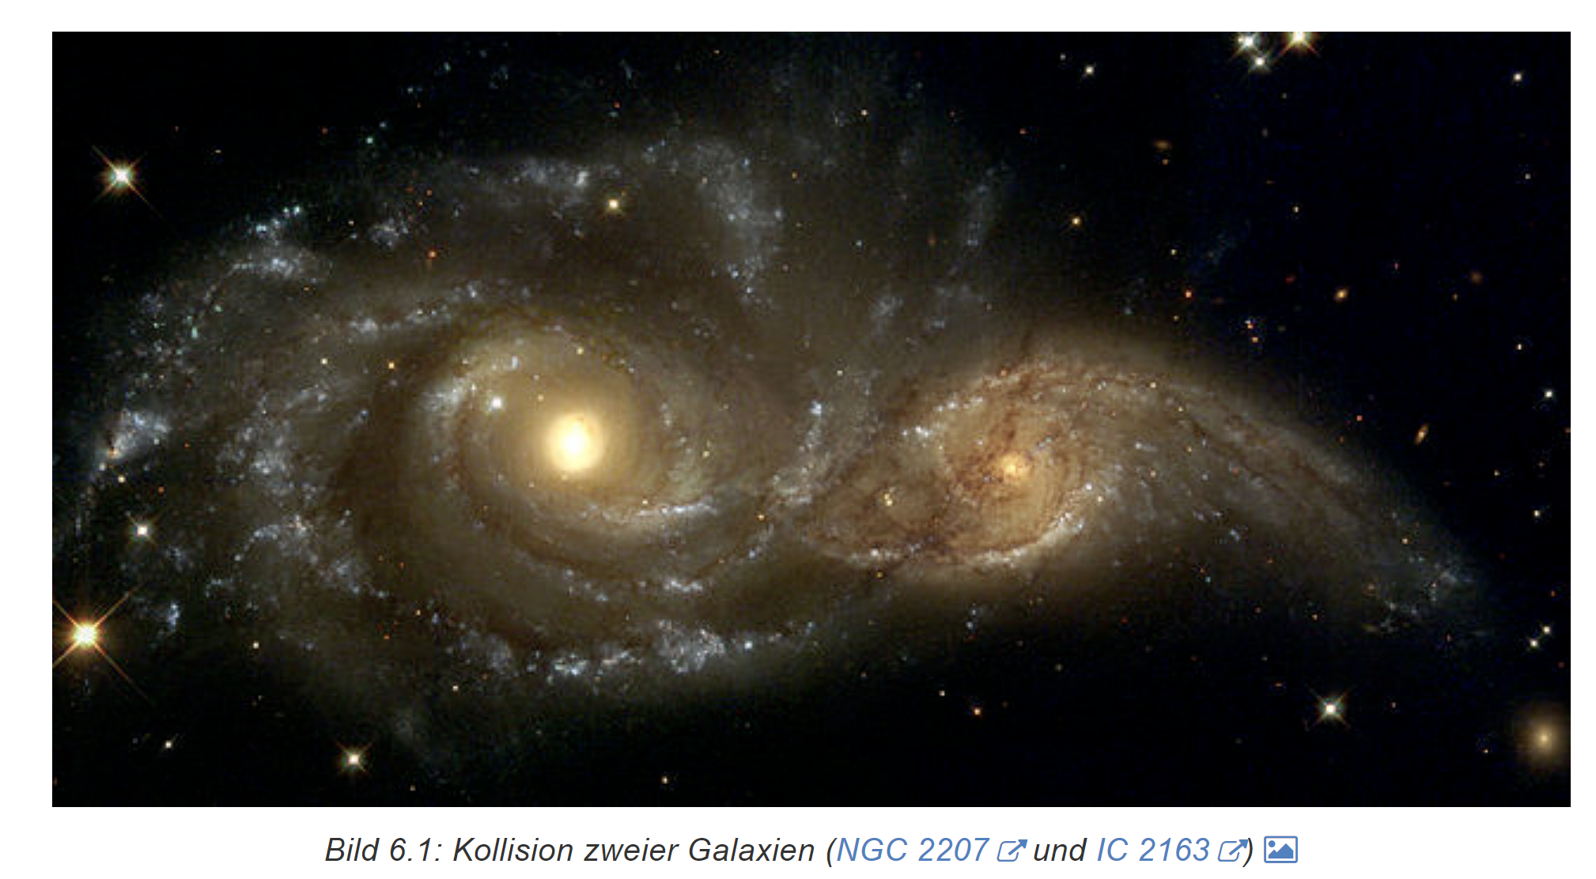
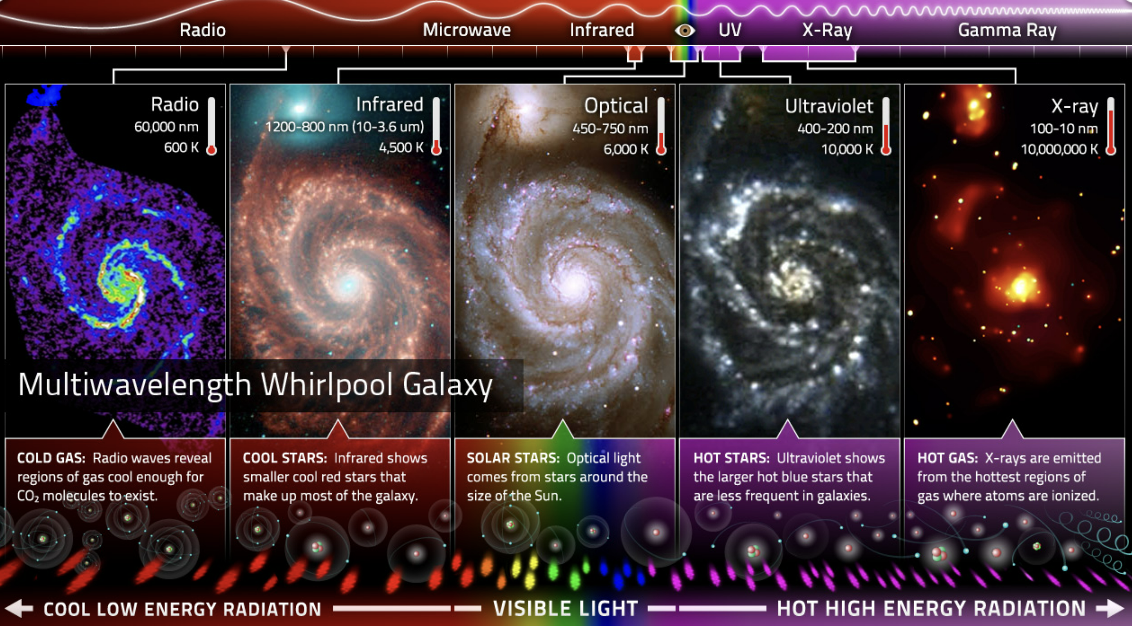
Basic Interactions
Gravitation
Electromagnetism
Strong Interaction
Weak Interaction
Force Carriers
  Photon, W, Z, Gluons, Higgs
Fermions
  Electron, Myon, Tau, Quarks, Neutrinos

Slide 3
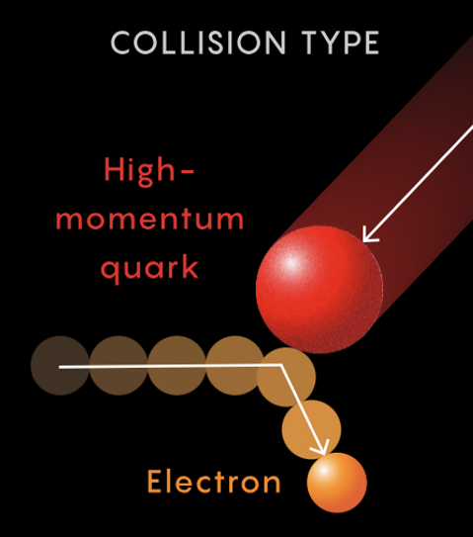
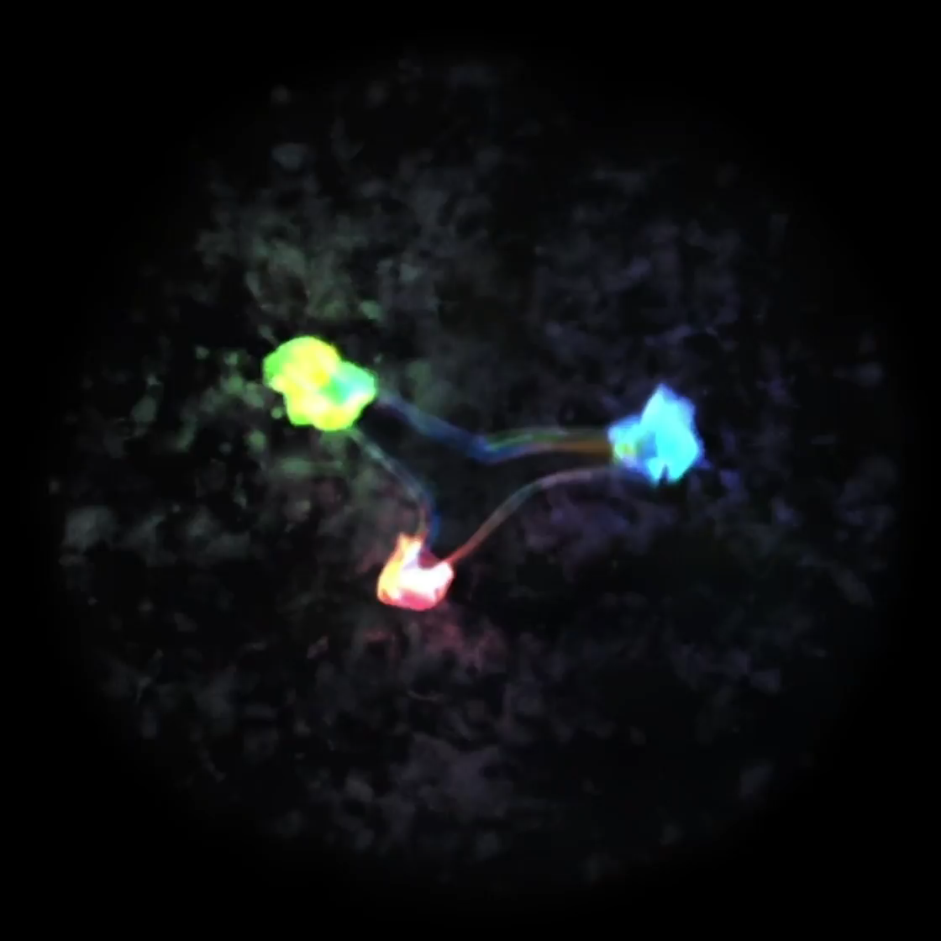
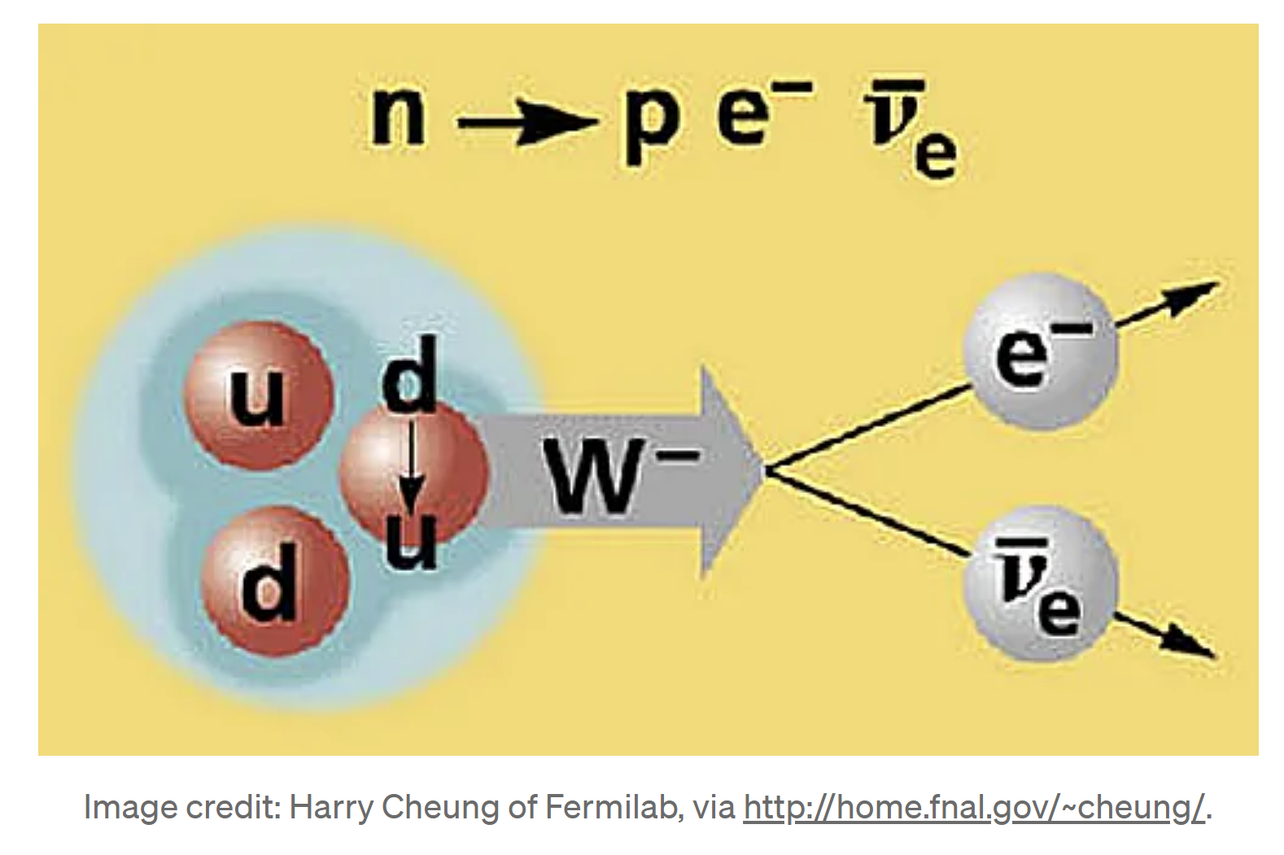
Basic Interactions
Gravitation
Electromagnetism
Strong Interaction
Weak Interaction
Force Carrier
  Photon, W, Z, Gluons, Higgs
Fermions
  Electron, Myon, Tau, Quarks, Neutrinos

Slide 4
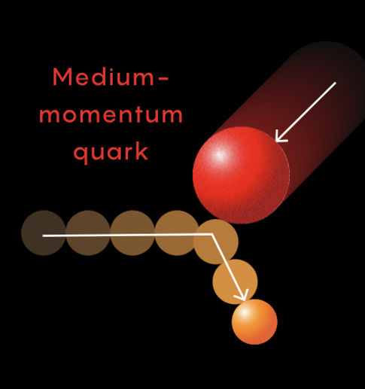
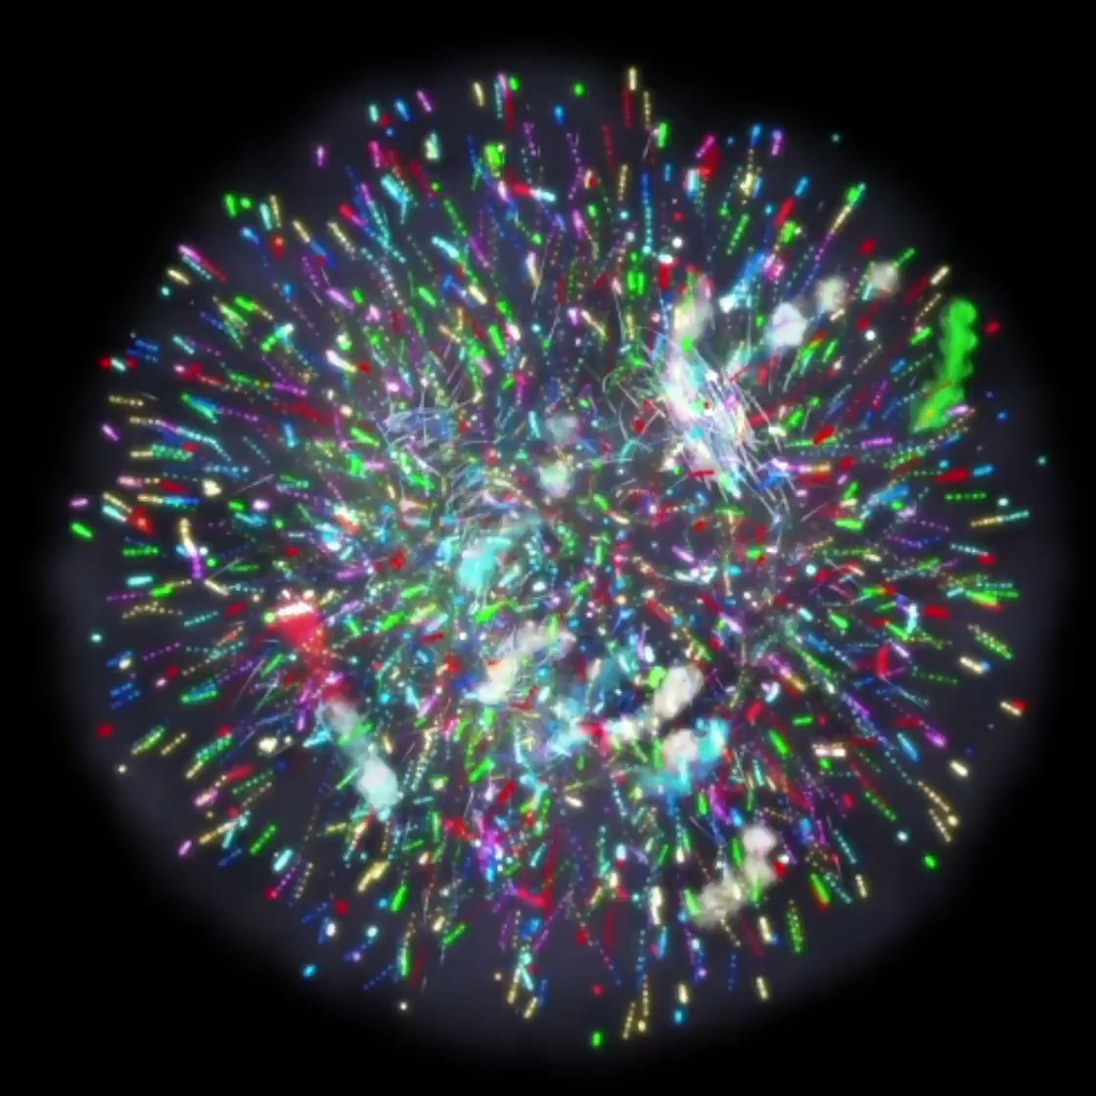
Basic Interactions
Gravitation
Electromagnetism
Strong Interaction
Weak Interaction
Force Carrier
  Photon, W, Z, Gluons, Higgs
Fermions
  Electron, Myon, Tau, Quarks, Neutrinos
https://www.quantamagazine.org/inside-the-proton-the-most-complicated-thing-imaginable-20221019/

Slide 5
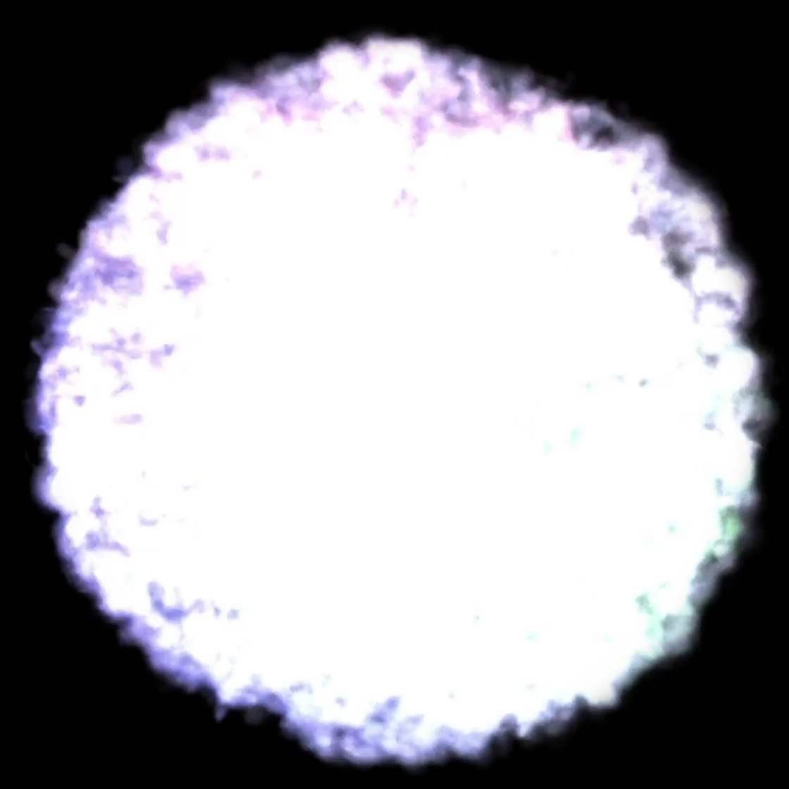
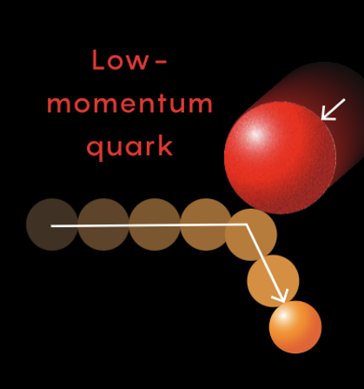
Basic Interactions
Gravitation
Electromagnetism
Strong Interaction
Weak Interaction
Force Carrier
  Photon, W, Z, Gluons, Higgs
Fermions
  Electron, Myon, Tau, Quarks, Neutrinos
https://www.quantamagazine.org/inside-the-proton-the-most-complicated-thing-imaginable-20221019/

Slide 6
Basic Interactions
Do we have indications for a theory of everything?
Where do we find additional CP violation effects?
What is Dark Matter?
What is Dark Energy?
What is mass?
I want to know the origin of the neutron mass?
Do we live with extra dimensions of space?
What is the origin of confinement?
What is the origin of parity violation?
A quantum theory of gravitation?
Gravitation
Electromagnetism
Strong Interaction
Weak Interaction
Force Carriers
  Photon, W, Z, Gluons, Higgs
Fermions
  Electron, Myon, Tau, Quarks, Neutrinos

Slide 7
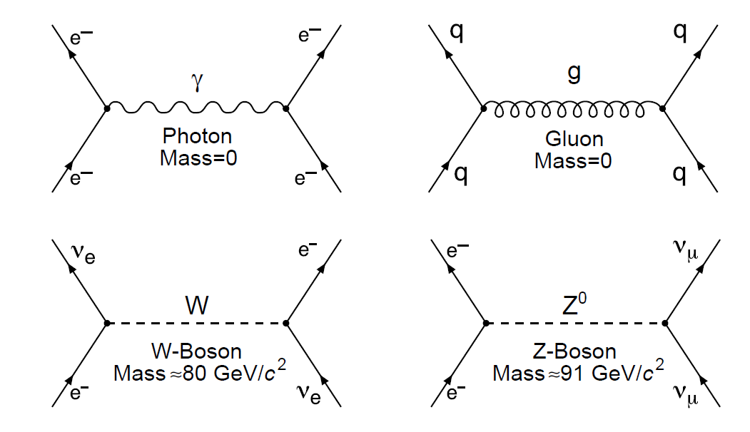
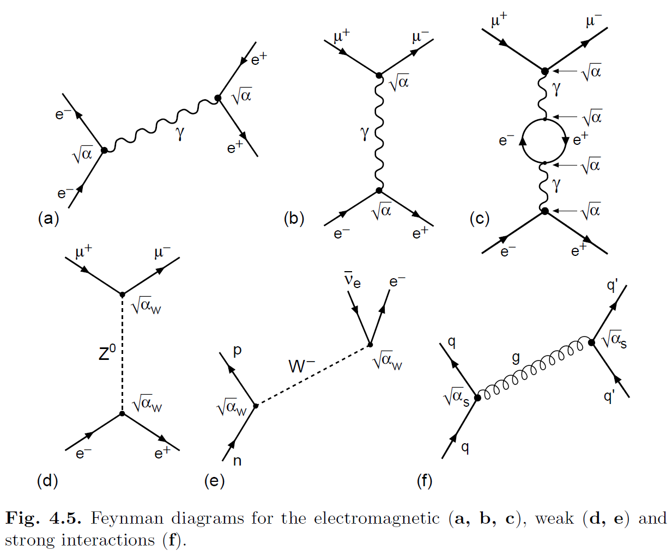

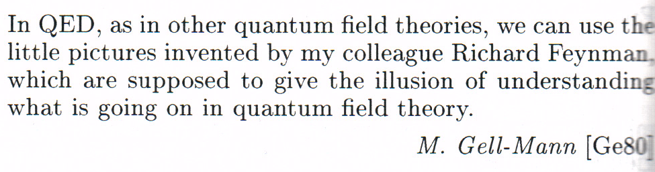
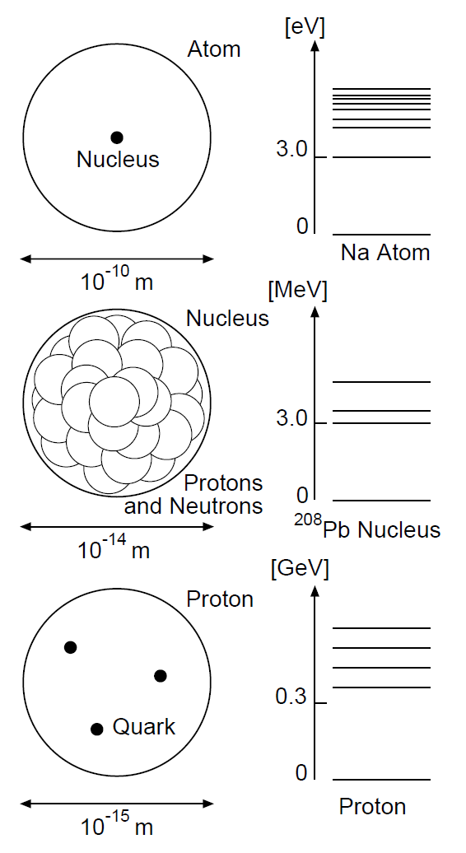
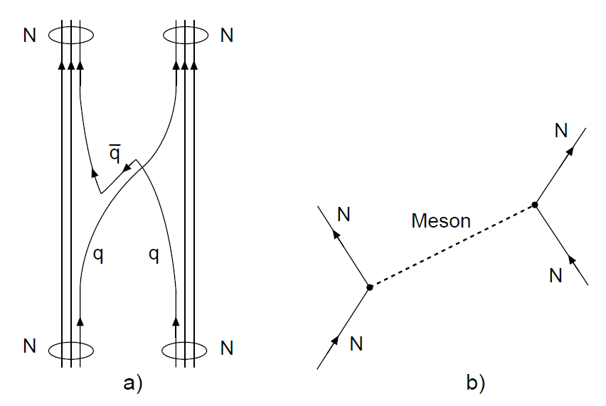
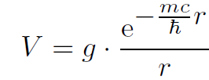
Propagator
The exchange particle mass contributes a propagator term
the hevier the weaker
Yukawa Interaction
the hevier the more short ranged

Slide 8
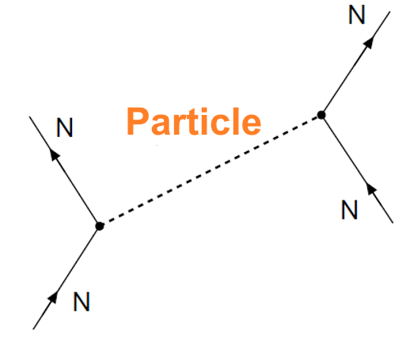
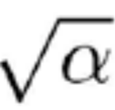
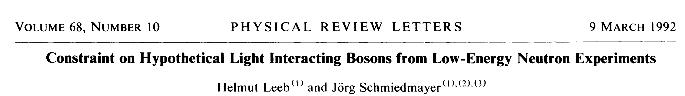
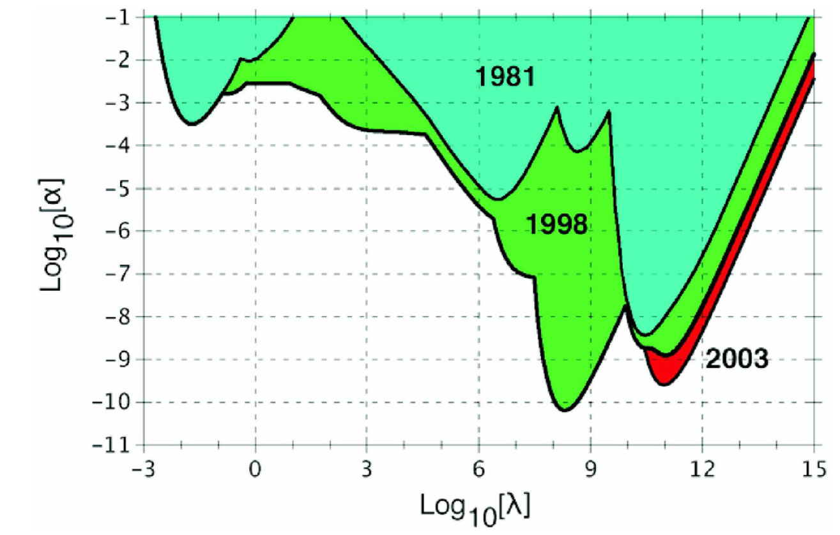
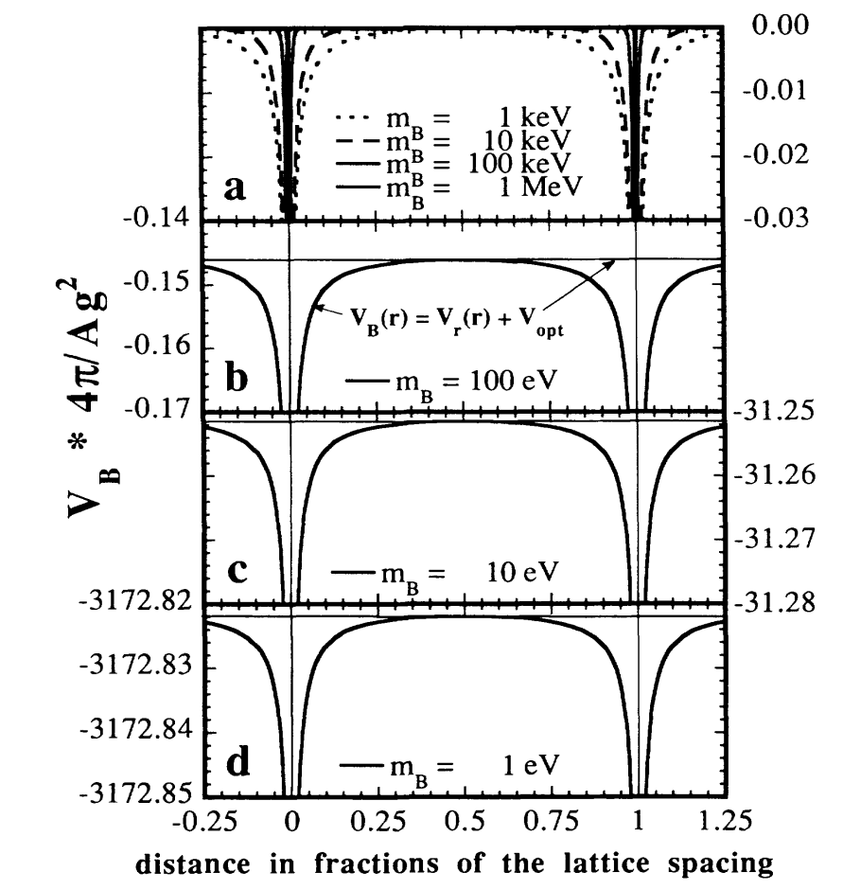

Question: where to search?
Hypothetical Exchange Particles
  Interaction with unknown range λ and strength α
Gravitation
Strong Interaction

Slide 9
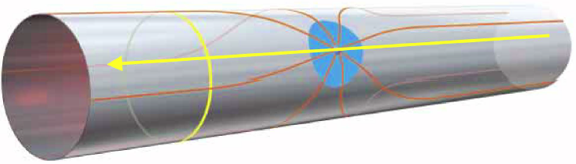
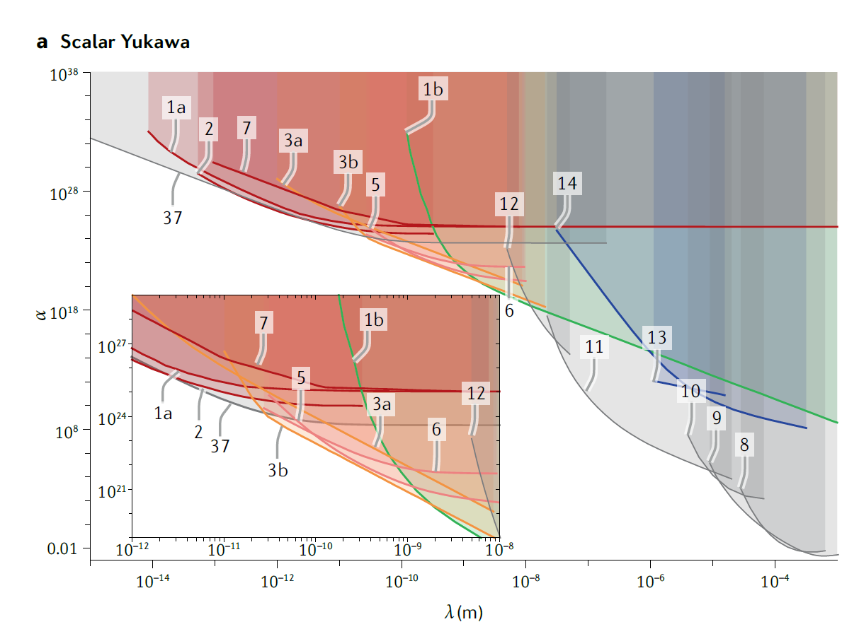
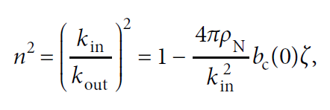
Modern Limits
Extra Dimensions:
The string and D_{p}-brane theories predict the existence of extra space-time dimensions
Infinite-Volume Extra Dimensions:
Randall and Sundrum
Exchange Forces from new Bosons: a deviation from the ISL can be induced by the exchange of new (pseudo)scalar and vector bosons
  Axion - - - - - → 0.2 µm < λ < 0.2 cm
  Scalar boson. Cosmological consideration
  Bosons from Hidden Supersymmetric Sectors
  Gauge fields in the bulk - →10⁶ < α < 10⁹
Supersymmetric large Extra Dimensions (B.& C.) - → α < 10⁶
References in Stephan Sponar et al., Tests of fundamental quantum mechanics and dark interactions with low- energy neutrons, Nature Review, 2021

Slide 10
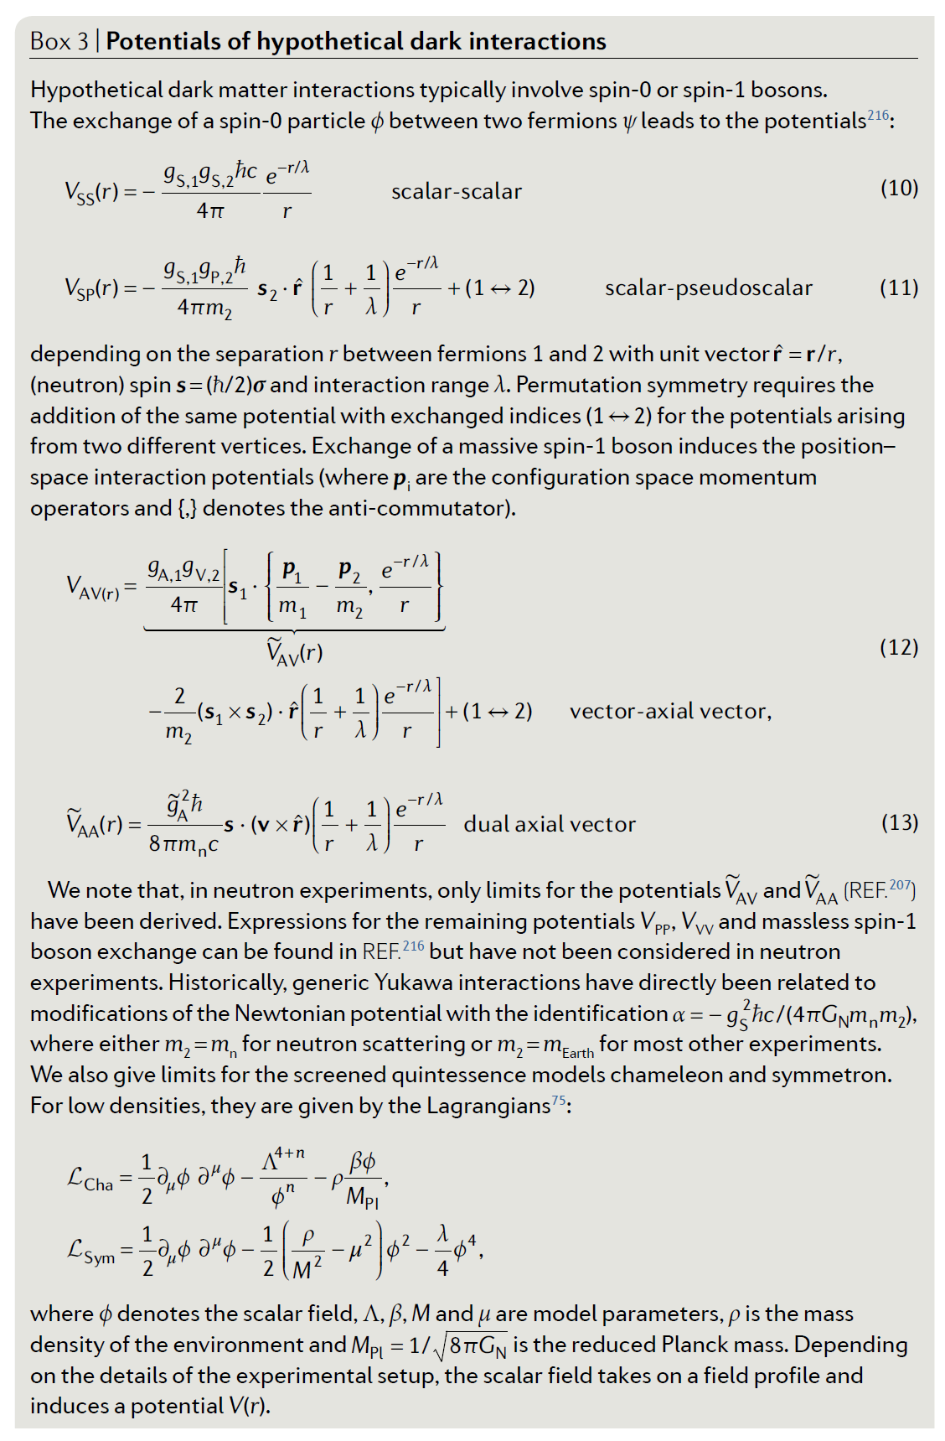
Modern Limits

Slide 11
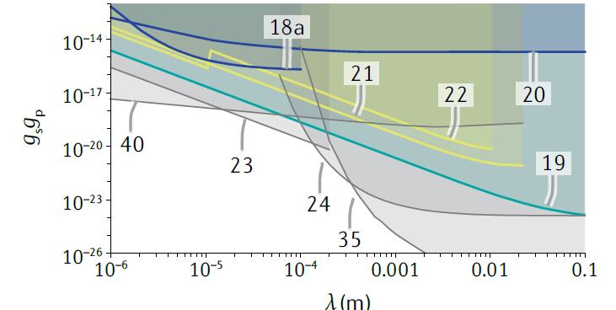
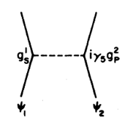
Axion Searches
Axion
Invented by Wilczek to explain the smallness of neutron EDM
Could explain DM
Could bring additional CP violation
References in Stephan Sponar et al., Tests of fundamental quantum mechanics and dark interactions with low- energy neutrons, Nature Review, 2021

Slide 12
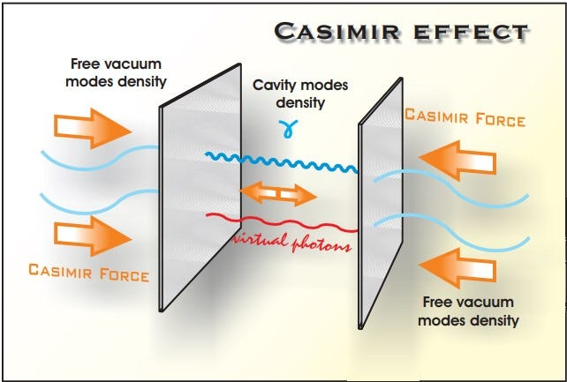
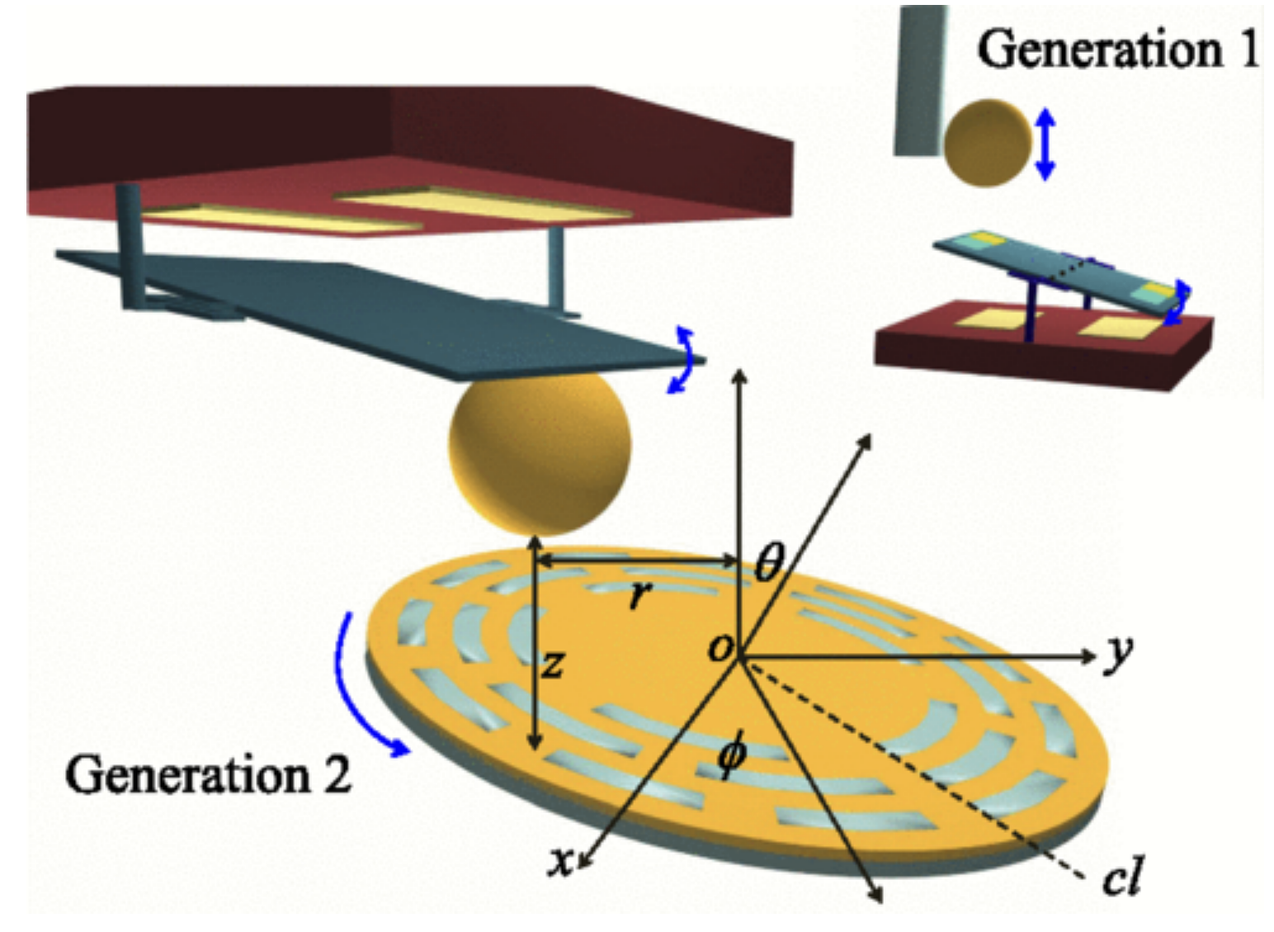
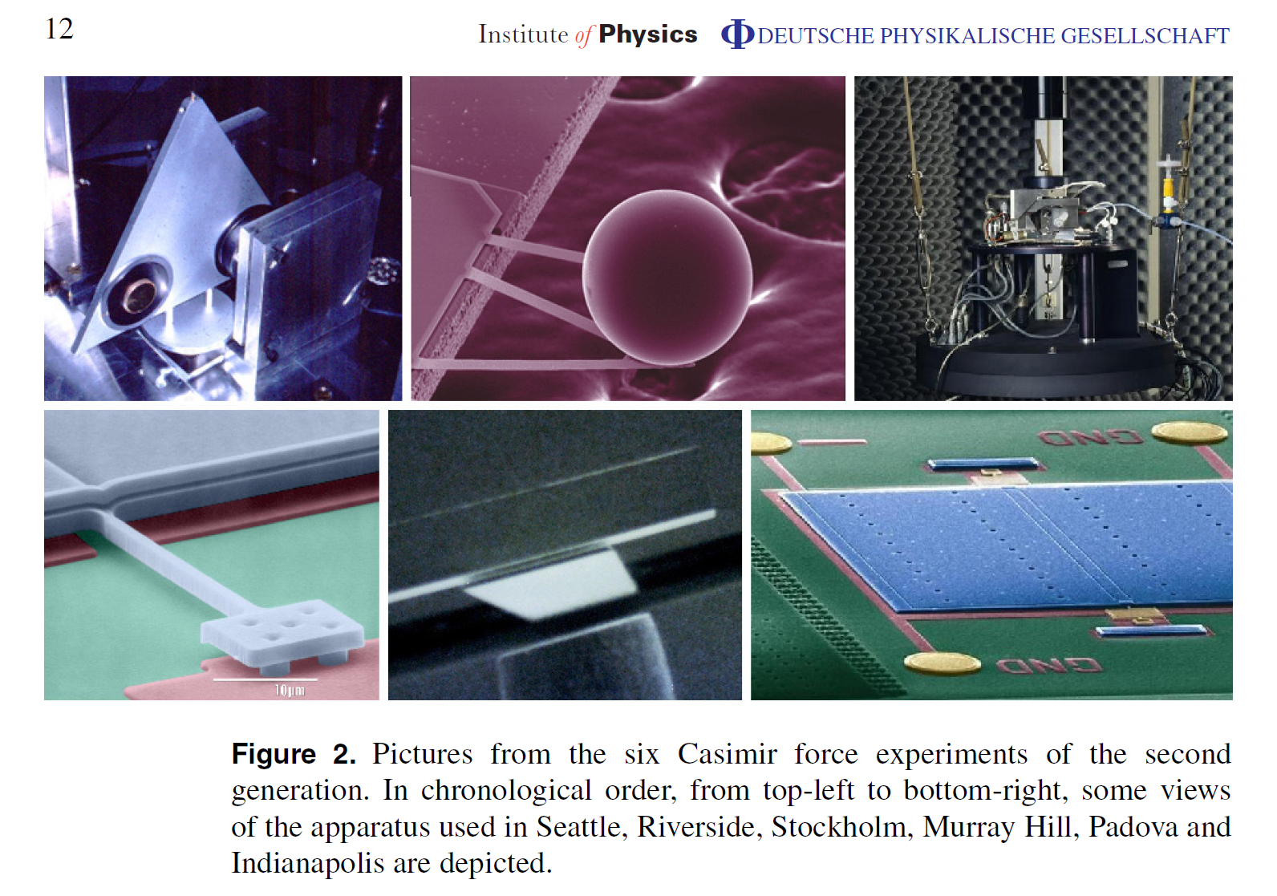
Casimir Force Measurements
Roberto Onofrio
https://medium.com/@britant808/vacuum-fluctuations-the-casimir-effect-7fb88b7a4d2d

Slide 13
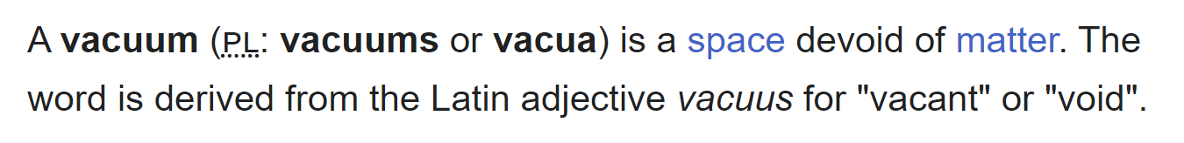
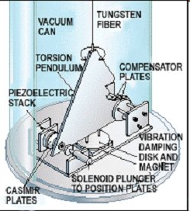
Vacuum, Wikipedia
_{Lamoreaux, PRL 78 (1997) 5}

Slide 14
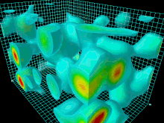
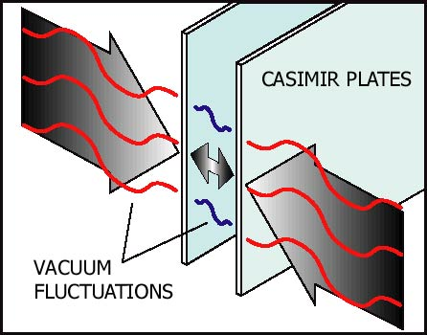
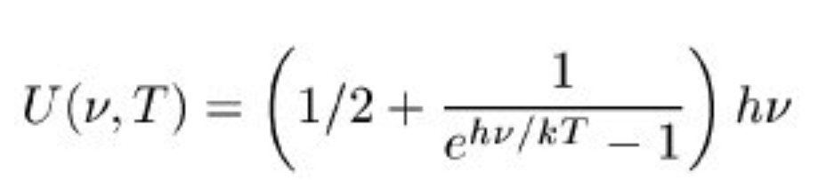
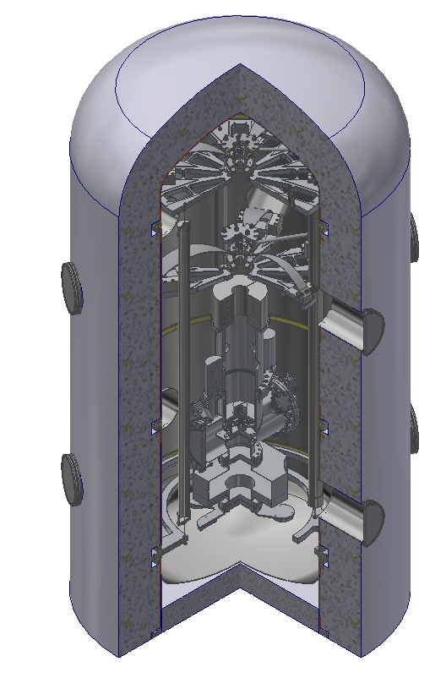
The quantum vacuum
Quantum Theory: ∞
QM + Cutoff 10⁹³kg/m³
Special Relativity Zero
Cosmology 6 x 10⁻²⁷ kg/m³
Vacuum = potential Energy (GR)
+ vacuum fluctuations
+ cosmological constant
~ Zero
thermal
insulation
stage 1
GAS filter
stage 2
GAS filter
access
ports
inverted
pendula
experimental
chamber
outer vacuum
chamber
with thermal
controllers
Research: René Sedmik, Haghmoradi et al.

Slide 15
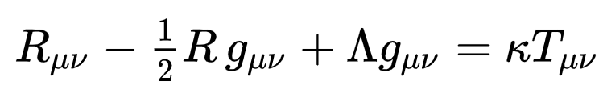
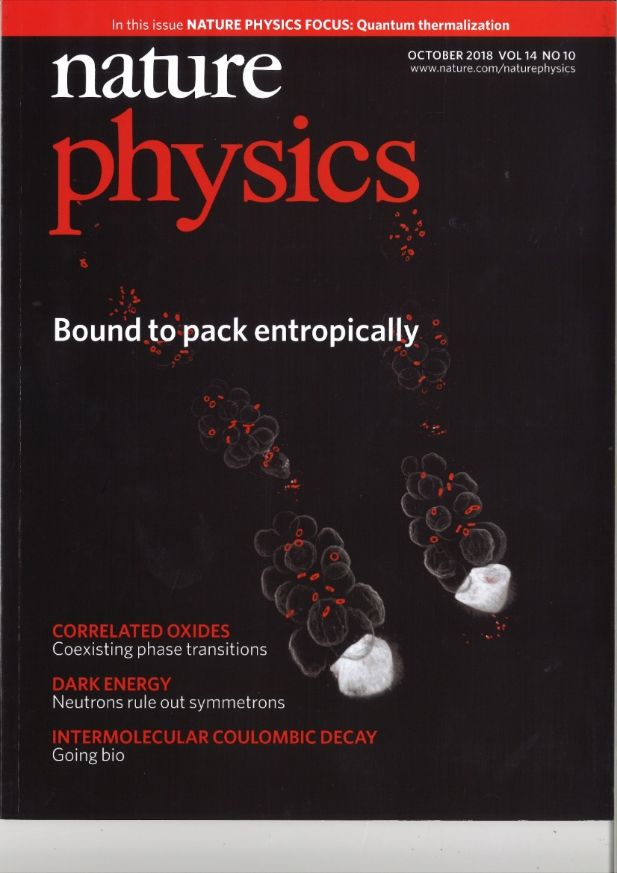

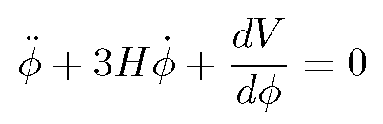
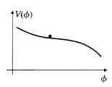

``Einstein‘s biggest blunder‘‘ turns to be right!
Einstein Equation:
Quintessence theories:
  It could well be that the universe is not in a vacuum state at all and has a dynamical evolution
  Scalar field φ as a Perfect fluid → Dark Energy
Chameleons
Symmetrons
Dilatons, DE particles
Axions …. (DM particles)
Notes:
Quintessence differs from the cosmological constant explanation of dark energy in that it is dynamic, changing over time, unlike the cosmological constant which always stays constant.

Slide 16

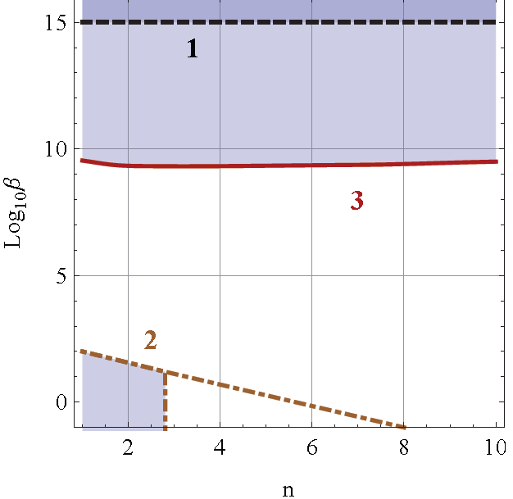
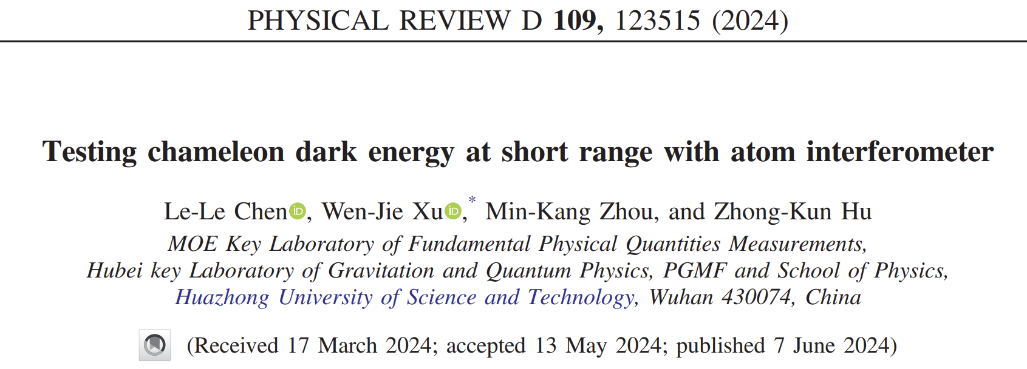

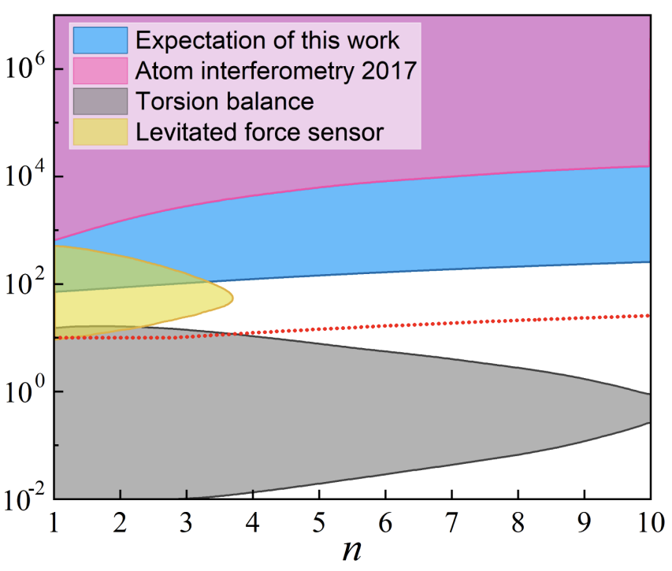


Dark Matter Chameleon Field
Chameleon fields, J.Khoury, A. Weltmann, P.Brax et al. Phys. Rev. Lett. 93, 171104, PRD 70, 123518 (2004)
2 Parameters β, n
Λ self interation
Jaffe et al., arXiv:1612.05171
PRL 107, 111301 (2011)
T. Jenke et al., Gravity Resonance Spectroscopy
constrains dark matter and dark energy scenarios, Physical Review Letters 112, 151105 (2014)
Notes:
What is dark energy, we have no idea, but it might be that a scalar field is responsible for the expansion of the universe, Explicit realizations of a quintessence model where the quintessence scalar field couples directly to baryons and
dark matter with gravitational strength vacuum energy, is timedependent. the vacuum energy is a field, assumed for simplicity to be
a fundamental scalar . The basic idea is that the scalar field acquires a mass which depends on the local background matter density. On Earth, where the density is high, the Compton wavelength of the field is sufficiently short to satisfy all existing tests of gravity; in the solar system, where the density is many orders of magnitude smaller, the Compton wavelength is larger than the size of the
solar system; in the cosmos, where the density is tiny, the field can have a mass of order H0 and cause cosmic
acceleration. Because its physical properties depend sensitively on the environment, such a scalar field was dubbed chameleon.
Two observable effects: shrinkage of wave function and shift of energy levels

Slide 17
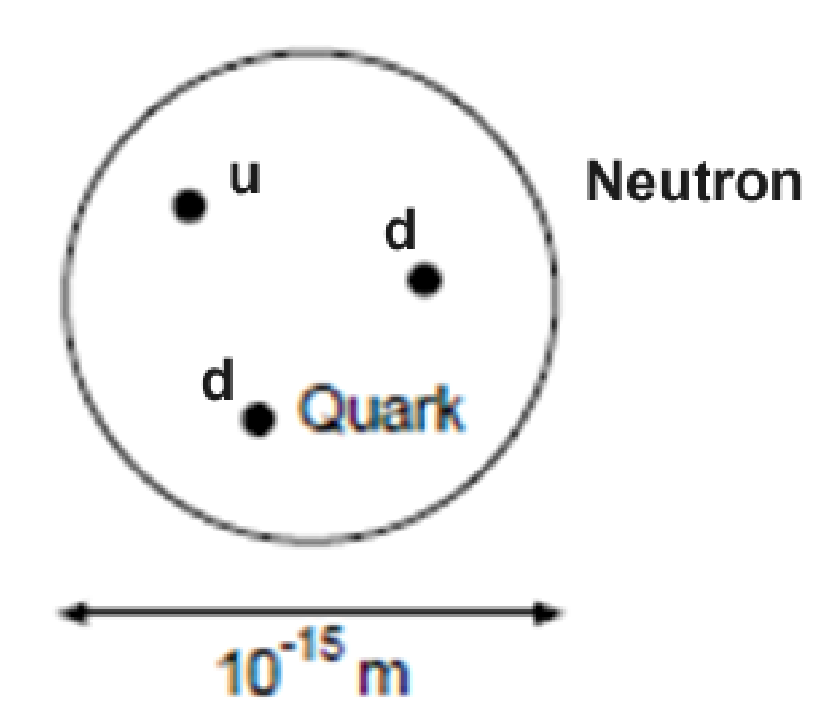
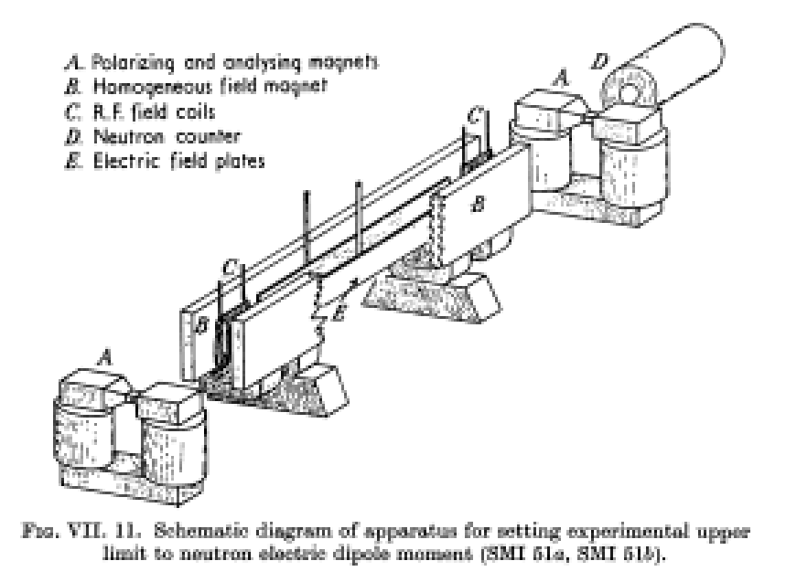

The Electric Dipole Moment of the Neutron
EDM
  d = 10⁻¹³ e cm Theory
  d < 10⁻²⁶ e cm Experiment
Ramsey Spectroscopy
  Quantum System, 2-Level System
  Coupling
    Magnetic Moment in
    outer magnetic field
    RF-field drives Transitions
  Examples
    Clocks, Spin Echo, EDM
    5 Regions
Neutron

Slide 18
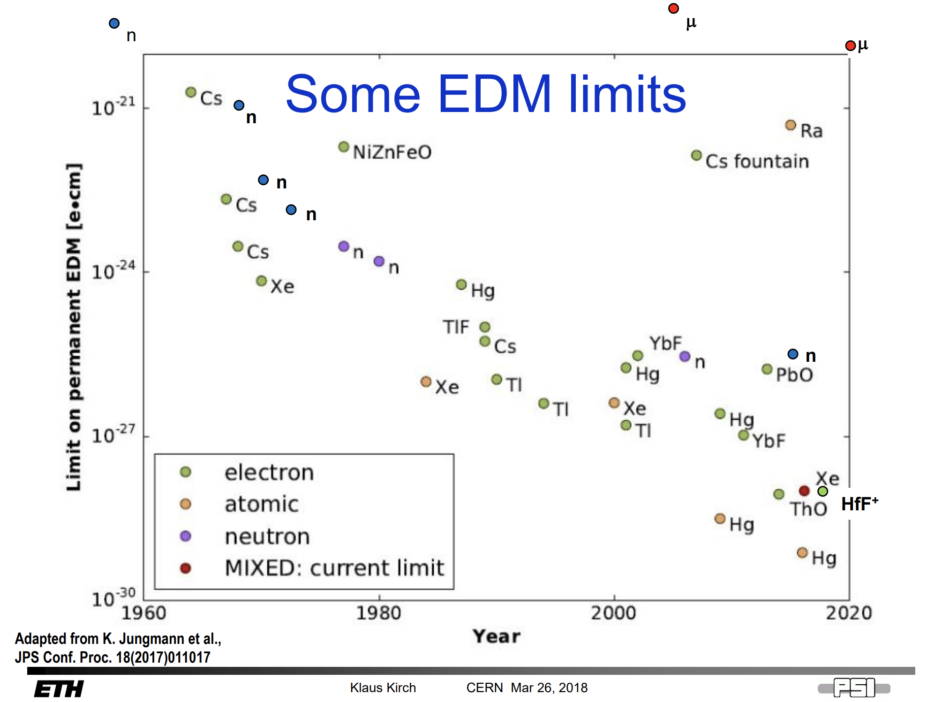

Slide 19

Motivation for high precision tests with neutrons: extreme sensitivity or precision
Energy ΔE = 10⁻²¹ eV
  Search for an electric dipole moment, neutron
  d_{n}<3 × 10⁻²⁶ ecm
  Ramsey‘s Spectroscopy Method of Separated Oscillating Field by NMR
Energy ΔE = 4 × 10⁻¹⁷ eV
  Ramsey‘s Spectroscopy Method of Separated Oscillating Field by GRS
All Spectroscopy methods so far use electromag fields or a coupling to a electromag. potential
Energy ΔE = 4 × 10⁻¹⁸ eV, ACME
  Search for an electric dipole moment, electron (ThO), d_{e} < 9 × 10⁻²⁹ ecm
Energy ΔE = 2 × 10⁻¹⁵ eV
  Rabi‘s Spectroscopy Method by GRS
Review Article: H.A., The neutron. Its properties and basic interactions, Prog. Part. Nucl. Phys. 60 1-81 (2008)

Slide 20
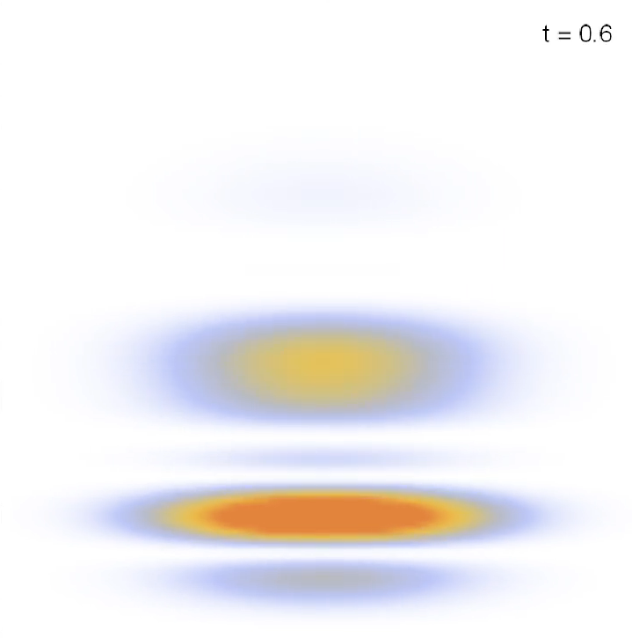

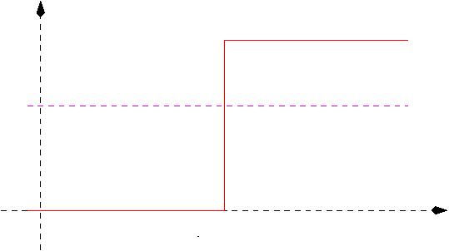
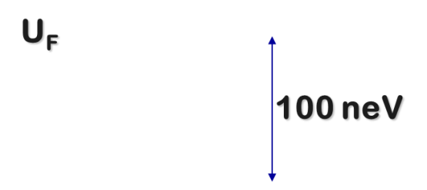
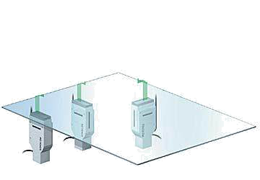
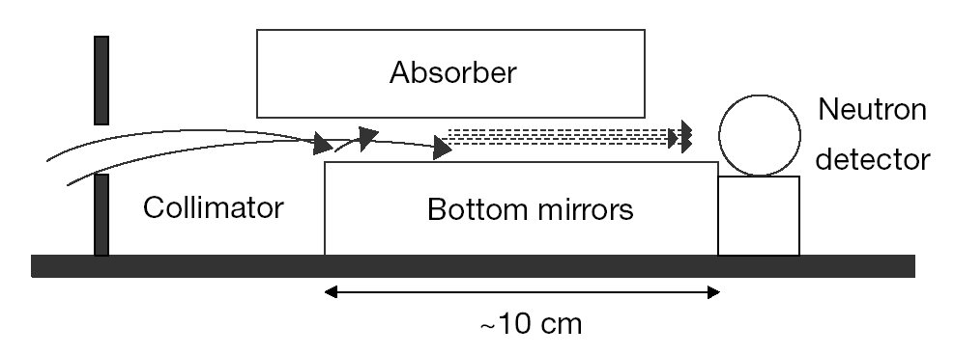
Free Fall at Short Distances
A simple gravitationally interacting quantum system
  A neutron with mass and spin
    falling in the Earth‘s gravity potential
  and a neutron reflector
    made out of glass
Reactor neutrons at ILL
  25 meV
Ultra-cold Neutrons
  @PF2 – ILL: T. Jenke
  v = (7±1)m/s
  U_{F} ~ 100 neV, 1…6 peV
Nesvizhevsky et al.
Nature 415 299 (2002), Phys. Rev. D 67 102002 (2003).
Abele, Jenke, Lemmel, Nature 2019

Slide 21

Micko, Jenke et al.: qBounce@ILL

Slide 22
Free Fall at Short Distances
A simple gravitationally interacting quantum system
  A neutron with mass and spin
    falling in the Earth‘s gravity potential
  and a neutron reflector
    made out of glass
Test the laws of gravity at small distances
Search for hypothetical gravity-like interactions, string theories etc.
High degree on Sensitivity regarding underlying theories about the expansion of the universe
Example Rb
Energy shift for Rb Atom at r = 1 µm
10⁻¹² eV
Neutron
Polarizability extremely small:
10⁻³⁰ eV
Abele, Jenke, Lemmel, Nature 2019

Slide 23


Quantum Gravitational States of a Neutron

Slide 24






qBounce:
$$²
Hypothetical New Interaction
Schrödinger Equation
Characteristic length and energy scale
Change of variable
Airy‘s Equation, and general Solution with AiryAi and AiryBi
Axion
Symmetron

Slide 25
Gravity Resonance Spectroscopy
Resonant Spectroscopy:
Dark Energy and Dark Matter scenarios
How far does GRS constrain Dark Energy and Dark Matter models
  Search for environment-dependent dilatons, H. Fischer et al., Physics of the Dark Universe 43, 101419 (2024)
  Gravity Resonance Spectroscopy constrains dark matter and dark energy scenarios, T. Jenke et al., Physical Review Letters 112, 151105 (2014)
  Acoustic Rabi oscillations between gravitational quantum states and impact on symmetron dark energy, G Cronenberg, et al., Nature Physics 14 (10), 1022-1026 (2018)
Is gravity an entropic force (E. Verlinde)
  Decoherence-Free Entropic Gravity for Dirac Fermion, Eric J. Sung et al., Phys. Rev. D 108, 104036 (2023)
  Decoherence-free entropic gravity: Model and experimental tests, AJ Schimmoller, G McCaul, H Abele, DI Bondar, Physical Review Research 3, 033065 (2021)
What about gravity theories based on geometries other than those of Riemann, Riemann-Cartan, etc. ("beyond-Riemann gravity")
  Quantum gravitational states of ultracold neutrons as a tool for probing beyond-Riemann gravity, A. Ivanov, M. Wellenzohn, H. Abele, Phys. Lett. B. 822 (2021) 136640
Is Lorentz Invariance violated?
  Probing of violation of Lorentz invariance by ultracold neutrons in the Standard Model Extension, AN Ivanov, M Wellenzohn, H Abele, Phys. Lett. B, Physics Letters B 797, 134819 (2019)

Slide 26

Dilaton Limits
  Search for environment-dependent dilatons, H. Fischer et al., Physics of the Dark Universe 43, 101419 (2024)

Slide 27
Gravity Resonance Spectroscopy
Resonant Spectroscopy:
Dark Energy and Dark Matter scenarios
How far does GRS constrain Dark Energy and Dark Matter models
  Search for environment-dependent dilatons, H. Fischer et al., Physics of the Dark Universe 43, 101419 (2024)
  Gravity Resonance Spectroscopy constrains dark matter and dark energy scenarios, T. Jenke et al., Physical Review Letters 112, 151105 (2014)
  Acoustic Rabi oscillations between gravitational quantum states and impact on symmetron dark energy, G Cronenberg, et al., Nature Physics 14 (10), 1022-1026 (2018)
Is gravity an entropic force (E. Verlinde)
  Decoherence-Free Entropic Gravity for Dirac Fermion, Eric J. Sung et al., Phys. Rev. D 108, 104036 (2023)
  Decoherence-free entropic gravity: Model and experimental tests, AJ Schimmoller, G McCaul, H Abele, DI Bondar, Physical Review Research 3, 033065 (2021)
What about gravity theories based on geometries other than those of Riemann, Riemann-Cartan, etc. ("beyond-Riemann gravity")
  Quantum gravitational states of ultracold neutrons as a tool for probing beyond-Riemann gravity, A. Ivanov, M. Wellenzohn, H. Abele, Phys. Lett. B. 822 (2021) 136640
Is Lorentz Invariance violated?
  Probing of violation of Lorentz invariance by ultracold neutrons in the Standard Model Extension, AN Ivanov, M Wellenzohn, H Abele, Phys. Lett. B, Physics Letters B 797, 134819 (2019)

Slide 28




Observables in neutron decay
J.D. Jackson et al., PR 106, 517 (1957)
Neutron Alphabet deciphers the Standard Model
Decay rate
2 unknown parameters: $Vud$,
20 or more observables: $n, a, b, A, B, C, D, …$
A
ϑ
Neutron Spin
Electron
a
B
D
R
N
Neutrino
C
Proton
Q
R
G. Konrad
2

Slide 29








Challenging the SM
PERC Experiment / Nab / Brand
Belle Experiment
10⁻²⁴
10⁻¹⁹
10⁻¹⁴
10⁻⁹
10⁻⁴
10¹
10⁶
10¹¹
10¹⁶
10²¹
10²⁶
EDM
2-level system
Spin clock resolution
Ultracold
neutrons
Neutron energy
Tau decay width
HL-
LHC
Future
100 TeV
GUT
Scale
Bell II energy
Planck
Scale
Bell II energy

Slide 30

Challenging the SM
Precision unitarity test of CKM’s first row
Search for New Physics through EFTs
10 – 100 TeV
10⁻²⁴
10⁻¹⁹
10⁻¹⁴
10⁻⁹
10⁻⁴
10¹
10⁶
10¹¹
10¹⁶
10²¹
10²⁶
EDM
2-level system
Spin clock resolution
Ultracold
neutrons
Neutron energy
Tau decay width
HL-
LHC
Future
100 TeV
GUT
Scale
Bell II energy
Planck
Scale
Bell II energy

Slide 31



Cirigliano: Effective Field Theories

Slide 32


Dubbers, Märkisch

Slide 33

ESFRI Landscapes – since 2016
‘’Neutron sources can have a serious impact on strategic areas such as particle physics, the fundamental quantum properties of the neutron, and cosmology” ESFRI Road Map p.164f

