Slide 1

ESS neutrino Super Beam
ESSnuSB+
Presentation at the ESS workshop in Lund 17 Januari 2025
Tord Ekelof Uppsala University

Slide 2

The Standard Model of Particle Physics 1995
In 1995 the top quark was discovered.
The Standard mode was now complete with exception of that the
Higg boson was still undiscovered.

Slide 3

The Standard Model of Particle Physics 1998
In 1995 the top quark was discovered.
The Standard mode was now complete with exception of that the
Higg boson was still undiscovered
In 1998 neutrino oscillations were discovered implying that the neutrinos, experimentally known since 50 years, are not massless as prescribed by the Standard Model and are therefore not part of it.
Massless neutrinos with the properties as described by
the SM do not exist.

Slide 4
The Standard Model of Particle Physics 2012
In 1995 the top quark was discovered.
The Standard mode was now complete with exception of that the
Higg boson was still undiscovered
In 1998 neutrino oscillations were discovered implying that the neutrinos, experimentally known since 50 years, are not massless as prescribed by the Standard Model and therefore not part of it.
The Higg Boson was discovered in 2012. A GREAT TRIUMPH! But the Standard Model IS STILL INCOMPLETE AS THE MASSLESS NEUTRINOS AS DESCRIBED BY THE SM DO NOT EXIST. This makes the neutrino a unique portal to physics beyond the Standard Model.
Massless neutrinos with the properties as described by
the SM do not exist.

Slide 5
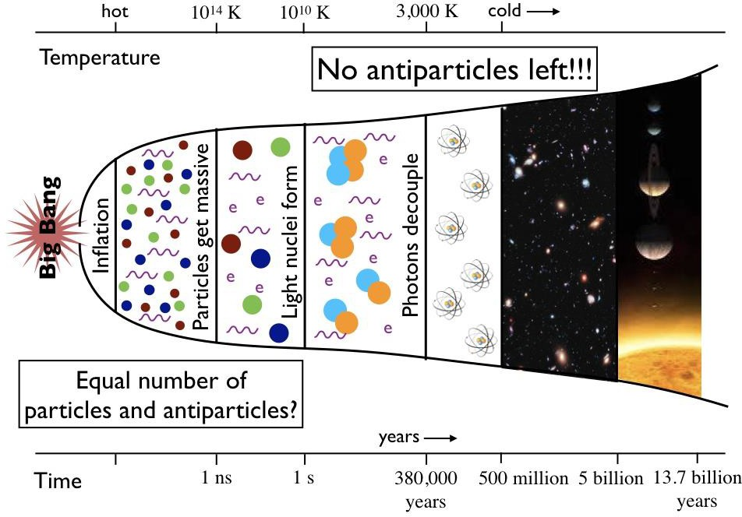
Moreover, the Standard Model cannot explain the presences of matter in the Universe. The exactly equal amounts of matter and antimatter created in the Big Bang annihilated each other immediately thereafter, resulting in a radiation density in today’s universe of ca 10⁹ photons per m³, A MATTER DENSITY OF ONE PARTICLE PER M³ AND NO ANTIMATTER!
In 1967 Sacharov formulated three necessary conditions for any theory that describes that matter remains after the original global annihilation of particles and antiparticles. One of these conditions is that there be a sufficient CP violation. The effects of the quark CP violation discovered in 1962 is far to week to fulfill this condition.
.

Slide 6
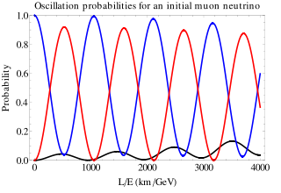
Neutrino oscillations for δ_{CP} determination
ν_{μ}
2nd oscillation maximum
ν_{τ}
δ_{CP}=-90
δ_{CP}=0
δ_{CP}=+90
P(ν_{μ}→ν_{e})
θ₁₃=8.8º
("large" θ₁₃)
τ
ν_{e}
c
c
L/E
δ_{CP} = 0
Close to 3 times more sensitivity
at 2nd oscillation max.
First
ν_{e} max
Second
ν_{e} max

Slide 7
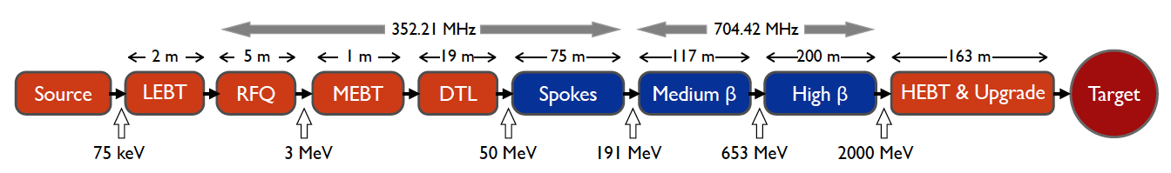
The baseline design of the ESS linac is to accelerate 14 proton pulses per second, each of 2.86 ms length, implying a 4% duty cycle, to 2 GeV, thus providing a 5 MW beam.
Gerigk’s and Montesinos’ proposal is to provide an additional 5 MW H⁻ beam, concurrently with the baseline 5 MW proton beam, by raising the duty cycle to 8% by adding a H⁻ pulse 35 ms after each proton pulse, thereby reducing the inter-pulse gaps from ca 70 ms to 35 ms.
To achieve this the main modifications of the linac will be
- add a H⁻ source at the side of the proton source
- upgrade the RQF for 10 MW beam operation
- install additional charging capacitors in the modulators to double the pulse rate of the modulators
- upgrade the klystron collectors to enable the production of the increased power
- add a third main electrical station to the 2 existing
In addition is proposed to add 8 new cryomodules to increase the energy to 2.5 GeV reducing the current accordingly for 8 MW operation.
“No show stoppers have been identified for a possible future addition of the capability of a 5 MW H- beam to the 5 MW H+ beam of the ESS linac built as presently foreseen. Its additional cost is roughly estimated at 250 MEuros.”
Required modifications of the ESS accelerator architecture for ESSnuSB
F. Gerigk and E. Montesinos CERN-ACC-NOTE-2016-0050 8 July 2016

Slide 8
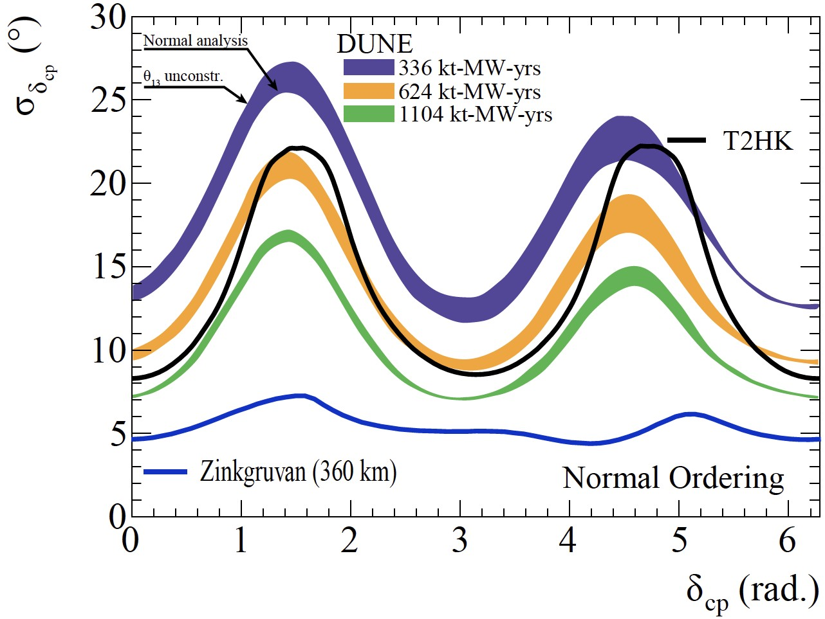
In order to verify or falsify specific symmetry approaches to the various Leptogenesis models, each of which predicts a specific value of the leptonic CP violation phase δ_{CP}, this phase angle has to be measured with the highest possible precision. A measurement of this phase angle can also help to verify the correct flavor model.
Owing to the use of the world-uniquely high power of the ESS linear accelerator the ESSnuSB project will enable a measurement of δ_{CP} with a standard error δ_{CP} below 8° for all values of δ_{CP} to be compared with an error below 22° for all CP angles for DUNE and Hyper-K.
ESSnuSB

Slide 9

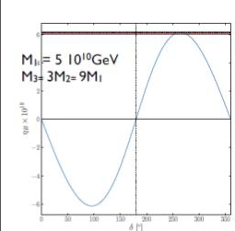
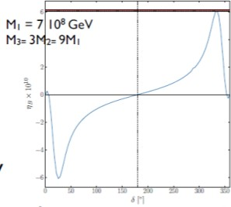
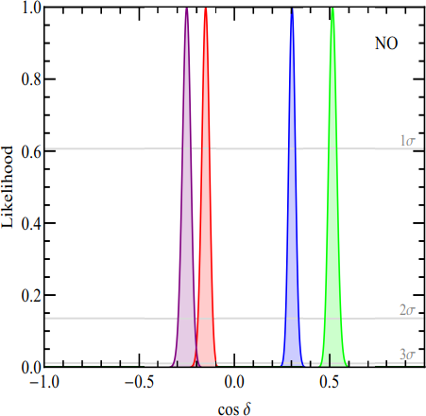
Selection of Leptogensis Theories and
Flavour Theories based on the measured value of δ_{CP}
Leptogensis theories with Dirac CP violation phase
Flavour Theories
4 different symmetry forms of
the neutrino mixing matrix
Moffat, Pascoli, Petkov, Turner 1804.05066, 1809.08251
δ_{CP}=260° (cosδ_{CP}=-0.17)
δ_{CP}=340° (cosδ_{CP}=+0.94)
13
cosδ_{CP}=-0.75, -0.85,+0.31,+0.53

Slide 10
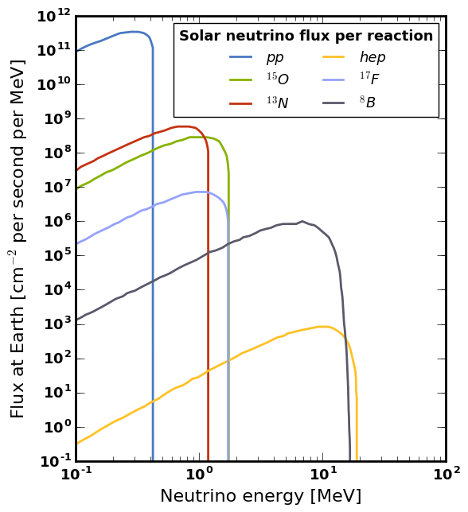
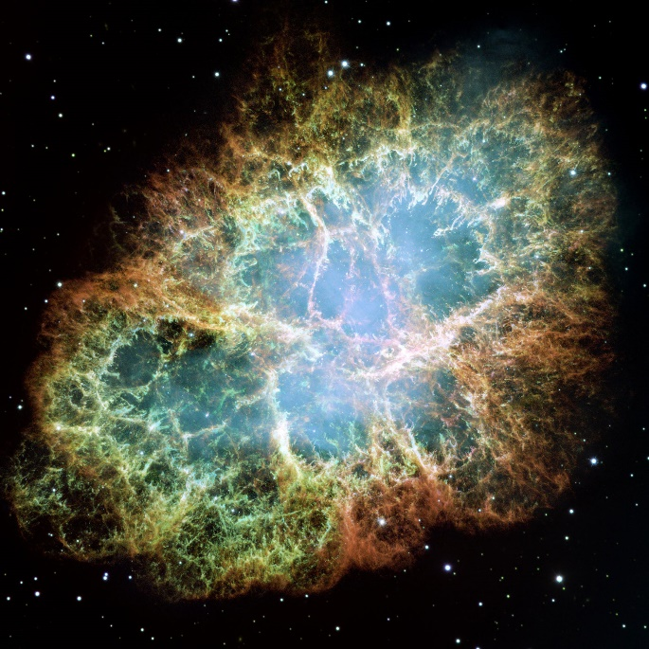
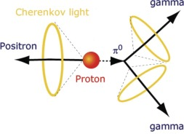
With ESSnuSB, many other leading research programs will also be carried out such as:
- search for sterile neutrinos
- measurement of solar, atmospheric and cosmic neutrinos
- search for proton decay
- measurement of coherent neutrino scattering with 10³ times reduced background
(- tests for the development of a muon collider)

Slide 11
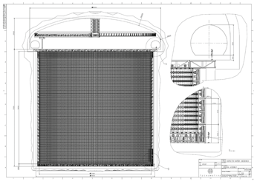
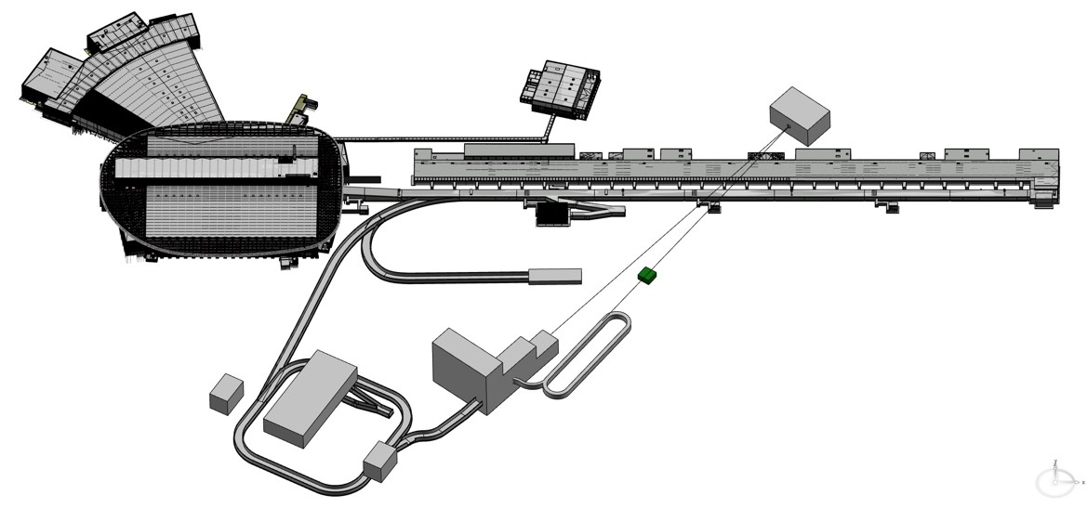
Lay-out of ESSnuSB+
ESS linac upgrade to 10 MW to provide:
- 14 proton pulses per second
for spallation neutron production
and
- 14 H- pulses per second
for neutrino production
ESSnuSB+ will be executed in stages:
Stage 1 2032 Start operation of the Low Energy Monitored Neutrino Beam LEMNB for
Stage 2 2035 Start of operation of the Low Energy muon Storage Ring LEnuSTORM for ν_{e} cross-section measurements
Stage 3 2039 Start of operation of ESSnuSB CP-violation Long Base Line operation to continue 10-20 years
360 km
Far Detector
(Tord)
Near Detector (Kaare)
ν
Monitored ν beam
Spallation target
Near Near
Detector (Kaare)
H⁻
(Francesco)
nuSTORM
(Ting)
Neutrino
production
target (Eric)
p
p
Accumulator ring (Eric)

Slide 12
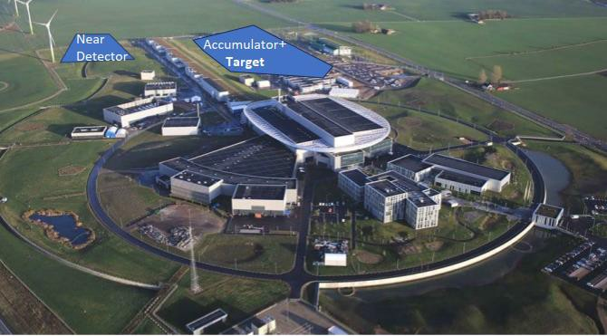
ESSnuSB undergound installations

Slide 13
ESSnuSB for neutrino oscillations with the
Far Detector
-

Slide 14
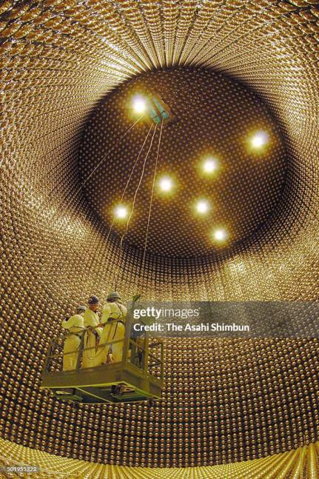
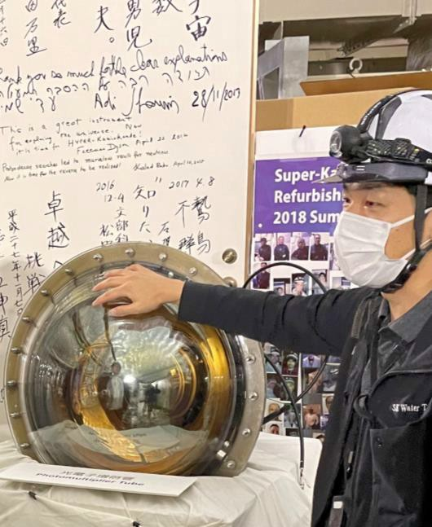
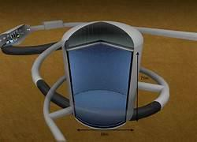
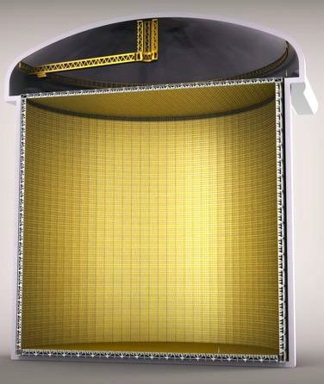
The ESSnuSB Far Detector will consist of two large Water Cherenkov detectors, each 74 m in hight and 74 m in diameter installed 1000 m undeground in the Zinkgruvan Mine 360 km north of ESS in Lund.
The Water Cherenkov detection technique has been pioneered by the Kamiokande experiments in Japan.
50 cm
Super-K Light detector
Super-K
Hyper-K
ESSnuSB x2

Slide 15
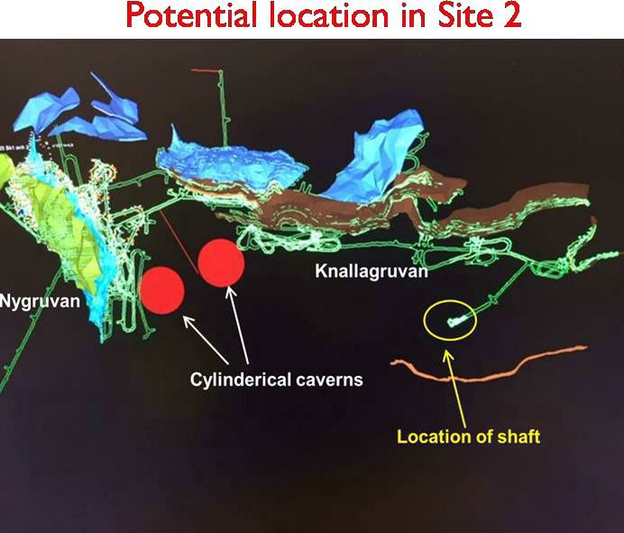
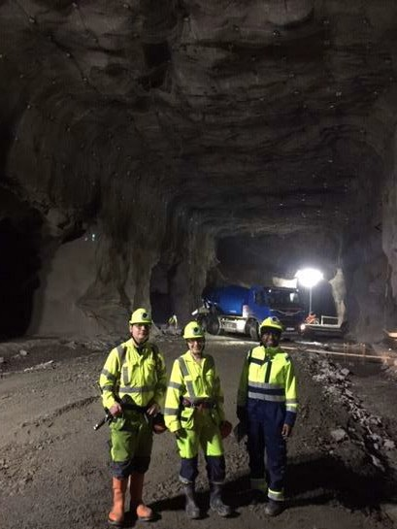
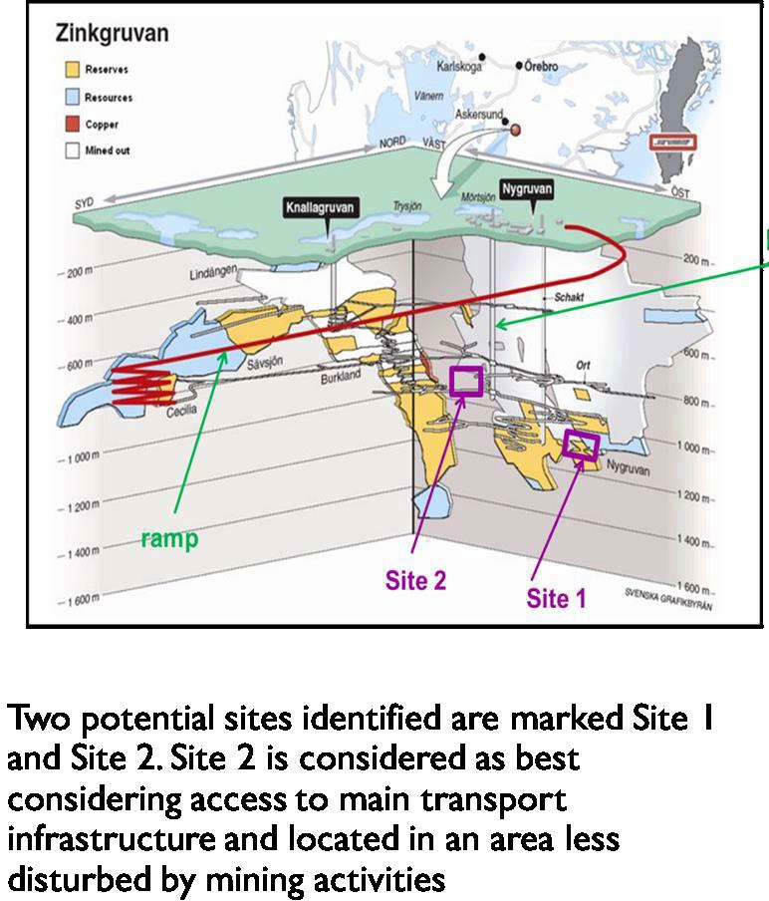
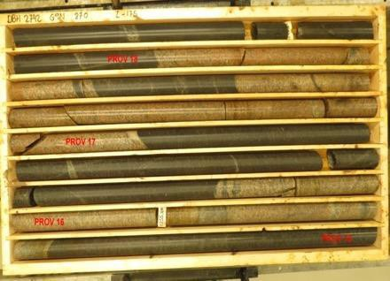
In order to prepare for the excavation of the two large underground caverns that will house the two ESSnuSB Far Detector cylinders in the Zinkgruvan Mine we are planning to make core drilling to evaluation of rock pressure and strength
Visist to Zinkgruvan March 2019 Underground map of Zinkgruvan
Core drilling samples
15

Slide 16
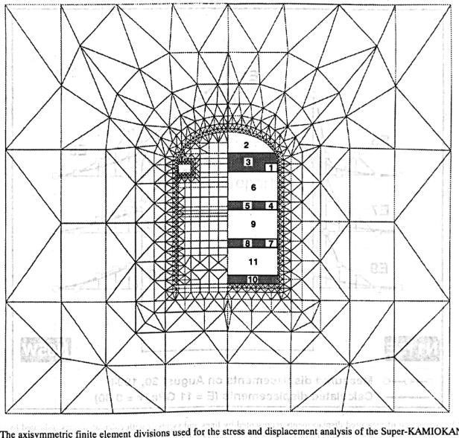
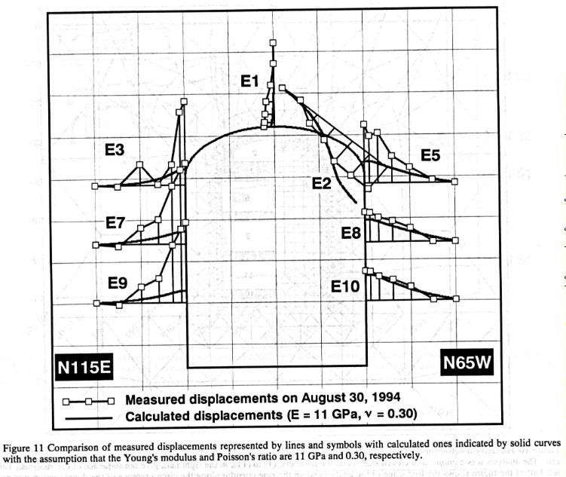
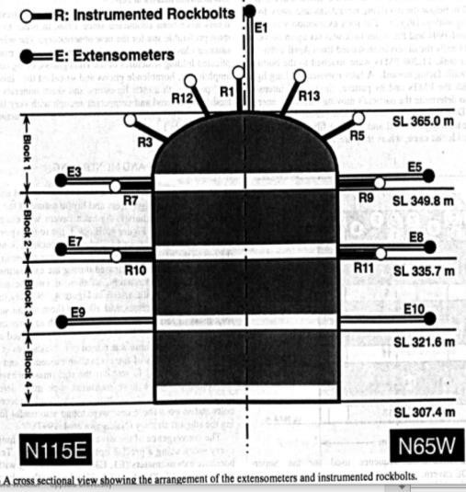
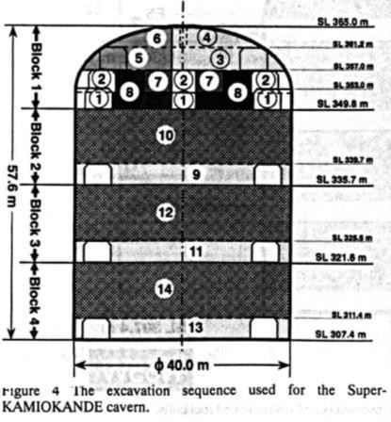
Engineering Design of the two 270’000 m³ caverns and service galleries 1000 m
underground and the access shaft 1.0 M€
Luleå, Oulu and Wroclaw Technical Universities in cooperation with Zinkgruvan Mining
Finite element analysis, excavation sequence, extensometers and displacements of the Super-Kamoikande cavern
https://admin.onepetro.org/isrmcongress/proceedings/CONGR
ESS99/All-CONGRESS99/ISRM-9CONGRESS-1999-305/168876
16

Slide 17
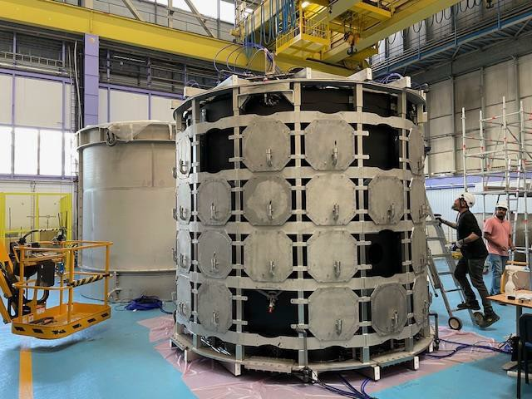
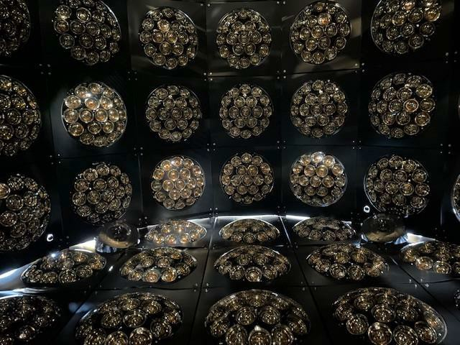
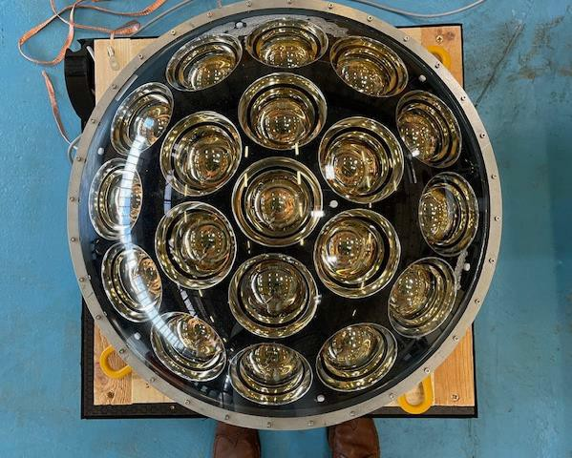
Water Cherenkov Test Experiments in the
Proton Synchrotron East Hall at CERN in Geneva that will be taking data during the spring 2025
50 cm
A new type of light detector
consisting of several smaller units
Support cage (in front) for the light detectors and the outer water container (in the back)
View inside with the light detectors on the cylinder wall

Slide 18






EU’s longterm support for to the European Neutrino Consortium
EU’s Research Directorate has provided support to the project of building a long baseline neutrino facility in Europe since nearly 20 year by funding during this period a long series of design studies :
first CARE/BENE (FP7), EURONU (FP7), LAGUNA (FP7), LAGUNA-LBNO (FP7) ,EUCARD (FP7) at CERN
followed by COST Action CA15139 ,ESSnuSB (Horizon 2020), and ESSnuSB+ (Horizon Europe) at ESS
and thereby appears as well determined to have a major neutrino project realized in Europe .
04/06/2024
14

Slide 19
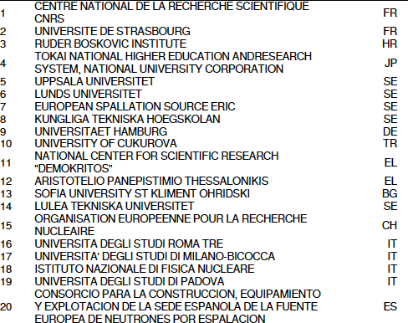
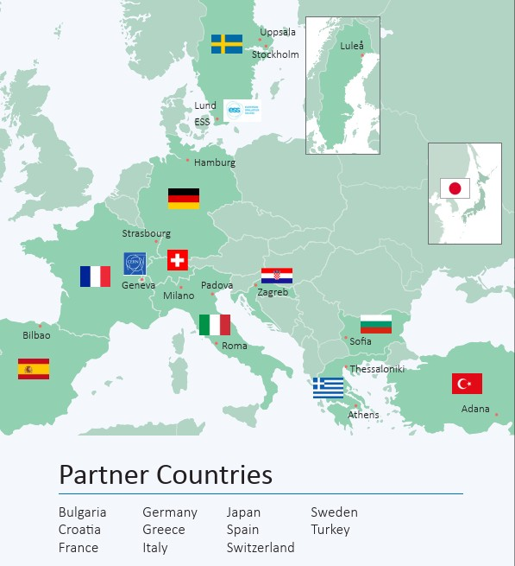
The ESSnuSB+ Collaboration
Currently 94 physicist at 23 Institutions in 13 countries
ASSOCIATE MEMEBRS: GENT UNIVERSITY, BE, UNIVERSITY OF CRACOW, PO, HELLENIC OPEN UNIVERSITY, EL

Slide 20
ESSnuSB Conceptual Design Report
Published on arXive 6 June 2022
https://arxiv.org/abs/ 2206.01208
Published in European Physical Journal 6 Nov 2022
Eur. Phys. J. Spec. Top. (2022) 231: 3779-3955
https://doi.org/10.1140/epjs/s11734-022- 00664-w
CDR Outline
Linac upgrade
The Accumulator Ring
The Target Station and 50 m Decay Tunnel
The Near Detector 250 from the targer
The 540 kt, 1000 m underground Far Detector at 360 km from ESS
ESSnuSB Physics Performance

Slide 21
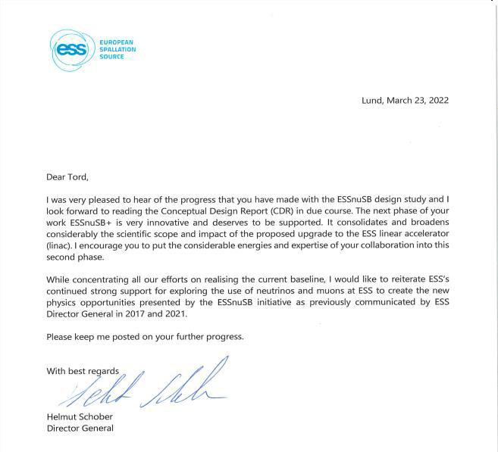
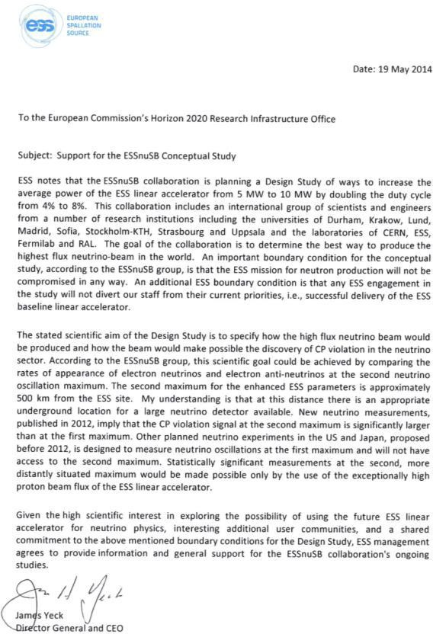
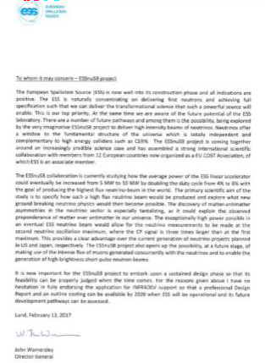
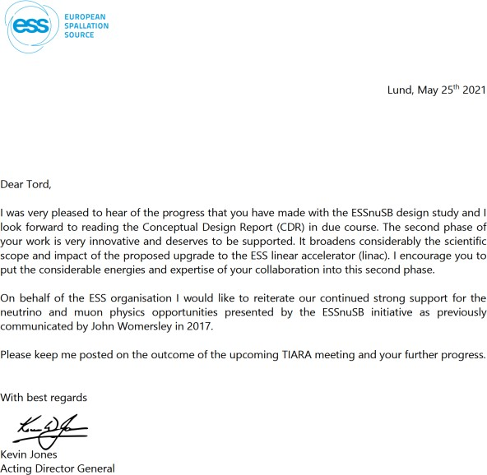
ESS management support for a neutrino physics program at ESS
ESS is a member of the ESSnuSB Collaboration and supports ESSnuSB strongly as
documented in recommendation letters from its four Director Generals since 2014
Jim Jeck in 2014
John Womersly in 2017
Kevin Jones in 2021
Helmut Schober in 2022
Helmut Schober: ”I would like to reiterate ESS’s continued strong support for exploring the use of neutrinos and muons at ESS to create the new physics opportunities by the ESSnuSB initiative as previously
communicated by ESS Director Generals in 2014-2021

Slide 22
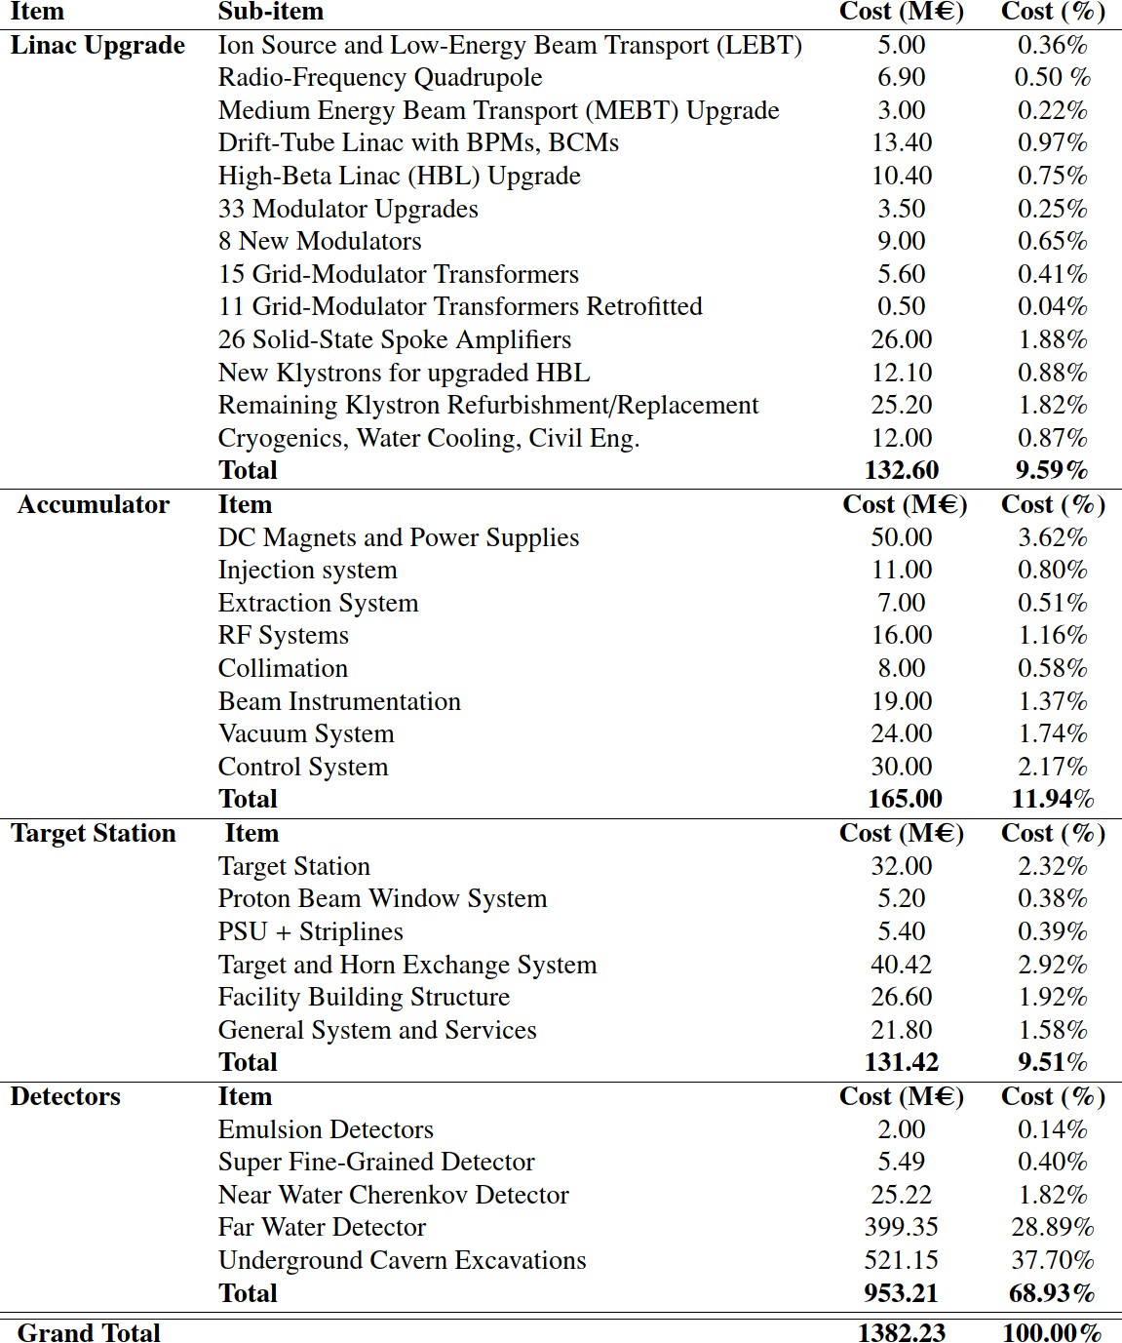


ESSnuSB Cost Esimate
as published in the ESSnuSB Conceptual Design report at arXiv:2203.08803v1
Work in progress.
The cost of civil engineering on the ESS site is not included. A cost estimate of the civil engineering will require a detailed study of the implementation of the components on the ESS site, that will be made only in the next phase of the study.
31

Slide 23
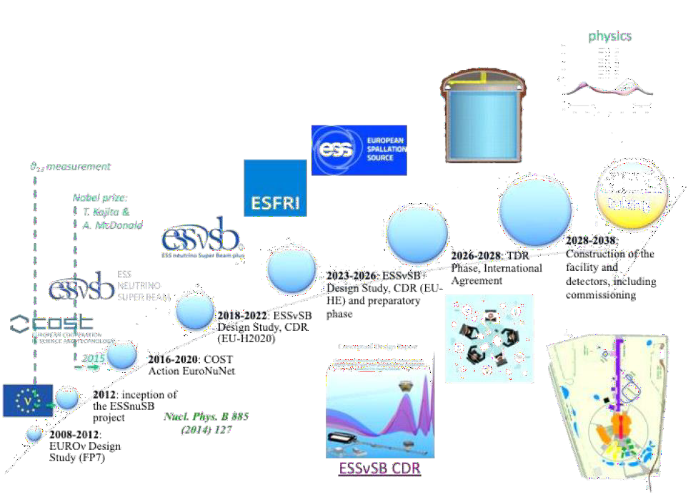
Schedule for the ESS-based neutrino
Super Beam ESSnuSB

Slide 24
Conclusions
A major goal of ESSnuSB is to measure the lepton CP violation with the highest possible precision and thereby to identify a
theory explaining the presence of matter in Universe
The first EU-supported phase of the ESSnuSB conceptual design study 2018-2021 has been successfully concluded, demonstrating the feasibility of using the ESS 5 MW linac as proton driver for a long base-line neutrino experiment with the exceptionally high resolution of 8° in the CP violating phase angle δ_{CP} .
A second EU-supported phase of the ESSnuSB design 2023-2026 is ongoing focussing on including facilities for high
precision neutrino cross-section measurements at low energy needed for the CP angle phase measurement.
The ESSnuSB Collaboration, currently consisting of ca 94 members from 20 universities and 11 European countries has had and has strong support from the EU Research INFRADEV Programme (Horison2020 and Horizon Europe), from the ESS Management and from the Zinkgruvan Mine Management.
The plan for the ESSnuSB is to request support from ESFRI in 2026, start construction around 2030 and start data taking
around 2038.
The ESSnuSB is an ESS-based neutrino super beam which would add a new long-term vision to the ESS as a world-leading laboratory also in Neutrino Physics.

Slide 25
Thank you!
04/06/2024
ESS Council
Tord ekelöf Uppsala University

