Slide 1
ESS𝜈SB Detectors and Physics Reach
On behalf of ESS𝜈SB WP5
The Fundamental Nuclear and Particle Physics at the ESS workshop - 17/1 2025
Kaare Endrup Iversen - Lund University
Figures supplied by:
D. Barčot, E. Baussian, T. Ekelöf, G. Fanourakis, M. Ghosh, B. Kliček, T. Tolba, S. Vihonen

Slide 2
Outline
The detectors
Near detector complex
Far detector
LEMMOND
𝛿_{CP} performance
Additional possible studies

Slide 3
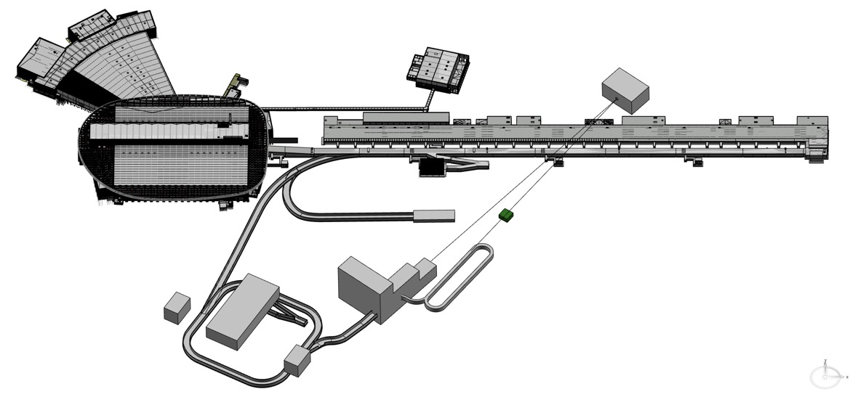
ESS𝜈SB/ESS𝜈SB+ accelerator complex
ESS linac
ESSnuSB Near Detector
LEMMOND
LEMNB
Transfer Line
Accumulator Ring
Decay Tunnel + Beam Dump
LEnuSTORM Ring
MW Target Building
Ring to Target transferline
Common Morgue and PSU room
Facility Buildings

Slide 4
ESS𝜈SB/ESS𝜈SB+ accelerator complex
ESS linac
ESSnuSB Near Detector
See Francesco’s talk at 13:50
LEMMOND
LEMNB
Transfer Line
Accumulator Ring
Decay Tunnel + Beam Dump
LEnuSTORM Ring
See Ting’s talk at 13:30
MW Target Building
See Eric’s talk at 12:15
Ring to Target transferline
Common Morgue and PSU room
Facility Buildings

Slide 5
ESS𝜈SB/ESS𝜈SB+ accelerator complex
ESS linac
ESSnuSB Near Detector
See Francesco’s talk at 13:50
LEMMOND
LEMNB
Transfer Line
Accumulator Ring
Decay Tunnel + Beam Dump
LEnuSTORM Ring
See Ting’s talk at 13:30
MW Target Building
See Eric’s talk at 12:15
Ring to Target transferline
Common Morgue and PSU room
Facility Buildings

Slide 6
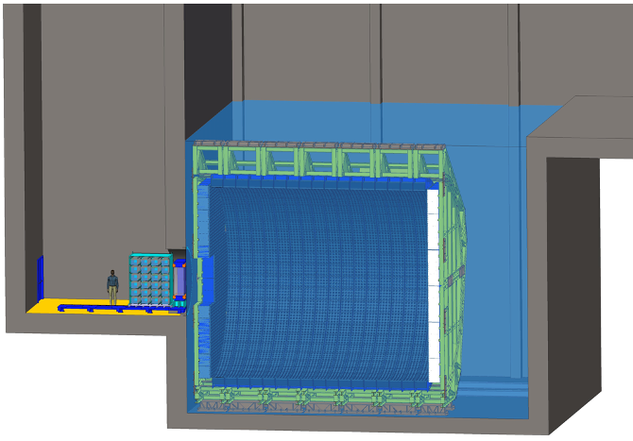
ESS𝜈SB near detector
𝜈 beam
Notes:
The main purpose of the near detector is to reduce the systematic uncertainties
Specifically, it measures:
 The unoscillated flux of neutrinos and, in particular, the electron neutrino contribution.
 The neutrino interaction cross section in water for all four neutrino flavors.

Slide 7
ESS𝜈SB near detector
Reduce systematic uncertainties
Measure unoscillated beam
Measure neutrino interaction cross section
𝜈 beam
Notes:
The main purpose of the near detector is to reduce the systematic uncertainties
Specifically, it measures:
 The unoscillated flux of neutrinos and, in particular, the electron neutrino contribution.
 The neutrino interaction cross section in water for all four neutrino flavors.

Slide 8
ESS𝜈SB near detector
22 000 PMTs
3.5 inch diameter
30% instrumentation coverage
𝜈 beam
Near Water Cherenkov detector (0.77 kt fiducial)
Notes:
Horizontally oriented detector tank submerged in clean water
22 000 PMTs, 3.5 inch diameter
30% instrumentation coverage
Measure non-oscillated neutrino beam
-> composition, absolute flux, and energy spectrum of the neutrino beam
DISTANCE: Near enough so that the oscillation is negligible, far enough to have the beam be “unidirectional” ??

Slide 9
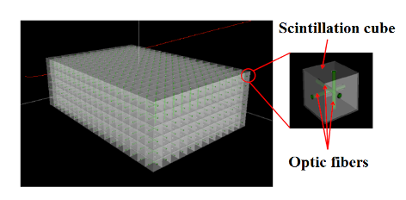
ESS𝜈SB near detector
Super-FGD like detector
(1 t fiducial)
Reconstruct interaction topology
1 T magnet
50 cm deep
𝜈 beam
Near Water Cherenkov detector (0.77 kt fiducial)
Notes:
A magnetised fine-grained tracker is used for precision measurements of neutrino cross-sections
A magnetic field of up to 1 T oriented perpendicular to the beam is applied in the tracker by a dipole magnet - TO MEASURE MOMENTEUM of charged leptons
The main task of the SFGD is to reconstruct the topology of neutrino interactions in order to facilitate the cross-section measurement
50 cm thick to allow charged leptons to penetrate the WC detector

Slide 10
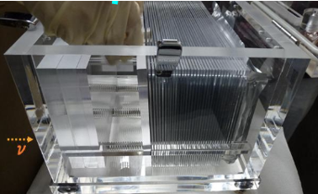
ESS𝜈SB near detector
Angle and # of pions and protons
Muon emission
NINJA-like water-emulsion detector (1 t fiducial)
Super-FGD like detector
(1 t fiducial)
𝜈 beam
Near Water Cherenkov detector (0.77 kt fiducial)
Notes:
Will be used for precise neutrino interaction cross-section measurements
Number of protons
Number of pions
Outgoing angles of protons
Muon emission angles
Outgoing angles of pions

Slide 11
ESS𝜈SB/ESS𝜈SB+ accelerator complex
ESS linac
ESSnuSB Near Detector
LEMMOND
LEMNB
Transfer Line
Accumulator Ring
Decay Tunnel + Beam Dump
LEnuSTORM Ring
MW Target Building
Ring to Target transferline
Common Morgue and PSU room
Facility Buildings

Slide 12
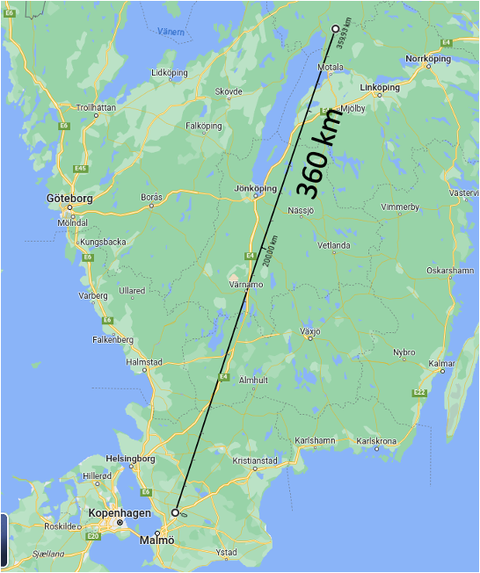
ESS𝜈SB/ESS𝜈SB+ accelerator complex
ESS linac
ESSnuSB Near Detector
LEMMOND
LEMNB
Transfer Line
Accumulator Ring
Decay Tunnel + Beam Dump
LEnuSTORM Ring
MW Target Building
Ring to Target transferline
Common Morgue and PSU room
Facility Buildings

Slide 13
ESS𝜈SB far detector
2nd maximum
2nd maximum
𝜈
𝜈
First and Second Oscillation maxima covered at 360 km baseline!

Slide 14
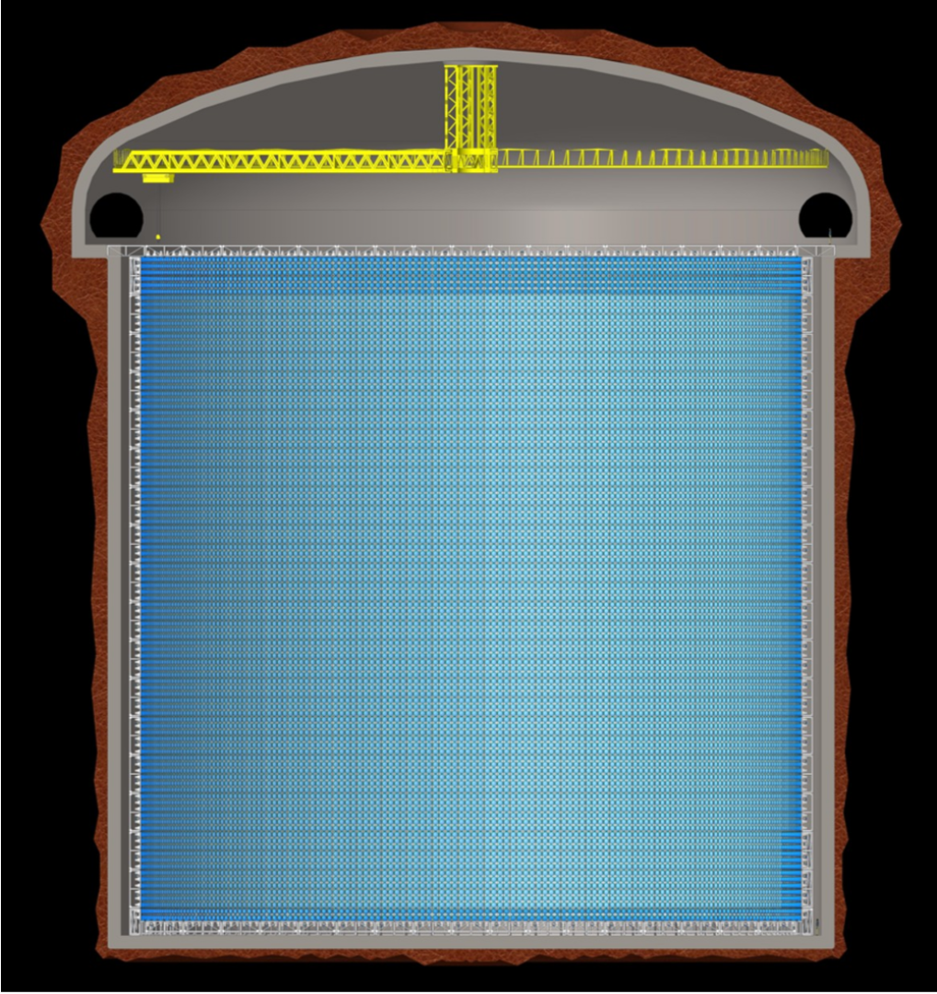
ESS𝜈SB far detector
Design
2 x 270 kt fiducial volume (~20xSuperK)
Readout: 2 x 38k 20” PMTs
30% optical coverage
Design here for 40% with an option that ¼ PMTs will not be installed
2x
Can also be used for other purposes:
Proton decay
Astroparticles
Galactic SN ν
Diffuse supernova neutrino background
Solar Neutrinos
Atmospheric Neutrinos

Slide 15
ESS𝜈SB/ESS𝜈SB+ accelerator complex
ESS linac
ESSnuSB Near Detector
LEMMOND
LEMNB
Transfer Line
Accumulator Ring
Decay Tunnel + Beam Dump
LEnuSTORM Ring
MW Target Building
Ring to Target transferline
Common Morgue and PSU room
Facility Buildings

Slide 16
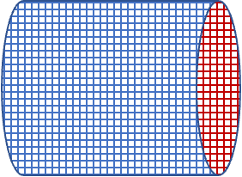
LEMMOND: the near-near detector of ESSnuSB+
Low Energy Neutrino Stored Muons and Monitored Beam Near Detector
A cylindrical detector with about 2.5m radius and 10 m length and a water volume ~200 tons, located 50 m downstream of LEnuSTORM or LEMNB facilities.
It will serve to precisely measure neutrino cross sections at the ESSnuSB energy range but also as a near detector for a Short Base Line setup.
Notes:
More precision on cross section studies
SBL setup aims to search for sterile neutrinos with LEnuSTORM (early results later)
Smaller than END which is 800ish tons

Slide 17
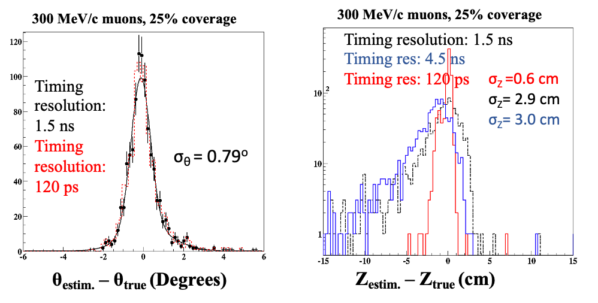
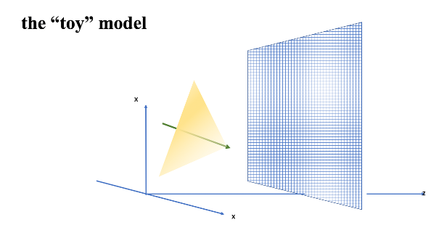
LEMMOND: the near-near detector of ESSnuSB+
Low Energy Neutrino Stored Muons and Monitored Beam Near Detector
A cylindrical detector with about 2.5m radius and 10 m length and a water volume ~200 tons, located 50 m downstream of LEnuSTORM or LEMNB facilities.
It will serve to precisely measure neutrino cross sections at the ESSnuSB energy range but also as a near detector for a Short Base Line setup.
“Toy model” simulations
Notes:
Toy model simulations are ongoing to investigate the viability of this detector which is looking promising.

Slide 18
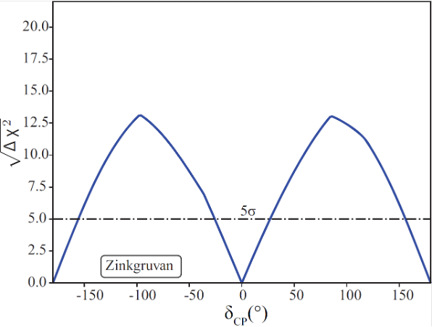
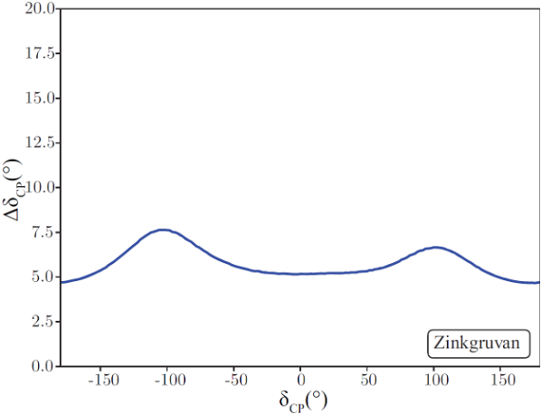
ESS𝜈SB Physics Reach
Sensitivity for δ_{CP}= ±π/2 ~ 12σ
Δδ_{CP}< 8°for all δ_{CP} values
Notes:
All 10 years of data taking In the most likely ranges we have great sensitivity
Also resolution is reasonable
Last plot: For a given fraction of possible CP values with the highest sensitivity, what is the lower bound
Or the other way around, for a chosen sensitivity bound, how big a fraction of the possible deltaCP values will fulfill that

Slide 19
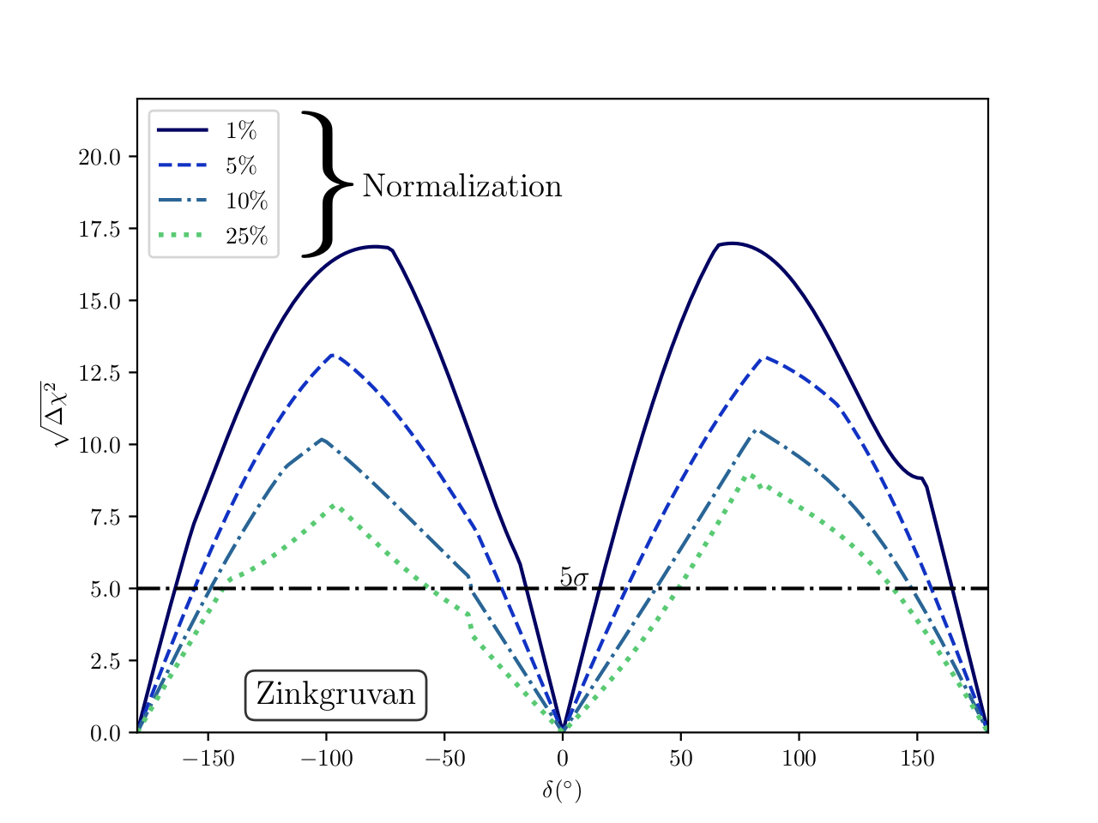
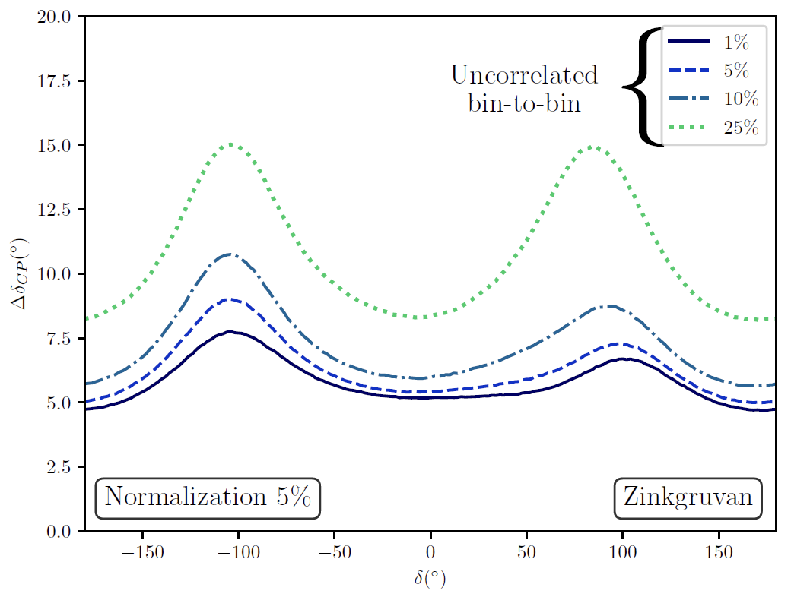
ESS𝜈SB Physics Reach
Because of the dependence on 𝛿_{CP} at the 2nd maximum, the sensitivity is less impacted by systematic errors!

Slide 20
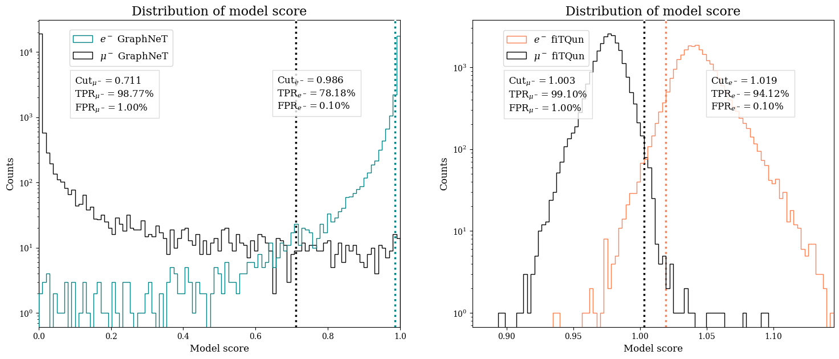
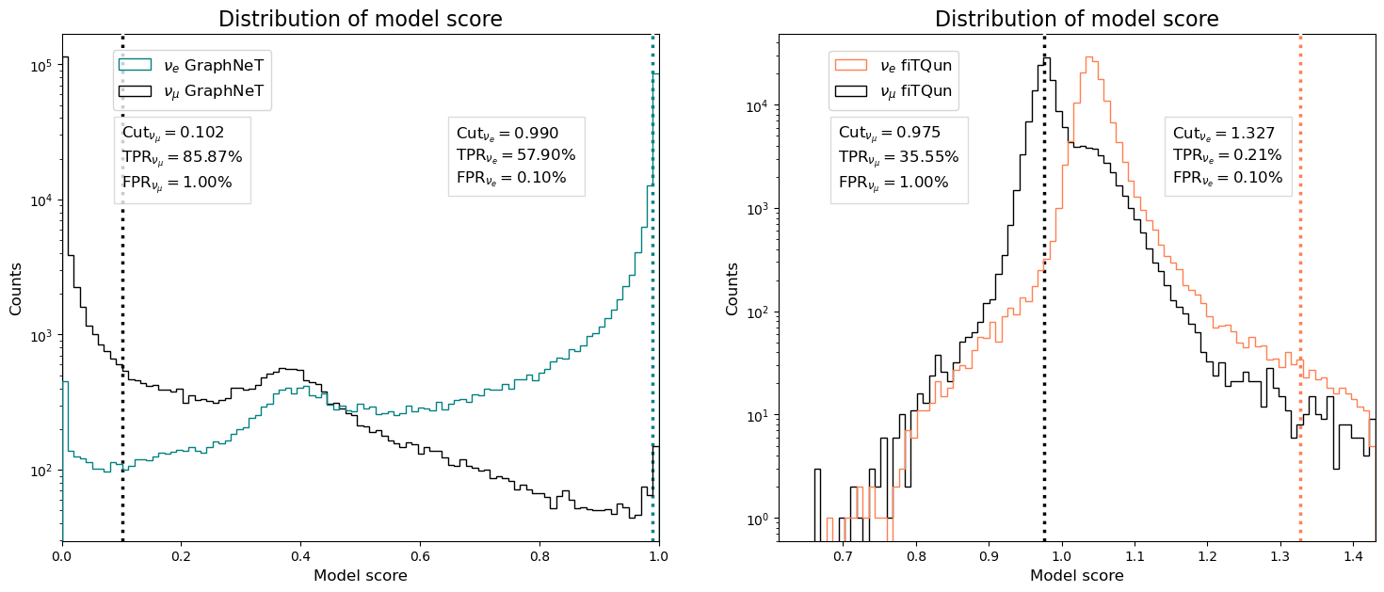
ND event classification using Graph Neural Networks (GNNs)
GNN
Conventional Method
GNN
Conventional Method
Charged lepton events:
Similar GNN and LLH performance
Full neutrino events:
Superior GNN performance
Preliminary

Slide 21
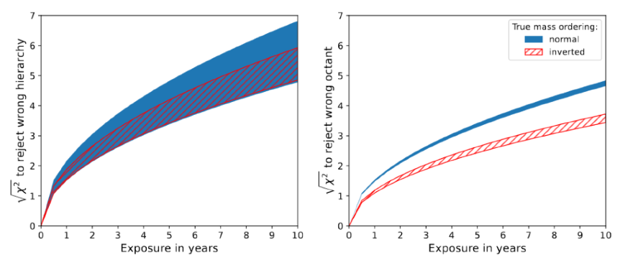
Atmospheric neutrino oscillations at ESS𝜈SB
JHEP 10 (2024), 187 Exploring atmospheric neutrino oscillations at ESSnuSB
Notes:
Using atmospheric neutrinos, we can measure
Mass ordering (3 sigma after 4 years, 5 sigma after 10)
Octant (3 sigma after 4/8 years depending on the mass ordering normal/inverted) - theta23 larger or smaller than 45 (it is very close)
Also constraints on the leptonic mixing parameters

Slide 22
Atmospheric neutrino oscillations at ESS𝜈SB
4 years: 3σ
10 years: 5σ
JHEP 10 (2024), 187 Exploring atmospheric neutrino oscillations at ESSnuSB
Notes:
Using atmospheric neutrinos, we can measure
Mass ordering (3 sigma after 4 years, 5 sigma after 10)
Octant (3 sigma after 4/8 years depending on the mass ordering normal/inverted) - theta23 larger or smaller than 45 (it is very close)
Also constraints on the leptonic mixing parameters

Slide 23
Atmospheric neutrino oscillations at ESS𝜈SB
4 years: 3σ
10 years: 5σ
4/8 years: 3σ
JHEP 10 (2024), 187 Exploring atmospheric neutrino oscillations at ESSnuSB
Notes:
Using atmospheric neutrinos, we can measure
Mass ordering (3 sigma after 4 years, 5 sigma after 10)
Octant (3 sigma after 4/8 years depending on the mass ordering normal/inverted) - theta23 larger or smaller than 45 (it is very close)
Also constraints on the leptonic mixing parameters

Slide 24
Atmospheric neutrino oscillations at ESS𝜈SB
JHEP 10 (2024), 187 Exploring atmospheric neutrino oscillations at ESSnuSB
Notes:
Using atmospheric neutrinos, we can measure
Mass ordering (3 sigma after 4 years, 5 sigma after 10)
Octant (3 sigma after 4/8 years depending on the mass ordering normal/inverted) - theta23 larger or smaller than 45 (it is very close)
Also constraints on the leptonic mixing parameters

Slide 25
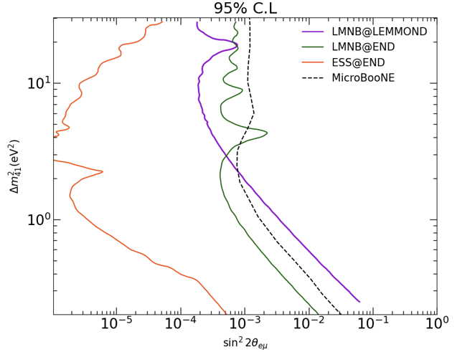
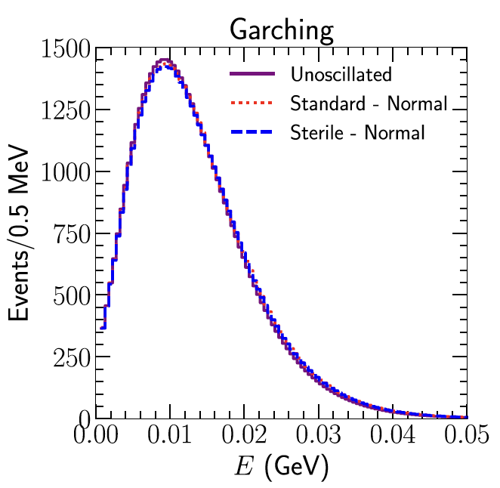
Sterile neutrino searches with LEMNB and ESS𝜈SB
LEMNB
Supernova 𝜈 with ESS𝜈SB
JHEP 03 (2020), 026 Sensitivity to light sterile neutrinos at ESSnuSB
Preliminary
Notes:
1: Search for sterile neutrinos using 3 setups, all better than microboone
2: Expected events at FD for supernova at a distance of 10 kpc assuming the Garching model of the supernova flux for 3 cases:
No oscillations
Standard 3 flavour
Sterile 3+1 flavour - is this good?

Slide 26
Sterile neutrino searches with LEMNB and ESS𝜈SB
LEMNB
Supernova 𝜈 with ESS𝜈SB
Even a low power beam can improve bounds
JHEP 03 (2020), 026 Sensitivity to light sterile neutrinos at ESSnuSB
Preliminary
Notes:
1: Search for sterile neutrinos using 3 setups, all better than microboone
2: Expected events at FD for supernova at a distance of 10 kpc assuming the Garching model of the supernova flux for 3 cases:
No oscillations
Standard 3 flavour
Sterile 3+1 flavour - is this good?

Slide 27
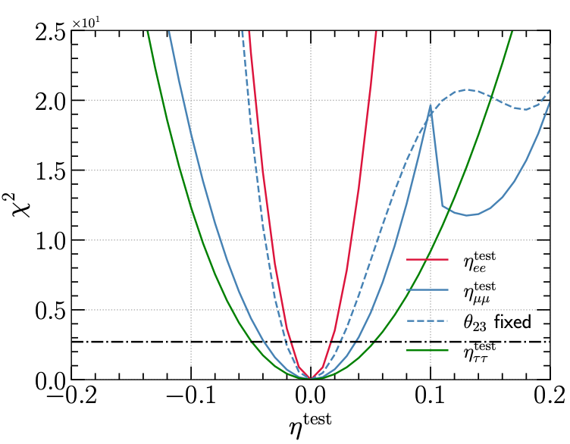
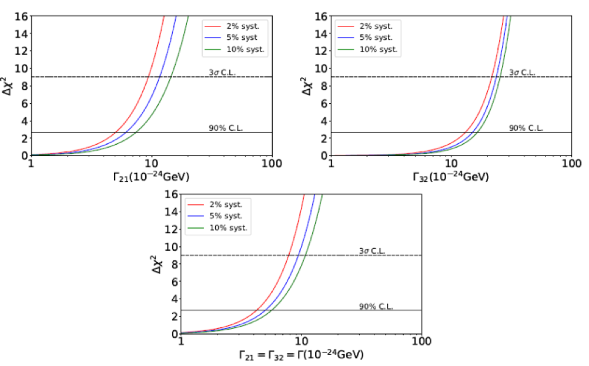
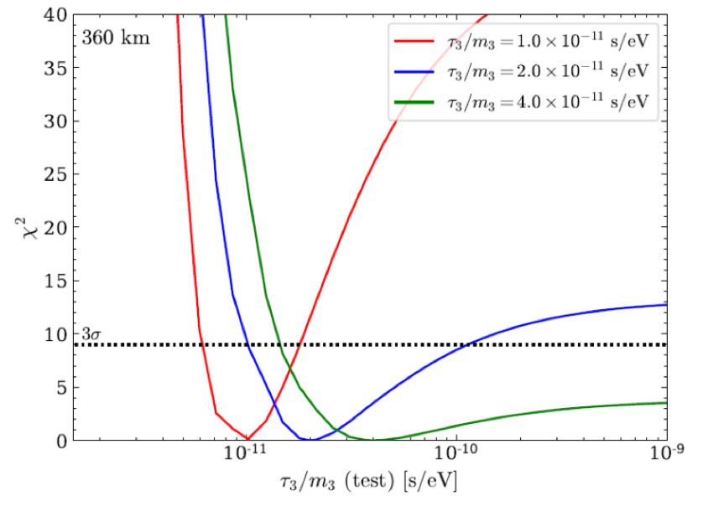
BSM Searches
Constraints on scalar NSI parameters
Constraints on Decoherence dissipative parameters
Invisible neutrino decays
Study of non-standard interaction mediated by a scalar field at the ESSnuSB experiment
Phys. Rev. D 109, (2024) 115010
Decoherence in Neutrino Oscillation
at the ESSnuSB Experiment
JHEP 08 (2024), 63
Exploring invisible neutrino decay at ESSnuSB
JHEP 05 (2021), 133
Notes:
Blabla

Slide 28
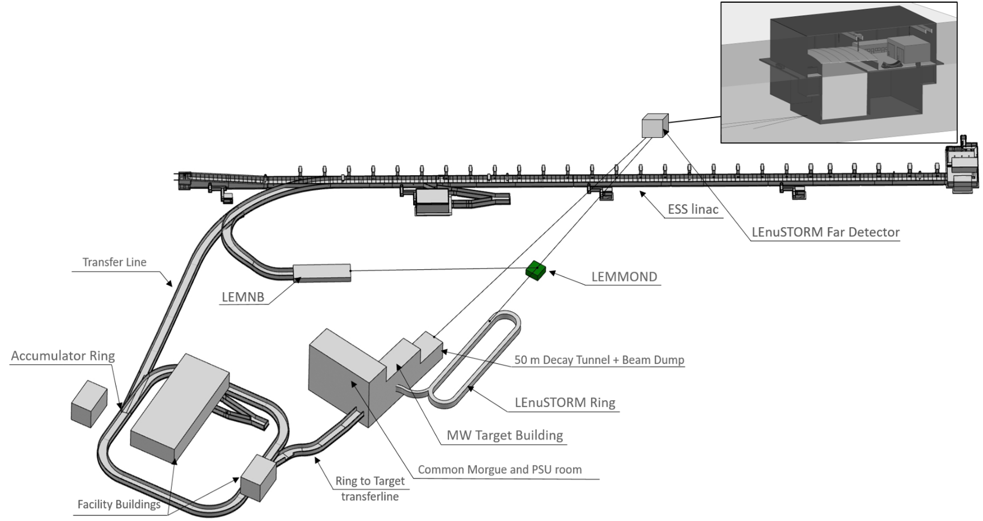
Summary
FD: 2x WC tanks
ND: WC, SFG & water emulsion
NND: LEMMOND
Sensitivity for δ_{CP}= ±π/2 ~ 12σ
Δδ_{CP}< 8° for all δ_{CP} values
Several other possible use cases, including atmospheric 𝜈, sterile 𝜈 and other BSM

Slide 29
Summary
FD: 2x WC tanks
ND: WC, SFG & water emulsion
NND: LEMMOND
Sensitivity for δ_{CP}= ±π/2 ~ 12σ
Δδ_{CP}< 8° for all δ_{CP} values
Several other possible use cases, including atmospheric 𝜈, sterile 𝜈 and other BSM

Slide 30
Summary
FD: 2x WC tanks
ND: WC, SFG & water emulsion
NND: LEMMOND
Sensitivity for δ_{CP}= ±π/2 ~ 12σ
Δδ_{CP}< 8° for all δ_{CP} values
Several other possible use cases, including atmospheric 𝜈, sterile 𝜈 and other BSM

Slide 31
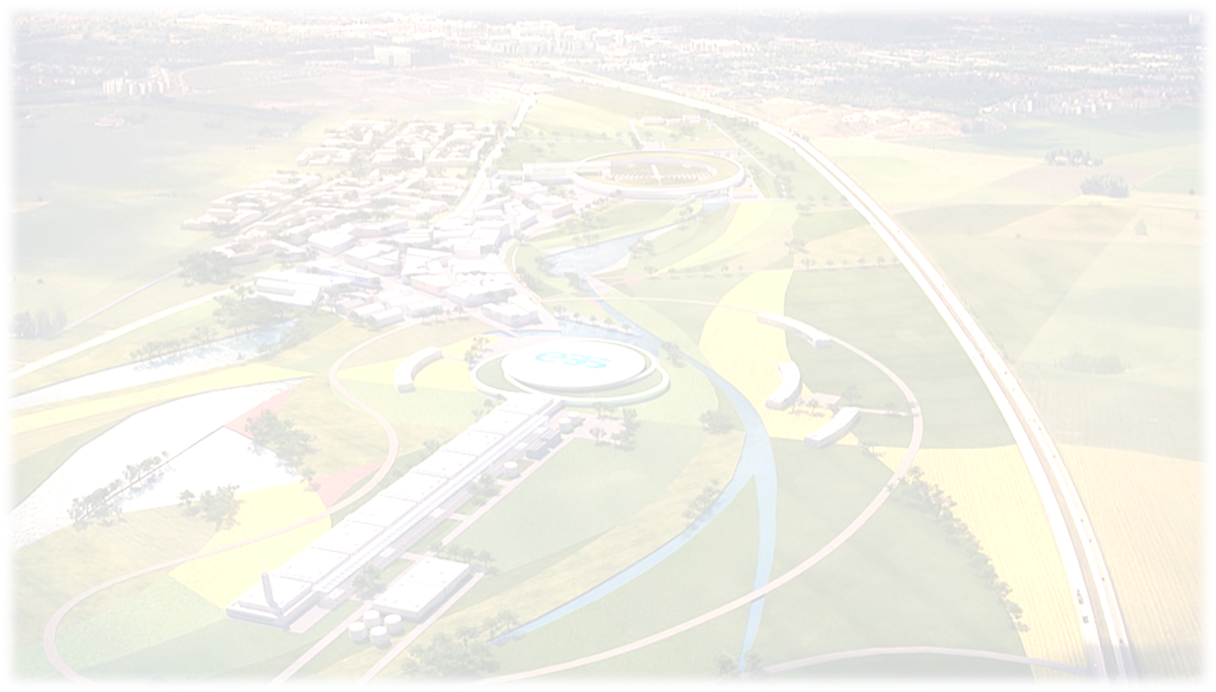
Thank you!

Slide 32
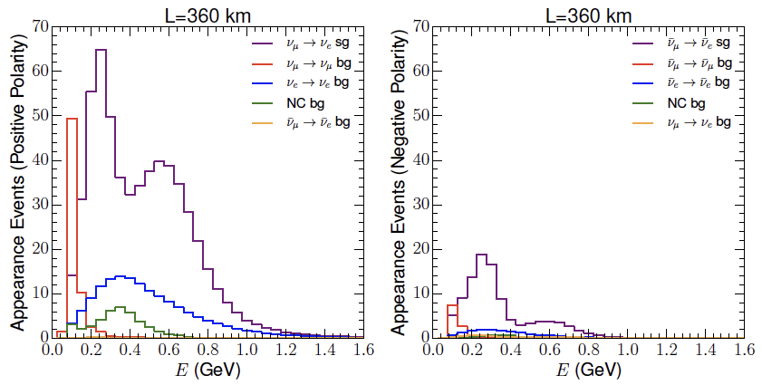
ESS𝜈SB far detector flux
𝜈
𝜈
Expected neutrino spectrum in the far detector for one year (200 days) in 𝜈-mode (left) and 𝜈-mode (right)
Notes:
Pion dictate production of neutrinos - antineutrino-mode should be longer than neutrino mode

