Slide 1

The Accumulator and Target Station Facility for the ESSnuSB experiment
The Fundamental Nuclear and Particle Physics
at the ESS workshop
E. Baussan on behalf of ESSνSB Collaboration
IPHC-IN2P3/CNRS Strasbourg

Slide 2
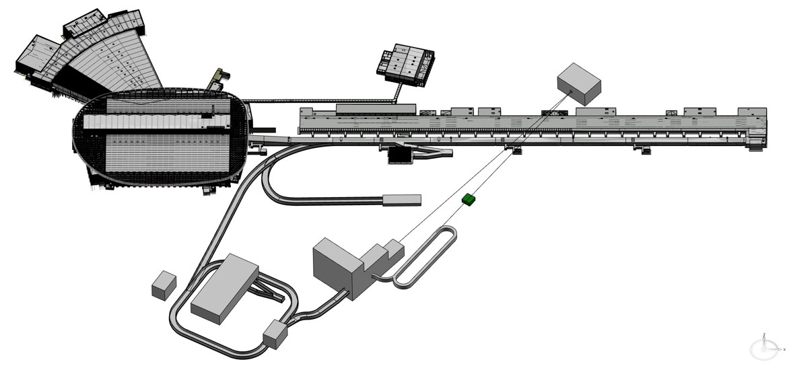
The Accumulator and Target Station Facility for the ESSnuSB experiment
Implementation on ESS Site
23m
23m
50m
50m
90m
140m
90m
140m
340m
340m
160m
160m
76m
76m
22.5m
MW Target Station Staging Approach:
ESSnuSB -> 5 MW
ESSnuSB+ -> 1.25 MW
22.5m
43m
43m
115m
115m

Slide 3
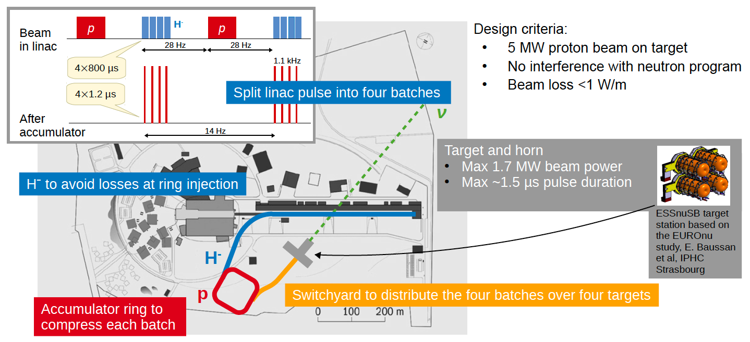
The Accumulator and Target Station Facility for the ESSnuSB experiment
Accumulator Ring Design

Slide 4
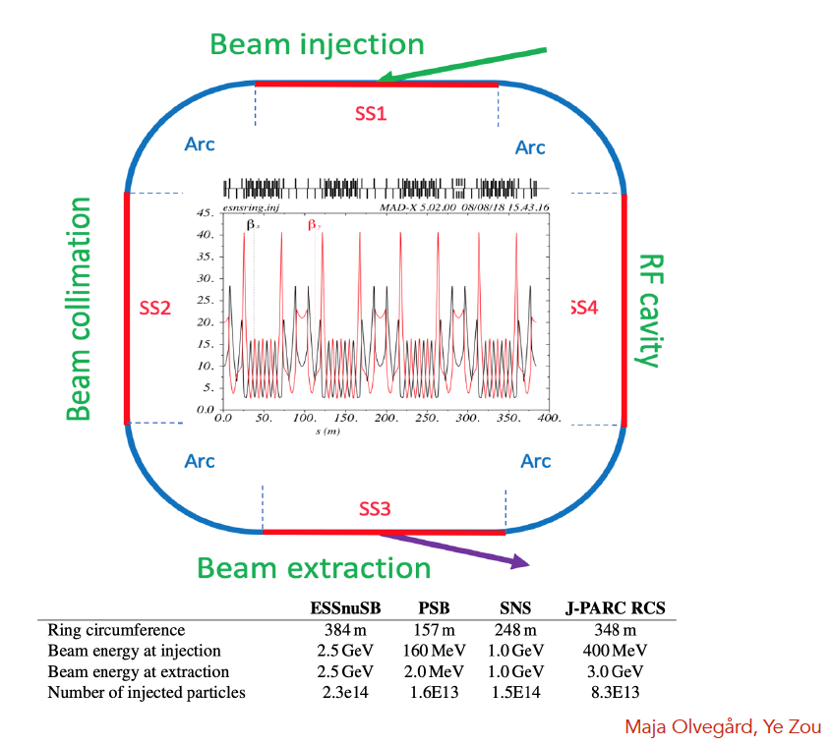
The Accumulator and Target Station Facility for the ESSnuSB experiment
Accumulator Ring Design
Main challenges
Beam loss control due to very high beam power
Space-charge tune shift due to very high beam intensity
Instabilities (e-p instability)
Lattice design
Developed by Horst Schönauer at CERN
Circumference: 384 m
4-fold symmetry
4 straight sections (SS1~SS4) and 4 arc sections (Arc)
Fixed injection chicane and fast programmable bump for injection painting

Slide 5
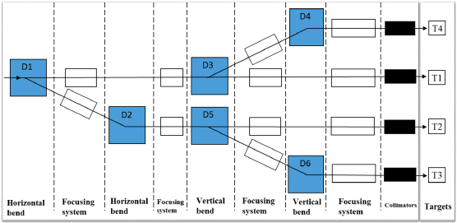
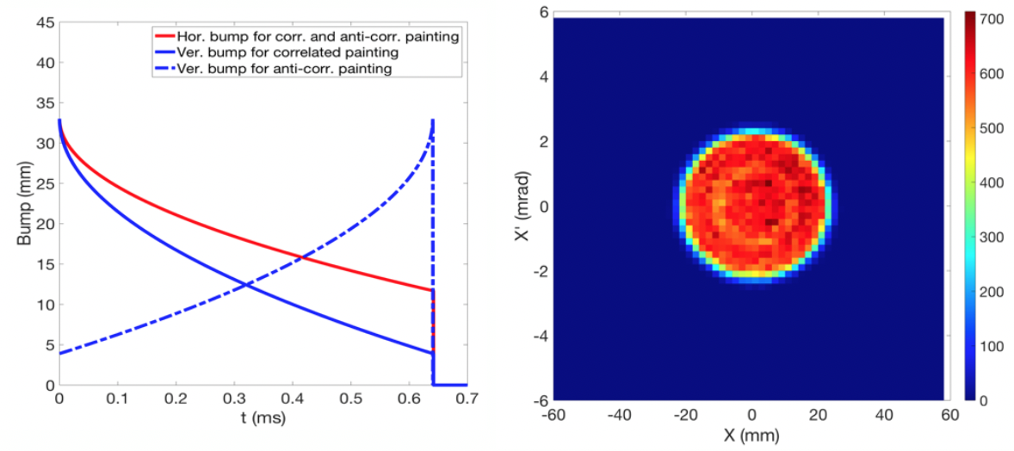
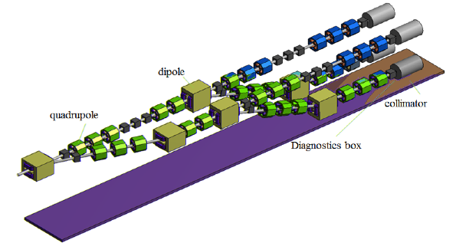
The Accumulator and Target station Facility for the ESSnuSB experiment
Accumulator Ring Design
Injection
Foil stripping: widely used in proton synchrotrons or accumulators, very challenging due to high power.
Laser stripping: a promising alternative method (ongoing development at SNS).
Direct proton Injection: under study at ESS.
Switchyard for beam delivery on the targets
1.25 MW
5 MW
1.25 MW
1.25 MW
1.25 MW
Beam Switchyard
Share the beam over
Four packed bed targets
Y. Zou, Uppsala University
E. Bouquerel, IPHC Strasbourg

Slide 6
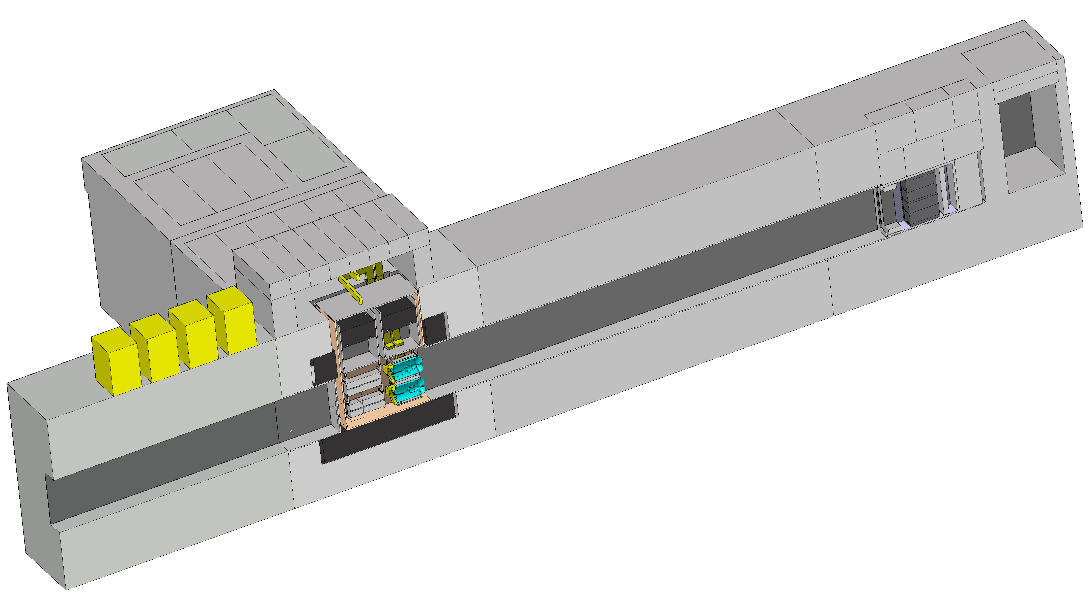
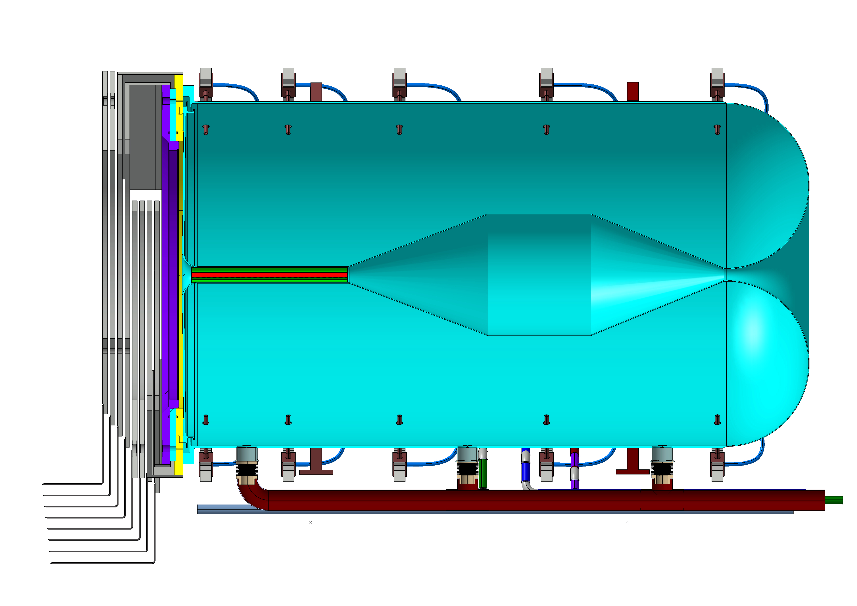
The Accumulator and Target Station Facility for the ESSnuSB experiment
The ESSnuSB Target Station
Power Supply Unit
16 modules (350 kA, 1.3 μs)
Located above the switchyard
Outside of radioactive part of Facility
Hot Cell
Able to manipulate/repair hadronic collector
Work under Radioactive Environment
Beam dump
Morgue
To Store radioactive
wastes
Decay tunnel
Beam Switchyard
Tunnel
Proton Beam
(Ep=2.5 GeV, 14 Hz) 4 x 1.25 MW
Hadronic Collector
WP3 (Accumulator+Switchyard)
Beam Switchyard
Share the beam over
Four packed bed targets
Beam Switchyard
MiniBOONE-like horn
Shape optimized with genetic algorithm

Slide 7
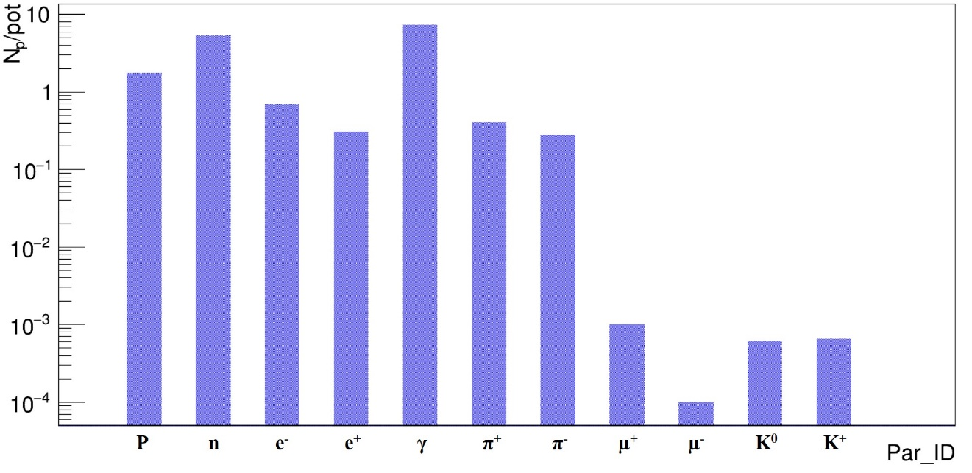
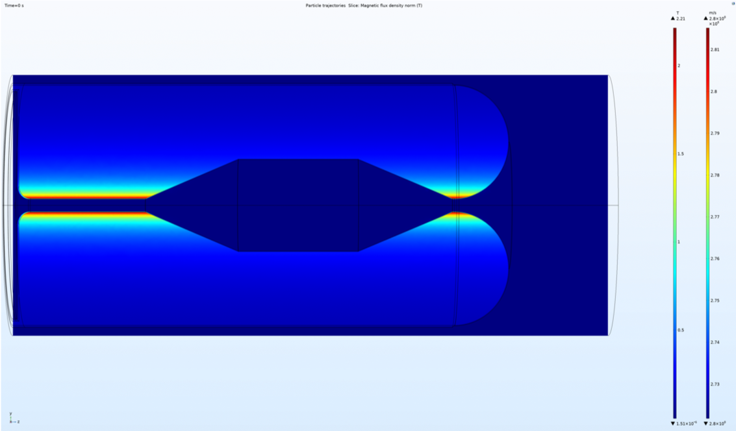
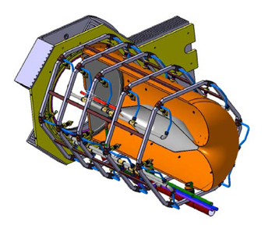
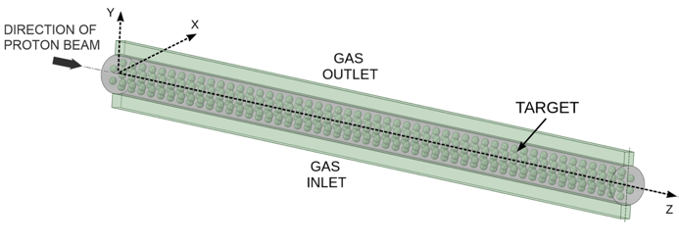
The Accumulator and Target Station Facility for the ESSnuSB experiment
The ESSnuSB Hadronic Collector
Production of the neutrino beam:
(Current pulse I = 350 kA, 14 Hz)
Pions
π⁺ -> μ⁺ + ν_{μ} (Positive mode)
π⁻ -> μ⁻ + ν_{μ} (Negative mode)
Neutrino/antineutrino mode selected by the polarity of the current.
B
Particle production at target level
B
Magnetic flux density T inside a horn and surrounding space, at time 50 μs.
Transverse view of one horn

Slide 8
The Accumulator and Target Station Facility for the ESSnuSB experiment
The ESSnuSB Hadronic Collector
Production of the neutrino beam:
(Current pulse I = 350 kA, 14 Hz)
Pions
π⁺ -> μ⁺ + ν_{μ} (Positive mode)
π⁻ -> μ⁻ + ν_{μ} (Negative mode)
Neutrino/antineutrino mode selected by the polarity of the current.
Particle production at target level
Magnetic flux density T inside a horn and surrounding space, at time 50 μs.
Transverse view of one horn

Slide 9
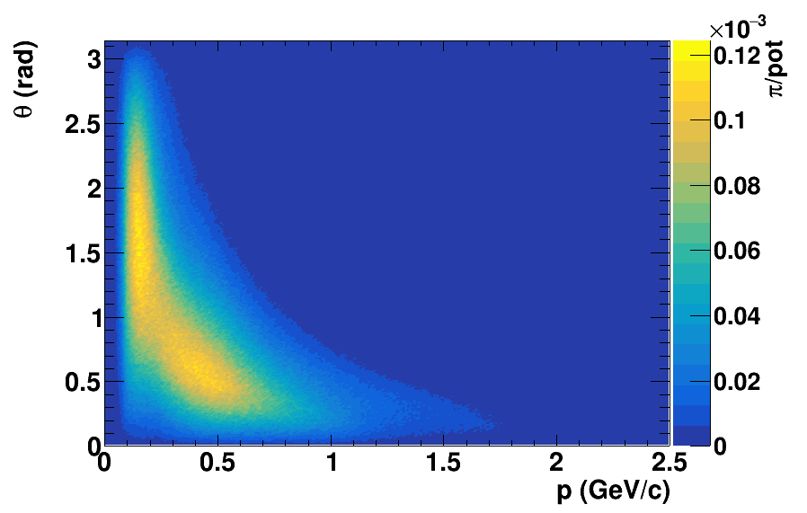
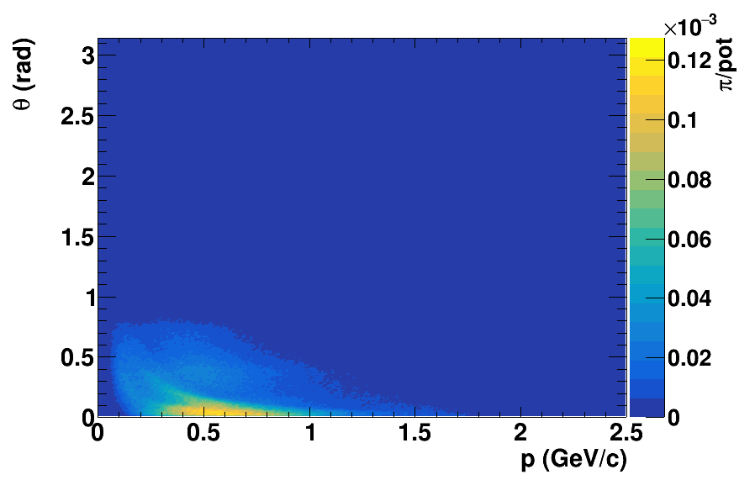
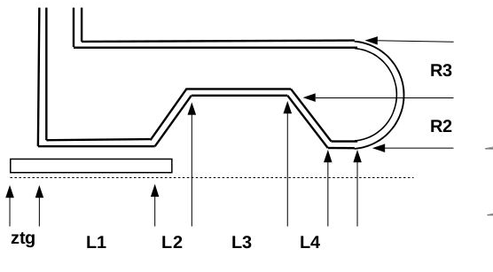
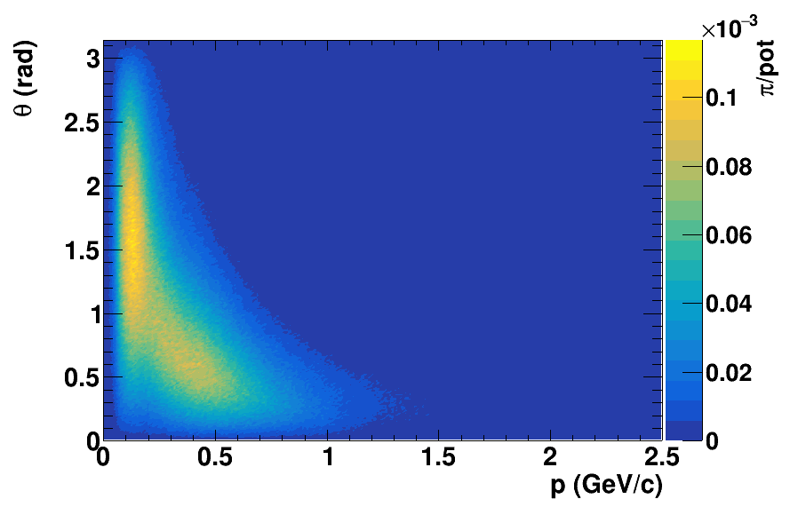
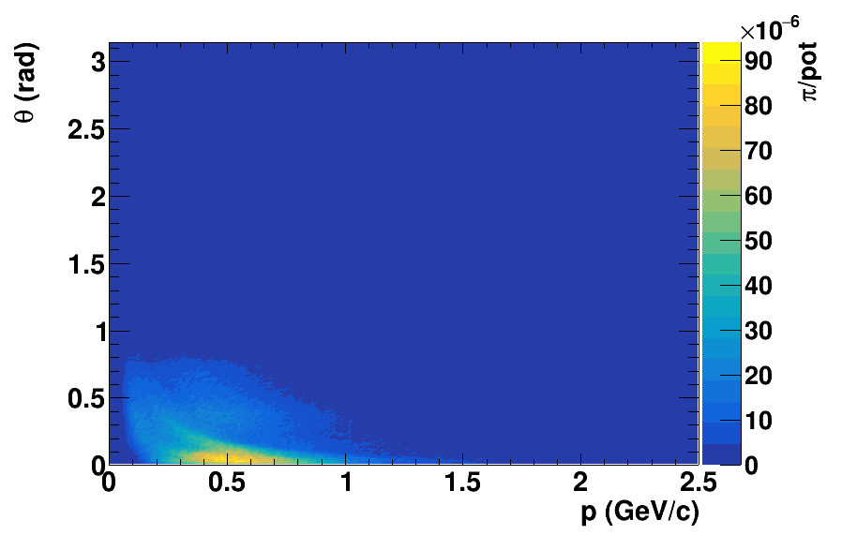
The Accumulator and Target Station Facility for the ESSnuSB experiment
The ESSnuSB Hadronic Collector
The shape of the horn has been optimized using Deep Learning Method (Genetic Algorithm) with different configurations of the magnetic horn conductors and decay tunnel geometry.
π⁺ at target
π⁺ at the entrance of decay tunnel
Pion Momentum vs angle distribution
Parametrisation of the horn shape
π⁻ at target
π⁻ at the entrance of decay tunnel
"new"
Optimisation of the
δ_{CP} Sensitivity
"old"
Pion Momentum vs angle distribution

Slide 10
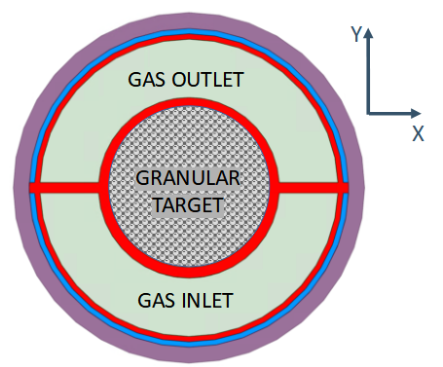
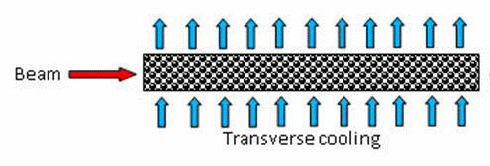
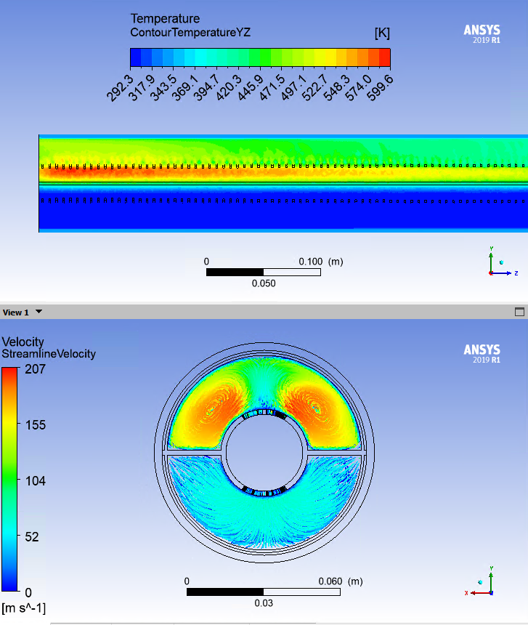
The Accumulator and Target Station Facility for the ESSnuSB experiment
The ESSnuSB Target
ESSnuSB Target : 78 cm X 3 cm diameter cylinder filled with 3 mm titanium spheres.
(66% packing fraction)
78 cm
Granular Target Concept:
Heat removal
Mechanical stresses
Radiation
Damages
Cross-section of the target-horn
integration system.
Simplified model of the granular target
Cooled with He gas 10 bars
Geometrical
Constraints
Packed Bed Target
Remote
Handling
Safe
Operations
Improved
Lifetime
Main conclusions (P. Sievers „A Stationary Target for the CERN-Neutrino-Factory”, CERN-NuFact-Note 065):

Slide 11
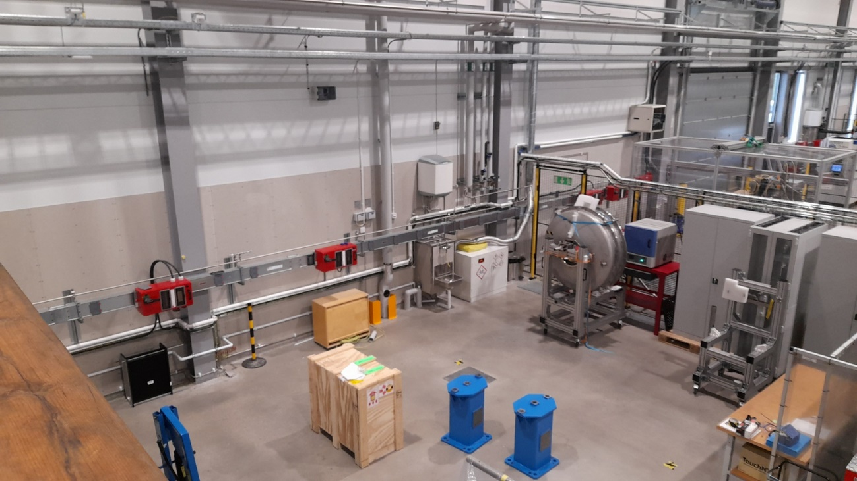

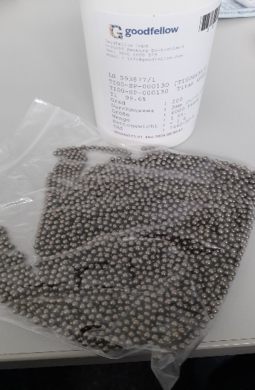
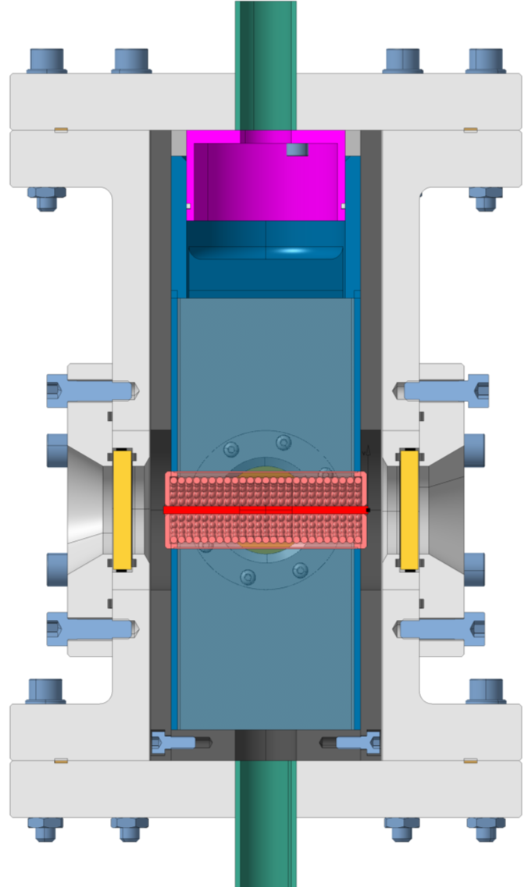
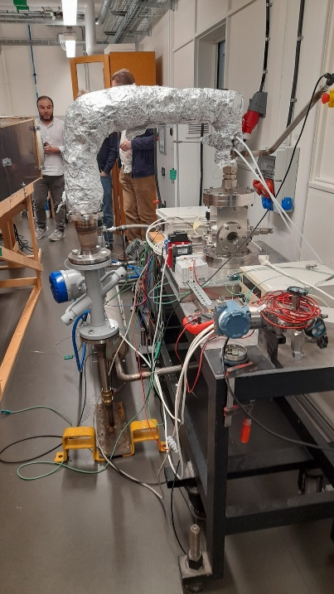
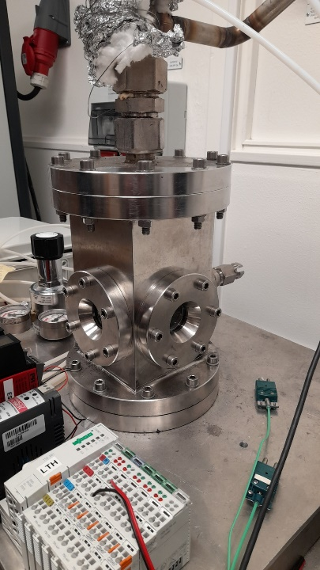
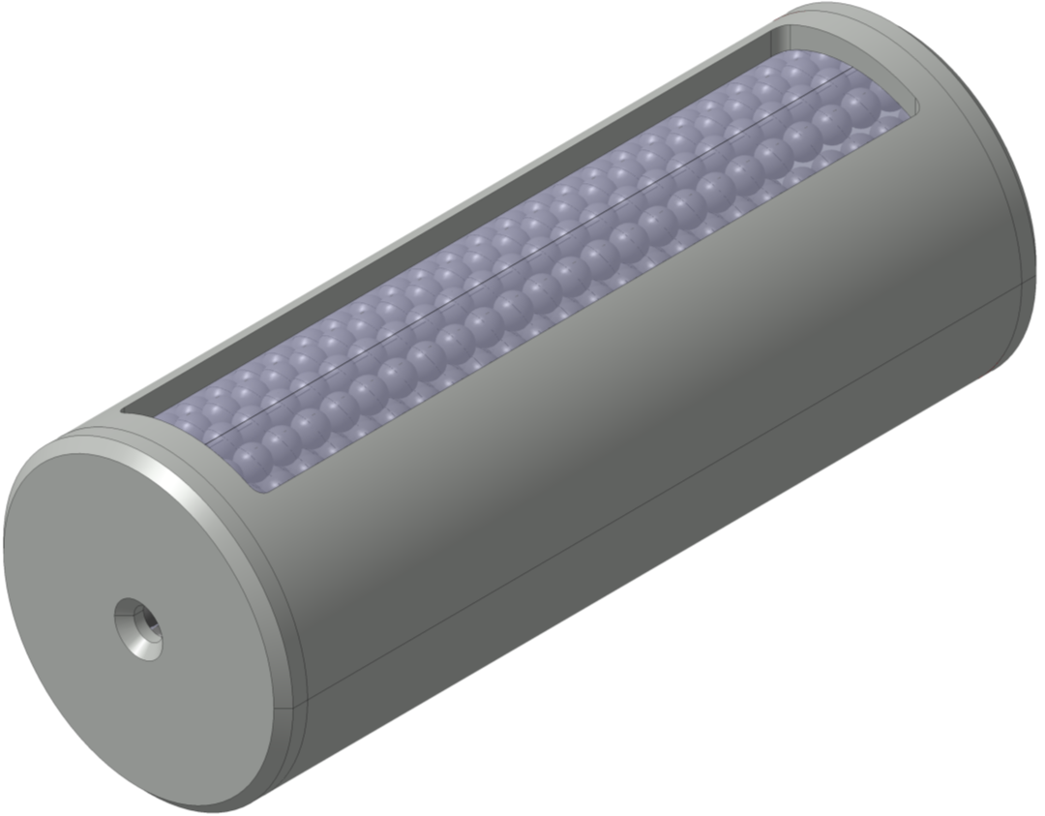
The Accumulator and Target Station Facility for the ESSnuSB experiment
Target Prototype (ETTF)
Mechanical Measurements Lab
(MML) @ESS
ESSnuSB adopts a granular target concept of 3 mm titanium spheres in 78 cm Ti Canister, cooled by transverse helium gas.
A Prototype of 7.8 cm length and a 3 cm diameter will be tested in the ETHEL test facility in ESS.
Cooling He_In
Ti pellets
(4000 pellets
D_{pellet} = 3 mm)
Cooling He_In
ESS Target Helium
Experiments at LTH
(ETHEL) @LTH
(https://indico.ess.eu/event/648/attachments/5153/7015/essDocumentDownload_002.pdf)
78 mm
30 mm
He
He_Out
UHH/ESS-Bilbao/ESS/IPHC

Slide 12
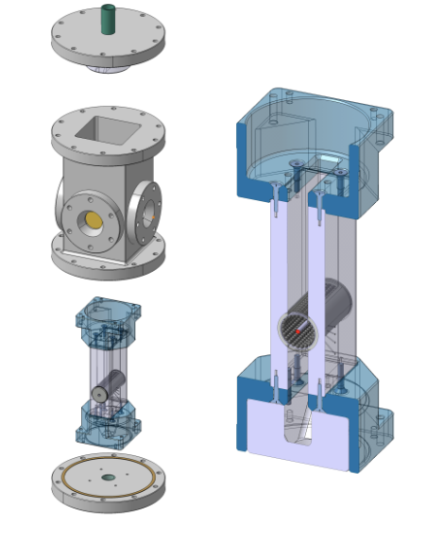
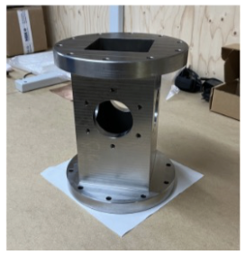
The Accumulator and Target Station Facility for the ESSnuSB experiment
Target Prototype (ETTF)
Mechanical Measurements Lab
(MML) @ESS
ESSnuSB adopts a granular target concept of 3 mm titanium spheres in 78 cm Ti Canister, cooled by transverse helium gas.
A Prototype of 7.8 cm length and a 3 cm diameter will be tested in the ETHEL test facility in ESS.
ESS Target Helium
Experiments at LTH
(ETHEL) @LTH
(https://indico.ess.eu/event/648/attachments/5153/7015/essDocumentDownload_002.pdf)
Helium Chamber
UHH/ESS-Bilbao/ESS/IPHC

Slide 13
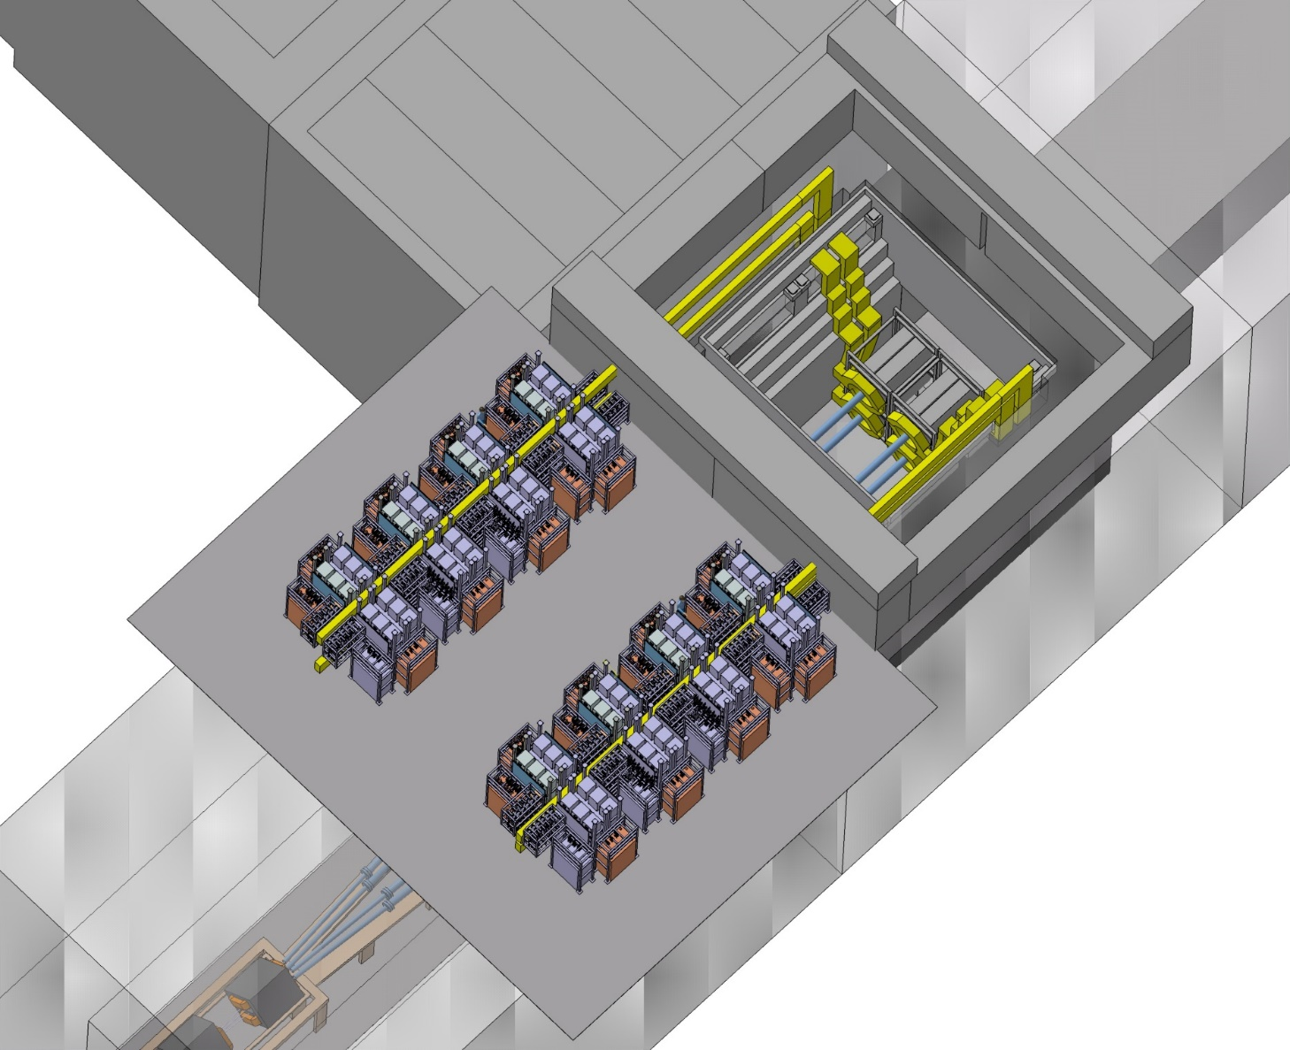
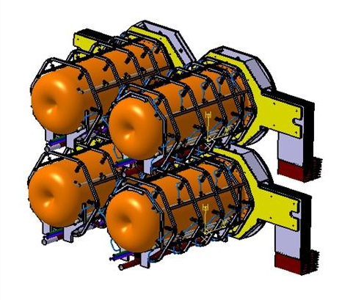
The Accumulator and Target Station Facility for the ESSnuSB experiment
The ESSnuSB Power Supply Unit
Power Supply Unit (PSU):
The modular concept for the PSU:
  One modules deliver 44 kA half-sinusoïd pulses 100 μs.
  The design of the module depend on the electrical parameter of the horn.
striplines
350kA
4 Horns PSU
Capacitor current (A)
2 outputs
of 44kA
Discharge and Recovery current
22400A
PSU Current Pulse
Time (ms)

Slide 14
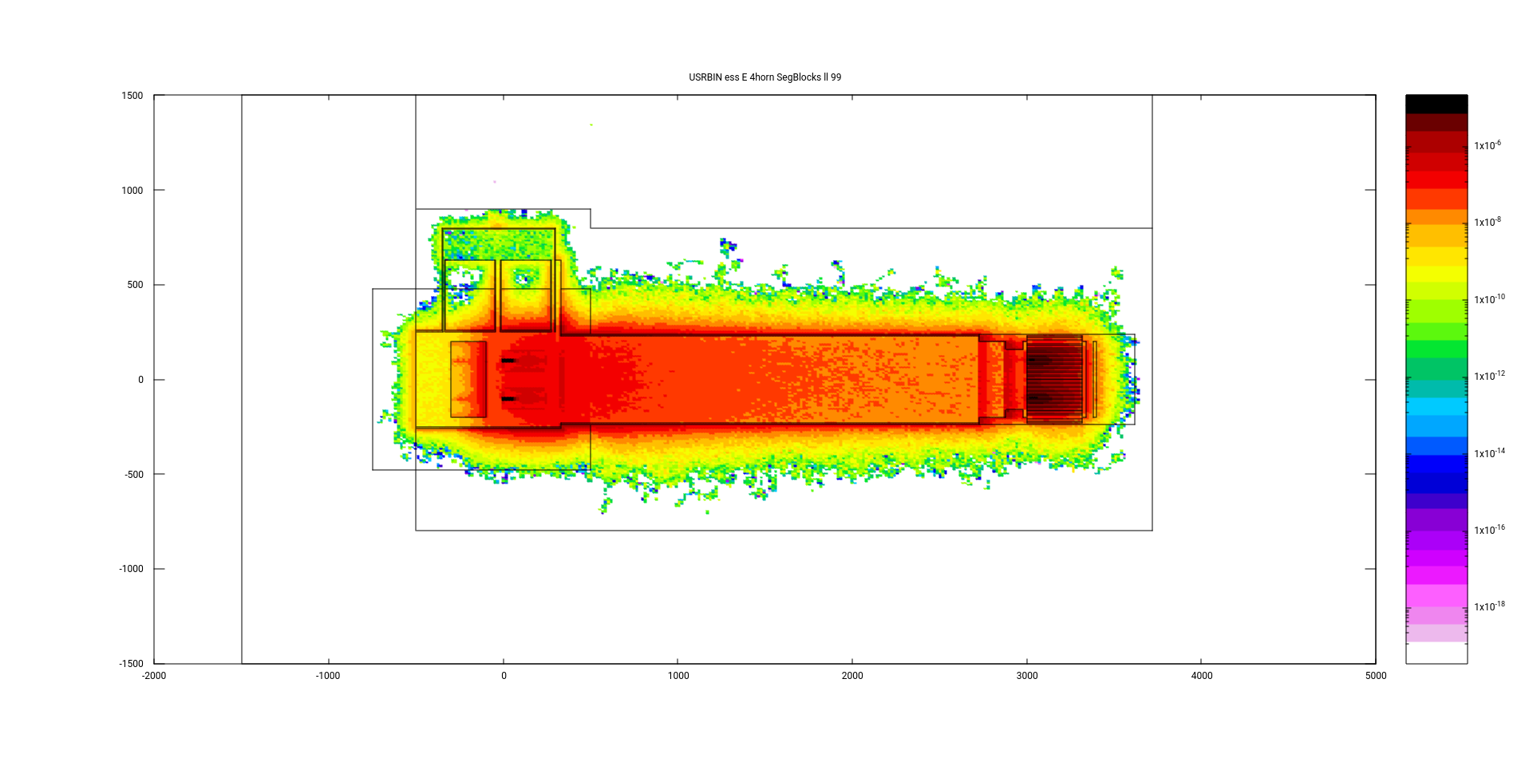
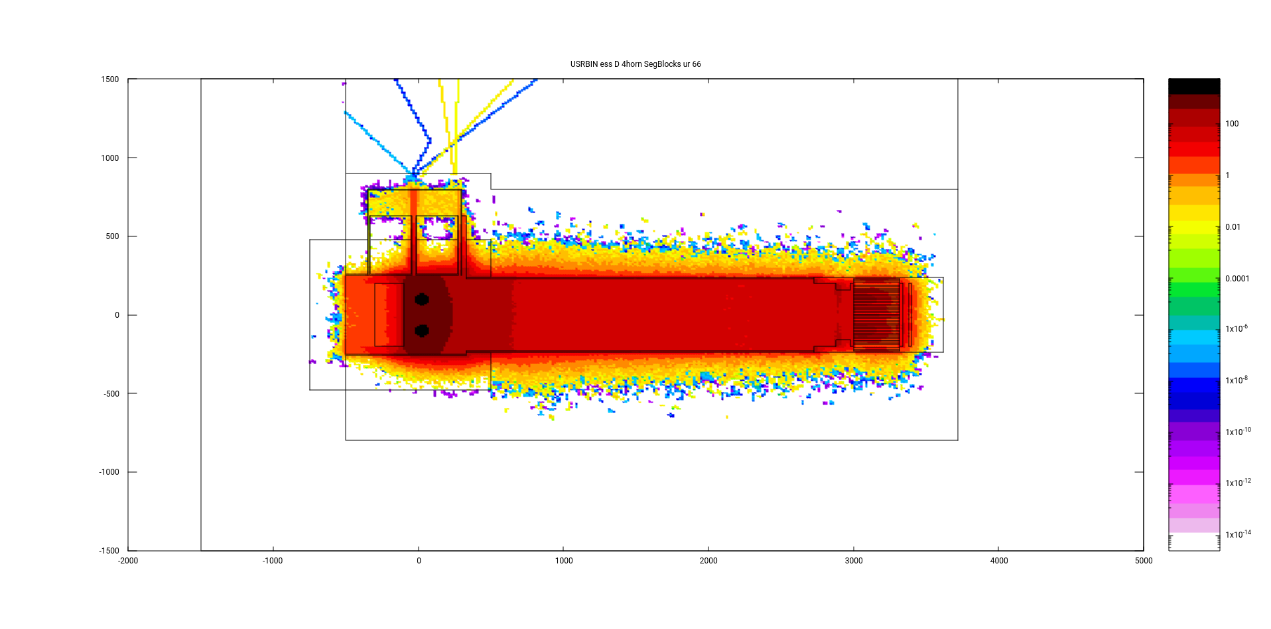
The Accumulator and Target Station Facility for the ESSnuSB experiment
The ESSnuSB Target Station
Safety
PSU Location
Out of Radioactive part
Concrete
Iron Shielding
Proton Beam
(Ep=2.5 GeV, 14 Hz) 4 x 1.25 MW
Helium
Total deposited power = 4180 kW
Residual equivalent-dose rate (1-months cooling time)

Slide 15
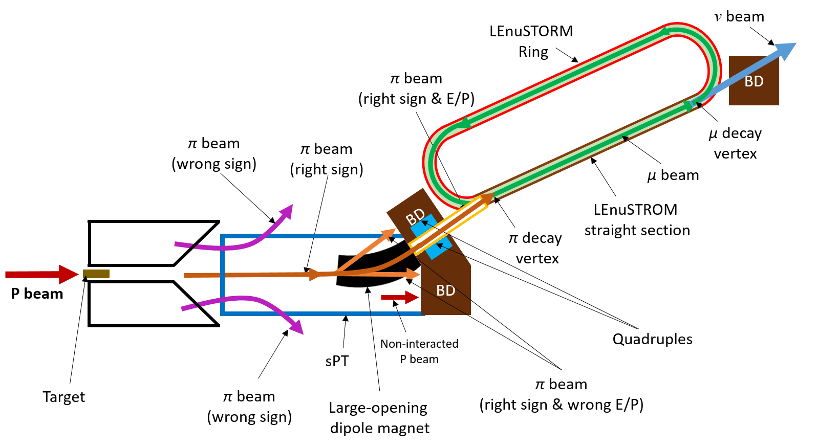
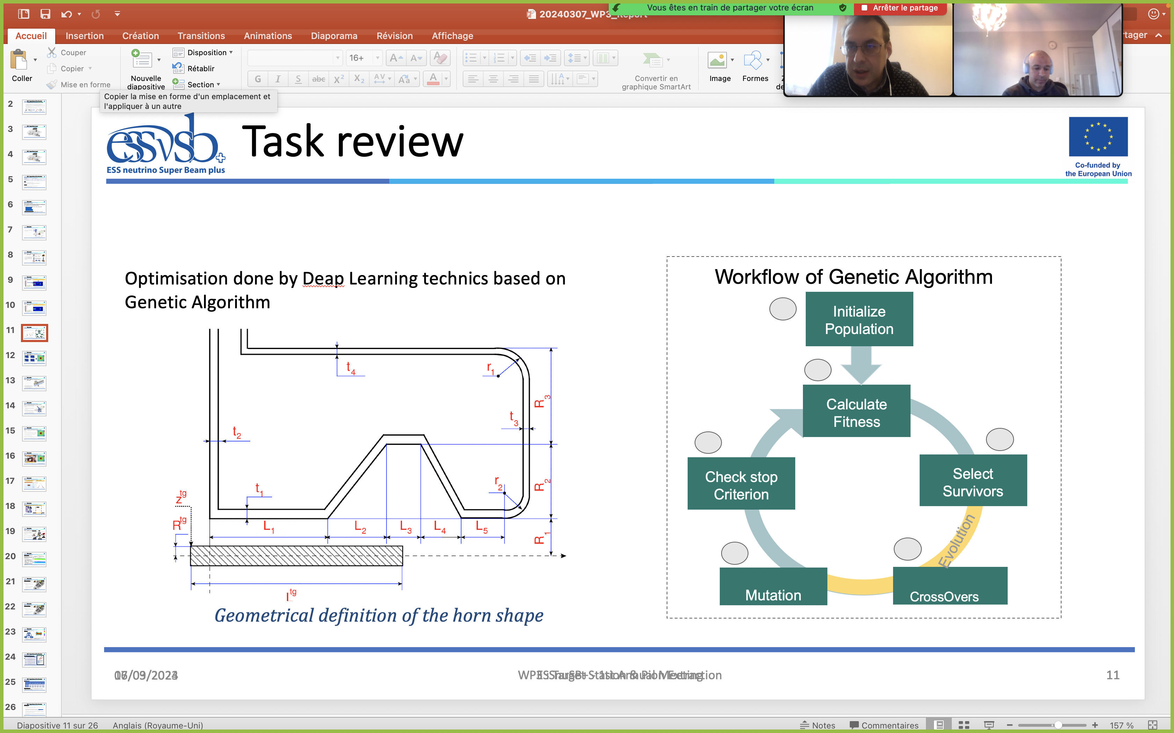
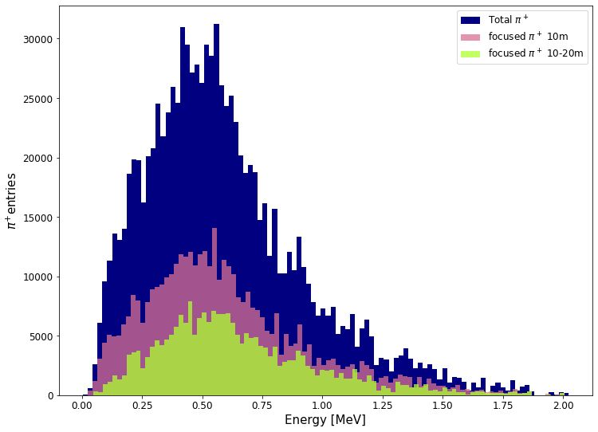
The Accumulator and Target Station Facility for the ESSnuSB experiment
The ESSnuSB+ Target Station
Production of the neutrino beam:
Goals:
Produce π⁺/π⁻ high intensity beam
Feed the LEnuSTORM ring
Withstand the energy deposition from
the 1.25 MW proton beam on the one
horn/target system
π⁺ -> μ⁺ + ν_{μ} (Positive mode)
e⁺ + ν_{e} + ν_{μ}
π⁻ -> μ⁻ + ν_{μ} (Negative mode)
e⁻ + ν_{e} + ν_{μ}
Requirements:
Optimisation of the hadronic collector
for pion production
Design the pion extraction and deviation
system
Design the Power Supply Unit
Radio safety studies
Proton Beam
(Ep=2.5 GeV, 14 Hz) 1.25 MW
Horn Optimisation using deep learning method

Slide 16
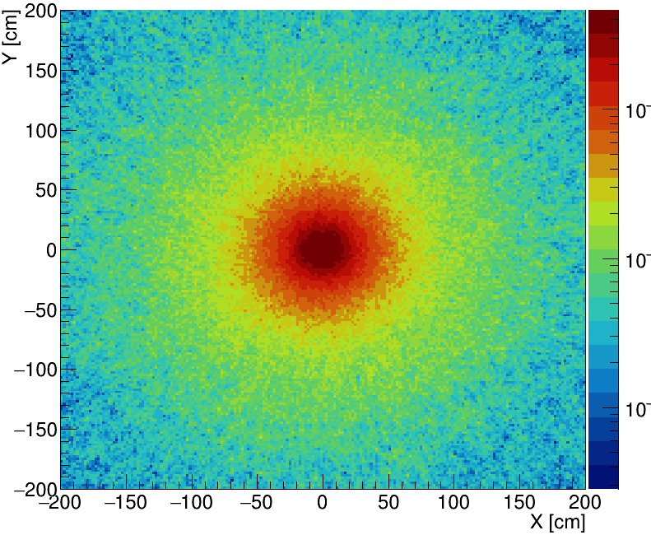
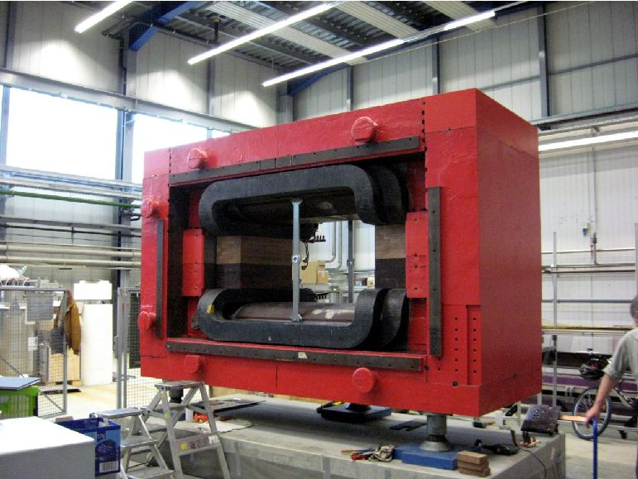
The Accumulator and Target Station Facility for the ESSnuSB experiment
The ESSnuSB+ Dipôle
The secondary-beam distribution, at a distance of 10 m from the target/horn system, shows a 2D-Gaussian distribution with σ ~ 0.38 m
➔ Requires large-opening dipole magnet!
10 m
Operates @ I_{max} = 1340 A and a central magnetic field strength of B_{max} = 0.54T (∫B dl ≈ 0.74Tm)
σ_{x/y} = 38 cm
1.5 m
3.9 m
0.84 m
2.8 m
1.5 m
1.5 m
Y
Z
Beam direction
X
BGO-OD @ at the ELSA facility in Bonn
x [cm]

Slide 17
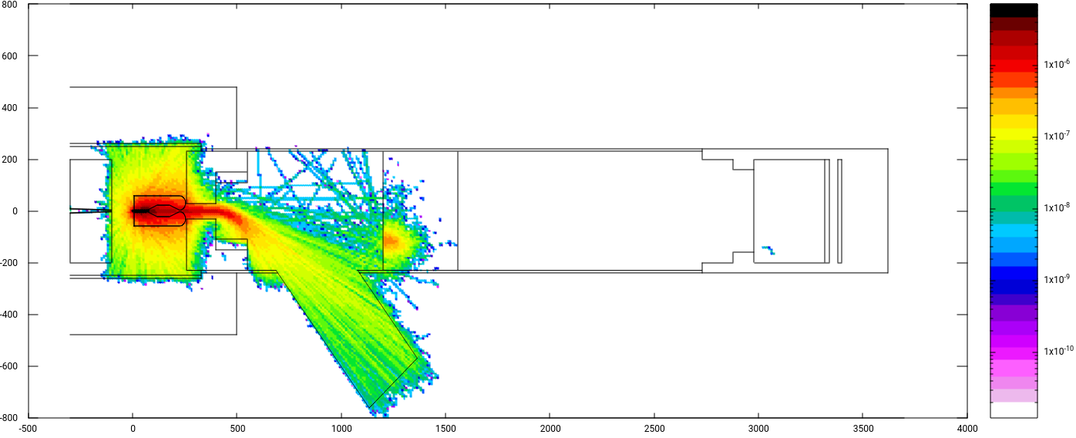
The Accumulator and Target Station Facility for the ESSnuSB experiment
The ESSnuSB+ Pion Deviation System
Energy [GeV]/cm³
X axis [cm]
π⁺ beam only
Assuming 1 Tesla magnetic strength
Beam axis [cm]

Slide 18
The Accumulator and Target Station Facility for the ESSnuSB experiment
The ESSnuSB+ Pion Deviation System
Race track ring (LENuSTORM)

Slide 19
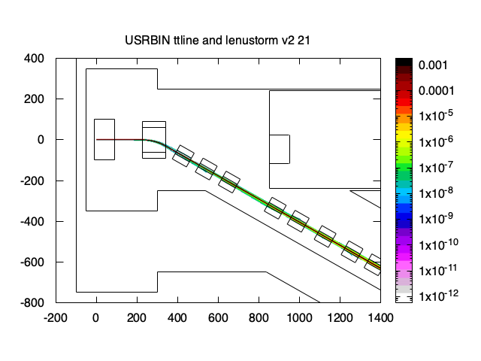
The Accumulator and Target Station Facility for the ESSnuSB experiment
The ESSnuSB+ Target Station
Race track ring (LENuSTORM)
Trajectory of the selected secondaries (pion) along
the target to ring transfer line.
The trajectory of the non-interacted, primary proton beam.

Slide 20
The Accumulator and Target Station Facility for the ESSnuSB experiment
The ESSnuSB/ESSnuSB+ Target Station
Conclusions
A conceptual design report has been produced in the ESSnuSB project validating the concept of the MW target station facility.
The granular target appears as a solution regarding the technical constrains. R&D is on going with ETTF project to investigate of the cooling efficiency.
New elements such Large Aperture Dipole and a muon racetrack ring are in development.
Synergies with other experiments are possible.

