Slide 1

A Low Energy
Muon Storage Ring at ESS for neutrino cross-section measurements
Ting Wing CHOI
Uppsala University, Sweden

Slide 2
European Strategy for PP update 2020
3. High-priority future initiative
https://cds.cern.ch/record/2720129/files/CERN-ESU-013.pdf

Slide 3
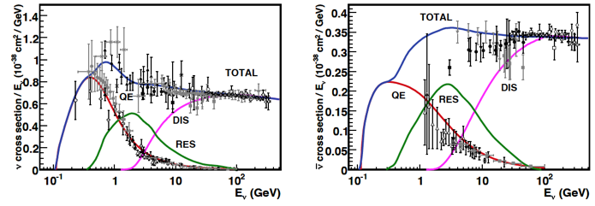
Why A Low Energy Muon Storage Ring at ESS?
neutrinos cross section measurement in the MeV range
  to reduce the systematic error in the ESSnuSB long baseline experiment
Total neutrino and antineutrino per nucleon CC cross sections (for an isoscalar target) /neutrino energy
J. A. Formaggio and G. P. Zeller, “From eV to EeV: Neutrino cross sections across energy scales,” Rev. Mod. Phys., vol. 84, no. 3, pp. 1307–1341, Sep. 2012, doi: 10.1103/RevModPhys.84.1307.

Slide 4
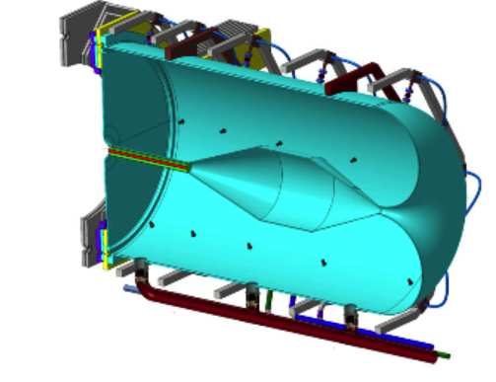


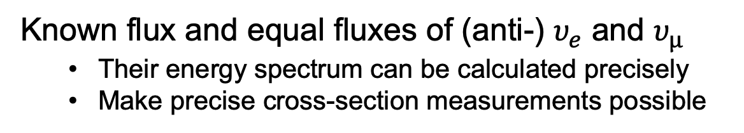
nuSTORM (Neutrinos from Stored Muons)
nuSTORM is a facility based on a muon decay ring.
Capture and transfer pions, and store muons
Known flux and equal fluxes of (anti-) $υ_{e}$ and $υ_{µ}$
  Their energy spectrum can be calculated precisely
  Make precise cross-section measurements possible
Pion transfer line
Beam target and
magnetic horn
Production straight section
Detector
Neutrino beam direction
(And their antiparticles)
Muon storage ring
Notes:
Muon decay length = 6 Pulse length = 3 circumference

Slide 5
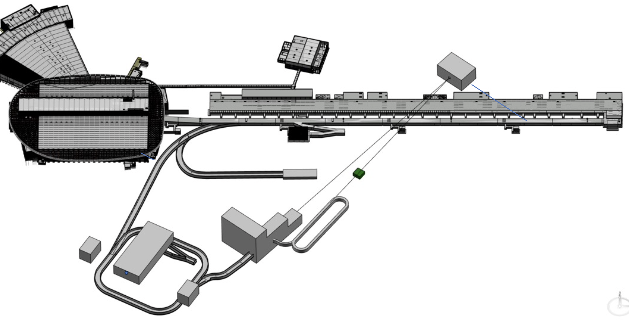
Low Energy nuSTORM at ESS
ESSnuSB Near Detector
ESS linear accelerator
LEMMOND
ESS H- 3ms pulses,
Particles direction
Target station
Production straight
return straight
(And their antiparticles)
Pion transfer line
Accumulator ring,
1.2 µs pulse
Muon storage ring, 180 m

Slide 6
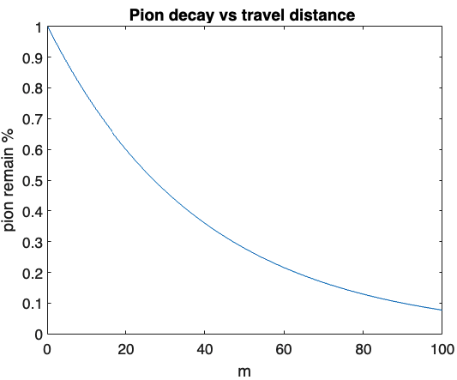
LEnuSTORM progress at ESS
Parameters range
Neutrino energy : 200 – 400 (800) MeV
Muon reference energy: 400 - 800 MeV/c
Pion reference energy: 700 - 900 MeV/c
Length of pion transfer line: < 20 m
Length of straight: 75 m
Length of arc: < Ls/3 ~ 25 m
Aperture radius of beamline : 0.2 m
ratio
Notes:
A decay plot in here,

Slide 7
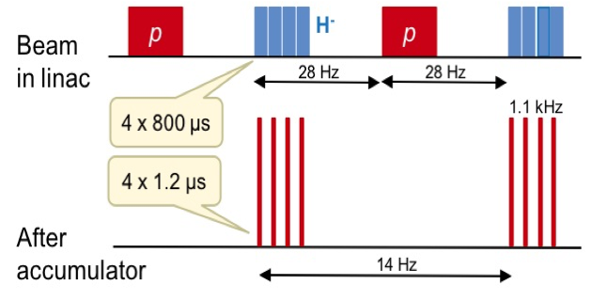
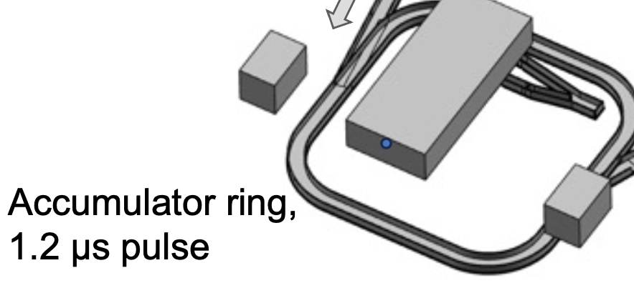
LEnuSTORM progress at ESS
We will use one out of four sub-pulses produced for ESSnuSB. (1/4 of 5 MW)
14 Hz to the horn
Notes:
The reason we need a short pulse for neutrino experiments is not to be
overwhelmed with cosmic ray events during the neutrino spill.

Slide 8
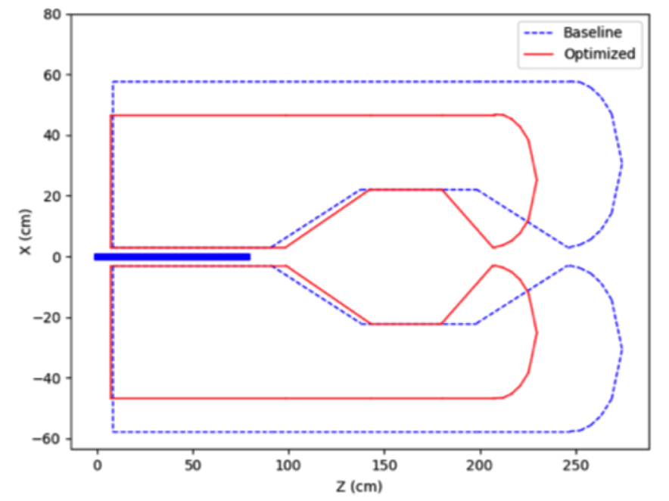
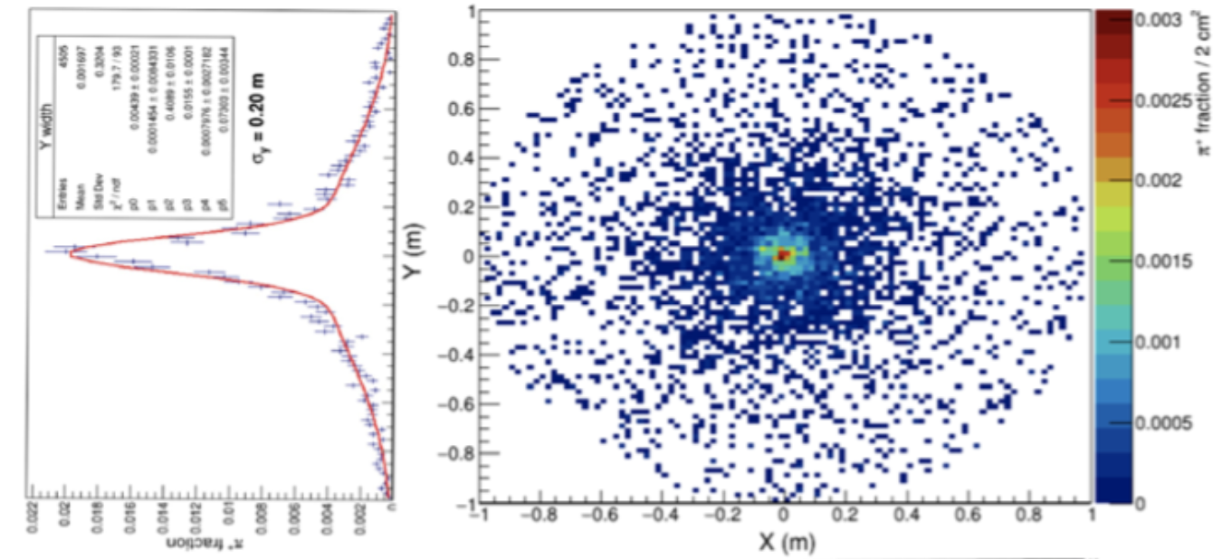
LEnuSTORM challenge and progress at ESS
Huge pion beam, hard to capture all
Optimized from the ESSnuSB Horn
cf. LHC beam size: O(µm)
Eric Baussan & Tamer Tolba

Slide 9
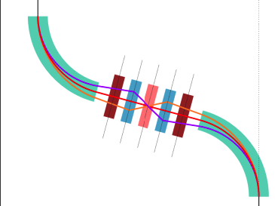
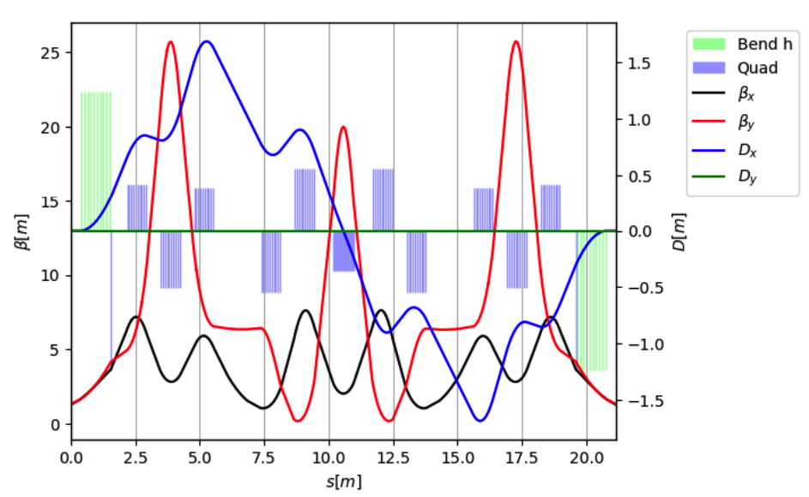
LEnuSTORM challenge and progress at ESS
A pion transfer line
Length <~20 m to balance cost final pion flux with cost/technical difficulties.
Max Topp-Mugglestone & Ilias Efthymiopoulos

Slide 10
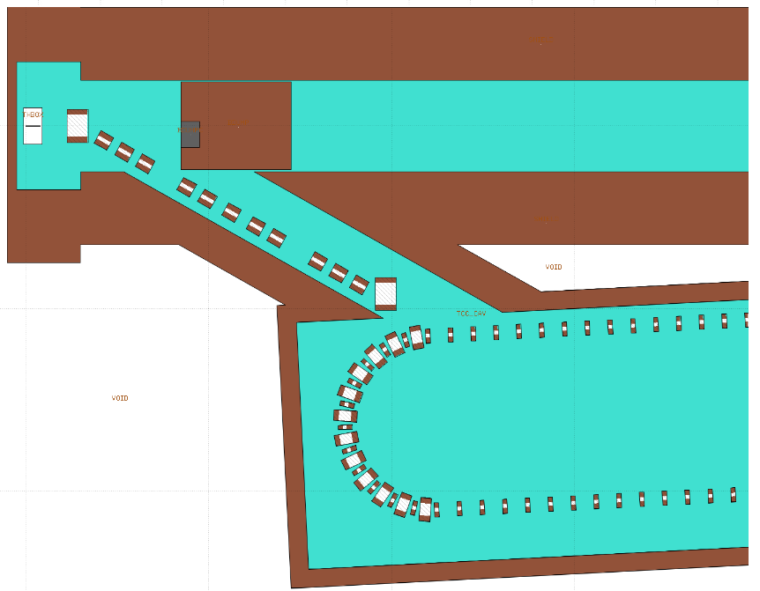
LEnuSTORM challenge and progress at ESS
Injection of pions
Different pion/muon momentum combinations can have different injection schemes
Small spacing to install magnets
Easier for a larger momentum difference between pions and muons.

Slide 11
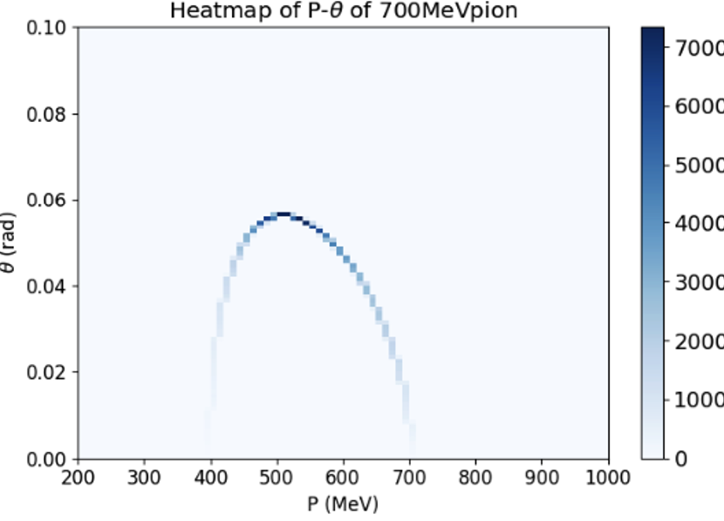
LEnuSTORM challenge and progress at ESS
cf. LHC beam divergence: O(µ rad)
Huge muon beam!
  20 cm beam width from source.
  High beam divergence from decay.
Muon distribution from pion decay

Slide 12
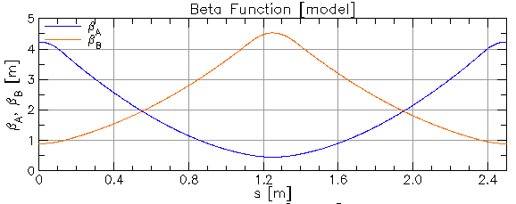
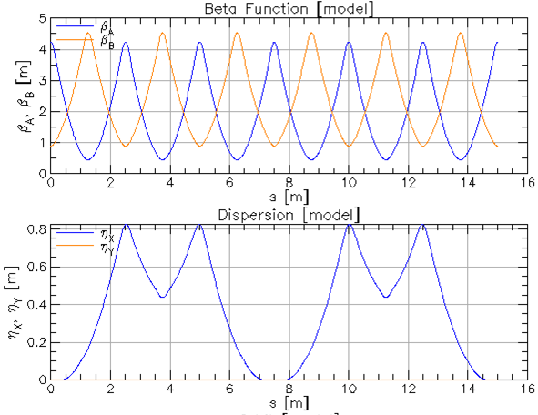
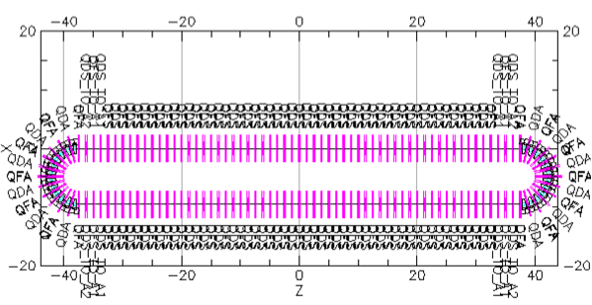
LEnuSTORM challenge and progress at ESS
Simpler design, strong B
  Normal conducting magnet, balance cost
  15 m/arc
  75m/straight
  180 m in total
straight
arc

Slide 13
Other opportunities besides cross-section …
Searches for sterile neutrino
  New physics at nuSTORM, https://journals.aps.org/prd/abstract/10.1103/PhysRevD.103.075009
  nuSTORM at CERN: Feasibility Study, https://indico.cern.ch/event/837890/attachments/1921676/3196005/2019-10-21-nuSTORM-at-CERN_Feasibility-study-d1.pdf

Slide 14
Other opportunities
Possibility to serve as a testbed for technologies essential for the Muon Collider
ν_{μ} + ‾ν_{e}
ν_{μ} or ‾ν_{μ}
ν_{e} + ‾ν_{μ}
Super Beam
nuSTORM
ESSνSB
Can be a FFAG design
https://accelconf.web.cern.ch/IPAC2014/papers/tupme012.pdf
Muon Collider
ESS is the work-package leader of the international Muon collider collaboration WP3 proton driver !

Slide 15
European Strategy for PP update 2020
3. High-priority future initiative
https://cds.cern.ch/record/2720129/files/CERN-ESU-013.pdf

Slide 16
Summary
Goal
Neutrinos cross-section measurement in the range of 0.2 – 0.8 GeV
LEnuSTORM: Good design progress at ESS
MW Target and Horn
Pion transfer line
Muon storage ring
Other opportunities
Searches for sterile neutrino
Testbed for Muon Collider

Slide 17
Back up

Slide 18
Other nuSTORM
 | FNAL | CERN | ESS
Proton beam Power (MW) | 0.4 | 0.4 | 1.25 MW
Proton energy | 120 GeV | 100 GeV | 2.5 GeV
Pion momentum | 5 GeV | 6？ GeV | ~ 0.7 GeV
Muon momentum | 3.8 GeV | 5.2 GeV | ~ 0.6 GeV
Neutrinos (peak) energy | 2 | 0.3 - 5.5 | 0.2 - 0.4 ?
https://lss.fnal.gov/archive/thesis/2000/fermilab-thesis-2015-04.pdf
Alekou, A., et al. "The ESSnuSB design study: overview and future prospects." arXiv preprint arXiv:2303.17356 (2023).
nuSTORM at CERN Feasibility Study
https://cds.cern.ch/record/2654649?ln=en

Slide 19
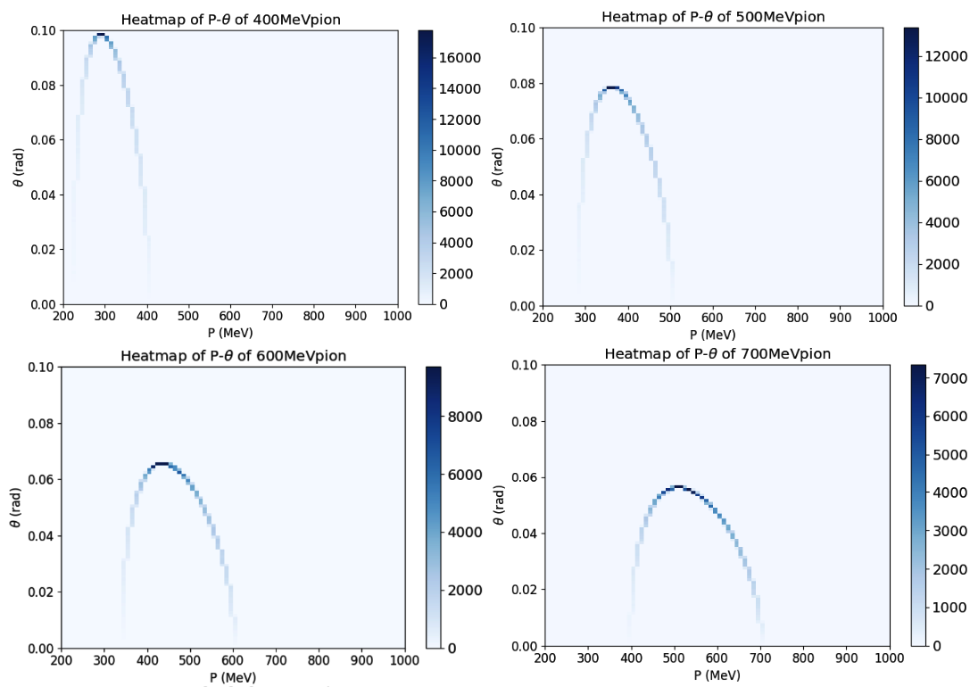

Muons from pion decay
But, due to technical limits, our ring can only accept muons within a small phase space area
Cut: $±10\% p, 0.05$ rad

Slide 20
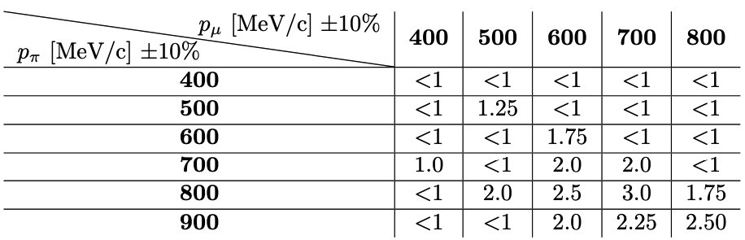
How many muons can we get?
Relative Intensity
  Selected with the beamline acceptances.
  Normalised to the case of 400MeV/c

