Slide 1


Moderator optimisation for a spallation-driven ultracold-neutron source using superfluid helium
January 17, 2025 – The Fundamental Nuclear and Particle Physics at the ESS workshop
Wolfgang Schreyer
Oak Ridge National Laboratory

Slide 2
A dedicated spallation target at TRIUMF
483MeV cyclotron
Beamline 1A
Fast kicker magnet
0 – 40μA for UCN
Spallation
target

Slide 3
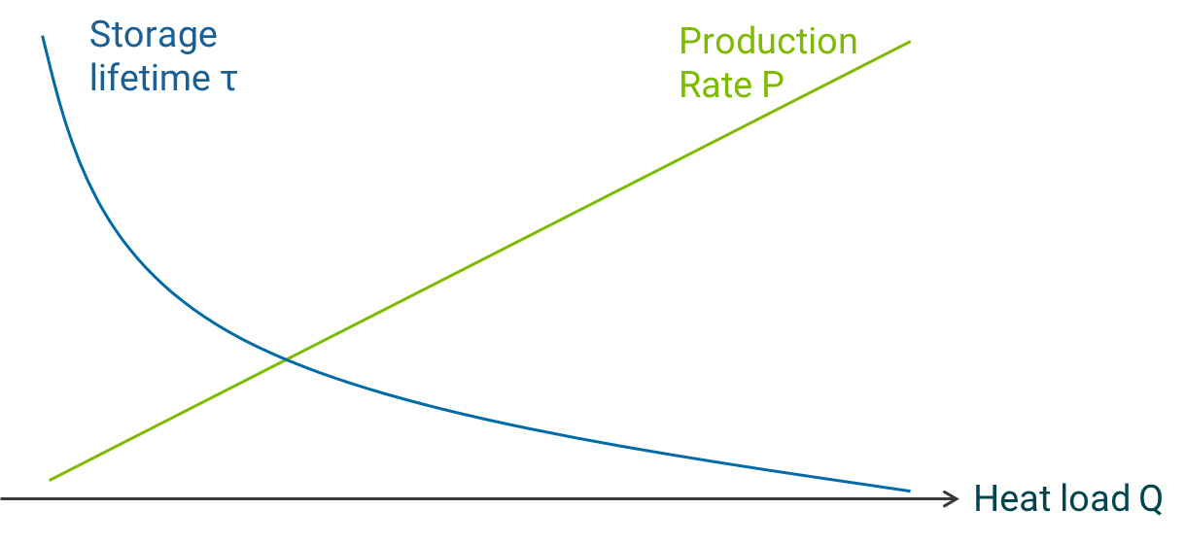
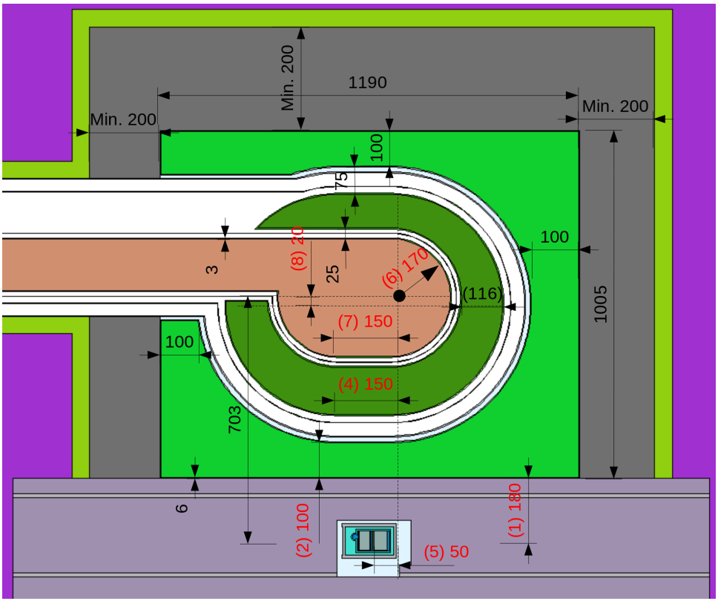
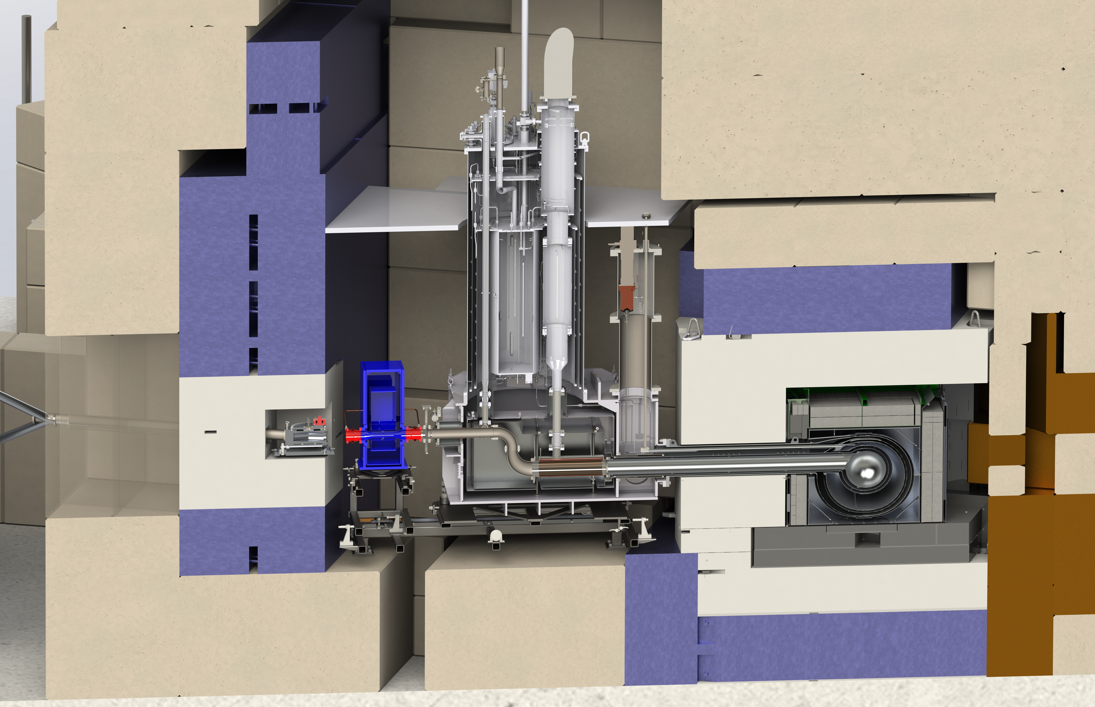
What to optimize:
UCN source parameters
TUCAN source optimization
TUCAN source cryostat and commissioning

Slide 4
Heat load and production rate need to be carefully balanced
Number of ultracold neutrons ~ Production rate P x Storage lifetime τ
Storage
lifetime τ
Optimized
moderators
Production
Rate P
Improved
cooling
sD₂ source
τ ~ 100ms
(PSI, LANL,
NCSU, FRM-2)
UCN converter
CN-beam
LHe source
τ → τ_{β}
Q ~ mW
(ILL)
CN source
Heat load Q
Spallation
LHe source
τ ~ 20s
Q ~ 10W
(TUCAN)
Reactor
LHe source
τ ~ 10s
Q ~ 35W
(PNPI)

Slide 5
UCN density must be extracted
UCN
density
V_{guide}
V_{exp}
Pτ_{src}/V_{src}
Valve
V_{src}
Pτ_{tot}/V_{tot}
CN source
Time
Valve
opened

Slide 6
Match production intervals to UCN experiment
Continuous (reactor) source
On-demand source
Intermittent (spallation) source
NCSU, FRM-2, PNPI
Continuous UCN production and full heat load
TUCAN, ILL
Continuous UCN production during experiment fill, minimal heat load otherwise
PSI, LANL
Intermittent UCN production during experiment fill (Beam cycle time > τ_{src}), minimal heat load otherwise
Heat
load
Heat load
Heat load
Fill
Fill
Fill
Fill
Fill
Fill
Time
Time
Time

Slide 7
Ultimate goal: maximize number of UCN that can be detected after experiment cycle
V_{guide}
V_{exp}
N_{det} ~ P(E)τ_{tot}(E) V_{exp}/V_{tot} ε(E)
Deuterium sources: E > 108 neV
Vertical extraction: ε(E) ~ √E/(E + mgh)
Valve
g
V_{src}
CN source

Slide 8
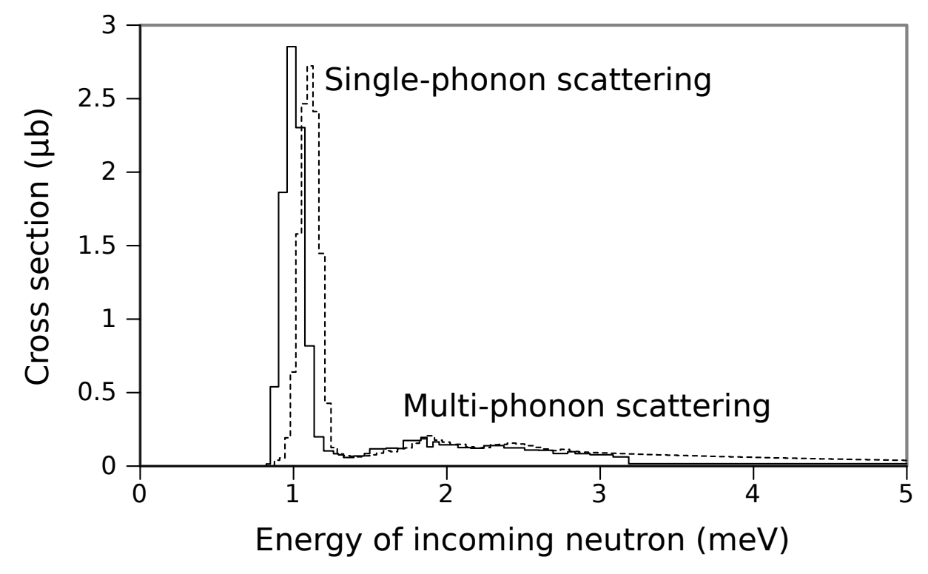
Optimal neutron temperature for a superfluid helium converter is 7.7K
Cold moderators considered for TUCAN:
Heavy water ice
Liquid deuterium
Liquid hydrogen
(Deuterated) solid methane
(Deuterated) solid mesitylene
P. Schmidt-Wellenburg et al, Nucl. Instr. Meth. Phys. Res. A, 611, 259-262 (2009)
E. Korobkina et al, Phys. Lett. A, 301, 462-469 (2002)

Slide 9
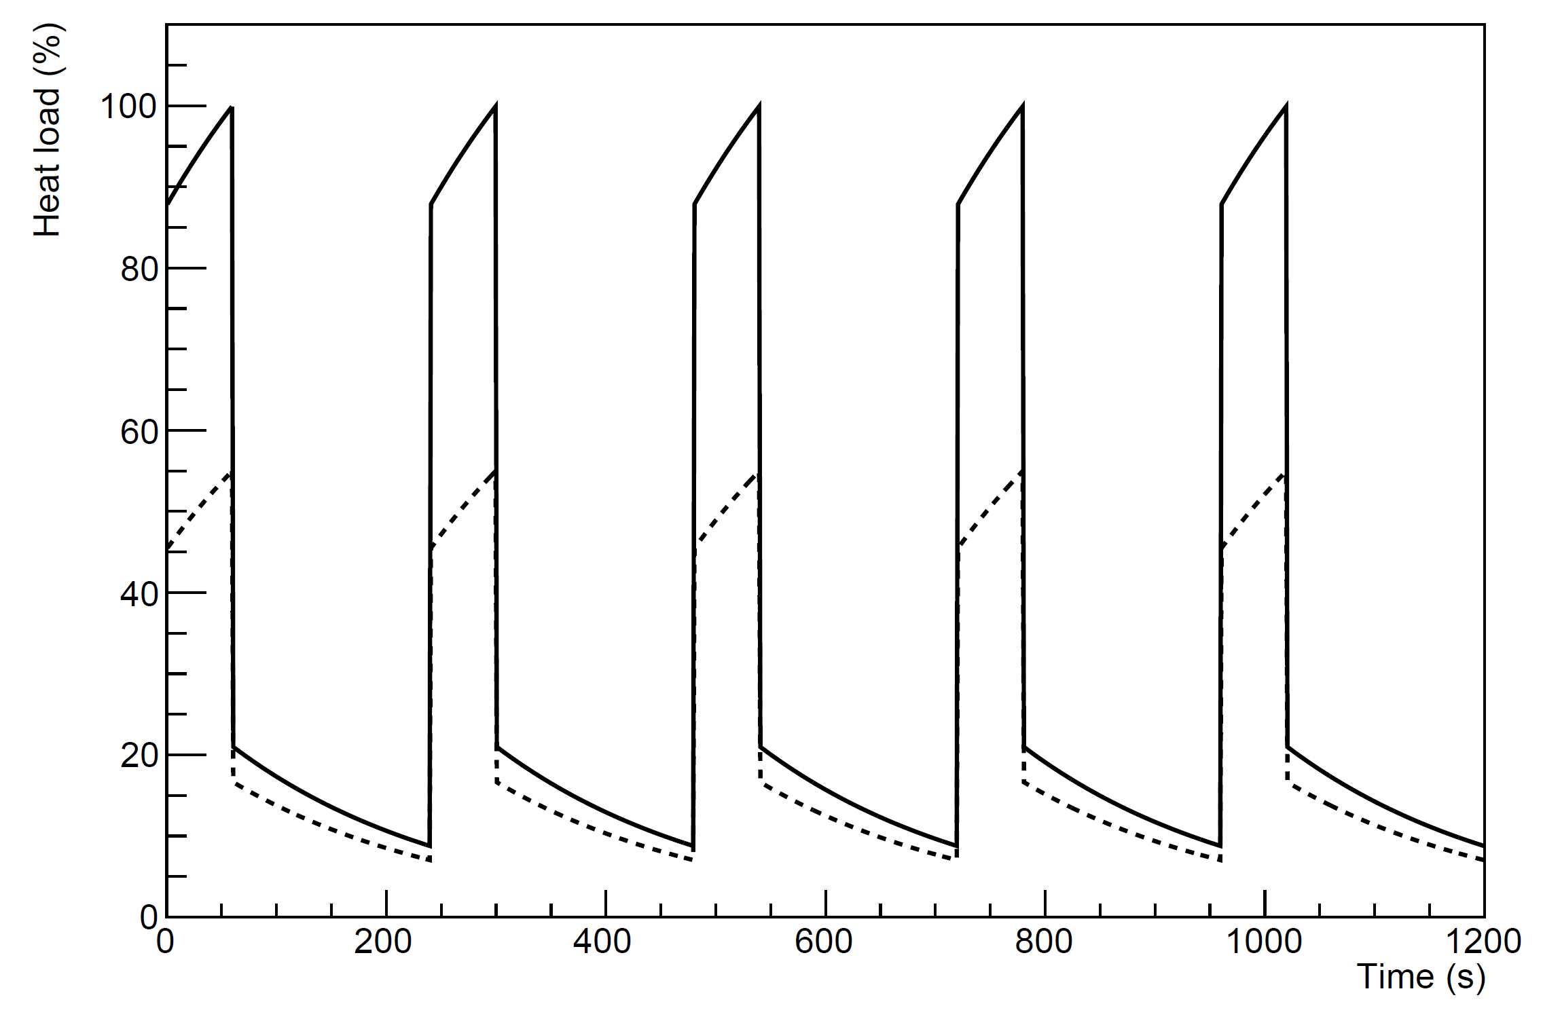
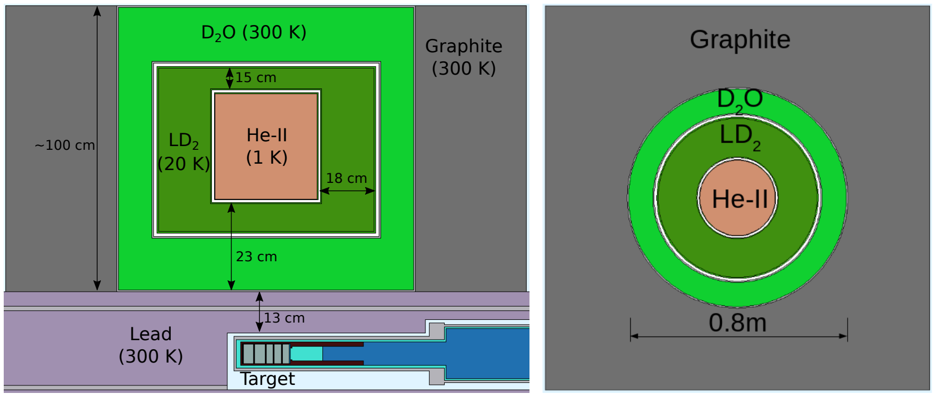
TUCAN moderator geometry was refined over many iterations

Slide 10
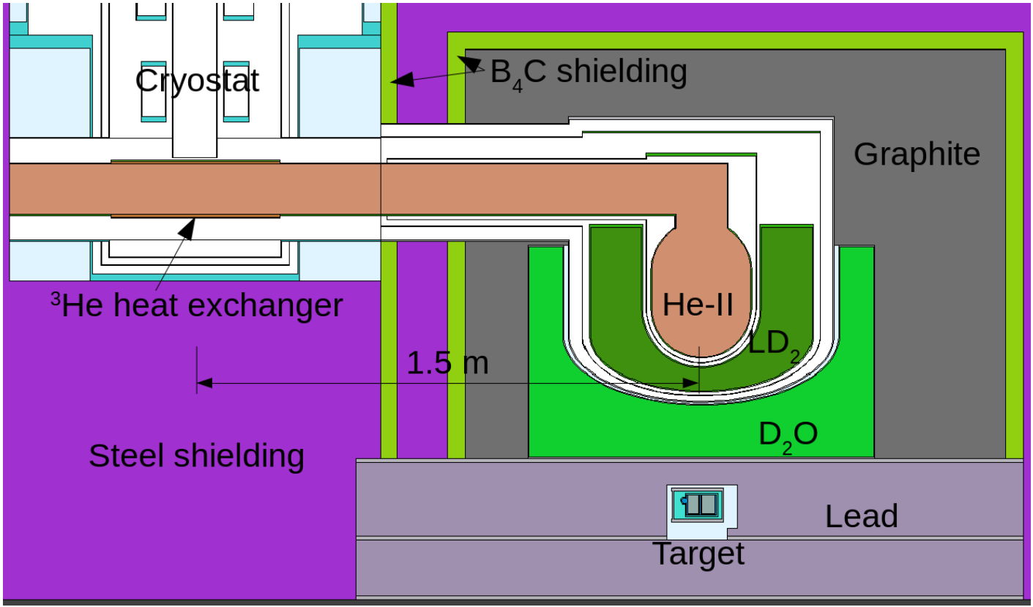
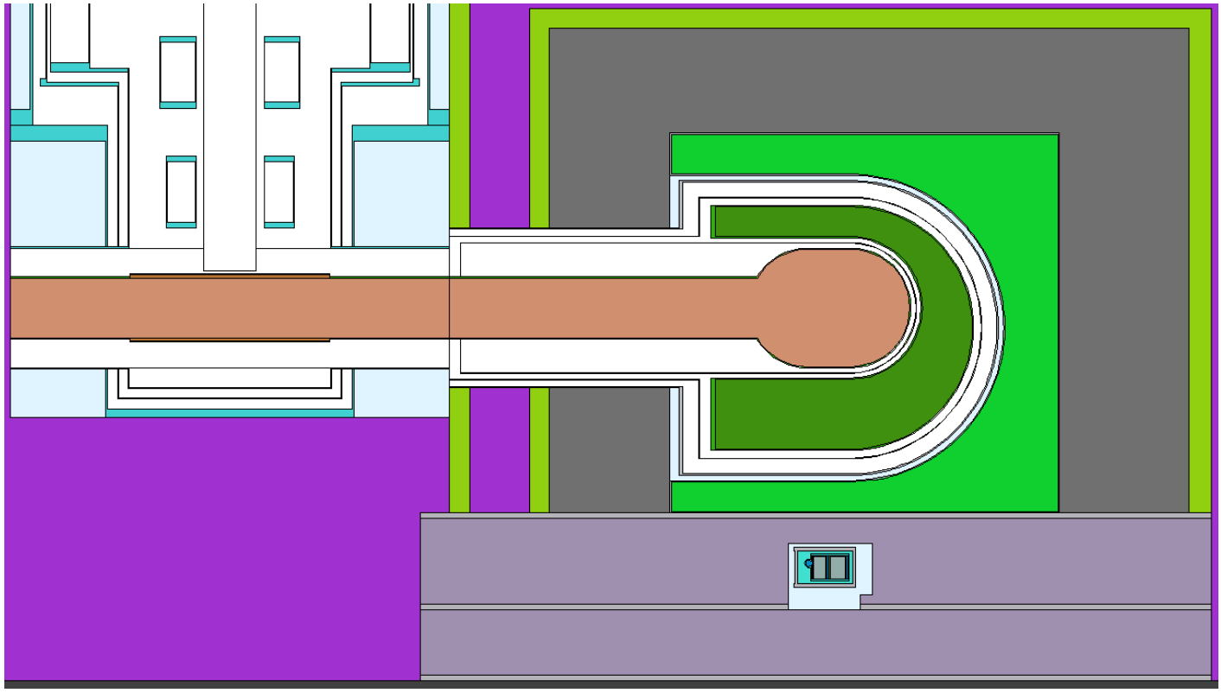
TUCAN moderator geometry was refined over many iterations
Vertical extraction
Horizontal extraction

Slide 11
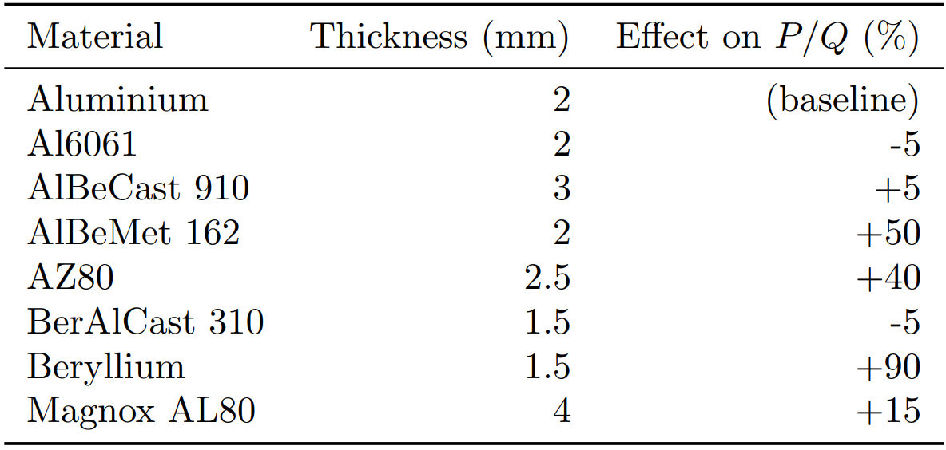
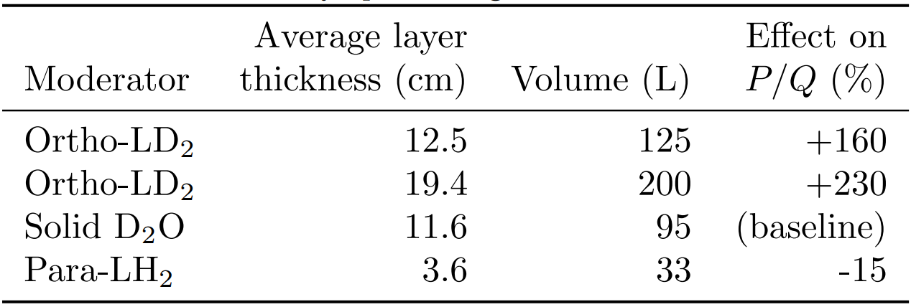
TUCAN moderator geometry was refined over many iterations
Effect of superfluid vessel material
Effect of cold moderator (individually optimized)

Slide 12
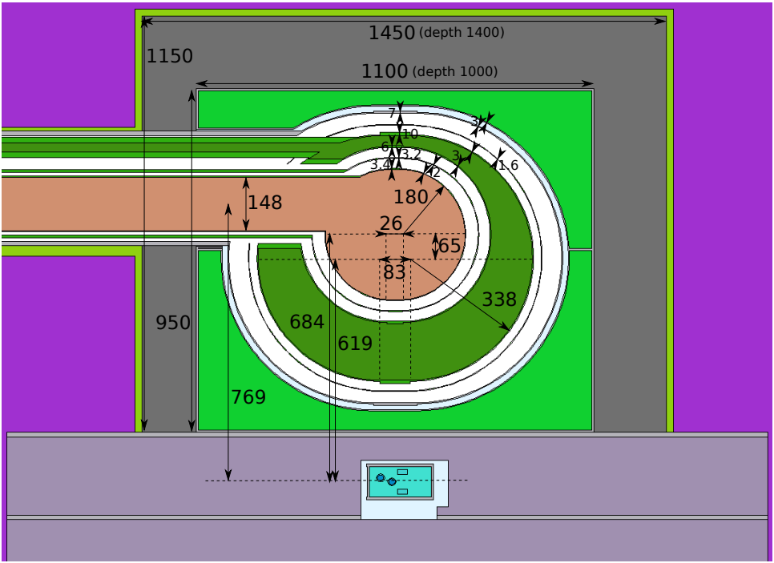
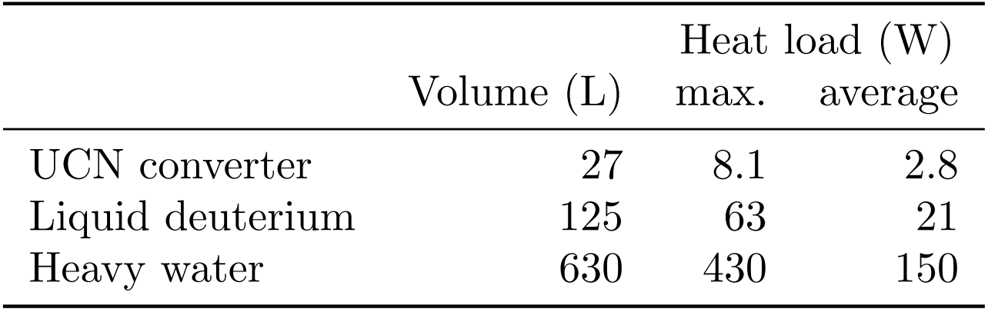
TUCAN moderator geometry was refined over many iterations
Fully optimized model maximizing Pτ_{src}/V_{tot}
With engineering constraints

Slide 13
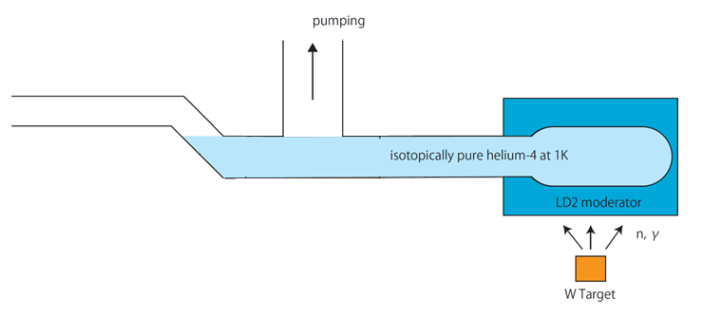
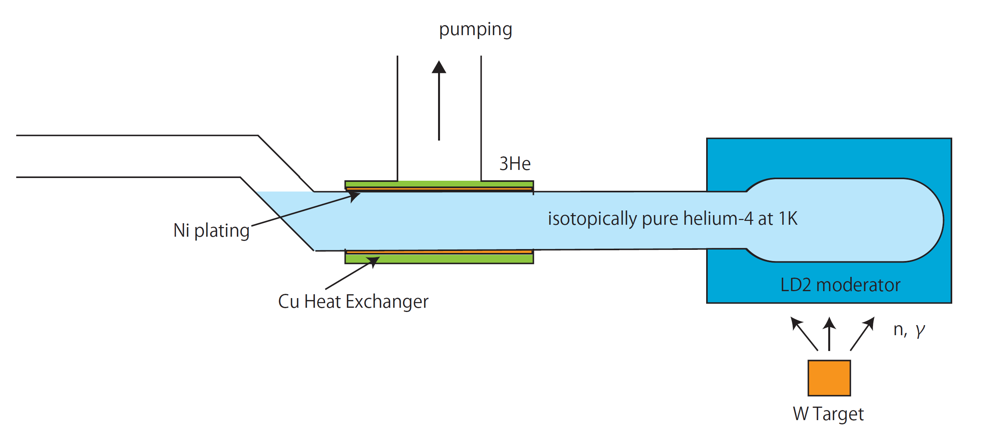
Need to cool large volume of superfluid helium to ~1K at heat load of ~10W
Direct pumping
3He fridge
τ_{src}⁻¹ ≈ τ_{He}⁻¹ + τ_{wall}⁻¹ + τ_{3He}⁻¹ + τ_{β}⁻¹
τ_{He} ~ Q^{-1..-1.5}
τ_{He}⁻¹ ≈ 0.016 T⁷
Heat transport in He-II (Gorter-Mellink)
Interface resistance at heat exchanger
Pumping speed

Slide 14
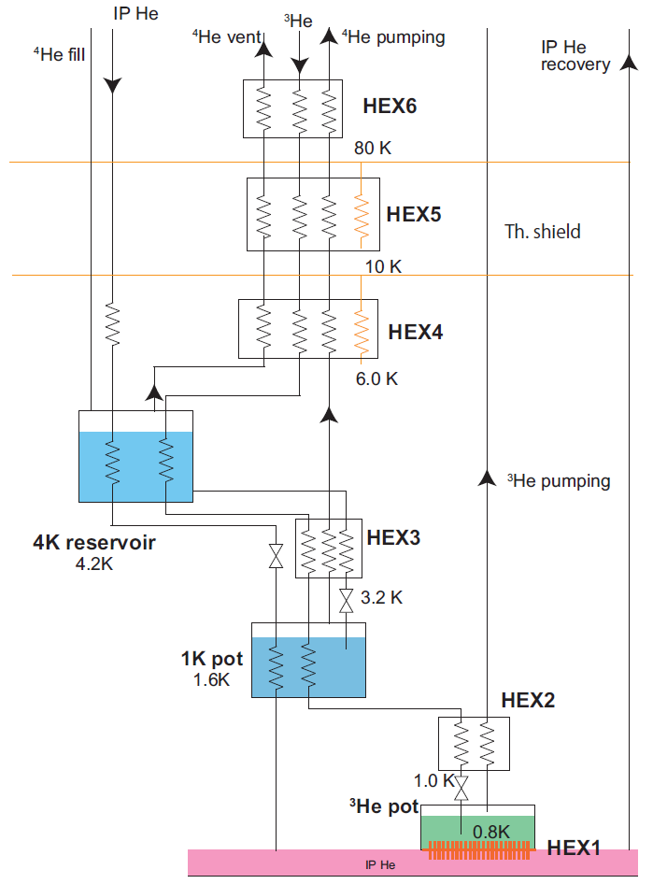
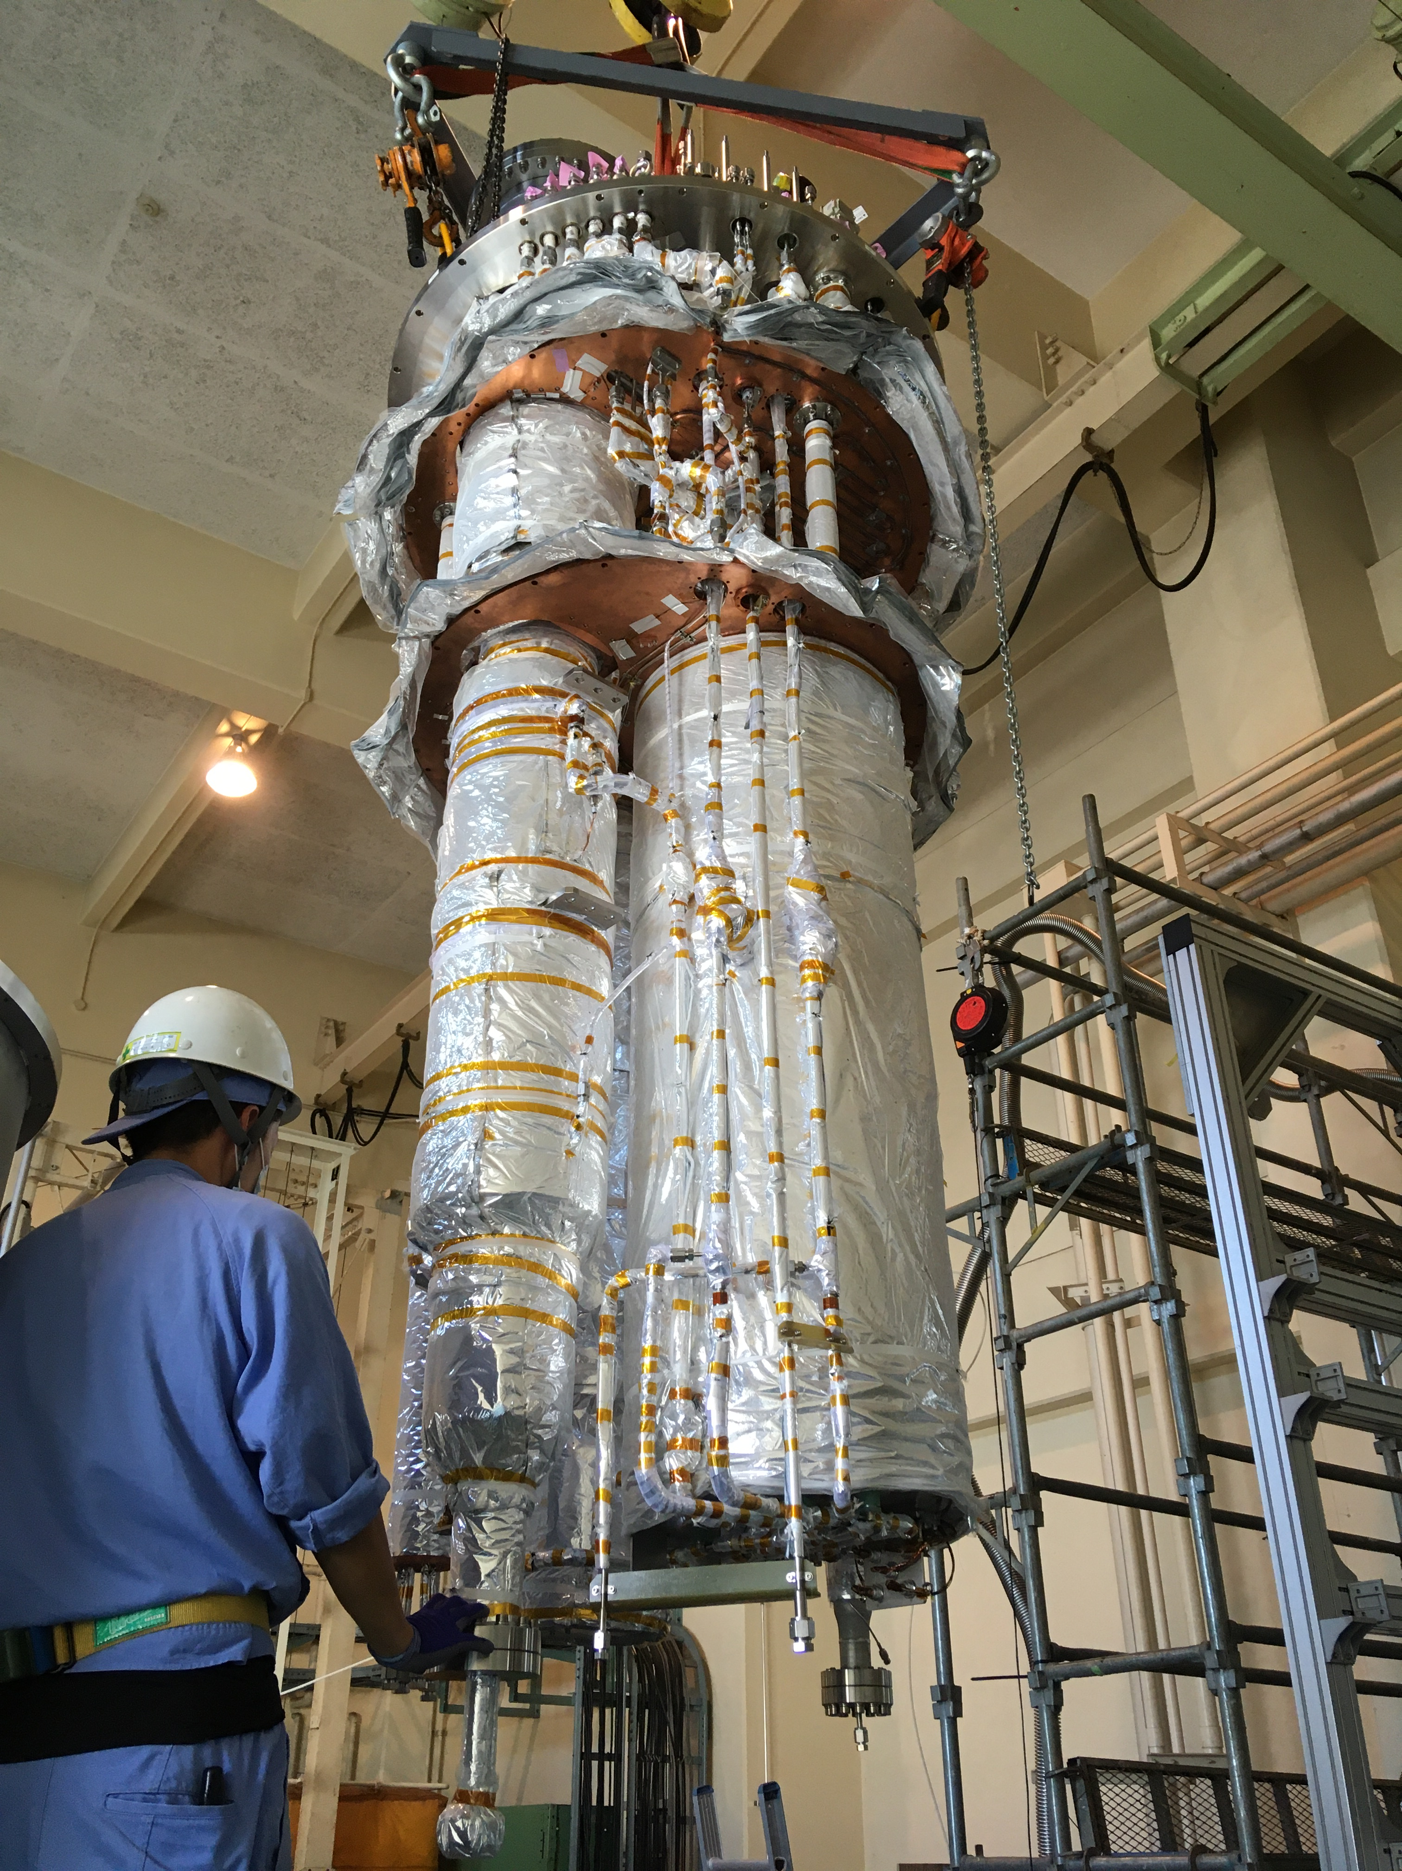
3He cryostat built in Japan

Slide 15
³He cryostat
LD₂ cryostat
Concrete
shielding
Concrete shielding
To nEDM
Steel shielding
Switch
B₄C-filled panels
Graphite
D₂O
LD₂
He-II
Target
Steel
shielding
2nd UCN port
³He-⁴He heat
exchanger
0
1
Superconducting
polarizer
m

Slide 16
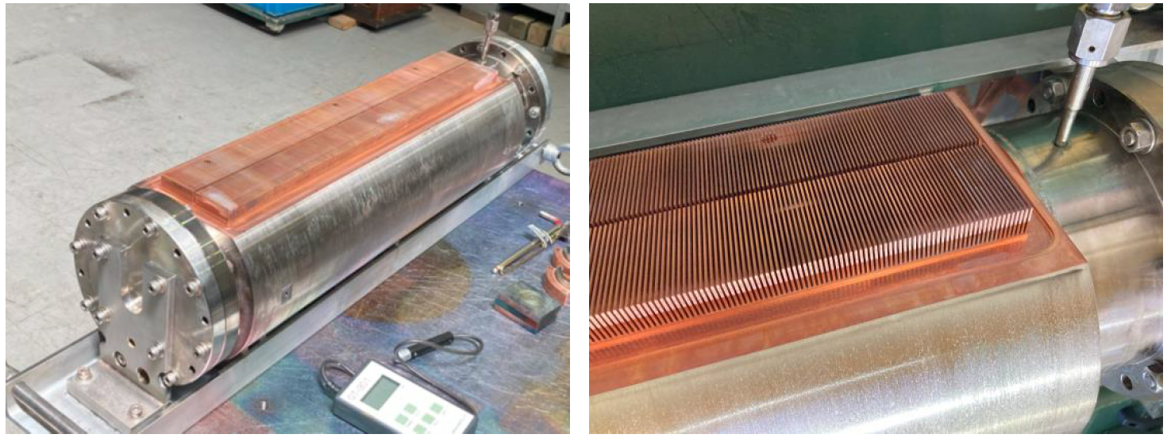
3He heat exchanger
60cm

Slide 17
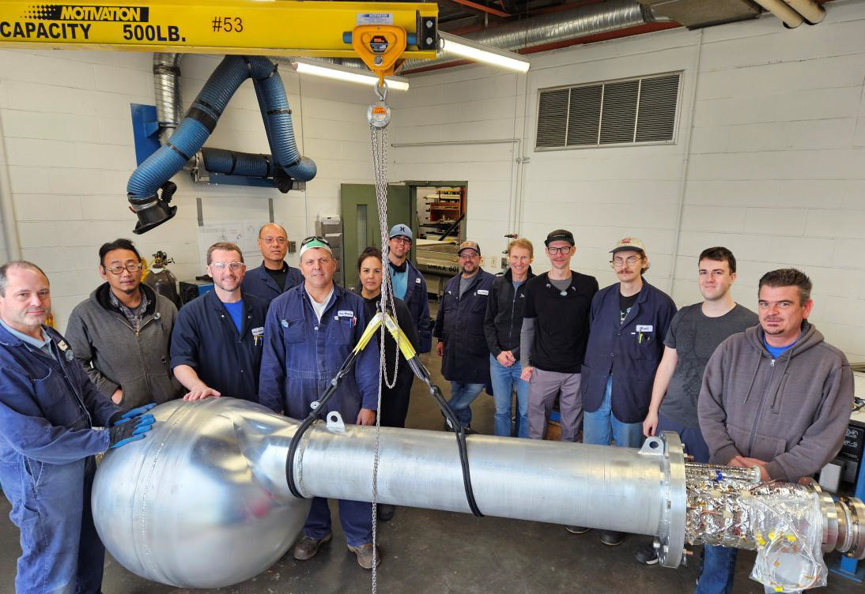
Multi-layer moderator vessels

Slide 18
Heat exchanger and cryogenic UCN guide installed in cryostat
Experiment
3He heat exchanger
Moderators

Slide 19
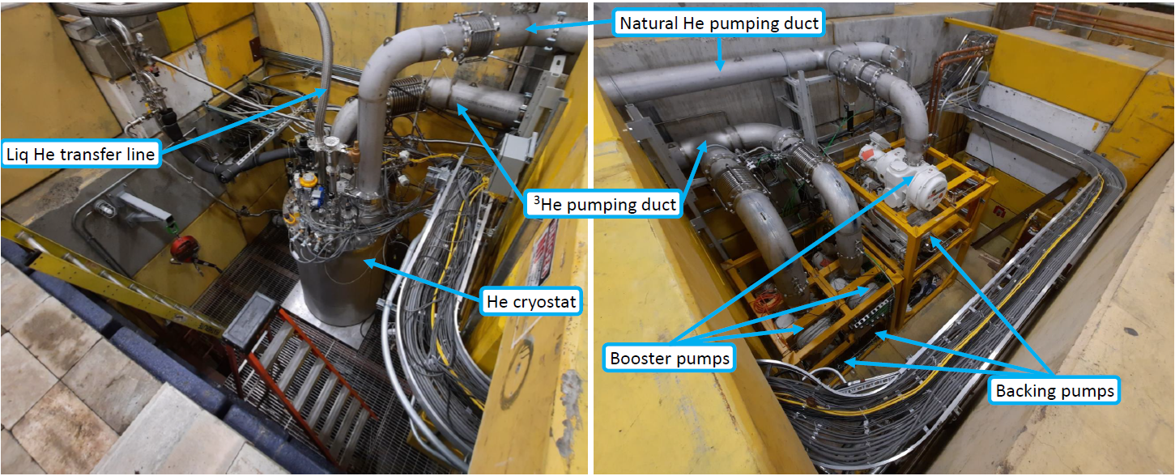
Nearly completed installation

Slide 20
Successful TUCAN source commissioning
Phase 1 | Performance test of pumps | 2021 ✓
Phase 2A | 4K cooldown | Fall 2023 ✓
Phase 2B | 1K cooldown (natural helium only) | Winter 2023 ✓
Phase 3A | 3He system filled with natural helium | June 2024 ✓
Phase 3B | First cooldown with 3He | July 2024 ✓
Phase 5 | Condensation of 4He | October 2024 ✓
Phase 6A | First UCN production without LD2 | November 2024 ✘
Phase 4 | LD2 condensation | Spring 2025
Phase 6B | UCN production with LD2 | Summer 2025
Phase 7 | UCN production and extraction into experimental area | Fall 2025
0.85K @ 10W!
No superleaks!

Slide 21
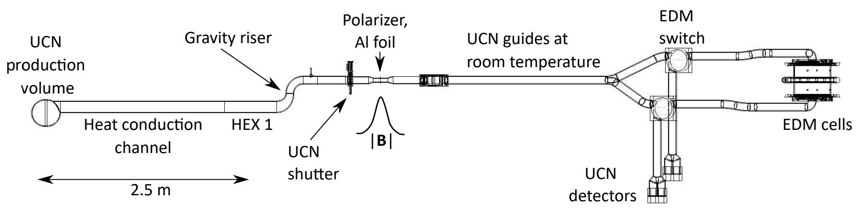
TUCAN source will be the strongest source in the world
Production rate: 1.5∙10⁷ UCN/s @ 8.1W
Storage lifetime: ~20 s
Filled into nEDM cells: 14,000,000 (230/cm³)
Detected after nEDM cycle: 1,400,000 (23/cm³)
nEDM sensitivity 10⁻²⁷ ecm achievable in 400 days
W. Schreyer et al, Nucl. Instrum. Meth. Phys. Res. A 927, 101-108 (2019)
S. Sidhu, W. Schreyer, et al, EPJ Web of Conferences 282, 01015 (2023)
C. M. Lavelle: Cryogenic Liquid He4 and Deuterated PMMA Scattering Laws for MCNP, AOS-20-0265

Slide 22
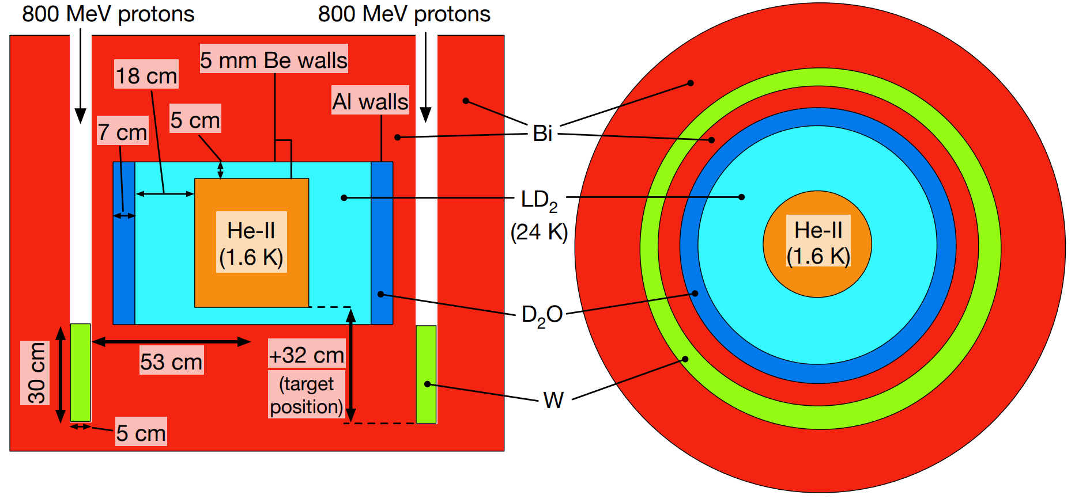
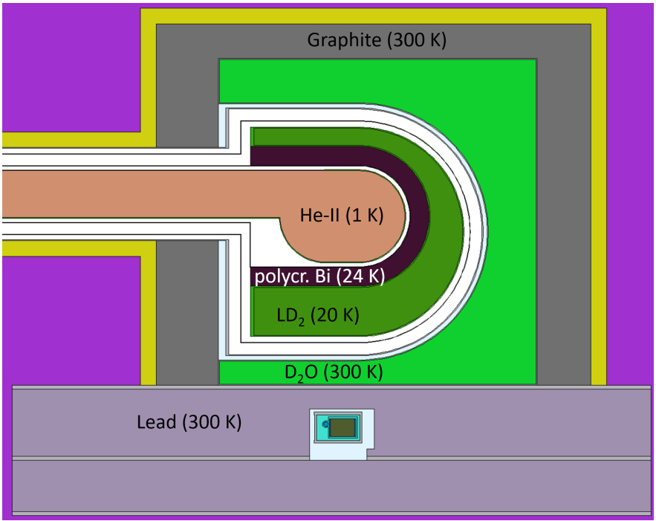
New moderator concepts and improved cooling techniques are needed to scale further
New moderator concepts
Improved cooling technologies
Scaled 3He fridge?
Direct pumping
Cryocompressors
2∙10⁹ UCN/s, 100W @ 1.6K
K.K.H. Leung et al, J. Appl. Phys. 126, 224901 (2019)
Neutron filter
Heat load -46%
Production -36%

Slide 23
TUCAN source will be the strongest source in the world
Production rate: 1.5∙10⁷ UCN/s @ 8.1W
Storage lifetime: ~20 s
Filled into nEDM cells: 14,000,000 (230/cm³)
Detected after nEDM cycle: 1,400,000 (23/cm³)
nEDM sensitivity 10⁻²⁷ ecm achievable in 400 days
W. Schreyer et al, Nucl. Instrum. Meth. Phys. Res. A 927, 101-108 (2019)
S. Sidhu, W. Schreyer, et al, EPJ Web of Conferences 282, 01015 (2023)
C. M. Lavelle: Cryogenic Liquid He4 and Deuterated PMMA Scattering Laws for MCNP, AOS-20-0265

