Slide 1
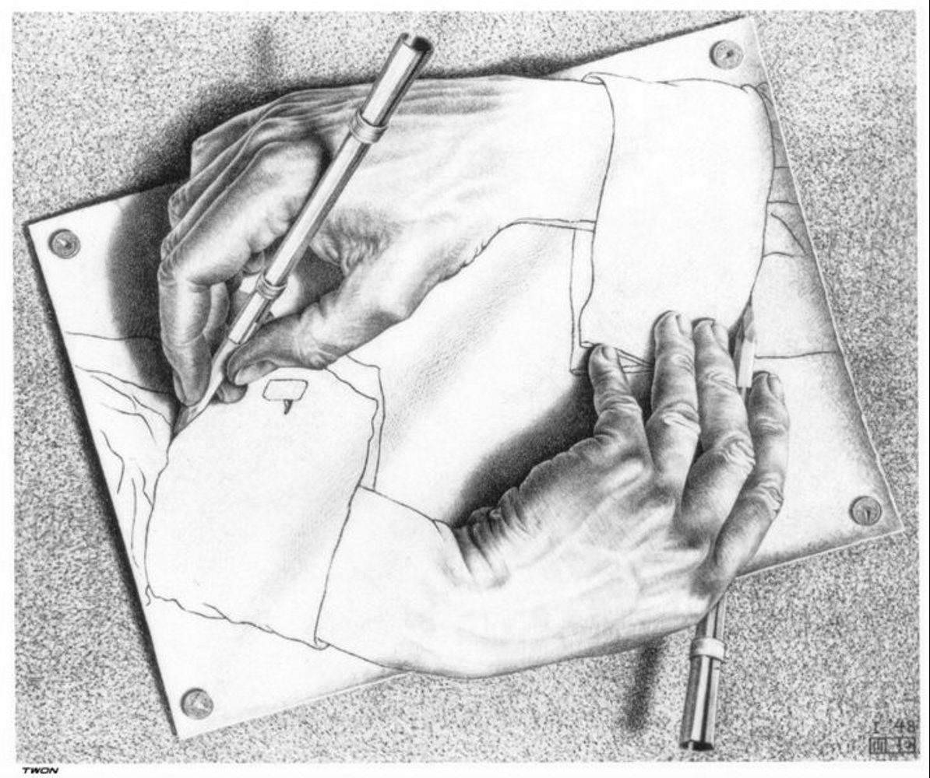
Hadronic
Parity Violation at the ESS
Christopher Crawford
University of Kentucky
ESS Fundamental Physics
Workshop, Lund, Sweden
2025-01-16
M.C. Escher (Drawing Hands)

Slide 2
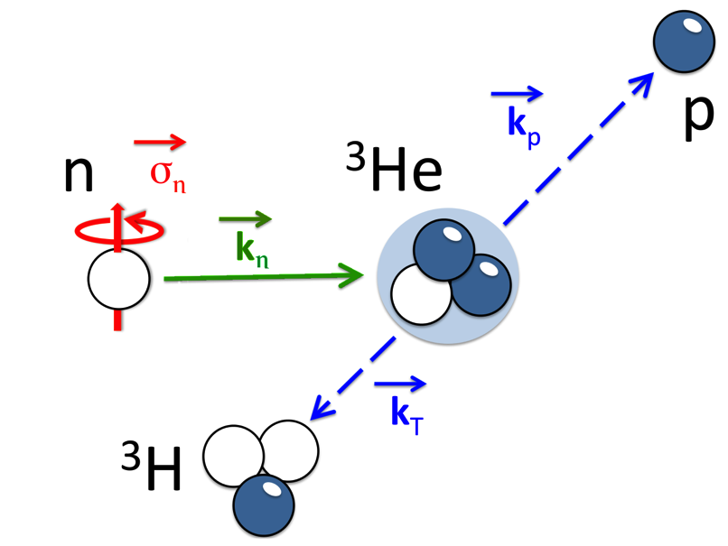
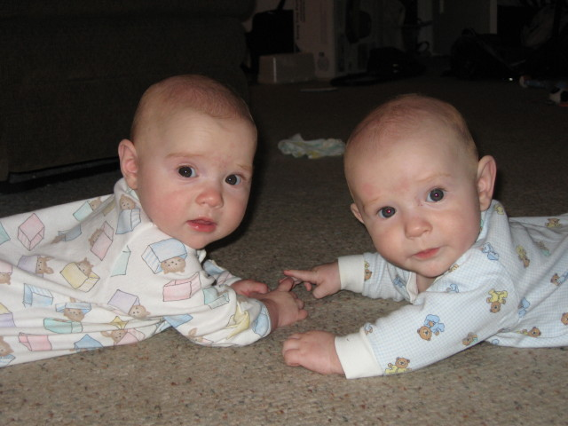
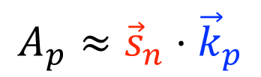
Overview
$$A_{p}≈{\vec{s}}_{n}⋅{\vec{k}}_{p}$$
Hadronic Parity Violation
  uniquely sensitive to the Hadronic Weak Interaction
  signal-to-noise ratio of 1:10⁷ !
Is a parity odd pseudoscalar!
HPV overview
Potential at the ESS
n3He/NPDGamma
NSR/NDTGamma
Madison
Spencer

Slide 3
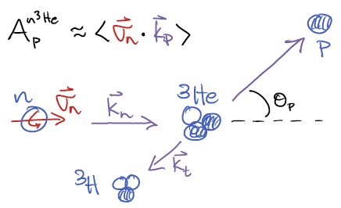

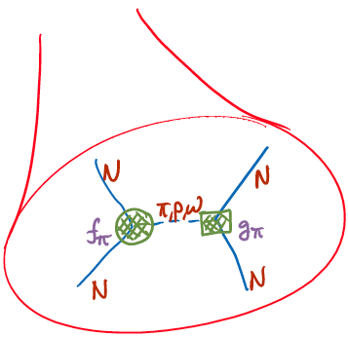
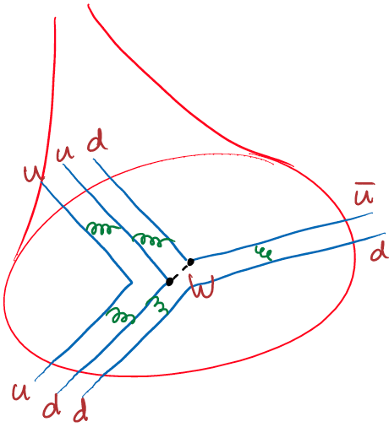
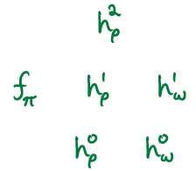
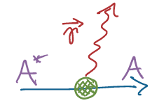
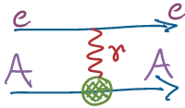

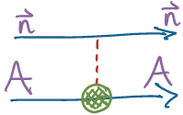

The Hadronic Weak Interaction (HWI) in a nutshell
Nuclear
<nuclear structure>
Hadronic
Meson Exchange
Potential
Many Body Nuclear PV
<QCD structure>
EW
Few-body PV
Standard Model

Slide 4
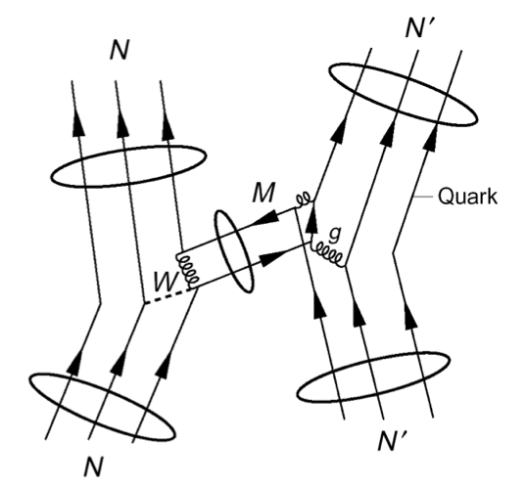
Motivation the studying the HWI
Least understood weak interaction
  EW: Quarks & Leptons, Semileptonic, Hadronic
  Complicated by nuclear structure
  Strongly suppressed by M_{π}^{2/}M_{W}² ~ 10⁻⁷
  Unique PV signature
Orthogonal probe of QCD structure
  test of QCD structure in ΔS = 0 sector
  (ΔI=1/2 rule not understood)
  Study the NC in hadronic systems –
  forbidden by ΔS = 1 by GIM mechanism
  W,Z range = 0.002 fm – probe of short-range
  quark correlations in QCD nonperturbative regime
  Nuclear and atomic PV test of nuclear structure models
  physics input to PV electron scattering experiments
  0νββ decay – matrix elements of 4-quark operators
  Same formalism used for Hadronic TRIV (complementary to EDM)

Slide 5
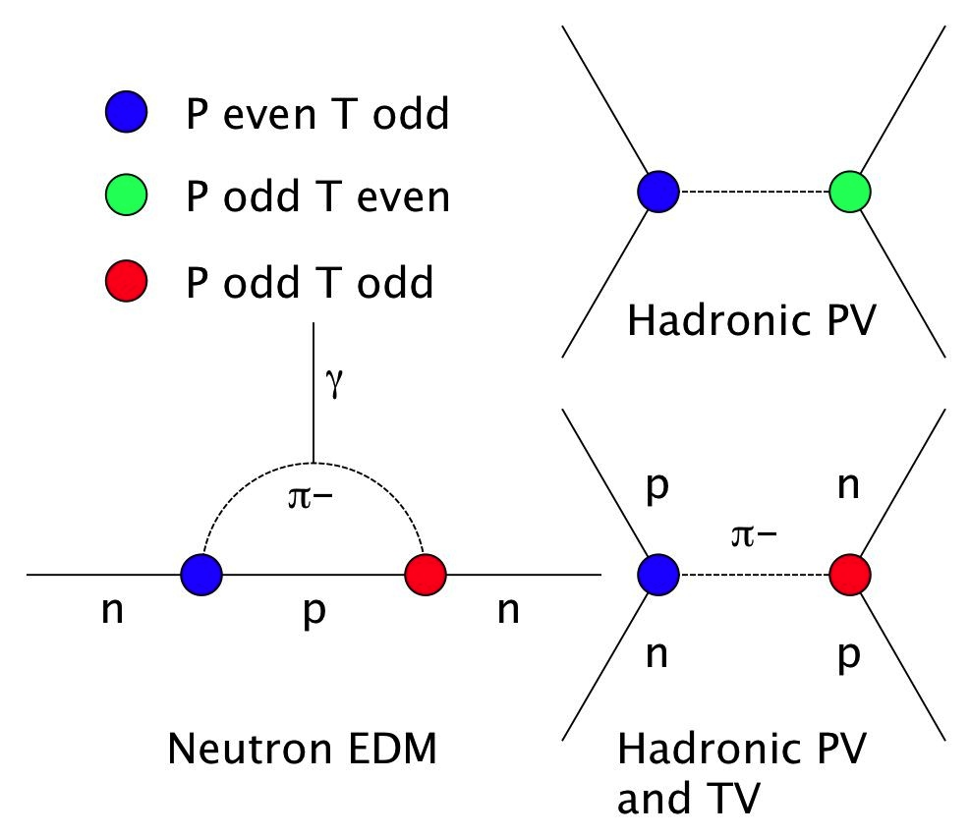

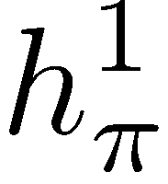
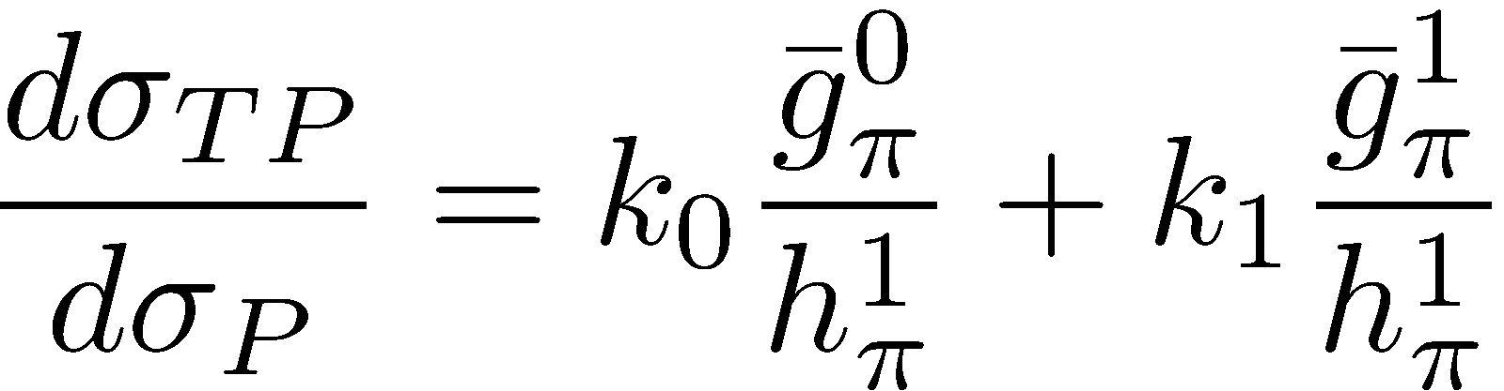
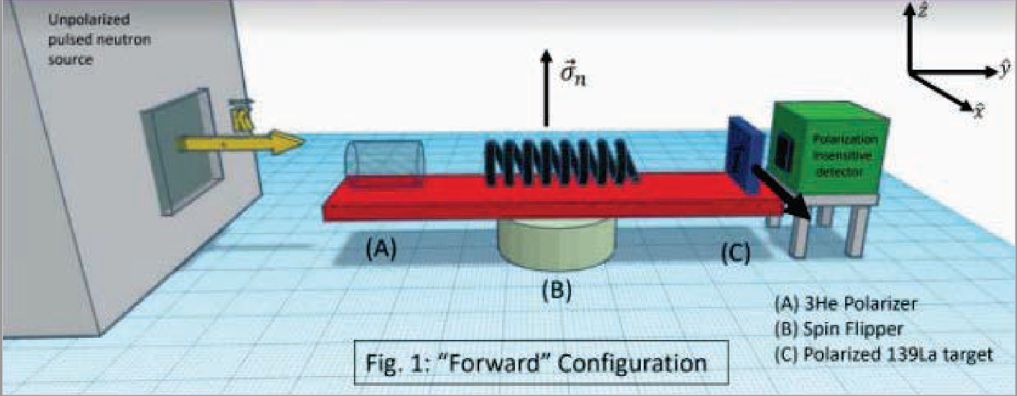
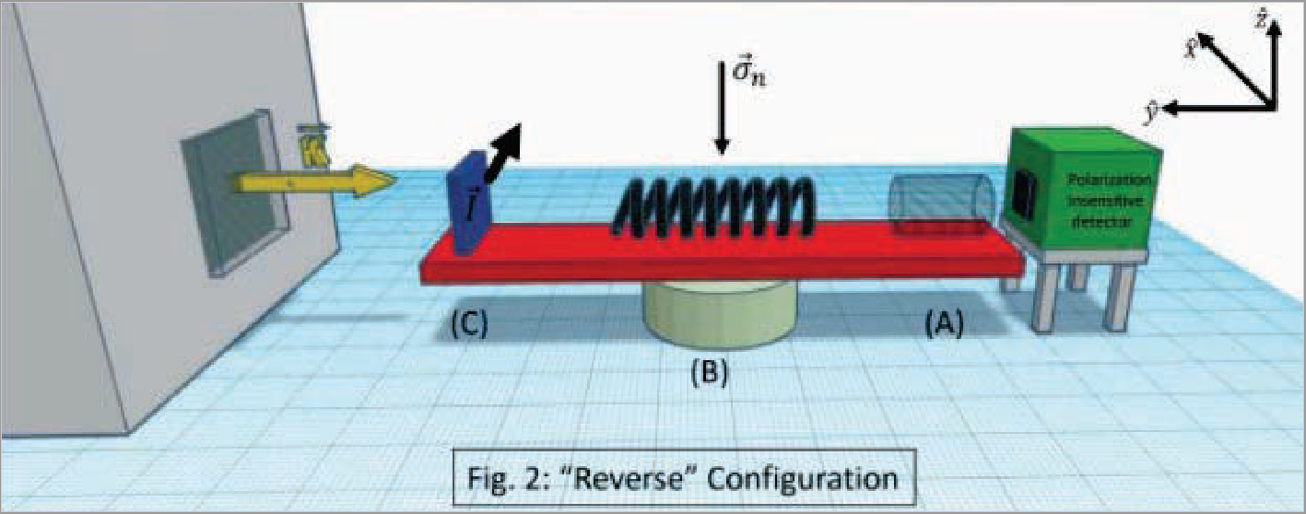
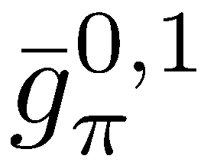

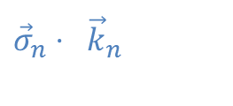

Relation between HPV and EDMs
Tree level diagrams
NOPTREX experiment
  US-Japan collaboration
  Preparations to measure
  TRIV forward elastic
  scattering amplitude:
    Measurements of $κ$,
    PV in double ¹³⁹La target
Bowman, Gudkov,
PRC 90, 065503 (2014)
${\vec{σ}}_{n}⋅ {\vec{k}}_{n}$
${\vec{σ}}_{n}⋅({\vec{k}}_{n}×\vec{I}$)
5

Slide 6
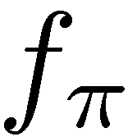
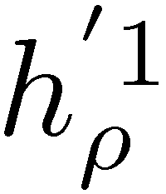
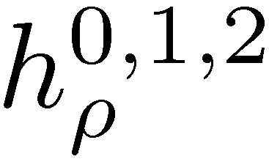
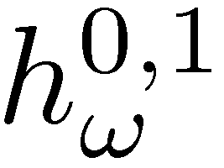

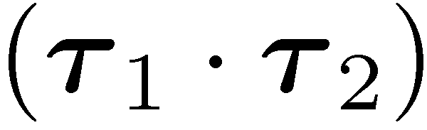


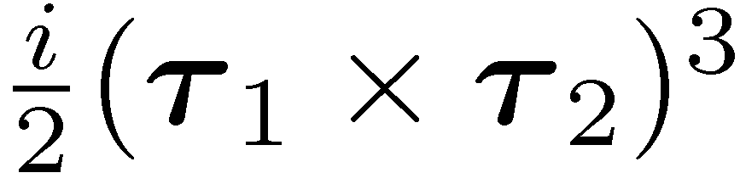
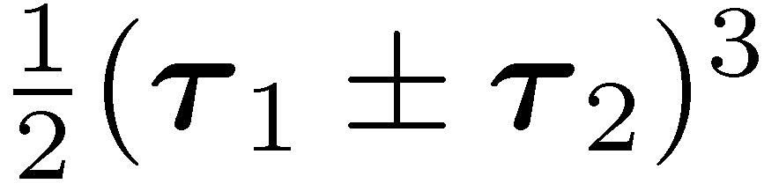

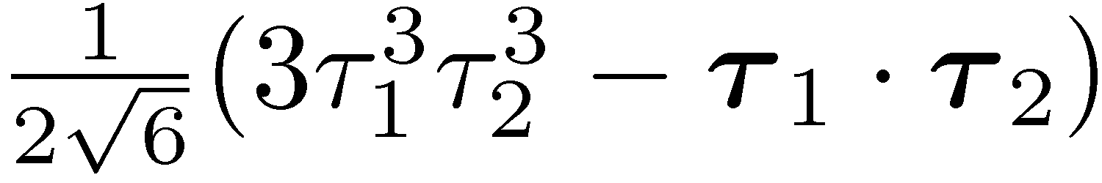



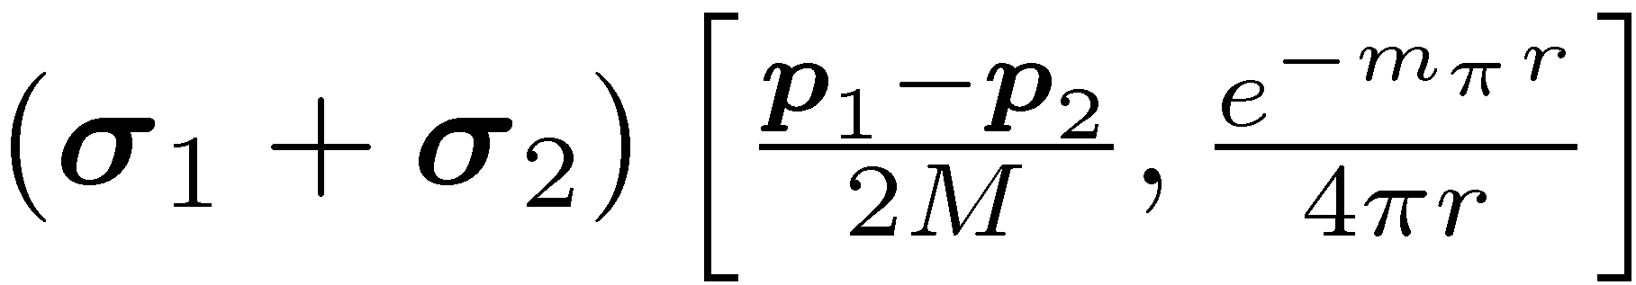
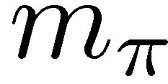
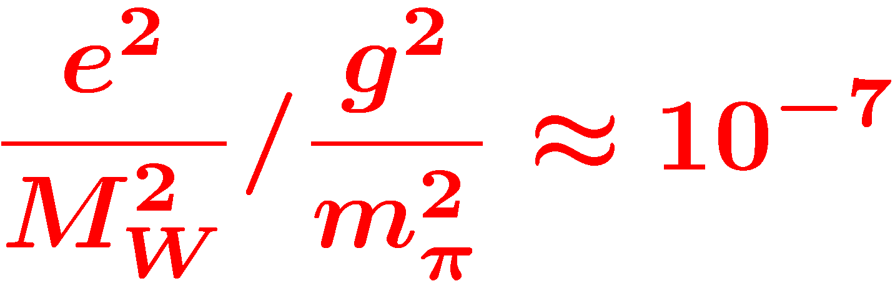

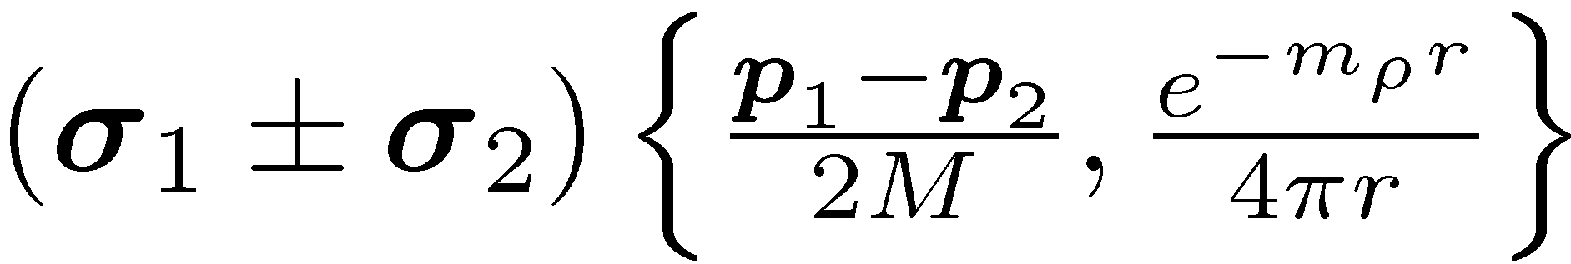

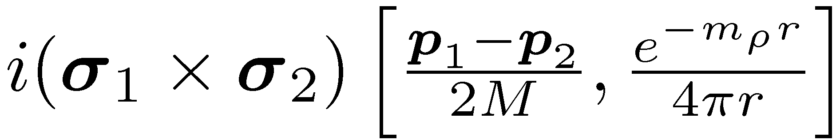
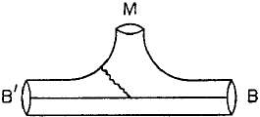
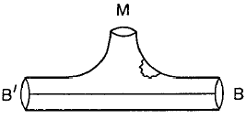
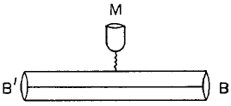
DDH Meson-exchange potential
PV meson exchange
isospin
N
N
STRONG
(PC)
WEAK
(PV)
Meson
exchange
range
N
N
Desplanques, Donoghue, Holstein,
Annals of Physics 124, 449 (1980)
Wasem, Phys. Rev. C 85 (2012) 022501
1st Lattice QCD result of f_{π} !!

Slide 7
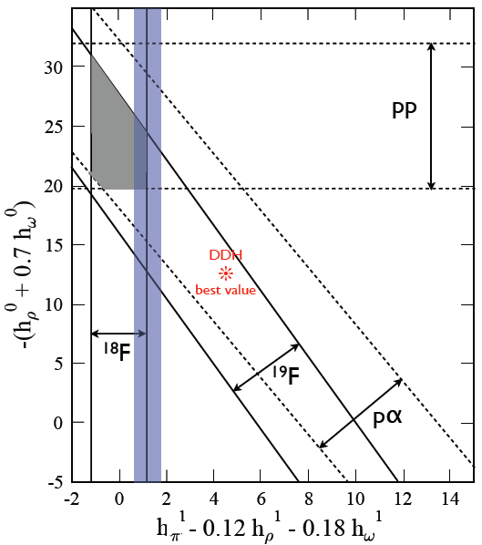
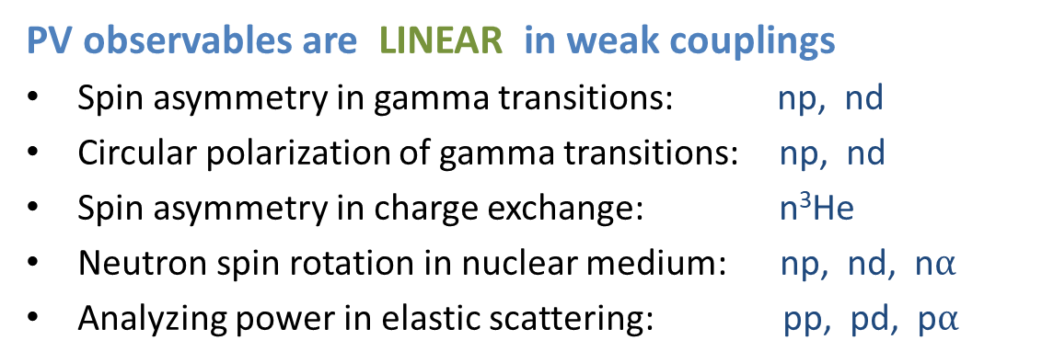
DDH Extraction
 | np A_{γ} | nD A_{γ} | n³He A_{p} | np φ | nα φ | pp A_{z} | pα A_{z}
f_{π} | -0.11 | 0.92 | -0.18 | -3.12 | -0.97 |  | -0.34
h_{r}⁰ |  | -0.50 | -0.14 | -0. 23 | -0.32 | 0.08 | 0.14
h_{r}¹ | -0.001 | 0.10 | 0.027 |  | 0.11 | 0.08 | 0.05
h_{ρ}² |  | 0.05 | 0.0012 | -0.25 |  | 0.03
h_{ω}⁰ |  | -0.16 | -0.13 | -0. 23 | -0.22 | -0.07 | 0.06
h_{ω}¹ | 0.003 | -0.002 | 0.05 |  | 0.22 | 0.07 | 0.06
Adelberger, Haxton,
A.R.N.P.S. 35, 501 (1985)
Viviani (PISA), [n-³He]
P.R.C. 82, 044001 (2010)
PV observables are LINEAR in weak couplings
Spin asymmetry in gamma transitions: np, nd
Circular polarization of gamma transitions: np, nd
Spin asymmetry in charge exchange: n³He
Neutron spin rotation in nuclear medium: np, nd, n$α$
Analyzing power in elastic scattering: pp, pd, p$α$
LQCD
Haxton & Holstein, PPNP 7, 1851 (2013)
J. Wasem, Phys. Rev. C 85, 022501(R) (2012)
Petschlies et al, arXiv:2306.03211

Slide 8
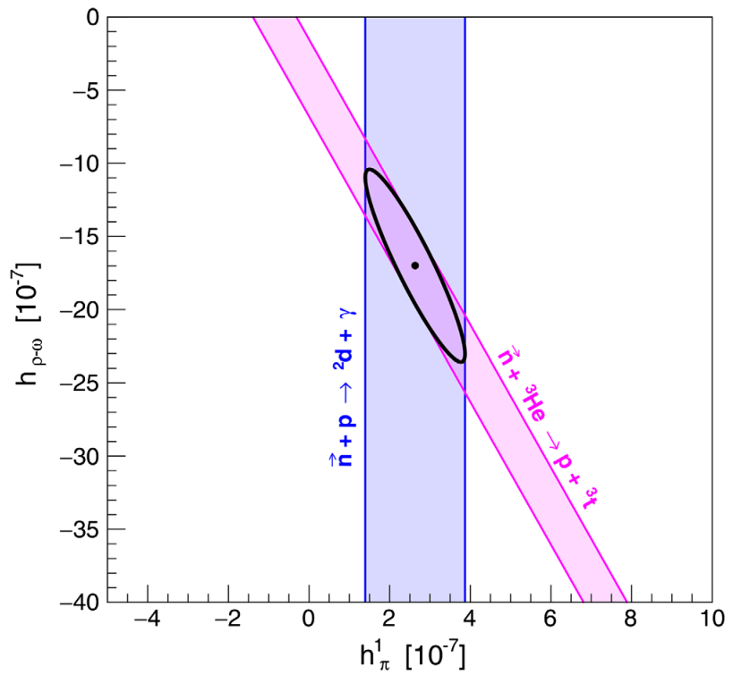



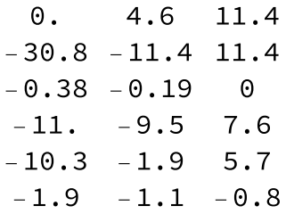
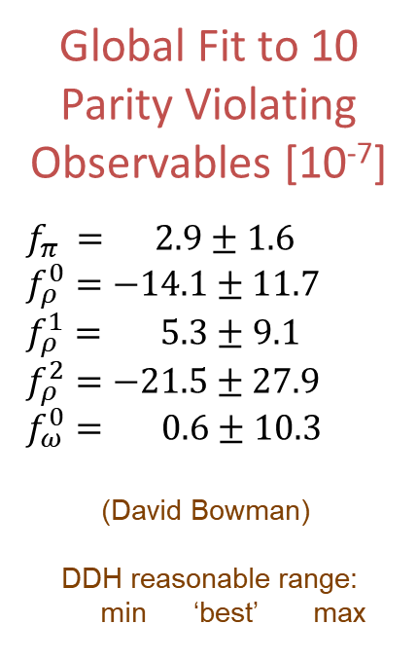

Interpretation of results in DDH formalism
Global Fit to 10
Parity Violating
Observables [10⁻⁷]
$f_{π} = 2.9±1.6$
$f_{ρ}^{0}=−14.1±11.7$
$f_{ρ}^{1}= 5.3±9.1$
$f_{ρ}^{2}=−21.5±27.9$
$f_{ω}^{0}= 0.6±10.3$
(David Bowman)
DDH reasonable range:
min ‘best’ max
DDH $ΔI=0, 1 projection$
NPDG + n³He extraction
NPDGamma
n-³He
LQCD
Haxton & Holstein, PPNP 7, 1851 (2013)
Gericke et al, PRL 125, 131803 (2020)

Slide 9
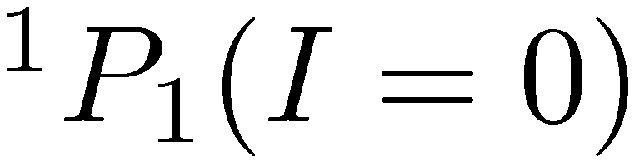
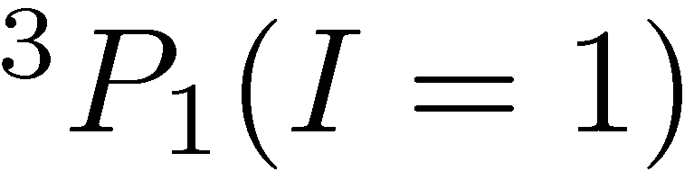
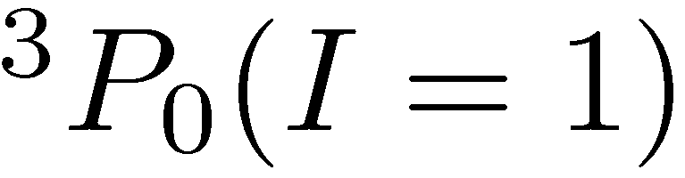
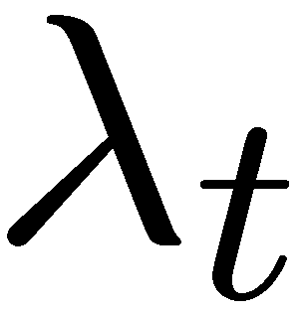


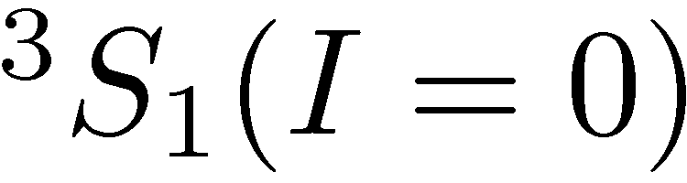
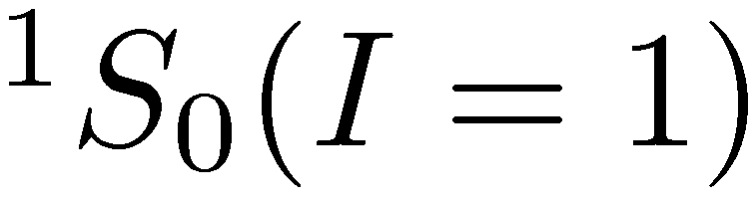
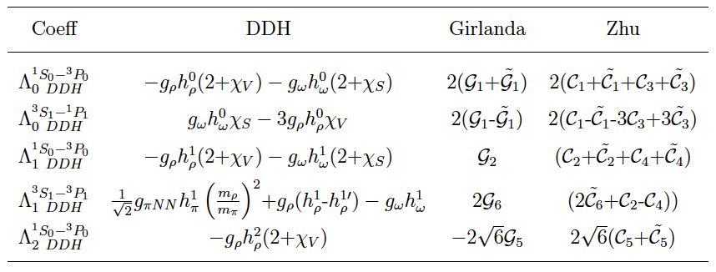
Danilov parameters / EFT
Elastic NN scattering
S-P transition amplitudes
S_{z}=±1/2 I₃=±1/2
antisymmetric in L, S, I
conservation of J
Equivalent to pion-less
Effective Field Theory (EFT)
in the low energy limit
C.-P. Liu, P.R.C. 75, 065501 (2007)
Haxton & Holstein, PPNP 7,1851 (2013)
Schindler & Springer, PPNP 72 1 (2013)
Lin & Vanasse, arXiv:2408.14602 [nd]

Slide 10
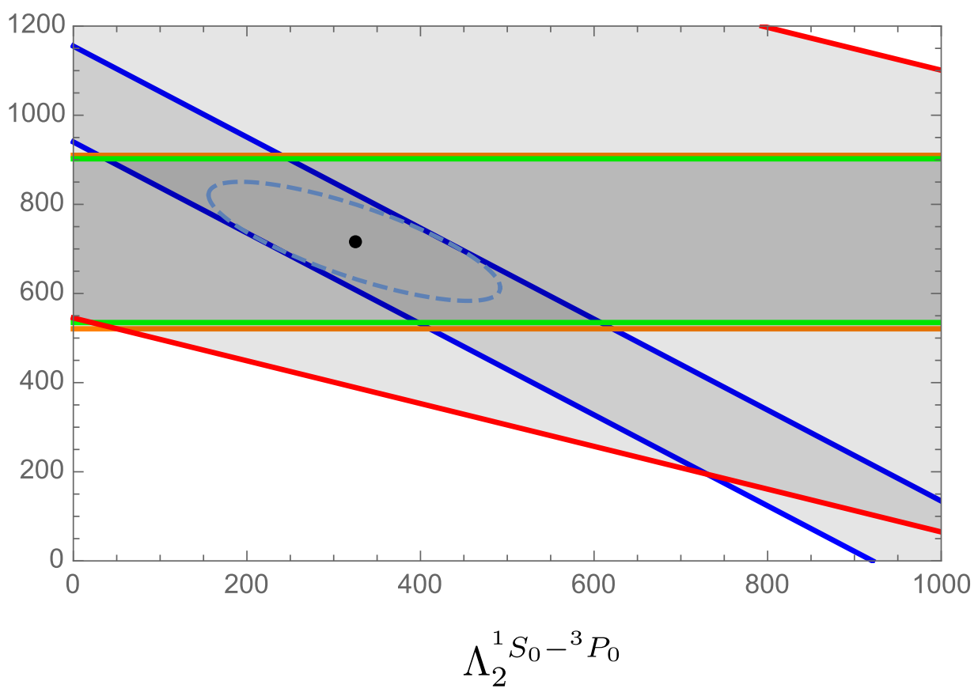



Large N_{c} expansion
Two leading order amplitudes
Others suppressed by N_{c}²
New paradigm for experiments
  NPDG tests the smallness of
  n³He an orthogonal constraint on , .
pp (220 MeV)
pp (15, 45MeV)
pα
¹⁹F
Phillips, Samart, Schat,
PRL 114, 062301 (2015)
Schindler, Springer, Vanasse,
PRC 93, 025502 (2016)
Gardner, Haxton, Holstein,
ARNPS 67, 69 (2017)

Slide 11


Interpretation of results in EFT/large N_{c} formalism
pp (220 MeV)
pp (15, 45MeV)
pα
NPDGamma
¹⁹F
¹⁸F
NPDGamma
projected
Gardner, Haxton, Holstein, ARNPS 67, 69 (2017)
Gardner, Haxton, Holstein, ARNPS 67, 69 (2017)

Slide 12





EFT+QCD analysis of ΔS = 0 HPV
Muralidhara & Gardner, Phys. Lett. B 849 (2024)
Gardner & Muralidhara, Phys.Rev.C 107 (2023) 5, 055501
Gardner & Muralidhara, Phys.Lett.B 833 (2022) 137372

Slide 13


NPDG/n³He are done—what next?
Few-body observables: Haxton & Holstein, PPNP 71, 195 (2013)
A=2: $A_{L}^{\vec{p}p}$, $A_{γ}^{\vec{n}p}$, $P_{γ}^{np}$, $φ_{,z}^{\vec{n}p}$, $A_{p}^{\vec{γ}d}$ A=4: $A_{γ}^{{\vec{n}}^{ 3}He}$
A=3: $A_{L}^{\vec{p}d}$, $A_{γ}^{\vec{n}d}$, $A_{γ}^{n\vec{d}}$, $φ_{,z}^{\vec{n}d}$A=5: $A_{L}^{\vec{p}α}$, $φ_{,z}^{\vec{n}α}$
✓
✓
✓
✗
✓
✗
✗
✓
A | Obs | Result (10⁻⁷) |  | $$Λ_{0}^{{ S}_{0}^{1}−P_{0}^{3}}$$ | $$Λ_{1}^{S_{0}^{1}−P_{0}^{3}}$$ | $$Λ_{2}^{S_{0}^{1}−P_{0}^{3}}$$ | $$Λ_{0}^{S_{1}^{3}−P_{1}^{1}}$$ | $$Λ_{1}^{S_{1}^{3}−P_{1}^{3}}$$ | Improvement
2 | $$A_{L}^{pp}$$ | 419 | $±$43 | 1 | 1 | 0.4088
 | $$A_{γ}^{np}$$ | -0.3 | $±$0.14 |  |  |  |  | -3.70E-04 | 5 | ESS
 | $$P_{γ}^{np}$$ | 1.8 | $±$1.8 | -0.00012 |  | 0.00154 | 0.00105 |  |  | thermal
 | $dφ/dz^{np}$ |  |  | 0.015 |  | 0.016 |  | -0.011 | ∞ | ESS/NG-C
3 | $$A_{L}^{pd}$$ | -0.35 | $±$0.85 | -0.001 | -0.0007 | -0.0002 | -0.0008
 | $$A_{γ}^{nd}$$ | 78 | $±$34 | 0.0139 | -0.0055 | -0.0035 | 0.0037 | 0.0024 | 39 | ESS
4 | $$A_{p}^{n^{3}He}$$ | 0.117 | $±$0.093 | 7.18E-04 | -2.25E-03 | 6.26E-05 | -4.68E-04 | -6.24E-04 | 5 | ESS
5 | $$A_{L}^{pα}$$ | -3.3 | $±$0.9 | -0.00355 | -0.00317 |  | -0.00268 | -0.00114
 | $$dφ/dz^{nα}$$ | 1.7 | $±$9.1 | 0.0138 | -0.0087 |  | 0.0033 | -0.0033 | 9 | NG-C
18 | $$P_{γ}^{18F}$$ | 0 | $±$5100 |  | 36.3 |  |  | 15
19 | $$A_{γ}^{19F}$$ | -740 | $±$190 | -1.12 | -0.75 |  | -0.48 | -0.32

Slide 14




ANNI neutron guide
Soldner et al, EPJ Web of Conferences 219, 10003 (2019)
Neutron flux
  11 × 7 cm²
  2.0 × 10¹⁰ n/s cm²
  × 0.5 (polarized)
  × 0.62 (HIBEAM)

Slide 15





n-³He Experimental setup
Notes:
15

Slide 16

n-³He Apparatus in the FnPB

Slide 17





Supermirror polarizer
T=25.8% transmission
P=95.3% polarization
N=2.2$×$10¹⁰ n/s output flux (chopped)
$FOM=P^{2}N$
simulations using
McStas / ROOT ntuple
S. Balascuta et al., Nucl. Instr. Meth. A671 137 (2012)

Slide 18


Resonant RF spin rotator
Resonant RF spin rotator,
  1/t RF amplitude tuned to velocity of neutrons
  Affects spin only–NOT velocity (no static gradient)
essential to reduce instrumental systematics
  danger: must isolate RF field from the detector
  false asymmetries: additive & multiplicave
$TOF$
P. Neo-Seo, et al. Phys. Rev. ST Accel. Beams 11 084701 (2008)

Slide 19


³He analyzer cell
externally
polarized
(SEOP) ³He cell
AFP spin
reversal of ³He
Measures
both neutron
polarization +
RFSF efficiency
U. Tennessee / ORNL

Slide 20





³He transmission polarimetry
Larmor
Resonance
Rabi
Oscillation
Polarization of ³He Cell
Beam Polarization
Spin Flip Efficiency
C. Hayes
U. Tennessee

Slide 21




Asymmetry extraction
PV physics asymmetry
  Extracted from weighted average
  of single-wire spin asymmetries
Geometry Factors$G=〈\cos{θ}〉$
Notes:
The neutron captures here, and we want to measure the proton asymmetry, or the proton angle as a function of spin.
But the event rate is too large to reconstruct tracks, so we must measure spin asymmetries on each wire.
The opposite triton dilutes the proton asymmetry, and also protons coming from decays downstream, but most decays happen at the front of the chamber.

Slide 22

Active target / ion chamber
  ³He serves as both target and ionization gas
  16 mCi tritium over life of experiment
University of Manitoba
  Macor frames with 9 x 16 sense wires, 8 x 17 HV wires
  12” x 0.9 mm CF aluminum windows
  All aluminum chamber except for knife edges

Slide 23






Readout electronics
T₀
dirty ground
Ionization read out in current mode
  144 channels read out simultaneously
  Low-noise I-V preamplifiers mounted on chamber
  24-bit, 100 kS/s, 48 channel Δ-Σ ADC FMC modules
Oak Ridge National Lab, Univ. Kentucky, Univ. Tennessee
Divider
Sig.Gen
Amp.
RFSR
Electronic Tests:
Instrumental
false asymmetry
measurements:
δA_{in}< 10⁻⁹
optical
isolator
Preamp
ADC
clean ground
Ion chamber ground

Slide 24
Individual wire asymmetries
Typical histogram of individual wire asymmetries
Timeline
2008 —proposal
Fall 2014—installation & commissioning
Feb-Dec 2015 — Data collection
PV asymmetry
31854 runs (~8 minute long)
# good pulses: 690937760
# pulses cut: 78335992 (10%)
PC asymmetry
1110 runs
# good pulses: 22529520
# pulses cut: 4468923 (17%)

Slide 25


Final Results
$A_{PV}= 15.5±9.7 \left(stat\right)±2.4 \left(sys\right) ppb$ (goal: 20 ppb)
$A_{PC}=−437±59 \left(stat\right)±4.3 \left(sys\right) ppb$
M.T. Gericke et al. (n3He Collaboration)
Phys. Rev. Lett. 125, 131803

Slide 26

Systematic Corrections and Errors
M.T. Gericke et al. (n3He Collaboration) Phys. Rev. Lett. 125, 131803

Slide 27



Motivation for TOF: PC Asymmetry
Energy dependence of parity-allowed n+³He asymmetry
G. Hale, private comm.
Viviani et al, Phys. Rev. C 110, L061001

Slide 28

NPDGamma – Experimental Layout

Slide 29



NPDGamma - 16L liquid para-hydrogen target
30 cm long → 1 interaction length
99.97% para → 1% depolarization
Improvements: pressure-stamped vessel
thinner windows
p
p
ΔE =
15 meV
p
p
para-H₂
ortho-H₂
ortho
15 meV
para
σ (b)
capture
E_{n} (meV)

Slide 30




CsI(Tl) Detector Array
4 rings of 12 detectors each
  15 x 15 x 15 cm³ each
VPD’s insensitive to B field
detection efficiency: 95%
current-mode operation
  5 x 10⁷ gammas/pulse
  counting statistics limited

Slide 31









Analysis of the Physics Asymmetry
$$Y=\int{L dt dΩ} \left[{dσ}/{dΩ}\right.=σ_{0}( 1+\underset{\cos{θ}}{\underbrace{{\hat{s}}_{n}⋅{\hat{k}}_{γ}}}A_{np}^{PV}+\underset{\sin{θ}}{\underbrace{{\hat{s}}_{n}⋅{\hat{k}}_{n}×{\hat{k}}_{γ}}}\left.A_{np}^{PC} )\right]$$
$$A_{d\overline{d}}=\frac{1}{2}\left[\frac{Y_{d}^{↑}−Y_{d}^{↓}}{Y_{d}^{↑}+Y_{d}^{↓}}+\frac{Y_{\overline{d}}^{↑}−Y_{\overline{d}}^{↓}}{Y_{\overline{d}}^{↑}+Y_{\overline{d}}^{↓}}\right]=P_{n}⋅\sum_{i=H, Al}{f_{i} (\underset{〈\cos{θ}〉}{\underbrace{G_{i}^{UD}}}A_{i}^{PV}}+f_{i}\underset{〈\sin{θ}〉}{\underbrace{G_{i}^{LR}}}A_{i}^{PC})$$
detector pair
asymmetry
neutron
polarization
fraction
of yield
geometry
factors
physics
asymmetry
$G_{i}^{UD}=〈\cos{θ}〉$
$G_{i}^{LR}=〈\sin{θ}〉$
11
0
10
1
9
$${\hat{k}}_{γ}$$
2
$${\hat{s}}_{n}$$
$$⊗$$
8
$${\hat{k}}_{n}$$
3
7
4
6
5

Slide 32
Hydrogen Data
minimal cuts: 1% beam stability for several pulses
three independent analyses: in excellent agreement
Detector 0
detector pair number
Detector 12
Final Result: $A_{γ,PV}^{np}=\left(−3.0±{1.4}_{stat}±{0.2}_{sys}\right)×{10}^{−8}$
D. Blythe et al. (NPDGamma Collaboration) Phys. Rev. Lett. 121, 242001 (2018)

Slide 33

Systematic Uncertainties
D. Blythe et al. (NPDGamma Collaboration) Phys. Rev. Lett. 121, 242001 (2018)

Slide 34





Parity-odd Neutron Spin Rotation
Analogous to optical rotation in a “handed” medium
Transversely-polarized neutrons corkscrew from any parity-odd interaction
PV Spin Angle is independent of incident neutron energy in cold neutron regime
${dφ_{PV}}/{dx≈8×{10}^{−7}rad/m}$ sensitivity achieved at NIST
$${\vec{σ}}_{n}$$
f
$$f\left(0\right)=f_{PC}+f_{PV}(\vec{σ}⋅\vec{k})$$
$${\vec{σ}}_{n}$$
${\left|↑ \right\rangle }_{i}=\frac{1}{\sqrt{2}}\left(\left| + \right\rangle +\left| − \right\rangle \right)$
$= \frac{1}{\sqrt{2}}\left(e^{−i(φ_{PC}+φ_{PV})}\left| z \right\rangle +e^{−i(φ_{PC}+φ_{PV})}\left| −z \right\rangle \right)$
Refractive index depends
on neutron helicity
$$φ_{PV}=φ_{+}−φ_{−}=2φ_{PV}=4πℓρf_{PV}$$

Slide 35

n-⁴He NSR apparatus ready for cryogenic testing
motion-control
system
+y
room-temperature
magnetic shields
cryogenic
magnetic shield
pi-coil
³He ionization
chamber
+x
+z
input coil
output
coil
supermirror
polarizer
supermirror
polarization
analyzer
input guides
liquid helium targets
output guide
cryostat
Modern theoretical calculation for n-⁴He P-odd spin rotation to NN weak amplitudes done (Lazauskis)
PV spin rotation angle estimated to be “large” (~ 4 x 10⁻⁷ rad/m), 90% dominated by $h_{ρ}^{0}$ coupling
A weak probe of quark-quark interactions of QCD in the confinement/chiral symmetry breaking regime
Test case for our ability to understand how high-scale symmetry violation evolves to low energy in strongly interacting systems through nonperturbative QCD scales, similar theory/experiment in many other areas

Slide 36

n-⁴He NSR apparatus ready for cryogenic testing

Slide 37



First measurement of NDTG @ ILL
$$δA=(7.8±3.4)×{10}^{−6}$$

Slide 38

General considerations of NDTG
$σ_{γ}^{nd}$ is $642×$ smaller than H !
  25$×$ reduction in sensitivity
  Domination by backgrounds
  J=1 deuteron $→$ depolarization
$A_{γ}≈1.7×{10}^{−6}$ expected to be$30×$ larger !
  Measurement at ILL: $A_{γ}=\left(4.2±3.8\right)×{10}^{−6}$ PLB 137, 125 (1984)
  Large asymmetry in a few-body neutron system
Measure asymmetry in counting mode
  Discriminate background from neutron capture and other gammas
  Must reduce background to acceptable counting rates
D₂O capture target
  $σ_{γ}^{nO}$ is $5.4×$ smaller than $σ_{γ}^{nd}$ ; can be discriminated in counting mode
  No safety issue of explosive gas like D₂ ; thin windows,

Slide 39

NDTG experimental setup
schematic of component layout
  background-less ³He polarizer
  highly segmented CsI array
  to spread out counting rate
  ⁶Li or ³He shielding essential!

Slide 40



Could we share the WASA detector?
http://collaborations.fz-juelich.de/ikp/wasa/data/WaC_Proposal.pdf
CsI(Na) - high rates, less afterglow, less radiation damage

Slide 41
Counting rates
Peta-gamma counting — 10¹⁵ $γ^{′}s$ / year!
  need highly segmented gamma detector 100-140 CsI crystals
  count rate: $R={ΦηκΩ}/{4π}=$ 390 kHz per detector
  CsI rise time: $τ = 1 μs→1$ MHz limit (NaI $3×$ faster; availability?)
Background reduction (below 1 $γ$ / 1000 n)
  need count rate dominated by $σ_{cap}$=0.52 mb on D to limit pile-up
  capture on O in target: $σ_{cap}$=0.19 mb $→$ 80 kHz (3.3 MeV)
  ⁶Li shielding: 0.0003 $γ$/n $→$ 100 kHz (2.2 MeV)
Digital Pulse Processing
  Must analyze gamma events in real time – new developments!
Further optimization of run conditions
  increased thickness of ³He polarizer to improve polarization
  reduction of target thickness to increase $P_{n}$ on capture
  possible 3x reduction of elastic scattering (cryogenic target)

Slide 42

Extraction of Asymmetry
Geometry factors:
  Averaging capture $σ_{±}=σ_{0}(1±PA\cos{θ})$ over each crystal,
  yields $Y_{i,±}=Y_{i,0}\left(1±PAG_{i}\right)$ form crystal asymetry $A_{i}≡\frac{Y_{i,+}−Y_{i,−}}{Y_{i,+}+Y_{i,−}}=PAG_{i}$
  where geom factor$G_{i}≡〈\cos{θ〉}$ is averaged over $γ$’s in each crystal.
  Each physics $A_{i}^{′}≡A_{i}/PG_{i}$ is weighted by ${w_{i}=δ}^{−2}A_{i}^{′}=P^{2}N_{i}G_{i}^{2}$
  to extract physics asymmetry $A^{′}=∑w_{i}A_{i}/∑w_{i}$,
  which has statistical error
  $δA^{′}=1/\sqrt{∑w_{i}}=1/P\sqrt{N}G$,
  The global geometry factor is:
  $G^{2}≡∑Ω_{i}G_{i}^{2}/4π$
  for an ideal spherical detector:
  $G_{0}^{2}≡∫dΩ\cos{θ/4π=1/3}$
# rings | # crystals | coverage | G / G₀
2 | 52 | 23.5% | 58.9%
4 | 100 | 45.1% | 79.5%
6 | 144 | 65.0% | 91.4%
8 | 180 | 81.2% | 97.3%
10 | 204 | 92.0% | 99.2%
12 | 216 | 97.4% | 99.4%

Slide 43

Statistical Sensitivity
Neutron polarization at capture $P=P_{0}εd=0.511$
  ³He polarizer: $P_{0}≈90\%$
  Spin flipper efficiency: $ε=99.8\%$
  Depolarization: $d=57\%$ (simple MC, data)
Neutron capture gammas $N=ΦTηκ=2.3×{10}^{15} γ$’s
  Neutron fluence at NG-C: $Φ=7.7×{10}^{11}$n/s
  Run time: $T=1×{10}^{7}$s (nominal)
  Polarizer transmission: $η≈25\%$
  Neutron capture probability: $κ=0.00117$ (MC simulation)
Geometry factor $G=f\sqrt{ε}/\sqrt{3}=0.473$
  Fraction of $〈\cos{θ〉}$ coverage: $f=91.4\%$ (analytic)
  Gamma detection efficiency: $ε=80.4\%$ (MCNP)
$δA^{′}=1/{P\sqrt{N}G}=8.6×{10}^{−8}$

Slide 44


Conclusion
  First generation of $n$ experiments
  at the SNS: NPDGamma $2σ$, n³He 1$σ$
  achieve 10% relative uncertainty at ESS
  The next generation of experiments
  will bring a unique set of challenges
  n-⁴He Spin Rotation: beam fluctuations
  NDTGamma: backgrounds: counting mode
  NPDGamma Circ. Pol: neutron statistics
ESS Beamline Requirements
  FOM: $P^{2}N$ statistics limited!
  TOF: Resonant SF, $λ$ dependence
  Time: 4200 hrs. per experiment
  Background: bending guide
Thank you!

