Slide 1
Epithermal and high-energy neutron beams for fundamental physics at ESS
L. Zanini, R.R. Fan, G. Gorini, P. Kinhult, H.M. Shimizu, W.M Snow, N. Tsapatsaris
The Fundamental Nuclear and Particle Physics at the ESS workshop, Lund 15-17/1/2025
www.europeanspallationsource.se

Slide 2
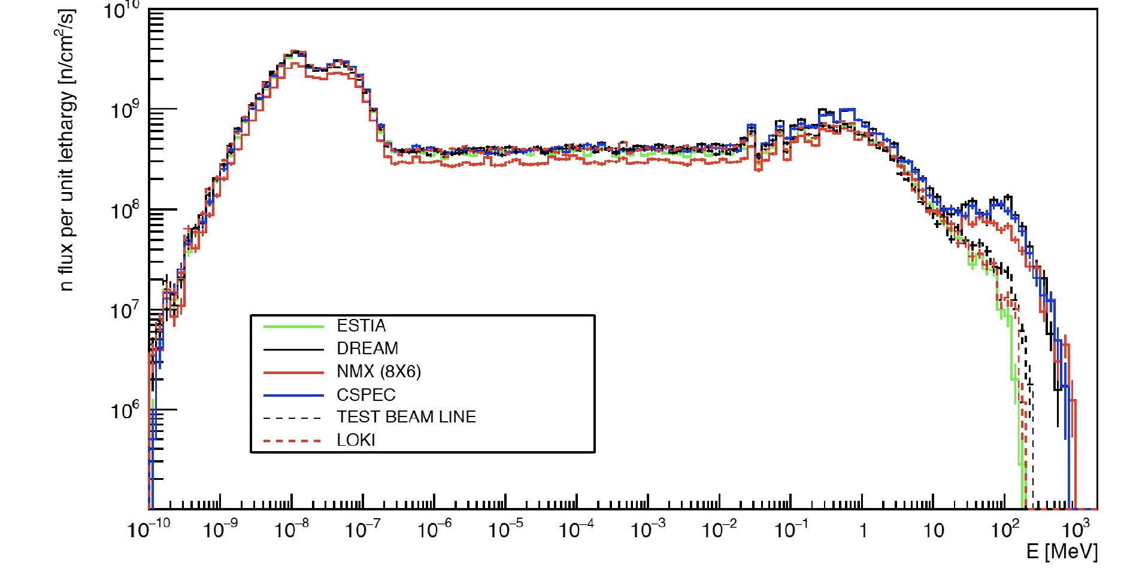
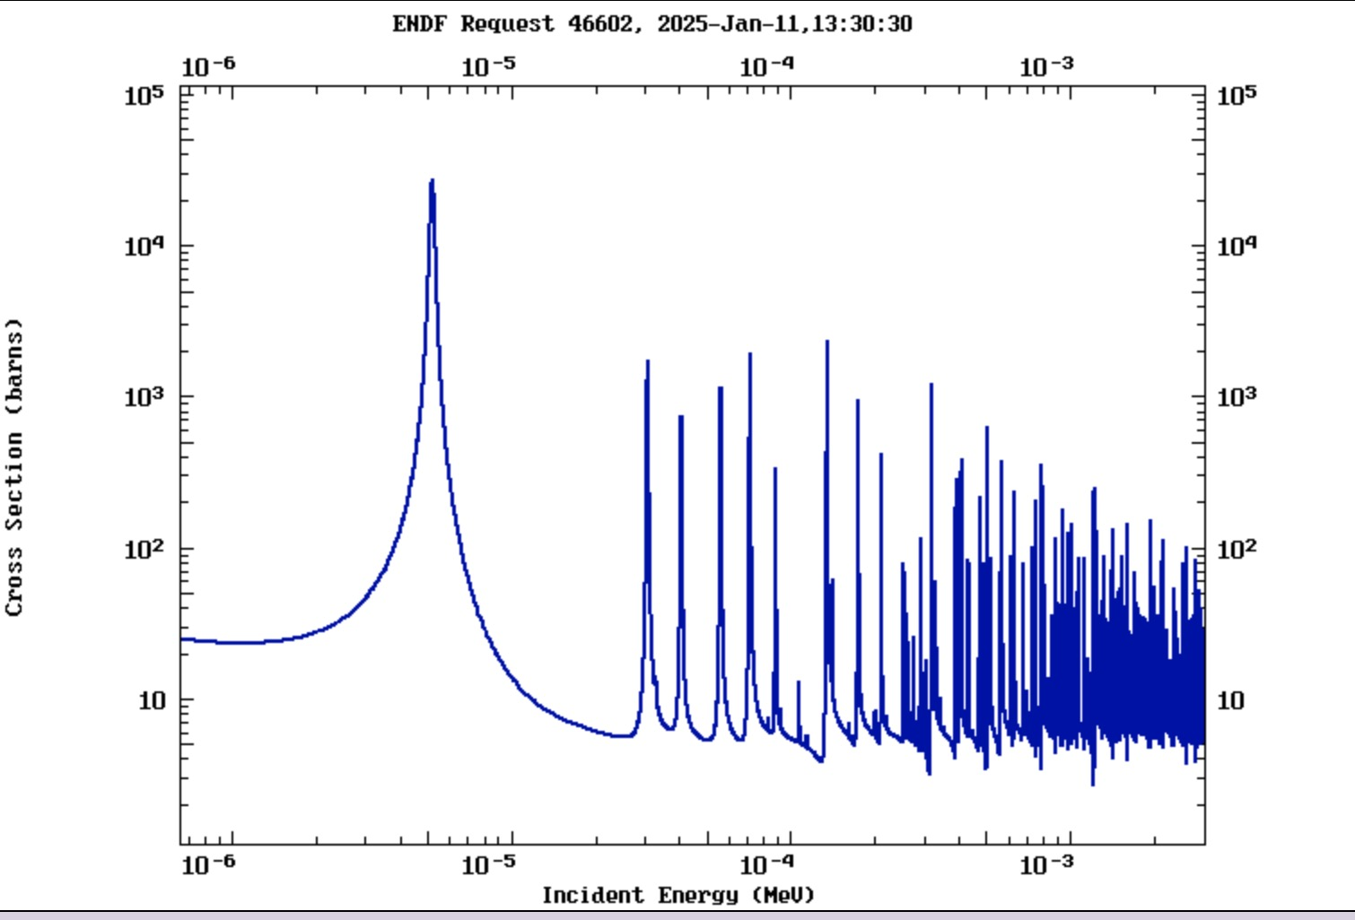
ESS calculated fluxes at 5.5 m for six different beamports
epithermal
High energy
thermal
cold
UCN

Slide 3
Neutron resonances
=0 s-wave resonance
=1 p-wave resonance
spin
parity
(L. Zanini, PhD thesis, 1998)

Slide 4
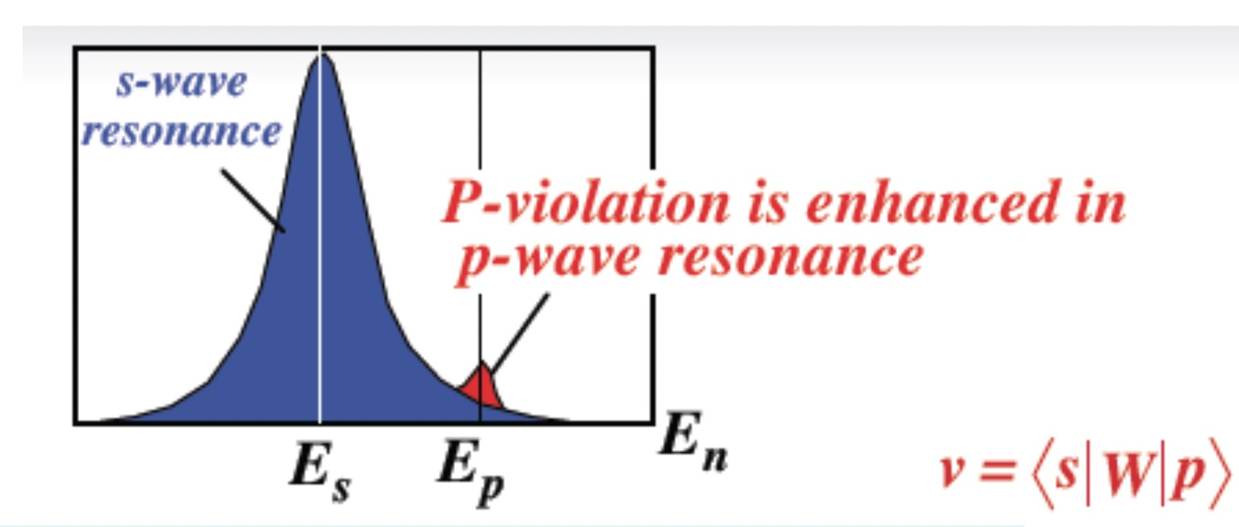
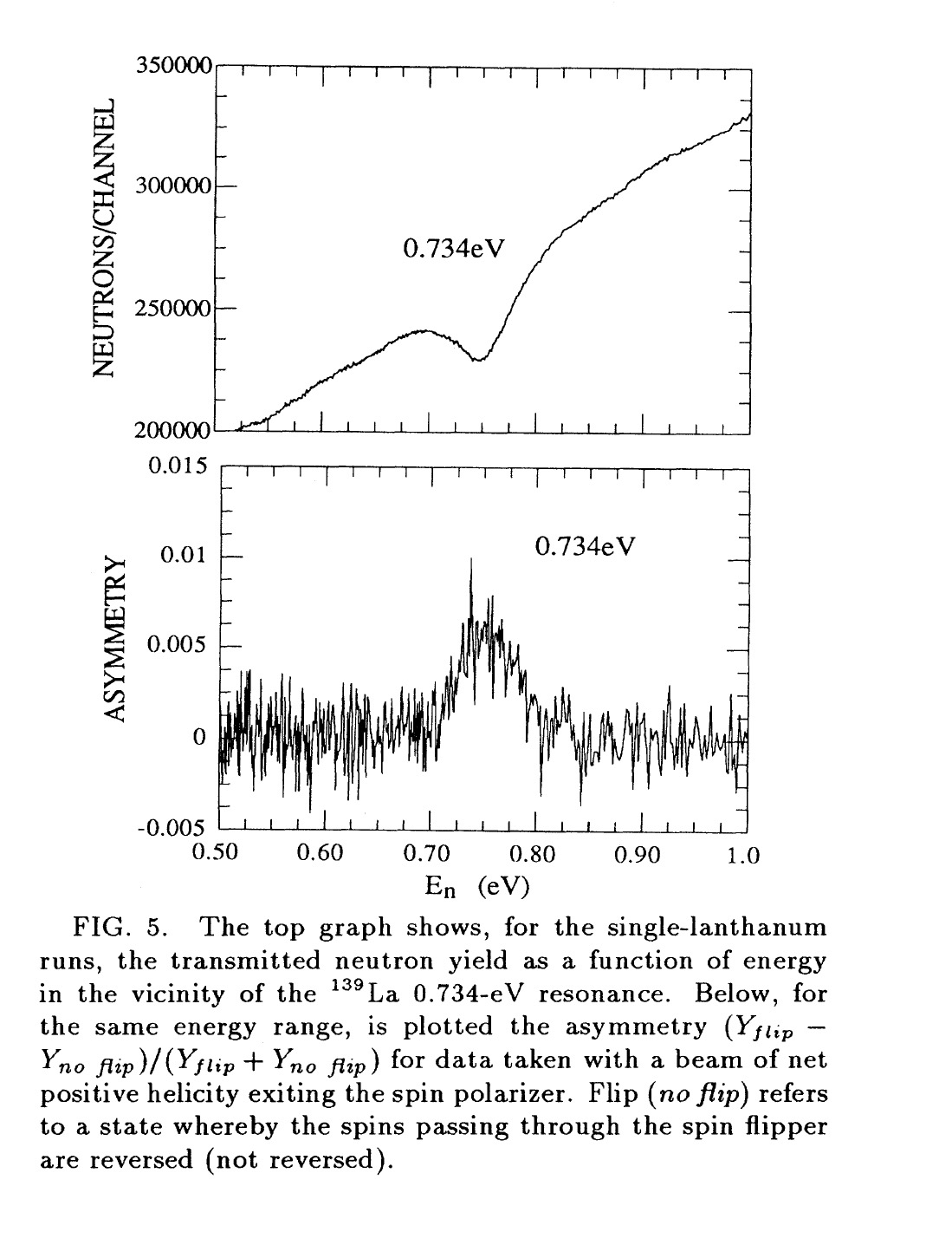
Two mechanisms of enhancement of P- and T-violation in compound nucleus reactions
(V. Yuan,Phys. Rev.C, 1991)
¹³⁹La
10% effect
kinematical enhancement
$$g≈\sqrt{Γ_{n}}$$
s
p
s
p
p
s
p
s
p
Dynamical enhancement
Total up to 10⁶

Slide 5
PV has been measured in many nuclei
TRIPLE data
(W. Snow)

Slide 6
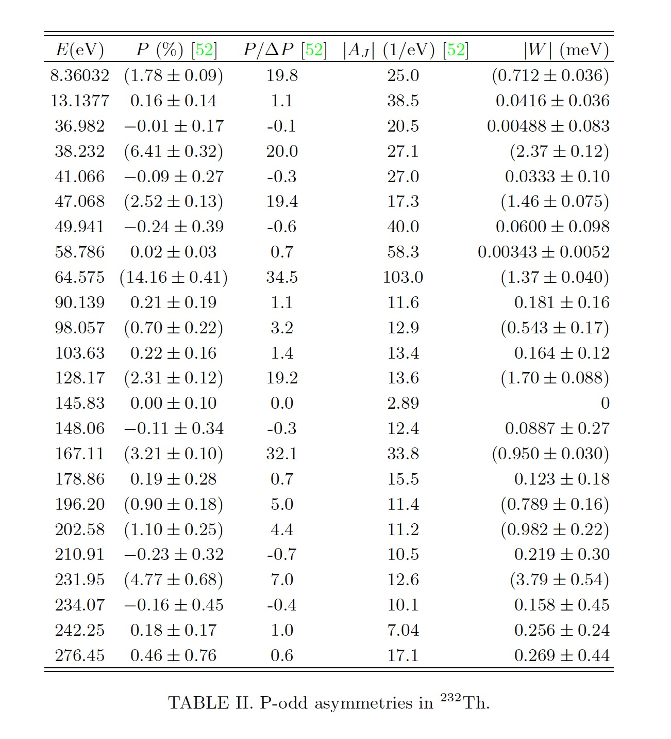
The list of potential measurements is long
²³²Th sign effect
neutron P/T violation
at individual p-waves
Taking wide range
uses ESS full beam
Different techniques
Transmission
Capture primary γ-rays
Capture low-level γ-rays
Angular distributions γ-rays
neutron resonance quantum # identification (spin/parity)
See also slide 13
(V. V. Flambaum and A. J. Mansour, arXiv: 2111.02037v1, 2021)

Slide 7
NOPTREX collaboration aims at measuring P and T
detector
Polarized
target
³He
polarizer
Spin flipper
(W. Snow)

Slide 8
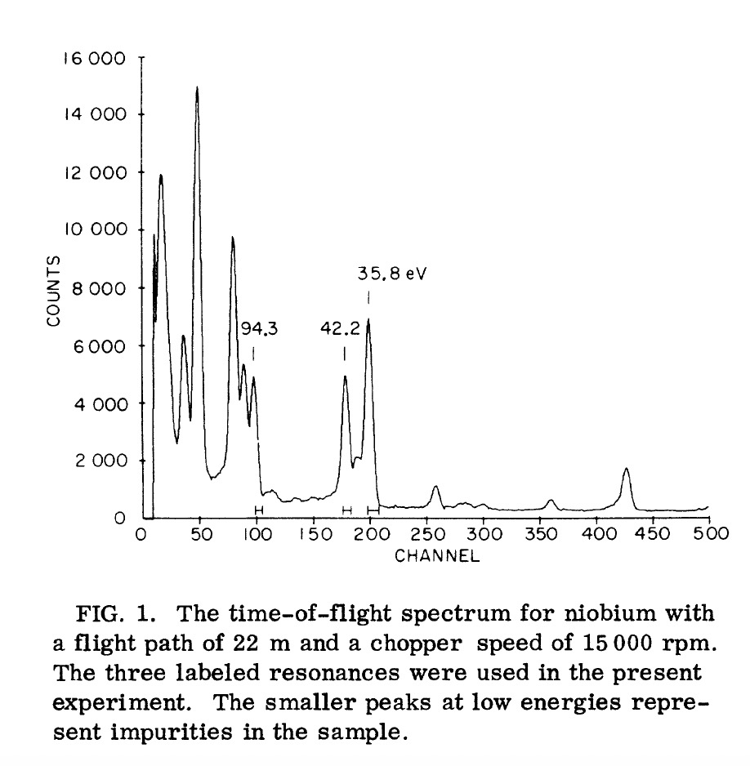
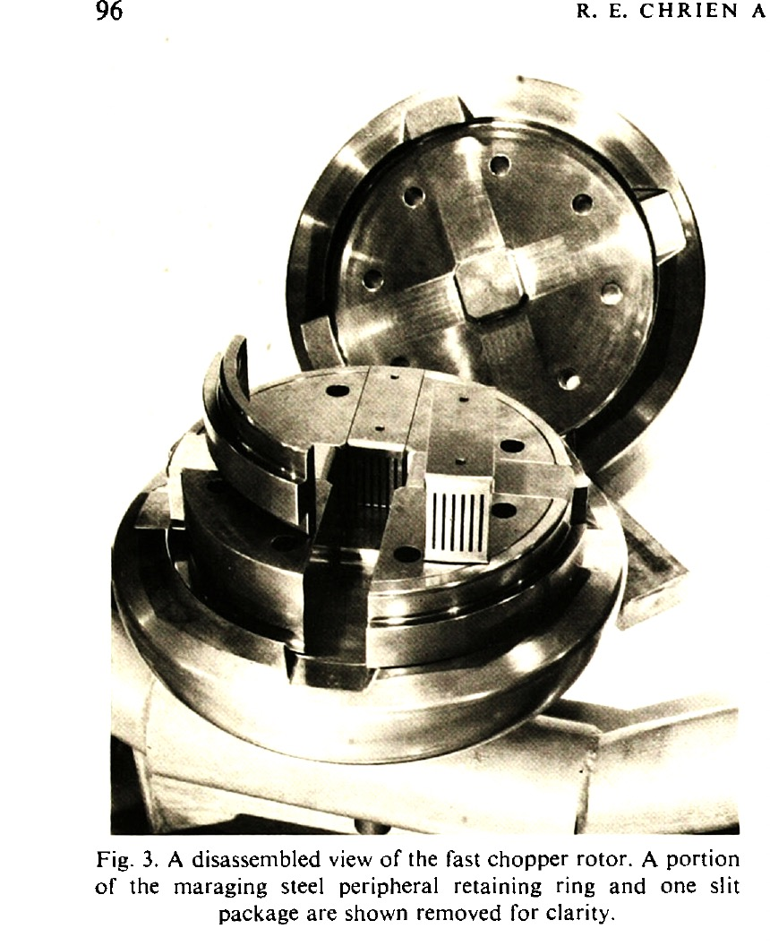
eV neutrons spectroscopy has been done at reactors
ESS duty factor 4%
Fluxes X 25!

Slide 9
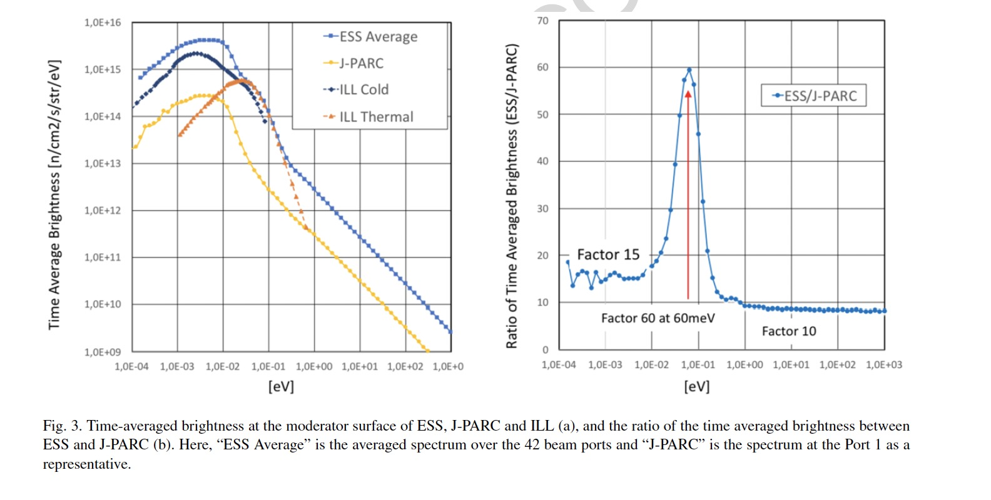
The time-average ESS epithermal brightness is 10 times JPARC how much can we have in TOF?
(M. Arai et al., Journal of Neutron Research 22 (2020) 71–85)

Slide 10
Preliminary chopper ideas
L
High frequency reached by using 2 counter rotating choppers at 600 Hz
Extract multiple pulses from 1 2.86 ms long pulse
More ideas under consideration to increase the efficiency above the present 1%
T
Chopper frequency | Bin width | resolution | transmissionfor 1 pulse | # pulses in 2.8 ms | Total beam fraction used
1200 Hz | 30meV | 5% | 2 10⁻³ | 4 | 8 10⁻³

Slide 11
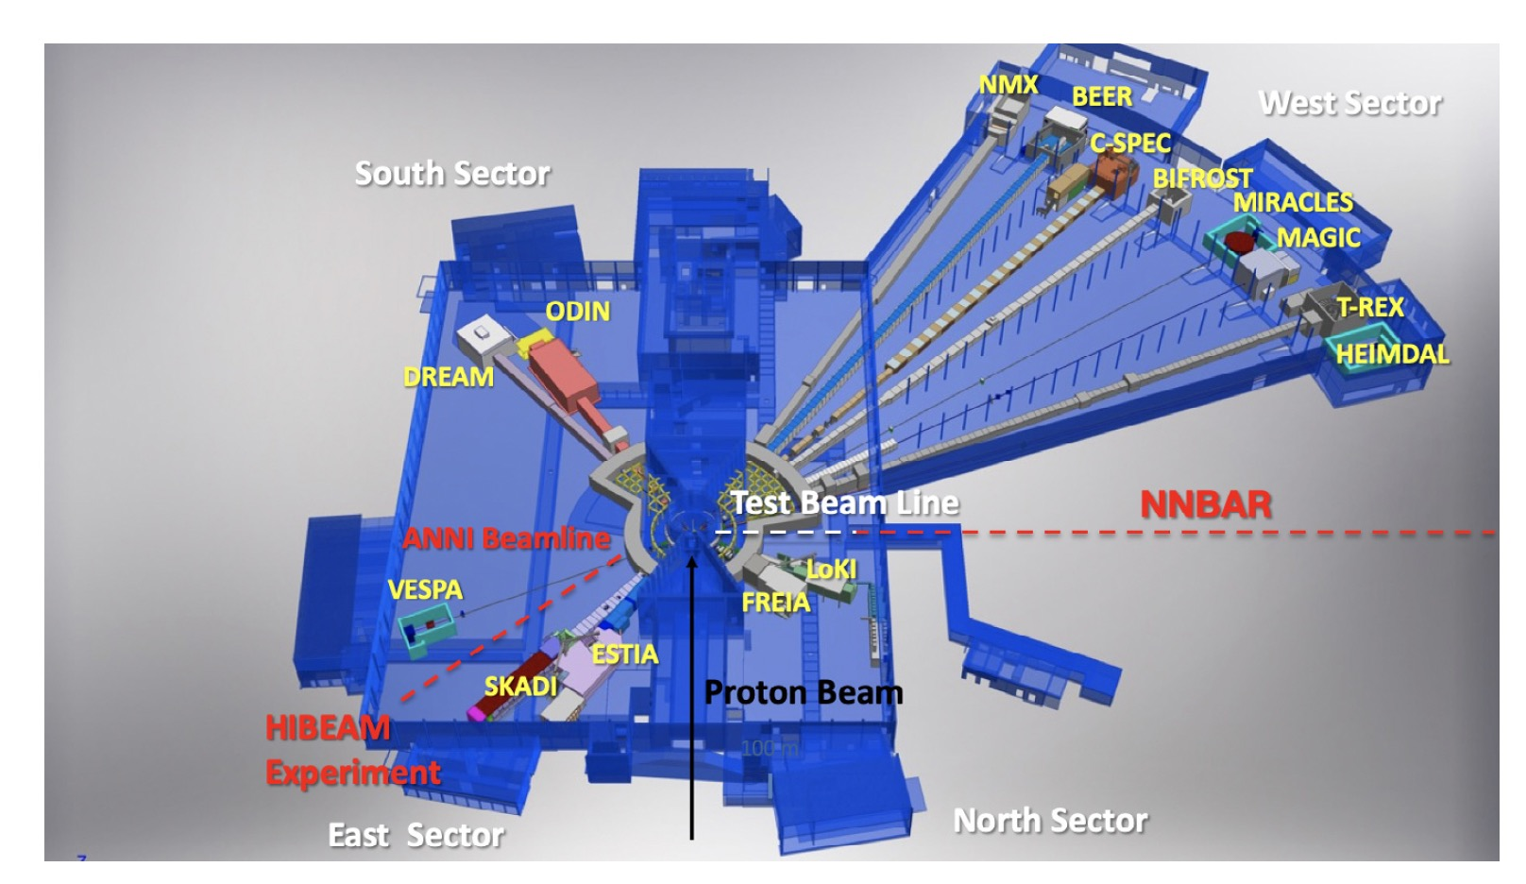
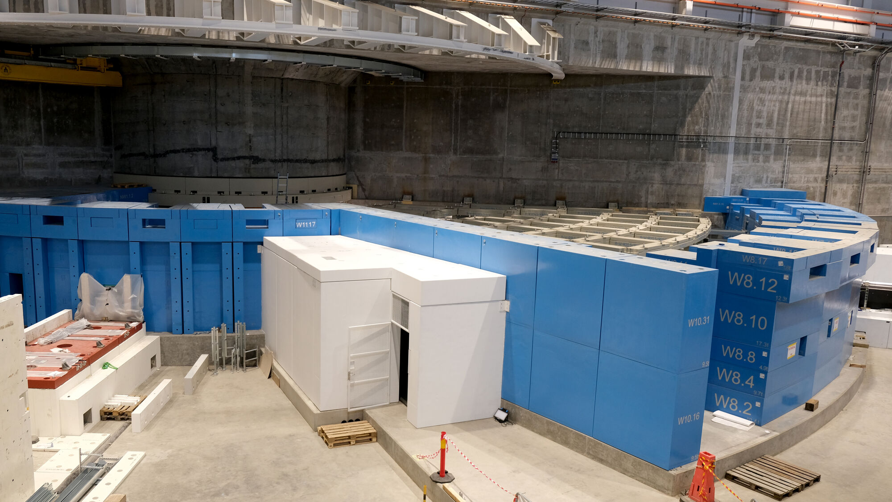
Measurements could be done at the ESS Test BeamLine

Slide 12
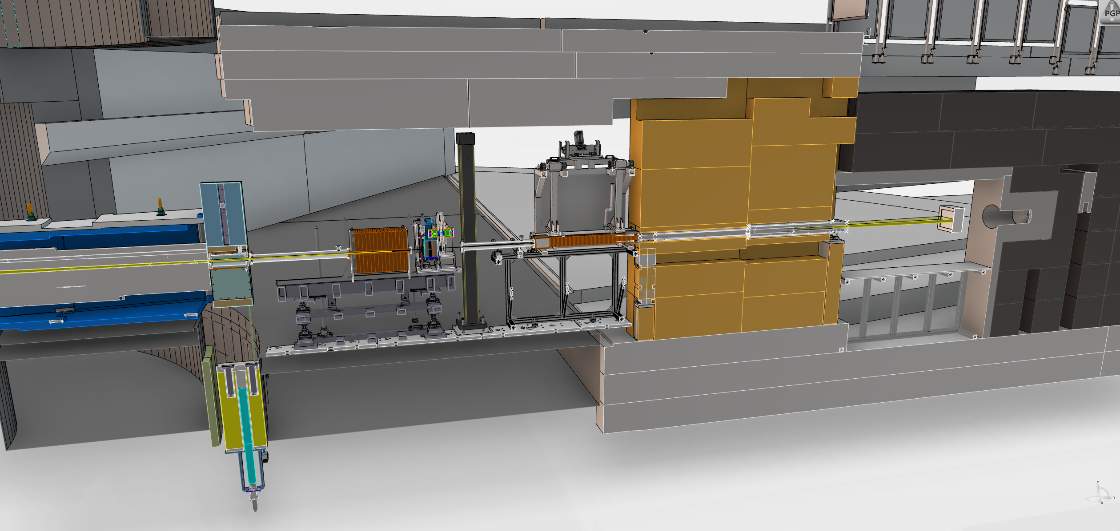
The Test Beamline
Position of Filter Stage
(not yet designed)
Detector, 17m
Double Disk Chopper and Adjustable Collimator
Neutron beam
Fixed Collimator
Heavy Shutter

Slide 13
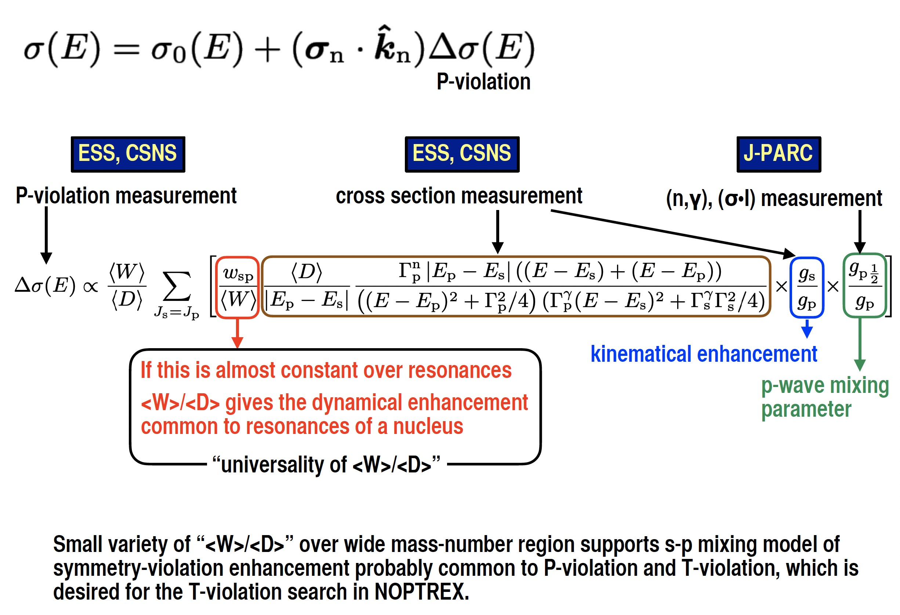
A possible research program on refined P-violation studies by J-PARC, CSNS, and ESSS

Slide 14
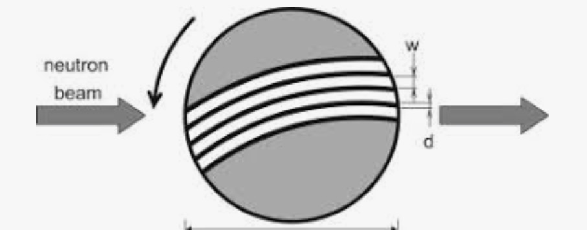
A workshop on eV neutrons at ESS?
neutron P/T violation,
neutron resonance quantum # identification
Measurements with
resonance integrals
…
Choppers
filter difference method
Crystals
Techniques for eV neutrons
Fundamental
physics
feedback from existing facilities and projects
.
filter difference neutron spectroscopy (VESUVIO)
Imaging (2D, 3D elemental mapping)
Neutron
scattering
BNCT
Cross section measurements
Fill in
Other ideas?
Integral measurements
TOF measurements

Slide 15
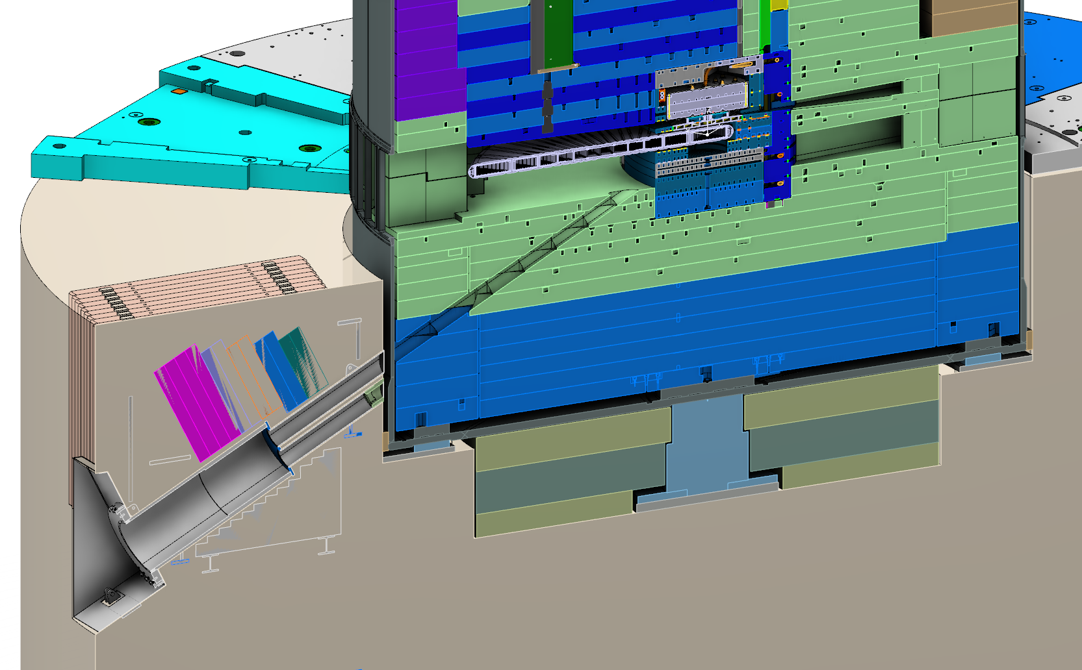
ECHIR: a beamline to directly see spallation neutrons from the target
Base Plates
Target Wheel
Moderator
Vessel
Inner Shielding
Monolith
ECHIR Opening
ECHIR Shielding
5.5 m
Vessel Support
Ground Shielding
ECHIR Pipe Structure
35° horizontally
27° vertically
15

Slide 16
(C. Frost, workshop on Fast neutron applications at spallation sources, 2013 Abingdon, UK)

Slide 17
(C. Frost, workshop on Fast neutron applications at spallation sources, 2013 Abingdon, UK)

Slide 18
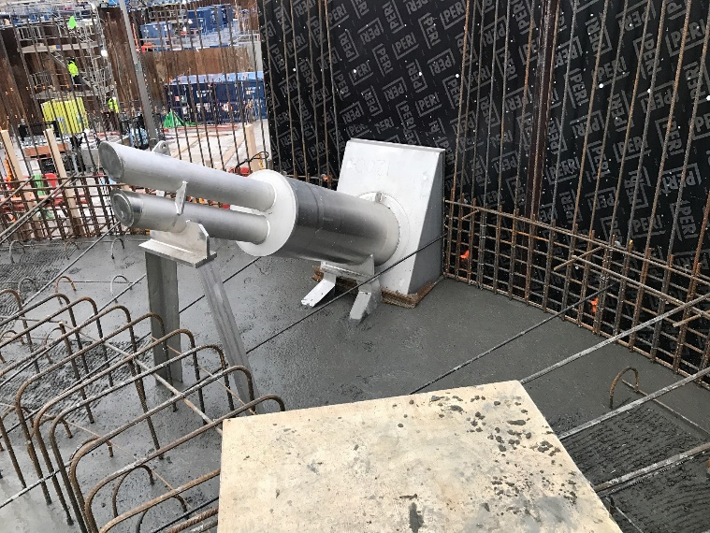
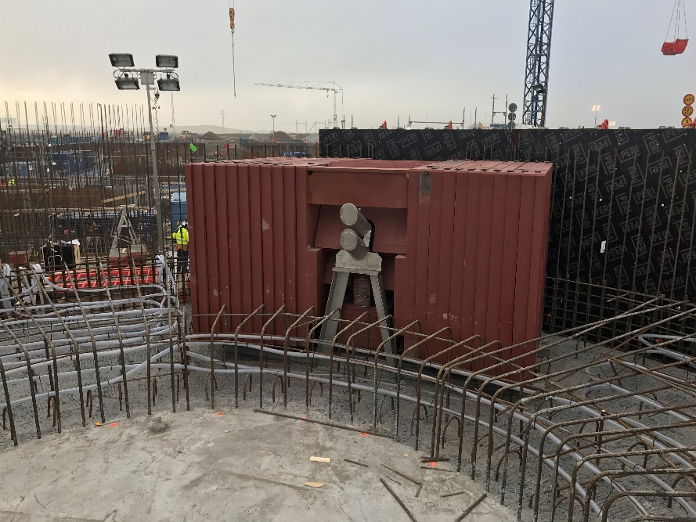
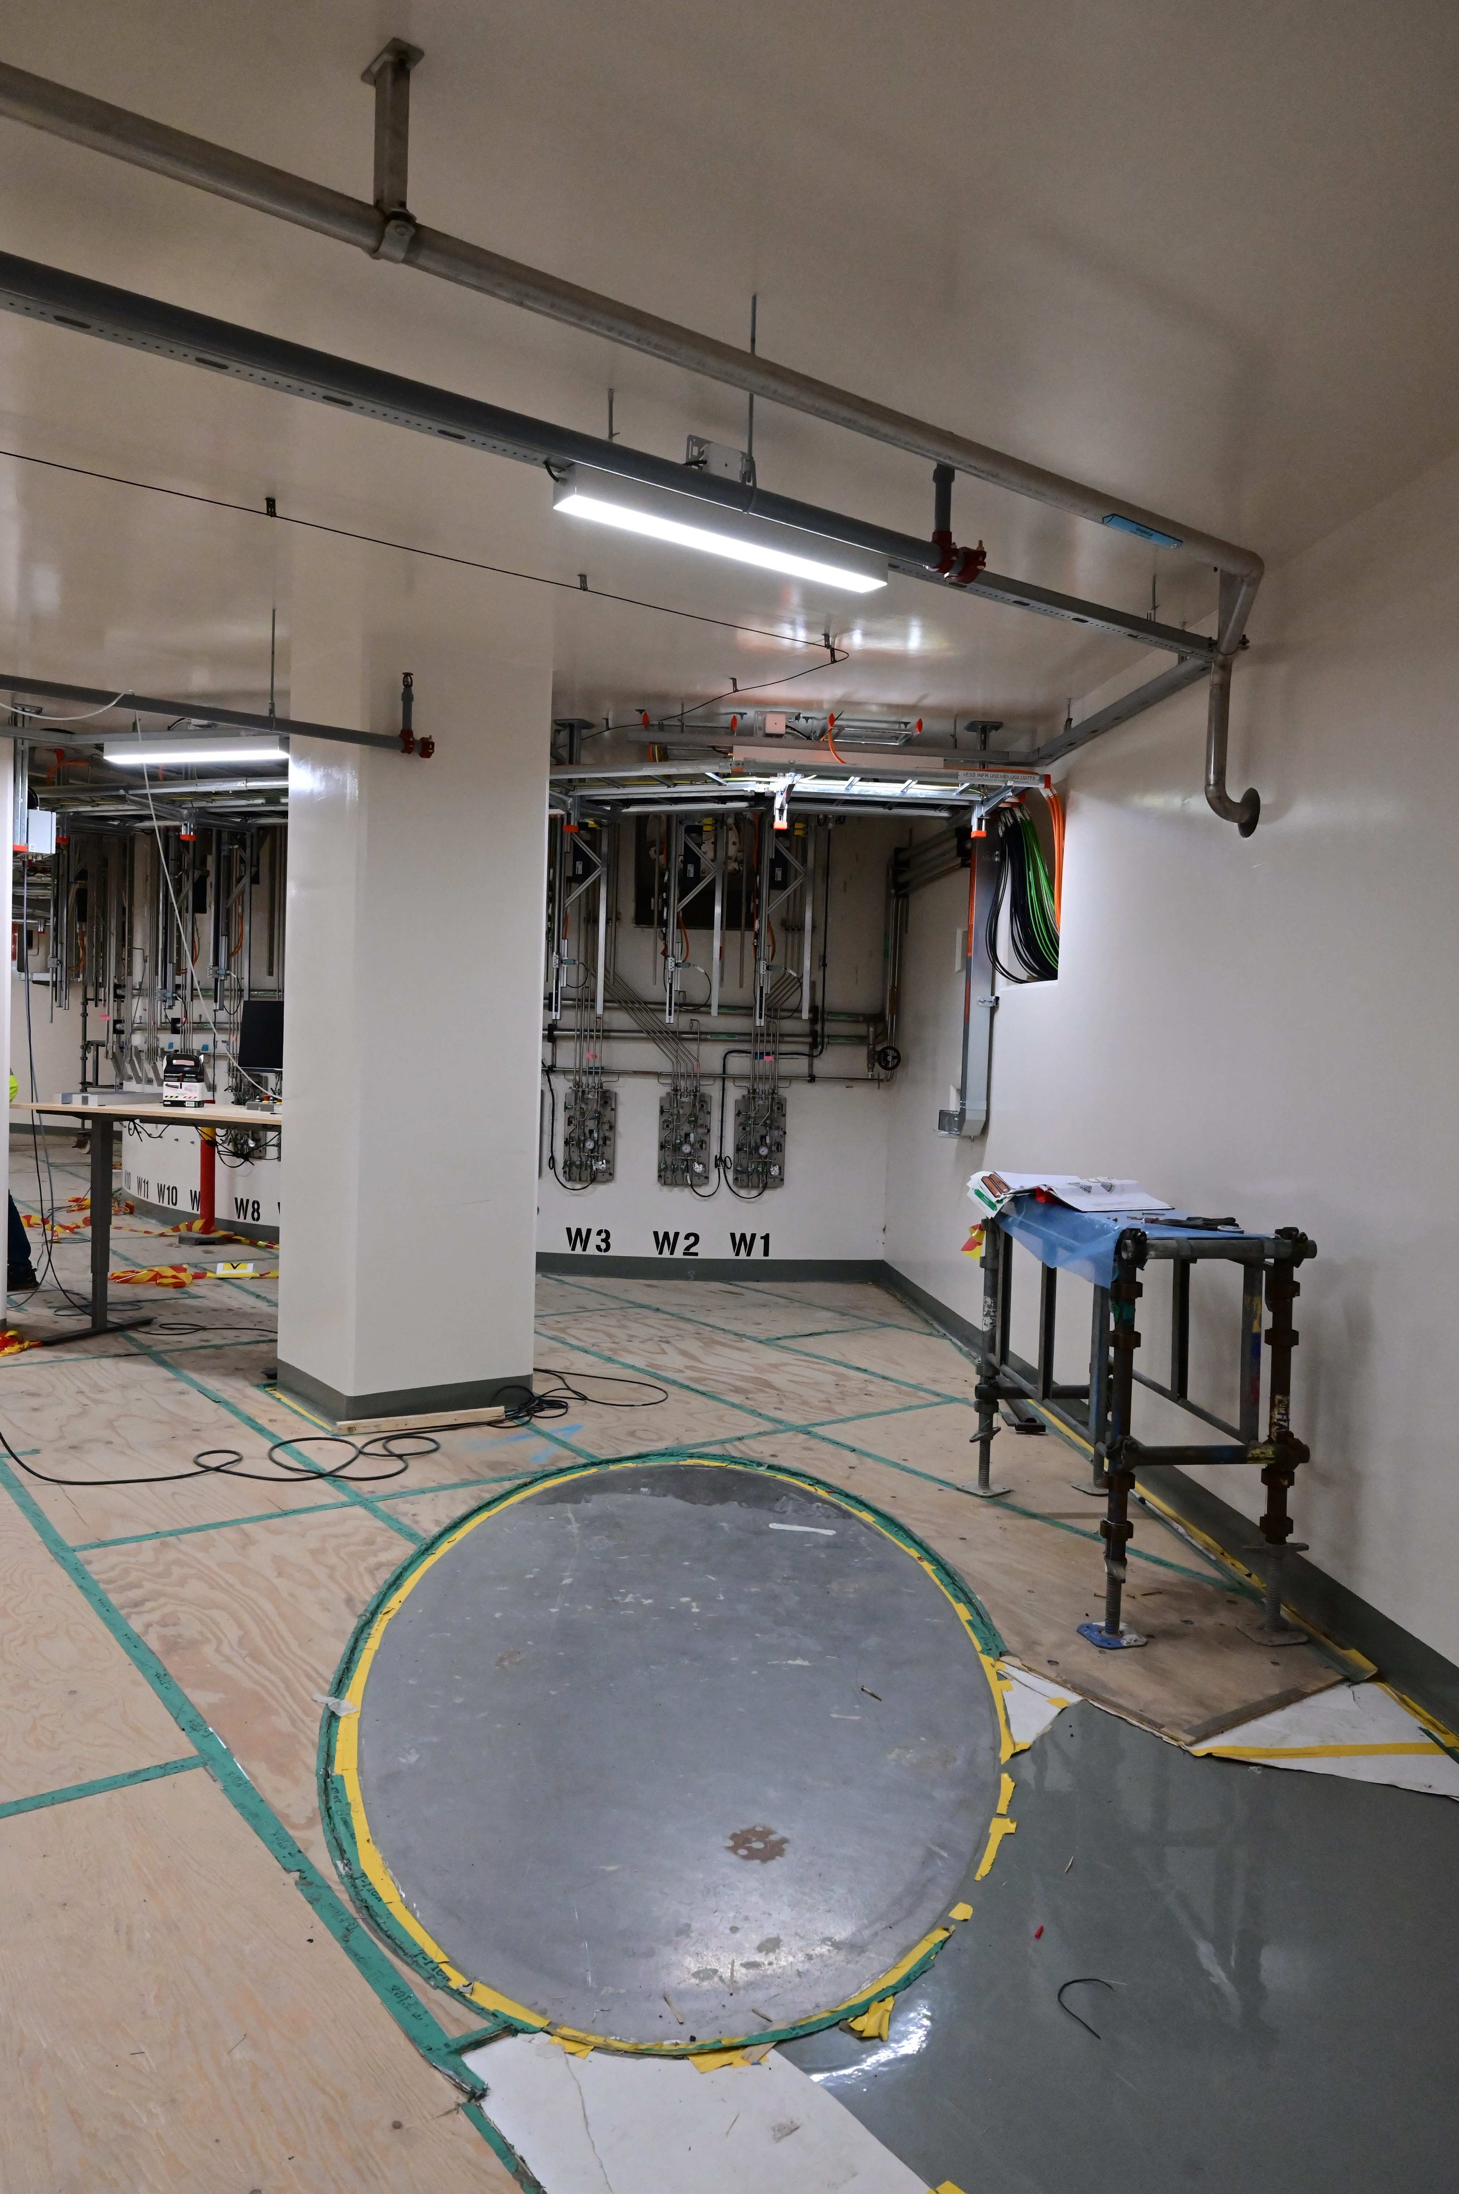
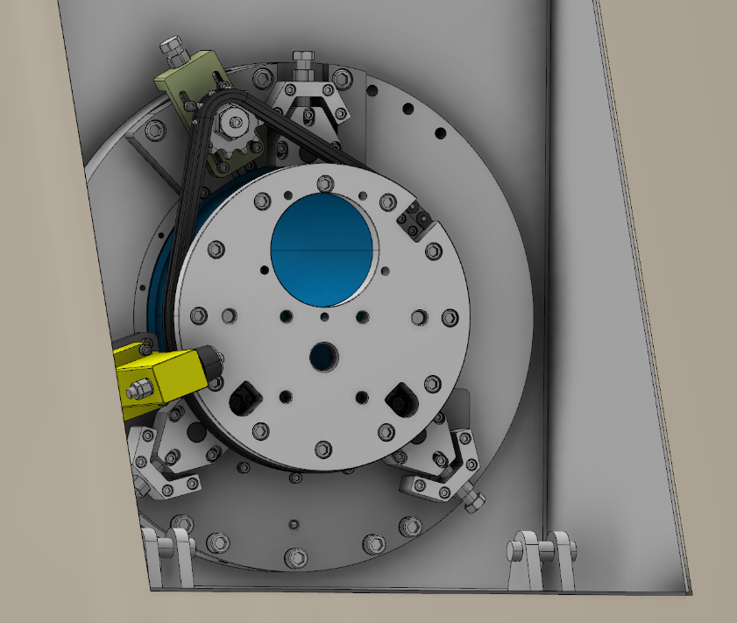
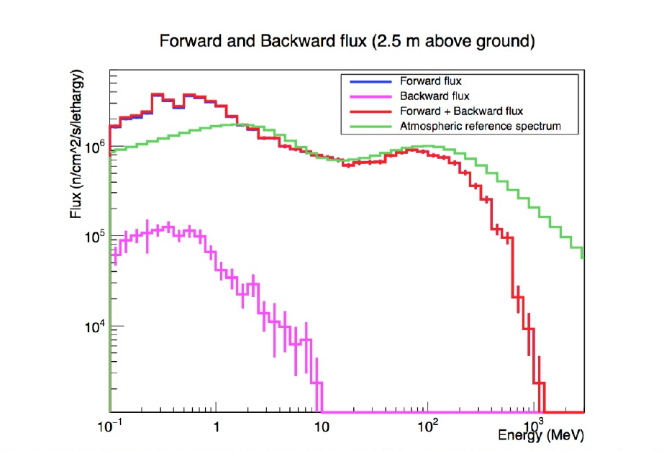
ECHIR has been partially built
shutter
Experimental room
Extra shielding
Beam dump cover
Atmospheric flux multiplied by 10⁹ to match ECHIR spectrum
Flux above 10 MeV about 10⁷ n/cm2/s

Slide 19
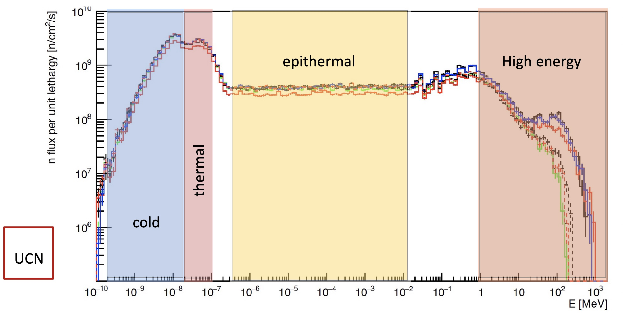
Conclusions
Fundamental physics with epithermal neutrons at ESS has strong potential
Experiments could be performed at the Test Beamline at relatively low cost
We invite the particle physics community to consider ECHIR (E > 1 MeV) to support their experiments (e.g. test detectors)
Particle physics can use of the full ESS n spectrum
nEDM
τ_{n}
…
ANNI
HIBEAM
NNBAR
…
P-T tests
…
Irradiation
and tests
components
…

