Slide 1
BIFROST update – STAP 22nd of October 2024 Rasmus Toft-Petersen, Lead scientist Liam Whitelegg, Lead engineer Greg Tucker, Data scientists Tamires Gallo, Instrument operations engineer Kristine Krighaar, PhD student (KU)

Slide 2
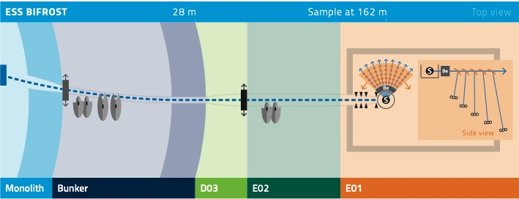
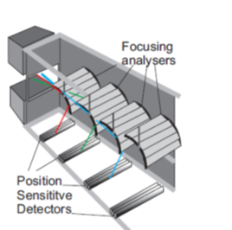
BIFROST: Indirect ToF with energy-multiplexing backend
Indirect neutron spectrometry: Fix the final energy via analysers, use time-of-flight to measure the incident energy

Slide 3
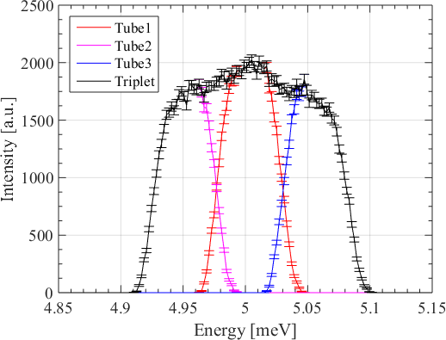
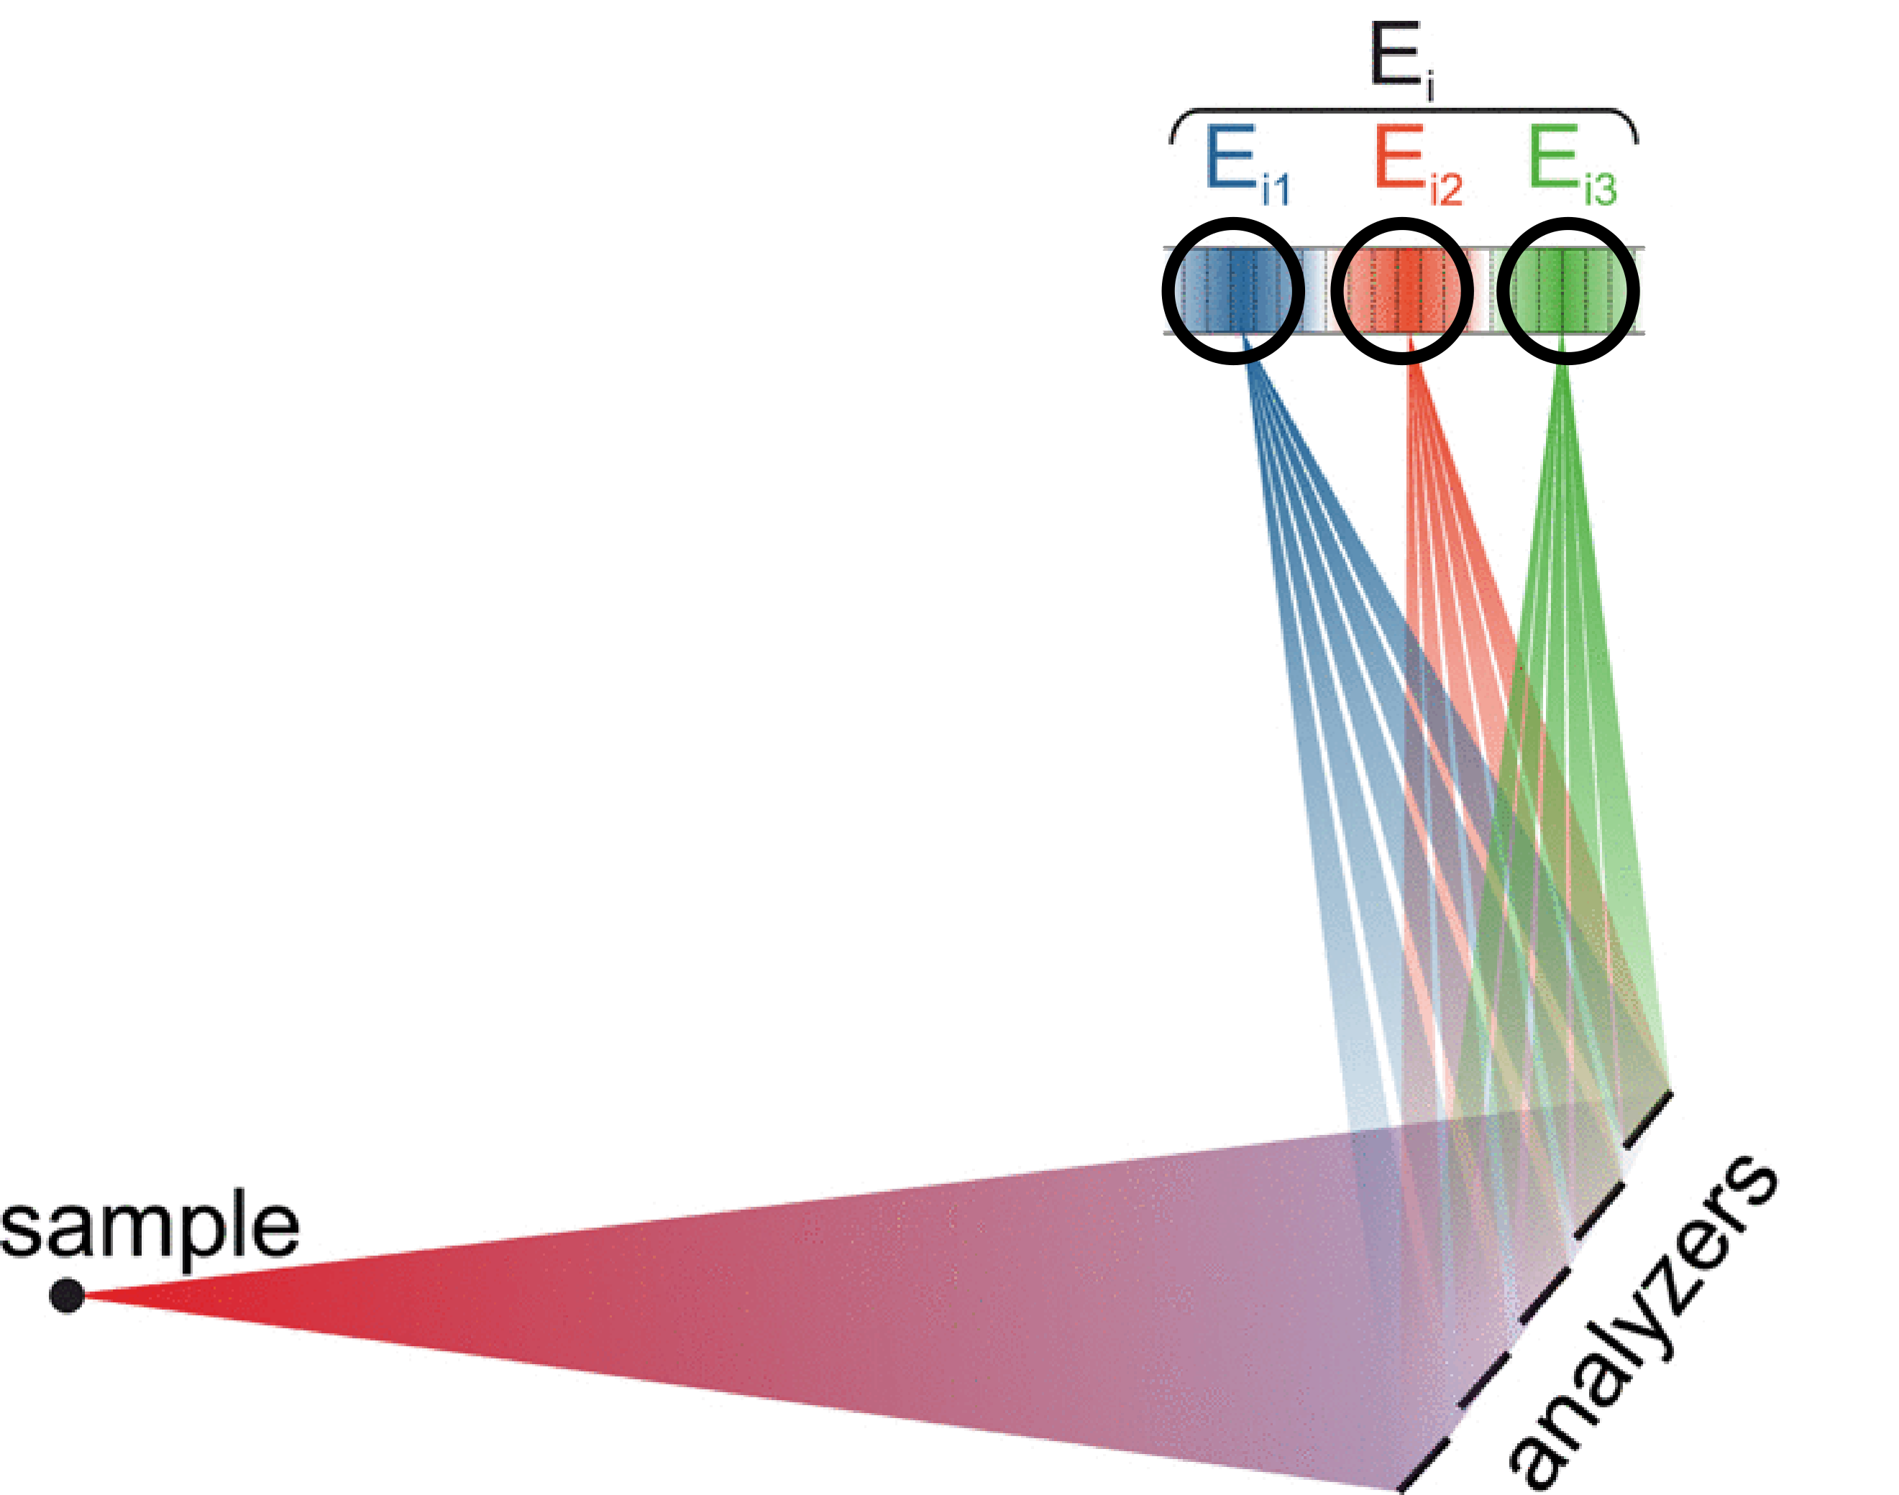
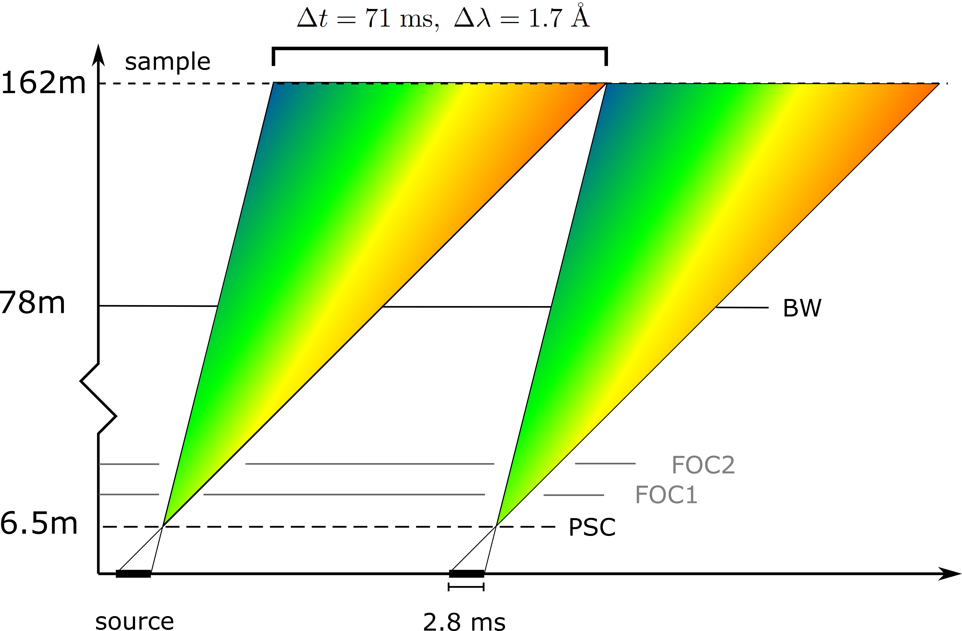
BIFROST: ToF frontend – multiplexing backend
Flux @ 2 MW: 6 · 10⁹ n/s/cm²
Elastic line resolution using full pulse: 170 μeV

Slide 4
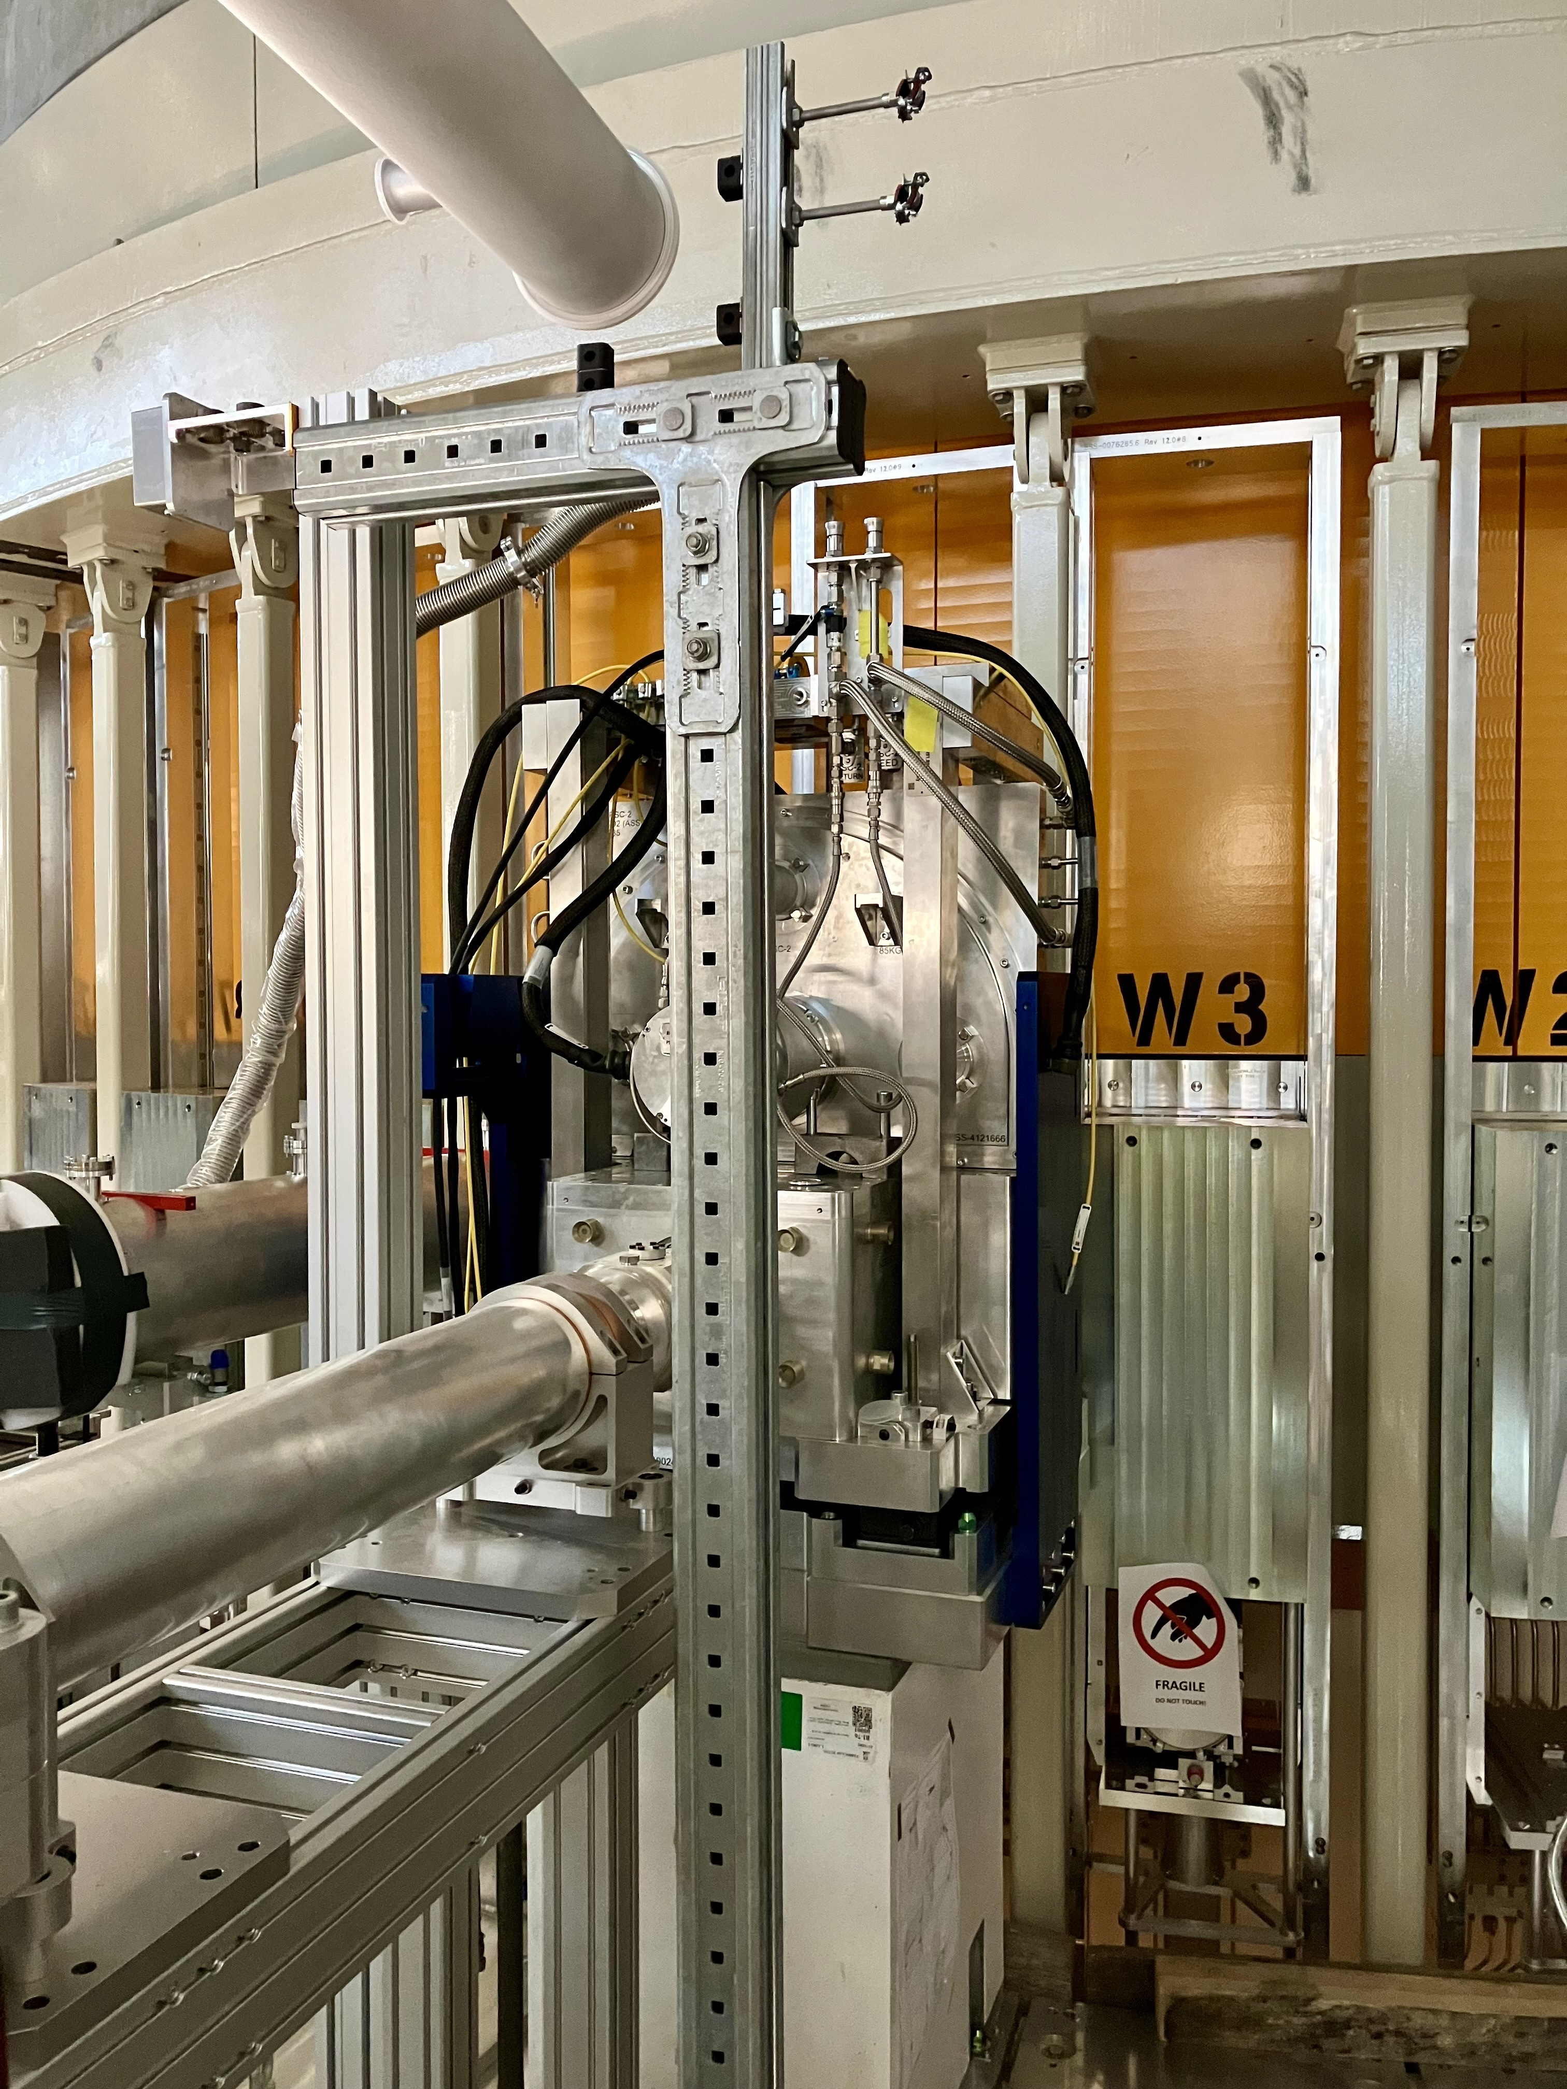
Primary Spectrometer - Bunker
PSC and FOCs installed in the bunker, monitor installed soon
Broken disc -> PSC maximum speed is 126 Hz until new discs are procured and tested
FOC’s are 14 Hz
PSC commissioning will be a challenge
Missing instrument deliverables
Beam Monitor 1
Vacuum snorkels for guides
Minor rework needed
Missing ESS deliverables
Cable installations
Cabinet installations
No commissioning feasible
until at least Nov 24

Slide 5
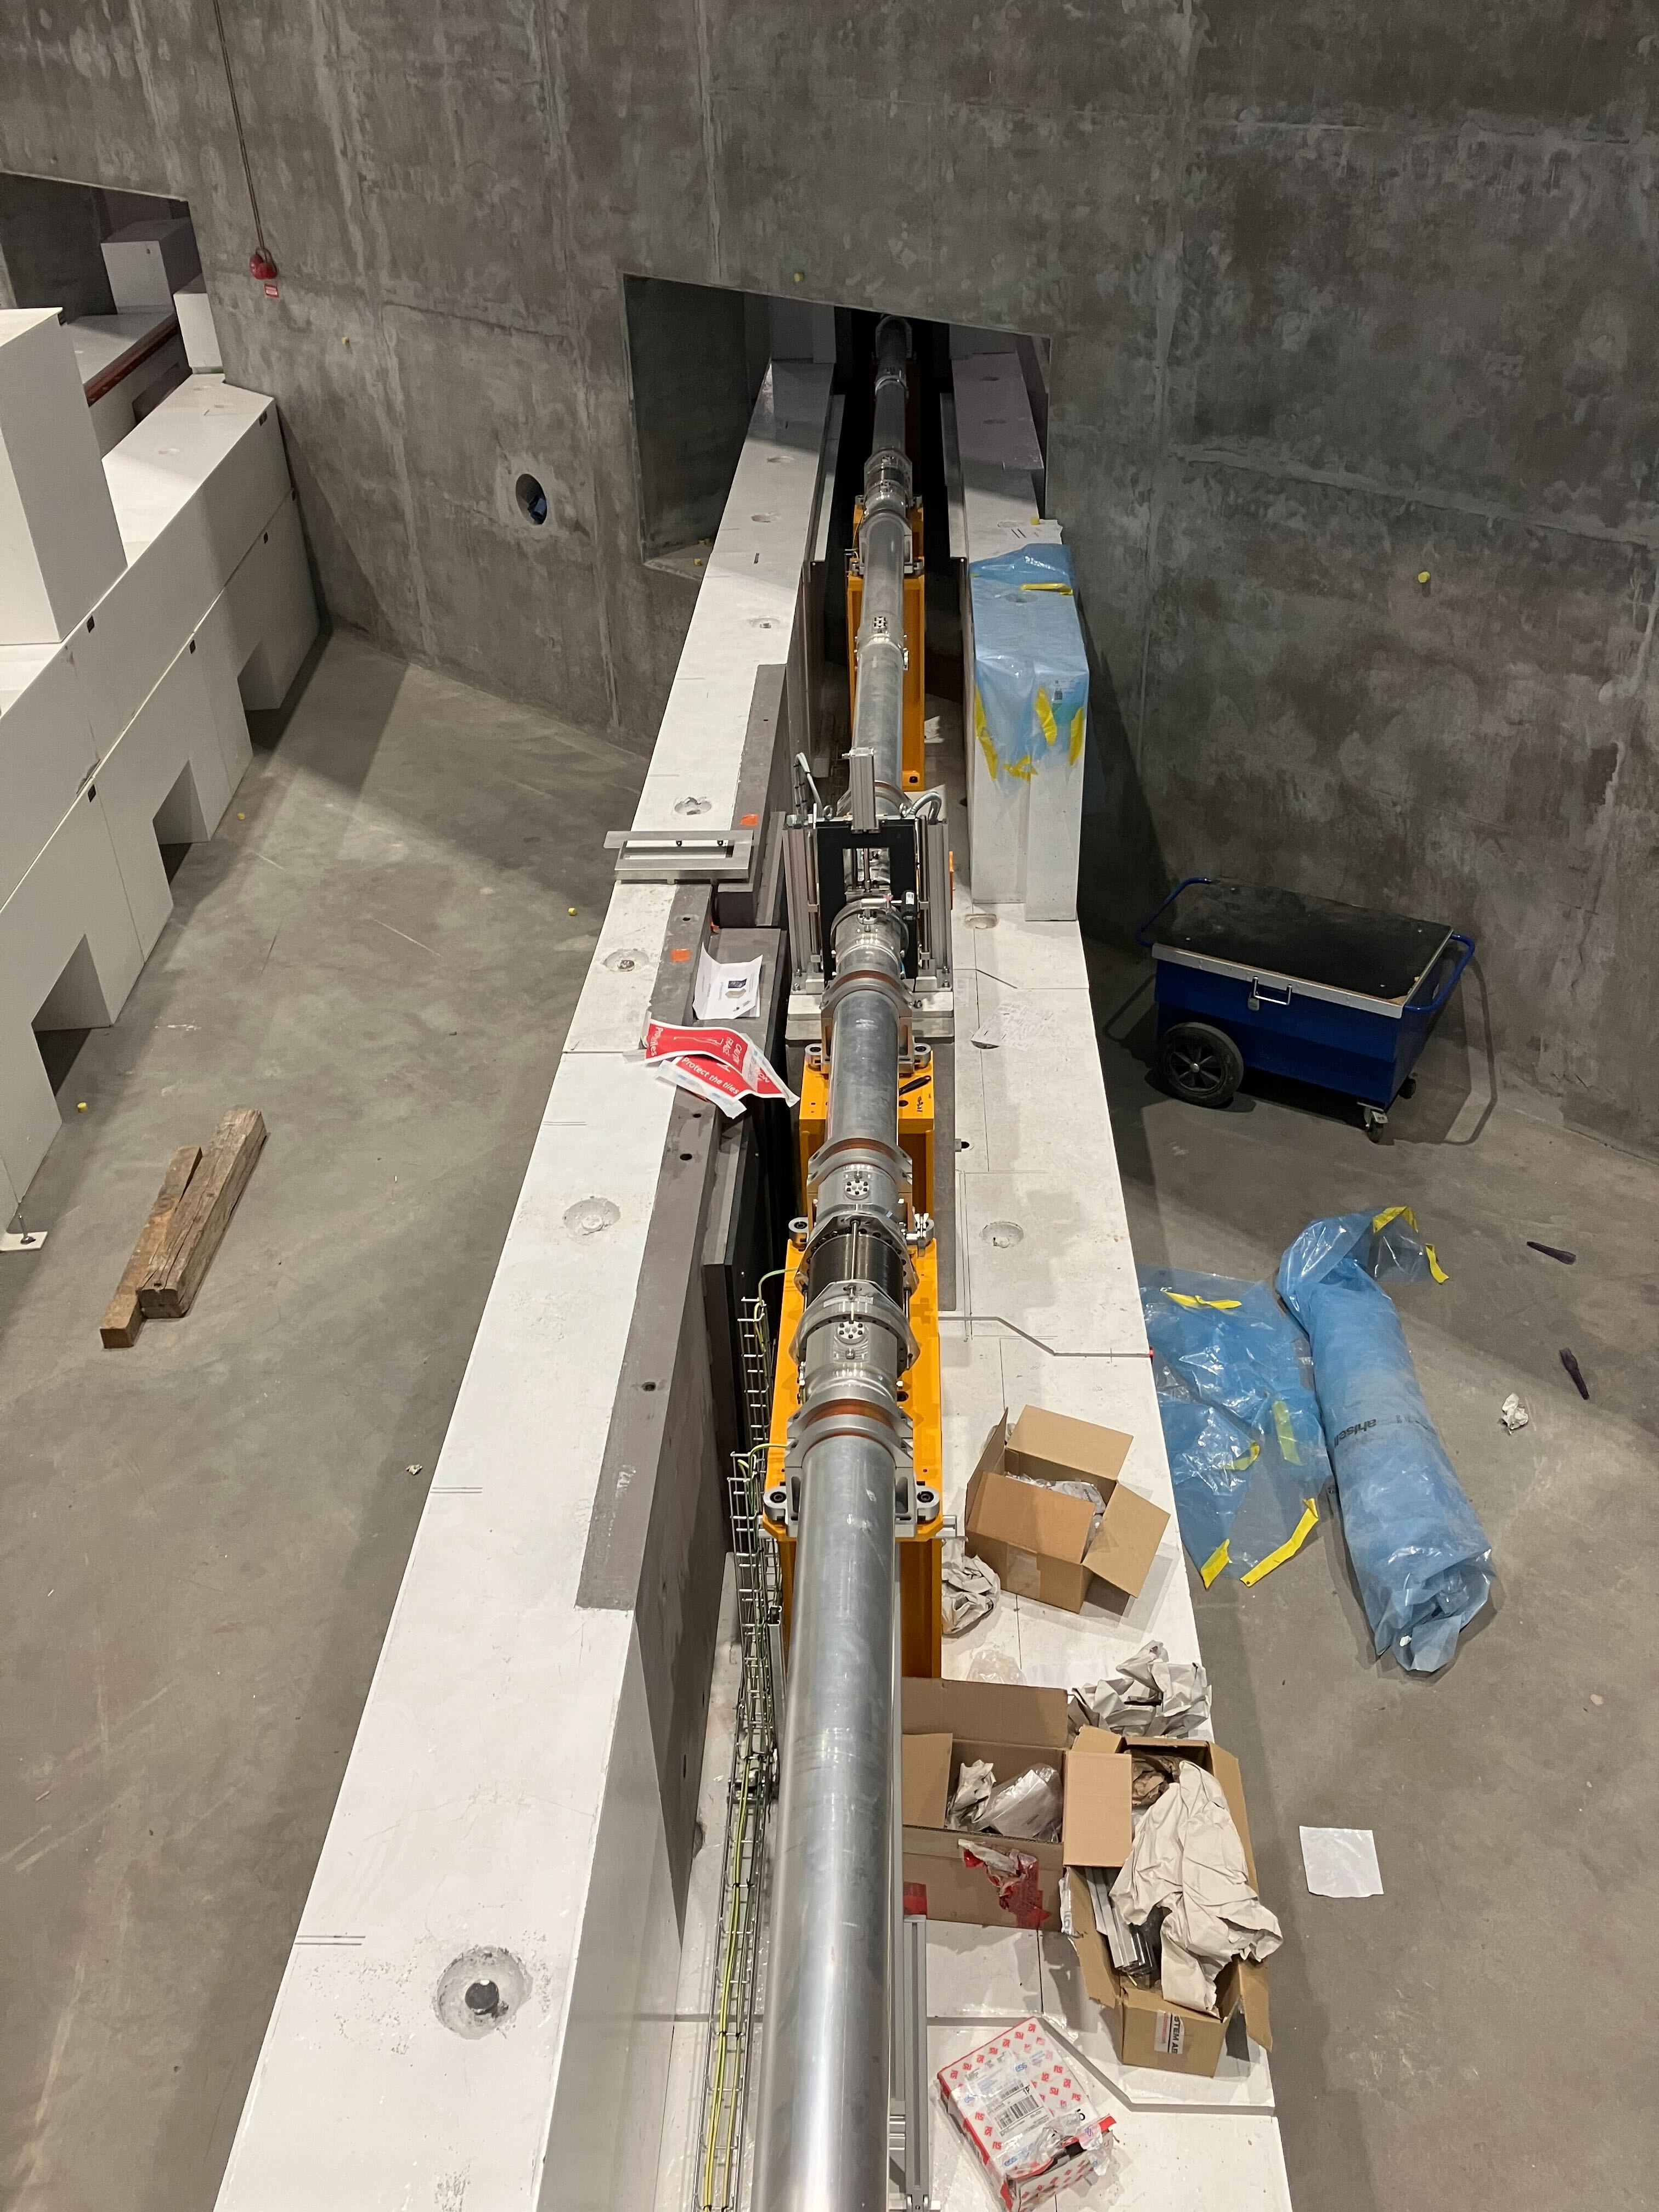
Primary Spectrometer - D03
In D03, we have guide, beam monitor and thermal neutron shutter.
Missing instrument deliverables
Beam Monitor 2 and mechanics
Shutter Q-Gate Tests
Missing ESS deliverables
Compressed air lines
Pneumatics box
Cable installations
Trunking installations
Network installations
Cabinet installations
Certain shielding blocks
No commissioning of shutter feasible until at least Dec 24

Slide 6
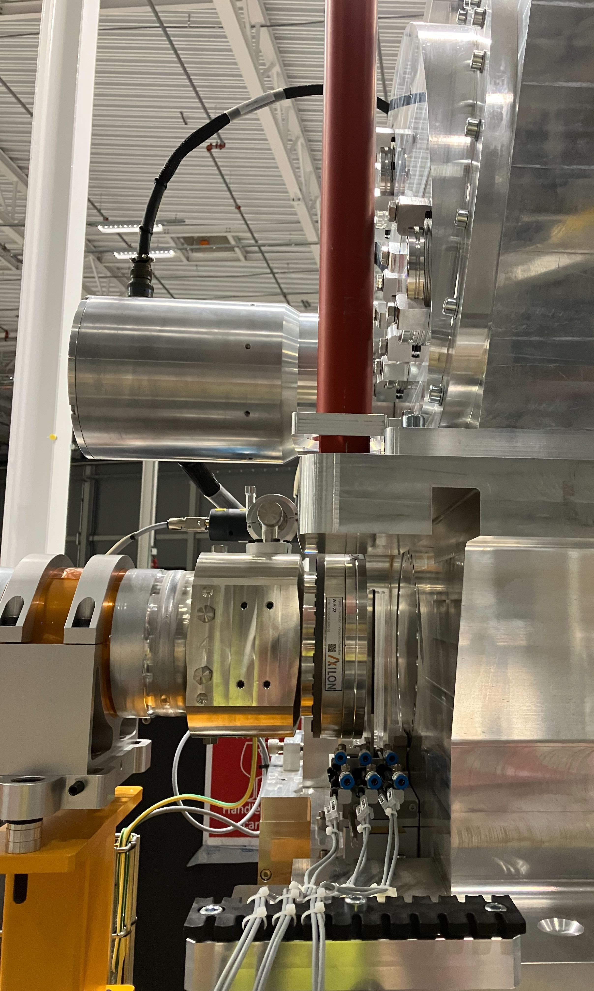
Primary Spectrometer - E02
BW chopper essentially commissioned
Beam Monitor 3 installed
False floor rebuilt
Attenuator installed
Missing ESS deliverables
Final media connections
Pneumatics box
Wall box energization
Monitor cabinet
Certain shielding blocks
Network

Slide 7
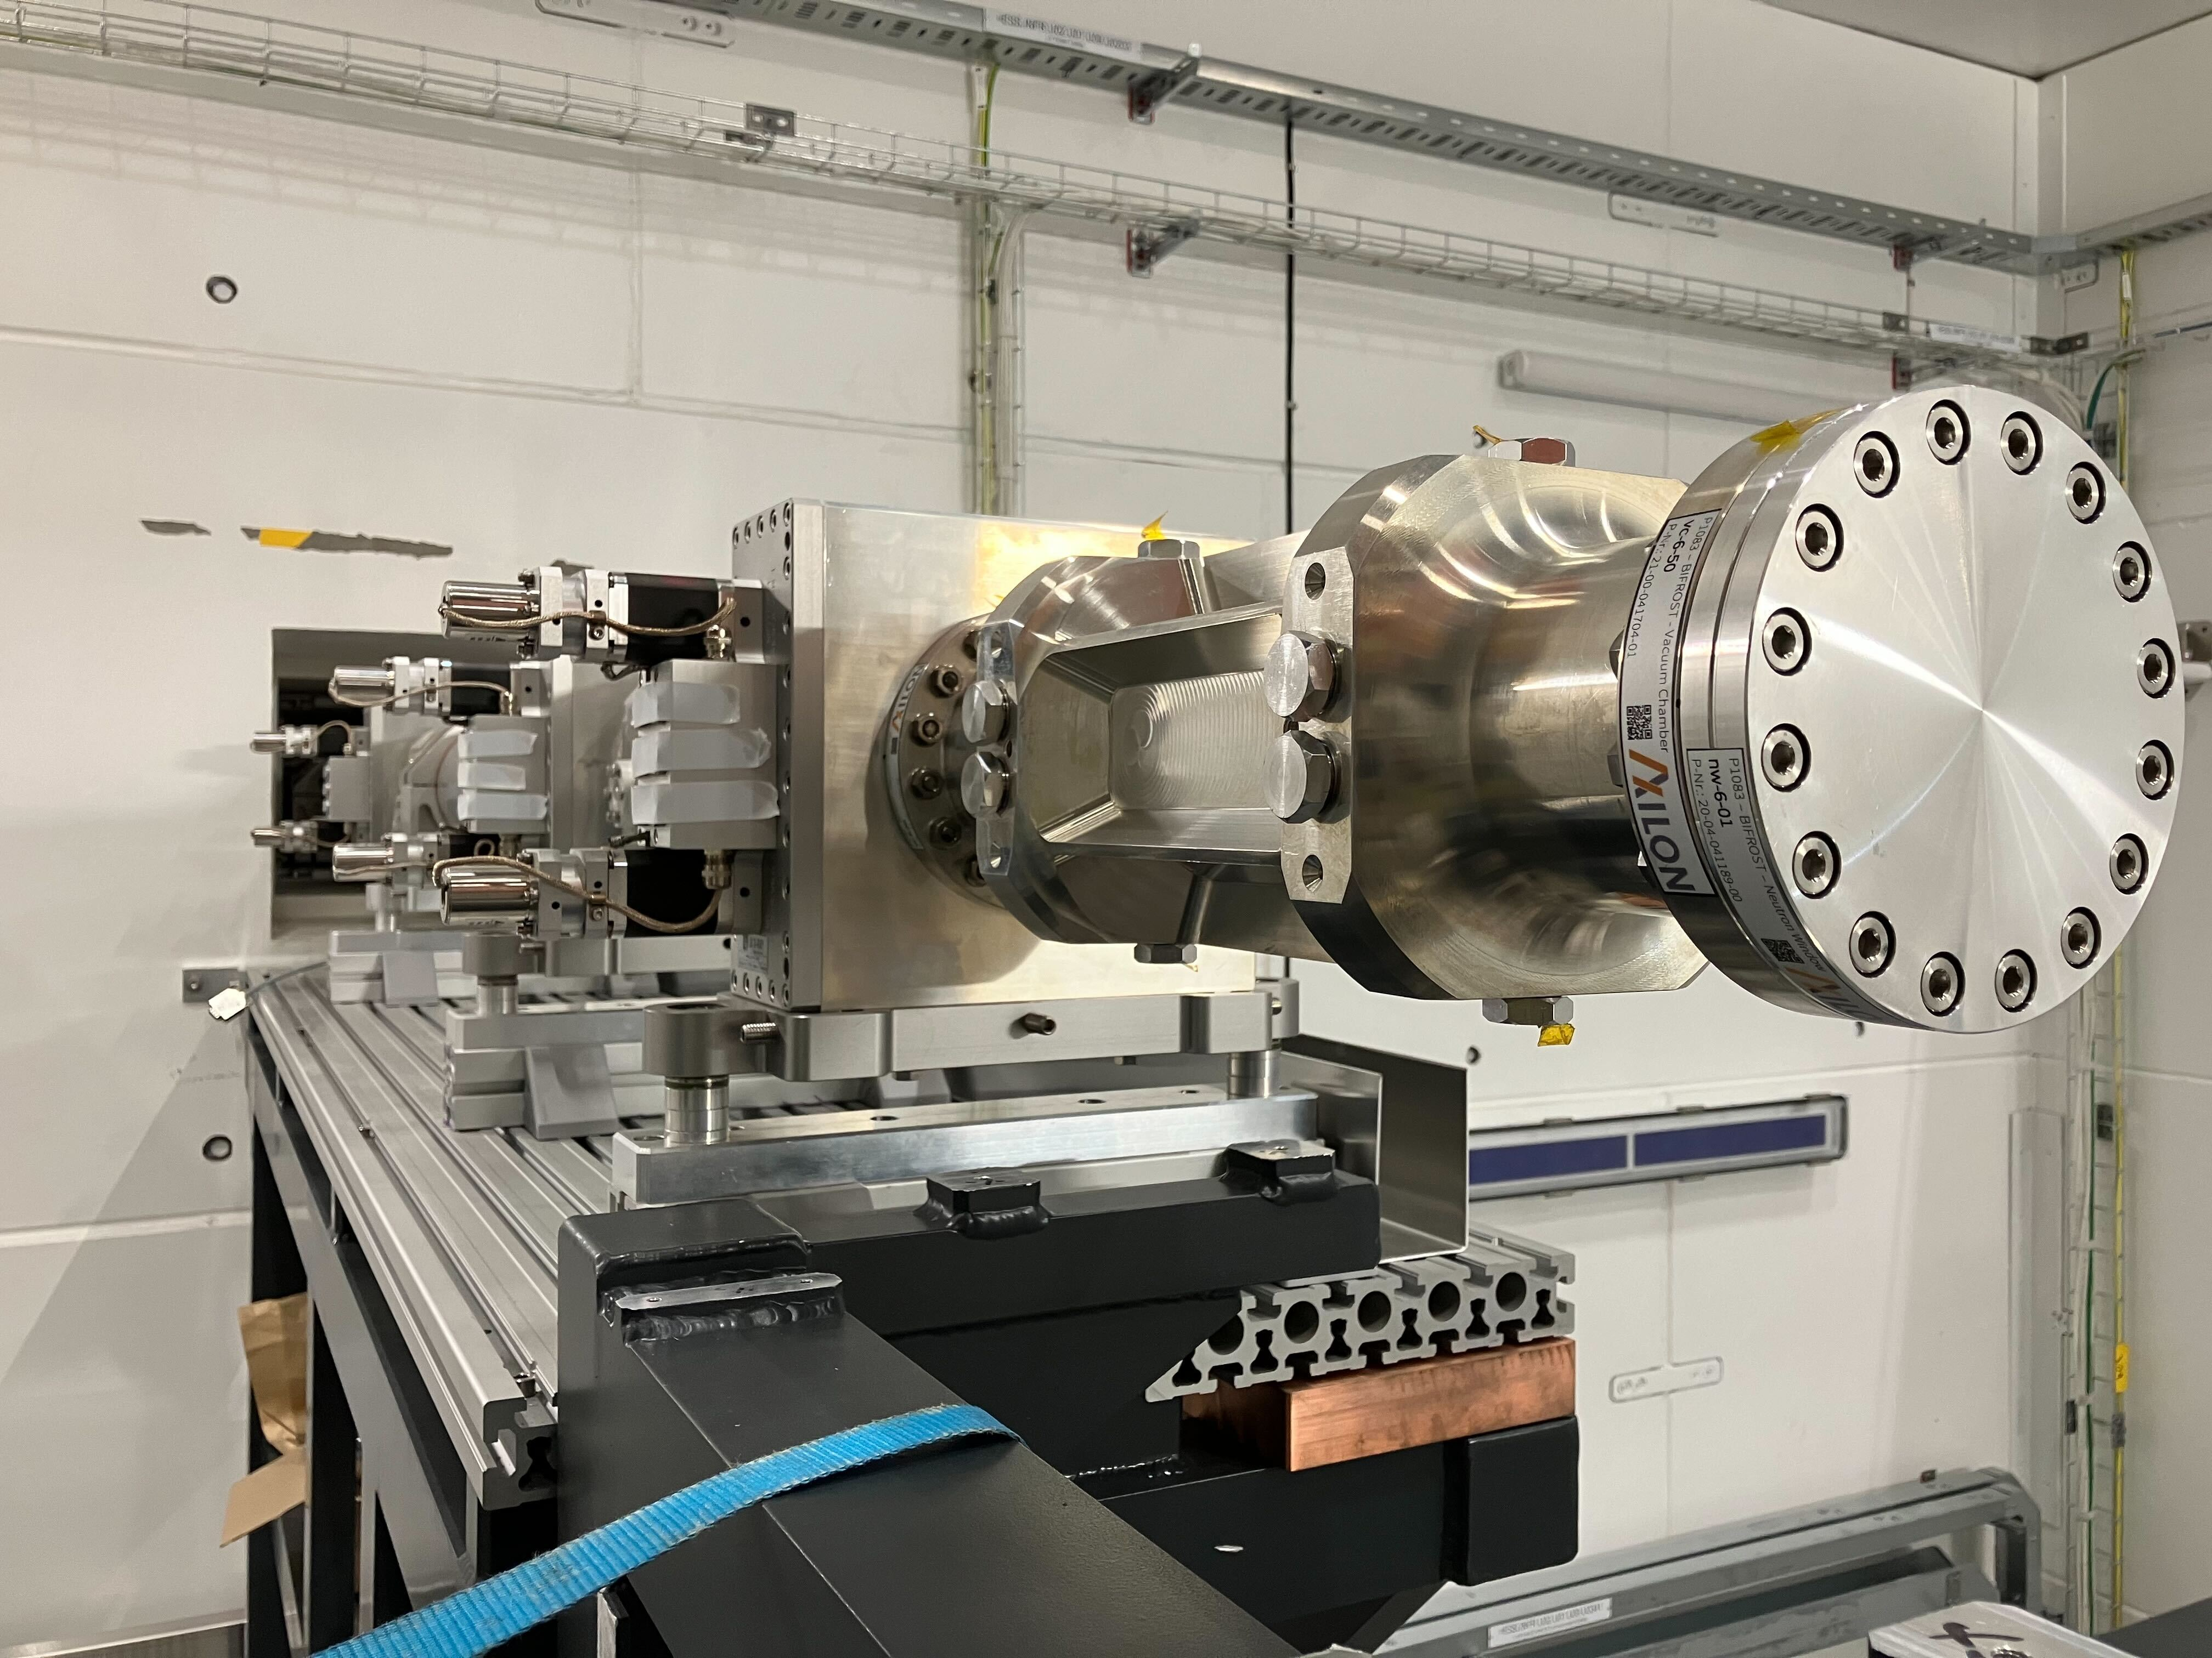
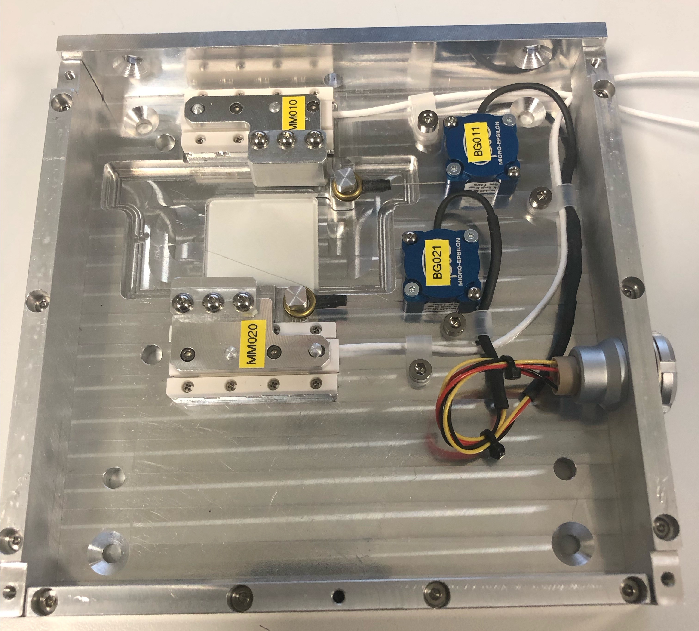
Primary Spectrometer - E01
Missing instrument deliverables
Sample Jaws
Beam Monitor 4
Missing ESS deliverables
Final media connections
Pneumatics box
Motion cabinet energization
Motion cable installations
Monitor cabinet
Network
Picture of cave
No motion commissioning feasible
Yet!

Slide 8
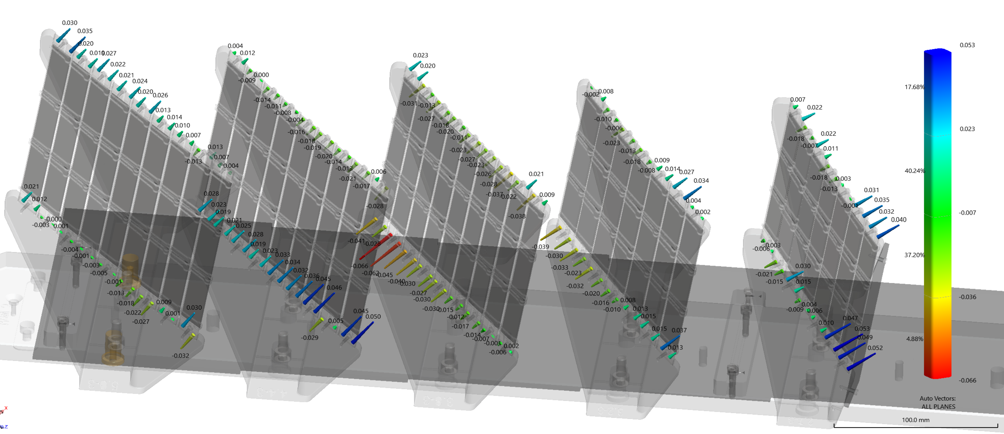
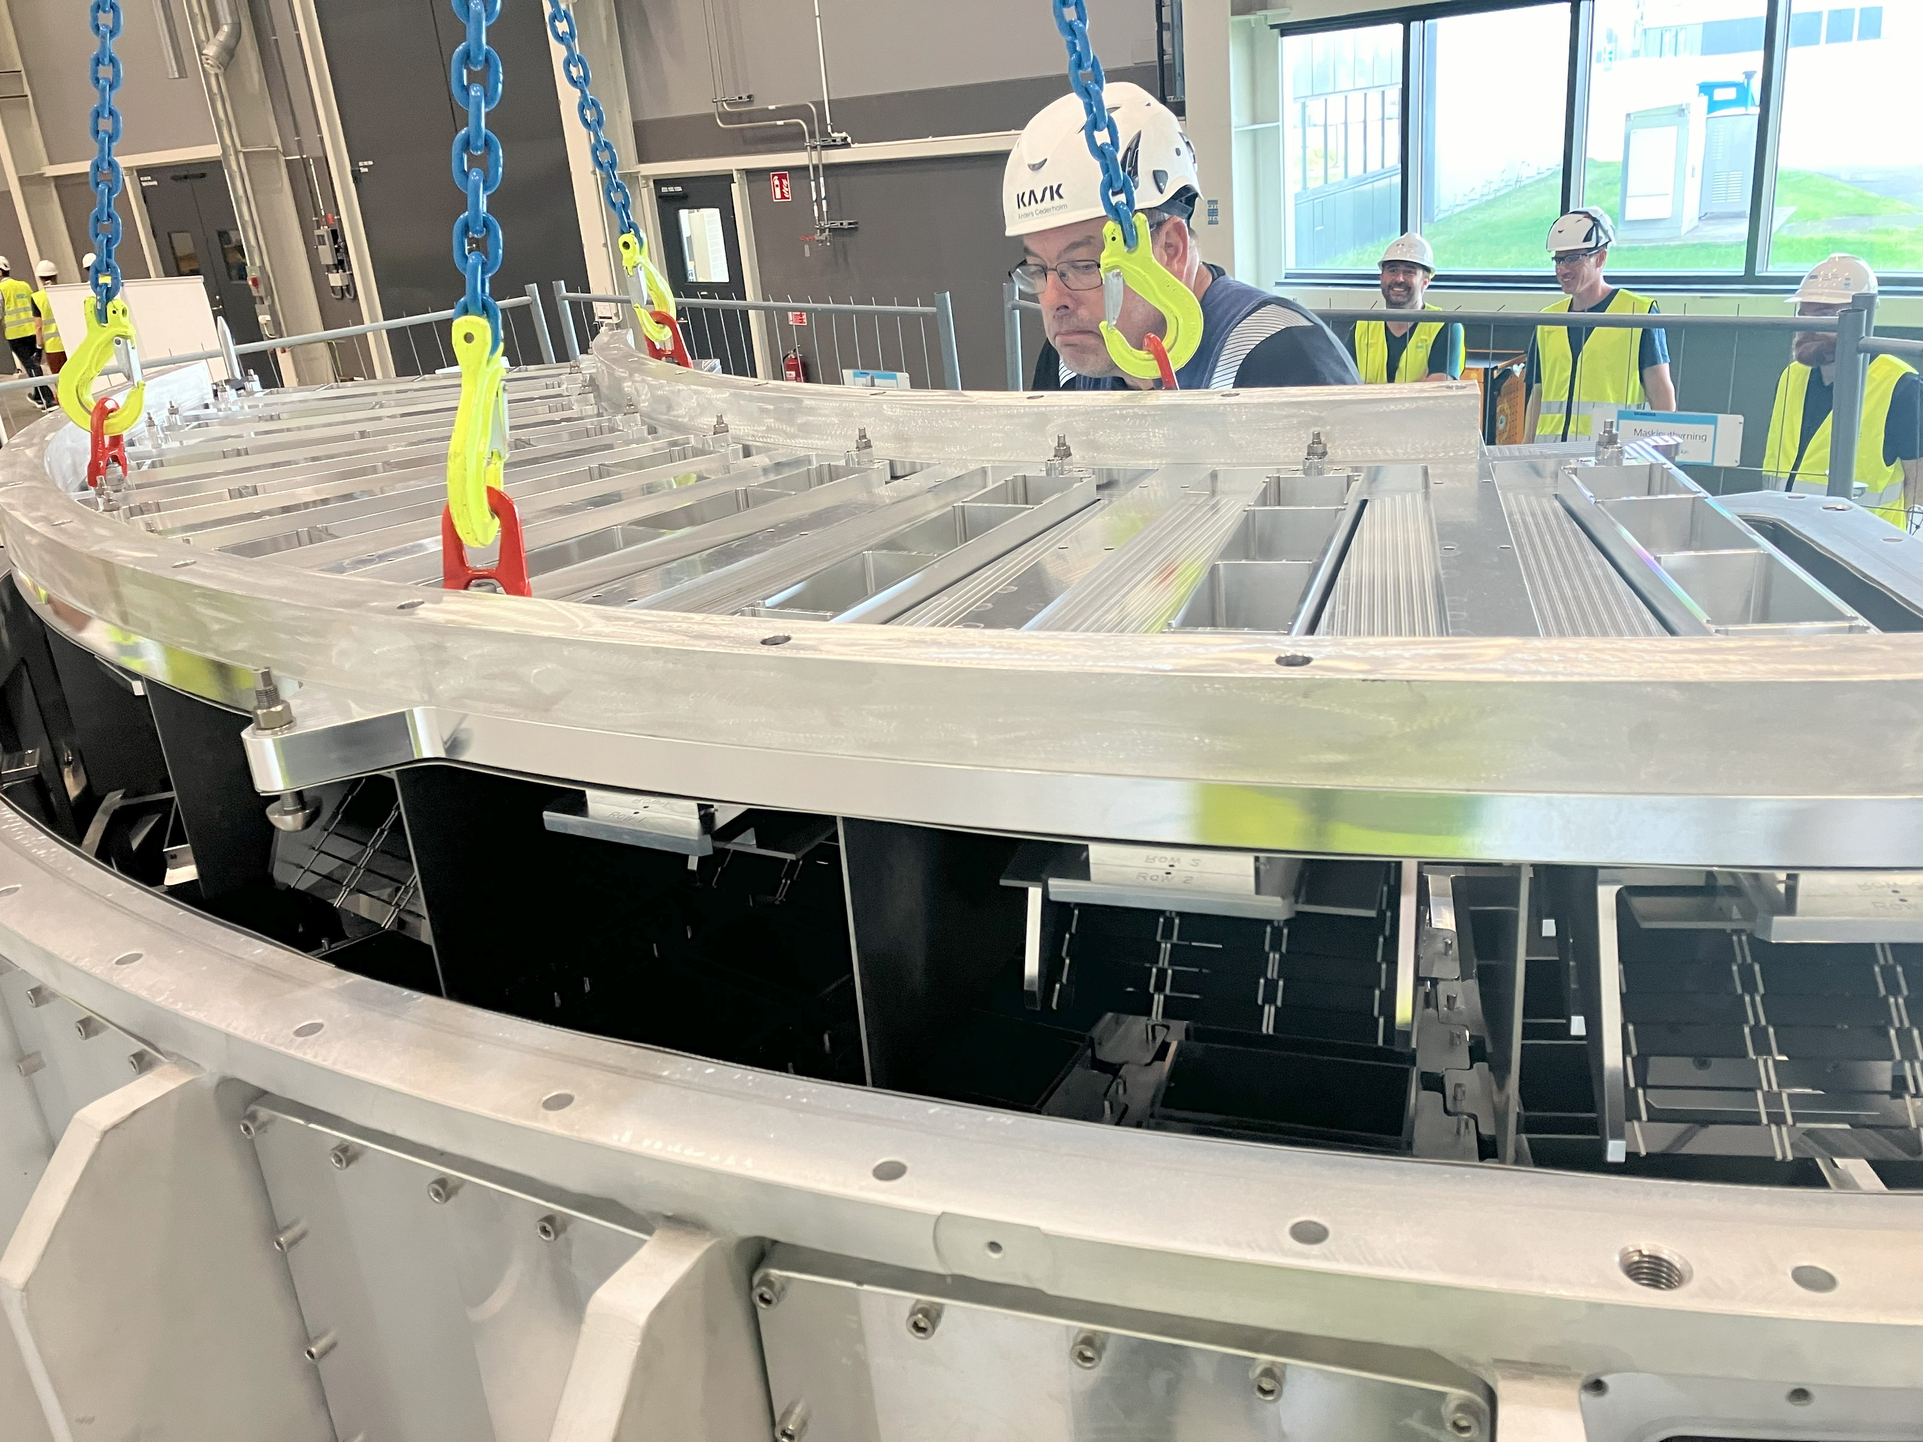
Analysers
Fully assembled on plate
Lots of measurement data
Installed inside vessel last week

Slide 9
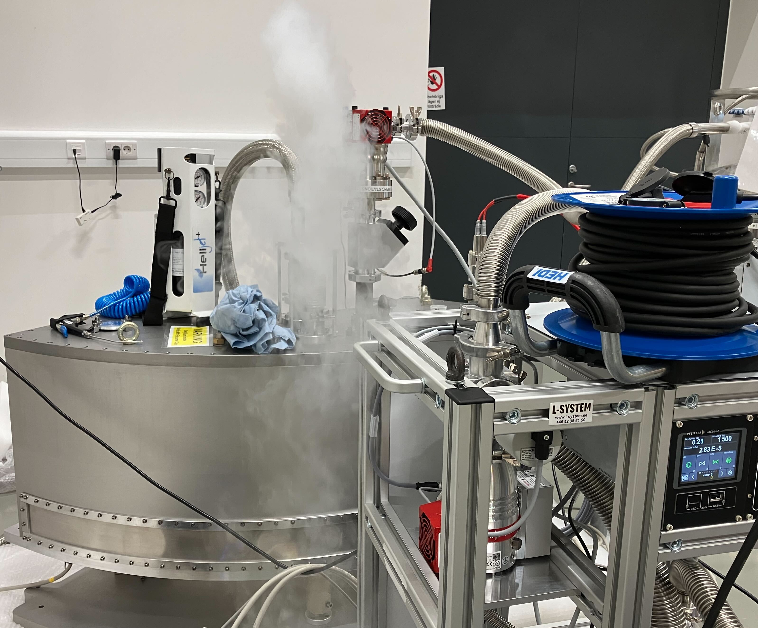
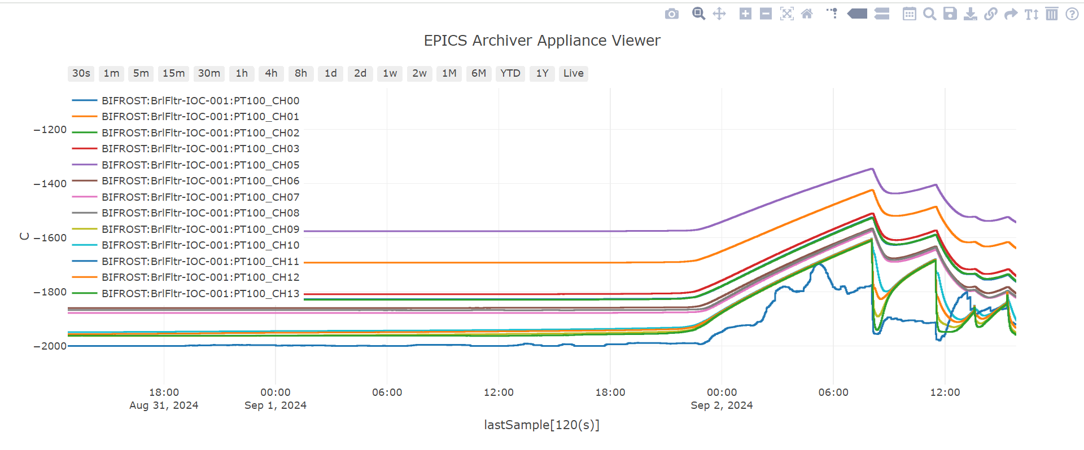
Beryllium Filter
FAT performed in August
Delivered to ESS and SAT performed last week
Vacuum performance is now robust
2x10⁻⁹mBar.l.s maximum leak rate at cold temperature
Secondary vacuum design now changed
Temperature readout through ICS hardware
Hold time of 55 hours, hopefully more soon!

Slide 10
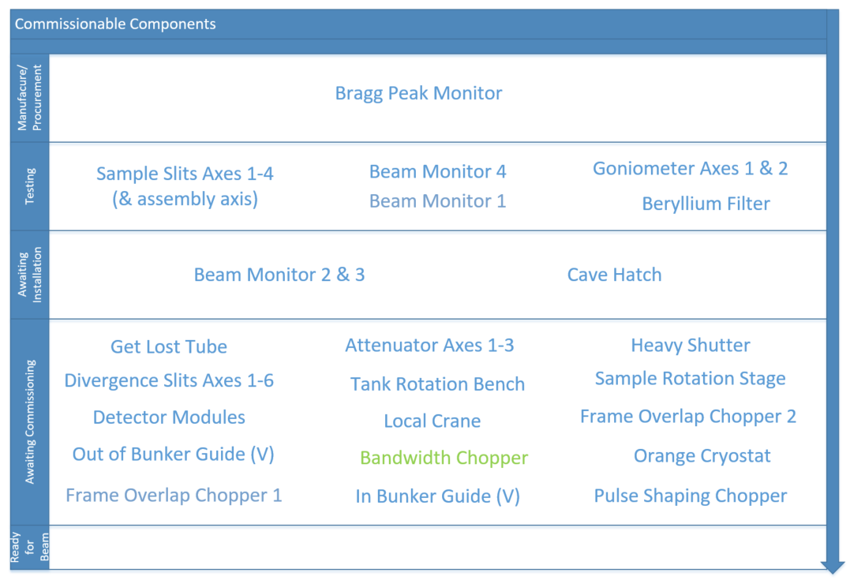
Component Summary

Slide 11
Component Summary
All hardware is procured
A few SAT tests remain to be done
By the end of the year, all major installations would be complete
What remains is integrated cold commissioning, a major task

Slide 12
Schedule
Estimated TG5 Dates – from P6
All cabinets installed and energized by end of December 24
All beamline components installed by the end of January 25
Full cold commissioning to be run from February 25
A number of bureaucratic processes to clear between then and Beam on Target We need to prepare TG5 documents and cold commission at the same time
Handover of beamline in July 25

Slide 13
Schedule
Critical Paths
CP01 and CP02 – Secondary Spectrometer
CP03, CP04 and CP05 – Electrical Installations within D03

Slide 14
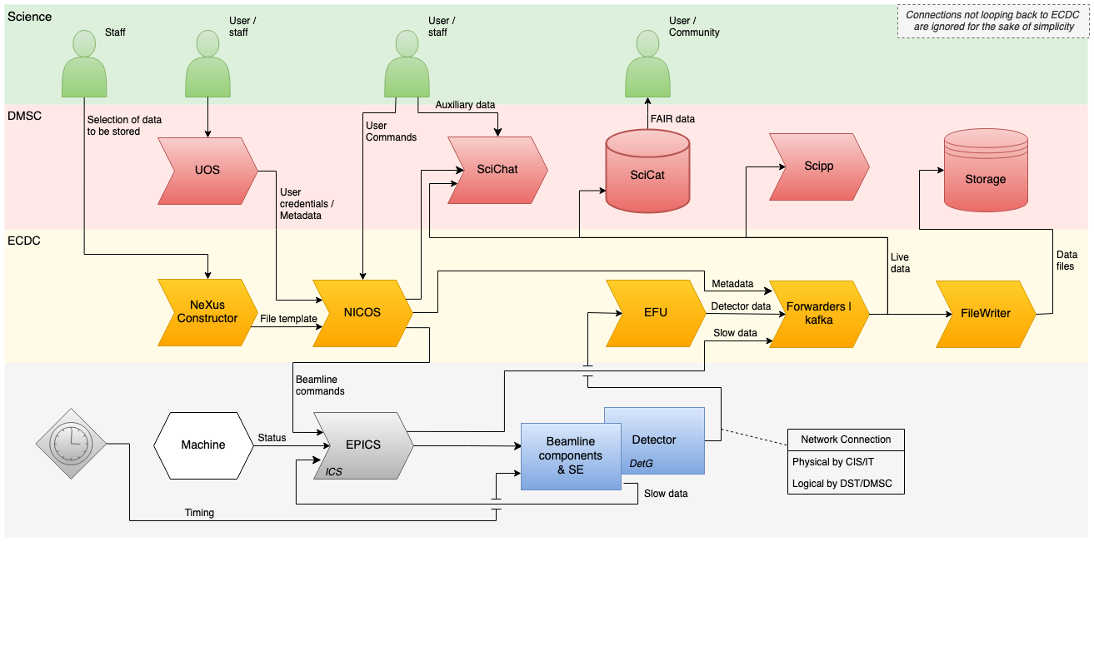
Cold commissioning – old understanding
Involved groups: Core team, ICS, MCA, Detector group, CEP, Sample environment

Slide 15
Cold commissioning
We now have two timing networks – low precision and high precision
Sample environment and motors interface with PtP (slow)
Detectors and monitors interface with fiber (fast)
Commissioning the detectors involves detector group, ICS, CUP, CEP, ECDC, IDS, data curation. We need to test preamps, ADC, timing, backend module, event formation unit, data format and storage, slow control and EPICS.
Motors involve a different timing network than detectors, encoders, limit switches, NICOS, encoder values need timestamping, we need to work with the data-file. Involves MCA and all above.
Staff have implemented great solutions. But we don’t think that cold commissioning will be fast or straightforward. Example: We tested a goniometer and ran into problems, that needed fixing in the lab. 4 months ago, not fixed yet. Such problems will be the norm and need to be resolved ad hoc

Slide 16
Cold commissioning summary
BW chopper is effectively commissioned (done by chopper group)
NICOS is up and running in the hutch (done by ECDC)
We have power and network in E01 (done by CEP)
Most motors have been tested during the FAT and SAT tests. However, this was a while back. We need to test the integration of the motor controllers in the rack with the timing system, NICOS and the nexus files
Critical tasks:
Getting the cables and pipes into the bunker, the racks energized in order to start the challenging commissioning of the choppers
Motion control
Detector readout chain (reference pulse timing, ADC, RMM, EFU, Kafka, NEXUS)

Slide 17
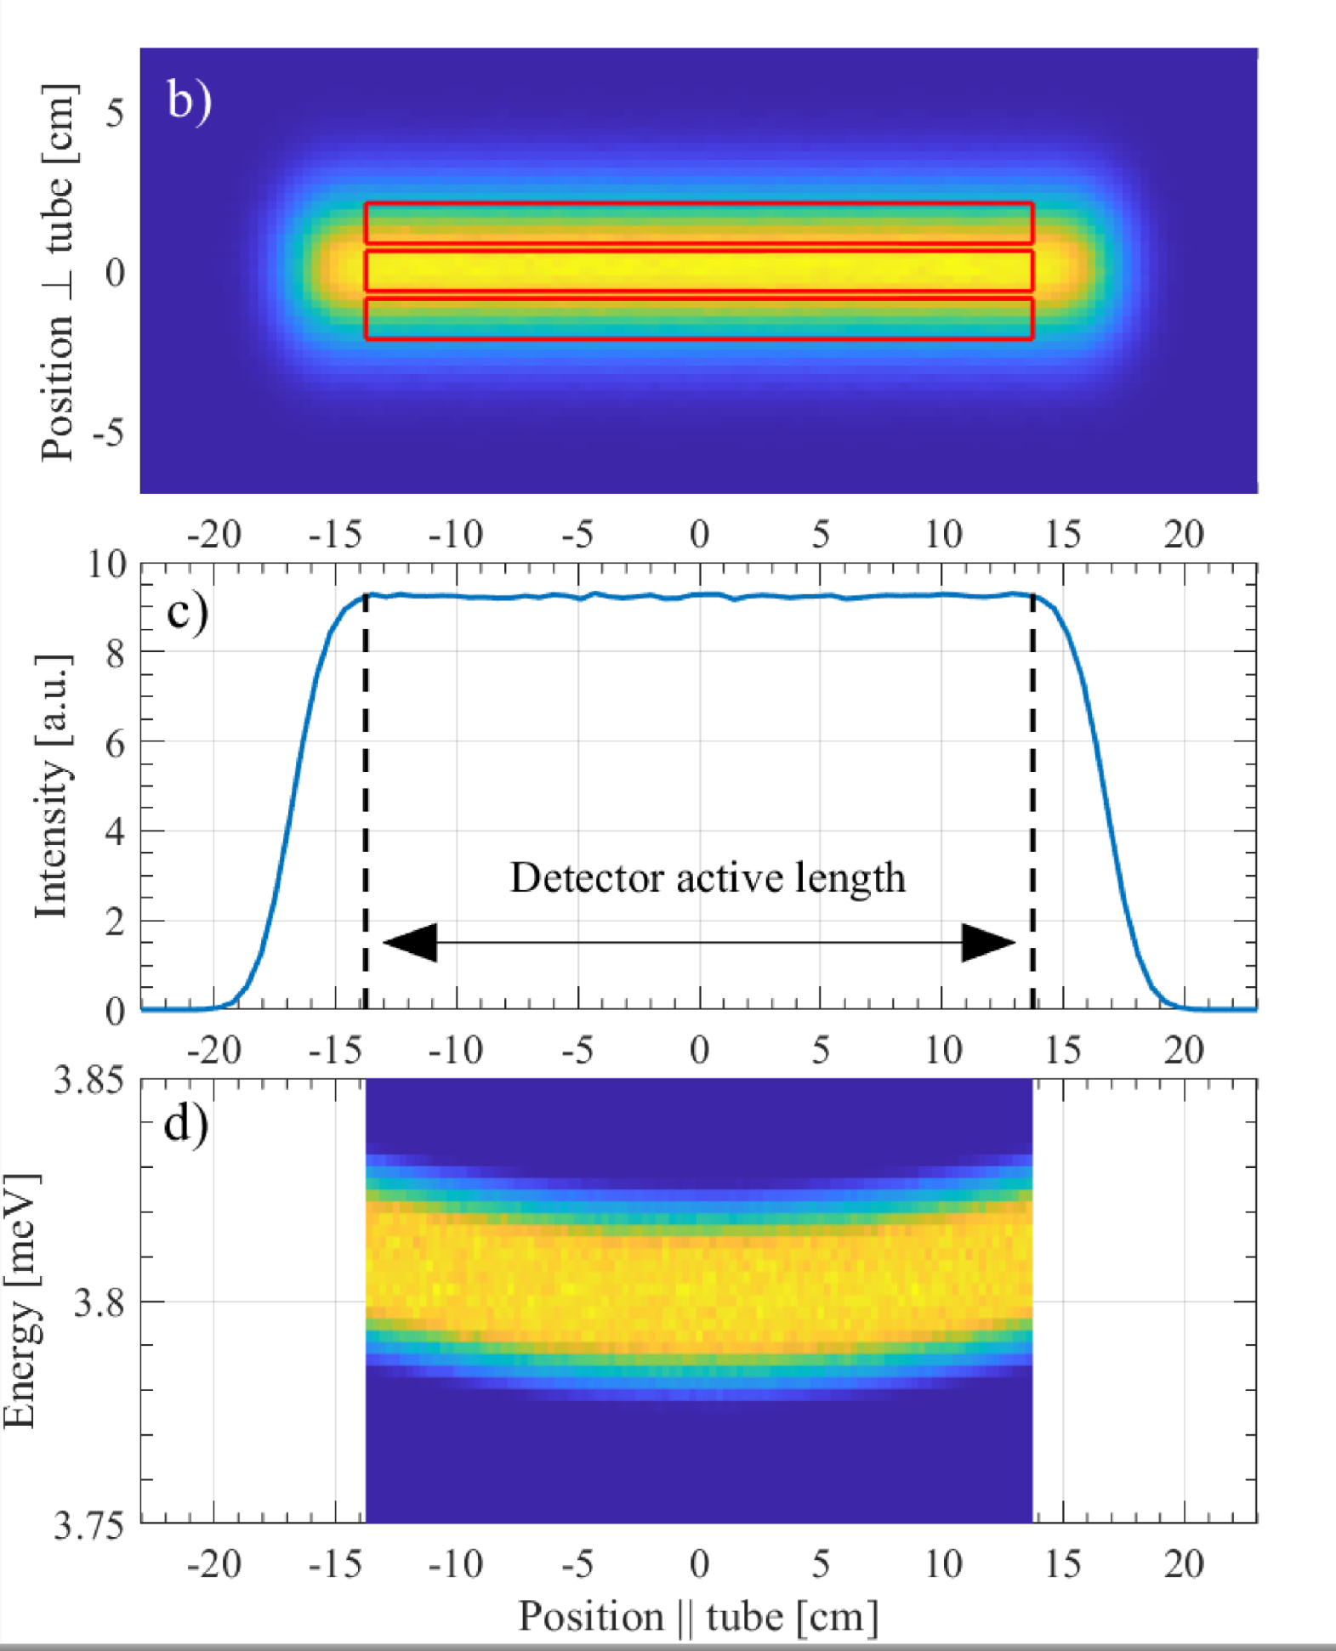
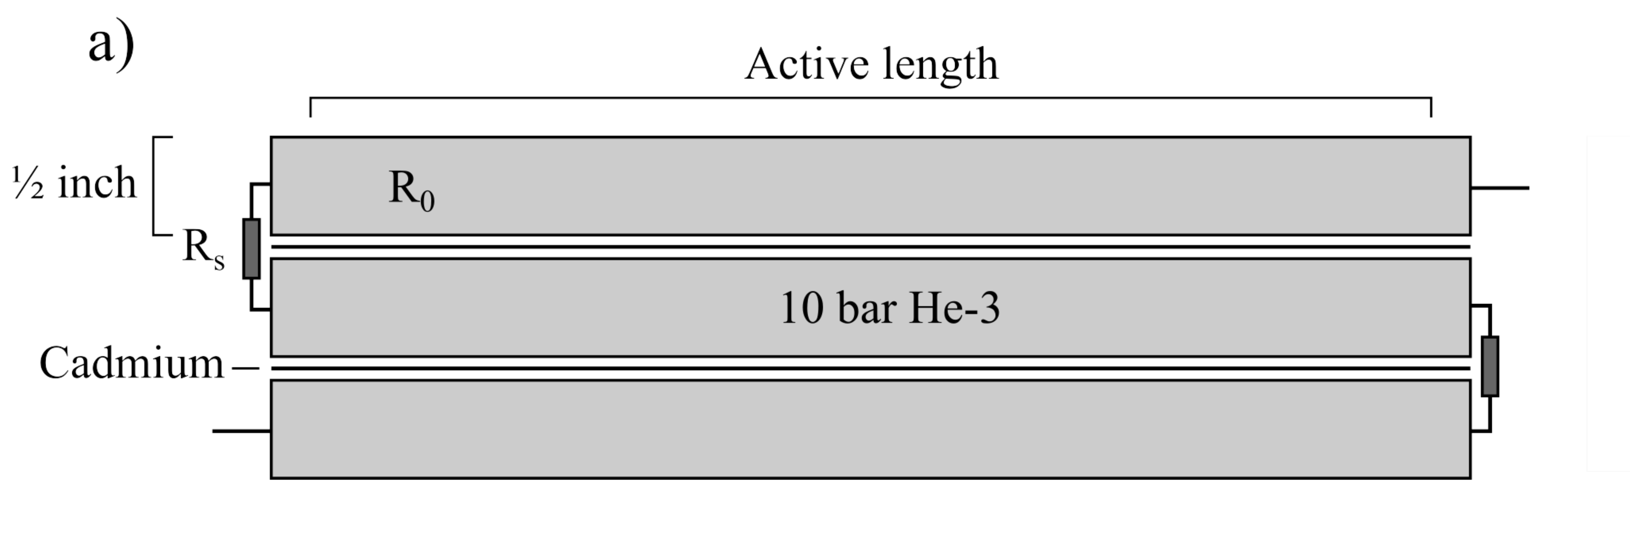
Detector design reminder

Slide 18
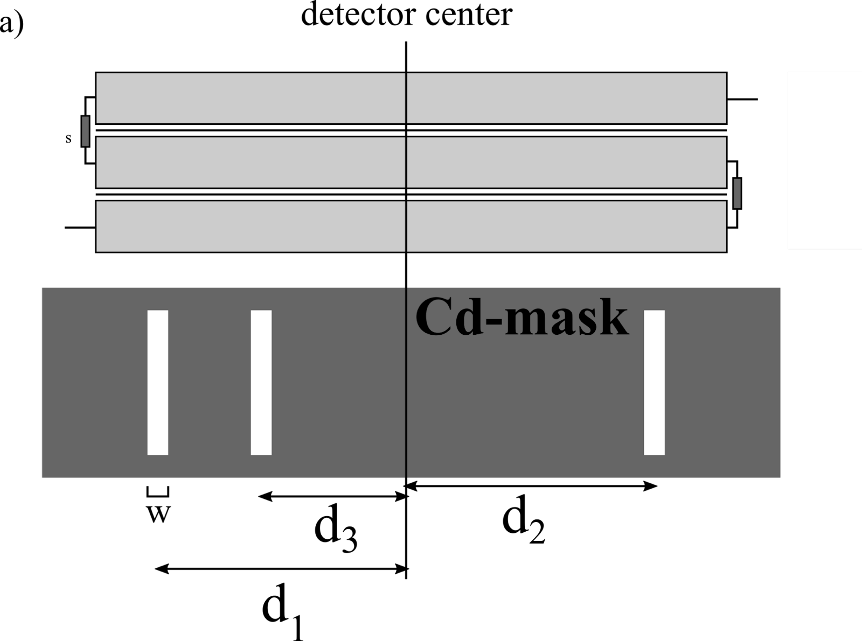
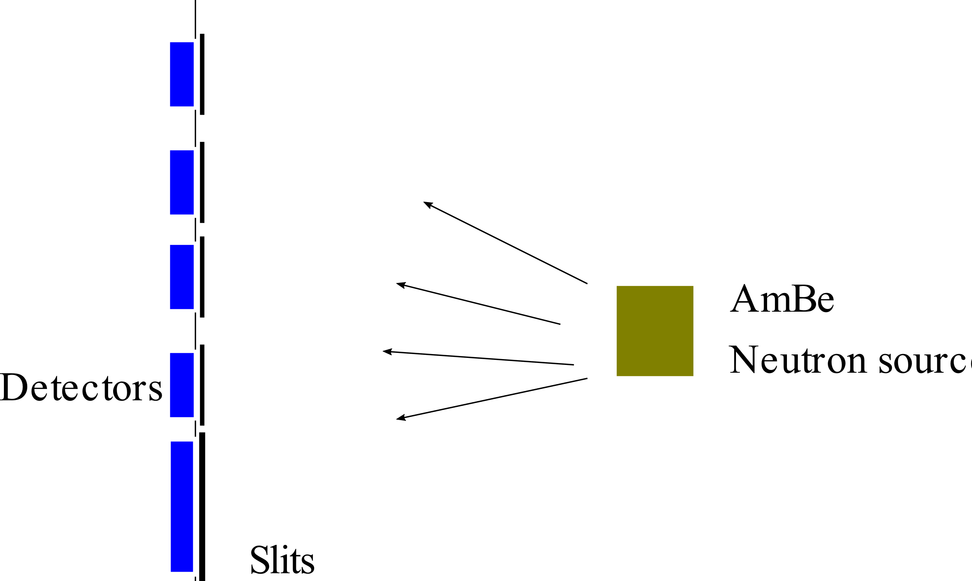
Detector test – April and September 2023 – at the LLB

Slide 19
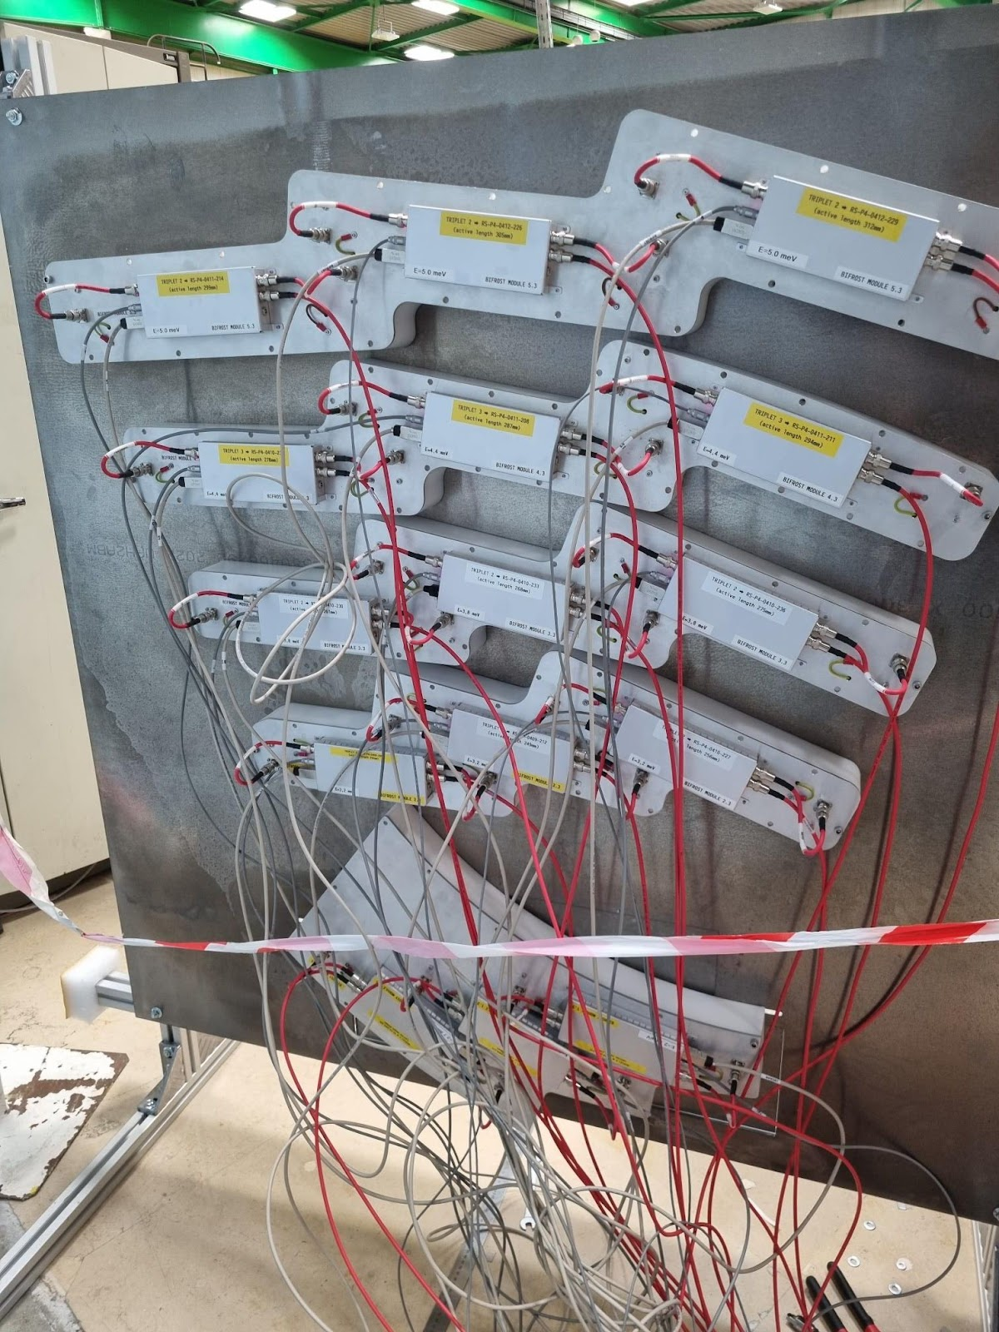
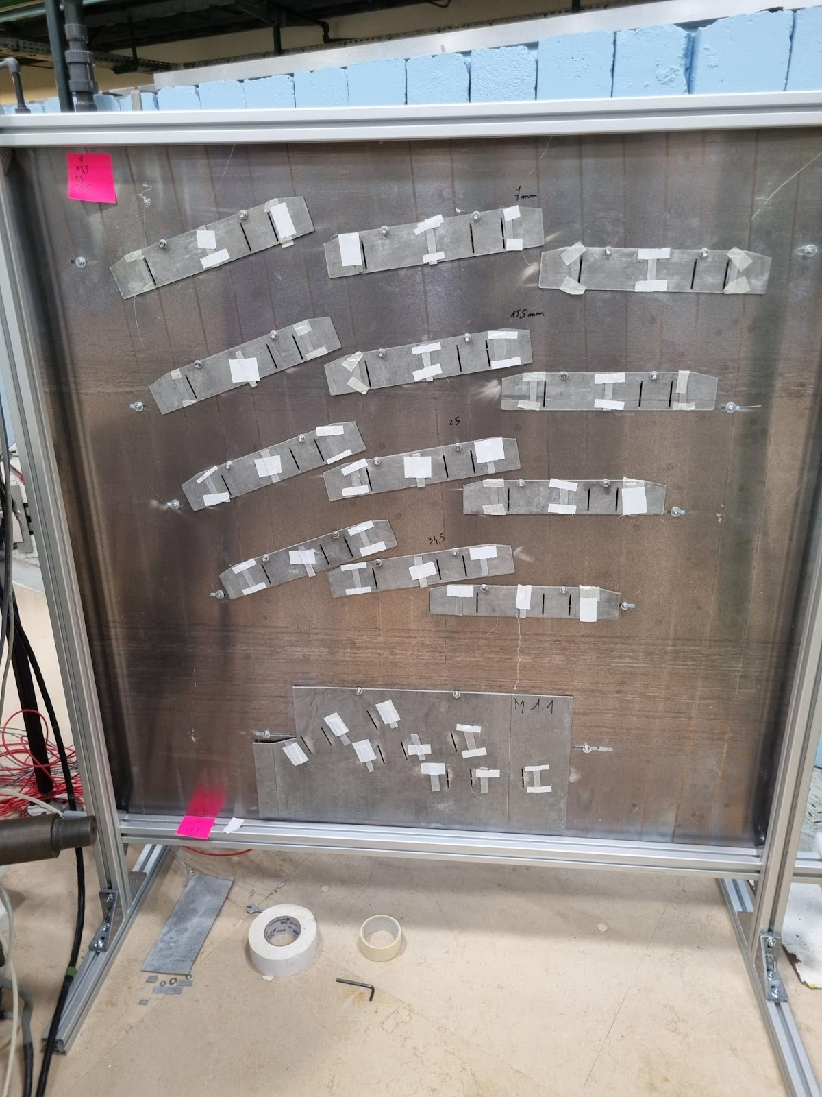
Detector test – April and September 2023 – at the LLB

Slide 20
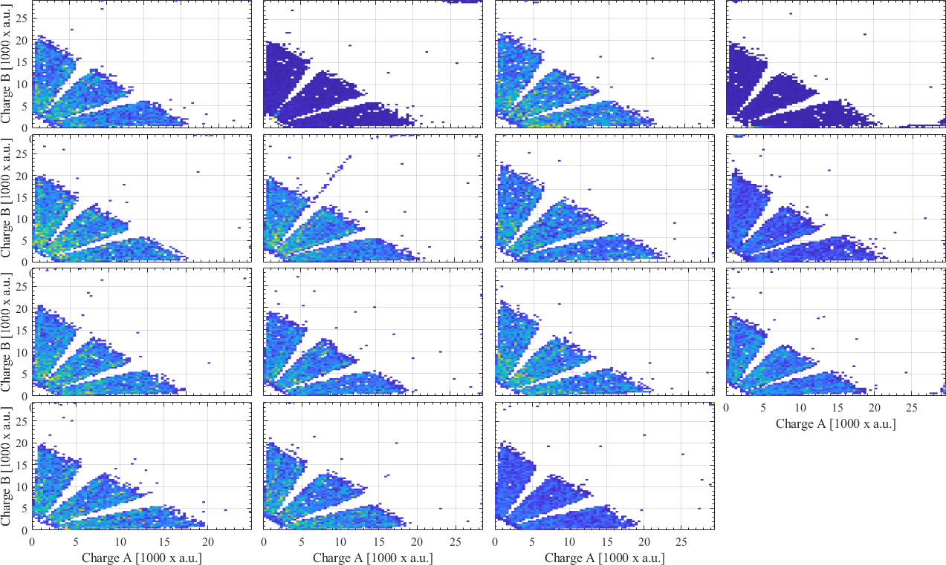
Detector test – September test, channels A and B histogrammed

Slide 21
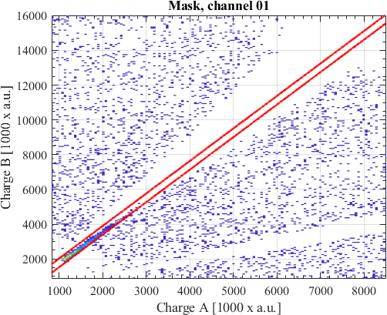
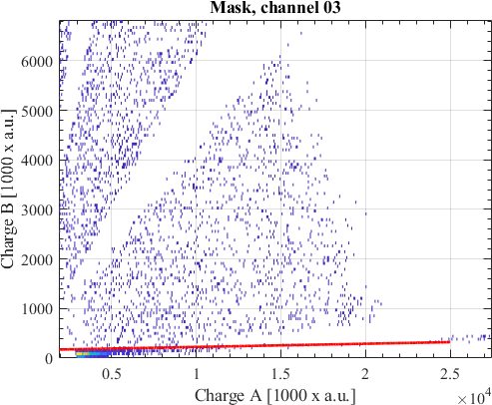
Detector test – Masks applied

Slide 22
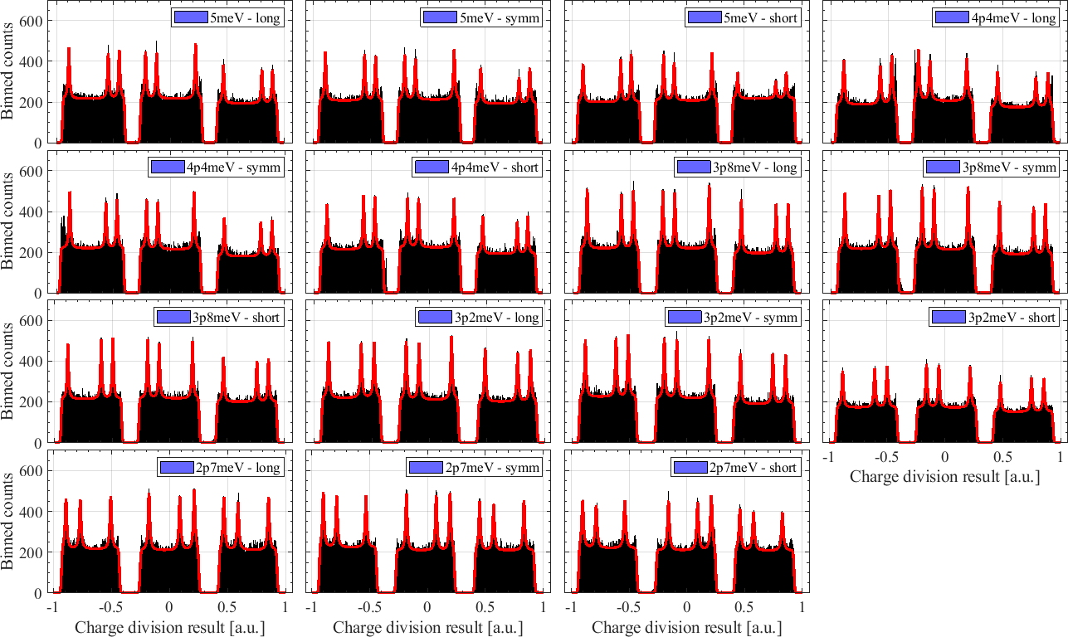
Detector test – Calibration

Slide 23
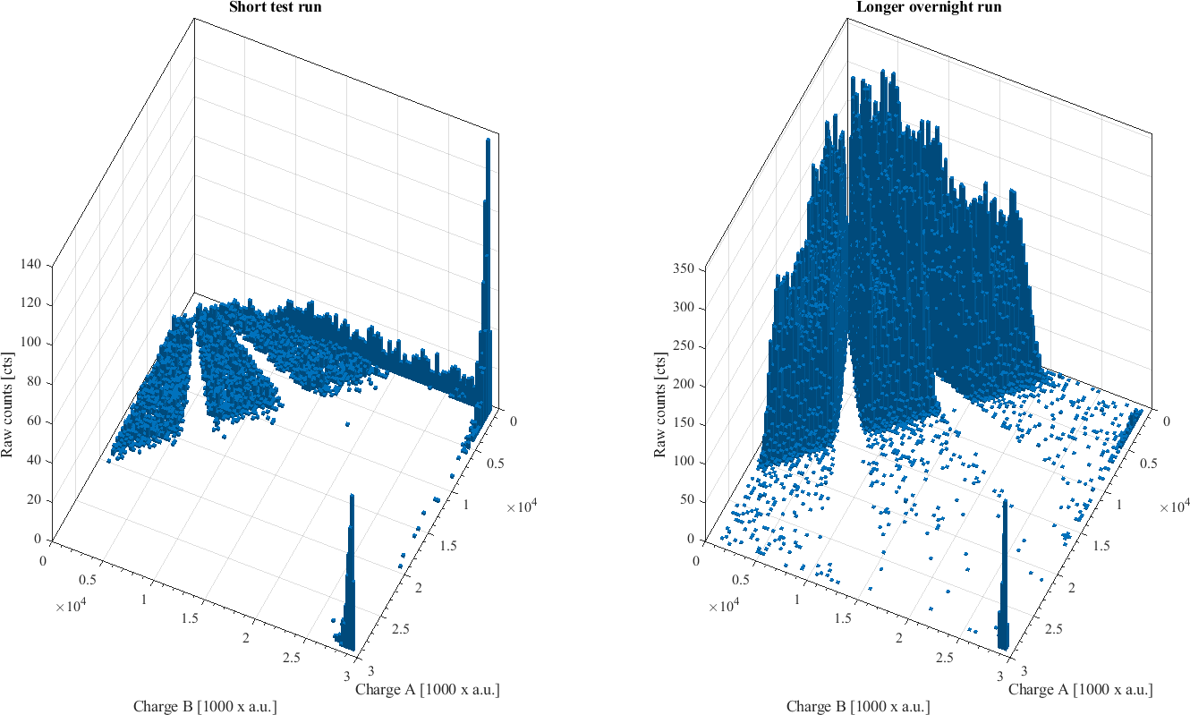
Reminder of the spectrum and sparks
Charge distribution on A and B channels shown on the right. Sparks occur at the edges of the polygon and at the high charge end. A triplet quiets down after a few days of operation

Slide 24
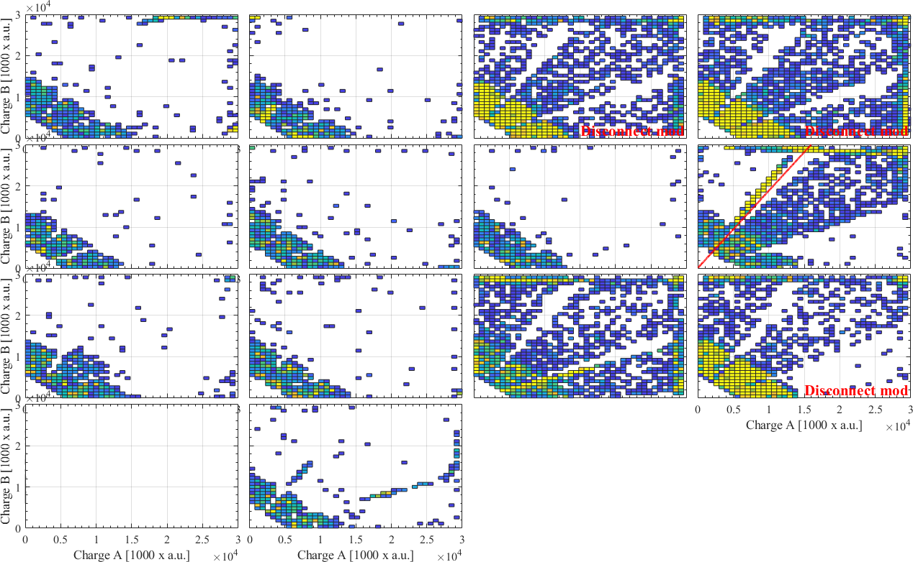
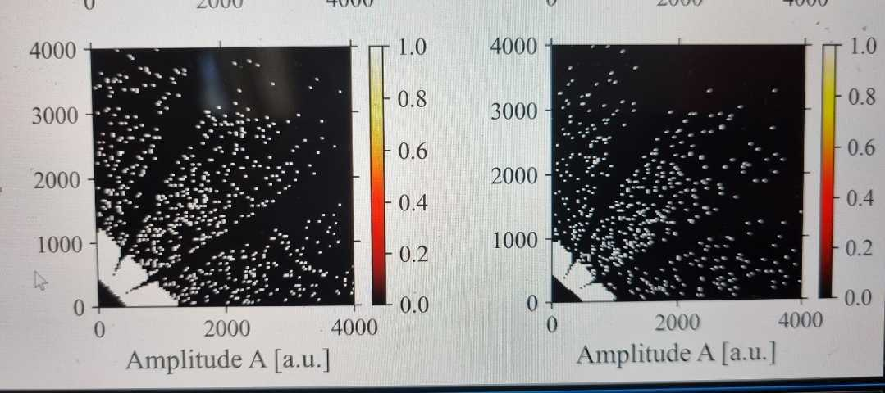
Tests at the ESS – minor noise problem
High charge noise in some tubes
NOT cables, preamps etc
Reproduced at the ILL using different power supply, ADC
1 cts/ min pr triplet
Not huge problem, but without diagnosis, we don’t know if this gets worse

Slide 25
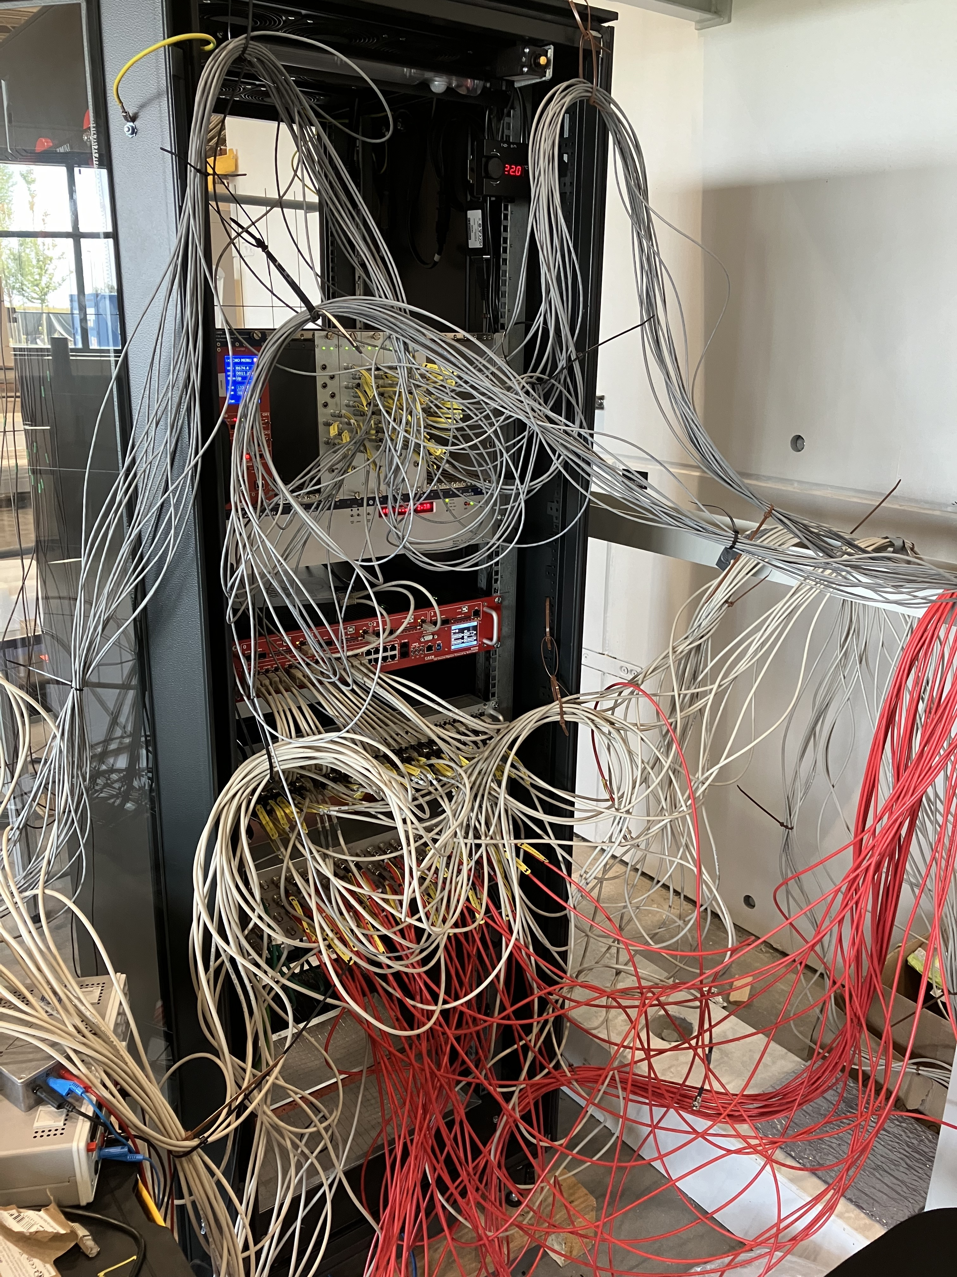
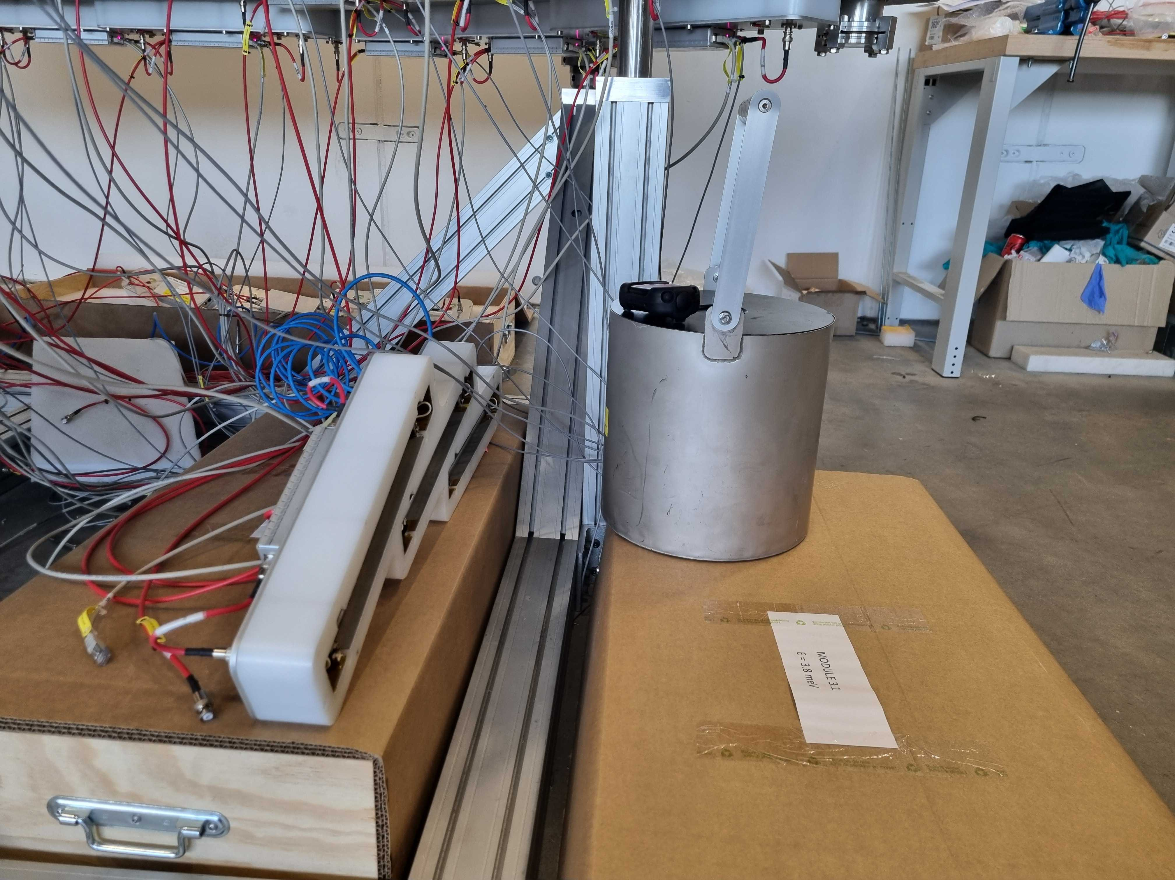
Tests at the ESS
After the trip to ILL, we left the noise problem for another day, and started testing all detectors
More than 1 week of cabling, 3 weeks of testing.
We now have a useful neutron source on site

Slide 26
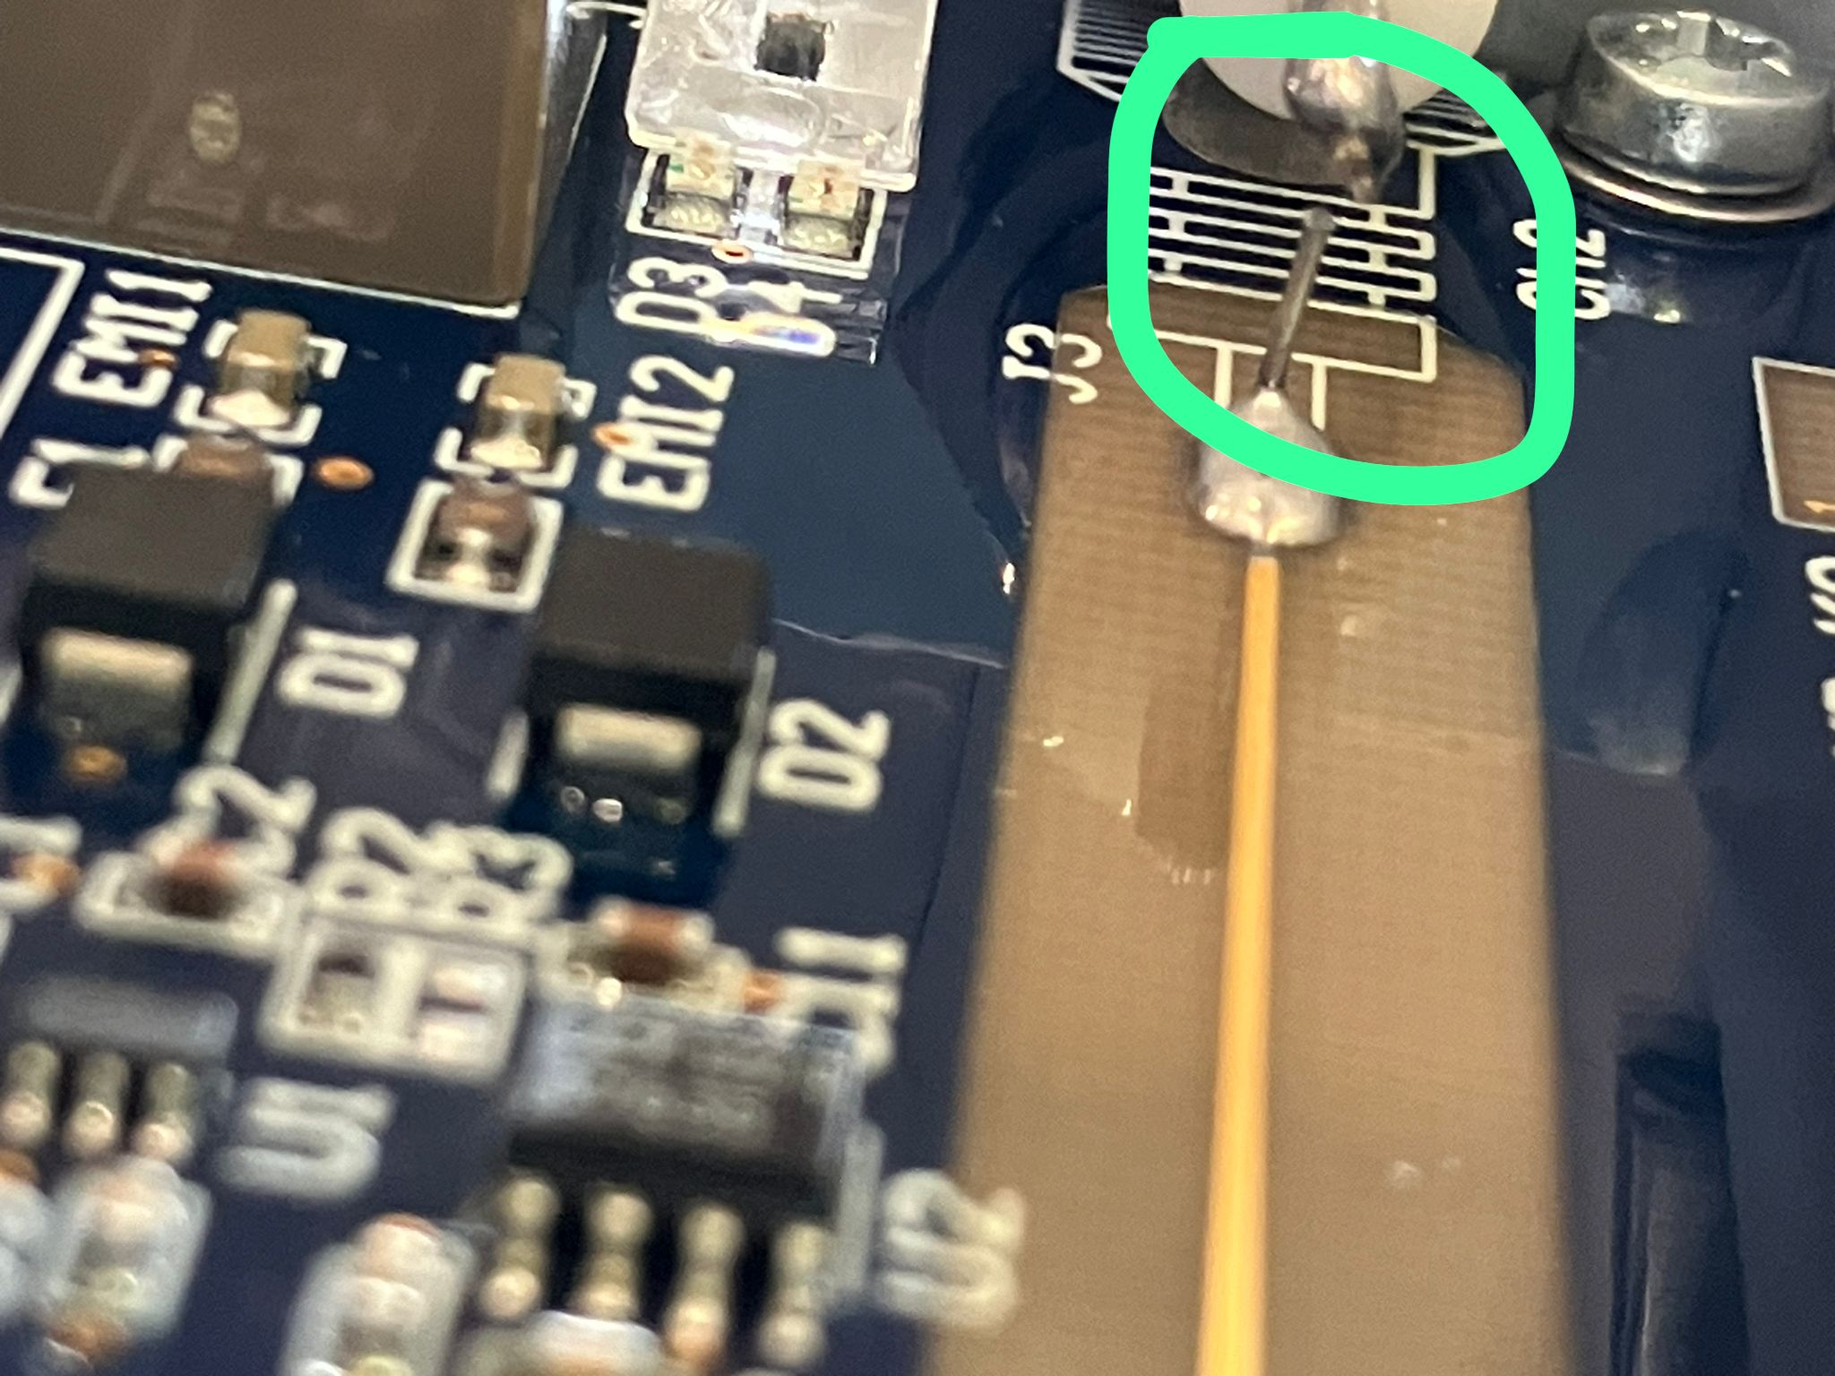
Tests at the ESS - results
The trivial problems:
One preamps LV circuit was broke (changed it)
Another preamps HV circuit was broke
3 RJ45 cables needed changing
Isopropanol and clean air on contacts

Slide 27
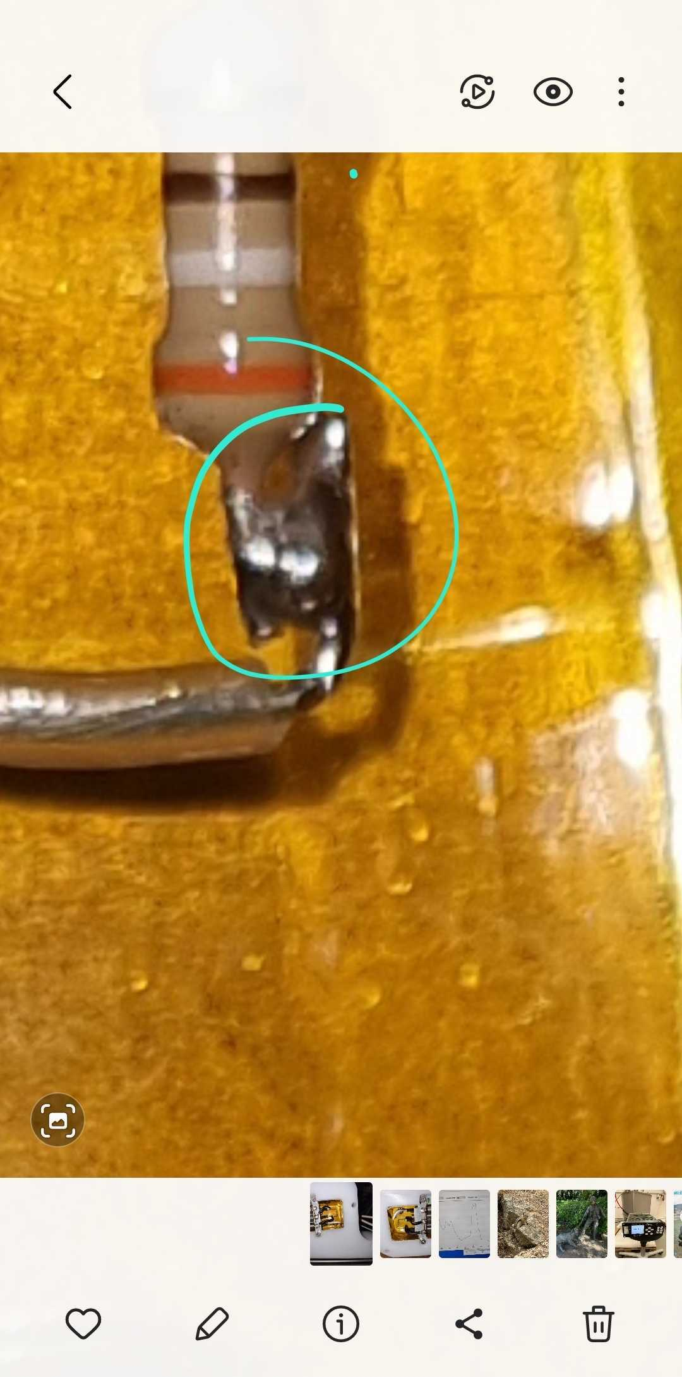
Tests at the ESS – Big problem 1
Soldering issue, generates sparks when it rains (!)
Needs resoldering. The ‘big’ problem is that we
need a pro to do it.

Slide 28
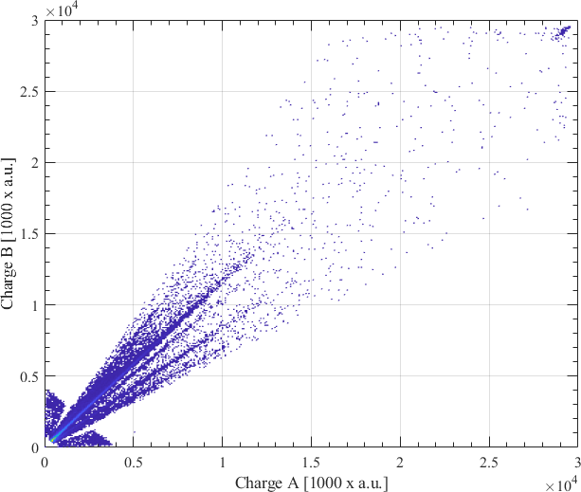
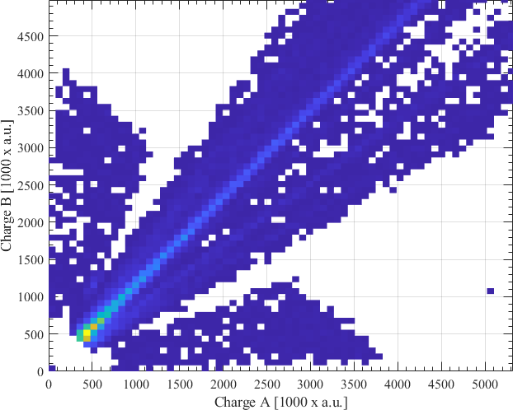
Tests at the ESS – Big problem 2
One triplet cannot be put to high voltage – leak current through the middle tube. Very likely broken – has to be changed before TG5

Slide 29
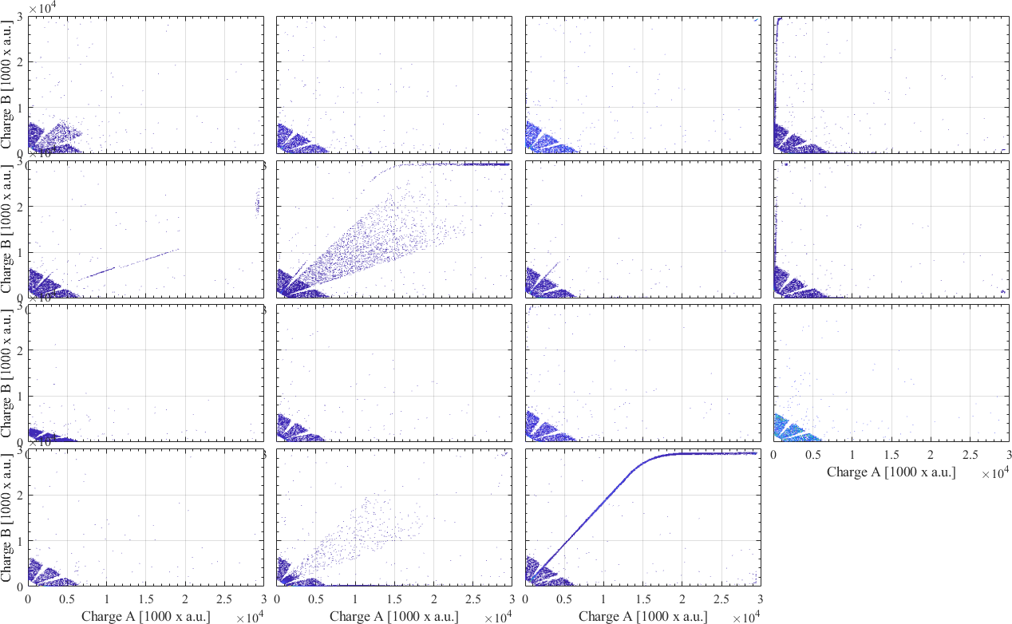
Tests at the ESS – overview

Slide 30
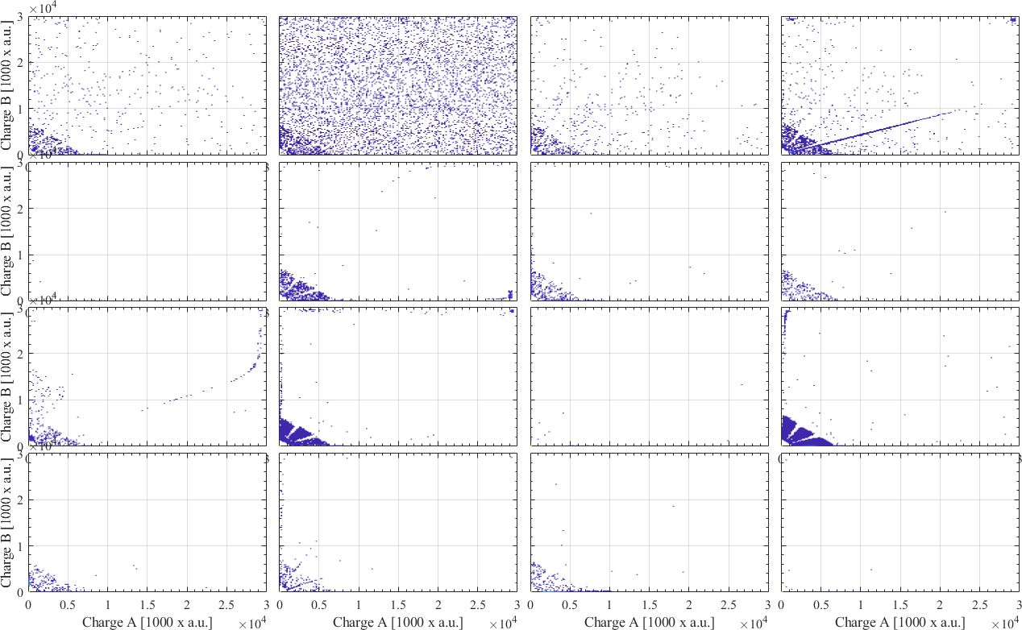
Tests at the ESS – overview

Slide 31
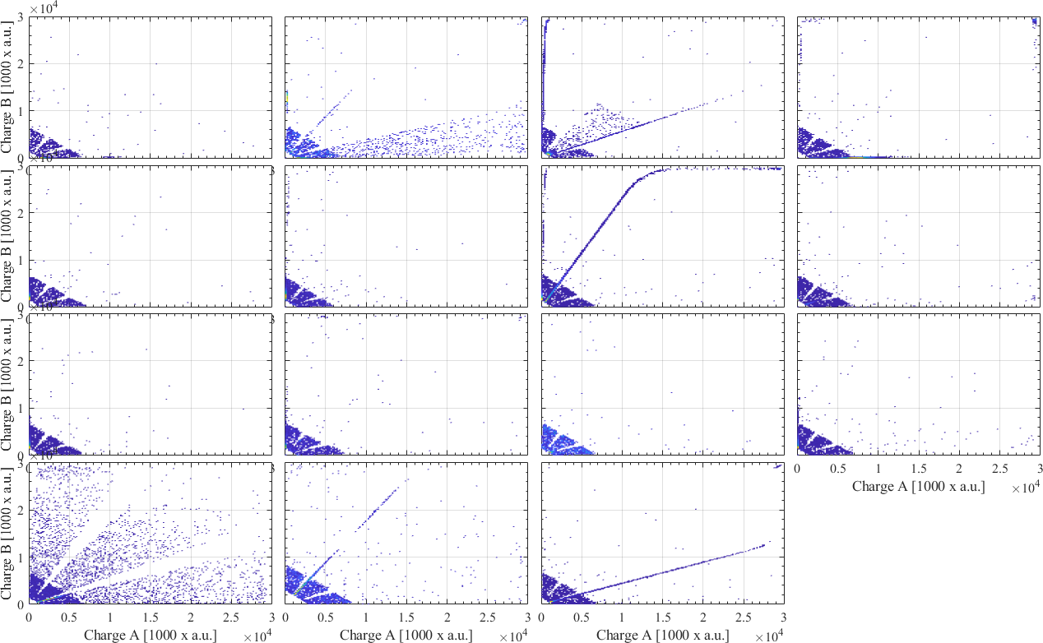
Tests at the ESS – overview

Slide 32
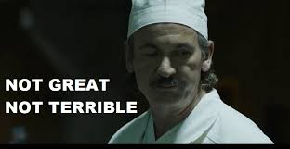
Tests at the ESS – overview
We need to be able to operate with all triplets, we don’t need gaps in our dataset (or slower hot commissioning) on top of everything else.
Need-to-have: Solder the bad triplet and change the badly broken tube
Nice-to-have: Change all the leaky tubes
Ideal scenario: Go into hot commissioning with 15 spare tubes, and spares for the noisy tones (got recent approval from Pascale)
Module ID | Triplet ID | Tube ID
5p1 channel 0 | 5p0 meV short | Middle
3p2 channel 8 | 3p8 meV short | B-side
4p2 | 4.4 meV middle | Middle
1p3 – channel 2 | 2.7 meV – long | Middle
1p1 – channel 13 | 2p7 middle | Middle

Slide 33
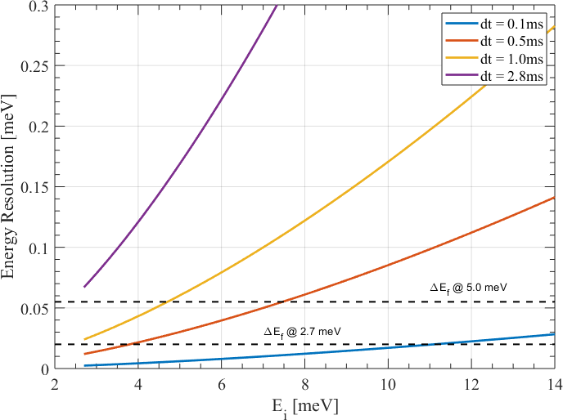
BIFROST: Energy resolution simulations
Using McStas, we simulated flat modes at various energy transfers, the plots below show the modes at 0.1 ms PSC opening speed, the
energy resolution remains similar across the band

Slide 34
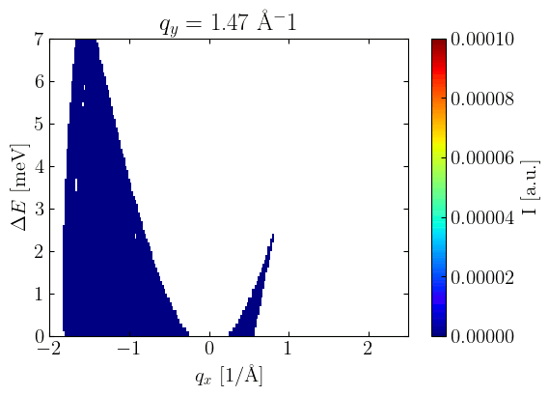
BIFROST: Preliminary phonon simulations, more to come
Phonon simulations using a PSC opening time of 1 ms. Nicely defined mode with a hint of focusing/defocusing effects

Slide 35
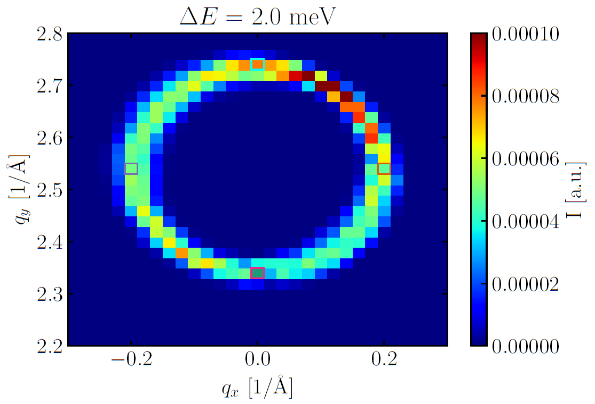
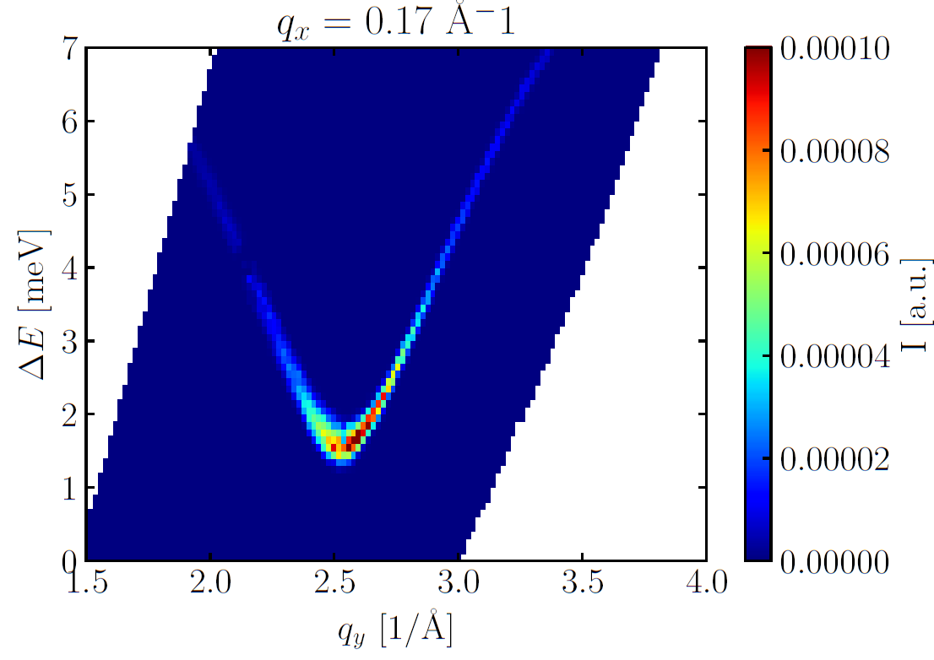
BIFROST: Preliminary phonon simulations, more to come
Slight asymmetry clearly present, we have a vertical tilt of the resolution function in (Q_z, E), efforts are ongoing to understand this in more detail

Slide 36
Upgrade path
Polarization analysis – incident polarization is being procured
Sample position and supermirrors are on holding pattern.
Other instruments need the money, we prefer to postpone and work on this on a prototype level (design, tests) – we need partners and funding
M. E. Zayed, et.al, Nature Physics, 13, 962, (2017) - SrCu₂(BO₃)₂

Slide 37
Early science on BIFROST – focus on scientific value but also on demonstrating what BIFROST can do
Hot commissioning, calibration
Round robins
Known physics, including intensity (direct ToF comparison)
Incremental physics
Demonstrating resolution
Demonstrating flux
Demonstrating mapping efficiency
Demonstrating extreme environment
M. E. Zayed, et.al, Nature Physics, 13, 962, (2017) - SrCu₂(BO₃)₂

Slide 38
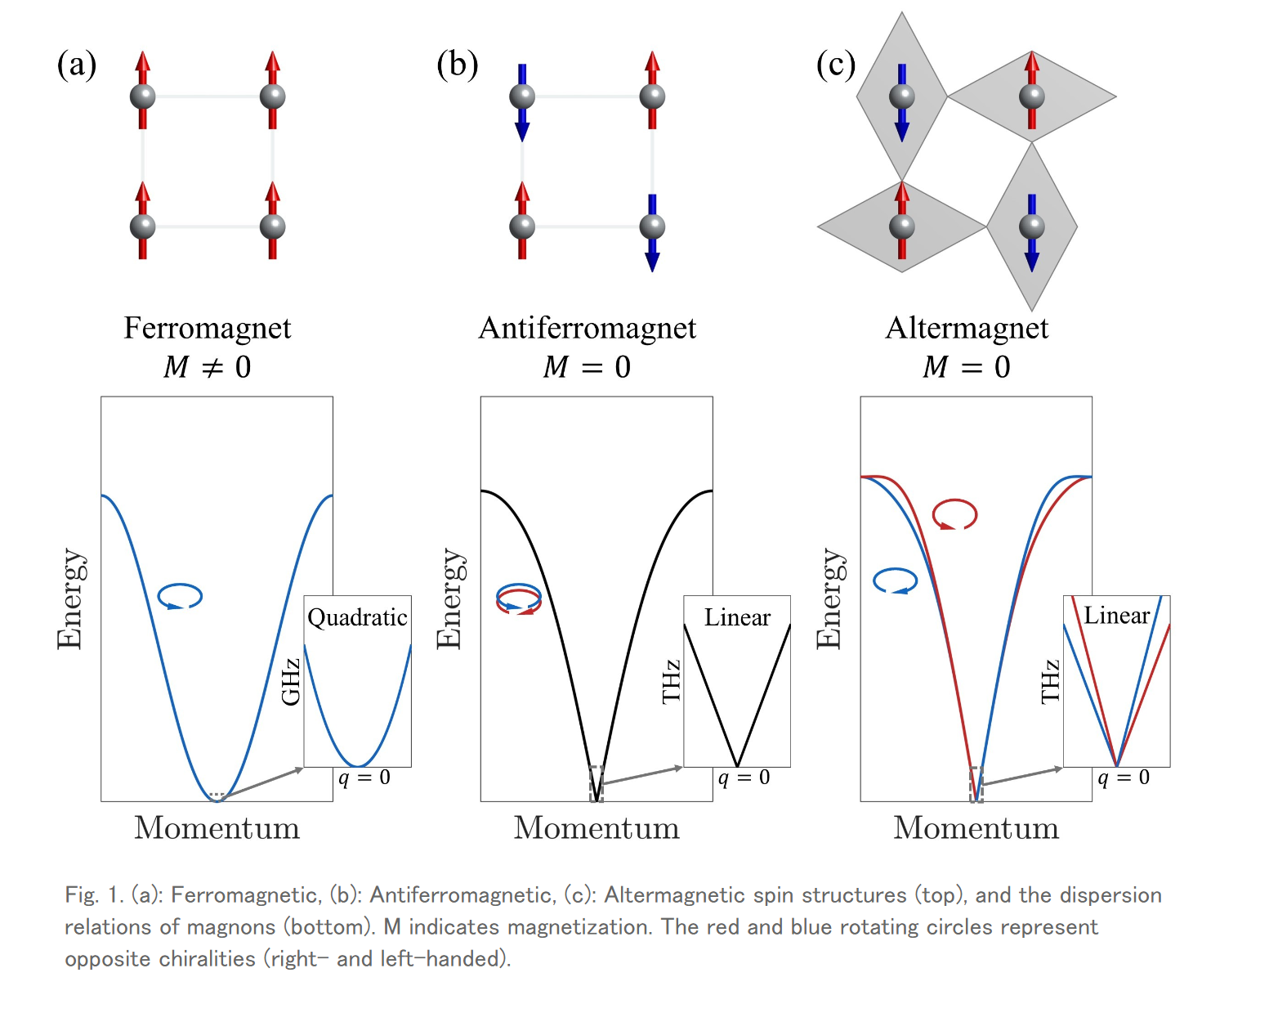
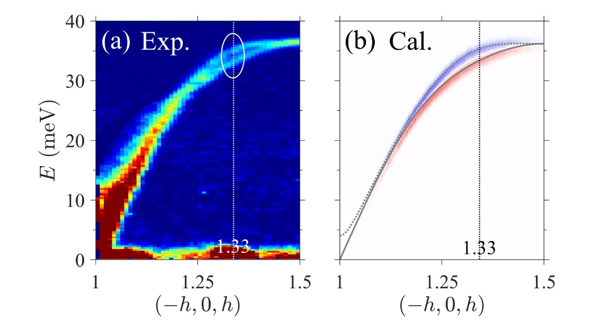
Early science on BIFROST – focus on scientific value but also on demonstrating what BIFROST can do
Altermagnets, chiral magnons slightly split in altermagnets, This splitting is key in this new field (here, MnTe, Masuda 2024)
M. E. Zayed, et.al, Nature Physics, 13, 962, (2017) - SrCu₂(BO₃)₂

Slide 39
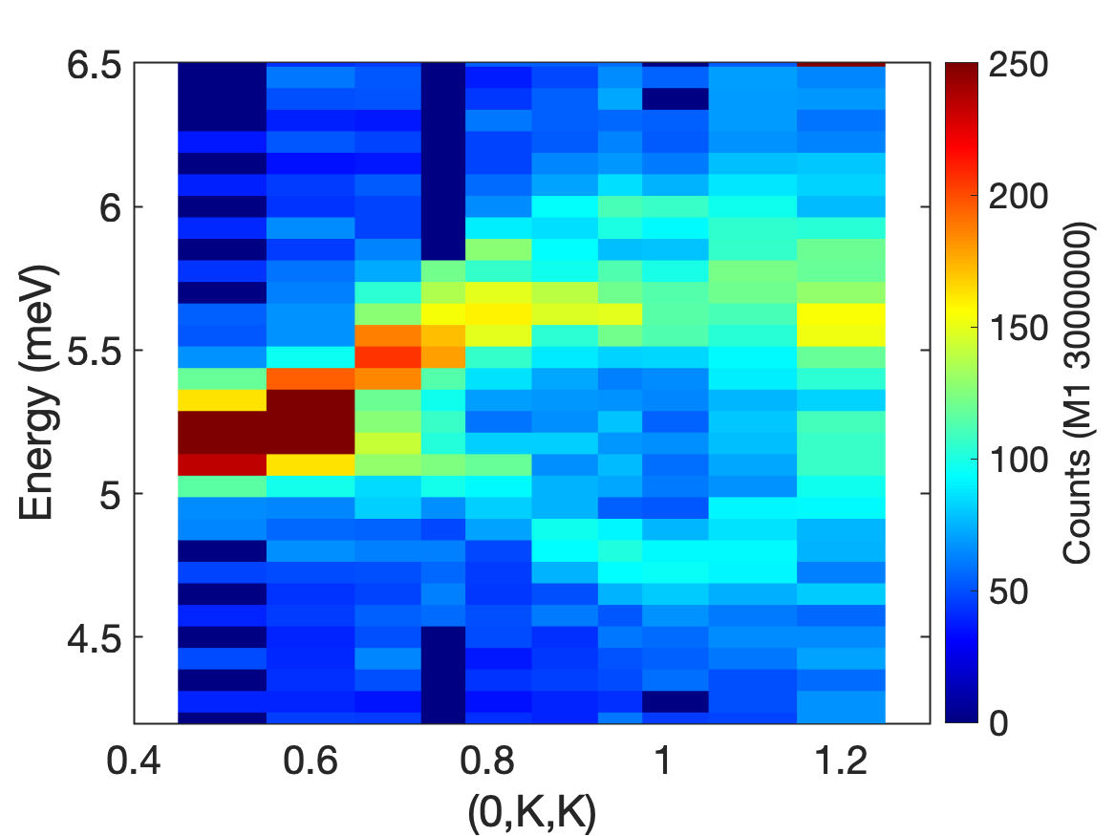
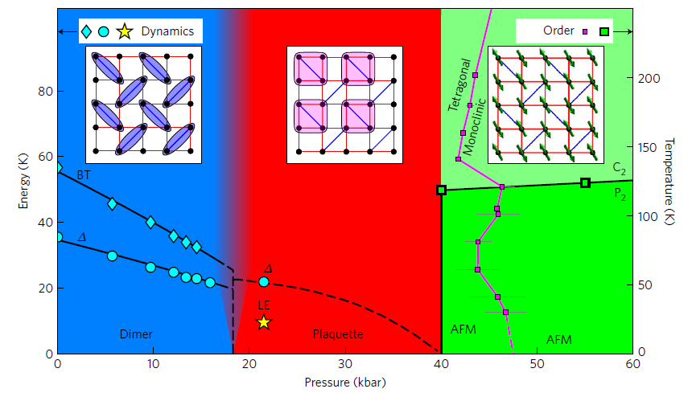
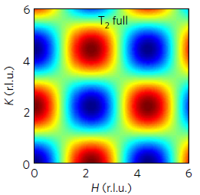
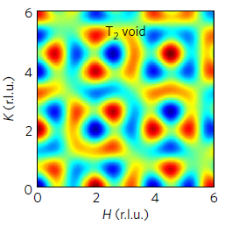
Early science on BIFROST
LiCoPO4, Thales @ ILL
Early project @ 100 kW – flux demonstration: Finally understanding LiCoPO4, a complex magnetoelectric with 4 spin wave branches and possible hybrid modes. Only small crystals available - on the feasibility limit today, we need more signal and better resolution -> BIFROST.
Early project @ 500 kW – Extreme environment + mapping efficiency: Shastry Sutherland compound. Well known system, the 4 spin plaquette exists at high pressure
The nature of the plaquette is unresolved, needs a mapping experiment on small crystals under large pressure. Possible for the first time on BIFROST at 500 MW accelerator power.
M. E. Zayed, et.al, Nature Physics, 13, 962, (2017) - SrCu₂(BO₃)₂
M. E. Zayed, et.al, Nature Physics, 13, 962, (2017) - SrCu₂(BO₃)₂

Slide 40
Early science workshop on BIFROST
Hold a workshop with the key partner scientists, local instrument scientists, inviting key external friendly users
Present the capabilities of the instrument
Create groups to come up with targeted demonstration experiments
Key criteria: Crystal exists, data analysis team exists, previous neutron measurements exists.
Do not promise anything
The choice of experiments is decided on the fly by local team. The right experiments depends on source power, background etc.
M. E. Zayed, et.al, Nature Physics, 13, 962, (2017) - SrCu₂(BO₃)₂

Slide 41
Thank you for your attention
Scientific contributors:
Rasmus Toft-Petersen
Jonas Okkels Birk
Greg Tucker Kristine Krighaar
Marton Marko
Rodion Kolevatov
Martin Olsen
Mads Bertelsen
Sonja Holm Dahlin
Jakob Lass
Felix Groitli
Fanni Juranyi
Jacob Larsena Paul Freeman
Isabel Llamas Jansa
Henrik M. Rønnow
Bjørn Hauback
Philippe Bourges
Christof Niedermayer
Kim Lefmann
Niels Bech Christensen
Technical contributors:
Liam Whitelegg
Sylvain Rodrigues
Finn Saxild
Keld Theodor
Tamires Gallo

