Slide 1
Chopper considerations for nEDM

Slide 2
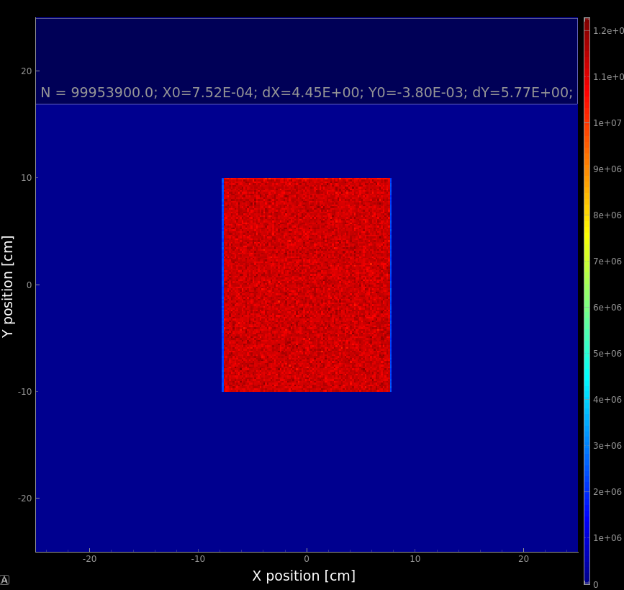
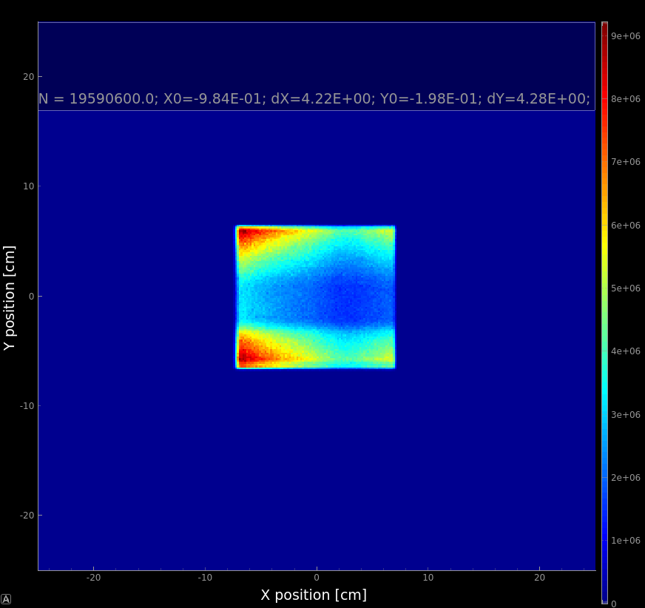
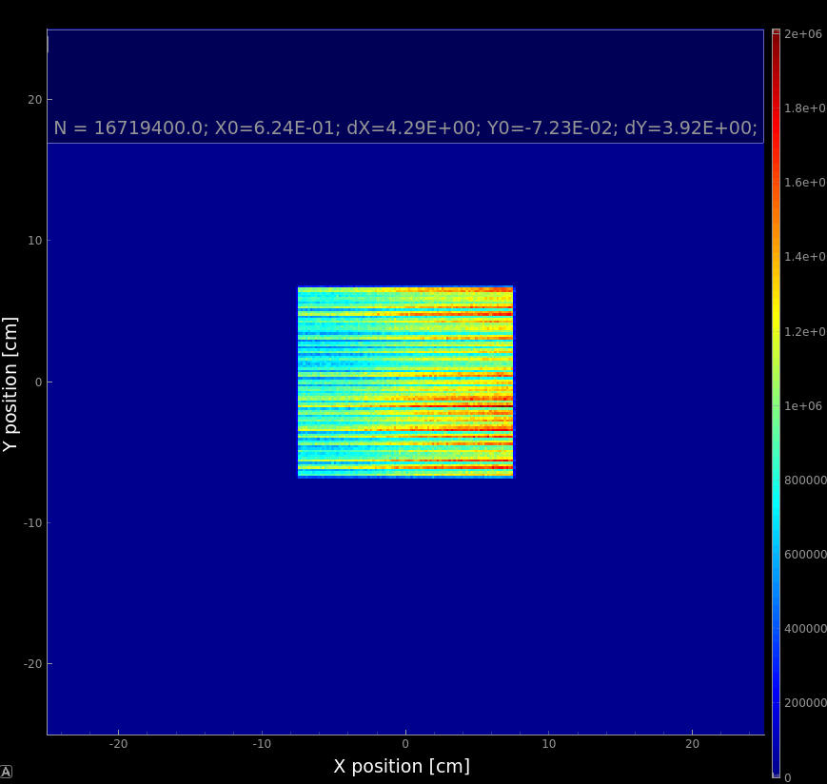
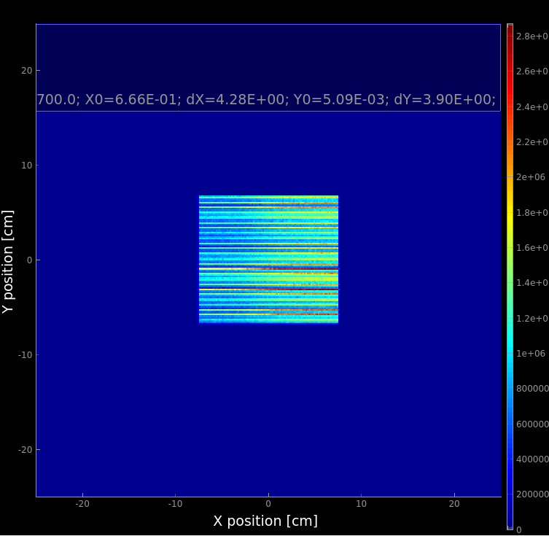
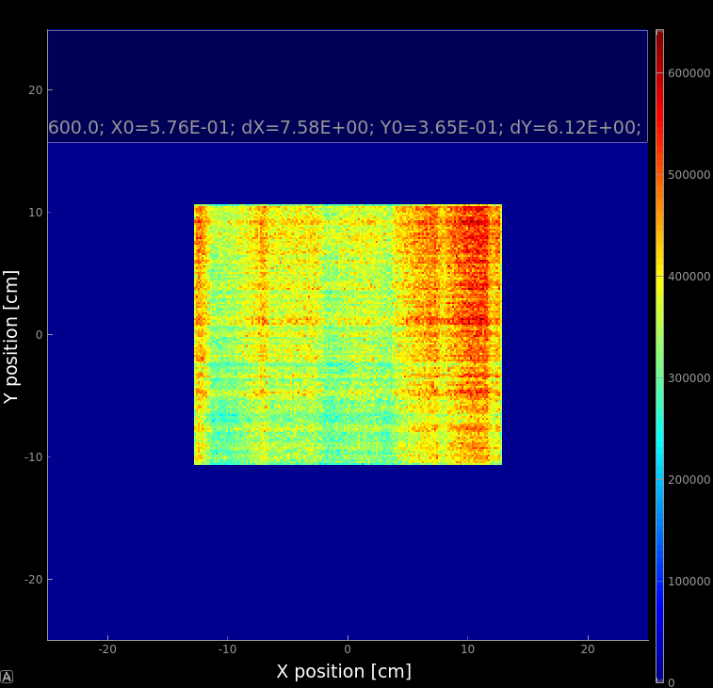
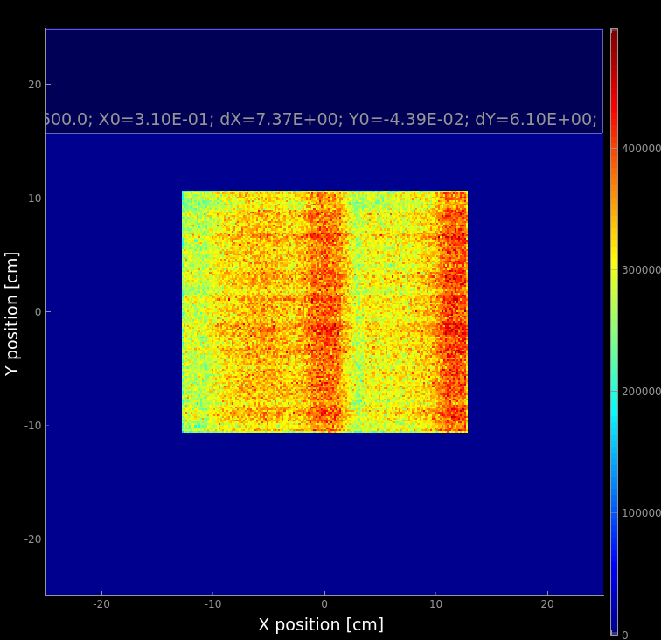
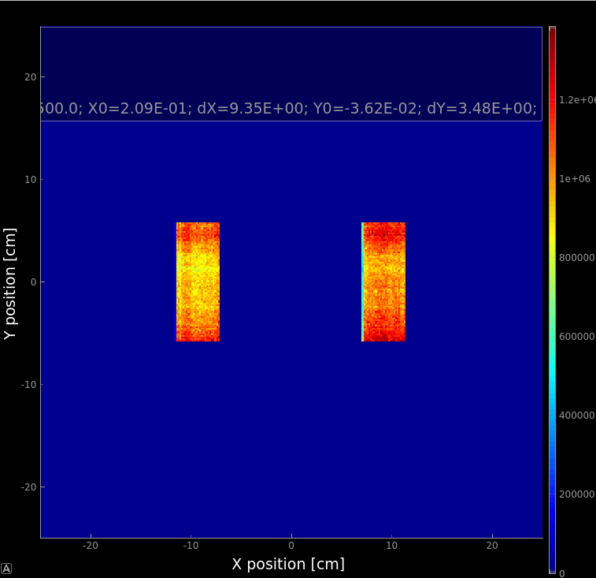
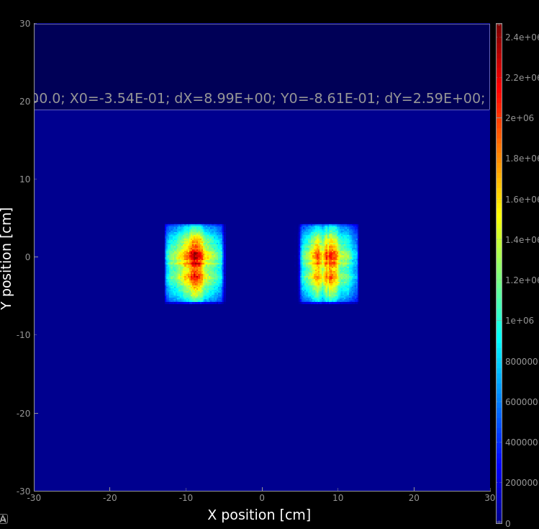
Optimized guide with 0.5m long C-bender

Slide 3
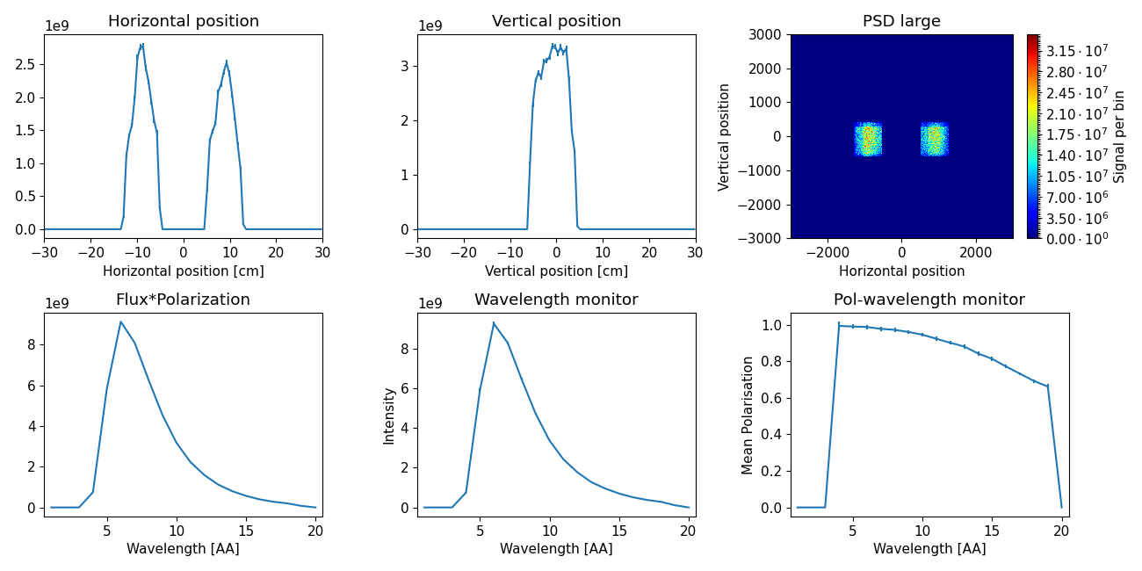
Performance, C-bender
Approximately 10% worse performance compared to S-bender:
4.43E09 n/s/AA @5MW,
~95% polarization@9AA (can be improved by shortening bender for cost of flux)

Slide 4
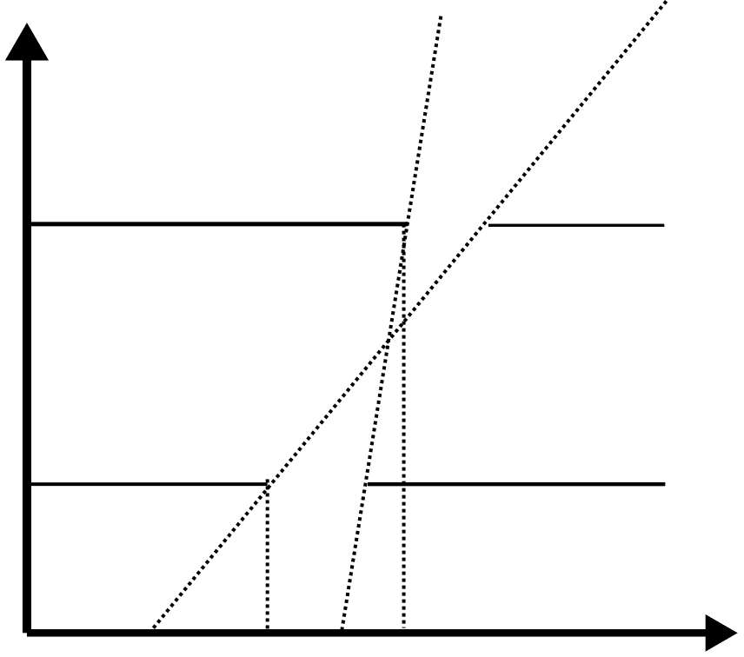
Wavelength selection
$$t_{2}+w_{2}−t_{1}=(d_{2}−d_{1})/v_{min}$$
$$λ_{min}, v_{max}$$
$$λ_{max}, v_{min}$$
$$t_{2}−t_{1}−w_{1}=(d_{2}−d_{1})/v_{max}$$
$$w_{2}$$
$$d_{2}$$
$w_{1}+w_{2}=(d_{2}−d_{1})(\frac{1}{v_{min}}−\frac{1}{v_{max}})$
Distance to source
$$Signal∝w_{1}⋅w_{2}⇒Optimal: w_{1}=w_{2}=0.5⋅(d_{2}−d_{1})(\frac{1}{v_{min}}−\frac{1}{v_{max}})$$
$$d_{1}$$
$$w_{1}$$
$$t_{1}$$
$$t_{2}$$
Time
Wavelength requirement: $8.9Å±1\%$ ( v = 440-448m/s ) $⇒$ theory limit ~0.2*4.43E09n/s/AA=8.86E08n/s in the cells
To increase performance, the flight path $d_{2}−d_{1}$ must be maximized
Partial opening of the choppers reduces performance $⇒$ high speed/large disc radius for the choppers

Slide 5
Extended flight path
PSC2
PSC1
Extend the straight part limiting final part to defocusing and splitter sections.
in-monolith beam extraction optics
bender to avoid line of sight (m=2), 10 horizontal channels
straight bunker wall feedthrough (m=2)
polarizing bender (m=4), 25 horizontal chanels
straight section (m=2)
defocusing part (11m)
focusing splitter(5m)

Slide 6
Maximal performance evaluation
Fraction of the ESS pulse selected by PSC1:
$$f_{1}=w_{1}[ms]/2.86$$
Fraction of the selected pulse passing through PCS2:
$$f_{2}=w_{1}/(w_{1}+w_{2})$$
$$t_{2}+w_{2}−t_{1}=(d_{2}−d_{1})/v_{min}$$
$$t_{2}−t_{1}−w_{1}=(d_{2}−d_{1})/v_{max}$$
$$λ_{min}, v_{max}$$
$$λ_{max}, v_{min}$$
$$w_{2}$$
$w_{1}+w_{2}=(d_{2}−d_{1})(\frac{1}{v_{min}}−\frac{1}{v_{max}})$
$$d_{2}$$
Distance to source
$$d_{1}$$
$$w_{1}$$
$$t_{1}$$
$$t_{2}$$
Time
Assuming choppers are fully open during opening times:
$$I_{max}=f_{1}⋅f_{2}⋅I_{theor}=\frac{\left(d_{2}[m]−d_{1}[m]\right)\left(v_{max}[\frac{m}{s}]−v_{min}\left[\frac{m}{s}\right]\right)}{v_{max}[\frac{m}{s}]v_{min}[\frac{m}{s}]}⋅\frac{1}{4⋅2.86⋅{10}^{−3}}$$

Slide 7
Maximal performance evaluation
d2-d1, m | w1=w2, ms | n/s max, C-bender | n/s max, S-bender
30 | 0.000683 | 1.05E+08 | 1.15E+08
35 | 0.000797 | 1.23E+08 | 1.34E+08
40 | 0.000911 | 1.40E+08 | 1.52E+08
45 | 0.001025 | 1.58E+08 | 1.72E+08
$$I_{max}=f_{1}⋅f_{2}⋅I_{theor}=\frac{\left(d_{2}[m]−d_{1}[m]\right)\left(v_{max}[\frac{m}{s}]−v_{min}\left[\frac{m}{s}\right]\right)}{v_{max}[\frac{m}{s}]v_{min}[\frac{m}{s}]}⋅\frac{1}{4⋅2.86⋅{10}^{−3}}$$

Slide 8
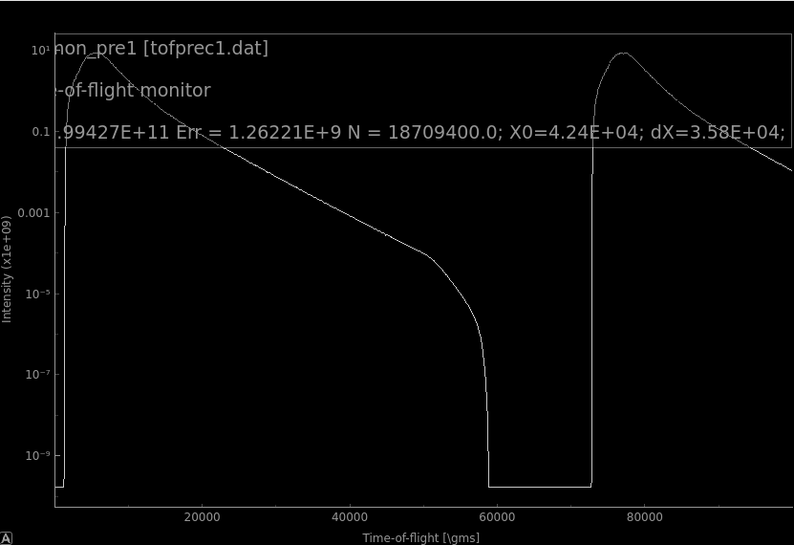
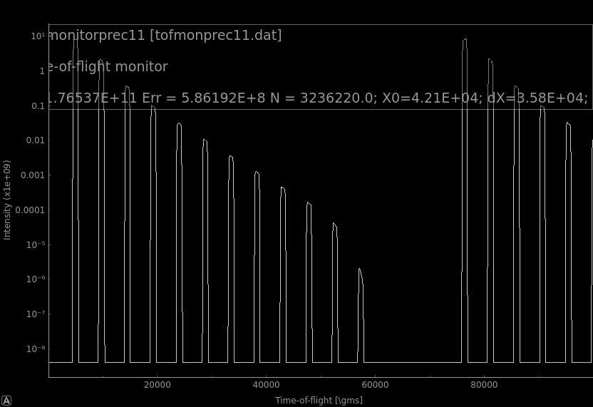
Fast pulse shaping choppers
Pulse to be selected by slow chopper
Slow chopper must be fully open
Must not go beyond the slow chopper
TOF distribution before and after fast chopper at 5.5 meters
With slow chopper next to the fast, the condition is satisfied up to 238Hz frequencies of the fast chopper.

Slide 9
Ideal chopper pair settings
3,4
1,2
5.5 m – 210 Hz chopper
5.5 m – 14 Hz chopper
41.6m – 14 Hz chopper
42.6m – 210 Hz chopper

Slide 10
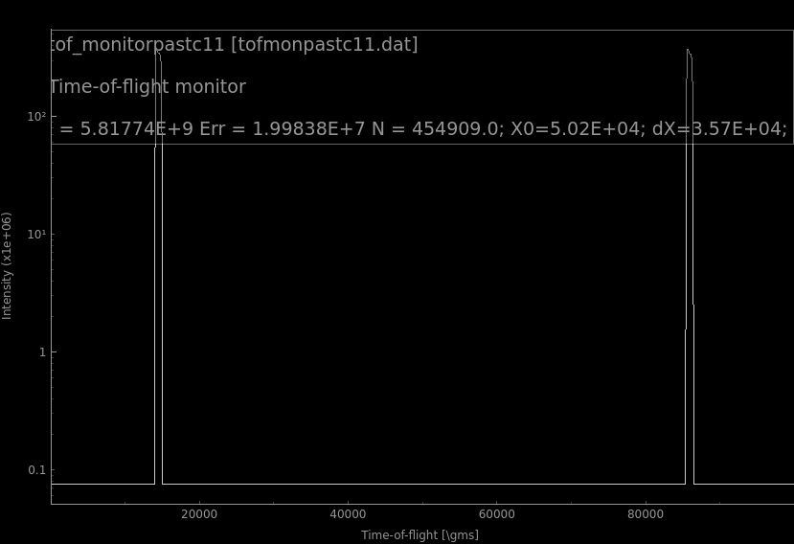
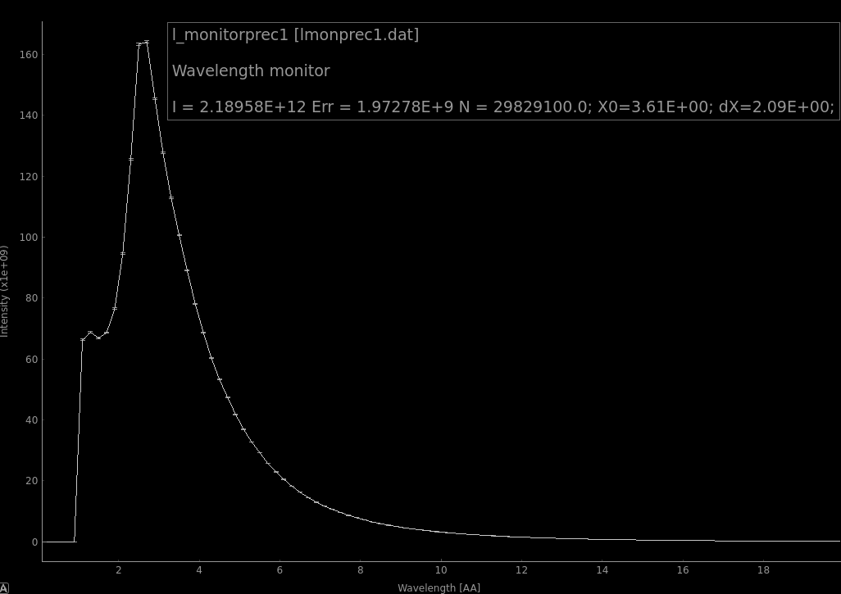
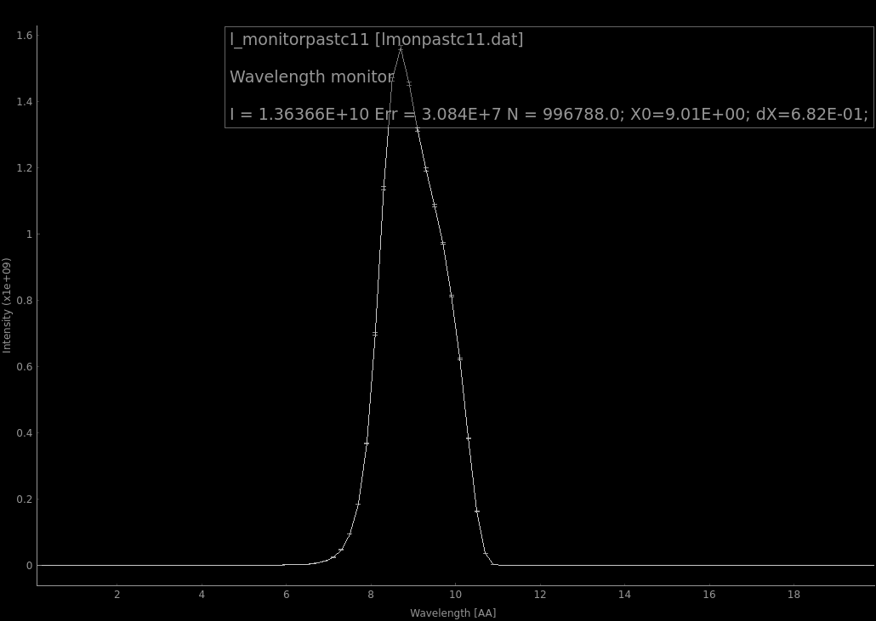
Before and after first chopper pair

Slide 11
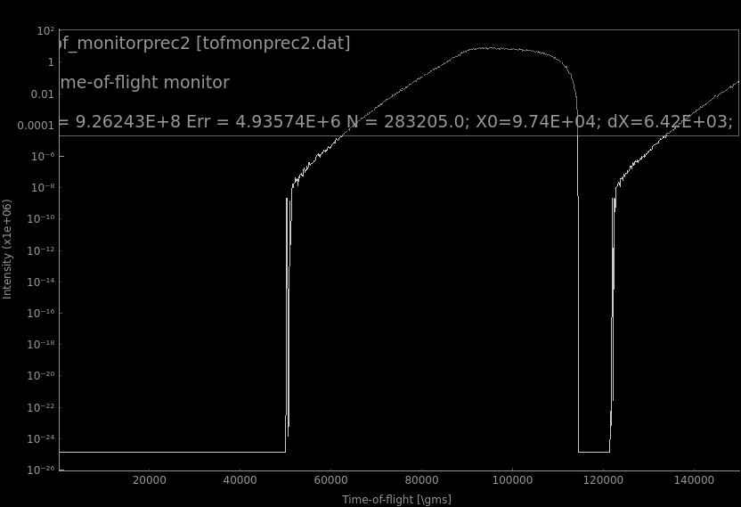
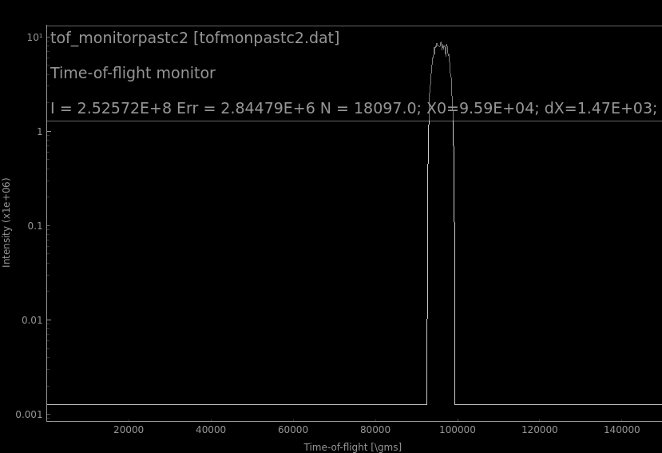
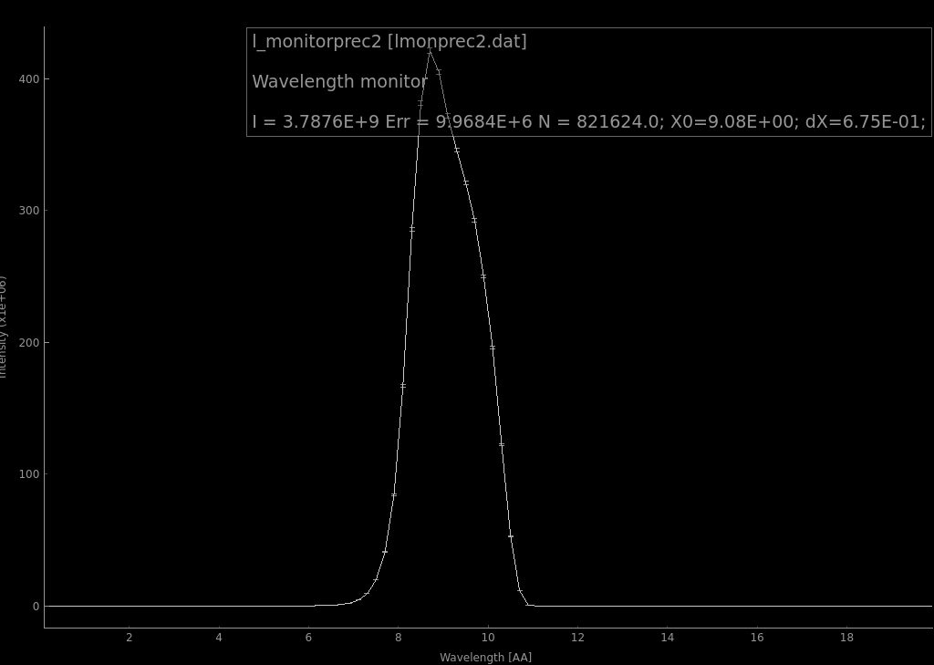
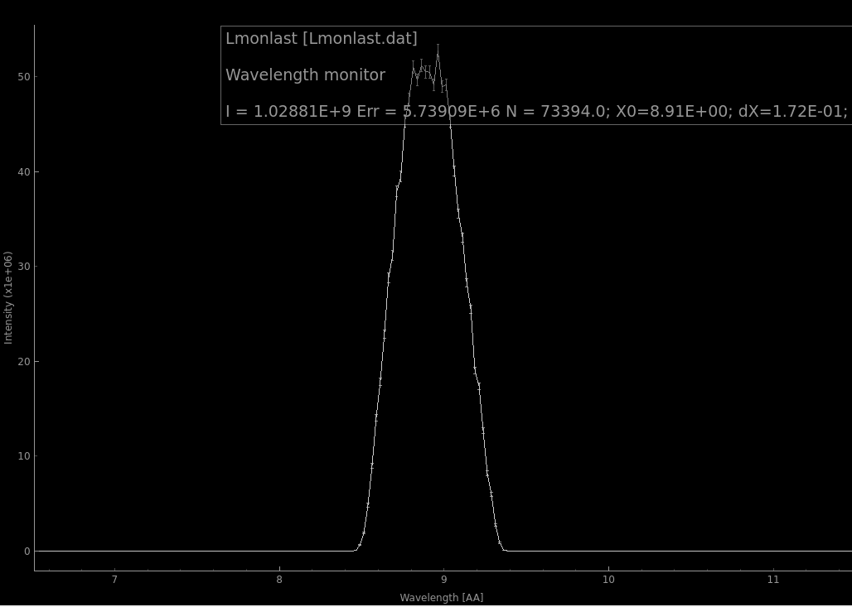
Before and after the second slow chopper

Slide 12
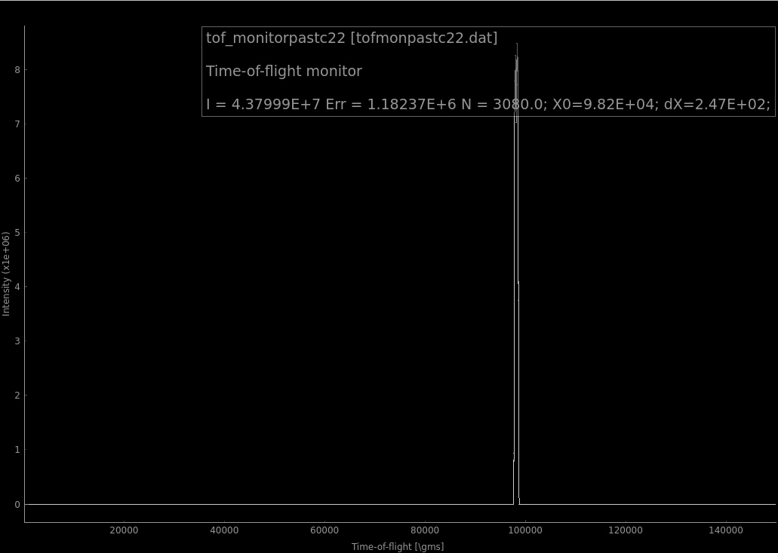
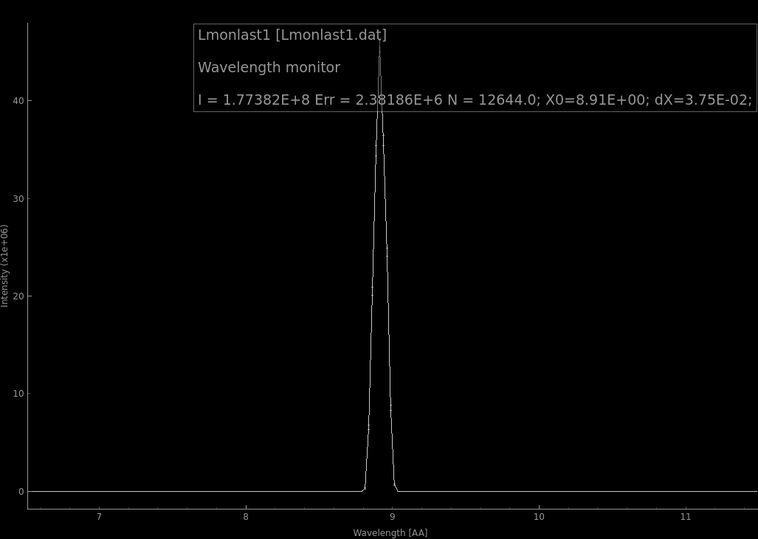
After the second fast chopper
FOM = 1.15E8 n/s neutrons in the cell
With chopper distance of 37.1m the theoretical maximum is 1.30E8 n/s
Reduction is explained by partial opening:
Frame width = 0.844ms, chopper opening/close time =0.207ms

Slide 13
Displaced slow chopper
2
3,4
1
5.5 m – 210 Hz chopper
15 m – 14 Hz chopper
41.6m – 14 Hz chopper
42.6m – 210 Hz chopper

Slide 14
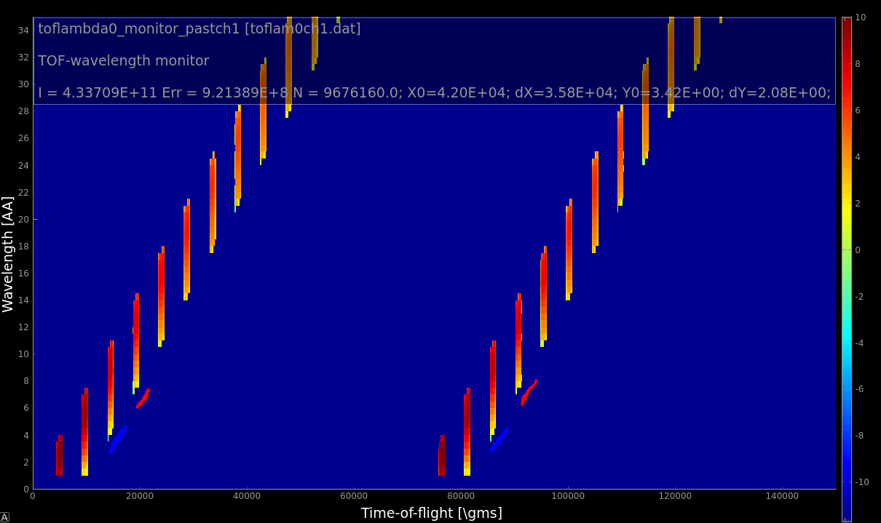
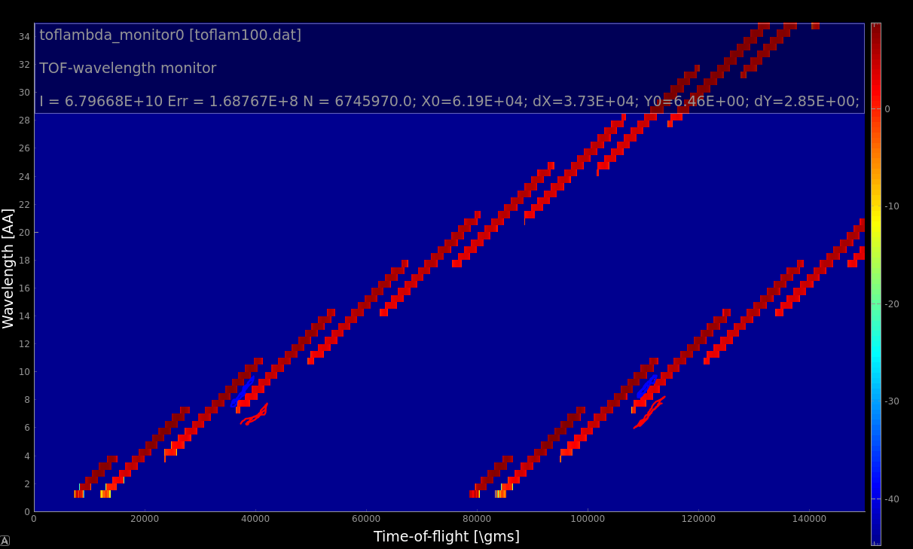
Frame overlap problem
9AA
9AA
Frames created after chopper 1 (fast) intersect at chopper 2 (slow)

Slide 15
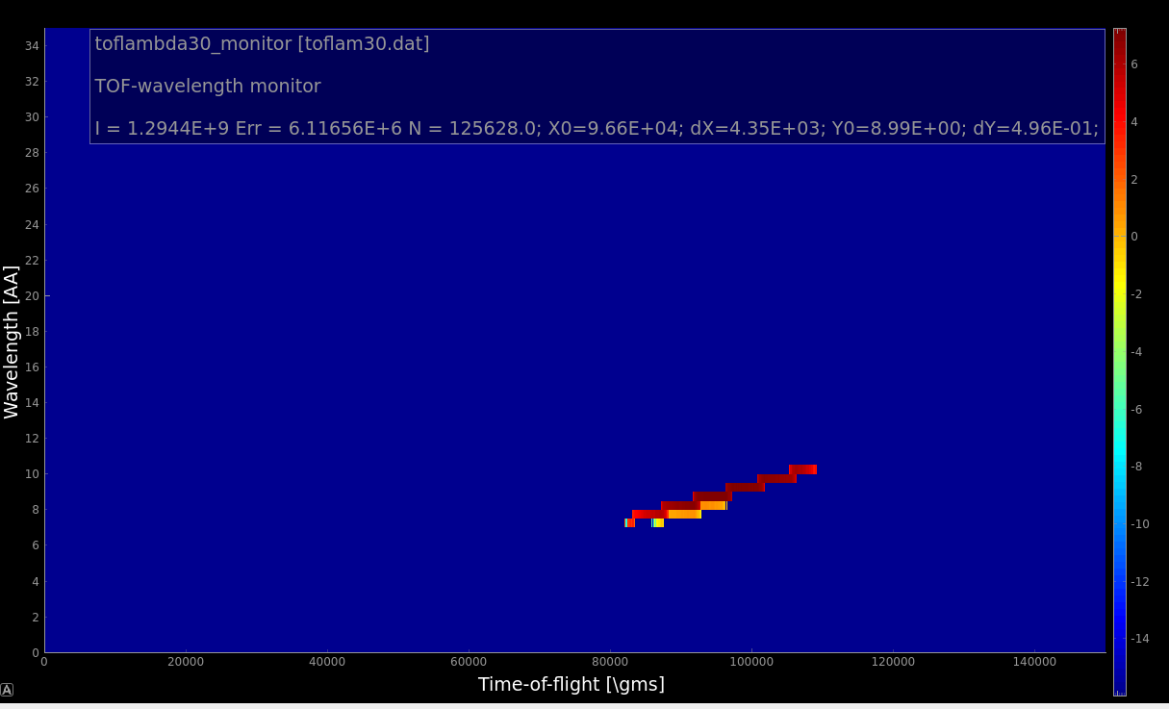
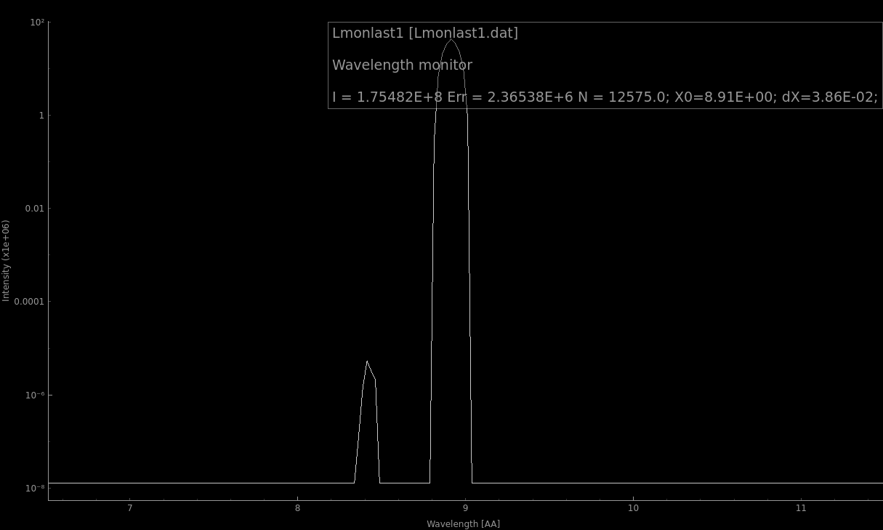
Contamination with shorter wavelength
Not enough flight path between fast choppers to separate shorter wavelength
Solution:
Reduce fast chopper speed (will decrease performance)
OR
Double slow chopper speed (will cut slower fast neutrons from next frame, same performance)

Slide 16
Summary
Compared to an ideal case, a significant FOM reduction from chopper cascade is observed
The reason for performance reduction is the combination of long ESS pulse duration and short flight path available between the pulse shaping choppers.
FOM = 1.15E8 n/s (compared to 8.86E8 in case of an “idealized” wavelength selection)

