Slide 1
nEDM beamline with V-cavity polarizer vs C-bender option

Slide 2
Old design
A very sharp curving in the bender 1 and polarizing bender optimized for 9AA.
Too low FOM for experiments sensitive for total flux/total capture flux due to poor transmission of shorter wavelength
FOM of the ANNI proposal can’t be reached until the requirement of loosing LOS in the bunker will be relaxed (proposal bending angle is 1/3 of what is needed to avoid LOS at 11.5 m)

Slide 4
New design
Slightly reduced height to allow for smaller curving angle which improves shorter wavelength transfer
Smooth curving in the second bender to improve
More complex polarizer:
Bender for shorter wavelength
Transmission V-cavities for wavelengths of 4A and above
Straight polarizer to remove high divergence with wrong polarization

Slide 5
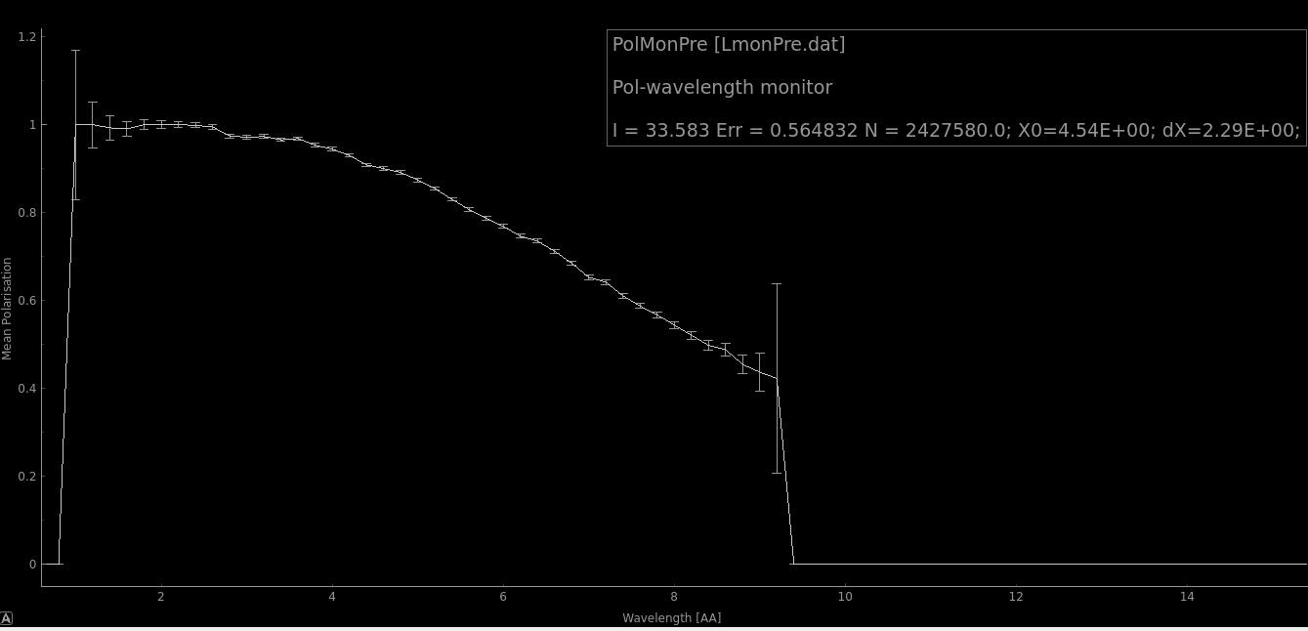
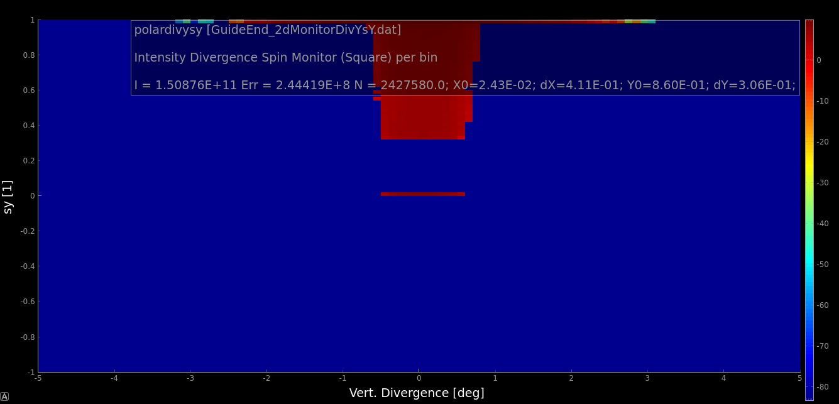
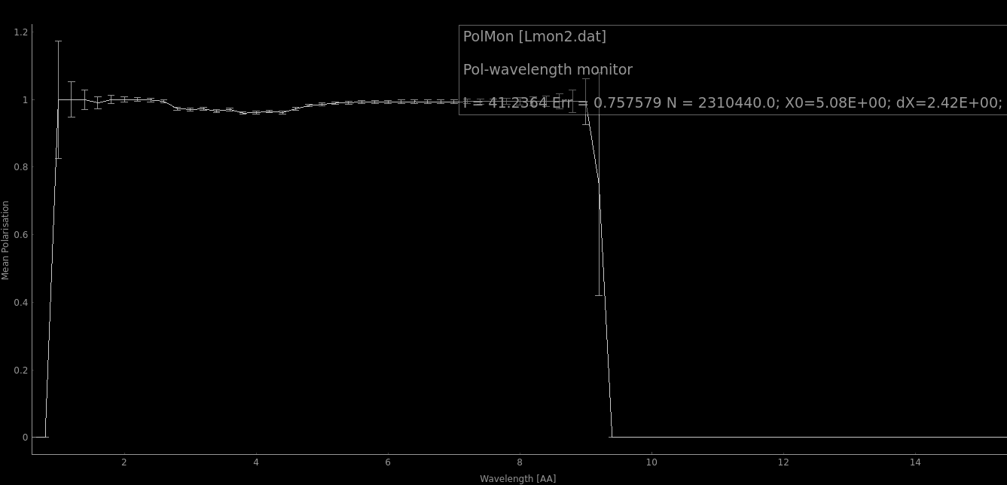
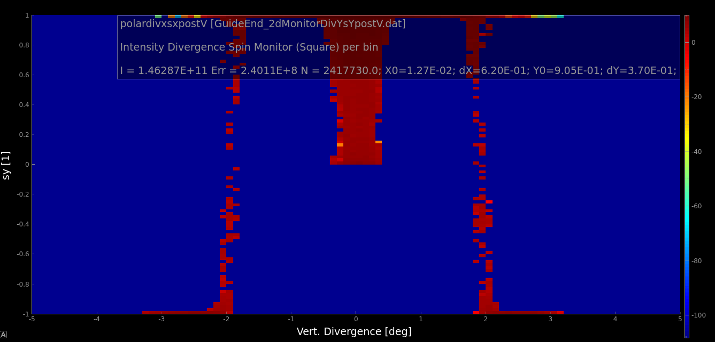
Polarization after curved guides
At guide exit
Polarization after curved guides
Effect of V-polarizer

Slide 7
ANNI (2019 version) vs nEDM with C-polarizer
Fluxes at 26m, past PDC2
Comparison of neutron fluxes beyond the second PDC@26m with identical chopper settings
70% polarization at 9AA for ANNI proposal, >95% polarization for a nEDM optimized C-bender option

Slide 8
Performance with V-polarizer
 | n/s 8.8-9AA | n/s total | ratio
1 | 1.13E+9 | 3.64E+09 | 0.31
2 | 1.19E+09 | 3.84E+09 | 0.31
3 | 1.22E+09 | 3.95E+09 | 0.31
4 | 1.16E+09 | 2.26E+09 | 0.52
A theoretical maximum after PDC2
is calculated to be 1.73E+09 under
the condition: choppers off, straight benders.
Cells: 1.26E9 (theoretical) 8.73E8 (3)
1: C-polarizer, m=2 guides, ANNI original chopper settings, PDC1@6.5m and PDC2@26m
2: C-polarizer, m=3 guides, ANNI original chopper settings, PDC1@6.5m and PDC2@26m
3: New concept with V-shaped polarizer, PDC1@6.5m and PDC2@26m
4: New concept with V-shaped polarizer, PDC1@6.5m and PDC2@42m

Slide 9
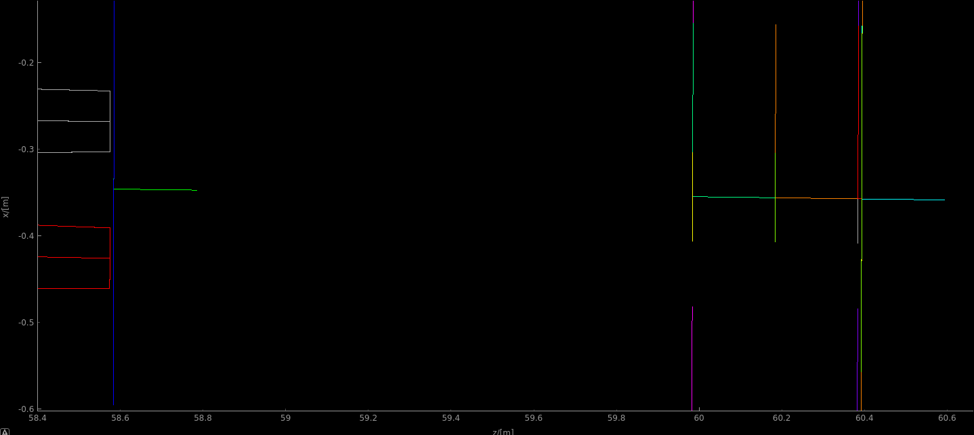
End of focusing guides
Slit 1 and 2
Beamstops 1,2 and 3
FOM is calculated as number of neutrons passing through both slits.

Slide 10
Chopper settings
Chopper angles and phasing analogous to original ANNI proposal
Chopper distances are same as in the proposal, with two positions for PDC2 and PSC studied (26m and 42.5m)
Chopper disk radius taken R=70cm.

Slide 11
FOM in the cells
 | n/s 8.8-9.0AA | n/s total | n/s/cm2 8.8-9.0AA | n/s/cm2 total
A | 1.03E09 | 3.13E09 | 6.87E06 | 2.09E07
B | 9.74E08 | 1.88E09 | 6.49E06 | 1.25E07
C | 1.12E09 | -- | 7.47E06 | --
D | 8.73E08 | 2.65E9 | 5.82E06 | 1.79E07
E | 8.28E08 | 1.6E09 | 5.52E06 | 1.07E07
F | 9.72E08 | -- | 6.48E06 | --
G | 1.26E09 | -- | 8.40E06 | --
A: C-polarizer, m=3 guides, ANNI original chopper settings, PDC1@6.5m and PDC2@26m
B: C-polarizer, m=3 guides, ANNI original chopper settings, PDC1@6.5m and PDC2@42.5m
C: C-polarizer, no choppers, wavelength restricted to 8.8-9.0AA, open choppers
D: New concept, curved with V-shaped polarizer, PDC1@6.5m and PDC2@26m
E: New concept, curved with V-shaped polarizer, PDC1@6.5m and PDC2@42.5m
F: New concept, curved with V-shaped polarizer, wavelength restricted to 8.8-9.0AA, open choppers
G: Theoretical max, straight guide (slits preserved), V-polarizer, wavelength restricted to 8.8-9.0AA, open choppers
Lower FOM for the concept with V-bender can be a consequence of more reflections in the long second bender with multiple horizontal slits. The second bender optimization should be studied (bending angle and height are fixed, but L and Nof slits can be varied)

Slide 12
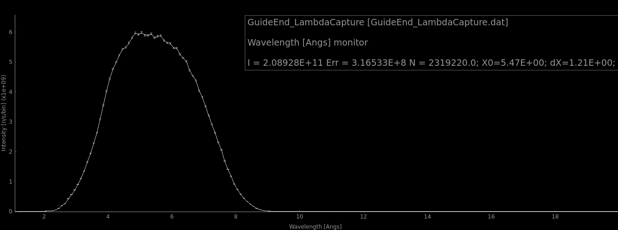
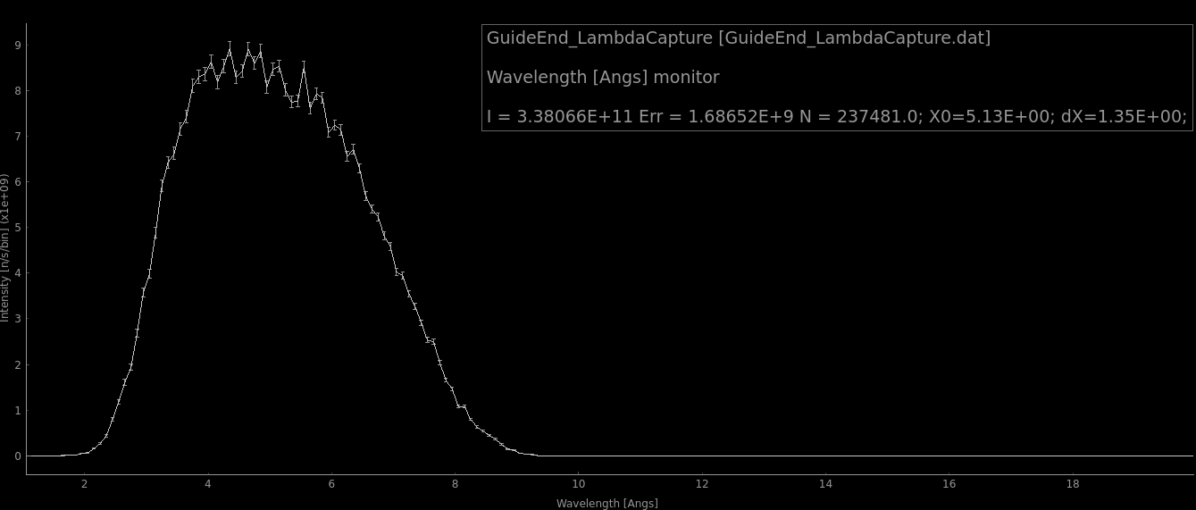
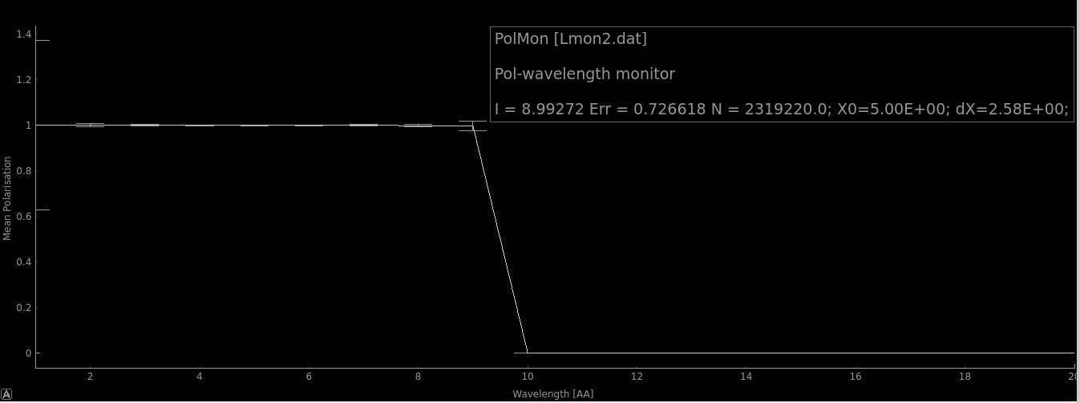
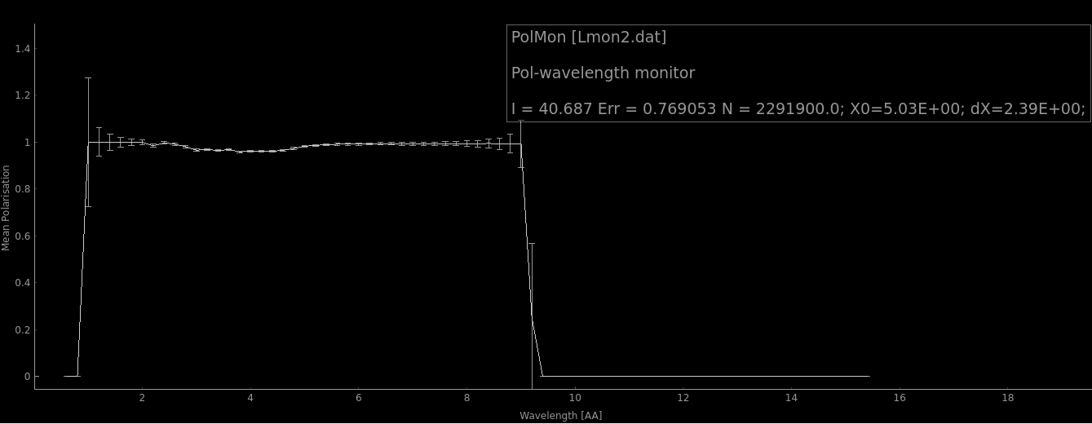
Improved performance for other experiments
C-bend
V-cavity
Approximately 50% higher performance, in new design for NPDgamma
Above 50% of the original performance in the ANNI proposal.

Slide 13
Extra components
Standard McStas:
Pol_bender
Based on Guide_curved which doesn’t work with gravity
Only vertical slits
Hard-coded my=1 (guide reference frame) for polarization vector
Pol_gude_vmirror
Only vertical V-cavities
Hard-coded my=1 (guide reference frame) for polarization vector
Current simulation:
Bender is approximated with several Guide_gravity components
Polarizer – by Guide_gravity_polar (Written by Xavier Fabreges for Magic) – horizontal slits polarizing in vertical direction
Pol_guide_vmirrorX on base of Pol_guide_vmirror. Hard-coded mx=1 for polarization vector, needs rotation by 90 degrees for vertical V-cavities and vertical polarization when inserted in beam.
NB! No attenuation in the transmission polarizer is implemented for the moment

