Slide 1
NMX Updates and Demos
Neutron Macromolecular Crystallography
PRESENTED BY Aaron finke
2025-04-08

Slide 2
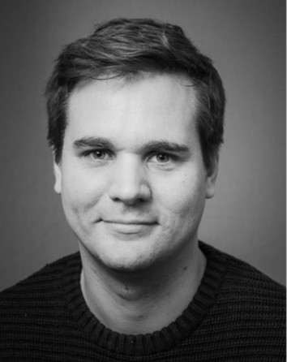
The NMX Team
Who’s building NMX?
Esko Oksanen
Lead Instrument Scientist
Justin Bergmann
Commissioning Instrument Scientist
Aaron Finke
Instrument Data Scientist
Zoë Fisher (DeMAX)
Deuteration Wizard
Laïs Passine (ECDC)
Controls/MXCuBE
Swati Aggarwal
Commissioning
Sample Scientist
Daniel Lundström
Lead Engineer
2025-04-08

Slide 3
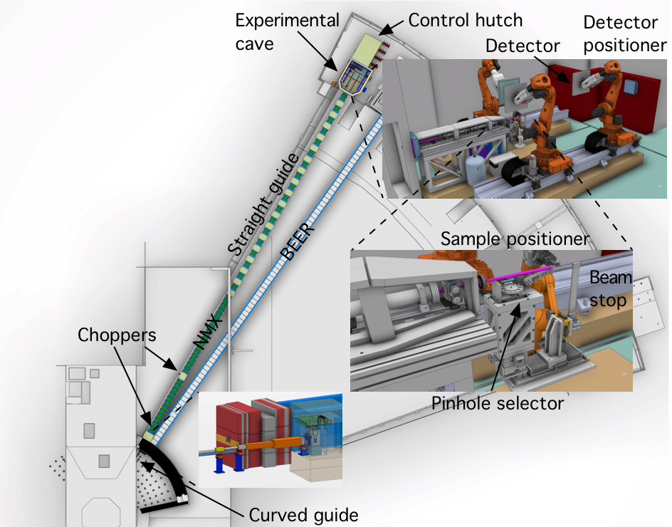
NMX: Neutron Macromolecular Crystallography
A Quasi-Laue TOF instrument for Macromolecular Crystallography
Determination of precise hydrogen atom positions in protein crystals with an innovative detector technology and robot-based goniometry.
DMSC Deliverables: ESSNMX, eventually to a complete diffraction-to-refinement pipeline using a combination of software developed at DMSC and partner institutions.
CC Goals: Processing simulated NMX data, motion tests (NICOS)
HC Goals: Beam-to-data
NMX moved from Tranche 2 to Tranche 1 in 2023
2025-04-08

Slide 4
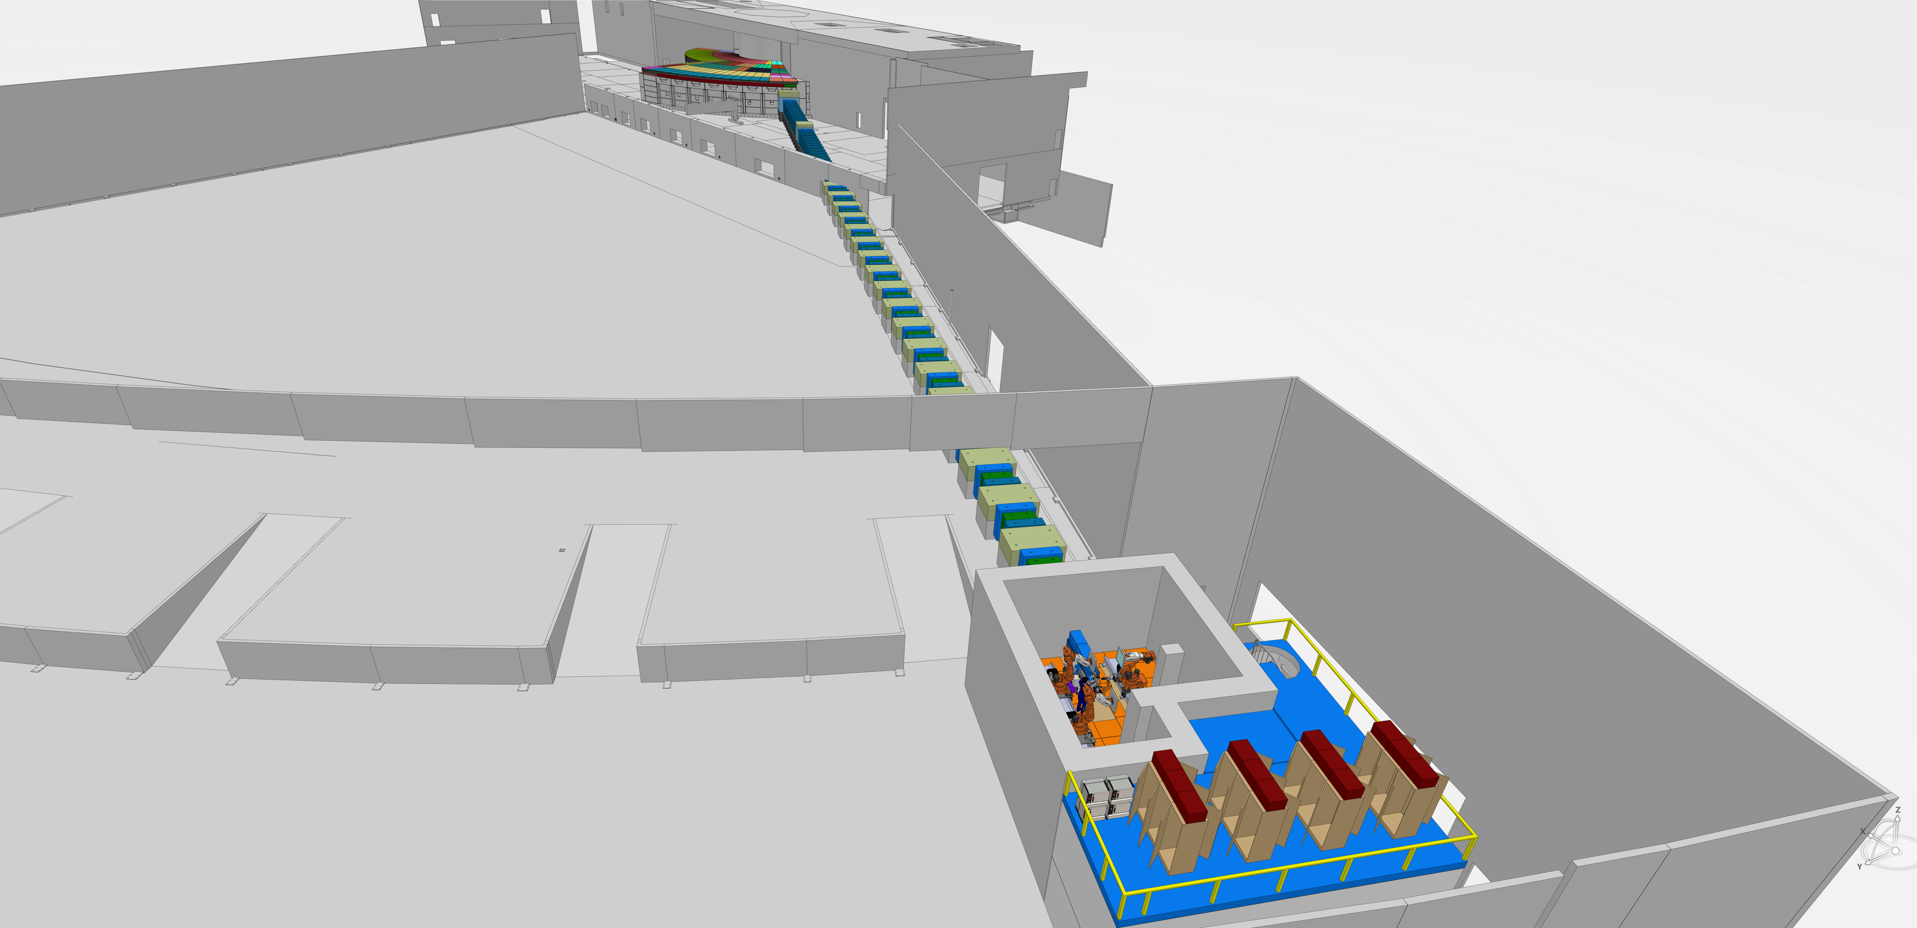
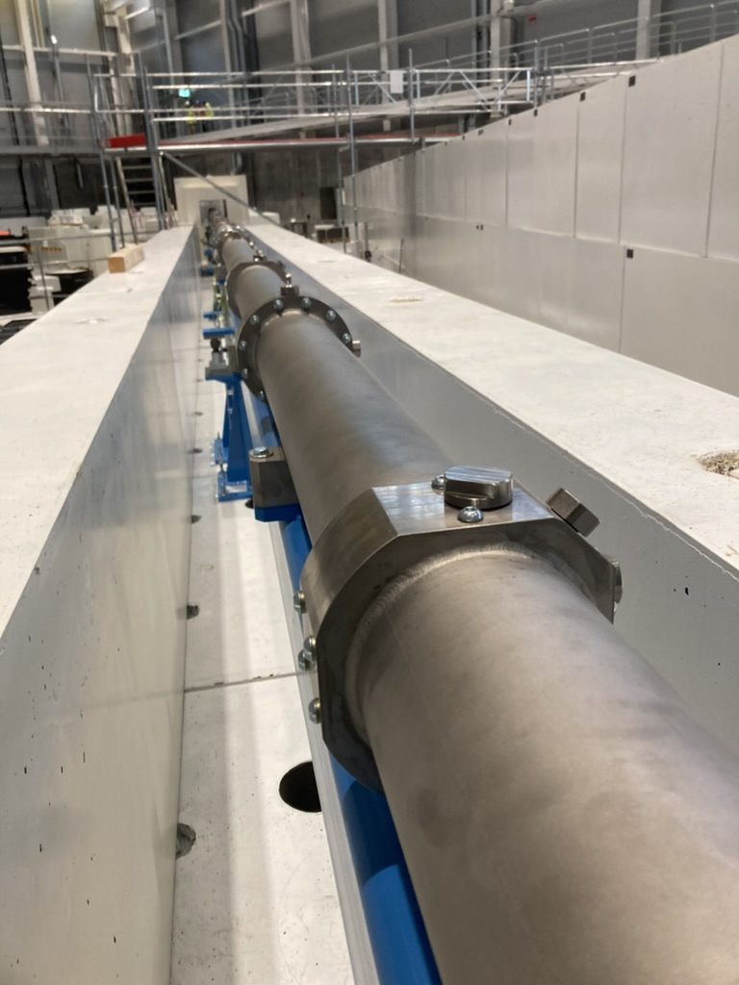
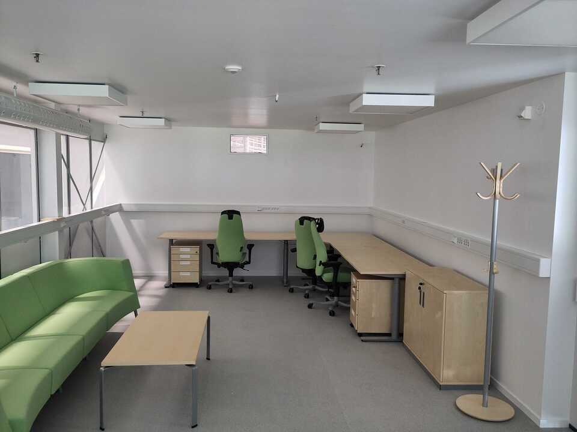
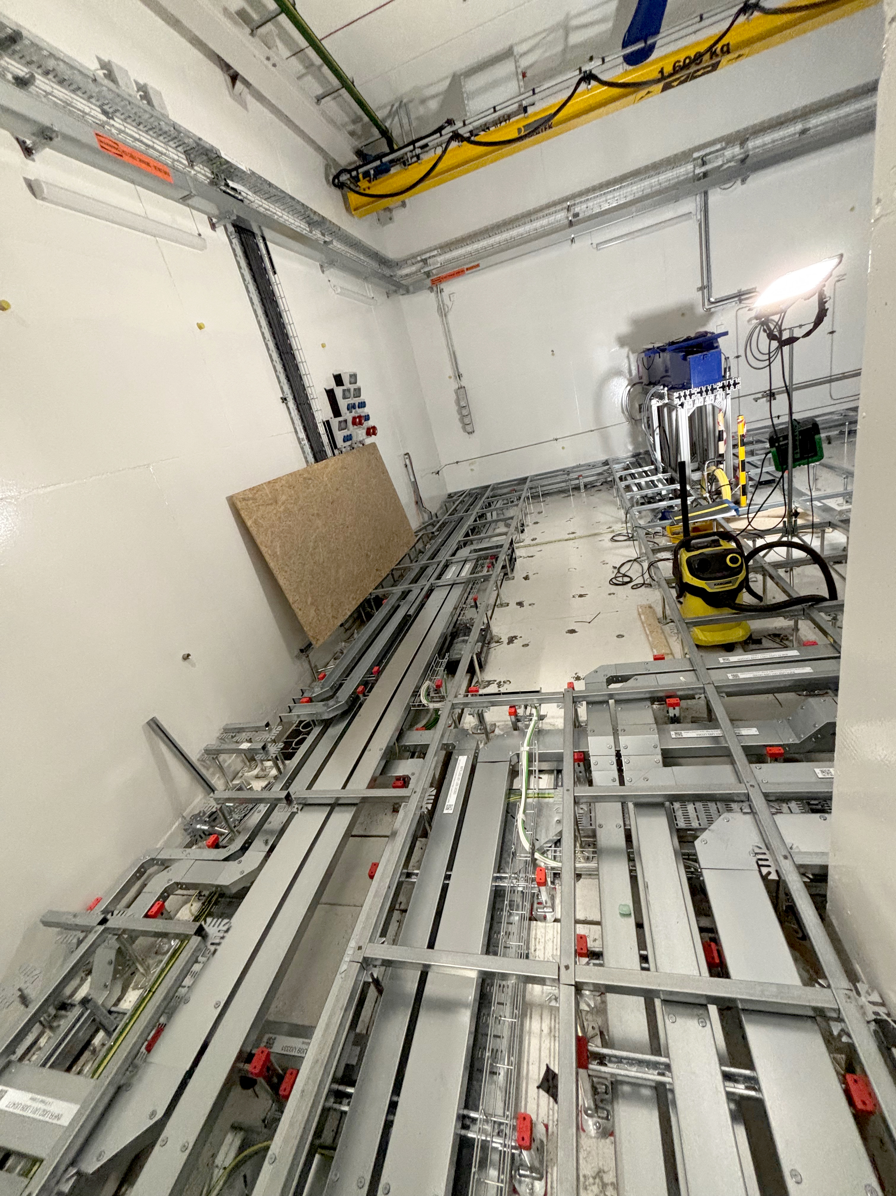
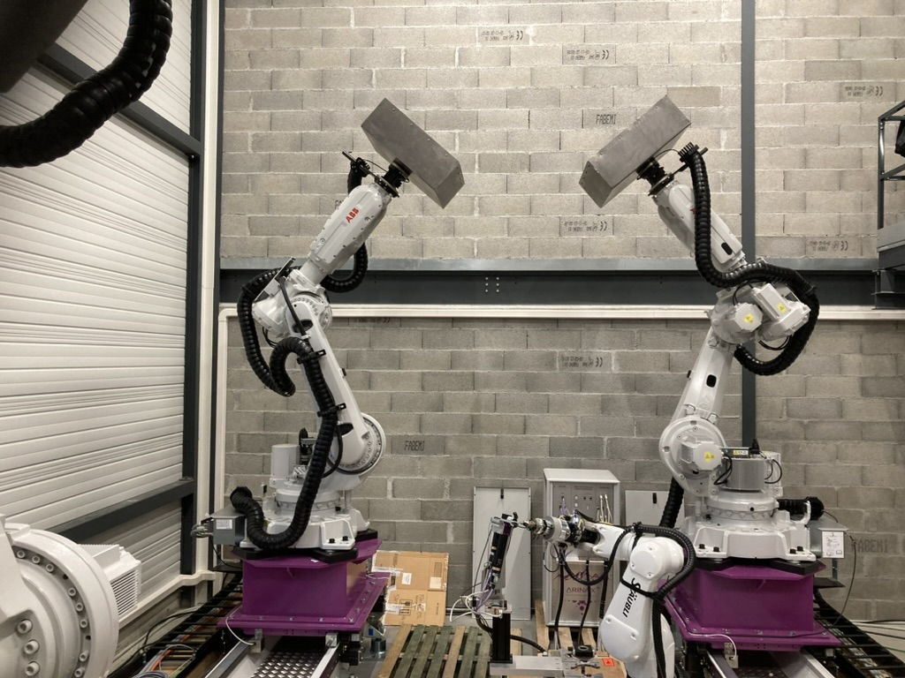
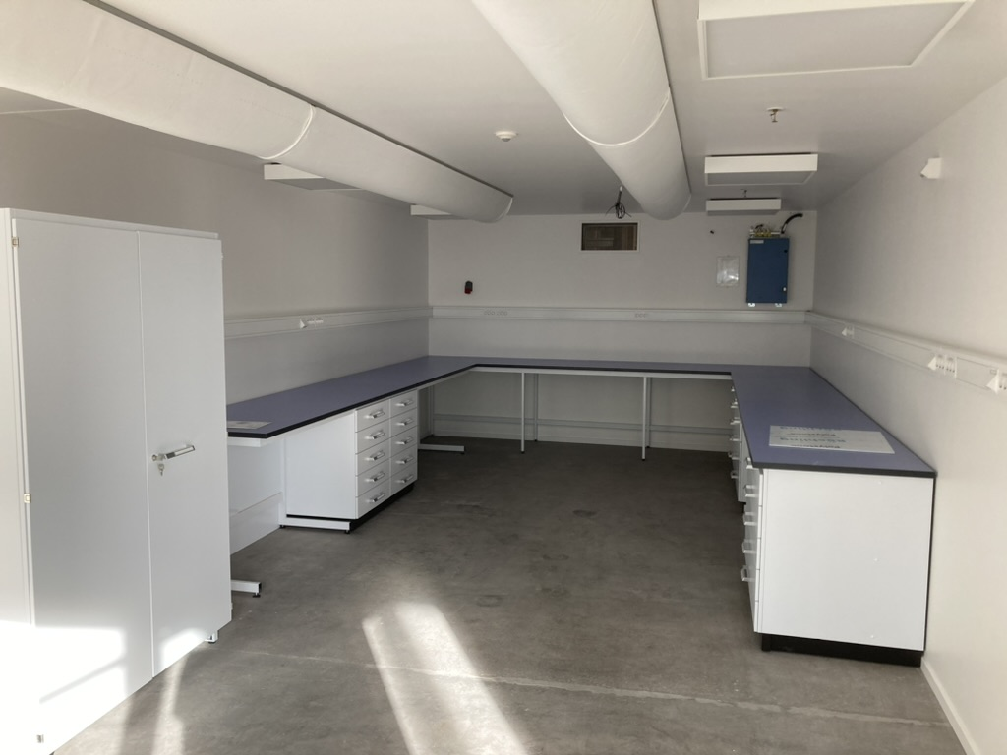
NMX Instrument Update
2024-04-17

Slide 5
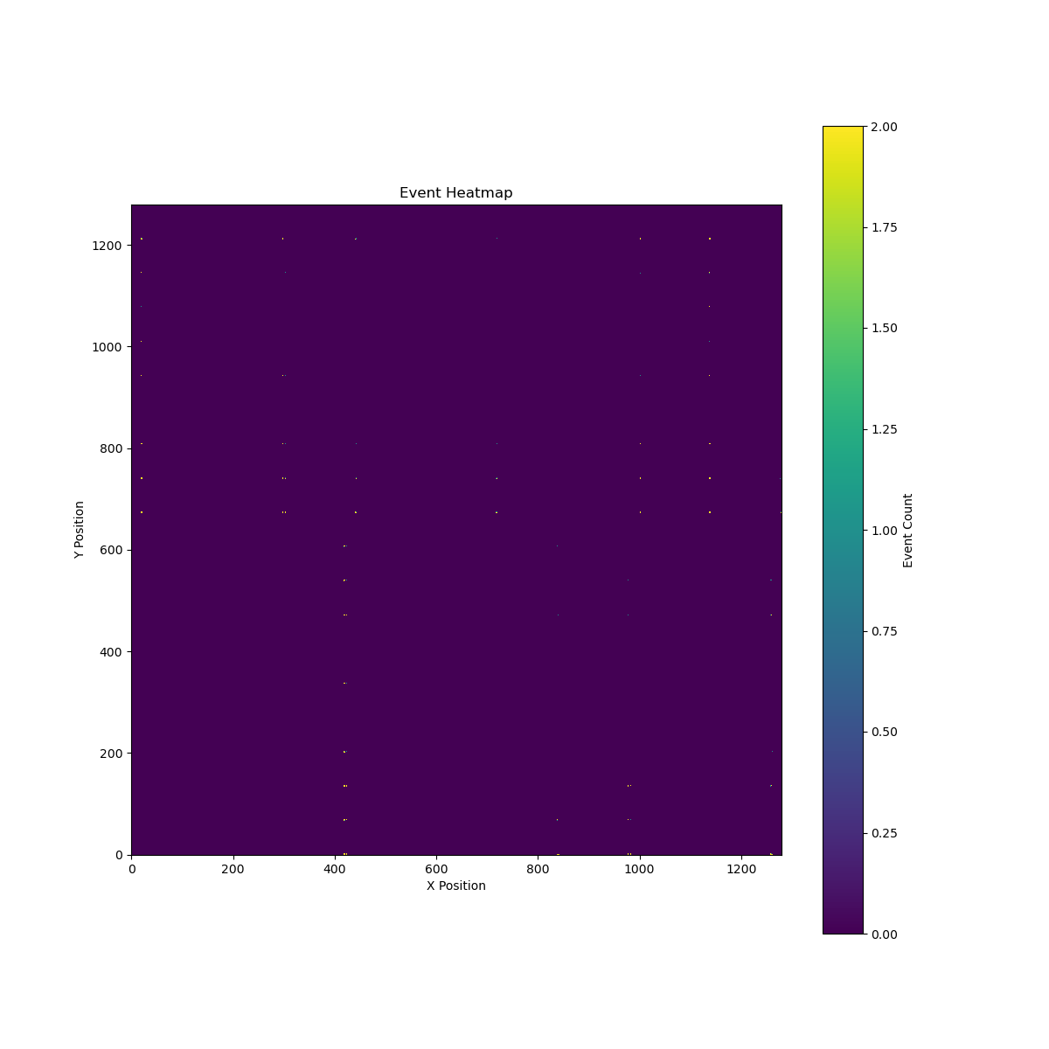
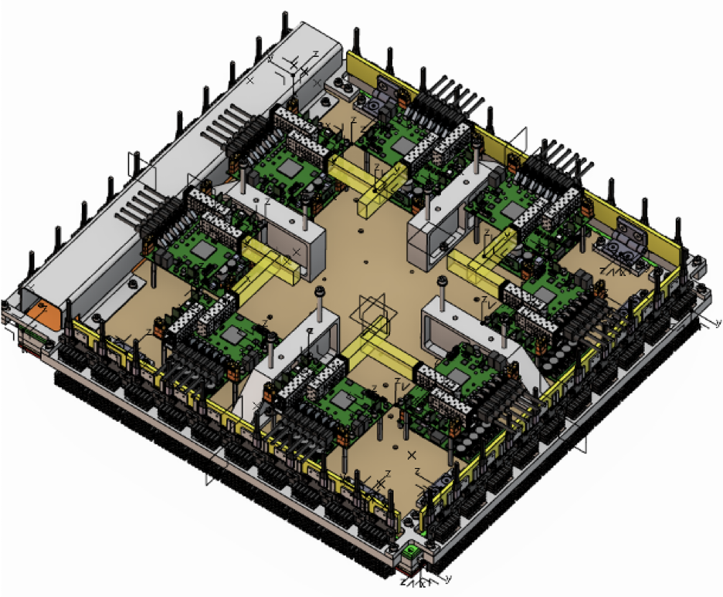
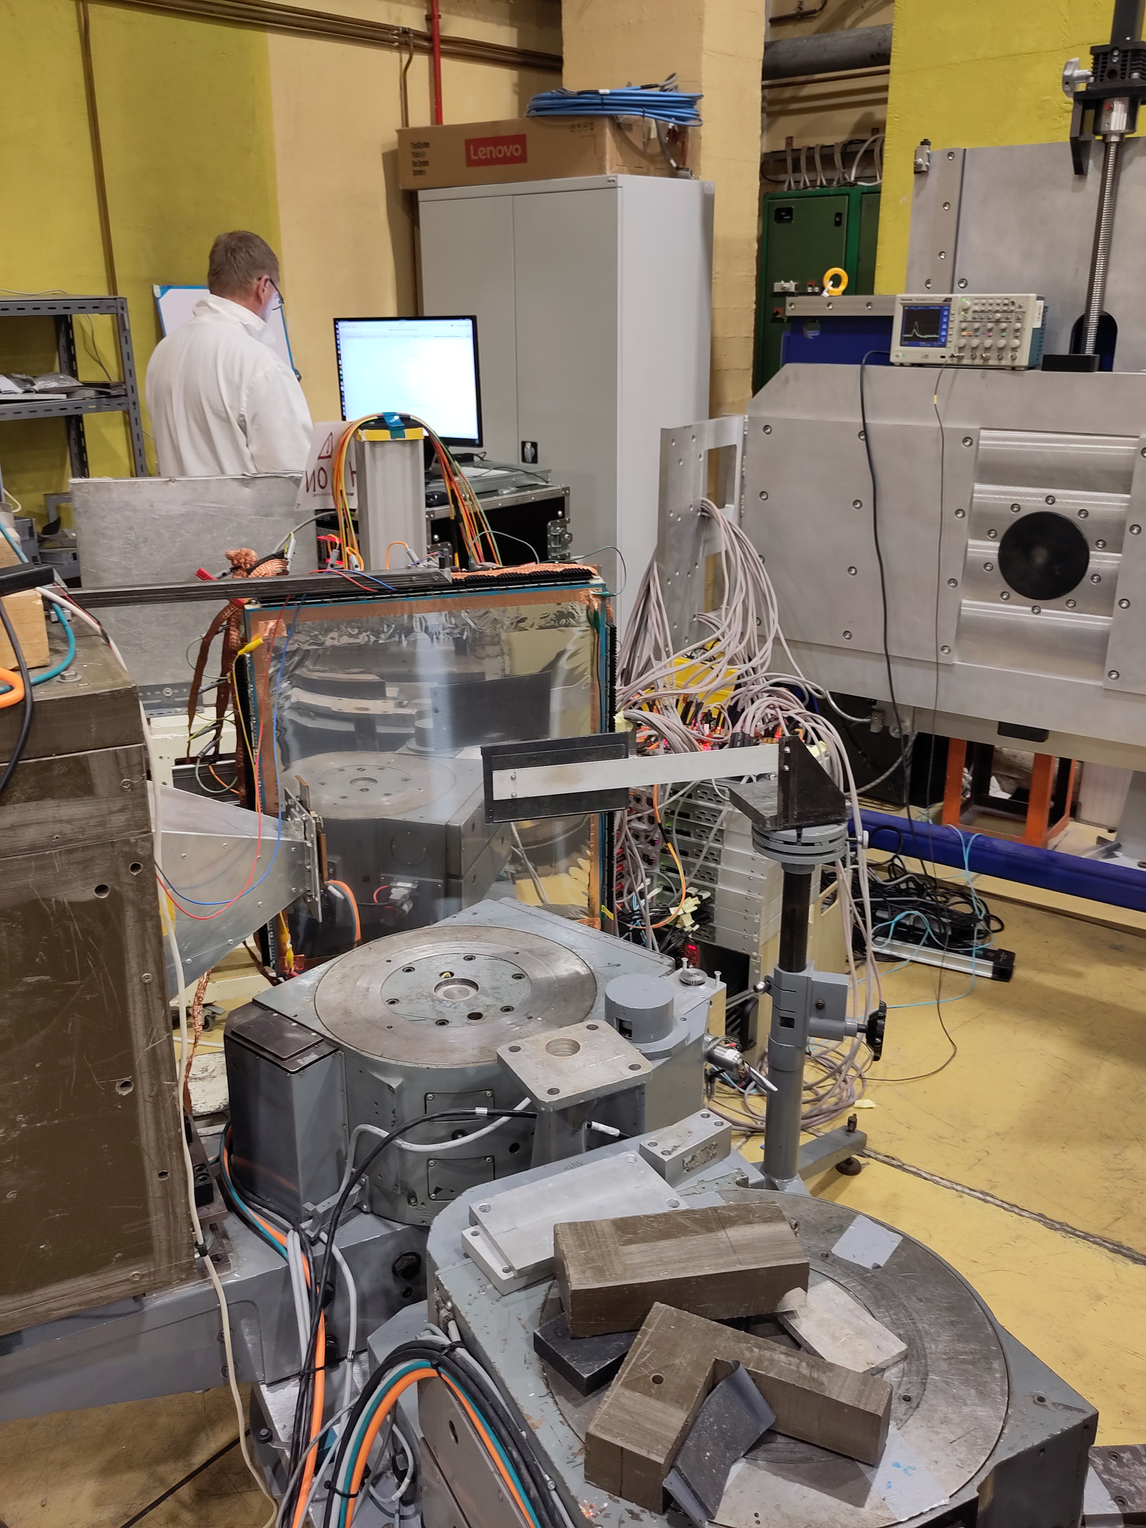
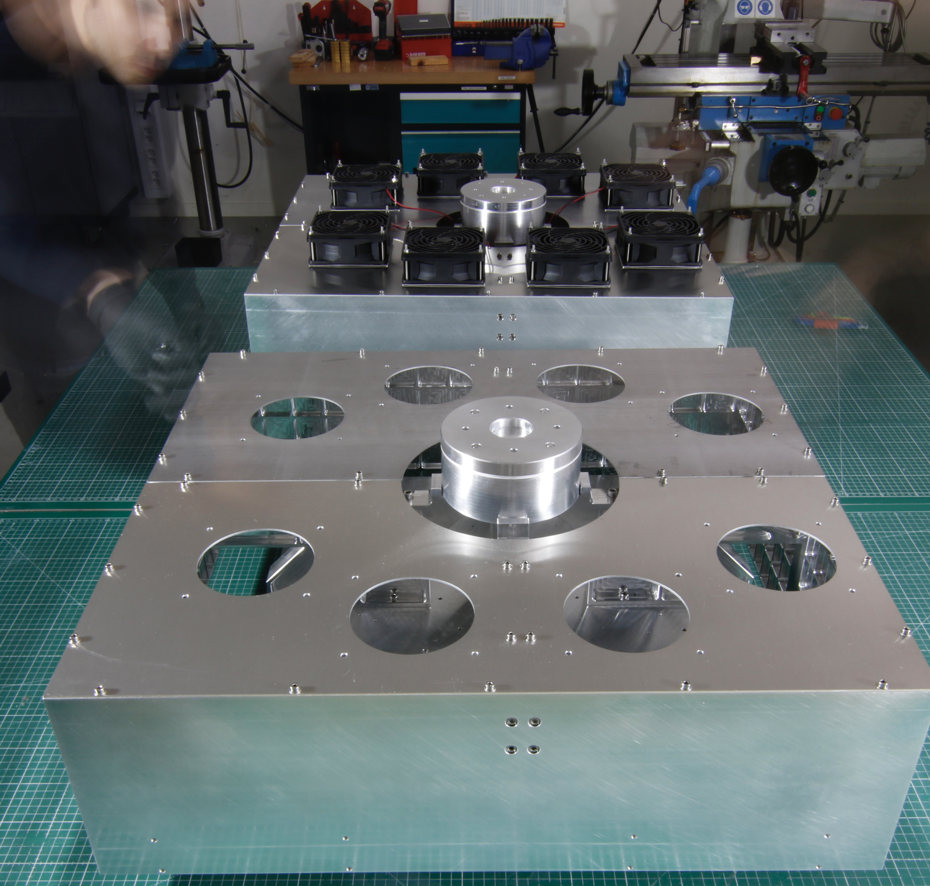
Detector Testing
Progressing!
Three detector panels
Triple Gd-GEM
Active area 512.2 mm x 512.2 mm
400 µm effective pixel size
1200 x 1200 effective pixels
We have demonstrated complete detector “events” → EFU → filewriter → Nexus TOFRaw pipeline
Next steps: tests at neutron sources (CERN in April, ILL in August)

Slide 6
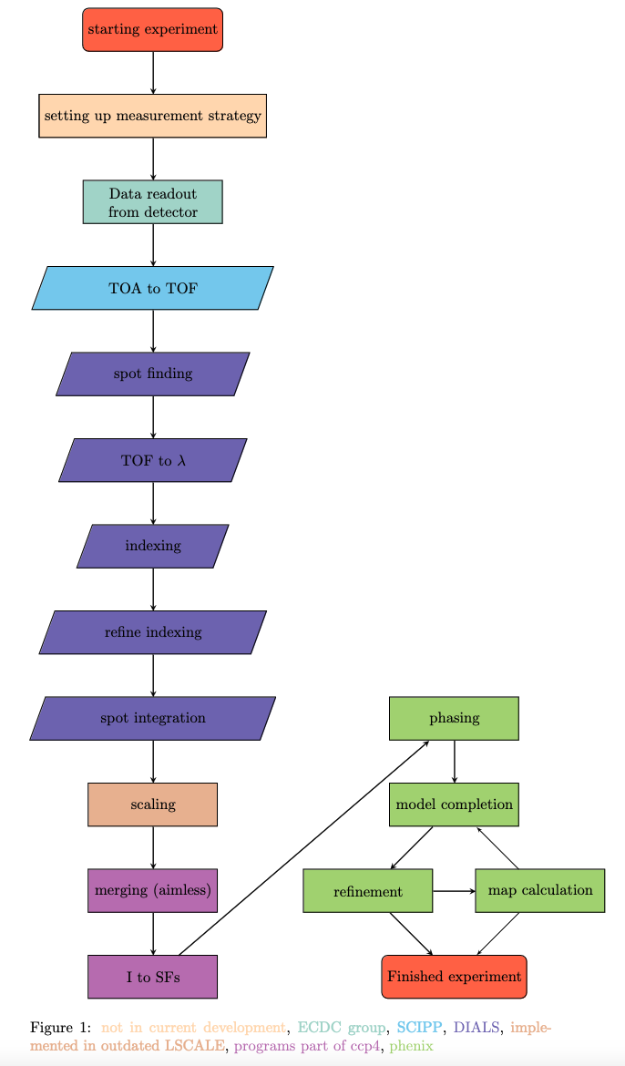
Data pipeline status
ESSNMX
Reduction Pipeline
Neutron Macromolecular Crystallography
Mcstas data modeling
Saving of events to Nexus NXLaueTOF format
Data Collection Strategy
Instrument simulation
ESSNMX Data Reduction Pipeline
Pyscale
Done
Done-ish*
In Progress
To do
Data reduction
DIALS for Neutrons
Phenix for Neutron MX
Data analysis
* Ready for HC but still under development
Metadata (NXLaueTOF format)
Piping to SciCat
Data archiving
2025-04-08

Slide 7
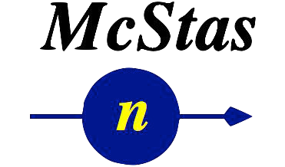
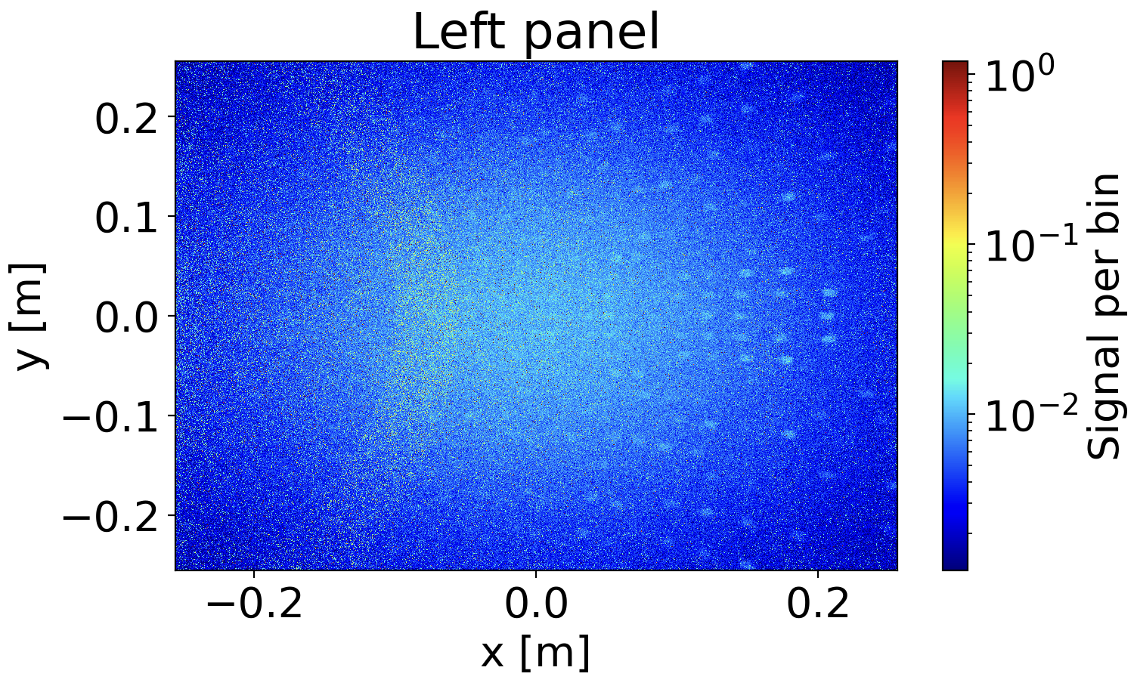
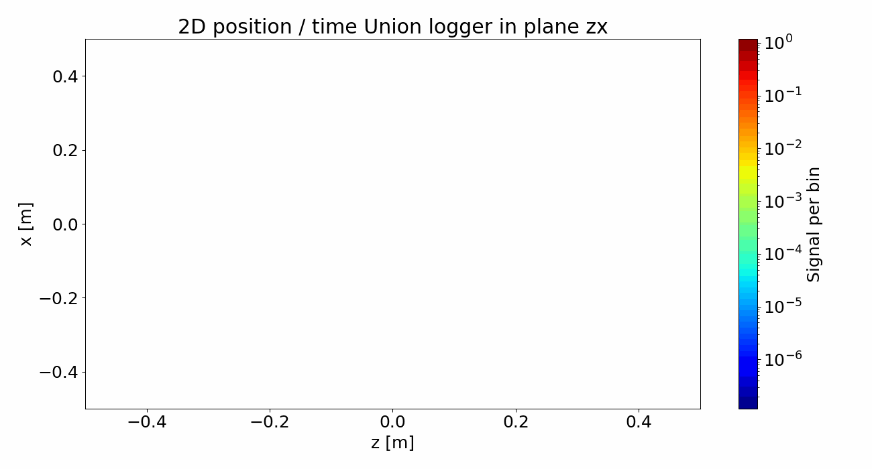
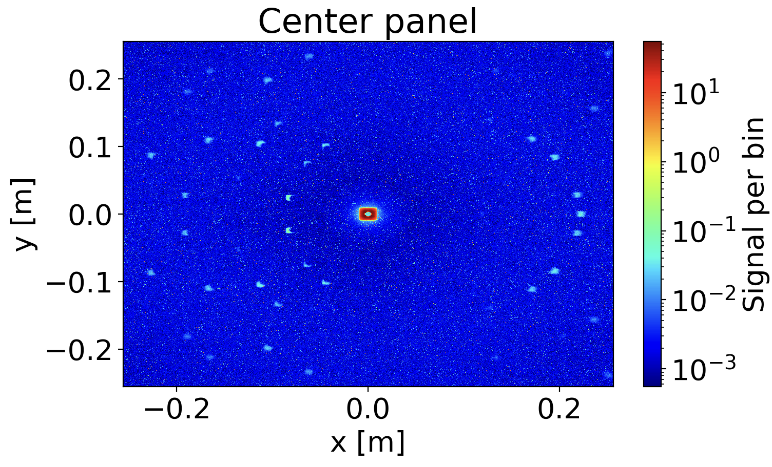
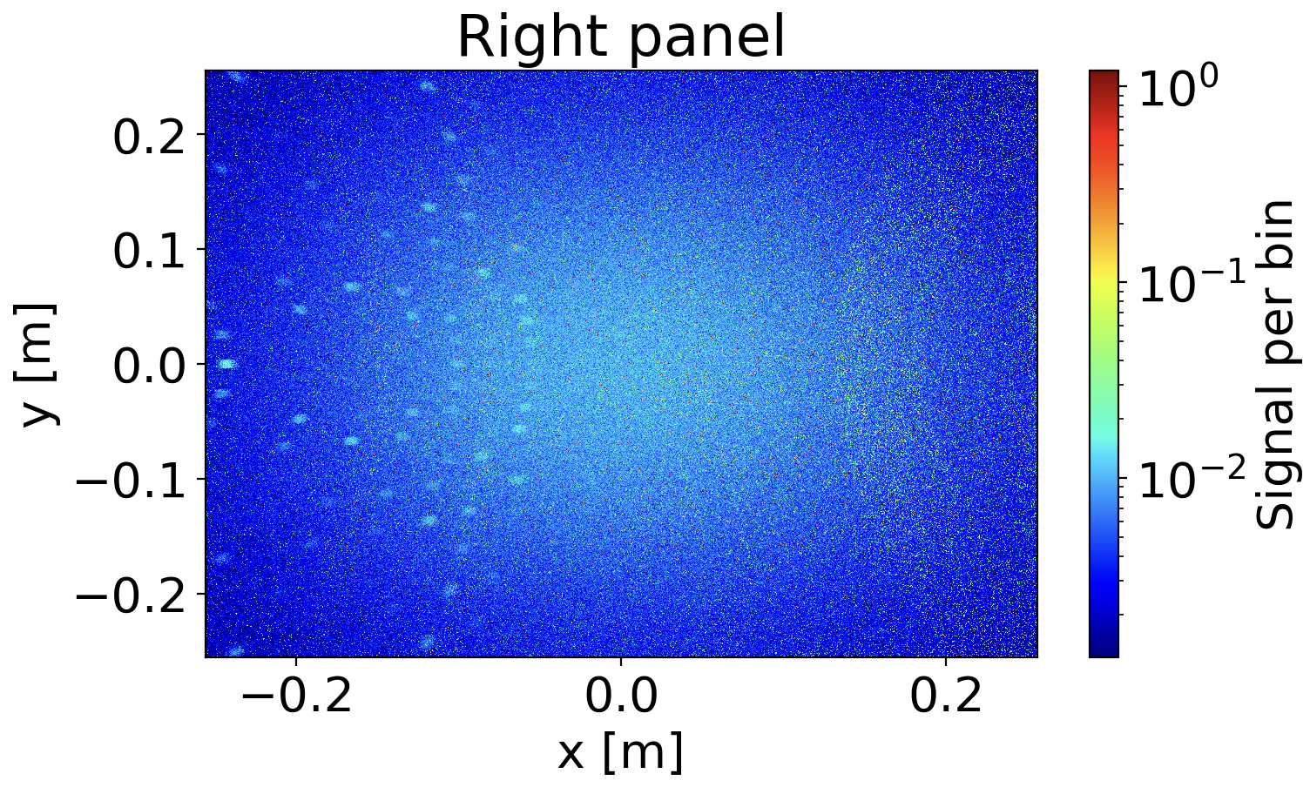
McStas NMX Simulations
McStas
Backend with Union
Small wavelength interval: 2.5 – 2.6 Å, full frame 1.7 Å
Mads Bertelsen
2025-04-08

Slide 8
NMX McStas Simulations
1st order
0th order
Single_crystal component
Used leucine with 4943 reflections
Higher speed up for longer lists
Perdeuterated pyrophosphatase with 1795256 reflections
Mads Bertelsen
2025-04-08

Slide 9
NMX McStas Simulations
1st order
0th order
Single_crystal component
To do:
Model scattering from solvent
Process simulated data in DIALS (in progress)
Mads Bertelsen
2025-04-08

Slide 10
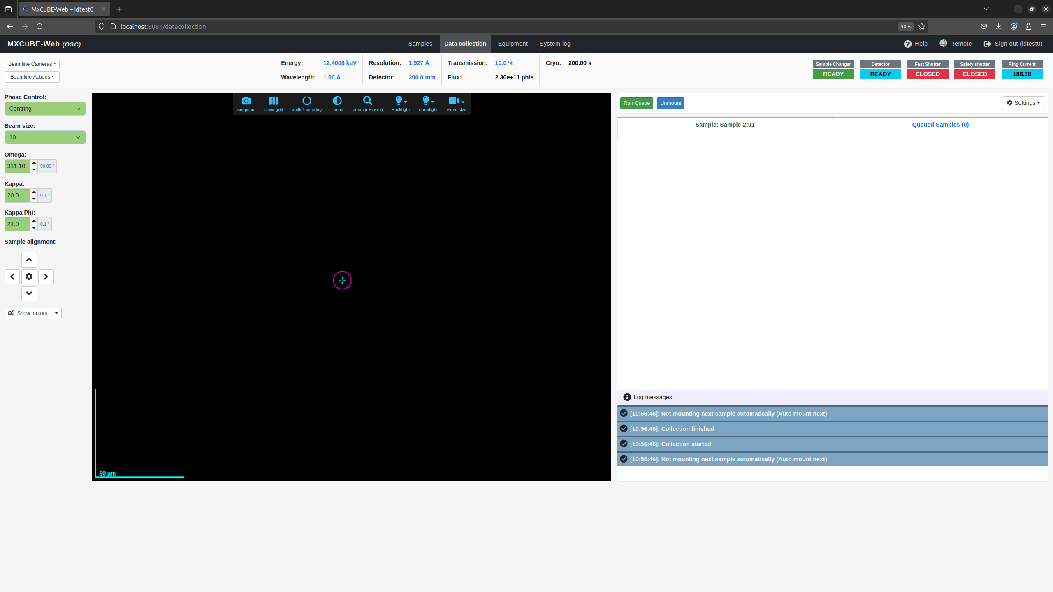
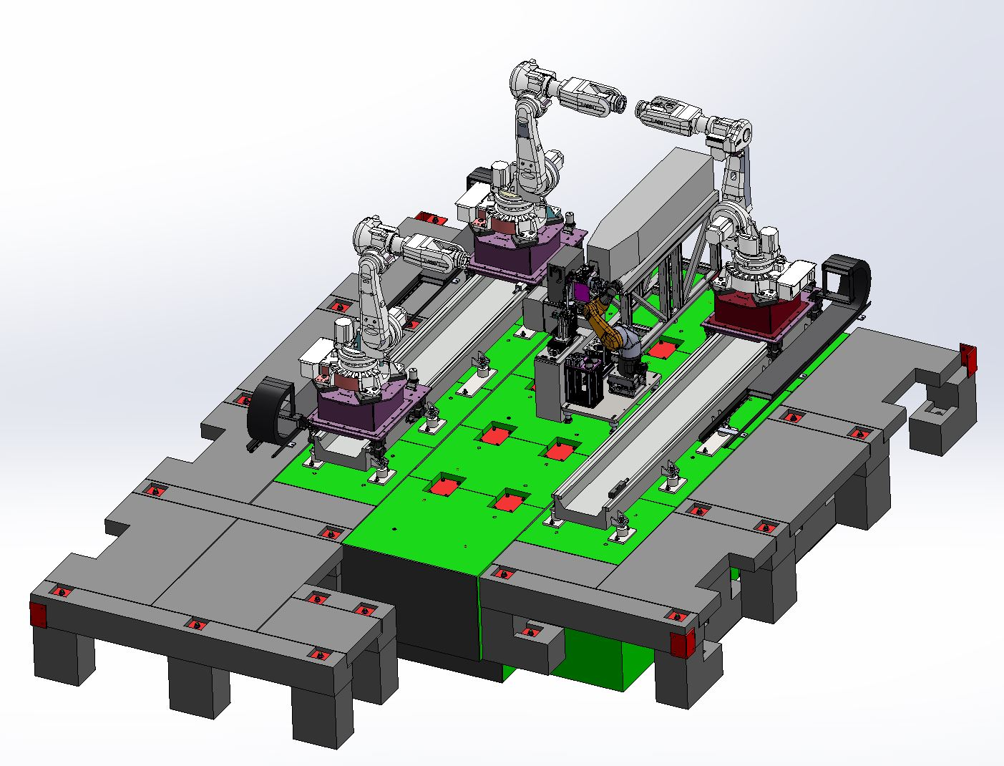
MXCuBE
The Data Collection GUI for NMX
Use MXCuBE Web at NMX for a more friendly UI.
MXCuBE is a multi-facility data collection GUI used at many MX synchrotron beamlines around the world.
NMX will be the first neutron facility to use MXCuBE. Joined the collaboration in 2024.
Have MXCuBE as the main interface for the user + NICOS also present for prototyping, calibration and backup.
MXCuBE Web
2025-04-08
View of NMX experimental hutch

Slide 11
Demo Neutron Single-Crystal MX Workflow
NMX
Fully automated workflow, from events -> h,k,l, I, I/sig(I)
Instrument simulation
Data catalogue
simulated detector data
Samples:
Rubredoxin
Data reduction
Data analysis
Reduced data files
Data catalogue
Loading NeXus file
Grouping detector data
Binning TOF histogram
“nxs” format
2025-04-08

Slide 12
Demo: Web-based interface
ESSNMX
Reduction Pipeline
Data reduction for NMX with ESSNMX/DIALS
Considerations:
NMX users by and large will not have a working knowledge of Python
Maybe they will know command line/Linux but not always
Automated processing should yield results in formats/statistics users understand
Since processing takes time, real-time results pending can be useful.
Web-based results interface app written in Flask/JS
2025-04-08

