Slide 2
Scientific Information Management Systems
SIMS
PRESENTED BY Fredrik Bolmsten

Slide 3
Group
Staff & Scope
Fredrik Bolmsten – Group lead
Max Novelli - Data curation scientist
Jay Quan - Software engineer
Yoganandan Pandiyan - Software engineer
Janos Babik – Software engineer
Jekabs Karklins – Software engineer (Grant)
Martin Trajanovski – DAPHNE contribution
User Office:
Proposal system
Scheduling software
Statistics
Data Curation:
Metadata catalogue
Electronic logbook
Scientific data management
Miscellaneous:
E-learning platform
Publication system
AI-Platforms

Slide 4
ECDC - DK
Line Management
DMSC/Lyngby site
Morten Jagd Christensen (60%) – EFU
Afonso Mukai - DevOps
George ONeill – Filewriter/CODA/YMIR
Tibor Bukovics - EFU
Michael Christiansen - EFU
Andre Costa - DevOps
Milosz Novak - DevOps
Mads Ipsen(Consultant) – EFU

Slide 5
The User Journey
Users notify ESS of team
User training
Experiment safety review
Travel and accommodation
Ship samples
Physical Access
Dosimetry
Feedback
Experiment report
Data curation
Expenses review
Publications
KPIs
Submit proposals
Technical review
Excellence review
Result notification
Registration
Proposal
Scheduling
Planning
Performing & Analysing
Wrap-up & Harvesting
Register
Personal Data
Digital Access
Experiments
Sample environments
Local contacts
User lab facilities
Experiment notification
Data directories in place
Automatic data processing
Manual data processing
Permissions for files
Done
Done since last STAP
Ongoing
To be done for HC
Not started

Slide 6
Status & Progress
User Office
ELI onboarded
New features
Custom technical/excellence reviews
Visit management
Experiment Safety
9 Facilities in stages of evaluation & onboarding
Diamond visit this week
Data Curation/SciCat
1 FTE DAPHNE contribution
Customization per technique
Ingestor for tranche 1 instruments deployed
AI
OPUS
Neutro
PaN-Finder(Grant)
Tailored Abstract Translator(Grant)

Slide 7
Update
Oliver Kirstein took over as project
manager for the parts of the science user journey that crosses directorates.
This has improved responses from other groups and we have succesfully delivered on user access and radiation protection.

Slide 8
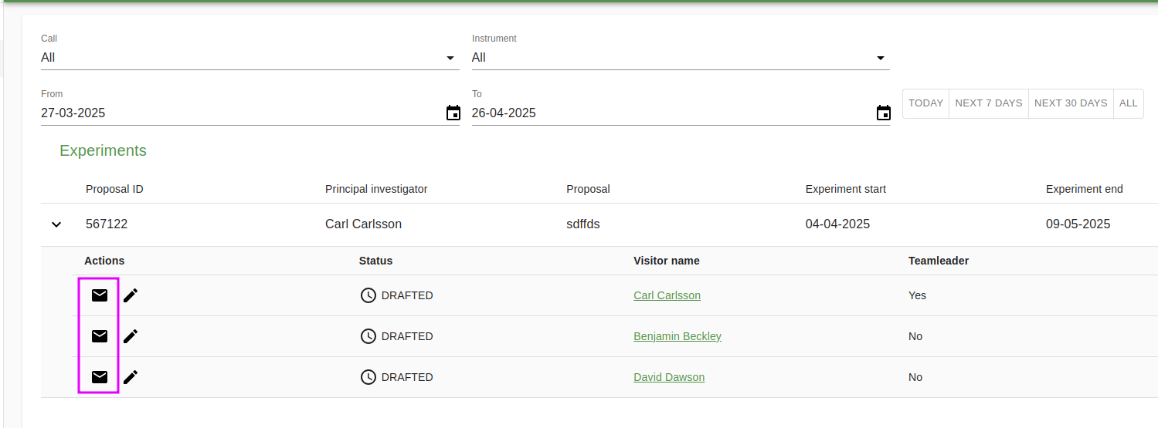
Science User Access
Science users
Todo:
Employee

Slide 9
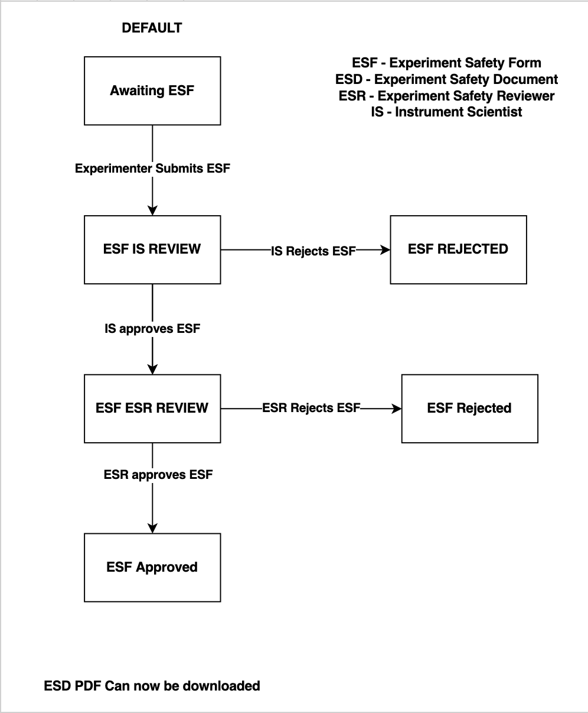
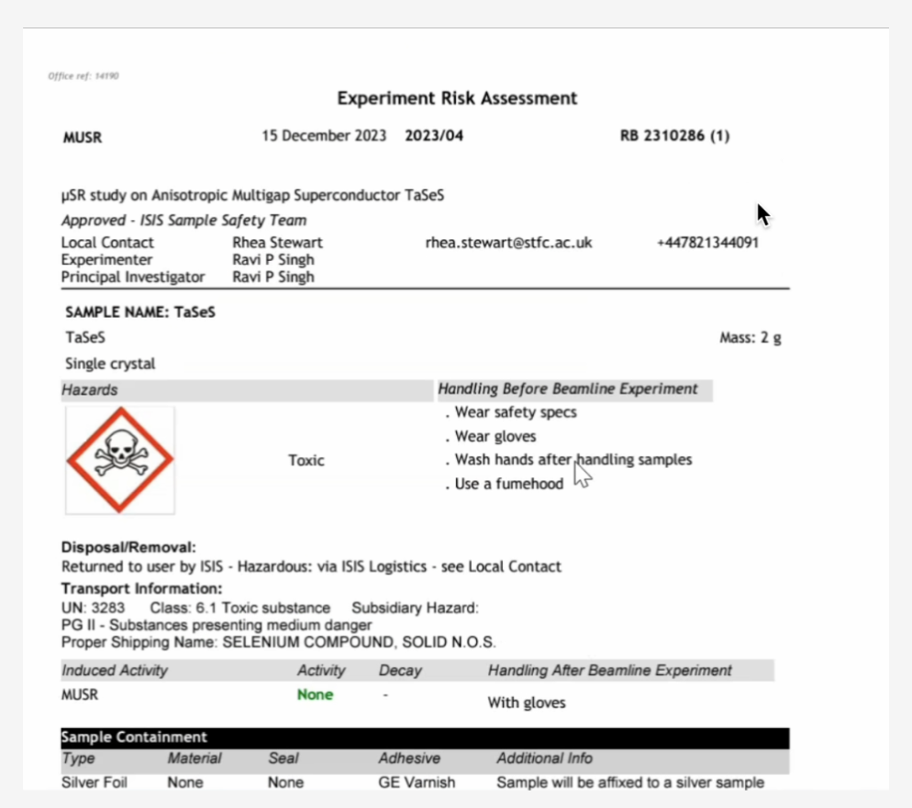
Experiment Safety Review
User Office

Slide 10
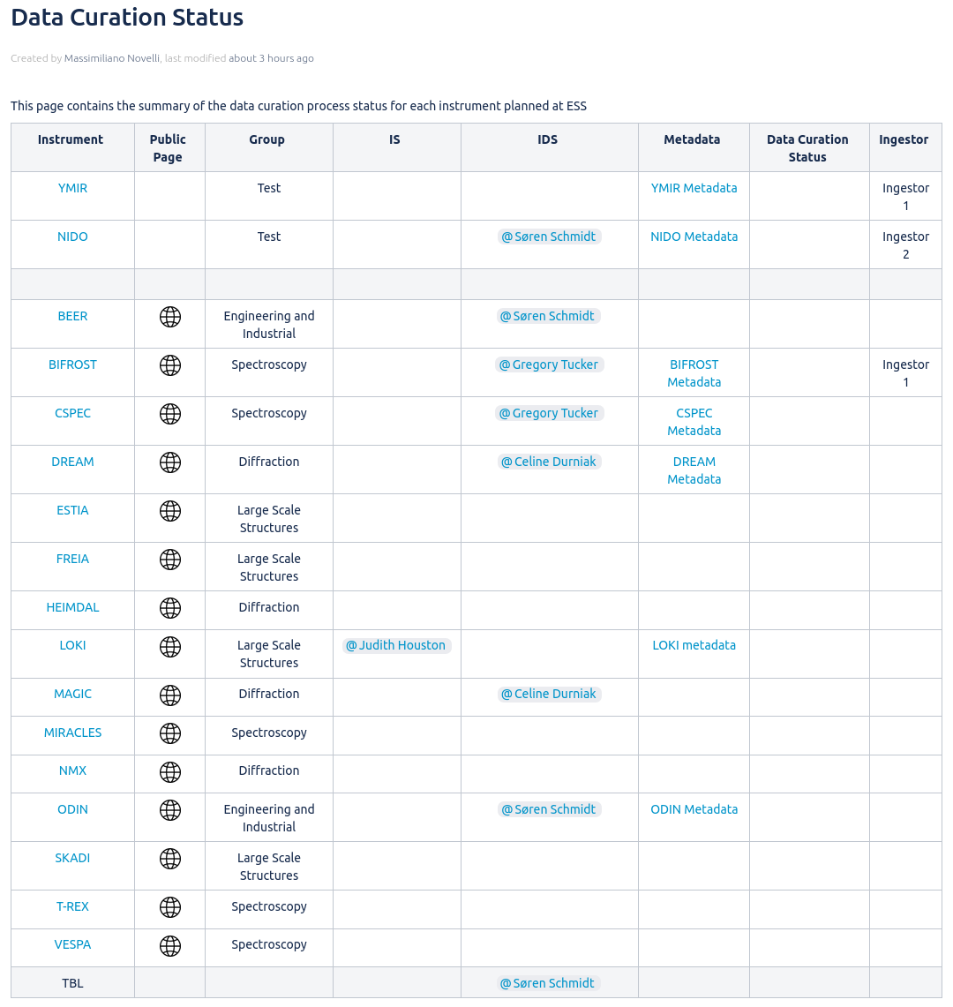
Data Curation
On-Going activities:
Documented individual instrument metadata
Instrument metadata acceptance from stakeholder
Finalize metadata configuration implementation
New dataset ingestor
Future milestones:
Technique specific dataset pages
Integration between VISA and SciCat
Technique widgets, HDF5 Viewer

Slide 11
AI-Powered search
Semantic search with LLM answer

Slide 12
Opus
Document search

Slide 13
Grants & EOSC
PaN-FINDER
HALRIC
EOSC
Summary: PaN-Finder will introduce an AI-powered search tool that simplifies user interaction, enabling intelligent, prompt-based searches.
Effort: 24 FTE Months
Grant: 250K Euro
Summary: Adapts life science abstracts to match the user's knowledge level, making complex biological and medical research more accessible.
Effort: 4 FTE Months
Grant: 20K Euro
Summary: Creation of the PaNOSC Node, with responsiblity for the Integration of the scientific data repository(PaN-Data).
Effort: 3 FTE Months

Slide 14
Future – PaNOSC & EOSC

Slide 15
LLM usage
PR descriptions
PR review
Coding
Task labelling

Slide 16
Questions?

