Slide 1
LOS considerations

Slide 2
FOM in the cells
 | n/s 8.8-9.0AA | n/s total | n/s/cm2 8.8-9.0AA | n/s/cm2 total
A | 1.03E09 | 3.13E09 | 6.87E06 | 2.09E07
B | 9.74E08 | 1.88E09 | 6.49E06 | 1.25E07
C | 1.12E09 | -- | 7.47E06 | --
D | 8.73E08 | 2.65E9 | 5.82E06 | 1.79E07
E | 8.28E08 | 1.6E09 | 5.52E06 | 1.07E07
F | 9.72E08 | -- | 6.48E06 | --
G | 1.26E09 | -- | 8.40E06 | --
A: C-polarizer, m=3 guides, ANNI original chopper settings, PDC1@6.5m and PDC2@26m
B: C-polarizer, m=3 guides, ANNI original chopper settings, PDC1@6.5m and PDC2@42.5m
C: C-polarizer, no choppers, wavelength restricted to 8.8-9.0AA, open choppers
D: New concept, curved with V-shaped polarizer, PDC1@6.5m and PDC2@26m
E: New concept, curved with V-shaped polarizer, PDC1@6.5m and PDC2@42.5m
F: New concept, curved with V-shaped polarizer, wavelength restricted to 8.8-9.0AA, open choppers
G: Theoretical max, straight guide (slits preserved), V-polarizer, wavelength restricted to 8.8-9.0AA, open choppers
In the options A-F line of sight is lost at 11.5 meters (just before the bunker wall)
Lower FOM for the concept with V-bender can be a consequence of more reflections in the long second bender with multiple horizontal slits. The second bender optimization should be studied (bending angle and height are fixed, but L and Nof slits can be varied)

Slide 3
Ways to increase flux in the cells:
Minimize losses in the benders
Minimize losses in the choppers

Slide 4
ANNI proposal
Benders for 1.7 degrees each
6 cm guide height
Line of sight to the moderator is avoided at ~15.5 m

Slide 5
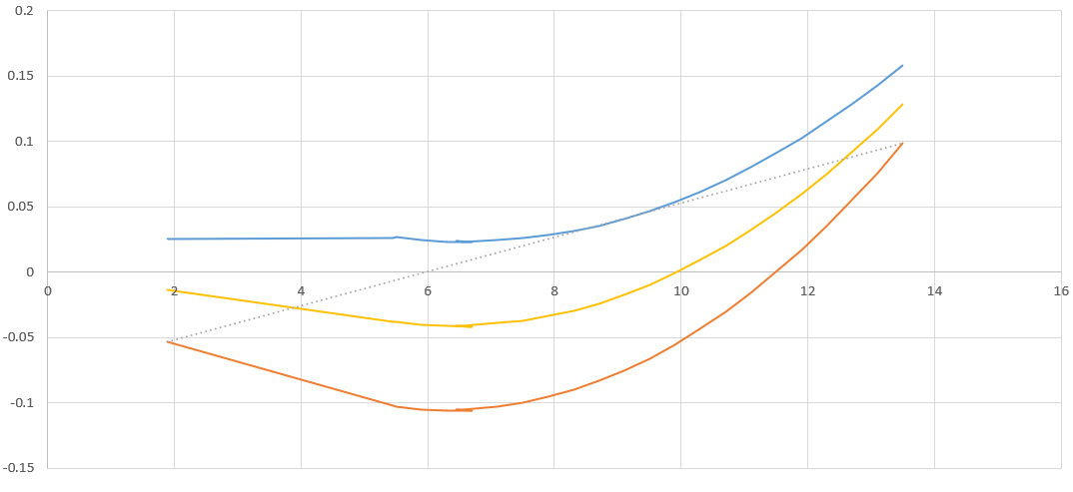
Attempt to reduce guide height
HIBEAM monolith insert
Different curving radii for upper and lower surfaces
Entrance height =13 cm
Exit height = 13 cm
LOS, m | $$α_{1}^{top}$$ | $$α_{1}^{bot}$$ | $$α_{2}$$
11.5 | 5 | 5 | 4.58
12.5 | 4.4 | 4.4 | 3.98
13.5 | 4 | 4 | 3.58
Entrance height =13 cm
Exit height = 6 cm
LOS, m | $$α_{1}^{top}$$ | $$α_{1}^{bot}$$ | $$α_{2}$$
11.5 | 3.2 | 4.54 | 3.451
12.5 | 2.92 | 4.06 | 3.071
13.5 | 2.7 | 3.7 | 2.781

Slide 6
Expectations from new concepts
Reduced curving angles
Less slits in the benders (10 slits in the current design)
Easier manufacture
less reflections
better transport

Slide 7
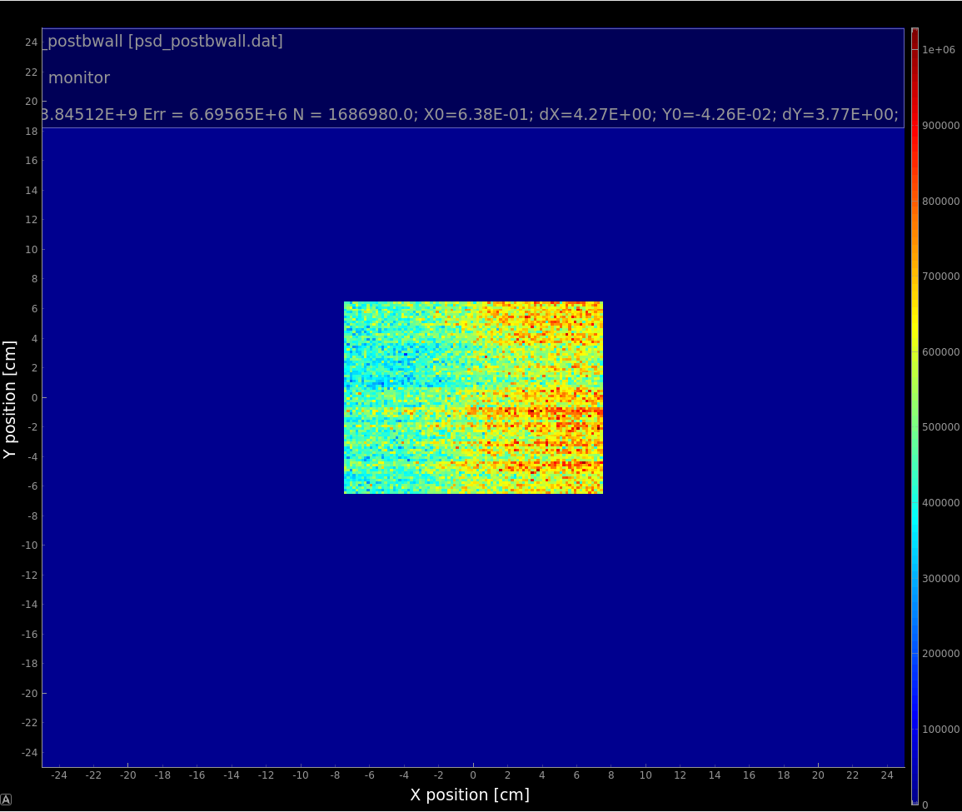
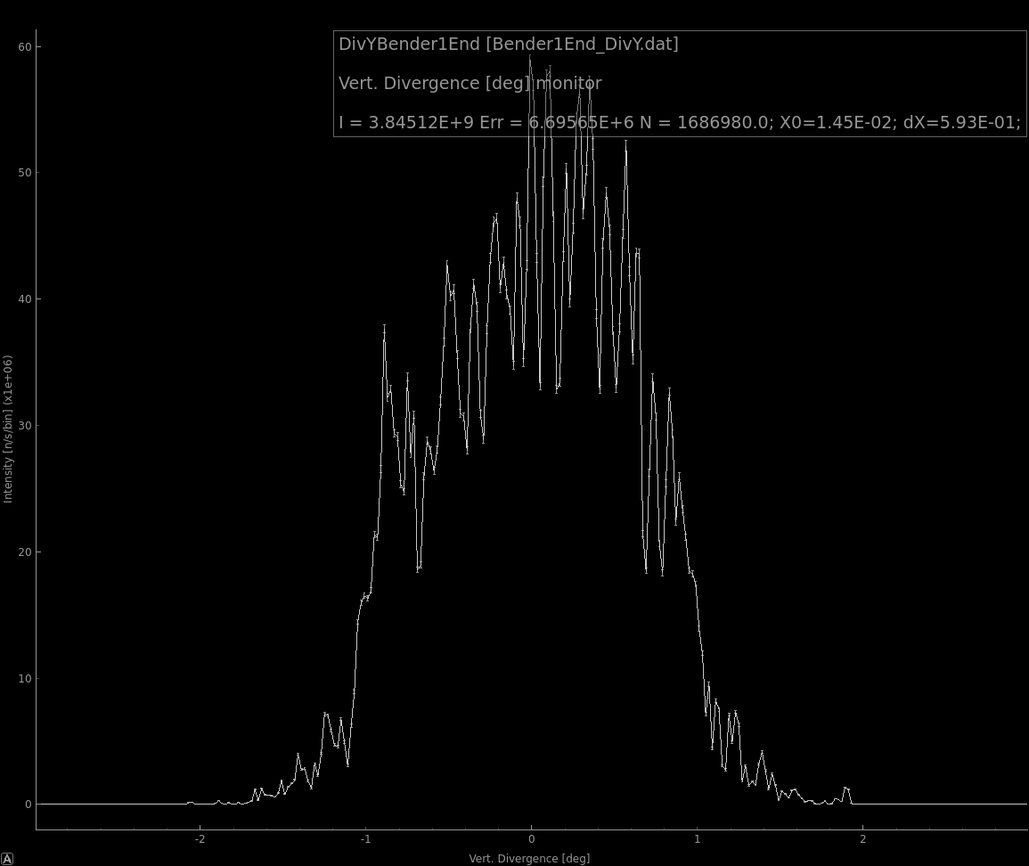
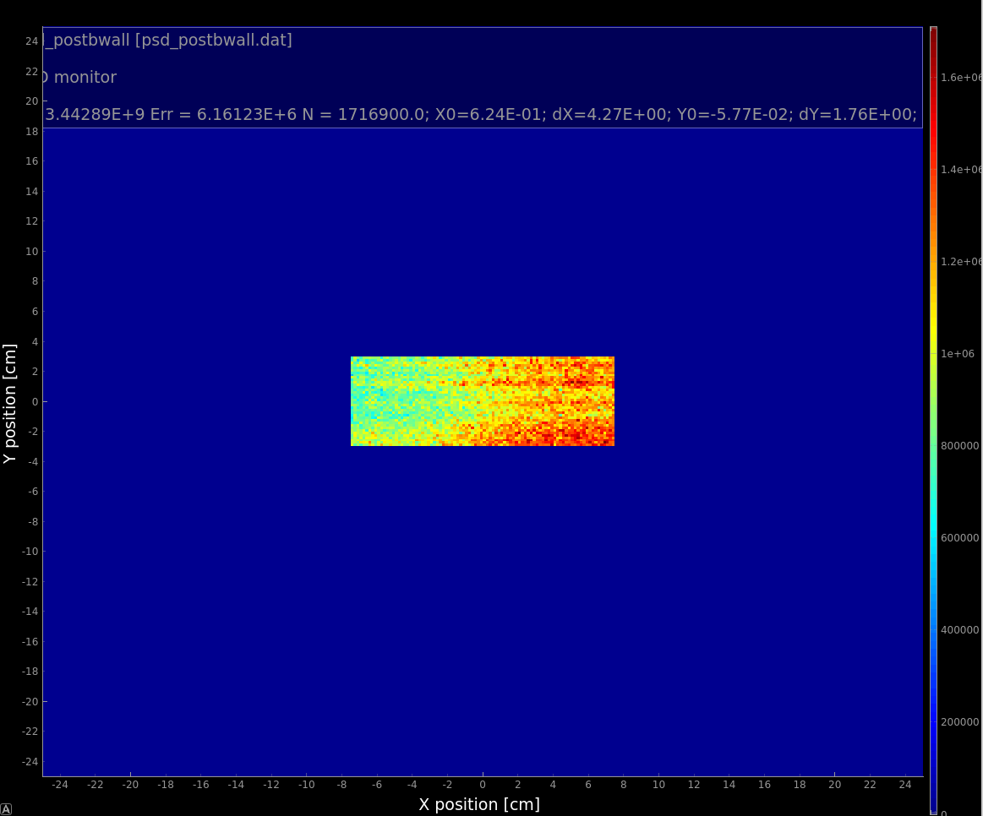
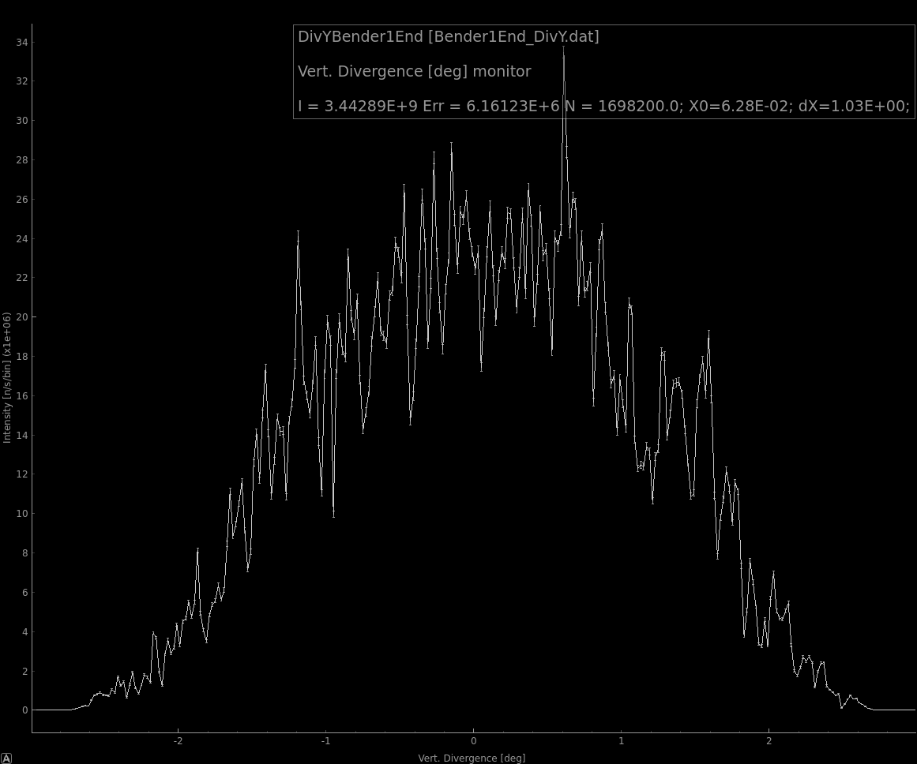
Past bunker wall
Original
3.84E9 n/s(0.2AAbw)
1 degree Vdiv
Tapered bender
3.44E9 n/s(0.2AAbw)
~1.8 degrees Vdiv

Slide 8
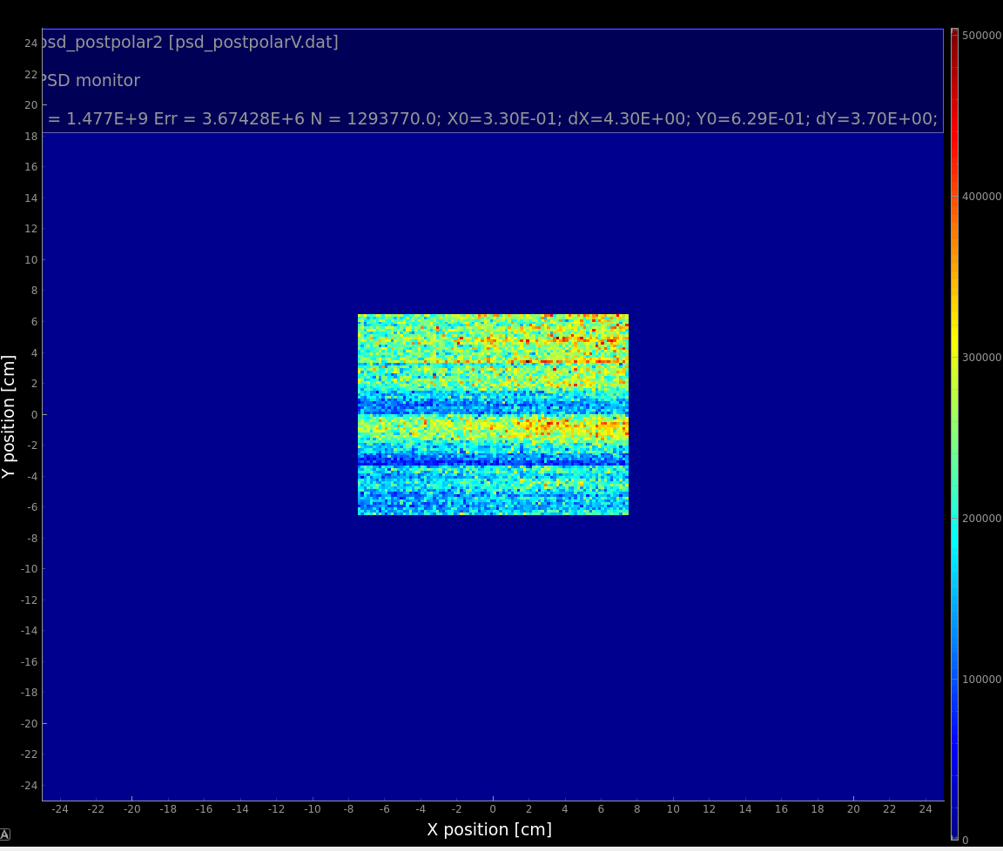
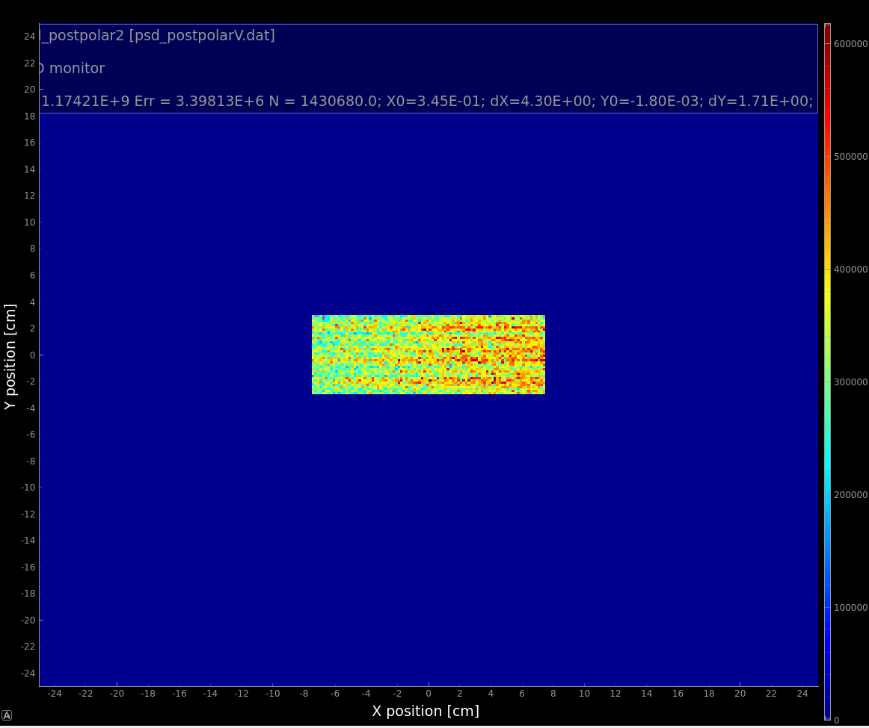
No gain in flux observed after bender 2 (unpolarized fluxes)

