Slide 1
BIFROST project & performance
4th of February 2025

Slide 2
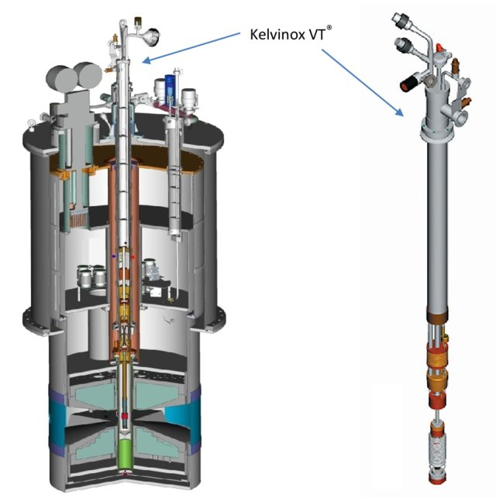
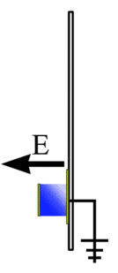
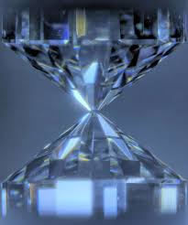
Neutron spectroscopy – experiments are getting harder
Evolution towards:
More complex phenomena:
- fractional excitations
- Line broadening
- Magnon-phonon coupling
- Complex systems
Smaller samples
More complex sample environment
2

Slide 3
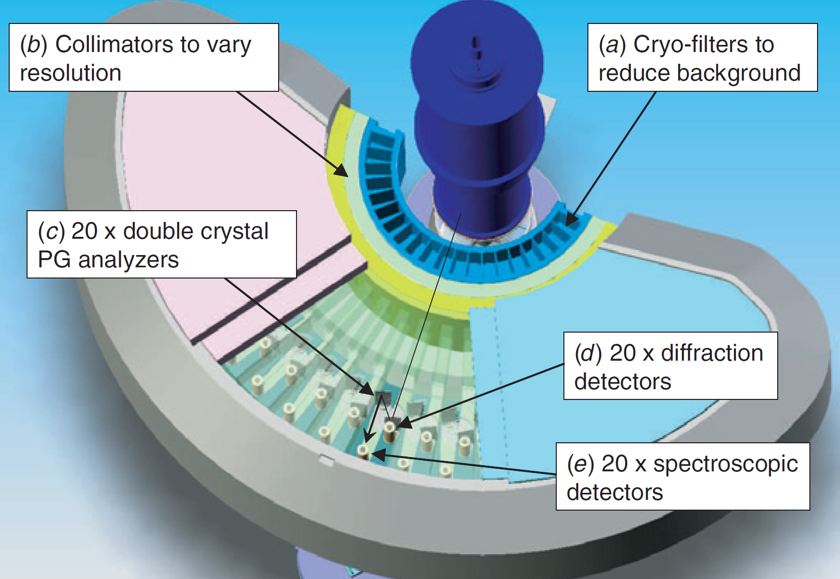
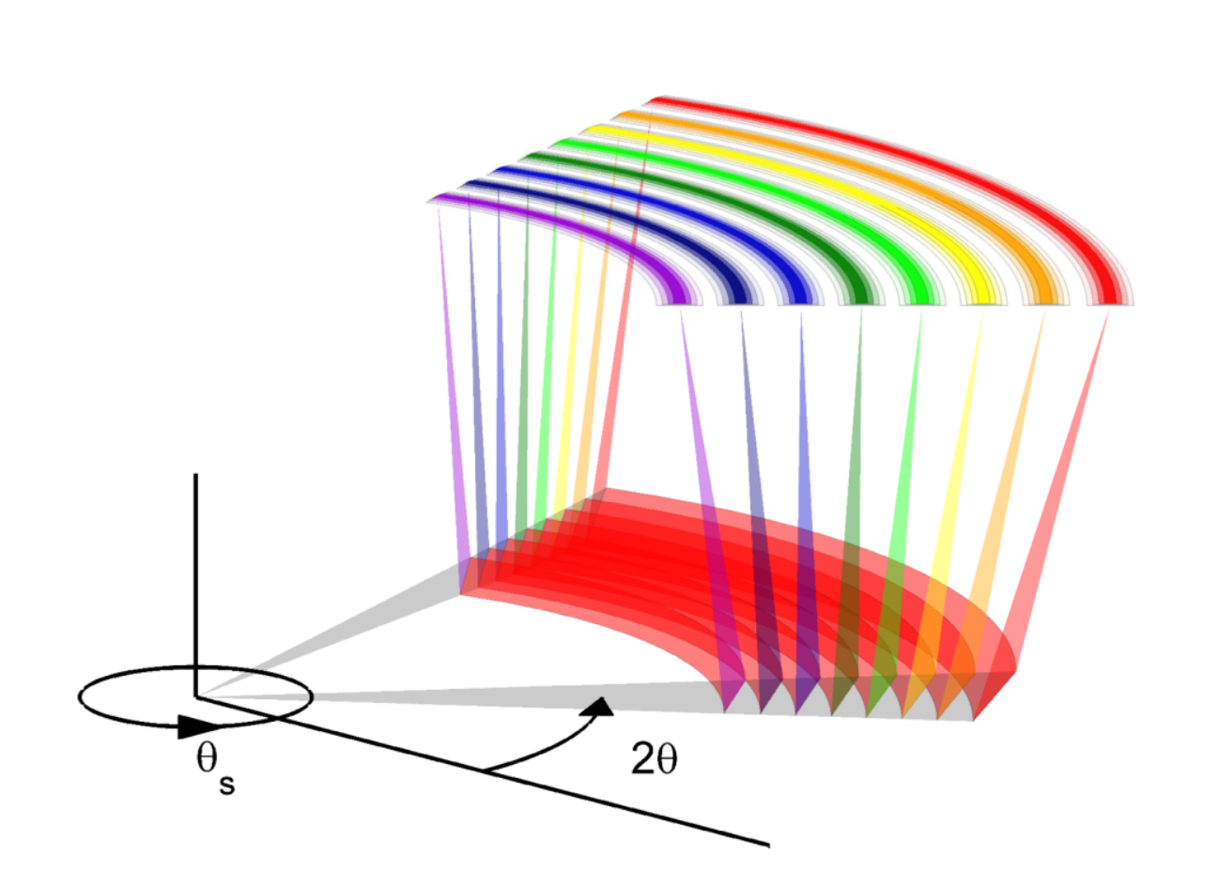
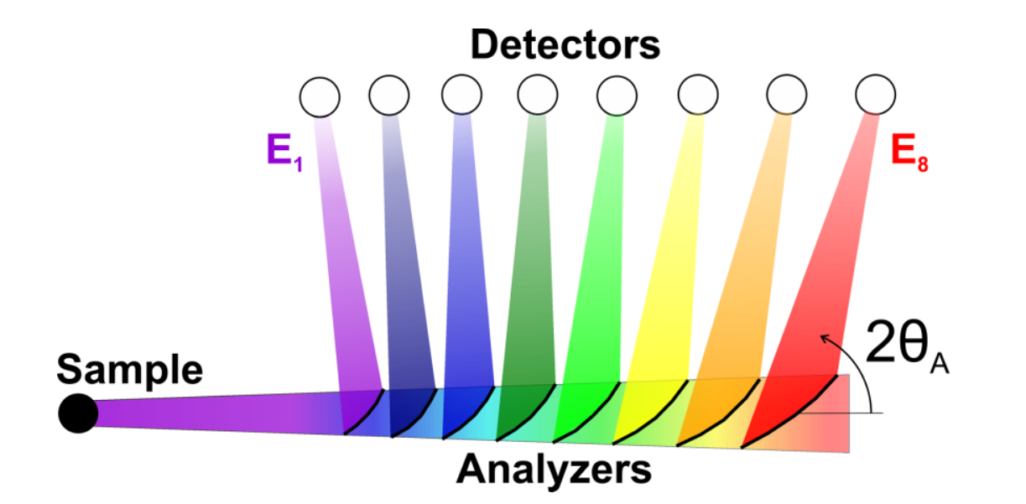
Neutron spectroscopy – experiments are getting harder
J. A. Rodgrigues, et al, Measurement Science and Technology, Volume 19, Number 3 (2008)
Evolution towards:
More complex phenomena:
- fractional excitations in quantum magnets
- Line broadening
- Magnon-phonon coupling
Smaller samples
More complex sample environment
TAS mapping projects:
MACS
BAMBUS & MultiFLEXX
CAMEA
F. Groitl, et al. Rev. Sci. Instrum. 87, 035109 (2016)
3

Slide 4
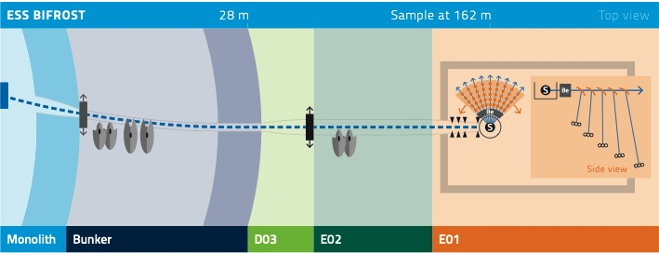
BIFROST: Indirect ToF with multiplexing backend

Slide 5

The European Spallation Source
  BIFROST: Norse mythology,
  a rainbow bridging the gap between
  triple axis spectroscopy and time-of-flight spectroscopy
5

Slide 6
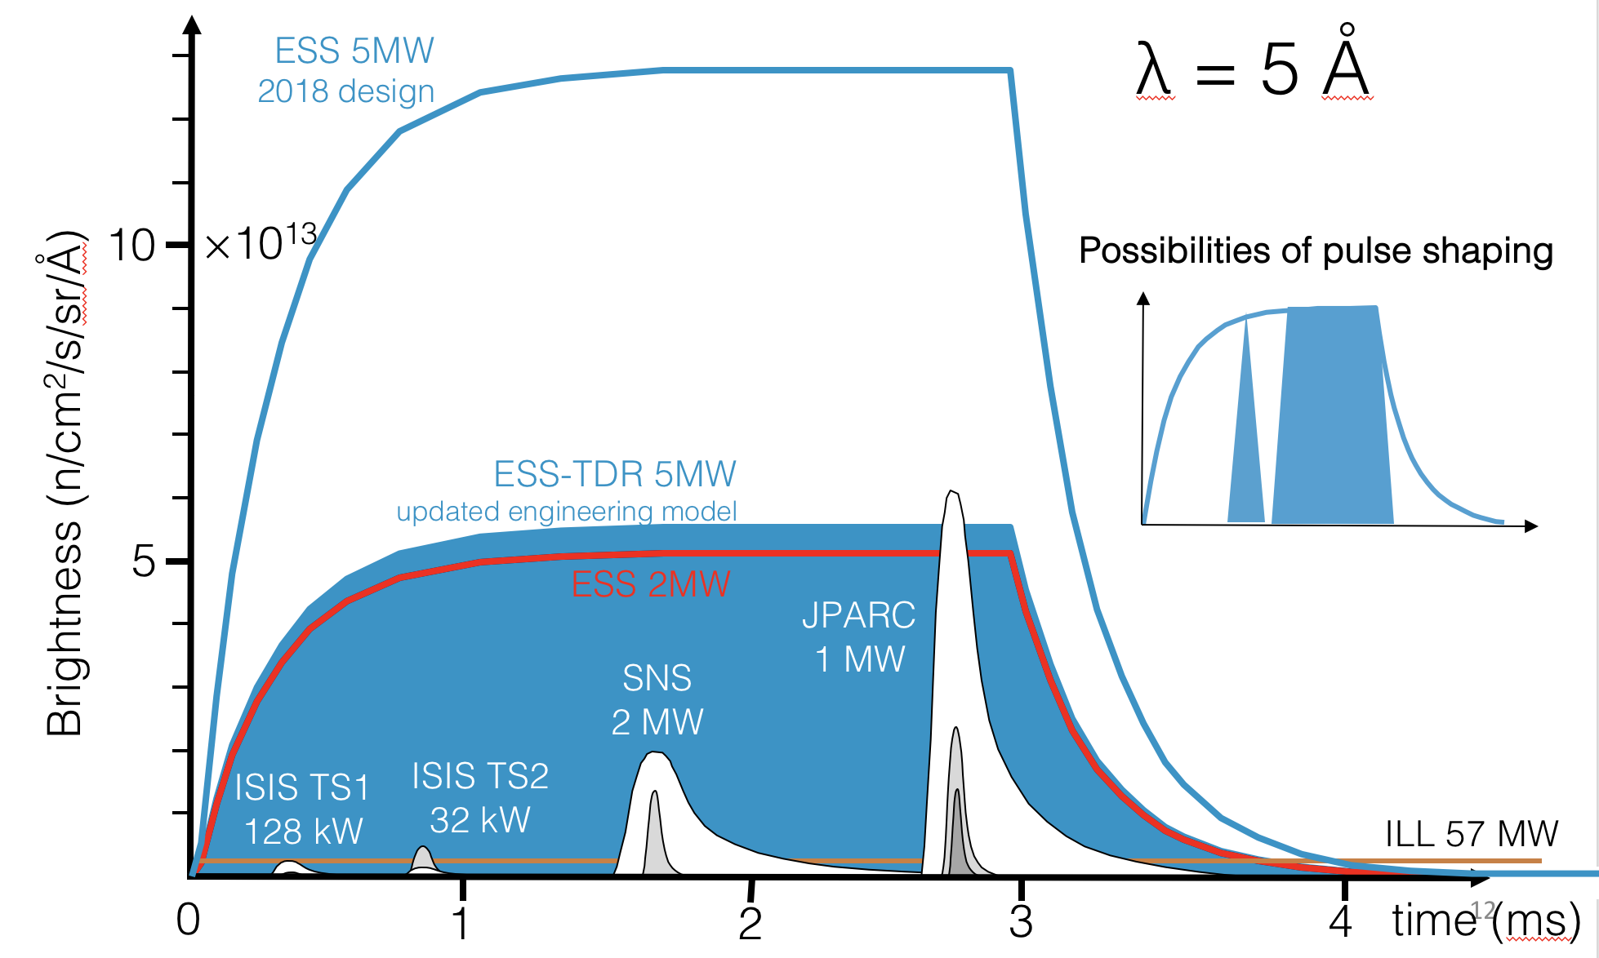
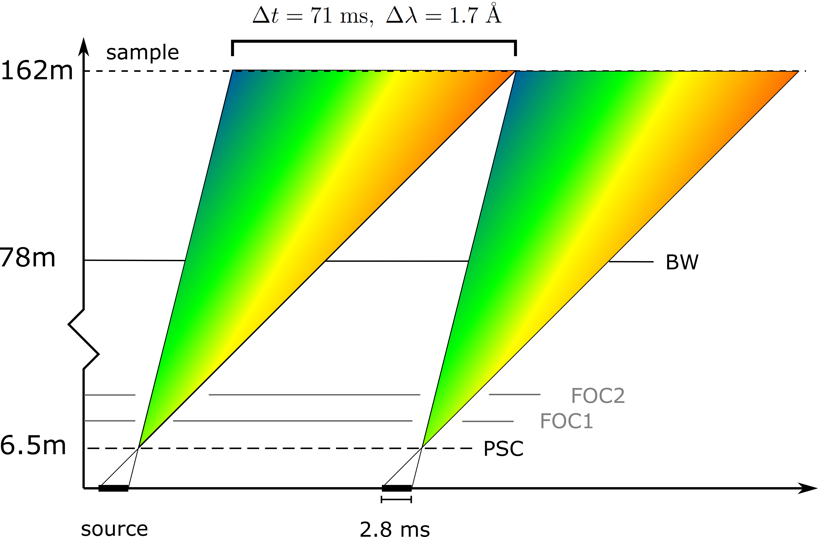
BIFROST: ToF frontend – multiplexing backend
Polychromatic beam:
High incident flux
Energy resolution of primary spectrometer
highly tunable via fast Pulse Shaping Chopper (PSC)
Flux @ 2 MW: 6 · 10⁹ n/s/cm²
Elastic line resolution at 5 meV using
full pulse: 170 μeV

Slide 7
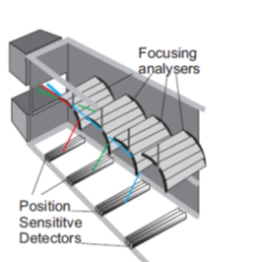
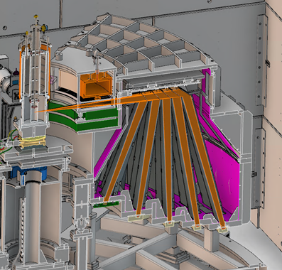
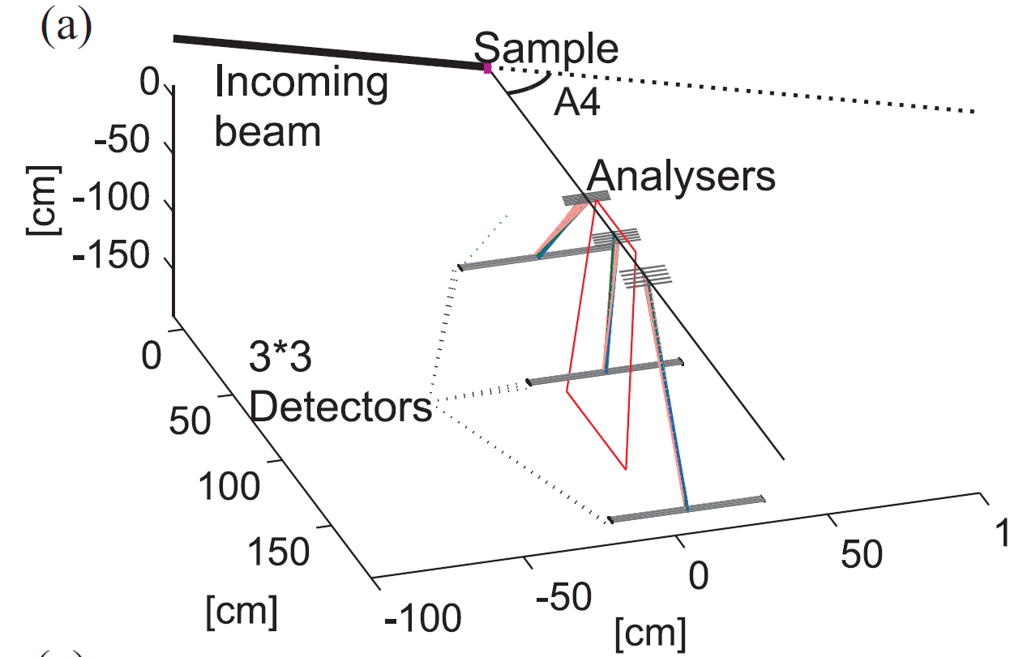
Backend principle of BIFROST – reality
Final energies: 2.7, 3.2, 3.8, 4.4 and 5.0 meV

Slide 8
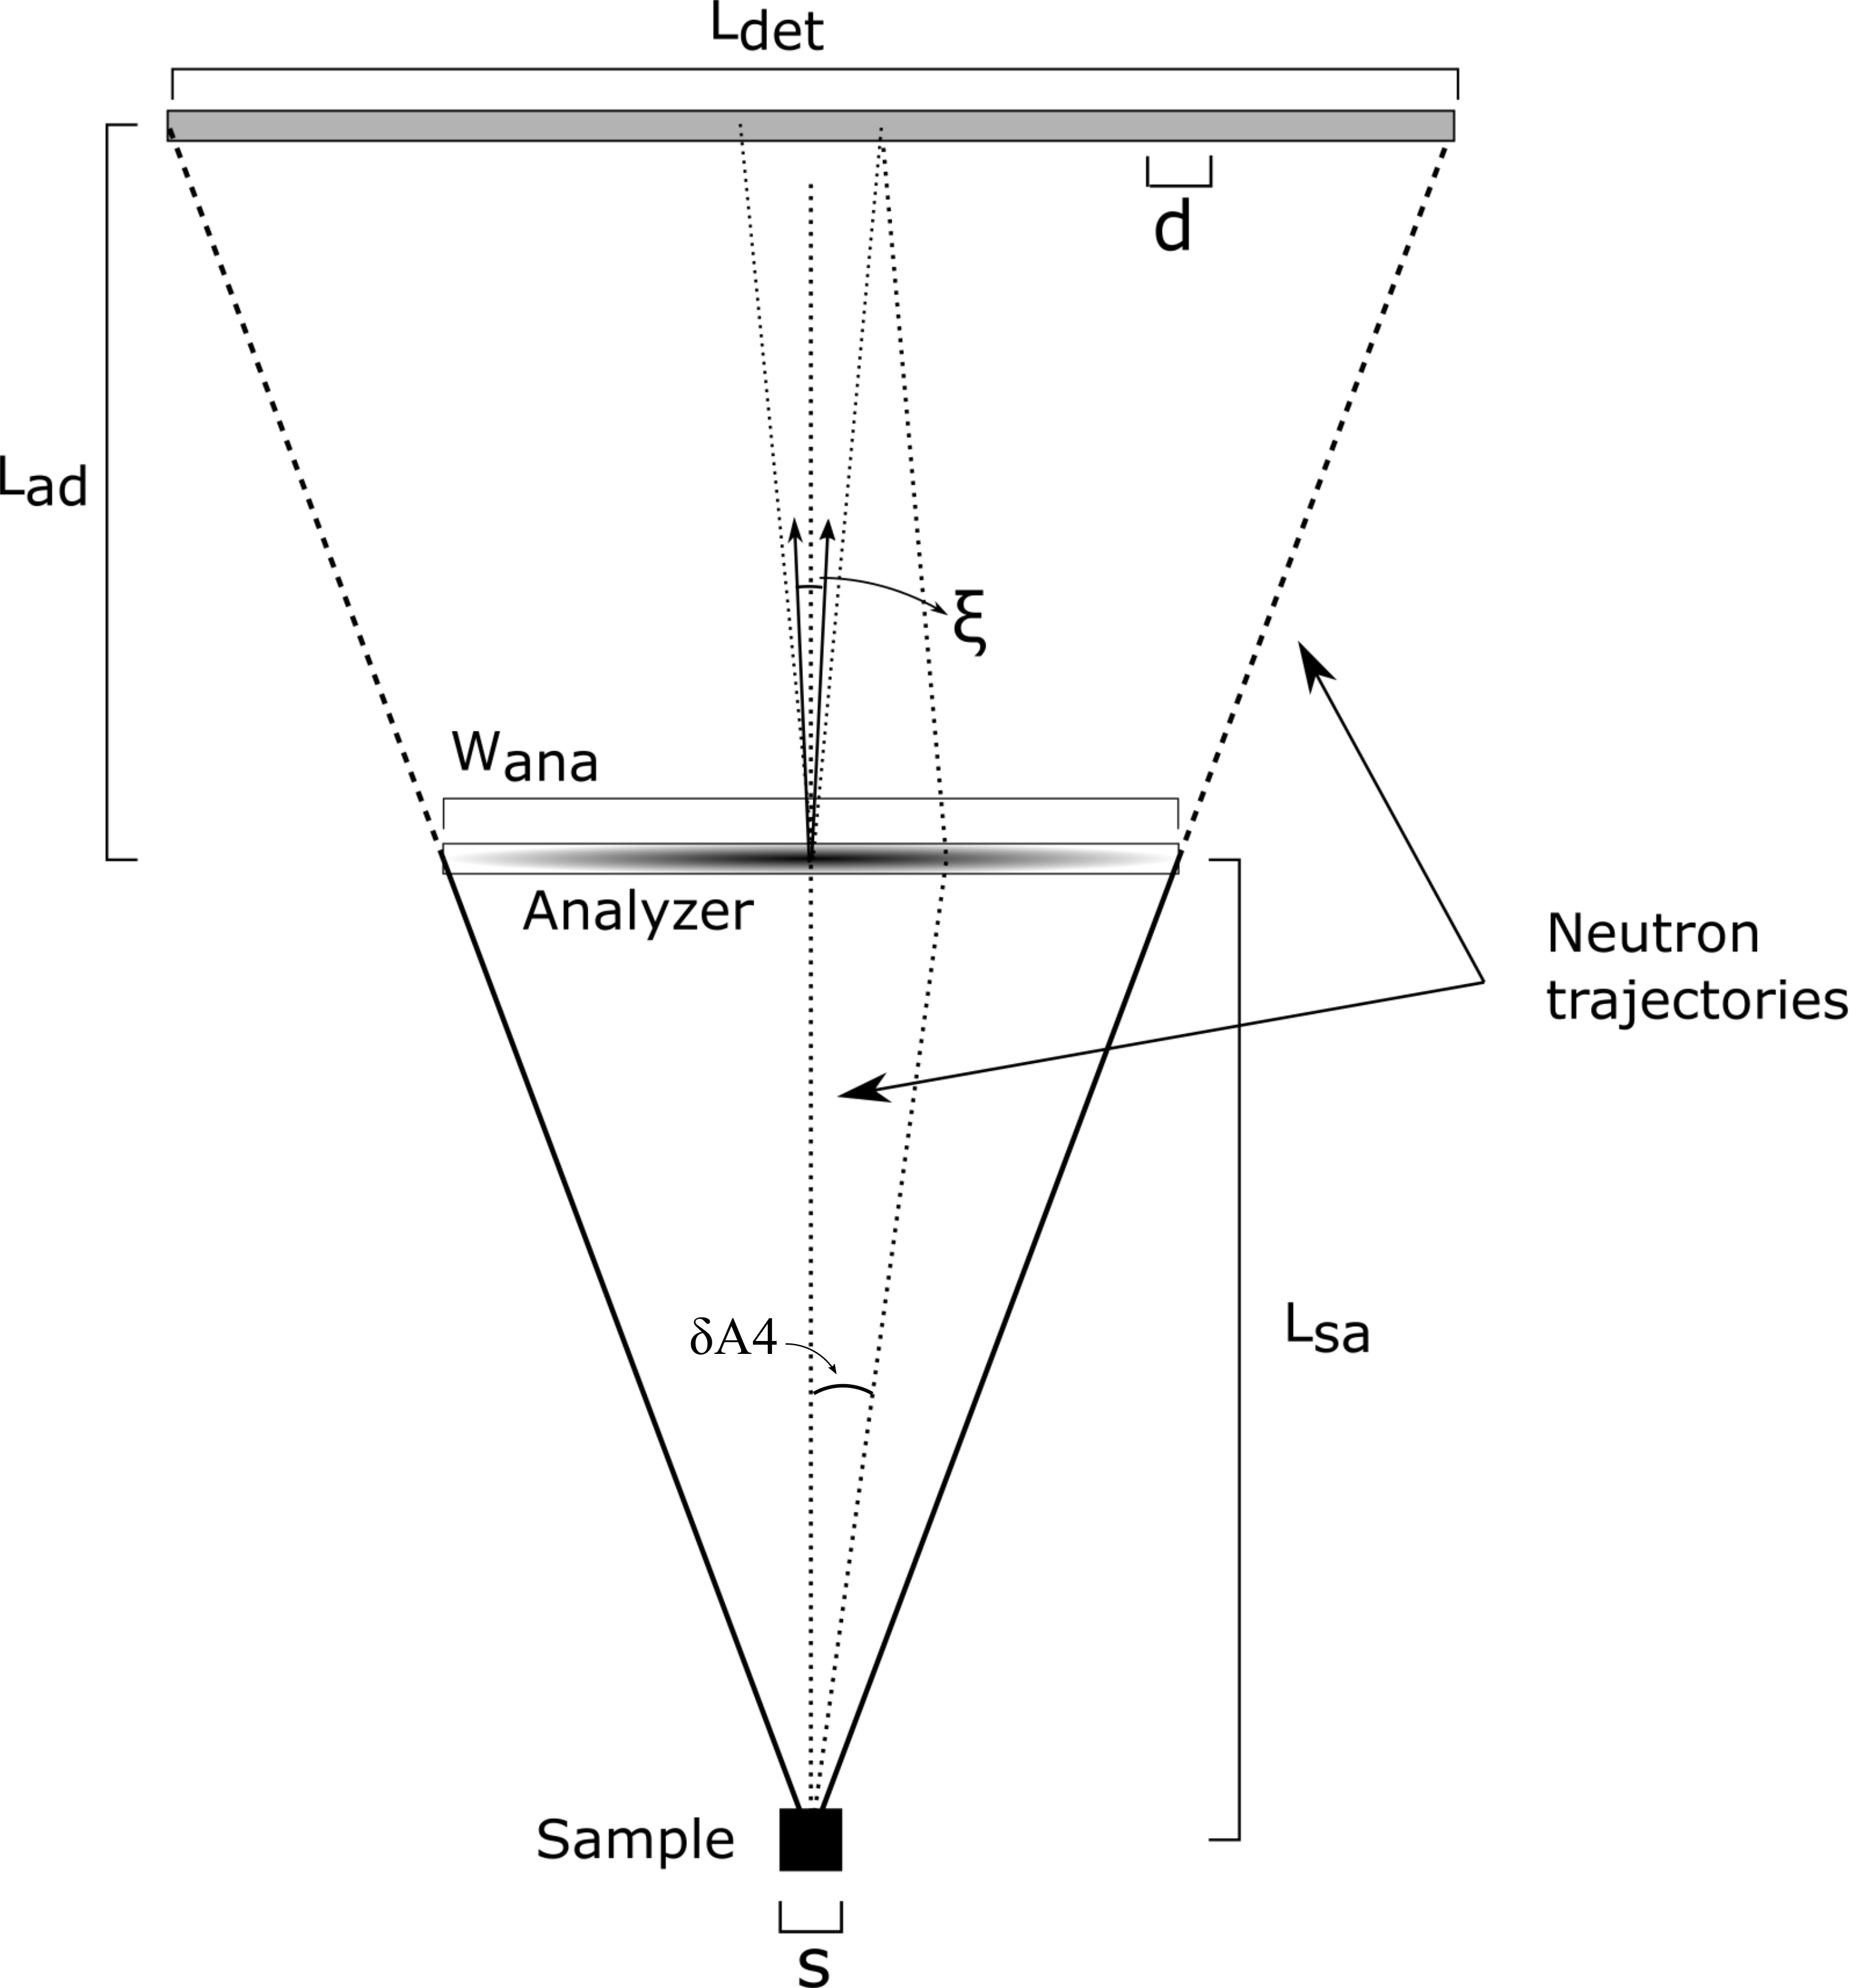
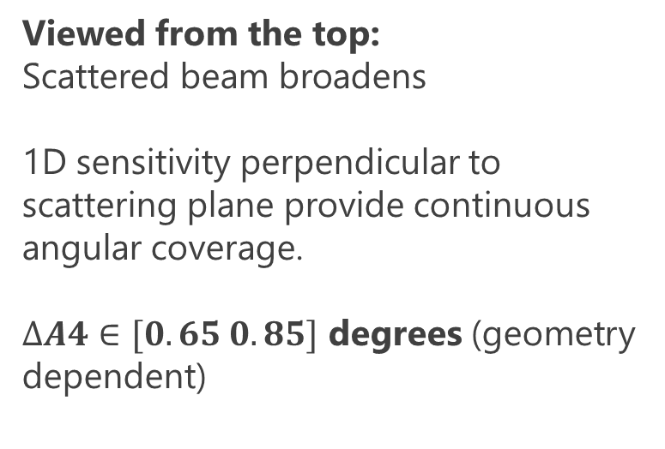
Sensitivity to scattering angle
Viewed from the top:
Scattered beam broadens
1D sensitivity perpendicular to scattering plane provide continuous angular coverage.
$∆A4∈[0.65 0.85]$ degrees (geometry dependent)

Slide 9
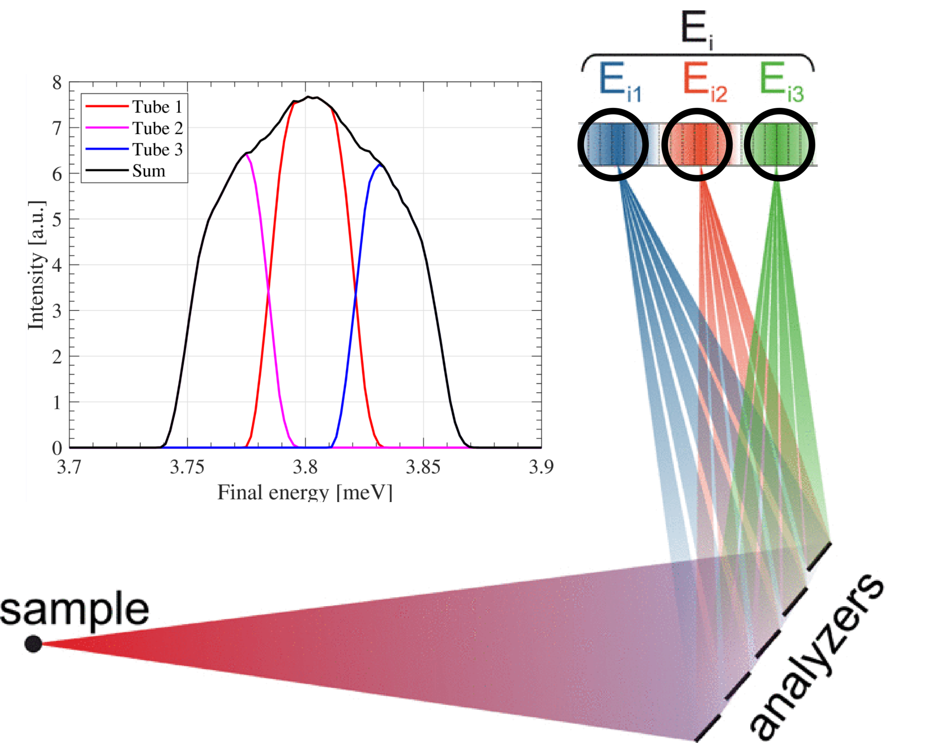
Prismatic analyser concept in point-to-point focusing
Small samples and spatial sensitivity of detectors define analyser scattering angle regardless of mosaicity
Broad mosaicity can then be used to increase resolution of backend.
Jonas Okkels Birk, Reviews of
Scientific Instruments (2014)

Slide 10
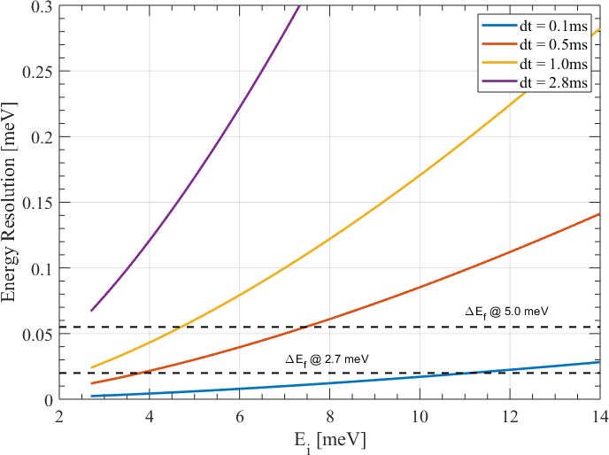
BIFROST: Tunable energy resolution
Using the PSC, we can match even the prismatic analyser resolution for very large Ei’s.
PSC opening time | Flux @ 2 MW
Full pulse | 6 · 10⁹ n/s/cm²
1.0 ms | 1.7 · 10⁹ n/s/cm²
0.5 ms | 9.5 · 10⁸ n/s/cm²
0.1 ms | 2.5 · 10⁸ n/s/cm²

Slide 11
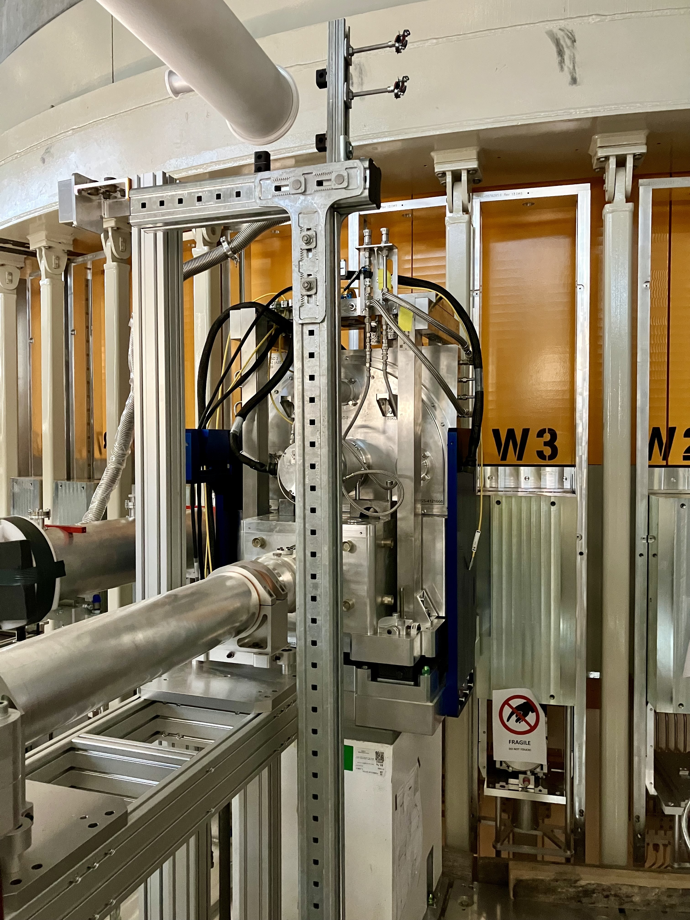
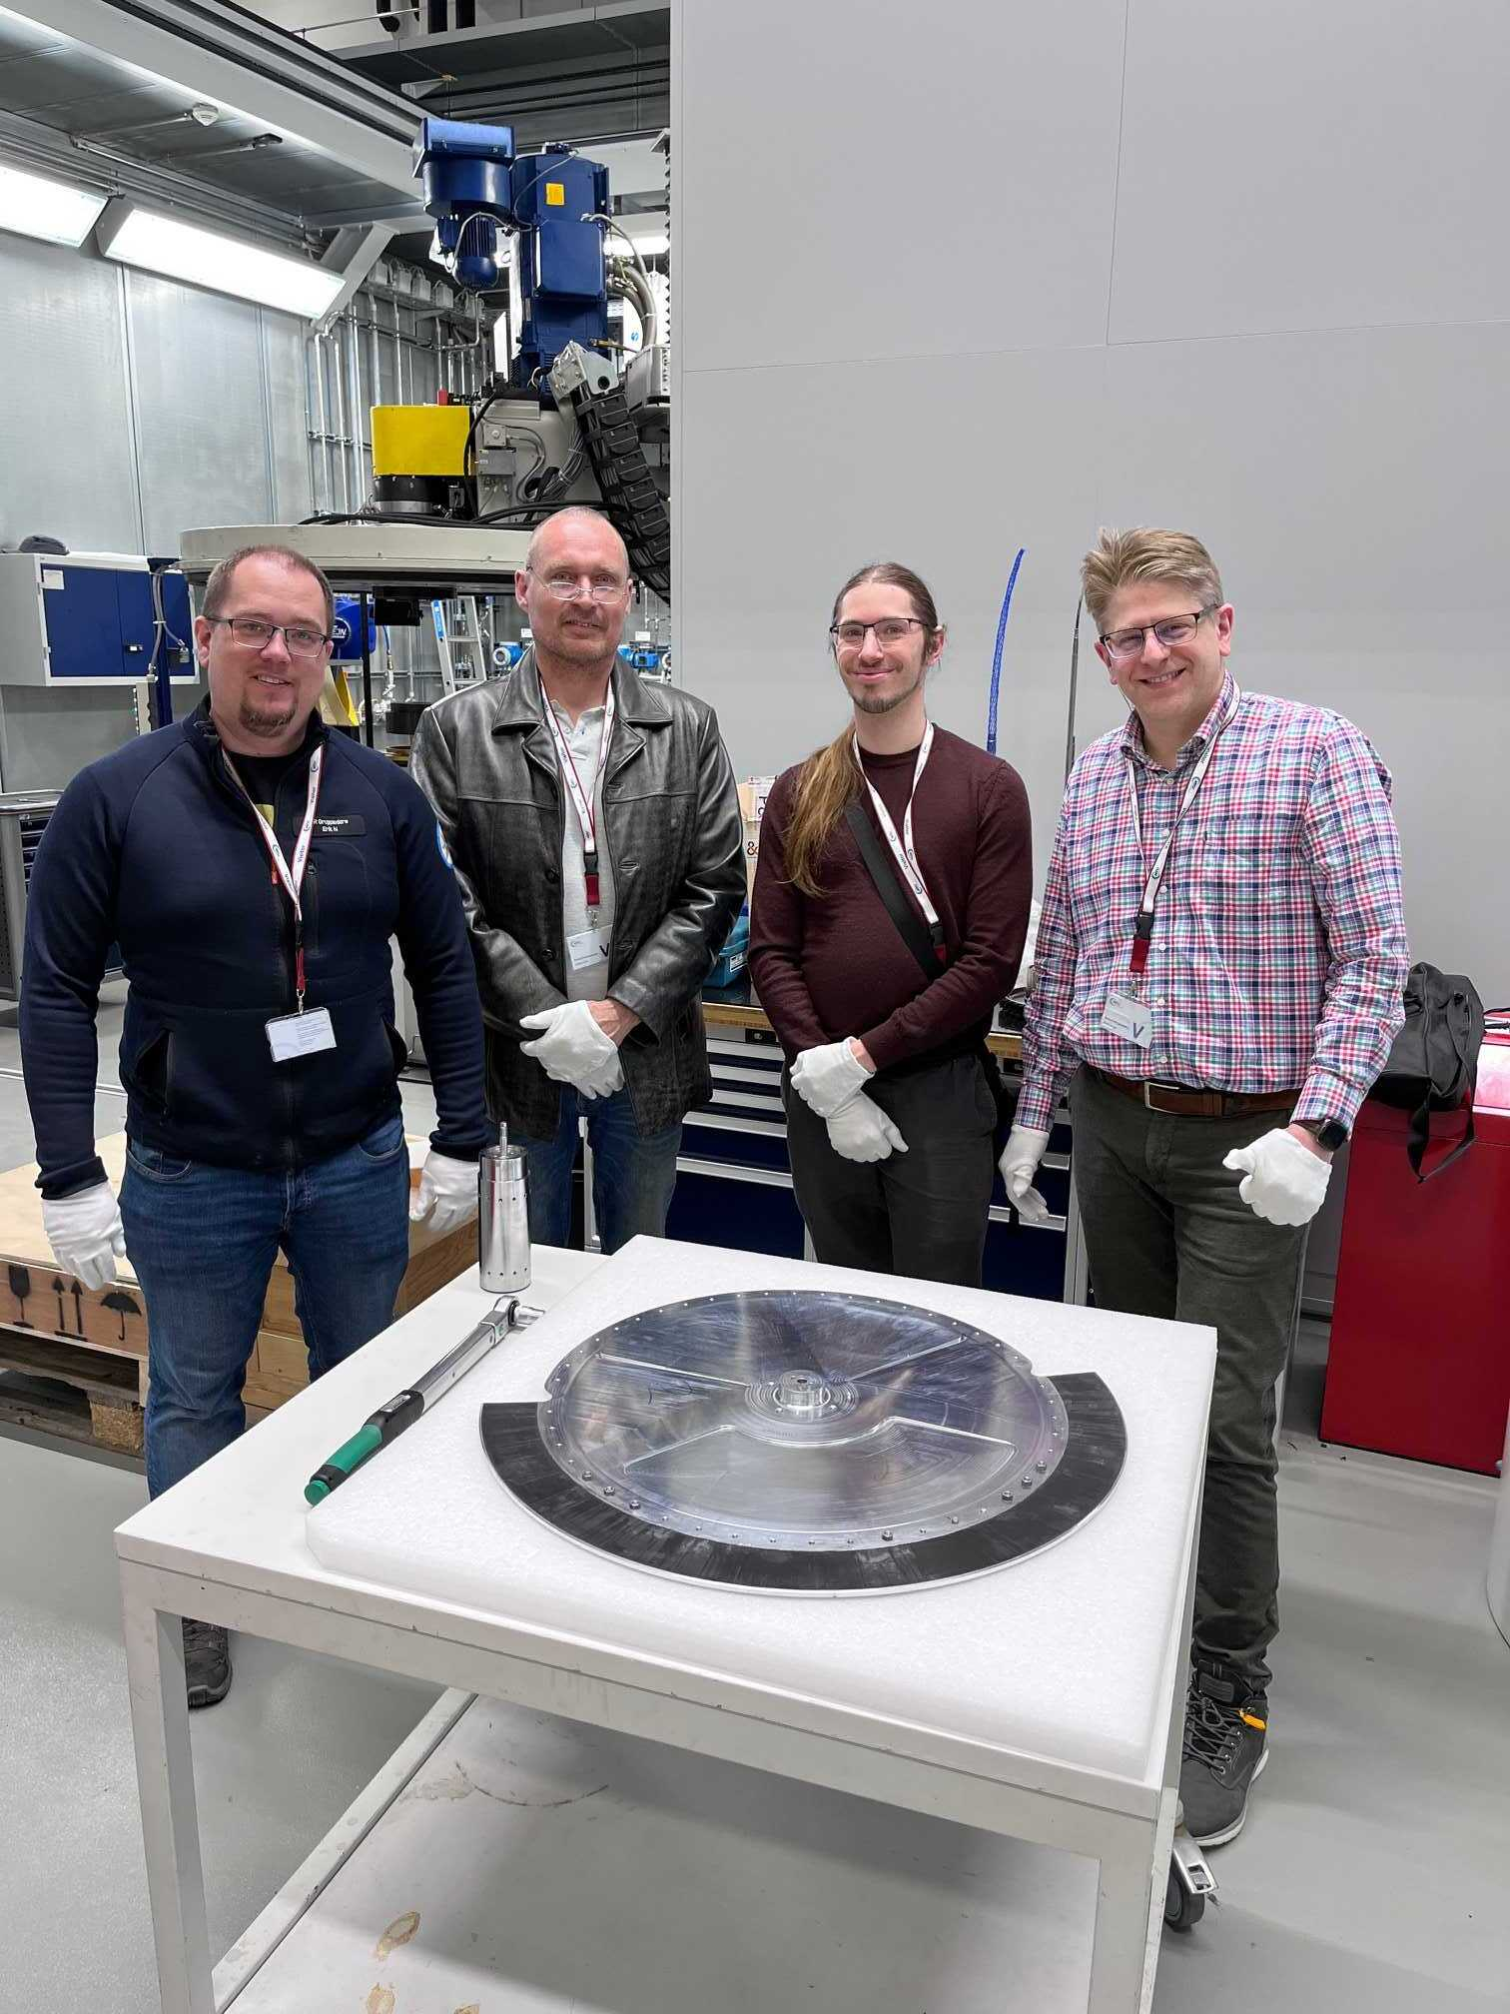
Primary Spectrometer - Bunker
  PSC and FOCs installed in the bunker, monitor installed soon
  PSC commissioning will be a challenge

Slide 12
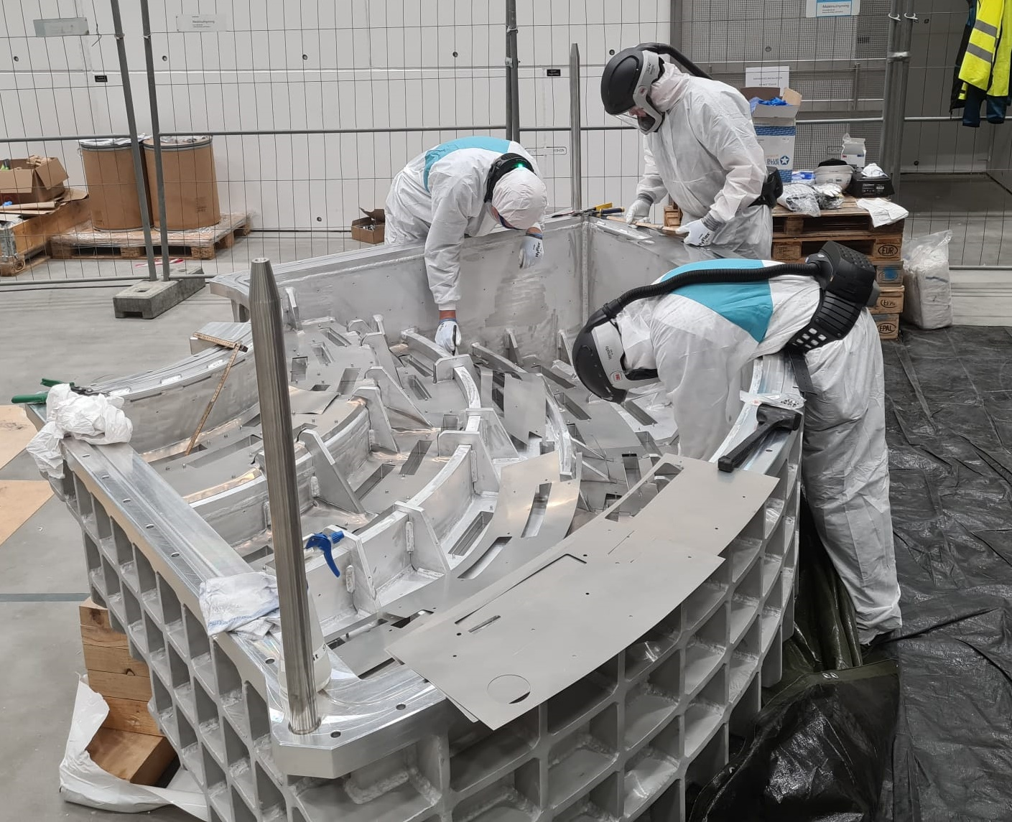

Cadmium lining and cross talk shielding

Slide 13
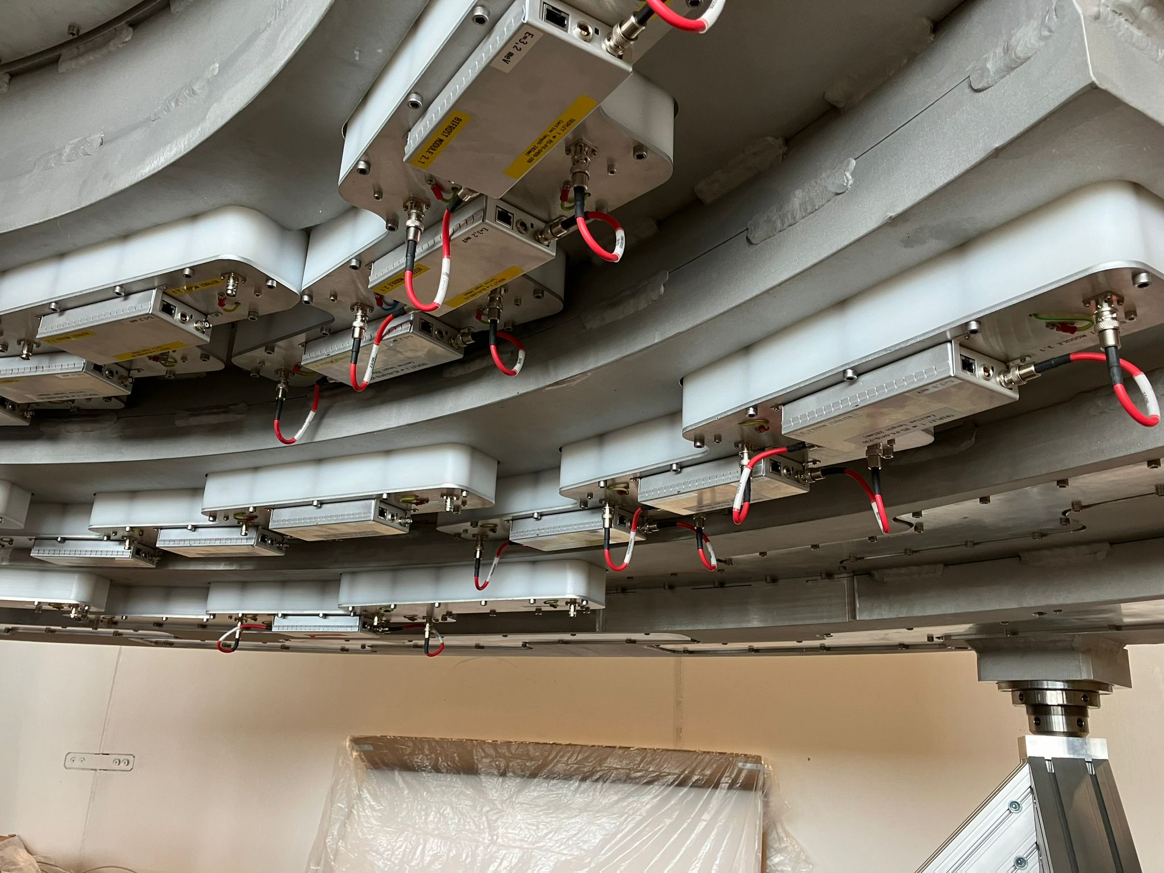

Detectors
Detectors now tested,
Full readout chain has been tested. What remains is firmware and EFU tweaks

Slide 14
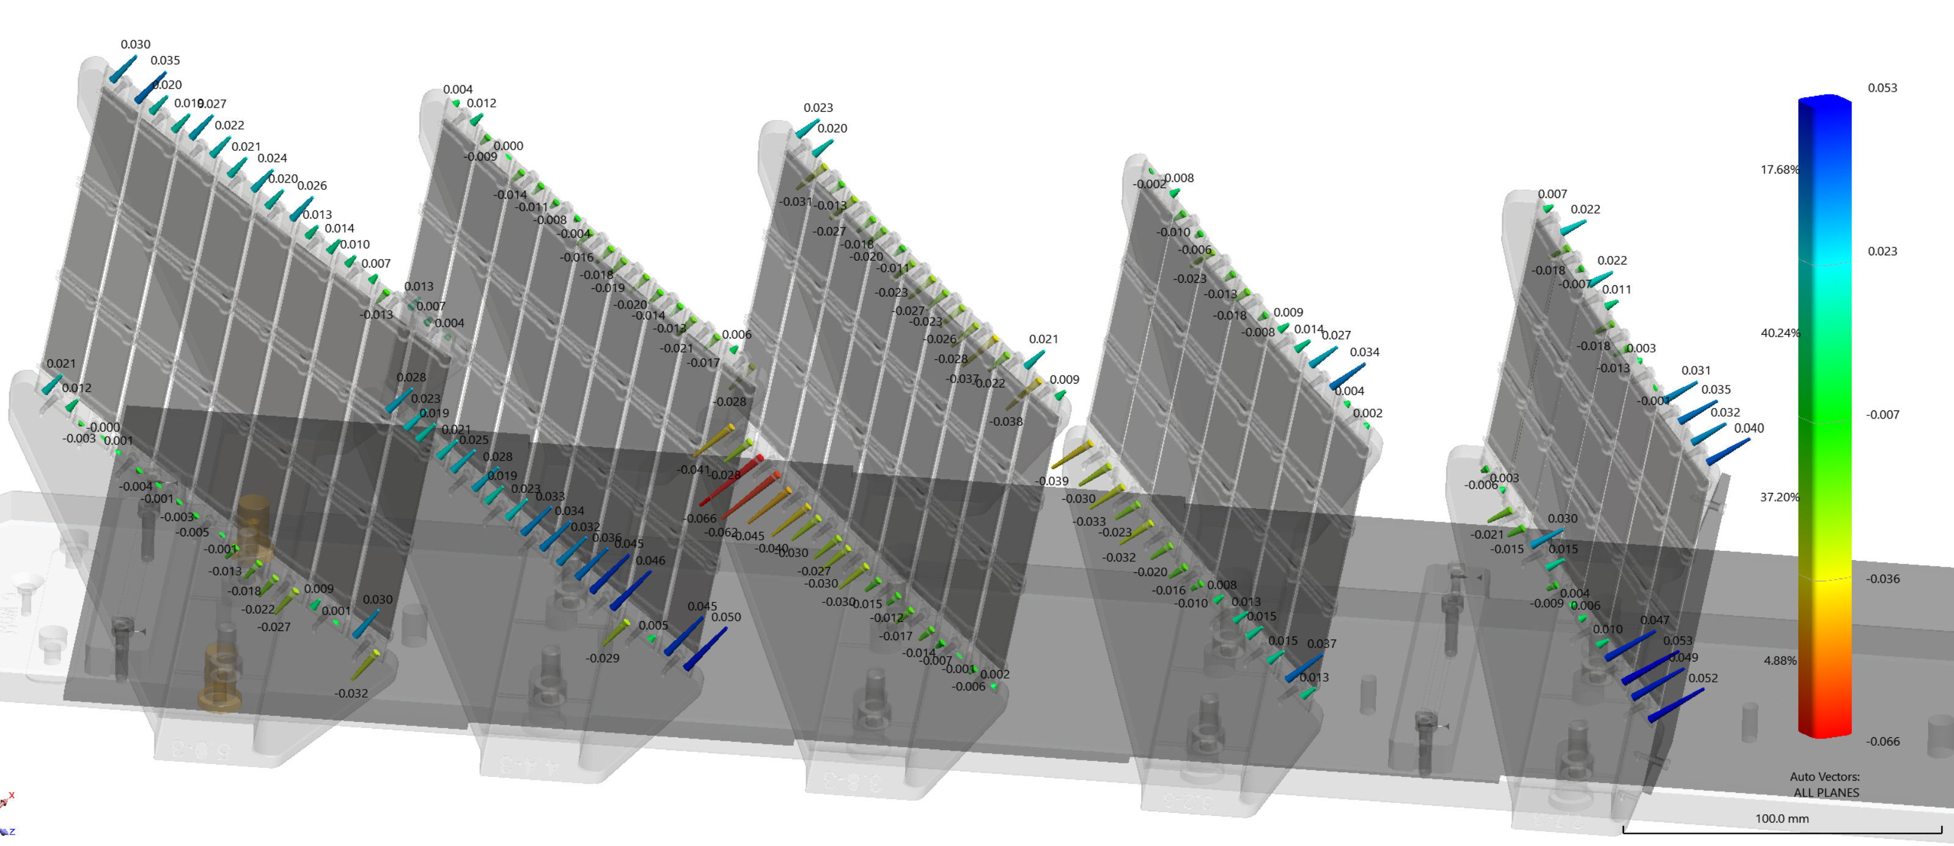
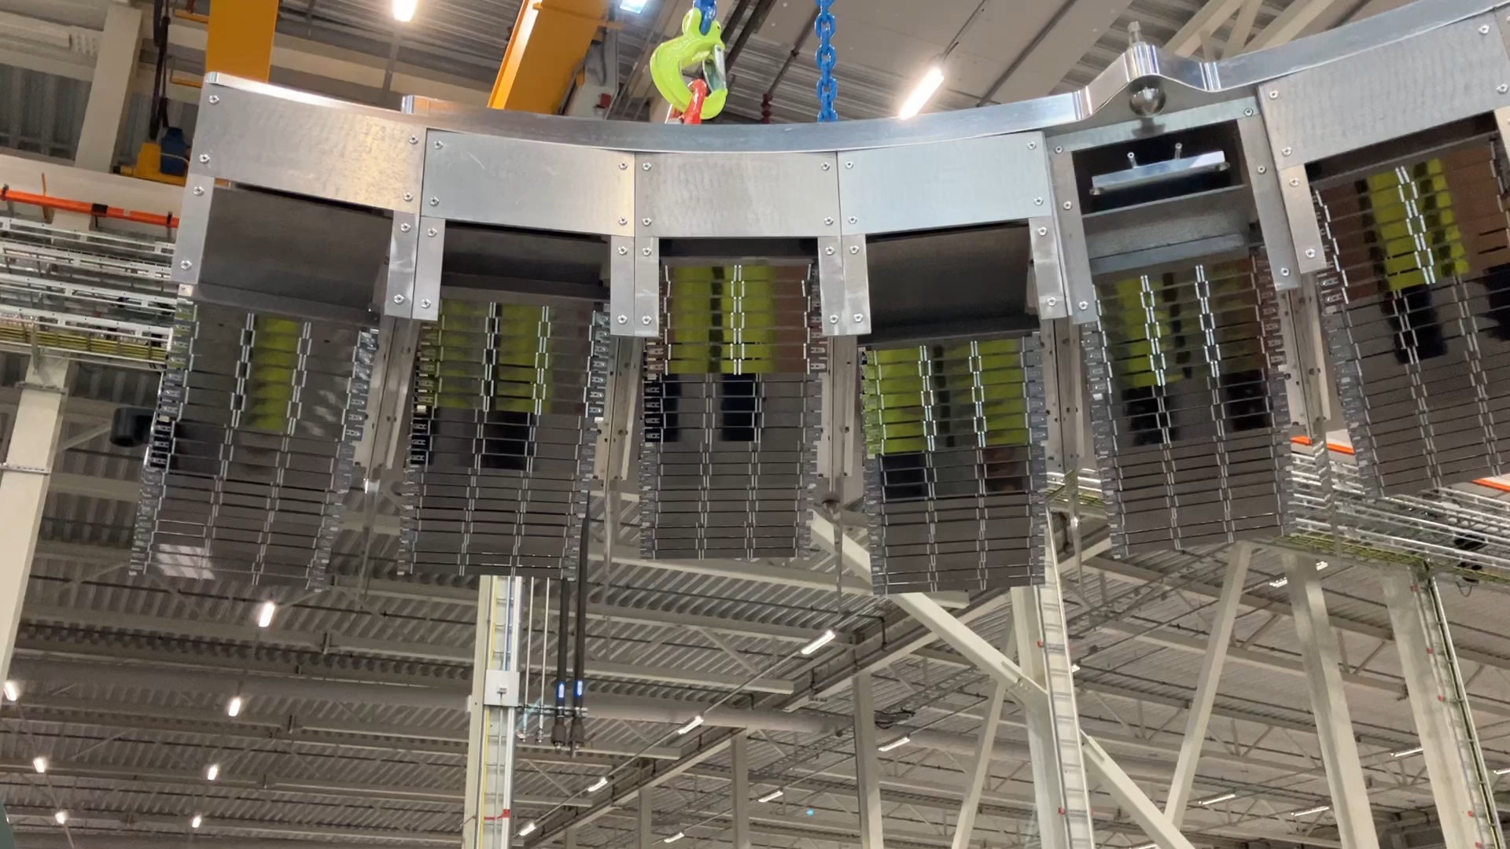
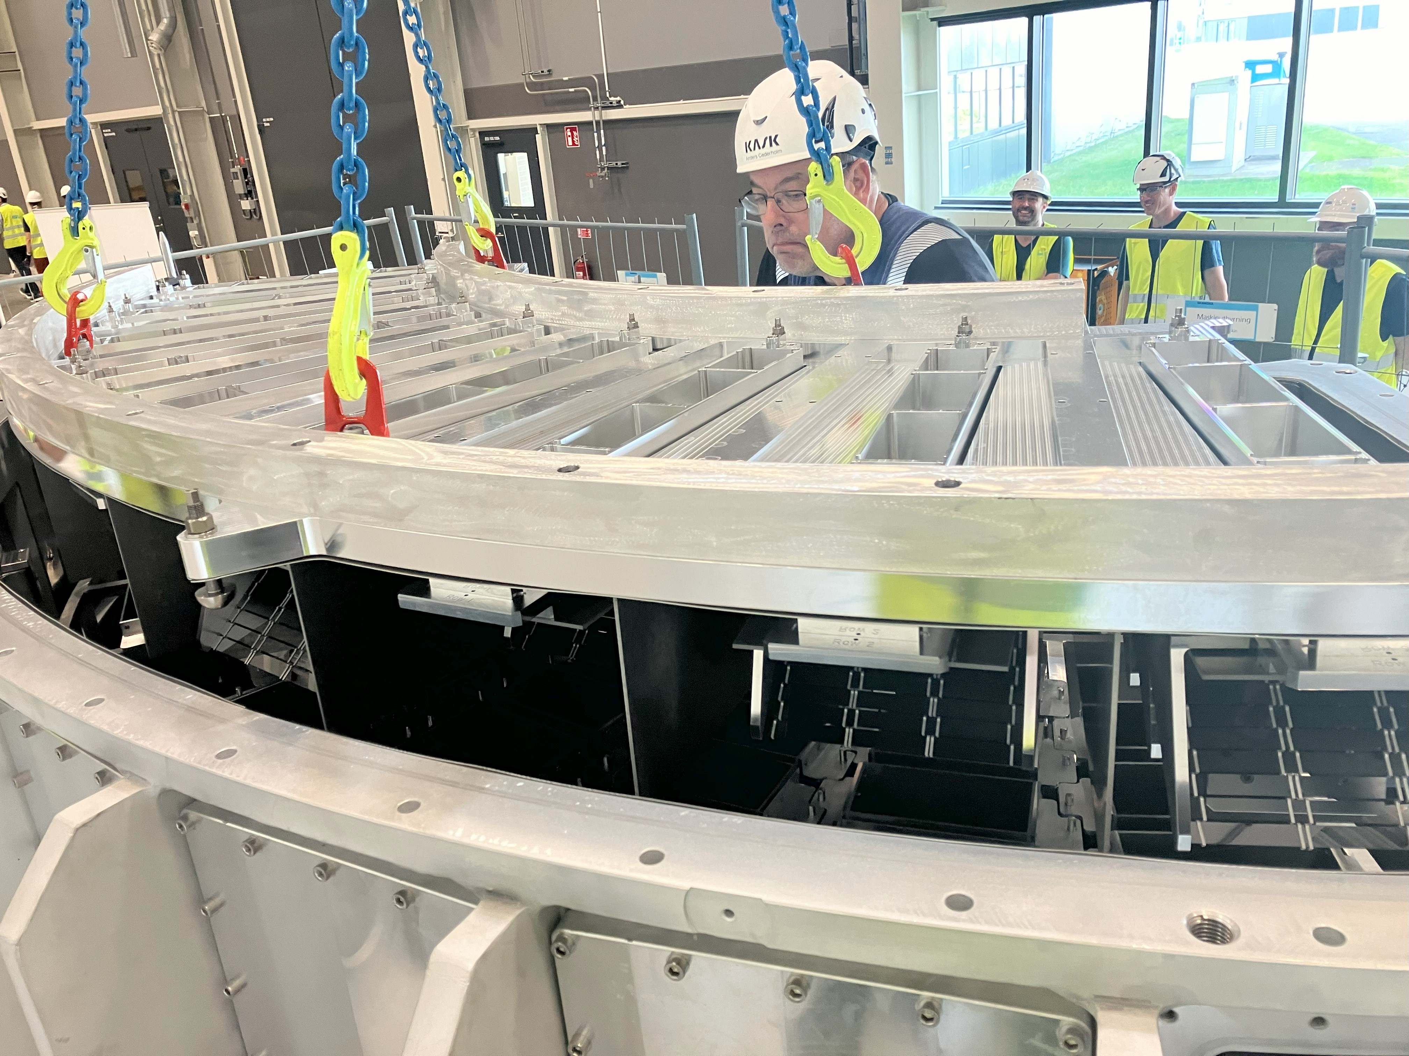
Analysers
  Fully assembled on plate
  Lots of measurement data
  Installed inside vessel last week

Slide 15
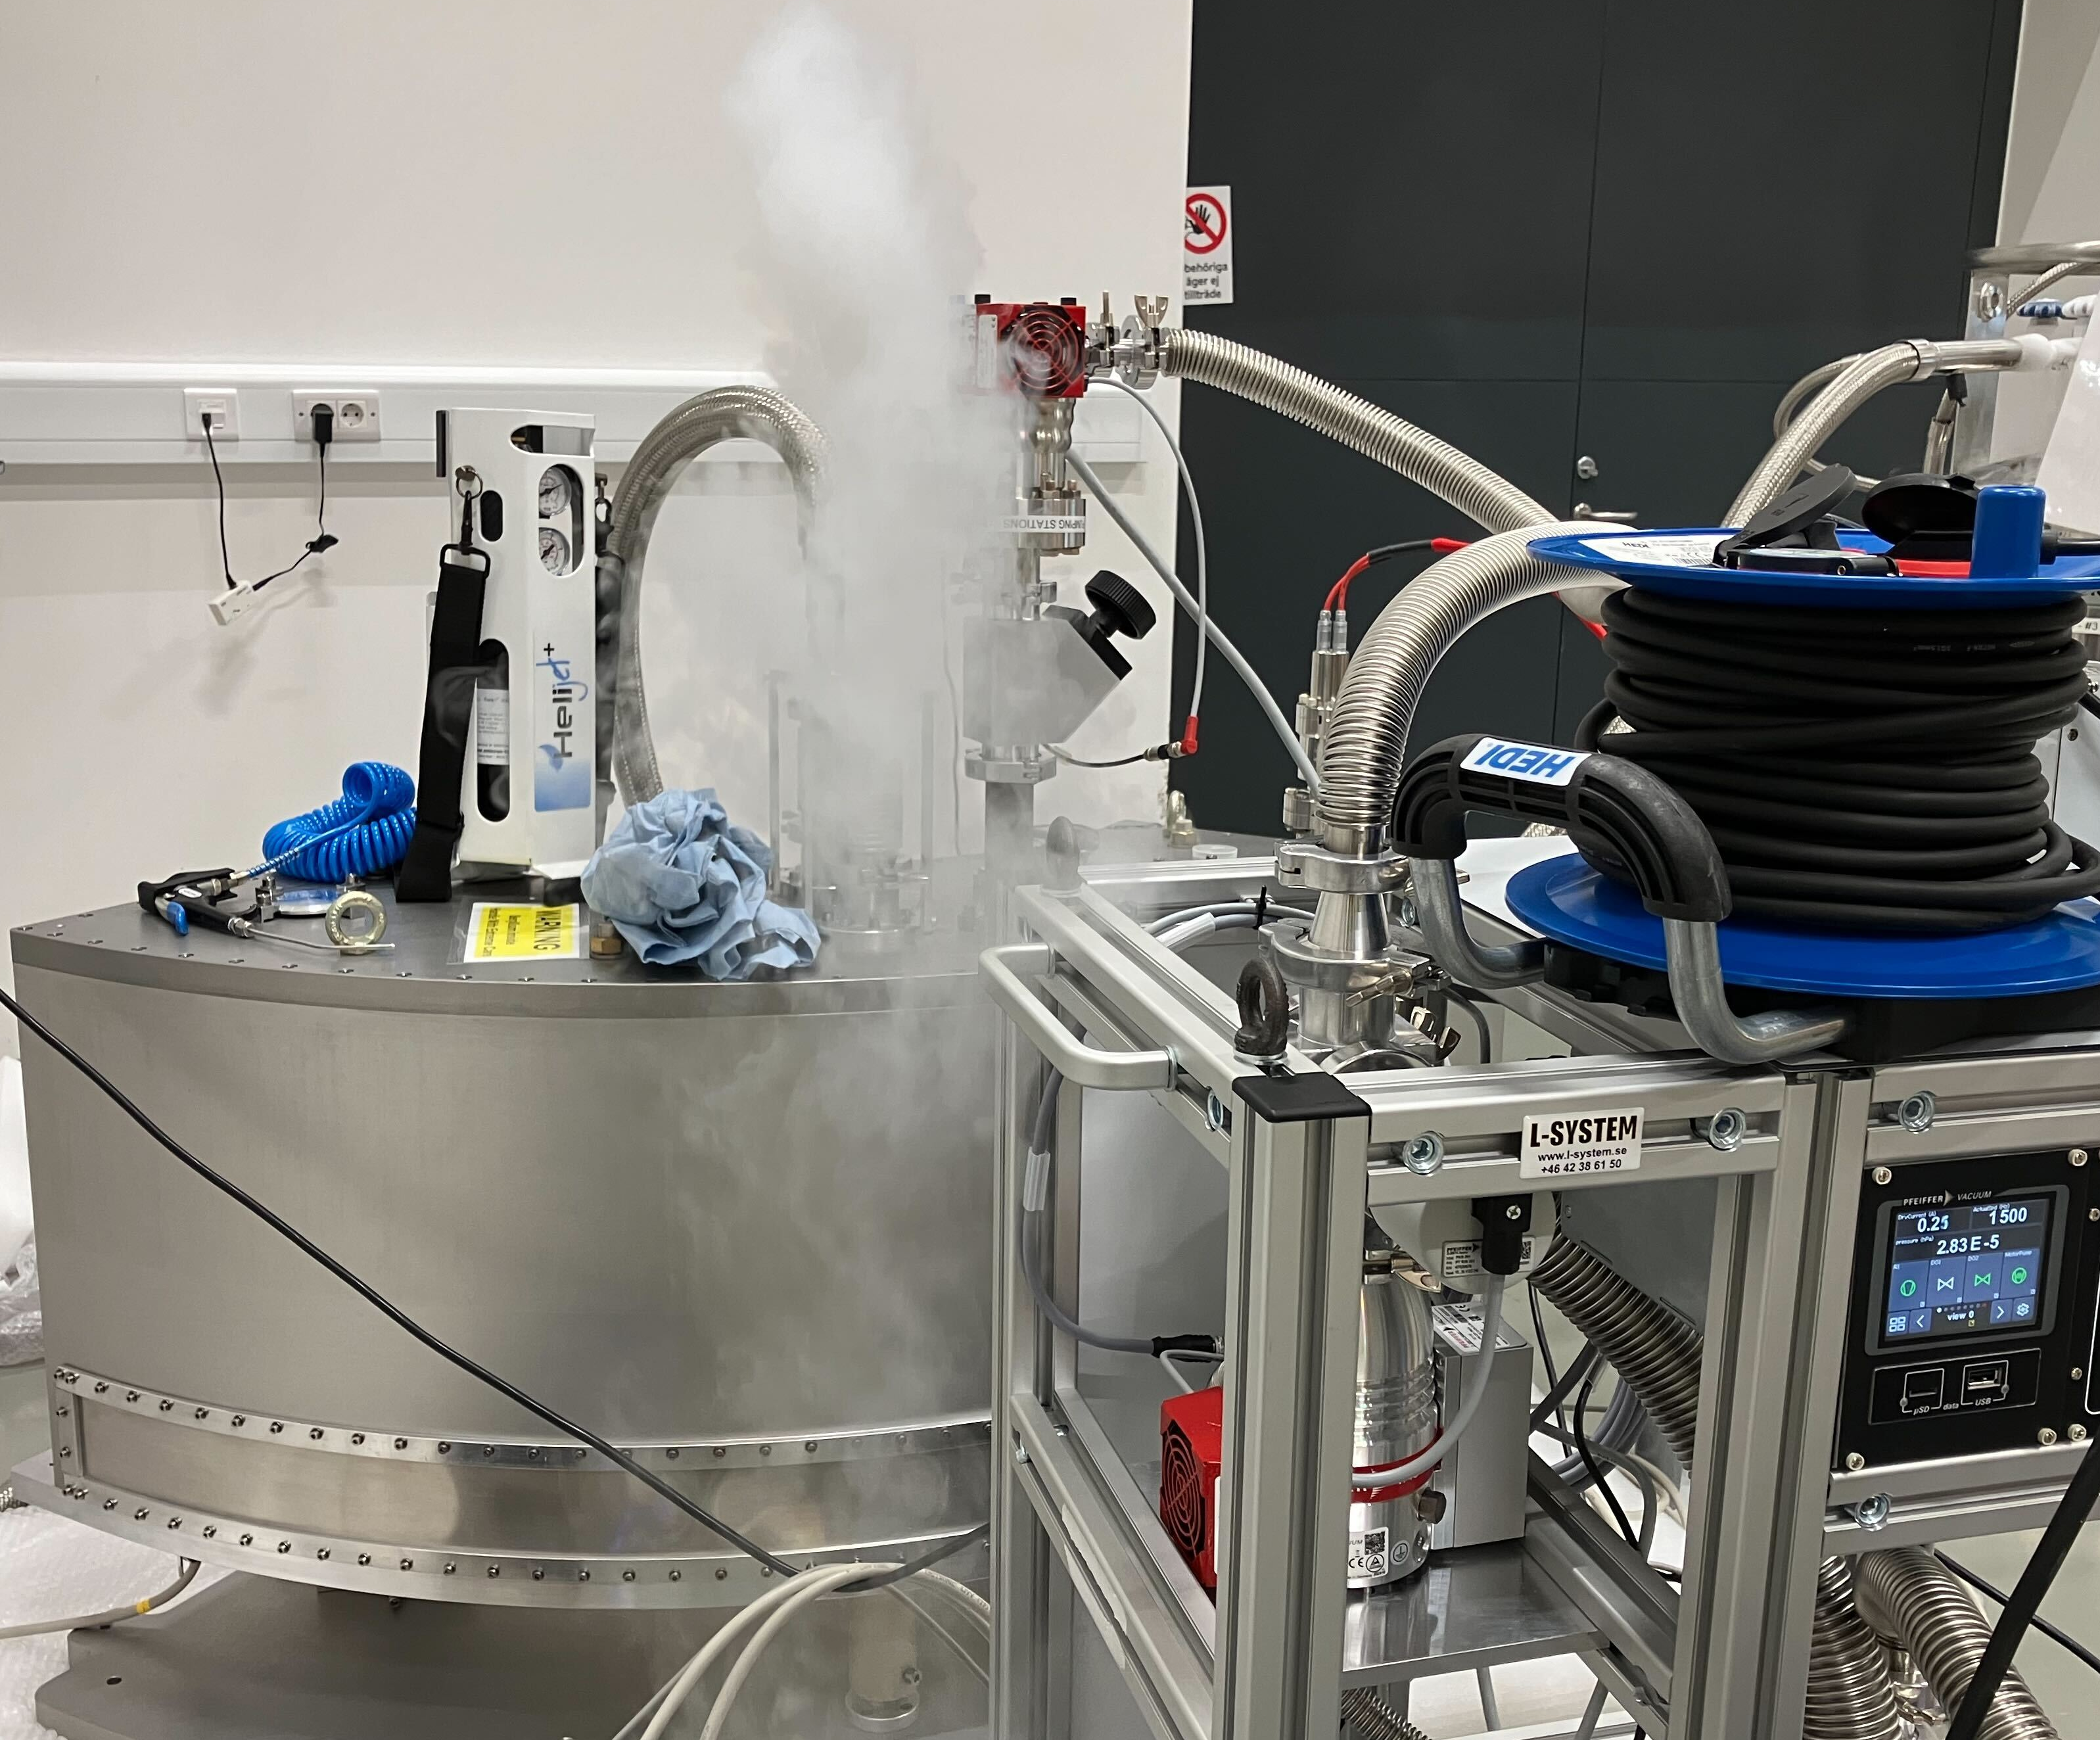
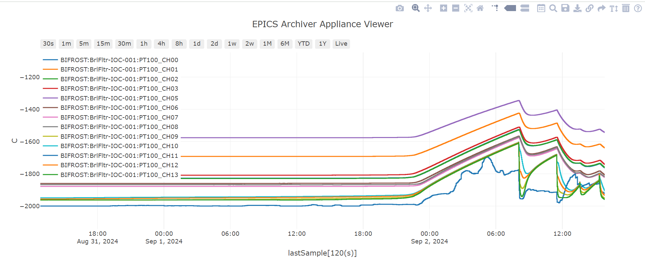
Beryllium Filter
  FAT performed in August
  Delivered to ESS and SAT performed last week
  Vacuum performance is now robust
    2x10⁻⁹mBar.l.s maximum leak rate at cold temperature
    Secondary vacuum design now changed
  Temperature readout through ICS hardware
  Hold time of 55 hours,
  hopefully more soon!

Slide 16
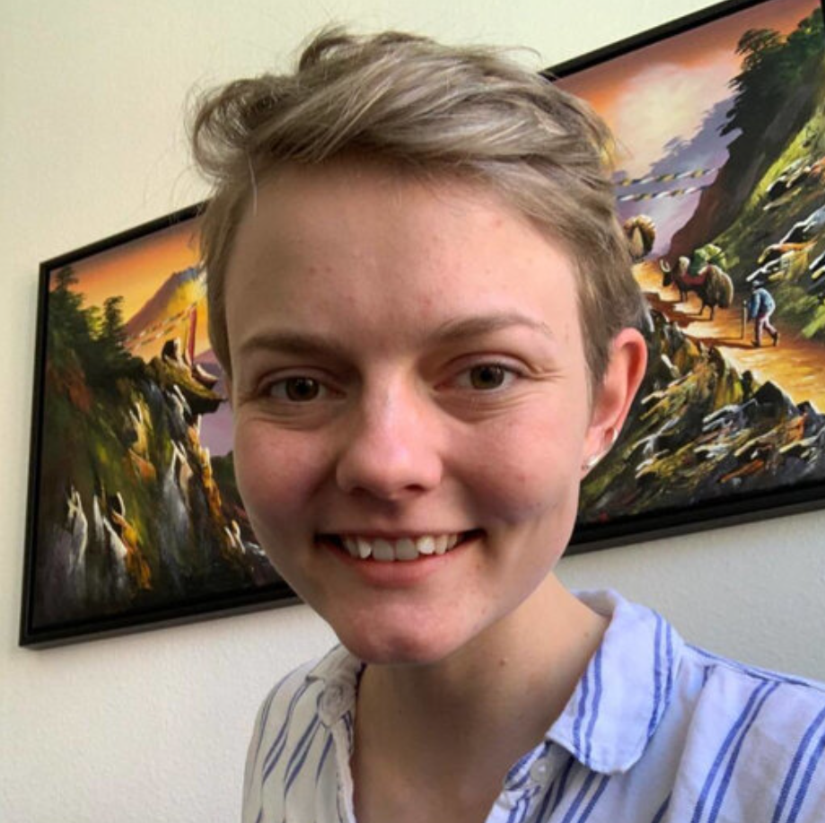
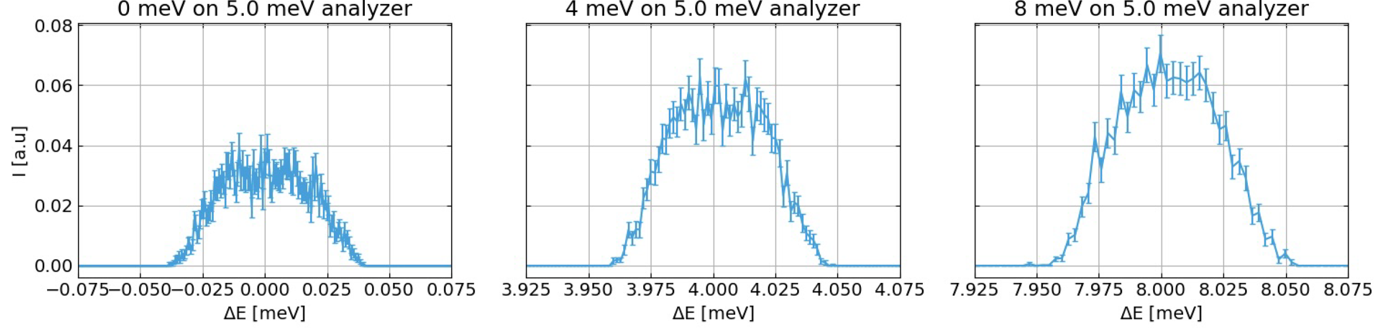
BIFROST: Energy resolution simulations
Using McStas, we simulated flat modes at various energy transfers, the plots below show the modes at 0.1 ms PSC opening speed, the
energy resolution remains
similar across the band
Kristine Krighaar,
PhD student,
University of Copenhagen

Slide 17
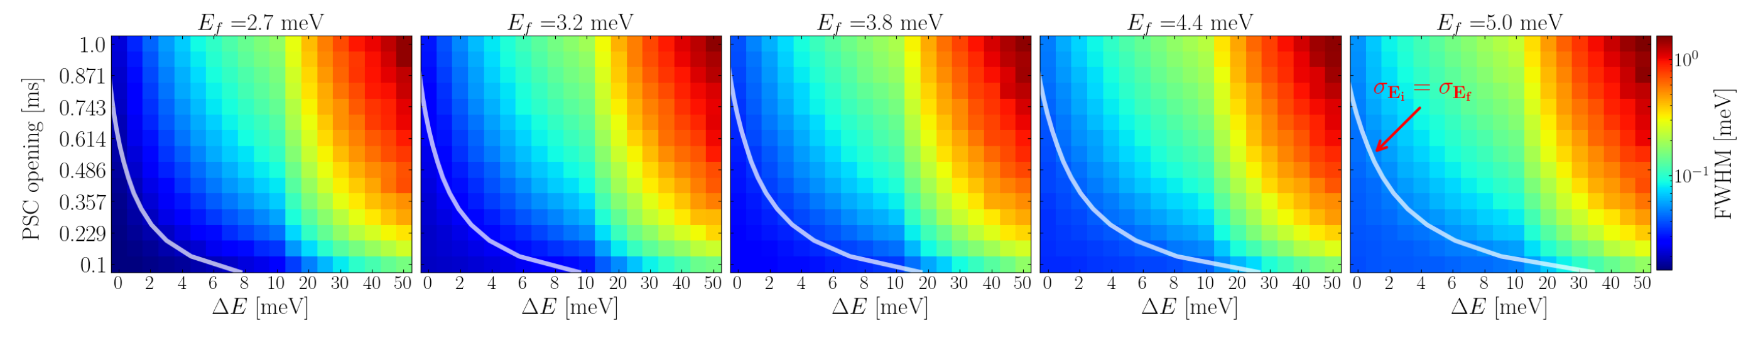
BIFROST: Energy resolution simulations
Using McStas, we simulated flat modes at various energy transfers, the plots below show the modes at 0.1 ms PSC opening speed, the
energy resolution remains
similar across the band
Kristine Krighaar,
PhD student,
University of Copenhagen

Slide 18
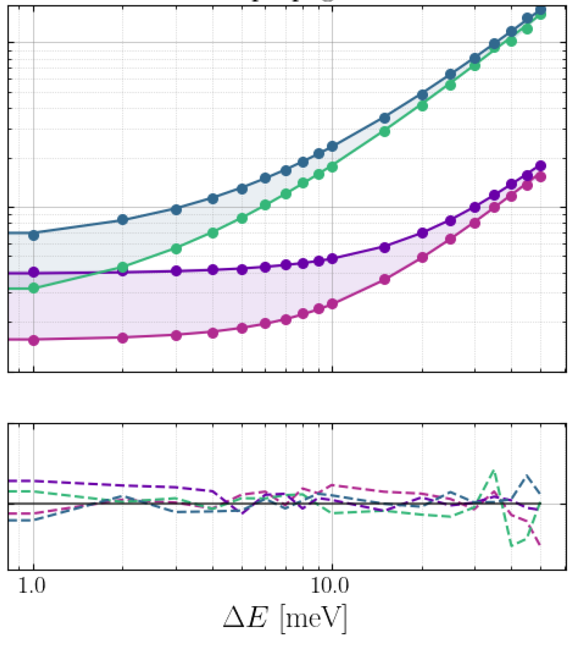
BIFROST: Energy resolution simulations
Dominating contributions are:
Time of flight uncertainty of the primary spectrometer
Bragg angle disitribution of the
secondary.
Less dominant contributions:
ToF uncertainty of the secondary spectrometer
Presumed negligible/not fully simulated:
Relative flightpath uncertainty
(not included moderator depth)
D-spacing variance of HOPG

Slide 19
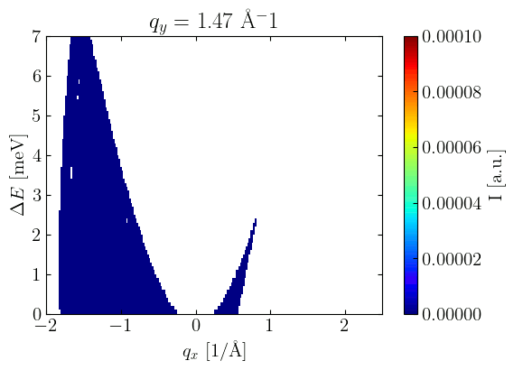
BIFROST: Preliminary phonon simulations, more to come
Phonon simulations using a PSC opening time of 1 ms. Nicely defined mode with a hint of focusing/defocusing effects

Slide 20
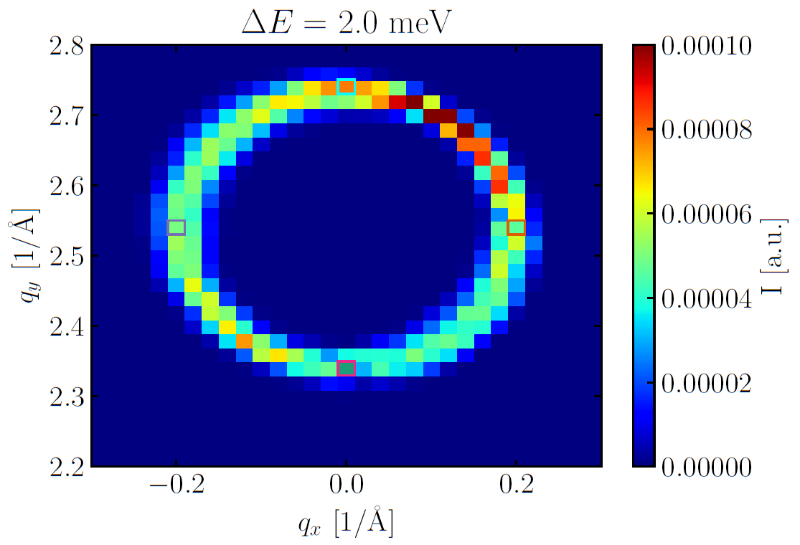
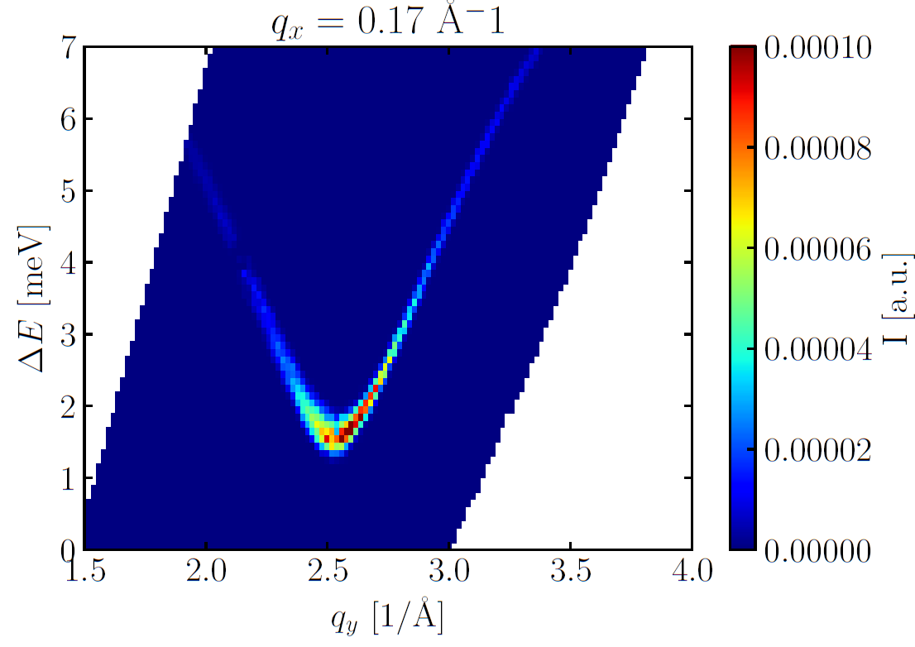
BIFROST: Preliminary phonon simulations, more to come
Slight asymmetry clearly present, we have a vertical
tilt of the resolution function in (Q_z, E),
efforts are ongoing to understand this in
more detail

Slide 21

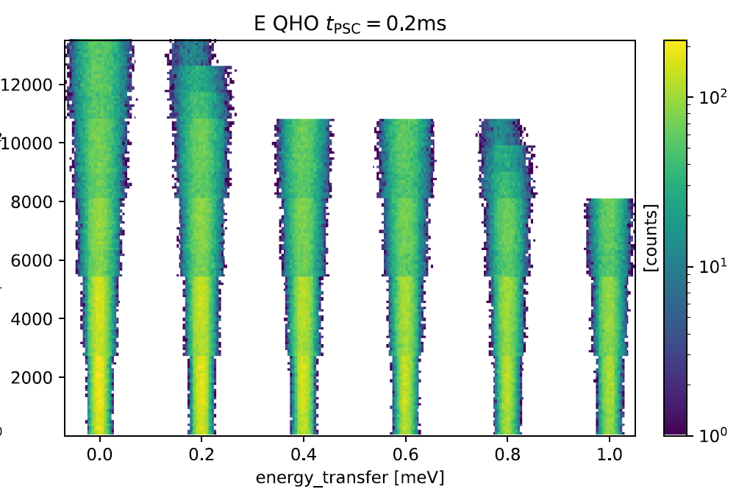
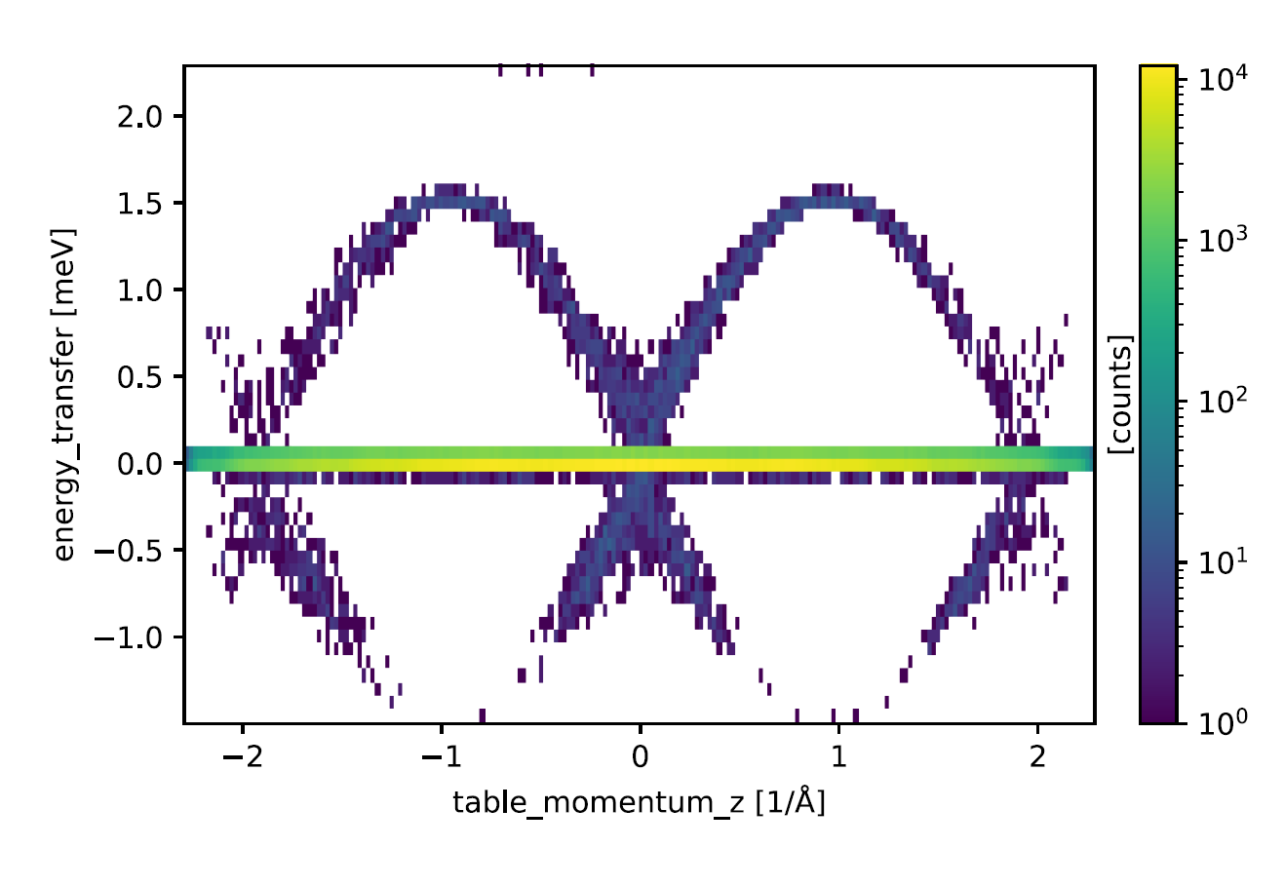
Data reduction and analysis
McStas-model of full instrument
Standard simulations possible, but also possible to send
events with (A, B) charge to Kafka via the preprocessing software (EFU).
Data reduction workflow established
Live detector viewer
Greg Tucker, instrument
data scientist for BIFROST, DMSC

Slide 22
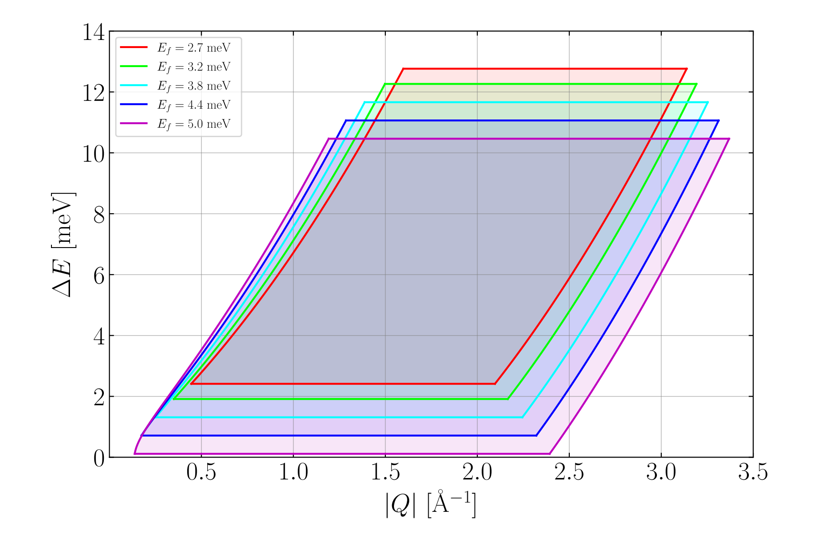
BIFROST: Range & Quick Facts
Scattering angle | 7 – 135 degrees
Incident beam divergence | 0.3 – 1 degrees (+/-)
Scattering angle resolution | 0.6 – 0.8 degrees
Analyser energies | 2.7, 3.2, 3.8, 4.4, 5.0 meV
Incident bandwidth | 1.7 Å
Energy transfer range | -3 to 55 meV
Sample flux @ 2MW | Low res: 6 · 10⁹ n/s/cm² High res: 2.5 · 10⁸ n/s/cm²
Elastic line resolution | 0.02 meV – 0.17 meV
Day 1 sample environment | 15 Tesla, 50 mK, 10+ kbar pressure

Slide 23
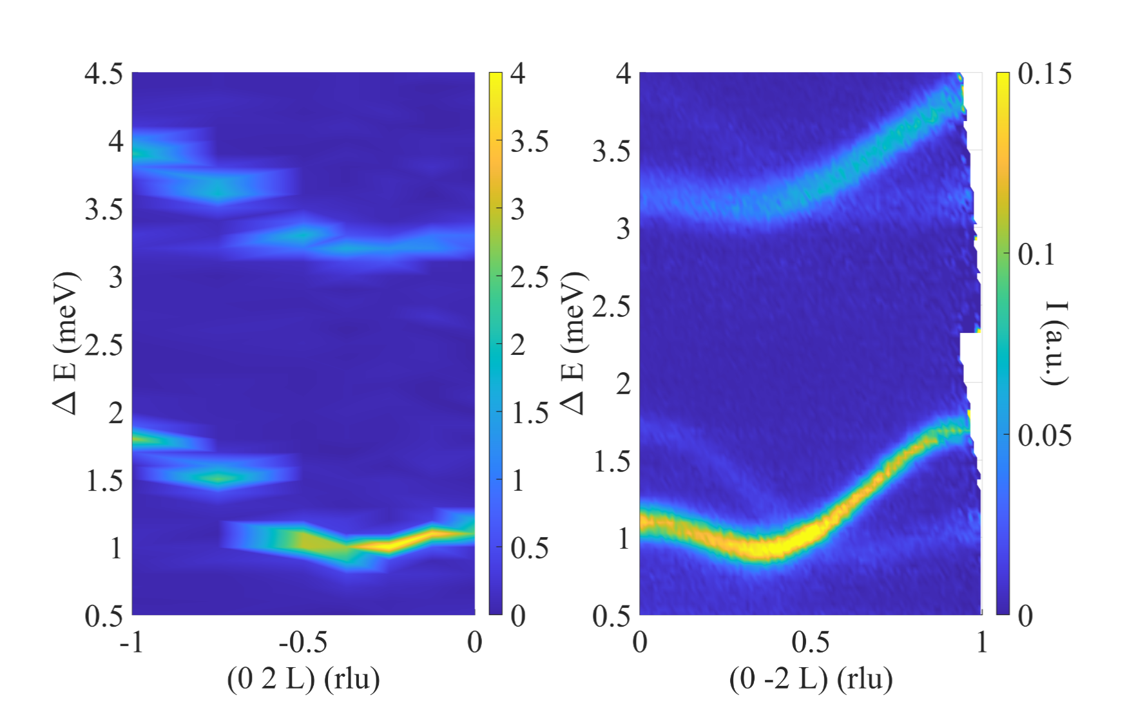
Early science – Purpose
Main purpose: Concrete experiments
Experiments leading to ‘quick publications’
Experiments demonstrating what BIFROST can do
Experiments pushing the limits of feasibility
We ask for you to keep relevance in mind:
- Single crystal exists
    Sample characterized
    Know signal existence (sample should have
    seen neutrons before
    Analysis team exists
Identify long term trends – which experiments should
be enabled (E-field, pressure, chemical composition)
Other purpose: Build a knowledgeable BIFROST user base
Diana’s example SrTm2O4: Have been working
On the family for a while. Diffraction exists, bulk
measurements exists, preliminary TAS data exists.
RPA model rests on too little inelastic data. Goes
to CAMEA, less than 1 year later, paper submitted
FLEXX
CAMEA
23

Slide 24
Early science – Agenda
9:00 Talk by Sylvain Petit
9:35 Talk by Klaus Habicht
10:00 Break
10:30 Jakob Lass on CAMEA
10:50 Plenum discussion
11:50 Talk by Daniel Mazzone
12:30 Lunch
13:30 Breakout session – demonstrating the strengths of BIFROST
15:00 Break
15:20 Presentation of suggestions
16:00 Concluding remarks and closeout
16:30 – 17:00 End of workshop
15:00 Breakout session – ‘extreme’ environments
16:15 Open discussion
17:00 Optional tour
13:45 Talk by Henrik M Rønnow
14:30 Break
15:00 Breakout session – ‘extreme’ environments
16:15 Open discussion
17:00 Optional tour
24

Slide 25
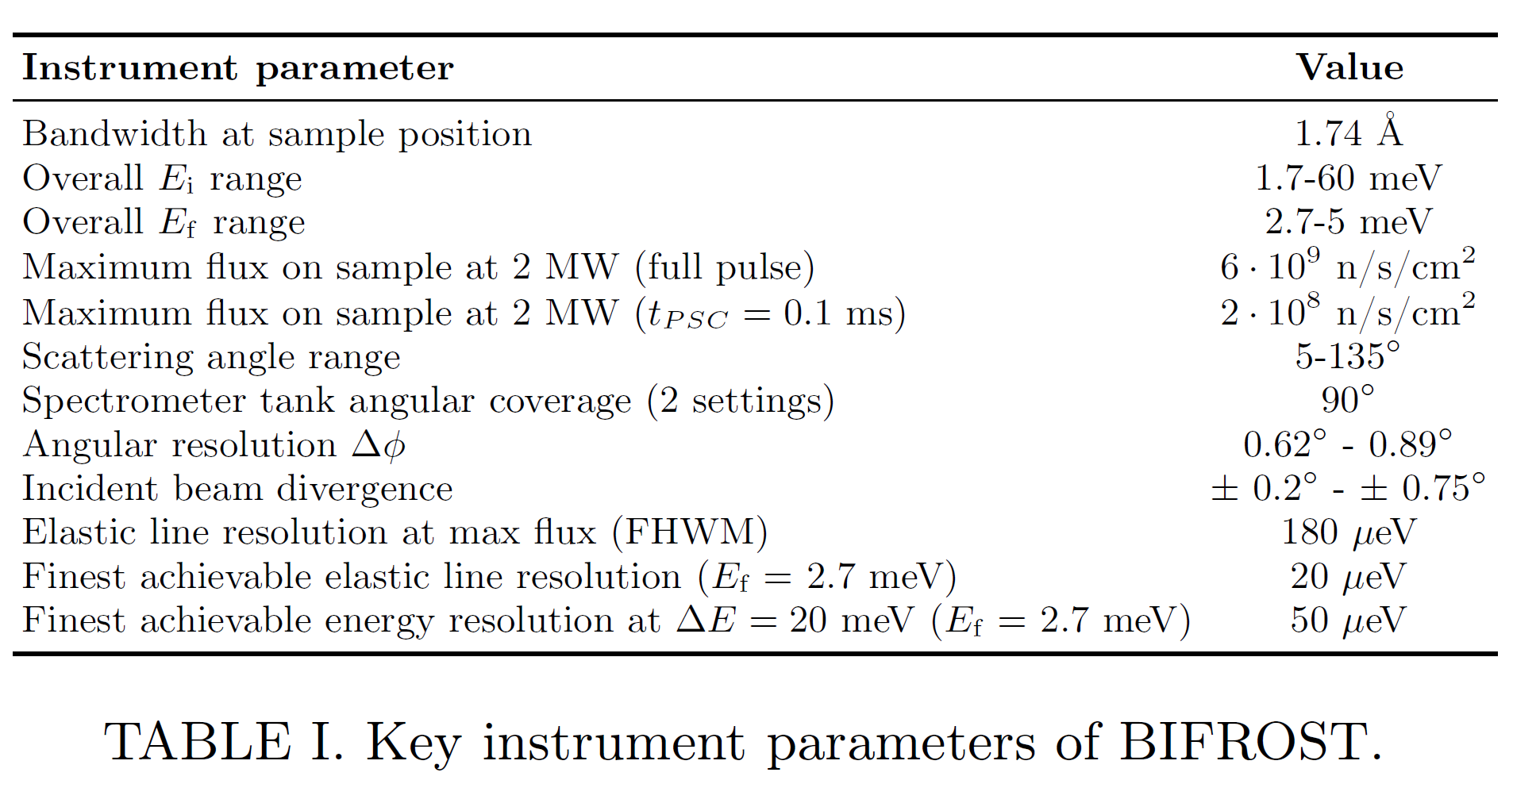
Early science – Performance assumptions!
200 kW: Scale flux down by a factor of 10
Leaves us with a flux similar to MACS, with 3 times larger detector spatial angle. Our flux is distributed in a 1.7 Å bandswidth. Key advantage is mostly the flexible energy resolution and the better Q-resolution
25

Slide 26
Early science – Day 1 Breakout
At BIFROST, we will be able to measure excitations in small plate-like samples suitable for electrical fields in the range of 5000 V / mm. During early days, this would likely be limited to large moments. This could involved direct mode manipulation with E-fields or simply domain selection in multiferroics
Any concrete BIFROST experiments involving electrical fields?
Any long term trends with electrical fields?
At BIFROST we would similarly be able to make high pressure spectroscopy much more feasible. In the beginning, due to the lower accelerator beam power, we would be limited to clamp-type cells, in-situ anvils or gas pressure cells with large volume. At 2MW beam power, with small sample sizes (1 mm^3), pressures up to 10 Gpa could be attainable
Can you think of a concrete pressure cell experiment, involving samples in the size range of 4 mm^3
Long term trends? In particular, are pressures above 2 GPa going to be crucial for BIFROST?
26

Slide 27
Early science – Day 1 Breakout
Small sample spectroscopy would be more feasible on BIFROST. Some systems only allow small crystals to be grown. For simple dynamics, co-aligning crystals can allow that barrier to be overcome, but for more complex collections of branches, linewidth studies, experiments where magnetic field uniformity is important, large collections of samples becomes a problem.
Have you experiments in mind that have been impossible so far, due to sample size, that BIFROST enables?
27

Slide 28
Early science – Day 2 Breakout
BIFROST enables an unprecedented flux/resolution combination, allowing for resolution of the order of 30 ueV, around 7 meV energy transfer.
Which concrete experiments, feasible with 200 kW proton beam power, needs this resolution? (complex low energy dynamics, systems where resolving power at higher energy transfer is necessary)
The mapping efficiency of BIFROST enables parametric mapping studies to be made, where around 5 full maps of the horizontal plane spectrum can be recorded in a few days. Initially as a function of pressure, temperature and chemical composition, later on, as a function of electrical field or pressure.
Have you worked on or are working on systems, where parametric mapping studies would be of great value, but have not been feasible until now?
Since we can study much smaller samples on BIFROST, we can get a signal from samples with higher absorption cross section than we usually accept (Eu, Dy, B, Hg etc)
Are there neutron absorbing systems, where isotopic enrichment is either infeasible or too expensive, that could be studied on BIFROST?
28

Slide 29
Early science – 7 in each
Group 1 (Maria Goppert Mayer):
Daniel Mazzone (PSI, chair)
Henrik M. Rønnow (EPFL)
Dalila Bounoua (LLB)
Pascale Deen (ESS)
David Tam (KTH/ILL)
Paul Steffens (ILL)
Kristine Krighaar (KU)
Group 2 Ernest Rutherford:
Rasmus Toft (ESS/DTU, chair)
Sylvain Petit (LLB)
Elizabeth Blackburn (LU)
Øystein Fjellvåg (Oslo)
Quintin Faure (LLB)
Ross Stewart (ISIS)
Jakob Lass (PSI)
Tamires Gallo (ESS)
Group 3 Maryam Mirzakhani
Kim Lefmann (KU, chair)
Philippe Bourges (LLB)
Bjørn Hauback (IFE)
Michel Kenzelmann (PSI)
Francoise Damay (Uni Saclay)
Mohamed Aouane (ESS)
Diana Q Castro (PSI)
Astrid Schneidewind (FRM2)
Group 4 Manne Siegbahn:
Greg Tucker (ESS, chair)
Niels Bech Christensen (DTU)
Paul McClarty (LLB)
Victor Baledent (Saclay)
Klaus Habicht (HZB)
Martin Månsson (KTH)
Paola Forino (DTU)
29

Slide 30
Thank you for your attention
Scientific contributors:
Rasmus Toft-Petersen
Jonas Okkels Birk
Greg Tucker
Kristine Krighaar
Marton Marko
Rodion Kolevatov
Martin Olsen
Mads Bertelsen
Sonja Holm Dahlin
Jakob Lass
Felix Groitli
Fanni Juranyi
Jacob Larsena
Paul Freeman
Isabel Llamas Jansa
Henrik M. Rønnow
Bjørn Hauback
Philippe Bourges
Christof Niedermayer
Kim Lefmann
Niels Bech Christensen
Technical contributors:
Liam Whitelegg
Sylvain Rodrigues
Finn Saxild
Keld Theodor
Tamires Gallo

Slide 31
Early science – old slide but message remains
Installation and Commissioning
Phase 4
(Installation & Integration)
TG5
SRR
Phase 5
(Hot Commissioning)
TG6
ORR
Operation
Early Science
User Prognam
(Installation & Integration)
Hot Commissioning
Operation
Sub-system SAT
Cold Commissioning
TG5
SRR
Sub-system Characterization and Calibration
Instrument Characterization
Validation Experiments
TG6
ORR
New Science
SRR, Safety Readiness Review
TG5
Outcome Meeting
Not a fixed period
in time. Depends on
hot commissioning
results, accelerator
problems
Hot Commissioning 9+ months
Early Science
9+ months
31

Slide 32

Early science – friendly users
Friendly user:
They do exist (right?)
Users who are interested in the instrument
and it’s performance – collaborating with
the instrument team
Accepts birth detects and helps fixing them
Ambassadors for the instrument,
helps us positively engage the
user community.
Participates in shaping the scientific profile
of the instrument (12-13 years after it was proposed)
You: Partner scientists, scientists from
partner labs, instrument scientists driving
multiplexing development, university scientists
involved in upgrade projects, or involved in
proposing the concept in the first place
32

Slide 33
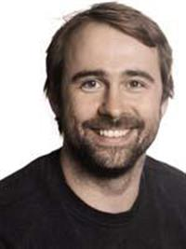

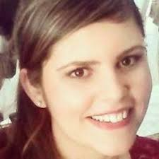

Early science – ESS people
Scientist: Rasmus Toft-Petersen
Scientist X
Instrument data
scientist: Greg Tucker
Instrument operations
engineer: Tamires Gallo
Partner lab scientist
Spectroscopy division
scientist
We will have support staff at the ESS, and therefore should have enough manpower.
We have great sample environment support, a 15 T magnet
dilution stick, and standard orange cryostat.
Data reduction workflow exists and have been tested (we still need normalization, interface with analysis tools)
33

