Slide 1
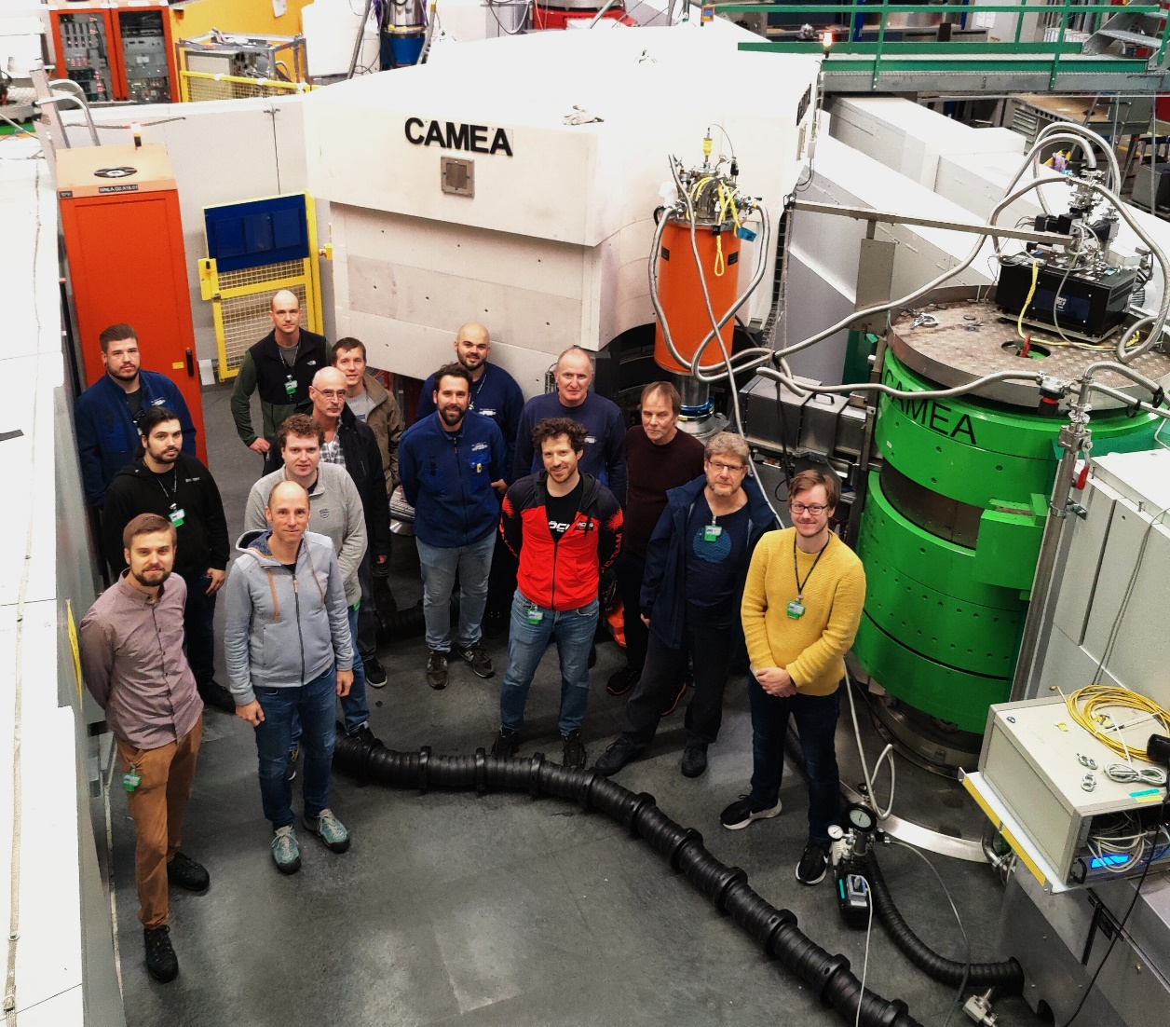
The early days on CAMEA
Experiences
Jakob Lass
BIFROST Early Science Workshop 2025

Slide 2
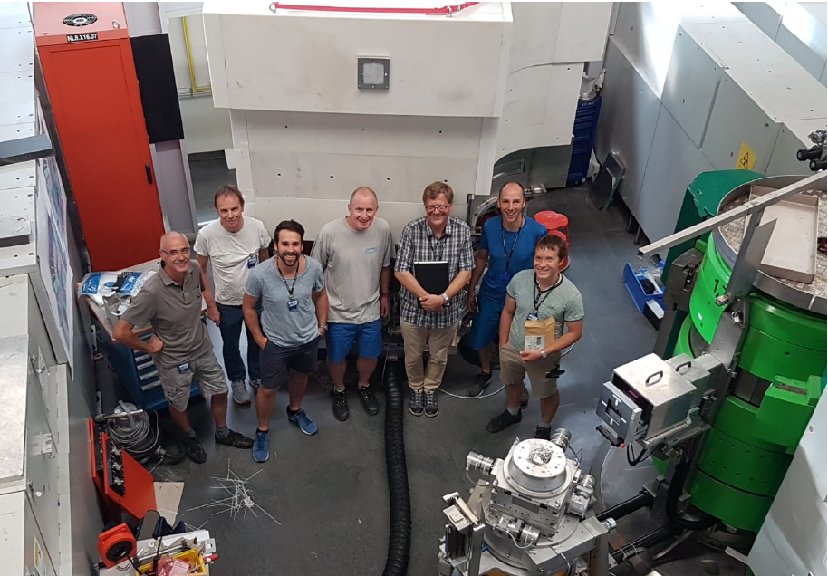
The CAMEA Team
Alex Bollhalder
Marcel Schild
Urs Greuter
Gerd Theidel
Marek Bartkowiak
Emmanouela Rantsiou
Masako Yamada
Mark Koennecke
Michele Brambillo
Márton Markó
Markus Zolliker
Paul Schurter
Silvan Stamm
Felix Fehrenbacher
Peter Keller
Raphael Müller
Roma Bürge
Manuel Lehman
Stefan Mathis
Marcel Schild
Robin Mühleback
Alexander Söderqvist
Sven Schlienger
Edward Wall
Uwe Filges
Christian Rüegg
Sandor Toth
Jonas Birk
Marc Janoscheck
Michel Kenzelmann
Kim Lefmann
Rasmus Toft-Petersen
Mads Bertelsen
Kristine Krighaar
Nicolai Amin
Luc Testa
Virgile Favre
Henrik Jacobsen
Rafal Wawrzynczak
Daniel Mazzone
Christof Niedermayer
………
Peter Keller
Christian Kägi
Dieter Graf
Frank Herzog
Roman Bürge
Manuel Lehmann
Rafael Müller
Notes:
I did not do all of the mechanical, electronic, and actual building work of the instrument
Huge thanks to the technicians at PSI; who’s skills I have only come to appreciate after some years, where I have figured out how good they are

Slide 3
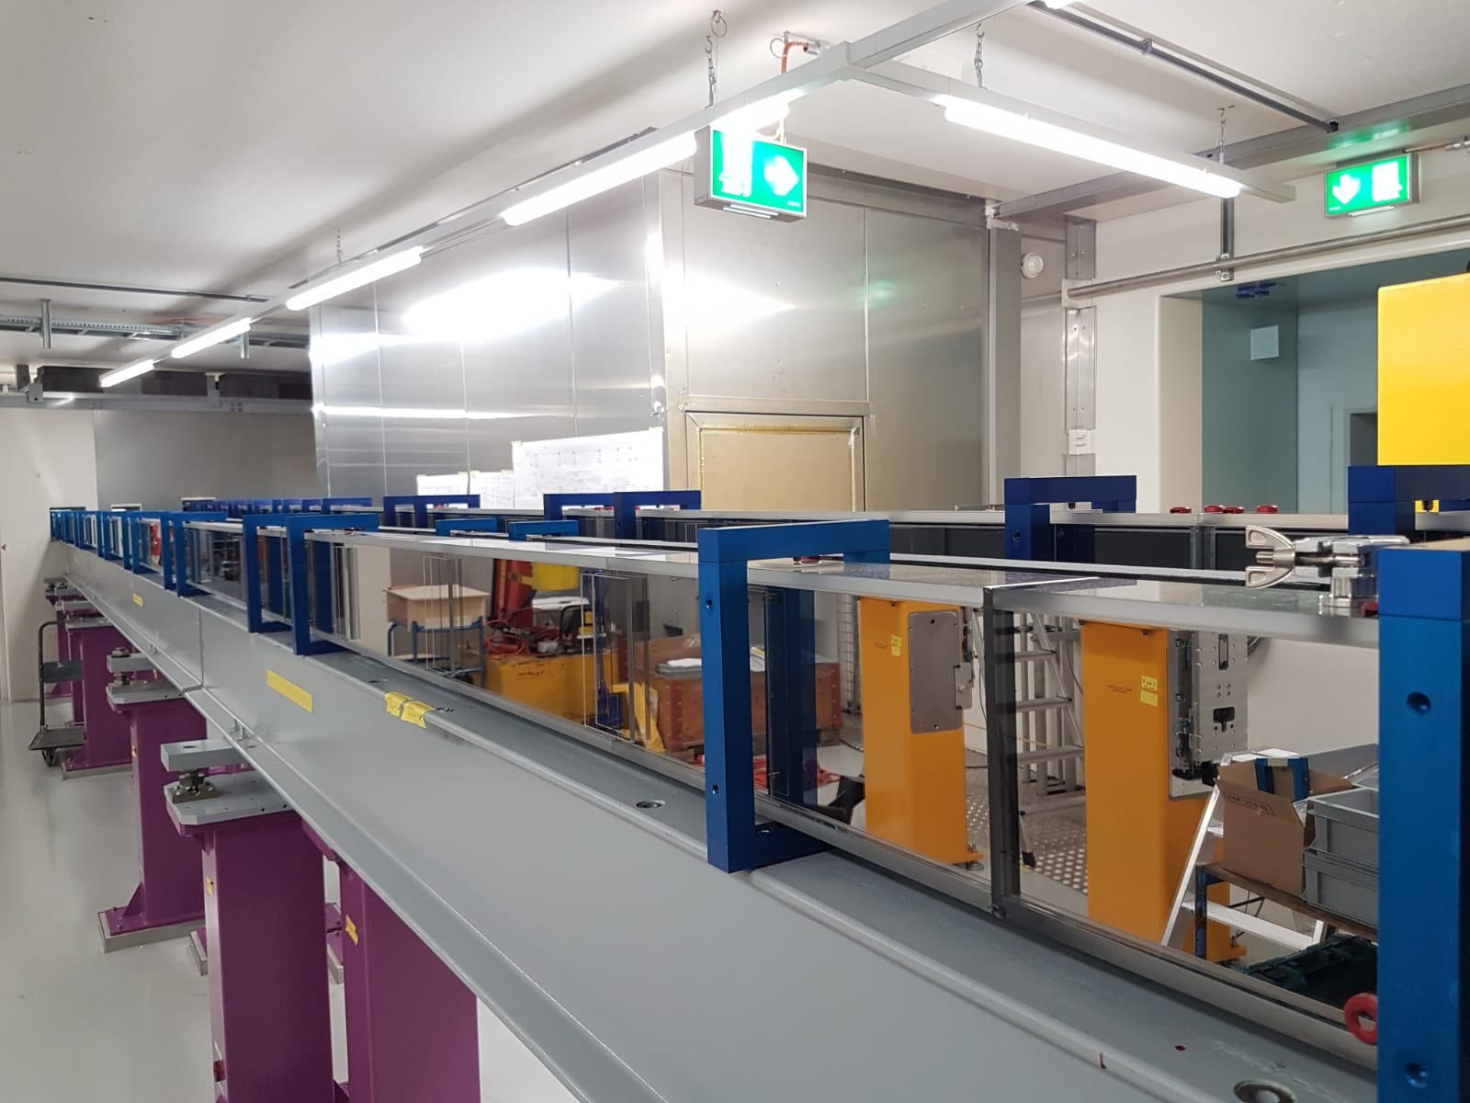
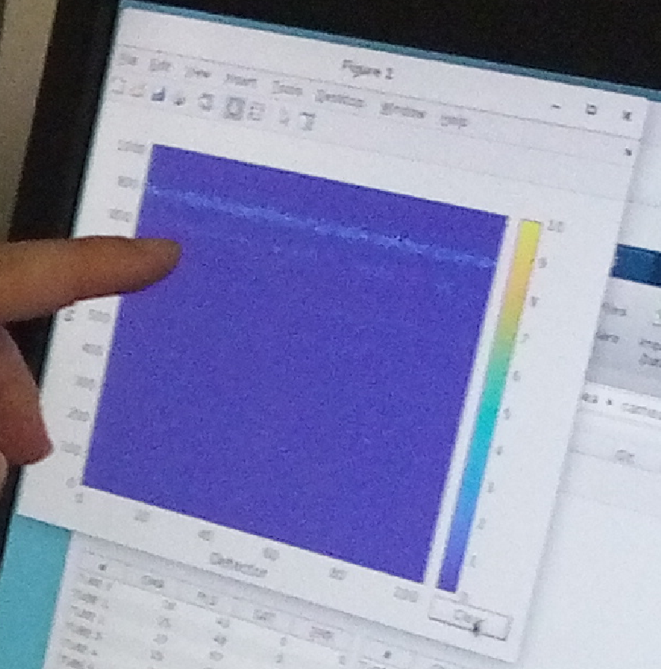
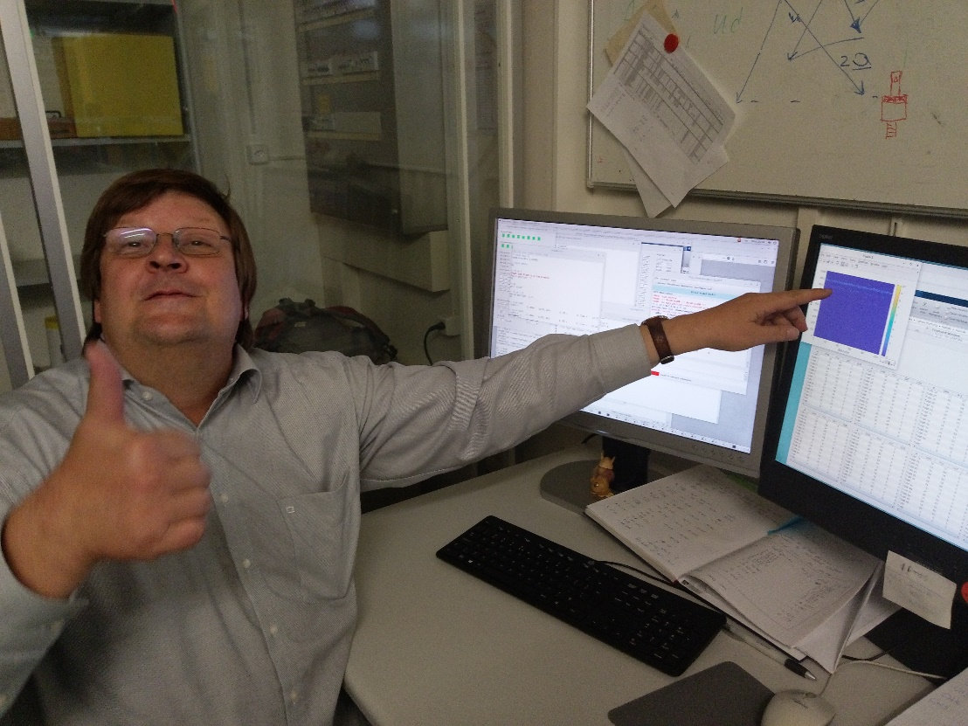
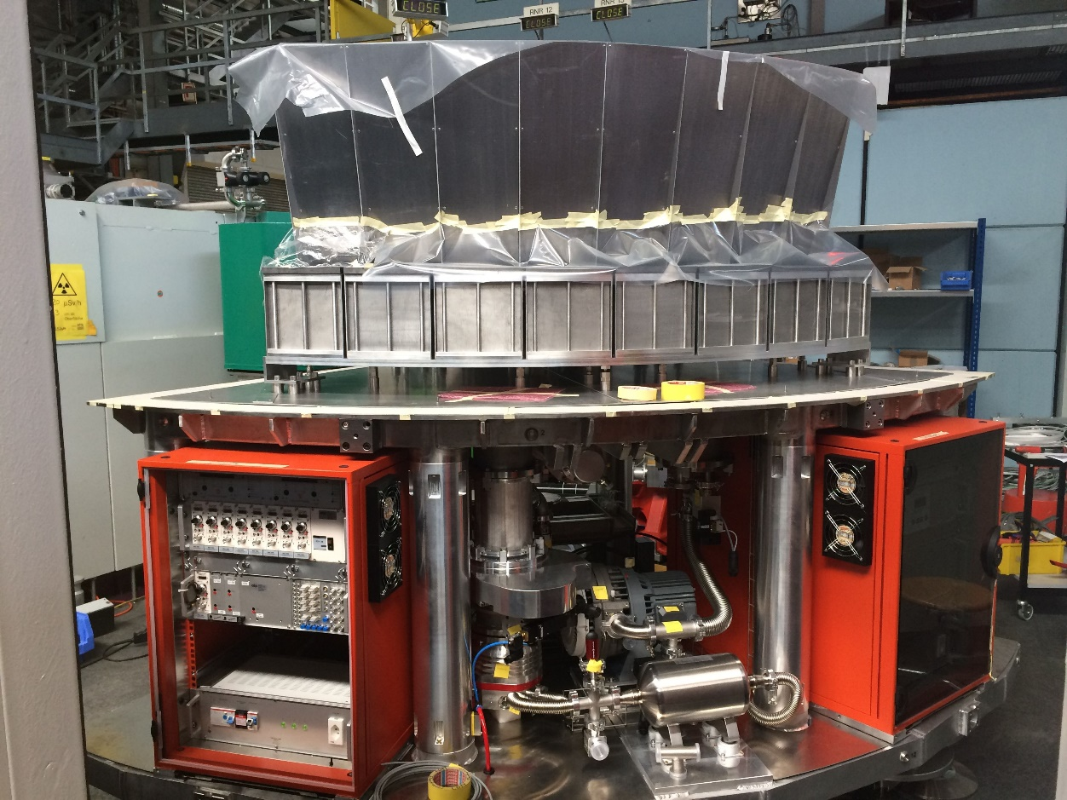
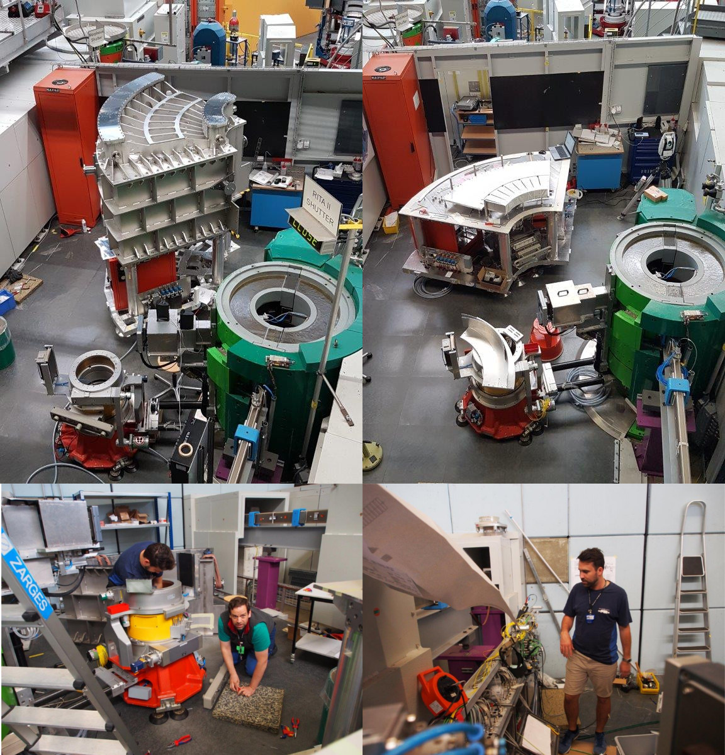
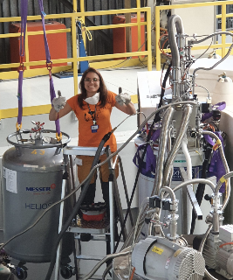
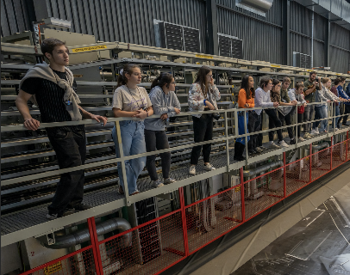
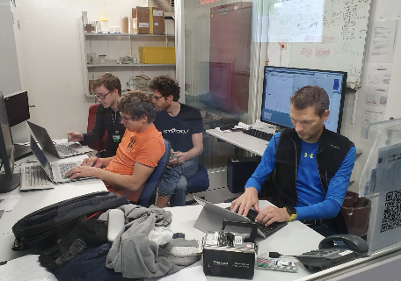
Commissioning Timeline
New Guide
Partial Operation
First Neutrons
Hot Commissioning
New Monochroamtor
2020
2018
2021
2013
Design Building
2022
2024
Full User Program
”Steady” State

Slide 4
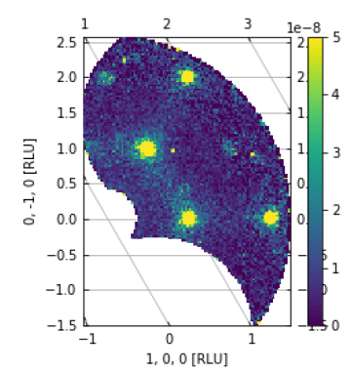
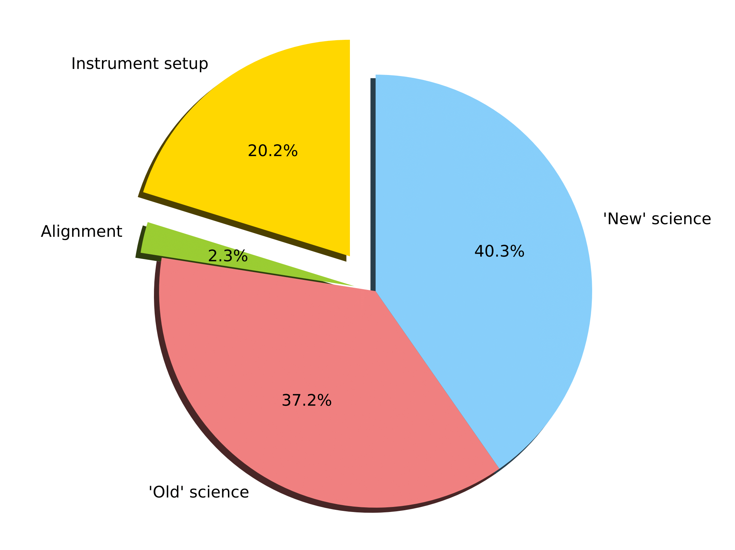
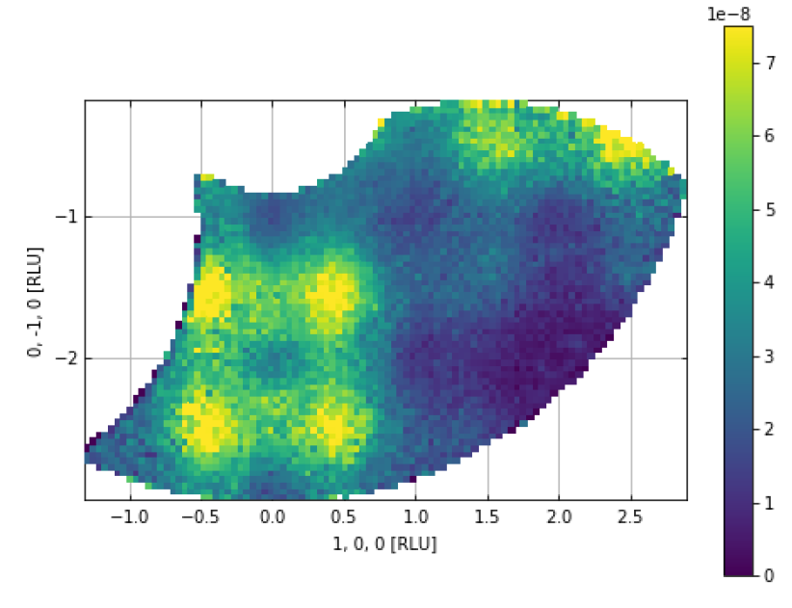
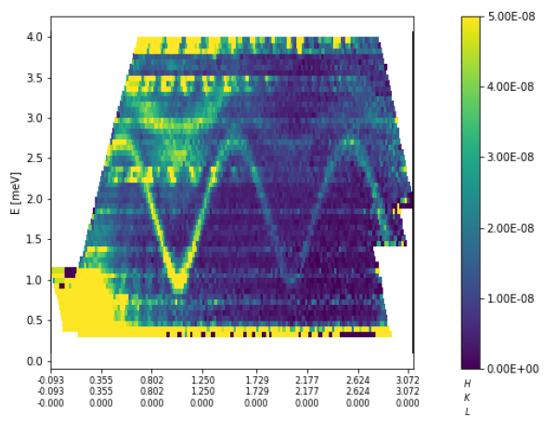
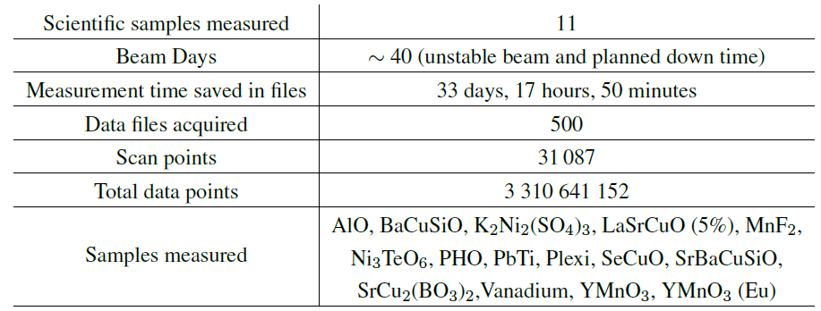
Internal Commissioning 2018
SrCu₂(BO₃)₂
YMnO₃
Pb(TiO)Cu₄ (PO₄)₄

Slide 5
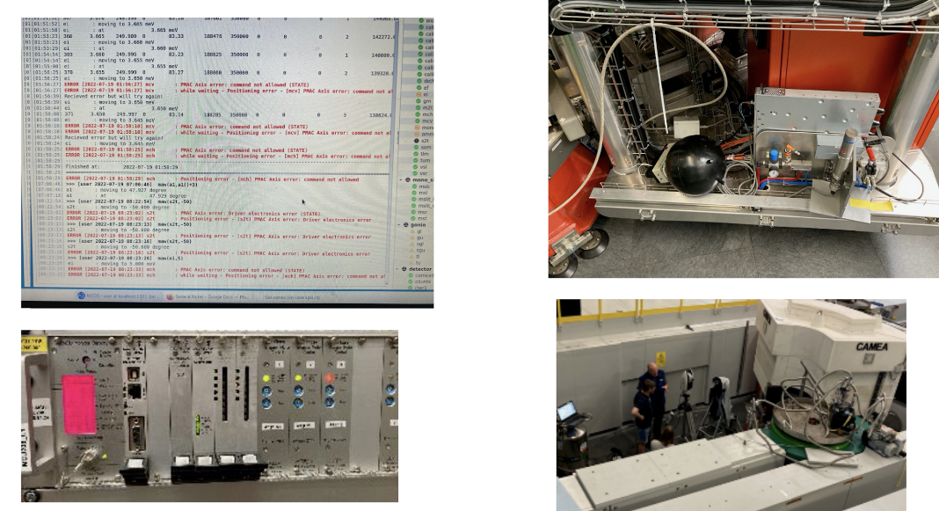
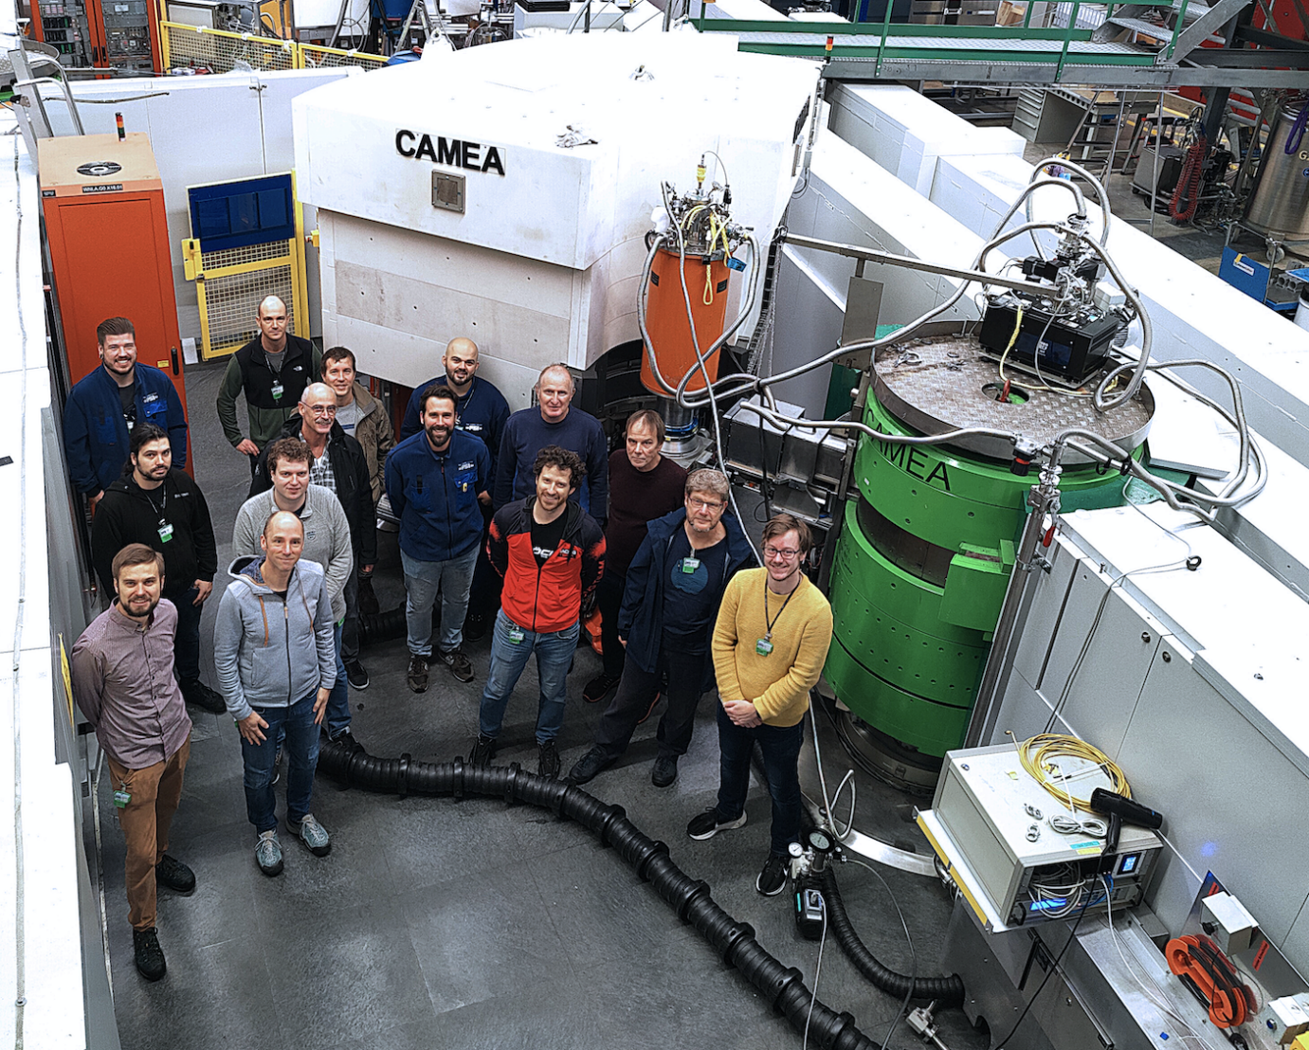
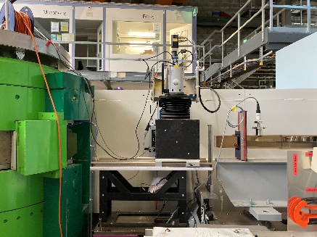
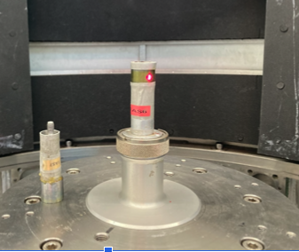
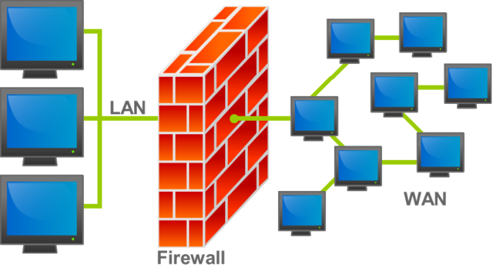
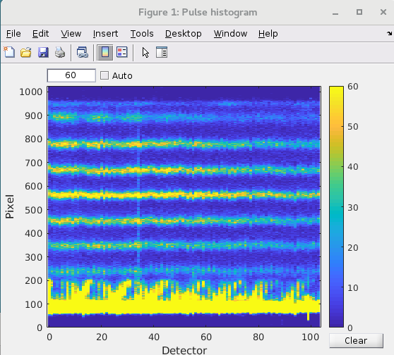
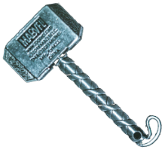
Commissioning (Actually)
Mechanical Challenges
Technical Challenges
Scientific Challenges
Electronics
Mechanics
SrCu₂(BO₃)₂
YMnO₃
SICS
Pb(TiO)Cu₄ (PO₄)₄
Software
Detectors

Slide 6
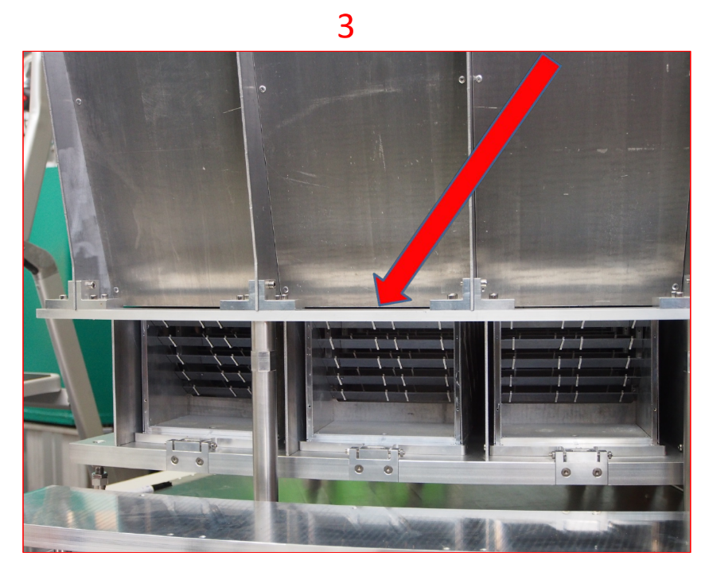
Background Hunting

Slide 7
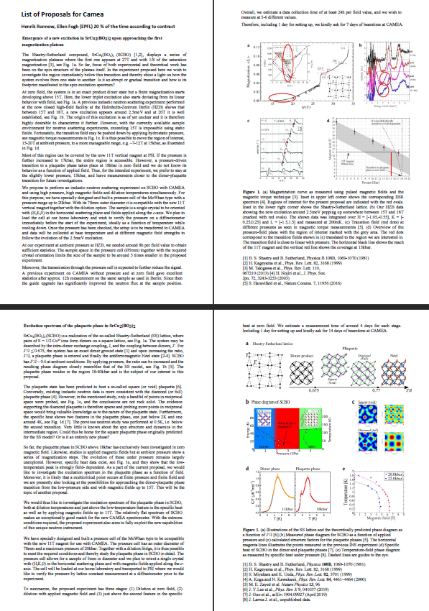
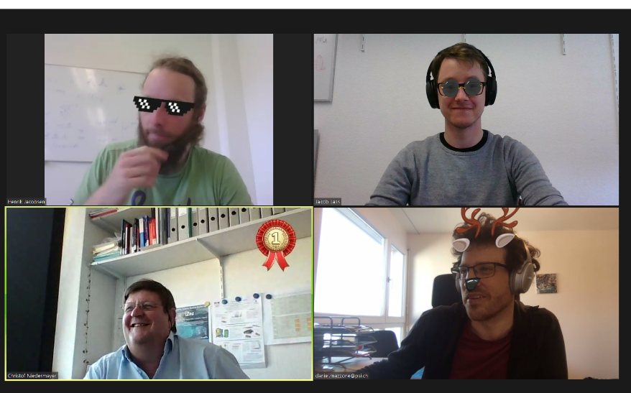
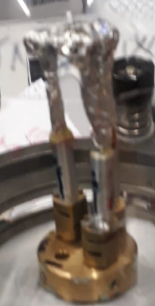
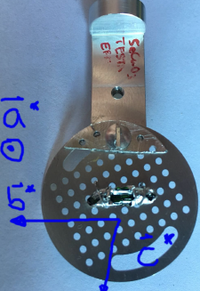
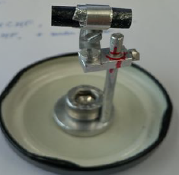
Early Science 2018-2021
Internal Proposal-like system
Samples available at instrument
Remote experiments
(Covid)

Slide 8
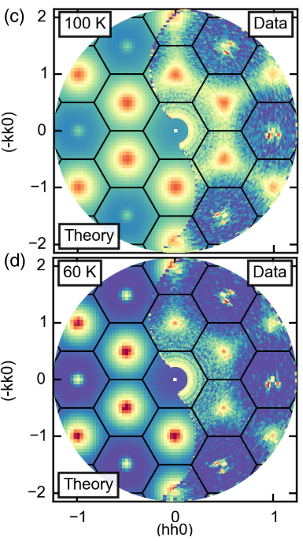
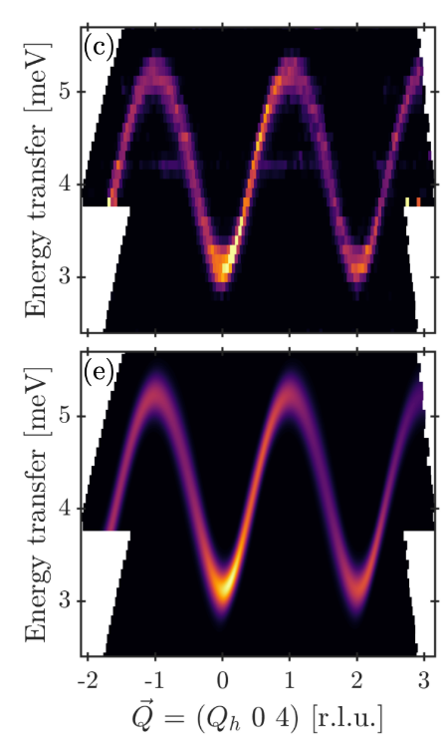
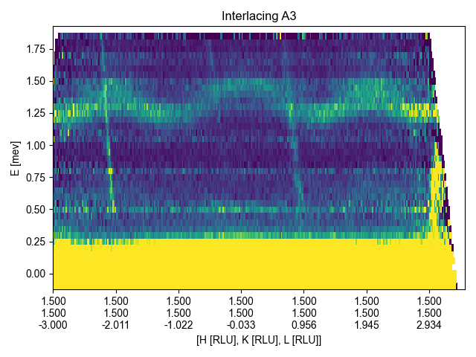
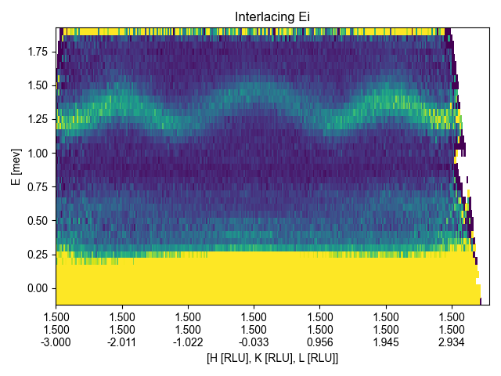
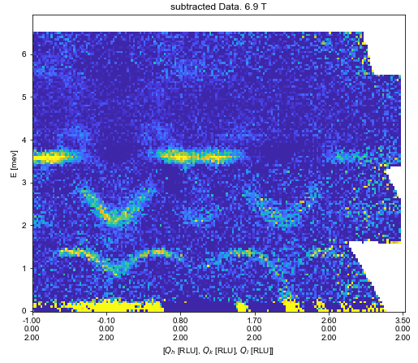
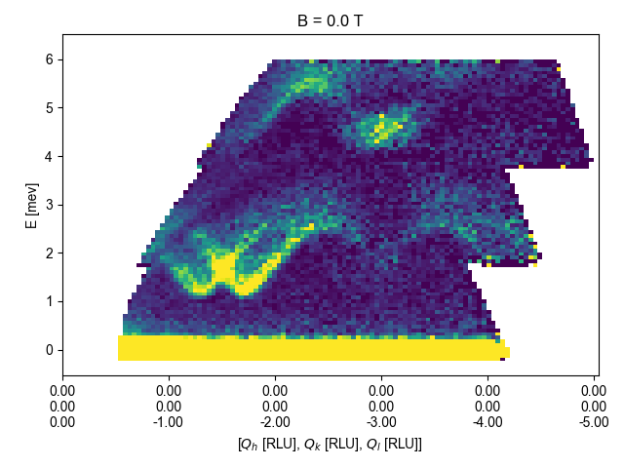
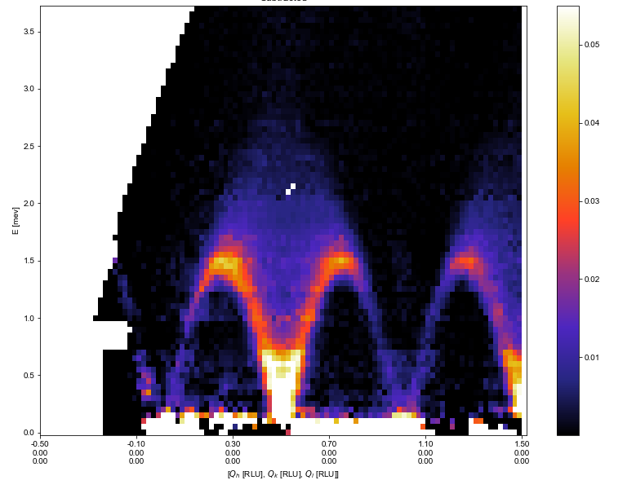
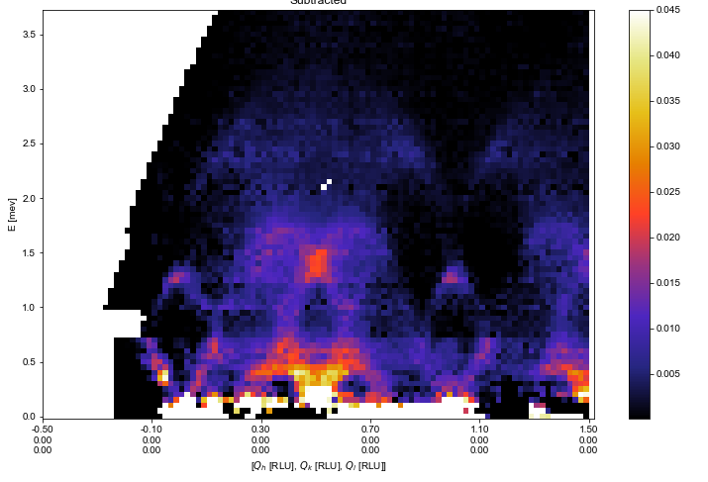
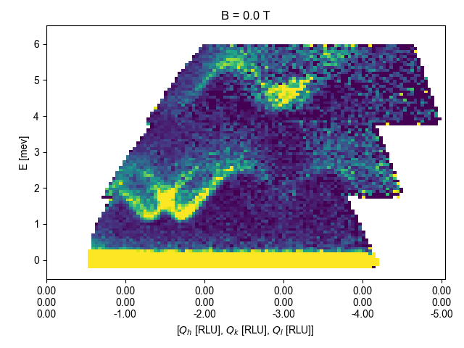
Hot commissioning - Science commissioning
Integration/Signal to noise
Compare to theory
Measurement technique
S. Allenspach et al. (2021). PRR, 3(2), 1–18. 10.1103/PhysRevResearch.3.023177
Background subtraction
Absorption correction
S. Janas et al. (2021). PRL, 126(10), 1–6. 10.1103/PhysRevLett.126.107203
1D systems/Masking

Slide 9
Early Science Lessons Learned
Early Science
Unpredictable
Time for instrument testing
Instrumental motivation as important as scientific
Sprint Marathon
Team sport
Notes:
Unpredictabiity:
Technical problems with the instrument
Beam instabilities
Samples not working
Instrumental artefacts need investigation
Participation/Flying in might be unfeasible/short notice
Data analysis will be painful
Support is limited
Unknown unknowns
Instrumental reason (resolution, size, splitting, limitations, …)
Scientific reason (Eminent publication possible, unfeasible elsewhere…)
Political reason (Time distribution, outreach, …)’

Slide 10
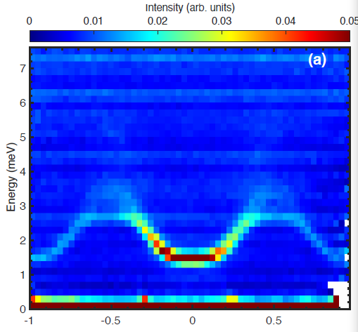
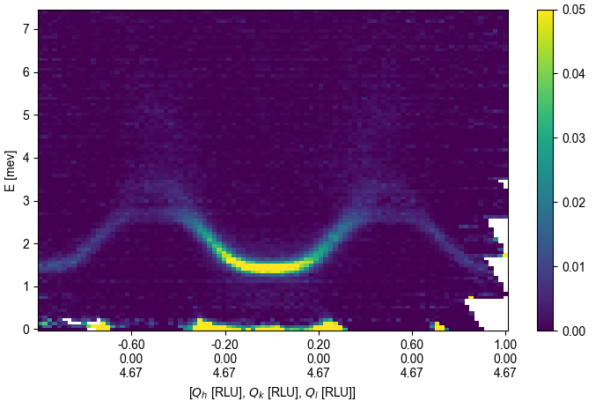
Time perspective
# Problems
Start up
Aging
Steady state
Time
Early Science
For the publication numbers please contact: jakob.lass@psi.ch

Slide 11
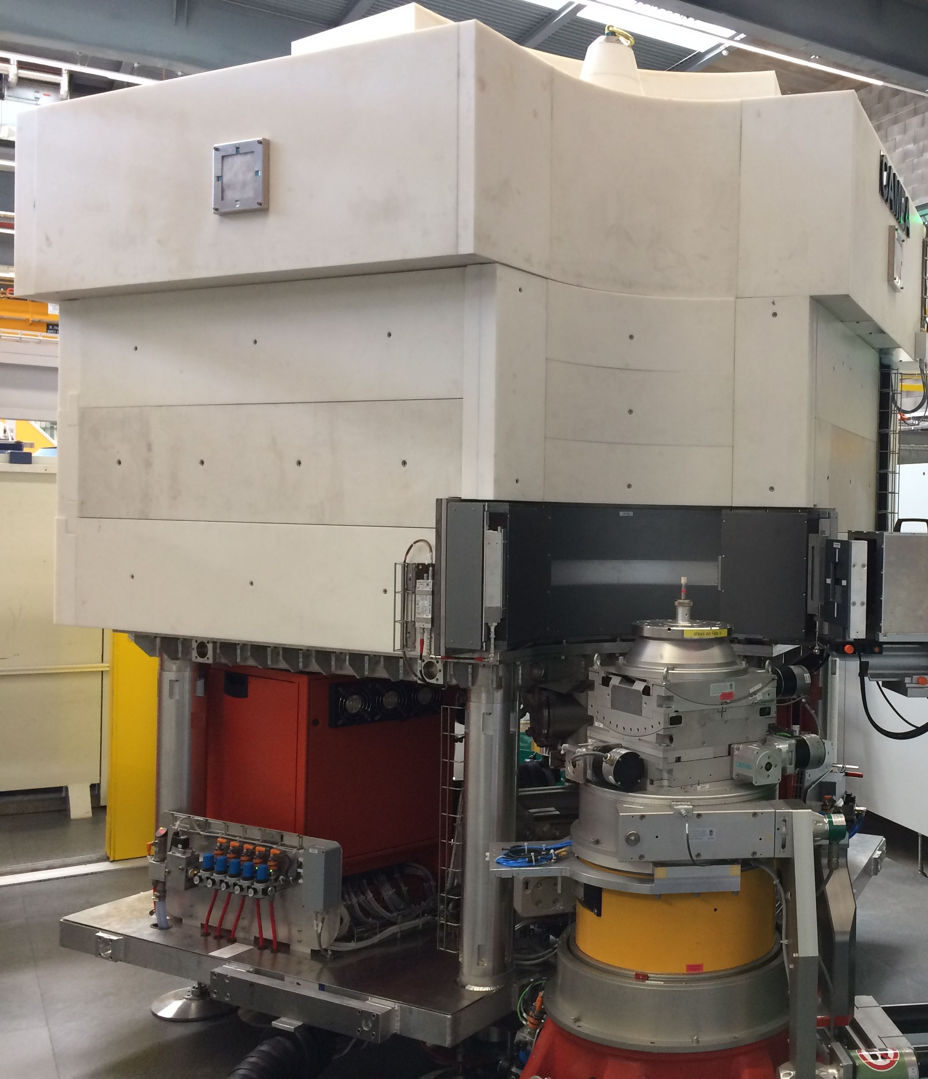
Comparison to BIFROST
Secondary spectrometer commissioning
Stepwise introduction of new components
Laptop-able data
Triple-Axis Spectrometer
Continuous “core” team (COVID)
New measurement/Data treatment style
New Neutron Facility
Fully new instrument
Cluster/VISA needed for data analysis
Indirect geometry time-of-flight spectrometer
Dynamic team?
New measurement/Data treatment style

