Slide 1
News and recent developments from the McStas team
Peter Willendrup, ESS DMSC & DTU Physics
Mads BERTELSEN, ESS DMSC GregorY S. Tucker, ESS DMSC
Thomas Kittelmann, ESS DMSC

Slide 2
Agenda
4-slide McStas intro
V 3.5.x news:
mcstas-pygen
Easy access to data interpretation
New 3D visualisation
Test tools
mcstas-antlr
Conda-forge packaging / shorter release cycle
GPU hackathon in FZJ
Enriched NeXus, use in ESS data pipeline work
Thanks / funding

Slide 3

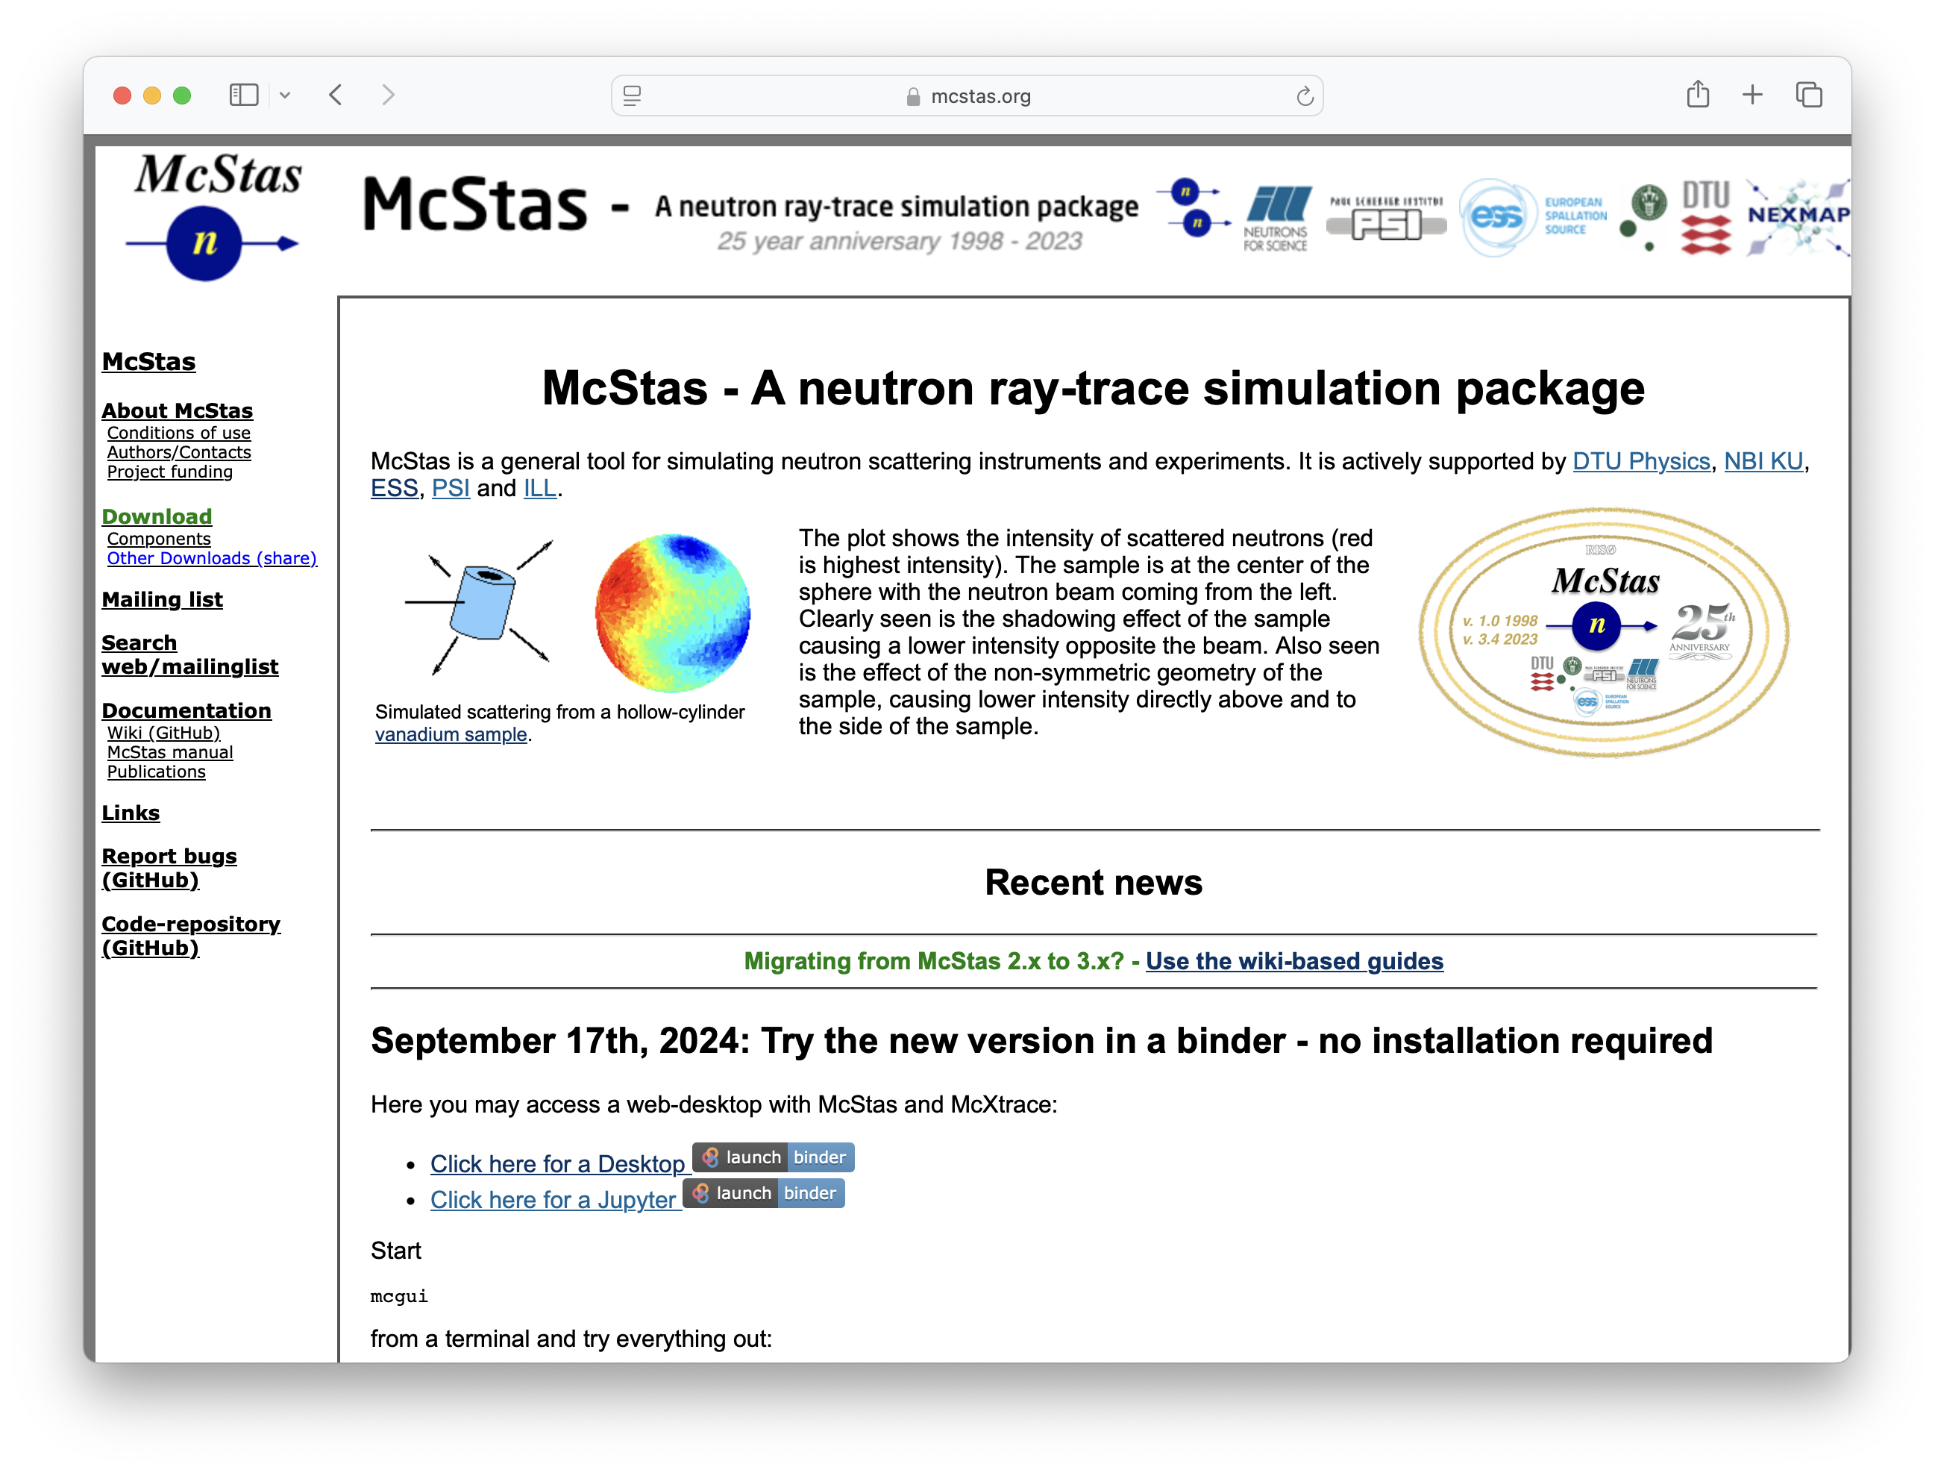
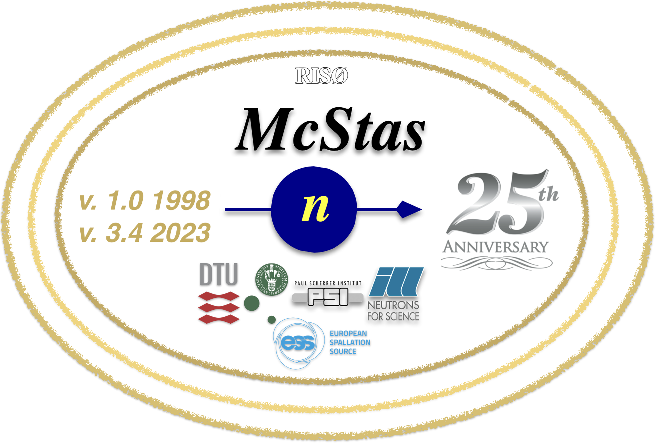
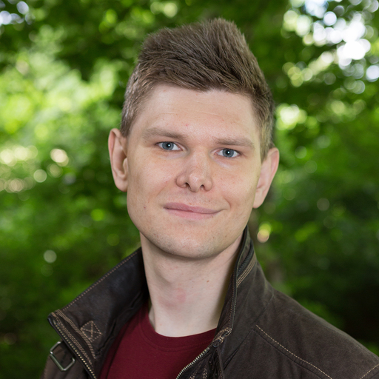
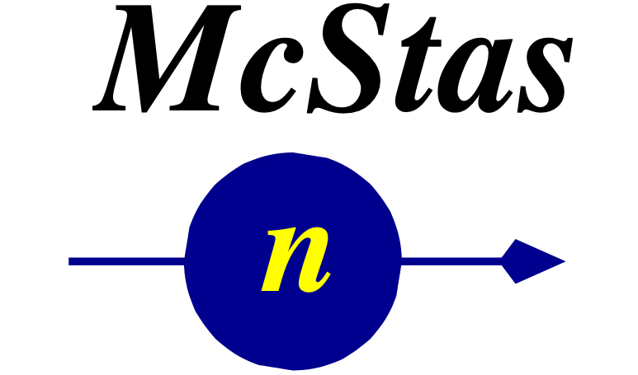
McStas Introduction
Flexible, general simulation utility for neutron scattering experiments.
Original design for Monte carlo Simulation of triple axis spectrometers
Developed at DTU Physics, ILL, PSI, Uni CPH, ESS DMSC
V. 1.0 by K Nielsen & K Lefmann (1998) RISØ
Currently ~6 people on joint McStas-McXtrace team but only 2 full time, based at ESS DMSC / DTU
GNU GPL v3 license
Open Source
Project website at
http://www.mcstas.org
mcstas-users@mcstas.org mailinglist

Slide 4
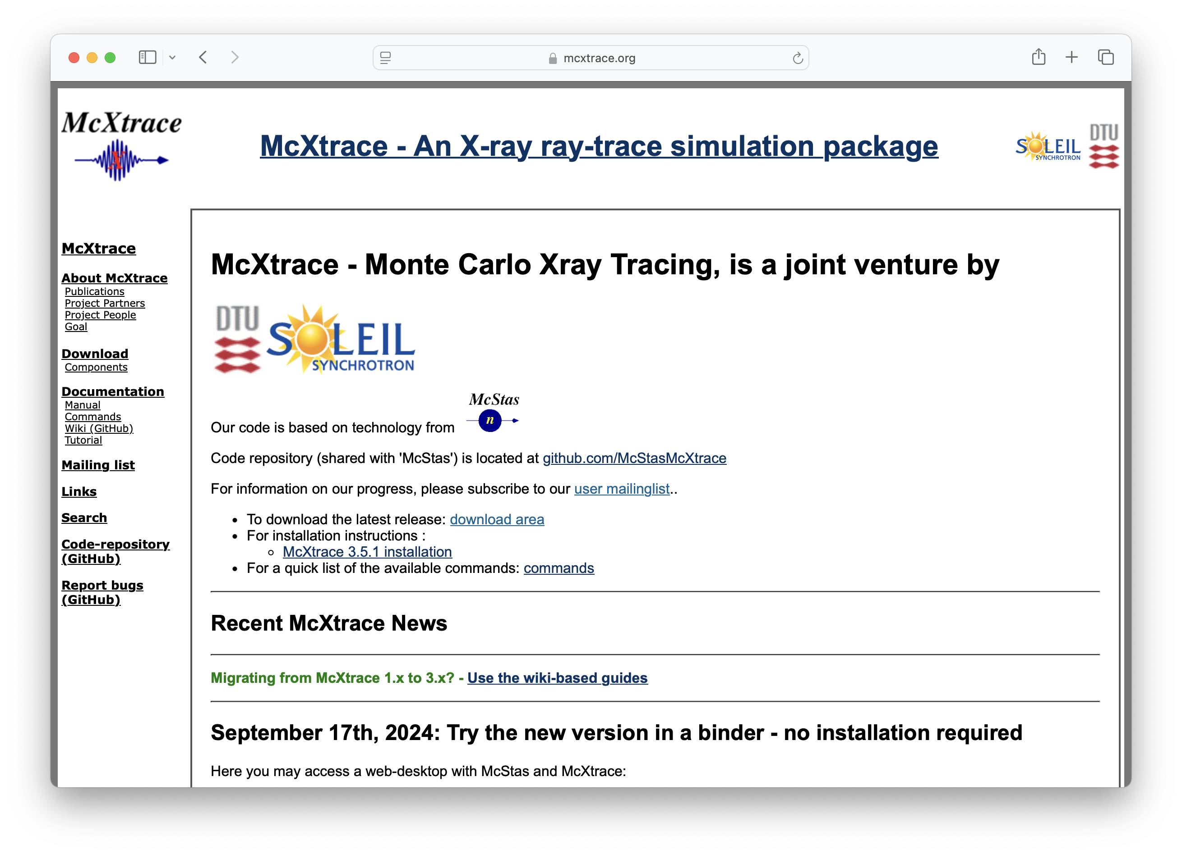

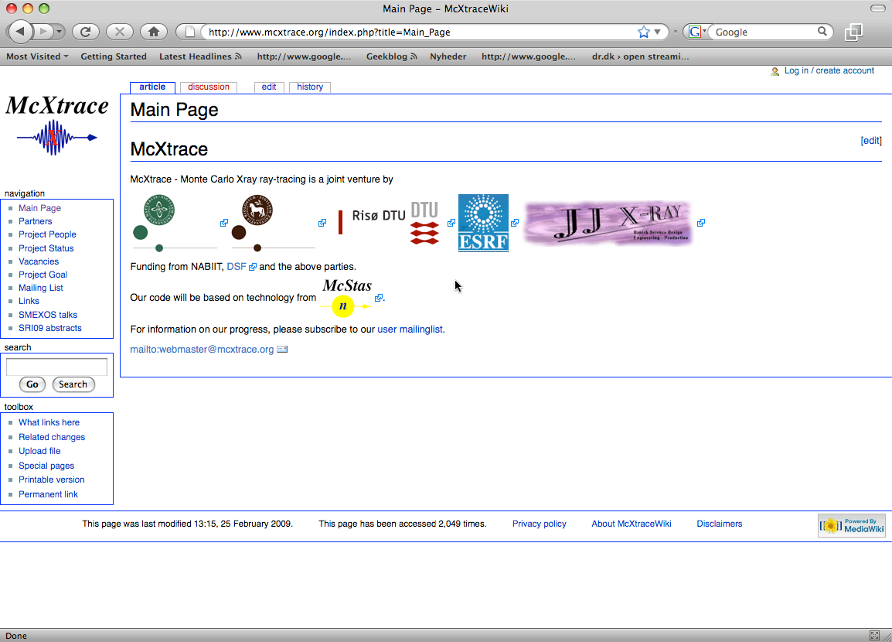




McXtrace - since jan 2009 similar for X-rays
mcxtrace-users@mcxtrace.org mailinglist
Project website at
http://www.mcxtrace.org
Original consortium
Synergy, knowledge transfer, shared infrastructure, repo etc.
4

Slide 5
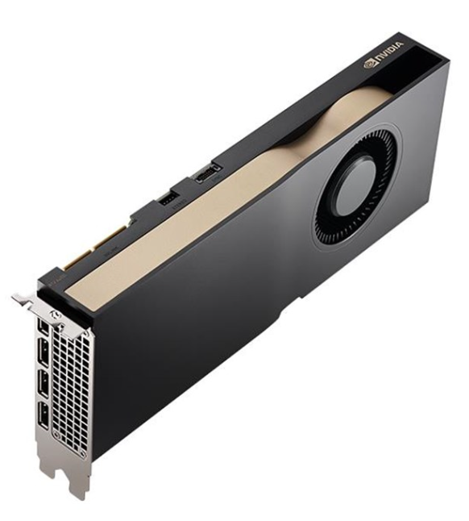
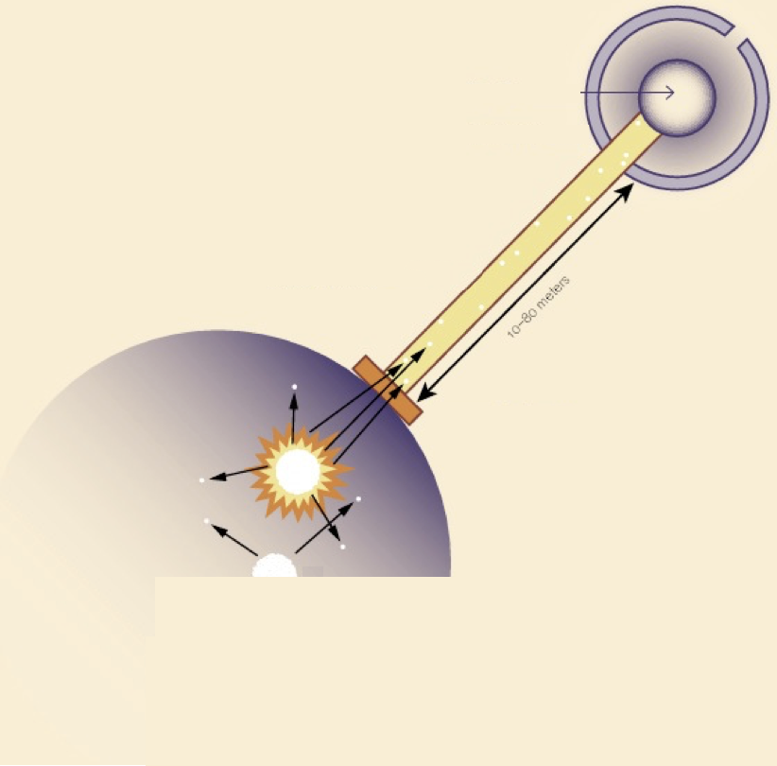
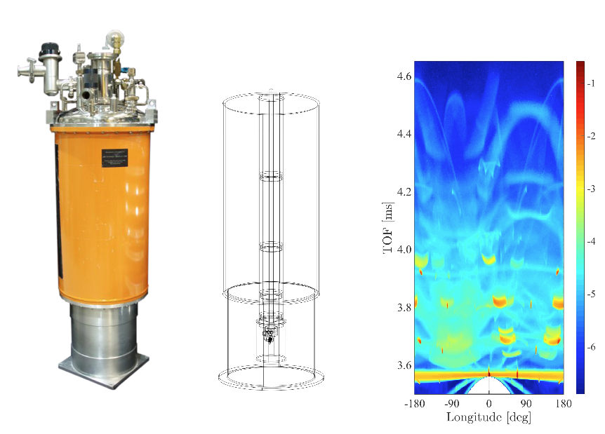
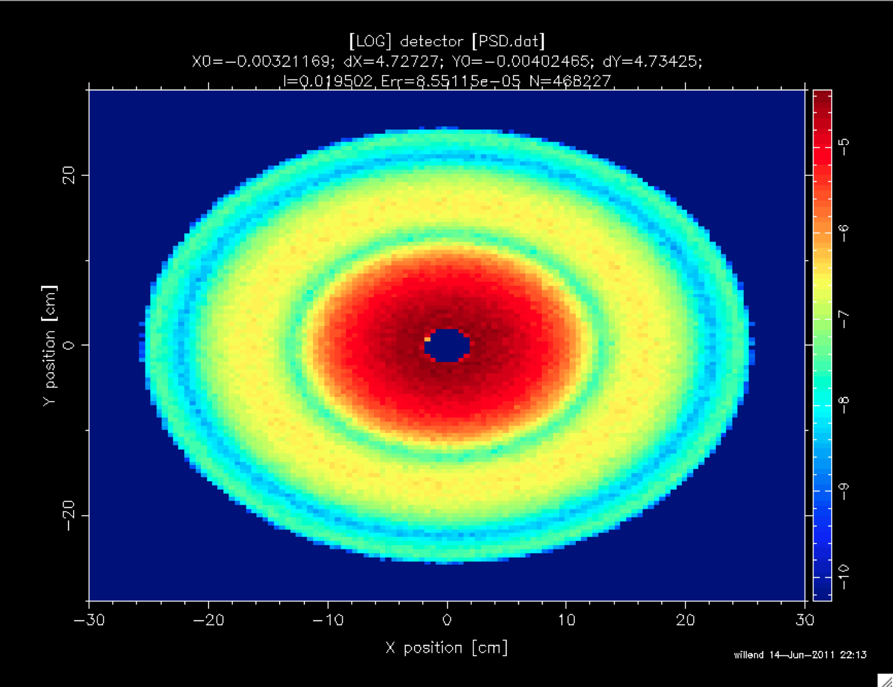
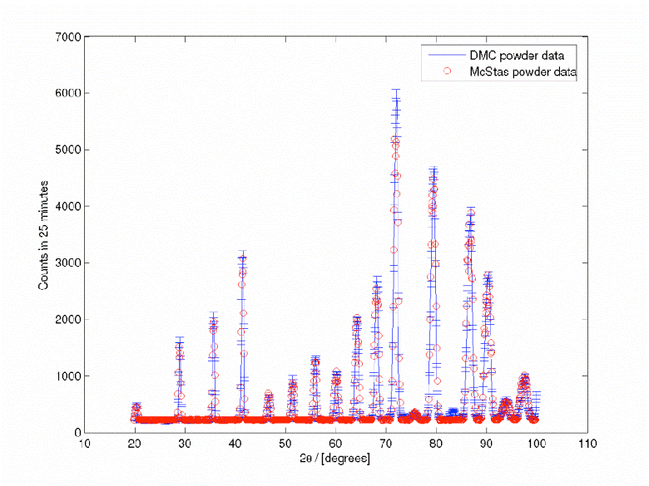

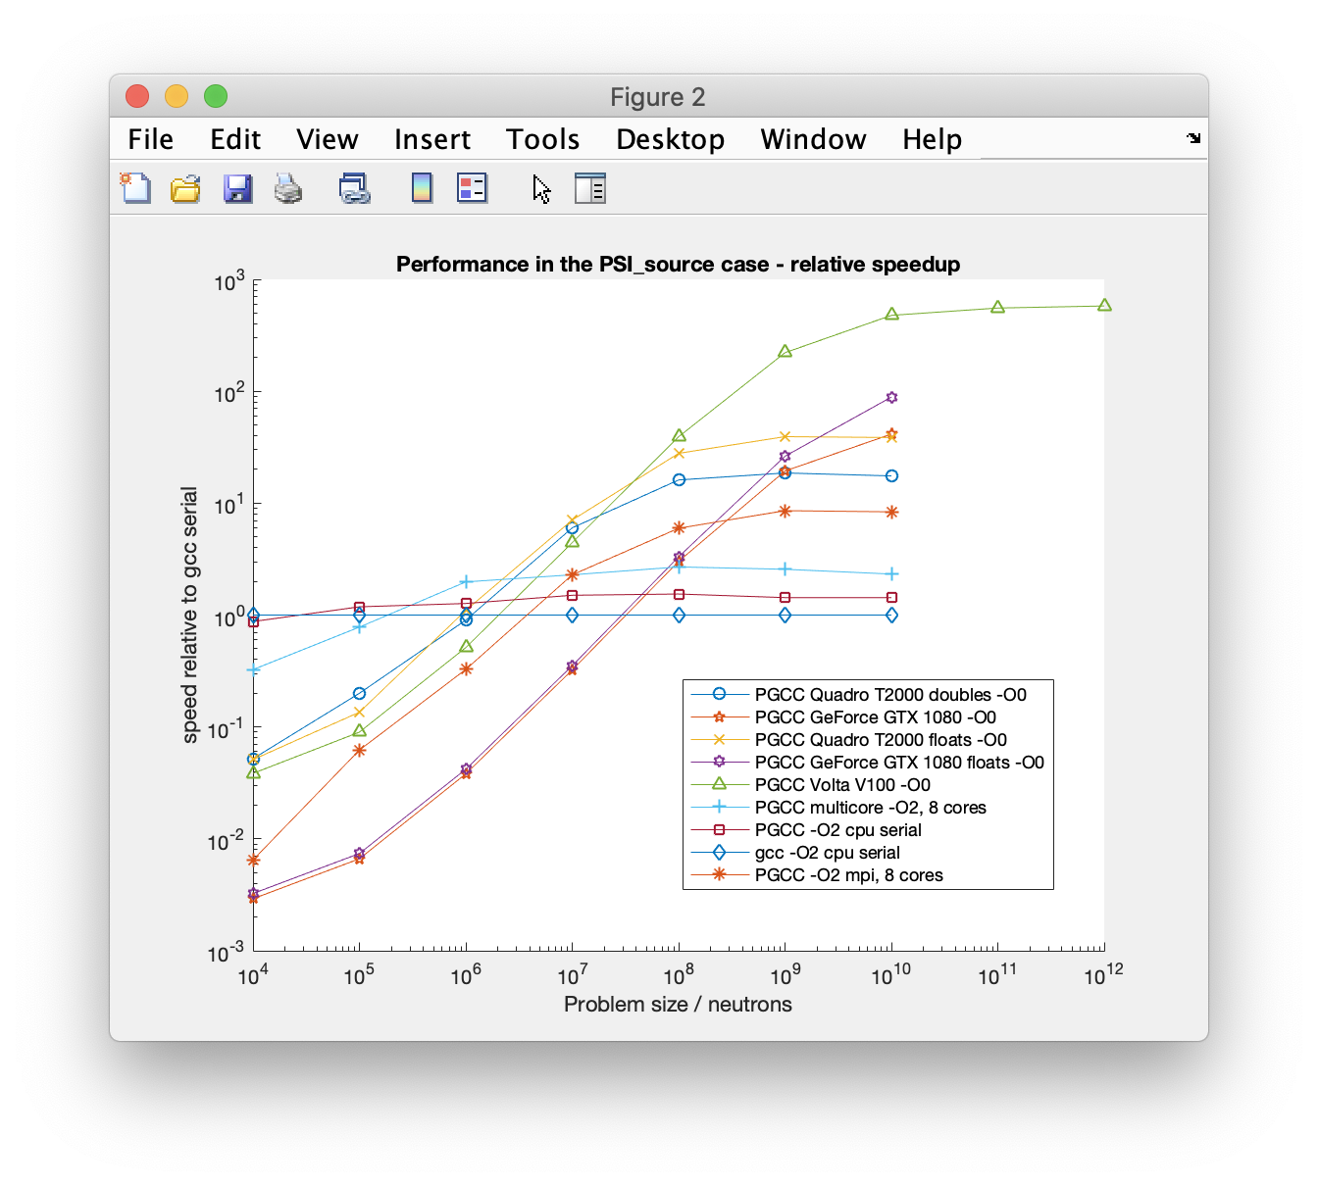
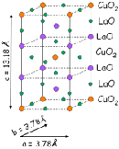

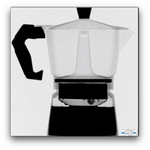

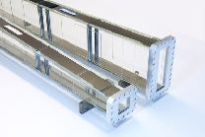
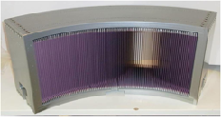
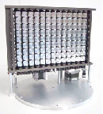
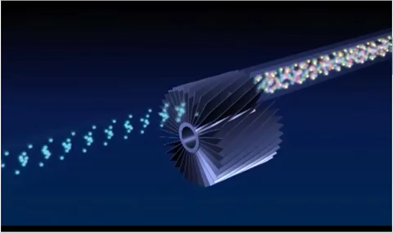
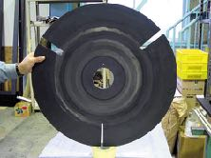
McStas: simulation toolkit for neutron scattering instruments, virtual experiments
… imagine a neutron instrument at a facility
Sample-environments - Union subsystem
+
2020: McStas 3.0 with support for MPI and multiple GPUs
Detectors
+
~600
McStas 3.x acc. on NVIDIA GPUs - 2 orders of magnitude speedup. (1x Tesla V100 vs 1 modern Intel Xeon core)
Scientific model-samples
Neutron optics
Starts with a source of neutrons, be it a reactor- or spallation source
Neutron moderators is where starts

Slide 6
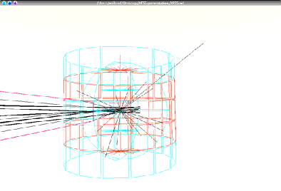
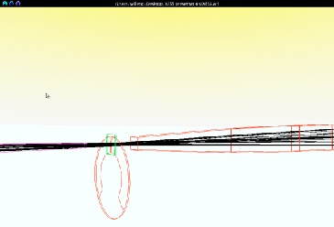
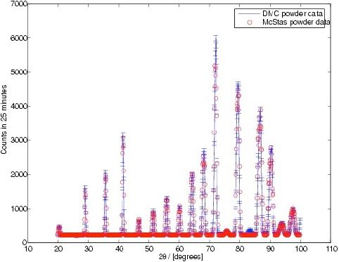
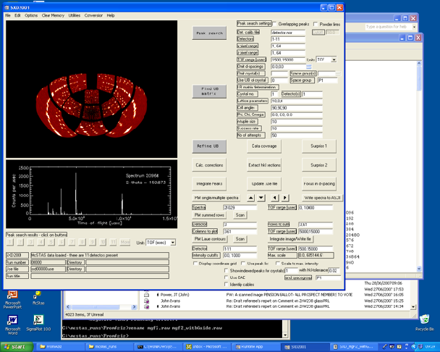
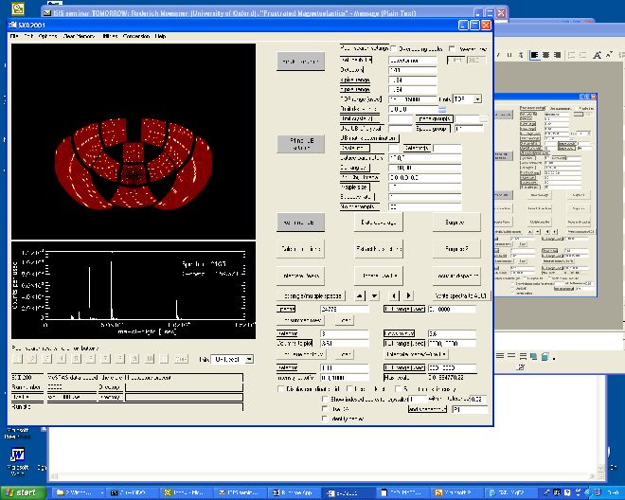
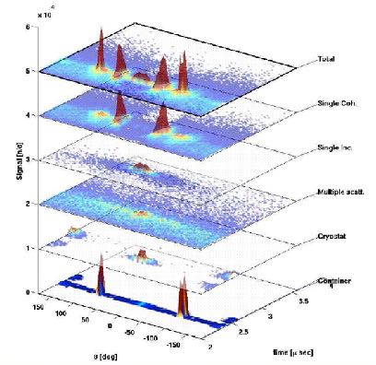
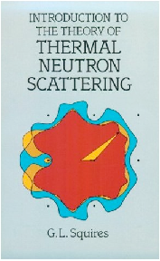
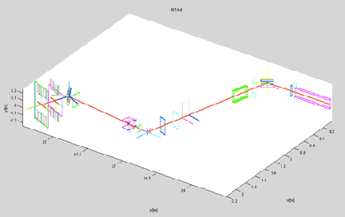
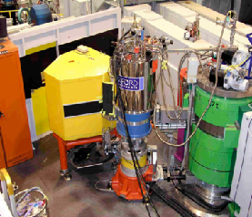
What is McStas used for?
Instrumentation
Planning
Construction
Virtual experiments
Data analysis
Teaching
(KU, DTU)

Slide 7
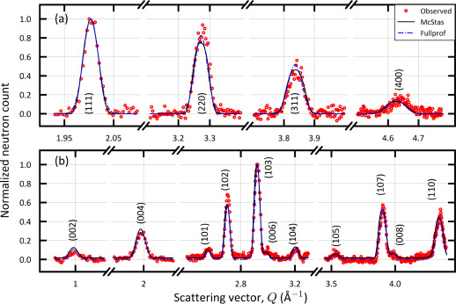
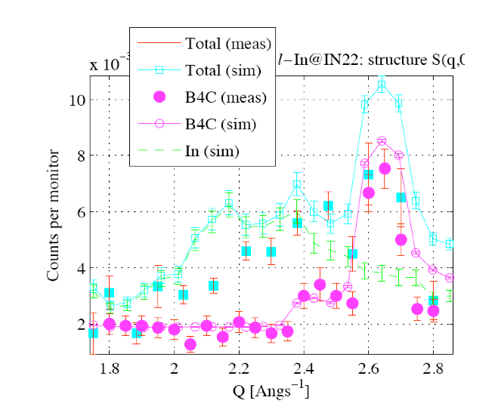
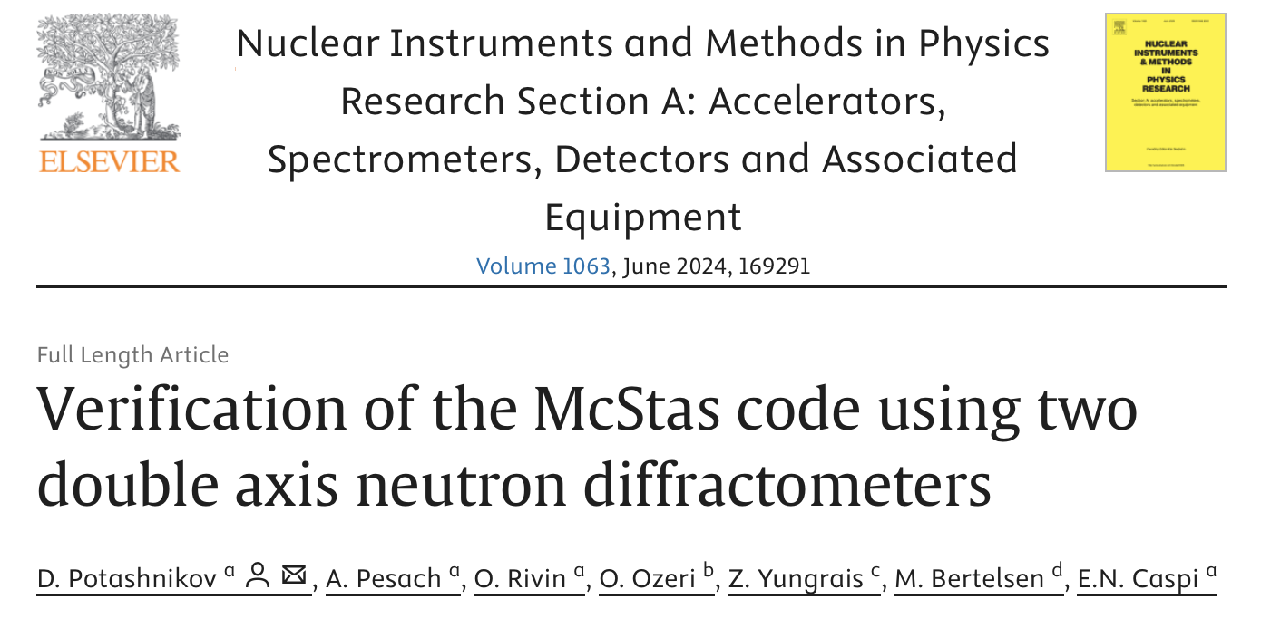
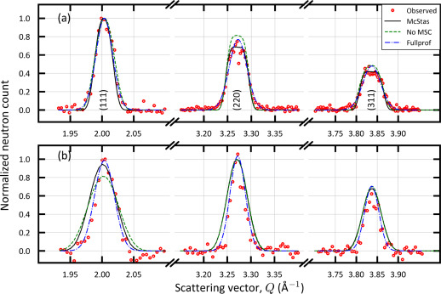
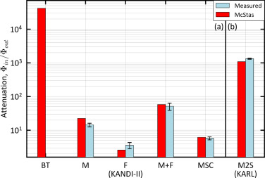
Reliability - cross comparisons
KANDI-II 2.47 Å wavelength
Much effort has gone into this
Here: simulations vs. exp. at powder diffract. DMC, PSI
The bottom line is
McStas agree very well with other packages (NISP, Vitess, SIMRES, MCViNE)
Experimental line shapes are within 5%
Absolute intensities are within 10%
Common understanding: McStas and similar codes are reliable
Si
Gr₂GaC
KARL Si sample
PG 2.421 Å
E. Farhi, P. Willendrup, from IN22 benchmark exp.
https://doi.org/10.1016/j.nima.2024.169291
Gold foil intensity measurements
Cu 0.98 Å
P. Willendrup et al., Physica B, 386, (2006), 1032.

Slide 8
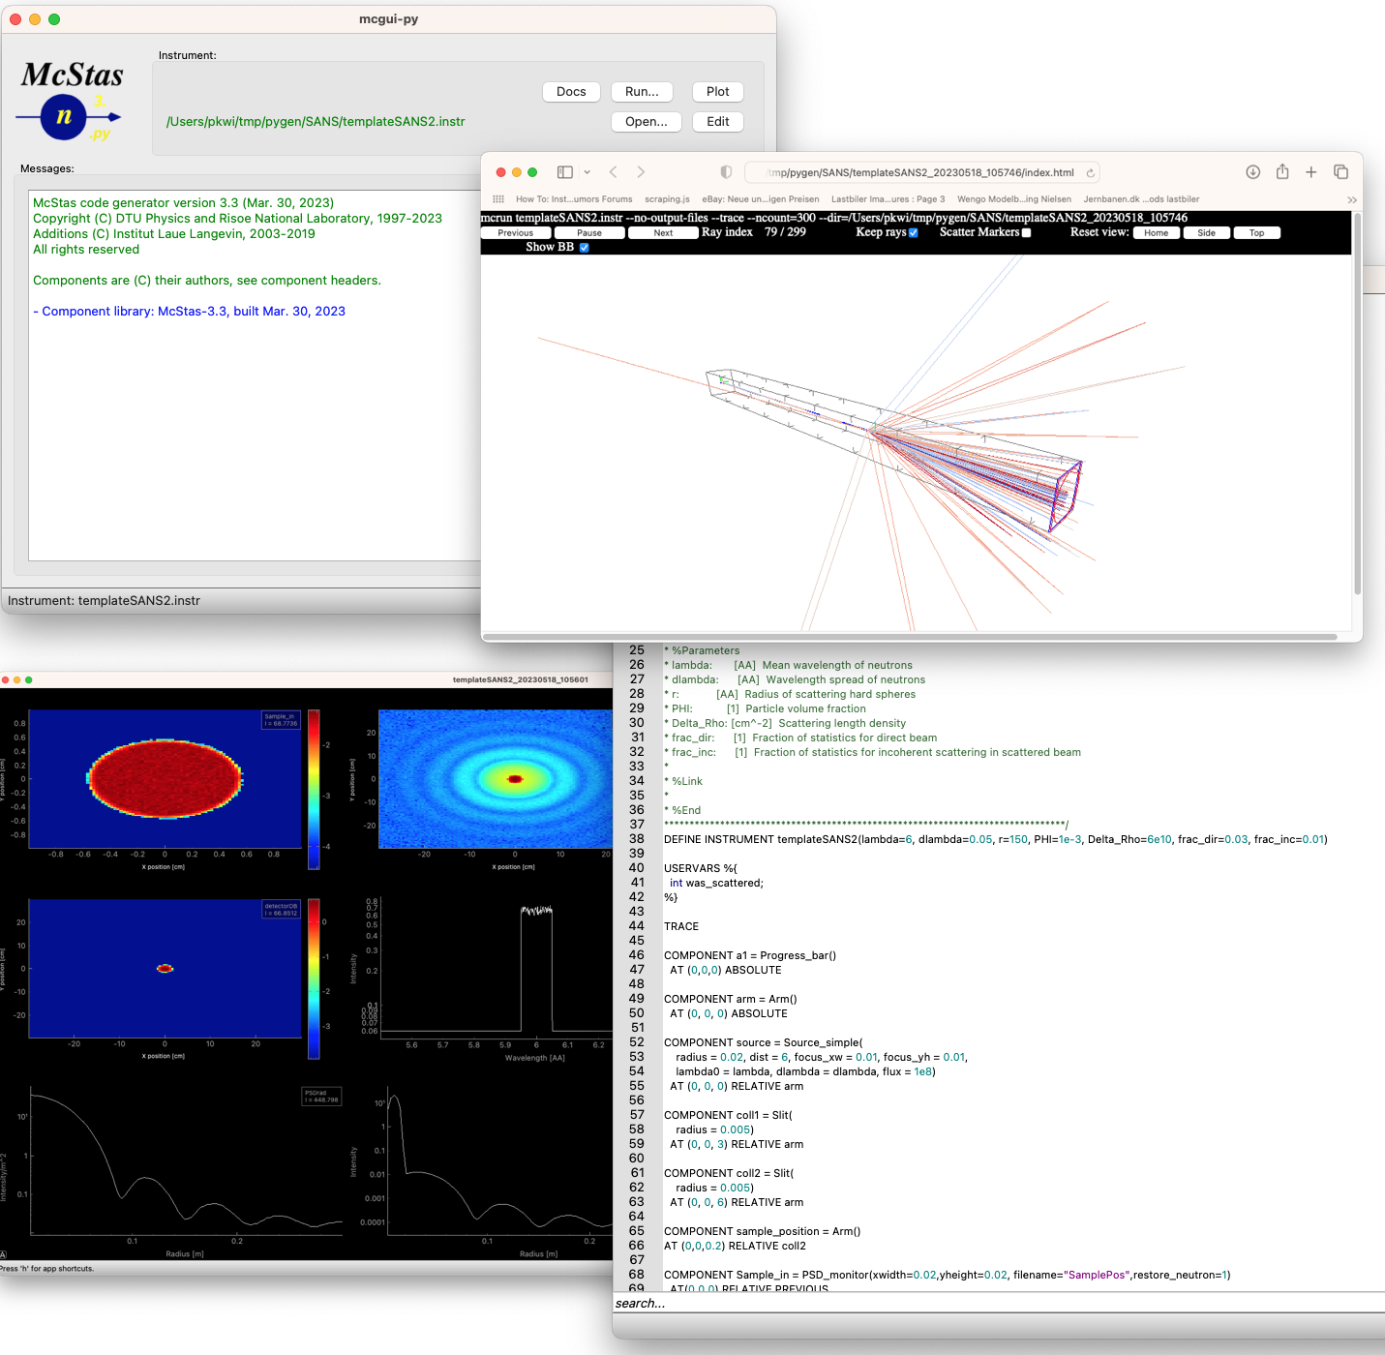
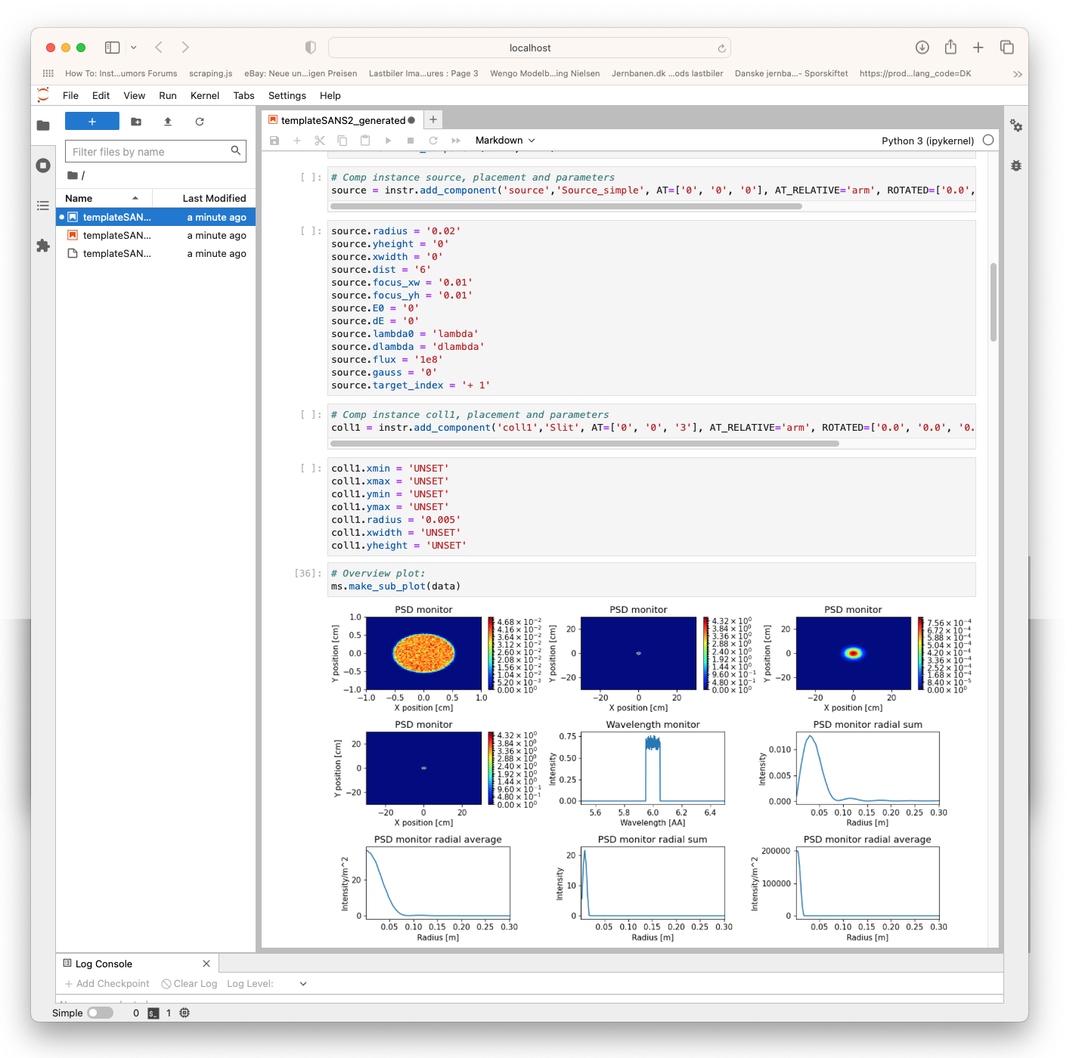
McStas: simulation toolkit for neutron scattering instruments, V.E.
… in .py / Jupyter notebooks using McStasscript
Work in GUI or fav. editor using DSL or …

Slide 9
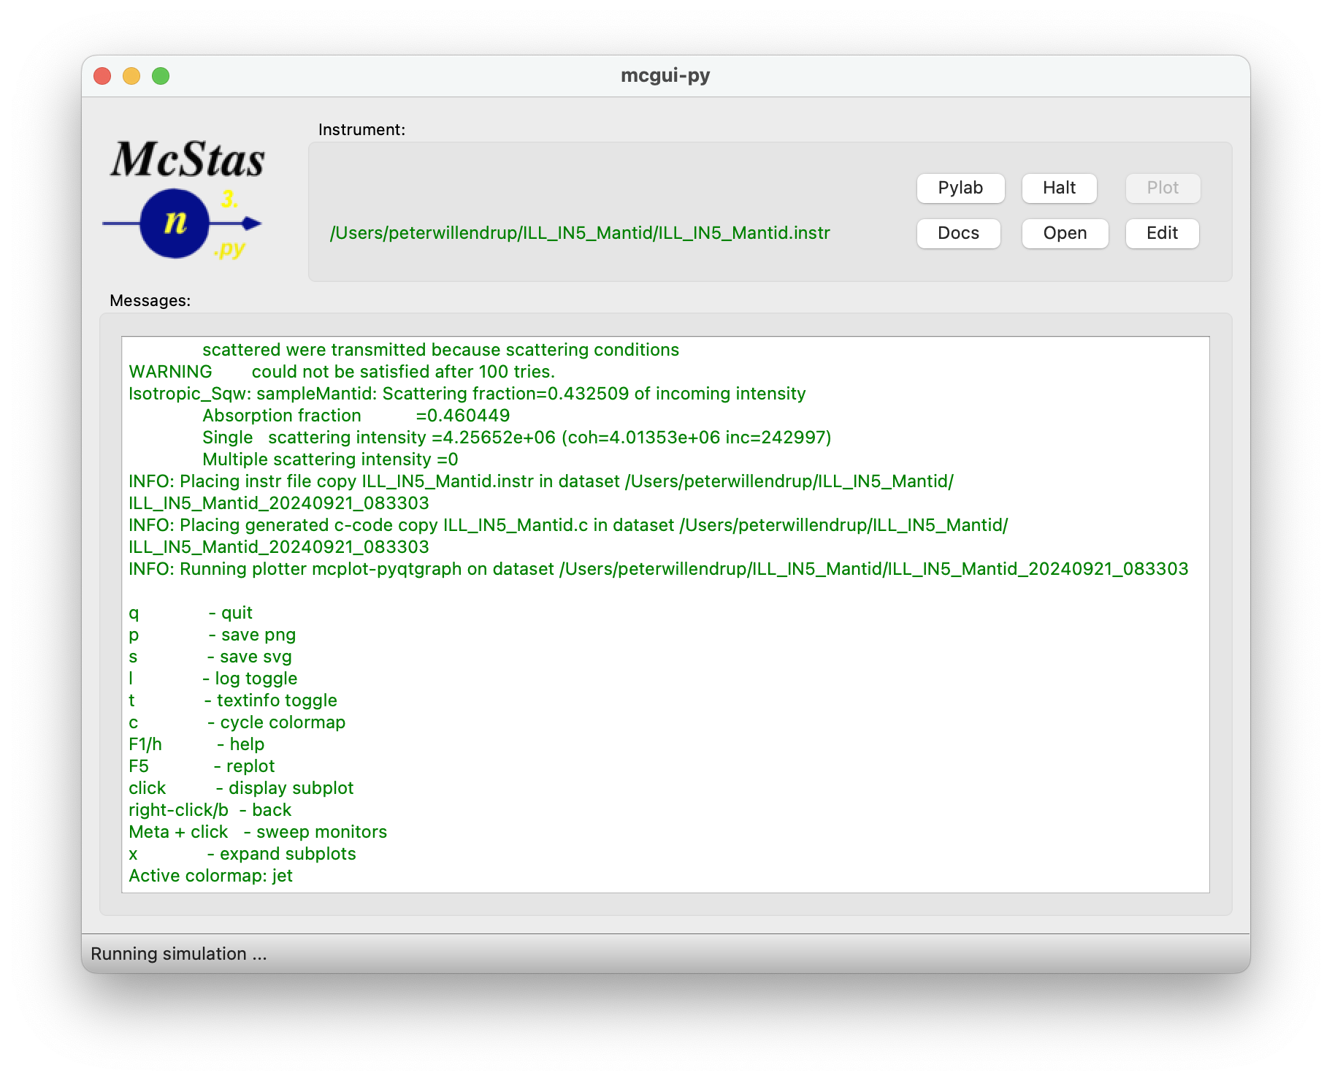



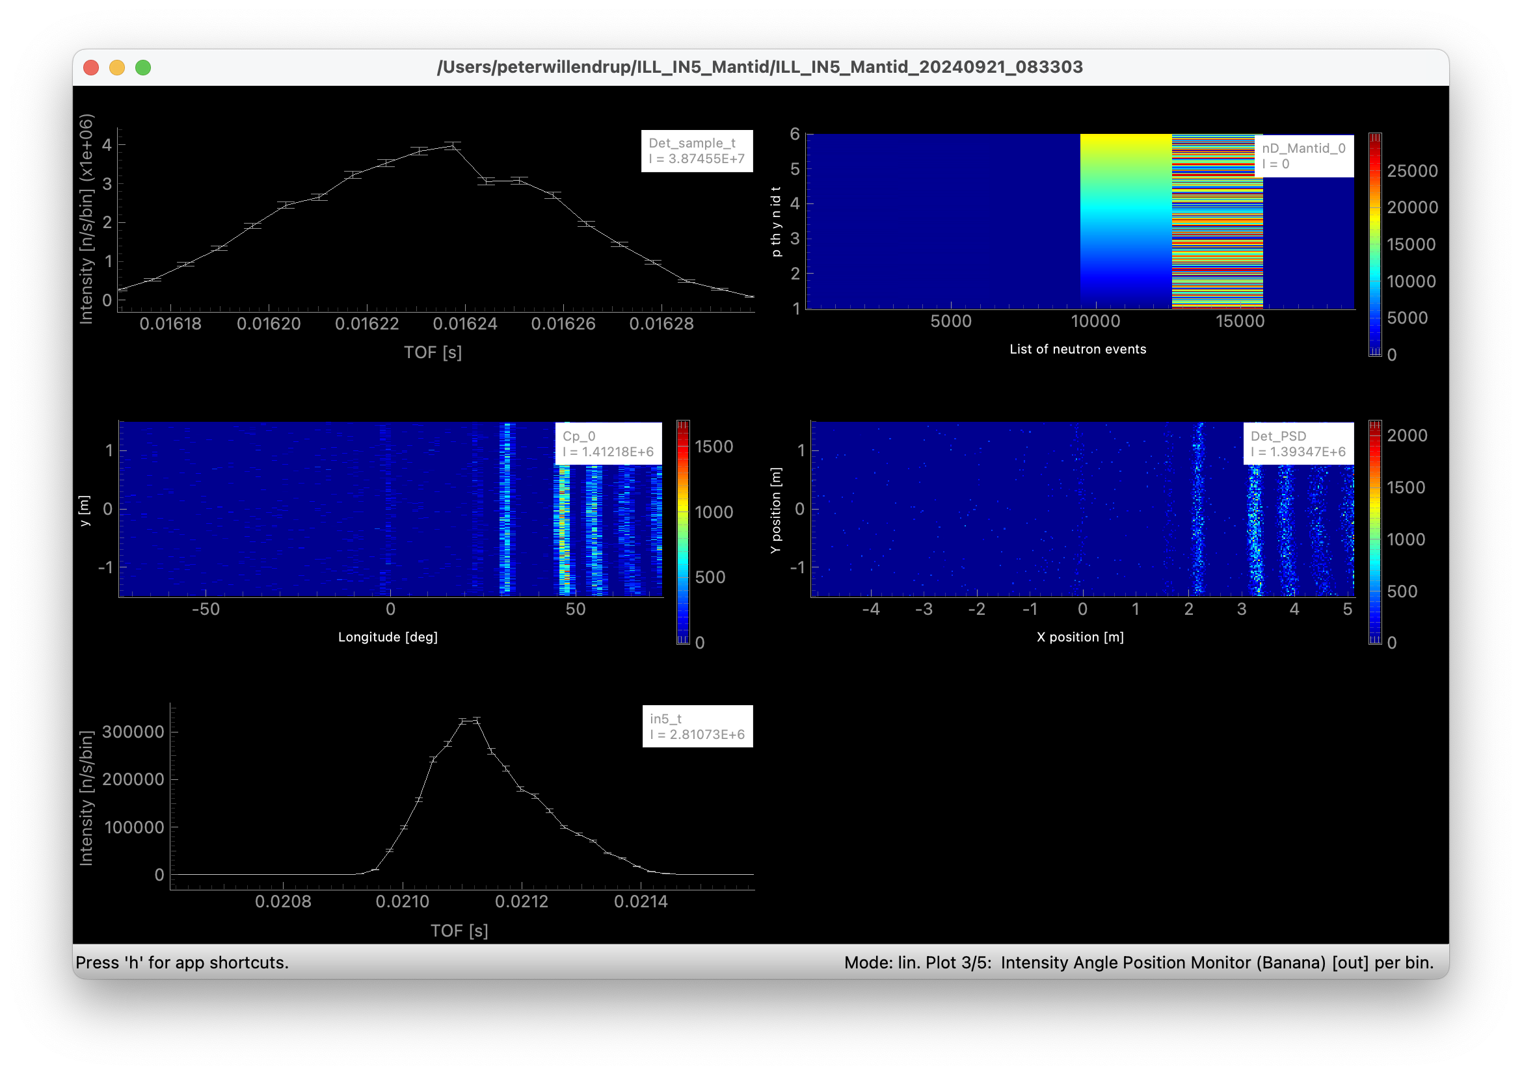
New stuff in series 3.5.x
Common release and versioning for McStas & McXtrace - no more 2.x and 1.x
We are now on conda-forge!
Forms support basis for Windows, macOS and non-Debian Linux
Lots of work from SOLEIL toward official Debian packages
CI (GitHub + conda) in place
Usability:
One-click transfer to McStasScript/Jupyter
Easy access to NeXus output through e.g. nexpy or silx
3D rendering modernised
mctest / mcviewtest tools
Various component / instr contributions, some presented later today!
Classic McStas/McXtrace data rep. via ‘mcplot’

Slide 10
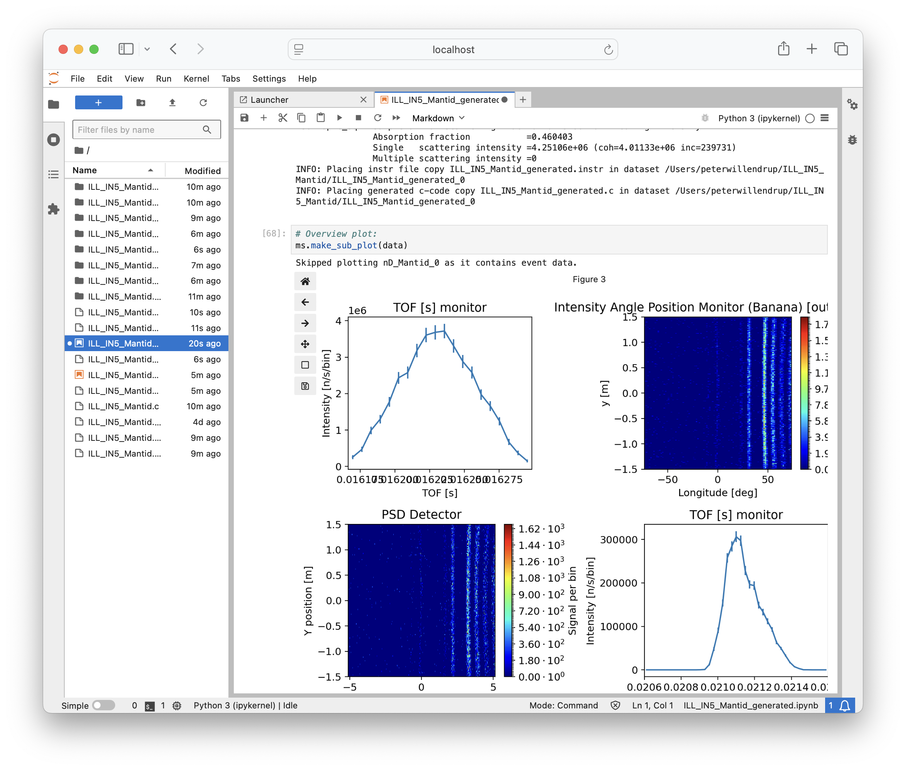
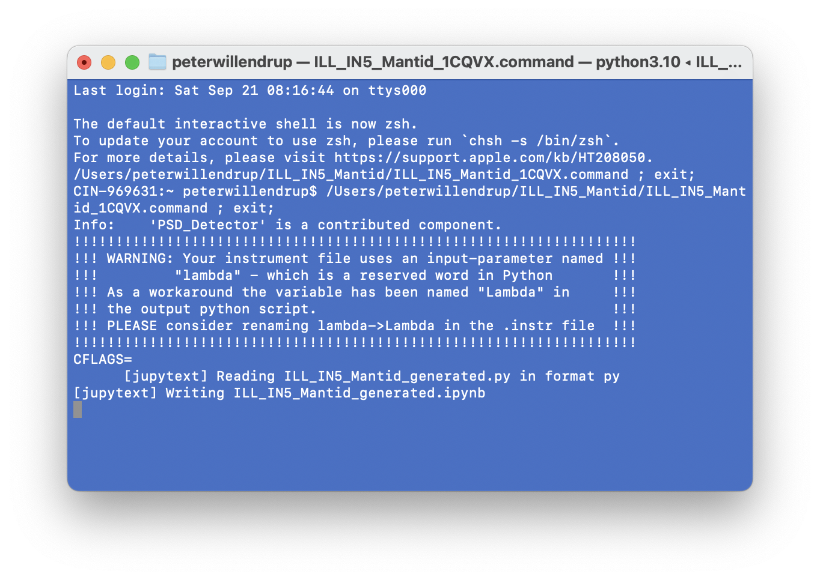
New stuff in series 3.5.x
Common release and versioning for McStas & McXtrace - no more 2.x and 1.x
We are now on conda-forge!
Forms support basis for Windows, macOS and non-Debian Linux
Lots of work from SOLEIL toward official Debian packages
CI (GitHub + conda) in place
Usability:
One-click transfer to McStasScript/Jupyter
Easy access to NeXus output through e.g. nexpy or silx
3D rendering modernised
mctest / mcviewtest tools
Various component / instr contributions, some presented later today!

Slide 11
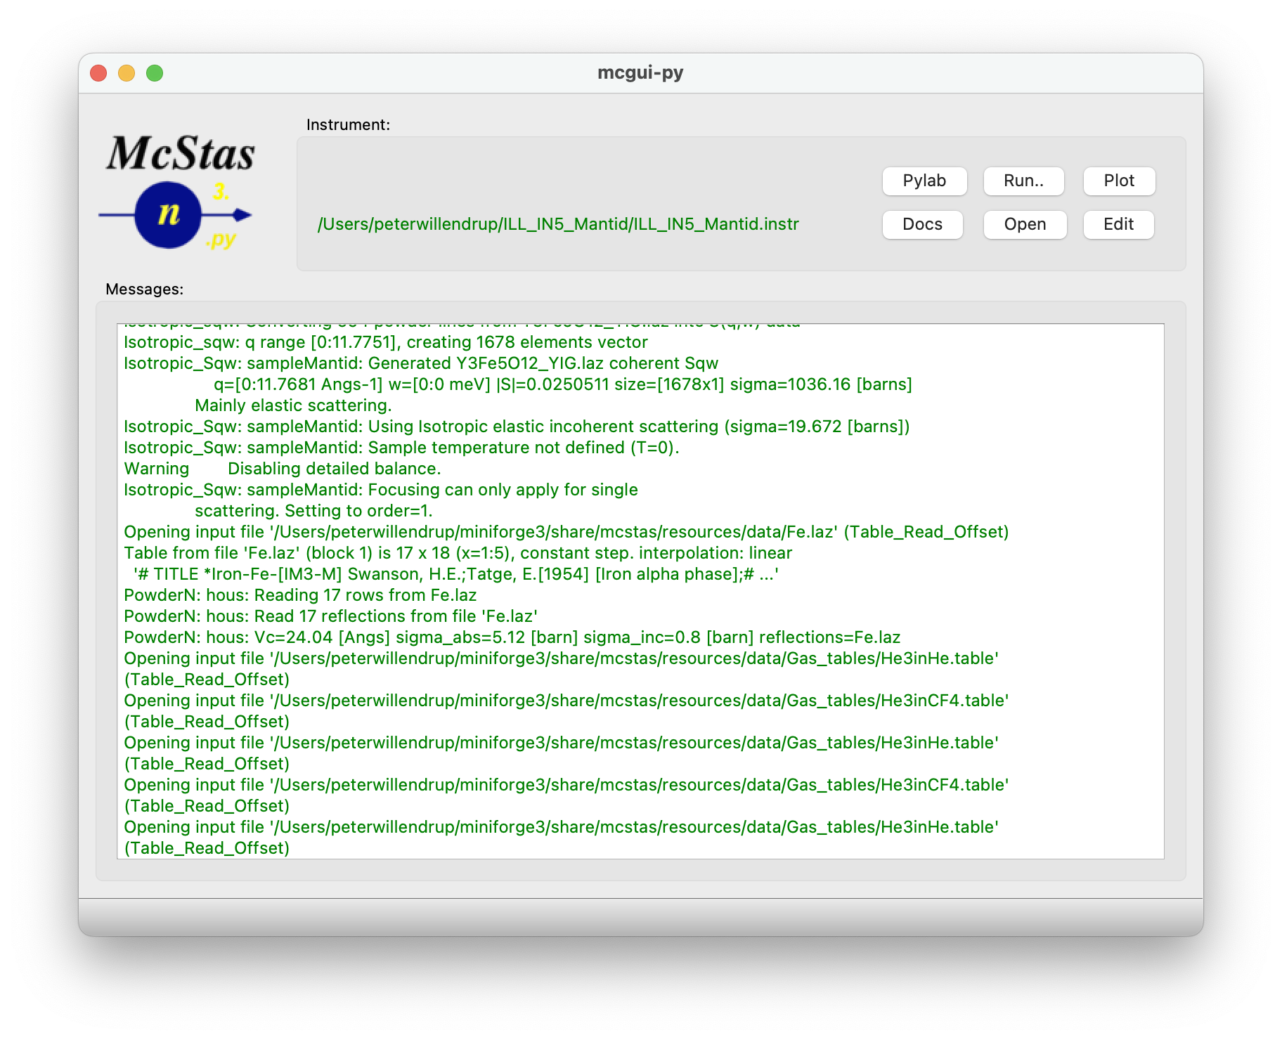
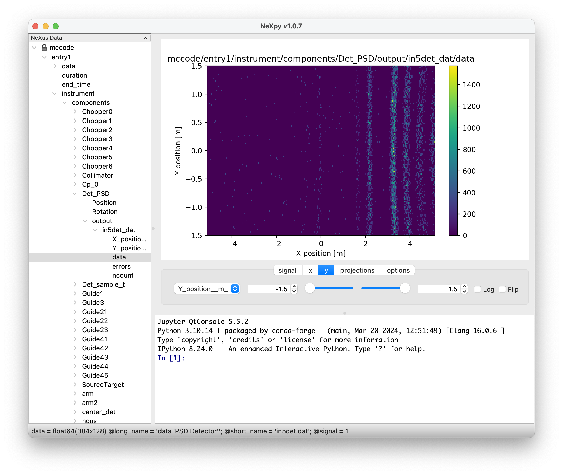
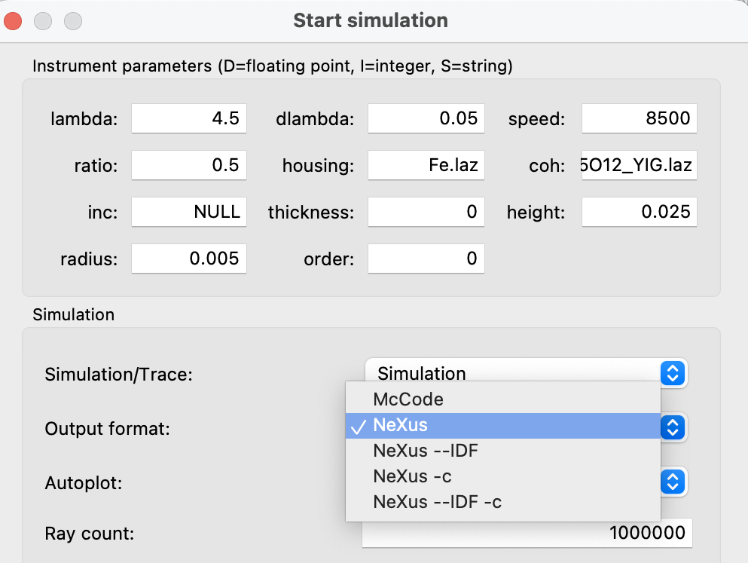
New stuff in series 3.5.x
Common release and versioning for McStas & McXtrace - no more 2.x and 1.x
We are now on conda-forge!
Forms support basis for Windows, macOS and non-Debian Linux
Lots of work from SOLEIL toward official Debian packages
CI (GitHub + conda) in place
Usability:
One-click transfer to McStasScript/Jupyter
Easy access to NeXus output through e.g. nexpy or silx
3D rendering modernised
mctest / mcviewtest tools
Various component / instr contributions, some presented later today!
Enables easy access to fitting etc.

Slide 12
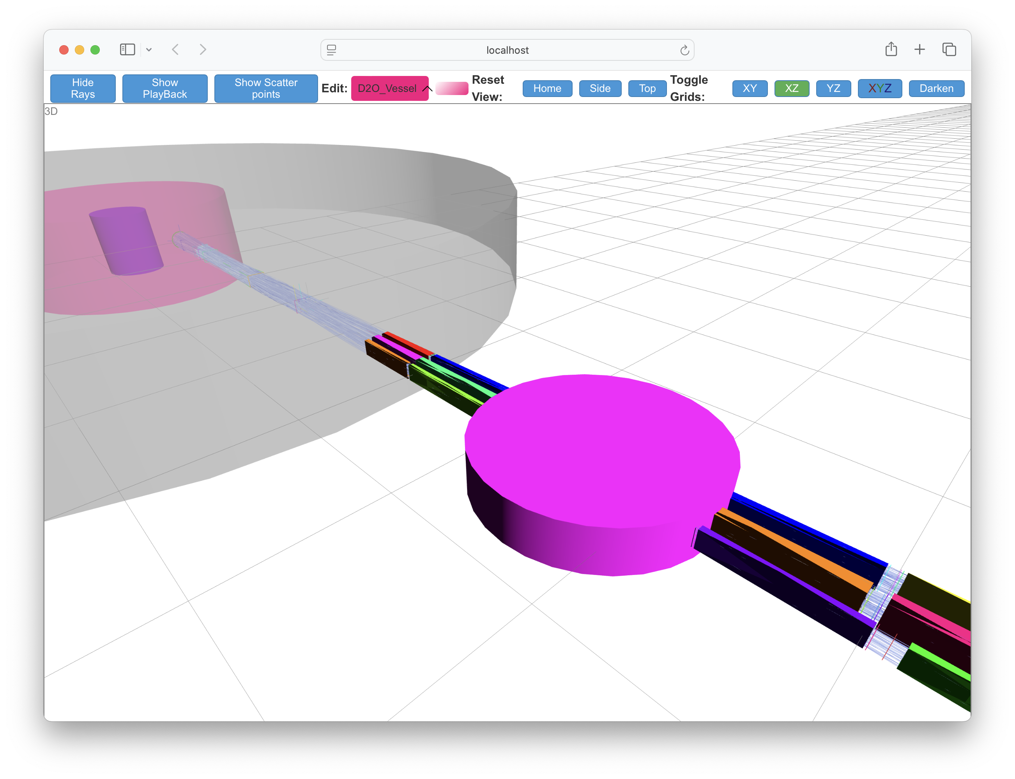
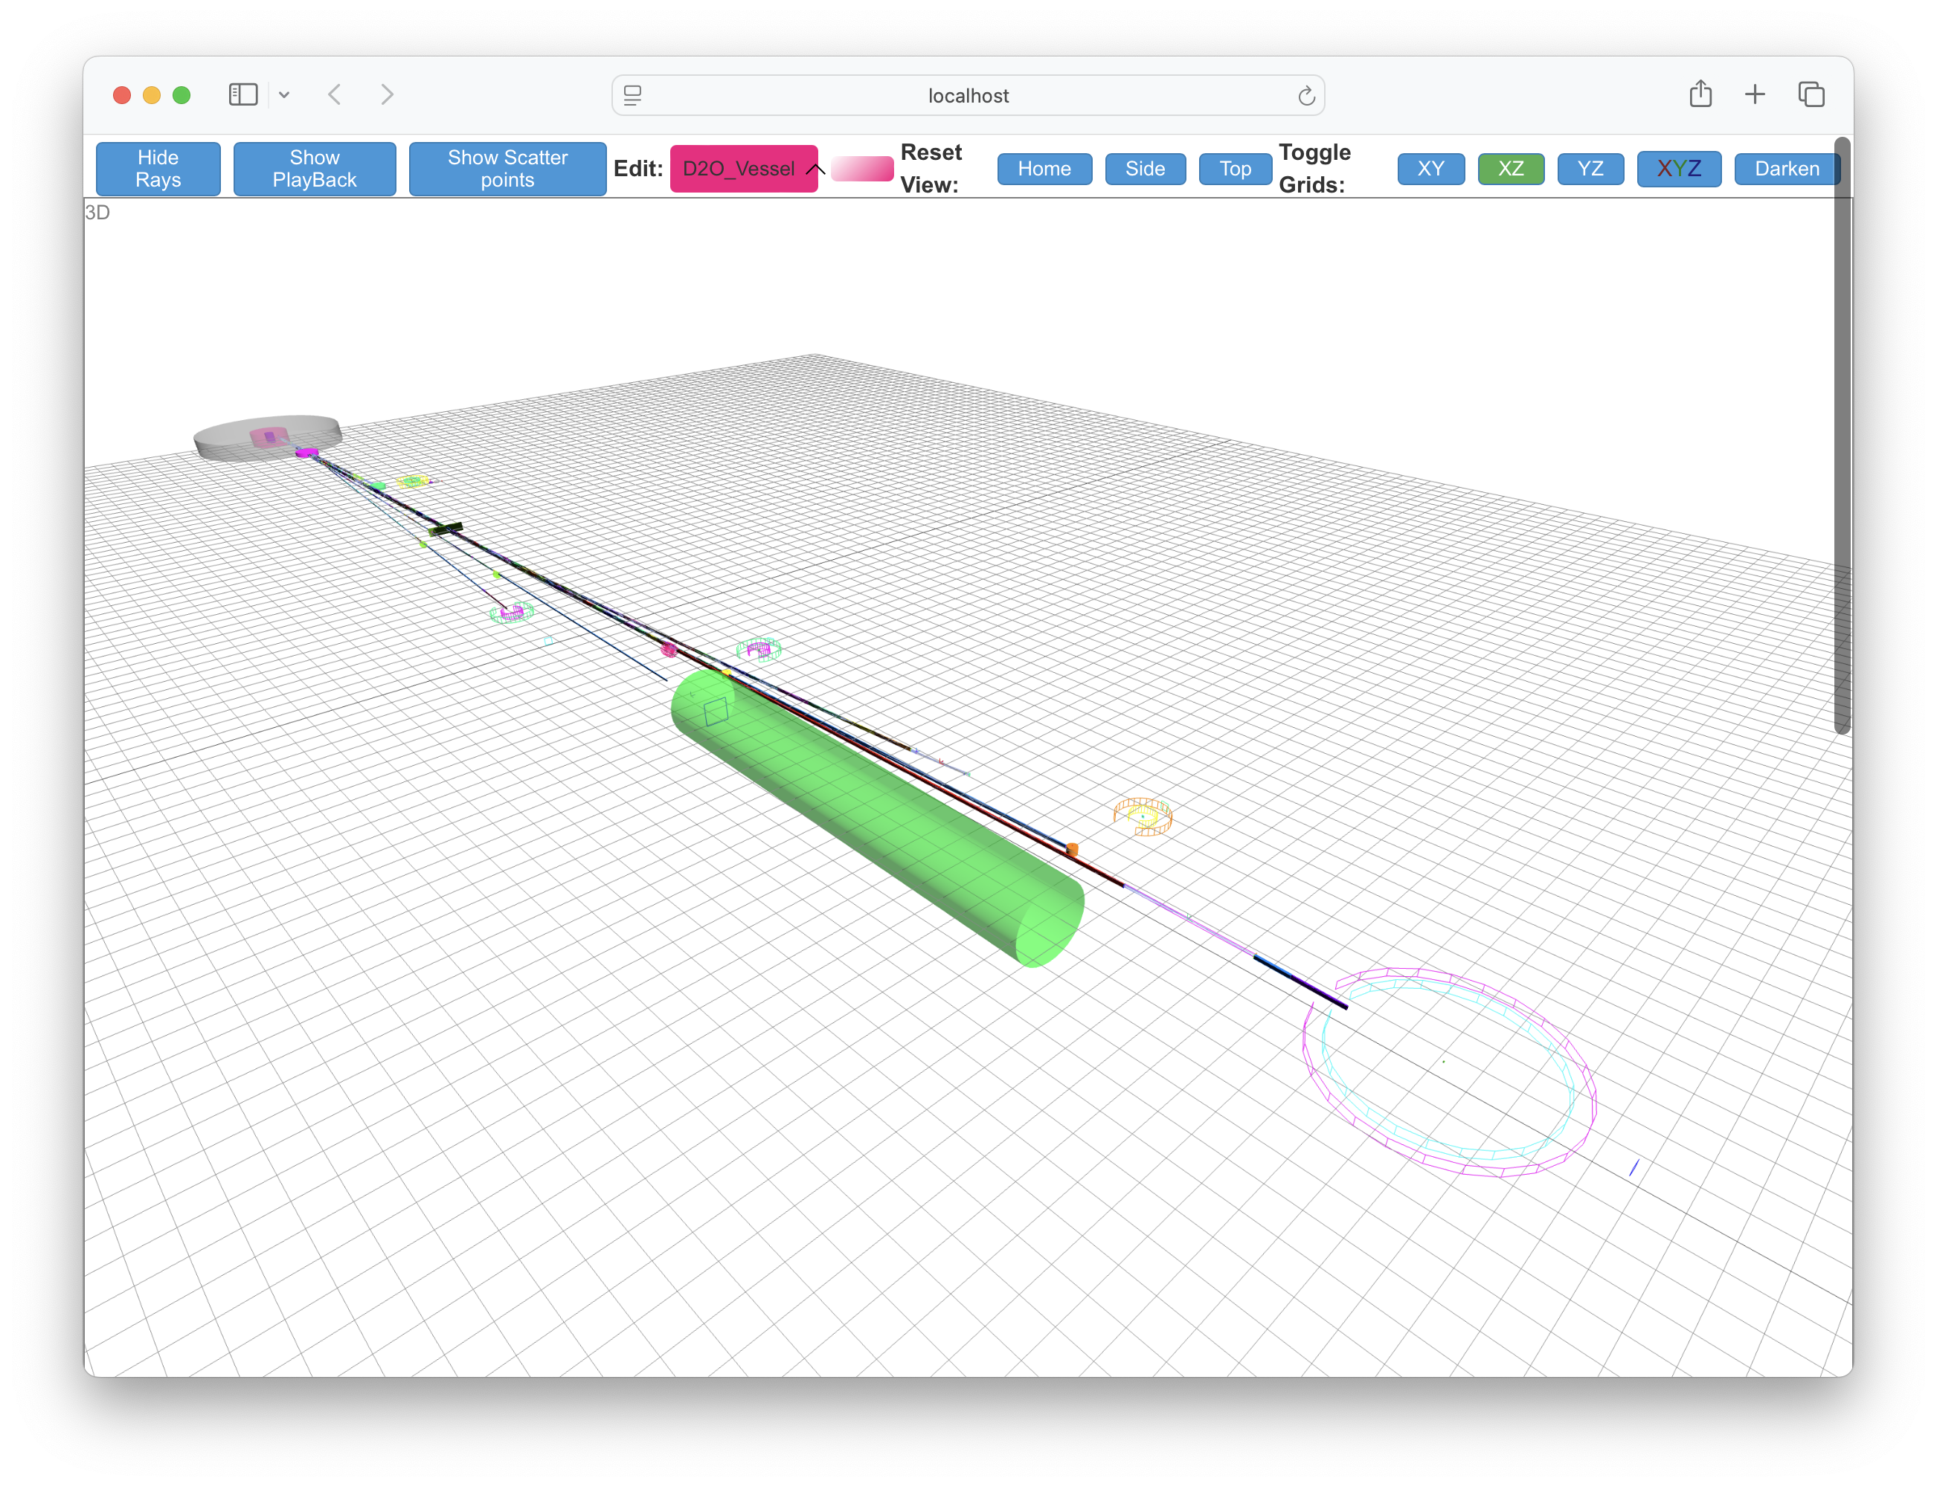
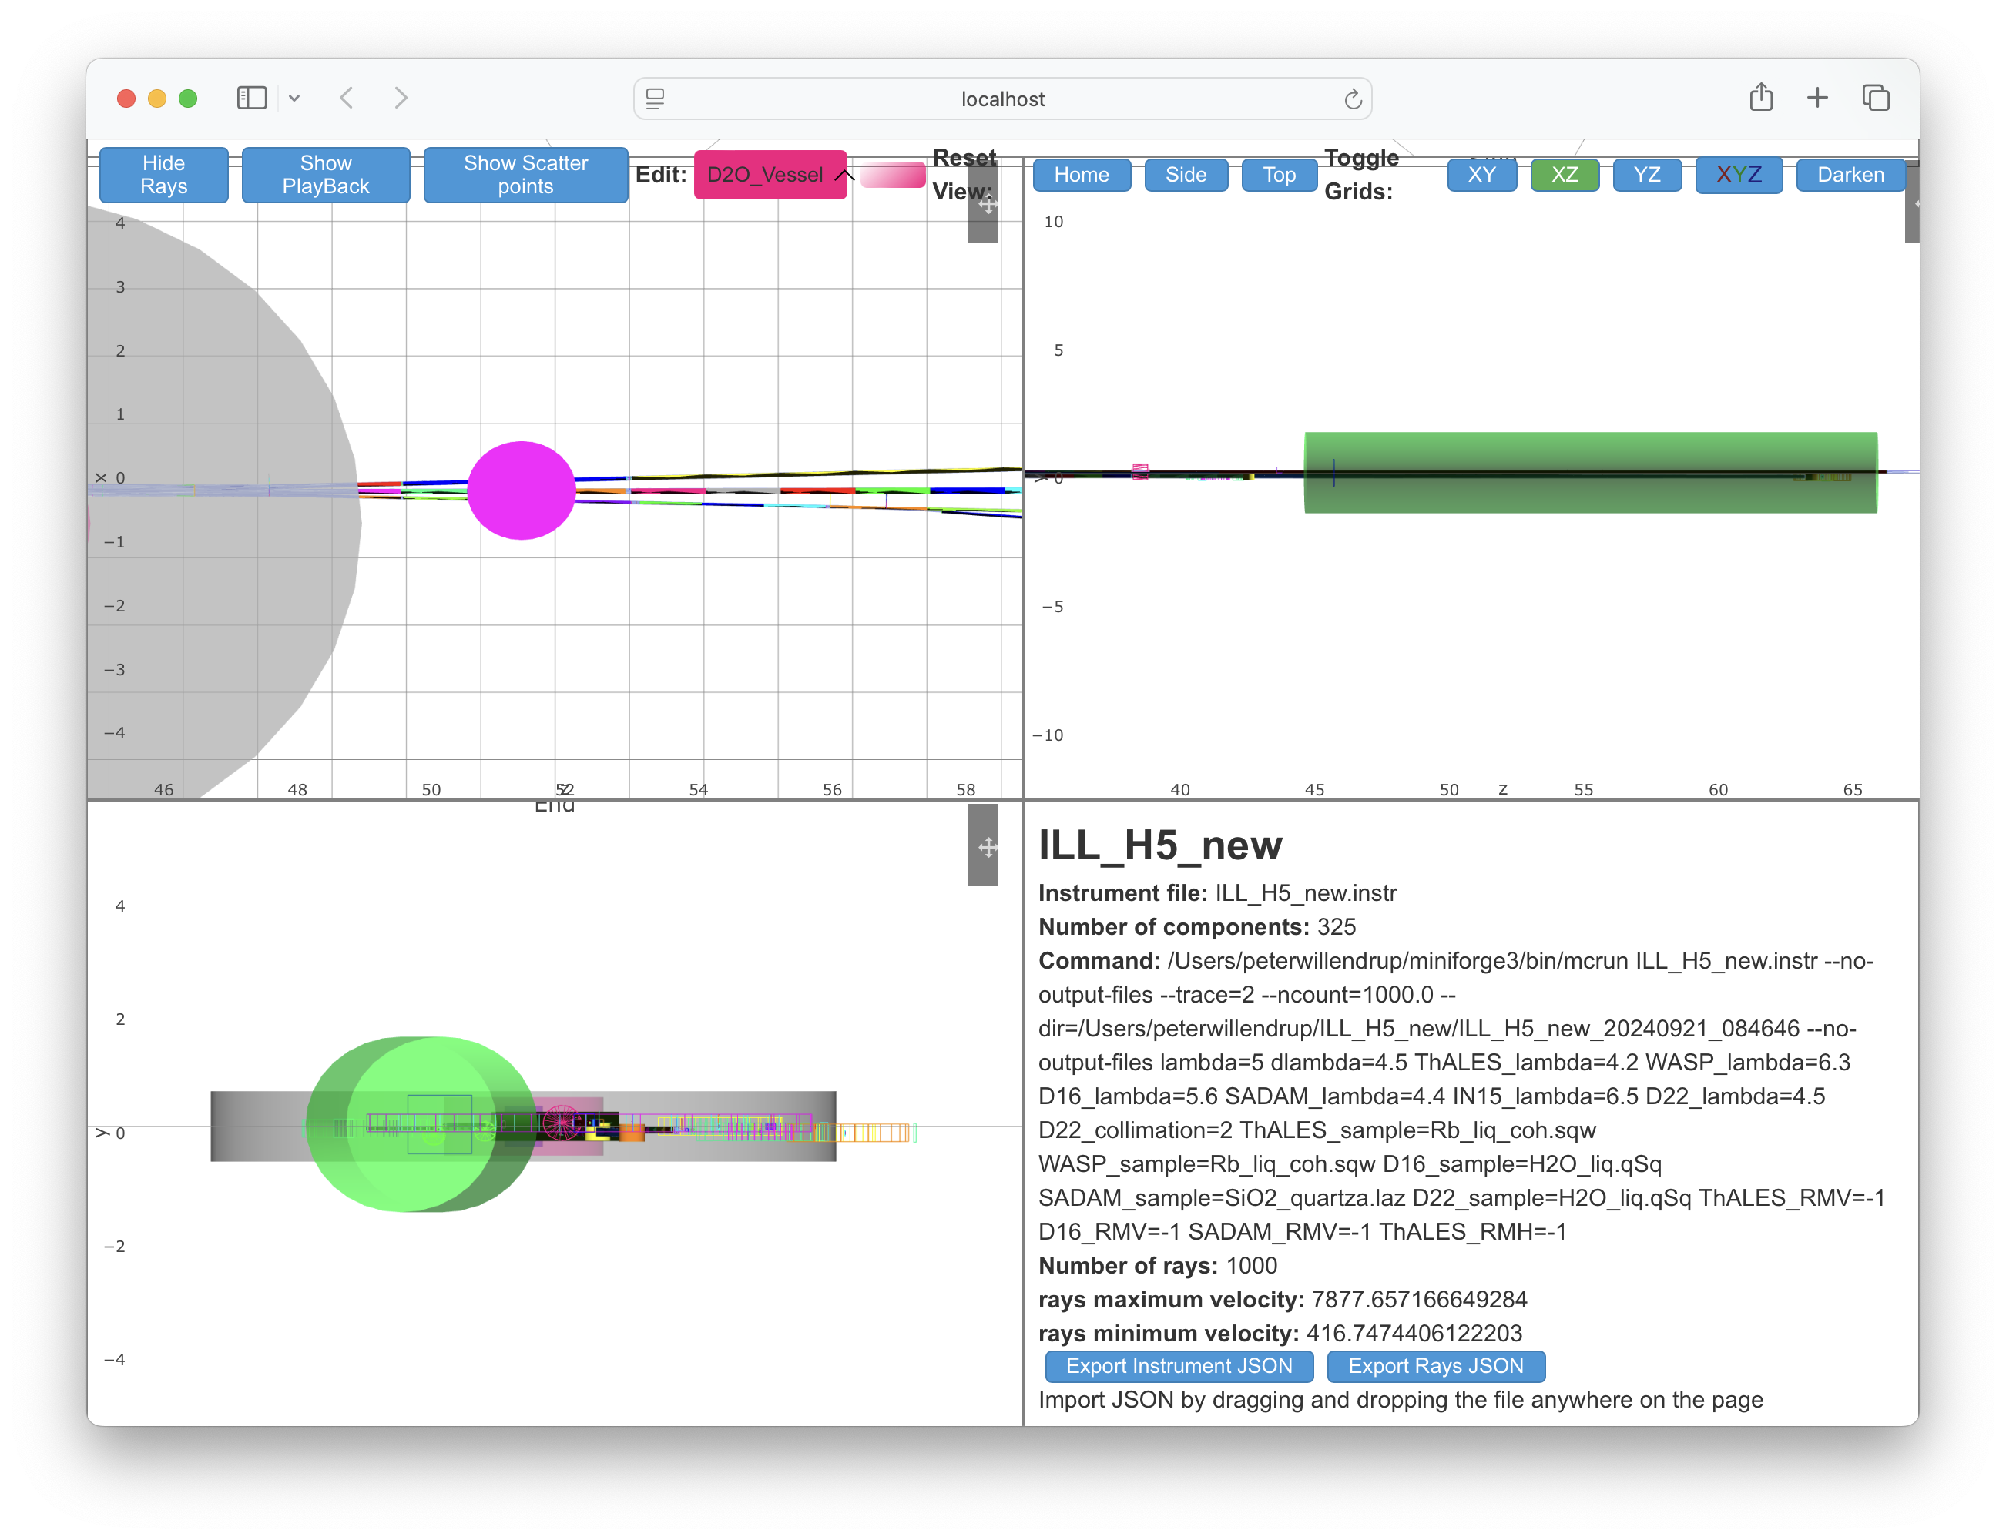
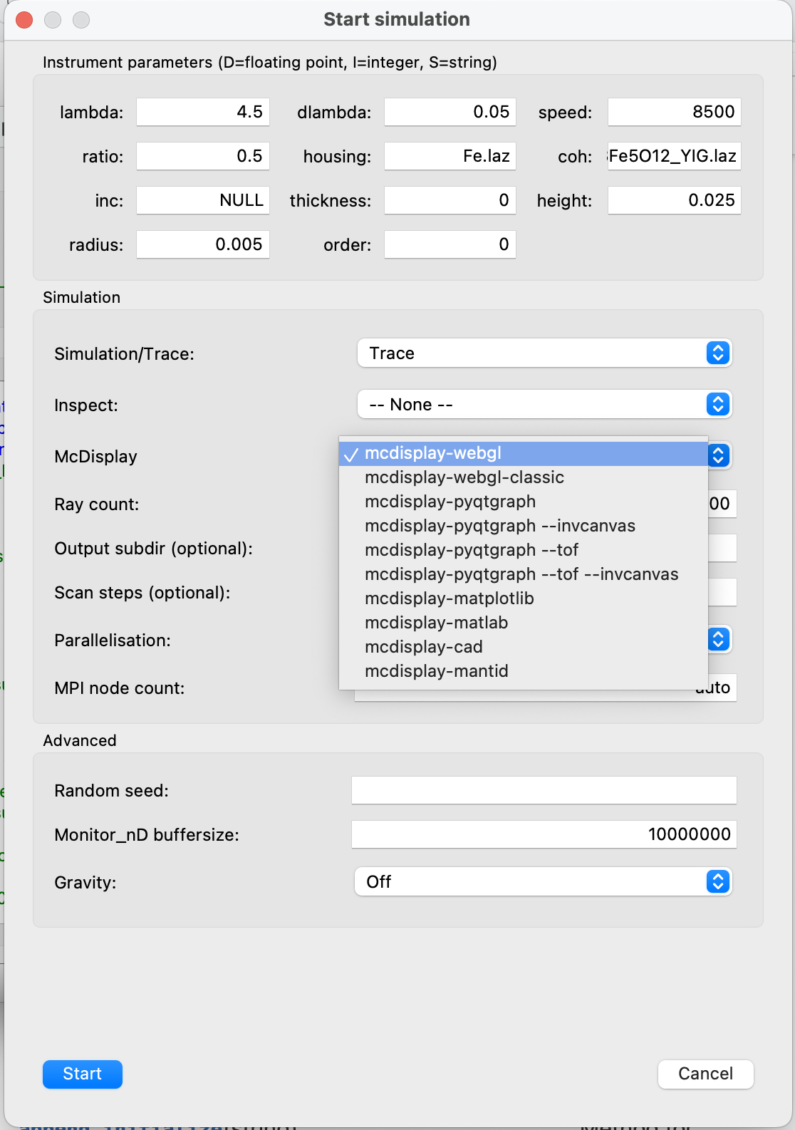
New stuff in series 3.5.x
Common release and versioning for McStas & McXtrace - no more 2.x and 1.x
We are now on conda-forge!
Forms support basis for Windows, macOS and non-Debian Linux
Lots of work from SOLEIL toward official Debian packages
CI (GitHub + conda) in place
Usability:
One-click transfer to McStasScript/Jupyter
Easy access to NeXus output through e.g. nexpy or silx
3D rendering modernised
mctest / mcviewtest tools
Various component / instr contributions, some presented later today!

Slide 13
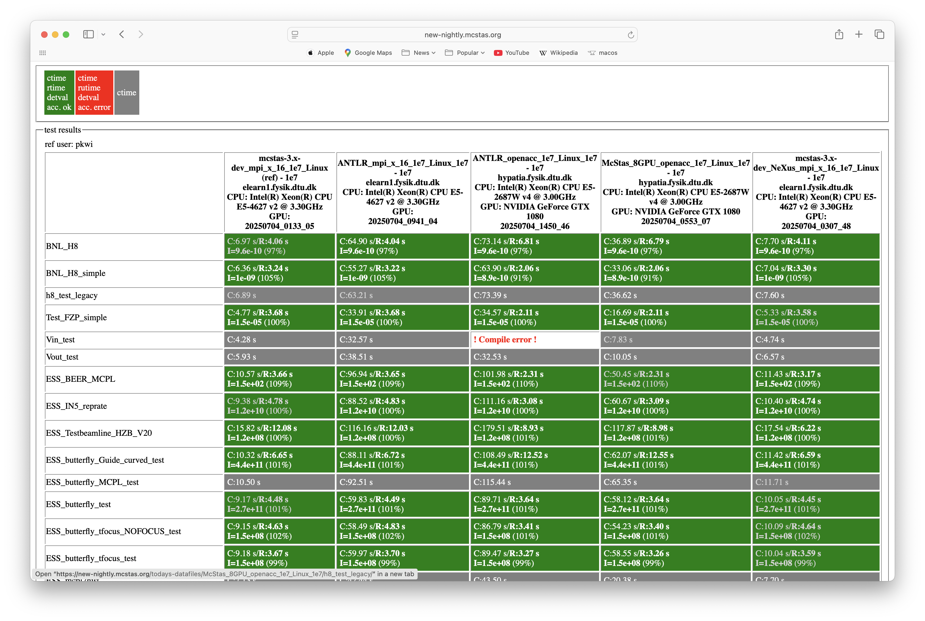
New stuff in series 3.5.x
New, feature-complete python/ANTLR4 code-generator mcstas-antlr from G S Tucker. install from e.g. conda-forge Want to know more? Talk to Greg in a break!
Common release and versioning for McStas & McXtrace - no more 2.x and 1.x
We are now on conda-forge!
Forms support basis for Windows, macOS and non-Debian Linux
Lots of work from SOLEIL toward official Debian packages
CI (GitHub + conda) in place
Usability:
One-click transfer to McStasScript/Jupyter
Easy access to NeXus output through e.g. nexpy or silx
3D rendering modernised
mctest / mcviewtest tools
Various component / instr contributions, some presented later today!
(base) laptop:~ user$ mctest --instr=BNL_H8 -n1e7 --testdir=$PWD --mpi=10
loading system configuration
Output of test will be placed in: /Users/user
ncount is: 1e7
mpi count is: 10
Testing: 3.5.32
Finding instruments in: /Users/user/micromamba/share/mcstas/resources/examples
Copying instruments to: /Users/user/mcstas-3.5.32_mpi_x_10_BNL_H8_Darwin
Compiling instruments [seconds]...
BNL_H8 : 3.50
BNL_H8_simple : 2.61
Running tests…
BNL_H8 : 2.58
BNL_H8_simple : 1.71
(base) laptop:~ user$ mcviewtest $PWD

Slide 14
New stuff in series 3.5.x
Common release and versioning for McStas & McXtrace - no more 2.x and 1.x
We are now on conda-forge!
Forms support basis for Windows, macOS and non-Debian Linux
Lots of work from SOLEIL toward official Debian packages
CI (GitHub + conda) in place
Usability:
One-click transfer to McStasScript/Jupyter
Easy access to NeXus output through e.g. nexpy or silx
3D rendering modernised
mctest / mcviewtest tools
Various component / instr contributions, some presented later today in afternoon session!

Slide 15
New stuff in series 3.5.x
Common release and versioning for McStas & McXtrace - no more 2.x and 1.x
We are now on conda-forge!
Forms support basis for Windows, macOS and non-Debian Linux
Lots of work from SOLEIL toward official Debian packages
CI (GitHub + conda) in place
Usability:
One-click transfer to McStasScript/Jupyter
Easy access to NeXus output through e.g. nexpy or silx
3D rendering modernised
mctest / mcviewtest tools
Various component / instr contributions, some presented later today in afternoon session!
LOTS of work on many layers + infrastructure -> solid basis for future work:
Used for preparing the ESS data pipeline
More emphasis on “in-experiment” and data-analysis features
Further modernisation
Project:
Historical “yearly release” -> release often, release early mode(conda-forge is the basis)
PR-only, “production grade” main branch
Plan to extend McStas/McXtrace collaboration
Even more emphasis on testing at different levels

Slide 16
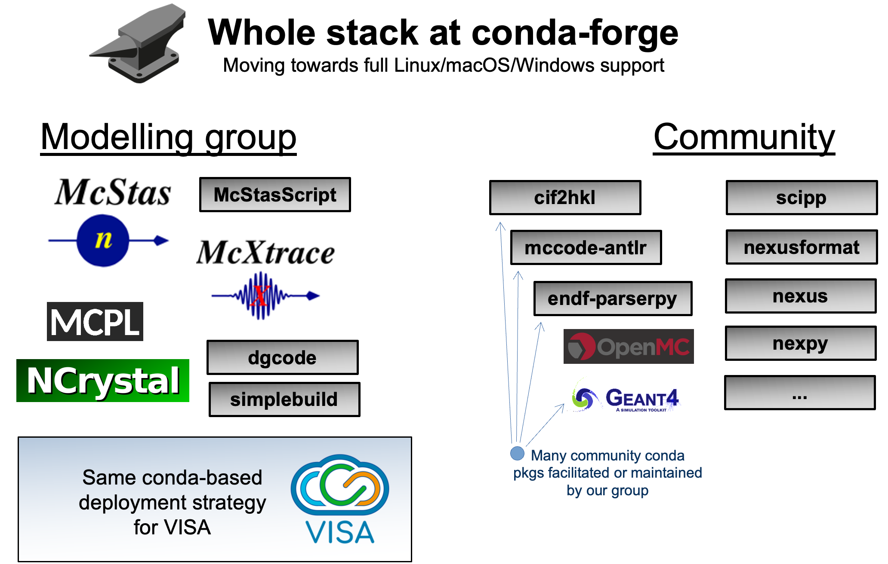

Slide 17
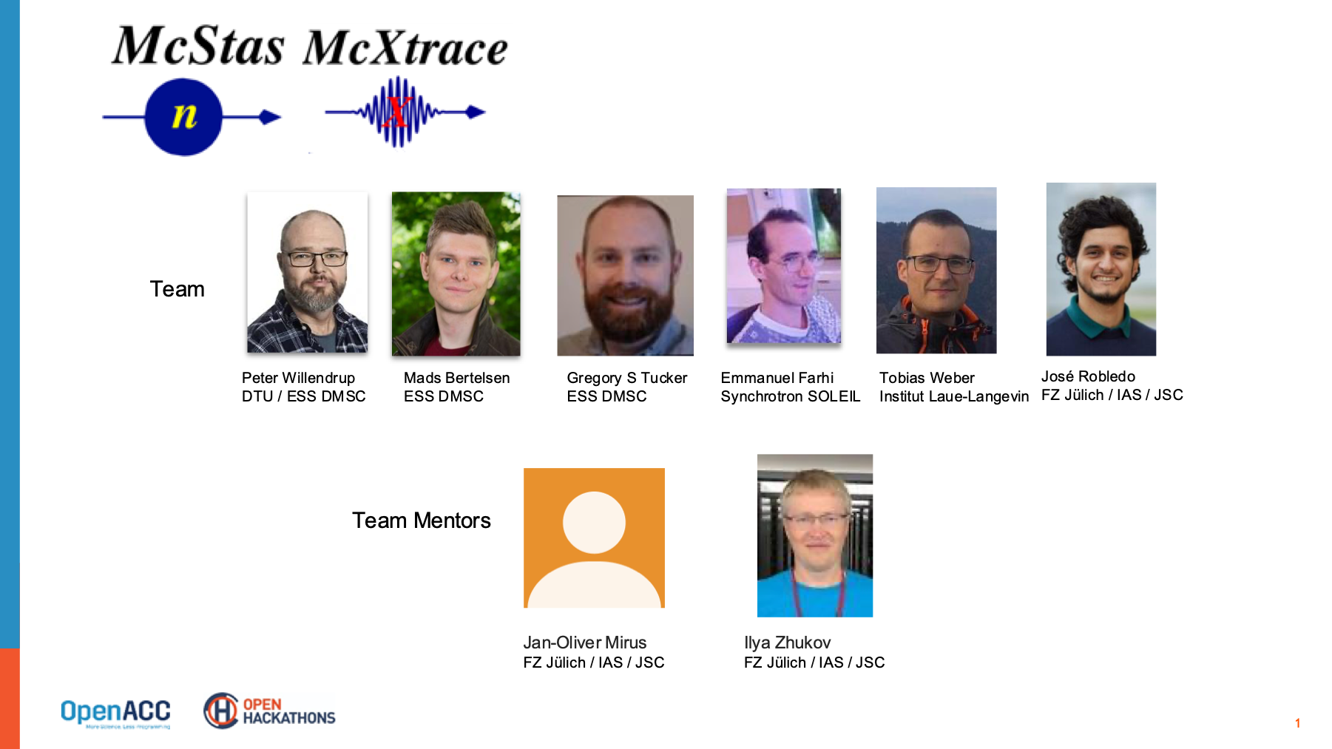
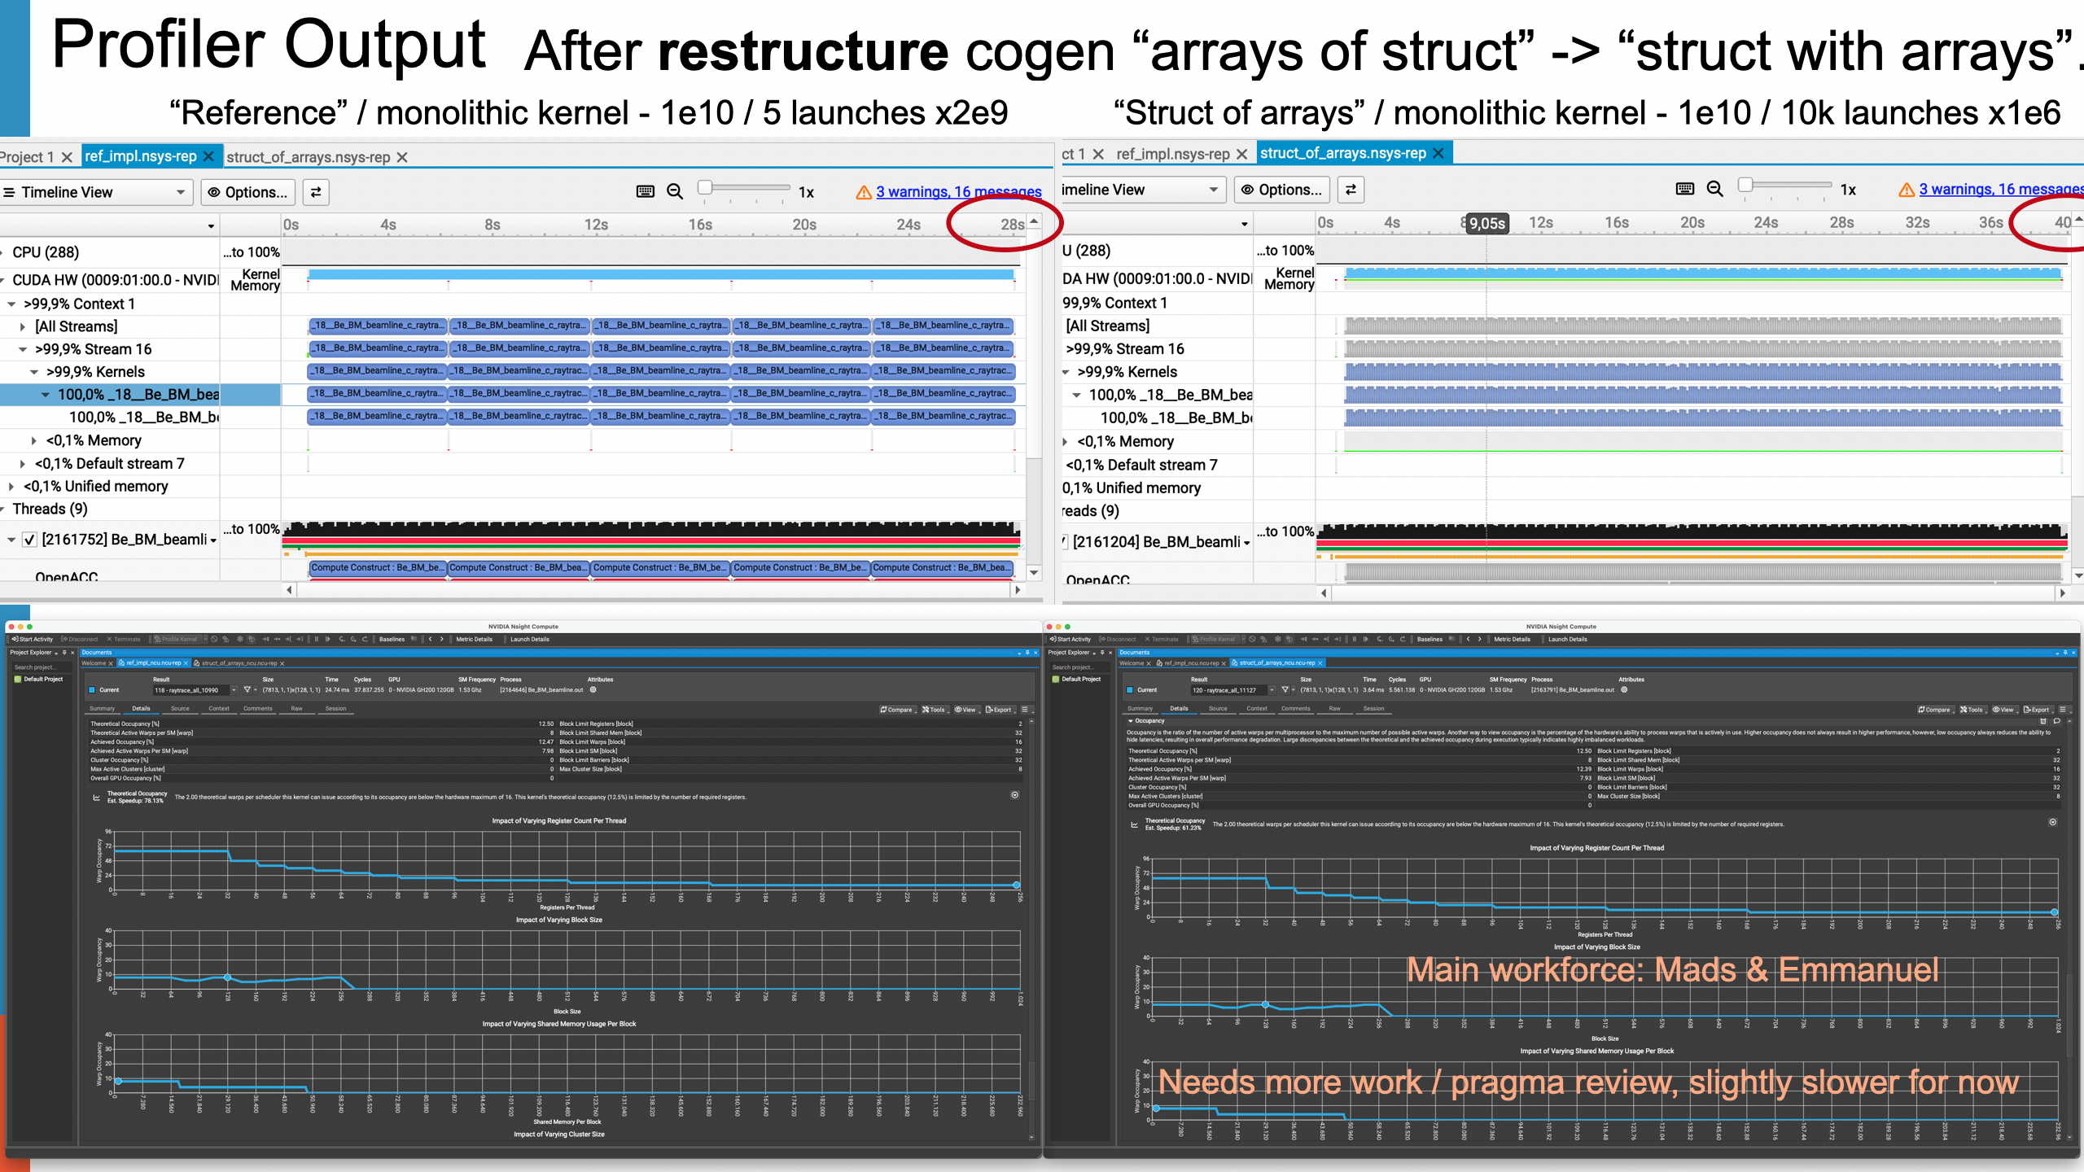

FZJ Hackathon in April
Got better at profiling
Overall extra x2 achieved
New ideas for added parallelism
New KU-DTU-ESS CS student in spring 26 to continue work

Slide 18






“Richer NeXus format”
All component AT / ROTATED data
All component param=value info (currently as text from instr file)
Monitor_nD geometry data included
Monitor_nD binning / pixellation arrays
“Hooking up to ESS data pipeline”
+ IDS group

Slide 19








McStas collaboration
PW:
“Mr. McStas”
2002- ?
Custodian,
community
caretaker,
sustained
workforce.
Support for
newcomers
and power
users alike.
Development
at all levels
and all syst.
Torben R. Nielsen:
Contributed solution
for connection with
“Mantid” data reduction,
work on SASmodel
integration
Thanks and acknowledgements to lots of people…
Kim Lefmann
Author of many
components, orig.
“power user”,
supervised many
KU stud. and
secured funding.
Part of McStas all
along the way.
Kristian Nielsen
Got input from
RISØ physicists,
(Incl. Kim & Henrik)
architect behind
“internals” and
LeX-Yacc gram.
Releases 1.0-1.4
Esben Klinkby
Mcnp-hooks,
scatter-logger
Gregory Tucker
ESS event-formation
hookup, recent
syntax / code-
generator additions
Plus MANY others among
the user community at neutron-
facilities, students etc.
Peter Christiansen
1st pol. solution
Kurt Clausen:
Came up with
original idea of
“framework”,
secured first EU
funding.
Emmanuel Farhi
First non-DK
“McStas system
developer”,
PW mentor for the
deeper tech.
Grammar ext.
advanced comps.
+ lots more
Now works
mainly on
McXtrace.
Thomas Kittelmann
Main developer of
MCPL particle list
Format and
NCrystal structure/
dynamics lib for MC
Erik Knudsen:
Developer of
prod. pol.env.,
main historical
workforce
behind
McXtrace.
lots more
Left for
CPH Atomics
in 2022.
Mads Bertelsen
“Next generation”,
Phd with KL,
contributed adv.
systems “around”
and “in” McStas:
guide_bot and
Union systems.
Henrik Rønnow
Drafted v 1.0
grammar w. Kim
& Kristian
Jakob Garde
2nd round of .py
tools, GPU
Johan Brinch
Transfer to CMake
1st round of .py
tools

Slide 20










Main McStas Funding sources

