Slide 1
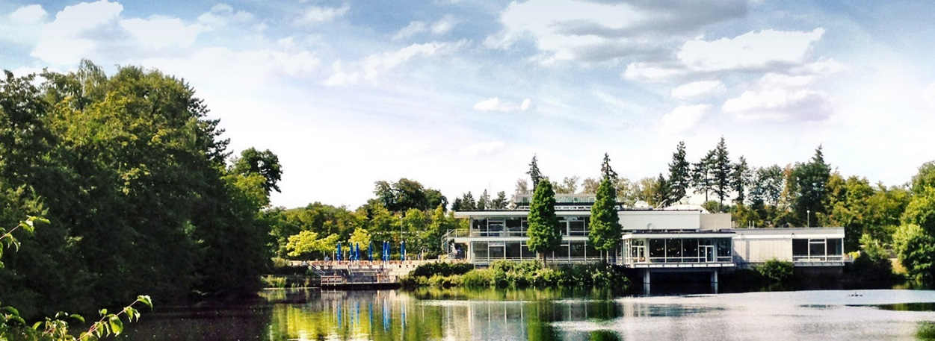


Version 3.7 of the neutron instrument simulation package VITESS
Advanced Computer Simulations for Neutron Scattering Instruments
Lyngby, 11 Sep 2025
K. Lieutenant F. Beule J. Robledo N. Schmidt N. Violini J. Voigt P. Zakalek

Slide 2
outline
General description of VITESS
Development and Tests
New features in VITESS 3.7
Outlook to VITESS 4 and 5

Slide 3

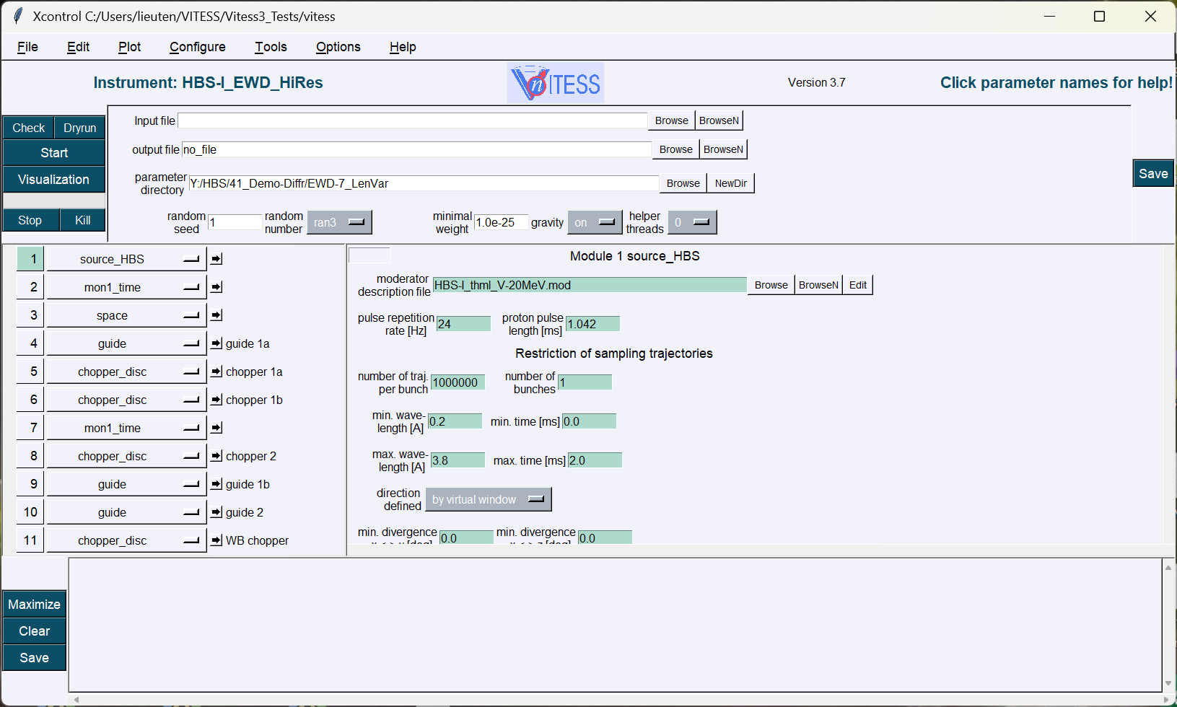
GUI after loading an instrument

Slide 4
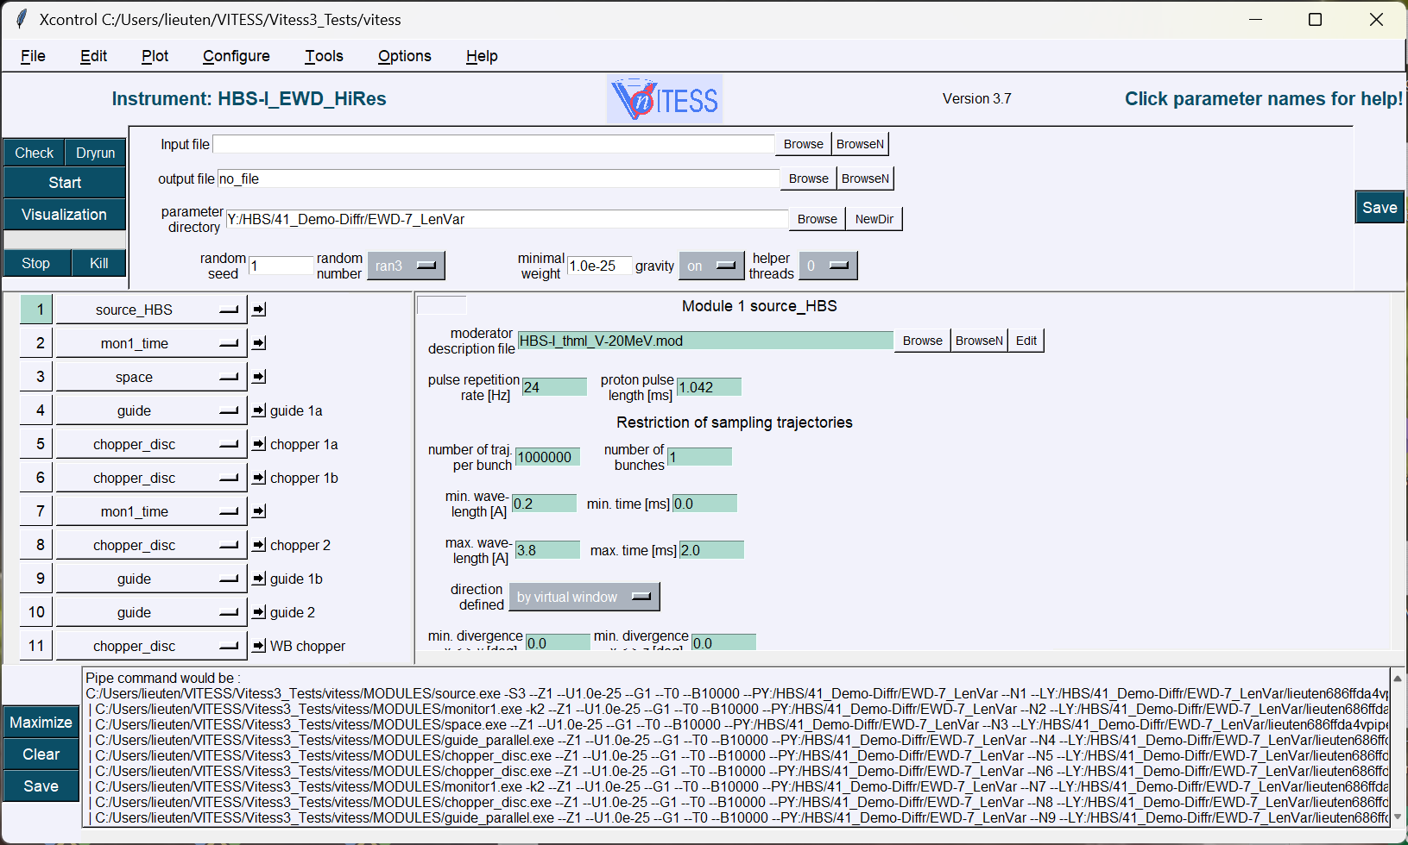
GUI after ‘check’

Slide 5
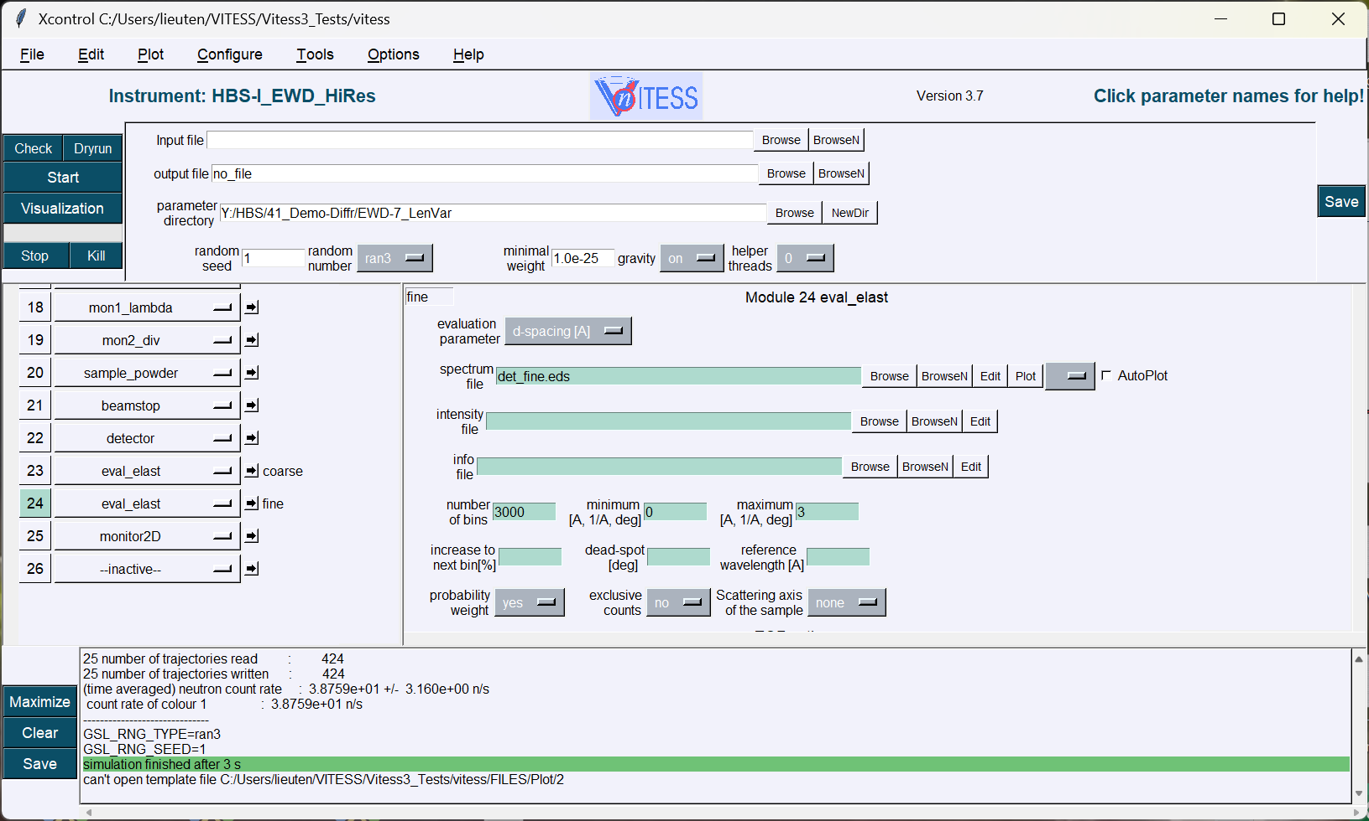
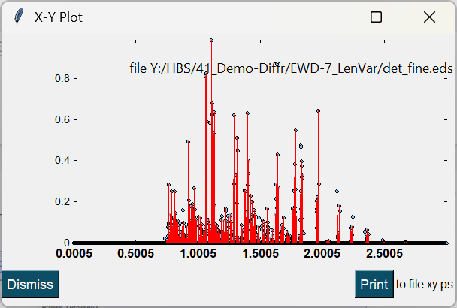
GUI after running the simulation

Slide 6
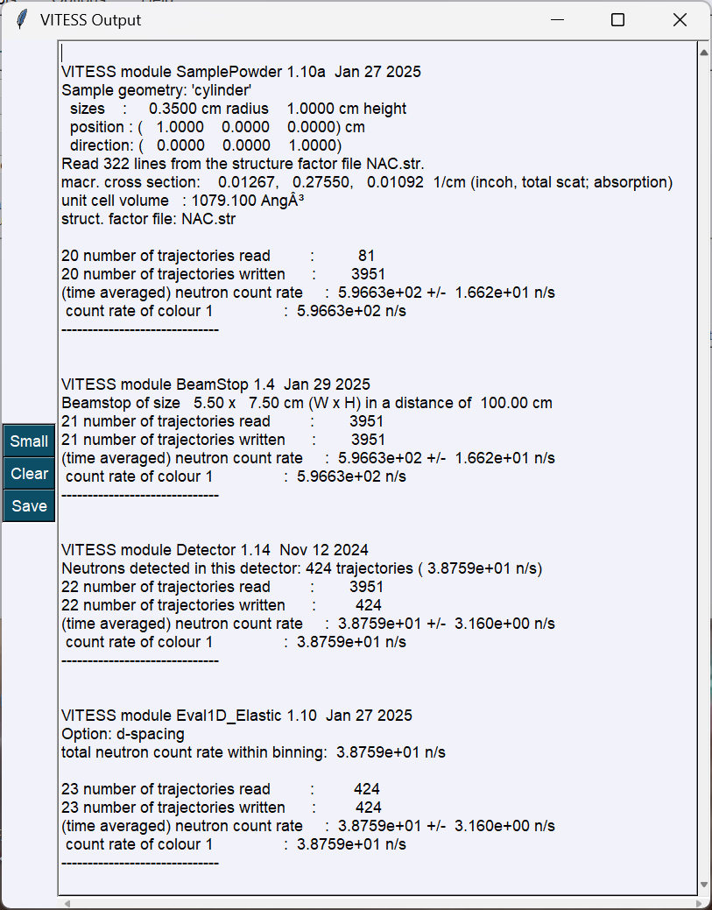
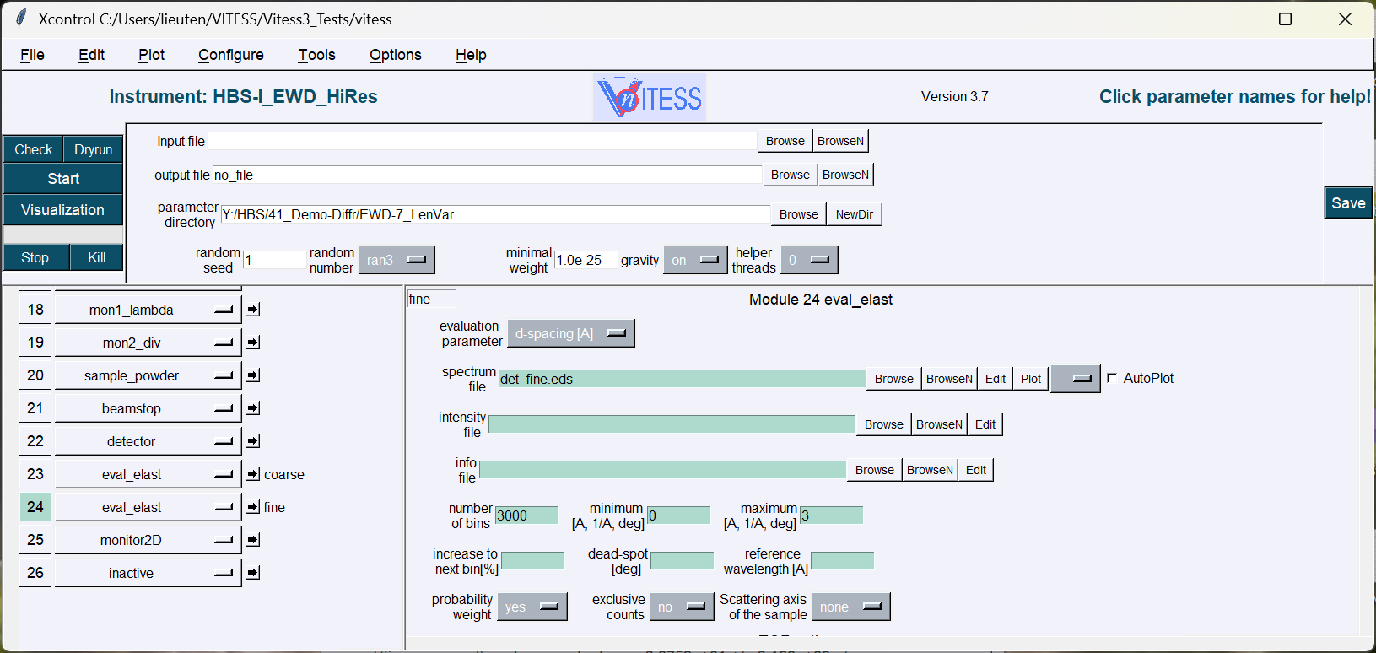
Log file

Slide 7
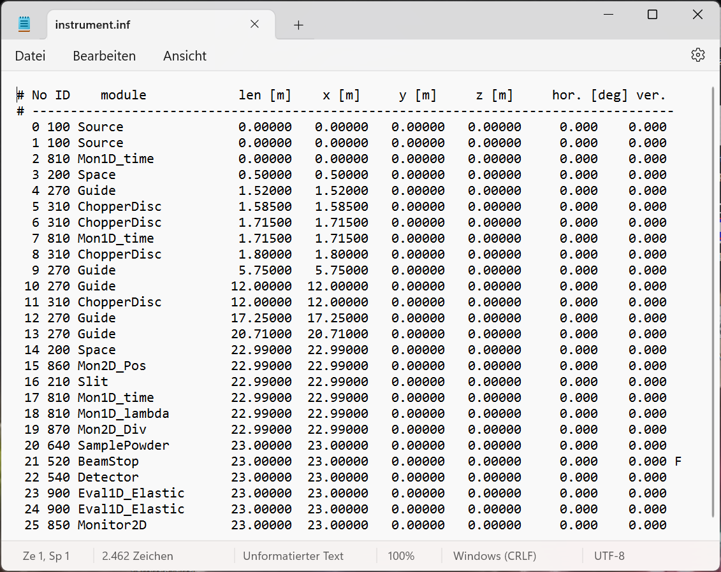
Instrument file

Slide 8
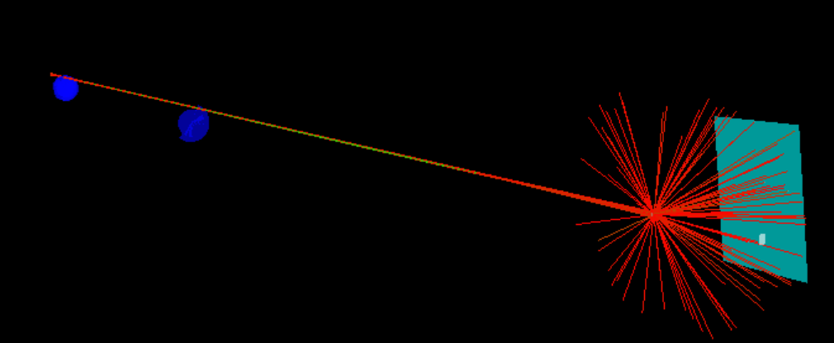
Visualization of instrument and trajectories

Slide 9
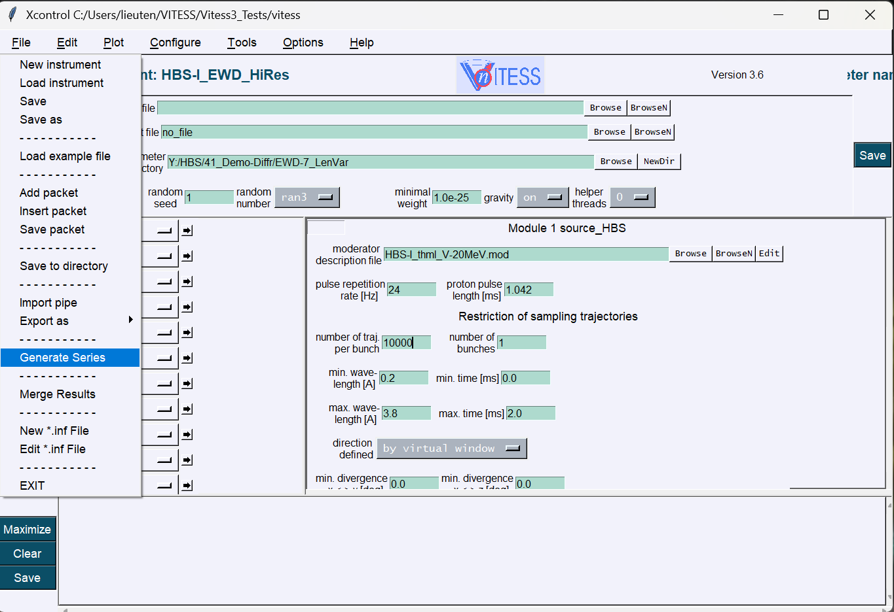
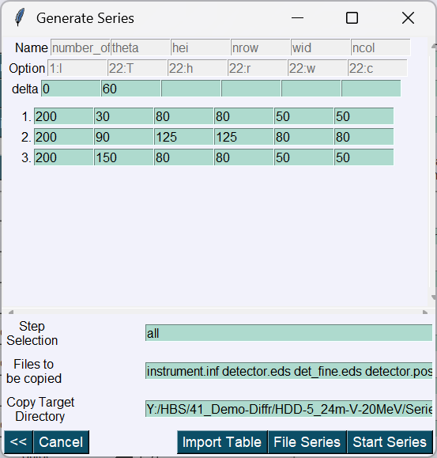
Series of simulations

Slide 10
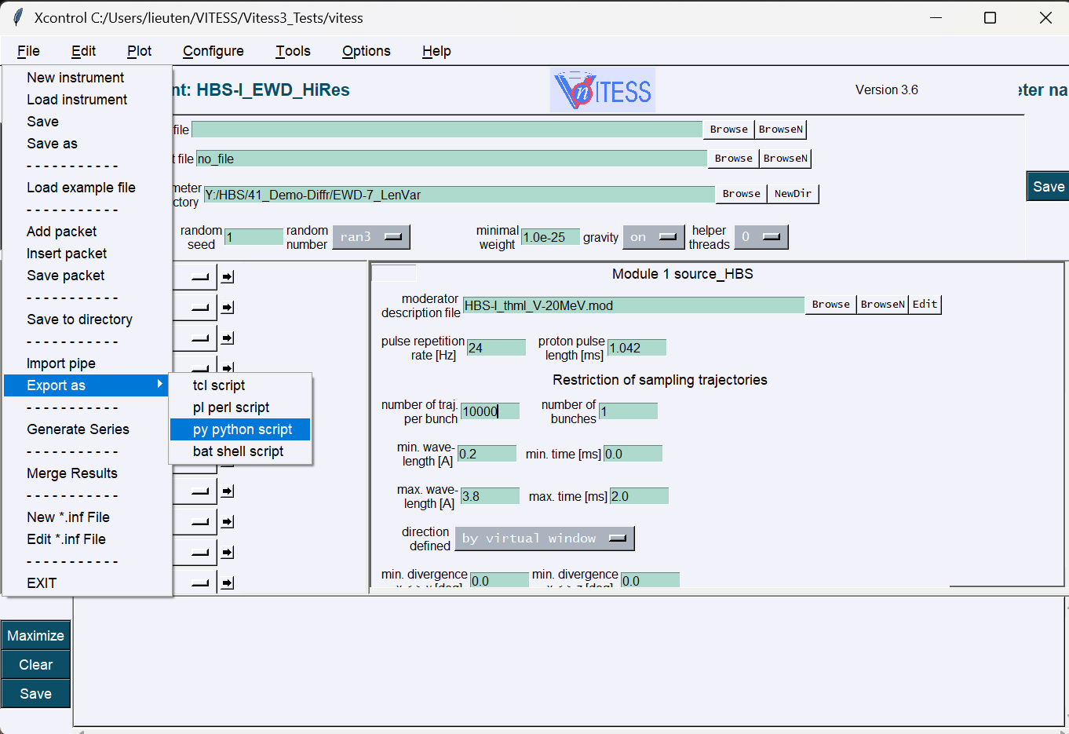
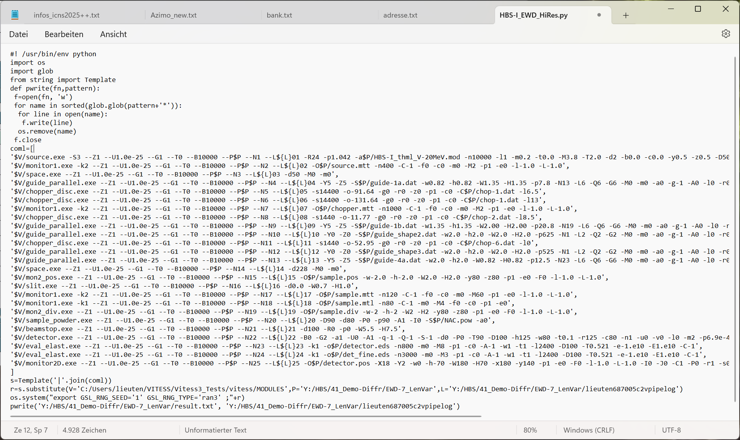
Working on python

Slide 11
Concept of piping
VITESS GUI
parameters
parameters
parameters
parameters
source
module 2
monitor
module n
param.file
I(par)
log file
geometry file
visualization file
neutron trajectories monitor update or reset
parameter change

Slide 12
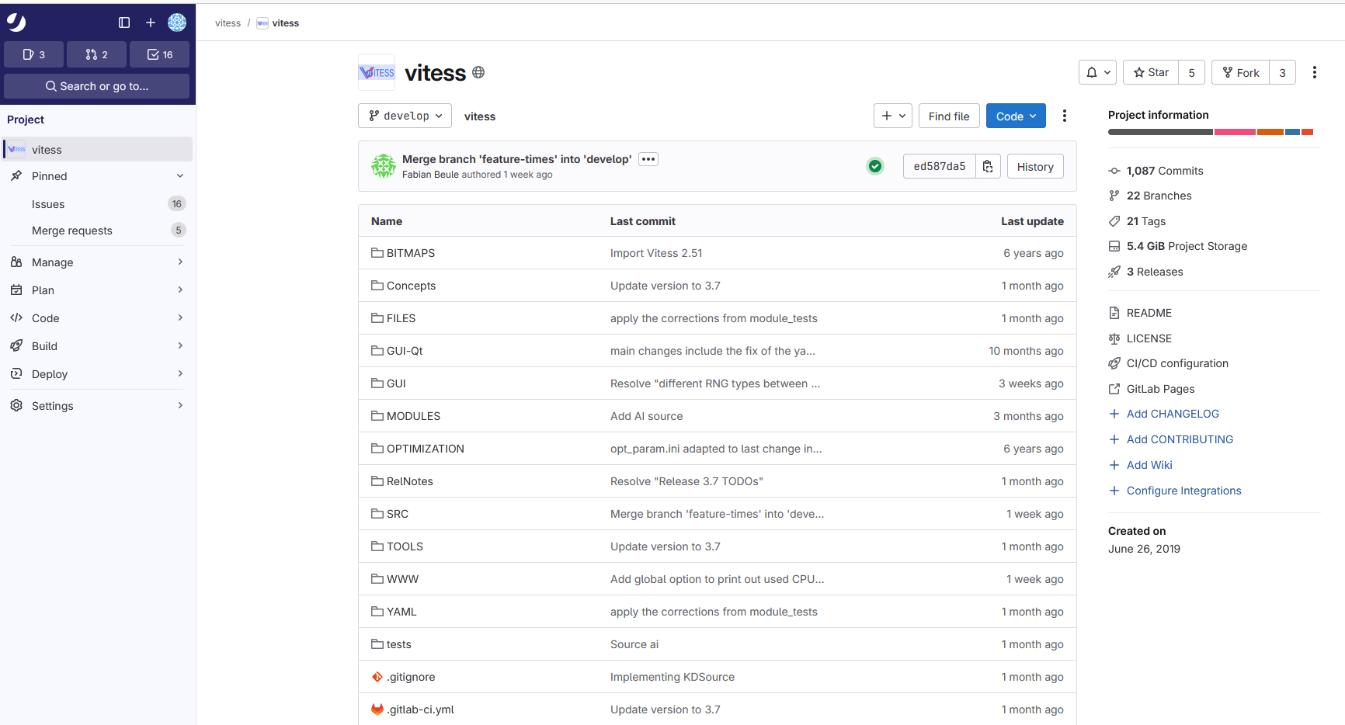
GIT for version control …
https://iffgit.fz-juelich.de/vitess/vitess

Slide 13
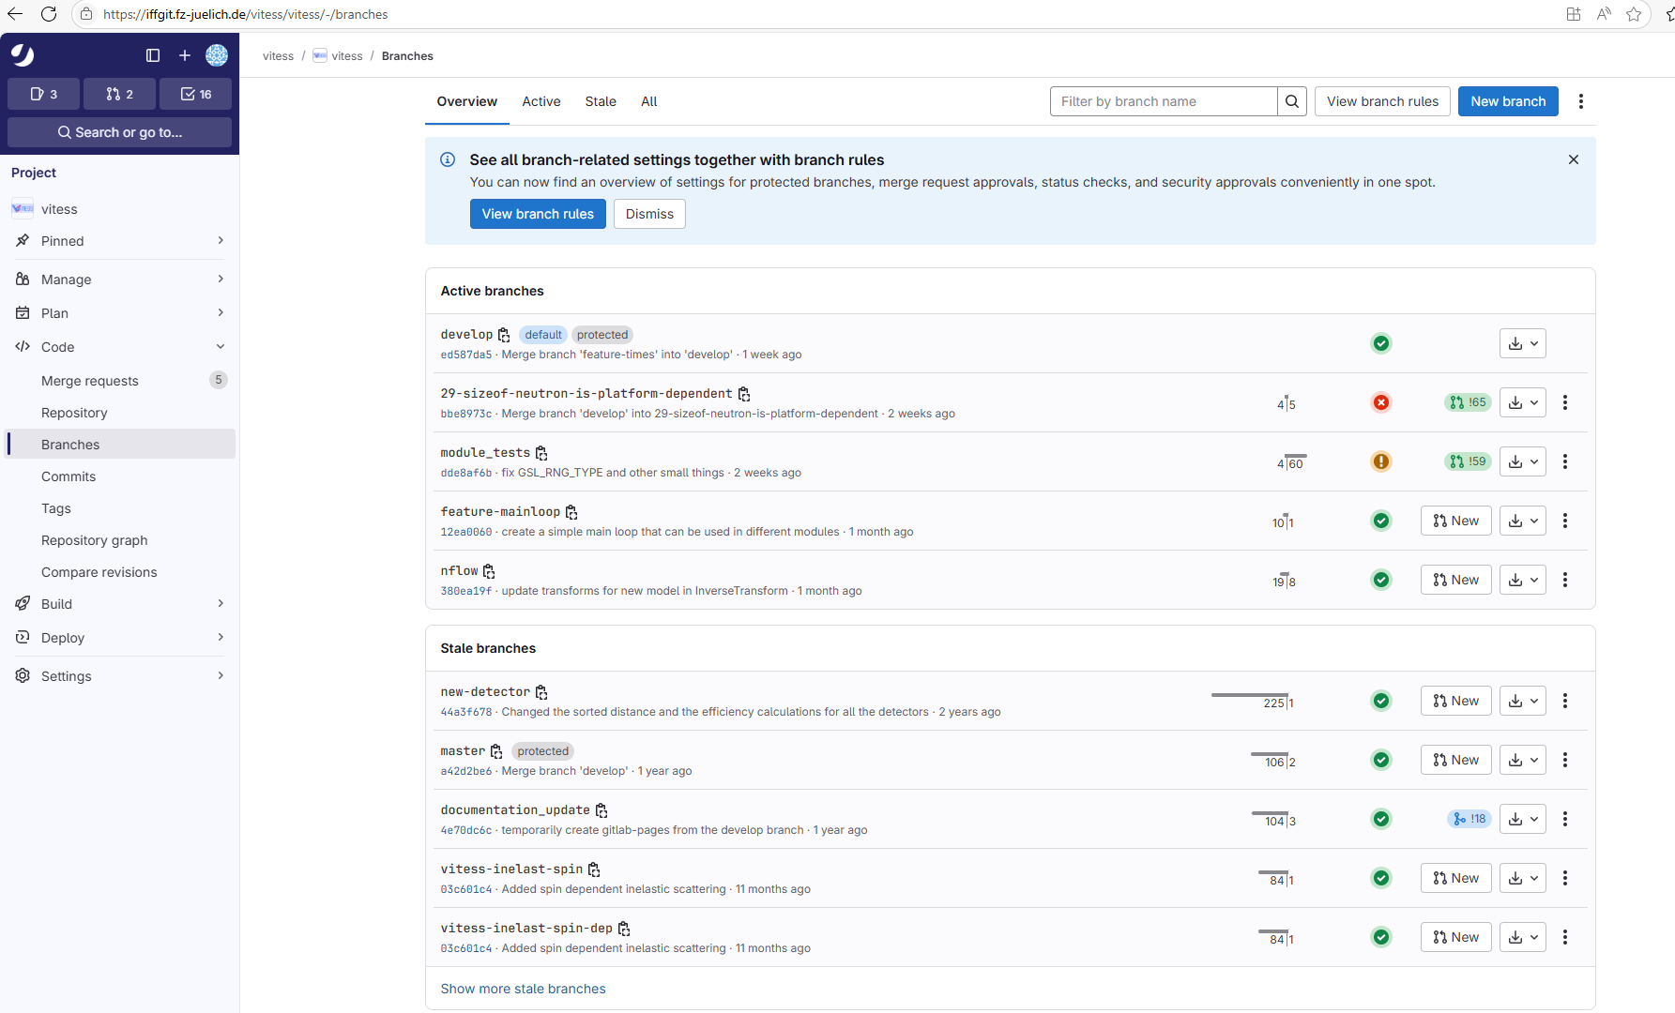
GIT for releases, tests …..
https://iffgit.fz-juelich.de/vitess/vitess

Slide 14
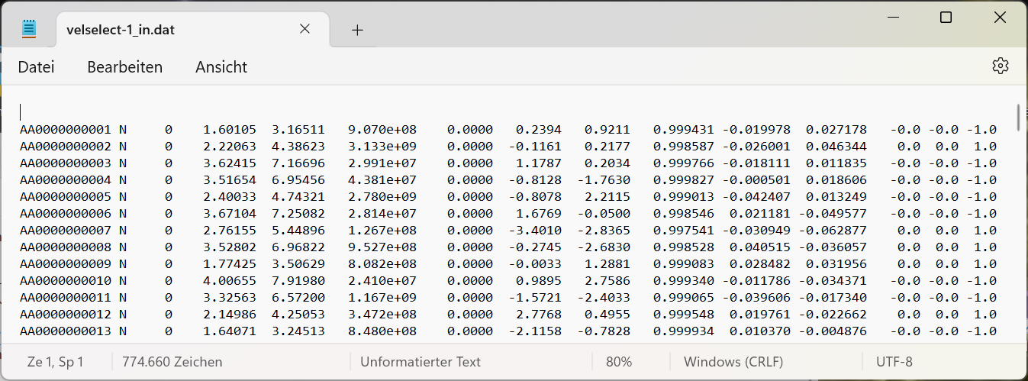
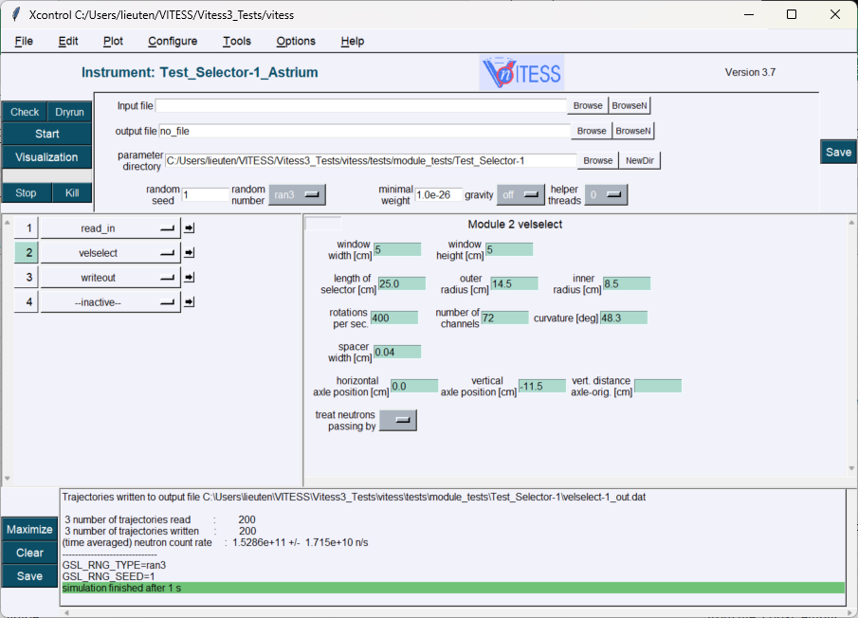
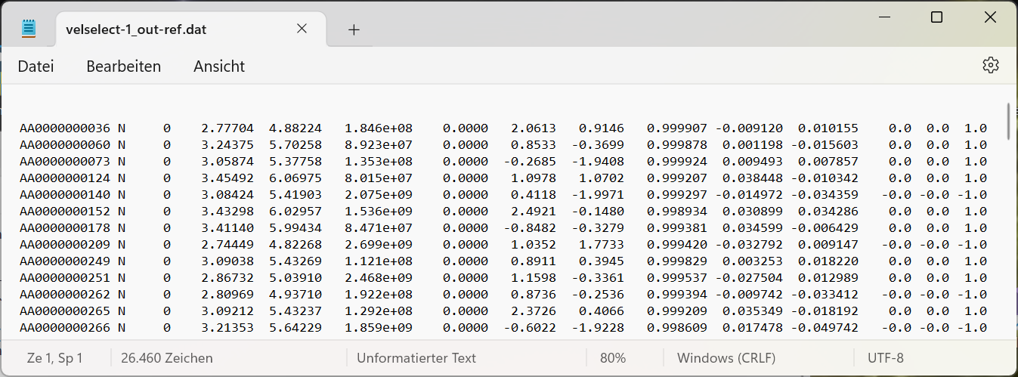
Module tests

Slide 15
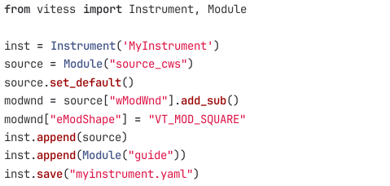
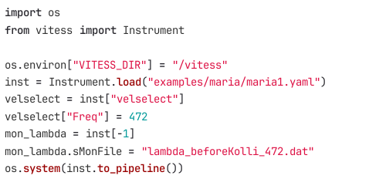
Python API
Create instrument
Load instrument
Modify
Run

Slide 16
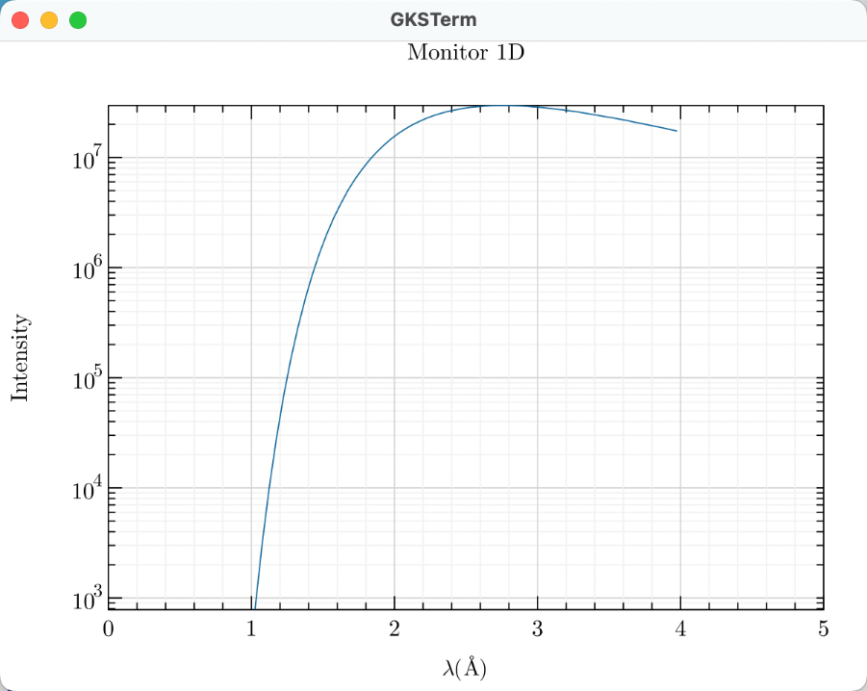
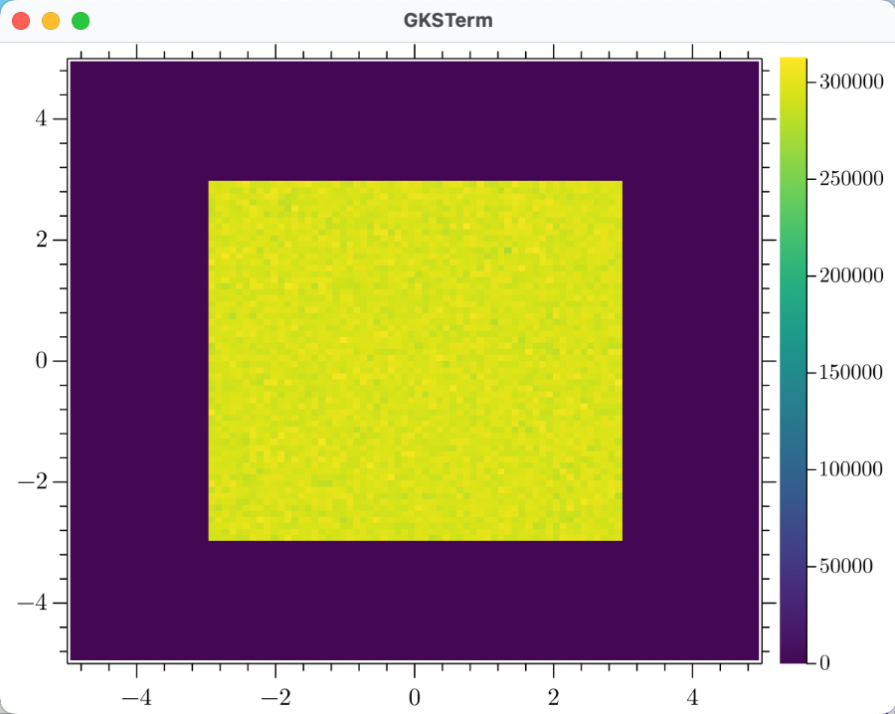
New visualization tool gr

Slide 17
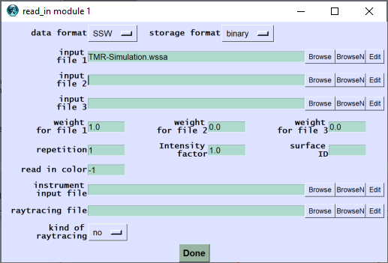
Reading and writing of MCPL, …. Nexus data
Simulation of the TMR unit using MCNP or any other program
Determination of source characteristics
Simulation of shielding, radiation background,…
using MCNP etc
MCPL WSSA
MCPL
MCPL
read_in
monitor
guide
detector
writeout
VITESSMcStas
VITESSMcStas
Simulation of instrument part M using VITESS or McStas
Data evaluation
NeXus
detector data
IDF file
Simulation of instrument part N using VITESS or McStas
Binary and Ascii files can be read and written now

Slide 18
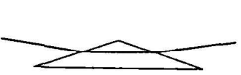
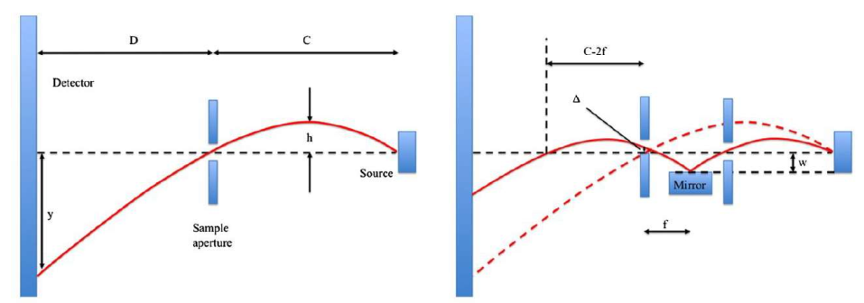
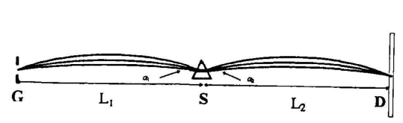
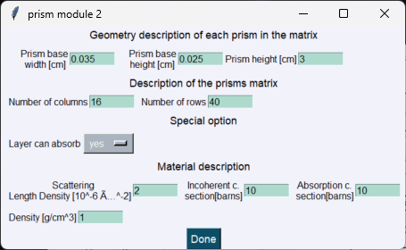
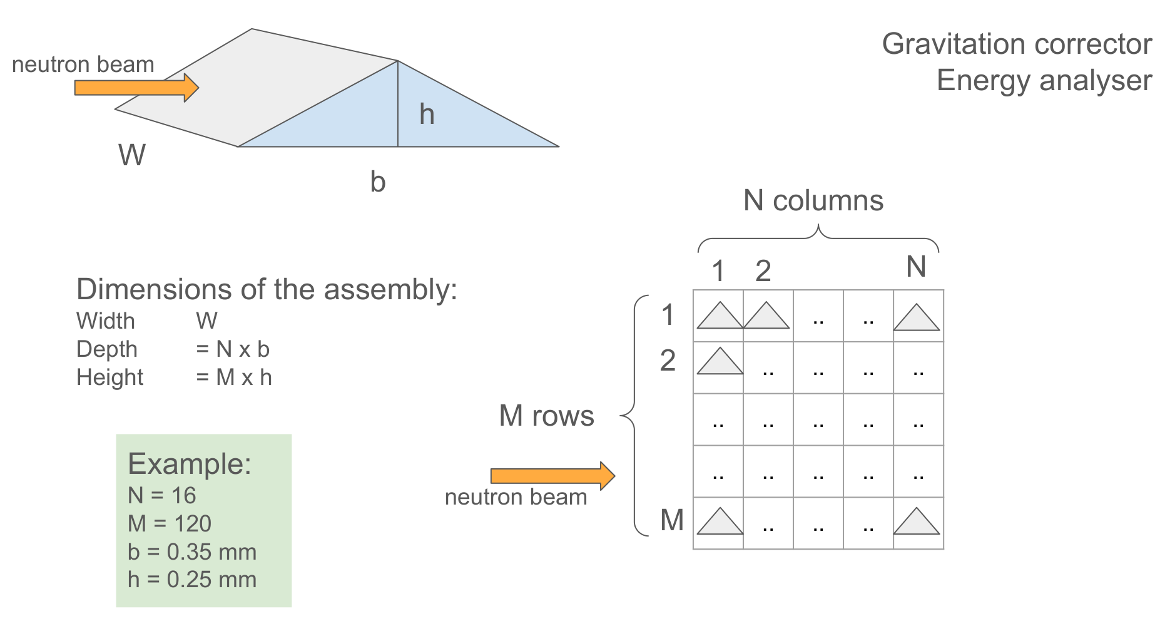
prism
Tocompensate gravity effect, e.g. on SANS instrument

Slide 19
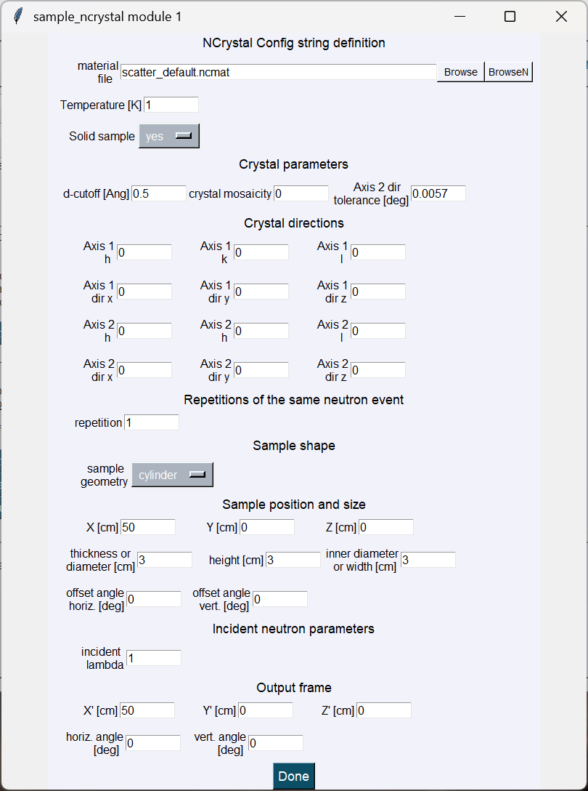
Sample_Ncrystal
Enables using the NCrystal library

Slide 20

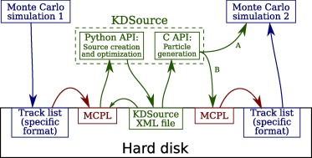
Kdsource
increases the number of new neutron trajectories
It estimates density distribution in energy, position and direction by means of Kernel Density Estimation (KDE)
Example: generation of more neutrons matching the output of a target-moderator simulation for instrument simulation
Included as a option of the module ‘read_in’

Slide 21
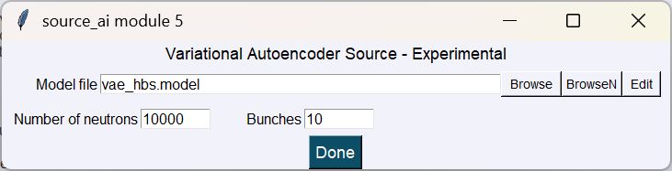
Source_ai
increases the number of new neutron trajectories
Fits the distribution in energy, position and direction by means of AI to an arbitrary function
Example: describing the output of a target-moderator simulation as a source for instrument simulation
Realized as a separate module ‘source_ai’
Once the fit is finished, the output of the moderator simulation is not needed anymore, model file is used.

Slide 22
Monochromator
Can be moved in 3 different ways now
Monochromator
Possible movements
Rotation about the vertical axis
Rotation about the eam axis (for phase space transformet – PST)
Oscillation along the beam axis (for Doppler drive)
And can have several layers

Slide 23
Monochromator
Can be moved in 3 different ways now
Monochromator
Possible movements
Rotation about the vertical axis
Rotation about the beam axis (for phase space transformet – PST)
Oscillation along the beam axis (for Doppler drive)
And can have several layers

Slide 24
Monochromator
Can be moved in 3 different ways now
Monochromator
Possible movements
Rotation about vertical axis
Rotation about beam axis (for phase space transformet – PST)
Oscillation along the beam axis (for Doppler drive)
And can have several layers

Slide 25
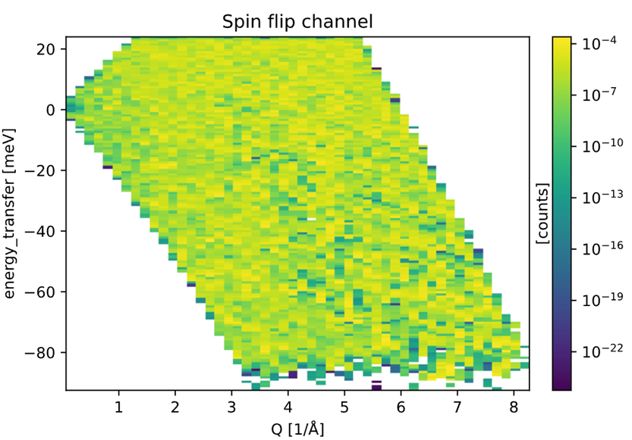
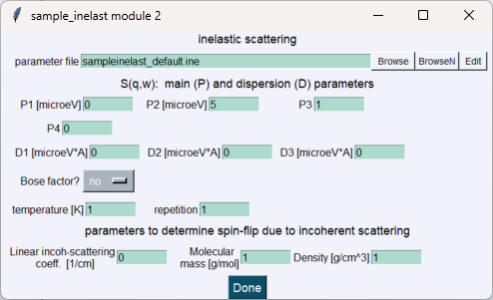
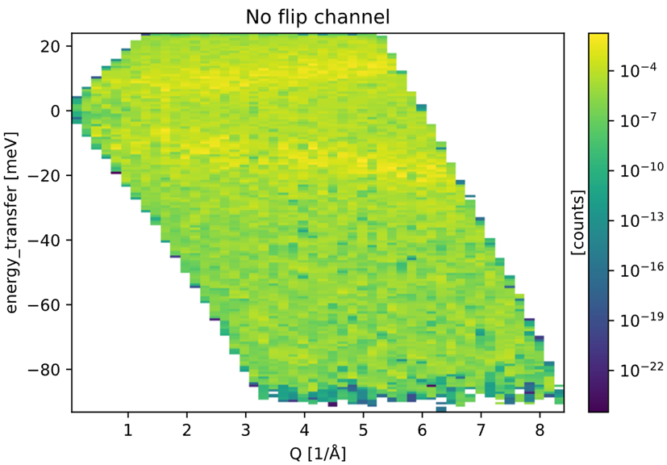
Sample_iNelast / eval_inelast
Can treat spin-dependent scattering now
Simulation on TOPAS@MLZ by N. Violini

Slide 26
The Reflectometer sample
slit
sample
detector
Considered
only neutrons reflected on the sample surface

Slide 27
The Reflectometer sample
slit
substrate
sample
Considers now also
neutrons passing by the sample
The substrate and attenuation in it
Handles correctly
Off-specular reflection
Incoherent scattering
detector

Slide 28
Modules for Data ANALYSIS
Monitor 1
Time
Wavelen
y-/z-pos
div-y/-z
Mon1D
MonBrill
Monitor 2
y-pos z-pos
div-y div-z
TOF λ
λ div_y/-z
y div-y
z div-z
k-y k-z
rad div-rad
Mon2D
MonPol 1
Time
Wavelen
y-/z-pos
div_y/-z
MonPol 2
y-pos z-pos
Evaluate
elast
elast2
inelast
runtime
elast_sans
Geometr.
frame
Trajector.
writeout
read_in
spin_reset
capt_flux
visualize

Slide 29

Modules representing Components in vitess 3.5
Sources
reactor
SPSS
LPSS
Space + Windows
space
slit
window/ beamstop
multiple windows
grid
beamstop
Choppers
disc
Fermi str.
Fermi curv.
vel.select
Monochr.
new
old
Modules f. Polaris.
³He-polar.
coil flipper
prec. field
quadr.field
pol. mirror
SM-polar.
grad. flipper
rot. field
res. Drabkin
Samples
elast. isotr.
powder
SANS
reflectom.
environm.
inelastic
NXS
S(Q)
sngl.crys.
Collimator
simple coll.
Soller coll.
radial coll.
Optics / Transport
guide
bender
SM ensemb
lens
ellipt. mirror
ideal guide
Various
detector
capture flux
filter 2D
29

Slide 30
Modules representing Components in vitess 3.7
Sources
reactor
SPSS
LPSS
Source_AI
Space + Windows
space
slit
window/ beamstop
multiple windows
grid
beamstop
Choppers
disc
Fermi str.
Fermi curv.
vel.select
Monochr.
new
old
Modules f. Polaris.
³He-polar.
coil flipper
prec. field
quadr.field
pol. mirror
SM-polar.
grad. flipper
rot. field
res. Drabkin
Samples
elast. isotr.
powder
SANS
reflectom.
Ncrystal.
environm.
inelastic
NXS
S(Q)
sngl.crys.
Collimator
simple coll.
Soller coll.
radial coll.
Optics / Transport
guide
bender
SM ensemb
lens
ellipt. mirror
ideal guide
prism
Various
detector
capture flux
filter 2D
30

Slide 31
Modules representing Components in vitess 4
Sources
simple
continuous
pulsed
Source_AI
ESS
ISIS
Space + Windows
space
slit
window/ beamstop
multiple windows
grid
beamstop
Choppers
disc
Fermi str.
Fermi curv.
vel.select
Monochr.
new
old
Modules f. Polaris.
³He-polar.
coil flipper
prec. field
quadr.field
pol. mirror
SM-polar.
grad. flipper
rot. field
res. Drabkin
Samples
elast. isotr.
powder
SANS
reflectom.
Ncrystal.
environm.
inelastic
NXS
S(Q)
sngl.crys.
Collimator
simple coll.
Soller coll.
radial coll.
Optics / Transport
guide
bender
SM ensemb
lens
ellipt. mirror
ideal guide
prism
Various
detector
capture flux
filter 2D
31

Slide 32
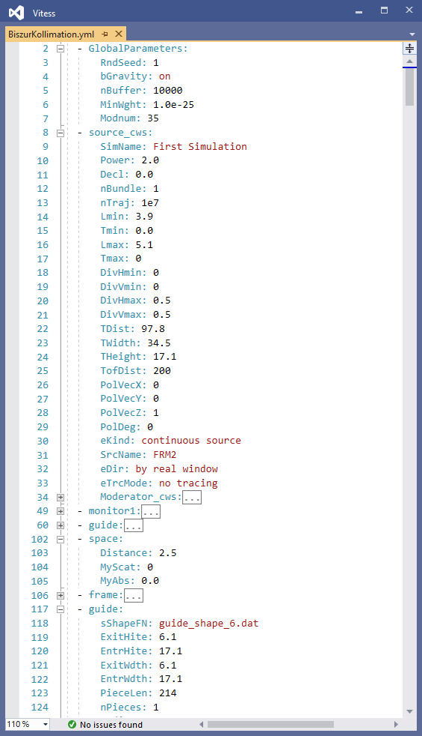
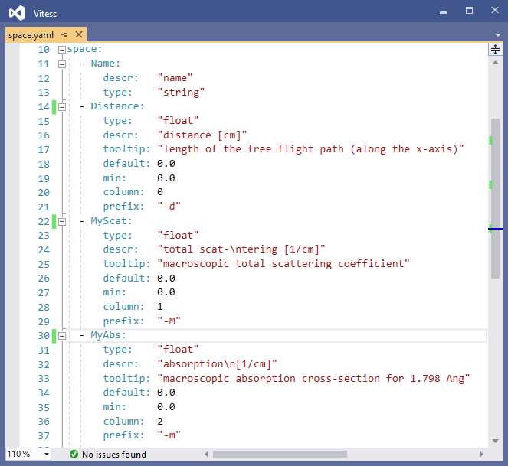
yaml files to store instruments and define modules
Part of reflectometer ‘MARIA’
Module ‘space’

Slide 33
Concept of piping
VITESS GUI
parameters
parameters
parameters
parameters
source
module 2
monitor
module n
param.file
I(par)
log file
geometry file
visualization file
neutron trajectories monitor update or reset
parameter change

Slide 34
Data handling for digital twins in vitess
Concept for Live Mode in VITESS
VITESS GUI
parameters
parameters
parameters
parameters
source
module 2
monitor
module n
param.file
I(par)
log file
geometry file
visualization file
neutron trajectories monitor update or reset
parameter change

Slide 35
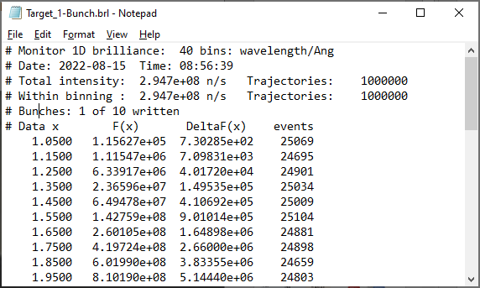
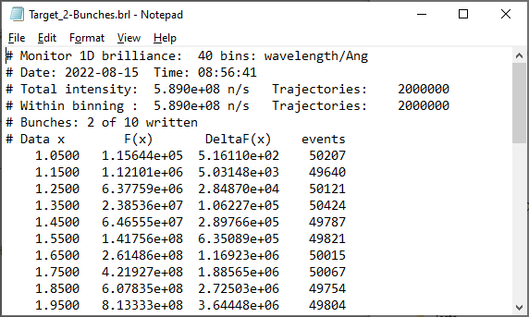
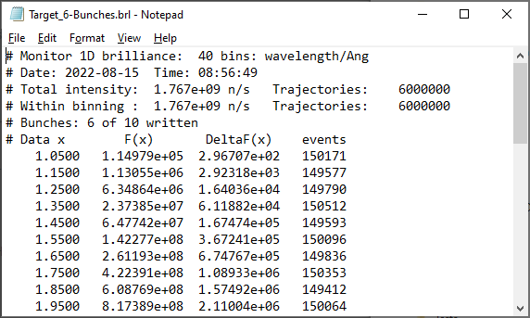
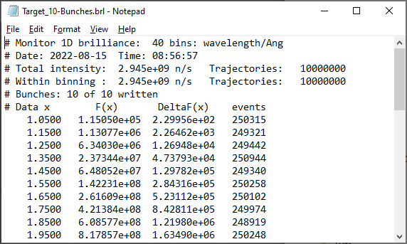
Updating of monitor output
Simulation split into a number of bunches, e.g. 10 x 1 Mio trajectories
All monitor outputs are updated after each bunch
Estimated intensity in the monitor channels roughly constant by considering the fraction of the simulated trajectories

Slide 36
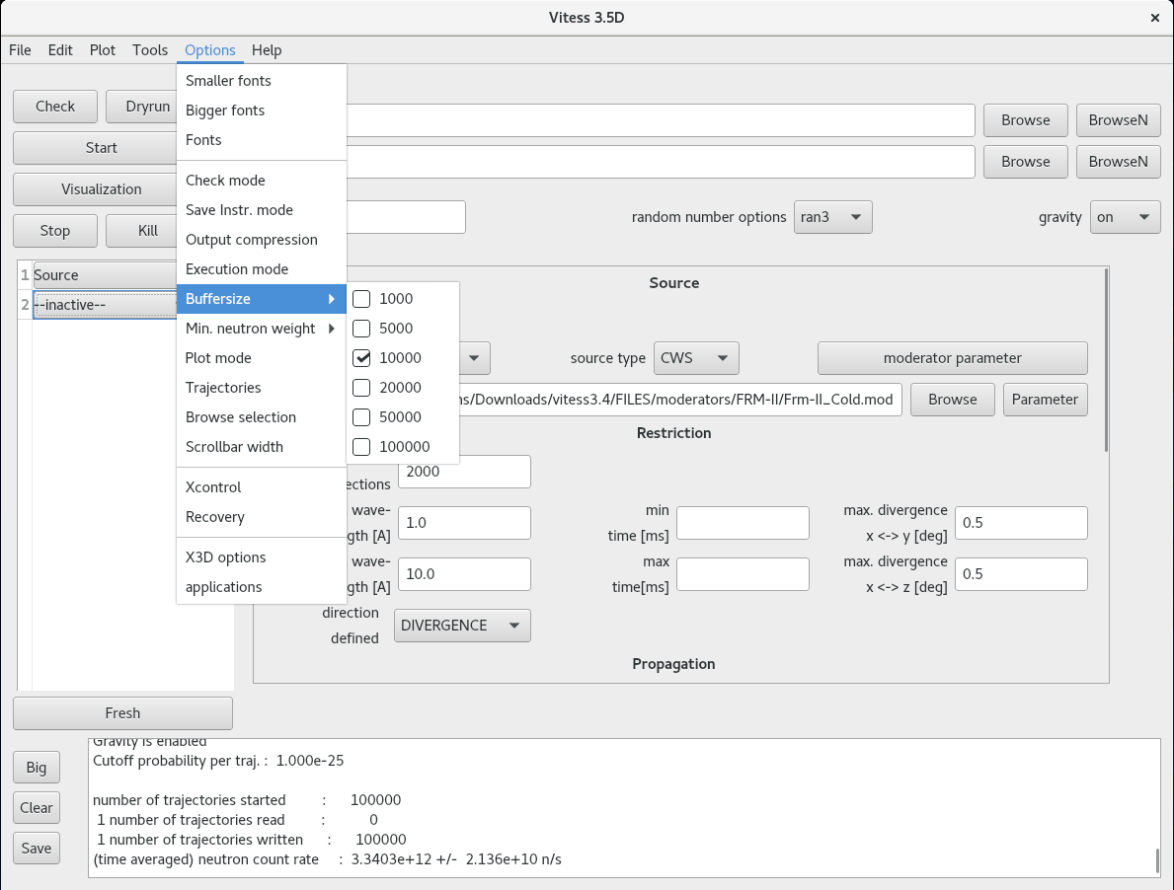
GUI of VITESS 4.0 using Qt

Slide 37
First ideas for vitess 5 in c++
Class Library
Instrument
Array[Component]
Simulation
nTrajectories
Instrument
check() start()
Component
readEvent() writeEvent()
Vector
Matrix
String
Union
Source
Device
Sample propToEntry() scatter()
Monitor
Array
Error
n-Fct. Library
SrcSimple
…
ReadIn
SmplSANS scatter()
……
SmplRefl scatter()
Intersection
Propagation
Event
Trajectory
Change
Command

Slide 38

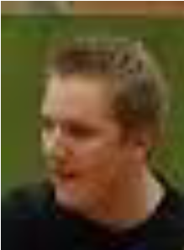
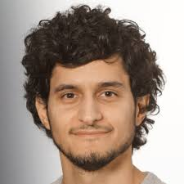
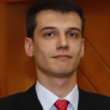
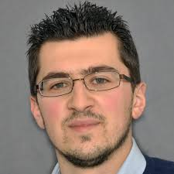
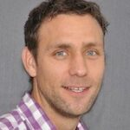

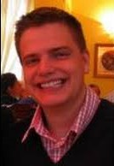
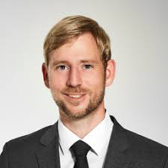
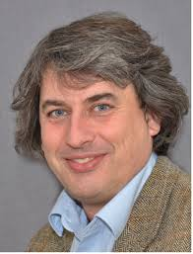
Vitess team
From Jülich
Klaus Lieutenant Fabian Beule José Robledo Norberto Schmidt Nicolò Violini Jörg Voigt Paul Zakalek
From MLZ Garching
Thank you for your attention!
Georg Brandl Christian Felder Stefan Mattauch
Notes:
38

