Slide 1
Instrument simulations with SIMRES
Advanced features and use cases
Jan Šaroun, Nuclear Physics Institute CAS, Řež, Czech Republic

Slide 2
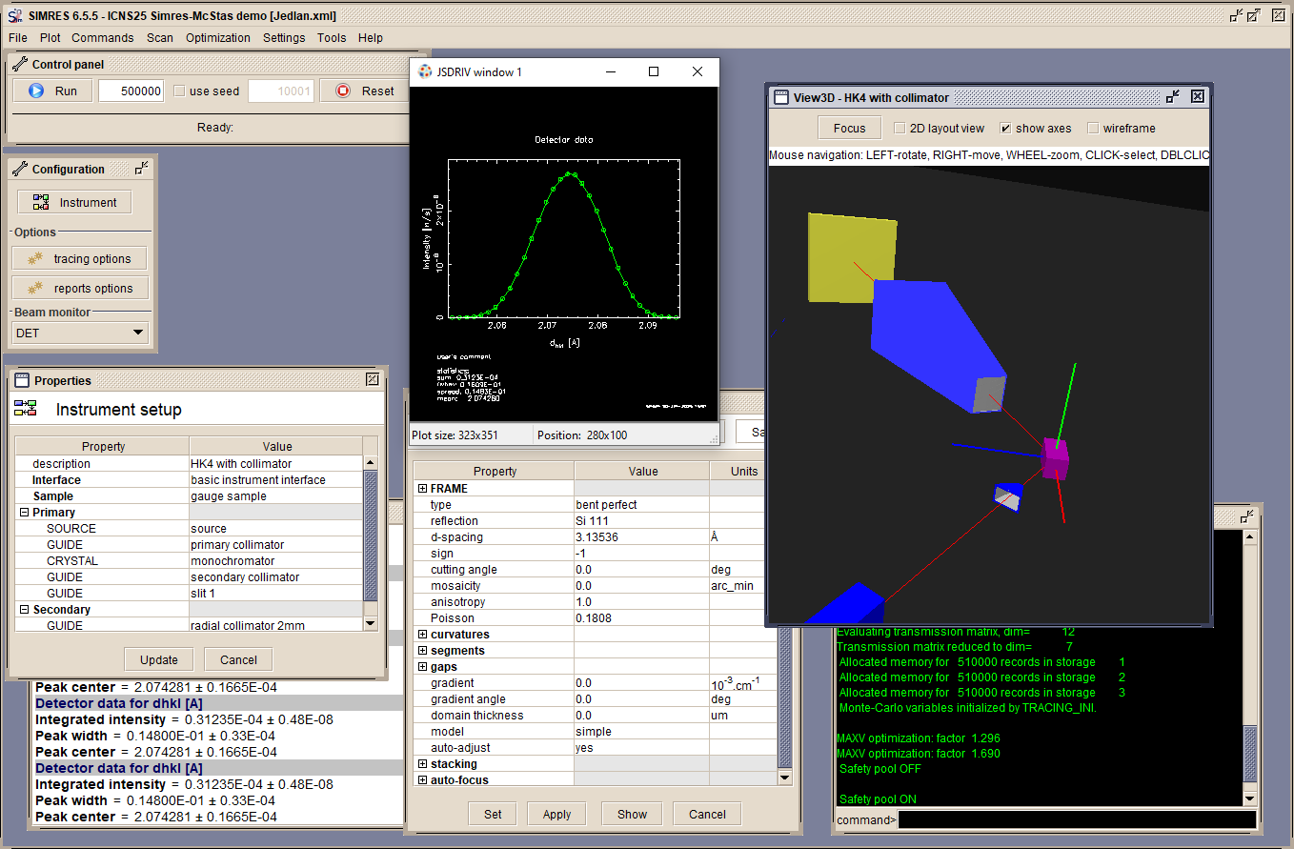
About SIMRES
History: since early 1990th, initially for 3-axis spectrometers (ResTrax)
Today: general purpose neutron ray-tracing
Differences vs McStas
Desktop application (interactive virtual instrument)
Not so versatile (new components difficult to implement)
Integrated variance reduction methods
= very fast (depending on configuration)
  Optional reverse tracing: start at the sample …
Complementary:
includes components and features not available in McStas

Slide 3
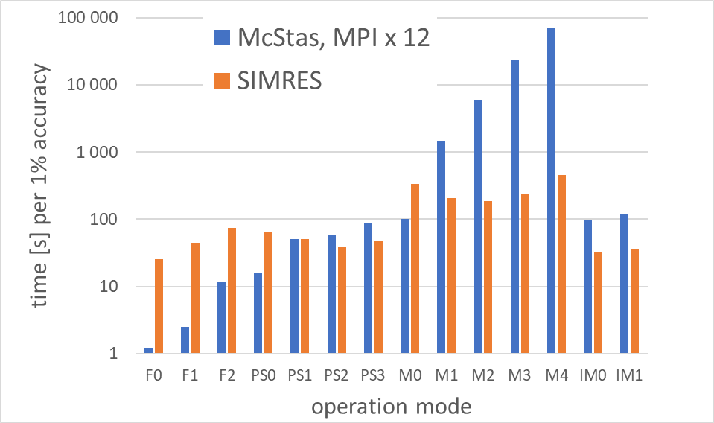
About SIMRES
History: since early 1990th, initially for 3-axis spectrometers (ResTrax)
Today: general purpose neutron ray-tracing
Differences vs McStas
Computing time to 1% accuracy for various BEER@ESS operation modes
Strain-scanning, beam 1x3 mm²
Desktop application (interactive virtual instrument)
Not so versatile (new components difficult to implement)
Integrated variance reduction methods
= very fast (depending on configuration)
  Optional reverse tracing: start at the sample …
Complementary:
includes components and features not available in McStas
Imaging,
slit 10x10 mm²
Diffration
beam 2x5 mm²
Full white beam
Project-driven development:
Powder and engineering diffractometers (monochromatic and ToF)
Neutron transport optics, crystal monochromators

Slide 4
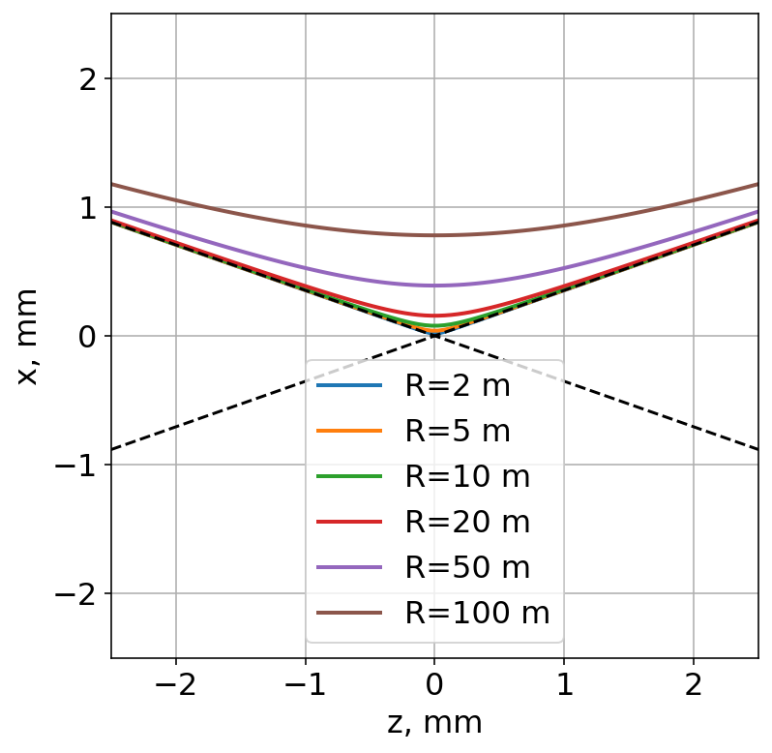
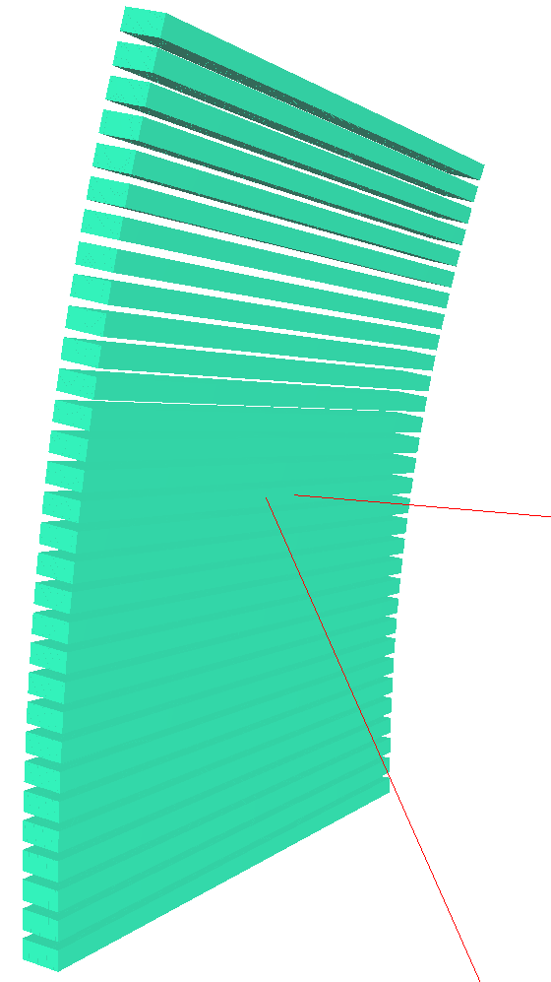
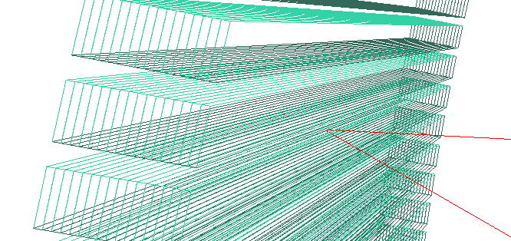

CRYSTAL: Elastically bent crystals
Quasiclassical neutron trajectories in uniformely bent single crystals
P. Lukáš, J. Kulda, Phys. stat. sol. (b) 166,41 (1989)
Si 111, λ=2.1 Å
Used as monochromators and analyzers
Single reflecting plane
OK for monochromators etc.
Hyperbola - can be replaced by lines for R <~ 10 m
Fails near the perfect crystal limit
Assumes uniform deformation:
$$∇\vec{G}=const$$
Today:
CRYSTAL models bent mosaic crystals and their 3D focusing arrays.
Bent perfect or flat mosaic crystals are special cases handled by the same algorithm
Arranged in a focusing array
Sandwich of bent Si wafers
Recently implemented in McStas
Daniel L. Christensen: ICNS2025 presentation
e.g. monochromator at SALSA@ILL

Slide 5
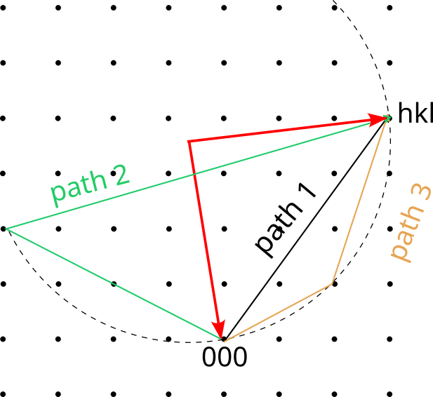







XTAL: Extended bent single crystal model
Bent perfect single crystals (Si, Ge, …)
Multiple reflections
(crystallographic data provided for Si, Ge, C, Al₂O₃, MgF₂, …)
$${\vec{G}}_{hkl}$$
How it works:
NOTE: rec. lattice varies with position in the crystal
$${\vec{k}}_{f}$$
$$\frac{{\vec{G}}_{hkl}}{2}$$
Choose a wavelength range
Find all G_{hkl} where Δλ_{hkl} fits in this range
Select one G_{hkl} or transmitted beam (G₀₀₀ )
Optional: include multiple reflections:
$${\vec{k}}_{i}$$
$${∆λ}_{hkl} =c ∗ path_length$$
$∝ \left({\vec{k}}_{i}+{\vec{G}}_{hkl}\right)∙∇{\vec{G}}_{hkl}∙$ ${\vec{k}}_{i}$
list all possible paths to hkl …
$${\vec{G}}_{hkl}$$
gradient of

Slide 6
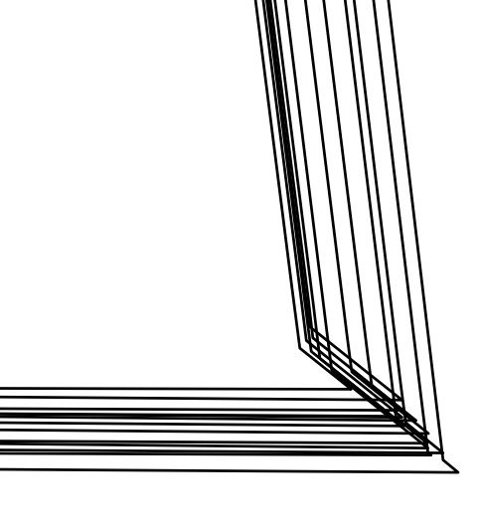
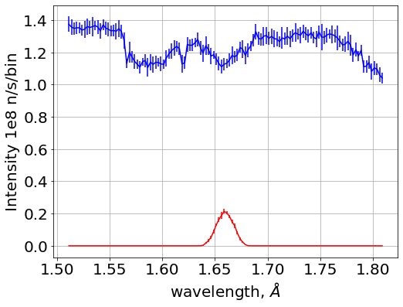
XTAL: Extended bent single crystal model
Fast algorithm – aims at a single final hkl reflection
All competing reflections are considered for beam attenuation
Simulation of “forbidden“ reflection Si 222
111
(222) = (331) + (111)
112
Experimentally verified:
P. Mikula et al., Phys. Met. Metall. 123 (2022) 354-1360
Aplication:
Studies of multiple reflection effects
monochromators, analyzers
(including focusing arrays)
… or a stack of bent wafers
Spectrum after monochromator
Transmitted
spectrum
solid state benders
SALSA@ILL monochromator
Si004
Beam attenuated by ~30 contributing reflections

Slide 7


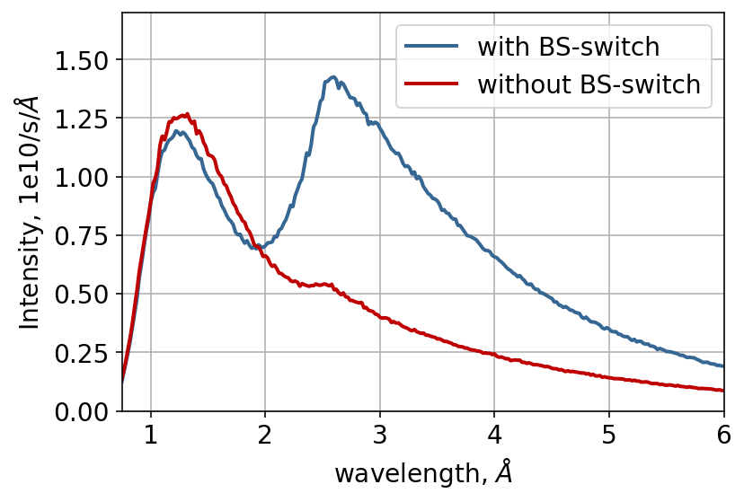
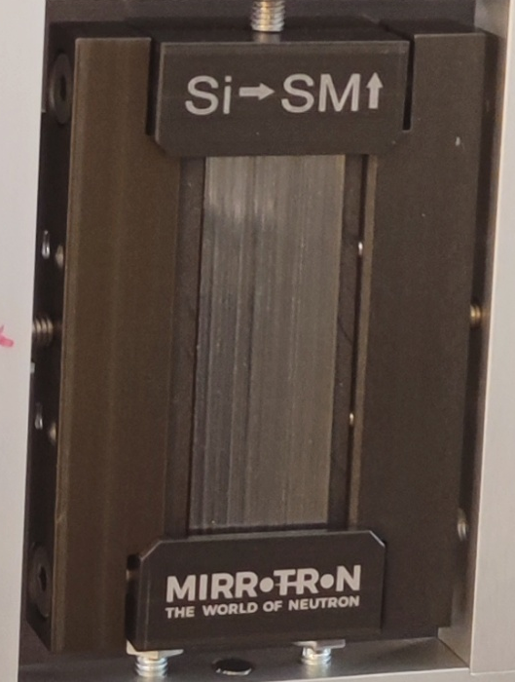
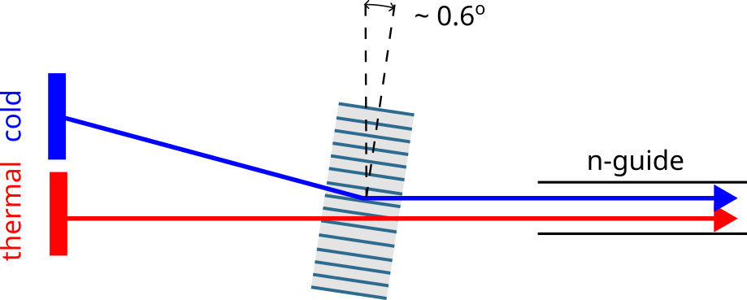
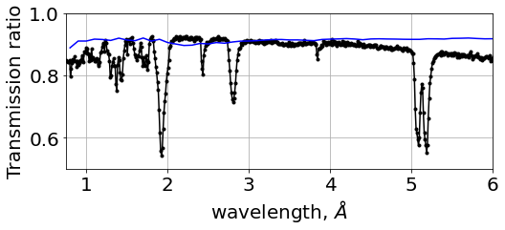
XTAL: Extended bent single crystal model
Example: Bi-spectral switch for BEER@ESS
Spectrum at the sample was predicted by both McStas and SIMRES models of BEER:
stack of 160 Si single-crystal blades
coated with m=3 NiTi supermirror
ESS moderator
?
Problem: residual elastic deformation of Si
expected
What we observed in the test at IMAT@ISIS:
measured

Slide 8
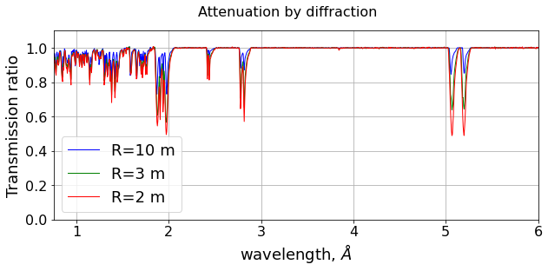
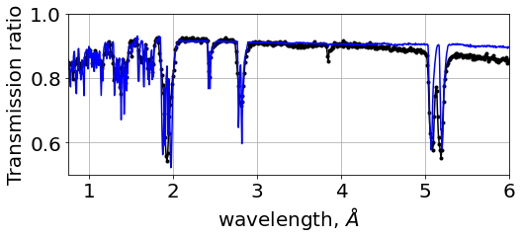
XTAL: Extended bent single crystal model
Example: Bi-spectral switch for BEER@ESS
SIMRES/XTAL: beam extinction by diffraction in a stack of bent Si blades (without NiTi)
McStas: simulation of the IMAT experiment with a new solid state bender component (under development, derived from Guide_multichannel.comp)
Total transmission probability for bending <R> = 2.5 m
simulated
measured
Details of the IMAT experiment presented at ICNS 2025:
J. Šaroun, J. Fenske, G. Nowak, C. Durniak, S. Britto, W. Kockelmann, D. Raspino, P. Beran, Z. Tasi, Z. Ludanyi
Poster B1/441

Slide 9
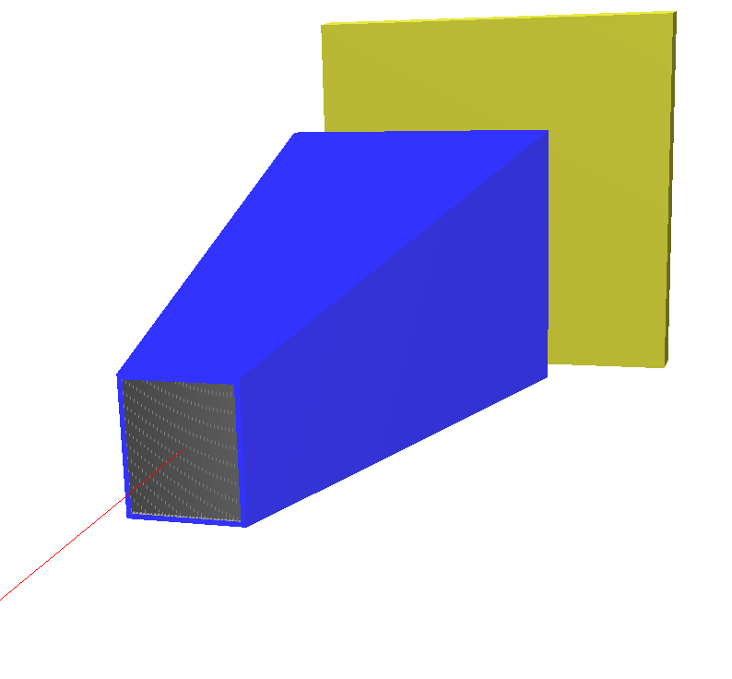
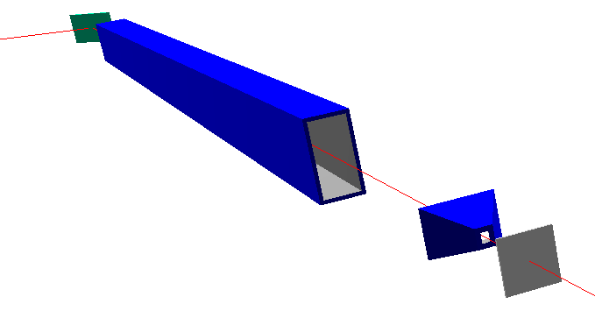
Binding to McStas running McStas as a part of SIMRES instrument model
SIMRES instrument model
Sample replaced by event monitor
Access to variety of McStas components
Advanced sample models
Neutron-optical components not available in SIMRES
Unions: e.g. complex samples and sample environment …
MCPL_input
McStas simulation
MCPL_output

Slide 10
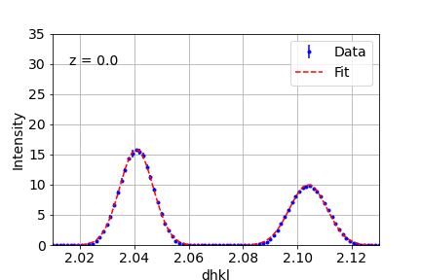
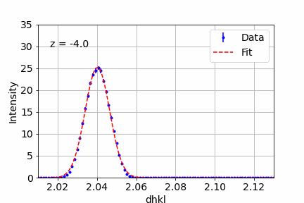
Binding to McStas
Example:
Residual stress mapping, simulation of pseudo-strains
SIMRES
secondary
beam
scan
McStas UNION section
γ-Fe
α-Fe 110
γ-Fe 111
3 cm
α-Fe
slit
2x3 mm²
SIMRES
HK4@NPI
primary beam
peak positions vary also for a stress-free material = pseudo-strain

Slide 11
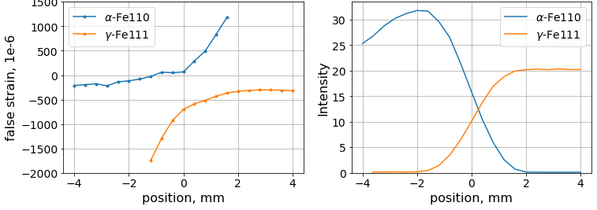
Binding to McStas
Example:
Residual stress mapping, simulation of pseudo-strains
Simulations are used to:
Correction for measured residual strain
(similar magnitude !)
Finding the position of the interface
Assess texture or chemical gradients
Peak shift
Peak intensity

Slide 12

Event monitors
sample
monitors
last component
source
trigger
a “successful neutron” triggers event storage
Registered events are kept in the memory until next simulation
=> visualize and export in any projection and binning
Usage
Instrument optimization
Sample monitors: provide sampling distribution for data analysis

Slide 13
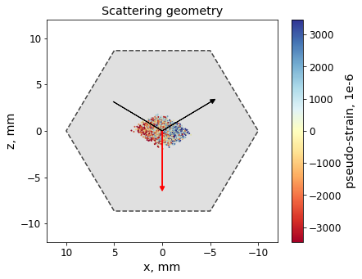
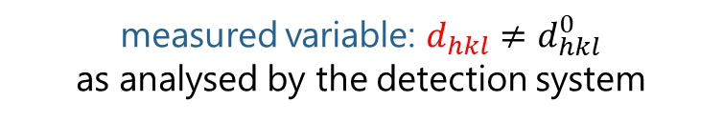
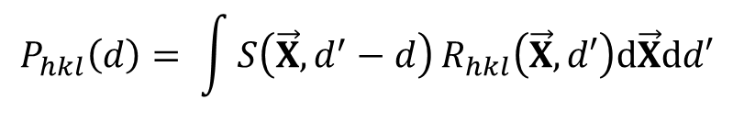


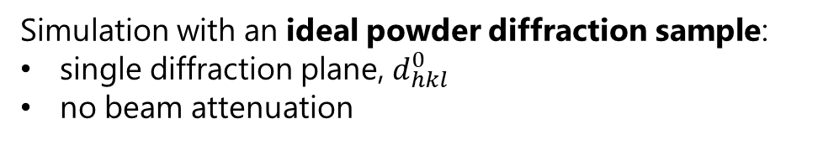
Sampling distribution for data analysis
Use case: treatment of pseudo-strains
Simulation with an ideal powder diffraction sample:
single diffraction plane, $d_{hkl}^{0}$
no beam attenuation
event list from sample monitors: (r, k_{i}, k_{f,} w)
+
measured variable: $d_{hkl}≠d_{hkl}^{0}$
as analysed by the detection system
=
Convolution sum can be evaluated by external tools:
complete instrument resolution function
$${P_{hkl}\left(d\right)= \int{S\left(\vec{X},d^{′}−d\right)}R}_{hkl}\left(\vec{X},d′\right)d\vec{X}dd′$$
$$R_{hkl}\left(\vec{X},d\right)$$
Peak profile
“as measured”
$${≡\vec{r},\vec{k}}_{i},{\vec{k}}_{f}$$
Sample properties

Slide 14
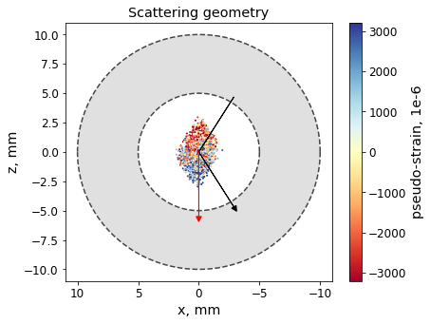
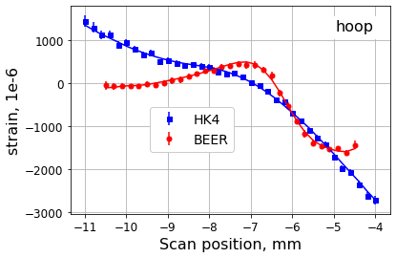
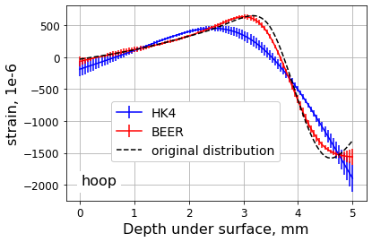
STRESSFIT: Python package for treatment of pseudo-strains
https://github.com/NPLtools/stressfit
The MC convolution is used in the cost function for deconvolution of measured residual strain distributions
Test on synthetic data for BEER and HK4 instruments:
Diffraction geometry
“As measured” strain distributions
Deconvoluted intrinsic strain

Slide 15
Concluding remarks
Availability: https://github.com/saroun/simres
Maintenance, bug fixes, minor upgrades + support continues …
Future:
Major refactoring would be desired but not likely to happen …
Complex development/compilation toolchain
  Core: Fortran+C, CLI: Java, GUI: Java+Java3D, Lazarus Pascal
  => Move to: Fortran/C + Python ?
Manpower …
Re-use in McStas:
Implementation of some of the SIMRES components in McStas (help welcome)
So far:
Monochromator_bent, NPI_tof_dhkl_detector, NPI_tof_theta_monitor, Guide_multichannel, bispectral_switch (under development) …

Slide 16
Thank you for attention

