Slide 2
Introducing Effects of Surface Physics in McStas Union
PRESENTED BY Mads Bertelsen

Slide 3
Introduction
McStas instrument structure
Component sequence
Source
Guide_bunker
Chopper
Guide_1
Guide_2
Guide_3
Sample
Analyzer
Detector

Slide 4
Union components
Geometry
  Geometry constructed from simple shapes
  Each assigned a material
  All shapes given a priority value
  Can overlap
  In overlap, largest priority value decides material
7.7
2.1
Boxes, cylinders, cones, spheres

Slide 5
Union components
Geometry
  Assemble materials from scattering processes
Incoherent_process
Al
Powder_process
Incoherent_process
Sample
Single_crystal_process
Incoherent_process
Inelastic sample
Single_crystal_process
NCrystal_process
Vacuum

Slide 6
Union components
Using the Union components
Union_init.comp
Typical sample component
Union components
Incoherent_process.comp
Incoherent scattering
Single_crystal_process.comp
Single crystal scattering
Union_make_material.comp
Union_box.comp
Single_crystal.comp
Geometry
Raytracing
Absorption
Scattering
- Incoherent
- Single crystal Bragg
Multiple scattering loop
Union_cylinder.comp
Union_master.comp
Raytracing
Absorption
Sampling scattering physics
Multiple scattering
Union_stop.comp

Slide 7

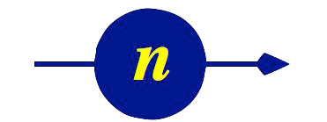
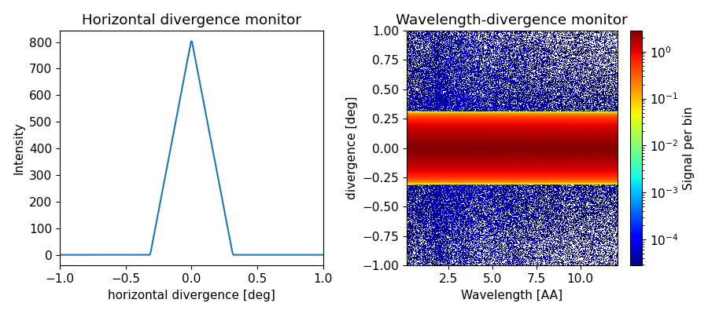
Union components
Simple example - colimator
McStas
  Lets make a colimator
  Absorbing blades limit divergence
Cd
Air

Slide 8
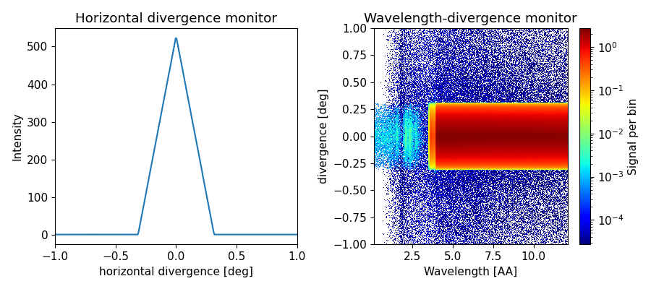
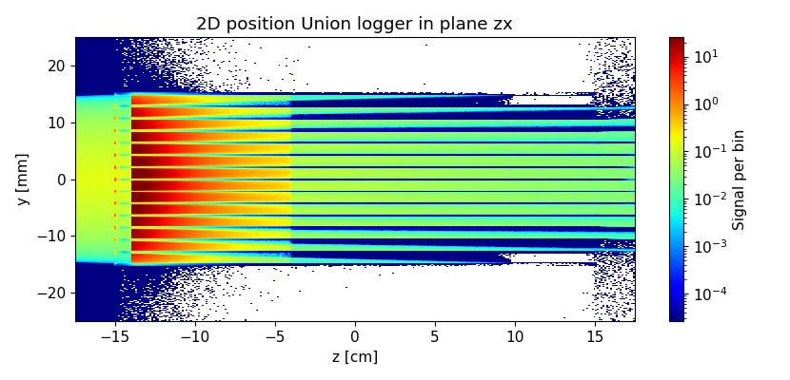
Union components
Simple example - filter
McStas
  Lets make a colimator
  Absorbing blades limit divergence
  Add a Be block, now its a filter
Cd
Air
Be

Slide 9
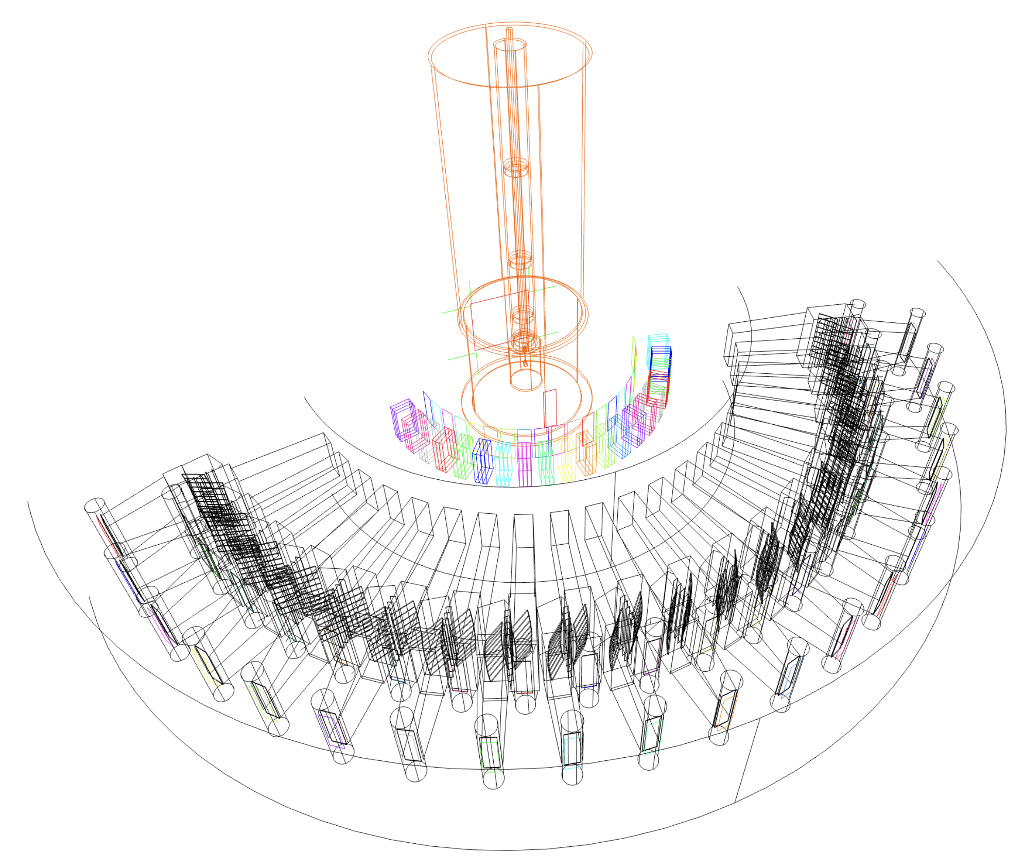
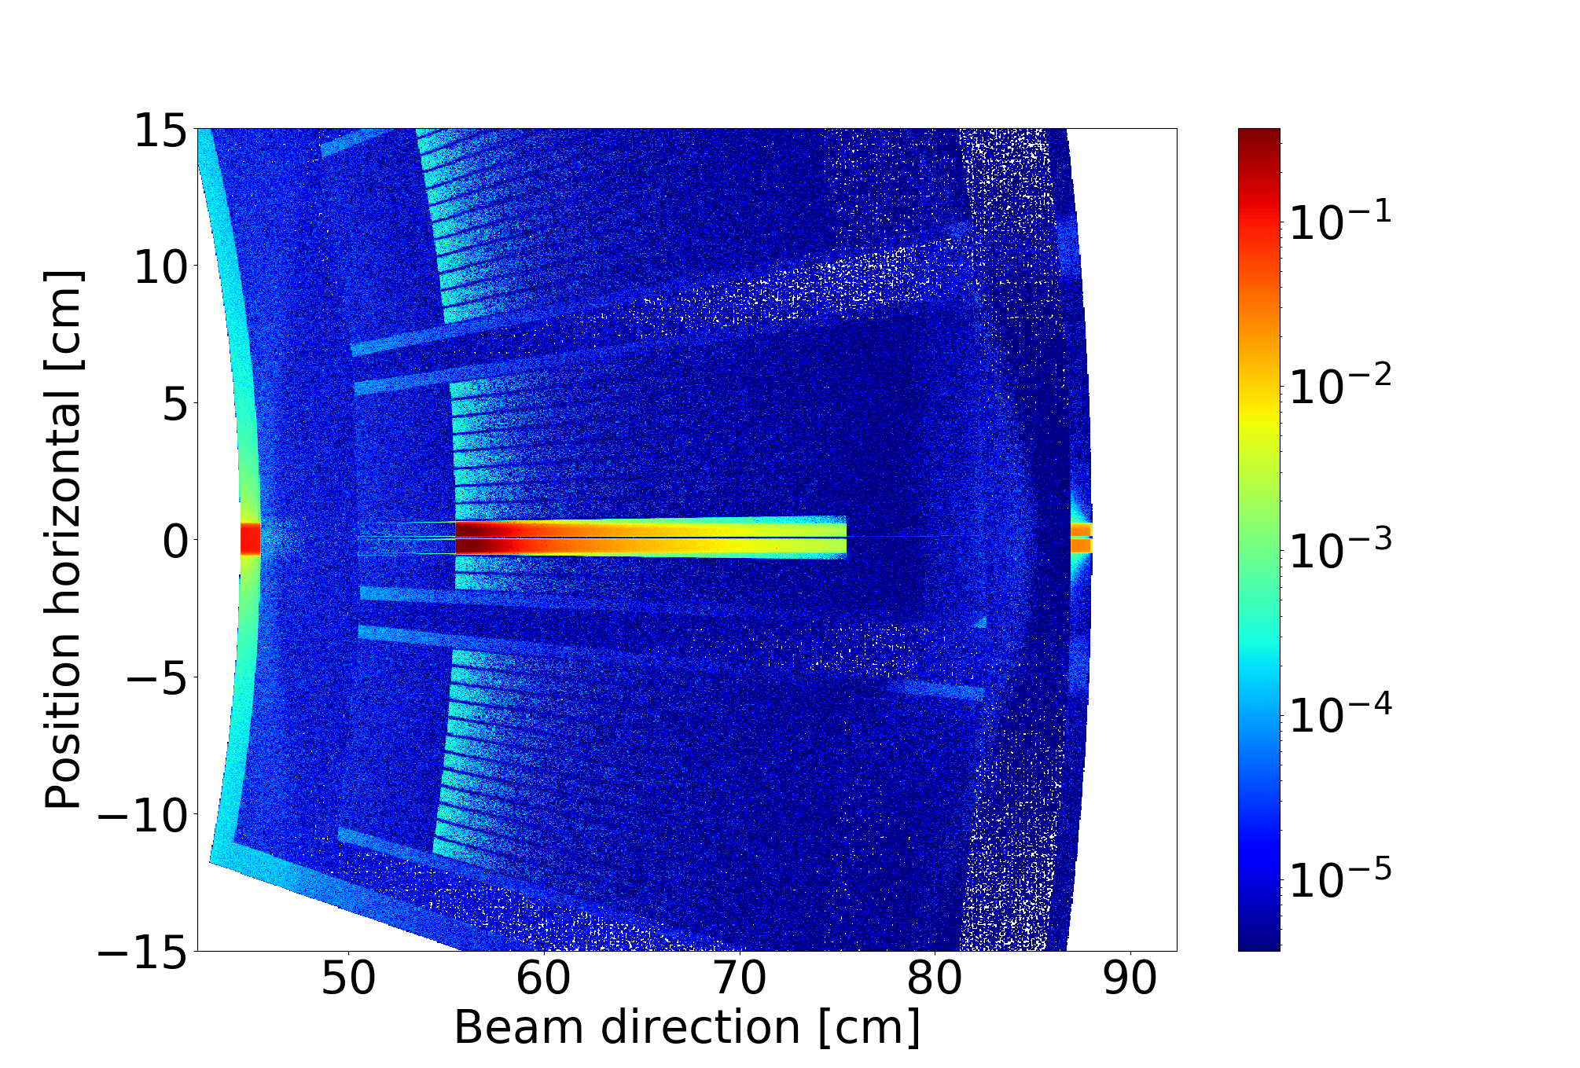
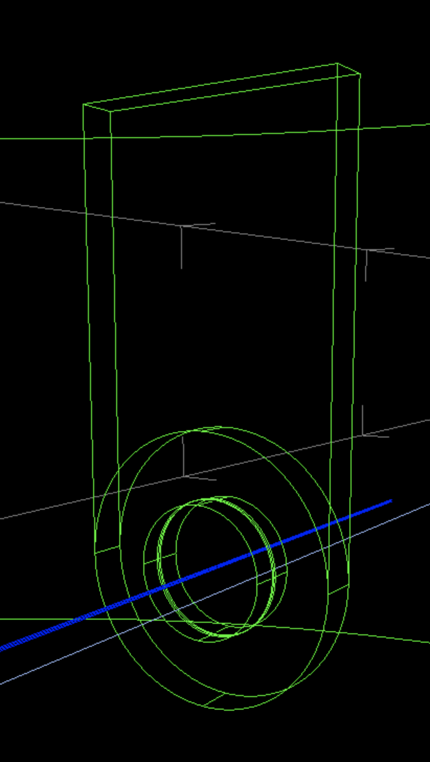
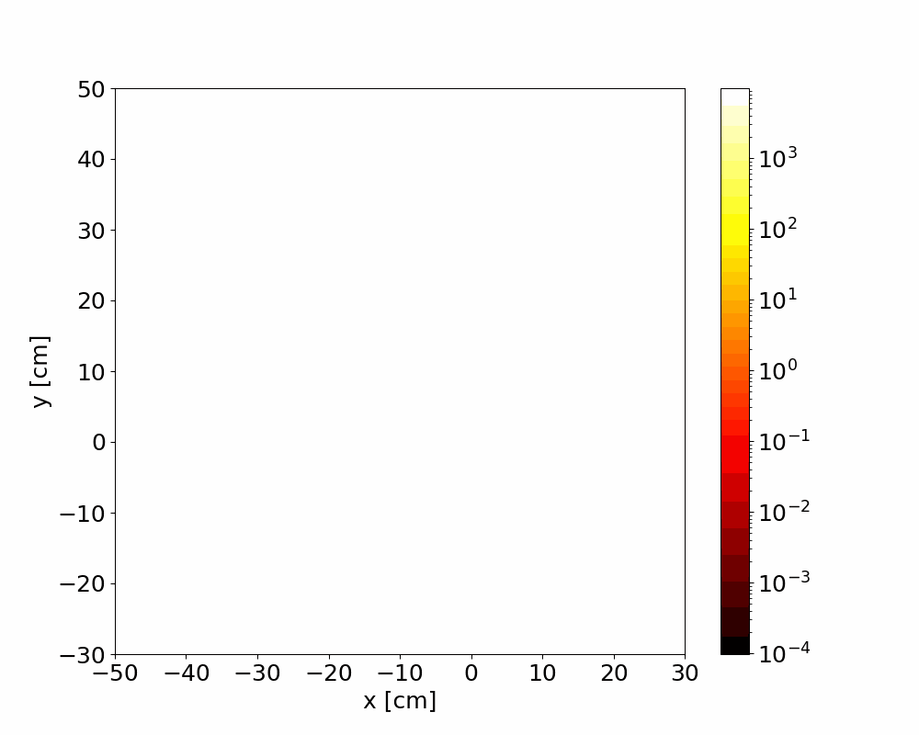
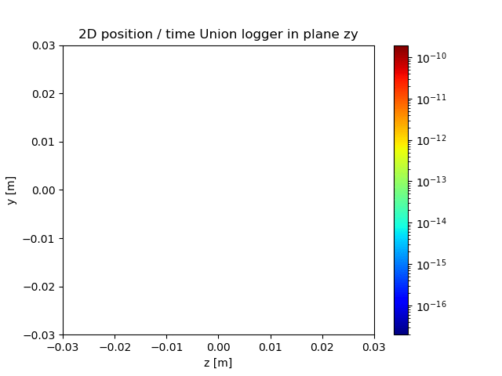
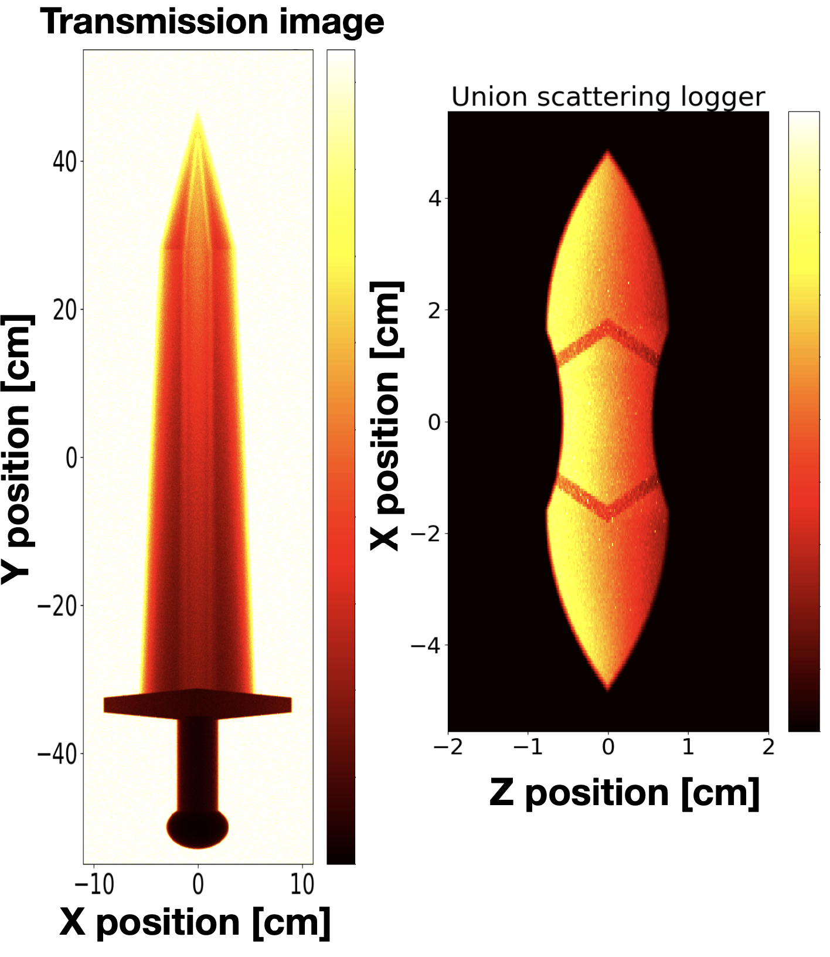
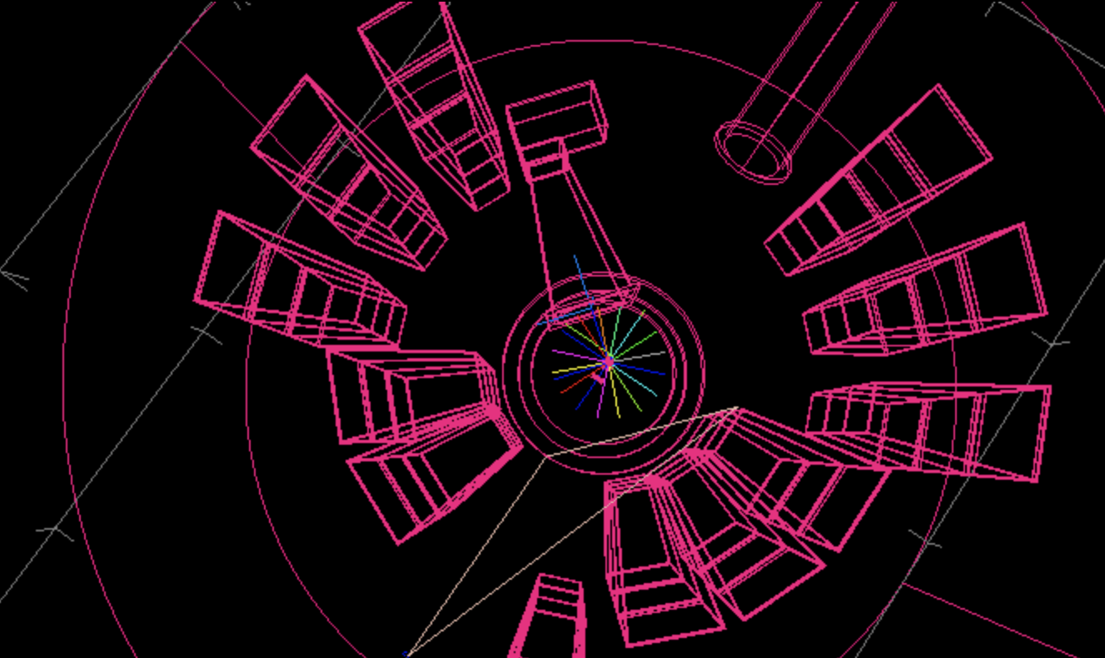
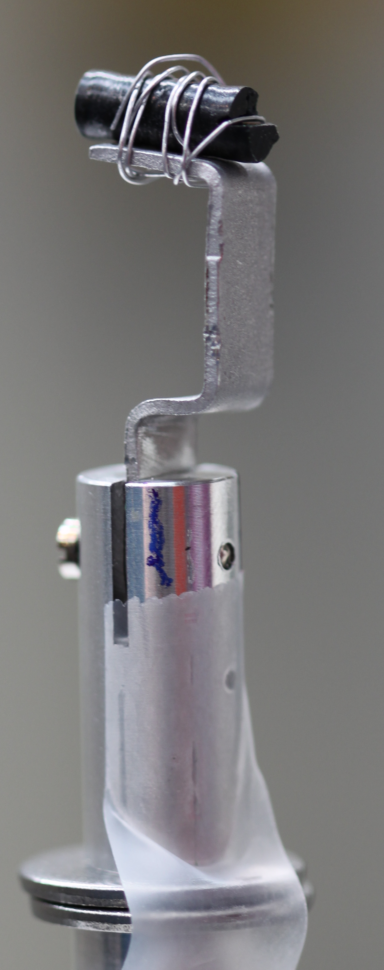
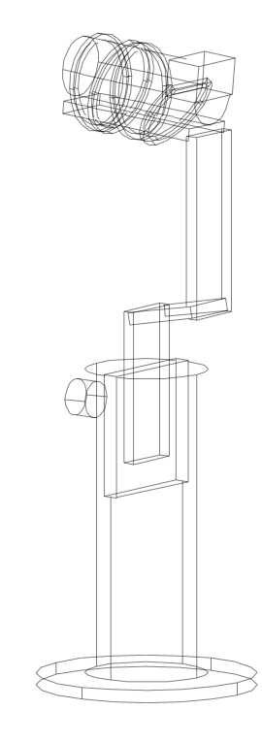
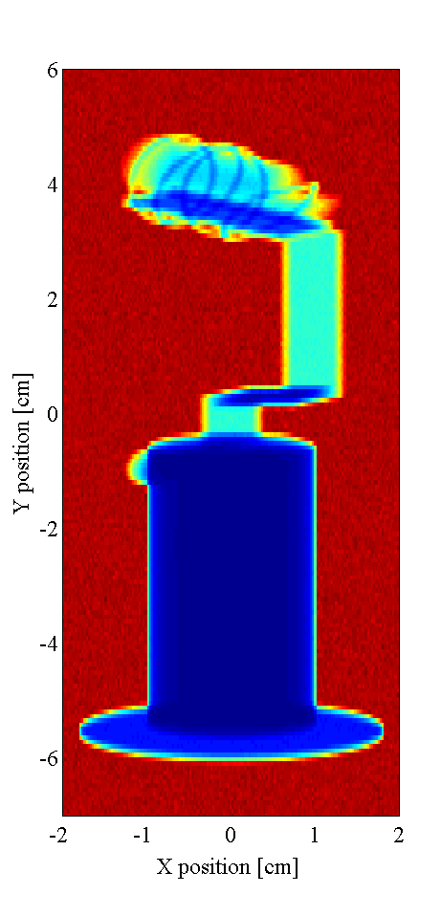
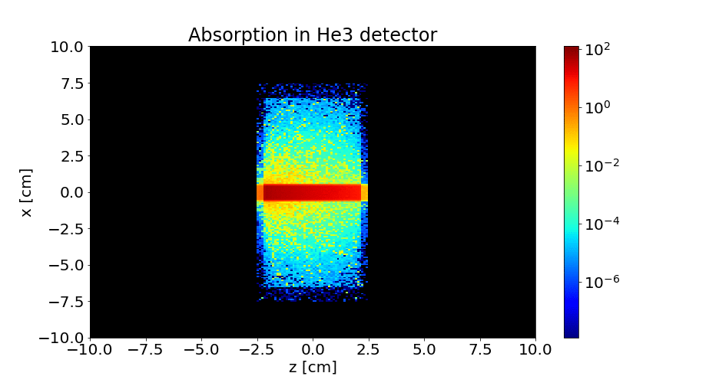
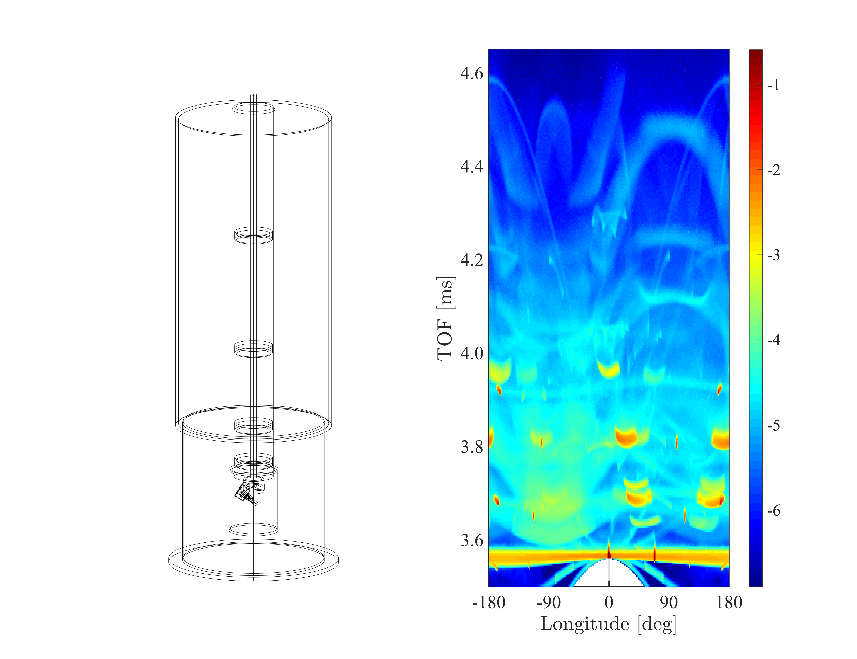
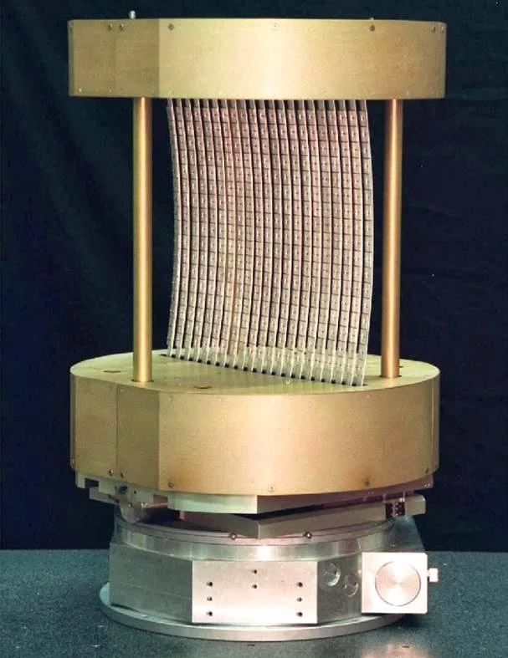
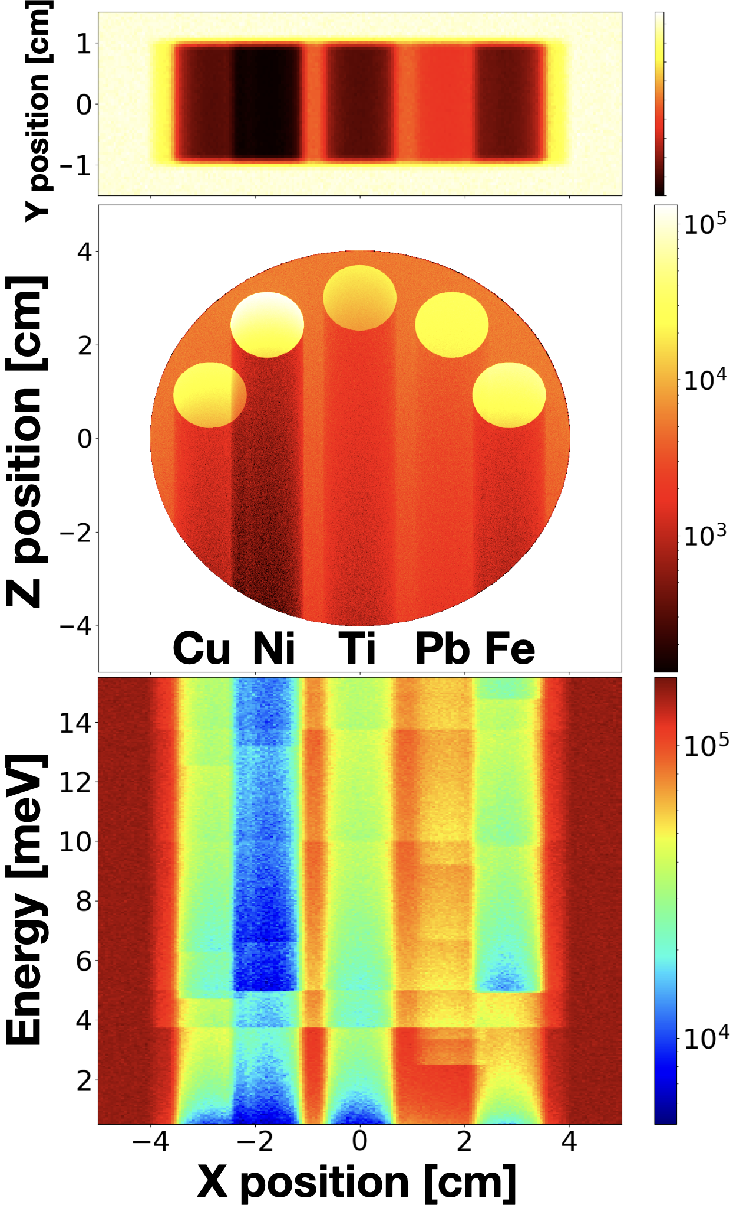
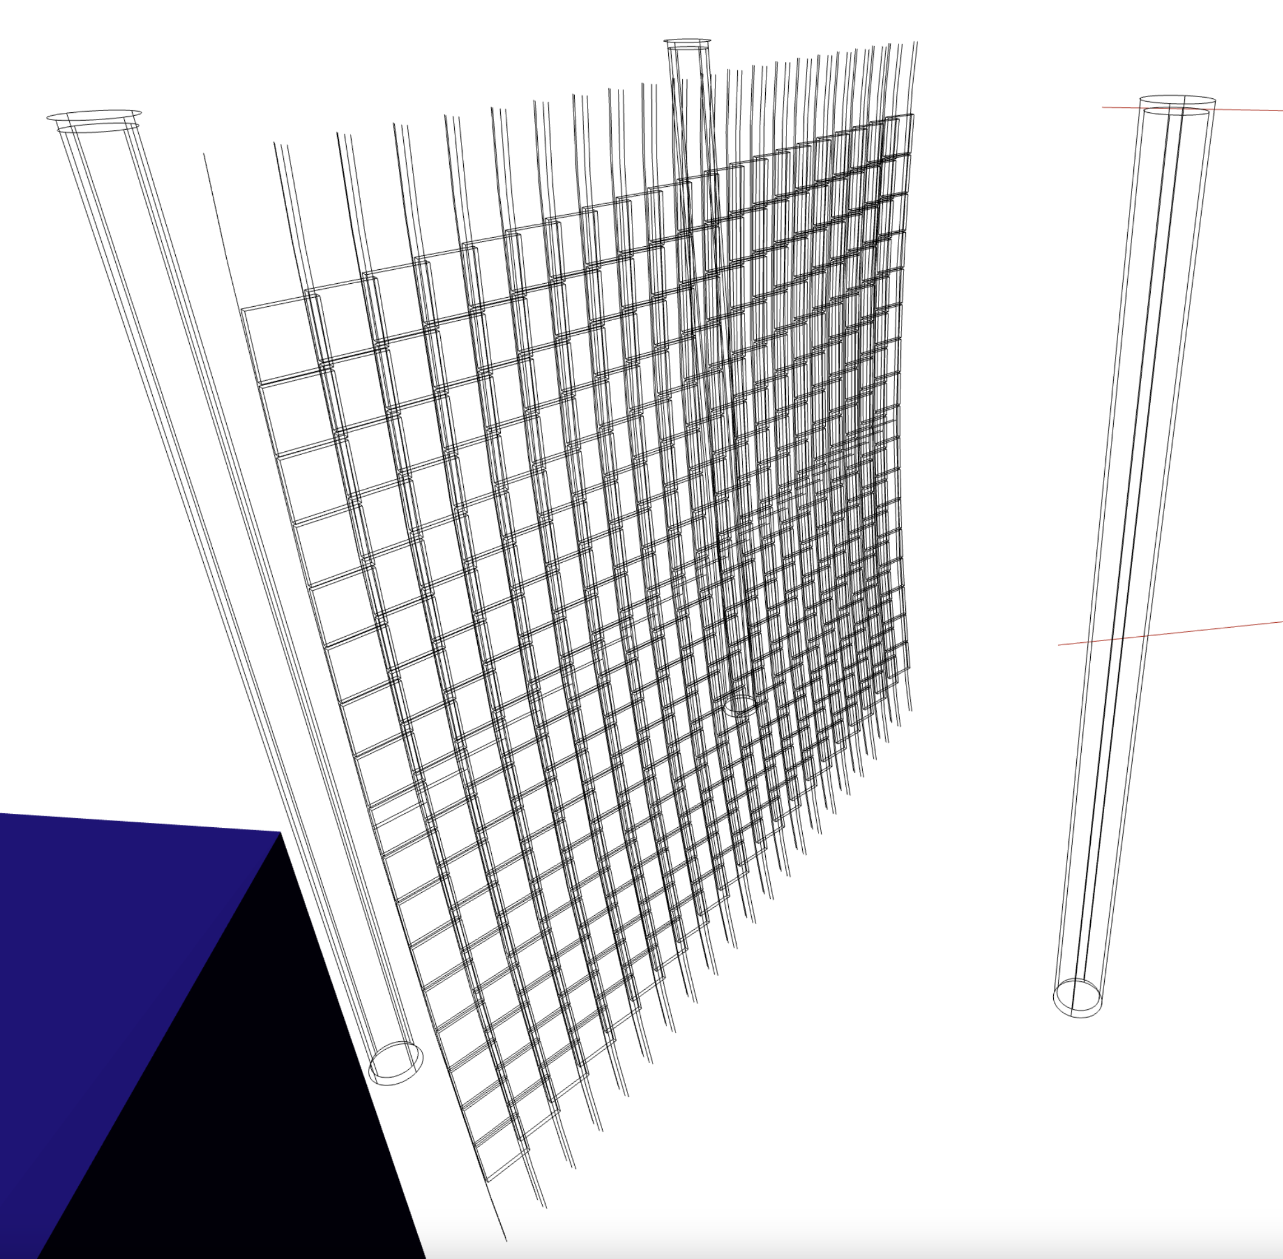
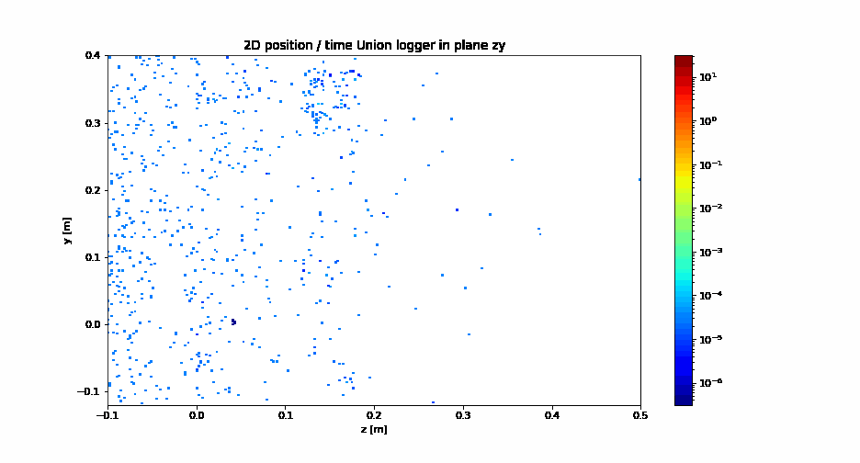
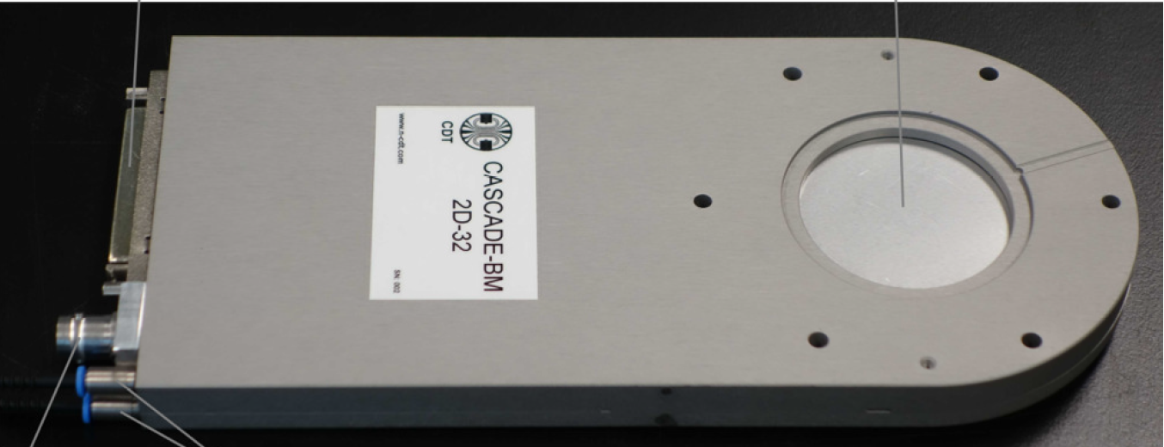
Use cases
  Samples
  Sample holder
  Air
  Sample environment
  Colimators
  Filters
  Beam monitors
  Monochromators
  Detectors
  Instrument backends
Photo by Pia Ray Jensen

Slide 10
Union components
Assumptions
  Bulk scattering, scattering properties independent of position in material
  Gravity not simulated
  Polarization not supported
  No physics when rays cross an interface

Slide 11
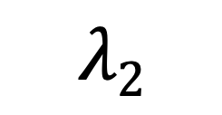
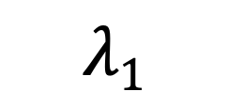
Interface physics update
Refraction
n₁
  Code from Refractor.comp by E. Farhi, B. Cubitt
  Scattering length density provided with material definitions
  Refraction calculation require SLD for both materials
  Snells law with fall of
$$λ2$$
n₂
$$λ1$$
n = sqrt(1.0-(lambda*lambda*SLD/PI))
n1 sin(theta1) = n2 sin(theta2)

Slide 12
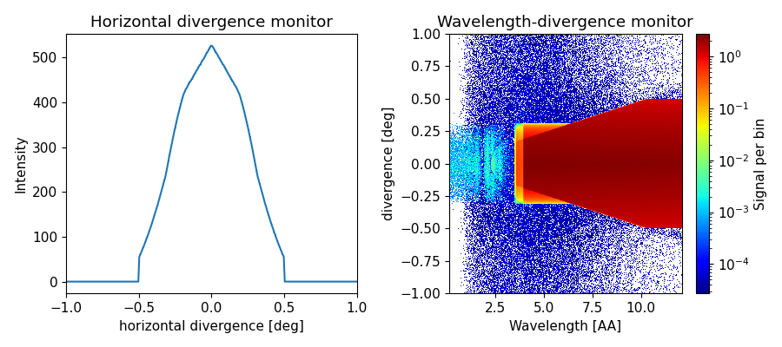
Interface physics update
Simple example - filter
No refraction
Refraction
Cd
Air
Be

Slide 13

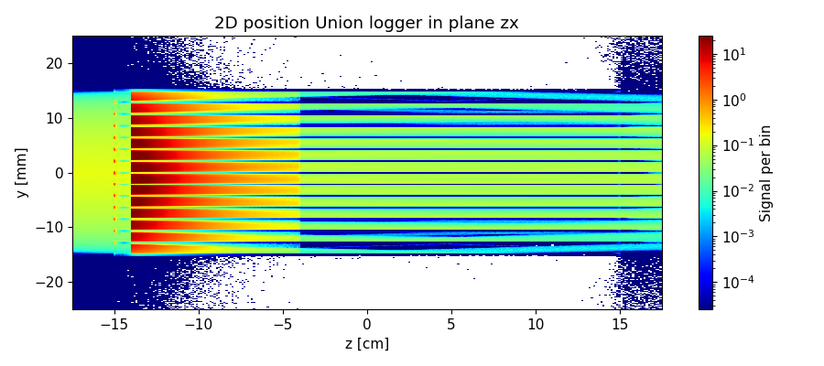
Interface physics update
Simple example - filter

Slide 14
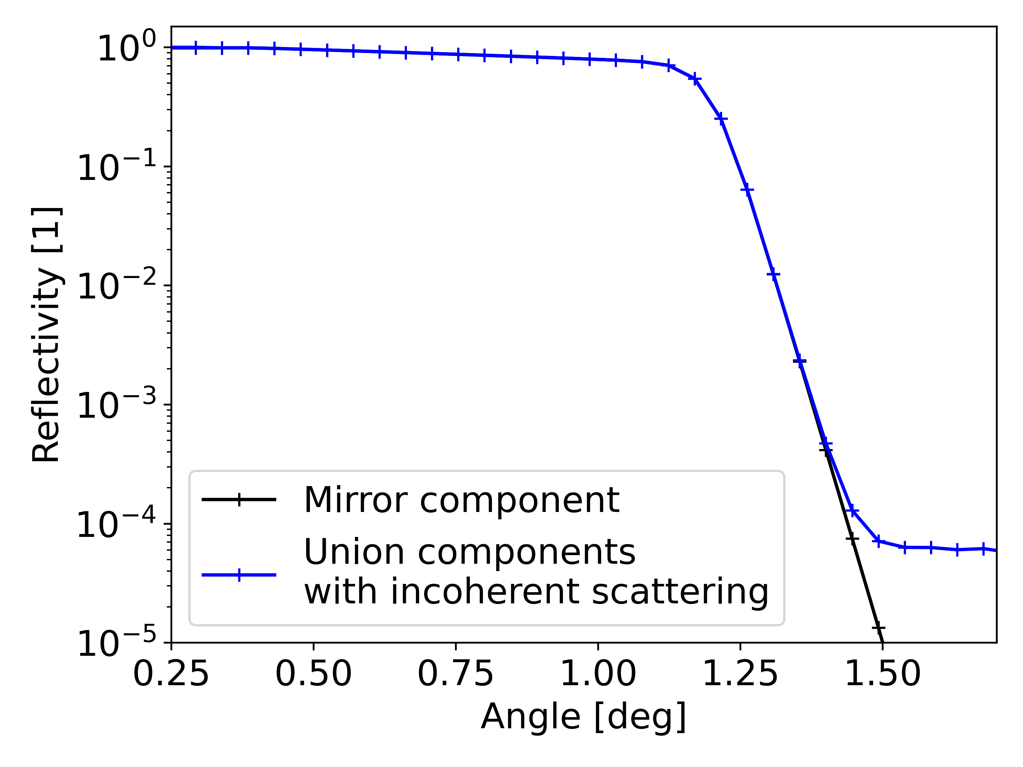
Interface physics update
Surface processes
  Surface process components
    Gets normal vector, initial wavevector and weight
    Returns final wavevector and weight
  Allows
    Reflectivity curve
    Thin absorbing paints
    …
  Can be attached to geometry faces
    Each outside face
    ... and one for all cuts in inside of material

Slide 15
Interface physics update
Surface stacks
  Surface process components
    Gets normal vector, initial wavevector and weight
    Returns final wavevector and weight
  Allows
    Reflectivity curve
    Thin absorbing paints
    …
  Can be attached to geometry faces
    Each outside face
    ... and one for all cuts in inside of material
Geometry A
A: Surface process
B: Surface process
Geometry B

Slide 16
Interface physics update
Surface stacks
  Surface process components
    Gets normal vector, initial wavevector and weight
    Returns final wavevector and weight
  Allows
    Reflectivity curve
    Thin absorbing paints
    …
  Can be attached to geometry faces
    Each outside face
    ... and one for all cuts in inside of material
    Several processes can be combined into a stack
Geometry A
A: Surface process 1
B: Surface process 2
B: Surface process 1
Geometry B

Slide 17
Interface physics demo
McStas
Al
Bi single crystal
Super-mirror
Fe
Ni
Beam

Slide 18
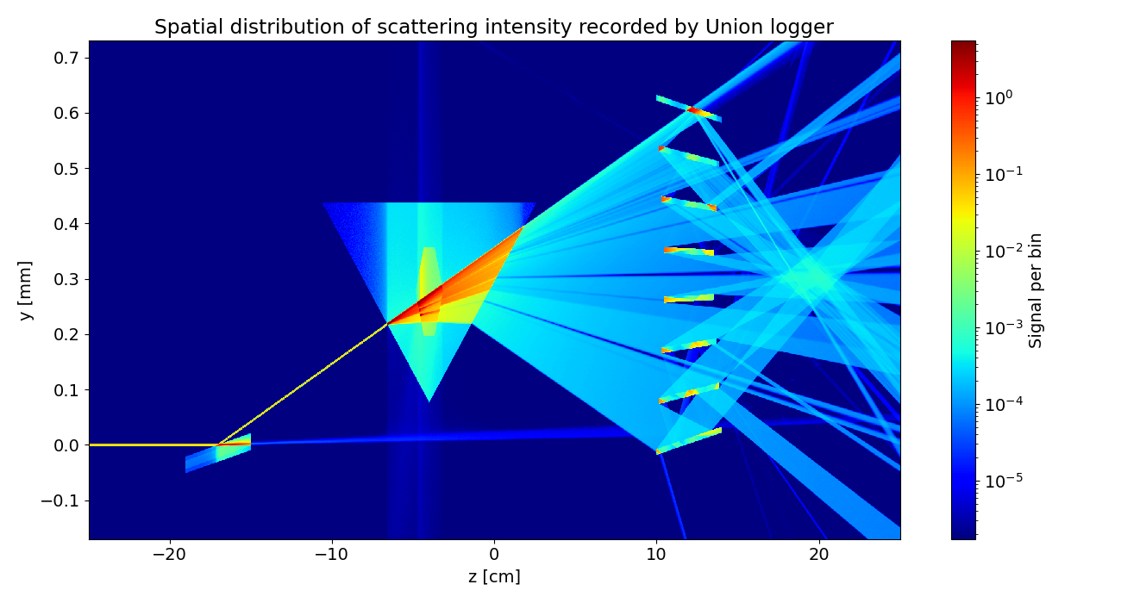
Interface physics demo
McStas

Slide 19
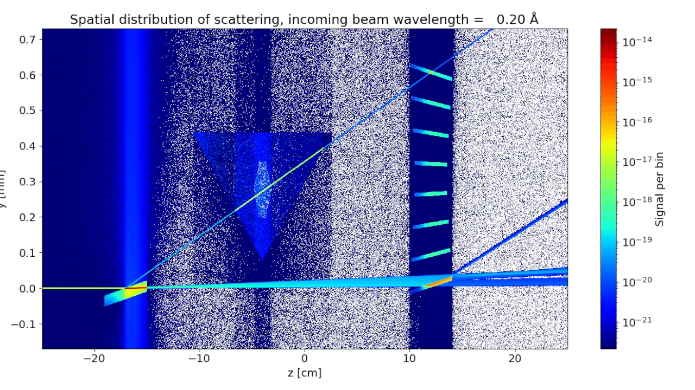
Interface physics demo
McStas

Slide 20
Interface physics use-case
Surface physics relevant for
  Optics
    Guides
    Focusing optics
    Refractive optics
    .. in sample environments
  Reflectometry
    Sample
    Substrate

Slide 21
Conclusion
  Union components constitutes a powerful tool in McStas to simulate complex systems
  Newly added interface physics expands their use case to optics, reflectometry and more
  Remaining limitations:
    No simulation of gravity
    Lack support for polarization

Slide 22
Thanks for your attention!

