Slide 1
McStas at ORNL
July 11th, Copenhagen
Thomas Huegle
Neutron Technologies Division

Slide 2
The instrument development group
The curse of High Flux
  Too many experiments!
  Not enough time!
SNS 1st generation (instrument scientists and engineers) is on their way out
Instrument development group
  Establish institutional knowledge
  Mediator between Scattering Science and Engineering, Neutronics
  Common vocabulary (standardized procedures?)
  Experience, communication, trust

Slide 3
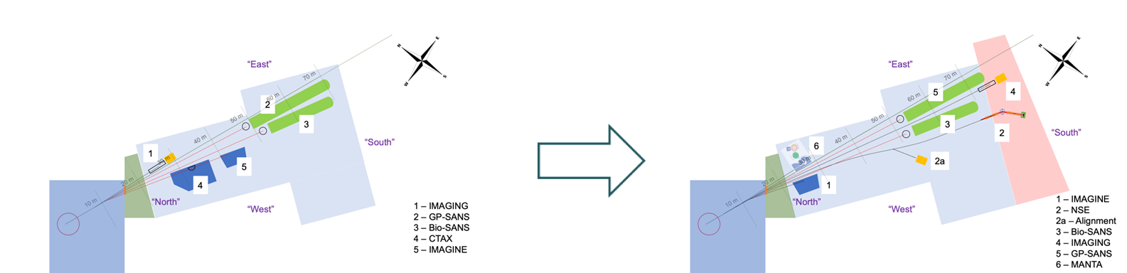
Our facilities
SNS
Mature facility
Mostly upgrading, refining
Just finished VENUS
Some open beam ports, conceptual work
HFIR
Major maintenance
HBRR
All instruments get taken out, reinstalled
Significant changes to CGH
  4 -> 6 guides
  CTAX > MANTA
  MARS CG1 > NB4
STS
Instrument design work
Restarted instrument selection

Slide 4
Workflows/digital shadows
calvera (galaxy)
Beam to sample
Instrument settings
Nexus file (simulation)
User starts experiment
Sample to detector
Sample description
Mantid
Scattering Kernel
Nexus file (experiment)

Slide 5
What we do
SNS
Mostly upgrading, refining
  3D printed collimators
  Detector layouts
  NMO “corrective lenses”
  Digital twin shadow
Just finished VENUS
  Optically pretty simple
Some open beam ports, conceptual work
  Large parameter optimization
HFIR
Major refurbishment, HBRR
All instruments get taken out, reinstalled
  McStas <> MCNP <> CREO
Significant changes to CGH
  4 -> 6 instruments
    A tangled mess
  MANTA
  MARS
STS
Instrument design work
Restarted instrument selection

Slide 6
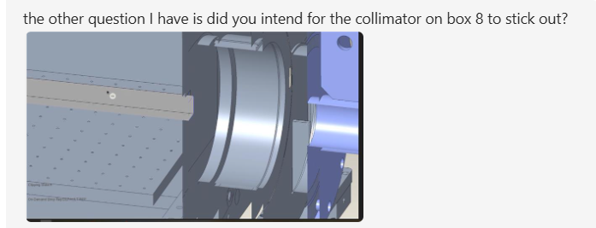
Communication
Engineering, instrument design, neutronics: CREO, McStas, MCNP
McStas is design base!
McStas2cad
  Initial Graphics Exchange Specification (IGES)
  Vendor neutral, last version: 1996
  long-time Department of Defense standard, import/export supported by most programs
Engineers import, do not change coordinates
Neutronics imports, create MCNP model
  Expands surfaces (e.g. glass), fills volumes, checks MCNP specific errors (e.g. shared surfaces)
  Heavily patched MCNP version, can handle Material effects (crystals, guide surfaces), gravity, …
https://code.ornl.gov/3xf/mcstas2cad

Slide 7
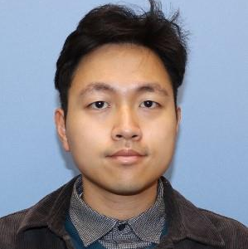
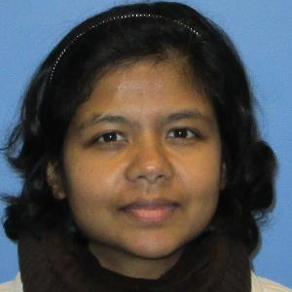
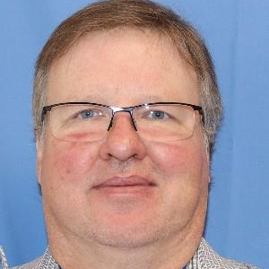
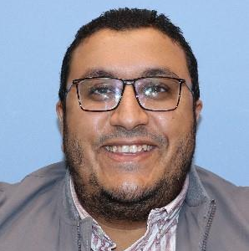
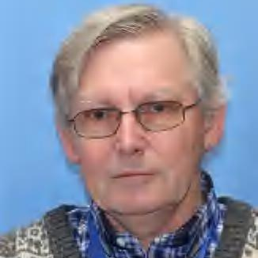
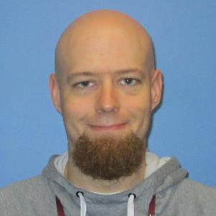
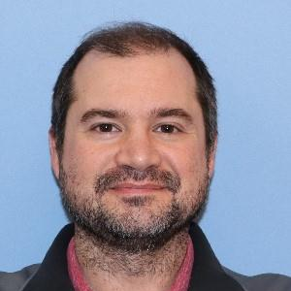
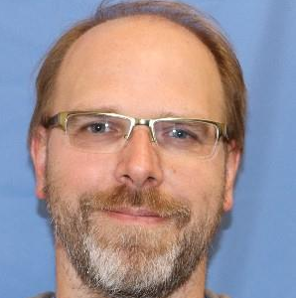
McStas at ORNL
Garrett Granroth
Junwoo Bae
AI/ML
Workflows/
Digital twins
Ramzy Altahhan
optimization
samples
Fahima Islam
Uli Wildgruber
mcstas2cad
optics
Kyle Grammer
Thomas Huegle
Matt Frost

